Slide 1
DOE EFCOG Laser Safety Task Group - Benchmark Study of ANSI Z136.1 (2014) Controls Requirements
11th DOE Laser Safety Officer Workshop
Jamie J. King, CLSO
LLNL LSO
September 29, 2016

Slide 2

Purpose
Working Group commissioned by Laser Safety Task Group of EFCOG
  Jamie King (LLNL) Chair
  Joanna Casson (LANL)
  Mathew Dabney (NREL)
  Mike Woods (SLAC)
Harmonization of best laser safety practices across the DOE Complex
Benchmark control requirements of ANSI Z136.1 (2014)
Motivation
  A lack of specificity for certain controls requirements.
  A lack of clarity for certain controls requirements.
  Changes in controls requirements between the 2000, 2007, and 2014 revisions.
  Lack of consistency was found in 2014
Address ambiguity written into ANSI Z136.1

Slide 3
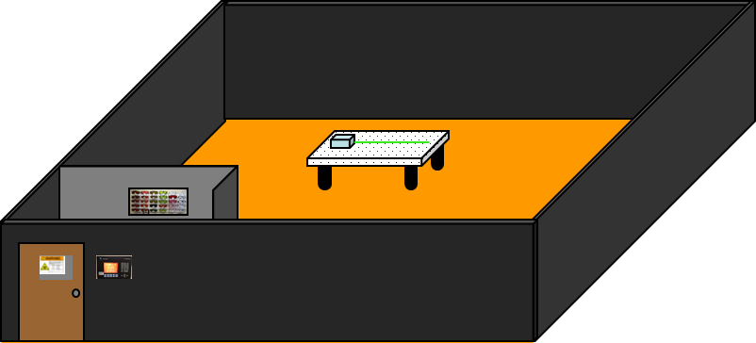
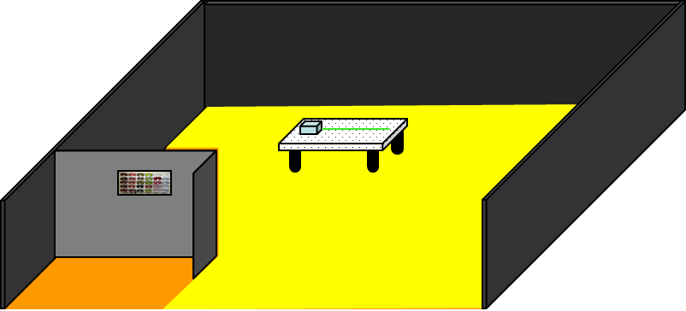
Basis for Report
Assumes a DOE Facility with a laser program as follows:
  More than one Class 3B or Class 4 LCA, and the LCAs often have more than one Class 3B or Class 4 laser.
  A typical laser lab has:
    A contained indoor LCA (enclosed within a room).
    A single entrance.
    A Safety Interlock System with an access control panel at the entrance.
    All lasers located within the LCA.

Slide 4
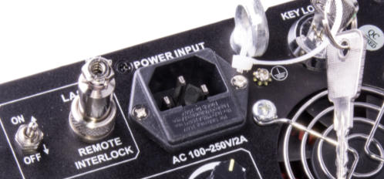
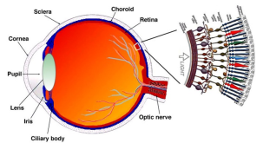
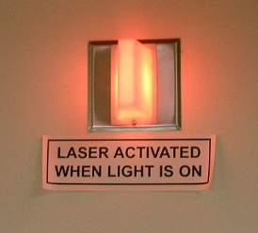
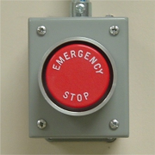
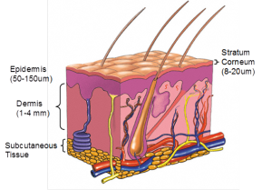

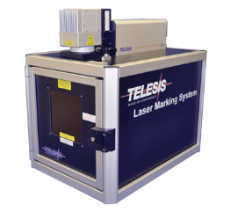
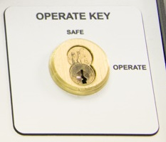

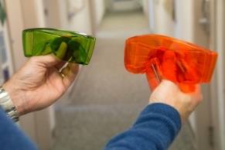
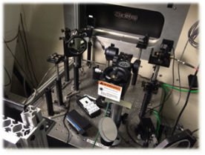
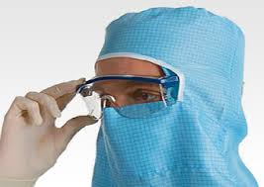
Topics of focus
Laser Controlled Area (LCA) Warning Device
Emergency Stop Button
Remote Interlock Connector
Laser Safety Officer Training
Standard Operating Procedure (SOP)
Skin Personal Protective Equipment (PPE) (Ultraviolet [UV])
Skin Exams (UV)
Medical Baseline Eye Exam
Full Protection Eyewear
Alignment Eyewear
Master Key
Cover Interlock for a Class 1 Enclosure and Protective Housing
Beam Stop/Attenuator
Topics were selected based on a 2015 survey send out to the DOE Labs

Slide 5
Approach
Definitions- Where available/applicable used ANSI definitions.
This report should not be viewed as an attempt to set policy as this is left up to each of the individual contractor-operated Laboratories and their DOE oversight.
A rationale statement was included for each item. This is the group’s thought process behind the policy statement.
Comparison was made with the Z136.1-2014 (Z136.8 for some controls).
A follow-up survey (2015) was performed based on agreement to the controls.
Feedback from Occ Med Task Group on both eye/skin exam controls requirement.

Slide 6
Data
Out of the twenty possible LSTG member Labs, there were sixteen survey responses from fourteen Labs
Overall there was excellent agreement on the recommended policy requirement statements*:
  5 controls statements had unanimous agreement from the 14 Labs
  5 controls statements had 13 Labs agreeing and 1 disagreeing
  2 controls statements had 12 Labs agreeing and 2 disagreeing
  1 controls statement had 10 Labs agreeing and 4 disagreeing
    *When two responses came from one Lab, the response from the LSO took precedence.
Research Laser Labs (with associated Principal Investigators or Program Managers) | 100%
User Facility (provided for non-employee research and investigations) | 51.74%
Industrial Laser (primarily operated as Class 1 laser systems | 64.29%
Other | 0.00%

Slide 7
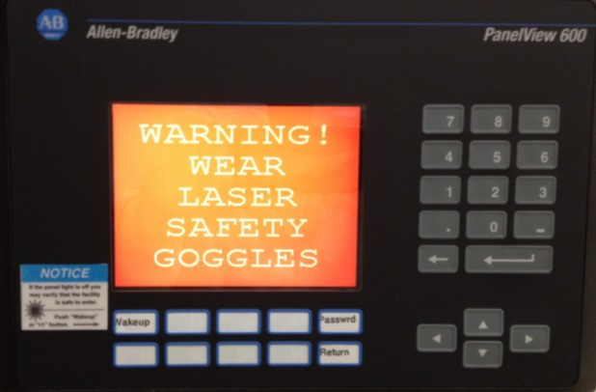
LCA Warning Device
An LCA Warning Device shall be installed at the LCA entryway so it is visible prior to entry. It shall also be installed inside the LCA, where it should be easily viewable to persons in the LCA. It should be electronically interfaced to a laser power supply, safety shutter, or safety interlock system.
An exception to the LCA Warning Device requirements above is permitted in cases where the Laser Safety Officer (LSO) determines that the NHZ within the LCA is very limited in extent. In this case the LSO shall require an NHZ warning device, sign or label to clearly communicate where laser radiation may be present above Class 3R levels.
  Deviations from Z136.1-2014:
    Z136.1 gives requirement as should for Class 3B.
    Z136.1 states separate requirements for an Area Warning Device (visible prior to entry) and a Laser Radiation Emission Warning (visible inside the LCA).
    Z136.1 does not describe the exception noted for NHZs with limited extent Z136.1 does not define an LCA Warning Device, but instead gives examples of visible and audible devices.
One Lab disagreed with the statement
The engineered control ensures worker protection rather than relying on a worker to announce…

Slide 8
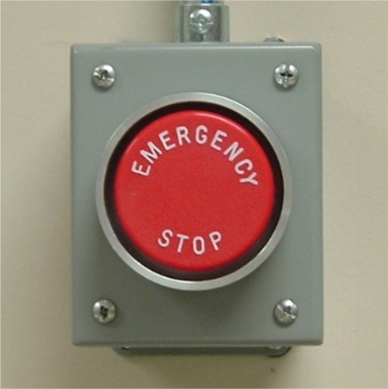
Emergency Stop (OFF) Device (Class 3B or Class 4 LCA)
A Class 4 LCA shall have and a Class 3B LCA should have a clearly marked Emergency Stop (OFF) device.
  Deviations from Z136.1-2014:
    Z136.1 has no requirement for Class 3B LCAs.
    (Z136.8-2012 does not require an Emergency Stop/Off/Shutdown provision.)
One lab disagreed with the statement
A marked switch on a power supply or even a keystroke is generally not sufficient if emergency personnel must enter

Slide 9
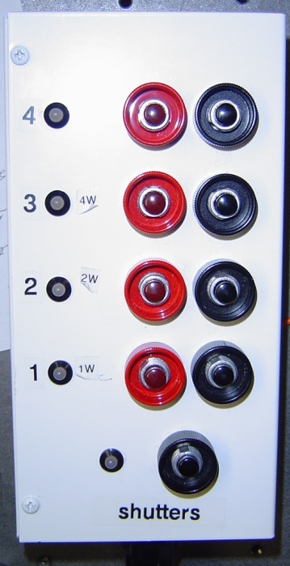
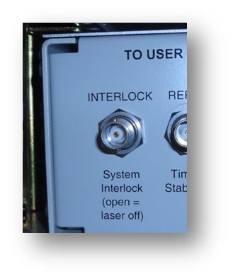
Remote Interlock Connector (Class 3B or Class 4)
Class 3B and Class 4 laser sources should have a remote interlock connector
  Deviations from Z136.1-2014:
    Z136.1 has no requirement. This was present in the 2007 revision.
    (Z136.8-2012 also has no requirement.)
There was no disagreement on this statement
The use of a remote interlock connector is paramount for the protection of non-laser workers.

Slide 10


Laser Safety Officer (LSO) Training
LSO training shall be provided. The training shall be commensurate to the highest Class of laser under the jurisdiction of the LSO and shall include potential hazards, control measures, medical examinations, applicable standards, and non-beam hazards. The LSO shall participate as a member of the DOE EFCOG Laser Safety Task Group (LSTG) and should obtain LSO certification with the Board of Laser Safety.
  Deviations from Z136.1-2014:
    Z136.1 does not have a requirement for EFCOG participation or for LSO certification.
Two Labs disagreed with the statement
A definition for LSO was added, “For the purpose of this document the LSO is the site-wide LSO with responsibility for the laser safety program at the site.”
The group felt that since there is a credentialing body for LSOs we should not ignore certification.

Slide 11
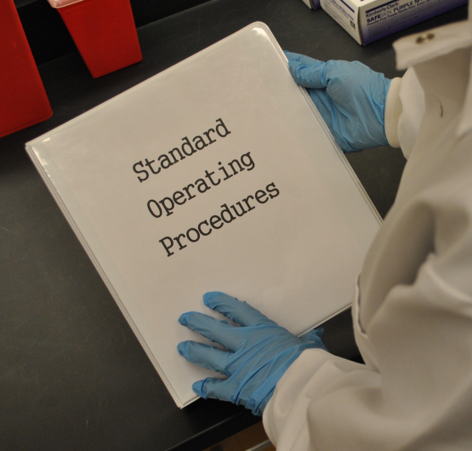
Standard Operating Procedures (SOPs) Requirements
SOPs for Class 3B and Class 4 lasers shall be required and approved by an LSO. Alignment procedures shall be included as part of the written SOP for both Class 3B and Class 4 lasers.
The SOPs should include the following items. If not included in the SOP they shall be documented elsewhere:
  The laser hazard parameters (power, pulse energy, pulse width, repetition rate).
  OD requirements and required PPE.
  Engineering and administrative controls.
  A schematic of the laser controlled area including where the lasers, emergency stop buttons, and external safety shutters are located.
  Deviations from Z136.1-2014:
    Z136.1 gives requirements as should for Class 3B.
    Z136.1 does not specify the listed items to include in the SOP or to document elsewhere.
    (Z136.8-2012 gives requirements as shall for Class 3B and Class 4.)
Although not required by Z136.1, Class 3B require an SOP due to hazard of said lasers at the upper end of classification.

Slide 12
Skin PPE Requirements
Skin protection shall be used if there may be UV radiation exposure above the MPE.
  Informational Note: Consideration needs to be given for:
    Chronic exposures to diffuse laser radiation hazards.
    The use of a full face shield in addition to gloves and long-sleeved clothing for high powered laser operations.
  Deviations from Z136.1-2014:
    None
There was 100% agreement on this statement!
Z136.1-2014 requires beam shields and skin protection for UV lasers with exposure above the MPE.

Slide 13

Skin Exams (UV)
Personnel should request a skin exam if they experience any symptoms from exposure to UV laser beams. If they are working with UV lasers and are at risk for exposure above the MPE, in particular if they have a history of photosensitivity, they should also request periodic skin exams.
Deviations from Z136.1-2014:
  Z136.1 only gives a recommendation in an informational appendix, with no “should” or “shall” requirements.
  (Z136.8 states that “Laser users chronically exposed to artificial sources of UV radiation should obtain an annual skin cancer screening.”)
One Lab disagreed with the statement.
The requirement statement was updated to take into account input from the EFCOG Occupational Medicine Task Group
Z136.1-2014 recommends skin exams for employees working with UV lasers.

Slide 14
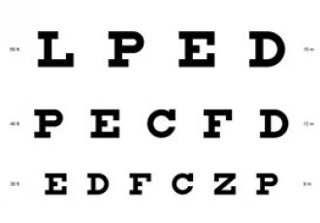
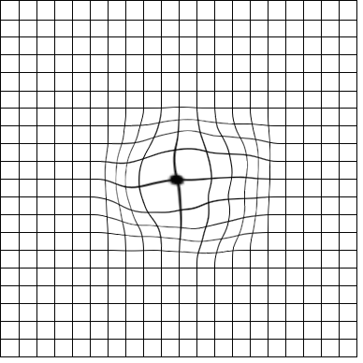
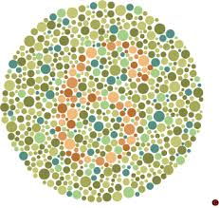
Medical Baseline Eye Exam
A baseline eye exam should be performed prior to commencement of laser work by qualified laser persons working in NHZs where Class 3B or Class 4 laser beams are present.
  Deviations from Z136.1-2014:
    Z136.1 gives requirements as should be considered for both Class 3B and Class 4.
    (Z136.8-2012 gives requirement as should for both Class 3B and Class 4.)
Two labs disagreed with the requirement statement
The group felt that the “shall” requirement was too stringent (thus keeping recommendation as “should”)

Slide 15
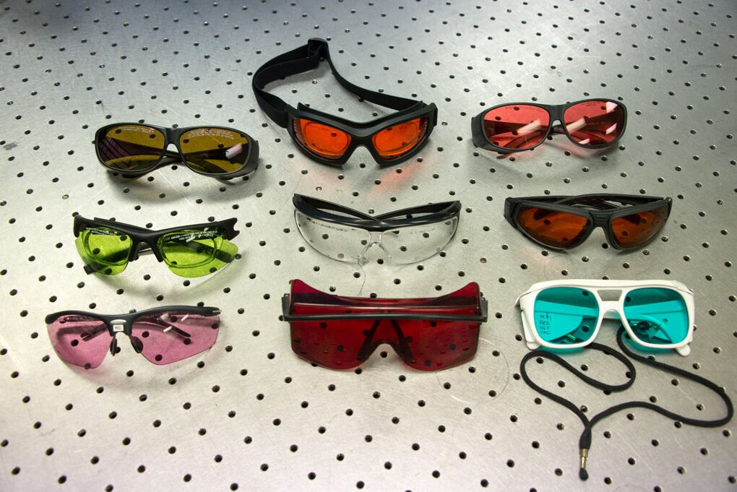
Full Protection Laser Eyewear
Full protection eyewear shall be required whenever Class 3B or Class 4 laser radiation is accessible within the NHZ, unless the LSO approves use of alignment eyewear.
  Deviations from Z136.1-2014:
    Z136.1 allows an exemption based on engineering and administrative controls.
    (Z136.8-2012 gives requirement as should for Class 3B and
    shall for Class 4 and permits the same exemption as Z136.1.)
There was 100% agreement with this requirement
statement!
An exemption based on other engineering and administrative controls is not justified.

Slide 16
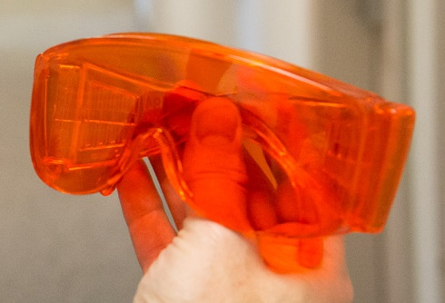
Alignment Eyewear
For all routine laser operations and for most laser alignment procedures, full protection eyewear shall be used. Alignment eyewear may only be used for specific visible wavelength alignment procedures that have been appropriately evaluated, documented, and authorized by the LSO. The minimum OD requirement for alignment eyewear shall be for viewing an ideal, point-source, diffuse reflection at a distance of 20 cm. Laser users shall be notified that
alignment eyewear will not protect them against a point
source intrabeam exposure.
There was 100% agreement with this requirement statement!
If alignment eyewear were to be used routinely, a single mistake could result in an injury.

Slide 17
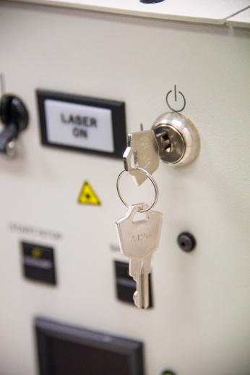
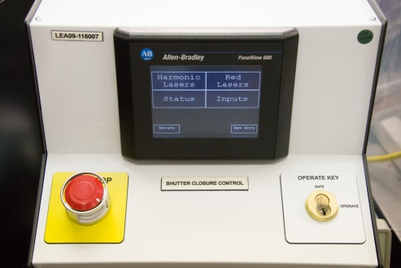
Master Key
A Master Key shall be provided for all Class 3B and Class 4 lasers or laser
systems.
  Deviations from Z136.1-2014:
    Z136.1 gives requirements as should for both Class 3B and Class 4.
    Z136.1 allows a coded access control as an alternative to a
    removable Master Key.
Four Labs disagreed with the requirement statement.
Response to comments:
  The group felt that all commercially sold Class 3B and Class 4 laser must have a key-controlled power supply, so the device is already in place for these. For most lab-built lasers it is generally not very expensive to add a key control. For other lab-built lasers, where it may not be practical to add a key control, alternative controls can be put in place.
The group added, “An LCA may have a single Master Key or multiple Master Keys” to the Informational Note.

Slide 18
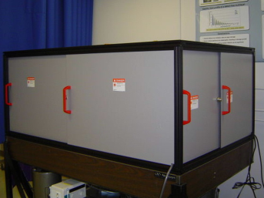
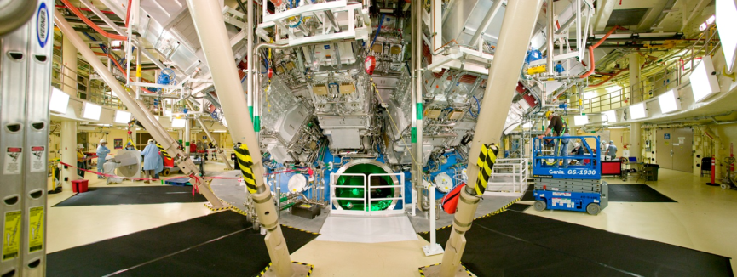
Cover Interlock for a Class 1 Enclosure or Protective Housing
Class 1 enclosure or Protective Housing covers:
  If removable during normal operation or maintenance shall be provided with failsafe or redundant interlocks.
  If only removed during infrequent service tasks shall either:
    be interlocked (failsafe or redundant interlocks not required), or
    be secured requiring a tool to remove.
  If defeatable interlocks are used, it shall not be possible to replace the cover with the interlock defeated.
  If defeatable interlocks are used, the cover shall have a warning label to identify this and to identify the class and wavelength of the enclosed laser(s).
  Deviations from Z136.1-2014:
    Z136.1 only describes requirements for protective housings and not for Class 1 enclosures.
    (Z136.8-2012 considers that securing with a tool is equivalent to an interlock.)
One Lab disagreed with the requirement statement
Engineering controls are emphasized.

Slide 19
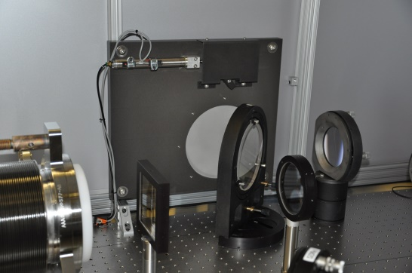
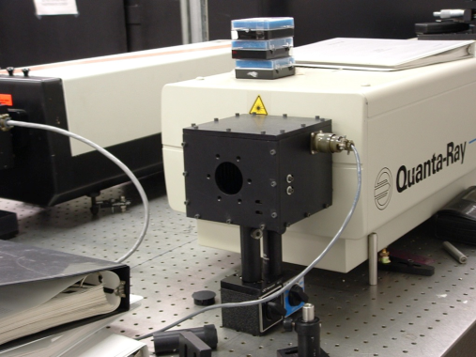
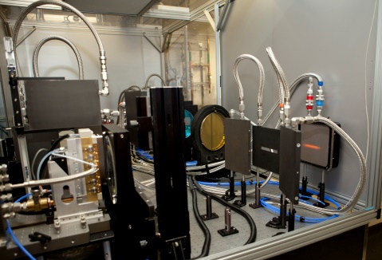
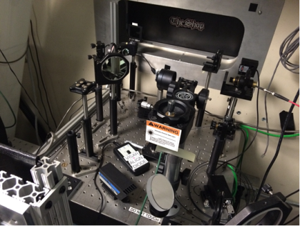
Beam Stop/Attenuator
A Class 3B and Class 4 laser or laser system should be provided with a beam stop or attenuator.
  Deviations from Z136.1-2014:
    Z136.1 has no requirement. This was present in the 2007 revision.
    (Z136.8-2012 also has no requirement.)
One Lab disagreed with the requirement statement
This is useful for reducing a laser hazard without turning off the laser.

Slide 20


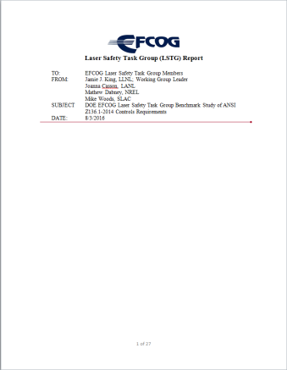
Summary
Overall great participation and agreement
The hope is that LSOs at DOE Labs will cut-and- paste controls right into their Laser Safety Manuals
This will be a living document where we will continue to add topics
  Next year one of the items will be how the LSO function is managed at each of the Labs along number and types of laser laboratories
Report is published at the EFCOG Laser Safety Task Group Wed Site:
  http://efcog.org/safety/worker-safety-health-subgroup/laser-safety-task-group/

Slide 21

THANK YOU!

