Slide 1
Targeting Studies for an 800 MeV beam for Mu2e-II
Takumi Matsuzawa
Lee Teng Internship Presentation
Mentors: Thomas Roberts and Eric Prebys
August, 2015

Slide 2
Outline
Overview
  Motivation for Mu2e
  Mu2e and Mu2e-II
Simulation Details
Simulation Results
Summary
2

Slide 3
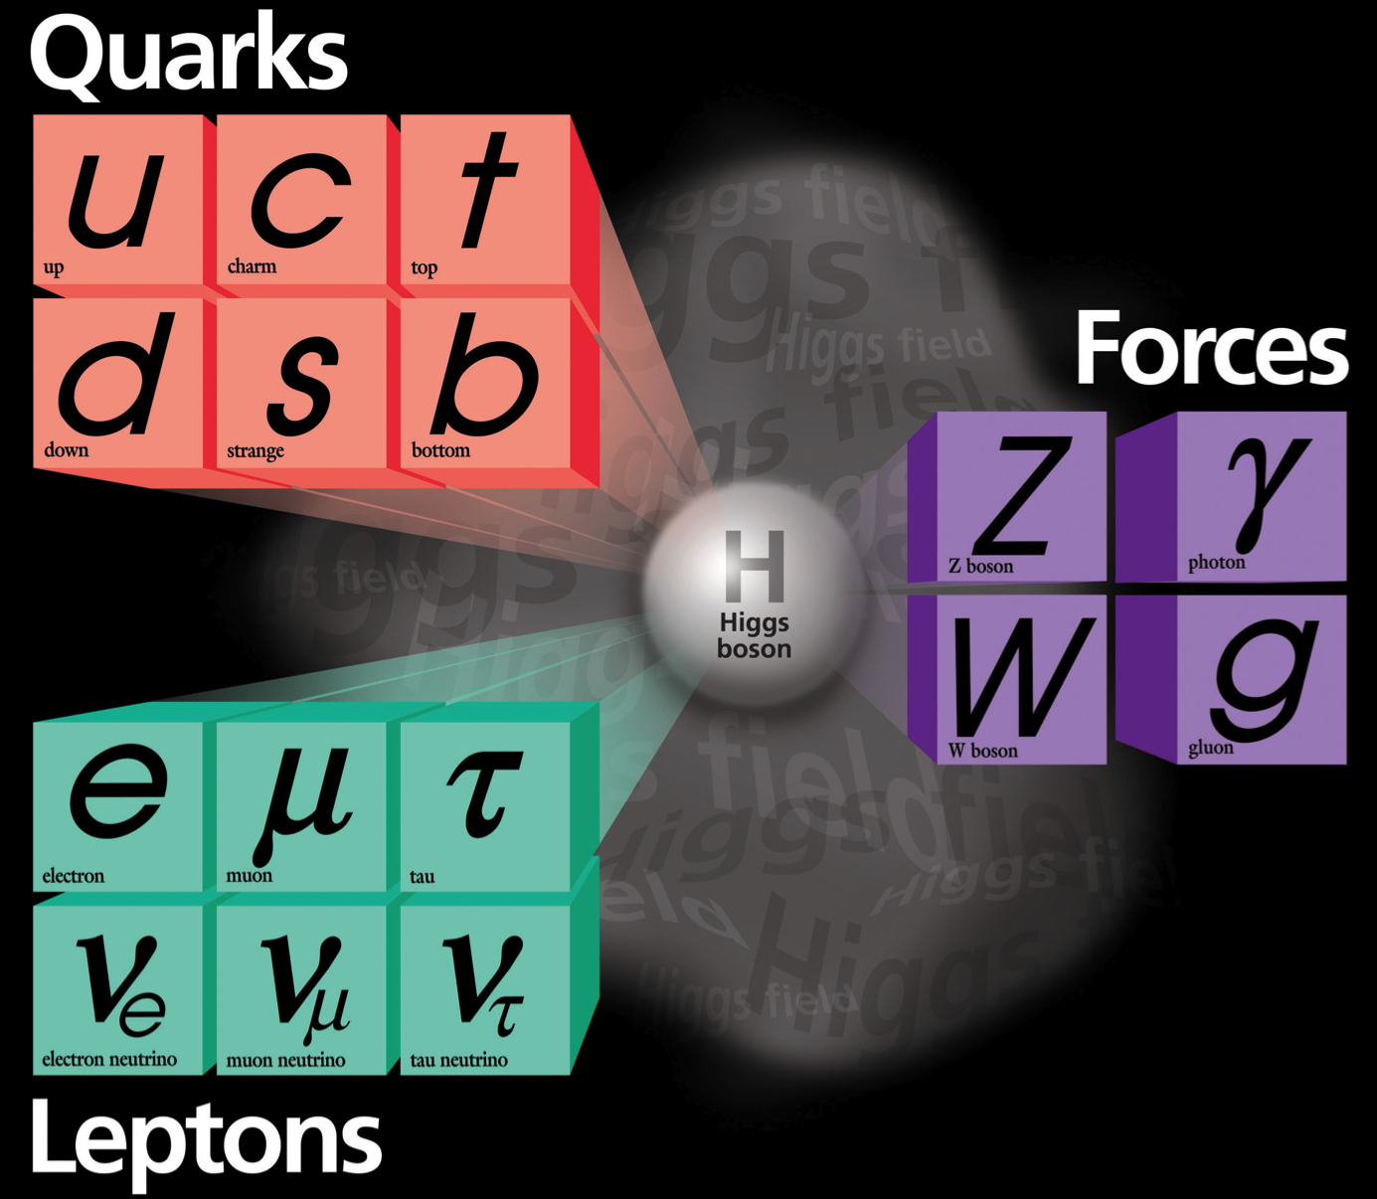
The Standard Model
Fermions
Bosons
Mixing
Flavor Violations?
Mixing
Weak charged current interactions “flip” fundamental fermions (analogous to spin flip)
Neutrino Oscillations
3
Notes:
Quark Mixing- CKM matrix (cabibbo-kobayashi-masukawa)
Neutrino Mixing- PMNS matrix (Pontecorvo-Maki-Nakagawa-Sakata)

Slide 4

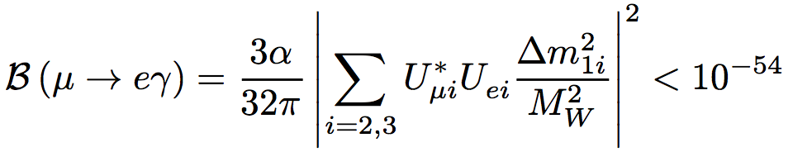
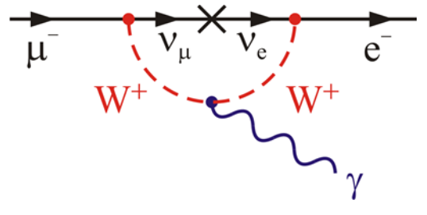
Charged-Lepton-Flavor Violation (CLFV)
CLFV is extremely suppressed in the Standard Model
e.g.- Single-event-sensitivity
A signal of CLFV → Evidence of New Physics!
4

Slide 5
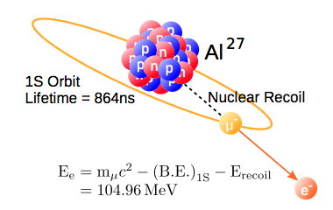


Mu2e Experiment
Mu2e searches for muon-to-electron conversion
with presence of a nucleus.
Mu2e measures the single-event-sensitivity:
Target sensitivity:
  Current limit: (SINDRUM-II)
Upgrade: Mu2e-II
5

Slide 6
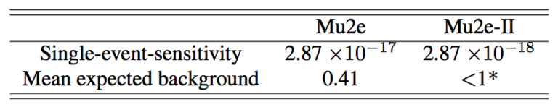
Mu2e Upgrade by Proton Improvement Plan-II
Mu2e-II aims to achieve ×10 Mu2e sensitivity
*hopefully achieved by the upgrade
Hopefully, only modest changes to the Mu2e design are required to pursue Mu2e-II.
After PIP-II is complete,
Beam power increase from 8 kW to ~100 kW
Improved duty factor
6

Slide 7
Why consider Mu2e-II?
Regardless the Mu2e result, Mu2e-II is important:
Mu2e observes CLFV ≥ 5σ
- Switch targets and measure the ratio of rates to further discriminate models of underlying physics
Mu2e observes CLFV at 3σ
- Collect ×10 data to definitely resolve the situation
Mu2e sets stringent new limit on CLFV
- Collect ×10 data and explore new parameter space
7

Slide 8
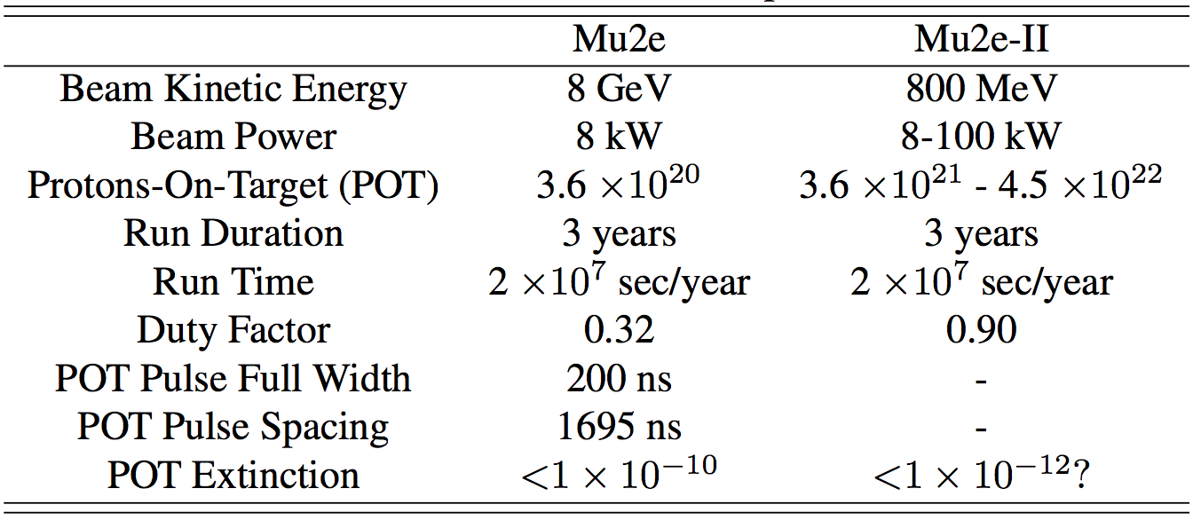
Beam Assumption
8

Slide 9
Beam Assumption
9

Slide 10
Potential of Mu2e-II
A 800 MeV proton beam (8-100 kW) will be available.
More protons
No antiproton background
Less radiation damage to the Production Solenoid / POT
Less Radiative Pion Capture (RPC) due to the narrower proton pulse
Improved duty factor
How does the low K.E. beam affect the muon production rate?
10
Notes:
Antiproton production threshold: K.E. ≥ 5.6 GeV and, due to Fermi motion, ∼ 4.3 GeV for a nuclear target
A modest upgrade of the cryogenic cooling capacity for the PIP-II superconducting linac will permit the proton beam to operate with nearly a 100% duty factor
PIP-II’s capabilities to improve Mu2e sensitivity have been studied by the collaboration [72]. PIP-II would replace the 8kW, 8-GeV proton beam of PIP-I with an 80kW 1-GeV beam with flexible proton pulse timing and a proton pulse width of 100 nsec, about half the proton width of PIP-I.

Slide 11
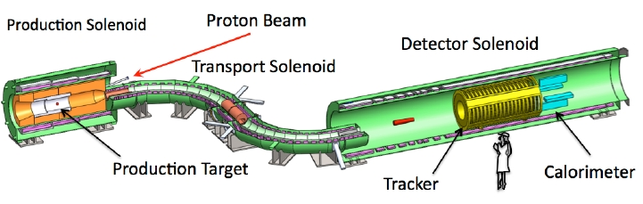
Simulation Details (1)
Software: G4beamline
Kinetic Energy of a beam: 8GeV and 800MeV
Starting position of a beam: 2 mm in front of the production target
Detectors: at the entrance and exit of the transport solenoid, and at the stopping target
11

Slide 12
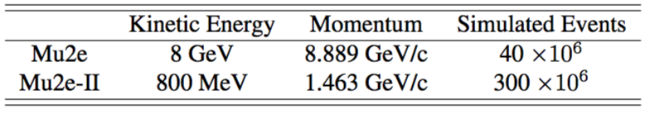
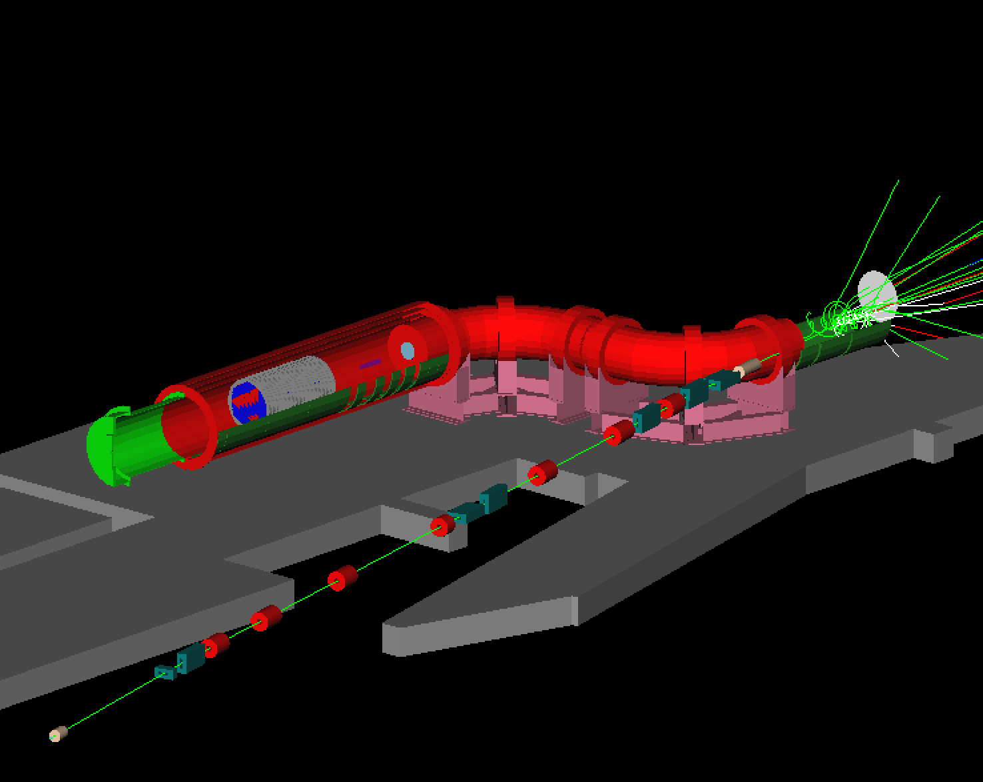
Simulation Details (2)
Number of Simulated Events
Submit jobs on FermiGrid
→ ~2 days using 100 nodes
12

Slide 13
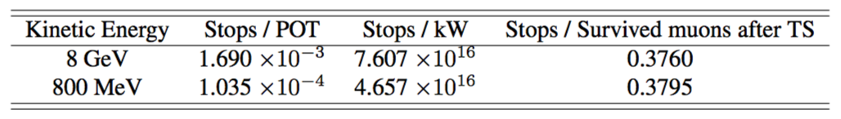
Simulation Results (1)
13

Slide 14
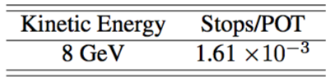
Simulation Results (2)
The result is consistent with a previous study in 2013.
(K. Knoepfel et al. 2013)
Simulated Events=100 x 10⁶
14

Slide 15
Simulation Results (3)
Muon Production/POT dropped by a factor of 16.3.
Muon Production/Power dropped by a factor of 1.63.
Mu2e (8GeV, 8kW): 6.086 × 10¹⁷ stops
Mu2e-II (800 MeV, 100 kW): 4.657 × 10¹⁸ stops
→ This is 7.65 times more stopped muons.
15

Slide 16
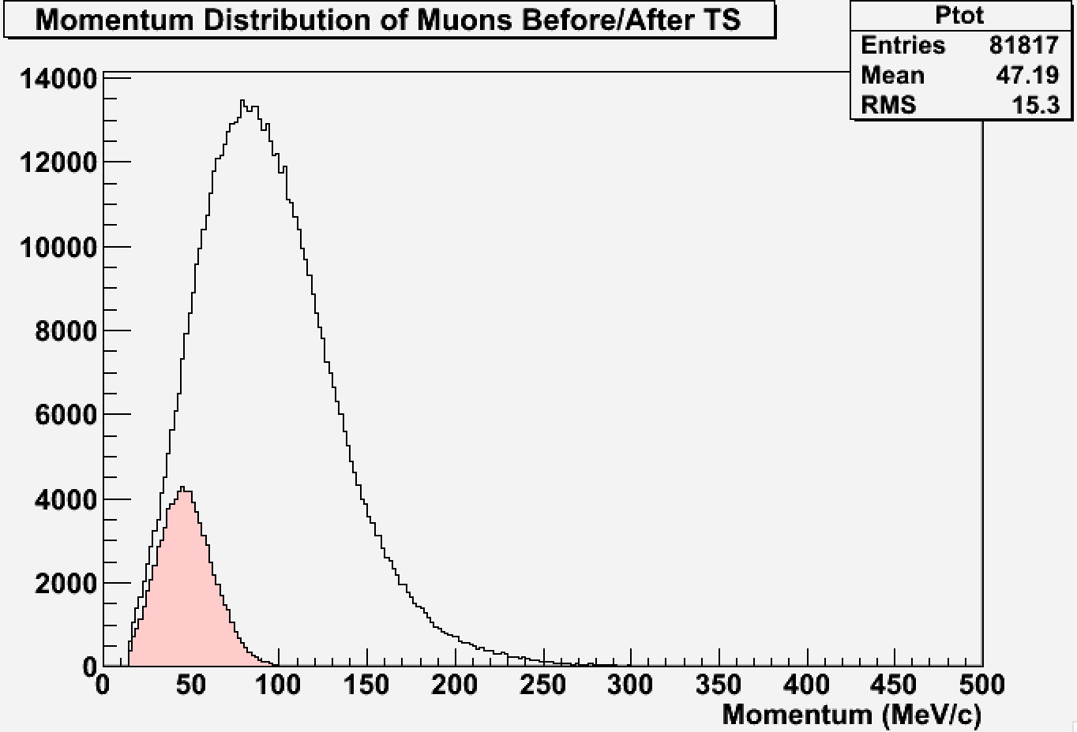
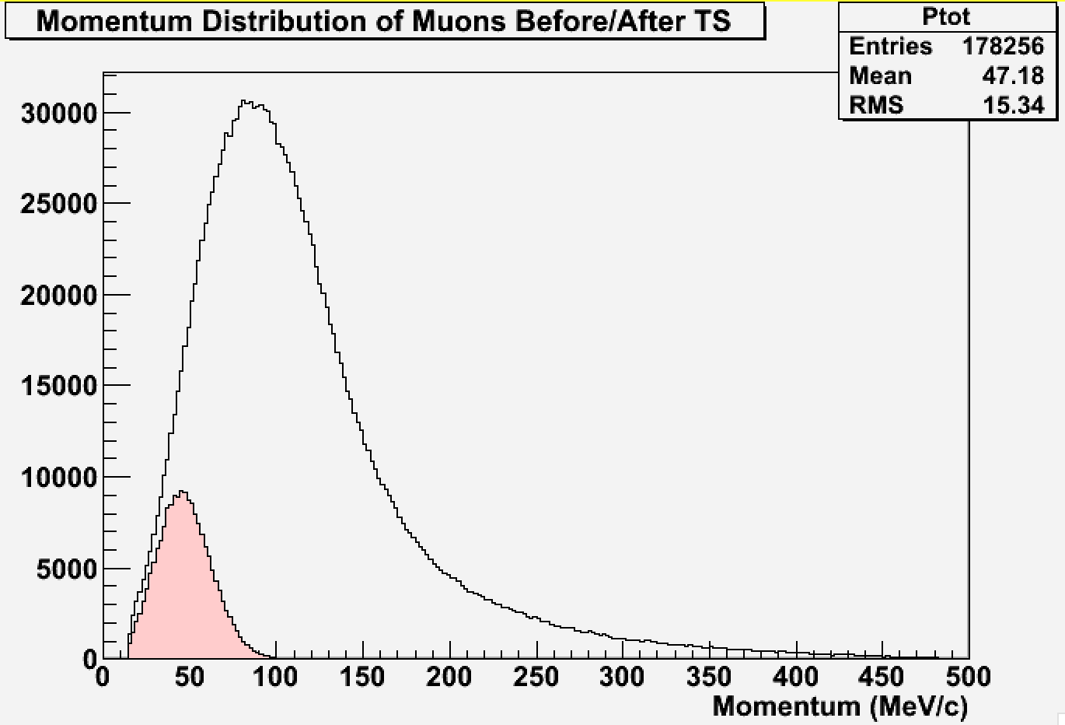
Why does it drop by only a factor of 1.63?
Momentum Distribution of muons before TS
Mu2e-II (800 MeV)
- Muons beforeTS
- Muons after TS
Mu2e (8 GeV)
- Muons beforeTS
- Muons after TS
The momentum distribution of 800 MeV has a shorter tail.
Pions/muons with high momentum are thrown away in the TS.
Muons with 15-100 MeV/c survive the TS.
16
Notes:
Normalize the histograms
Make these into one plot

Slide 17
Simulation Results (4)
Momentum distributions of survived muons for both scenarios were very alike.
~38% of the survived muons are stopped.
17

Slide 18
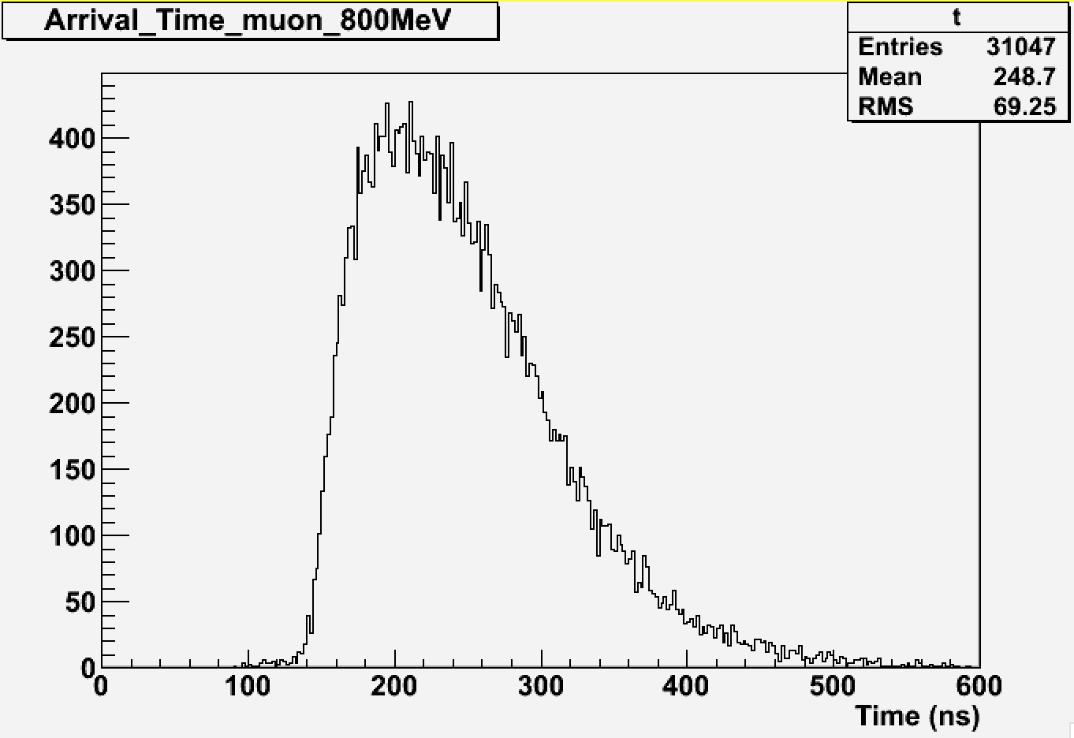
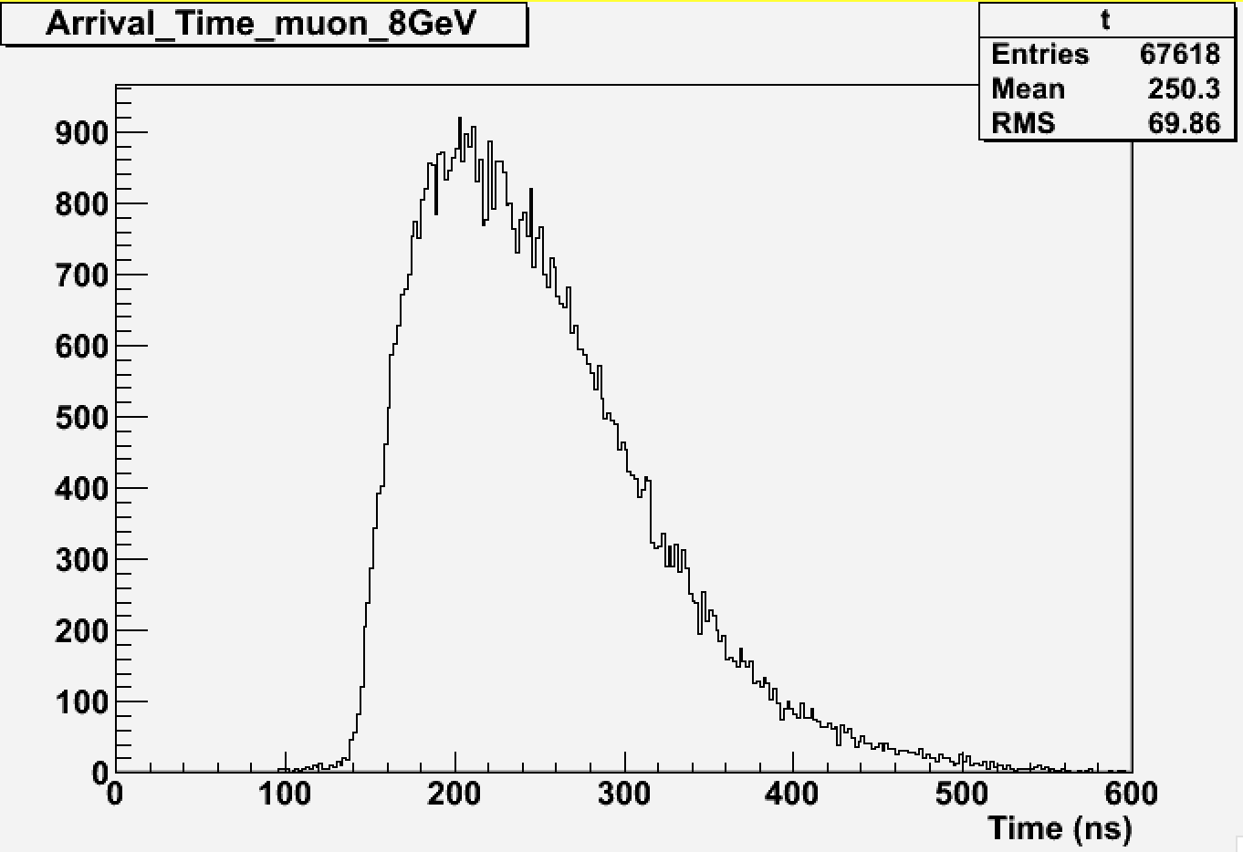
Simulation Results (5)
Arrival Time of Muons
The arrival time is independent of proton beam energy.
→ Timing structure of a beam may be retained.
18

Slide 19
Remaining Questions
How would we get protons to the primary target?
(On Progress)
______________________________________________________
Background study with a PIP-II scenario
Cosmic Ray Veto considerations
Hadronic flash
For PIP-II, we are not constrained to the 1695 ns time cycle.
– What would be ideal for Mu2e-II?
19
Notes:
Hadron flashes
Cosmic ray veto-
1. Cosmic-ray-induced-background scales up with the live window unlike other background. High duty factor
2. Produced neutrons and gammas could false vetoes

Slide 20
Summary
Mu2e-II targets ×10 better sensitivity.
Muon Production/Power dropped by a factor of 1.63.
Mu2e-II may produce 7.65 times more stopped muons than Mu2e during 3 years.
High power with a low-energy beam would eliminate antiproton background
20

Slide 21
Acknowledgements
    I am very grateful to my mentor, Thomas J. Roberts for his valuable advice, Eric Prebys, and Tanja Waltrip for organizing the internship.
    I learnt significant amount of knowledge about accelerator physics at US Particle Accelerator School thanks to William Barletta, Linda Spentzouris, and Elvin Harms.
    Finally, I would like thank the Fermi National Accelerator Laboratory, the Illinois Accelerator Institute, and Department of Energy for funding the internship.
21

Slide 22
Reference
[1] K. Knoepfel et al., “Feasibility Study for a New-Generation-Mu2e Experiment”, 2013, arXiv:1307.1168v2 [physics.ins-det].
[2] Mu2e Collaboration, “Mu2e Technical Design Report”, 2014
[3] T.J. Roberts and D.M. Kaplan, “G4beamline simulation program for matter-dominated beamlines”, Proceedings of the Particle Accelerator Conference, 2007, Albuquerque, NM, USA, PAC.IEEE, 3468.
22

Slide 23
Backup Slides
23

Slide 24
Charged-Lepton-Flavor Violation (CLFV)
CLFV is extremely suppressed in the Standard Model
e.g.-
A signal of CLFV → Evidence of New Physics!
Several theories suggest CLFV with higher sensitivities.
Supersymmetry
Heavy Neutrinos
Leptoquarks
Compositeness
Second Higgs Doublet
Heavy Z’ and Anomalous Z Coupling
24

Slide 25
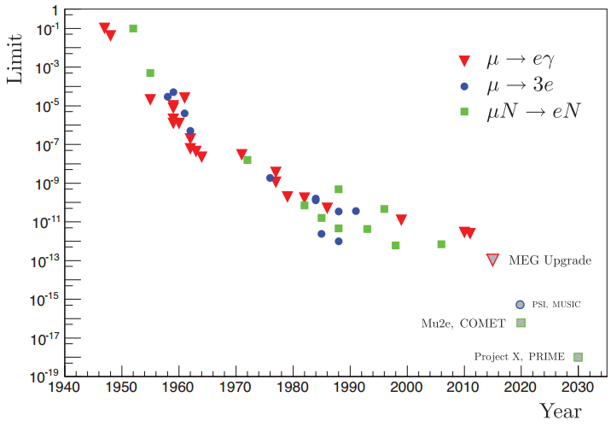
CLFV History
25

Slide 26
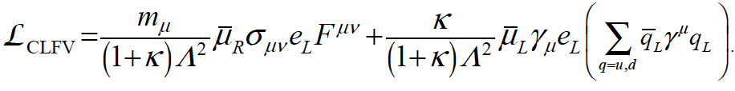
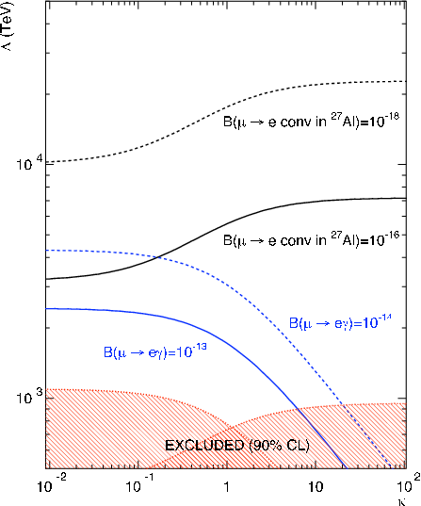
CLFV Parameter Space
Model-Independent-CLFV Lagrangian
26

Slide 27
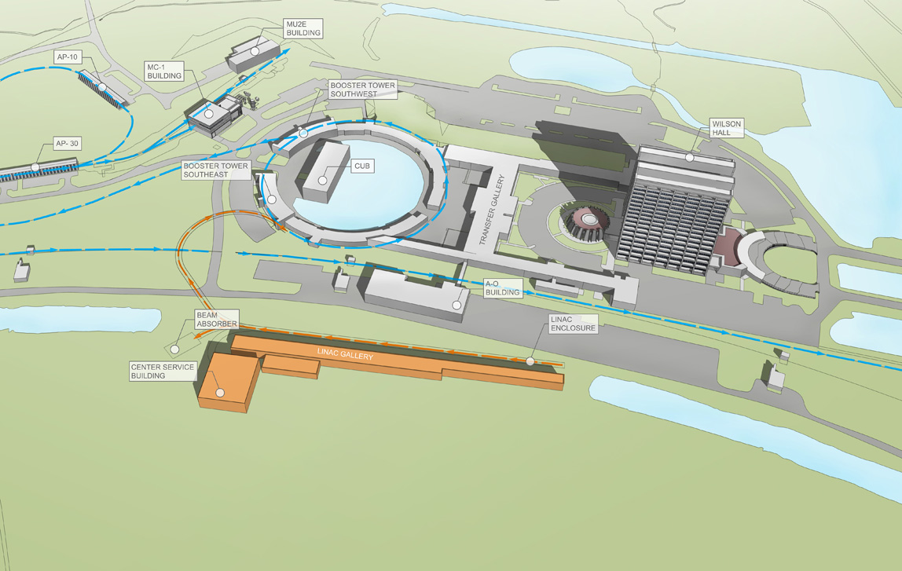
Proton Improvement Plan-II (PIP-II)
27

Slide 28
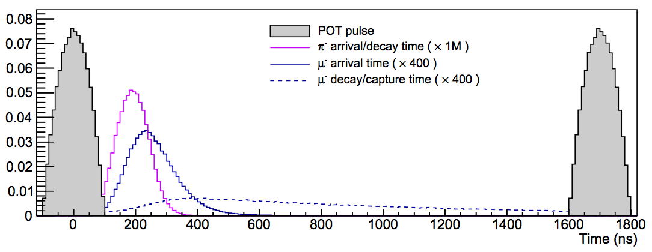
Timing Structure
Pion arrival time will be narrower for Mu2e-II due to the narrower proton pulse. [1]
Mu2e (8 GeV)
Arrival time of muons will not change for Mu2e-II.
Live Search Window
(Knopfel et al., 2013)
DIO has to be studied for Mu2e-II background.
The width will be halved for Mu2e-II.
28

Slide 29
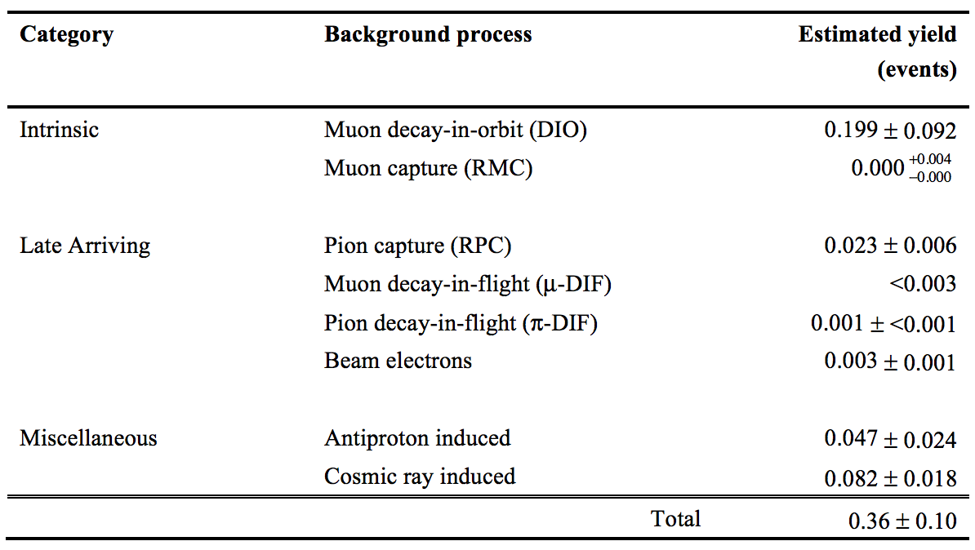
Background of Mu2e
55%
No antiproton background for Mu2e-II.
13%
23%
29

