Slide 1
Liquid Scintillator Purification for Solar Neutrinos
Frank Calaprice
Princeton University

Slide 2
Low-Background Strategy
Water, Buffers(2) and Scintillator Self-Shielding
  Designed to suppress external backgrounds
  Scintillator and vessel radioactivity are left as the main background sources.
Scintillator Containment Vessel
  Nylon balloon with small mass and low radioactivity.
  Built in low-radon cleanroom to avoid dust and ²¹⁰Pb (22 yr)
  Expect ~ 1cpd ²¹⁰Pb due to radon exposure during construction.
  Two nylon vessels motivated by CTF results.
Purification of liquid scintillator
  Pseudocumene (PC) + 1.5 g/l PPO
  Distillation, water extraction, and N₂ gas stripping.
  Precision cleaning methods.

Slide 3
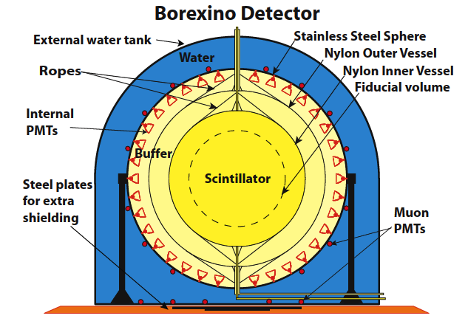
Shielding Against External Background.
  Water: 2.25m
  Buffer zones: 2.5 m
  Outer scintillator zone: 1.25 m

Slide 4
Special Backgrounds
Radioactive isotopes made by cosmic ray interactions in liquid scintillator:
  ¹²C + μ -> ¹¹C +n + μ’
  ¹¹C -> ¹¹B + e⁺ + ν (t_{1/2} ~20 min, KE ~1 MeV)
  Ultimate solution: a deeper laboratory such as SNO Lab
  Cuts for positrons and muon produced events.
Mobile radioactivity on liquid scintillator vessel.
  Movement by diffusion or convection of radon and its daughters from scintillator vessel into the fiducial volume.
  ²¹⁰Pb (β, 22 y) -> ²¹⁰Bi(β, 5 d) -> ²¹⁰Po (α, 138d)
  Requires clean fabrication of vessel in radon-free cleanroom.

Slide 5
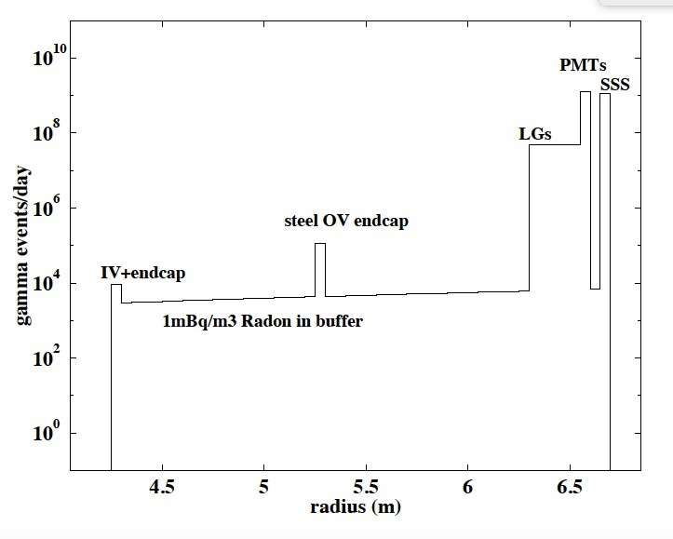
Radial Distribution of External Background in Stainless Steel Sphere

Slide 6
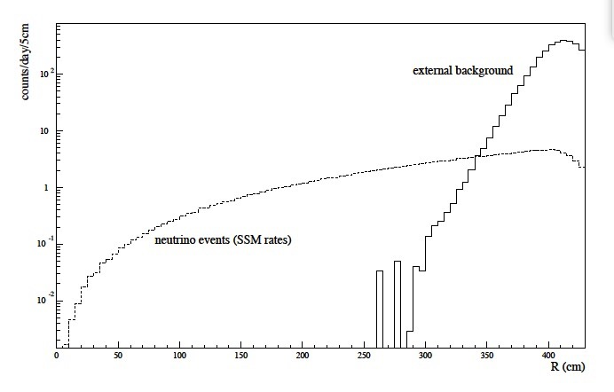
Radial Distribution of
External Background in Inner Vessel
(0.2-0.8 MeV)

Slide 7
Ideal Purification System
High efficiency to remove impurities.
All parts accessible to “precision cleaning” without dead-ends.
  Mechanical and electro-polished stainless steel minimizes surface area and makes it easier to remove contaminants.
  Turbulent flow and spray balls remove surface contamination well.
  Well-planned cleaning procedure.
Self-cleaning during purification operation removes impurities.
Maintains chemical composition of scintillator
  Solvent, wave-length shifter, other components(?)
A “counting test facility” is very useful measure effectiveness of operations.

Slide 8
Borexino Scintillator Purification
Distillation
  Separate distillation plants for pseudocumene and PPO.
  Systems are design to reject components with boiling point higher than scintillator. Impurities are left in bottom of the evaporator continuously wasted.
Water Extraction
  transfer of impurities from scintillator to water when two components are mixed thoroughly in a column. Works best to remove polar molecules from scintillator, but works also for less polar species.
  Water and scintillator are immiscible and separate after mixing.
  Water is more dense and flows down column while scintillator flows up.
  Structured packing inside column assures good contact between two fluids.
Nitrogen Stripping
  High purity nitrogen is used in separate volatile components from scintillator. This includes water, and rare gasses, especially ⁸⁵Kr and ²²²Rn.

Slide 9
Scintillator Purification System
Distillation, N₂ Stripping, Water Extraction @ ~1 ton/hr
Precision Cleaned. Assembled in Low-radon Clean Room
4-story tall skid

Slide 10
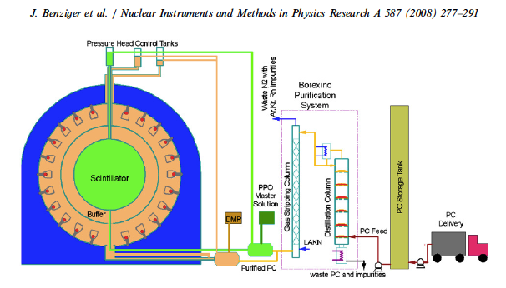
Pseudocumene Purification During Filling Operations.

Slide 11
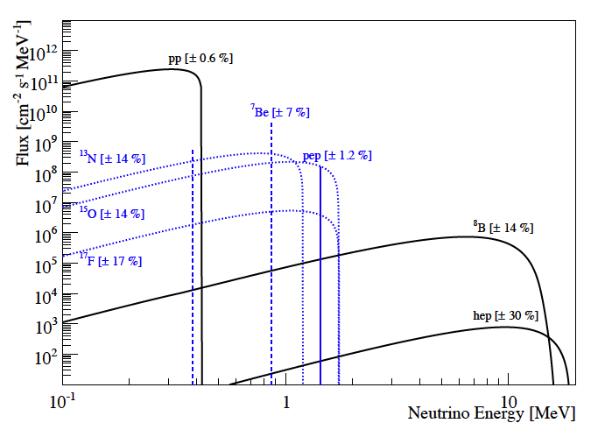
Solar Neutrino Spectra
Neutrino Energy Spectrum
Neutrino-Electron Elastic Scattering
Energy Spectrum
X2 for keV

Slide 12
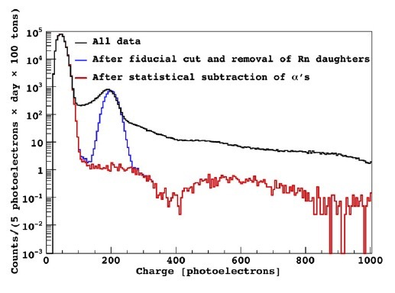
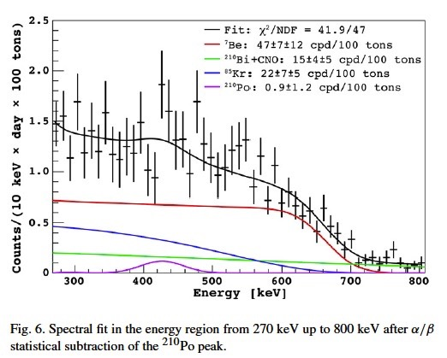
Borexino First Spectrum 2007
⁷Be neutrino
Note high rate of ²¹⁰Po α’s: ~ 8000 cpd/100t Note low ²¹⁰Bi rate: ~15 cpd/100t
The last decays of ²²²Rn decay chain: ²¹⁰Pb (22 yr) -> ²¹⁰Bi (5 d) -> ²¹⁰Po (138 d) -> ²⁰⁶Pb
How did secular equilibrium get broken so badly? Purification removed ²¹⁰Pb but not ²¹⁰Po.

Slide 13
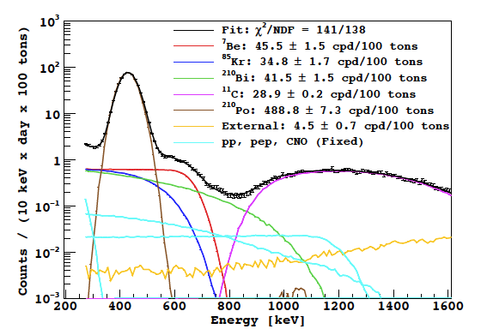
Phase I spectrum with backgrounds
¹¹C
²¹⁰Po
²¹⁰Bi
⁸⁵Kr
CNO

Slide 14
Phase II
Scintillator Re-purification 2010-2011
  Water extraction
  N₂ stripping
Data acquisition 2011-2014.
First direct measurement of pp- neutrinos

Slide 15
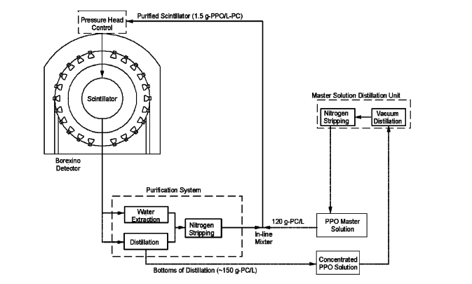
Borexino Re-Purification Systems
Water Extraction or Distillation followed by N₂ Stripping

Slide 16
Performance of Scintillator Purification
Distillation system
  Achieved low radioactivity after first purification
    Low level of ²¹⁰Pb ~ 15 cpd/100t
    ✗ Poor for ²¹⁰Po: ~ 8000 cpd/100t (Why? From groundwater?)
N₂ stripping
  Removed ⁸⁵Kr during scintillator re-purification.
Water extraction (Re-purification)
  Reduced ²³⁸U and ²³²Th upper chain.
  Moderate reduction of ²¹⁰Pb
  ✕ Poor removal of ²¹⁰Po (volatile ²¹⁰Po in groundwater?)

Slide 17
Results of Re-purification by Water Extraction
⁸⁵Kr: 30 cpd/100t → < 5 cpd/100t
²³⁸U (²²⁶Ra): [(530 ± 50) → < 8 x 10⁻²⁰ gU/g
²¹⁴Bi-²¹⁴Po Reduction factor > 77 (< 0.8 count/100t/yr).
²³²Th: [(3.8 ± 0.8 → < 1.0] x 10⁻¹⁸ gTh/g
²¹²Bi-²¹²Po Reduction factor > 3. ( < 0.8 count./100t/yr)
²¹⁰Bi: 70 cpd/100t → 20 ± 5 cpd/100t
²¹⁰Po: Essentially not reduced!! Volatile ²¹⁰Po?
Rates before purifcation are based on 153.6 ton-yr exposure taken in 740.7 d between May 16, 2007 and May 8, 2010.

Slide 18
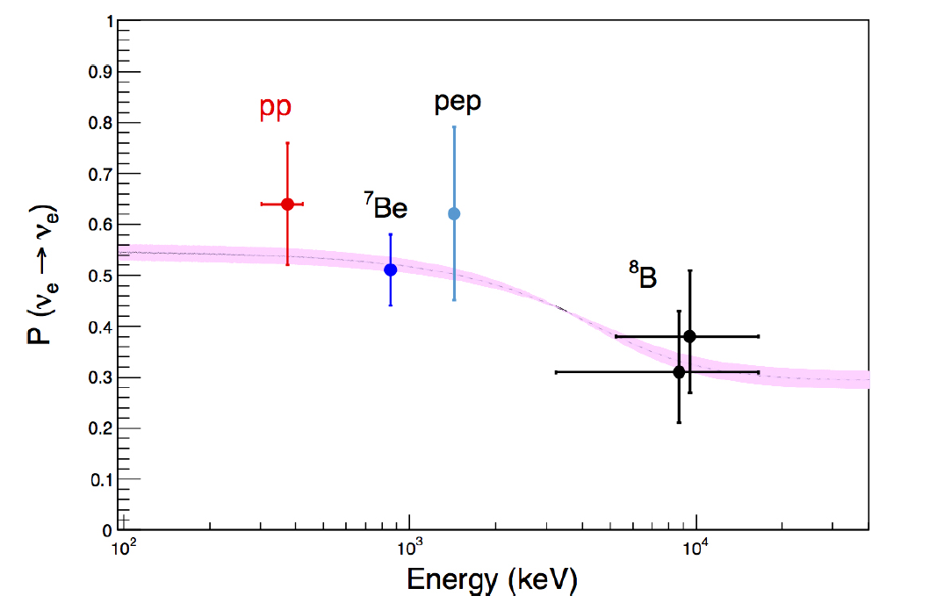
Borexino Measurements
  ✓ ⁷Be 46.0 cpd/100t ± 5%. PRL 2011
  ⁸B (> 3 MeV) 0.22 cpd/100t ± 19% PRD 2010
  pep 3.1 cpd/100t ± 22% PRL 2012
  CNO limit: < 7.9 cpd/100t PRL 2012
  pp 144 cpd/100t ± 16% Nature 2014

Slide 19
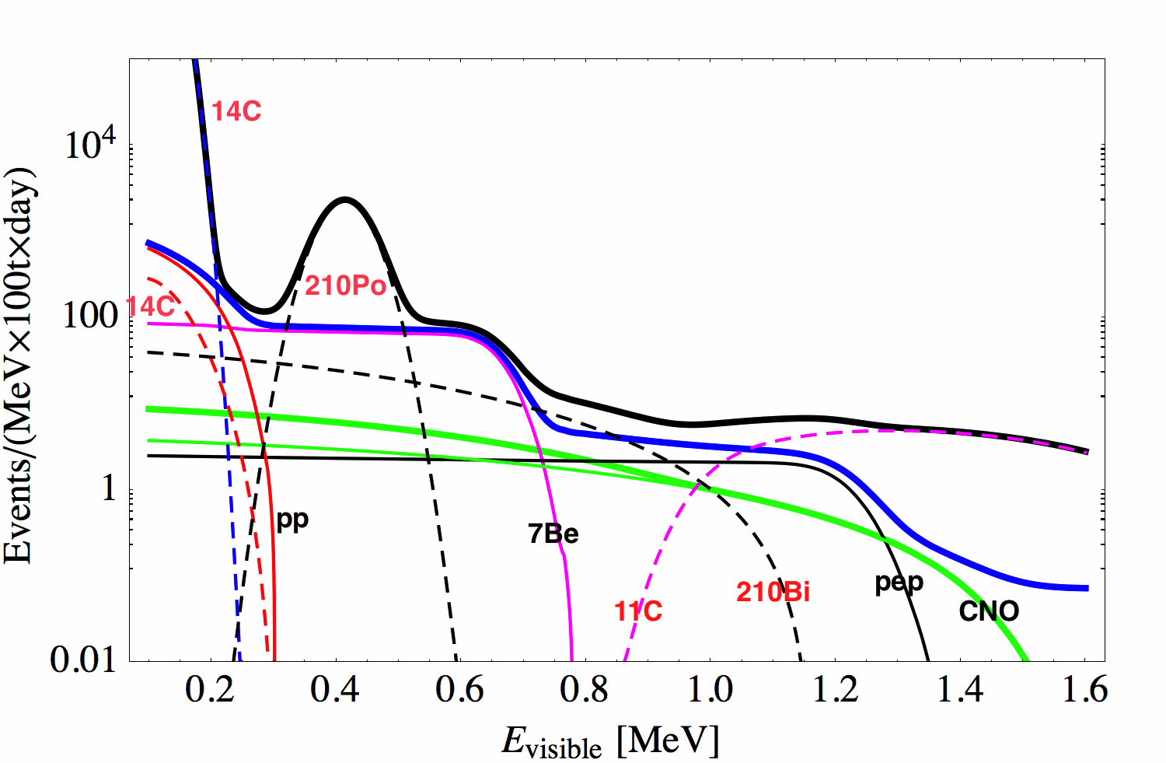
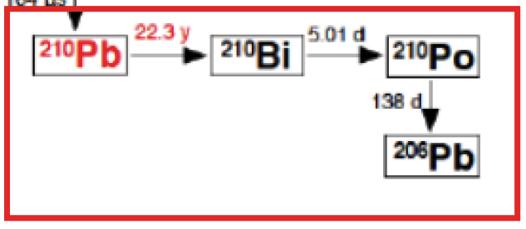
²¹⁰Bi after Re-purification & CNO
The CNO spectrum is obscured by ²¹⁰Bi beta decay in scintillator.
  ²¹⁰Bi beta decay = 1.16 MeV
  ¹⁵O solar ν-e max = 1.51 MeV
Strategies to reduce ²¹⁰Bi:
Measure ²¹⁰Bi rate from ²¹⁰Po by secular equilibrium. ✓
  Pule shape discrimination gives clean signal for ²¹⁰Po alphas.
  Secular equilibrium requires stable detector temperature, to avoid motion of ²¹⁰Po by convection.
Reduce ²¹⁰Bi background by scintillator re-purification. ✓

Slide 20
What’s Next?
On-going Efforts with Borexino
Data Analysis:
  4 years of data since scintillator re-purification
  Improve all measurements: pp, ⁷Be, pep, ⁸B neutrinos.
  Refine MSW vacuum-to-matter oscillation transition
Detector hardware upgrades for CNO:
  Added thermal insulation to water tank.
    Stabilize temperature to prevent convection currents that move ²¹⁰Po from vessel surface into fiducial volume.
    The should achieve secular equilibrium in ²¹⁰Pb-²¹⁰Bi-²¹⁰Po sequence.
  Upgrade scintillator re-purification systems.
    Remove ²¹⁰Bi by water extraction/distillation.

Slide 21
Science Motivation
Borexino Phase III: Precision Solar Neutrino Measurements
Solar Metallicity Problem and CNO
Comparing neutrino and radiant luminosities.
Neutrino physics beyond standard model.

Slide 22
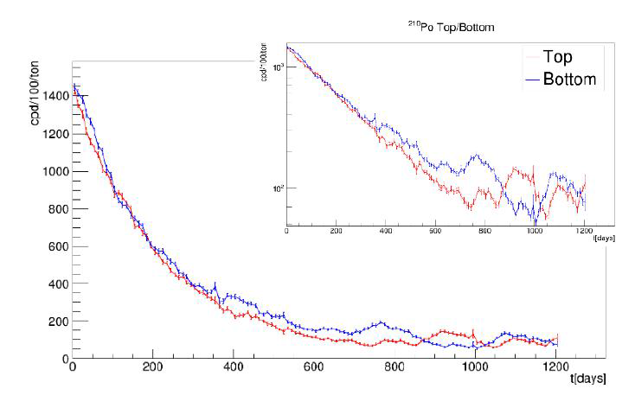
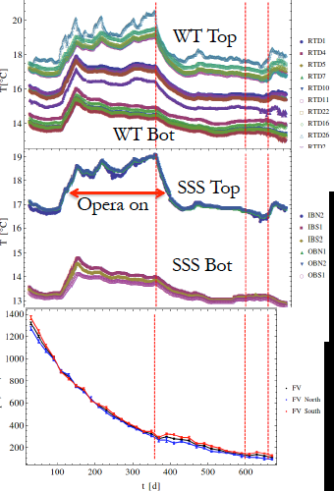
Temperature & ²¹⁰Po instabilities
²¹⁰Po non-exponential decay
Seasonal Temperature variations
²¹⁰Po is moved from vessel surface by convection
currents driven by temperature changes. This breaks
secular relationship between ²¹⁰Bi and ²¹⁰Po.

Slide 23
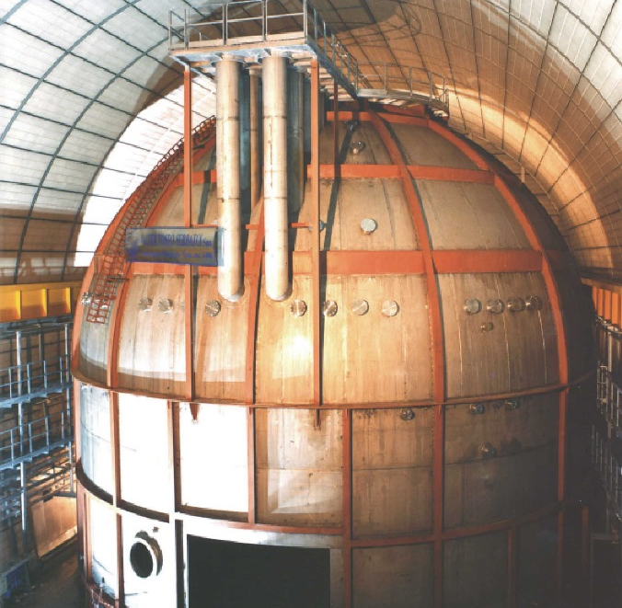
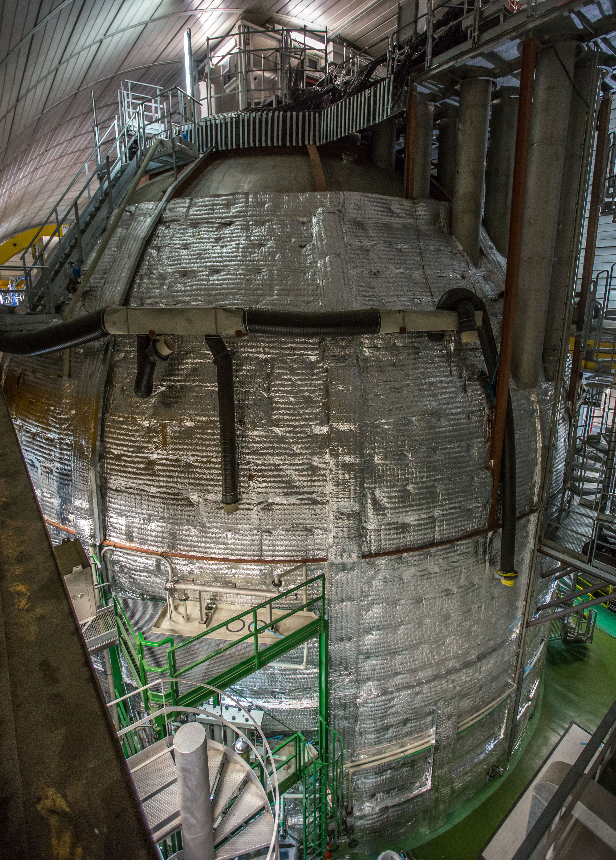
Thermal Insulation
Rockwool: 20 cm thickness k = 0.03 W/m/K
Before Insulation
During Insulation

Slide 24
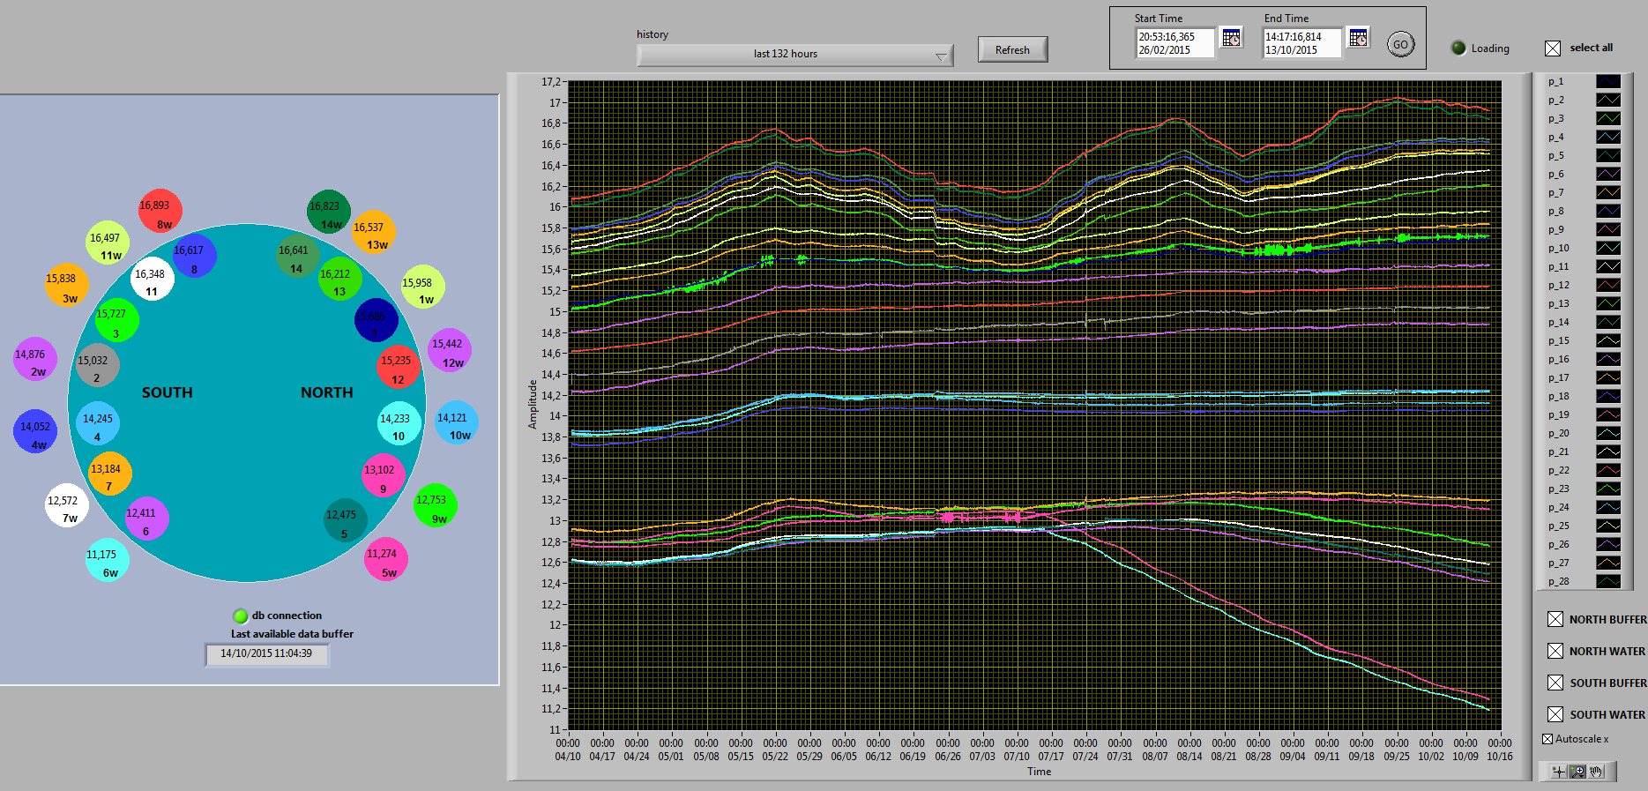
Temperatures
1. Thermal insulation partially complete
2. Water circulation in External Tank turned off
Uninsulated
17 C
15 C
13 C
Insulated
11 C
Water reciculation off
To Rock @ 8 C

Slide 25
Temperature Profiles
Insulation completed early December 2015
Data up to January 2016
Temperatures are continuing to stabilize- Data in analysis, results 2016?

Slide 26
Upgrade of Water Purification System
Reducing ²¹⁰Pb/²¹⁰Po from Scintillator
Recent studies show that ground water purified by ion exchange methods has trace concentrations of ²¹⁰Pb. This can be removed with distillation.
Studies also show that even distillation may not remove ²¹⁰Po, due to a biological process of micro-organisms in groundwater that produce dimethyl polonium, a volatile compound (B.P. ~ 130 C)
New fractional distillation columns were added to water purification systems.
  More effective removal of ²¹⁰Pb
  Designed to remove dimethyl polonium (²¹⁰Po)

Slide 27
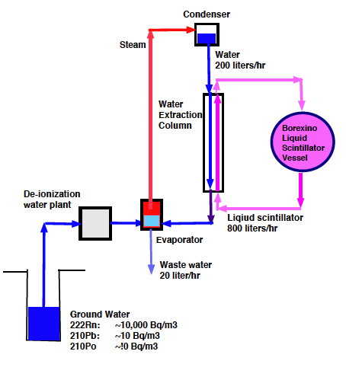
Borexino Water Extraction Systems
Original & upgraded systems with 2 new fractional distillation columns
Avoiding ground water is also being considered.
Proposed
System
Present
System
Upgraded
System
Original
System
Make-up water
system not shown.
Make-up water
system not shown.

Slide 28
Summary
Borexino is a unique liquid scintillator detector that achieved an extremely low background and high sensitivity to rare solar neutrino events.
Liquid scintillator purification was a key factor for low background.
Results:
  First direct spectroscopic measurements of all four solar neutrinos in pp fusion reactions, confirming Bethe’s theory of energy production in stars.
  Confirmation of MSW theory of neutrino oscillations.
Strong scientific motivation motivates on-going effort to reduce background for CNO measurement.
Meanwhile, lessons from Borexino inform future experiments on solar neutrinos to search for new neutrino physics and to study the Sun.
Notes:
Too many details.
Shorten and highlight future possibilities.

Slide 29
The End

Slide 30
Science Motivation
Precision Phase of Solar Neutrino Measurements
Solar Metallicity Problem and CNO
  All elements heavier than ⁴He in the Sun were made before the Sun formed. Their concentrations should be uniformly distributed in Sun, contrary to data that implies lower metallicity in photosphere compared to core.
    CNO rate differs by 30% for high and low metallicity
    An accurate measurement of CNO can clarify the metallicity problem.
Comparison neutrino and radiant luminosities.
    Stability of Sun’s energy output, sterile neutrinos.
    Improve measurement of pp neutrinos to few %.
      Liquid scintillator with low ¹⁴C; Liquid xenon dark matter detector (LZ)
Neutrino physics beyond standard model.
  Mapping out vacuum to matter-effect transition, etc.
  See, M. Maltoni and A. Smirnov, “Solar Neutrinos and Neutrino Physics”, arXiv: 1507, 11 Aug. 2015

Slide 31
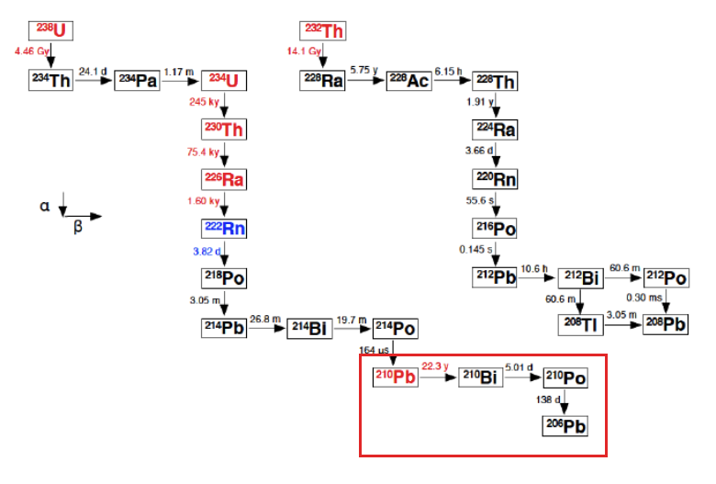
The ²³⁸U and ²³²Th Decay Chains
Radon deposits ²¹⁰Pb (22 yr) which later contaminates scintillator with ²¹⁰Bi (1 MeV β) and ²¹⁰Po (5 MeV α).

