Slide 1
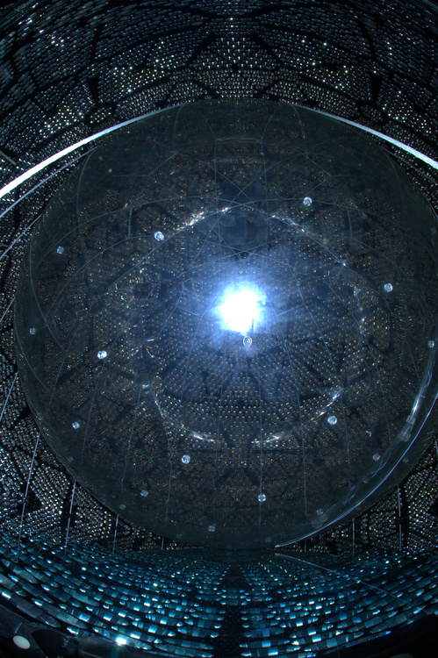
Neutrinoless Double Beta Decay in
Liquid Scintillator
Mark Chen
Queen’s University
FroST Workshop
March 18, 2016

Slide 2
Talk Outline
double beta decay
favorable isotopes
brief history of double beta decay in liquid scintillator
liquid scintillator NLDBD approach
  advantages
  requirements

Slide 3
Double Beta Decay
some even-even nuclei cannot β decay but can undergo double beta decay, a very rare second-order weak process
e.g. ⁷⁶Ge has half-life 1.8 × 10²¹ years
mass
ββ
Z, atomic number
n
p
W⁻
e⁻
2νββ
e⁻
n
p

Slide 4

Double Beta Decay
some even-even nuclei cannot β decay but can undergo double beta decay, a very rare second-order weak process
e.g. ⁷⁶Ge has half-life 1.8 × 10²¹ years
Q: can this (Beyond the Standard Model) process occur? neutrinoless double beta decay
mass
ββ
Z, atomic number
n
p
W⁻
e⁻
0νββ
x
requires neutrinos to be their own antiparticle − i.e. Majorana fermions
as opposed to Dirac fermions
e⁻
n
p

Slide 5
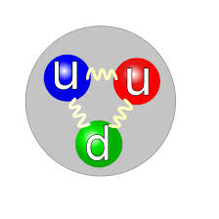
Are Neutrinos Majorana Fermions?
they carry no electromagnetic charge, no QCD colour, no moments, no other quantum number
other than lepton number…but what is that?
ν_{e}

Slide 6

Are Neutrinos Majorana Fermions?
they carry no electromagnetic charge, no QCD colour, no moments, no other quantum number
other than lepton number…but what is that?
ν_{e}
e⁺
Why does this only happen for the
“anti”-neutrino? Does the proton
know it was an anti-lepton?

Slide 7
Answer: Chirality and the Weak Interaction
the weak interaction distinguishes between left and right chirality and that’s why
does the weak interaction distinguish between lepton number L = 1 and L = –1, in addition? Or is that simply redundant?
if lepton number is meaningful, then particles and antiparticles are fundamentally different
if one discards lepton number as a meaningful quantity (why would lepton number be?) then neutrinos are Majorana fermions…FACT!

Slide 8
Why is 0νββ Interesting?
if neutrinos are Majorana particles
  lepton number is not conserved (L conservation is “ad hoc” in the Standard Model, so this is fine to throw out)
  offers “simpler” theory for massive neutrinos
light neutrino exchange can mediate the 0νββ process
  rate (i.e. half-life) depends on effective Majorana neutrino mass
  double beta decay experiments probe absolute neutrino mass scales
possible connection to cosmology via combination of CP-violating Majorana phases, ΔL ≠ 0 and leptogenesis giving rise to the matter-antimatter asymmetry in Universe
definite connection to physics at higher energy scales (e.g. as in the see-saw mechanism)
in EFT, the lowest-order extension to the Standard Model is a unique dimension-5 operator…and it’s Majorana neutrino mass
d=5 operator coefficient <Φ>²/Λ
(246 GeV)²/10¹⁵ GeV ≈ 60 meV

Slide 9
Majorana Mass
is precisely the term in the Lagrangian
that’s responsible for this process

Slide 10
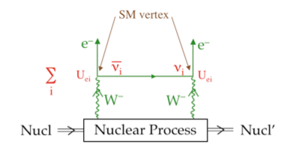
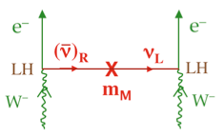
Neutrinoless Double Beta Decay Amplitude
if and only if Majorana
  antineutrino = neutrino
chirality mismatch
  antineutrino is dominantly right-handed with component m/E that is left-handed
amplitude
decay rate is amplitude squared,
hence
take note: it’s the sum of complex-valued U_{ei} with the “Majorana phases”

Slide 11
and the Neutrino Mass Hierarchy
best-fit oscillation parameters with ±2σ for θ₁₃, δ=0, ±1σ for the other relevant oscillation parameters
all Majorana phases 𝛼 from [ 0, π ]
Blue and Green: CP-conserving Majorana phases
Red: at least one of 𝛼_{21,31} and (𝛼₃₁–𝛼₂₁) CP-violating
e.g. HdM
10 kg scale
1000 kg scale
updated figure by S. Pascoli in RPP 2013 “Neutrino Mass, Mixing and Oscillations”,
originally in S. Pascoli and S. Petcov, PRD 77, 113003 (2008)

Slide 12
Which Isotope?
35 naturally-occurring isotopes can double beta decay
  double beta isotopes with Q > 2 MeV listed below
34 naturally-occurring isotopes can EC/EC, EC/β⁺, β⁺/β⁺
  only six of them have high enough Q to emit double positron
isotope | Q-value [MeV] | natural abundance
⁴⁸Ca | 4.27 | 0.187%
¹⁵⁰Nd | 3.37 | 5.6%
⁹⁶Zr | 3.35 | 2.8%
¹⁰⁰Mo | 3.03 | 9.8%
⁸²Se | 3.00 | 8.7%
¹¹⁶Cd ¹³⁰Te ¹³⁶Xe ¹²⁴Sn ⁷⁶Ge ¹¹⁰Pd | 2.80 2.53 2.48 2.29 2.04 2.01 | 7.5% 34.1% 8.86% 5.8% 7.73% 11.7%
CANDLES, AMoRE
SNO+, DCBA
MOON, AMoRE, LUMINEU
SuperNEMO, LUCIFER
C0BRA
CUORE, SNO+
KamLAND-Zen, EXO, NEXT
Sn-loaded scintillator
GERDA, MAJORANA

Slide 13
Nuclear Matrix Element
rate of 0νββ decay:
G_{0ν} is the phase space integral (“precisely” calculable) [g_{A} is here too]
M_{0ν} is the nuclear matrix element
NME for Different Isotopes

Slide 14
History of NLDBD in Liquid Scintillator
possibility of Xe-loaded liquid scintillator was studied by Borexino in the mid-90’s
  of course, you have to procure enriched xenon to have an actual experiment
Xe-loaded KamLAND was an original objective of KamLAND since ~1998 or a bit earlier

Slide 15
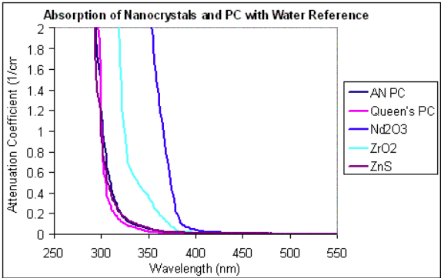
History NLDBD in SNO+
proposed, developed since ~2003 or a bit earlier
xenon idea was out there since Raghavan; SNO+ wanted to see what other isotopes could be deployed in liquid scintillator
  nanoparticles (CdSe, CdTe, Nd₂O₃, ZrO₂): in Chen lab at Queen’s
  organometallic compounds (Nd, Te): Dai, Wright, Chen at Queen’s
Nd carboxylate – BNL (see figure), Queen’s
[Nd-acac – MPIK (F.X. Hartmann)]
Nd, Te in water, miscible with liquid scintillator
(Dai, Wright at Queen’s)

Slide 16
History NLDBD – KamLAND-Zen
KamLAND was funded to procure enriched ¹³⁶Xe in ~2009
  and became KamLAND-Zen
built mini-balloon, Xe handling and loading systems
deployed balloon filled with enriched ¹³⁶Xe liquid scintillator
first results in 2012!
[see talk by Itaru Shimizu]

Slide 17
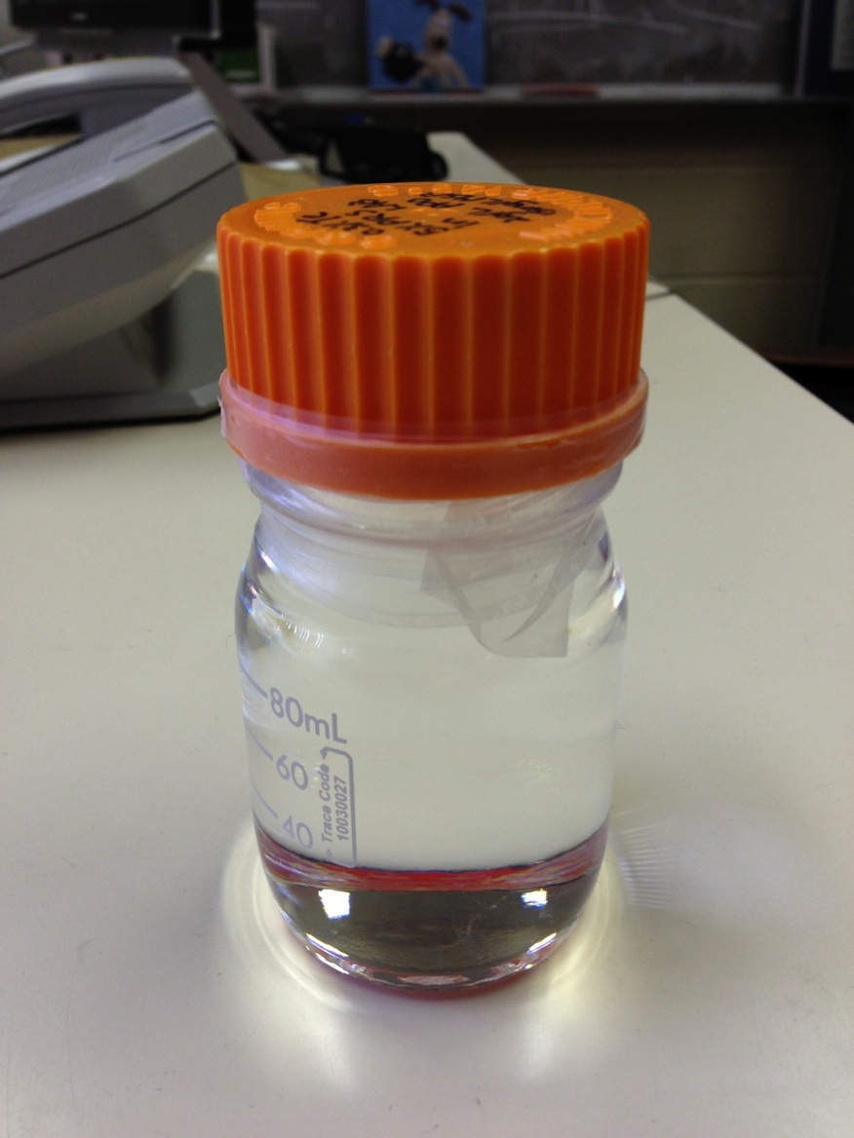
SNO+ Nd SNO+ Te
SNO+ was funded in late 2010
[see talk by Szymon Manecki]
Nd has some advantages for NLDBD
enrichment of Nd using AVLIS facility in France brought to our attention at Neutrino 2006 as a possibility
  and remained a remote possibility until ~2011 or a bit earlier
in late 2011-early 2012, BNL surfactant approach (developed from WbLS R&D) successful at loading tellurium

Slide 18
Tellurium NLDBD Advantages
especially important for loaded liquid scintillator approach to tonne-scale NLDBD
natural isotopic abundance 34.1%
slow 2νββ background (Xe and Te are the slowest)
  2ν/0ν ratio is smallest
in the 0νββ ROI, backgrounds from U and Th can be rejected with high efficiency (²¹⁴Bi-Po)

Slide 19
Xenon NLDBD Advantages
especially important for loaded liquid scintillator approach to tonne-scale NLDBD
¹³⁶Xe argubly easiest and cheapest isotope to enrich
slow 2νββ background (Xe and Te are the slowest)
    2ν/0ν ratio is smallest
in the 0νββ ROI, backgrounds from U and Th can be rejected with high efficiency (²¹⁴Bi-Po)

Slide 20
Ideal NLDBD Experiment Capabilities
from NSAC Town Meeting in September 2014 [in Chicago]
  very low backgrounds: internal and external
  good energy resolution (and calibration)
  scalability – acceptable cost
  tracking of betas to identify ββ event topology
  large Q-value (ROI above U and Th backgrounds, larger phase space) – what SNO+ Nd was about
  ability to remove or replace isotope to demonstrate possible signal
The loaded liquid scintillator approach does these ones (in blue) very well.

Slide 21
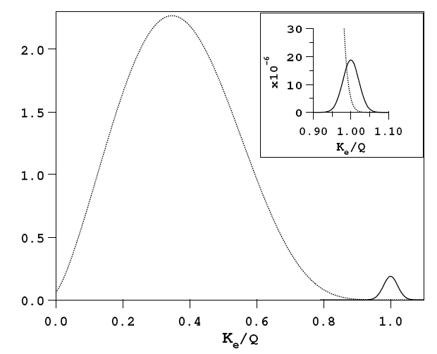
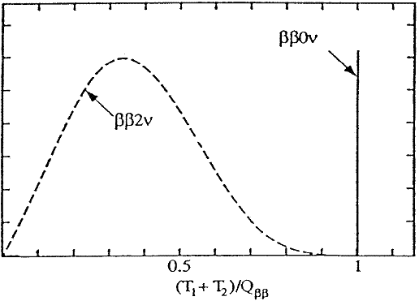
How to Search for 0νββ?
look at sum of energy of both electrons (calorimetry)
search for a peak at the double beta endpoint

Slide 22
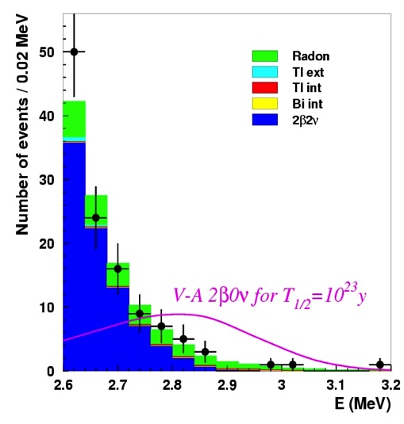
Backgrounds
separation of 0νββ from 2νββ (i.e. energy resolution) is not the only important experimental requirement
background reduction and rejection are necessary too
  natural radioactivity (U, Th, K, Rn…all the usual suspects)
  cosmogenic radioactivity – will be more and more important as we increase the sensitivity of next-generation experiments
  neutron-induced backgrounds
  selection of materials for detector components
  “monolithic” detector design (external background rejection) and reliable background model
  radiopurity of the detection medium and the double beta isotope (often one and the same)
  event “topology” – spatial and/or temporal – for background rejection
e.g. Ge detector with excellent energy resolution
still has background counts under the peak
e.g. NEMO-3 with not-as-good energy resolution has excellent background rejection from track identification

Slide 23
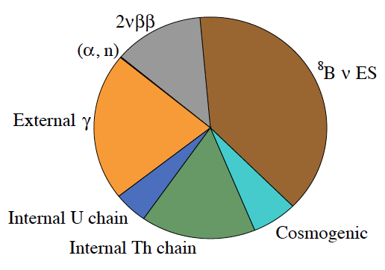
Example Background Pie Chart
NLDBD background sources, in general
i.e. surface
including (n,γ)

Slide 24
Example Background Pie Chart
How to reduce?
energy resolution
shielding
and background cuts
i.e. surface
make volume
smaller
shielding
and background cuts
including (n,γ)
purification
and background cuts
purification
and background cuts
and waiting for decay

Slide 25
Liquid Scintillator Requirements for NLDBD
Q: What is more important, energy resolution or low backgrounds?
A: both, of course…
liquid scintillator formulation must be amenable to purification to achieve ultra-low background
good energy resolution: intrinsic light yield, long attenuation length also important
  transparency gives rise to better uniformity of energy response across large detector; smaller energy resolution systematics

Slide 26
Other Desirable Features for NLDBD in Liquid Scintillator
dense loading (maintaining suitable optical properties)
  concentrate isotope in smaller volume – only way to reduce ⁸B solar neutrino background
  optimize light collection for the smaller volume (e.g. Winston cones)
scintillation fast timing
  position reconstruction (resolution) to reject external backgrounds
  coincidence background rejection
  coupled with fine granularity light collection gives possibility of β/γ event topology “figure of merit” (i.e. single-site/multi-site discrimination)

Slide 27
More Desirable Features
pulse-shape discrimination
  alphas not really direct background in ROI
  PSD can help alpha ID in coincidence tagging, in the presence of other larger background rates
Cherenkov-scintillation separation
  the only other way to reduce ⁸B solar neutrino background

Slide 28
Summary
In general, next-gen double beta decay experiments:
1. NEED TO BE BIG
2. HAVE GOOD ENERGY RESOLUTION
3. AND HAVE ULTRA-LOW BACKGROUND
These are the most important requirements for tonne-scale NLDBD. Loaded liquid scintillator approach excels at #1 and #3.

Slide 29
Backup Slides

Slide 30
Sn-Loaded Liquid Scintillator
for NLDBD

