Slide 1
R&D Experience for KamLAND 3M liter Liquid Scintillator Detector
F. Suekane
RCNS, Tohoku Univ.
suekane@awa.tohoku.ac.jp
Frontiers of Liquid Scintillator Technology
FroST16@ FermiLab. USA

Slide 2
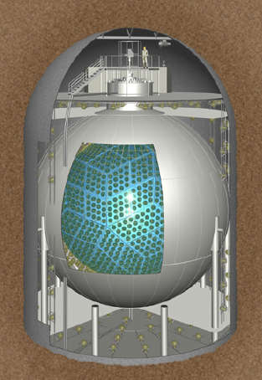
Motivation of this talk
The KamLAND Detector uses 3000m³ of
oil (1200m³ of LS+1800m³ of Buffer Oil).
The detector has successfully produced
important physics results.
The detector was constructed 15 years ago
but is still the largest homogeneous LS
detector in the world.
It may be useful to show our experience of
the detector R&D for future large scale LS
experiment.
The following is a simplified R&D story of
the complicated actual tries and errors.

Slide 3
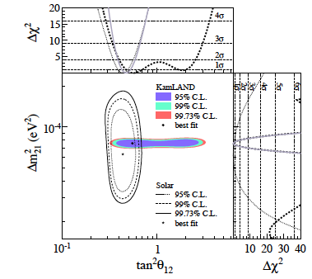
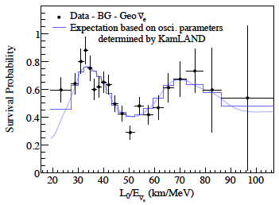
Major Results from the KL detector
Discovery of Reactor
Neutrino Oscillation
θ₁₂ & Δm²₁₂ measurement
GeoNeutrino
Measurement
Awarded
Breakthrough
Prize

Slide 4
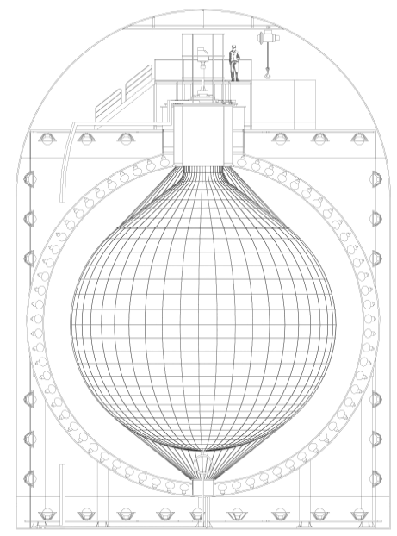
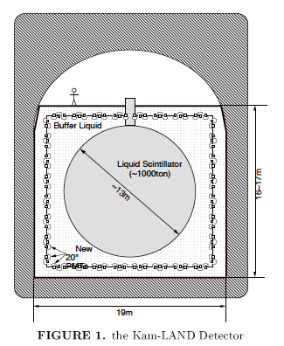
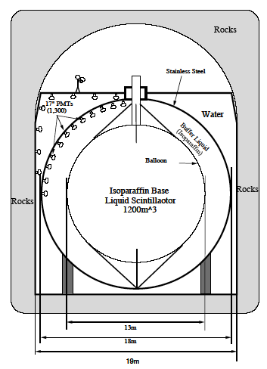
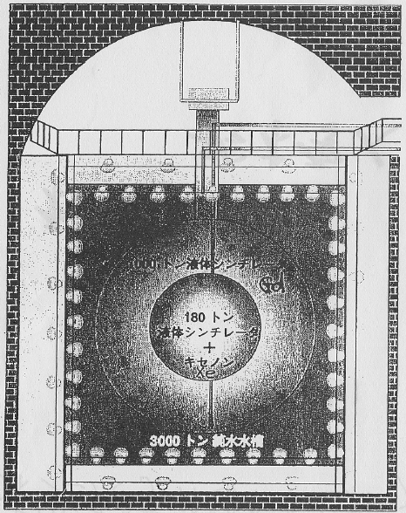
An Early History of KamLAND
Idea (A.Suzuki) ~1993
Project Approval 1997
Detector Construction 1998~2001
Start Data Taking 01/2002
1st reactor paper (deficit) 12/2002 (PRL 90:021802)
2nd reactor paper (spectrum distortion) 06/2004 (PRL 94:081801)
Geo neutrino paper 07/2005 (Nature 436:499-503)
1995
Neutrino man
1997
1998
2001
Evolution of the Detector Design

Slide 5
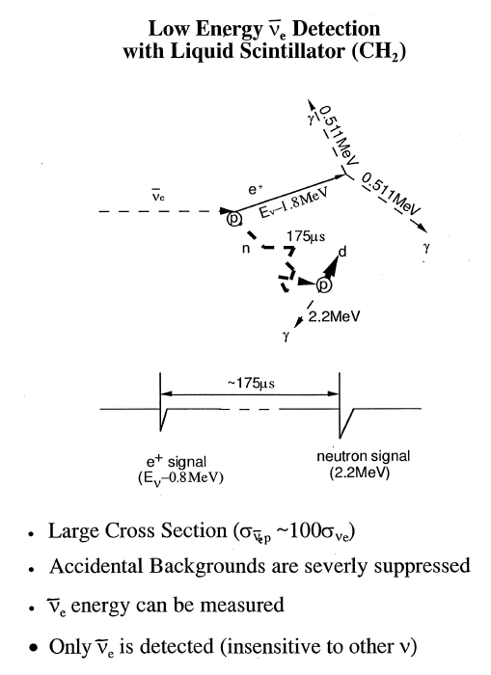
Why Liquid Scintillator?
(1) Very Large & Uniform
Detector possible
➔ High Quality & Quantity Data
(2) High Light Output(>Cherenkov)
➔ Good Energy Resolution &
Low Energy threshold
(3) Abundant Protons
➔ Good for Low Energy ν_{e}
Detection
(4) Fast Pulse
➔ Good Timing & Position
Reconstruction
(5) Intrinsically Low U/Th/K
➔ Very Low Backgrounds
(6) price ~ a few K US$ /ton
➔ Low Cost
The signal is delayed
coincidence with
n capture on H

Slide 6
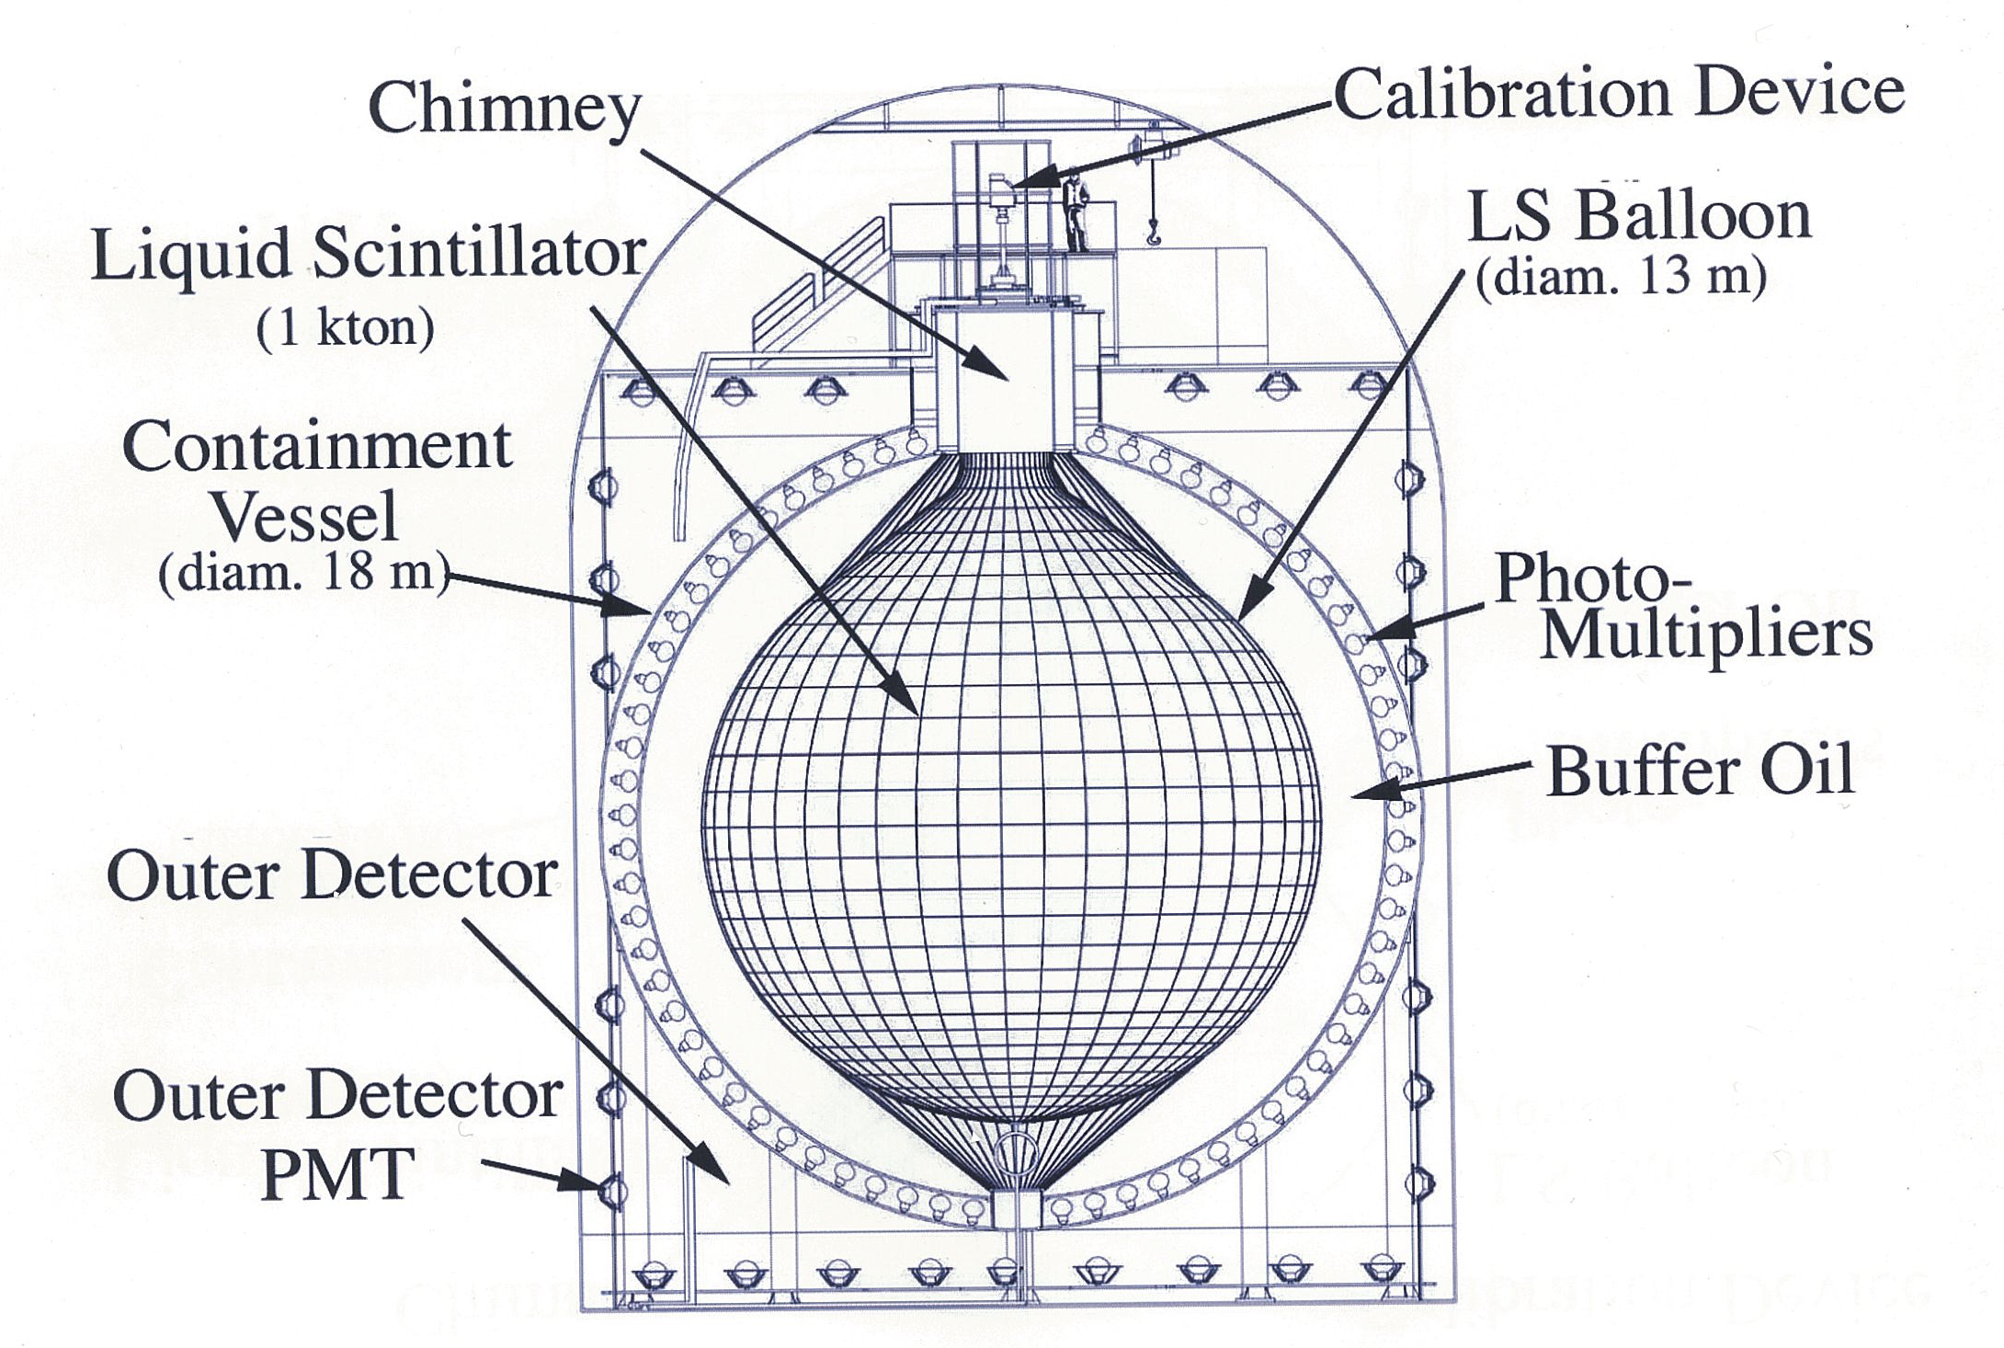
KamLAND Detector
... subjects of this talk
(1800m³)

Slide 7
Our Conditions and R&D Strategies
(1) Limited time, money, manpower and expertise of LS
(2) The LS can not be replaced after filling (no reservoir tanks).
(= Like a satellite, we can not fix problems once launched. )
(3) The detector size is very much larger than lab. test experiments.
(4) The required radio purity level was below the sensitivities of
laboratory measurements.
⇩
(1,2)➔ Use only proven technologies. Make LS as simple as possible.
(1) ➔ Robust design (⬄ fine design based on sofisticated tests and
simulations) . Purpose of test experiments was to judge the tested
quality was OK or not. Not to evaluate the quality in detail nor to
make thorough investigations.
(2,3) ➔ Do final check by 1-dimentional real length (6.5m) test
experiment to confirm the real scale performances.
(4) ➔ Prepared the last resort (E>3MeV was safe) .
Do measures to reduce U/Th/K as much as possible.

Slide 8
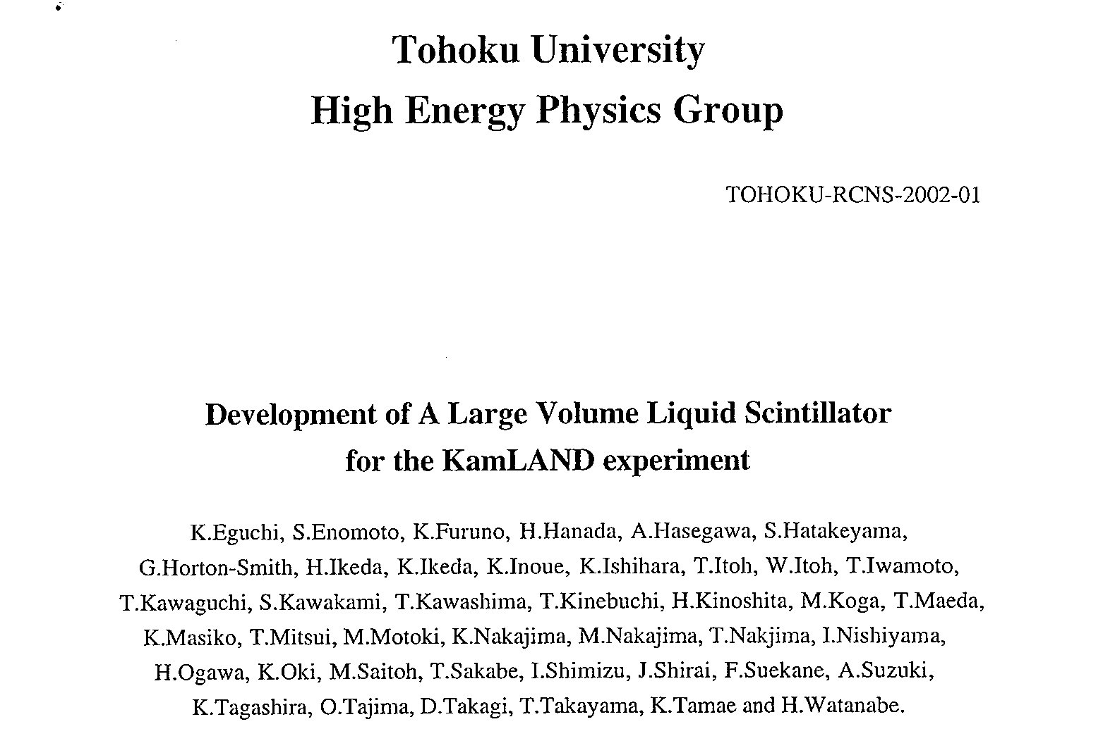
I. Liquid Scintillator R&D
References:
Tohoku-RCNS-2002-01
Contents
1. Introduction
2. Overview
3. Outline of R&D
4. Light Output
5. Transparency
6. Direct Light Yield Measurement
7. n/γ, α/γ Pulse Shape Discrimination
8. α Quenching
9. Oxygen Quenching
10. Studies with 1/14 scale LS System
11. Material Selection
Radio Purity
12. Preparation of LS and Initial
Performance in the detector
&
ArXive physics/0404071
"An Overview of the KamLAND
1 Kiloton Liquid Scintillator"
.... and recollection of my memories.

Slide 9
Requirements for KamLAND LS
* Energy Resolution
* Light Output > 40% anthracene
* Light Attenuation Length >10m
* Radio Purity( U/Th/⁴⁰K) <10⁻¹⁴/10⁻¹⁴/10⁻¹⁵g/g
* Quench Factor for 7.7MeVα >10
*Safety
Flash point >50℃
* Price a few US$/liter
* Oil companies have capacity to supply the large amount
of high quality oils within half year of filling period

Slide 10
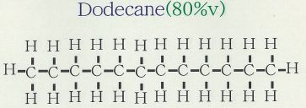
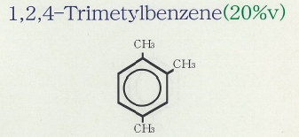
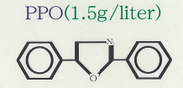
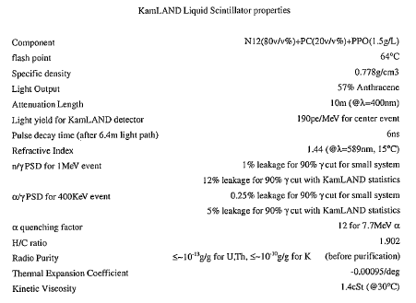
KamLAND Liquid Scintillator (No hidden ingredients)
Pseudcumene

Slide 11
Choice of the Aromatic Liquid
At that time,
* Xylene and Pseudocumen (PC) were commonly used in liquid
scintillators.
* PXE was less common.
* Linear Alkylbenzene(LAB) was not discovered yet by M.C..
➔ Thinking of our conditions, PC was almost unique candidate
because ...
* PC has higher flashpoint and more moderate and less toxic
compared with Benzen-Toluene-Xylen family
* PC was widely used for large scale LS detectors, such as
MACRO, Chooz, PaloVerde, and Borexino was planning to use it.
* Transparency of pure PC was measured to be very good.
* Large amount of high quality PC was produced in Japan by
COSMO oil company and it was not necessary to carry by ship.
(We were afraid of contamination from shipping tank wall. )

Slide 12
Dilution of PC with Paraffin Oil
➔ Our LS did not need to have as high light output as solar
neutrino detectors. Therefore, we diluted the PC with paraffin oil
(PO) to obtain,
* higher flashpoint (for safety),
* less toxicity, odor, reactivity (for safety),
* more H/C (more ν_{e} events) ,
* more transparency.
➔ There are 2 kinds of paraffin oil
H
H
H
H
H
H
H
H
H
H
H
H
Normal -Paraffin
(unique molecular structure)
Iso-Paraffin (or Mineral Oil)
(various molecular structures )
H-C-C-C-C-C-C-C-C-C-C-C-C-H
H
H
H
H
H
H
H
H
H
H
H
H
H
H
H
C
H
H
C
H
H
H
H
H
H
H
H
H
H
H
etc.
H-C-C-C-C-C-C-C-C-C-C-C-C-H
H
H
H
H
H
H
H
H
H
H
H
H

Slide 13
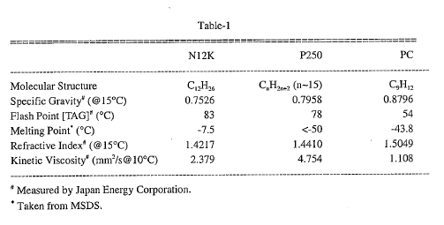
Normal-Paraffin vs Iso-Paraffin (Mineral oil)
We picked up candidate products from NP and IP based on
high flashpoint and good availability in Japan.
NP ➔ Dodecane (N12K, Nikko Oil Company),
IP ➔ Paraol-250(Showa Shell)

Slide 14
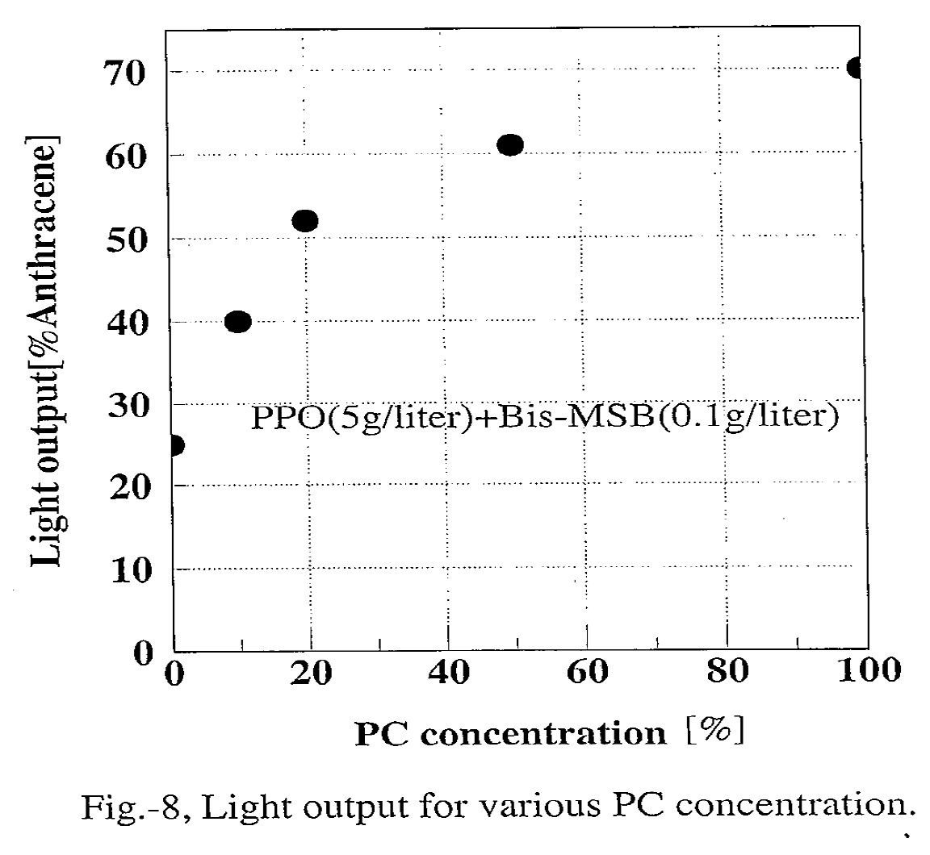
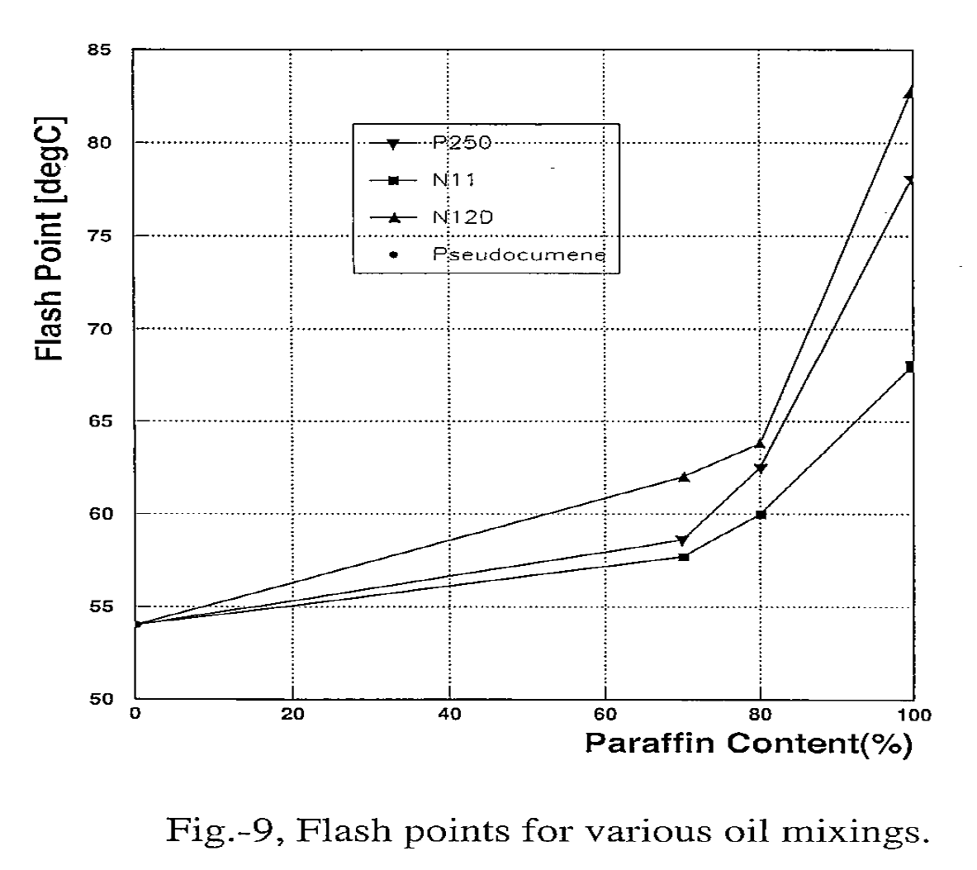
Determination PC : PO Dilution Ratio
Light Output
Flash Point
N12
P250
For >20%PC, the increase rate of the light output becomes slow.
Flashpoint became reasonably higher.
➔ Determined to PC:PO=20:80 volume %
Then we measured transparency of the oils. Since the KL detector
size is ~10m, we needed to measure the attenuation length of Λ>10m

Slide 15
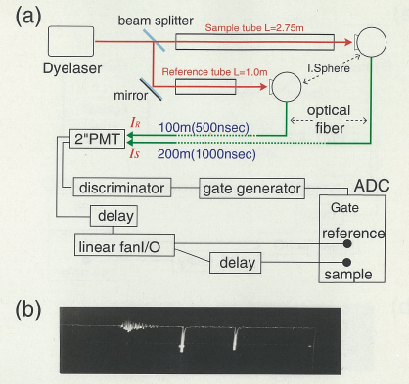
Attenuation Length (Λ>10m) Measurement
1.75m
I_{S}
I_{L}
Attenuation Length
* Long path length (1.75m)
* Remove laser noise
* Cancel laser instability
* Cancel PMT instability
* 0-calibration with air
➔ Measurement of Λ>10m
possible
Noise of
Laser flash
Signal (I_{L})
(L=2.75m)
Signal (I_{S})
(L=1.0m)

Slide 16
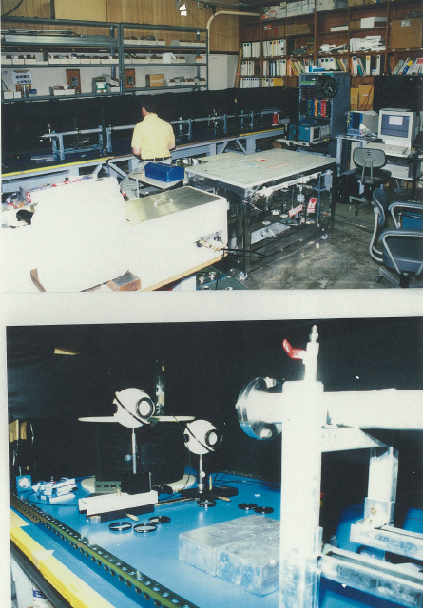
N₂ Dye Laser
Oil tubes
Integration
Spheres
End of an oil tube.
( UV transparent acrylic window)
Optical fibers

Slide 17
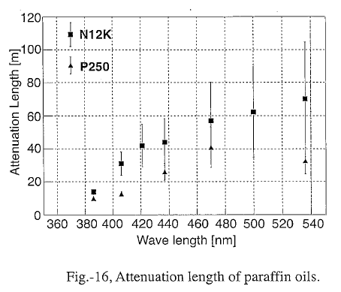
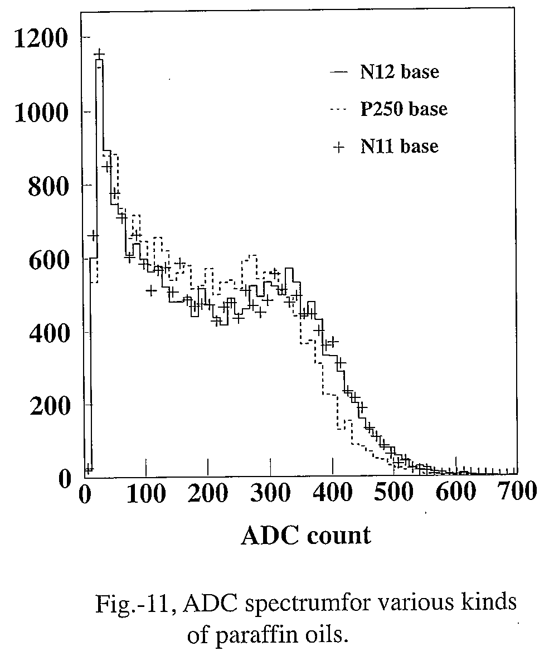
N12K vs P250
Attenuation Length
Light output (PC20%+PO80%)
N12K
P250
N12K was more transparent
N12K gave slightly higher light output
➔ We chose N12K to dilute PC
Additional good features of NP
* Distillation temperature window is narrow (➔ intrinsically pure)
* H/C ratio and density etc. are accurately known
(Less systematic error of ν flux measurement, safe filling, etc.)

Slide 18
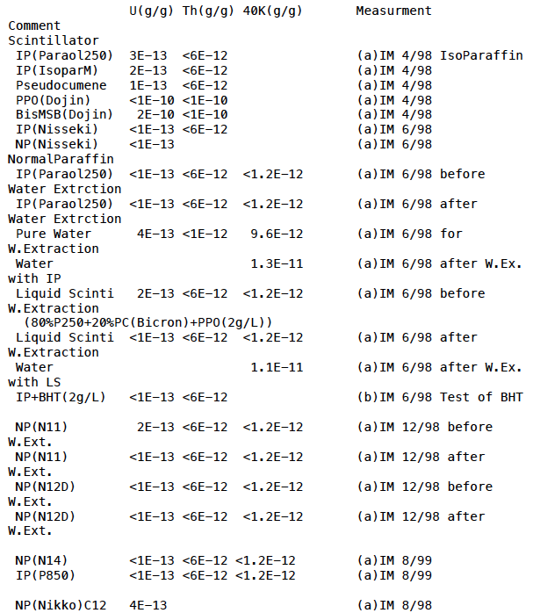
Radio Purity Measurements of Oils
Sample U(g/g) Th(g/g) ⁴⁰K(g/g)
Requirements: U/Th/⁴⁰K <10⁻¹⁴/10⁻¹⁴/10⁻¹⁵ g/g
It was necessary to measure many samples.
Measurement Methods: ICP-MS (Inductively Coupled Plasma Mass-Spectrometry) ;
Sensitivity ~10⁻¹³ g/g
Reactor neutrino oscillation measurement
at E>3MeV was guaranteed from these
results.
However, E<3MeV was not guaranteed.
We could only hope, after careful treatments
and water extraction, the actual
contaminations would satisfy the
requirements.
➔ In the end the contamination turned out
to be very low. ☺

Slide 19
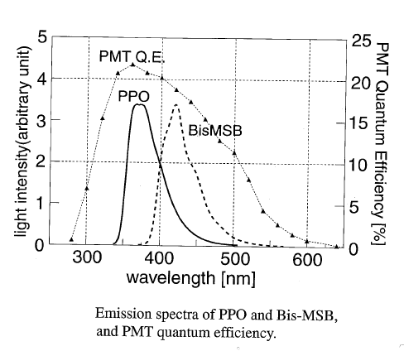
Flours
* 1st Flour
PC+PPO was most widely used in
large LS detectors. The emission
spectrum matches to the Q.E.
spectrum of our PMT.
➔ We decided PPO was the first
candidate.
* 2nd- ary wave length shifter:
2nd- ary wave length shifter, such as bis-MSB shifts the wavelength beyond the PMT highest Q.E. region.
A simulation showed light yield would be reduced with bis-MSB.
➔ We decided not to use 2ndary flour.
* Antioxidants:
We decided not to use antioxidants such as BHT because the LS would
be kept in completely dark and cold environment, and LS will be bubbled
by N₂ before filling and kept in N₂ gas.

Slide 20
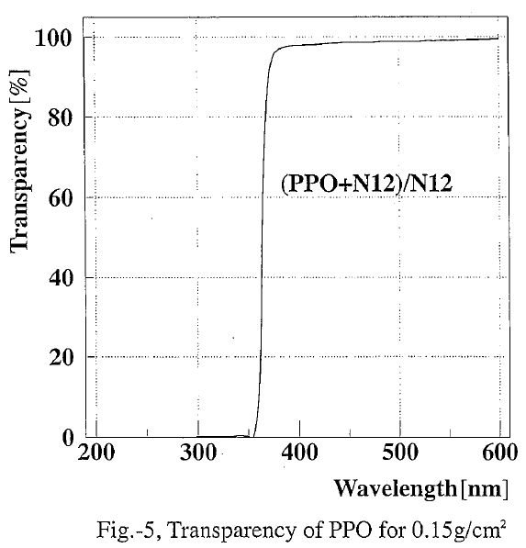
Choice of PPO Manufacturer
Manufacturer of the PPO was selected by
(1) Light absorption and sediments when dissolved in N12,
(2) Radio Purity, (3) Capacity of production (1.8ton) (4) Price,
(1) Light absorption is a very good indicator of contaminations.
15g/L (10 times of LS) of PPO was dissolved in N12 and light absorption
was measured. Dissolution power of N12 is poorer than BTX and
contaminations more likely come out as sediments.
L=10cm
(2) Radio purity measurements
➔ next page
PPO samples from 5 different
manufacturers were tested and we
found the quality very much depend
on the manufacturers and even production
batches.
good
example

Slide 21
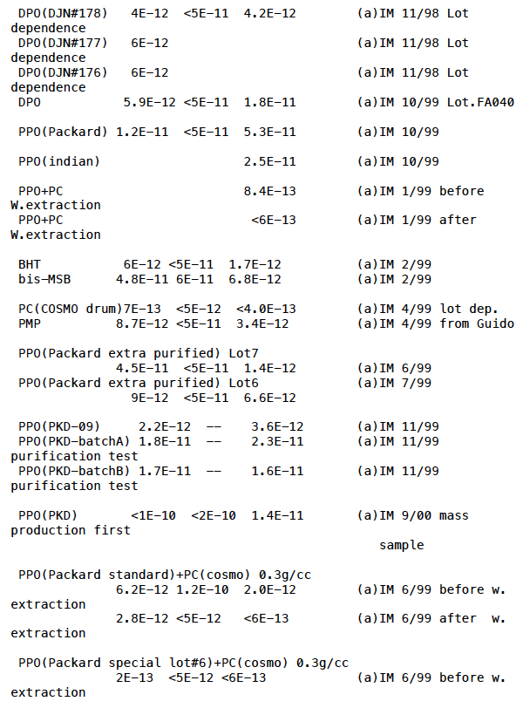
Choice of PPO Manufacturer
Sample U(g/g) Th(g/g) ⁴⁰K(g/g) Method and date
(2) Radio purity measurement.
Since PPO was the "dirtiest"
material in the LS, we made
many U/Th/K measurements
with various conditions.
➔Some samples did not
satisfy our requirements.
We asked extra purification to
manufactures.
Finally Packard PPO with
extra purification was selected.
(Another company produced very
good PPO but did not have capacity)

Slide 22
Real Path Length (6.5m) Direct Light Yield Measurement
In order to determine the PPO concentration and measure the actual
number of p.e./MeV in the KL detector, full scale light yield
measurement was performed.
5"PMT
Cosmic ray
L=6.5m system
* The 5" PMT has the same
photocathode as the KL PMT.
0.1~0.2 p.e./signal ➔ photon counting
Absolute p.e. yield/MeV can be
measured after passing through 6.4m.
LS in black-anodized
aluminum tube (V=105 liter).

Slide 23
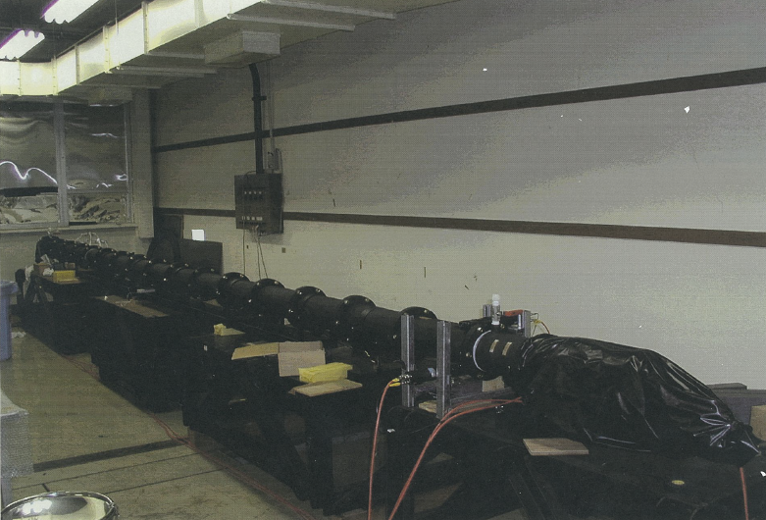
Black Anodized Tubes(6.8m Long)
5"PMT
(photon counter)
Cosmic-ray trigger counters
5"PMT
(reference)

Slide 24
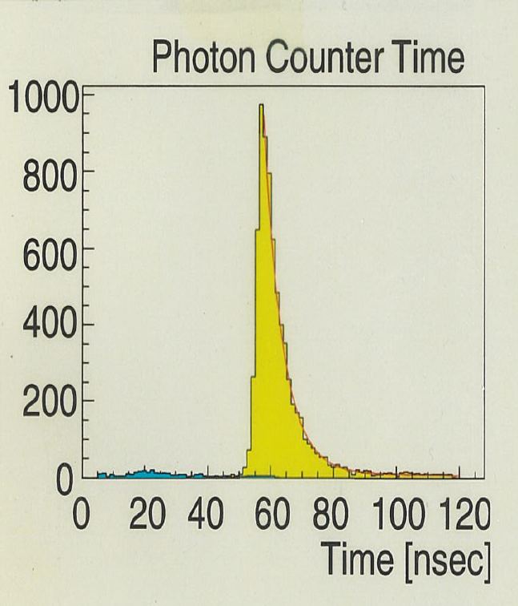
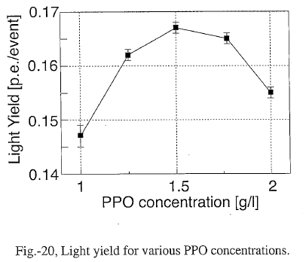
PPO concentration dependence of light yield
degradation due to
self absorption
From this study,
(1) Optimum PPO concentration=1.5g/liter for this size.
(2) Absolute light yield = 190 p.e./MeV
(3) Time structure of signal
(4) N12K base LS was found 30% more p.e. than P250 base LS.
(5) Long time stability
were measured.
With these results, we finally select N12K and became confident
that the LS will work in the KamLAND detector.

Slide 25
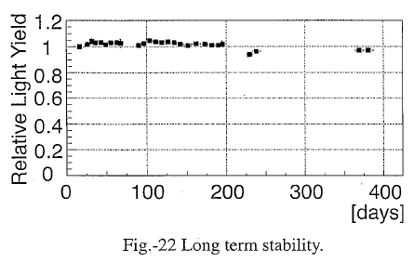
Long term stability measurement
The 6.5m system was used for the long term stability measurement
Since L is long, a slight changes of transparency as well as light output,
due to degradations of the LS affect the light yield much.

Slide 26
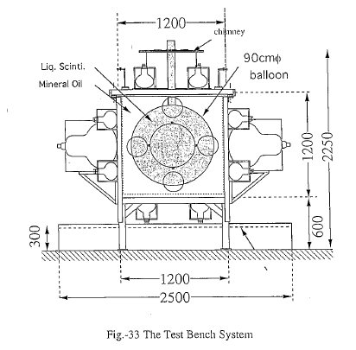
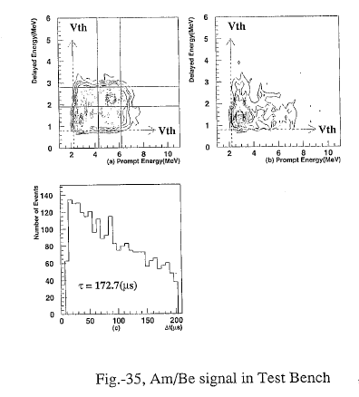
Confirmation of delayed coincidence with 1/14 scale (380 liter)
test system (we did not have experience of delayed coincidence.)
E_{d}
E_{d}
Am-Be
BKG
E_{p}
E_{p}
This was our first
delayed coincidence
signal
Δt (p-d)
➔ We learned how the delayed coincidence signal looks like.
Measured neutron absorption time, etc.

Slide 27
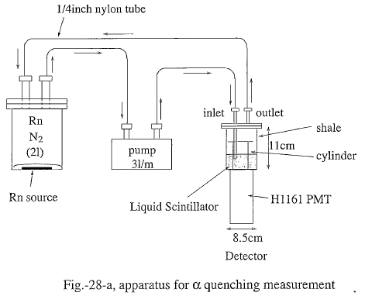
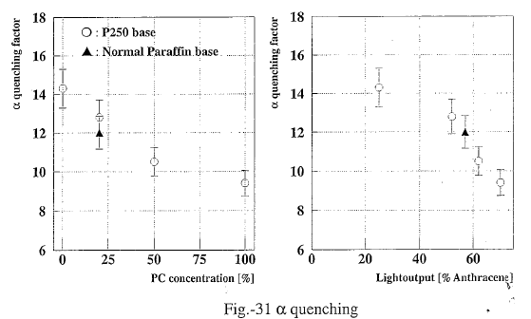
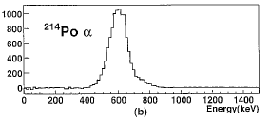
α quench factor (R_{Q})
Possible correlated
BKG
Dissolved Rn in the
LS by bubbling
N₂+Rn gas and
measured α quench
and α/γ PSD.
²¹⁴Bi
²¹⁴Po(τ=236μs)
²¹⁰Pb
β(3.26MeV)
γ(0.8MeV)
+α(6.9MeV)
U rich soil
required
7700KeVα
➔ 600KeV
(R_{Q}~12)
R_{Q}
R_{Q}

Slide 28
Buffer Oil Determination
1kton's of LS is contained in a thin
plastic balloon. It was necessary to
match the specific gravity of LS and
the buffer oil to avoid the pressure
caused by the density difference.
➔ Since P250 is heavy and we had
measured P250 has good properties,
we mixed N12 and P250 and tuned
the specific gravity of the buffer oil.
B.O.=0.41 N12K + 0.59 P250
Specific Gravities: ρ_{N12}=0.7526, ρ_{PC}=0.8796, ρ_{P250}=0.7958

Slide 29
Initial Performances (Values may be different from current ones)
 | Requirements | Expected from Lab. Tests | Achieved in real detector
Energy Resolution (1/sqrt(E(MeV)) | <10% | 7.3% (statistical only) | 7.5%
Attenuation Length | >10m | 10m @400nm | ~22m (effective length)
Light Output (anthracene) | > 40% | 50% | ~57%
Light Yield (pe/MeV) | 100 | >190 | ~300
Radio Purity(g/g)
U/Rn | < 10⁻¹⁴ | < 2x10⁻¹³ | 3.5 x 10⁻¹⁸
Th | < 10⁻¹⁴ | < 2x10⁻¹³ | 5.1 x 10⁻¹⁷
40K | < 10⁻¹⁵ | <2x 10⁻¹⁴ | 2.7x 10⁻¹⁶
The Light yield was much more than expected due to light absorption &
reemission effect which could not be measured with small test systems.

Slide 30
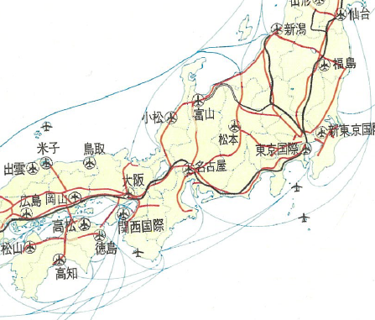
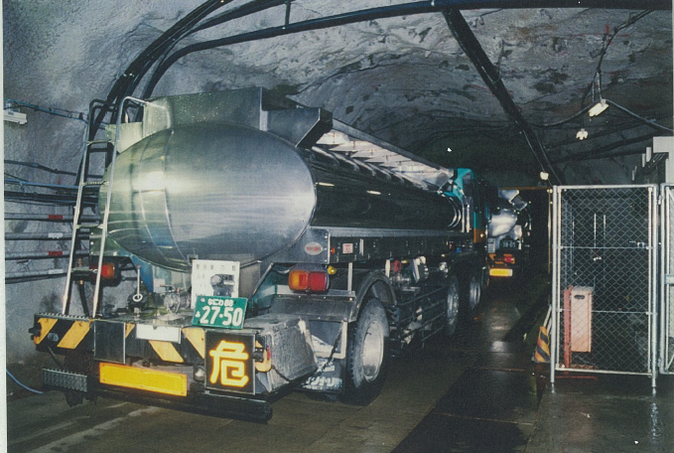
from Europe
The LS was blended on site by us.
1.8 ton PPO
1,000m³ P250
(80x12m³ tank truck)
240m³ PC
(120x0.2m³
s.s. drums)
1,800m³ N12
(150x12m³ tank truck)
We cleaned inside the lorry tanks

Slide 31
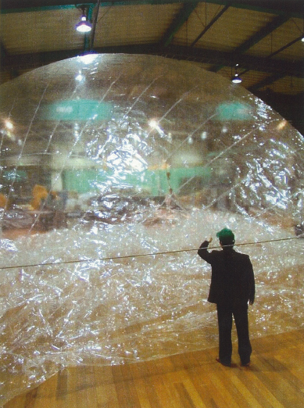
II. R&D of 1200 m³ Balloon
Real Size
Prototype Balloon

Slide 32
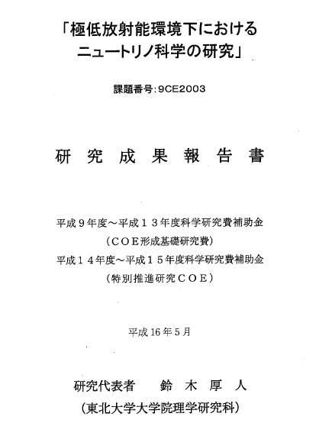
II. R&D of 1200 m³ Balloon
Reference: Achievement Report by Prof. A.Suzuki (2004)

Slide 33
Design Requirements for balloon
(1) Size: 13mφ (slightly teardrop shape) (V=1,200m³)
(2) Strength: 1cm head pressure +Δρ (0.3%)
(3) Oil tolerance: Compatible with LS and BO
(4) Transparency: >90% for λ=400nm
(5) Radio purity: <0.1Hz /m² γ(Ε>1MeV)
(= <1Hz @ fiducial (r<5.5m) in LS)
(6) Gas permeability: ρ_{Rn}(in)/ρ_{Rn}(out) <10⁻⁴
(7) Oil leakage: <20m³/year
(8) Lifetime >5 years

Slide 34
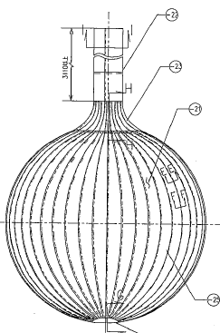
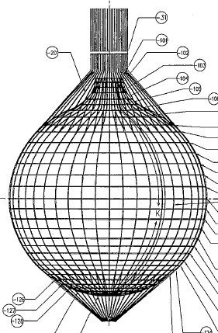
Film and Net structure
The central part of the balloon is
made of 44 lens-shaped films.
Kevlar braid ropes surround
the balloon and hang and fix the
position
44 panels

Slide 35
Film
Film: 5-layers 135μm thick (Nylon(ON)+EVOH(XL)) films
H
H
H
H
EVOH
-C-C-
-
-C-C-
H
H
n
H
OH
m
XL(15μm)/ON(25μm)/ON/ON/XL
135μm
Multilayer film:
Pros.➔ * Design freedom, * Avoid pin-hole
Cons.➔ * Tests are needed for glue of lamination
* Dust contamination between the films

Slide 36
Our Magic Film : Ethylene Vinyl Alcohol (EVOH)
H
H
H
H
-C-C-
-
-C-C-
H
H
n
H
OH
m
* As strong as Nylon.
* However, the max. thickness = 15μm ➔ multi layer film
* Better transparency than Nylon,
* Good oil compatibility.
* Very good gas barrier (Rn protection)
* RF welding possible
* Good hygroscopicity ➔ antistatic ➔ prevent dust collection
 |  | EVOH | Nylon | Polyethylene
Parameter | unit | EF-XL (Kuraray) | ON | LDPE
Tensile Strength | kg/mm² | 21 | 20 | 2
Young modulus | kg/mm² | 360 | 170 | 15
Gas Parmiability (N₂) | cc m/m²/day/atm | 0.001 | 0.2 | 4~8
Melting Temp. | deg C | 181 | 220 | ~110
Oil Compatibility | hrs (JIS Z 1515) | infinite | infinite | 20
Transparency | λ=420nm, 0.1mmt | 92% | 80% | 90%
Hygroscopic | % | 2.8 | 4.0 | 0.2
Microwave absorption |  | Yes | No | No
Molecular Structure |  | [CH₂CH-OH] | [CO-(CH₂)₅-NH] | [CH₂CH₂]

Slide 37
Our Magic Film : Ethylene Vinyl Alcohol (EVOH)
H
H
H
H
EVOH
-C-C-
-
-C-C-
H
H
n
H
OH
m
Item | Unit | EF-XL | ON | LDPE
 |  | EVOH | Nylon | Polyethylen
tensile strength | kg/mm² | 21 | 20 | 2
Young's modulus | kg/mm² | 360 | 170 | 15
hygroscopicity | % | 2.8 | 4.0 | 0.2
gas permeability | cc/m²/day/atm (O₂) | 0.3 | 50 | 2700
Oil Compatibility | hrs (JIS 2 1515) | Infinite | Infinite | 20
melting temp. | deg C | 181 | 220 | ~110
transparency | l=420nm, t=0.1mm | 92 | 80 | 90
RF welding |  | Yes | No | No
 |  | EVOH | Nylon | Polyethylene
Parameter | unit | EF-XL (Kuraray) | ON | LDPE
Tensile Strength | kg/mm² | 21 | 20 | 2
Young modulus | kg/mm² | 360 | 170 | 15
Gas Parmiability (N₂) | cc m/m²/day/atm | 0.001 | 0.2 | 4~8
Melting Temp. | deg C | 181 | 220 | ~110
Oil Compatibility | hrs (JIS Z 1515) | infinite | infinite | 20
Transparency | λ=420nm, 0.1mmt | 92% | 80% | 90%
Hygroscopic | % | 2.8 | 4.0 | 0.2
Microwave absorption |  | Yes | No | No
Molecular Structure |  | [CH₂CH-OH] | [CO-(CH₂)₅-NH] | [CH₂CH₂]

Slide 38
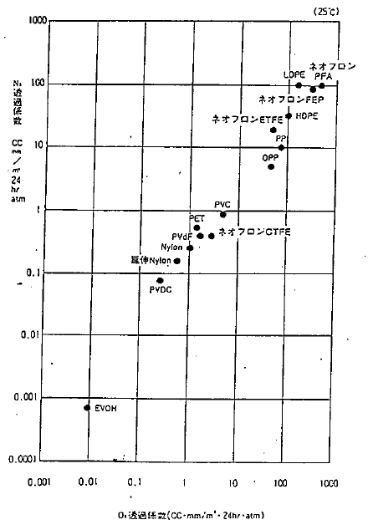
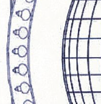
Good Gas barrier property of EVOH
➔ Prevent for Rn intrusion to the LS region
U in PMT glass → Rn
→ Balloon film → LS
PE/FEP
N₂ permeability
PVC
Nylon
Rn
EVOH
O₂ permeability

Slide 39
How to join the films.
The -OH part of EVOH absorbs micro wave and heated from inside.
Sandwich another EVOH film at joining part and apply RF.
Pressure
metal
rod
RF
EVOH
Metal table
The 3 EVOH film layers melt to one.
* Heated from inside
➔ The metal rod does not damage the surface of the film
* The melting temperature of EVOH is lower than Nylon
➔ does not damage Nylon layer.
* Visual inspection of joining part possible.

Slide 40
Tests of Films
Strength tests for film material and welding part
Pulling
Creeping
repeating load/unload
Tearing
Compatibility with LS/BO
Transparency
Radioactive contamination
Rn barrier (by Stanford Univ. )
:
:

Slide 41
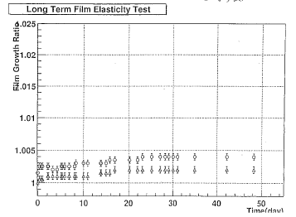
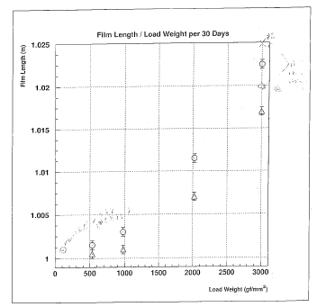
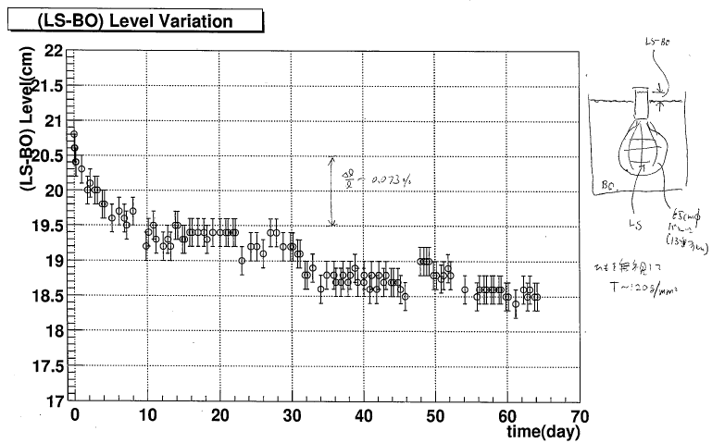
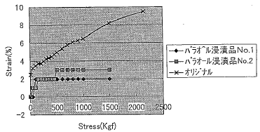
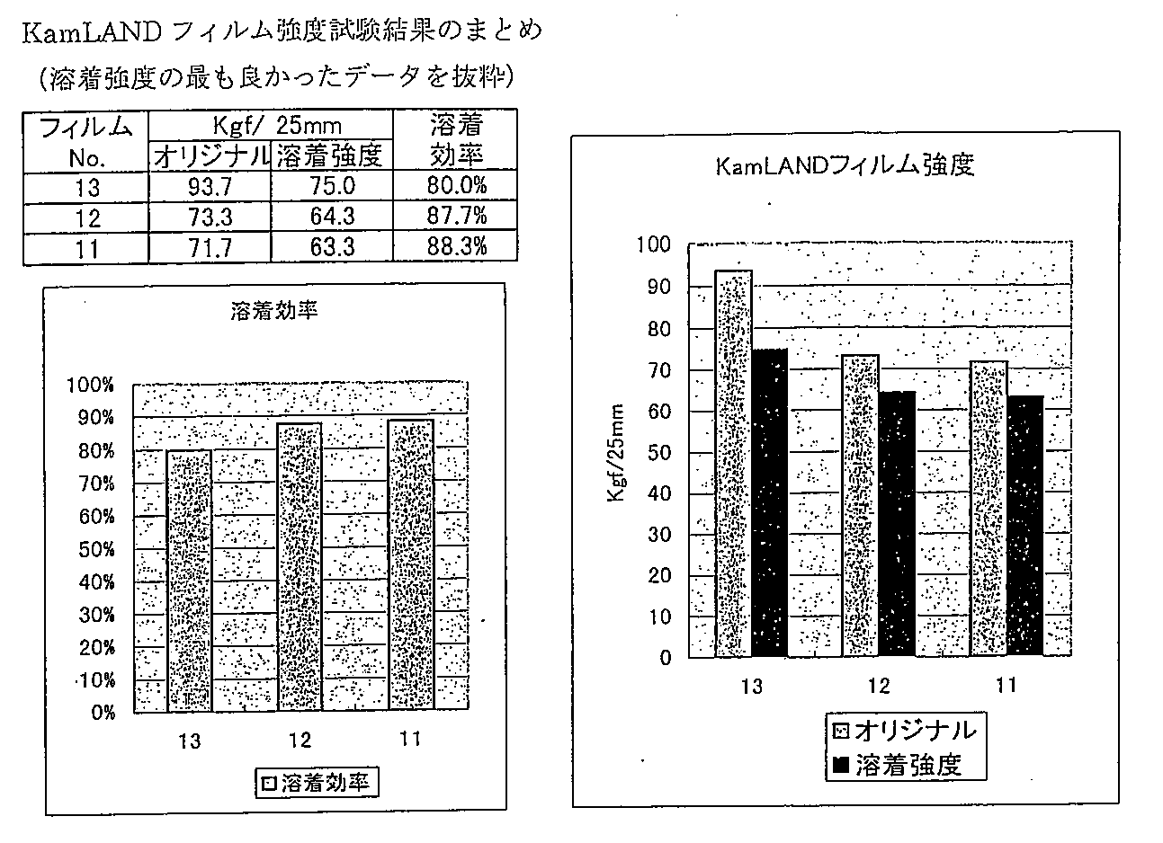
A lot of lot of tests

Slide 42
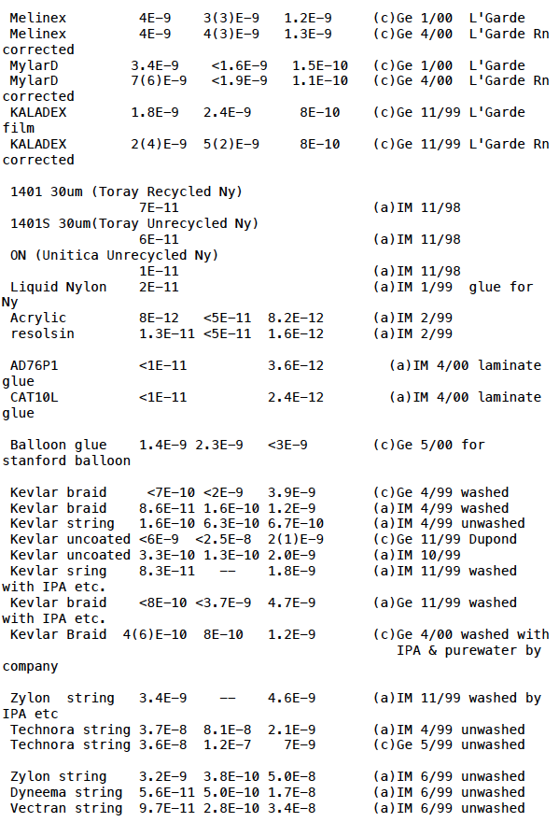
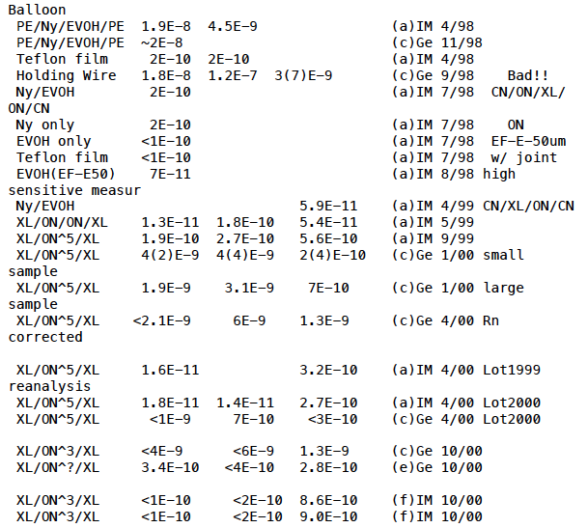
Radio contamination measurements
ICP-MS
Flame A. A.
Final film

Slide 43
9 test balloons were made before real one
# | Diameter (scale) | Film configuration | Main Test Subject
1 | 90cm (1/14) | CN/ON/XL/CN | Strength test
2 | 90cm(1/14) | CN/ON/XL/CN | Used in the test bench.
3 | 65cm(1/20) | XL/ON⁵/XL | Used in the test bench. Took delayed coin. signal.
4 | 90cm(1/14) | XL 15μmt | Study of LS filling method
5 | 65cm(1/20) | XL/ON⁵/XL | Strength Test
6 | 65cm(1/20) | XL/ON⁵/XL | Long term strength test
7 | 3.25m(1/4) | XL/ON⁵/XL | ¼ scale. Water-water strength test
8 | 3.25m(1/4) | XL/ON⁵/XL | ¼ scale. Water-water strength test
9 | 13m(1/1) | XL/ON⁵/XL | Full scale. Comprehensive practice in real KL tank.
10 | 13m (Real) | XL/ON⁵/XL | Final balloon

Slide 44
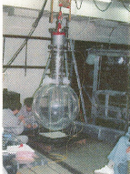
Test balloons

Slide 45
KamLAND Balloon Under Fabrication
➔ Then Installation and LS filling followed.

Slide 46
The First Result 2002.12
Front
Page
of PRL
2416 citations (as of 20/Mar./2016)

Slide 47
Conclusions
* R&D for KamLAND detector was successfully completed and
a good neutrino detector was realized. It has been in operation
for 15 years and has led several important physics results.
* When we started R&D for the KamLAND detector, we did not
know LS technology well. We owe many people for their advices
and helps.
Although this talk showed only a small part of the whole R&D
stories, I hope this could be any repay to the next large LS
detectors.

