Slide 1




Results on
Open and Hidden
Heavy Flavor
Matt Durham
durham@lanl.gov

Slide 2
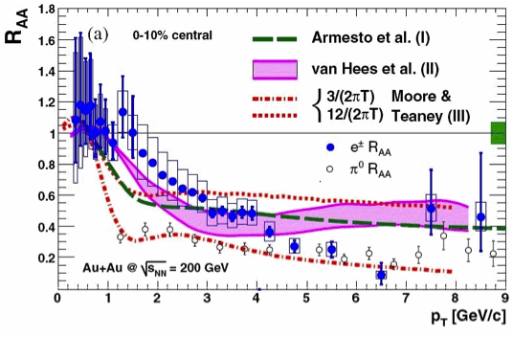
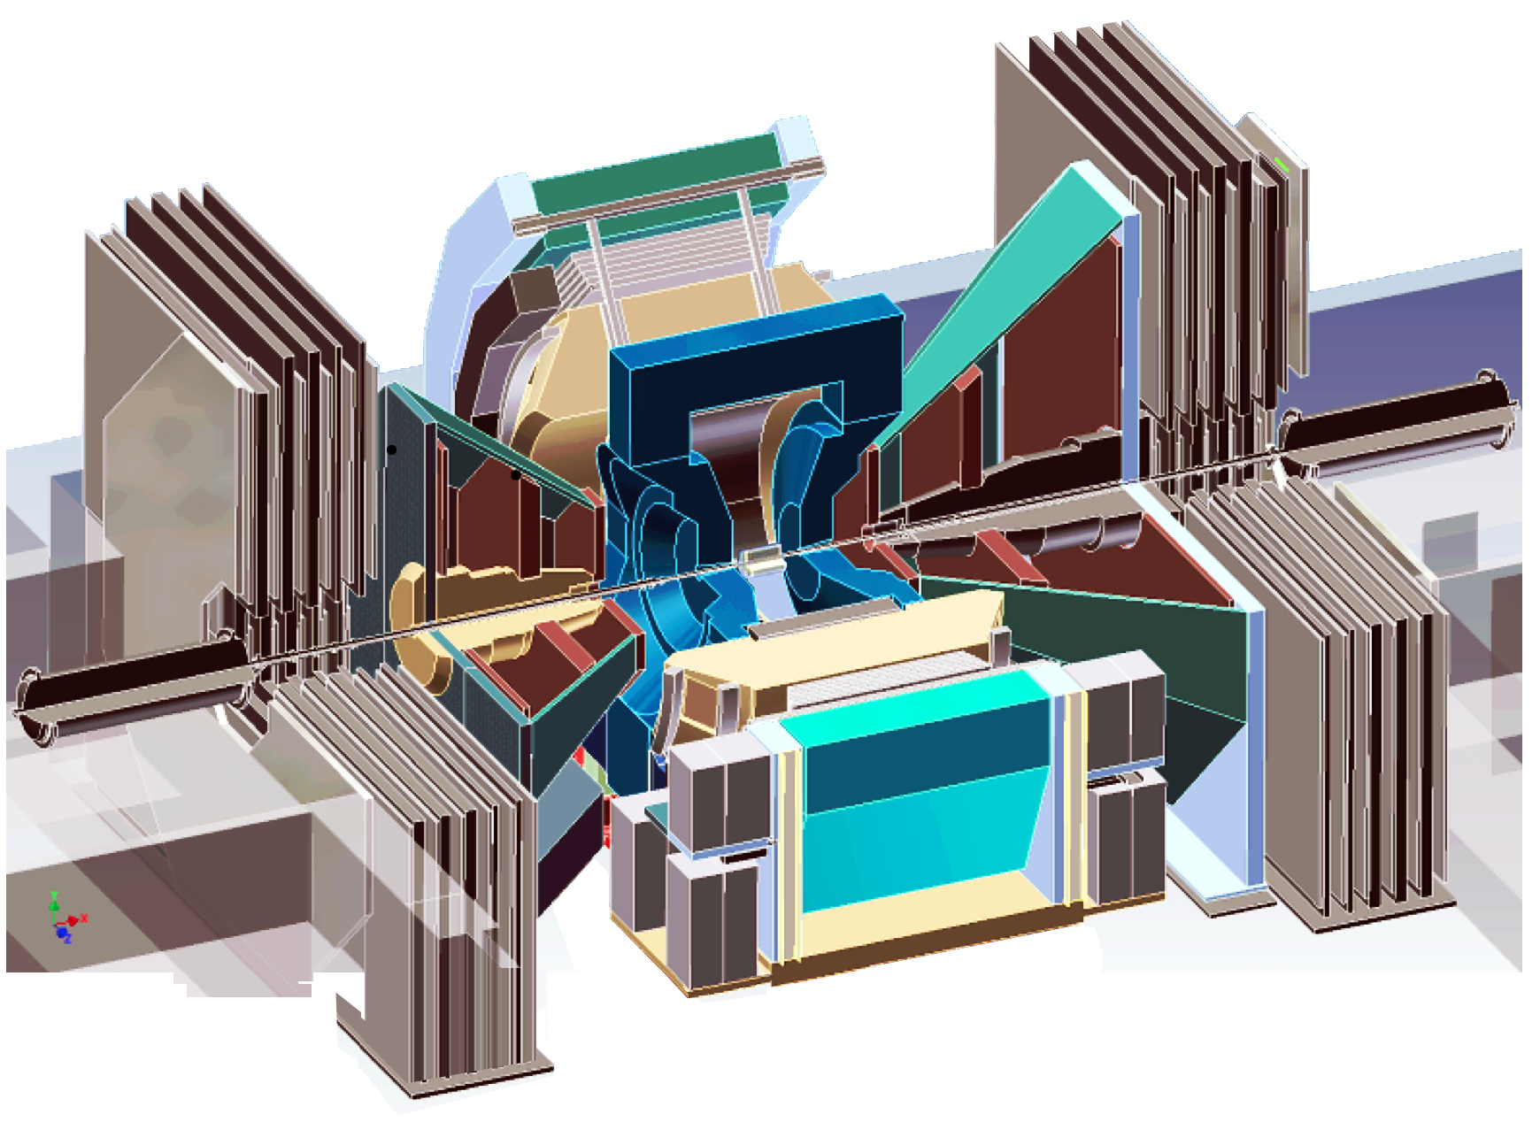
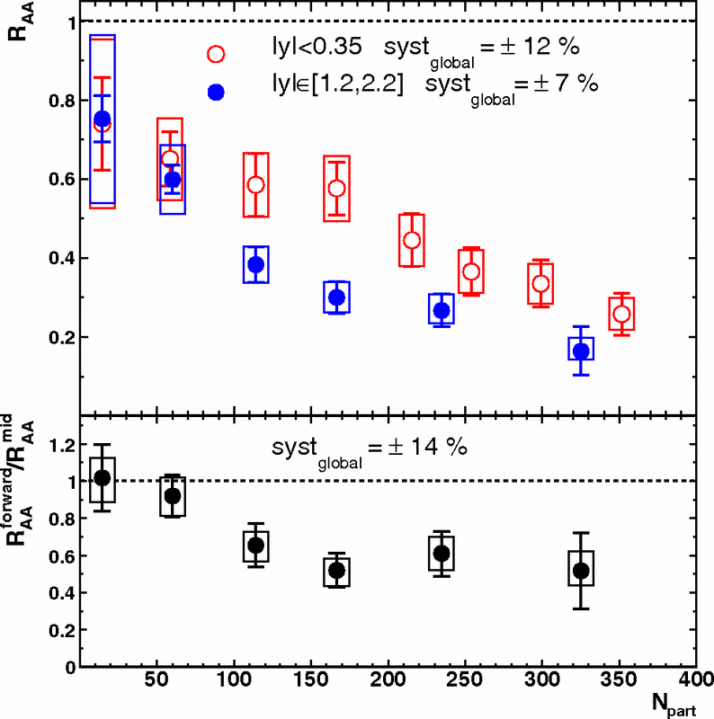
15 years of results
e
μ
μ
PRL 98 172301 (2007)
582 citations
~40 papers published on open and hidden heavy flavor production.
More currently in preparation.
PRL 98 232301 (2007)
524 citations

Slide 3
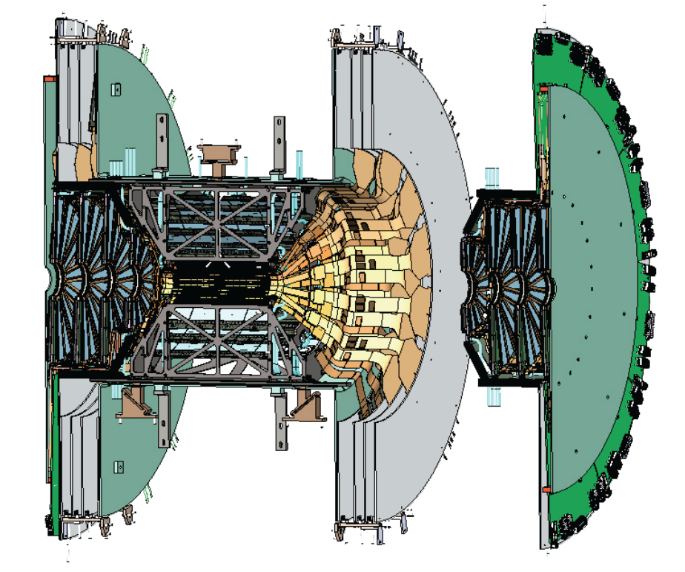
A New Era at PHENIX: Precision tracking with silicon
Midrapidity, 2011 - on: VTX provides precision DCA and vertex measurements
Finalized results on b,c suppression in Au+Au at arXiV:1509.04662
Forward, 2012 - on: FVTX gives precision tracking in front of absorber
Improved dimuon mass resolution, precision DCA measurements
Data recorded: p+p, p+Al, p+Au, ³He+Au, Cu+Au, Au+Au
Coming soon: d+Au energy scan
We have barely scratched the surface of what we can do with this new capability. Expect new heavy quark results for years to come.

Slide 4
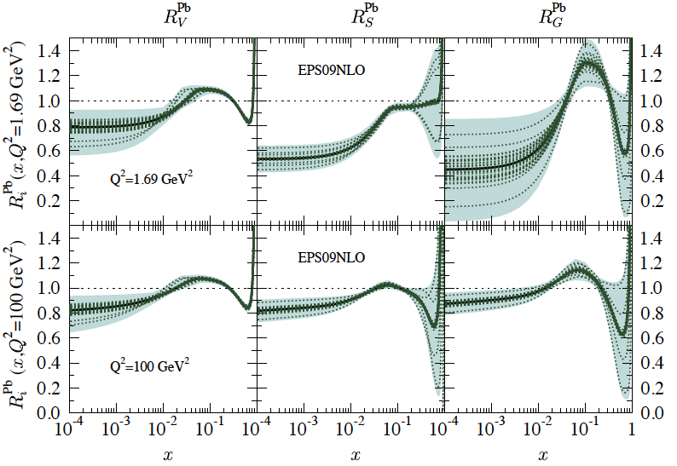
The Nuclear “Initial State”
Collisions of nuclei are inherently different from collisions of bare nucleons
Nuclear PDF is modified: S, AS, EMC, saturation?
  RHIC probes a unique crossover region in x, both shadowing and anti-shadowing regions easily accessible
  Heavy quarks especially sensitive
  to gluon nPDF

Slide 5
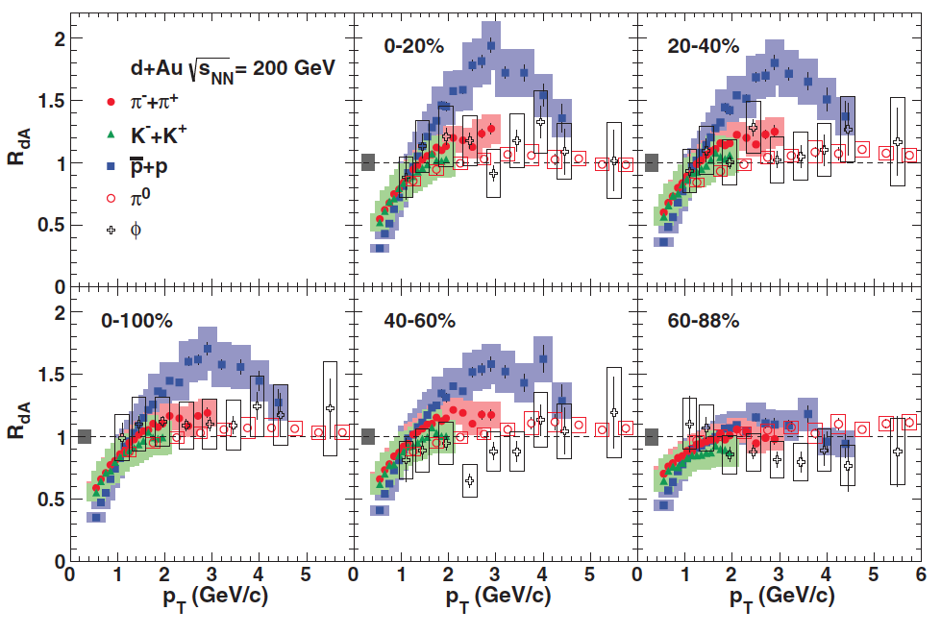
The Nuclear “Initial State”
Collisions of nuclei are inherently different from collisions of bare nucleons
Nuclear PDF is modified: S, AS, EMC, saturation?
  RHIC probes a unique crossover region in x, both shadowing and anti-shadowing regions easily accessible
  Heavy quarks especially sensitive
  to gluon nPDF
PRC 88 024906
Partonic interactions in nucleus
  kT kicks (“traditional” explanation
  of Cronin, but mass dependence?)
  Energy loss
Baryon enhancement, recombination?

Slide 6
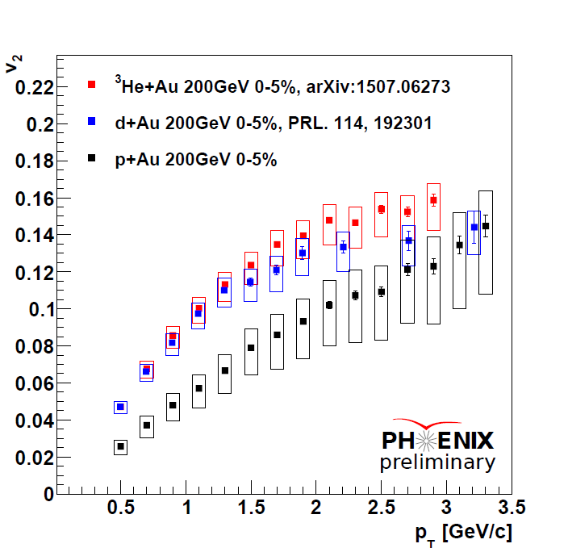
The Nuclear “Initial State”
Collisions of nuclei are inherently different from collisions of bare nucleons
Nuclear PDF is modified: S, AS, EMC, saturation?
  RHIC probes a unique crossover region in x, both shadowing and anti-shadowing regions easily accessible
  Heavy quarks especially sensitive
  to gluon nPDF
Partonic interactions in nucleus
  kT kicks (“traditional” explanation
  of Cronin, but mass dependence?)
  Energy loss
Baryon enhancement, recombination?
Phenomena which may be of hydrodynamic origin
NONE of these effects are accounted for with a p+p reference
How we can study these effects:
-Change system geometry (p+various A, d+Au, ³He+Au, Cu+A, etc)
-Look in different rapidity ranges (vary x, comover density)
-Vary beam energy (BES at RHIC, RHIC vs LHC)

Slide 7
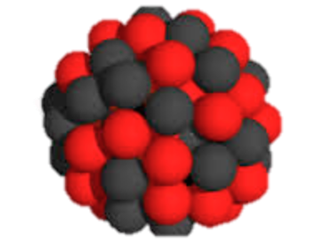

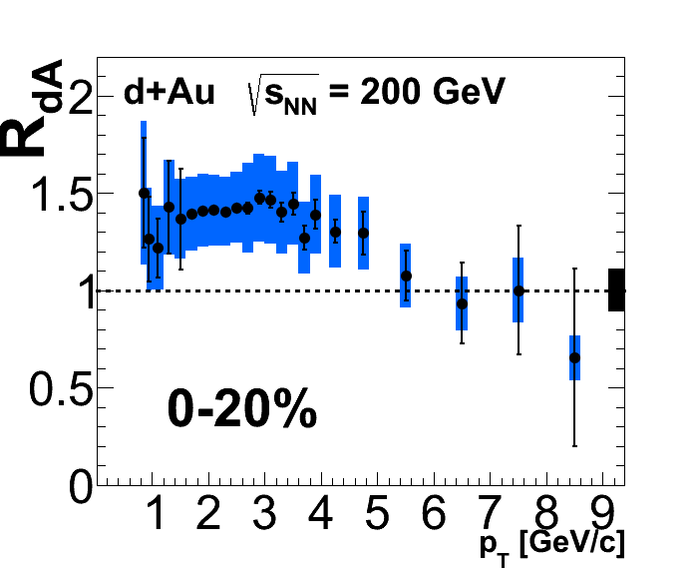
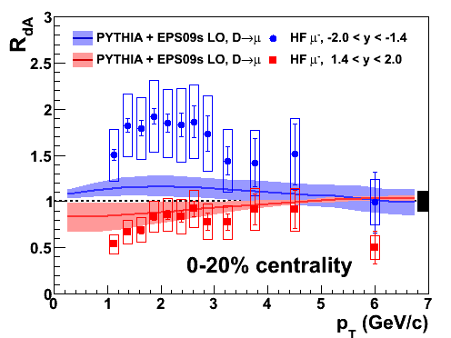
Open HF in d+Au
Familiar data, new ideas
PRL 109, 242301 (2012)
PRL 112, 252301 (2014)
No combination of modified nPDF and pT broadening can simultaneously describe all the data. Must be additional effects.

Slide 8
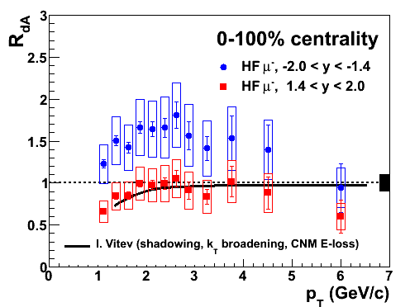
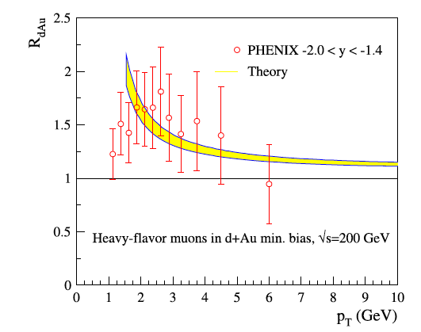
CNM Models
Kang et al, PLB 740 (2015)
Phys. Rev. C 75, 064906 (2007)
New calculation at backward rapidity also includes incoherent multiple parton scattering in nuclear medium.
->AFAIK, the only calculation that can reproduce backwards rapidity data.
Calculation includes Cronin broadening via parton scattering, shadowing, energy loss in cold nuclear matter

Slide 9
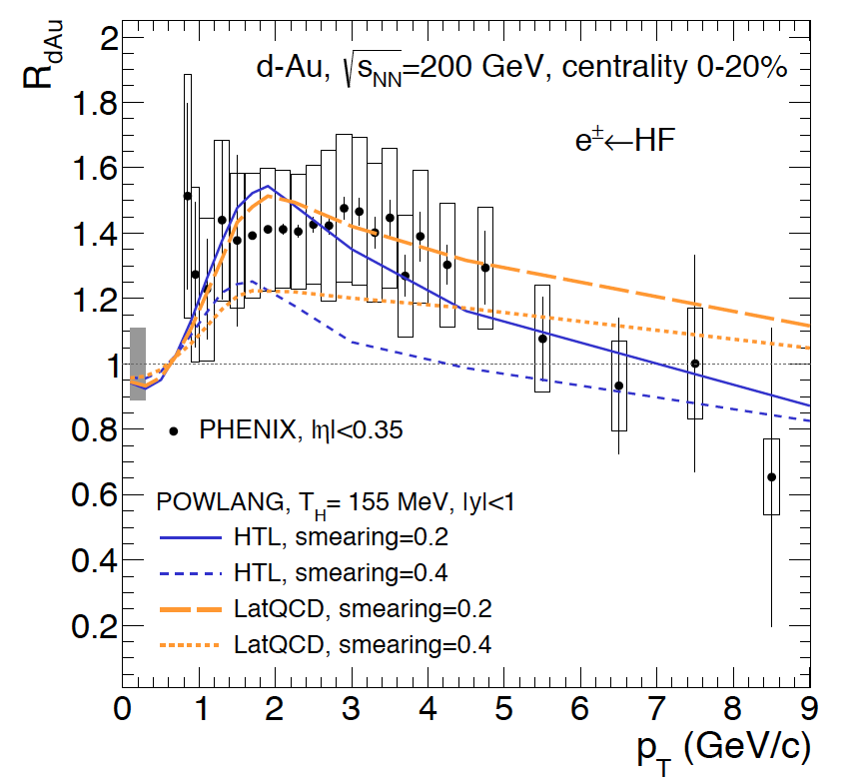
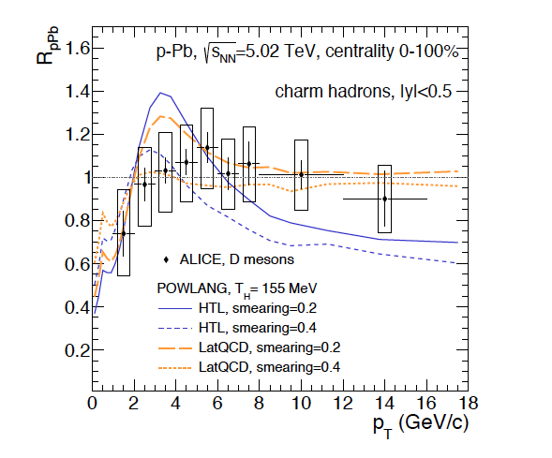
Flow Model
Beraudo et al, arXiv:1512.05186
EPS09 + kT broadening, Langevin transport in short-lived medium, with different transport coefficients.
This model also reproduces midradpidity PHENIX + ALICE data.

Slide 10
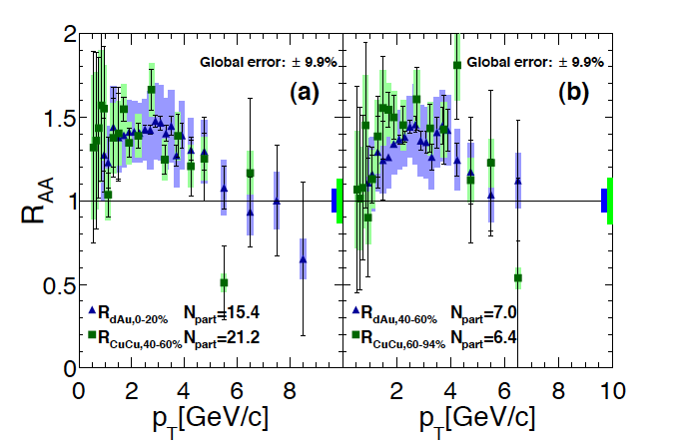


Small systems comparison
central d+Au
Peripheral Cu+Cu
Central d+Au and semi-peripheral Cu+Cu have similar Ncoll/Npart, and display same behavior of RAA
This different collision geometry could be an interesting test for flow models.

Slide 11
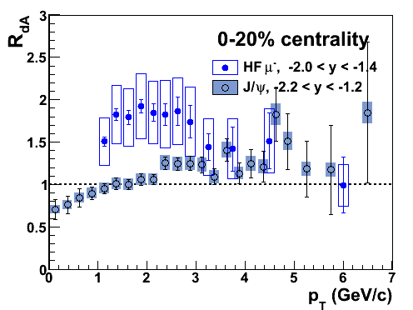
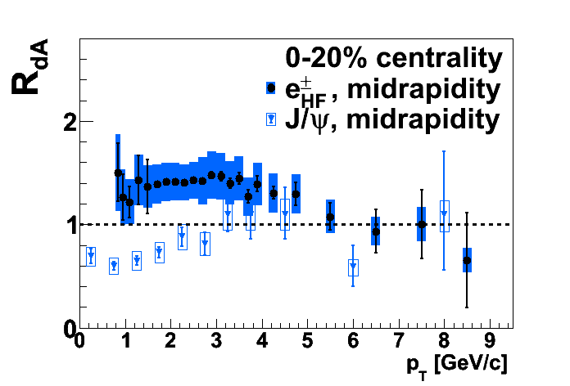
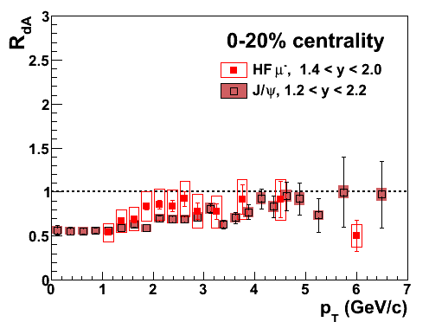
Charmonia in d+A
PRL 109, 242301
PRC 87, 034904
PRC 87, 034904
PRL 112, 252301
PRC 87, 034904
PRL 112, 252301
Mid- and backwards rapidity: DIFFERENT behavior
enhanced open HF versus suppressed J/ψ
Forward: similar behavior
-Short time in nucleus
-Low co-mover density
-Shadowing region of nPDF
Sensitive to same initial state effects: gluon shadowing, kT broadening, partonic energy loss in nucleus
Direct evidence for significant cc breakup effects

Slide 12
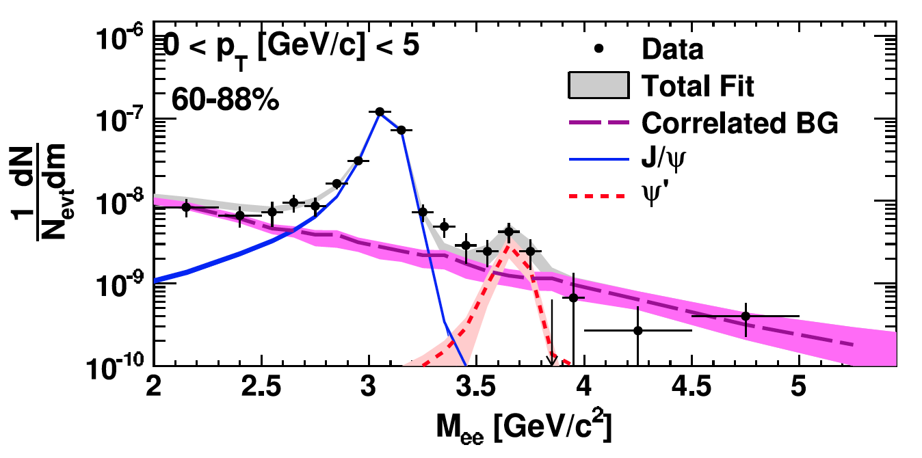
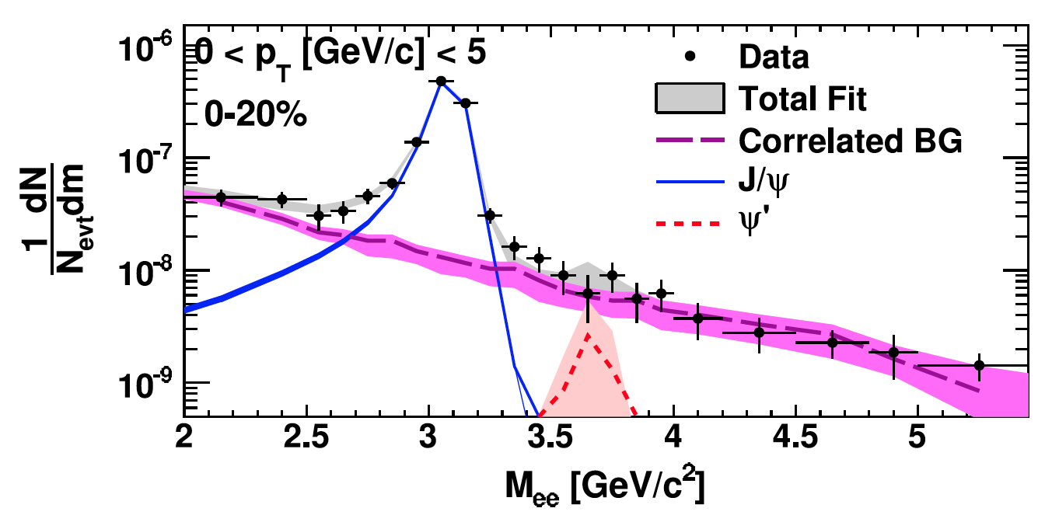
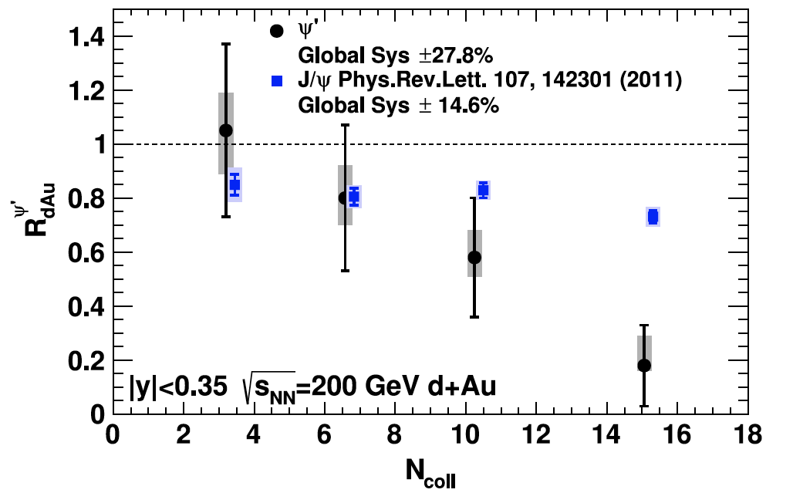
Excited charmonia: ψ(2s)
Peripheral d+Au
Central d+Au
VERY similar effects:
~identical shadowing, energy loss, etc on cc precursor pair in nucleus
Different tend and magnitude of suppression with increasing N_{coll}
->Something happening in later stages
PRL 111, 202301 (2013)

Slide 13
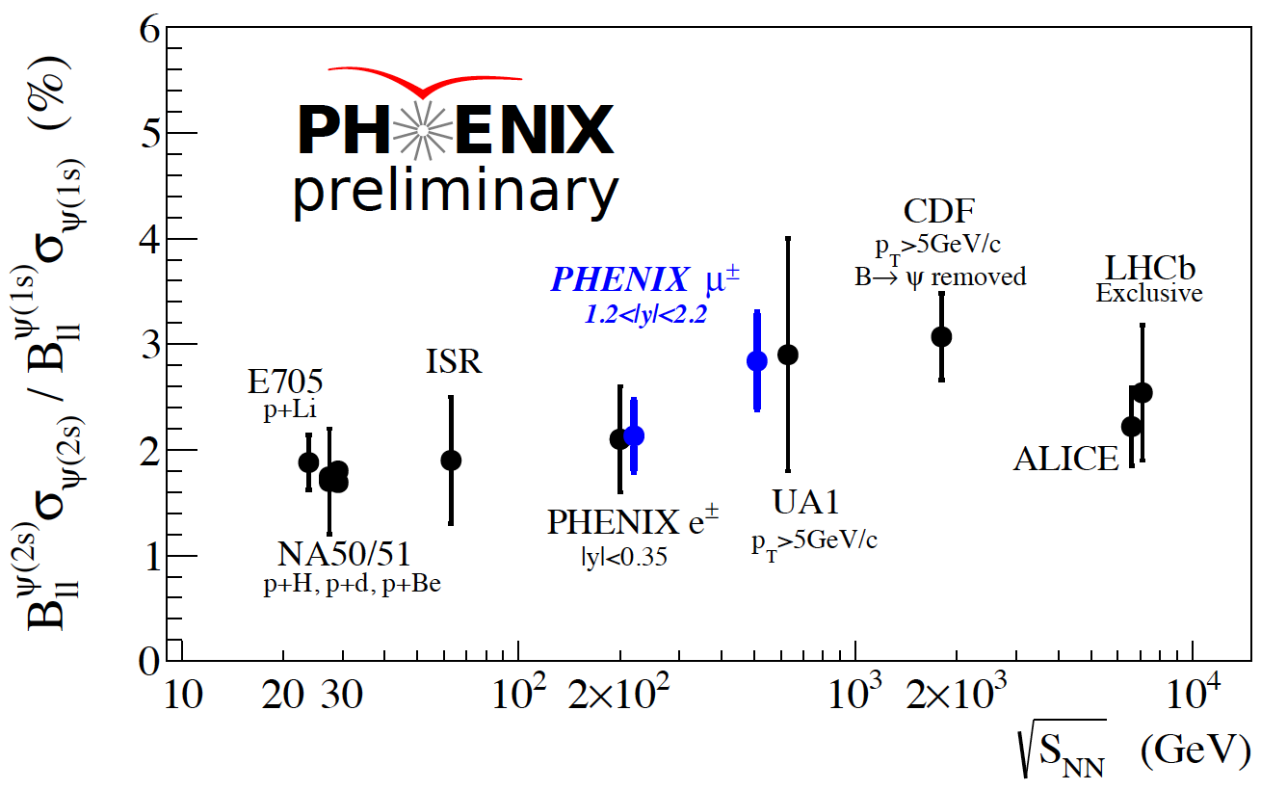
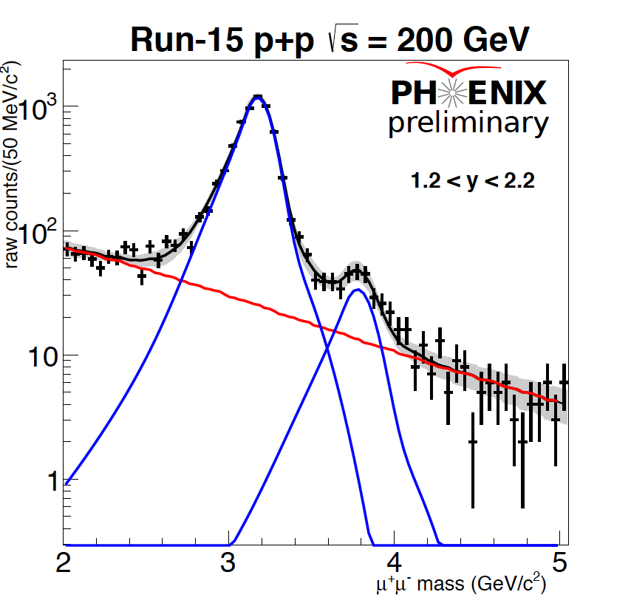
New capability:
Forward ψ(2s) measurements
FVTX: Measures dimuon opening angle in front of hadron absorber. Installed in 2012.
->Can now resolve ψ(2s) state in dimuon continuum and examine suppression at forward/backward rapidity
Consistent w/ world data

Slide 14
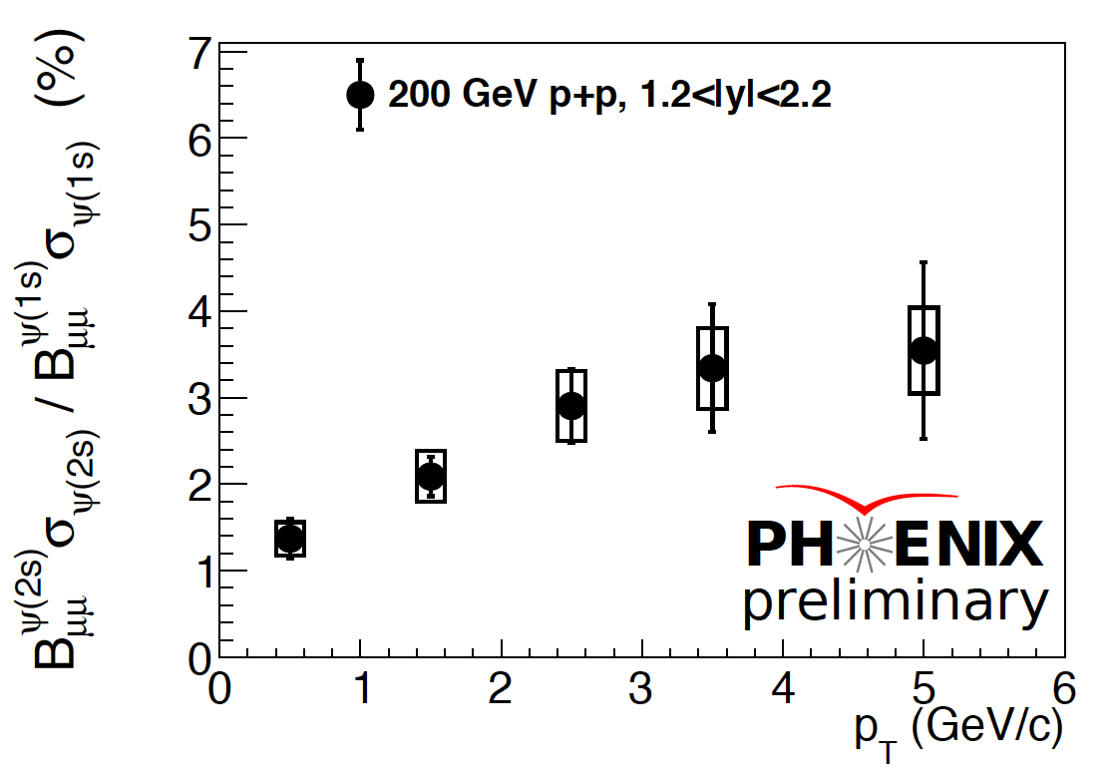
200 GeV p+p
Forward ψ(2s) measurements

Slide 15
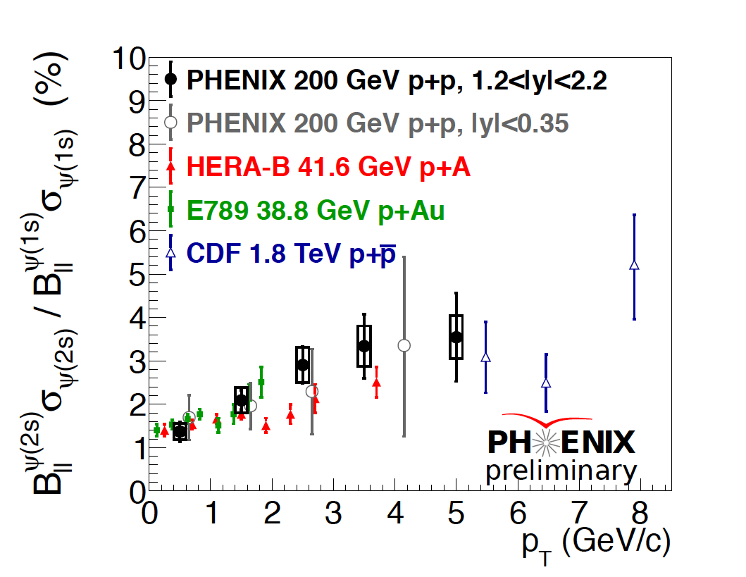
200 GeV p+p
Forward ψ(2s) measurements

Slide 16
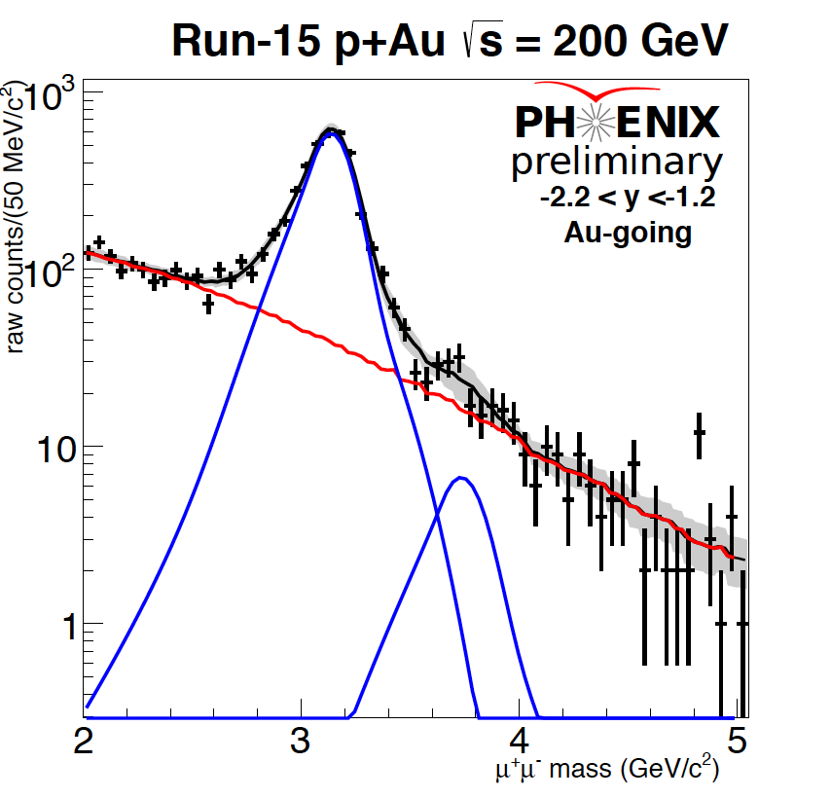
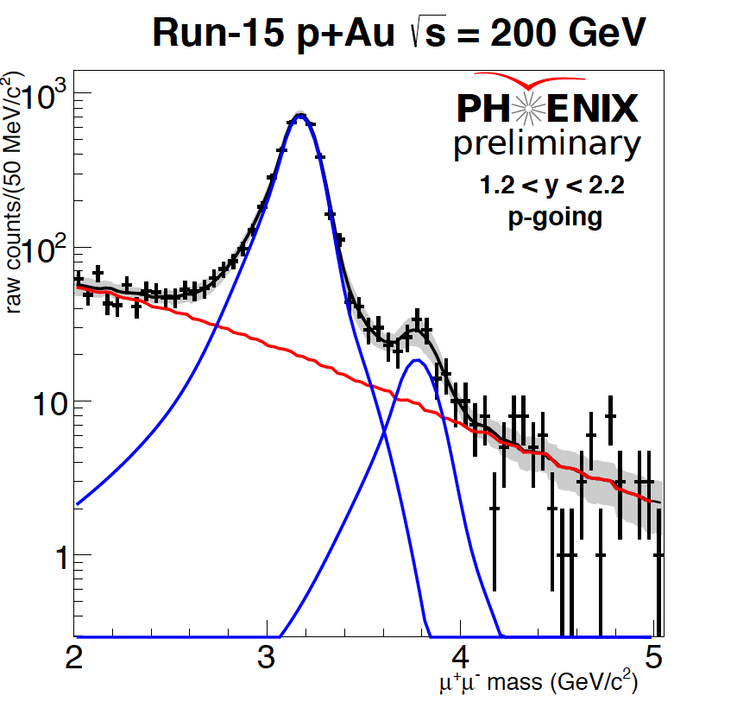
p+Au dimuon mass
Immediately apparent that ψ(2s) yields are preferentially
suppressed in Au-going direction.

Slide 17
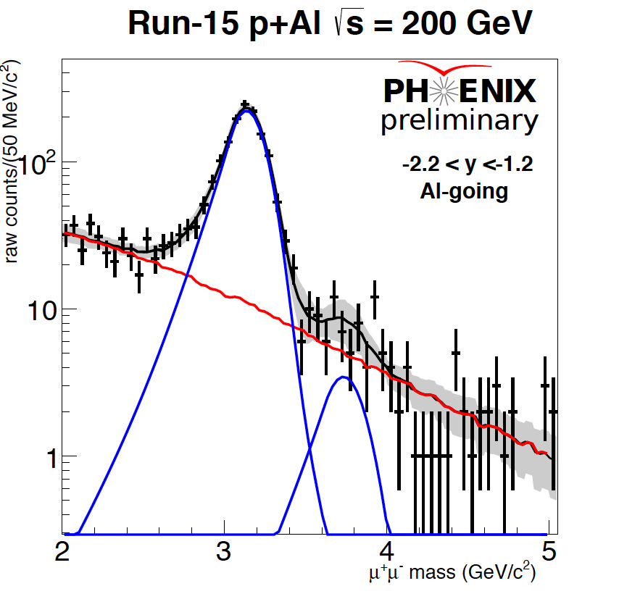
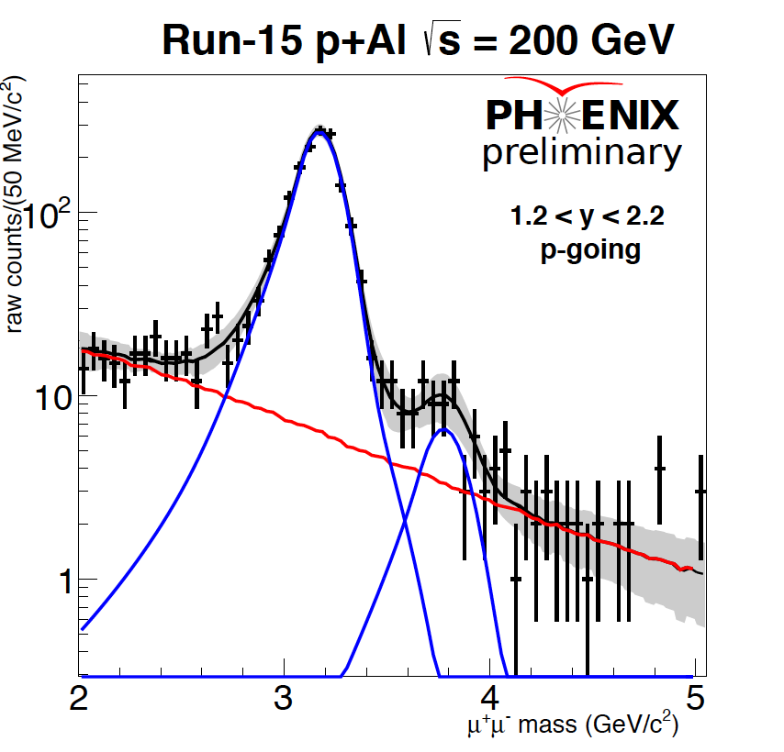
p+Al dimuon mass

Slide 18
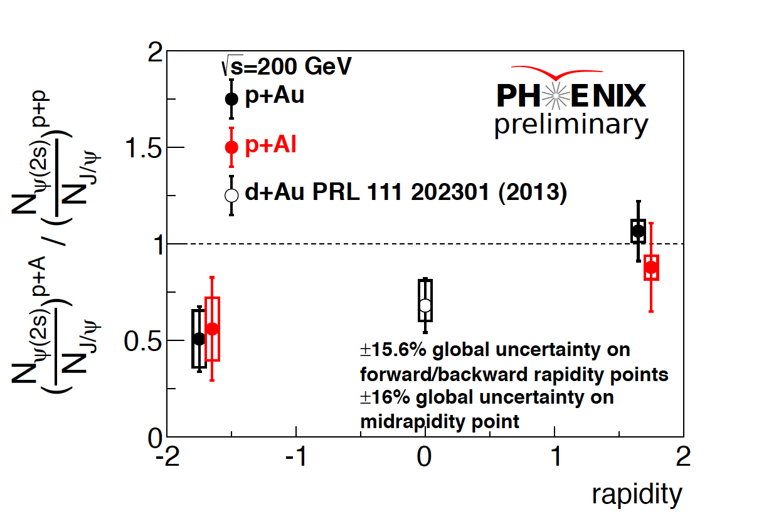
Relative suppression in p+A
Moderate J/ψ suppression.
STRONG ψ(2s) suppression.
STRONG J/ψ suppression.
Equivalent ψ(2s) suppression.

Slide 19
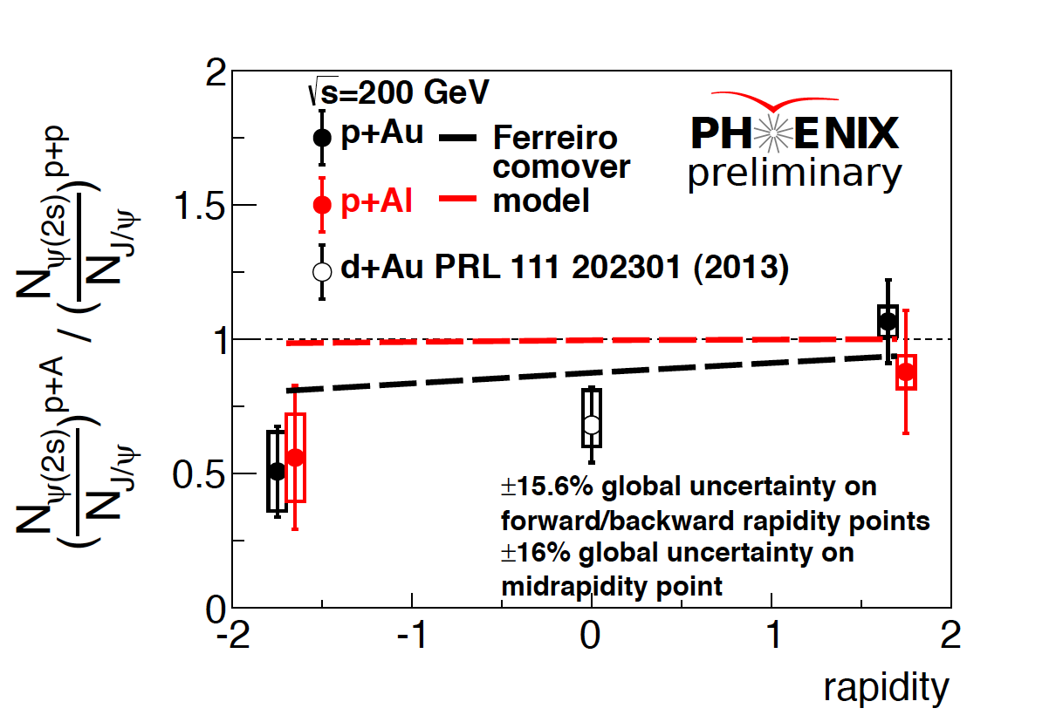
Relative suppression in p+A
Moderate J/ψ suppression.
STRONG ψ(2s) suppression.
STRONG J/ψ suppression.
Equivalent ψ(2s) suppression.
E. Ferreiro, PLB 749 (2015)
~consistent within significant statisitical uncertainties with comover dissociation model

Slide 20
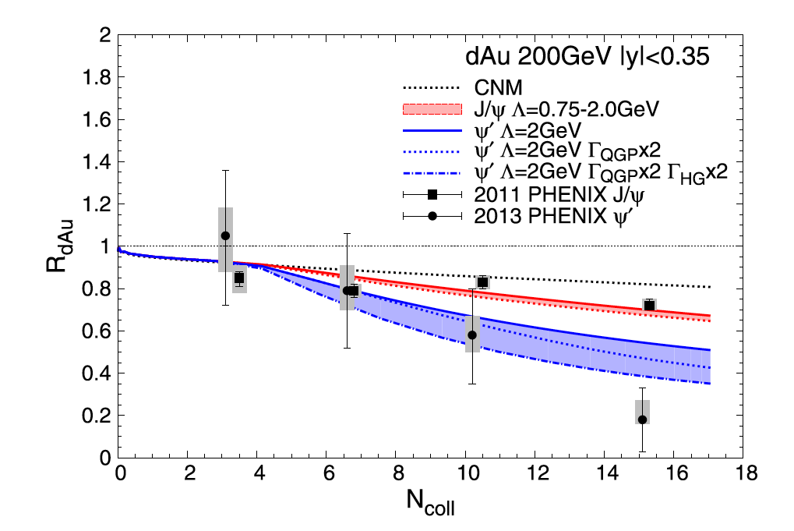
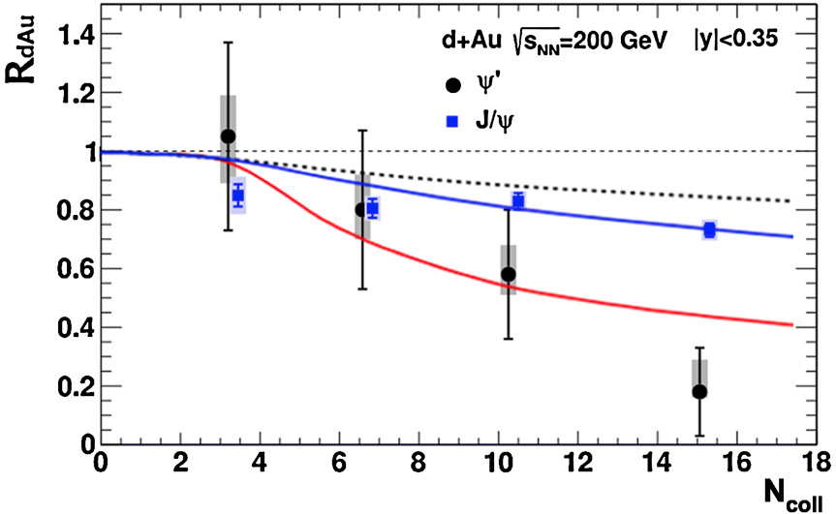
Model comparisons
(midrapidity data)
Ferreiro PLB 749 (2015)
PHENIX data from PRL 111, 202301 (2013)
Du, Rapp NPA 943 (2015)
Ferreiro co-mover model ~consistent with mid, backward, and forward rapidity p(d)+Au data.
New calculation allows for short QGP phase in central collisions + hadron resonance gas.

Slide 21
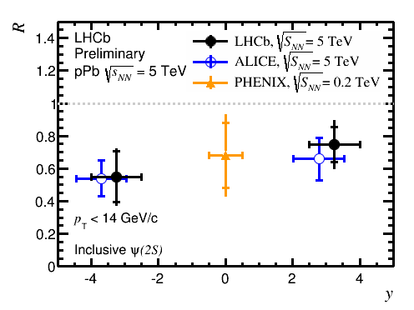
Comparison with LHC
LHCb, QM15
ALICE, JHEP 12 (2014)
Similar suppression at forward and backward rapidities at LHC. Unlikely to be comovers or breakup in nucleus.
Is there an additional breakup effect? Color screening in p+A at LHC?

Slide 22
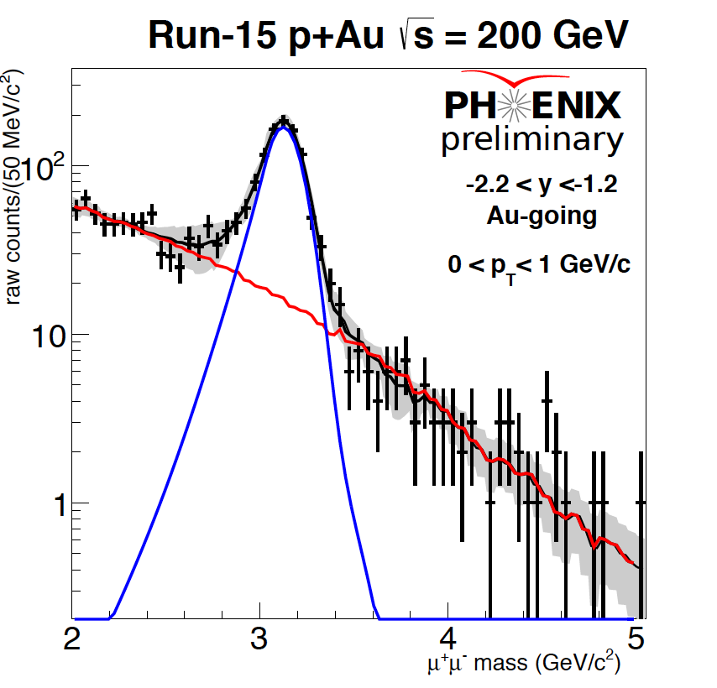
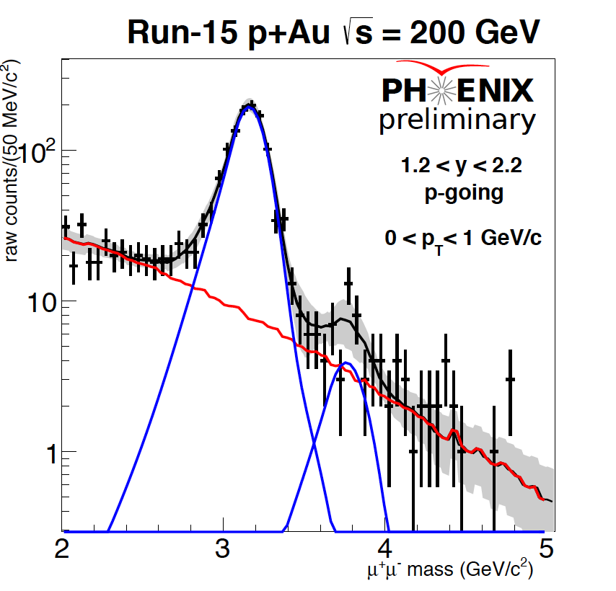
p+A pT dependence
Low pT, backwards rapidity ψ(2s) yields consistent with ZERO.

Slide 23
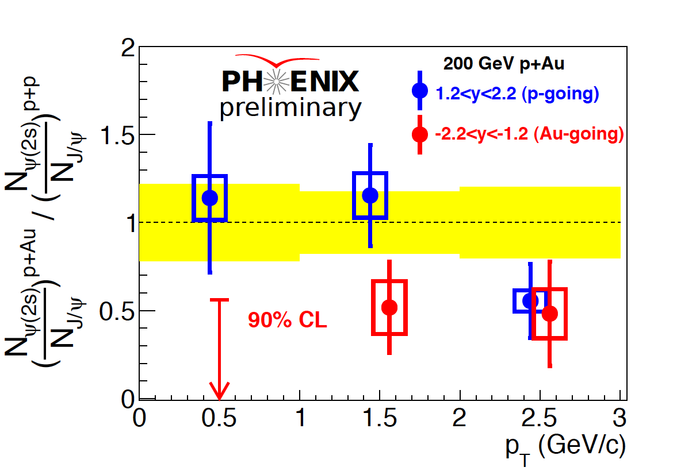
p+A pT dependence
Slowest ψ(2s) are GONE.
->Longest wavelength
->Spent the most time with soft comovers

Slide 24
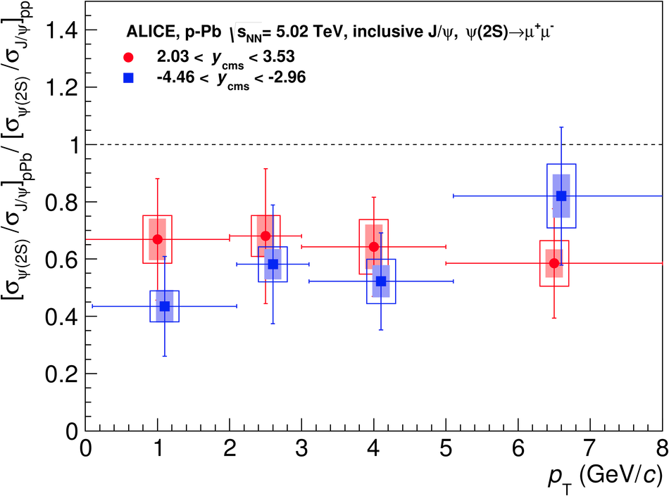
p+A pT dependence
JHEP 12 (2014) 073
Again, little difference between forward/backward at LHC, despite difference in comovers. Could imply that comover breakup is not the dominant effect at LHC energies.

Slide 25
Conclusions
A new era of heavy quark physics at RHIC is upon us.
“Final state effects” clearly play an important role, even in p+A collisions.
New models of effects due to medium formation in p+A have matched some existing heavy flavor data.
However, pure CNM models also describe heavy flavor data without invoking plasma formation in small systems.
More comparisons with other systems/rapidity ranges are necessary to more fully test various models.
Many, many more results soon to come.

Slide 26
BACKUP

Slide 27
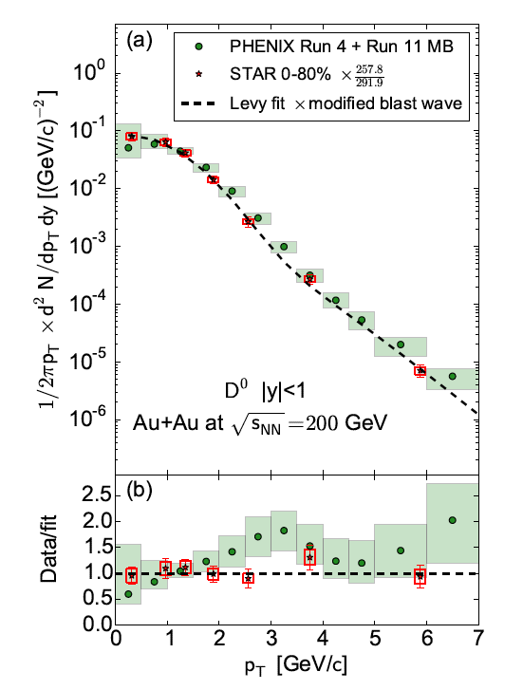
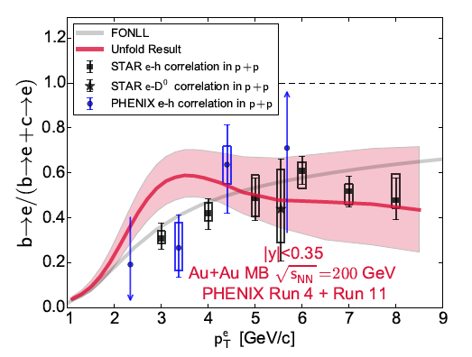
A+A separated c,b
arXiv:1509.04662

Slide 28
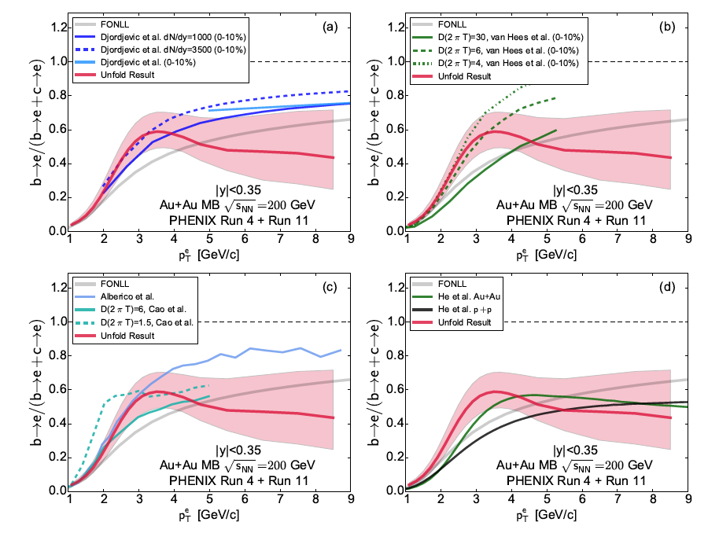
A+A separated c,b
arXiv:1509.04662

Slide 29
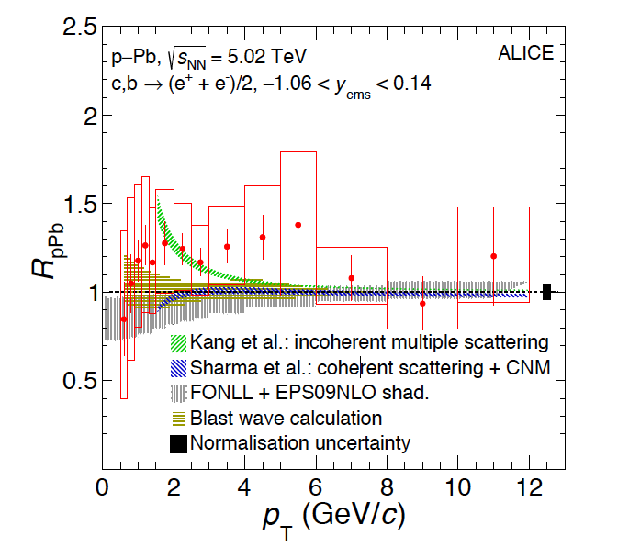
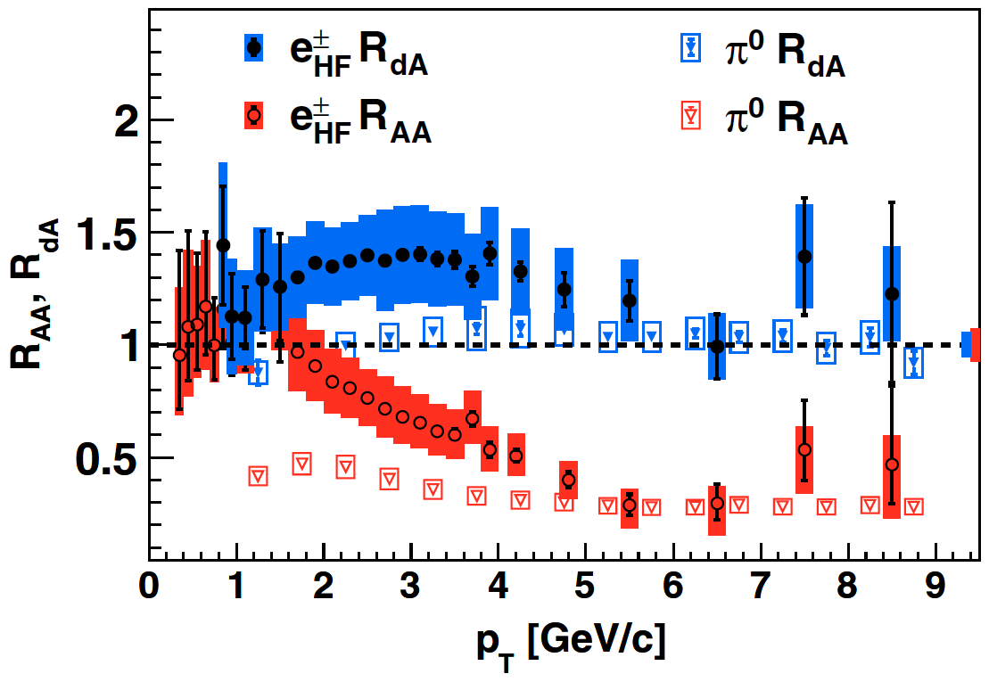
Heavy Quark Initial State
PRL 109, 242301 (2012)
1509.07491
-HF electrons at RHIC show enhancement at midrapidity in dA
-Different pattern from pi0
-Light and heavy quarks have different baseline in AA collisions
Surprise: ALICE data shows identical phenomena at LHC, despite very different x range for charm.
PDF modification is not dominant effect on charm in pA? Then what is?

Slide 31
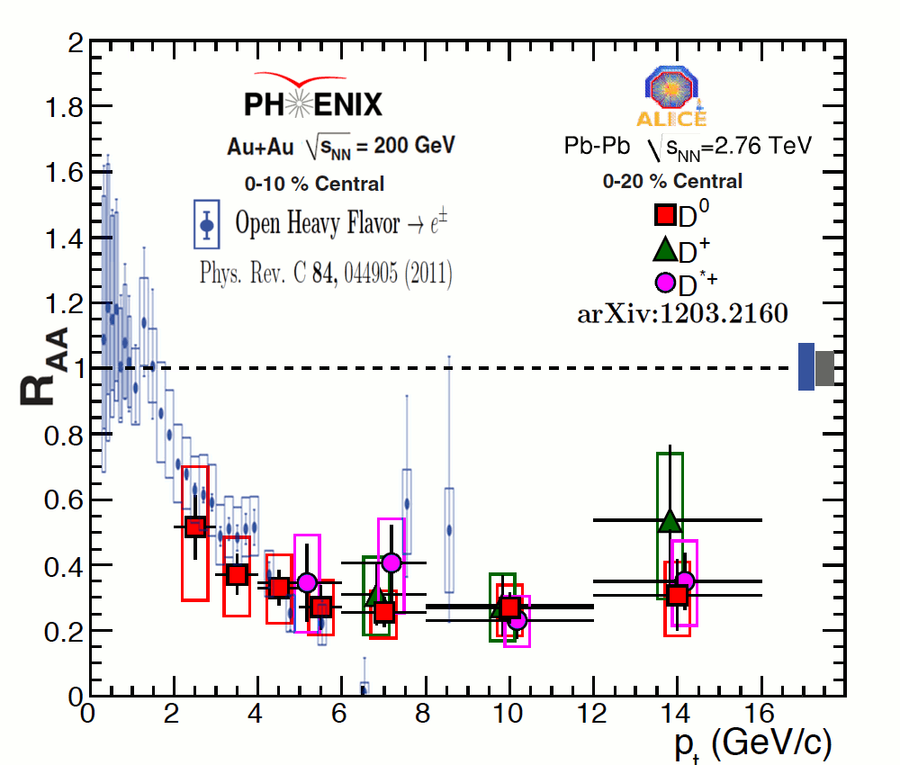
Open HF in A+A
One of the most striking results from RHIC:
Large suppression of open heavy flavor mesons
Heavy quarks produced only in initial hard scattering
Perturbative QCD techniques applicable

Slide 32
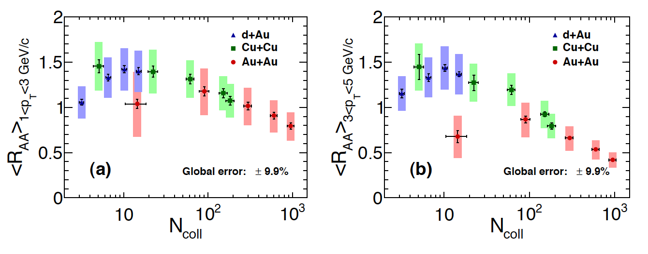
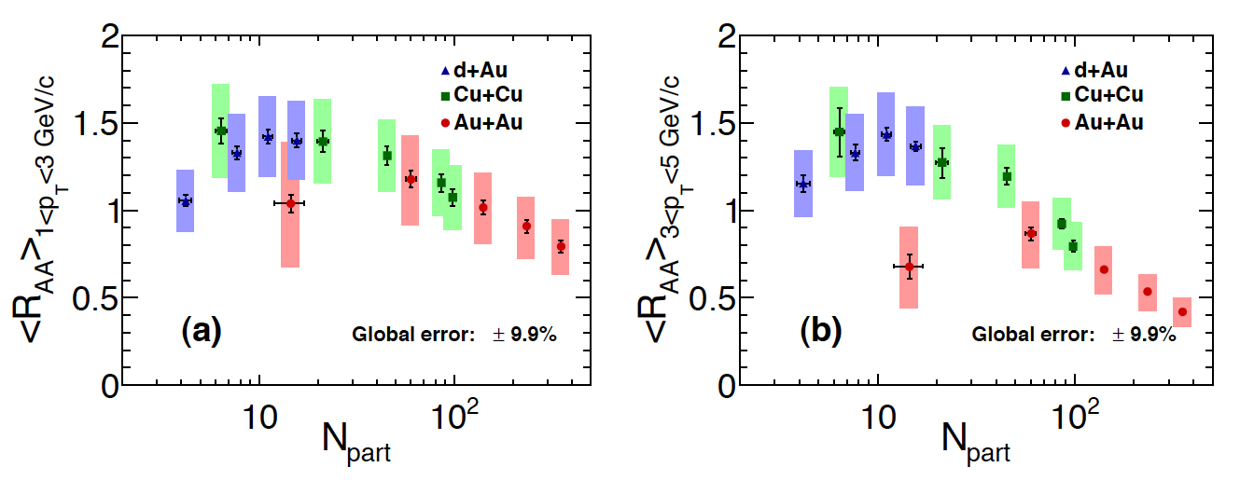
Trend across system size
arXiv:1310.8286

