Slide 1
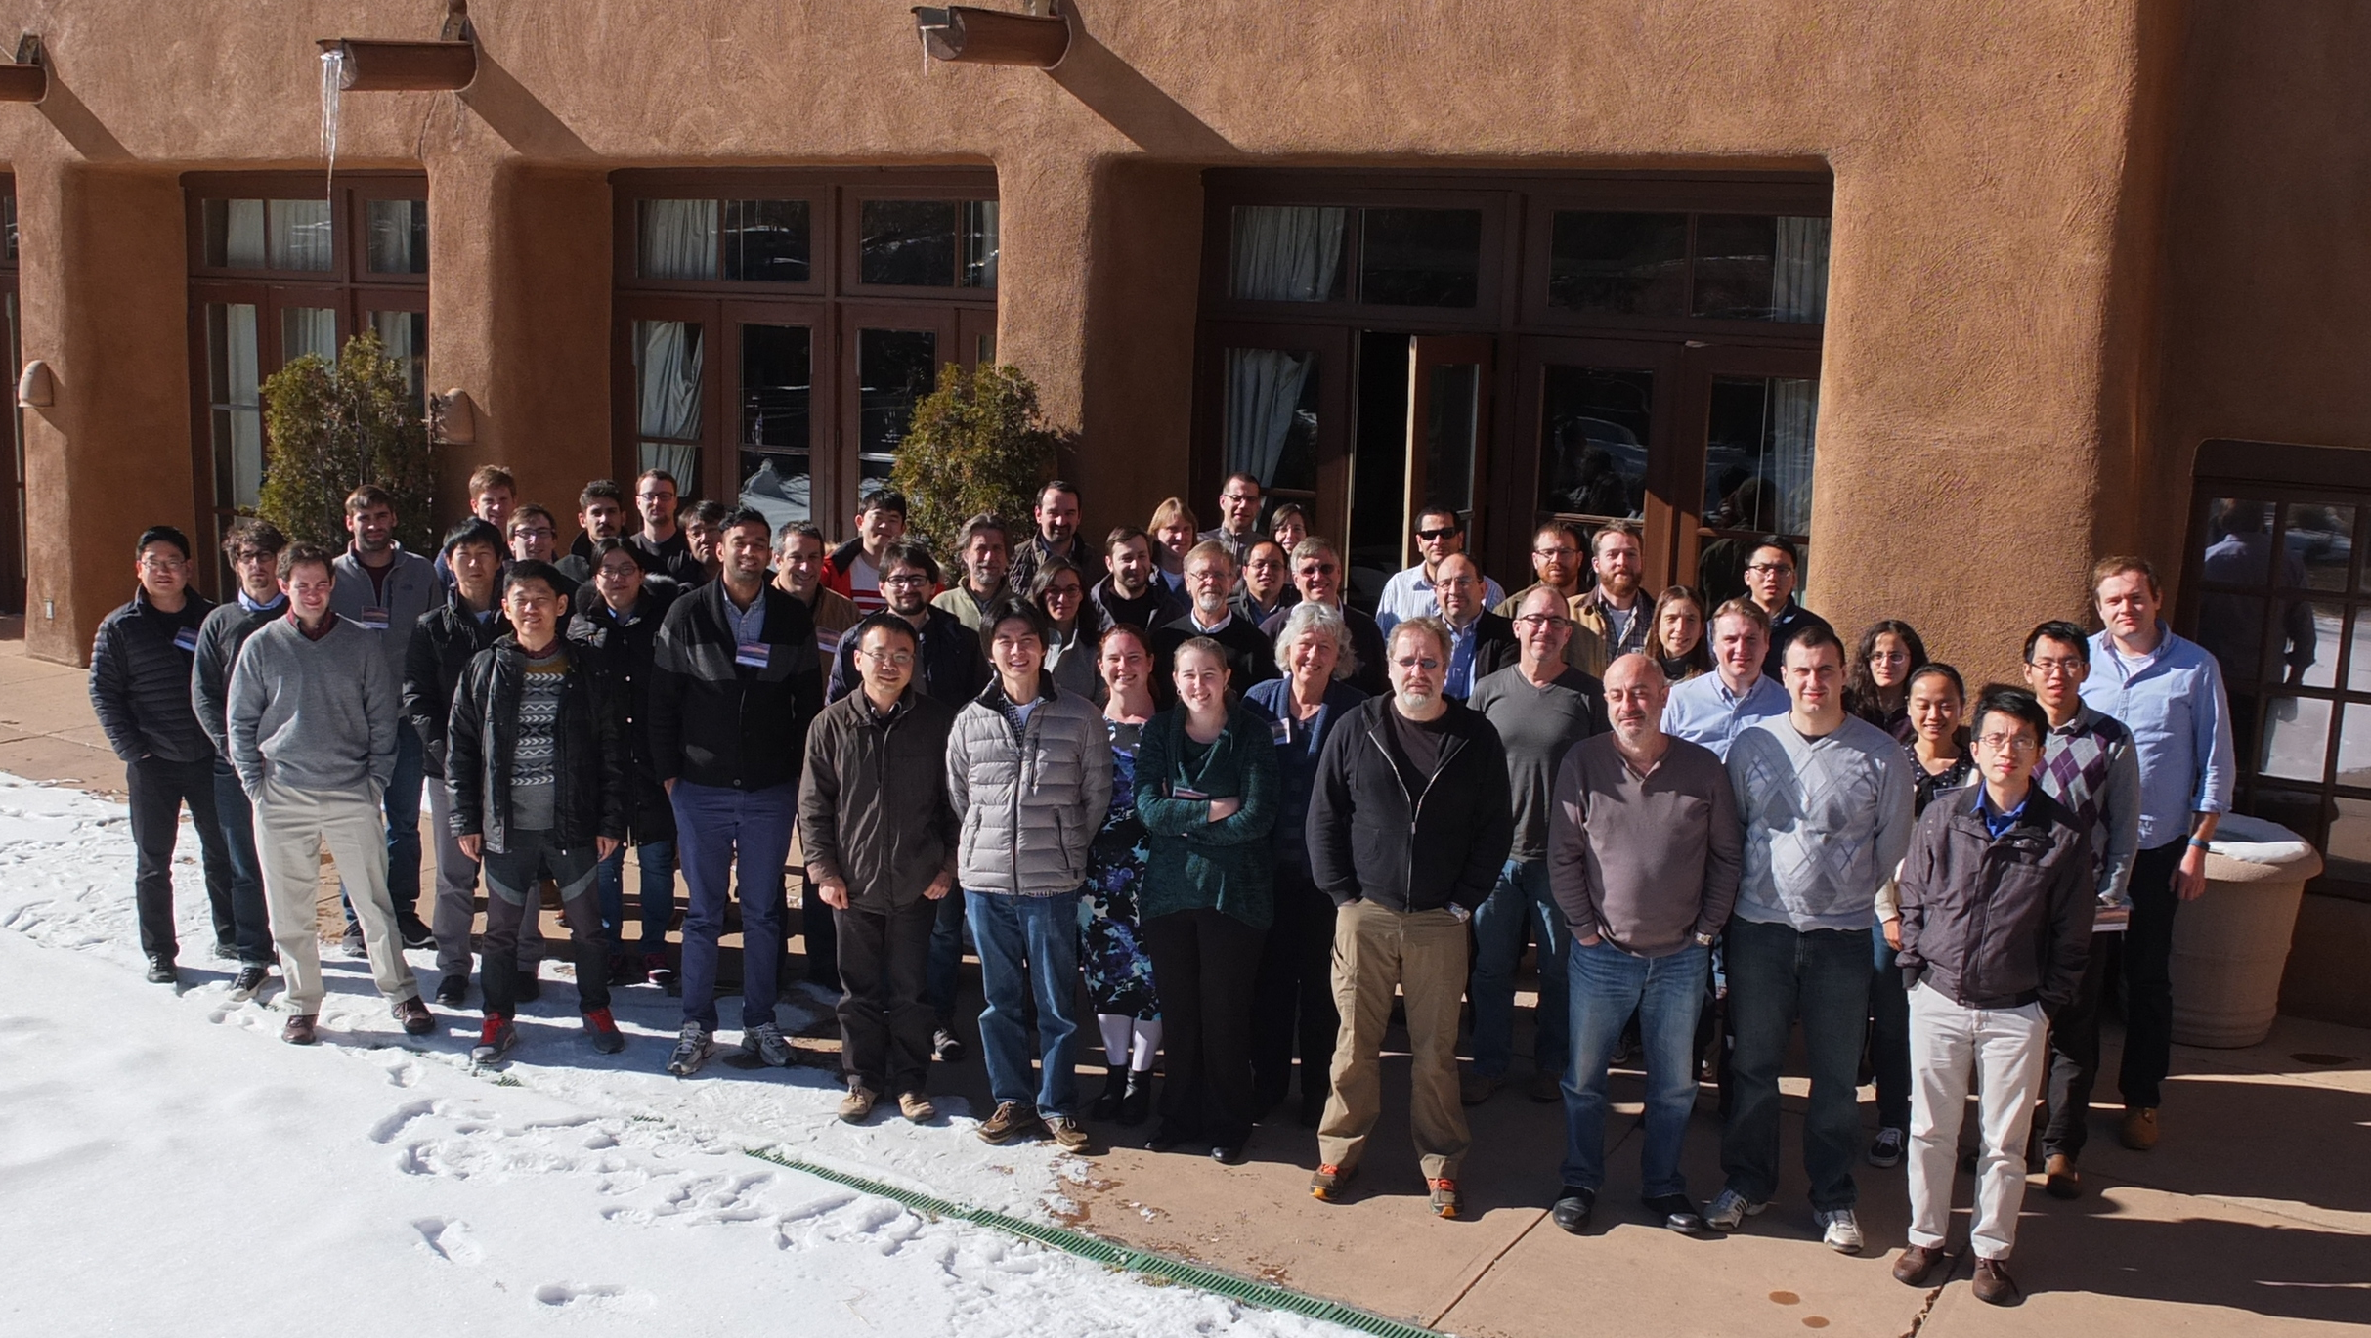
Thank you!

Slide 2
Our Intent for this Workshop
Make it a yearly workshop
Attract further participants
We look forward to seeing you again

