Slide 1
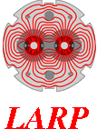

MQXF quench protection update
E. Ravaioli
with inputs from
GL. Sabbi (LBNL), G. Ambrosio, G. Chlachidze, S. Stoynev (FNAL),
V. Marinozzi (INFN), T. Salmi (TUT),
B. Auchmann, J-P. Burnet, S. Izquierdo-Bermudez, F. Rodriguez-Mateos, H. Prin, J. Rysti, E. Todesco, A. Verweij, D. Wollmann (CERN),
and many other CERN and LARP colleagues
Joint LARP CM26/Hi-Lumi Meeting at SLAC
19 May 2016

Slide 2
Outline
  Powering scheme and Quench protection system
      Circuit analysis
      CLIQ configuration
      Quench heater connection scheme
      Worst-case analysis
  Analysis of the MQXFS01 quench protection tests
      Heater minimum power density to quench (G. Chlachidze)
      Measured and simulated heater delays (G. Chlachidze, T. Salmi & S. Izquierdo-Bermudez, J. Rysti)
      Dynamic effects during the decays (G. Chlachidze, V. Marinozzi)
      Energy extraction decays
  Next steps & conclusions

Slide 3
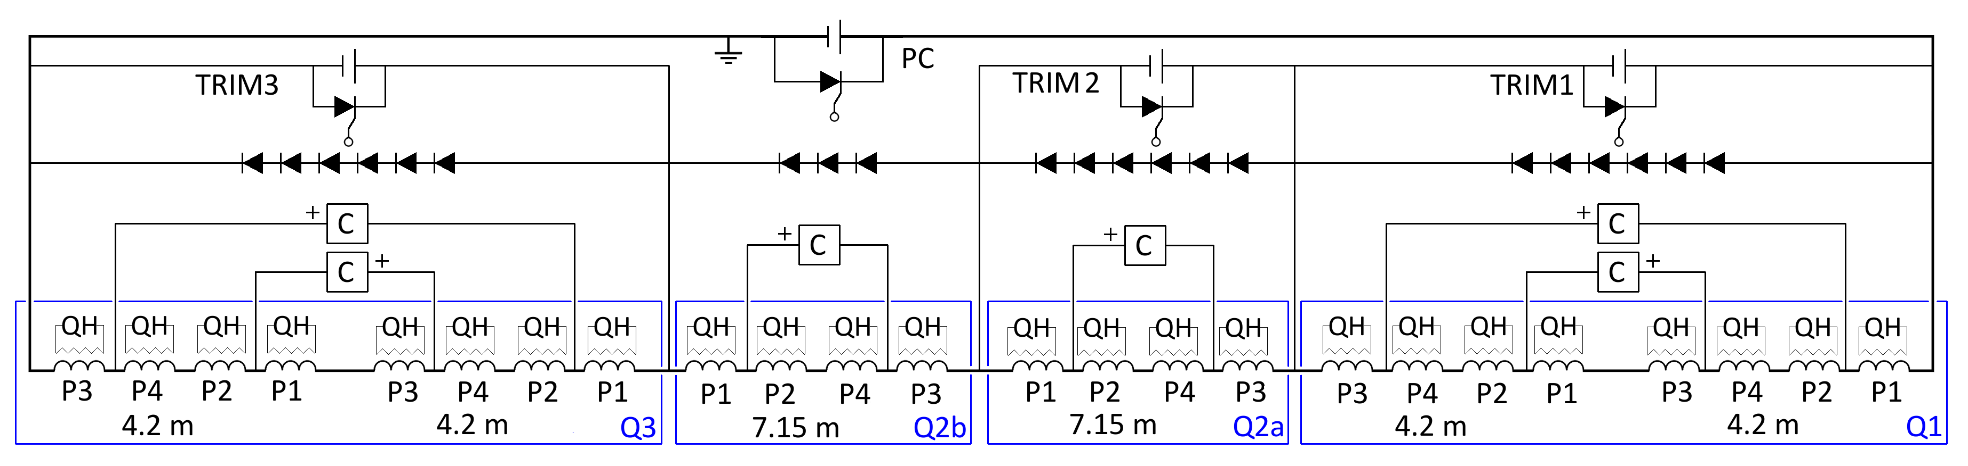
Powering and Quench protection system
Following the
Conceptual Design Review of the Magnet Circuits for the HL-LHC
(CERN, 21-23 March 2016)
POWERING SYSTEM
1 main power supply (2-quadrant)
3 trim power supplies
Parallel Diodes
MAGNETS
4x 4.2 m QXF (LARP)
2x 7.15 m QXF (CERN)
Quench protection system based on quench heaters and CLIQ is expected to provide the best solution for reducing hot-spot temperature and thermal stress, both in nominal and failure scenarios.
PROTECTION SYSTEM
CLIQ system + Quench Heater system

Slide 4
Circuit analysis
6 CLIQ units and 4 warm diode strings per triplet
AC currents
Parallel diodes only carry small current differences between magnets during the discharge
Voltages to ground just after triggering
600V
1kV
1kV
600V
600V
600V
~0
+300V
-300V
+300V
-300V
~0
+500V
-500V
~0
+500V
-500V
~0
+300V
-300V
+300V
-300V
~0

Slide 5
Simulated currents in the circuit
Q2a/Q2b
Q1/Q3
CLIQ units for Q2a/Q2b
Charging voltage: 1000 V
Capacitance: 40 mF
CLIQ units for Q1/Q3
Charging voltage: 600 V
Capacitance: 40 mF
Diodes
Hot-spot temperature T_{hot}~230 K
Currents through the SC Link (no fault case)
Main leads: Magnet current ± AC oscillations, 1.5 kA, 12 Hz
Trim leads: Their initial current + AC pulse, 500 A, 12 Hz
CLIQ
Simulations performed with TALES

Slide 6
Simulated voltages to ground
Voltages to ground and between coil sections in Q1/Q3 are 40% lower than Q2a/Q2b
Q1
Q2a
Q2b
Q3
Simulations performed with TALES

Slide 7
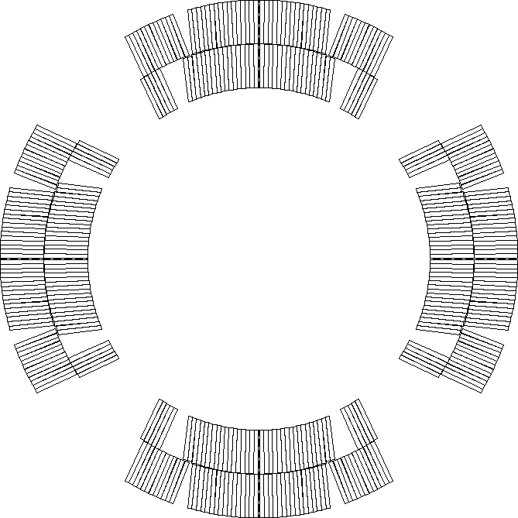
Proposed QH connection scheme
Each QH supply is connected to 2 strips in series
  Connection scheme that compensates the voltages induced by CLIQ and QH
  For inner quench heaters, option to power each strip individually (increased deposited power density, but more inner QH supplies needed, 4→8 per magnet)
LF3
LF2
HF3
HF2
HF4
HF1
IN3
IN2
LF4
IN4
IN1
LF1
Standard LHC quench heater power supply
Charging voltage: 900 V
Voltage to ground: ±450 V
Capacitance: 7.05 mF
Note: 2x 450 V, 14.1 mF modules in series
LF1
IN1
IN4
LF4
IN2
IN3
HF1
HF4
  Only a quarter of the circuits shown
HF2
LF2
LF3
HF3

Slide 8
Worst-case analysis
  The probability of particularly dangerous failure cases can be almost nullified by implementing the proposed mitigations.
  In the remaining “realistic” failure cases, the worst-case analysis yields
 | Q2a/Q2b (7.15 m) | Q1/Q3 (4.2 m)
Peak hot-spot temperature | 320 K | 320 K
Peak voltage to ground | 520 V | 430 V
Peak coil-to-QH voltage | 520 V | 430 V
Peak mid-plane voltage | 500 V | 400 V
Peak layer-to-layer voltage | 500 V | 340 V
Peak turn-to-turn voltage* | 50 V | 30 V
* Currently in the process of refining these values. Updated results expected soon.

Slide 9
Outline
  Powering scheme and Quench protection system
      Circuit analysis
      CLIQ configuration
      Quench heater connection scheme
      Worst-case analysis
  Analysis of the MQXFS01 quench protection tests
      Heater minimum power density to quench (G. Chlachidze)
      Measured and simulated heater delays (G. Chlachidze, T. Salmi & S. Izquierdo-Bermudez, J. Rysti)
      Dynamic effects during the decays (G. Chlachidze, V. Marinozzi)
      Energy extraction decays
  Next steps & conclusions

Slide 10
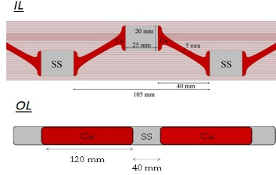
Minimum QH power density to quench
CERN style heaters only
Expected power density in 7 m long MQXF:
OL – 144-149 W/cm2 (2-strips in series per HFU)
IL – 59 W/cm2 (2-strips in series per HFU ), 217 W/cm2 (1 strip per HFU)
C=19.2 mF
τ_{OL-LF}=23 ms
τ_{OL-HF}=21 ms
τ_{IL}=18 ms
G. Chlachidze (FNAL)

Slide 11
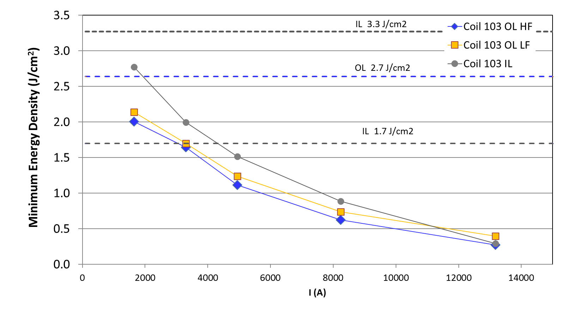
Minimum QH energy density to quench
CERN style heaters only
Expected energy density in 7 m long MQXF:
OL – 2.6-2.7 J/cm2 (2-strips in series per HFU)
IL – 1.7 J/cm2 (2-strips in series per HFU ), 3.3 J/cm2 (1 strip per HFU)
C=19.2 mF
τ_{OL-LF}=23 ms
τ_{OL-HF}=21 ms
τ_{IL}=18 ms
To further improve low-current performance, consider changing the QH strip design (longer heating stations) or use QH supplies with higher energy
Data: G. Chlachidze
Analysis: S. Izquierdo-Bermudez, E. Ravaioli, J. Rysti

Slide 12
Measured and simulated heater delays – Outer layer
12 ms
18 ms
Data: G. Chlachidze (FNAL)
Simulations: T. Salmi (TUT)
Simulations performed with CoHDA

Slide 13
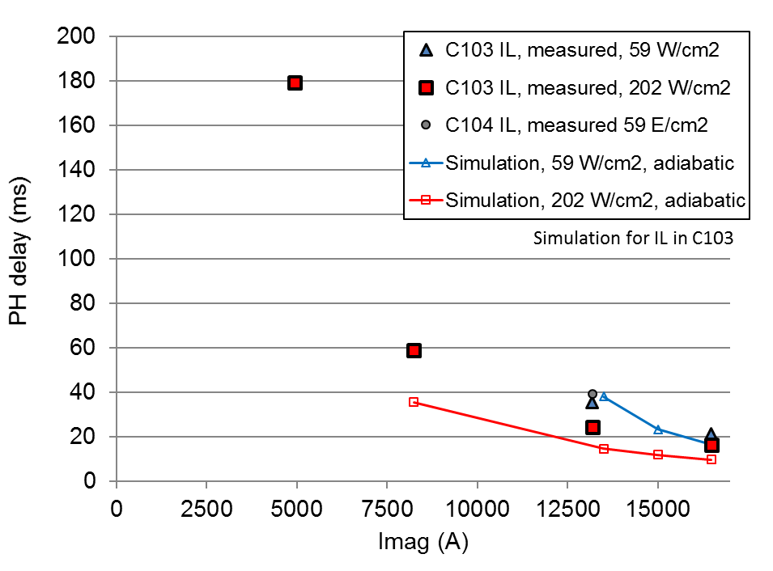
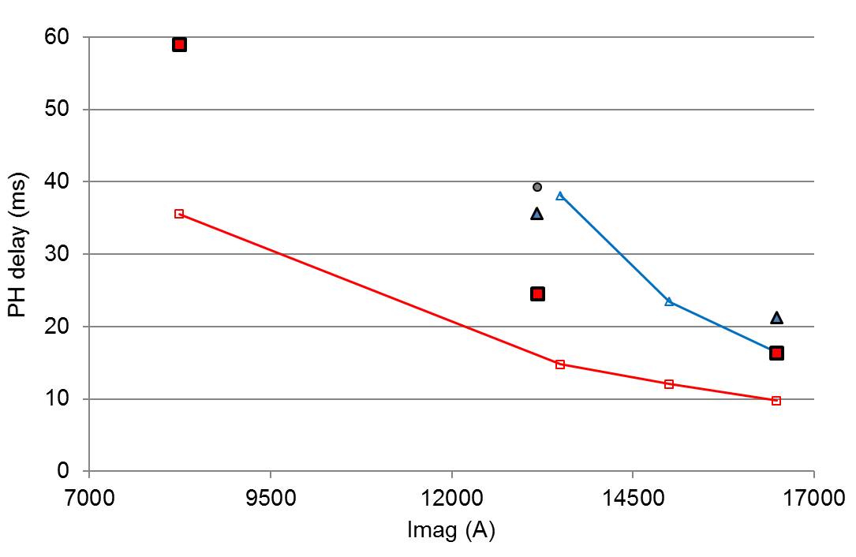
Measured and simulated heater delays – Inner layer
MQXFS01 stainless-steel only IL heaters not yet tested
18 cpr 10 ms
Data: G. Chlachidze (FNAL)
Simulations: T. Salmi (TUT)
Simulations performed with CoHDA

Slide 14
Measured and simulated heater delays – Outer and inner layers
OL heaters: Very nice agreement between measurements and simulations from two independent models
IL heaters: Both independent models predict shorter delays at nominal current.
Further analysis required
Additional heater delay tests with added warm resistance foreseen in the coming weeks
Data: G. Chlachidze (FNAL)
Simulations: J. Rysti (CERN)
Simulations performed with Comsol

Slide 15
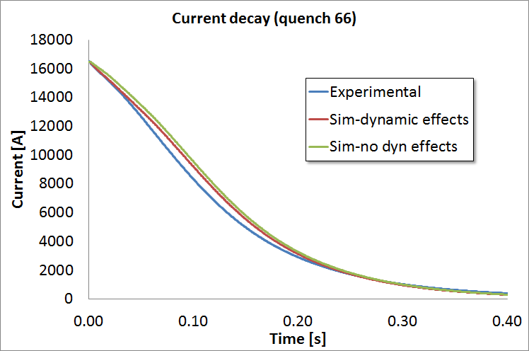
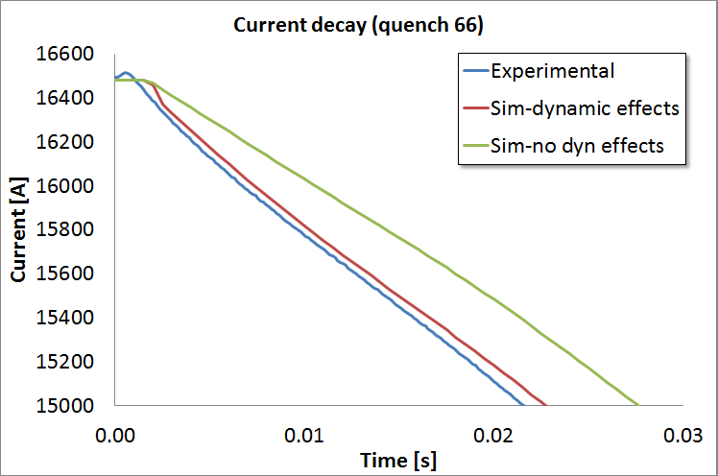
Measured and simulated decays
– Dynamic effects
Quench load [MA²s]
Experimental | Sim-dynamic | Sim-no dynamic
19.8 | 22.4 | 23.8
Data: G. Chlachidze (FNAL)
Simulations: V. Marinozzi (INFN)
Simulations performed with QLASA
Preliminary results

Slide 16
Energy extraction decays (no heaters)
I₀=8.24 kA
R_{EE}=90 mΩ
Simulations performed with LEDET
Data: G. Chlachidze (FNAL)

Slide 17
Energy extraction decays (no heaters)
Quench back and inductance reduction
I₀=8.24 kA
R_{EE}=90 mΩ
L_{diff}~50% L_{nom} R_{coil}~5 mΩ → The faster decay observed in this discharge is mainly due to a reduction of the inductance, not due to quench-back
L_{diff}~50% L_{nom}
Simulations performed with LEDET
Data: G. Chlachidze (FNAL)

Slide 18
Next steps & conclusions
Summer 2016 testing campaigns
(MQXFS1b, MQXFS2, Long mirror)
Circuit design
Heater delay tests
Final heater design
Circuits, Strip design, Supplies
Quench integral studies
(no energy extraction)
Energy extraction tests
(strand parameters)
CLIQ performance
Final CLIQ design
Capacitance, Charging voltage
Validation of independent models
Additional heater delay tests
Reliability studies
  Conclusions
  Improved confidence and validation of independent simulation tools
  Next test campaign critical for the definition of the parameters of the integrated quench protection system (heaters and CLIQ)
  Targeted improvements
  Assure the effectiveness of the quench heaters below 3 kA
  Achieve faster response time of the inner-layer quench heaters
  Test performance of stainless-steel only IL heaters

Slide 19
Annex
  Here you’ll find:
  Additional information about the circuit (slides 20-23)
  Criteria for the powering and protection design choices (slides 24-27)
  Simulated currents, voltages to ground, hot-spot temperature (slides 28-31)
  Requirements on CLIQ terminals and leads – to be updated (slide 32)
  Proposed electrical schemes for CLIQ tests (slide 33)
  Superposition of CLIQ and QH induced voltages (slides 34-36)
  Simulations of failure cases (slides 37-50)
  Tables of characteristic voltages in failure cases (slides 51-56)
  First redundancy studies (slides 57-58)
  Hot-spot temperature and temperature distribution for various protection system options (slides 59-60)
  Reason why parallel elements are needed in the circuit (slides 61-62)
  What is CLIQ (slide 63)
  Quick way to tell if a CLIQ configuration is optimized for MQXF or not (slides 64-65)
  Influence of an energy-extraction system (slide 66)

Slide 20
Notes
  When not specified:
  The powering scheme includes one power supply (less expensive, more challenging)
  EE system is not present
  QH attached to the outer layer of the coil (2 circuits per pole) but not to the inner layer
  Current level set to the nominal current (I₀=16.47 kA)
  Each CLIQ unit has a capacitance C=40 mF charged to U₀=1 kV
  Each QH system has 8 circuits, each with a capacitance 9.6 mF charged to ±450 V (Q1/Q3) or ±300 V (Q2a/Q2b)

Slide 21
Powering and Quench protection system
  This is a conceptual diagram. The actual electrical order and connection scheme of the poles of each magnet will depend on several factors:
  Opposite field orientation required for Q1/Q3 versus Q2a/Q2b
  Naming of the poles based on the physical position they occupy (with respect to the lead end? to the interaction point?)
  Pizza box design
  Rotation of the coil around its axis
  Positioning of the lead ends of each magnet

Slide 22
CLIQ system
6 CLIQ units and 4 warm diode strings per triplet
  The proposed connection scheme of 2 units to Q1/Q3 greatly reduces the peak voltage to ground in the case of misfiring of one CLIQ unit
  Additional current lead between the 2 magnets of Q1/Q3 not needed
  All parallel elements can be installed to the leads already foreseen for the trim power supplies
  Polarities of the CLIQ units is a key ingredient! (QA, testing at 50 V)
  All CLIQ units have the same capacitance (easier to design, manufacture, maintain the units). Units connected to Q1/Q3 can be charged to a lower voltage (600 V)
  Warm diodes are preferred over resistors (no leakage current during ramps, better control of the voltages to ground in failure cases)

Slide 23
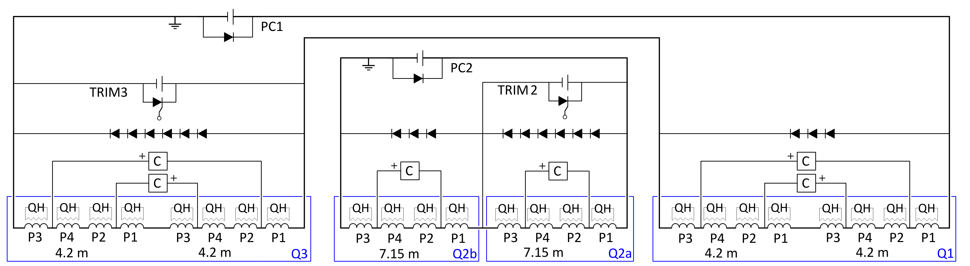

Powering schemes
Baseline: Two main 1-quadrant power supplies + 2 trim power supplies
Slow discharge with free-wheel discharge
One main 2-quadrant power supplies + 3 trim power supplies
Slow discharge achieved with 2-quadrant supply
Little impact on magnet protection!

Slide 24
1 or 2 circuits – Advantages
 | 1 Circuit |  | 2 Circuits
Criterion | Fulfillment | Advantages | Fulfillment | Advantages
Protection | 1 |  | 1 | Lower stored energy per circuit
Compatibility | 0.8 | Less effect of power converter ripples on beams as compensated. Faster ramp down (2 Quadrant PC) | 0.8
Reliability | 0.7 | Less electromagnetic interference. | 0.8 | Reduced # of high current quenches. Better distribution of voltage to ground during quench (without parallel elements).
Availability | 0.8 | Less high current power converters & links → less beam aborts | 0.7 | Quicker quench recovery (firing of heaters in less magnets).
Maintainability | 0.8 | Less high current power converters & links | 0.6
Simplicity | 0.7 | Less high current leads. | 0.6 | Only two trim circuits.
Cost saving | 1 | 1 main power converter (but 3 trims). Less high current leads + less splices. Reduced operational costs | 0.7
Space Saving | 1 | 1 main power converter (but 3 trims). Less high current leads. 2 Quadrant power converters save space (less warm cables needed) | 0.6
Judgment of fulfillment [0…1], subjective and open for discussions

Slide 25
Options for the quench protection
 | CLIQ + Outer QH (+Inner QH?) |  | Outer QH + Inner QH
Criterion | Fulfillment | Features | Features | Fulfillment
Protection | 1 | Hot-spot temperature <300 K and peak voltage to ground <500 V in all realistic failure cases analyzed |  | 0.9
Compatibility | 1 | Less dependence on magnet/cable/strand parameters |  | 0.9
Reliability | 1 | Higher redundancy No expected performance degradation More homogeneous temperature distribution in the coil windings | Lower characteristic voltages (in absence of failures) Some concern on long-term inner QH performance | 0.75
Availability | 0.9 (0.8) | 1 CLIQ and 8(+4) QH supplies per magnet [Option to rely on less QH power supplies increasing availability at the cost of redundancy] | 8+4 QH supplies per magnet | 0.9
Maintainability | 1 | Very easy repair/replacement of damaged CLIQ units (room temperature operation) |  | 0.9
Simplicity | 0.9 | Less dependence on magnet/cable/strand parameters | R&D needed for Inner QH technology Easier modelling | 0.9
Cost saving | 0.9 (0.8) | 1 CLIQ and 8(+4) QH supplies per magnet | 8+4 QH supplies per magnet | 0.9
Space Saving | 0.9 (0.8) | 1 CLIQ and 8(+4) QH supplies per magnet | 8+4 QH supplies per magnet | 0.9

Slide 26
Options for CLIQ configuration
 | 6-CLIQ, 4 Warm Diodes |  | 4-CLIQ, 4 Warm Diodes
Criterion | Fulfillment | Advantages | Advantages | Fulfillment
Protection | 1 | Both options assure hot-spot temperature <300 K and peak voltage to ground <500 V in all realistic failure cases analyzed |  | 1
Compatibility | 1 | Both options use identical CLIQ units for all magnets |  | 1
Reliability | 1 | Reduces voltages to ground and between coil sections in Q1/Q3 by 40% |  | 0.85
Availability | 0.9 |  | 4 CLIQ units per triplet circuit instead of 6 | 1
Maintainability | 0.9 |  | 4 CLIQ units per triplet circuit instead of 6 | 1
Simplicity | 0.9 | Same pole electrical order and similar CLIQ connection scheme for short and long magnets. CLIQ performance can be tested in machine-relevant configuration more easily. | 4 CLIQ units per triplet circuit instead of 6 | 0.7
Cost saving | 0.9 | No need to redesign the pizza box of Q1/Q3 | 4 CLIQ units per triplet circuit instead of 6 | 0.9
Space Saving | 0.9 |  | 4 CLIQ units per triplet circuit instead of 6 | 1

Slide 27
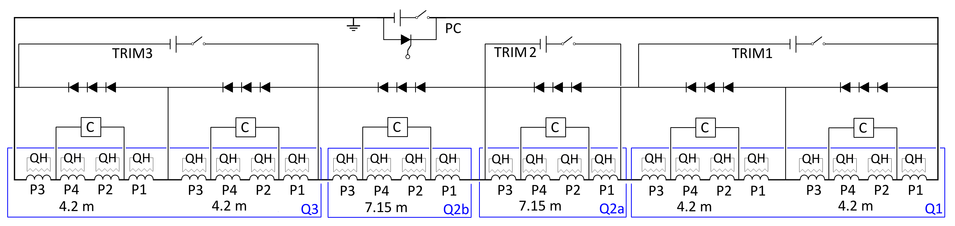
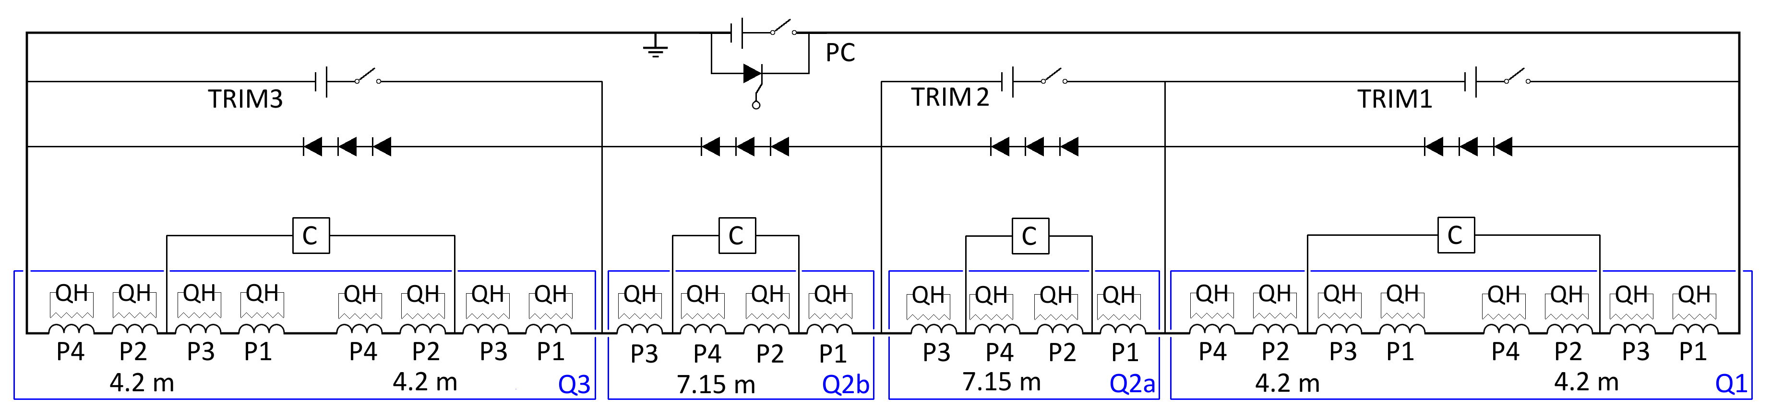
CLIQ configuration -1
6 CLIQ units and 6 warm diode strings per triplet
4 CLIQ units and 4 warm diode strings per triplet
Less CLIQ units, parallel elements, parallel leads. But change of the electrical order of Q1/Q3 required, and peak voltages to ground in Q1/Q3 increased.

Slide 28
What are the expected voltages during a discharge?

Slide 29
Simulated currents in the circuit
4-CLIQ
4 Warm Diodes
6-CLIQ
4 Warm Diodes
Negligible difference in the hot-spot temperature (T_{hot}~230 K)

Slide 30
Simulated voltages to ground
4-CLIQ
4 Warm Diodes
6-CLIQ
4 Warm Diodes
Q1
Q2a
Q2b
Q3
Q1
Q2a
Q2b
Q3
Reduced voltages to ground and between coil sections in Q1/Q3 by 40%

Slide 31
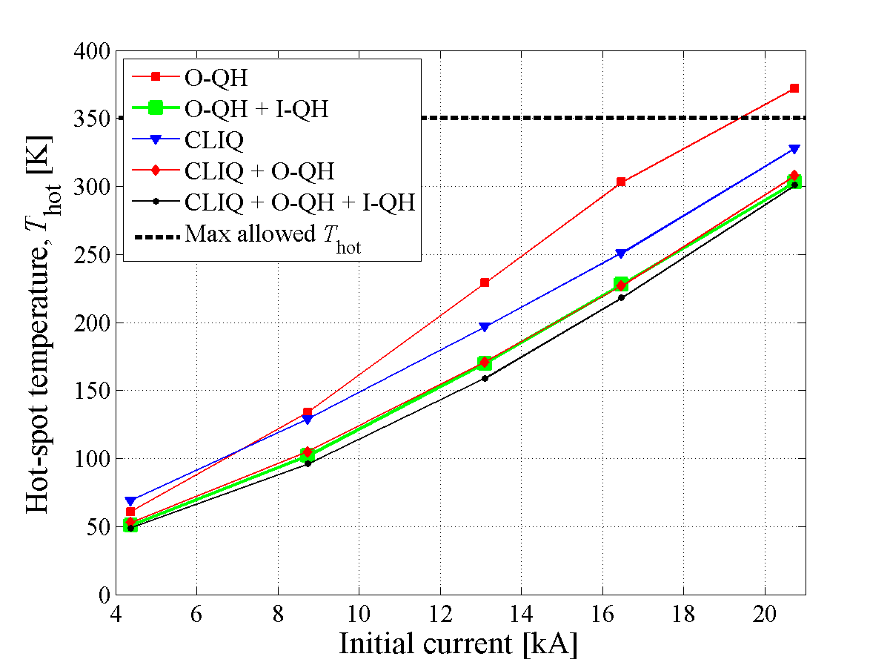
Simulated hot-spot temperature
Nominal I
CLIQ |  | Y | Y | N | N | N
OL heaters |  | Y | Y | Y | 3/4 strips | 2/4 strips
IL heaters |  | Y | N | N | N | N
Hot-spot Temp. | K | 216 | 210-231 | 303- | 325-366 | 322-363
Coil-Ground | V | 510 | 510 | 290-470 | 460-680 | 690-950
Turn-Turn | V | 30 | 35 | 53-61 | 64-75 | 72-88
 |  |  | ** | * | * | *
*Note1: QH simulations performed with and without quench-back and dynamic inductance effects, and assuming QH are triggered 1ms after detection/validation (present value is 5ms)
**Note2: CLIQ+QH simulations performed varying in a wide range the cable/strand parameters
CLIQ + QH’s seems the best compromise for reducing
hot-spot temperature and thermal stress, and increasing redundancy and robustness.

Slide 32
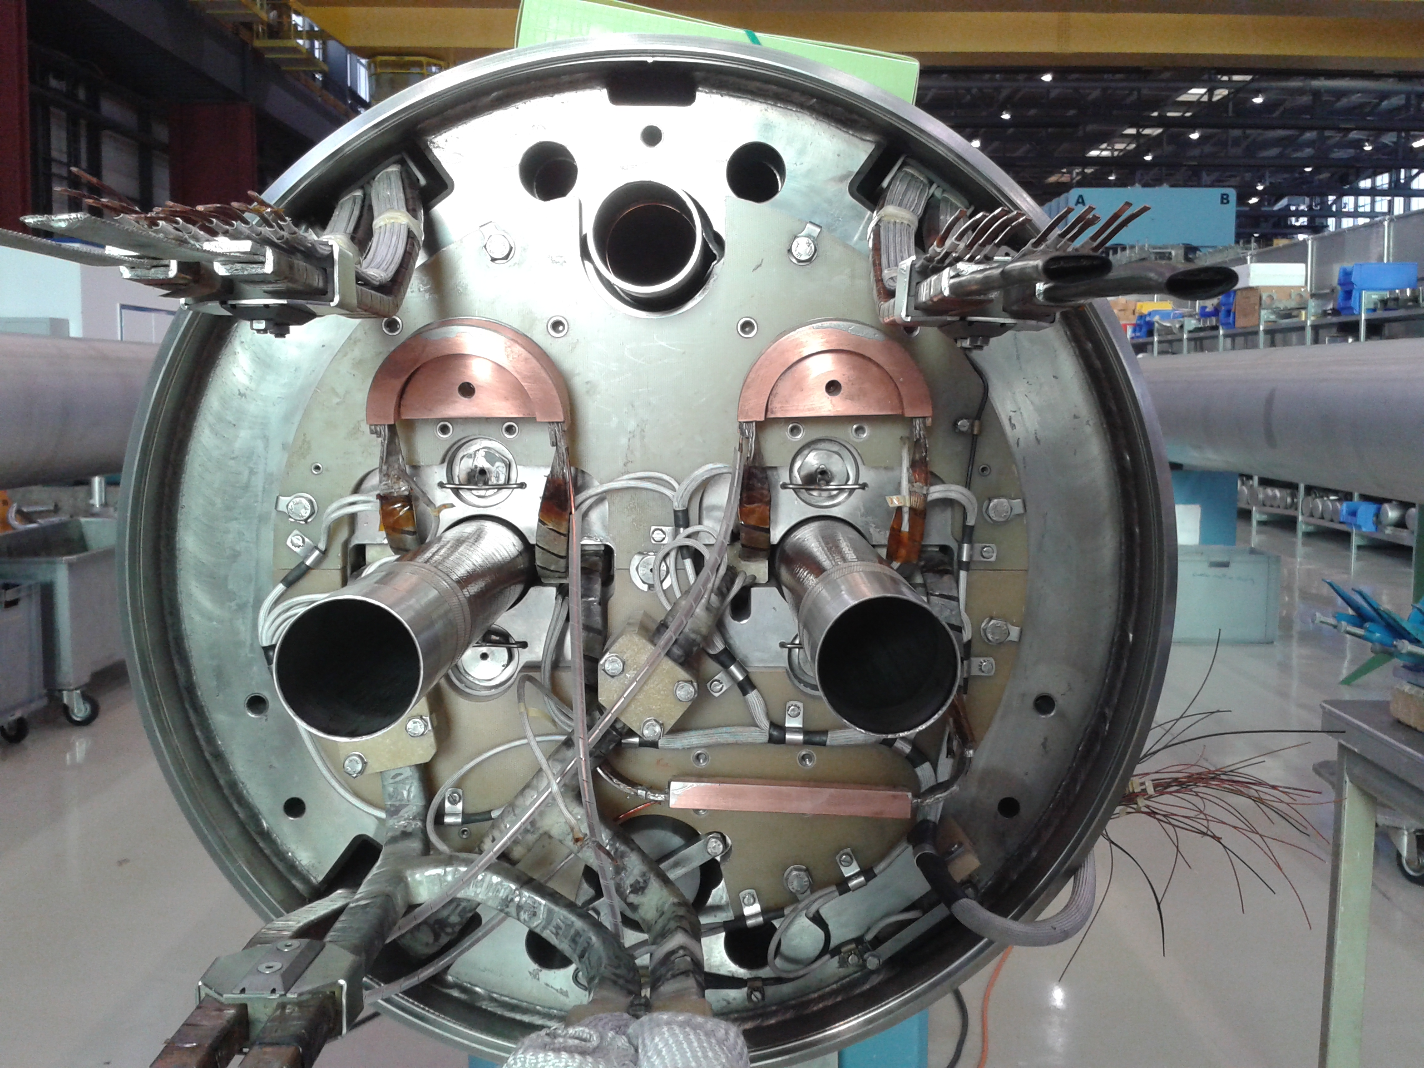
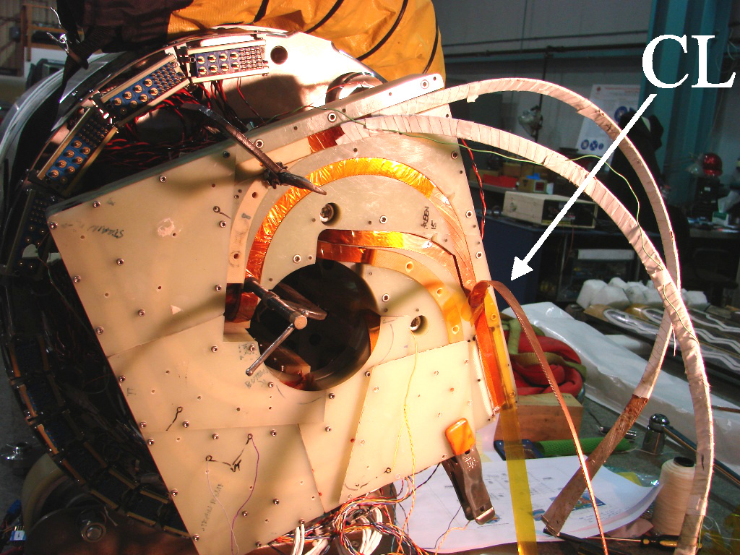
What are the requirements for the CLIQ terminal and leads?
  Leads attached to the coils: Copper cross-section >10 mm2, RRR>100
  Superconducting lead preferred to further reduce its resistance
  Leads outside the cryostat: If the units are located relatively far from the magnet area (80 m?), larger cross-section needed
  Target: Overall resistance of a CLIQ discharge system (external leads + internal resistance of the unit) < 10 mΩ
Aug 2015: full-size 15 m LHC main dipole
2014: H02b
Courtesy of Dan Cheng

Slide 33
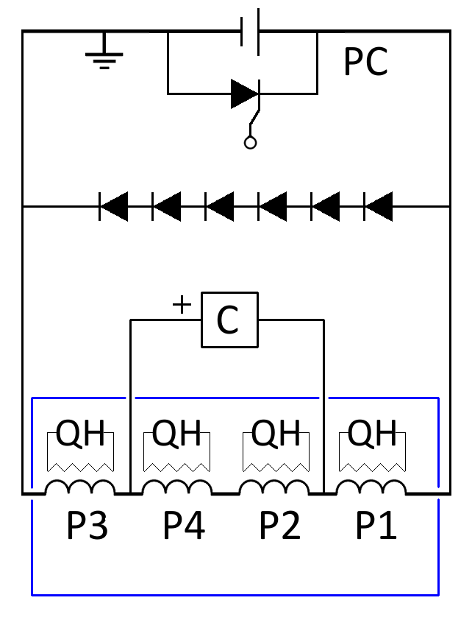
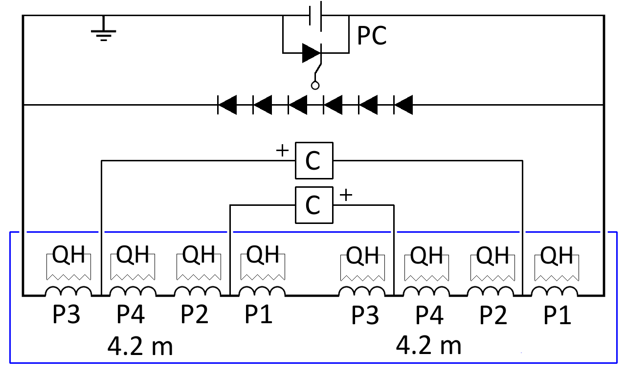
Test of magnets and cold masses
6 CLIQ units and 4 warm diode strings per triplet
Magnet test (7.15 or 4.2 m long)
Cold mass test (2x 4.2 m long)

Slide 34
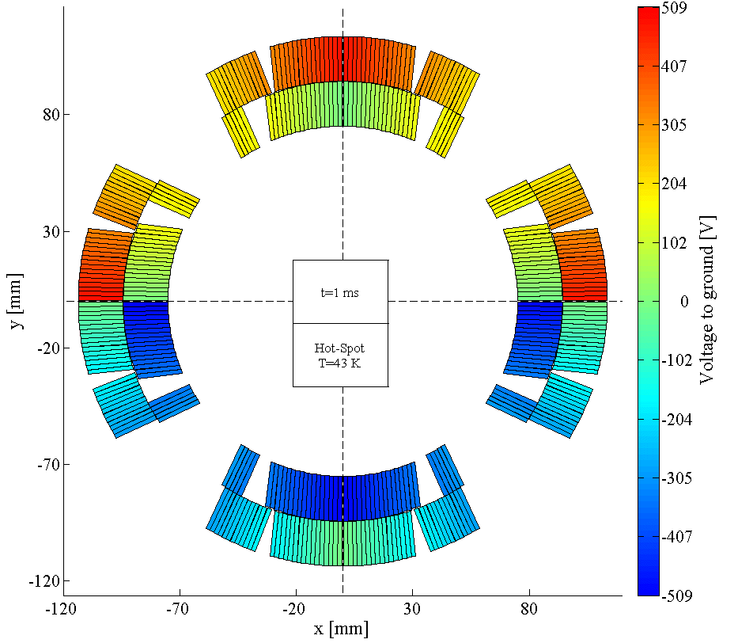
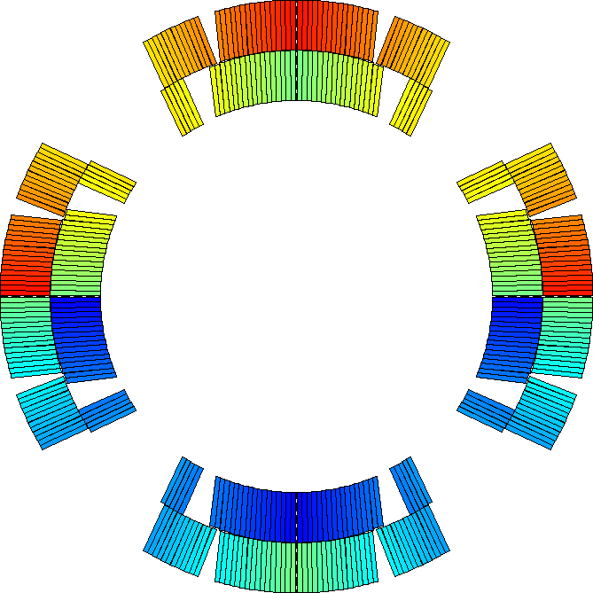
CLIQ-induced voltage distribution
  The voltage distribution in the windings just after triggering CLIQ remains almost constant along the magnet length, but is inhomogeneous in the magnet cross-section

Slide 35
QH-induced voltage distribution
  The voltage distribution in the QH strips just after triggering varies linearly along the conductor length, but is homogeneous in the cross-section
+
-

Slide 36
Coil to heater voltage optimization
  CLIQ and QH are triggered simultaneously. It is important to choose a QH connection scheme that compensates the voltages induced by CLIQ and QH
LF3
LF2
Q2a/Q2b case
HF3
HF2
Peak coil-to-QH voltages ≤500 V
HF4
HF1
IN3
IN2
LF4
IN4
IN1
LF1
LF1
IN1
IN4
LF4
IN2
IN3
HF1
HF4
Peak coil-to-QH voltages ≤500 V
HF2
LF2
LF3
HF3

Slide 37
Summary of failure cases -1
Failure | Consequences | Probability | Mitigation
One QH supply (2 strips) not triggered | Hot-spot T = Peak voltage to ground = | Low | Parallel diodes CLIQ
Two QH supplies (4 strips) not triggered | Hot-spot T = Peak voltage to ground = | Very low | Parallel diodes CLIQ
CLIQ capacitor in open circuit | Hot-spot T = Peak voltage to ground = ~500 A through the diodes | Low | Capacitors in parallel Parallel diodes
CLIQ capacitor in short circuit | Hot-spot T = Peak voltage to ground = ~1 kA through the diodes | Very low | Capacitors in series Parallel diodes
One CLIQ unit triggered spuriously | Hot-spot T = Peak voltage to ground = ~2 kA through the diodes | Very low | Units interlocked Parallel diodes
One CLIQ unit not triggered | Hot-spot T +70 K (290-305 K) Peak voltage to ground = ~2.5 kA through the diodes | Very low | Double triggers Voltage monitor Parallel diodes QH
One CLIQ unit and one QH supply not triggered | Hot-spot T +70 K (290-305 K) Peak voltage to ground = ~2.5 kA through the diodes | Very low | QH connection scheme Parallel diodes

Slide 38
Summary of failure cases -2
Failure | Consequences | Probability | Mitigation
One parallel element disconnected | Hot-spot T = Peak voltage to ground = ~500 A through the diodes | Very low
One lead of the parallel elements disconnected | Hot-spot T = Peak voltage to ground = ~500 A through the diodes | Very low
Two leads of the parallel elements disconnected | Hot-spot T = Peak voltage to ground 600 V ~500 A through the diodes | Nihil | Monitoring currents in the circuit during each discharge
Entire CLIQ unit in short circuit | Hot-spot T +70 K (<300 K) Peak voltage to ground = ~2.5 kA through the diodes CLIQ unit to replace | Nihil | Capacitors in series CLIQ chargers protected QH
One CLIQ unit not triggered and one lead of the parallel elements disconnected | Hot-spot T +50 K (<280 K) Peak voltage to ground 1.6 kV ~1.5 kA through the diodes | Nihil | Monitoring currents in the circuit during each discharge
One CLIQ unit and all QH protecting the same magnet not triggered | Hot-spot T >500 K Magnet current through the diodes | Nihil | Redundant triggers for CLIQ and QH

Slide 39
Sim- 1 QH supply (2 strips) not triggered
D
4-CLIQ 40 mF, 600 V
2-CLIQ 40 mF, 1 kV
Peak voltages to ground unchanged
300 500 V
(Q1/Q3 Q2a/Q2b)
Hot-spot temperature
unchanged
Peak current in the parallel elements
500-750 A
for 50-100 ms

Slide 40
Sim- 2 QH supplies (4 strips) not trig’d
D
4-CLIQ 40 mF, 600 V
2-CLIQ 40 mF, 1 kV
Peak voltages to ground unchanged
300 500 V
(Q1/Q3 Q2a/Q2b)
Hot-spot temperature
unchanged
Peak current in the parallel elements
500-750 A
for 50-100 ms

Slide 41
Sim- One CLIQ unit not triggered
D
4-CLIQ 40 mF, 600 V
2-CLIQ 40 mF, 1 kV
Peak voltages to ground unchanged
300 500 V
(Q1/Q3 Q2a/Q2b)
Hot-spot temperature
305 K
Peak current in the parallel elements
2-2.5 kA
for 100-200 ms

Slide 42
Sim- One CLIQ unit not triggered
D
4-CLIQ 40 mF, 600 V
2-CLIQ 40 mF, 1 kV
Peak voltages to ground unchanged
300 500 V
(Q1/Q3 Q2a/Q2b)
Hot-spot temperature
291 K
Peak current in the parallel elements
1.5-2 kA
for 100-200 ms

Slide 43
Sim- 1 CLIQ and 1 QH supply (2 strips) not trig’d
D
4-CLIQ 40 mF, 600 V
2-CLIQ 40 mF, 1 kV
Peak voltages to ground unchanged
300 500 V
(Q1/Q3 Q2a/Q2b)
Hot-spot temperature
299 K
Peak current in the parallel elements
2-2.5 kA
for 100-300 ms

Slide 44
Sim- Disconnection of one parallel lead
D
4-CLIQ 40 mF, 600 V
2-CLIQ 40 mF, 1 kV
Peak voltages to ground slightly increased
375 500 V
(Q1/Q3 Q2a/Q2b)
Hot-spot temperature
unchanged
Peak current in the parallel elements
500-750 A
for 50-100 ms

Slide 45
Sim- Disconnection of a parallel diode
D
4-CLIQ 40 mF, 600 V
2-CLIQ 40 mF, 1 kV
Peak voltages to ground slightly increased
385 500 V
(Q1/Q3 Q2a/Q2b)
Hot-spot temperature
unchanged
Peak current in the parallel elements
500 A
for <50 ms

Slide 46
Sim- CLIQ not trig’d + lead disconnected
D
4-CLIQ 40 mF, 600 V
2-CLIQ 40 mF, 1 kV
Peak voltages to ground greatly increased!
1619 500 V
(Q1/Q3 Q2a/Q2b)
Hot-spot temperature
268-276 K in Q1 and Q2a
Peak current in the parallel elements
1-1.5 kA
for 100-200 ms

Slide 47
Simulation of a short in a CLIQ unit
D
4-CLIQ 40 mF, 600 V
2-CLIQ 40 mF, 1 kV
Peak voltages to ground unchanged
300 500 V
(Q1/Q3 Q2a/Q2b)
Hot-spot temperature
305 K
Peak current in the parallel elements
2-2.5 kA
for 100-200 ms

Slide 48
Simulation of a short in a CLIQ unit
D
4-CLIQ 40 mF, 600 V
2-CLIQ 40 mF, 1 kV
Peak voltages to ground unchanged
300 500 V
(Q1/Q3 Q2a/Q2b)
Hot-spot temperature
300 K
Peak current in the parallel elements
0.5-1 kA
for 100-200 ms

Slide 49
Simulation of a short in a CLIQ unit
D
4-CLIQ 40 mF, 600 V
2-CLIQ 40 mF, 1 kV
Peak voltages to ground unchanged
300 500 V
(Q1/Q3 Q2a/Q2b)
Hot-spot temperature
269 K
Peak current in the parallel elements
1-1.5 kA
for 100-200 ms

Slide 50
Sim- CLIQ and all QH not triggered
D
4-CLIQ 40 mF, 600 V
2-CLIQ 40 mF, 1 kV
500K→
Peak voltages to ground unchanged
300 500 V
(Q1/Q3 Q2a/Q2b)
Hot-spot temperature
>>500 K
Parallel elements will receive the circuit current

Slide 51
Simulated characteristic voltages
Characteristic voltage | 4-CLIQ 40mF/600V 2-CLIQ 40mF/1kV |  | 4-CLIQ 40mF/1kV |  | 4-CLIQ 40mF/600V Opt 2-CLIQ 40mF/1kV
NO FAILURES | Q1/Q3 | Q2a/Q2b | Q1/Q3 | Q2a/Q2b | Q1/Q3 | Q2a/Q2b
Peak voltage to ground [V] | 316 | 513 | 513 | 509 | 316 | 512
Turn to turn voltage [V] | 16* | 29* | 16* | 28* | 19* | 32*
Mid-plane voltage [V] | 307 | 509 | 500 | 512 | 307 | 509
Layer to layer voltage [V] | 295 | 496 | 247 | 492 | 296 | 495
Layer-layer of adjacent poles [V] | 600 | 1000 | 505 | 1000 | 600 | 1000
CLIQ unit Q1 not triggered | Q1/Q3 | Q2a/Q2b | Q1/Q3 | Q2a/Q2b | Q1/Q3 | Q2a/Q2b
Peak voltage to ground [V] | 312 | 509 | 502 | 509 | 313 | 509
Turn to turn voltage [V] | 28* | 32* | 29* | 32* | 28* | 32*
Mid-plane voltage [V] | 307 | 512 | 497 | 512 | 307 | 512
Layer to layer voltage [V] | 295 | 492 | 246 | 492 | 297 | 492
Layer-layer of adjacent poles [V] | 600 | 1000 | 502 | 1000 | 600 | 1000
CLIQ unit Q2a not triggered | Q1/Q3 | Q2a/Q2b | Q1/Q3 | Q2a/Q2b | Q1/Q3 | Q2a/Q2b
Peak voltage to ground [V] | 318 | 506 | 502 | 516 | 316 | 506
Turn to turn voltage [V] | 16* | 42* | 19* | 47* | 19* | 46*
Mid-plane voltage [V] | 307 | 512 | 497 | 512 | 307 | 512
Layer to layer voltage [V] | 295 | 492 | 246 | 492 | 492 | 492
Layer-layer of adjacent poles [V] | 600 | 1000 | 502 | 1000 | 600 | 1000
Note: When not specified, peaks occur 1 ms after triggering the protection system. Values marked with “*” refer to a peak occurring 100-120 ms after triggering the protection system.

Slide 52
Simulated characteristic voltages
Characteristic voltage | 4-CLIQ 40mF/600V 2-CLIQ 40mF/1kV |  | 4-CLIQ 40mF/1kV |  | 4-CLIQ 40mF/600V Opt 2-CLIQ 40mF/1kV
Disconnection of 1 // lead | Q1/Q3 | Q2a/Q2b | Q1/Q3 | Q2a/Q2b | Q1/Q3 | Q2a/Q2b
Peak voltage to ground [V] | 418* | 522* |  |  | 375 | 521
Turn to turn voltage [V] | 19* | 32* |  |  | 19* | 33*
Mid-plane voltage [V] | 421 | 509 |  |  | 339 | 509
Layer to layer voltage [V] | 295 | 499 |  |  | 296 | 500
Layer-layer of adjacent poles [V] | 600 | 1000 |  |  | 600 | 1000
Disconnection of 2 // leads | Q1/Q3 | Q2a/Q2b | Q1/Q3 | Q2a/Q2b | Q1/Q3 | Q2a/Q2b
Peak voltage to ground [V] | 527* | 642*
Turn to turn voltage [V] | 19* | 32*
Mid-plane voltage [V] | 493 | 509
Layer to layer voltage [V] | 295 | 498
Layer-layer of adjacent poles [V] | 600 | 1000
One // diode in open circuit | Q1/Q3 | Q2a/Q2b | Q1/Q3 | Q2a/Q2b | Q1/Q3 | Q2a/Q2b
Peak voltage to ground [V] |  |  |  |  | 385 | 521
Turn to turn voltage [V] |  |  |  |  | 19* | 32*
Mid-plane voltage [V] |  |  |  |  | 314 | 509
Layer to layer voltage [V] |  |  |  |  | 296 | 498
Layer-layer of adjacent poles [V] |  |  |  |  | 600 | 1000
Note: When not specified, peaks occur 1 ms after triggering the protection system. Values marked with “*” refer to a peak occurring 100-120 ms after triggering the protection system.

Slide 53
Simulated characteristic voltages
Characteristic voltage | 4-CLIQ 40mF/600V 2-CLIQ 40mF/1kV |  | 4-CLIQ 40mF/1kV |  | 4-CLIQ 40mF/600V Opt 2-CLIQ 40mF/1kV
1 OutHF QH not triggered | Q1/Q3 | Q2a/Q2b | Q1/Q3 | Q2a/Q2b | Q1/Q3 | Q2a/Q2b
Peak voltage to ground [V] | 318 | 513 |  |  | 316 | 512
Turn to turn voltage [V] | 20* | 32* |  |  | 19* | 32*
Mid-plane voltage [V] | 307 | 509 |  |  | 307 | 509
Layer to layer voltage [V] | 295 | 496 |  |  | 296 | 495
Layer-layer of adjacent poles [V] | 600 | 1000 |  |  | 600 | 1000
2 OutHF QH not triggered | Q1/Q3 | Q2a/Q2b | Q1/Q3 | Q2a/Q2b | Q1/Q3 | Q2a/Q2b
Peak voltage to ground [V] | 316 | 513 |  |  | 318 | 512
Turn to turn voltage [V] | 21* | 32* |  |  | 20* | 32*
Mid-plane voltage [V] | 307 | 509 |  |  | 307 | 509
Layer to layer voltage [V] | 295 | 496 |  |  | 296 | 495
Layer-layer of adjacent poles [V] | 600 | 1000 |  |  | 600 | 1000
CLIQ unit Q1 not triggered and disconnection of 1 // lead | Q1/Q3 | Q2a/Q2b | Q1/Q3 | Q2a/Q2b | Q1/Q3 | Q2a/Q2b
Peak voltage to ground [V] | 909 | 509 |  |  | 1619 | 509
Turn to turn voltage [V] | 33* | 32* |  |  | 32* | 50*
Mid-plane voltage [V] | 801 | 512 |  |  | 707 | 1494
Layer to layer voltage [V] | 295 | 492 |  |  | 295 | 492
Layer-layer of adjacent poles [V] | 725 | 1000 |  |  | 600 | 1336
Note: When not specified, peaks occur 1 ms after triggering the protection system. Values marked with “*” refer to a peak occurring 100-120 ms after triggering the protection system.

Slide 54
Simulated characteristic voltages
Characteristic voltage | 4-CLIQ 40mF/600V 2-CLIQ 40mF/1kV |  | 4-CLIQ 40mF/1kV |  | 4-CLIQ 40mF/600V Opt 2-CLIQ 40mF/1kV
1CLIQ and 1 OutHF QH not trig’d | Q1/Q3 | Q2a/Q2b | Q1/Q3 | Q2a/Q2b | Q1/Q3 | Q2a/Q2b
Peak voltage to ground [V] | 324 | 509 |  |  | 428 | 509
Turn to turn voltage [V] | 34* | 32* |  |  | 29* | 32*
Mid-plane voltage [V] | 307 | 512 |  |  | 396 | 512
Layer to layer voltage [V] | 295 | 492 |  |  | 339 | 296
Layer-layer of adjacent poles [V] | 600 | 1000 |  |  | 600 | 1000
1CLIQ and 2 OutHF QH not trig’d | Q1/Q3 | Q2a/Q2b | Q1/Q3 | Q2a/Q2b | Q1/Q3 | Q2a/Q2b
Peak voltage to ground [V]
Turn to turn voltage [V]
Mid-plane voltage [V]
Layer to layer voltage [V]
Layer-layer of adjacent poles [V]
CLIQ Unit in short circuit | Q1/Q3 | Q2a/Q2b | Q1/Q3 | Q2a/Q2b | Q1/Q3 | Q2a/Q2b
Peak voltage to ground [V] | 318 | 506 |  |  | 302 | 509
Turn to turn voltage [V] | 19* | 46* |  |  | 29* | 32*
Mid-plane voltage [V] | 307 | 512 |  |  | 307 | 512
Layer to layer voltage [V] | 295 | 492 |  |  | 296 | 492
Layer-layer of adjacent poles [V] | 600 | 1000 |  |  | 600 | 1000
Note: When not specified, peaks occur 1 ms after triggering the protection system. Values marked with “*” refer to a peak occurring 100-120 ms after triggering the protection system.

Slide 55
No CLIQ – Sim characteristic voltages
Characteristic voltage | Q1/Q3 | Q2a/Q2b
No CLIQ, With // diodes, 1 OutHF QH not trig’d | Q1/Q3 | Q2a/Q2b
Peak voltage to ground [V] | 324* | 330*
Turn to turn voltage [V] | 34* | 46*
Mid-plane voltage [V] | 162* | 35*
Layer to layer voltage [V] | 240* | 374*
Layer-layer of adjacent poles [V] | 149* | 24*
No CLIQ, No // diodes, 1 OutHF QH not trig’d | Q1/Q3 | Q2a/Q2b
Peak voltage to ground [V] | 616* | 729*
Turn to turn voltage [V] | 29* | 50*
Mid-plane voltage [V] | 431* | 170*
Layer to layer voltage [V] | 245* | 427*
Layer-layer of adjacent poles [V] | 223* | 111*
No CLIQ, No // diodes, 2 OutHF QH not trig’d | Q1/Q3 | Q2a/Q2b
Peak voltage to ground [V] | 988* | 1020*
Turn to turn voltage [V] | 27* | 47*
Mid-plane voltage [V] | 802* | 229*
Layer to layer voltage [V] | 408* | 406*
Layer-layer of adjacent poles [V] | 417* | 146*
Note: When not specified, peaks occur 1 ms after triggering the protection system. Values marked with “*” refer to a peak occurring 100-120 ms after triggering the protection system.

Slide 56
Simulated characteristic voltages
Characteristic voltage | 4-CLIQ 40mF/600V 2-CLIQ 40mF/1kV |  | 4-CLIQ 40mF/1kV |  | 4-CLIQ 40mF/600V Opt 2-CLIQ 40mF/1kV
With CLIQ, All QH not trig’d | Q1/Q3 | Q2a/Q2b | Q1/Q3 | Q2a/Q2b | Q1/Q3 | Q2a/Q2b
Peak voltage to ground [V] |  |  |  |  | 358 | 593
Turn to turn voltage [V] |  |  |  |  | 29* | 47*
Mid-plane voltage [V] |  |  |  |  | 307 | 509
Layer to layer voltage [V] |  |  |  |  | 296 | 495
Layer-layer of adjacent poles [V] |  |  |  |  | 600 | 1000
No CLIQ, Only Out QH trig’d | Q1/Q3 | Q2a/Q2b | Q1/Q3 | Q2a/Q2b | Q1/Q3 | Q2a/Q2b
Peak voltage to ground [V]
Turn to turn voltage [V]
Mid-plane voltage [V]
Layer to layer voltage [V]
Layer-layer of adjacent poles [V]
No CLIQ, Out and In QH trig’d | Q1/Q3 | Q2a/Q2b | Q1/Q3 | Q2a/Q2b | Q1/Q3 | Q2a/Q2b
Peak voltage to ground [V] |  |  |  |  | 179* | 285*
Turn to turn voltage [V] |  |  |  |  | 18* | 30*
Mid-plane voltage [V] |  |  |  |  | 46* | 34*
Layer to layer voltage [V] |  |  |  |  | 115* | 193*
Layer-layer of adjacent poles [V] |  |  |  |  | 47* | 34*
Note: When not specified, peaks occur 1 ms after triggering the protection system. Values marked with “*” refer to a peak occurring 100-120 ms after triggering the protection system.

Slide 57
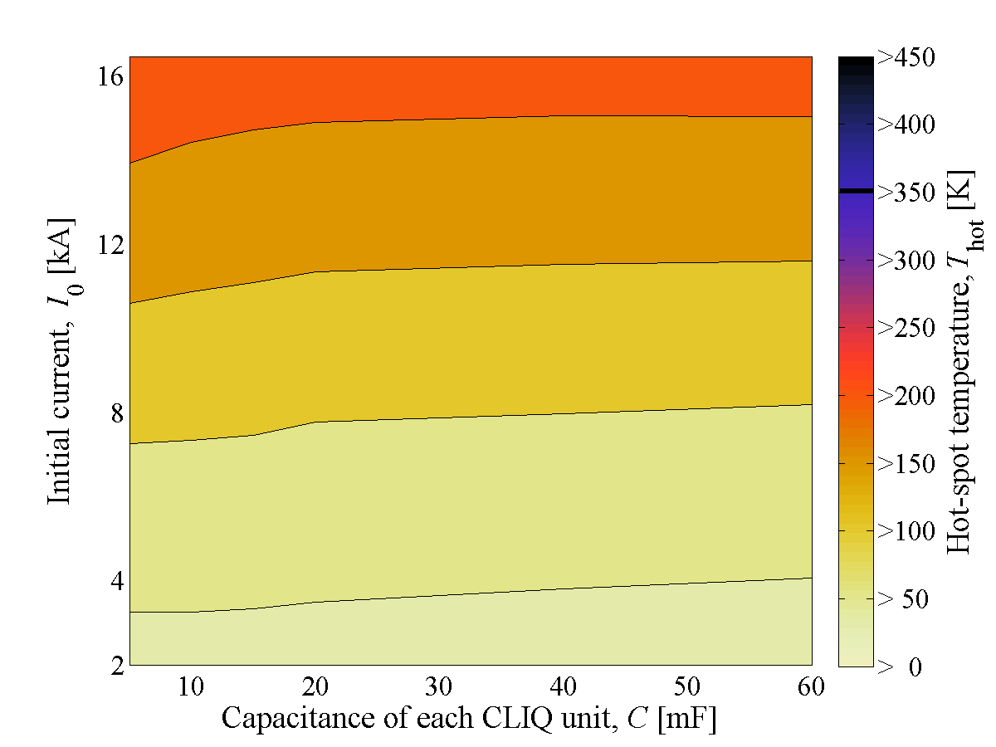
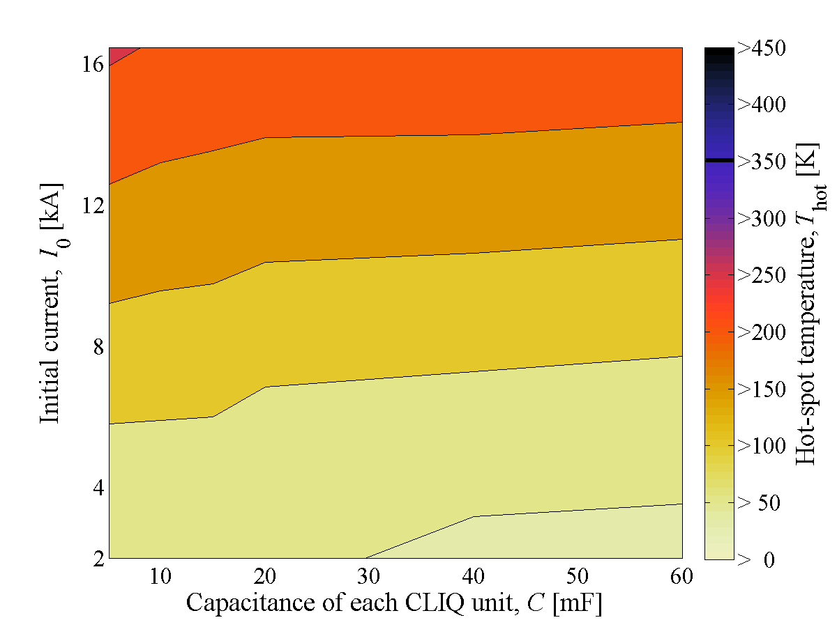
Level of redundancy
  Choose an optimum level of redundancy
      Reduce capacitance of CLIQ units to reduce their size and cost?
      Keep some QH as spares to reduce the risk of degradation?
      Redesign QH to be more effective at low-to-medium current? (Tiina)
  Next step: Once determined the baseline circuit, Failure cases with reduced number of QH units and with reduced capacitance of CLIQ units
Simulated hot-spot temperature
CLIQ + 4 HF QH strips + 4 LF QH strips
CLIQ + 4 HF QH strips

Slide 58
Simulated currents in the circuit
6-CLIQ, 40 mF
6-CLIQ, 10 mF

Slide 59
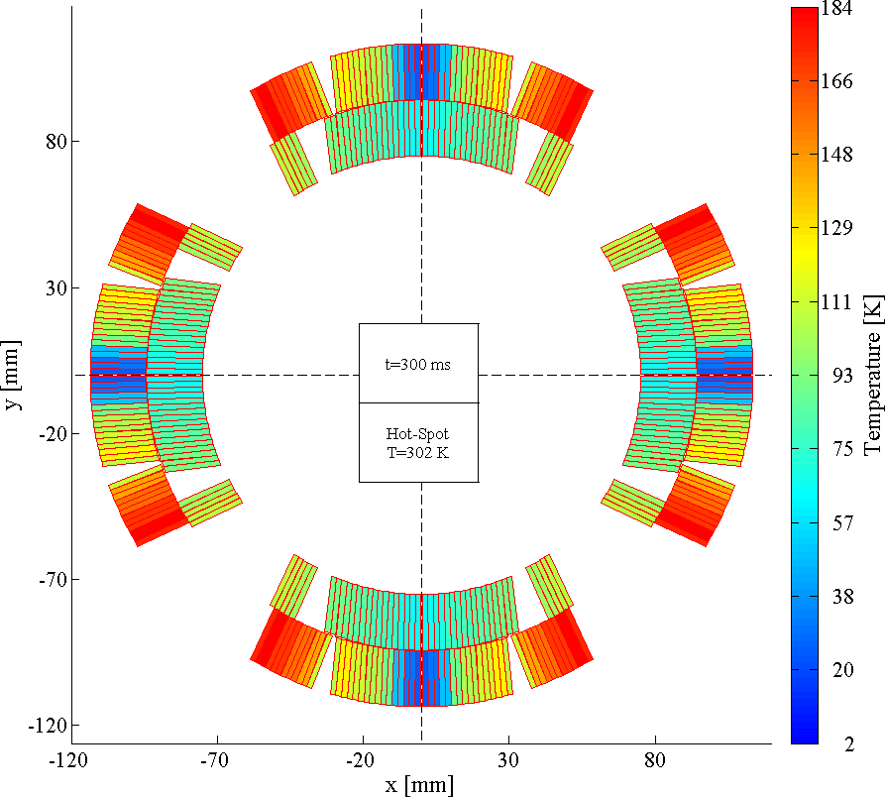
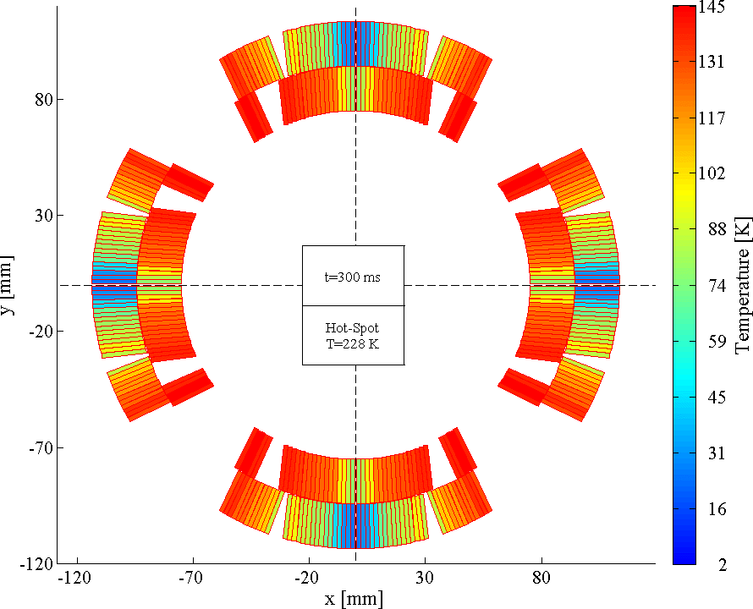
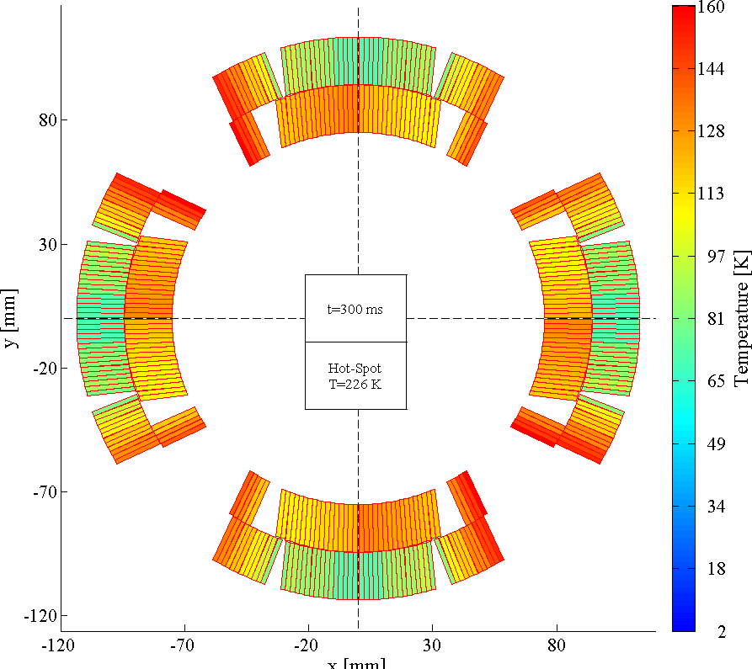
Simulated temperature profiles
  CLIQ + Quench Heaters assure the most homogeneous temperature distribution in the coil windings at the end of a discharge
  Reducing the thermal gradients reduces the thermal stress
Outer QH
Outer+Inner QH
CLIQ + Outer QH
ΔT=140 K
ΔT=100 K
ΔT=85 K

Slide 60
Simulated hot-spot temperature
Nominal I
Protection system | Hot-spot T
CLIQ | 250 K
CLIQ+8 outer QH’s | 230 K
CLIQ+8 outer QH’s+4 inner QH’s | 220 K
CLIQ+4 outer QH in HF region | 240 K
The more QH units are triggered, the higher the probability of degrading the electrical insulation
CLIQ+4 HF outer QH’s seems the best compromise for reducing
hot-spot temperature and thermal stress, and increasing redundancy and robustness.

Slide 61
Why do we need parallel elements?
  Voltages to ground reduced by means of parallel elements across parts of the circuit which equalize the voltage distribution
  Avoid very high voltages to ground in several CLIQ failure cases
  Cold parallel diodes are probably incompatible with the very high expected radiation dose in the interaction regions
  Proposed solution: Warm parallel diodes utilizing existing leads of the trim supplies (but needs different connection schemes for Q1/Q3 and Q2a/Q2b)
  Back-up solution: 1Ω parallel resistors (but leakage currents, cryo loads)
No parallel elements
1 Ω resistors
Warm diodes
Q1
Q2a
Q2b
Q3

Slide 62
Why do we need parallel elements?
Failure: One CLIQ unit not triggered
  Worst-case: CLIQ unit at one end of the circuit is not triggered
  Without parallel elements, the voltage to ground just after triggering the CLIQ units reach 3*U₀=3 kV
4-CLIQ system, no parallel diodes
4-CLIQ system, 4 parallel diodes
Q1
Q2a
Q2b
Q3
Q1
Q2a
Q2b
Q3

Slide 63

Current change
What is CLIQ?
Magnetic field change
Coupling losses (Heat)
Temperature rise
QUENCH
5/19/2016

Slide 64
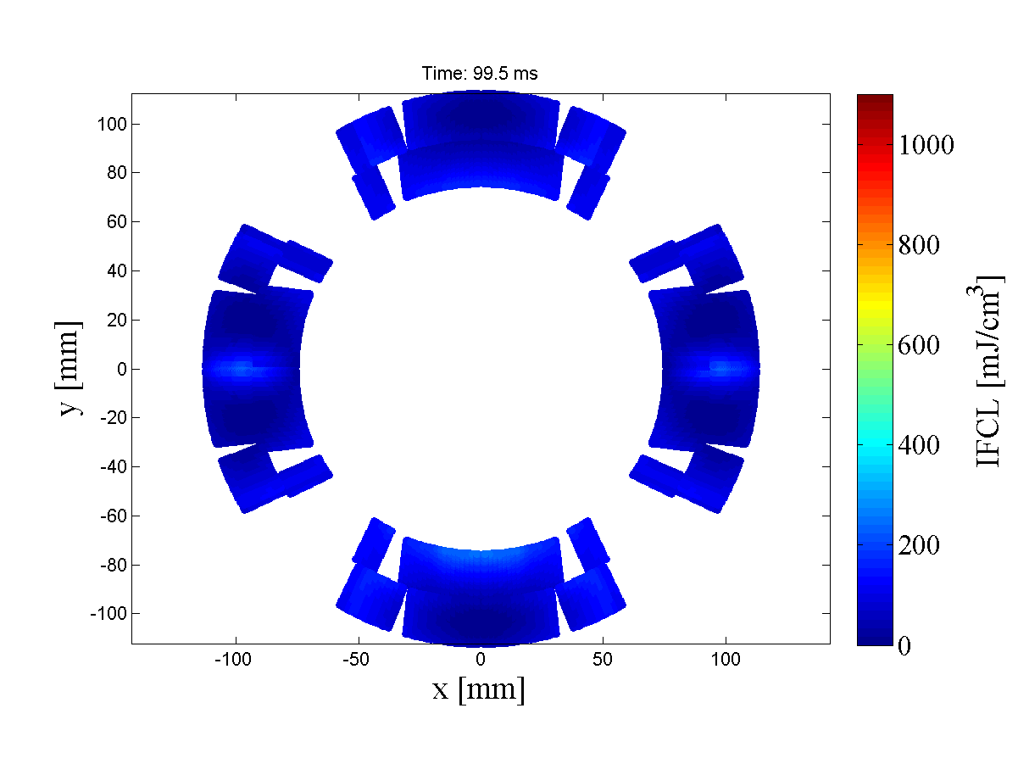
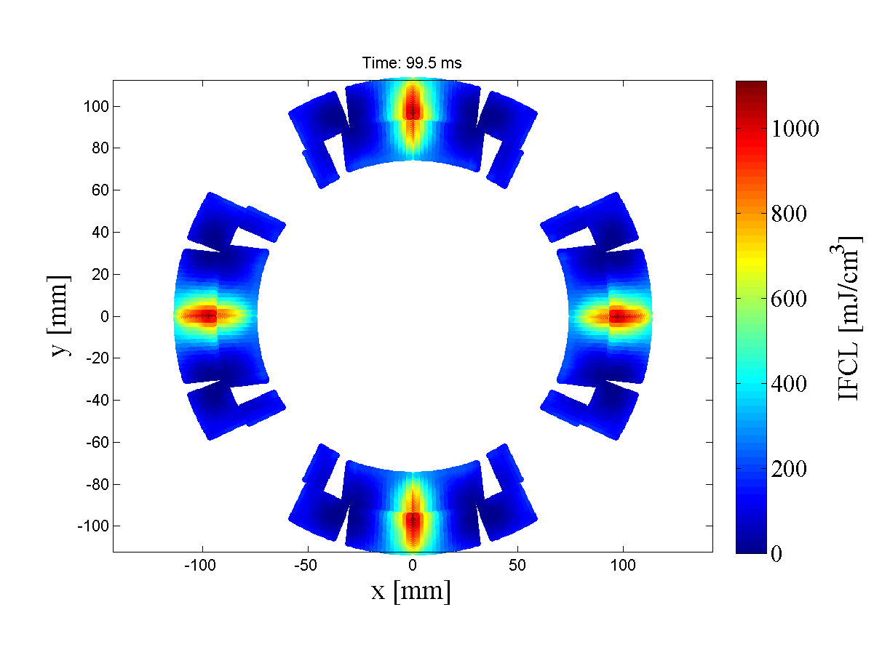
Why does it matter if the pole electrical order is different?
  Depending on the connection of the CLIQ units to the magnets in the circuit, different coil sections will receive different current changes. For MQXF, two options are possible
Not optimized
Optimized
About 10 times faster heat deposition, AND more uniform

Slide 65
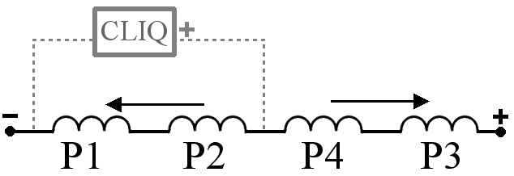

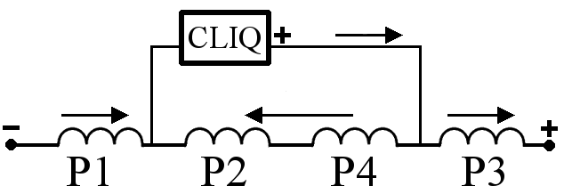

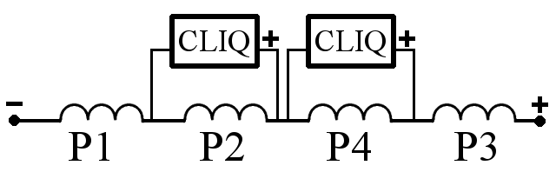
Is there a quick rule to determine whether a configuration is optimized?
  Indeed!
  Poles that are physically adjacent must receive opposite dI/dt.
  Some examples:
2
1
1
2
4
3
3
4
1
2
4
3
1
3
2
4
3
1
2
4
1
2
4
3
2
4
3
1
4
2
1
3

Slide 66
Wouldn’t adding an EE system help?
  The addition of a 50 mΩ EE system decreases the hot-spot temperature only by a few degrees
  On the other hand, the peak voltage to ground is increased
4-CLIQ +OutQH
4-CLIQ +OutQH +EE
OutQH +EE
±500 V
1100 V
-800 V
Q1
Q2a
Q2b
Q3

