Slide 1
Reflective Laser Protective Eyewear
James K Santucci
2016 DOE Accelerator Safety Workshop
21 September 2016

Slide 2
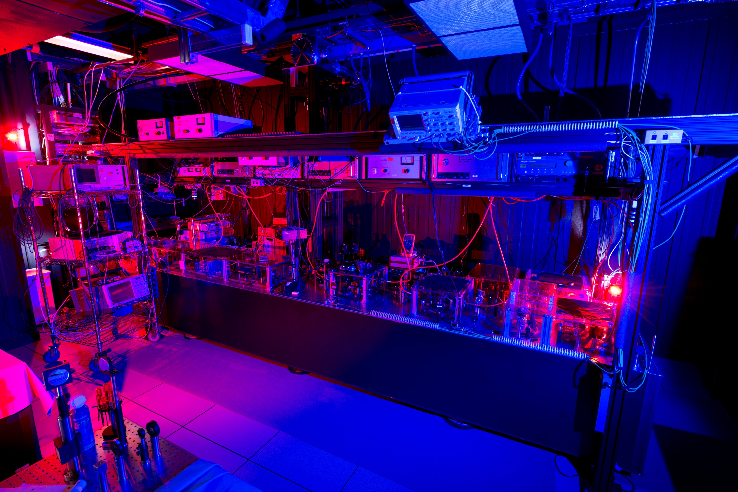
Laser Familiarity
I am not a safety professional, I am a customer
I have been working with high-powered lasers for over 20 years
and I have noticed a few things over the years
“The majority of accidences result from carelessness that accompanies familiarity.” –Ken Barat, LBNL.
Notes:
“Hi, I am not a safety professional, I am a customer.”
However I did stay at a Holiday Inn Select.
I have been working with high-powered lasers for over 20 years.
And I have notice a few things over the years.
“The majority of accidences result from carelessness that accompanies familiarity.” –Ken Barat, LBNL.

Slide 3
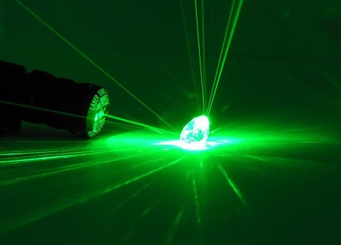
Reflective Best Practices
As an experimenter and a laser operator (LO), I understand the importance of knowing where the beam is and being aware of all stray reflections.
I know how to mitigate stray reflections by;
keeping the beam in one horizontal plane,
using beam blocks & dumps,
removing watches, jewelry, ID badges
being careful with tools near the beam.
Notes:
As an experimenter and a laser operator (LO), I understand the importance of knowing where the beam is and being aware of all stray reflections. I know how to mitigate stray reflections by; keeping the beam in one horizontal plane, using beam blocks & dumps, removing watches, jewelry, ID bages, and being careful with tools near the beam.

Slide 4
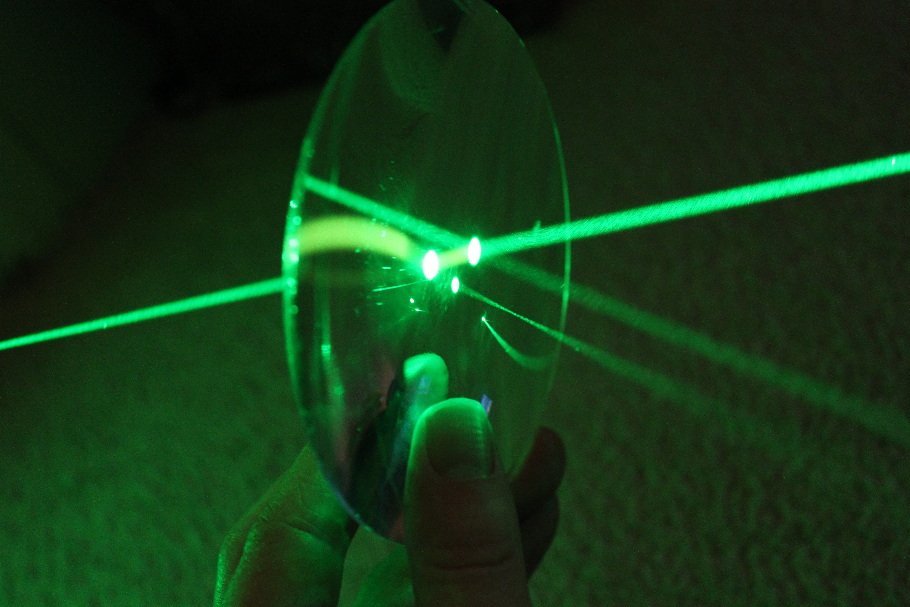
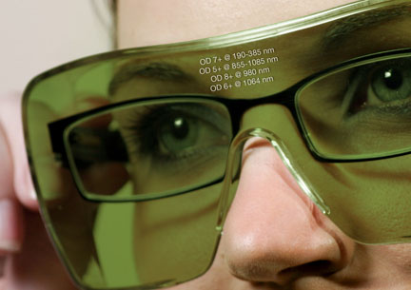
Reflections
Being a safe LO I am aware that transmitting optics can also reflect & reflecting optics can also transmit.
But usually LOs do not think about the reflections of the LPE (Laser Protective Eyewear) on their face.
Notes:
Being a safe LO I am aware that transmitting optics can also reflect & reflecting optics can also transmit.
But usually LOs do not think about the reflections of the LPE (Laser Protective Eyewear) on their face. (take off things as each is mentioned).

Slide 5
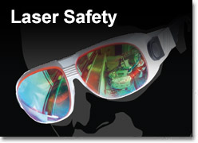
Reflections
Most laser eye accidents involve a specular reflection.
e.g. April 2003, UC Berkeley campus, During alignment of the laser's Nd:YAG beam, a graduate student was struck in the eye by a specular reflection (a stray beam).
Reflective LPE, by design, reflects in a specular way.
Notes:
Most laser eye accidents involve a specular reflection.
e.g. April 2003, UC Berkeley campus, During alignment of the laser's Nd:YAG beam, a graduate student was struck in the eye by a specular reflection (a stray beam).
R-LPE by design, reflects in a specular way.

Slide 6
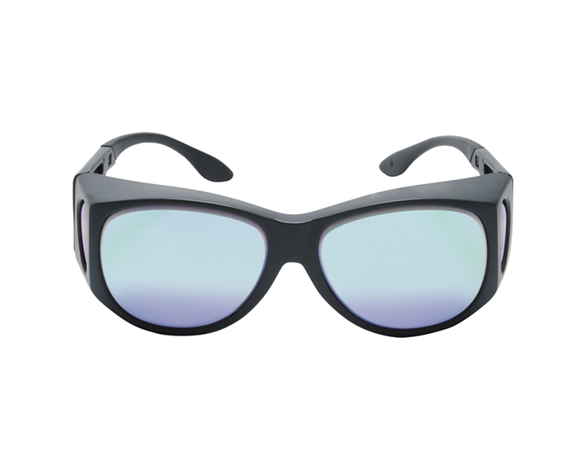
Reflective LPE
With more and more labs using multiple wavelengths, Reflective LPE is here to stay
Reflective LPE have become very useful for users that want to be protected from multiple wavelengths yet still benefit from high VLT
But we must be careful
Notes:
With more and more labs using multiple wavelengths, R-LPE are here to stay.
R-LPE have become very useful for users that want to be protected from multiple wavelengths yet still benefit from high VLT.

Slide 7
Reflective LPE
e.g. October 2012, LANL, Through the C505C R-LPE center field of view, Laser worker observed a diffused reflection of a green 527nm beam during laser Installation.
The LPE used were thought to be defective and taken out of service.
But in fact they were perfectly fine and performed as engineered.
The C505C filters in the above example were designed to protect against Nd:YAG (1064nm) and it’s 2HG (532nm) and 4HG (266nm).
The above laser system was Nd:YLF (1053nm). 2HG = 527nm.
Notes:
e.g. October 2012, LANL, Through the C505C R-LPE center field of view, Laser worker observed a diffused reflection of a green 527nm beam during laser
Installation. The LPE used were thought to be defective and taken out of service. But in fact they were perfectly fine and performed as engineered. The C505C filters in the above example were designed to protect against Nd:YAG (1064nm) and it’s 2HG and 4HG.
The above laser system was Nd:YLF (1053nm). 2HG = 527nm. Which is in the tails of protection.

Slide 8
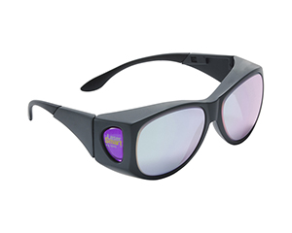
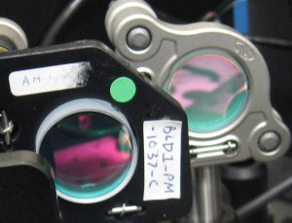
How Reflective LPE works
R-LPE have absorptive as well as reflective properties
They use absorptive filters for wide BW coverage of IR and of UV
To filter out the 2HG green while still providing high VLT they use a notch filter at that exact wavelength.
The notch filters are deposited dielectric coatings
the same way laser HR mirrors are made
Notes:
How R-LPE works:
R-LPE have absorptive as well as reflective properties.
They use absorptive filters for wide BW coverage of IR and of UV.
To filter out the 2HG green while still providing high VLT they use a notch filter at YAG 2HG (532nm).
The notch filters are dielectric coatings, the same way laser HR mirrors are made.

Slide 9
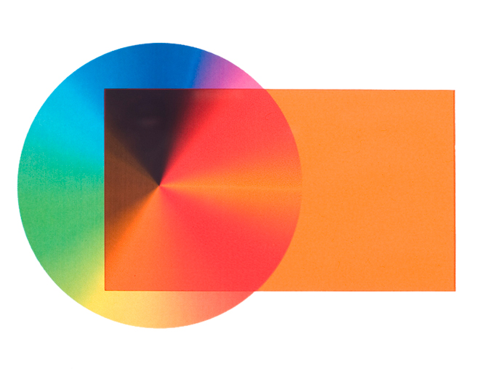
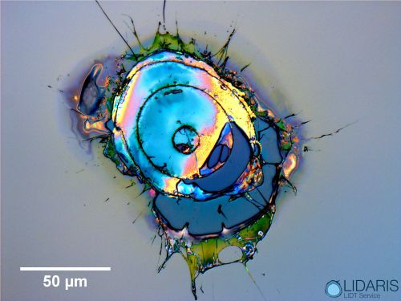
Reflective LPE
Two issues;
Specular reflection from R-LPE
Dielectric coating has narrow BW
make sure your wavelength is covered.
Use opaque box to enclose non-covered wavelength.
Available from many laser safety vendors.
Damage to dielectric coating is undetectable
some have hard protective coatings on outside
Laser Filter Plastic Box Option
OD 5+ @UV, OD 4+ @Green, ~30% VLT
Notes:
Two issues;
Reflection,
dielectric coating is narrow BW (need to make sure your wavelength is covered.
…also coating can be damaged and inspection will not show (some have hard protective coatings on outside).
Use NML plastic box example as alternative. Available from laser safety vendors.
OD 5+ @ UV,OD 4+ @ Green,~30% VLT

Slide 10
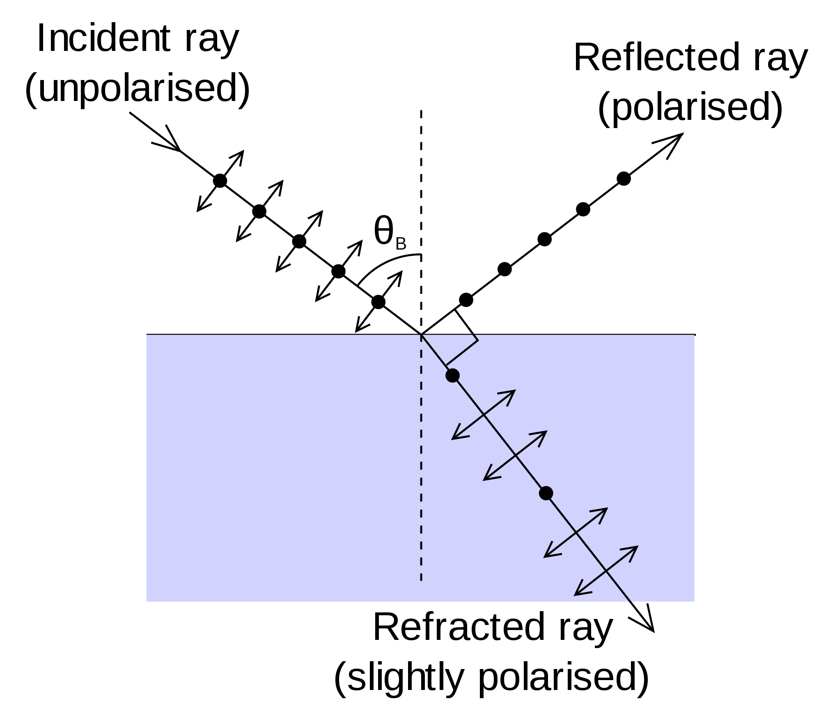
Reflective LPE
Even absorptive glass of traditional LPE produces 5% reflection from front surface
(back surface has 2X the rated OD in reduction).
Under certain conditions all of the light is reflected from traditional glass LPE
At Brewster’s angle all of the light reflected
Typical Q-switched Nd:YAG is >1J
50mJ is 5% of 1J
Nd:YAG MPE is 50mJ
Notes:
Even regular absorptive glass of traditional LPE produces 5% reflection from front surface (back surface has 2X the rated OD in reduction).
Under certain conditions all of the light can be reflected from standard absorptive glass LPE (At Brewster’s angle (~56°) all of the light of one polarization (S) is reflected.)
Example: typical Q-switched Nd:YAG MPE is 17uW/cm2, which is 5% of 340uW/cm². Or 50mJ/m², which is 5% of 1J/m².
Typical Q-switched Nd:YAG is >1J. MPE for a Green ns pulse is 5E-7 W/cm².

Slide 11
Reflective LPE Guidance Document
DOE Energy Facility Contractors Group (EFCOG) Laser Safety Task Group (LSTG) is currently producing a guidance document on reflective laser protective eyewear (R-LPE).
The LSTG is looking for safety community input on this document.
If you would like to comment or advise on this subject, please contact Jamie Santucci santcci@fnal.gov or Jamie King king75@llnl.gov or through the DOE/EFCOG/LSTG website
http://efcog.org/safety/worker-safety-health-subgroup/laser-safety-task-group/
Notes:
DOE Energy Facility Contractors Group (EFCOG) Laser Safety Task Group (LSTG) is currently producing a guidance document on reflective laser protective eyewear (R-LPE). The LSTG is looking for safety community input on this document. If you would like to comment or advise on this subject, please contact Jamie Santucci or Jamie King

Slide 12
Questions or Comments?
If there are no questions or comments I will fill the rest of my time slot with a dry reading from ANSI Z136 which I will call…
“Safety First, Safety Always”
Notes:
If there are no questions or comments, I will fill the rest of my time slot with a dry reading from ANSI Z136 which I will call “Safety First, Safety Always”.
ANSI Z136.1-2007
4.6.2.1 Eye Protection (Class 3B or Class 4). Eye protection devices which are specifically designed for protection against radiation from Class 3B lasers or laser systems should be administratively required within the NHZ and their use enforced when engineering or other procedural and administrative controls are inadequate to eliminate potential exposure in excess of the applicable MPE.
Eye protection devices which are specifically designed for protection against radiation from Class 4 lasers or laser systems shall be administratively required and their use enforced when engineering or other procedural and administrative controls are inadequate to eliminate potential exposure in excess of the applicable MPE.
Laser protective eyewear is usually not required for Class 2 or Class 3R lasers or laser systems except in conditions where intentional long-term (> 0.25 s) direct viewing is required.
Laser protective eyewear may include goggles, face shields, spectacles, or prescription eyewear using special filter materials or reflective coatings (or a combination of both) to reduce the potential ocular exposure below the applicable MPE.
Laser protective eyewear shall be specifically selected to withstand either direct or diffusely scattered beams depending upon the anticipated circumstances of exposure. In this case, the protective filter shall exhibit a damage threshold for a specified exposure time, typically 10 seconds (see Appendix C). The eyewear shall be used in a manner so that the damage threshold is not exceeded in the “worst case” exposure scenario. Important in the selection of laser protective eyewear is the factor of flammability (see ANSI Z87.1-2003, American National Standard for Occupational and Educational Personal Eye and Face Protection Devices, or the latest revision thereof).
Recent studies have indicated that existing laser eye protective filters (plastic, glass, interference, or hybrid filters) often exhibit non-linear effects such as saturable absorption when exposed to ultrashort (e.g., femtosecond) pulse durations. Laser users should request test data from laser eyewear manufacturers.

