Slide 1
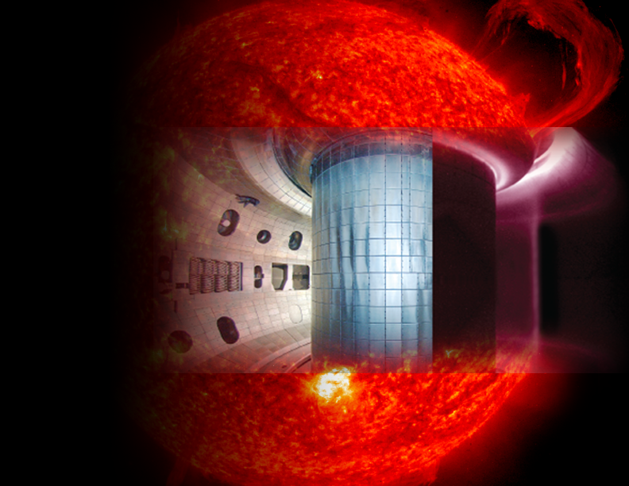
Safety Issues for Fusion Research
THE U.S. FUSION ENERGY SCIENCES PROGRAM:
Why fusion?
What is the U.S. fusion program?
Commonalities between
fusion and accelerator
safety
Presented by Scott Davis
On behalf of
Fusion Energy Sciences
Office of Science
U.S. Department of Energy
Fermilab
Sept 21, 2016

Slide 2
WHY FUSION?

Slide 3
Energy challenge for 21st century
Energy is critical for economic competitiveness, transportation, standard of living, health, environment, technological innovation, and national security
World energy use will likely double by 2045
Continued reliance on fossil fuels will cause unacceptable impacts on the atmosphere and climate
Serious R&D programs are needed to find alternative sources of energy
Present research investment is small, compared to the $3 trillion world energy market

Slide 4
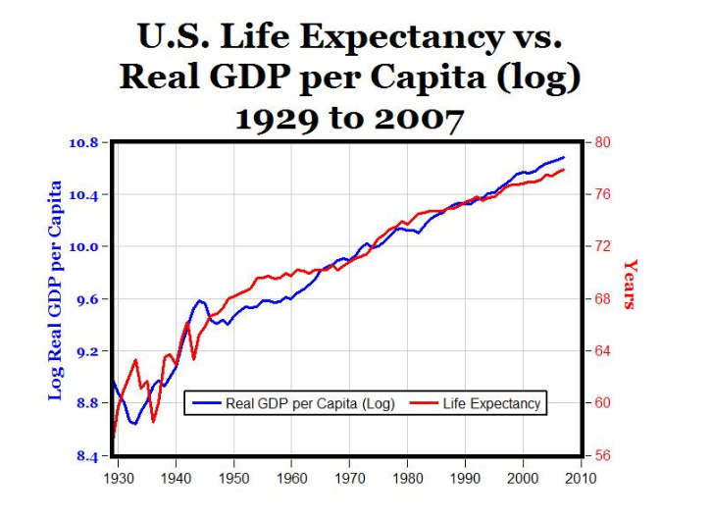

Slide 5
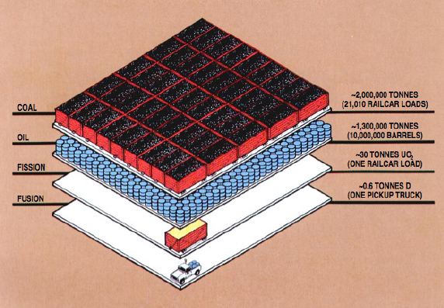
Disparity of energy output

Slide 6
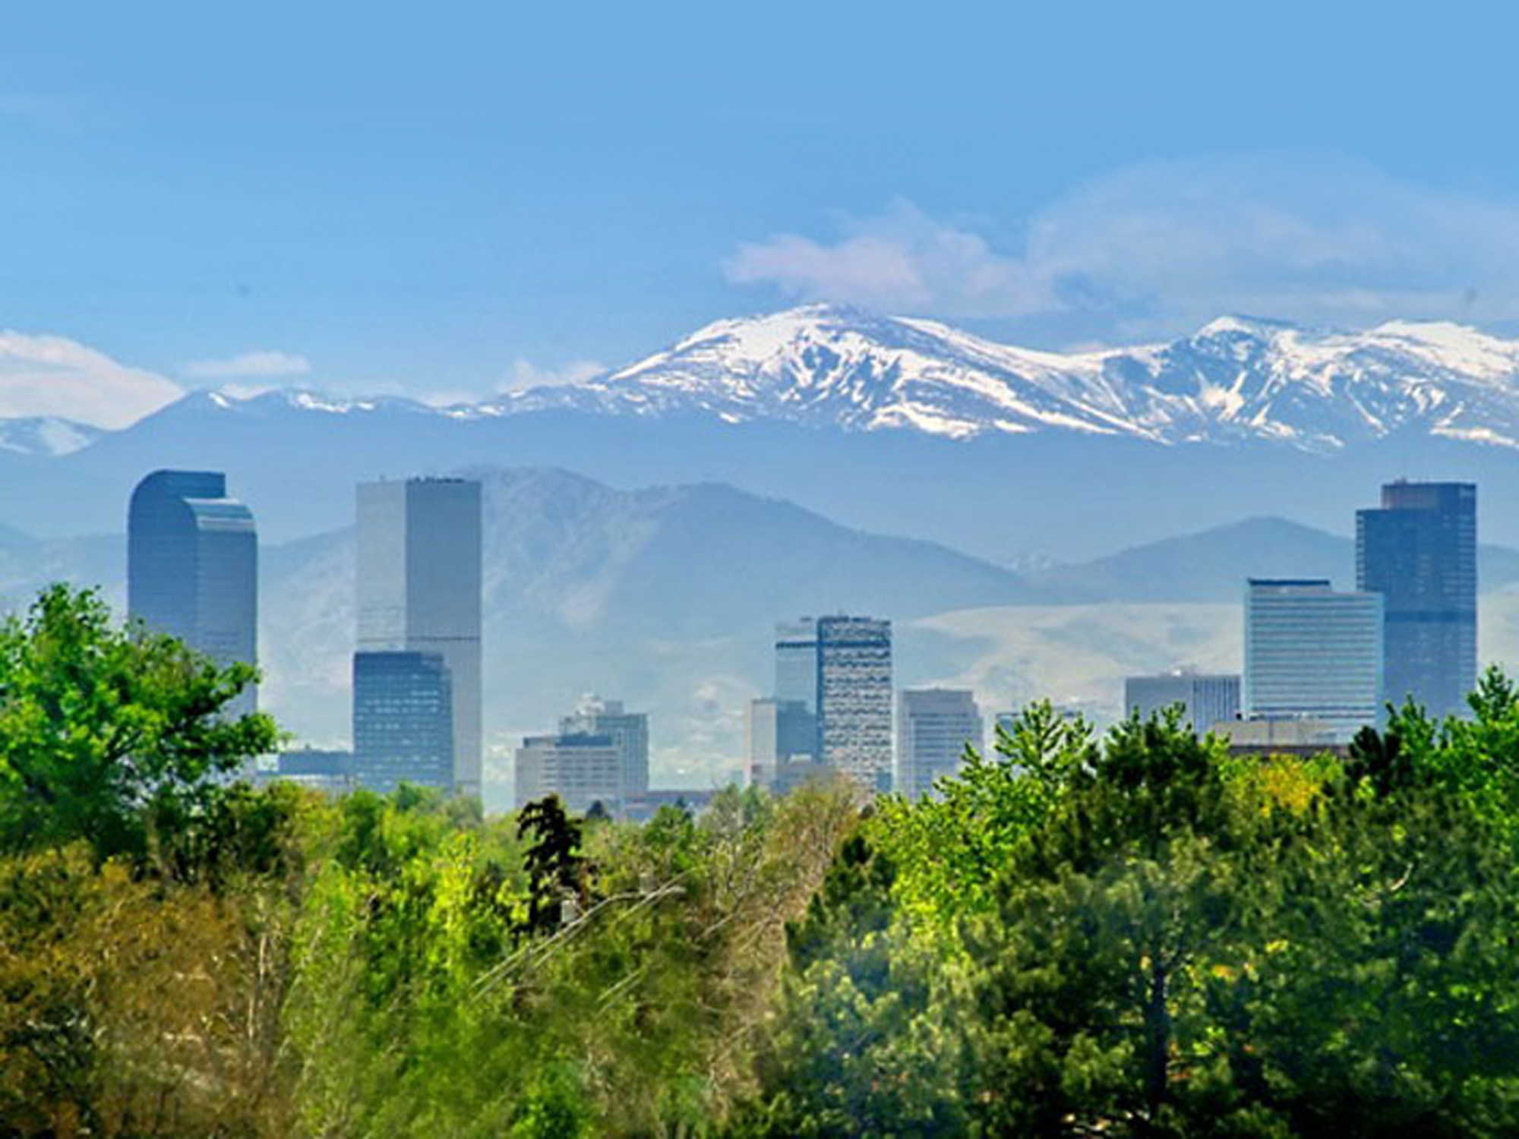
Advantages of Fusion
Potential for large scale energy generation
Plentiful fuel around the globe
No carbon or acid rain-producing emissions
No long-lived radioactive waste
No potential for melt-down or catastrophe
Notes:
Fuel
Huge supply, well distributed on Earth
Deuterium: plentiful in oceans
Tritium: produced from lithium
Safety
No run-away effect
No proliferation issues
Wastes
Neutron-induced activation has low radio-toxicity (< 100 years)
Worldwide availability of low-cost fuel, billion-year supply
No greenhouse-gas production, no smog, no acid rain
No possibility of runaway reaction or meltdown
No proliferation threat (not a credible bomb factory)
Comparatively short-lived radioactive wastes (due to neutron bombardment of vessel material)

Slide 7
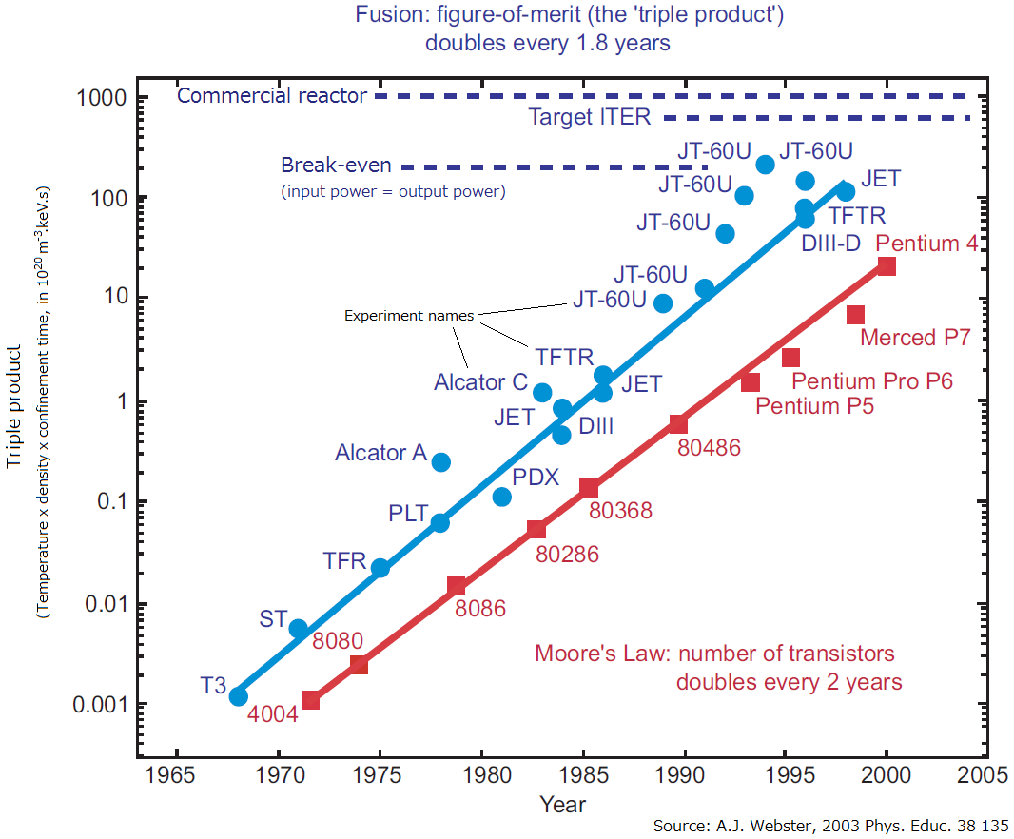
Progress in the fusion “triple product” has been significant
fusion triple product
Confinement time: “Plasma needs to hang on to fusion heat to make more fusion happen”
nTτ
Fusion fuel density: “need a lot of collisions per unit time”
Fusion fuel temperature: “nuclei need hard, fast collisions for any fusion to happen”
10,000-fold increase in 30 years, another factor of 6 for a power plant

Slide 8
WHAT IS THE U.S. FUSION PROGRAM?

Slide 9
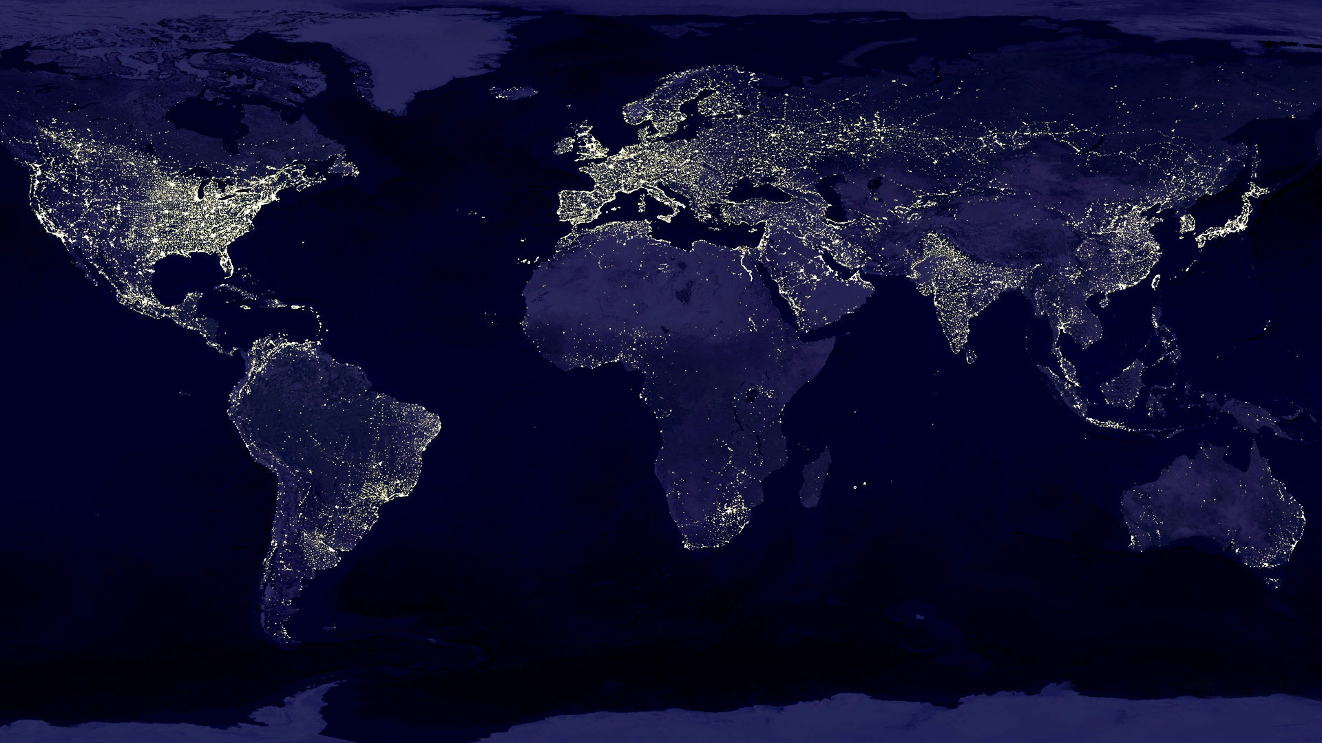
U.S. Fusion Energy Sciences program supports both fusion and plasma science
Objectives
Advance the fundamental science of magnetically confined plasmas for fusion energy
Pursue scientific opportunities and grand challenges in high energy density plasma science
Support the development of the scientific understanding required to design and deploy fusion materials
Increase the fundamental understanding of plasma science beyond burning plasmas
Mission
The mission of the U.S. Fusion Energy Sciences (FES) program is to expand the fundamental understanding of matter at very high temperatures and densities and to build the scientific foundations needed to develop a fusion energy source. This is accomplished by the study of the plasma state and its interactions with its surroundings.

Slide 10
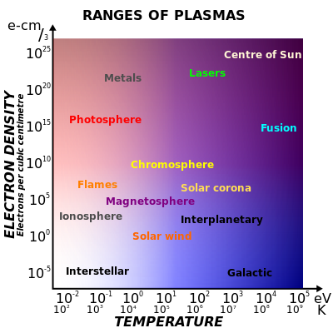
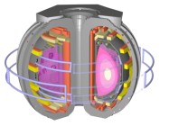
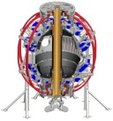
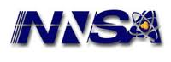
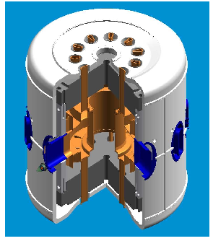
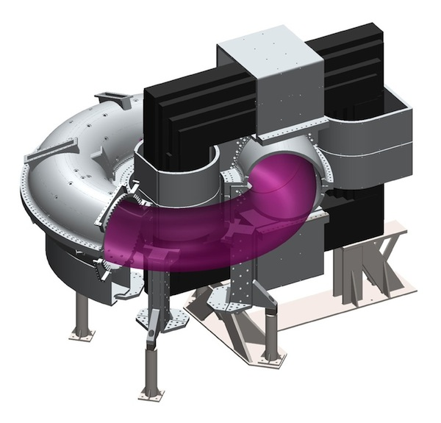
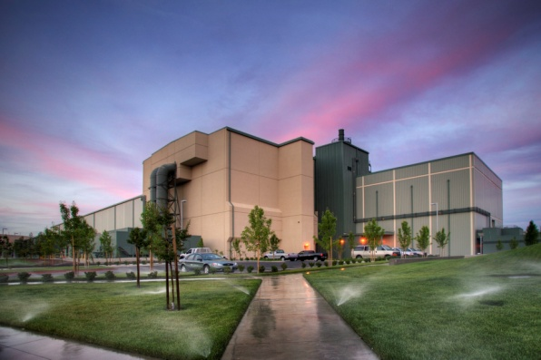
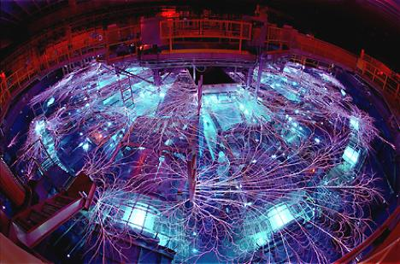
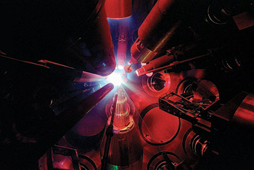
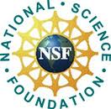
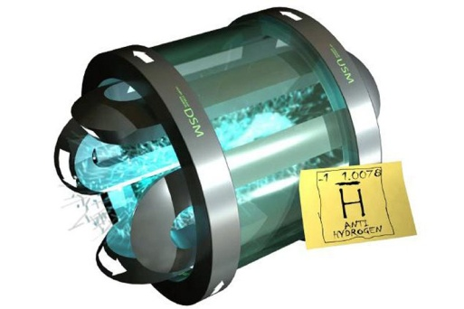
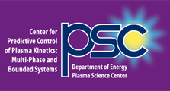
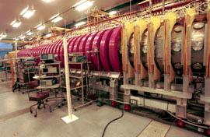
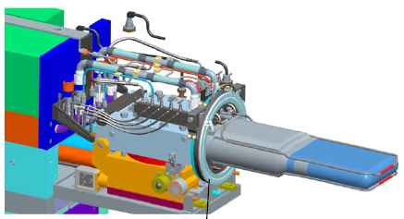
U.S. Fusion Energy Sciences: snapshot
High Energy Density Plasmas
ITER Project
(international partnership)
Inertial Fusion Energy Science
Magnetic Confinement Fusion
Materials in Extreme Conditions Instrument (MECI) @ SLAC-LCLS
Facilities
DIII-D
NSTX-U
Joint Program with National Nuclear Security Administration
C-Mod
MST
Experimental Plasma Research
Diagnostics
Theory & Simulation, SciDAC
General Plasma Science
International collaborations
NSF/DOE Partnership in Basic Plasma Science
Max Planck Princeton Research Center for Plasma Physics
Enabling R&D
Fusion Materials Science
Enabling Technology
Advanced Design
Low Temperature Plasma
Basic Plasma Science Facility

Slide 11
U.S. Fusion Energy Sciences: snapshot
High Energy Density Plasmas
ITER Project
(international partnership)
Inertial Fusion Energy Science
Magnetic Confinement Fusion
Materials in Extreme Conditions Instrument (MECI) @ SLAC-LCLS
Facilities
DIII-D
NSTX-U
Joint Program with National Nuclear Security Administration
C-Mod
MST
Experimental Plasma Research
Diagnostics
Theory & Simulation, SciDAC
General Plasma Science
International collaborations
NSF/DOE Partnership in Basic Plasma Science
Max Planck Princeton Research Center for Plasma Physics
Enabling R&D
Fusion Materials Science
Enabling Technology
Advanced Design
Low Temperature Plasma
Talks from DIII-D (A. Kellman), NSTX-U (A. von Halle) and Z machine (J. Lash)
Basic Plasma Science Facility

Slide 12
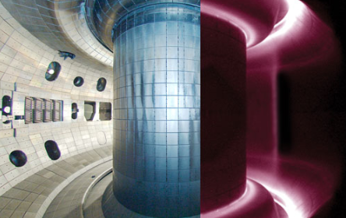
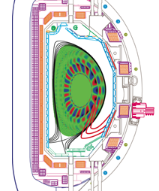
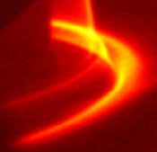
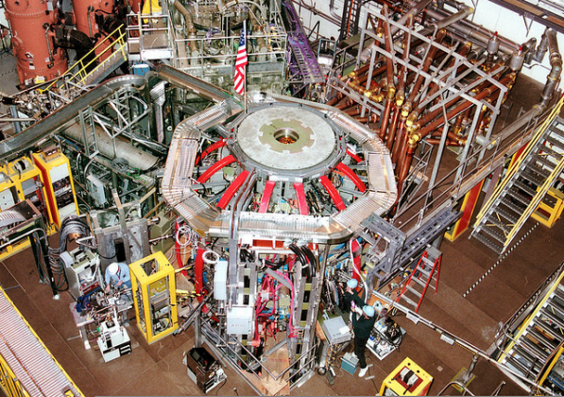
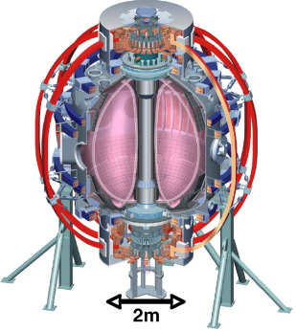
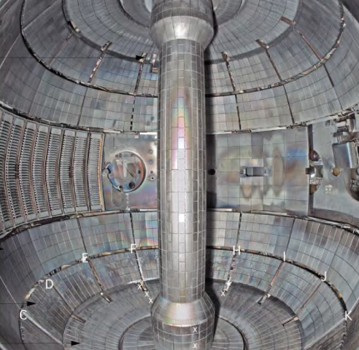
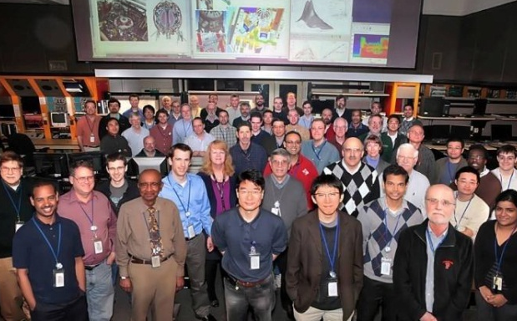
Major facilities DIII-D and NSTX-U
20 graduate students, 14 post docs
DIII-D national user facility (General Atomics)
DIII-D is the largest magnetic fusion research experiment in the U.S. and can magnetically confine plasmas at temperatures relevant to burning plasma conditions.
Grow
Students
31 graduate students, 16 post docs
NSTX-U national user facility (PPPL)
NSTX-U is the world’s highest performance spherical tokamak. It can confine plasma with pressure that is high compared to the magnetic field pressure.

Slide 13
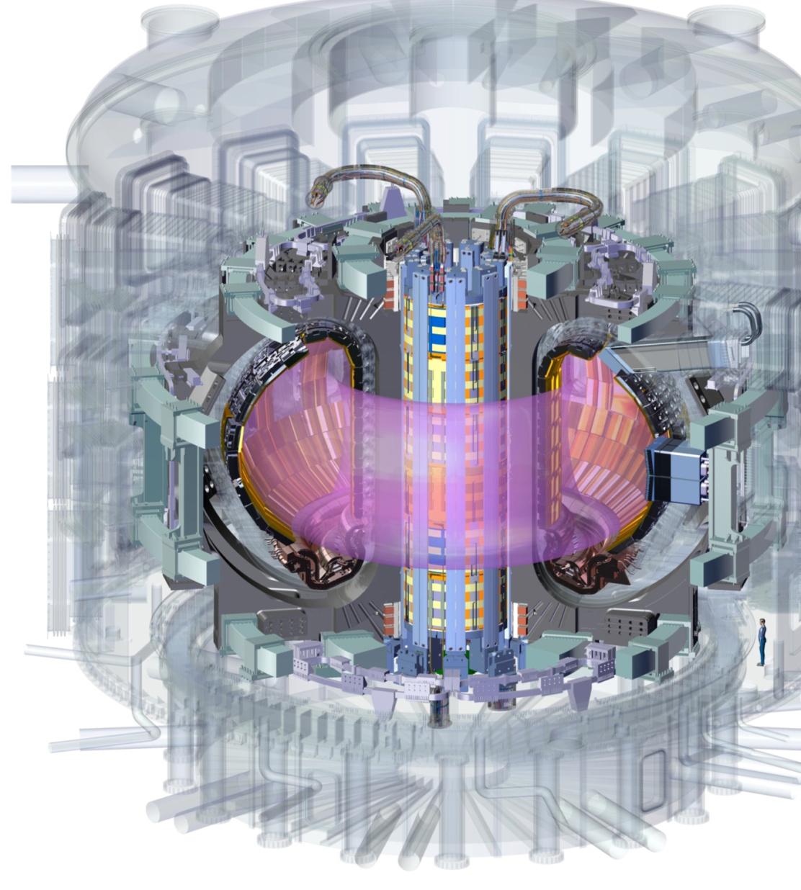
ITER is the next frontier
The ITER Project represents the next frontier in energy generation and will deliver an international scientific laboratory that demonstrates hydrogen fusion as a practical source of electricity in the 21st Century
ITER partners = EU, Japan, Russia, US, Korea, China, India
7 international partners represent 50% of world’s population

Slide 14
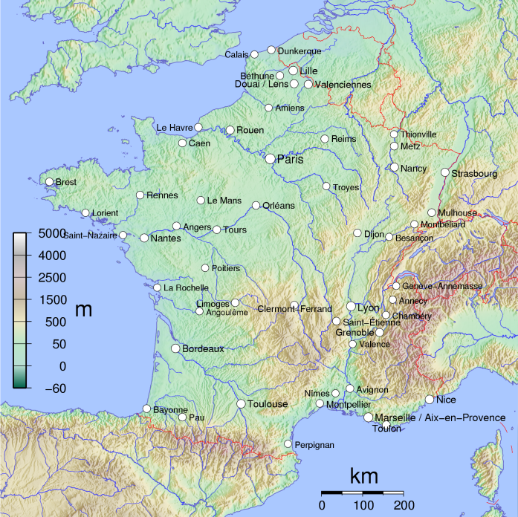
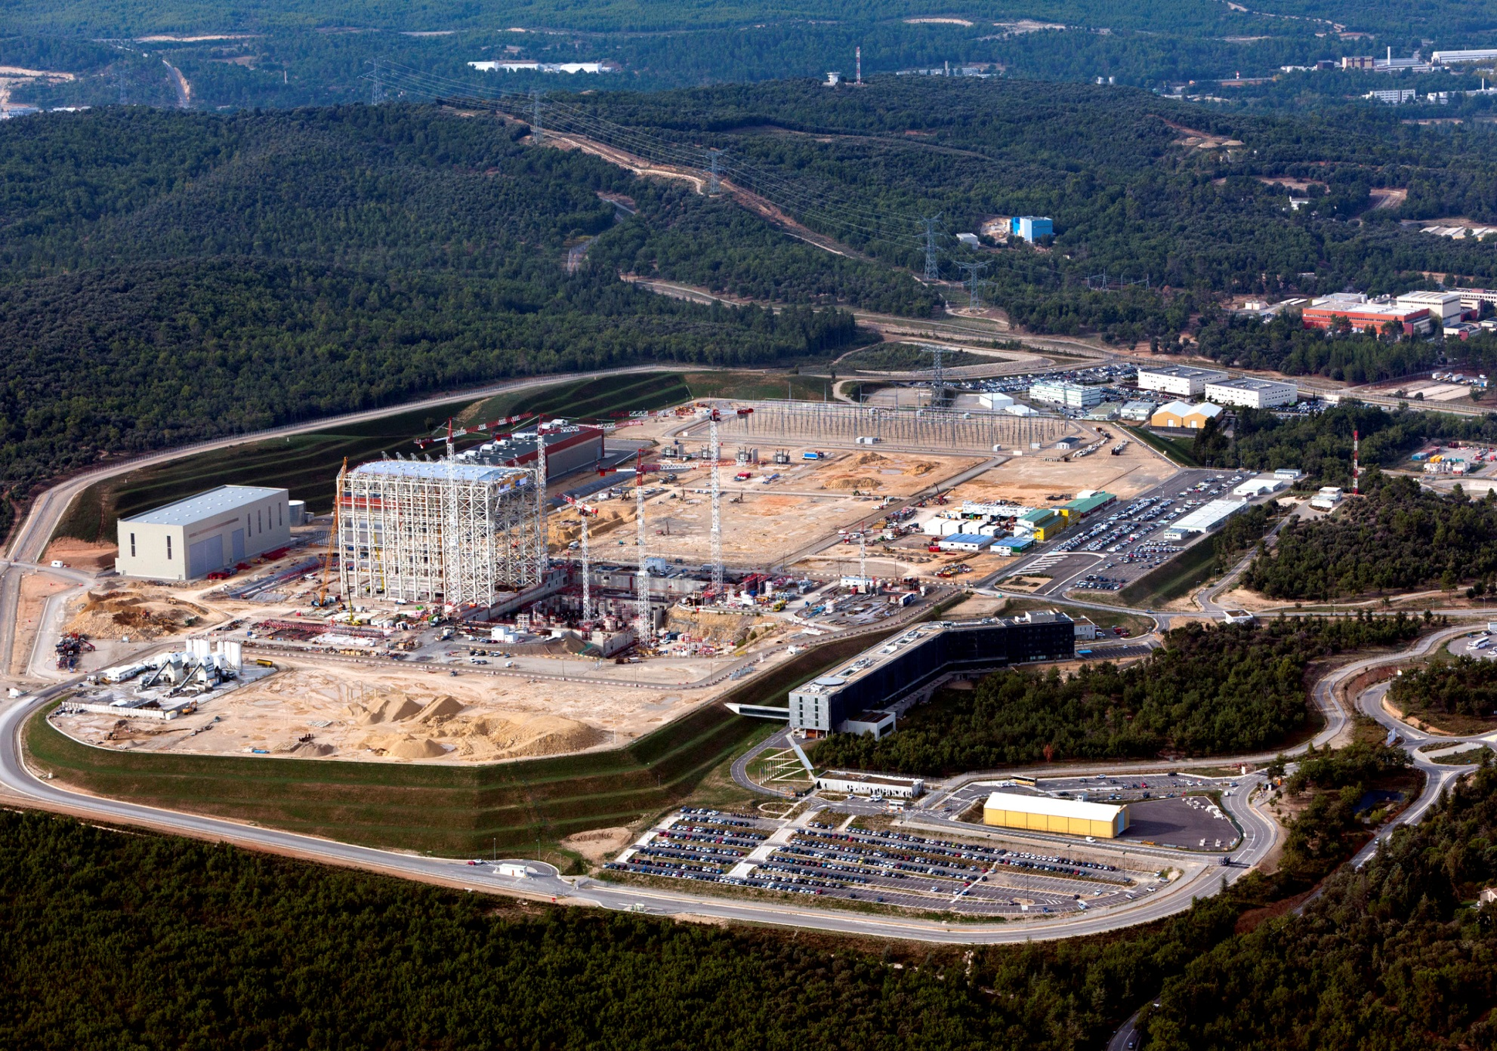
ITER Site
February 2013
Photo: MatthieuCOLIN.com / ITER Organization
Drone video of ITER work site

Slide 15
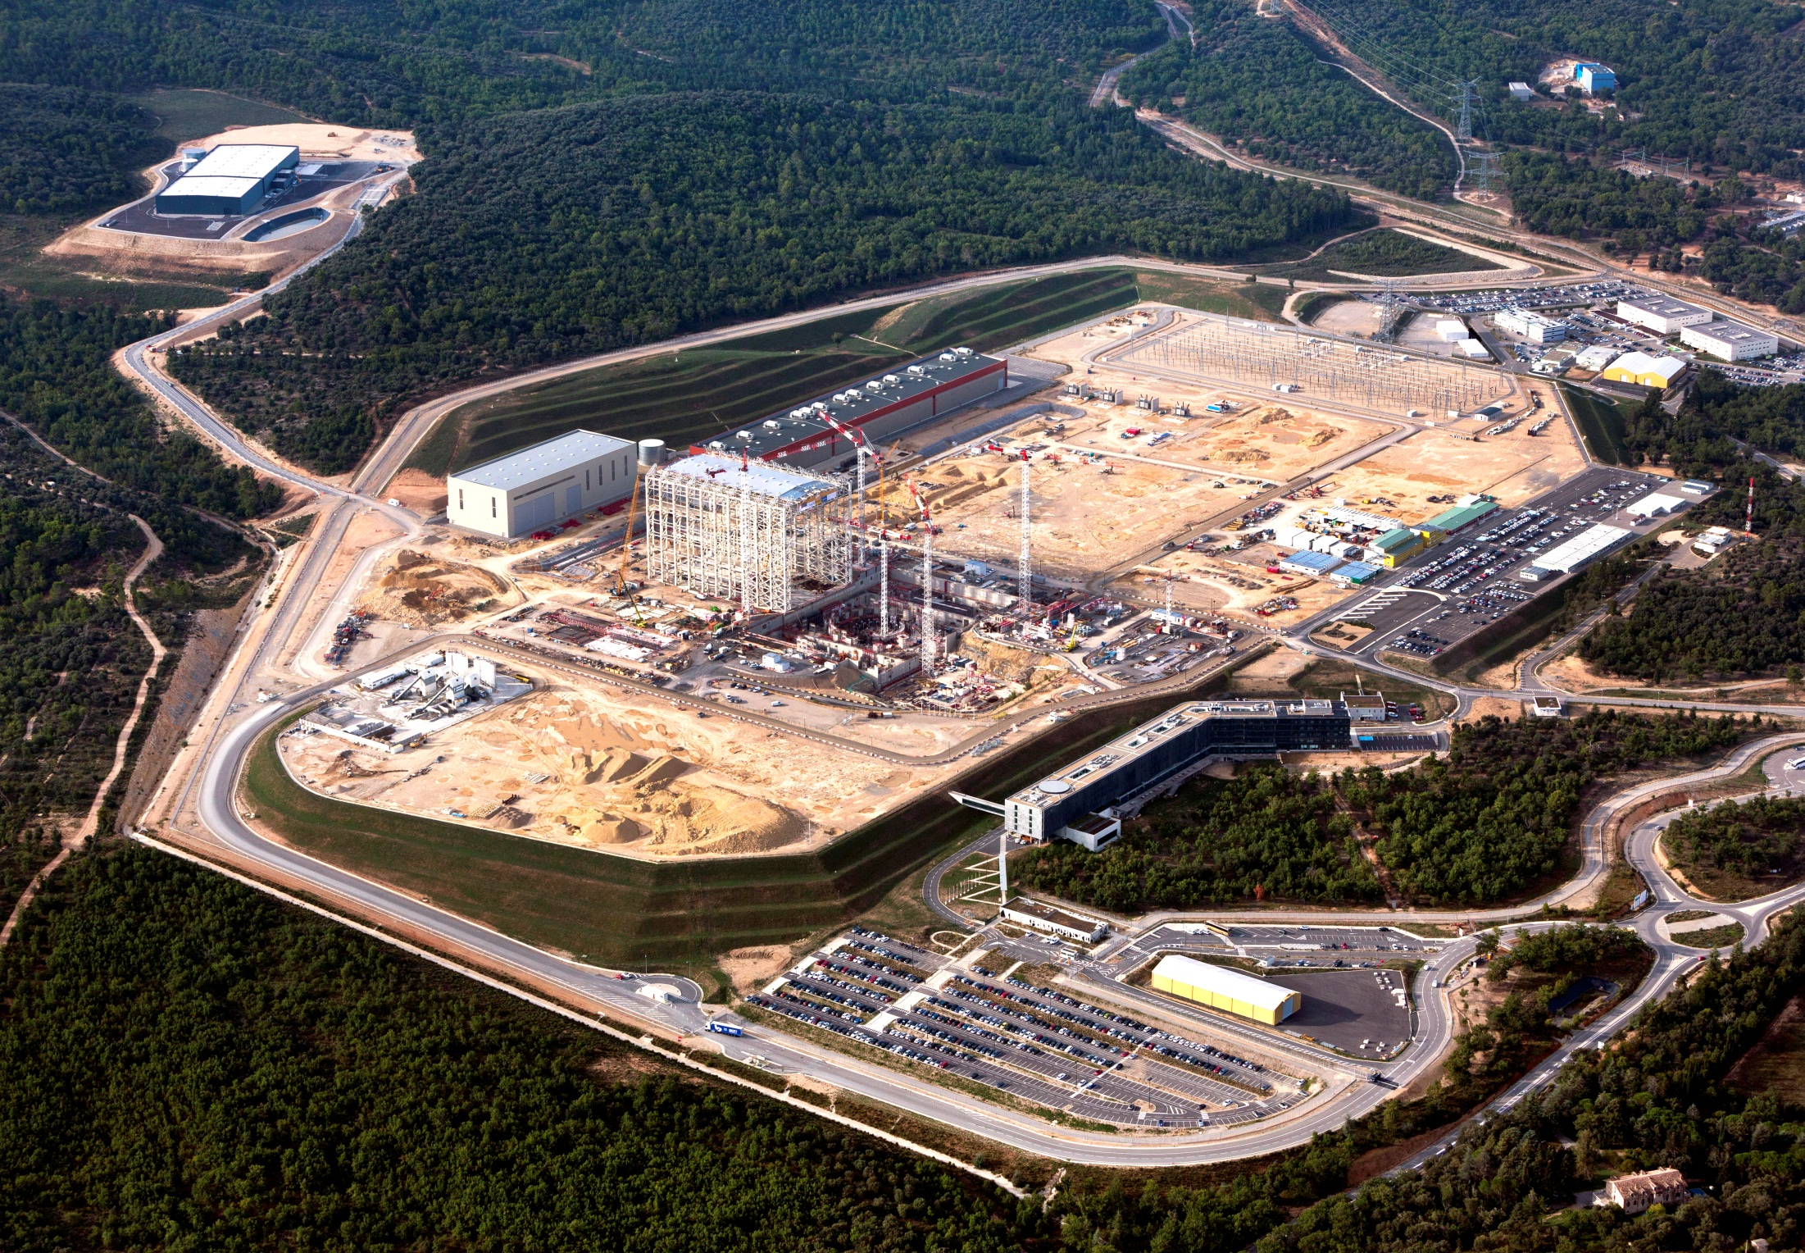
Worksite progress
Storage Area 2
Transformers
(Installation Complete)
Storage Area 3
PF Coils Building
400 kV switchyard
Tokamak Complex
(Under construction)
Assembly Hall
(Under construction)
Subcontractors Area
Cryostat Workshop
(now receiving components)
Preparatory works
Magnet Conversion Power
Cryogenics Buildings
Under construction
Site Service buildings
Under construction
Batching Plant
HQ Extension
Preparatory works
Cooling Water Building
Storage Area 1
Preparatory works
Control Building
ITER HQ
Courtesy of ITER Organization
Courtesy of ITER Organization

Slide 16
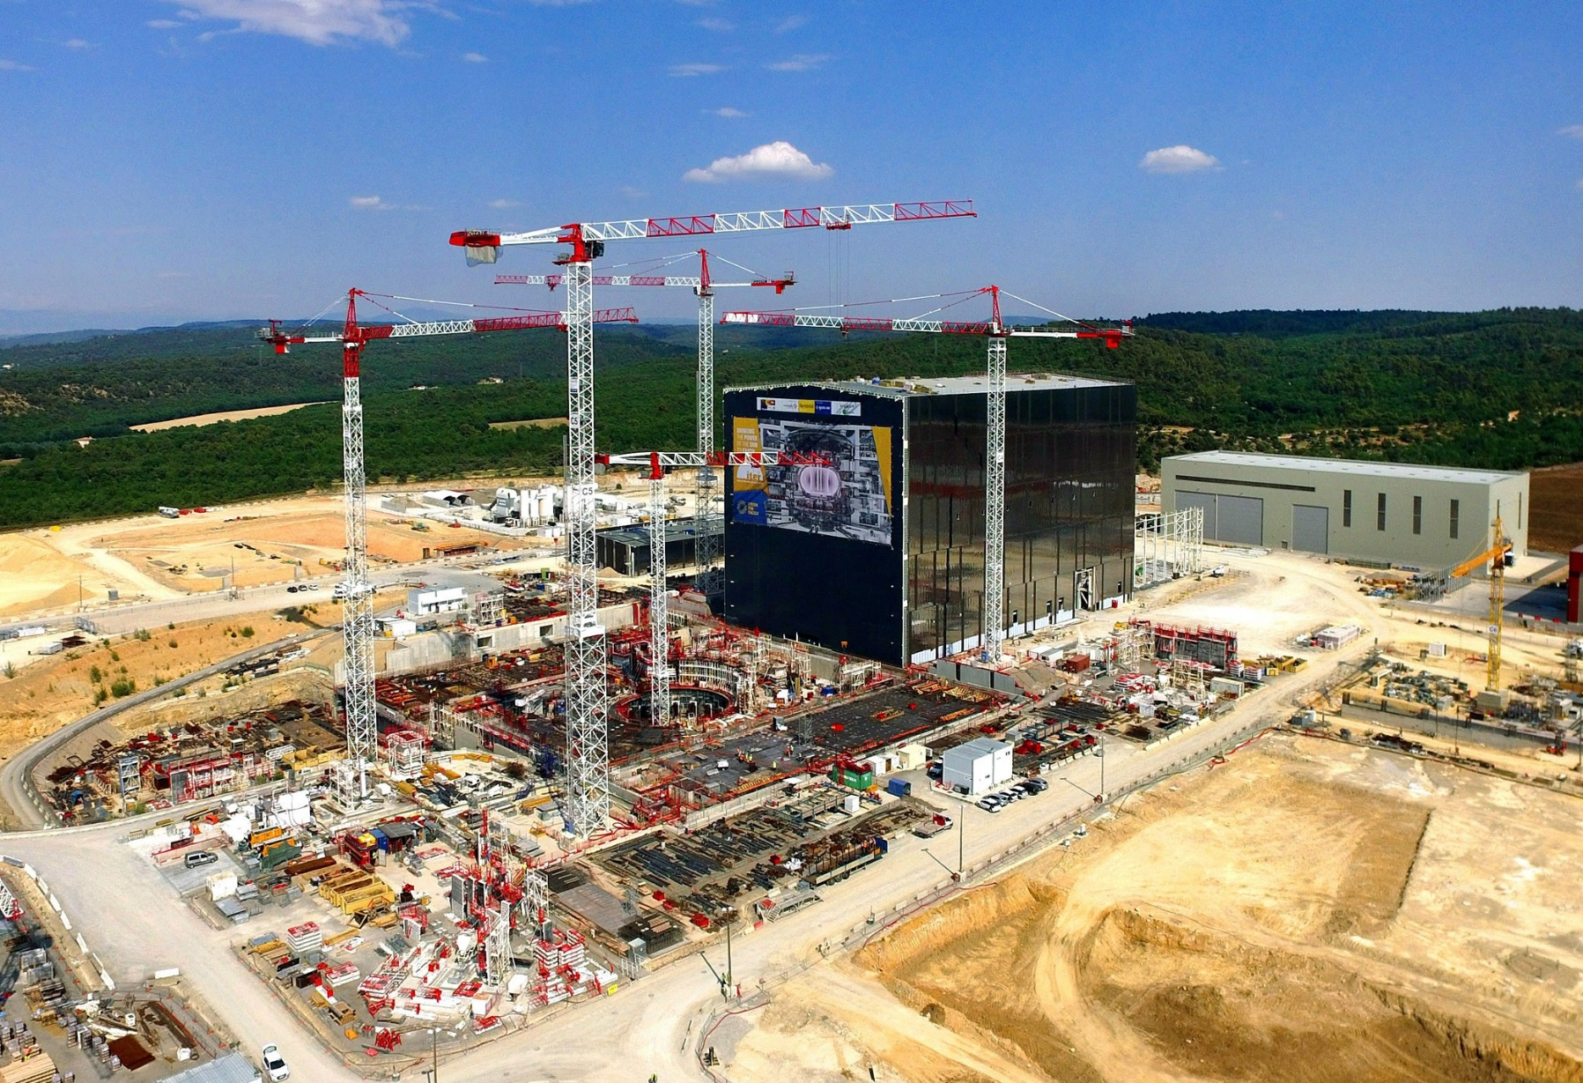
ITER Site as of July 2016
Tokamak Assembly Hall at the right background; tokamak pit in the center foreground

Slide 17
COMMONALITIES BETWEEN FUSION
AND ACCELERATOR SAFETY

Slide 18
Fusion and Accelerator research shares nearly all of the same safety issues
High Voltage Hazards are inevitable for any system requiring Tesla level magnetic fields (13 T ITER center solenoid, 8.3 T for LHC)
Arc Blasts have been experienced at both DIII-D and NSTX-U facilities
Radiation hazards are present as fusion reactions generate neutrons
Confined spaces are inherent to any toroidal confinement device, whether meters of kilometers in length
etc…

Slide 19
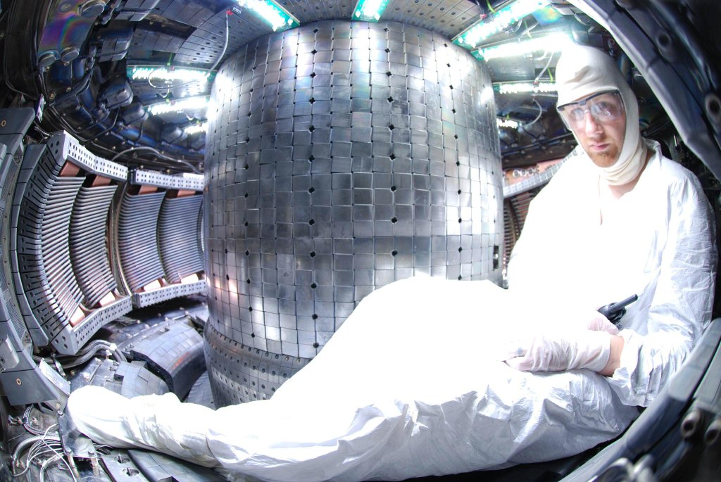
MIT’s Alcator C-mod
A fusion confined space claustrophobia is not an option

Slide 20
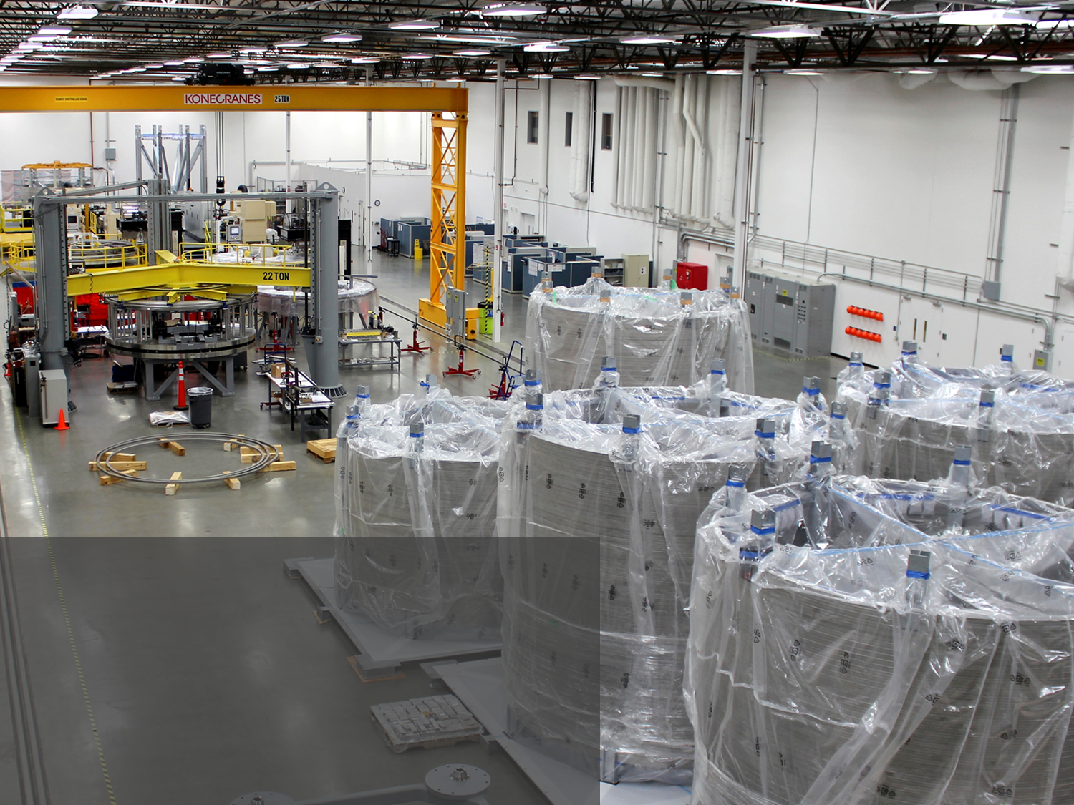
ITER Central solenoid fabrication facility at General Atomics in Poway, California
Heavy lifting crane hazards
Electrical hazards during eventual testing

Slide 21
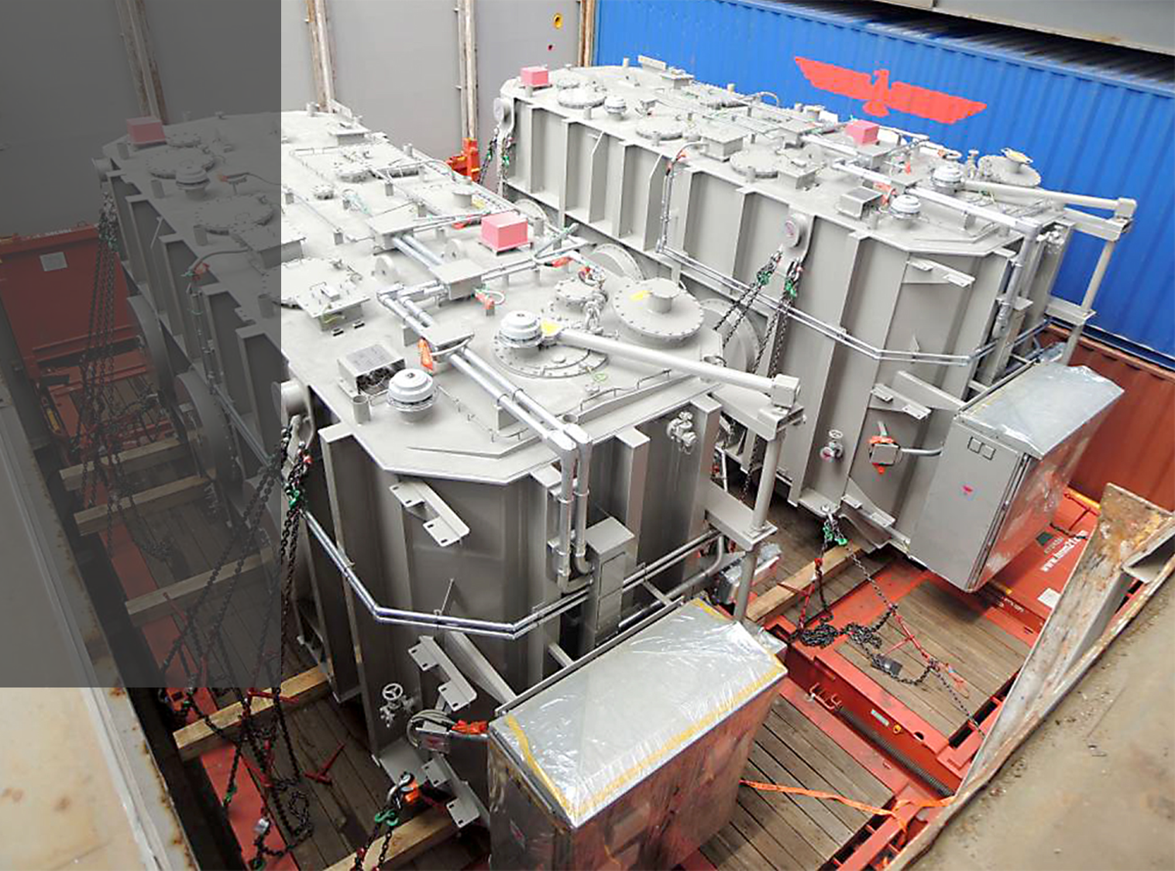
Two ITER high voltage substation transformers
Photo: HHI
HV substation transformers
22 kV: switchgear
6.6 kV switchgear

Slide 22
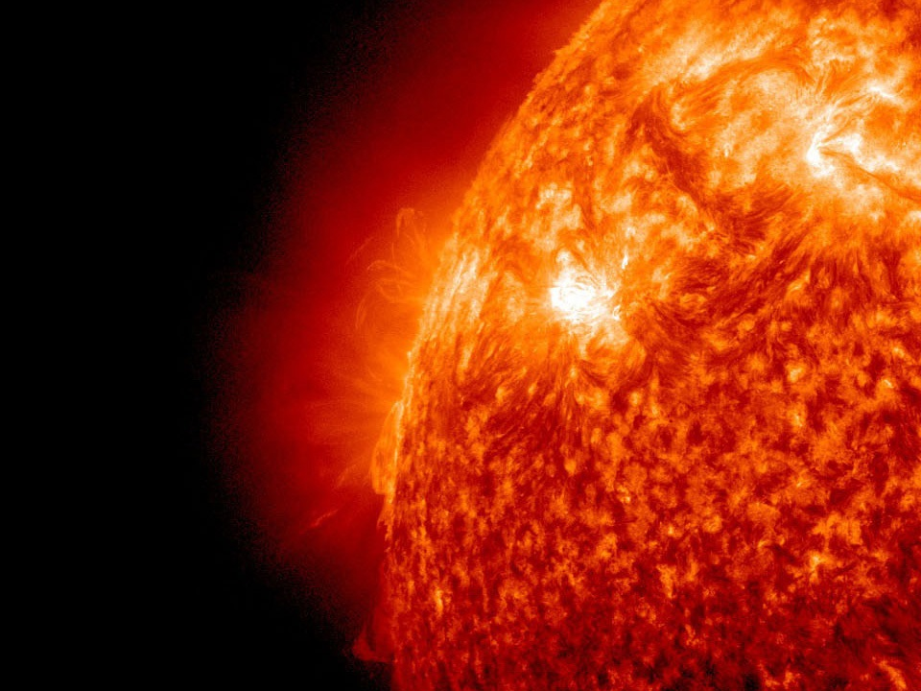
Links for more information:
http://science.energy.gov/fes/
https://burningplasma.org

