Slide 2
Intervention Management Planning & Activity Coordination Tool (IMPACT)
From different tools and approaches to a single tool and a centralized vision

Slide 3
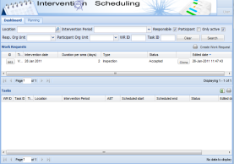
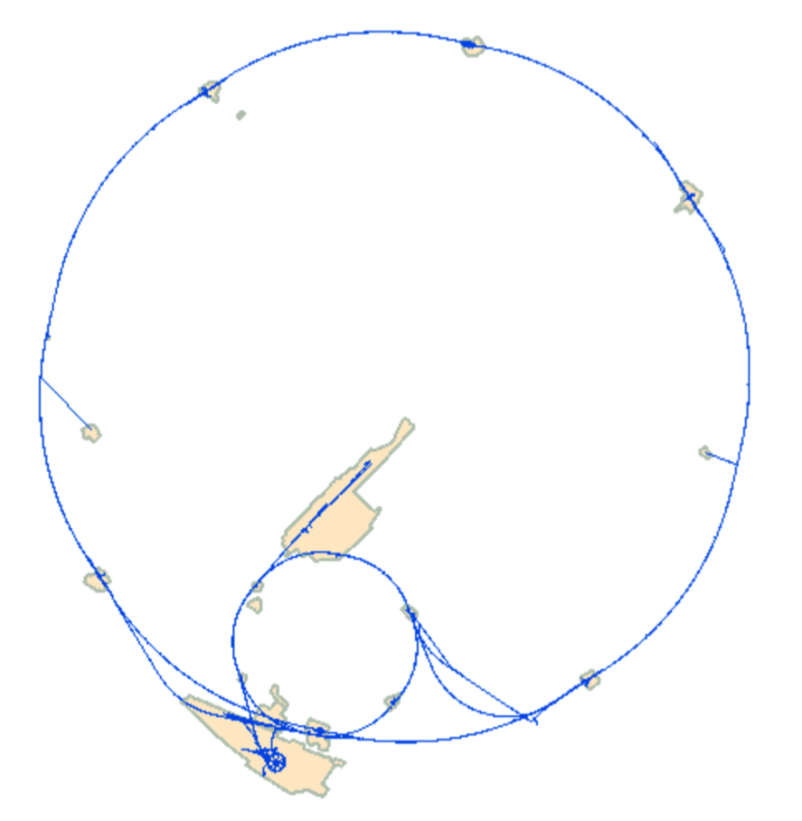
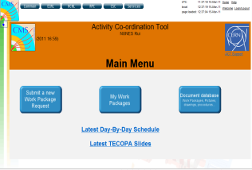
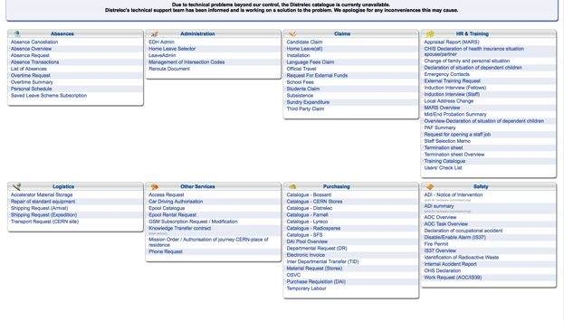
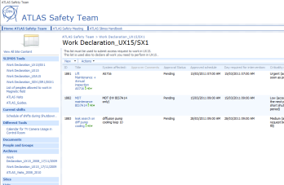
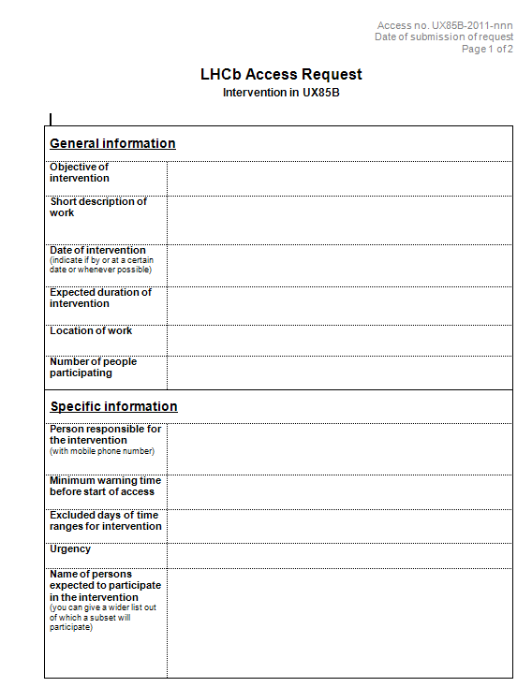
Work Authorization - Situation before IMPACT
Work Activity Tool (WAT) – LHC Machine
Activity Coordination Tool (ACT) – CMS Experiment
Avis de Intervention (ADI/EDH) – ALICE Experiment
SharePoint – ATLAS Experiment
Word + Email – LHCb Experiment
Avis de Ouverture de Chantier (AOC/EDH) – Surface Buildings in the main sites
+ Other experiments, Coordination meetings, ...

Slide 4
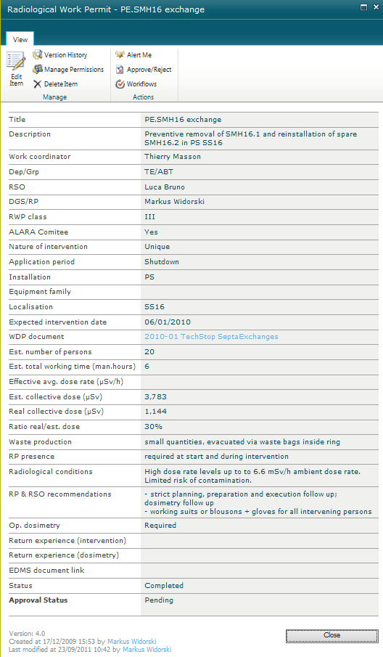
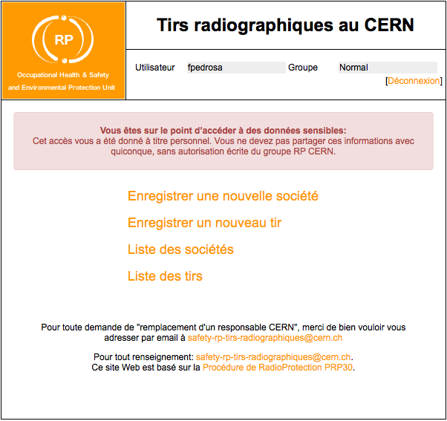
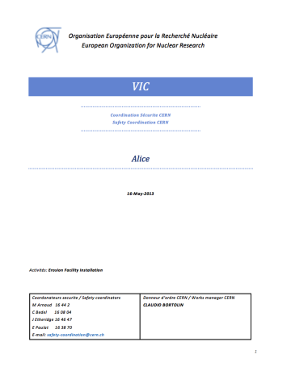
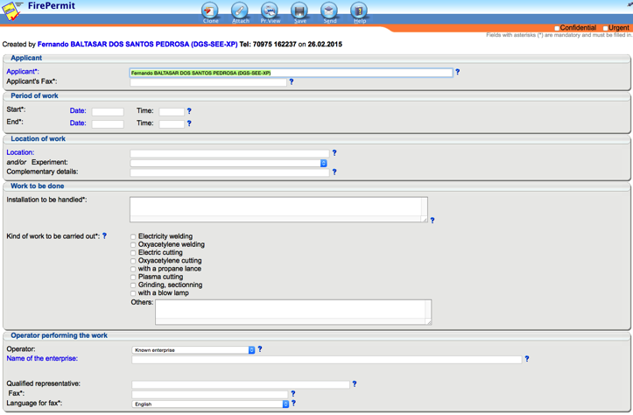
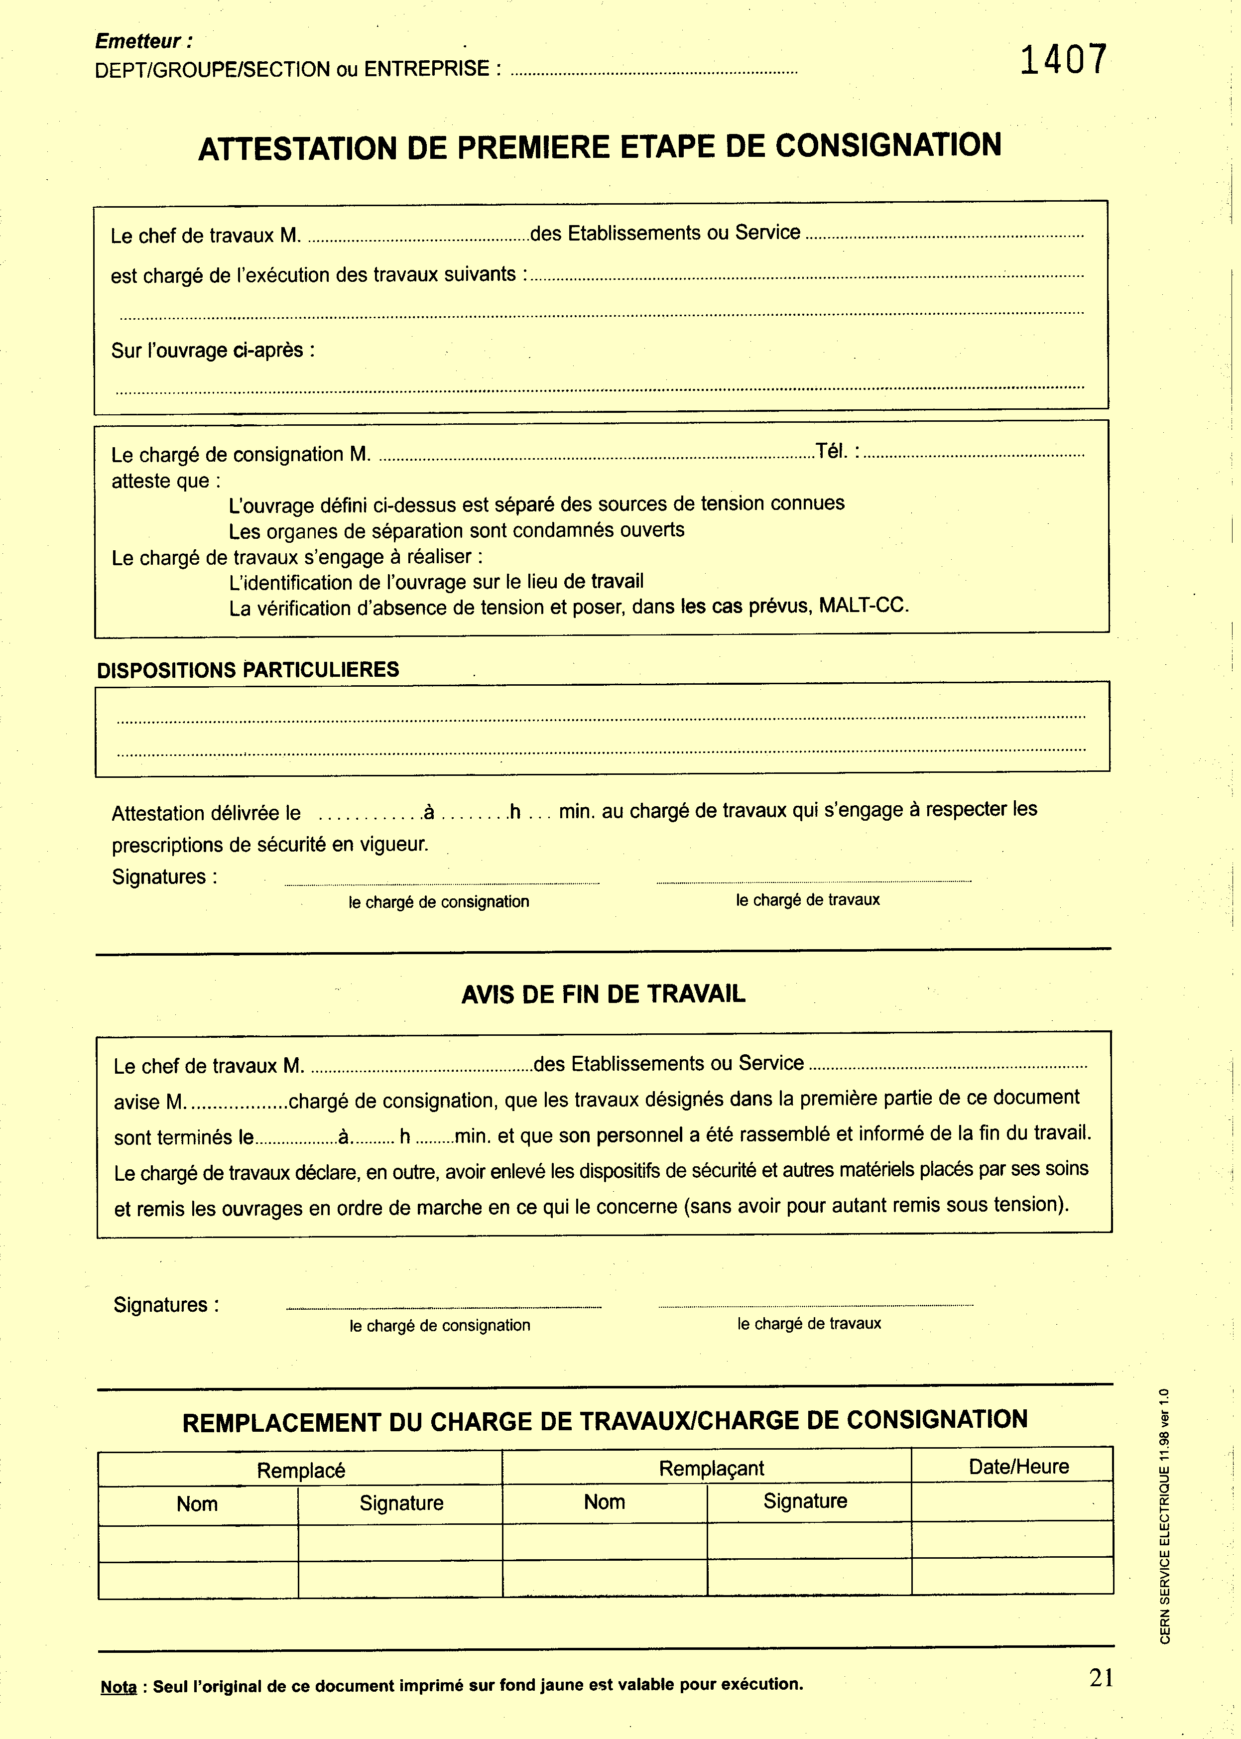
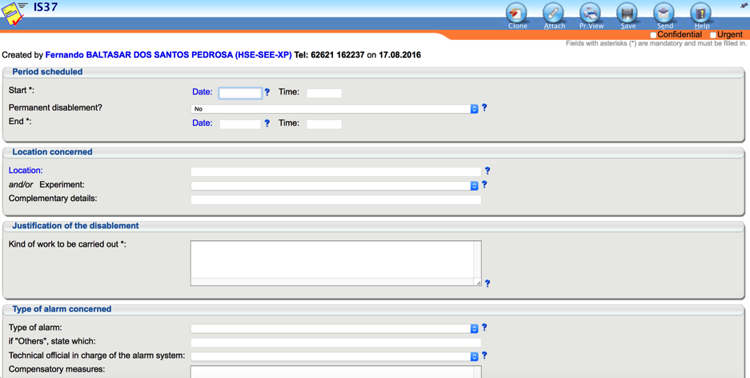
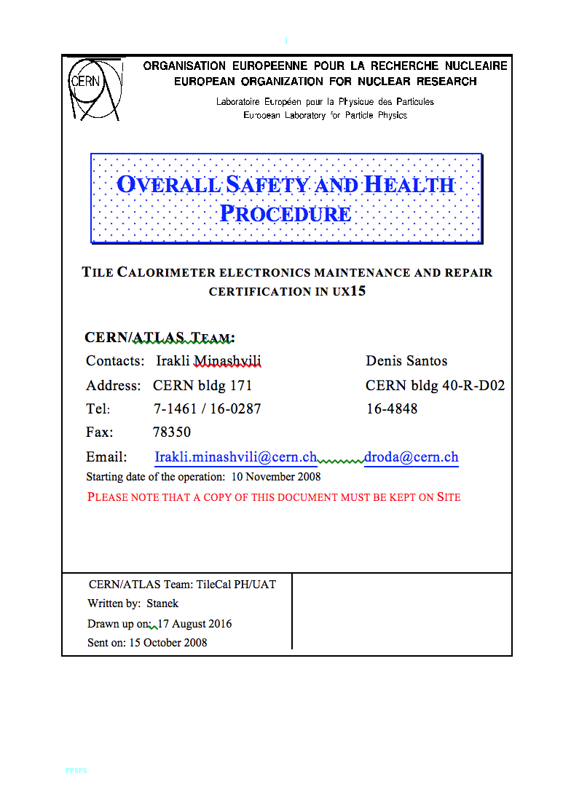
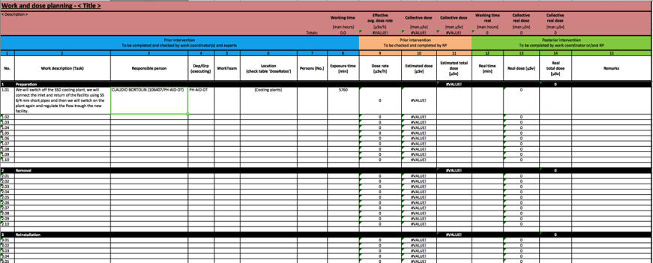
Safety Procedures - Situation before IMPACT
Visit the Inspection Commune (VIC) – Word file Stored in EDMS
Dossier d’intervention en milieu radioactif (DIMR) – SharePoint form
P
Gammagraphy – Web site
Fire Permit (= Hot Work Permit) – EDH form
+ Cryogenic Lockout, Vacuum Lockout, Hazard identification, ...
Electrical Lockout – Request by email/phone + paper
Disable/Enable Alarm (IS37) – EDH form
Plan Particulier de Sécurité et de Protection de la Santé (PPSPS) – Word file Stored in EDMS
Operational Doses Record – Paper + Manual input into a DB
Work Dose Planning – Excel file stored in EDMS and SharePoint
Notes:
EDH = Electronic Document Handling System
EDMS = Engineering & Equipment Data Management Service

Slide 5
Main issues
Groups that intervene in different facilities had to learn all different systems used to declare and obtain a permit
The systems didn’t talk to each other, so the same information had to be filled in n times if the activity was performed in n Facilities;
There was no automatic link between a work declaration and a Safety procedure;
A lot of manual actions were requested to the different users;
A lot of word documents were used and stored in different places with different visibility rights, and not all the people that should have access to the document had it;
Data entered manually in a DB following a paper register (in some cases a long delay was observed);
Many different approaches that were not transparent for the end user;

Slide 6
Steps followed to reach the actual situation
Initial phase (March to June 2011):
  Interview the different facility coordinators, some working groups, and the Safey Responsible for some facilities
Definition of specific Sub-working groups:
  Maintenance, Workflow, Safety, Location, Schedule
First Technical Specifications - September 2011
First version of the tool – December 2011
  Used by: LHC machine, ATLAS, ALICE, LHCb, SPS machine, PS machine
Continuous involvement of the different stakeholders in the sub-working groups
Continous requests from the users for new features (e.g. New Facilities, new forms, ...)
Preserve the initial goals: 1) create a tool adapted to the CERN way of working; 2) implement features only if they are associated to a work activity.

Slide 7
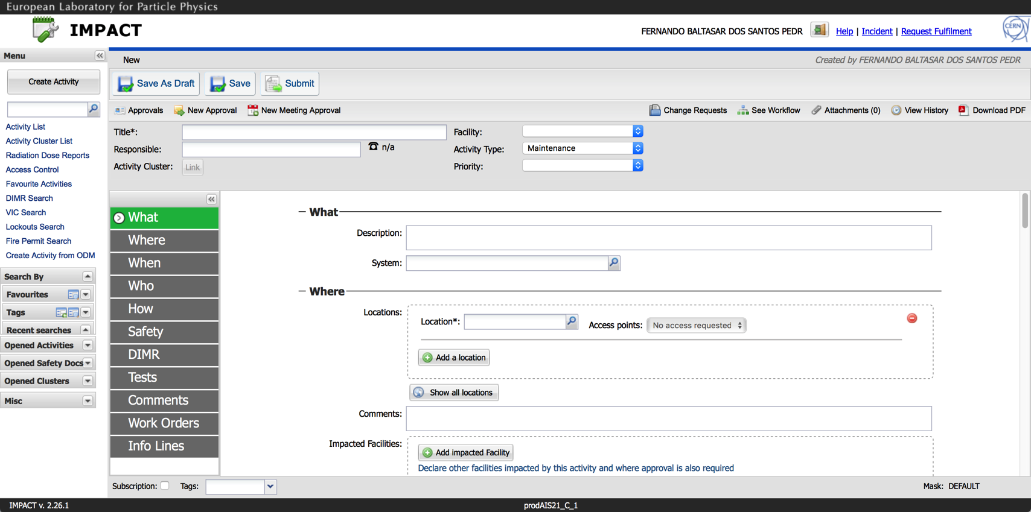
Actual situation for work declaration at CERN
Only one IMPACT is used to declare work activities at CERN – all the other tools have been abandoned
24 different facilities are defined in the tool
  Specific workflow
  Specific mask
  Specific locations tree
  Specific systems
Many different Safety processes are already integrated in the tool
  E.g.: Fire Permit, DIMR, Gammagraphy, VIC
First release in Dec 2011 and today we are in v.2.26.1 of IMPACT
Used during operation and maintenance periods by the operations team or the coordination teams (workflow is function of intervention the period defined directly in the tool)

Slide 8
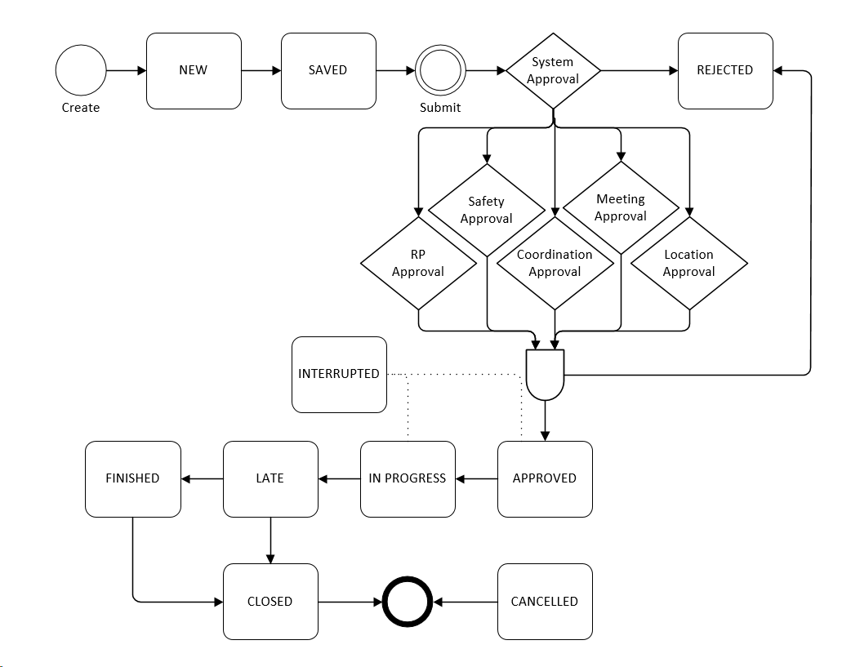
Workflow
The workflow is customizable per Facility, intervention period, system, location, area classification, …, allowing to integration of coordiation and control aspects in the approval or follow-up chain;
The end user just has to create/complete an activity, submit it for approval, and the system will calculate the right workflow that the activity will have to follow;
Due to some coordination and Safety controls performed in the field or due to specific Safety conditions the activities may be “Interrupted” (it will block the access to the areas where IMPACT is linked to the access system);
The Specific forms have their own specific workflows, and don’t interfere with the approval of the activity
Notes:
Any interruption/resume of an activity triggers a notification to the activity responsible. It is up to the responsible to inform every participant to his activity, specially if there is no access system that prevents people to access a given working area.
In the areas where IMPACT is linked to the access system, workers can access only if the IMPACT is approved.

Slide 9
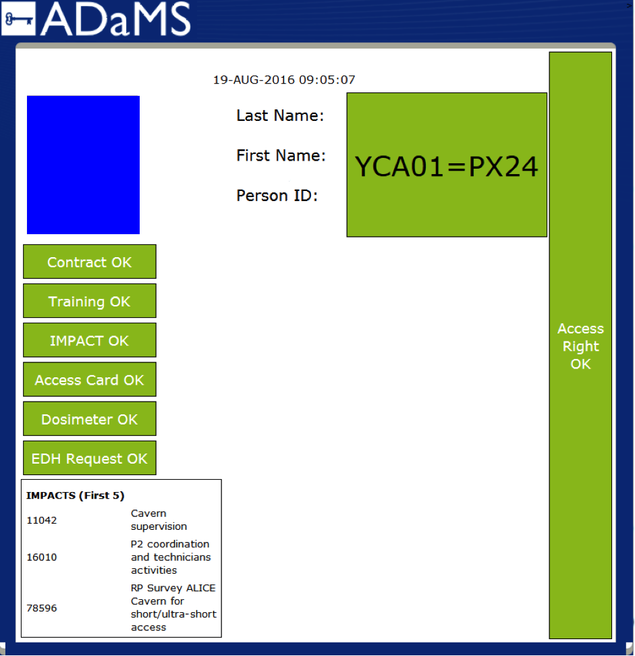
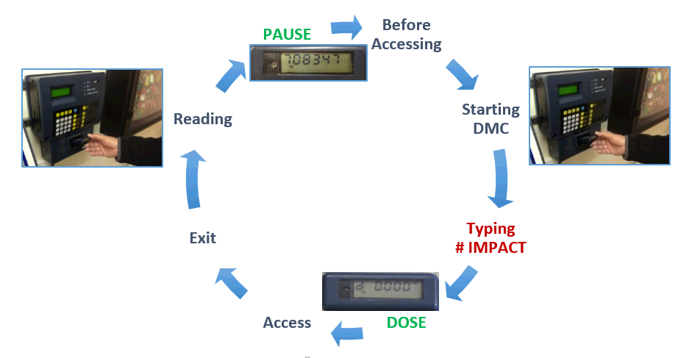
Link with external systems
ADAMS – a valid IMPACT is a condition like the Safety trainings or the dosimeter to allow access to certain areas;
INFOR EAM – It is possible to create an IMPACT activity from a Work Order (ODM) in INFOR;
DOSISERV – the operational doses taken are registered directly to the activity the person is performing ;
EDH – For some facilities or some specific documents the EDH workflow is used to get the approval;
An API is available which allows external systems to retrieve data and perform actions (e.g. CERN Control Center, and CMS detector applications)
Notes:
ADAMS = Access Distribution and Management System
INFOR EAM = Information Enterprise Asset Management
DOSISERV = Operational Dosimetry Service
EDH = Electronic Documents Handling

Slide 10
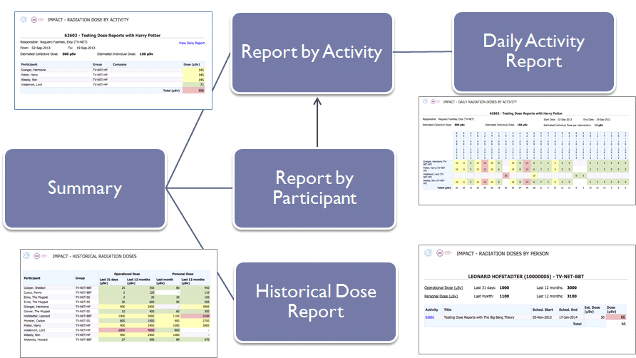
Radiation Protection Controls
Approval of IMPACT activities based on the area classification, type of work or if there is a radiation hazard imported by the activity (e.g. use of radiation source);
Approval of all Gammagraphys;
Operational Dose Follow-up via the link with the DOSISERV system and the Dose Reports available directly in IMPACT;
For the operational dose follow-up there are other roles involved in the control and not only the HSE-RP group.
By automatic alerts triggered by IMPACT or DOSISERV based on some filtering criteria;
Number of operational dose reports generated
Notes:
2014 was part of the Long Shut Down 1, and 2015 was a normal operational year, so the difference between the two years is expected

Slide 11
Worksite preparation and controls
The user can detail his/her activity directly in the IMPACT activity and CLONE it in a future occasion, attach a document, link a document that is in EDMS, …
As part of the work preparation and especially when there is co-activity, the work supervisor writes a VIC (visit d’inspection commune);
The visits and the work preparation identify the need to create other documents like Fire Permit, Lockout request, IS37, …
Number of VICs generated in 2015
Type of document | N. of documents generated or attached since 2011
PDP | 811
PPSPS | 4623
Work Procedure | 997
Notes:
PDP – Plan de Prevention / Prevention Plan
PPSPS - Plan Particulier de Sécurité et de Protection de la Santé (PPSPS) / Specific Prevention Plan
IS37 – Enable/Disable a level 3 alarm system

Slide 12
Some numbers
Number of IMPACT activities per year:
  2011 – 1841
  2012 – 7669
  2013 – 13053
  2014 – 16111
  2015 – 10899
Number of IMPACT users per year:
  2012 – 86
  2013 – 2524
  2014 – 3145
  2015 – 3569
Number of DIMRs:
  850
Number of VICs:
  1682 since October 2013
Number of Fire Permits:
  653 since December 2015
Number of electrical lockout requests:
  370 since December 2013
Number of Visits:
  10438
Number of Gammagraphy:
  172 since March 2015

Slide 13
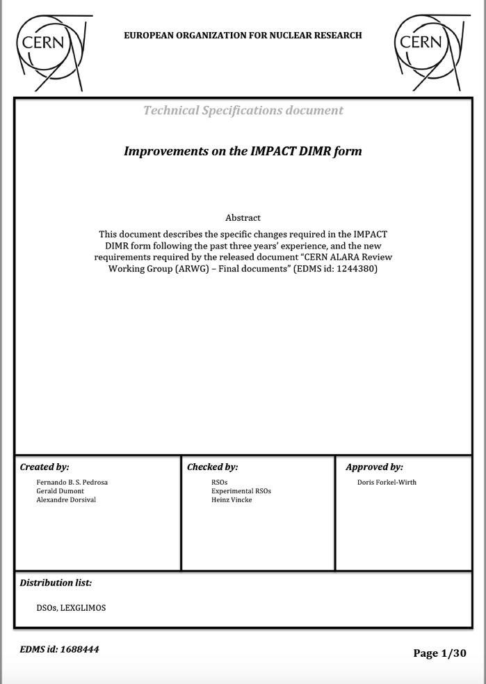
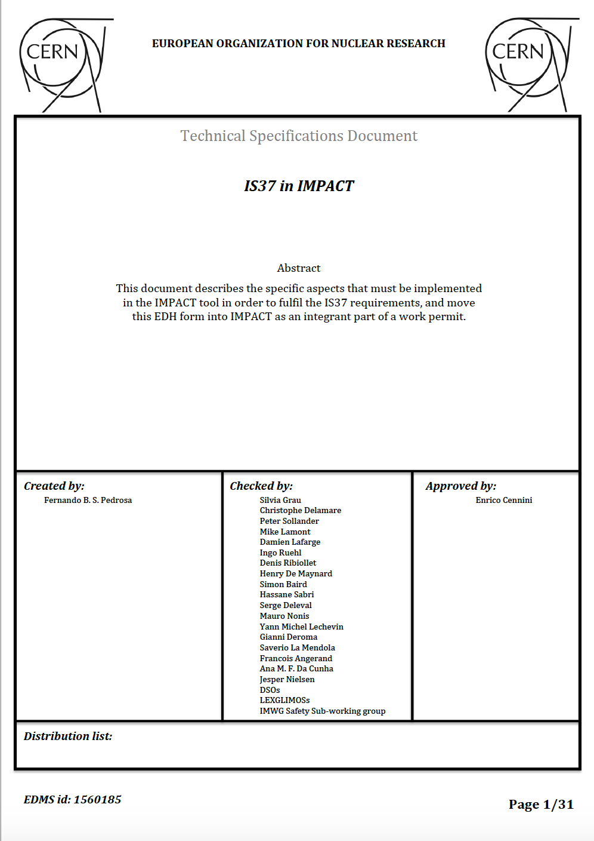
List of Future development
Due to the success of the tool the development is still ongoing and there are a large number of features that we would like to implement in the tool. Among these additional features it is possible to list some like:
DIMR v2
IS37 integration (Enable/disable level 3 alarm systems)
AET (work outside normal working hours)
WDP (Work Dose Planning)
Activity risk assessment
NdC (Planned outage of a service)
The implementation of new features follows a sistematic quality approach. Such quality approach ensures that the implemented solutions follow what is performed by the intervention teams on the field, that the Safety/confidentiality rules are respected, and that the decisions taken are recorded.
Notes:
AET – Avis d’execution de travaux en dehors de la plage horaire admise comme “Horaire normal”
DIMR - Dossier d’intervention en milieu radioactif (DIMR)

