Slide 1
Fermilab LBNF/DUNE Project
Vaia Papadimitriou
LBNF Beamline Manager
2016 DOE Accelerator Safety Workshop
September 20, 2016

Slide 2
Outline
Scope of LBNF and DUNE
Overview of the designs of:
  the Beamline (Near site)
  the Detectors (Near and Far sites)
  Conventional Facilities and other infrastructure (Near and Far sites)
Timetable
Safety related challenges

Slide 3
What is DUNE? What is LBNF?
The Deep Underground Neutrino Experiment will be a game-changing experiment for neutrino science, potentially transforming our understanding of why the universe exists as it does.
  Measure neutrino oscillations (CP violation, CP phase, mass hierarchy,…, in a single exp.)
  study other fundamental physics enabled by a massive underground detector (nucleon decay, atmospheric neutrinos, neutrinos from galactic core collapse supernovae)
The Long-Baseline Neutrino Facility is the infrastructure necessary to send a powerful, broad band beam of neutrinos produced at Fermilab 800 miles through the earth, and measure them deep underground at South Dakota’s Sanford Underground Research Facility (SURF).
The DUNE/LBNF project will be the first internationally conceived, constructed, and operated mega-science project hosted by the Department of Energy in the United States.
LBNF and DUNE: two sub-projects with a single DOE Federal Project Director
  LBNF: DOE project with support from non-DOE partners
  DUNE: U.S. as partner in an international project

Slide 4
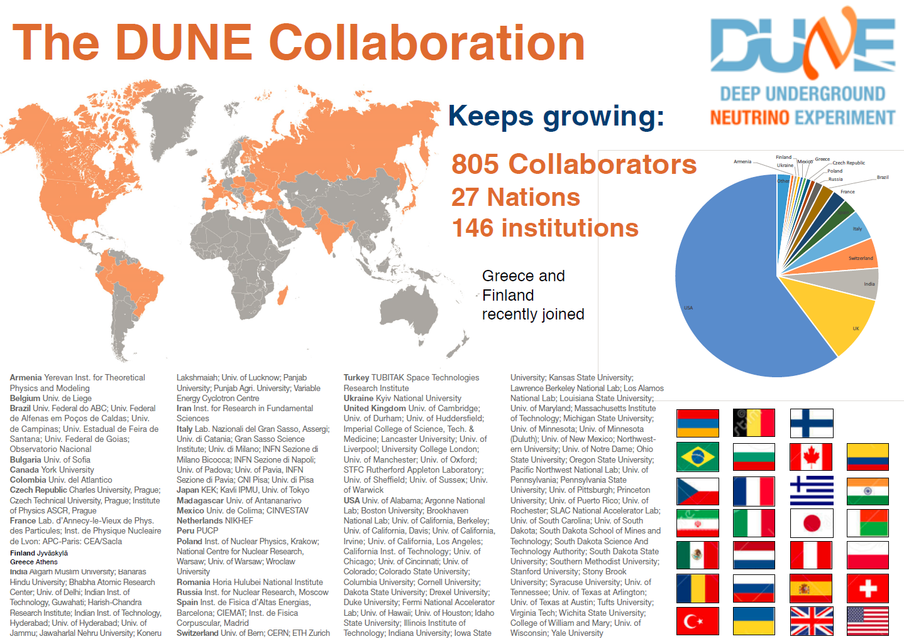
897 Collaborators
29 Nations
154 Institutions
Collaboration has come together faster than even the optimistic schedule considered by P5… an indication of strong interest in this science and the perception that the U.S. is prepared to host an ambitious world-class neutrino facility.
09.20.16

Slide 5
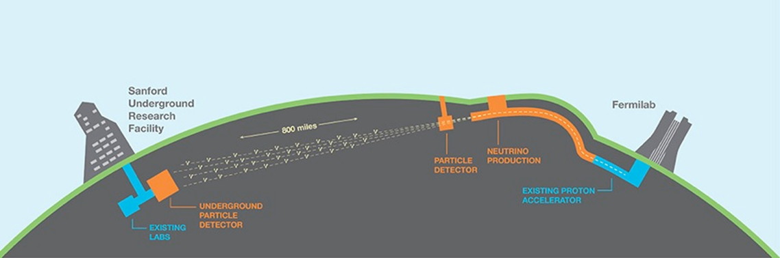

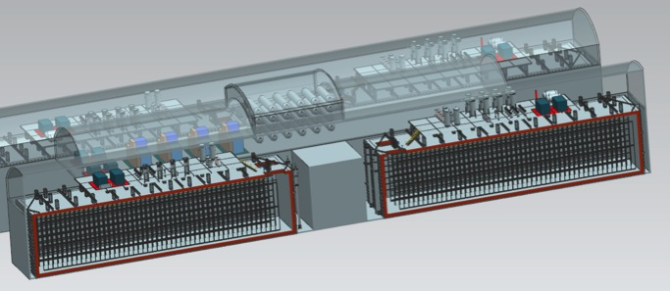
Facility and Experiment
  LBNF:
    Near site: Fermilab, Batavia, IL – facilities and infrastructure to:
      create a broad band, sign selected neutrino beam
      host the near DUNE detector
    Far site: Sanford Underground Research Facility, Lead, SD – facilities to support the far DUNE detectors (4850 L)
  DUNE:
    Near site detector
    Far site detector
ν_{μ}
ν_{μ} & ν_{e}
FD
ND

Slide 6
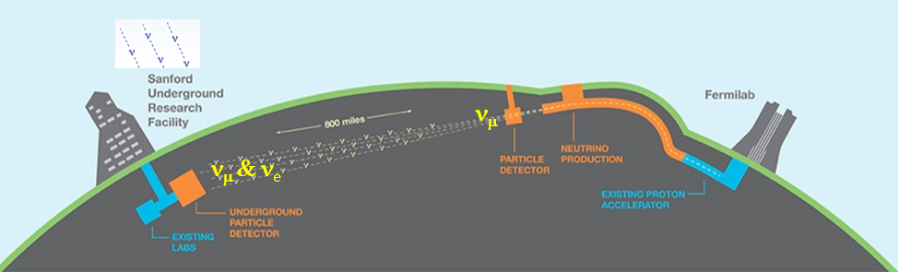
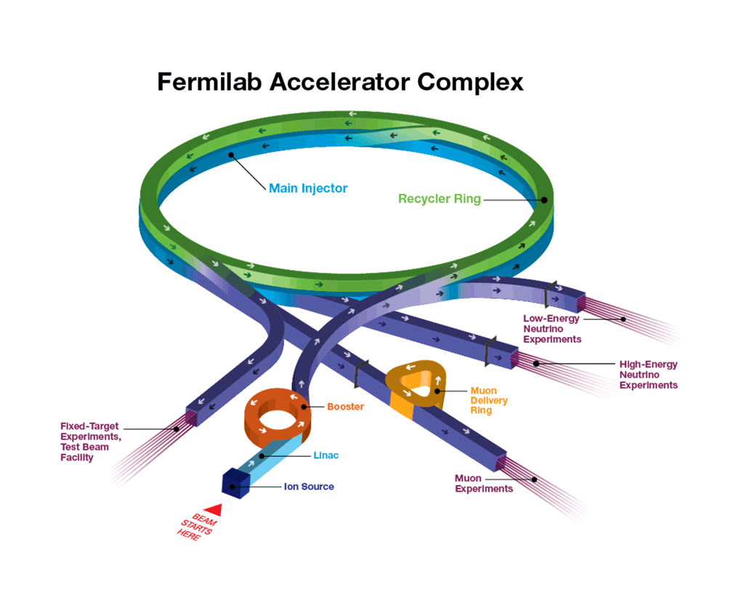
Fermilab Accelerator Complex
LBNF proton beam extracted from MI-10 straight section
800 MeV
SBN
20 Hz
MINOS, NOvA
400 MeV
701 kW on the NuMI/NOvA target in one supercycle on June 13, 2016!!
Proton Improvement Plan (PIP)
PIP-II ~ 2025
  1.2 MW @ 120 GeV
  100+ kW @ 800 MeV

Slide 7
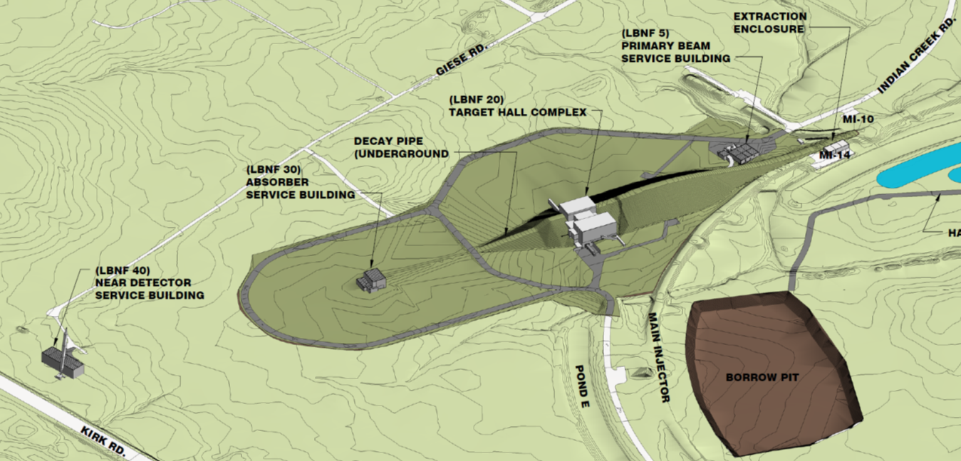
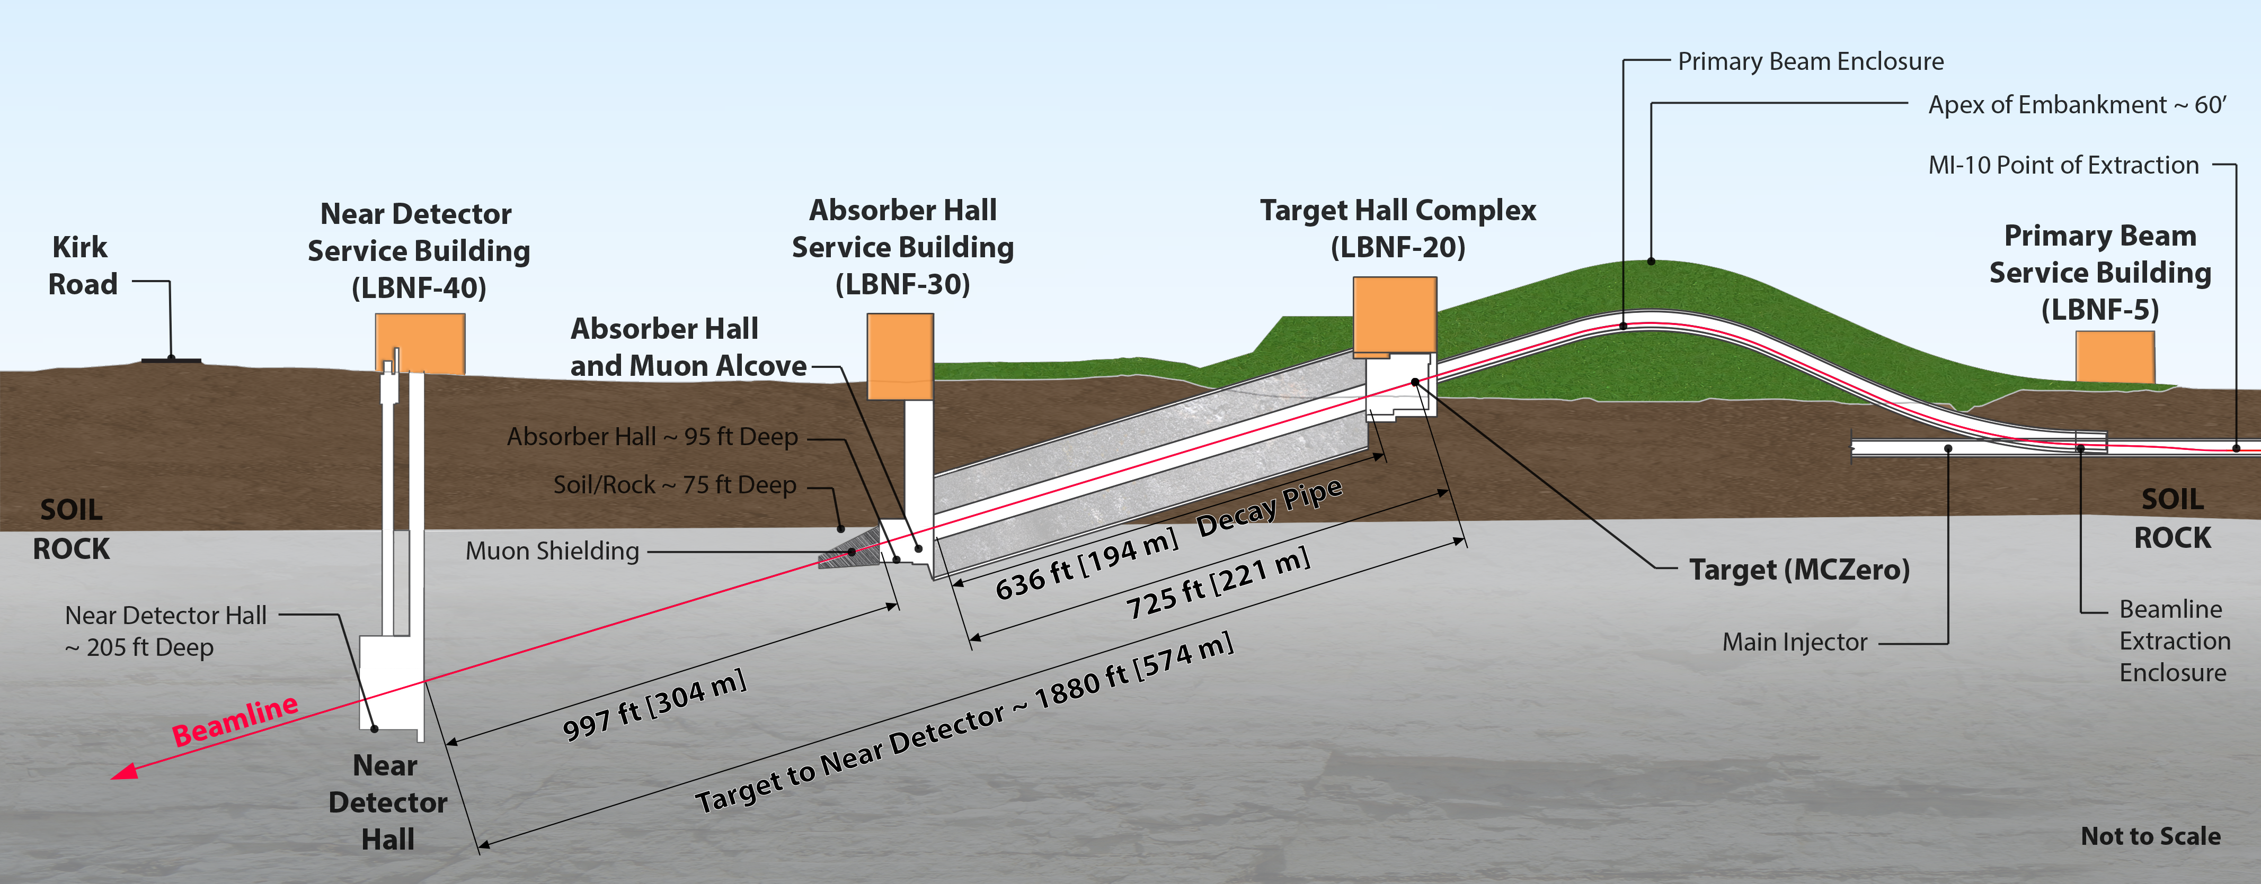
LBNF Beamline
~ 21,000 m²
To SURF
Designed to run at 1.2 MW beam power (PIP-II) and upgradable to 2.4 MW
60-120 GeV proton beam
Constructed in Open Cut
Tunneled excavation

Slide 8
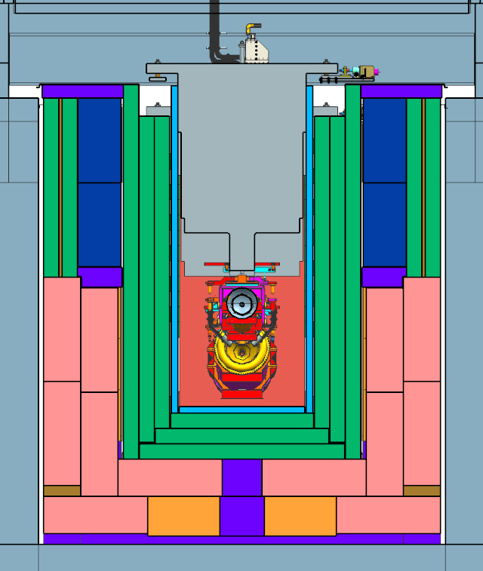
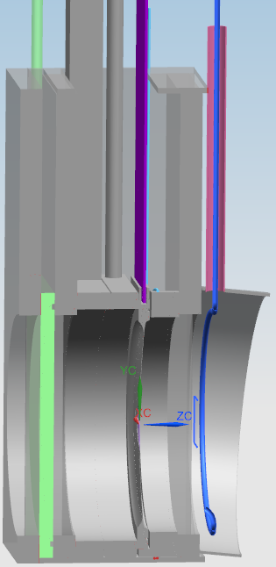
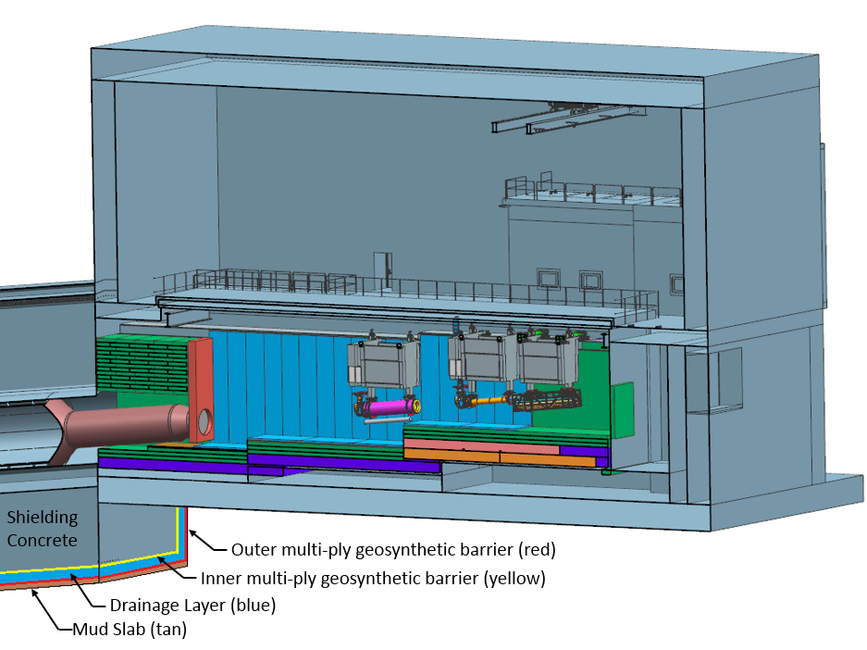
Target Hall and Decay Pipe Layout
~ 40% of beam power in target shield pile
~ 30% of beam power in decay pipe
50 TON CRANE
DECAY PIPE
UPSTREAM
WINDOW
Support modules
WORK CELL
Water cooling panels
DECAY
PIPE
SNOUT
Air
Beam
He
Downward bend of 5.8⁰
Beam size at target tunable between 1.0-4.0 mm
Decay Pipe: 194 m long, 4 m in diameter, double – wall carbon steel, helium filled, air-cooled.
5.6 m
Target Chase: 2.2 m/2.0 m wide, 34.3 m long air-filled and air & water-cooled (cooling panels). Sufficiently big to fit in alternative target/horns.
Main alternatives for Chase gas atmosphere: N₂ or He

Slide 9
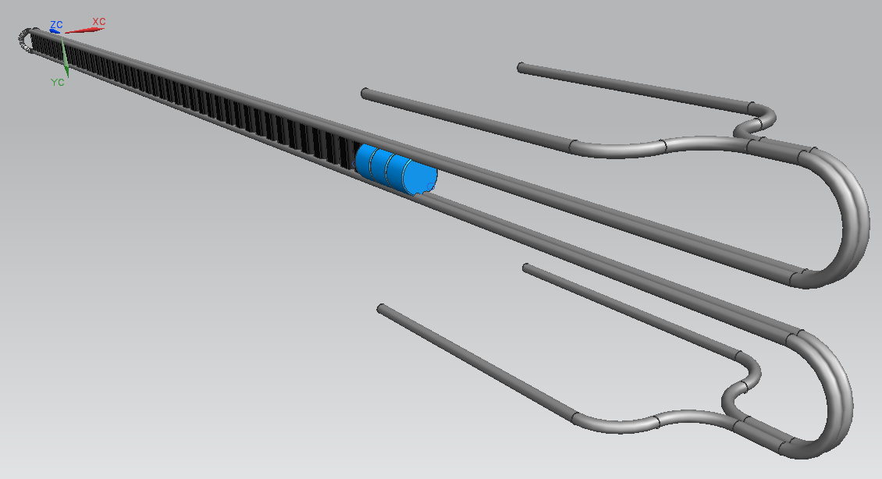
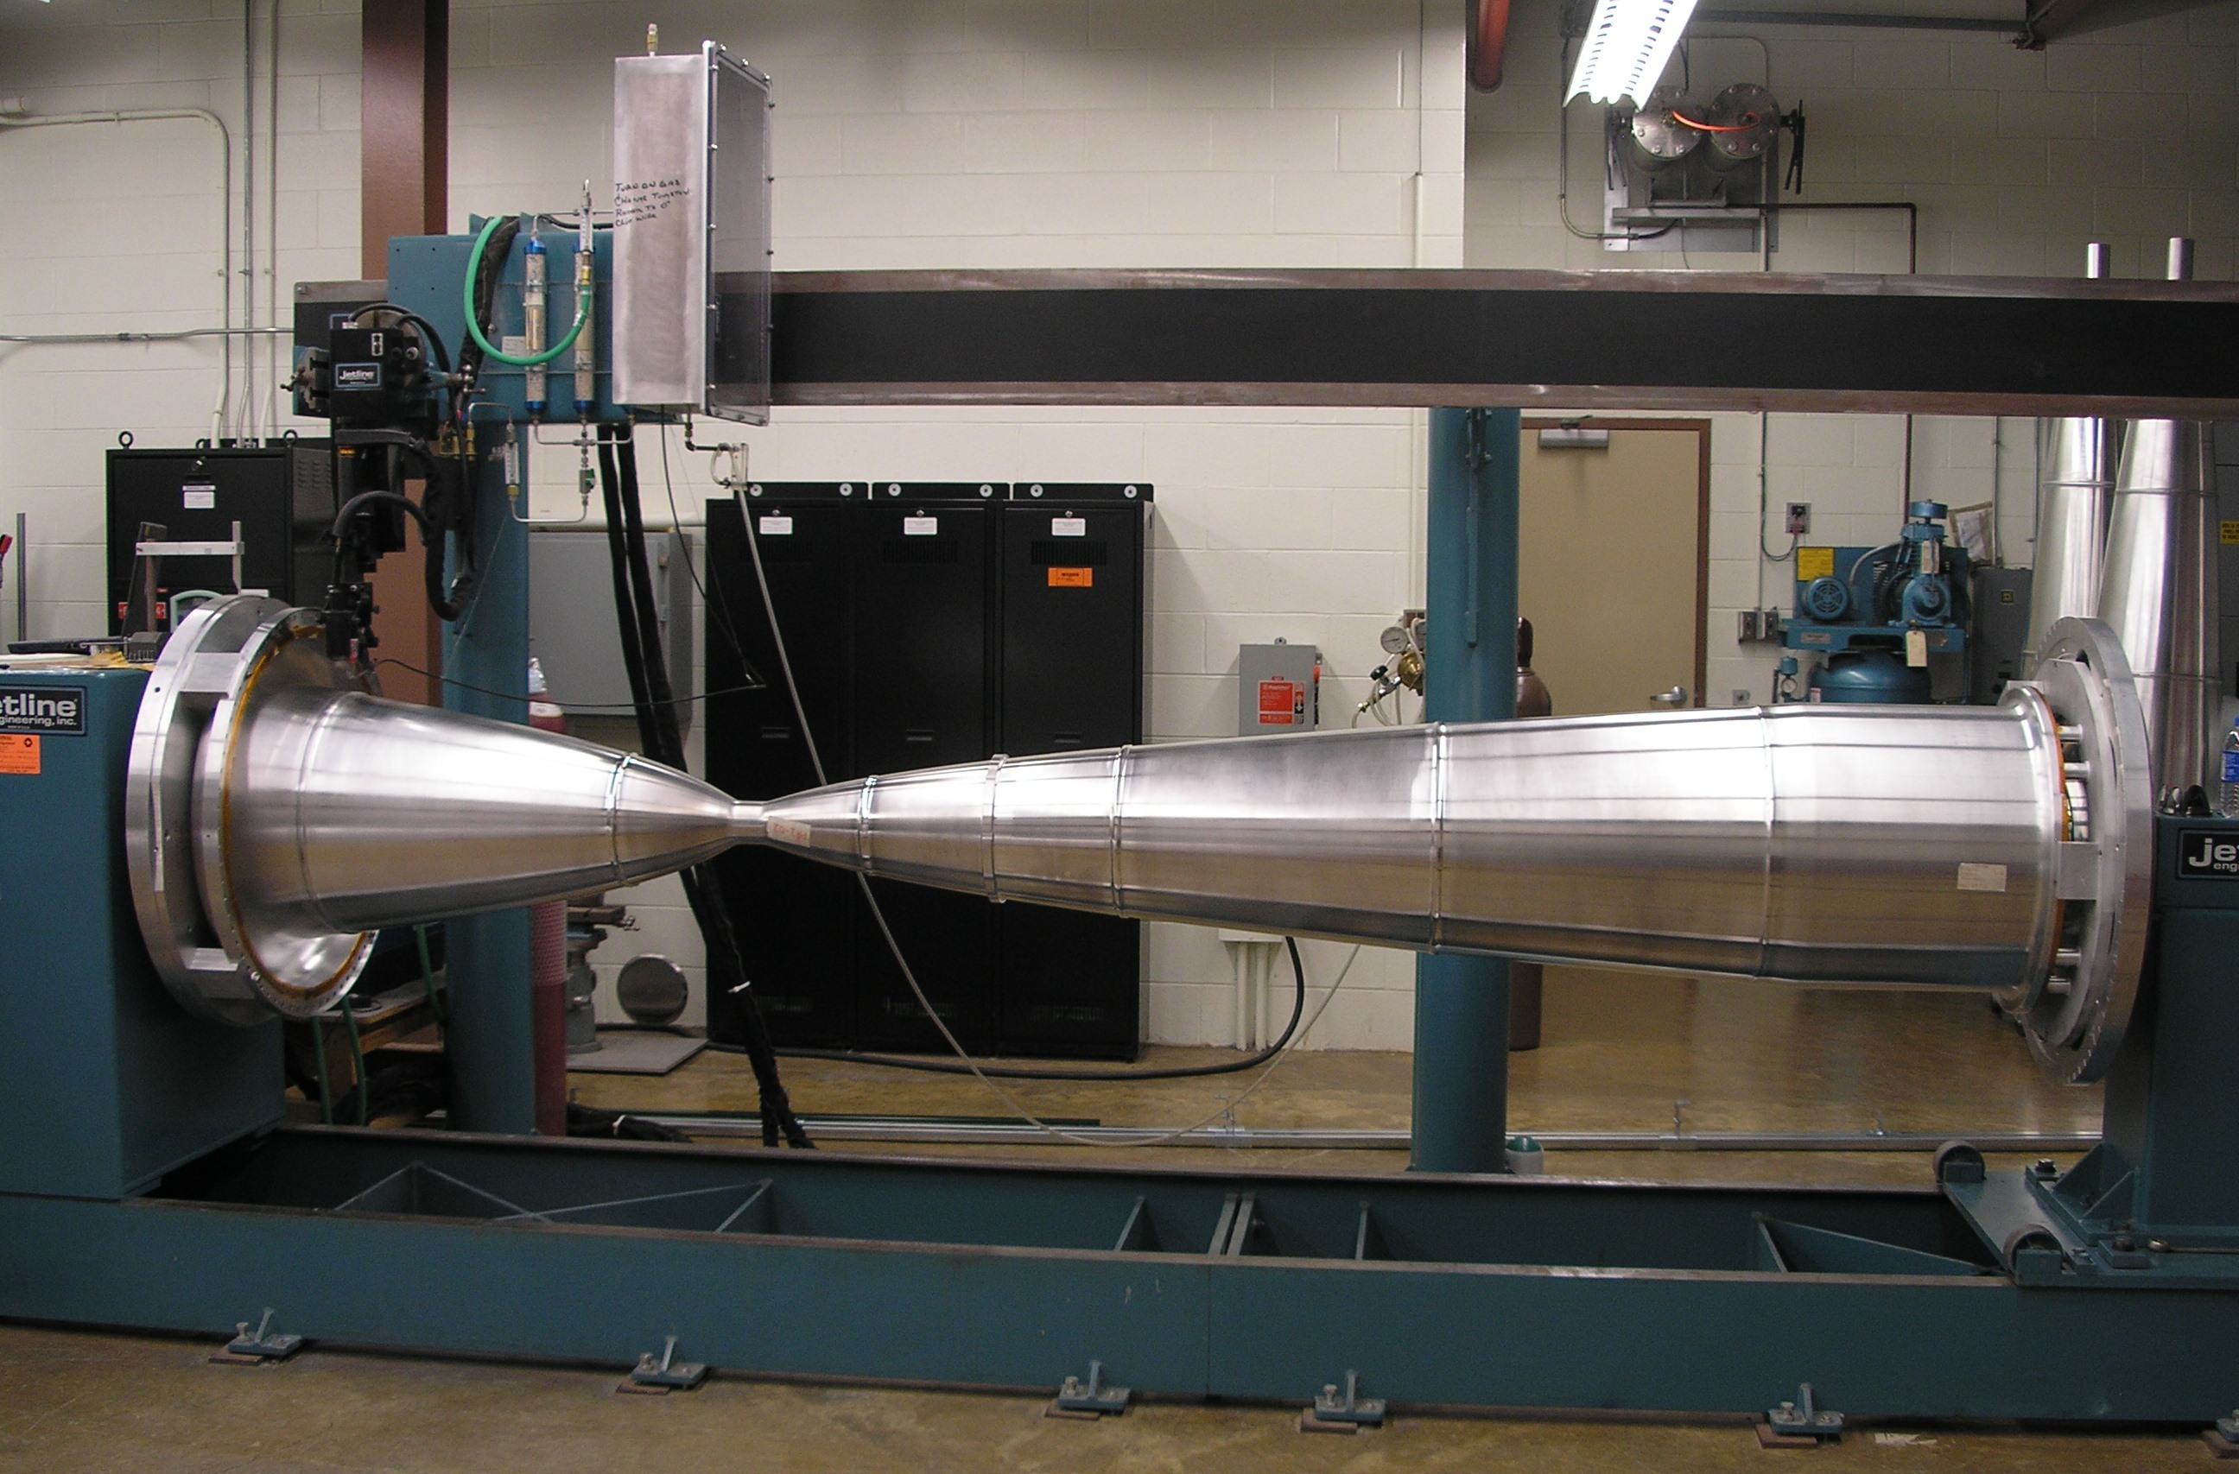
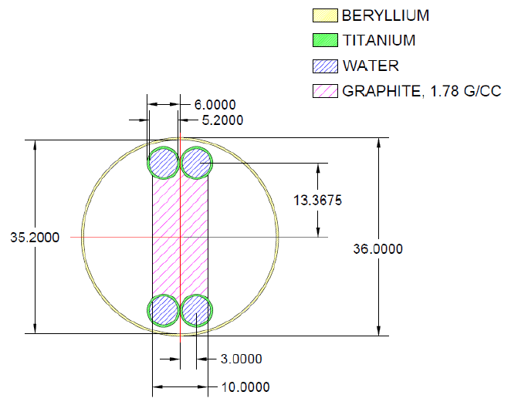
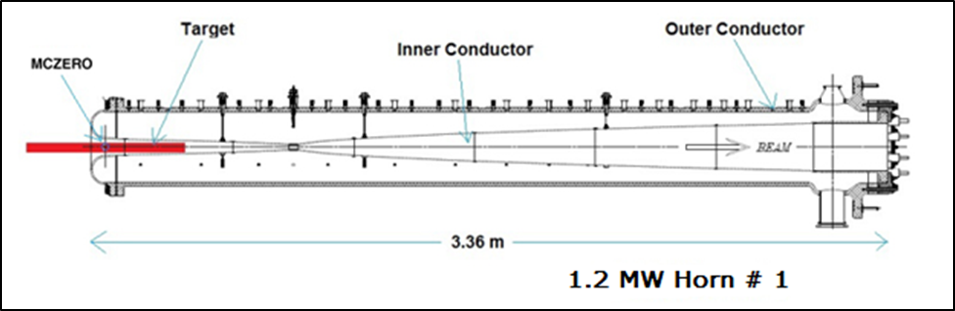
Reference design for target and horns - Viable for 1.2 MW
47 graphite target segments, each 2 cm long and spaced 0.2 mm apart, 10 mm in width
NuMI-like (low energy), with modest modifications
Inner Conductor of NuMI Horn
Two interaction lengths, 95 cm
Target cross section
Strong target R&D program in place (graphite, Be, etc.)
Operated at 230 kA for LBNF
mm
New Horn power supply needed to reduce the pulse width to 0.8 ms.

Slide 10
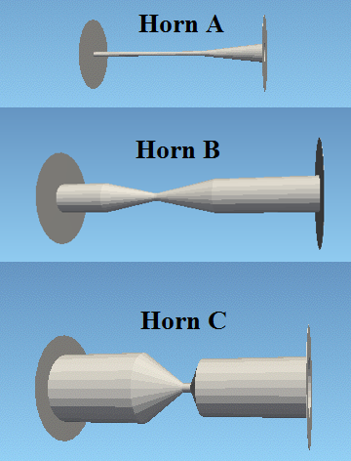
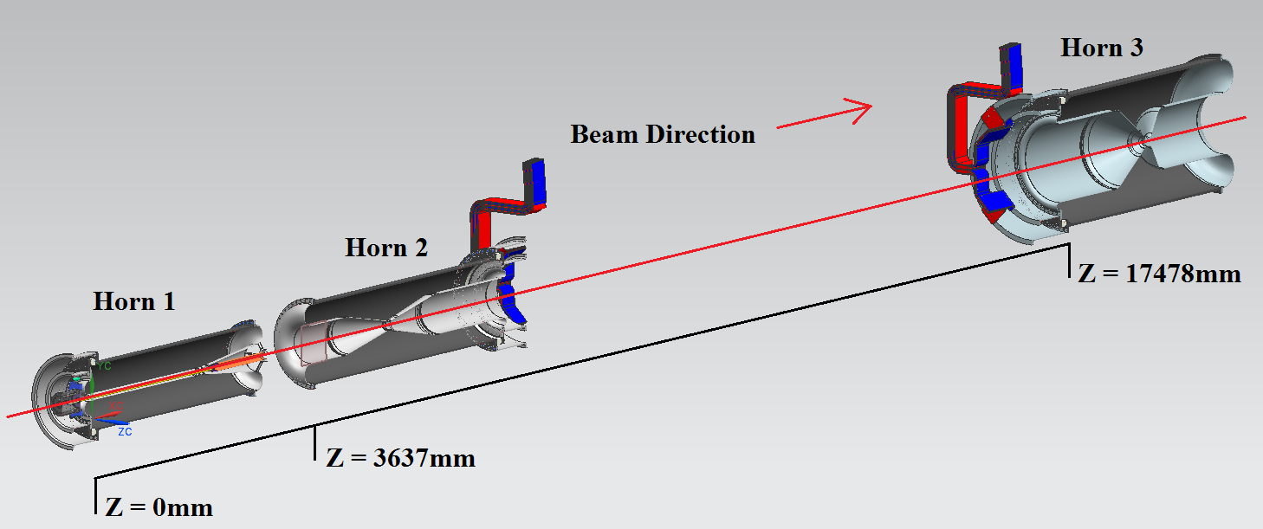
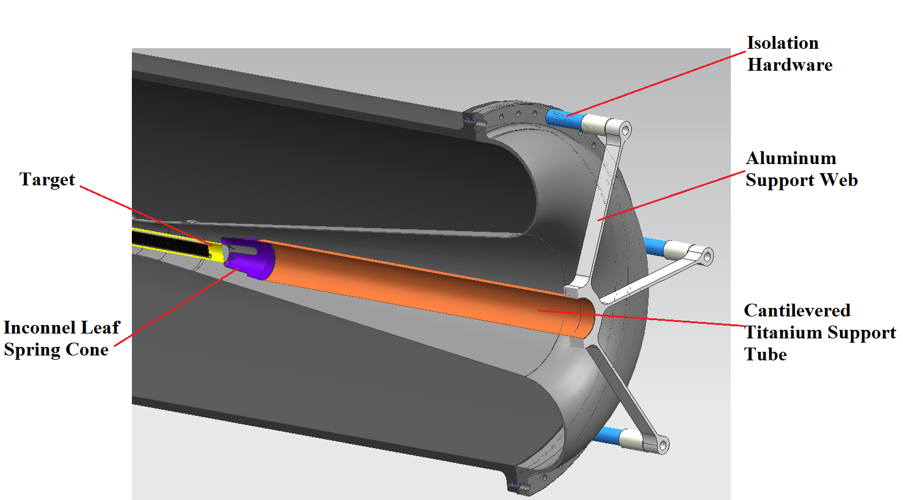
Mechanical model for optimized horns and target
2.8 m long
35 mm neck radius
C
L. Fields
3.2 m long
191 mm neck radius
B
A
2.8 m long
398 mm neck radius
Max current 300 kA
2m long NuMI style target for first iteration of MARS simulations; cylindrical and spherical targets under R&D as well.

Slide 11
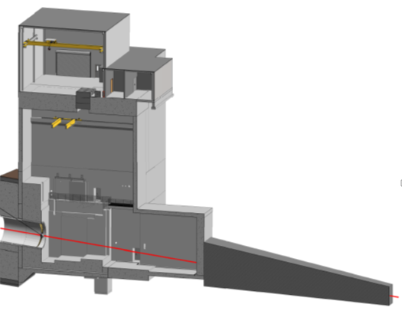
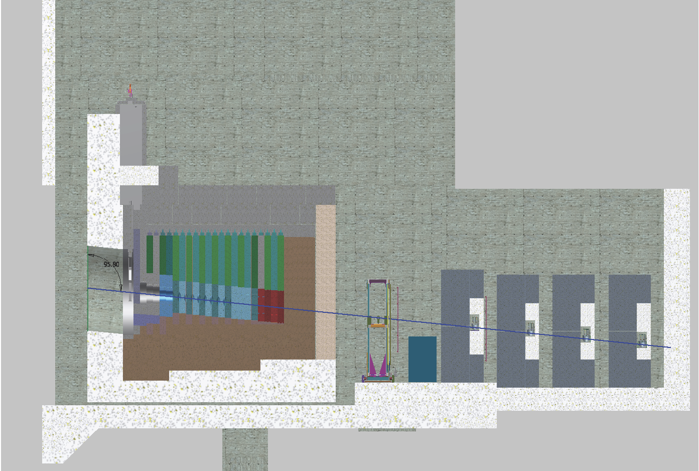
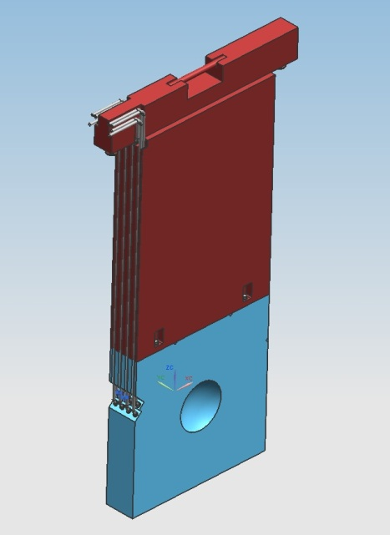
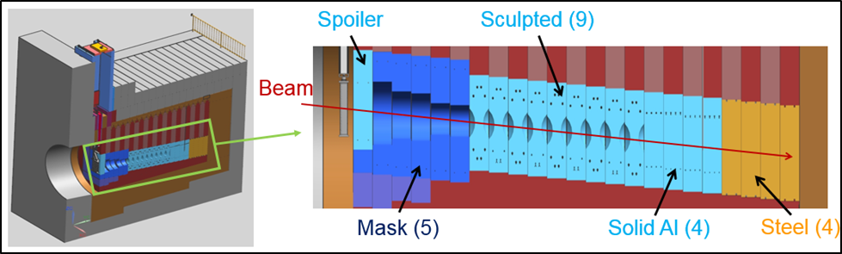
Hadron Absorber
The Absorber is designed for 2.4 MW
~ 30% of beam power in Absorber: 515 kW in central core 225 kW in steel shielding
Absorber Hall and Service Building
Absorber Cooling
Core: water-cooled
Shielding: forced air-cooled
Gas Cherenkov
Stopped μ counters
Ionization detectors
Steel shielding
Muon Alcove
Core blocks replaceable (each 1 ft thick)
Muon Shielding (steel)
Beam
Beam
Hadron Absorber
Sculpted Al (9)
Flexible, modular design
Hadron Monitor

Slide 12
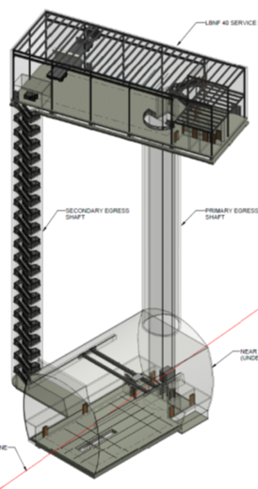
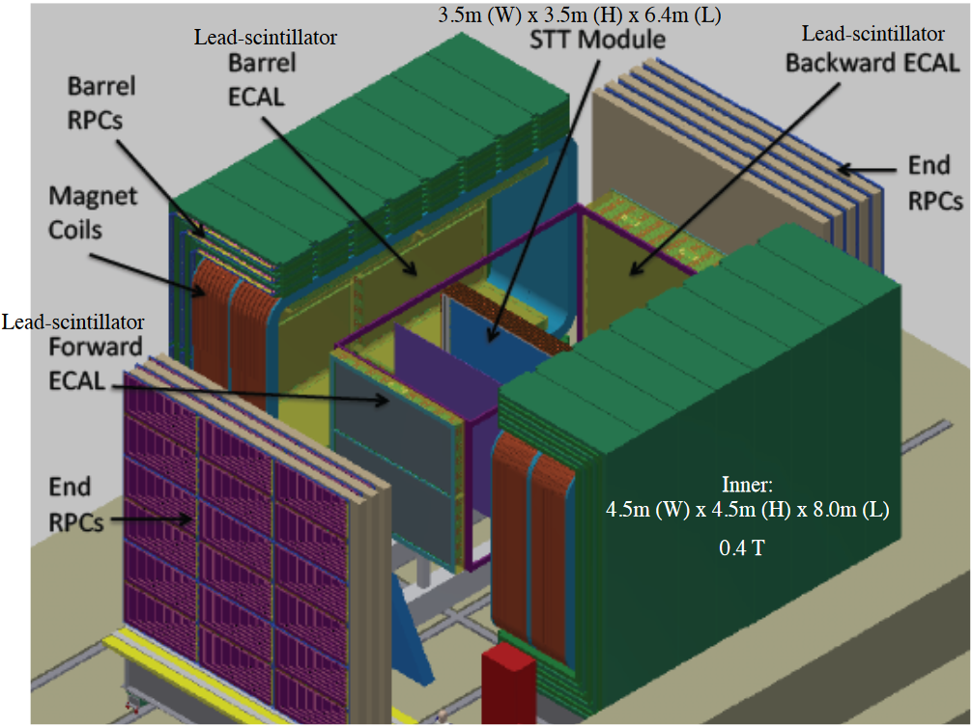
Near Detector Hall and Detector
Near Neutrino Detector Hall and LBNF 40 Service Building
Three types of Near Detector considered:
Fine-Grained Tracker (reference)
High-Pressure Gaseous Argon TPC
Lar-TPC
Straw Tube Tracker
~205 ft deep
09.20.16

Slide 13
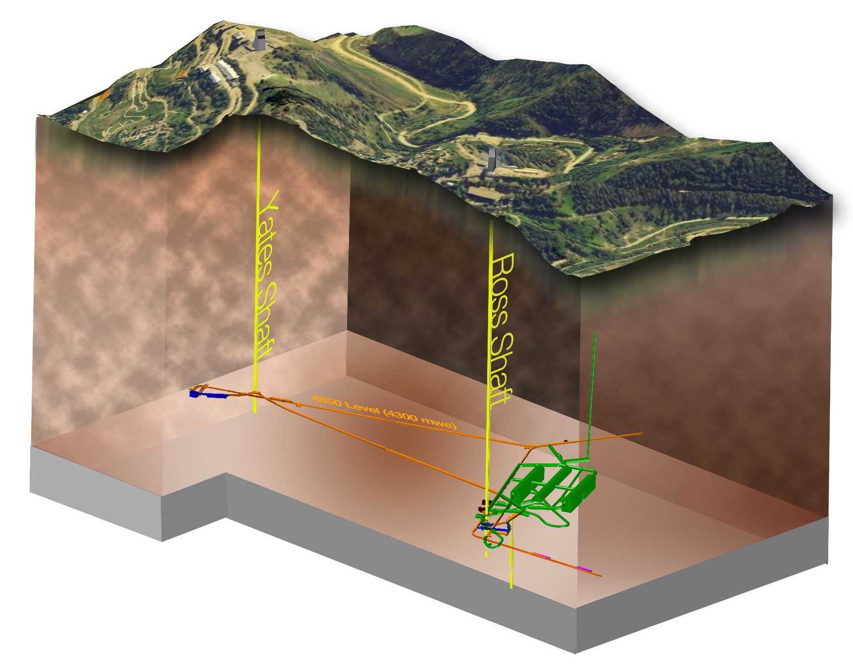
Far Site Scope – Phases of Work for LBNF
Sanford Lab Reliability
Projects
FY16 – 18
  Ross shaft rehab
  Hoist motor
  rebuilds, more…
Pre-Excavation
FY17 - 18
  Rock disposal
  systems
  Ross headframe
  upgrade, more…
Excavation/
Construction
FY18 – 22
  Brow/Caverns/Drifts/Utilities/Surface building
Cryostats/Cryogenic Systems FY20 – 25
4850 L

Slide 14
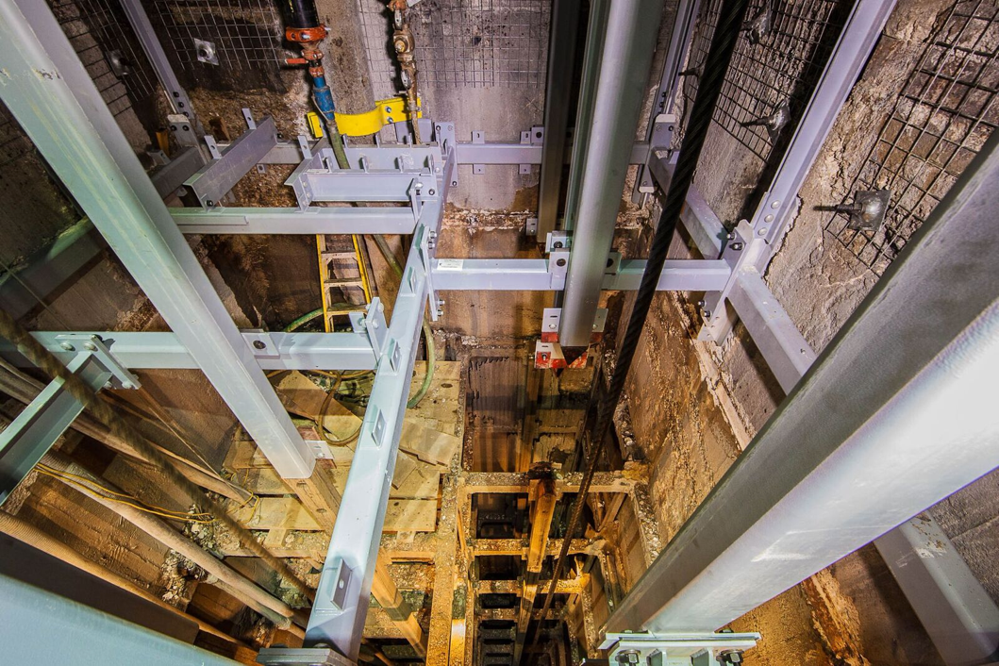
Reliability Projects: Example - Ross Shaft Refurbishment
Surface
Tramway
300 L
800 L
1250 L
1400 L
1550 L
1700 L
1850 L
2000 L
2150 L
2300 L
2450 L
2600 L
2750 L
2900 L
3050 L
3200 L
3350 L
3500 L
3650 L
3800 L
3950 L
4100 L
4250 L
4400 L
4550 L
4700 L
4850 L
5000 L
Schedule
Ross Shaft refurbishment required to support construction of the Long-Baseline Neutrino Facility (LBNF) Project. Shaft originally build in 1930’s.
The Ross Shaft has been refurbished to 3,765 feet from surface (75% completed). On track for a 2017 completion and a transition to LBNF construction.
Q1 CY2014
Completed
Q1 CY2015
New Shaft Steel Recently Installed
Q1 CY2016
Q1 CY2017
Mid CY2017

Slide 15
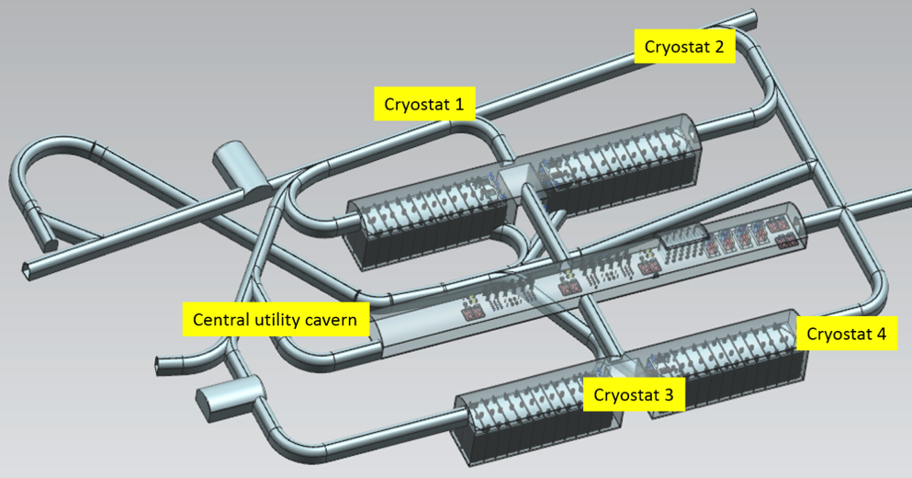
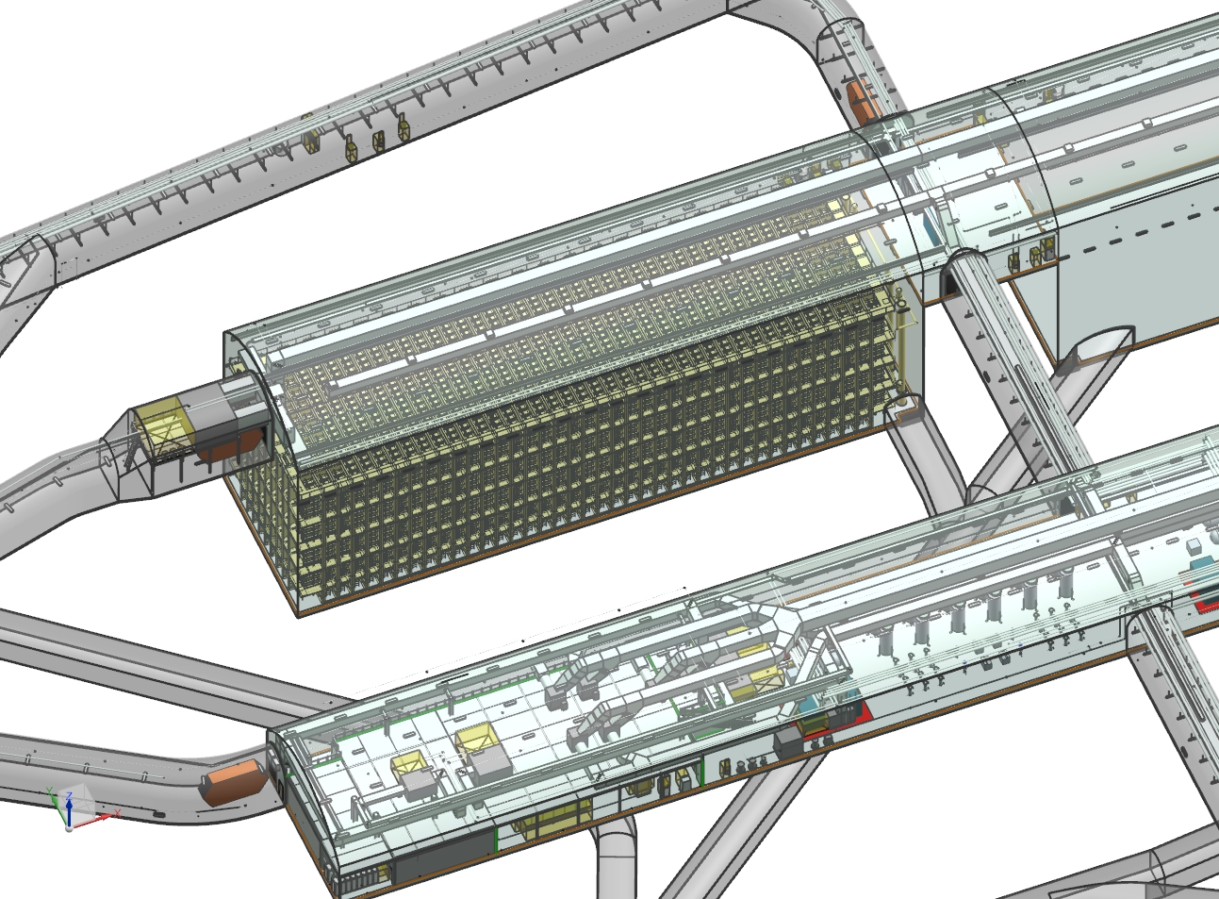
Overview – “Far Site” – LBNF/DUNE at Sanford Lab, Lead, SD
CD-3a
Conventional Facilities:
  Surface and shaft Infrastructure including utilities
  Drifts and two caverns for detectors
  Central utility cavern for conventional and cryogenic equipment
Cryostats:
  Four identical membrane cryostats supported by external steel frames will contain the LAr and Time Projection Chambers
Cryogenic Systems:
  LN2 refrigeration system for cooling
  and re-condensing gaseous Argon
  Systems for purification and
  recirculation of LAr
Argon: 70kt LAr (~40kt “fiducial” mass)
DUNE LAr-TPC Detectors
4850L cavern and drift layout
Extensive prototyping program in progress to scale LAr TPC detector technology to 10kt fiducial volume
Single cryostat and portion of central utility cavern

Slide 16
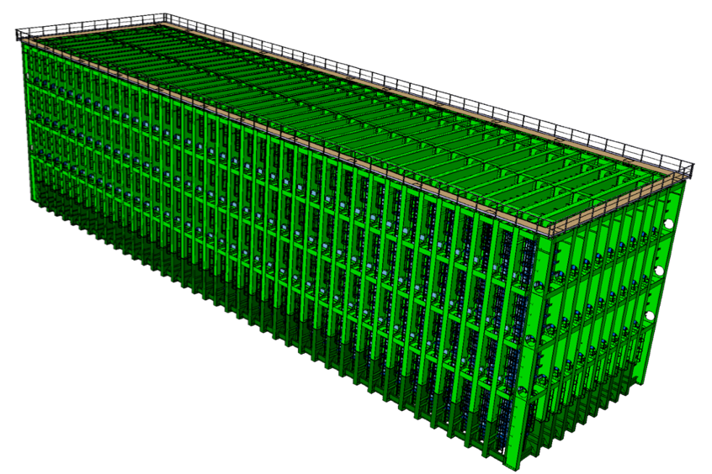
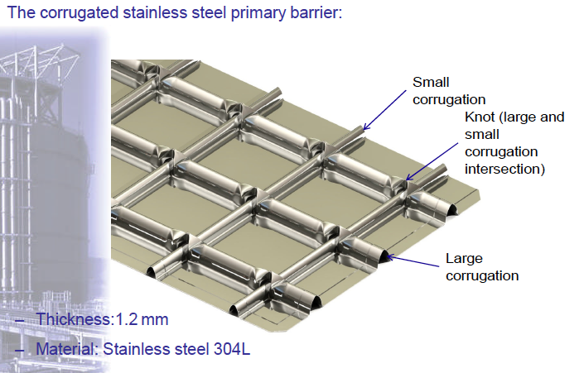
Far Site – Free-Standing Steel Cryostat Design
Each cryostat is composed of:
A free-standing steel outer support or warm vessel
A membrane cryostat or cold vessel
 | Length (mm) | Width (mm) | Height (mm)
Membrane Internal Dimensions | 62,000 | 15,100 | 14,000
SS Plate Internal Dimensions | 63,600 | 16,700 | 15,600
External Dimensions of steel structure | 65,836 | 18,936 | 17,888

Slide 17
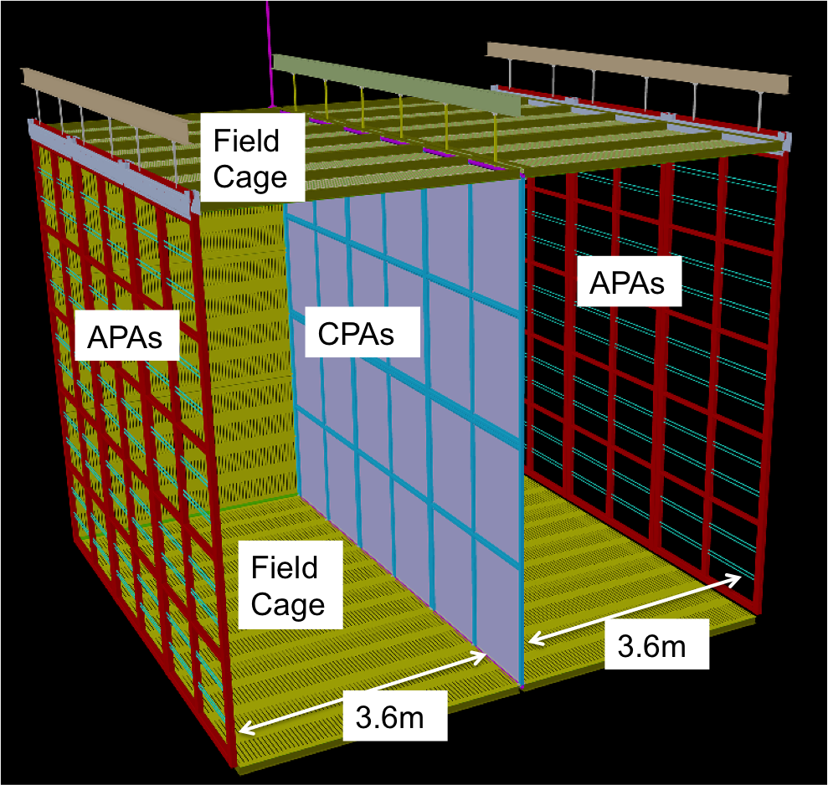
Single Phase Detectors inside the Cryostats
Detectors consist of:
  Anode Plane Arrays
  Cathode Plane Arrays
  Field Cage
  Photon detectors
  Readout electronics and DAQ
How they work:
  Neutrinos (occasionally) collide with Argon atom.
  Resulting particles cause electrons to be knocked loose from liquid argon atoms, which “drift” to the APAs

Slide 18
LBNF/DUNE Milestones
Critical Decision-0 (CD-0) approved, January 8, 2010.
CD-1 Refresh approved, November 5, 2015 (Conceptual Design)
CD-3a approved, September 1, 2016 (far-site pre-excavation and excavation)
Complete Sanford Laboratory reliability projects in FY2018
CD-2 for the entire project expected in December 2019 (baselining)
Complete first cryostat and cryo systems construction to enable detector installation to begin in 2021
Commission first 10 kTon far detector in 2024
Add a second 10 kTon far detector and the near detector by 2026
Produce neutrino beam in 2026

Slide 19
Safety related challenges – Near Site
Main ES&H Issues:
  Radiological (extensive MARS simulations and benchmarking with NuMI)
    Ground water and surface water
    Prompt radiation
    Residual radiation
    Activated air emissions
      Air-releases analyses demonstrated that using LBNF target hall and the primary beam area is sufficient to reach the goal of using < 30% of the Laboratory’s limit of 100 μrem. NuMI target hall and other NuMI areas may be used for additional decay before release if needed.
      Inert gas alternative for target chase
  Installation (geomembrane system, magnets on slope,…)
    ES&H Construction Safety Specialist during the installation phase
shielding
shielding & remote handling
containment & controlled release
Lessons learned from NuMI have been incorporated in the design

Slide 20
Safety related challenges – Far Site
Big excavations at 4850 L underground.
  Hiring experienced CM/GC is a key element for success. Bids due November 15, 2016.
LAr transported to and used at 4850 L underground.
  Delivering to SURF as liquid, make it gas before transporting through Ross shaft and re-condense underground.
  Extensive ODH analysis. ODH manageable. Ross shaft ODH 0.

Slide 21
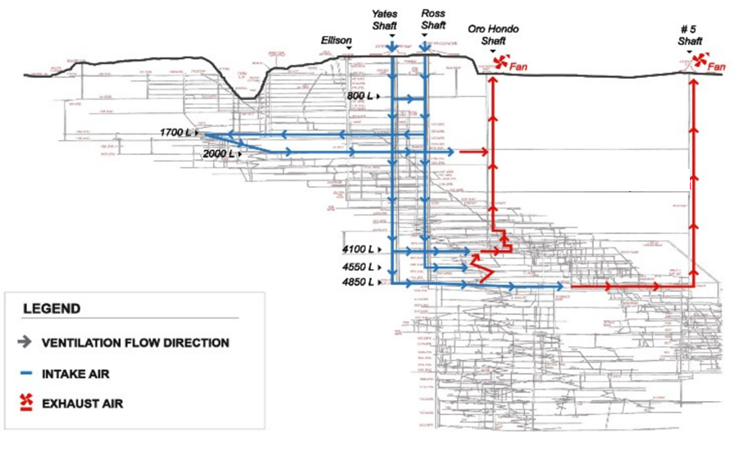
ODH Class Map at Far Site
Two independent exhaust shafts with 2 fans each,
powered by site power and backup generator.
The argon is transferred as gas down to the 4850 L where it is purified and liquefied back to Lar to fill the cryostats
ODH 0
ODH 0
ODH 0
ODH 0
ODH 0
ODH1

Slide 22
Summary
  CD-1 (conceptual design) approval for the entire project and just had the CD3-a DOE milestone approved for the far site.
  A lot of consideration for safety aspects of the design following Fermilab’s and SURF’s safety requirements and goals.
  Effectively incorporated lessons learned from various related facilities and detectors.
  Ready to begin extensive construction effort at far site to support installation of first DUNE detector in the 2021/2022 timeframe.
  LBNF/DUNE Project on track and moving ahead aggressively.

Slide 23
Backup

Slide 24
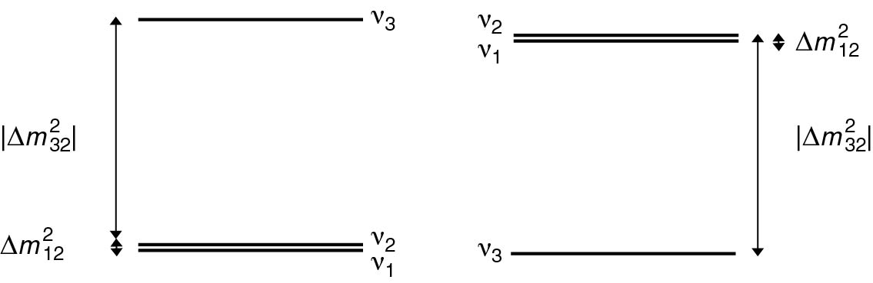
LBNF/DUNE Science Goals
LBNF/DUNE is a comprehensive program to:
Measure neutrino oscillations
  Direct determination of CP violation in the leptonic sector
  Measurement of the CP phase δ
  Determination of the neutrino mass hierarchy
  Determination of the θ₂₃ octant and other precision measurements
  Testing the 3-flavor mixing paradigm
  Precision measurements of neutrino interactions with matter
  Searching for new physics
Study other fundamental physics enabled by a massive, underground detector
  Search for nucleon decays (e.g. targeting SUSY-favored modes)
  Measurement of neutrinos from galactic core collapse supernovae
  Measurements with atmospheric neutrinos
In a single experiment
Start data taking ~ 2026
Start data taking ~ 2024

Slide 25
Near Site Facilities Scope
Primary Beam (beam optics, magnets, magnet power supplies, LCW, vacuum, beam instrumentation).
Neutrino Beam (primary beam window, baffle, target, 2 focusing horns, support modules, instrumentation, horn power supply, target shield pile, decay pipe cooling and windows, hadron absorber, RAW, remote handling, storage of radioactive components).
Beamline System Integration ( controls, interlocks, alignment, installation infrastructure and coordination).
Beamline Modeling and Radiation Physics & Protection.
NS Conventional Facilities (all site improvements, tunnels, halls, service buildings and excavations at the Near Site).
  Advanced Site preparation (pond F replacement and associated utility relocation)
  Beamline Conventional Facilities
  Near Detector Conventional Facilities
09.20.16

Slide 26
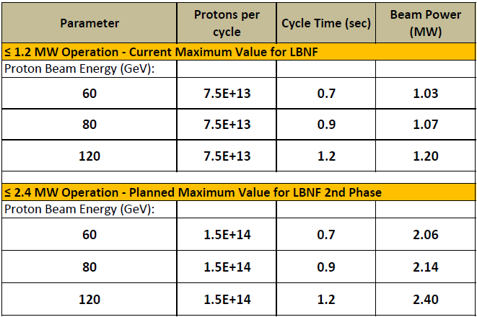
LBNF Beam Operating Parameters
Summary of key Beamline design parameters for ≤1.2 MW and ≤2.4 MW operation
Pulse duration: 10 μs
(1.1 – 1.9)x10²¹ POT/yr
Assuming a superconducting 800 MeV Linac (PIP-II)
Assuming a Linac extension to the PIP-II Linac

Slide 27
What is being designed for 2.4 MW
Designed for 2.4 MW, since upgrading later would be prohibitively expensive and inconsistent with ALARA:
  Size of enclosures (primary proton beamline, target chase, target hall, decay pipe, absorber hall)
  Radiological shielding of enclosures (except from the roof of the target hall, that can be easily upgraded for 2.4 MW when needed)
  Primary Beamline components
  The water cooled target chase cooling panels
  The decay pipe and its cooling and the decay pipe downstream window
  beam absorber
  remote handling equipment
  radioactive water system piping
  horn support structures are designed to last for the lifetime of the Facility
09.20.16

Slide 28
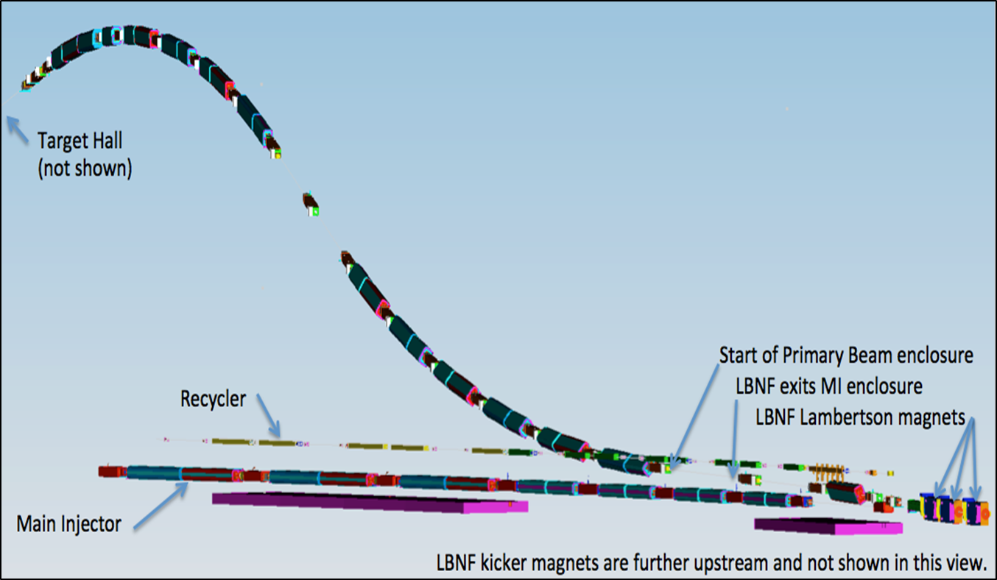
Primary Beamline
The primary beam designed to transport high intensity protons in the energy range of 60 -120 GeV to the LBNF target, with repetition rate of 0.7-1.2 sec, and 10 μs pulse duration
The beam lattice points to:
25 dipoles
21 quadrupoles
23 correctors
6 kickers
3 Lambertsons
1 C magnet
Protons/cycle:
1.2 MW era: 7.5x10¹³
2.4 MW era: (1.5-2.0)x10¹⁴
Embankment
Beam size at target tunable between 1.0-4.0 mm
MI-10

Slide 29
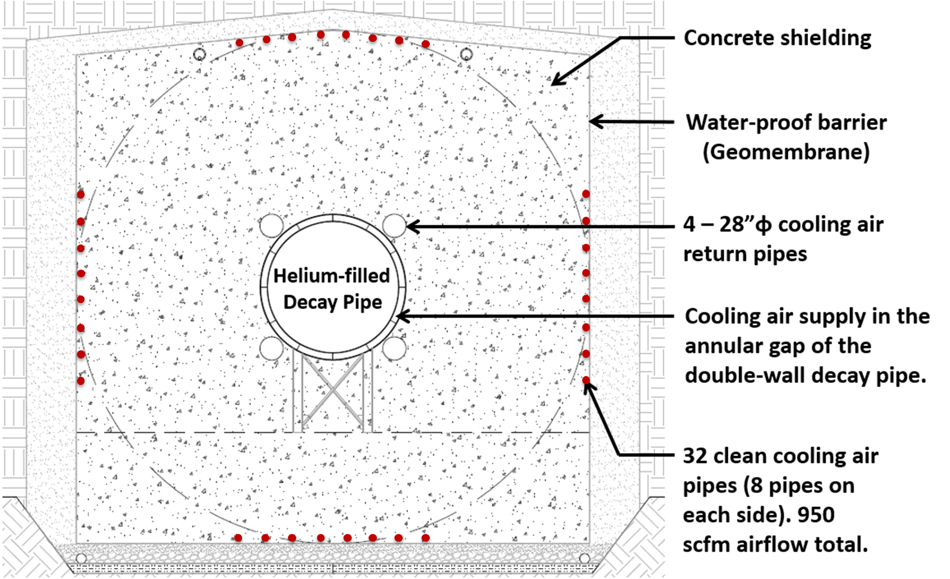
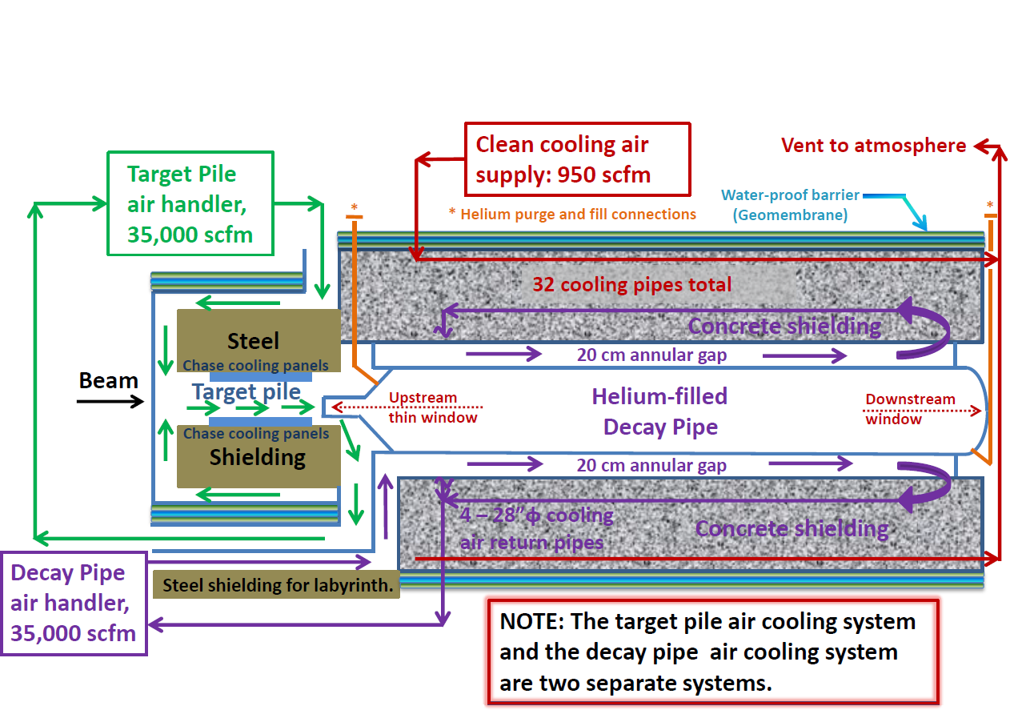
Decay Pipe Layout
Porous cellular
concrete drainage
layer
194 m long, 4 m inside diameter
Helium filled
Double-wall, carbon steel decay pipe, with 20 cm annular gap
5.6 m thick concrete shielding
It collects ~30% of the beam power, removed by an air cooling system

Slide 30
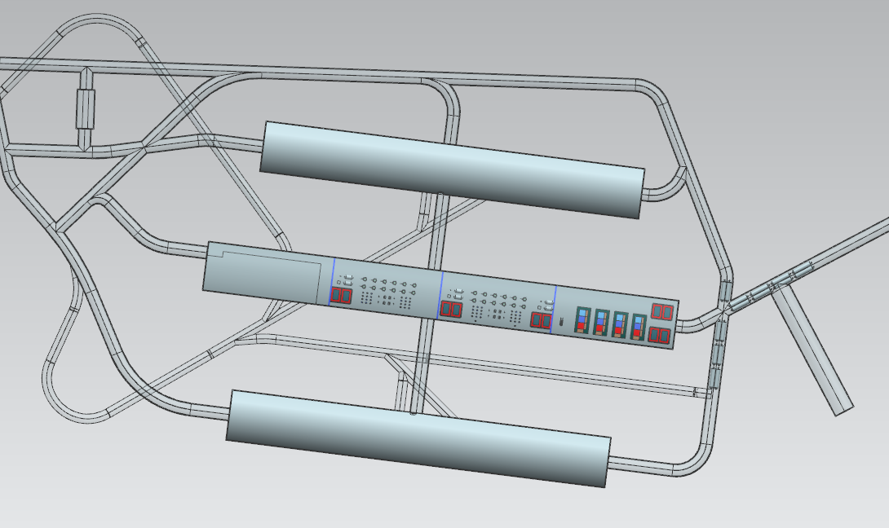
4850L ODH Class Map
Y
Fresh Air
Fresh Air
R
ODH 0
Fresh Air
ODH 0
Fresh Air
Exhaust
ODH1
ODH1
Fresh Air
Exhaust
ODH1
ODH1
ODH1
Exhaust
Fresh Air
Exhaust
ODH1
ODH1
Y – Yates shaft
R – Ross shaft
09.20.2016

