Slide 1

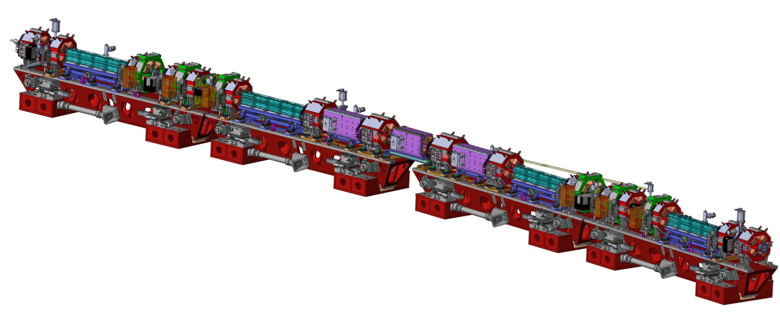
2016 DOE Accelerator Safety Workshop
Fermilab, 20 – 22 September 2016
EBS project at the ESRF: safety challenges
Paul Berkvens

Slide 2
Ebs project at the esrf: safety challenges
Contents
Short introduction to the ESRF
EBS project
Decommissioning of existing storage ring
EBS project: general safety challenges
EBS project: radiation protection challenges

Slide 3
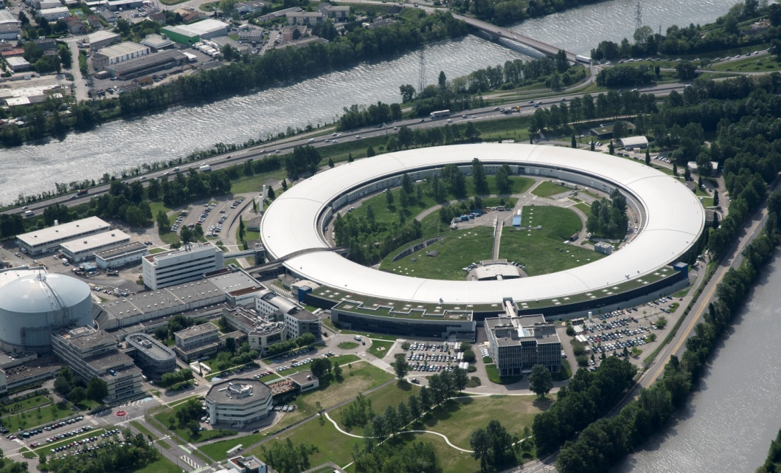
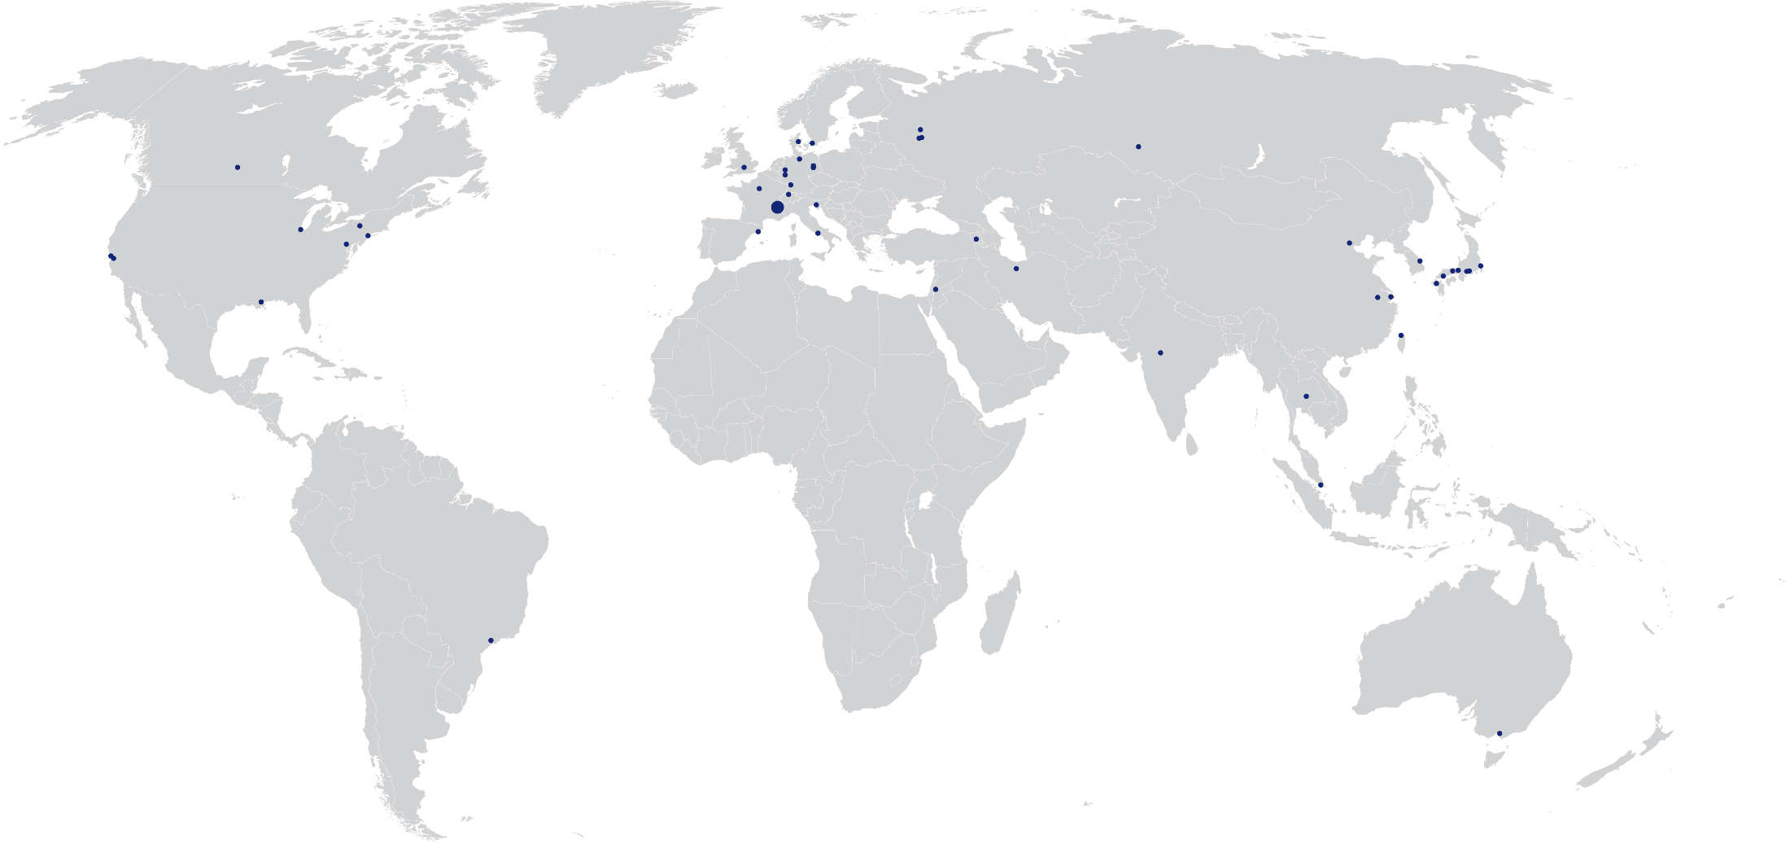
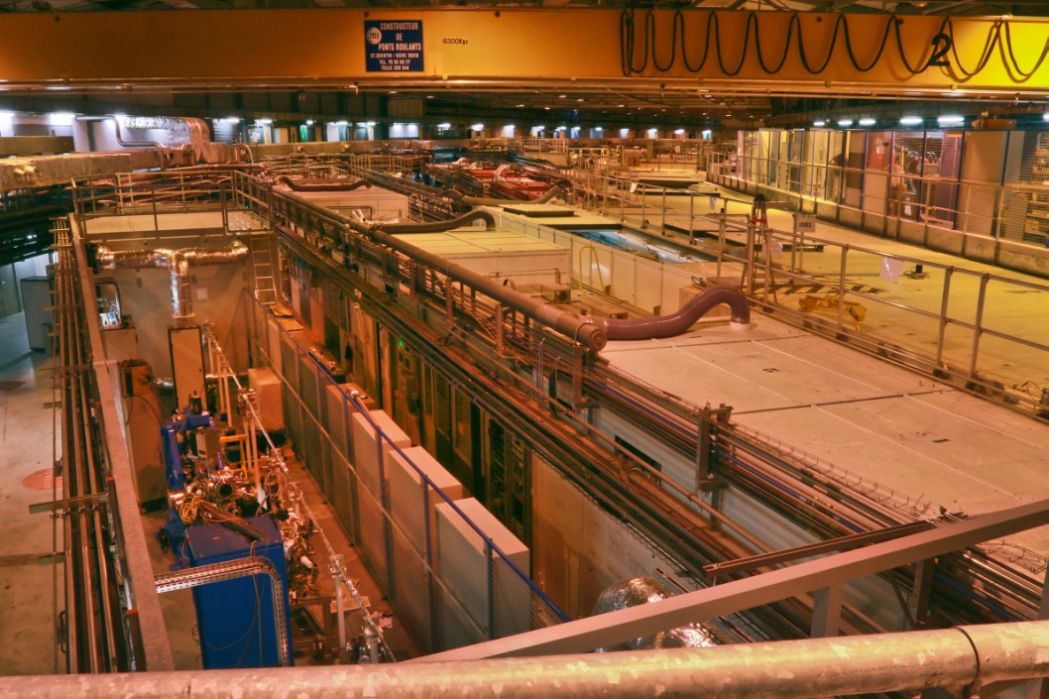
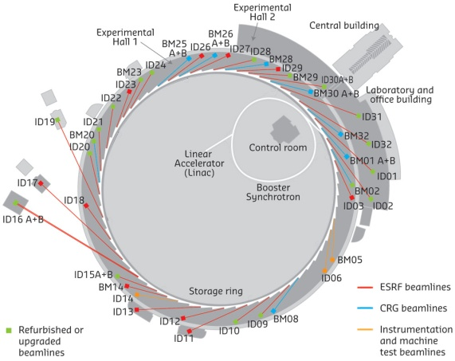
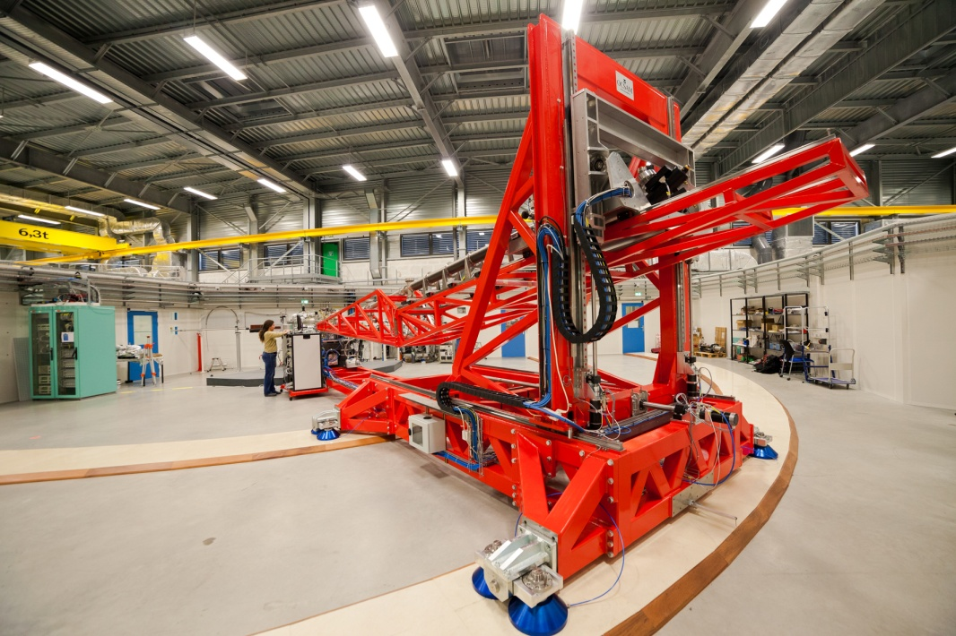
ESRF: short introduction
European Synchrotron Radiation Facility
3rd generation high energy synchrotron radiation facility
A research facility unique worldwide
6,500 scientific visitors every year including 4,000 users
2,000 proposals per year: 900 accepted,
1,550 experimental sessions
30% of the research involves industrial developments
Scientific excellence recognised worldwide
N ◦ 1 in scientific output
N ◦ 2 in number of users
N ◦ 1 in reliability & quality
4 Nobel prize-winners among the ESRF users
25,166 reference articles during the period 1994-2014
̴ 30 articles in Nature and Science per year
Nearly 2,000 publications per year: ̴ 5 every day
6 GeV storage ring
31 public beamlines
12 CRG beamlines

Slide 4
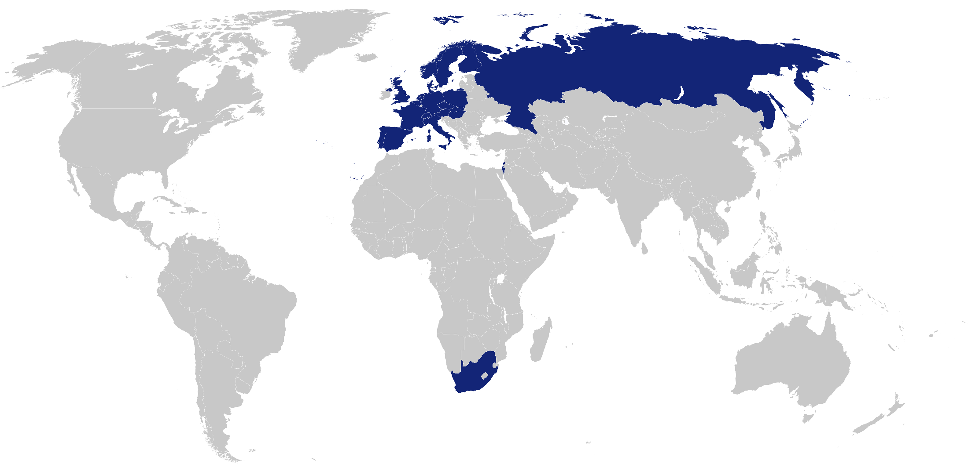
ESRF: short introduction
13 Member states:
France 27,5 %
Germany 24 %
Italy 13,2 %
United Kingdom 10,5 %
Russia 6 %
Benesync 5,8 %
(Belgium, The Netherlands)
Nordsync 5 %
(Denmark, Finland, Norway, Sweden)
Spain 4 %
Switzerland 4 %
8 Associate countries:
Israel 1,5 %
Austria 1,3 %
Centralsync 1,05 %
(Czech Republic, Hungary, Slovakia)
Poland 1 %
Portugal 1 %
South Africa 0,3 %
Contribution to the budget in %
21 partner nations
Annual budget: 100 million euros
Members of staff: 630 of 40 different nationalities
Legal status: Private civil company subject to French law

Slide 5
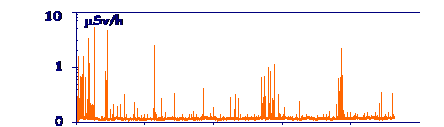
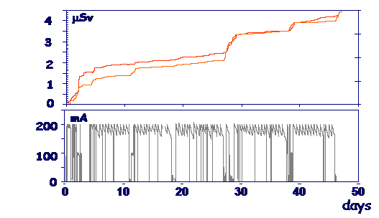
ESRF Radiation PROTECTION POLICY
ALARA principle: nobody at ESRF should be considered as exposed worker.
→ In all accessible areas during operation: guarantee non-exposure limit (1 mSv/y)
Guaranteed by:
  Shielding
  Personnel Safety Systems
  Interlocked radiation monitors:
    64 neutron monitors on storage ring roof
    1 ionisation chamber per optics hutch

Slide 6
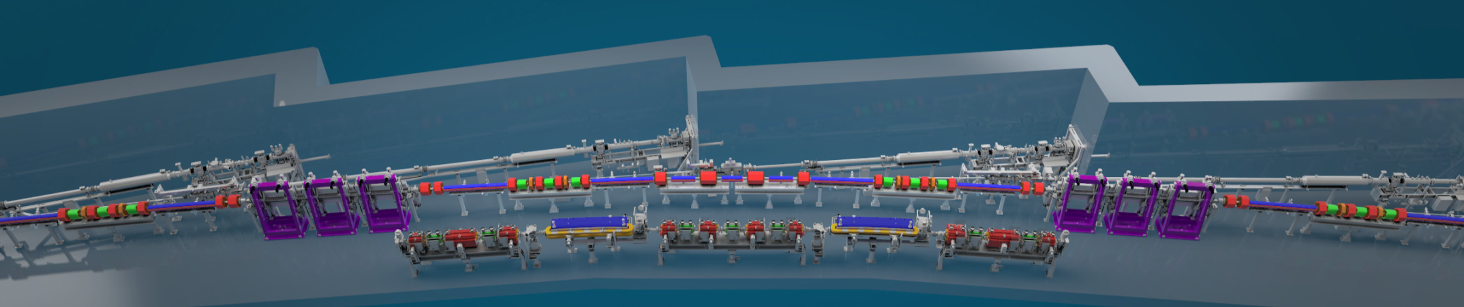
ESRF UPGRADE: EXTREMELY BRILLIANT SOURCE PROJECT
Parameter | Existing Lattice | New Lattice
Energy, E [GeV] | 6.04 | 6.04
Circumference, C [m] | 844 | 844
RF frequency, fRF [MHz] | 352 | 352
Beam current [mA] | 200 | 200
Horizontal Emittance [pm ·rad] | 4000 | 150
Vertical Emittance [pm ·rad] | 4 | 3
Beta at ID center, βx , βy [m] | 37.6 , 3.0 (high β) 0.35 , 3.0 (low β) | 3.6 , 3.6
Beam size at ID center, σx , σy [μm] | 413 , 3.9 (high β) 50 , 3.9 (low β) | 24 , 3.3
Beam div. at ID center, σx’ , σy’ [μrad] | 10 , 1.3 (high β) 107, 1.3 (low β) | 6.4 , 0.91

Slide 7
ESRF UPGRADE: EXTREMELY BRILLIANT SOURCE PROJECT
now

Slide 8
Decommissioning of the existing storage ring
magnets | 511,360 kg iron |  |  | cables | 186 km
 | 82,240 kg copper
 |  |  |  | cable trays | 9 km
vacuum vessels | 9,600 kg stainless steel
 | 800 kg aluminum |  |  | 160 supports

Slide 9
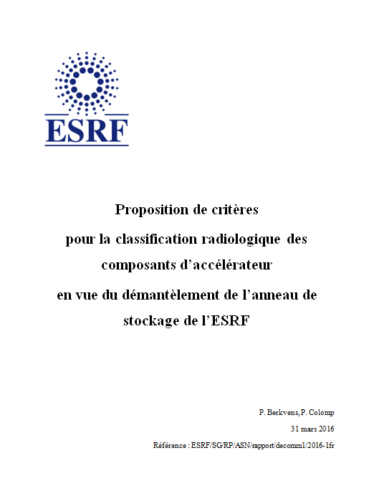
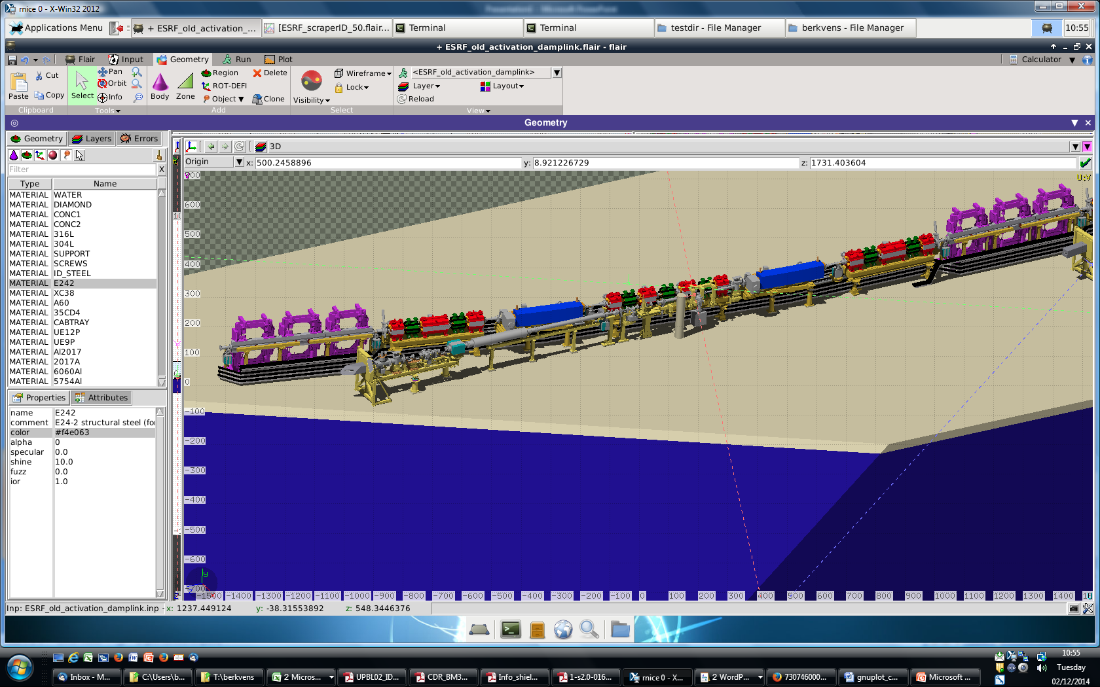
Decommissioning of the existing storage ring
Decommissioning of the existing storage ring has to be done within the French legal framework: absence of clearance levels.
Revised technical study sent to ASN, March 2016
Proposed criteria for radiological classification of accelerator components
Detailed activation calculations of standard cell
Measurement protocols for different components
Reply from ASN expected mid 2017
q

Slide 10
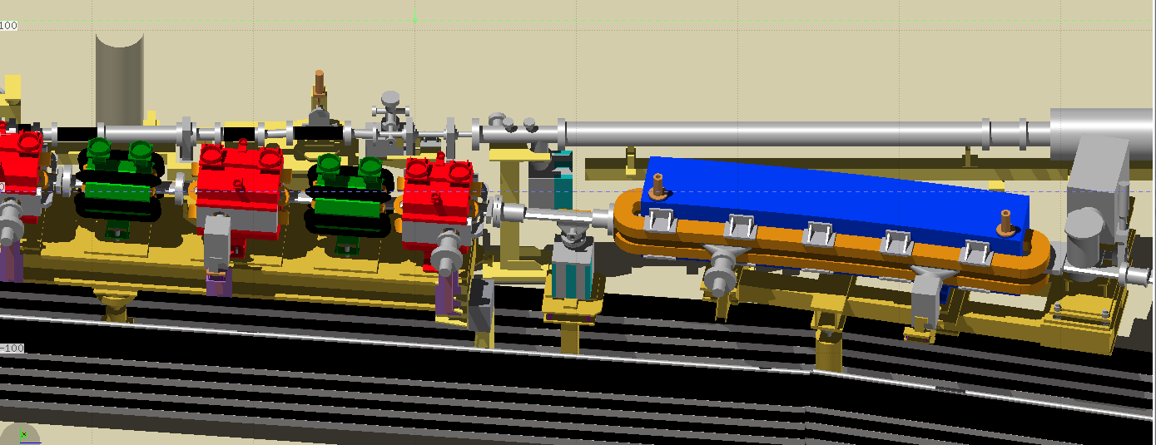
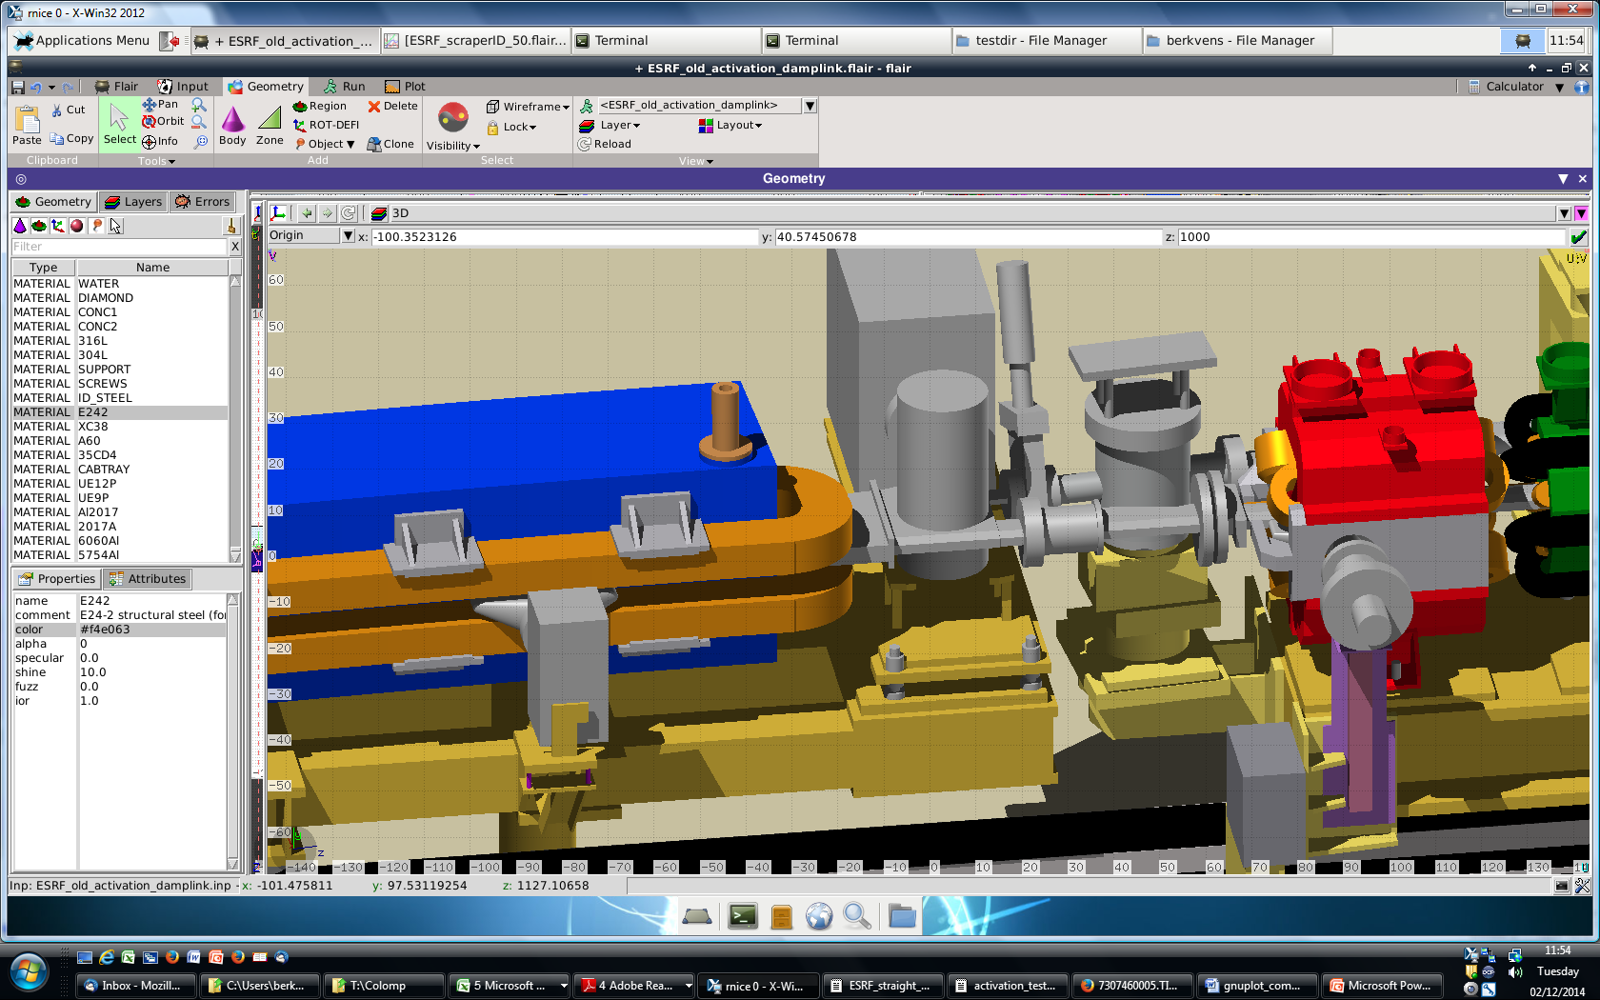
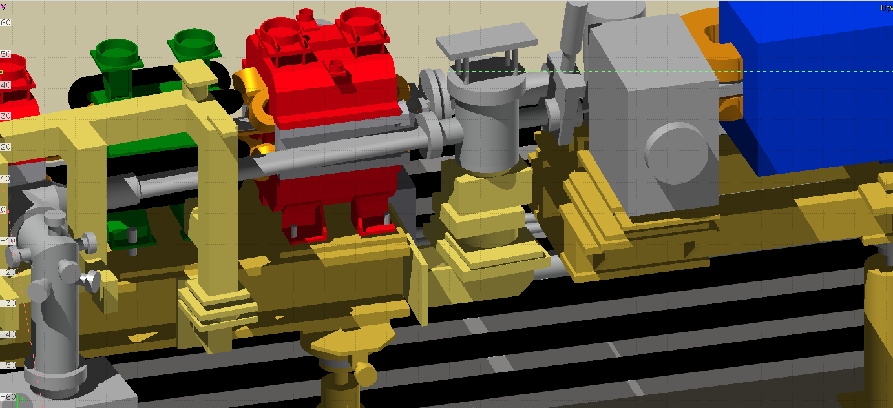
Decommissioning of the existing storage ring
Monte Carlo simulations:
FLUKA
Process knowledge:
Beam loss distributions
Injected charge history

Slide 11
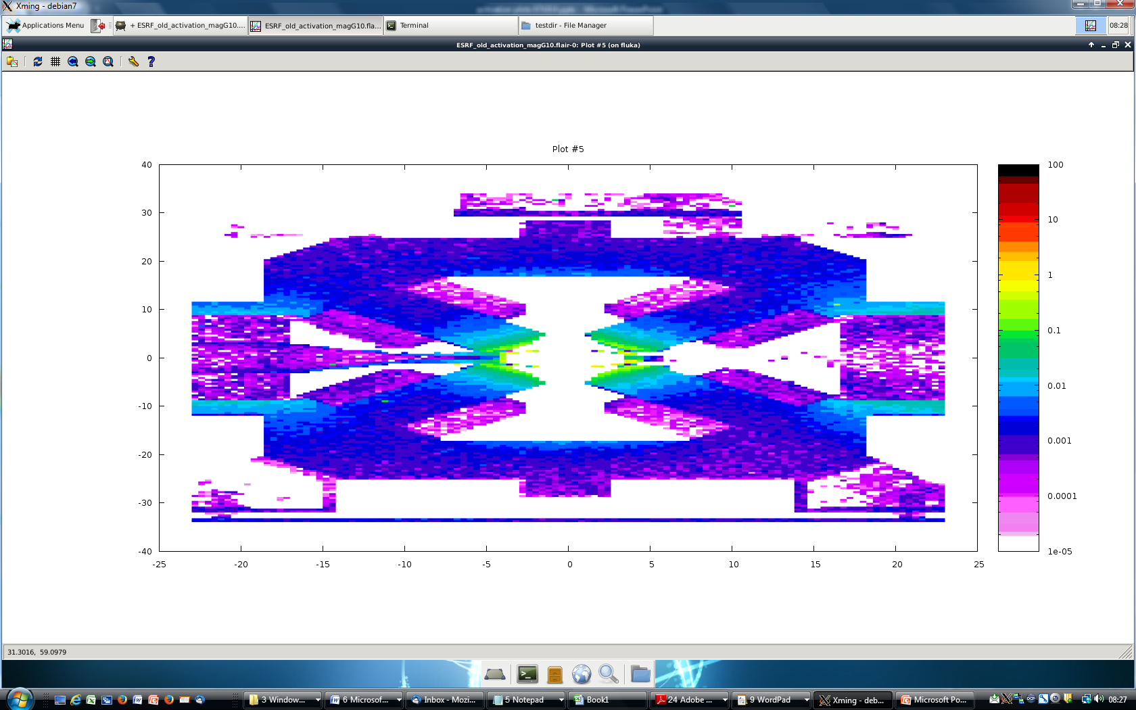
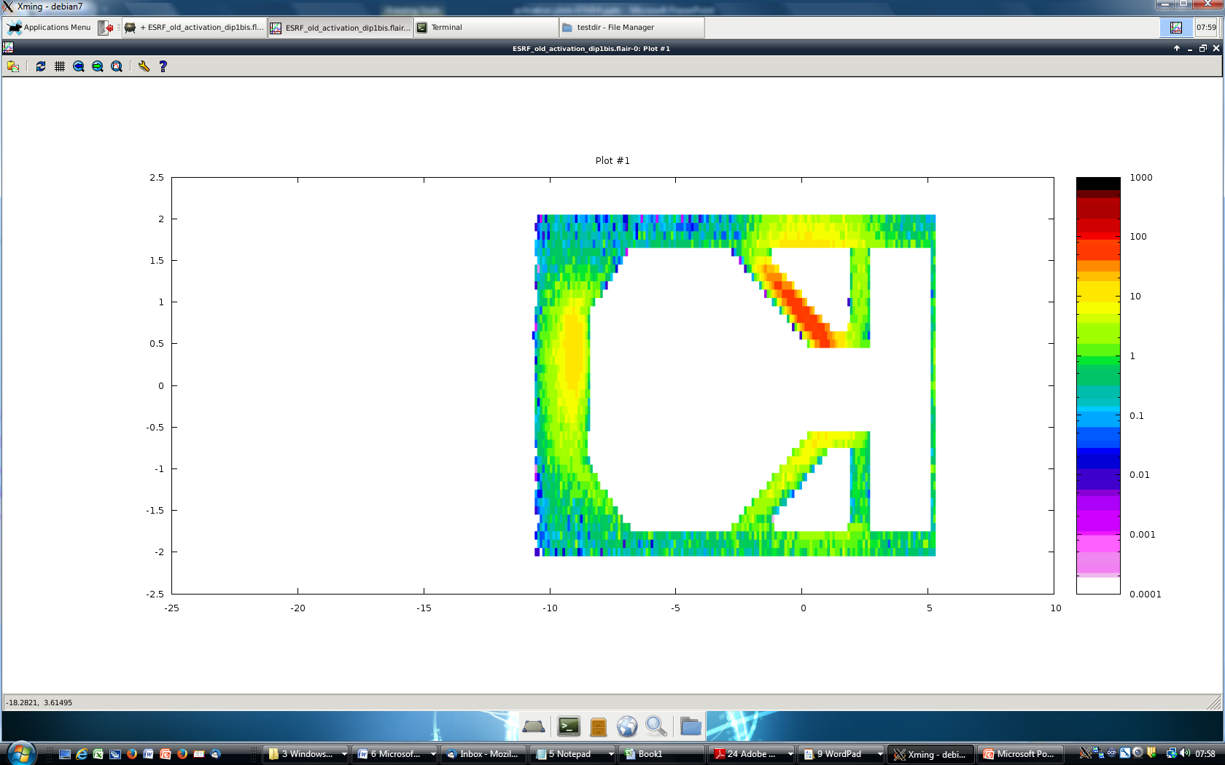
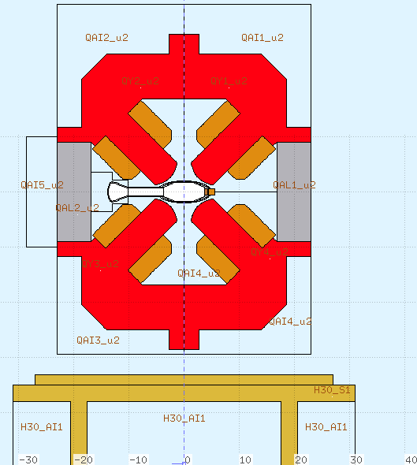
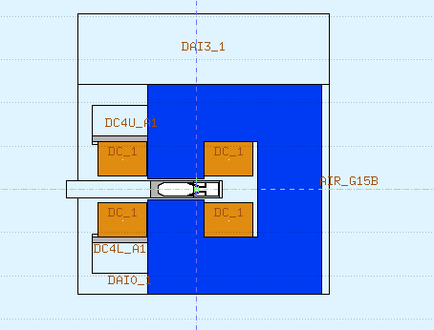
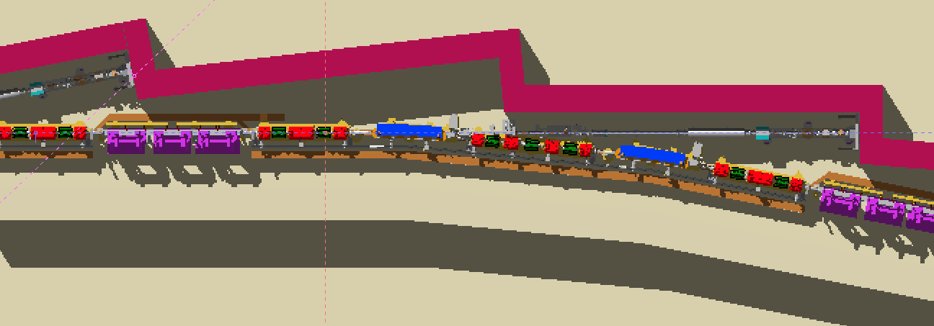
Decommissioning of the existing storage ring
sum
Total specific activity (all isotopes), integrated over all z
Sum specific activity/EU clearance level, integrated over z = [890 cm, 900 cm]
Bq/g
Cooling down time = 1 month

Slide 12
Decommissioning of the existing storage ring
Proposed classification criterion
Indistinguishable from background
(Compliance with the clearance levels defined in the Council Directive 2013/59/EURATOM)
count rate distributions
y#
y*
NF ISO 11929 standard, May 2010
Detector:
Exploranium Gr-130 miniSPEC
(1.5” × 1.5”× 2” NaI(Tl) scintillator)
Decision threshold: 2.7 nSv/h
Detection limit: 4.5 nSv/h
(for 30 nSv/h background)
3.1·u(y₀)
3.1·u(y#)
0
β = α = 1·10⁻³
net count rate

Slide 13
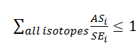
Decommissioning of the existing storage ring
Equivalence between classification criterion and compliance with the clearance levels defined in the Council Directive 2013/59/EURATOM
Surface dose measurements (indistinguishable form background)
guaranteed for 1 cm³ hotspots.

Slide 14
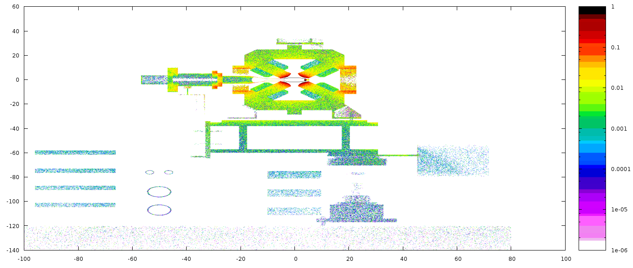
Decommissioning of the existing storage ring
Proposed criterion
Only a few vacuum vessels should be considered as activated.
Σ_{i}(AS_{i}/SE_{i})
100 % local losses

Slide 15
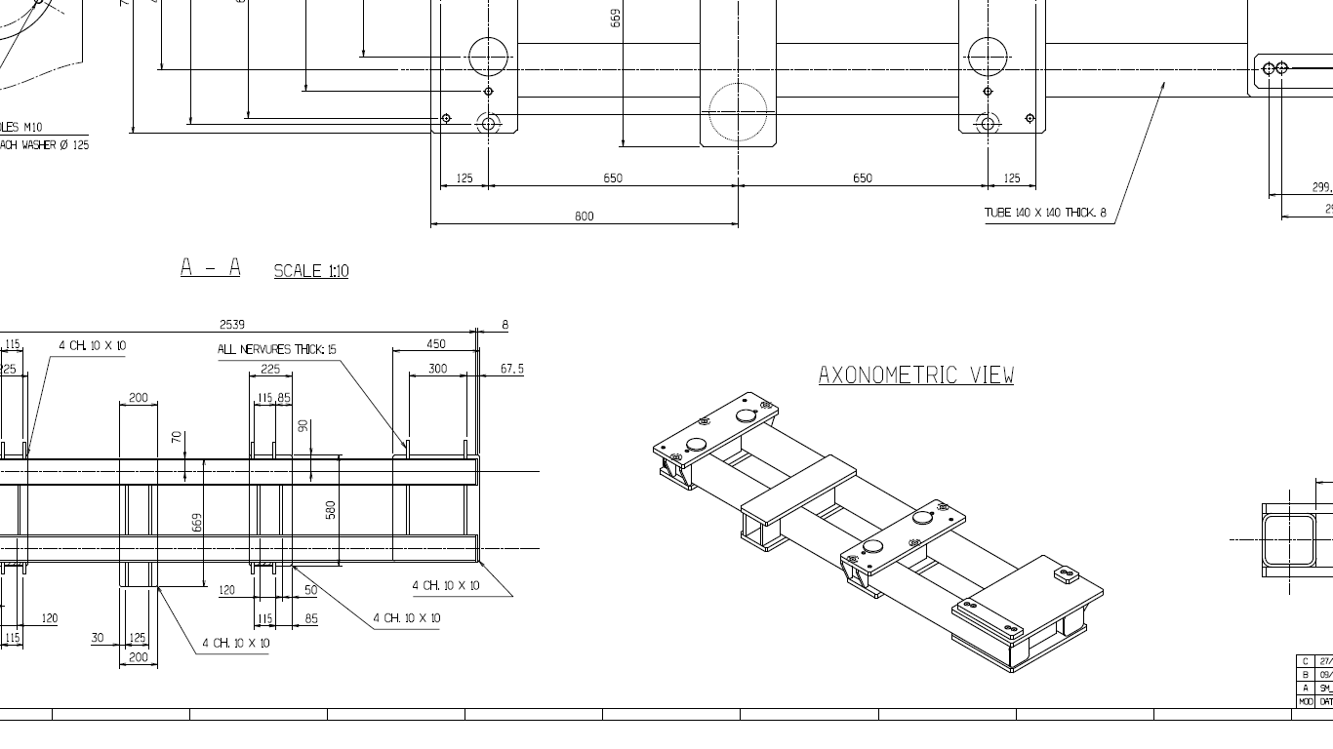
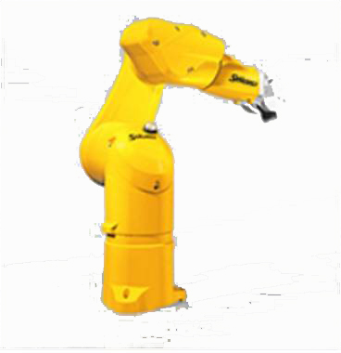
Decommissioning of the existing storage ring

Slide 16
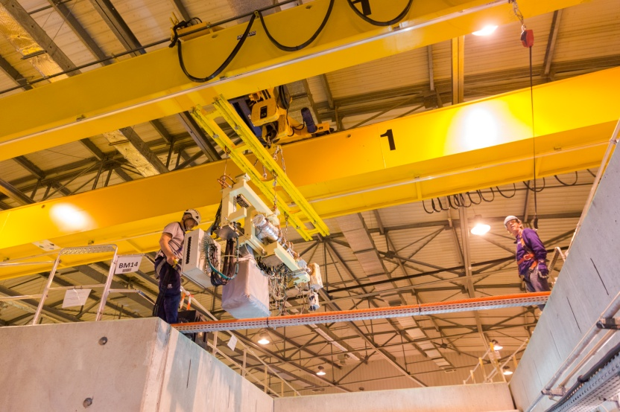
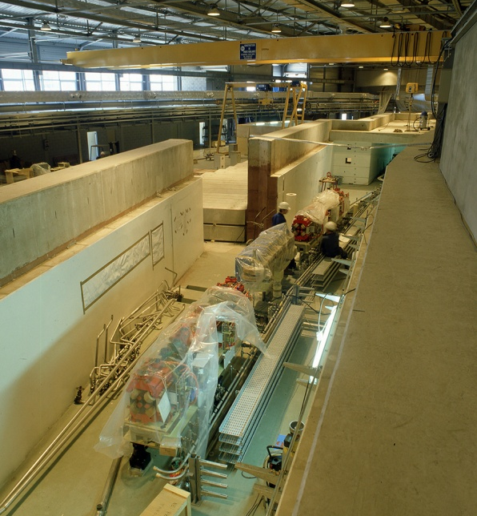
General safety challenges related to EBS project
Intensive handling activities:
  Removing existing storage ring with 6 T overhead cranes.
    Securing crane operators when storage ring tunnel roof open.
  Installation of new storage ring:
    12 T preassembled girders require specific transport / lifting tools.
    Smaller items installed using 6 T overhead cranes.
Confined space inside storage ring tunnel
Tight schedule
  Dismantling planned in two 8 hours shifts / day
  Intensive use of contractors on site
Since beginning 2016:
  Weekly installation meetings to define:
    Detailed planning,
    Safe work methods.
  Participation of Safety Group to weekly meetings.

Slide 17
EBS project: radiation protection framework
1st discussions with ASN:
  Upgrade should not be considered as new facility but as a modification of an existing facility.
  Authorisation request to be submitted to ASN mid 2017
  Radiation exposure should be as low as for present facility
  → Aim ESRF: - Dose constraint: 1 mSv/y → 800 μSv/y (2 μSv/4 h → 1.6 μSv/4 h)
- Commissioning period: maintain non-exposure status
          Limit access to experimental hall to staff and long-term contractors
          Guarantee monthly non-exposure limits
Compliance with Council Directive 2013/59/EURATOM

Slide 18
EBS project: shielding assessment
Purpose: assessment of "normal exposure” and verify compliance with dose constraint.
2013/59/EURATOM : "normal exposure” means exposure expected to occur under the normal operating conditions of a facility or activity (including maintenance, inspection, decommissioning), including minor incidents that can be kept under control, i.e. during normal operation and anticipated operational occurrences.
Major challenge:
  maximum beam losses × 10 use existing bulk shielding
  → install few beam loss collimators + local shielding
 |  | Lifetime (h) |  | Beam losses (e/s)
Beam mode | Stored current (mA) | Present lattice | EBS lattice | Present lattice | EBS lattice
Multi-bunch | 200 | 45 | 19.3 | 2.2 10⁷ | 5.1 10⁷
16 bunch | 92 | 16 | 1.8 | 2.8 10⁷ | 2.5 10⁸
4 bunch | 40 | 9 | 1.2 | 2.2 10⁷ | 1.6 10⁸

Slide 19
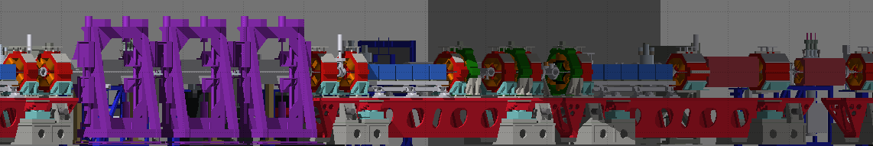
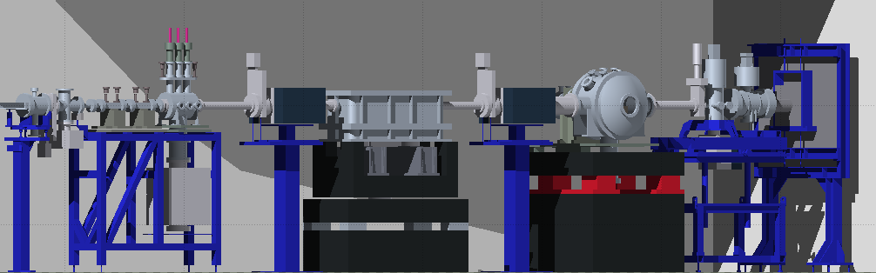
ebs project: shielding assessment
Shielding study: need for
  realistic geometry
  realistic beam losses
FLUKA model of EBS storage ring
FLUKA model of optics hutch

Slide 20
Electron Beam loss distribution
beam loss per unit cell (% of total losses)
Matlab Accelerator Toolbox
→ Module developed for Touschek losses:
6 dimensional phase space distribution of lost electrons
unit cell number
beam loss distribution along storage ring
collimator location:
between QF4E and SD1E

Slide 21
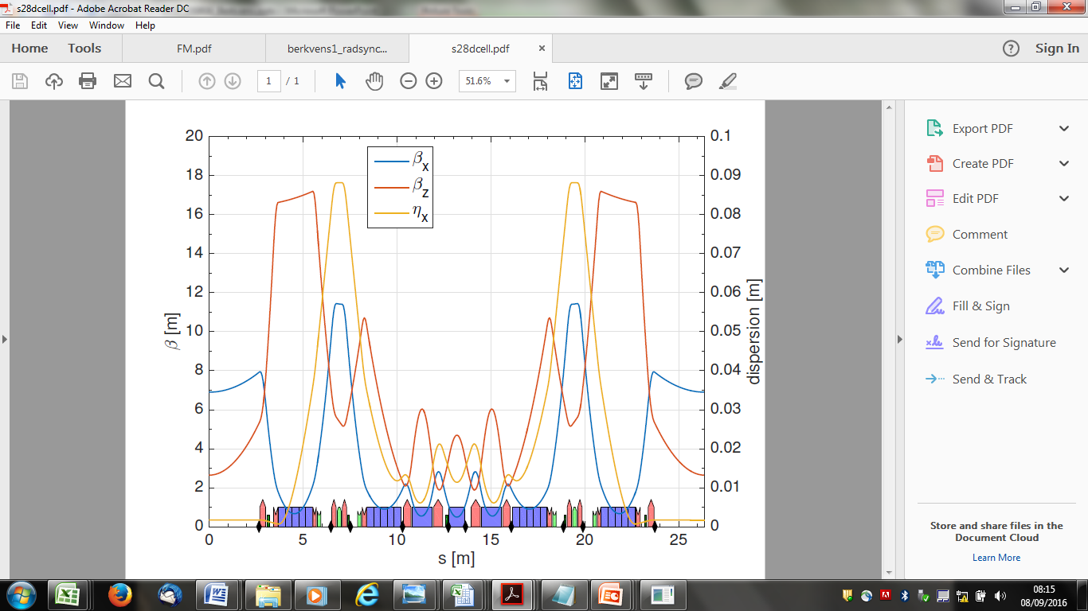
Electron Beam loss distribution: example unit cell number 10
for each unit cell: 6 dimensional phase space distribution of lost electrons
x' (rad)
cumulative beam losses within unit cell
x (m)
y' (rad)
beam loss distribution within unit cell
y (m)

Slide 22
Beam loss collimator: principle design
# photons × energy [GeV/e⁻]
# neutrons × energy [GeV/e⁻]
10¹
10⁻¹
photons
neutrons
10⁰
10⁻¹
10⁻²
10⁻²
10⁻³
10⁻⁴
10⁻⁵
10⁻⁶
10⁻³
0
10
20
30
40
0
10
20
30
40
thickness [cm]
thickness [cm]

Slide 23
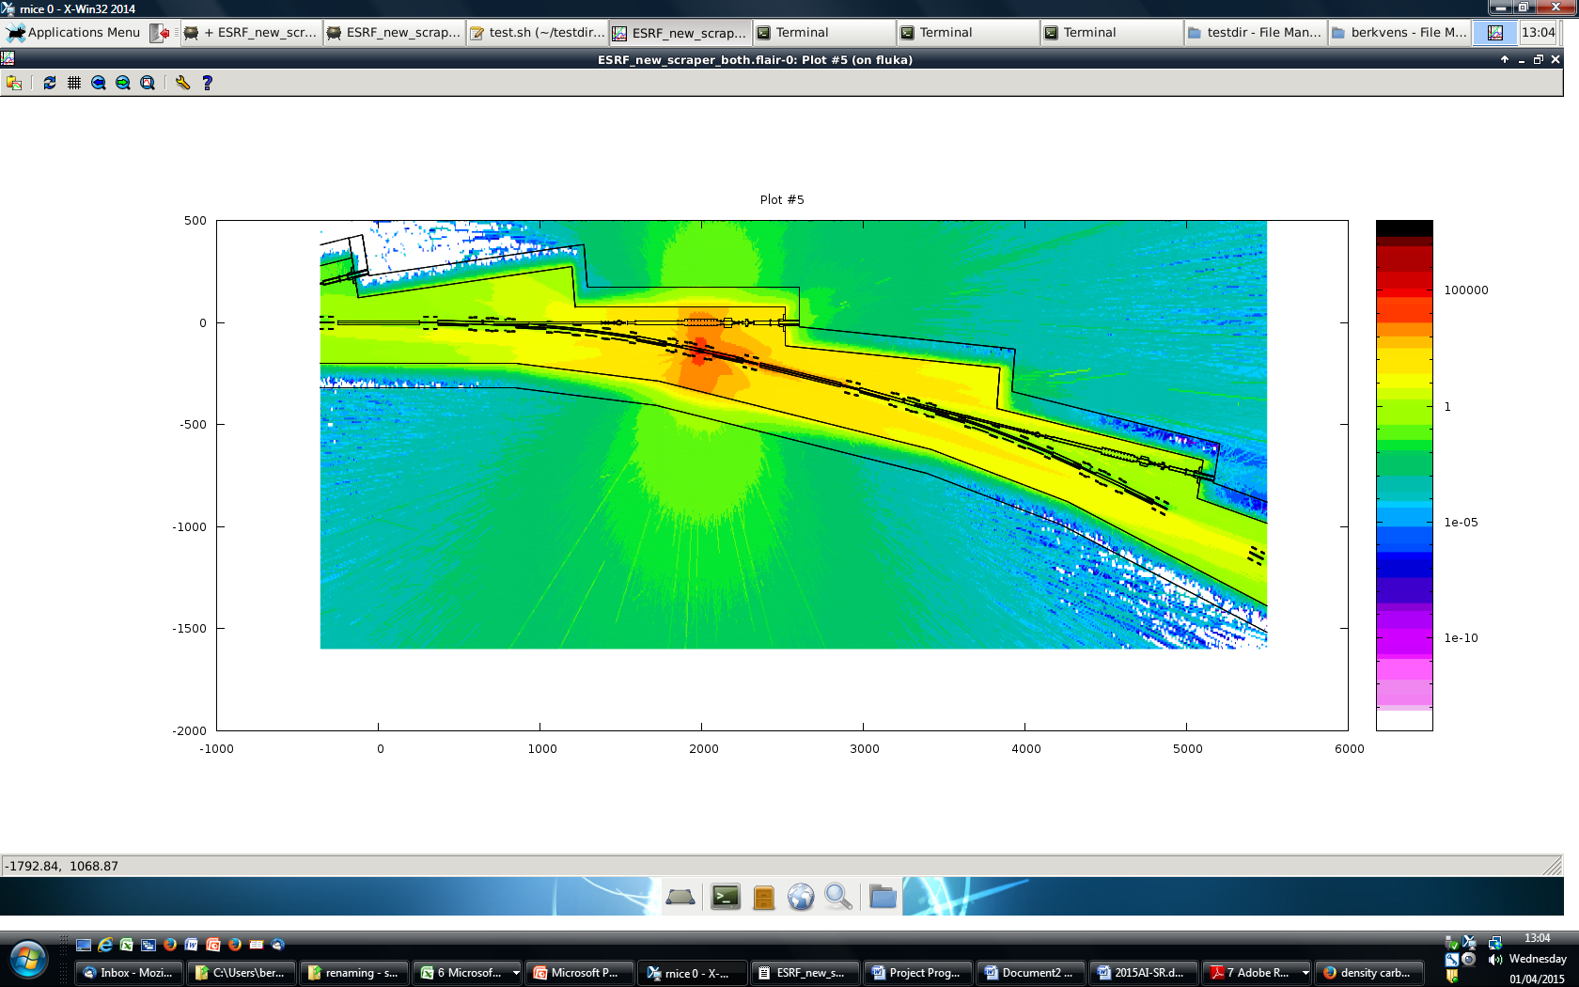
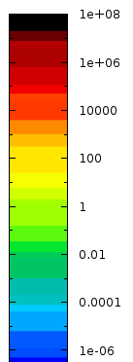
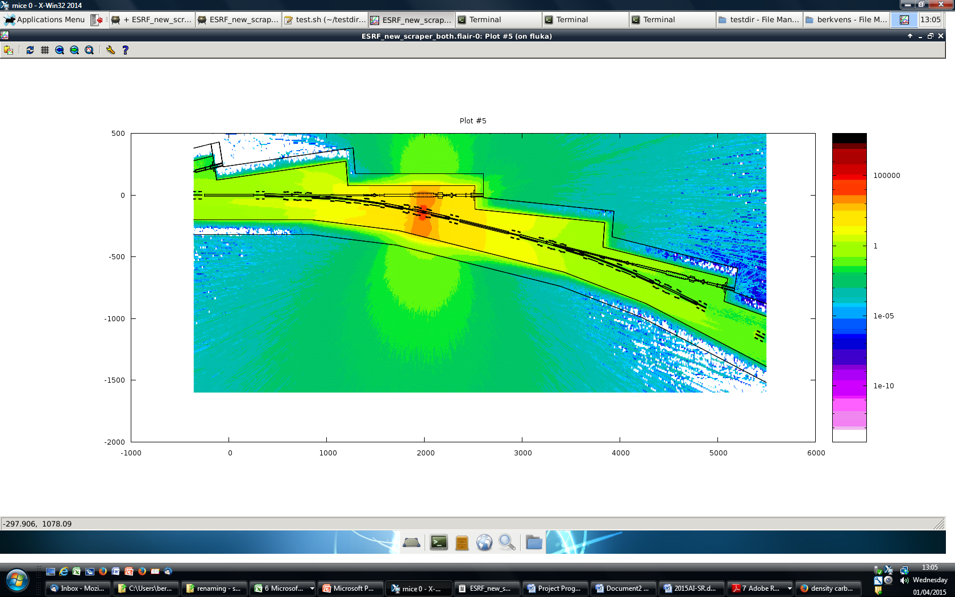
Collimator shielding tungsten collimator
μSv/h
total
0.4
neutrons
effective dose rate (μSv/h)
0.4 μSv/h
cm

Slide 24
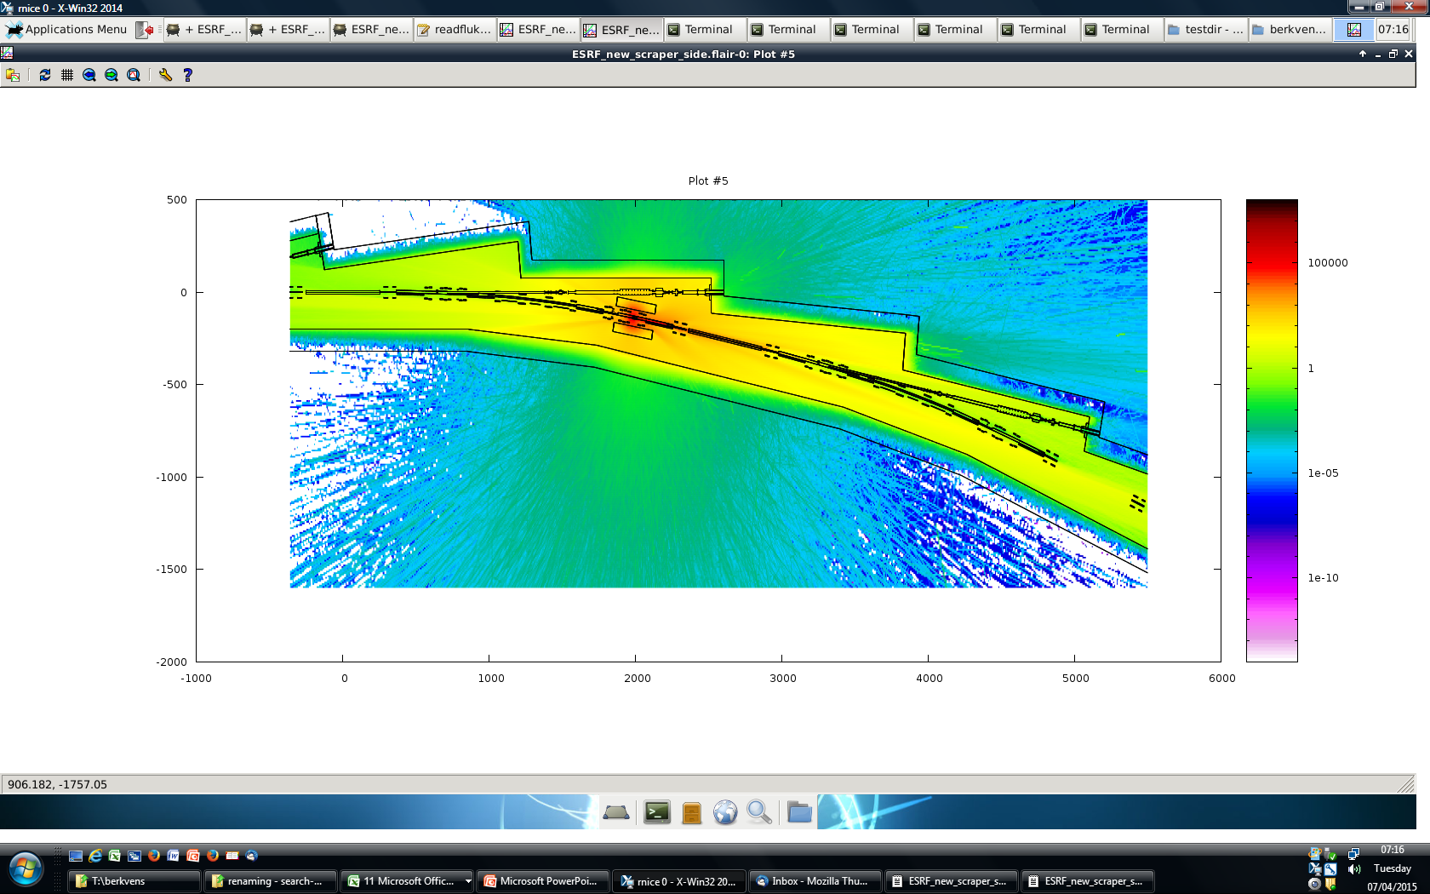
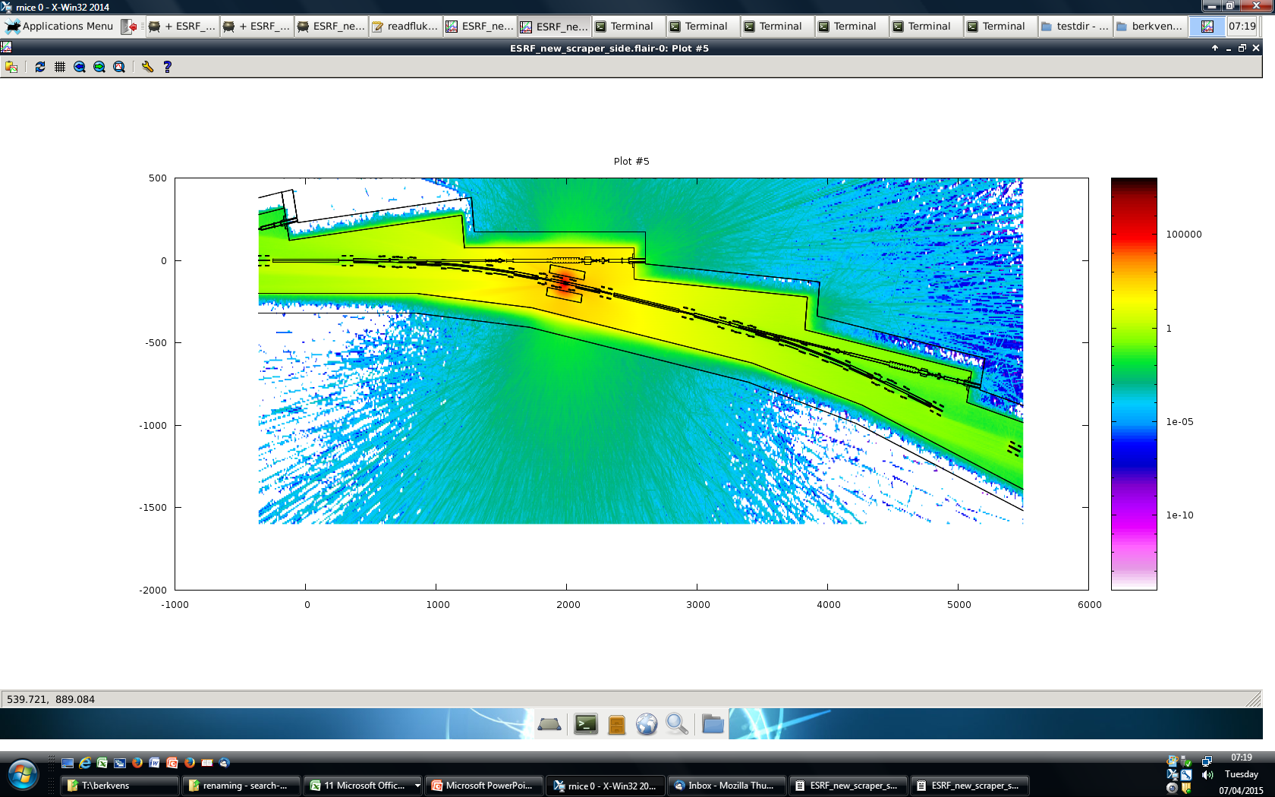
Collimator shielding 50 cm steel local shielding
μSv/h
total
0.4
neutrons
effective dose rate (μSv/h)
0.4 μSv/h
cm

Slide 25
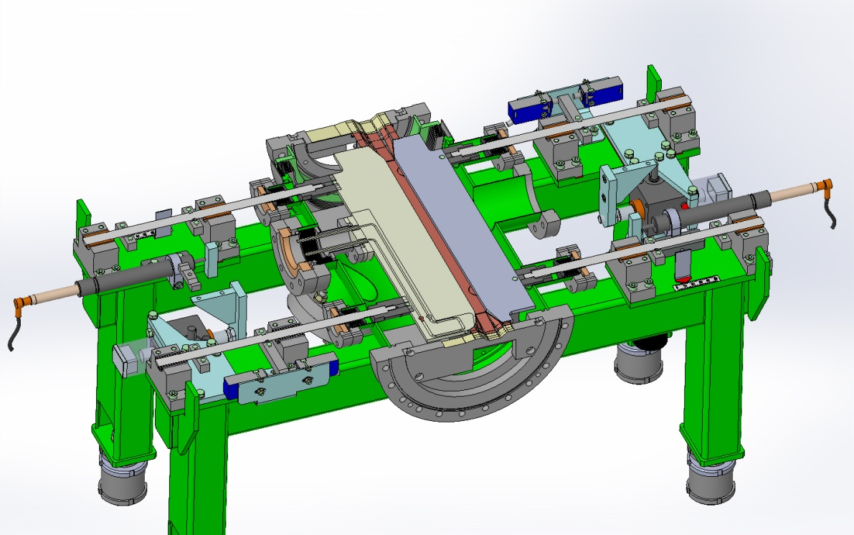
Beam loss collimator
Engineering design of collimator is being finalised.
Next steps:
  Modeling collimator in FLUKA
  Design local shielding
  Activation calculations

Slide 26
Shielding assessment
2013/59/EURATOM : "normal exposure” means exposure expected to occur under the normal operating conditions of a facility or activity (including maintenance, inspection, decommissioning), including minor incidents that can be kept under control, i.e. during normal operation and anticipated operational occurrences.
Normal losses
  Verify that effective dose rates are << 0.4 μSv/h (1.6 μSv / 4h)
Minor incidents
  Stored beam losses: estimate probability, assess dose
  Injected beam losses
    Assess integrated dose per 5 nC booster pulse (6 GeV, 5 mA, 1 μs)
    Verify doses are kept under control via interlocked radiation monitors
      Dose / booster pulse < 1.6 μSv
      Validate number / location of interlocked dose monitors

Slide 27
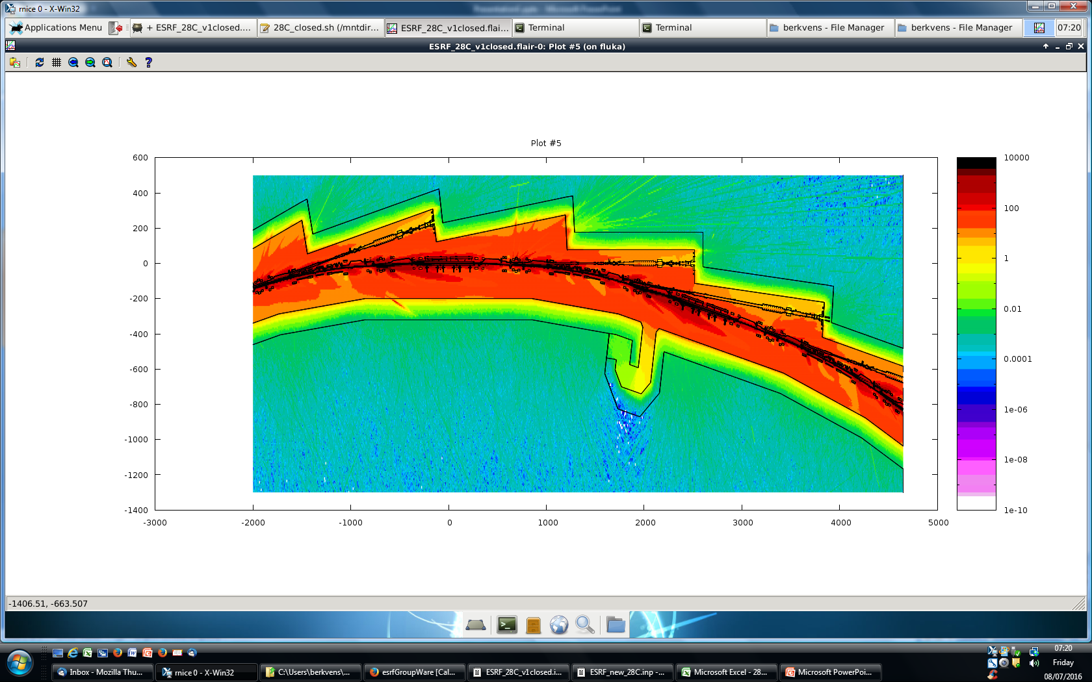
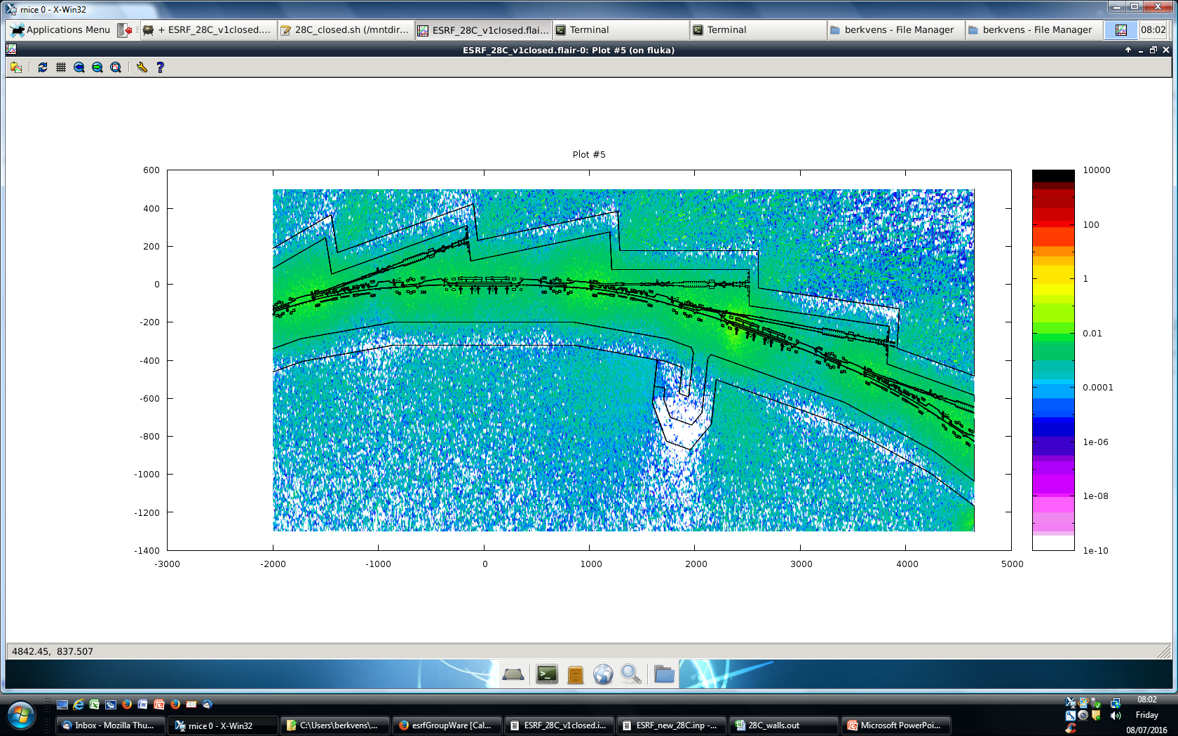
Normal beam losses: 92 mA, 1.8 h lifetime – 1 % local loss per cell
total effective dose rate (μSv/h)
0.4 μSv/h
μSv/h
cm
beam height
above roof

Slide 28
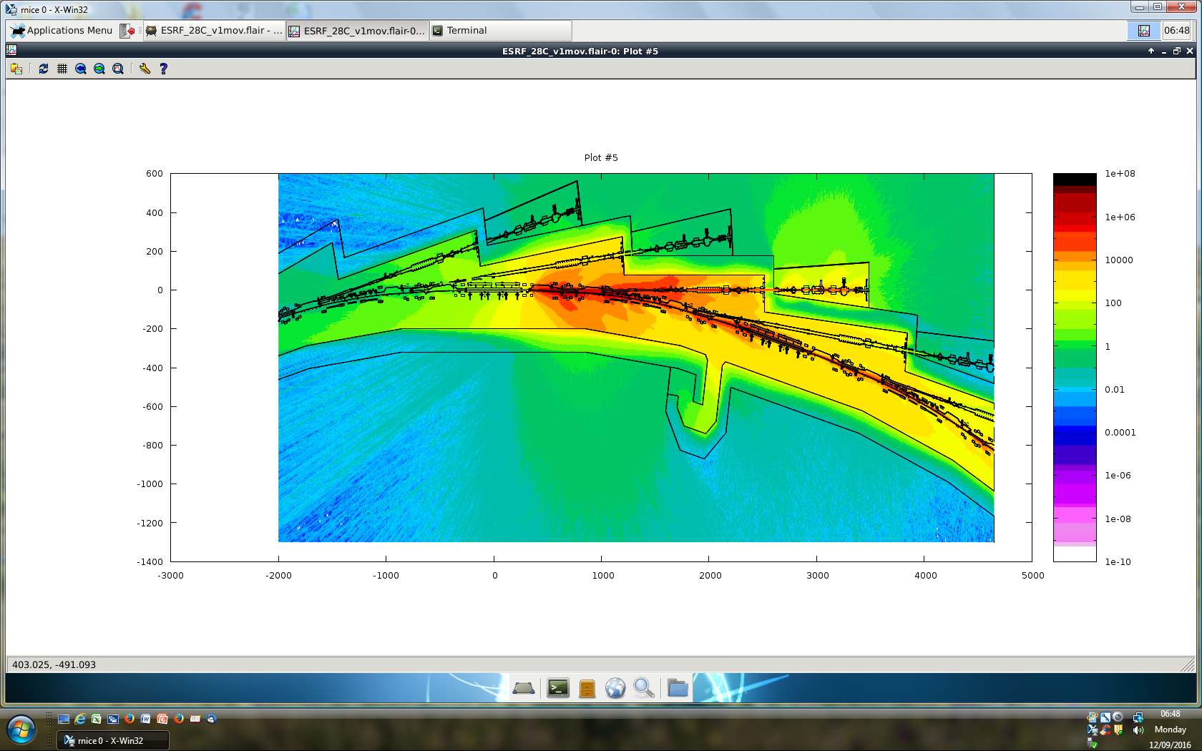
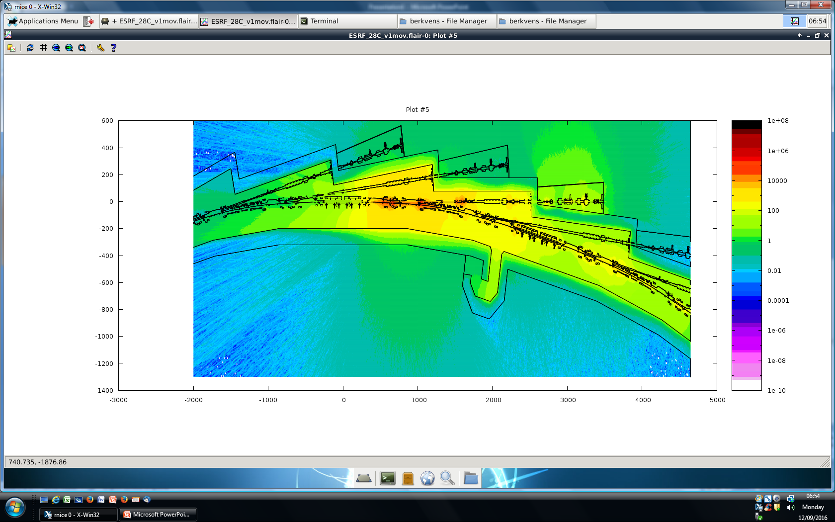
STORED BEAM incident: 200 mA lost on closing gate valve
total effective dose (μSv)
1.6 μSv
μSv
cm
total dose
neutrons

Slide 29
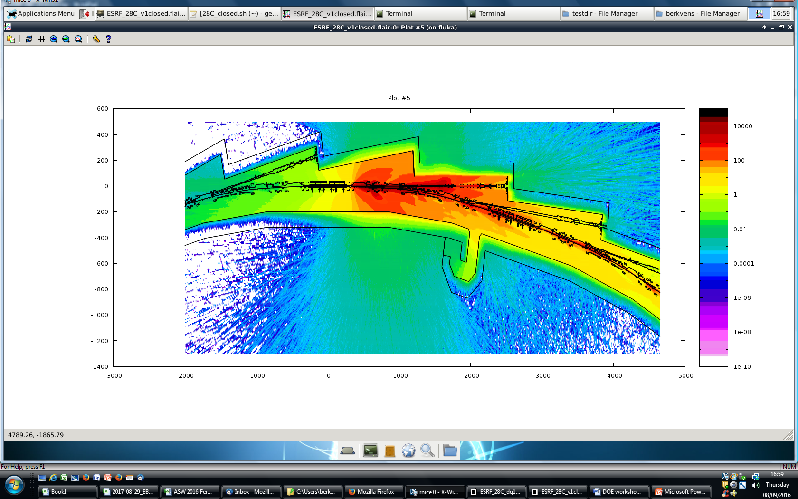
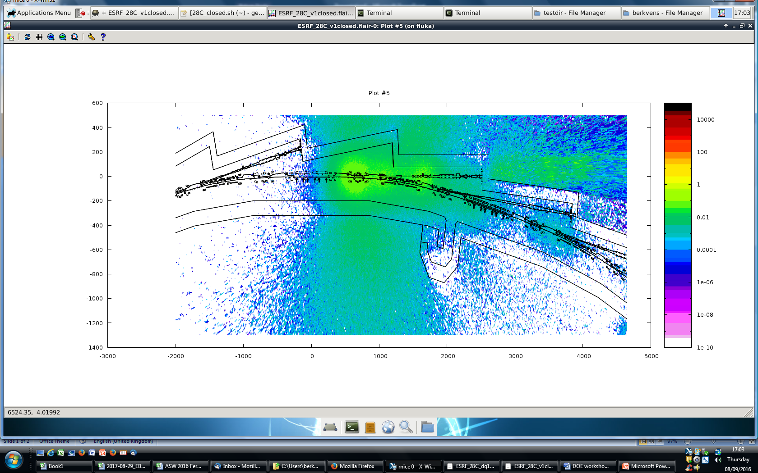
Injected beam incidents: 5 nC injected on closed gate valve
total effective dose (μSv)
μSv
cm
beam height
above roof

Slide 30
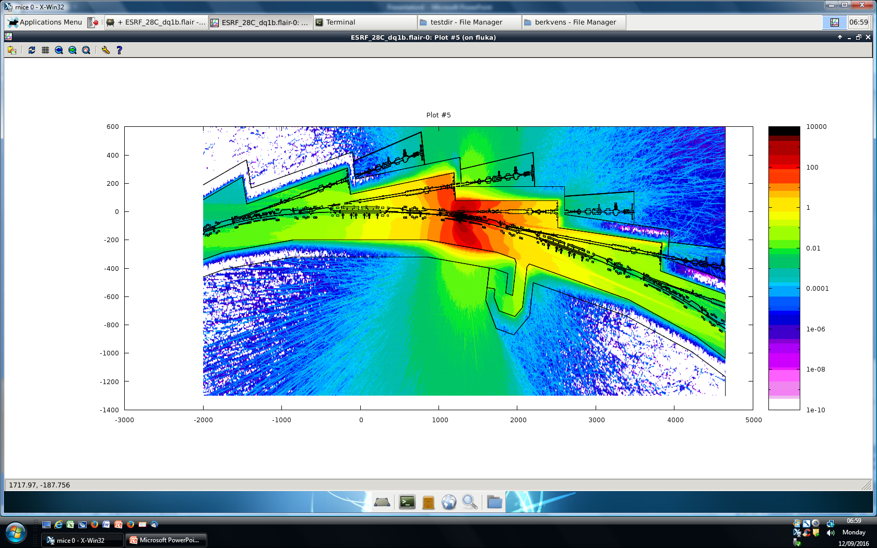
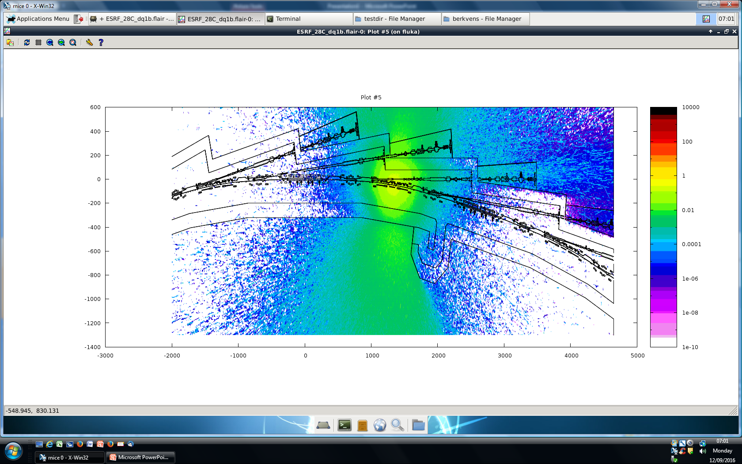
Injected beam incidents: 5 nC injected with DQ1B magnet off
total effective dose (μSv)
μSv
cm
beam height
above roof

Slide 31
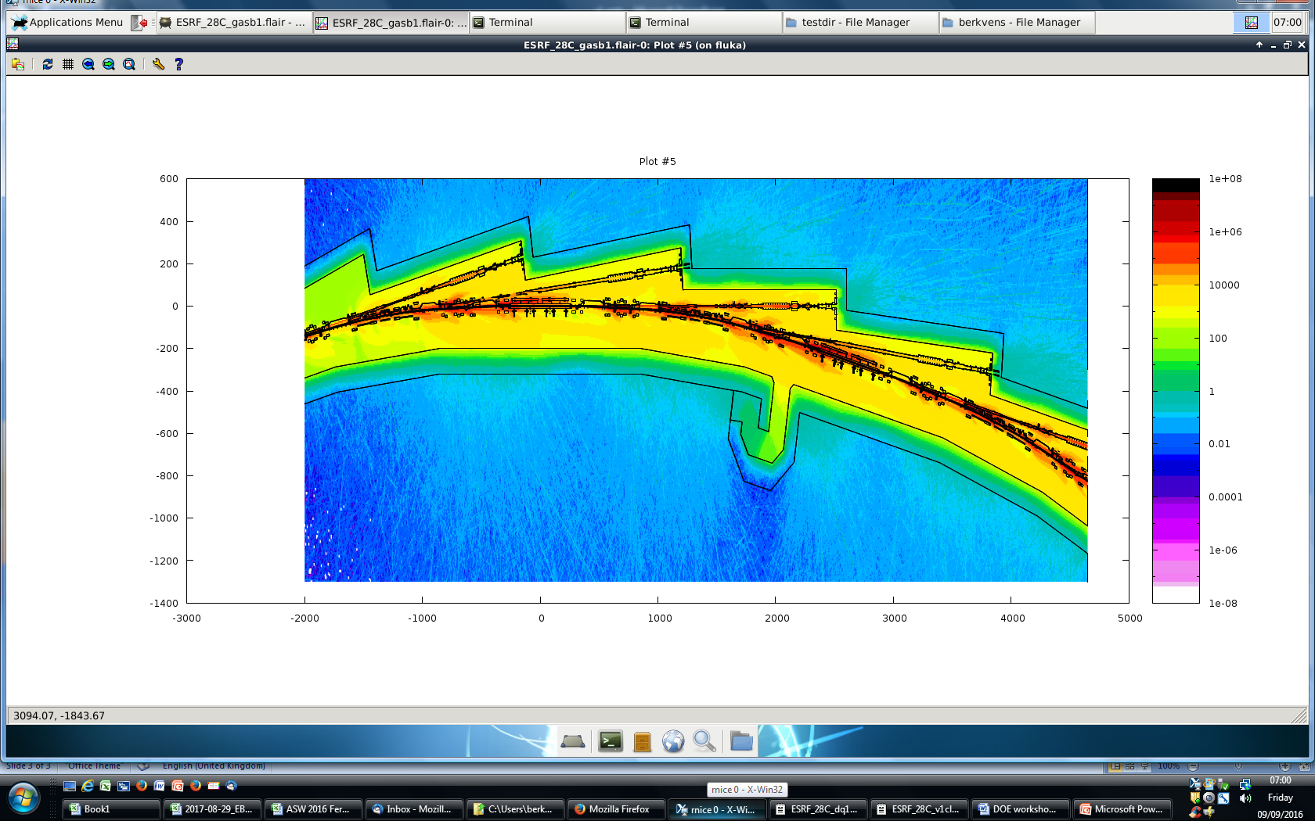
Storage ring Vacuum conditioning - 1 A.h – 200 mA
total effective dose rate (μSv/h)
0.4 μSv/h
μSv/h
cm
beam height
Initial vacuum conditioning of storage ring
After 1 A.h of conditioning:
  Total dose rate outside walls: 0.7 μSv/h
  Total dose rate above roof: 1 μSv/h
  → Radiation protection will not be an issue for the storage ring commissioning
mbar
average pressure @ 200 mA: 7.5×10⁻⁷ mbar
mm

Slide 32
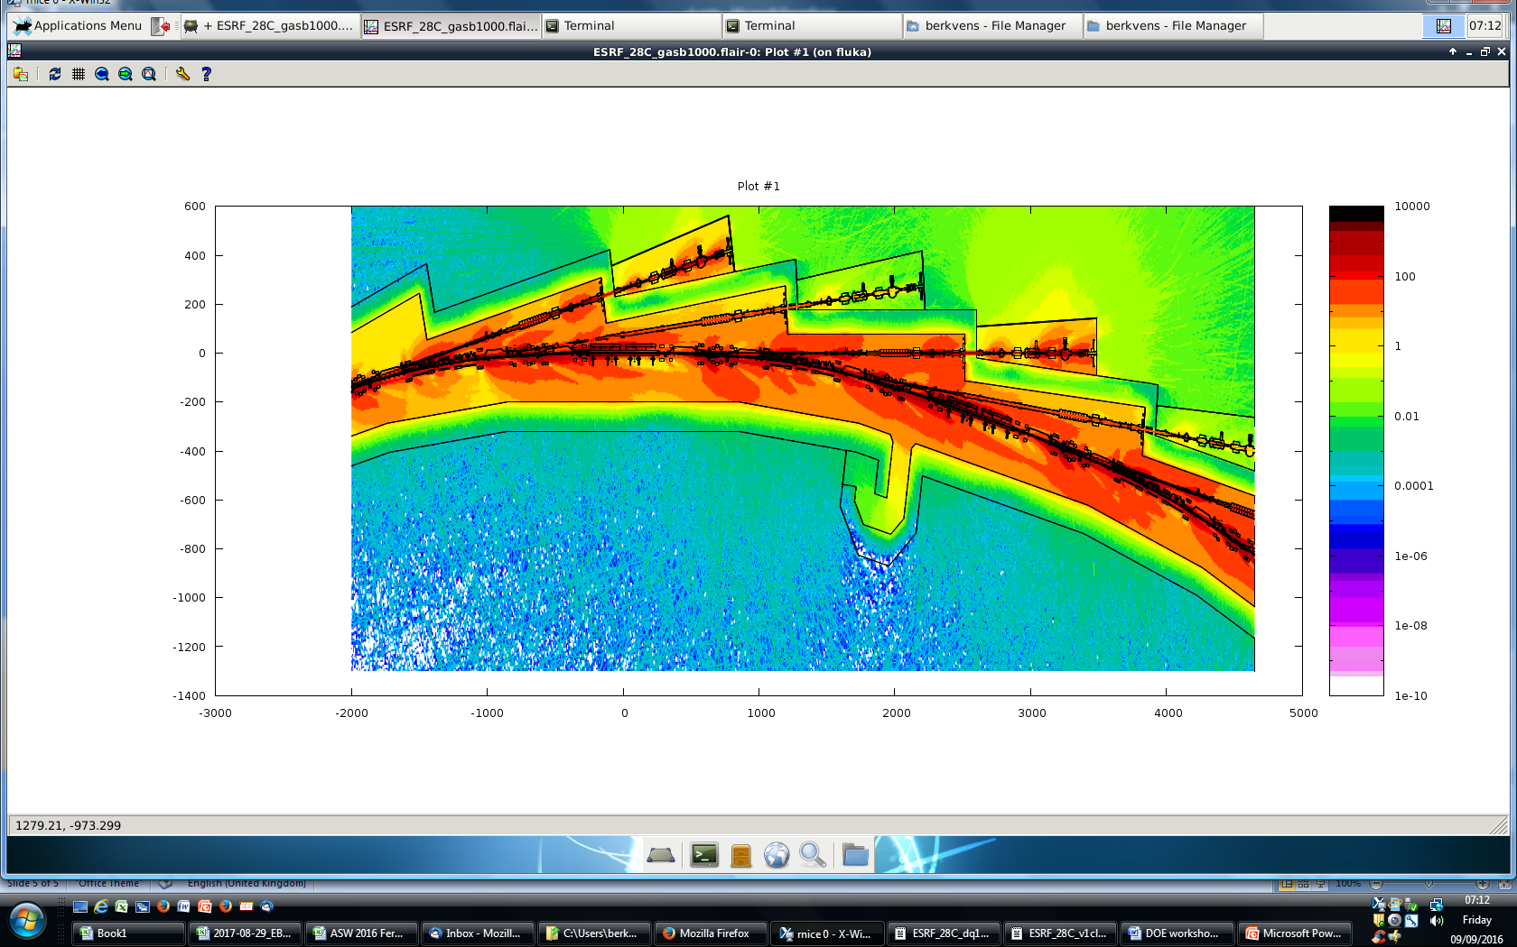
Beamline commissioning - 1000 A.h – 200 mA
effective dose rate (μSv/h)
0.4 μSv/h
μSv/h
cm
beam height
Beamline commissioning
After 1000 A.h of conditioning:
  Outside ID optics hutch: 0.75 μSv/h
  Outside BM optics hutch: 0.025 μSv/h
  → Vacuum conditioning needs to be reassessed.
mbar
average pressure @ 200 mA: 4×10⁻⁹ mbar
mm

Slide 33
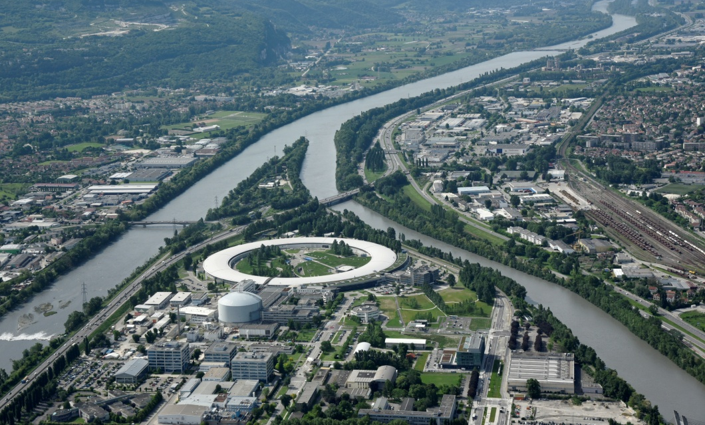
Many thanks for your attention

