Slide 1
Best Practice: Laboratory Operations Supervisor Academy (LOSA)
2016 DOE Accelerator Safety Workshop
Sept 20-22, 2016
Chris Patton, CSP
Senior Technical Advisor
ES&H Directorate
Oak Ridge National Laboratory

Slide 2
The power of supervisors
“We tend to think that what matters is having outstanding leadership at the senior level. But great leadership at the top doesn't amount to much if you don't have exceptional leadership at the unit level. That's where great things get done.”
Jim Collins
The Re-education of Jim Collins (Bo Burlingham)

Slide 3
Supervisors are critical to affecting our culture, yet we haven’t done a very good job of preparing them for this role

Slide 4
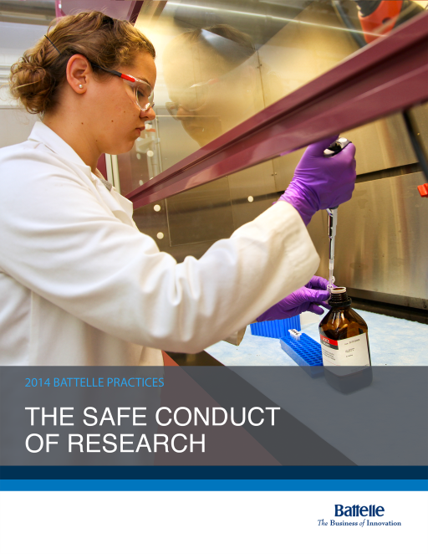
Laboratory Operations Supervisor Academy (LOSA)
Battelle-wide experience-based
learning and diagnostics workshop
  Simulation-intensive approach
  Small groups
  Immediate feedback
Initial focus:
Mission support front-line supervisors
Expanded focus:
Mission support and Research
front-line leaders, side-by-side

Slide 5
LOSA simulations/scenarios
SME brings you photo
of unsafe act
1
10
Manager responds inappropriately to report of electrical shock
Experienced crew member discourages questioning attitude
2
9
Senior worker
defends failure to follow procedure
Supervisors work through
scenarios
linked to key safety principles
Senior craftsman
with expert knowledge
is disengaged
3
8
Workers disregard procedure change
Researcher resists
safety suggestion
from staff
4
7
Valued customer requests work outside package scope
Change in requirements must be communicated to staff
5
6
SME and worker disagree on need
to change procedure

Slide 6
What’s in a simulation?
Preparation
Role-play the scenario
Peer feedback
  Shine
  Polish
  Use of safety principles
Discussion on safety culture relative to this situation
  Use of case study questions
Roles:
  Lead Role Player (1)
  Facilitator (1)
  Supervisor participants (5)
    Hot Seat Supervisor
    Participant role players
    Observers

Slide 7
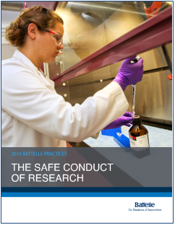
Reinforce Key Principles for a Strong Safety Culture
Everyone is personally responsible for ensuring safe operations
Leaders value the safety legacy they create in their discipline
Staff raise safety concerns because trust permeates the organization
Cutting-edge science requires cutting-edge safety
A questioning attitude is cultivated
Learning never stops
Hazards are identified and evaluated for every task, every time
A healthy respect is maintained for what can go wrong

Slide 8
Sustaining this effort
Continued development
Performance
management
Ongoing engagement
Town hall meetings
Alumni group
Culture of mentoring
Engage line management
Educate manager
on role
as mentor
Structured mentoring
Senior Safety Mentors
Implementing lessons from LOSA

Slide 9
Outcome: Supervisors who are…
Aligning their groups’ cultures with the Safe Conduct of Research
Better equipped to foster the behaviors we expect
Empowered to critically evaluate and resist unreasonable burdens, management expectations, and customer demands
Guardians of our safety culture

Slide 10

Questions?

