Slide 1
Introduction to Statistical Issues for Phystat-ν
Louis Lyons
Imperial College, London
and
Oxford
FNAL
Sept 2016

Slide 2
Statistical Procedures
Why bother ?
Experiments are expensive and time-consuming, so:
Worth investing effort in statistical analysis
→ better information from data
Parameter Determination
Central value and range
e.g. sin²2ϴ
Comparing data with Hypotheses → Discoveries, Upper Limits,…
Just one Hypothesis
Goodness of Fit
e.g. Current 3-neutrino mixing params
Comparing 2 Hypotheses
Hypothesis Testing
e.g. Standard 3ν or 3ν plus sterile ν
ν mass hierarchies

Slide 3
TOPICS
A brief reminder about Likelihoods
A few comments on Bayes, Frequentism and Feldman-Cousins
Some issues related to Discovery claims
Upper Limits
Summary

Slide 4
Likelihoods
Here just for parameter determination
Also very important for Hypothesis Testing,
in Bayesian and Frequentist approaches
Procedure:
Write down P(data|hypothesis’ param)
pdf: Regard this as fn of data, for fixed param values
Likelihood: Fn of parameter, for given data
e.g. Poisson P(n|µ) = e^{-µ} µ^{n}/n!
Data:
Can be individual values. Does not have to be a histogram

Slide 5
Simple example of Likelihood: Angular distribution
y = N (1 + β cos²θ) N = 1/{2(1+β/3)}
y_{i} = N (1 + β cos²θ_{i})
= probability density of observing θ_{i}, given β
L(β) = Π y_{i}
= probability density of observing the data set y_{i}, given β
Best estimate of β is that which maximises L
Values of β for which L is very small are ruled out
Precision of estimate for β comes from width of L distribution
****** CRUCIAL to normalise y N = 1/{2(1 + β/3)}
(Information about parameter β comes from shape of exptl distribution of cosθ)
β = -1 β large L
cos θ cos θ β

Slide 6
How it works: Resonance
y ~ Γ/2
(m-M₀)² + (Γ/2)²
m m
^{Vary M}₀ ^{Vary Γ}

Slide 7
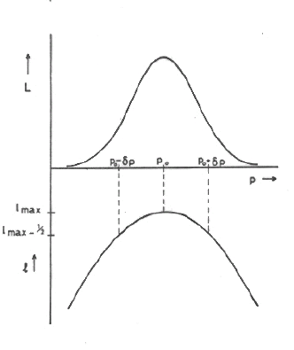
Conventional to consider
l = ln(L) = Σ ln(y_{i})
For large N, L → Gaussian

Slide 8
ΔlnL = -1/2 rule
If L(μ) is Gaussian, following definitions of σ are equivalent:
1) RMS of L(µ)
2) 1/√(-d²lnL/dµ²)
3) ln(L(μ₀±σ) = ln(L(μ₀)) -1/2
If L(μ) is non-Gaussian, these are no longer the same
“Procedure 3) above still gives interval that contains the true value of parameter μ with 68% probability”
Heinrich: CDF note 6438 (see CDF Statistics Committee Web-page)
Barlow: Phystat05

Slide 9
COVERAGE
How often does quoted range for parameter include param’s true value?
N.B. Coverage is a property of METHOD, not of a particular exptl result
Coverage can vary with μ
Study coverage of different methods for Poisson parameter μ, from observation of number of events n
Hope for:
100%
Nominal value

Slide 10
COVERAGE
If true for all : “correct coverage”
P< for some “undercoverage”
(this is serious !)
P> for some “overcoverage”
Conservative
Loss of rejection power

Slide 11
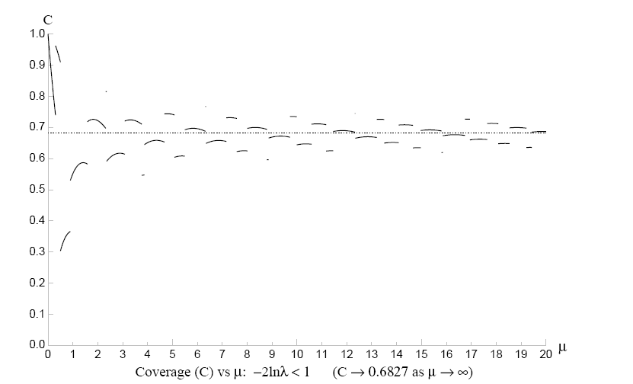
Coverage : L approach (Not frequentist)
P(n,μ) = e^{-μ}μ^{n}/n! (Joel Heinrich CDF note 6438)
-2 lnλ< 1 λ = P(n,μ)/P(n,μ_{best}) UNDERCOVERS

Slide 12
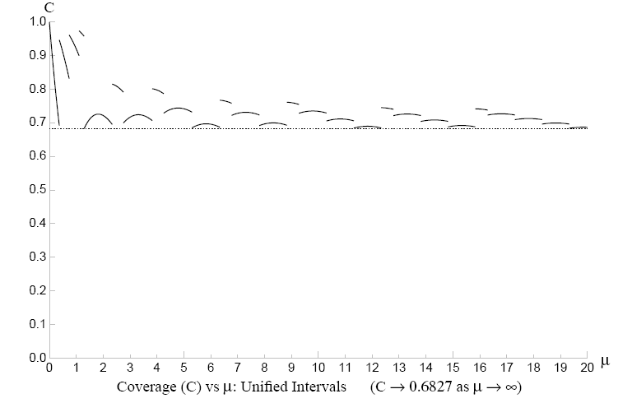
Feldman-Cousins Unified intervals
Neyman construction so NEVER undercovers

Slide 13
 | Moments | Max Like | Least squares
Easy? | Yes, if… | Normalisation, maximisation messy | Minimisation
Efficient? | Not very | Usually best | Sometimes = Max Like
Input | Separate events | Separate events | Histogram
Goodness of fit | Messy | No (unbinned) | Easy
Constraints | No | Yes | Yes
N dimensions | Easy if …. | Norm, max messier | Easy
Weighted events | Easy | Errors difficult | Easy
Bgd subtraction | Easy | Troublesome | Easy
Uncertainty estimates | Observed spread, or analytic | - ∂²l ∂p_{i}∂p_{j} | ∂²S 2∂p_{i}∂p_{j}
Main feature | Easy | Best for params | Goodness of Fit

Slide 14

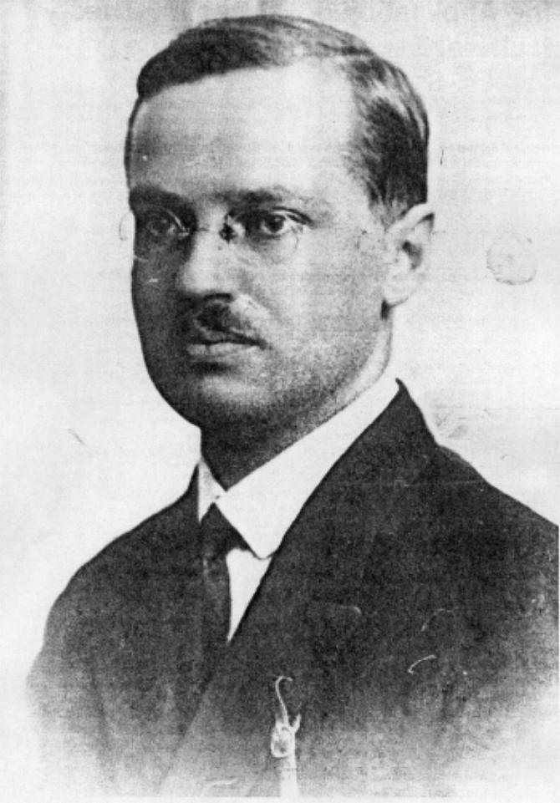
BAYES and FREQUENTISM:
Different views of probability

Slide 15
We need to make a statement about
Parameters, Given Data
The basic difference between the two:
Bayesian : Probability (parameter, given data)
(an anathema to a Frequentist!)
Frequentist : Probability (data, given parameter)
(a likelihood function)

Slide 16
PROBABILITY
MATHEMATICAL
Formal
Based on Axioms
FREQUENTIST
Ratio of frequencies as n→ infinity
Repeated “identical” trials
Not applicable to single event or physical constant
BAYESIAN Degree of belief
Can be applied to single event or physical constant
(even though these have unique truth)
Varies from person to person ***
Quantified by “fair bet”

Slide 17
Bayesian versus Classical
Bayesian
P(A and B) = P(A;B) x P(B) = P(B;A) x P(A)
e.g. A = event contains t quark
B = event contains W boson
or A = I am in FNAL
B = I am giving a lecture
P(A;B) = P(B;A) x P(A) /P(B)
Completely uncontroversial, provided….

Slide 18
Bayesian
Bayes’ Theorem
p(param | data) α p(data | param) * p(param)
posterior
likelihood
prior
Problems: p(param) Has particular value
“Degree of belief”
Prior What functional form?
Coverage

Slide 19
P(parameter) Has specific value
“Degree of Belief”
Credible interval
Prior: What functional form?
Uninformative prior: flat?
In which variable? e.g. m, m², ln m,….?
Even more problematic with more params
Unimportant if “data overshadows prior”
Important for limits
Subjective or Objective prior?

Slide 20
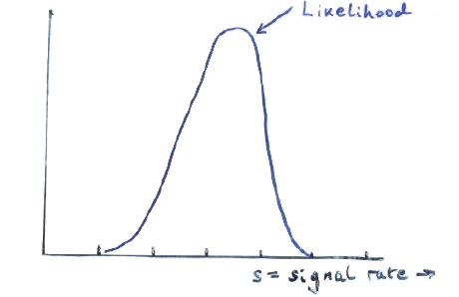
Prior
Even more important for UPPER LIMITS

Slide 21
Mass-squared of neutrino
Prior = zero in unphysical region

Slide 22
Bayes: Specific example
Particle decays exponentially: dn/dt = (1/τ) exp(-t/τ)
Observe 1 decay at time t₁: L(τ) = (1/τ) exp(-t₁/τ)
Choose prior π(τ) for τ
e.g. constant up to some large τ L
Then posterior p(τ) =L(τ) * π(τ)
has almost same shape as L(τ)
Use p(τ) to choose interval for τ τ in usual way
Contrast frequentist method for same situation later.

Slide 23
Classical Approach
Neyman “confidence interval” avoids pdf for
Uses only P( x; )
Confidence interval :
P( contains _{t} ) =
True for any _{t}
Varying intervals from ensemble of experiments
fixed
Gives range of for which observed value was “likely” ( )
Contrast Bayes : Degree of belief = is in

Slide 24
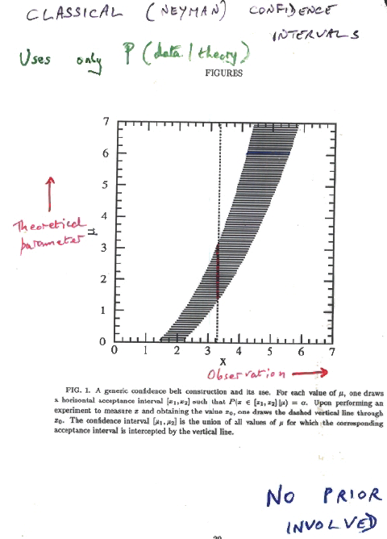
Classical (Neyman) Confidence Intervals
Uses only P(data|theory)
Theoretical Parameter
µ
Data x
Example:
Param = Temp at centre of Sun
Data = Est. flux of solar neutrinos
Prob(µ_{l}<µ<µ_{u}) = α
μ≥0 No prior for μ

Slide 25
Classical (Neyman) Confidence Intervals
Uses only P(data|theory)
Theoretical Parameter
µ
Data x µ range
<1.5 Empty
1.5 – 2.2 Upper limit
>2.2 2-sided
Data x
Example:
Param = Temp at centre of Sun
Data = est. flux of solar neutrinos
μ≥0 No prior for μ

Slide 26
90% Classical interval for Gaussian
σ = 1 μ ≥ 0
e.g. m²(ν_{e}), length of small object
x_{obs}=3 Two-sided range
x_{obs}=1 Upper limit
x_{obs}=-1 No region for µ
Other methods have different behaviour at negative x

Slide 27
FELDMAN - COUSINS
Wants to avoid empty classical intervals →
Uses “L-ratio ordering principle” to resolve ambiguity about “which 90% region?”
[Neyman + Pearson say L-ratio is best for hypothesis testing]
Unified → No ‘Flip-Flop’ problem

Slide 28
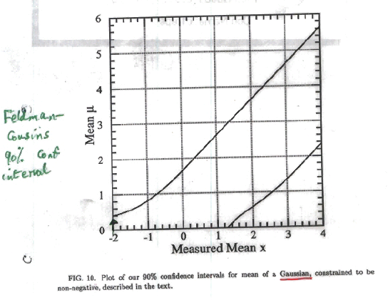
Feldman-Cousins 90% conf intervals
Uses different
ordering rule
X_{obs} = -2 now gives upper limit

Slide 29
Frequentism: Specific example
Particle decays exponentially: dp/dt = (1/τ) exp(-t/τ)
Observe 1 decay at time t₁: L(τ) = (1/τ) exp(-t₁/τ)
Construct 68% central interval
t = .17τ
dp/dt
τ
t
t = 1.8τ
t₁ t
68% conf. int. for τ from
t₁ /1.8 → t₁ /0.17

Slide 30
at 90% confidence
and known, but random unknown, but fixed Probability statement about and
Frequentist
and known, and fixed unknown, and random Probability/credible statement about
Bayesian

Slide 31
Choosing between 2 hypotheses
Possible methods:
Δχ²
p-value of statistic →
lnL–ratio
Bayesian:
Posterior odds
Bayes factor
Bayes information criterion (BIC)
Akaike …….. (AIC)
Minimise “cost”
See ‘Comparing two hypotheses’
http://www-cdf.fnal.gov/physics/statistics/notes/H0H1.pdf

Slide 32
Using data to make judgements about H1 (New Physics) versus
H0 (S.M. with nothing new)
Topics:
Example of Hypotheses
H0 or H0 v H1?
Blind Analysis
Why 5σ for discovery?
Significance
P(A|B) ≠ P(B|A)
Meaning of p-values
Wilks’ Theorem
LEE = Look Elsewhere Effect
Background Systematics
Upper Limits
Higgs search: Discovery and spin
(N.B. Several of these topics have no unique solutions from Statisticians)

Slide 33
Examples of Hypotheses
1) Event selector
Selection of event sample based on required features
e.g. H0: Cerenkov ring produced by electron H1: Produced by other particle
Possible outcomes: Events assigned as H0 or H1
2) Result of experiment
e.g. H0 = nothing new
H1 = new particle produced as well
(Sterile neutrino,…..)
Possible outcomes H0 H1
✓ X Exclude H1
X ✓ Discovery
✓ ✓ No decision
X X ?
.

Slide 34
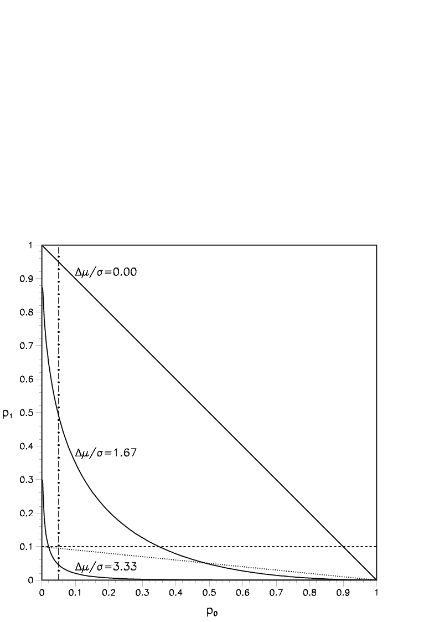
Errors of 1st and 2nd Kind
1st Kind: Reject H0 when H0 true
Should happen at rate α
2nd Kind: Fail to reject H0 when H0 is false
Rate depends on:
How similar H0 and H1 are
Relative rates of H0 and H1 (for event selector)
For event selector: E1st = Loss of efficiency
E2nd = Contamination
As α ↓, efficiency ↑ and contamination ↓
For result of expt , E1st gives incorrect result
E2nd fails to make discovery
α = E1st
β = Prob of failing to exclude
H0, if H1 = true
1- β = power of test for H1
β
α

Slide 35
H0 or H0 versus H1 ?
H0 = null hypothesis
e.g. Standard Model, with nothing new
H1 = specific New Physics e.g. Higgs with M_{H} = 125 GeV
H0: “Goodness of Fit” e.g. χ², p-values
H0 v H1: “Hypothesis Testing” e.g. L-ratio
Measures how much data favours one hypothesis wrt other
H0 v H1 likely to be more sensitive for H1
or

Slide 36
Choosing between 2 hypotheses
Hypothesis testing: New particle or statistical fluctuation?
H0 = b H1 = b + s

Slide 37
First define your data statistic t (n, L-ratio, etc.)
(a) (b)
H0 H1
t_{obs}
t
t_{obs}
t
p₁ p₀
With 2 hypotheses, each with own pdf, p-values are defined as tail areas, pointing in towards each other
(c)
H0 H1
t_{obs}
t

Slide 38
Procedure for choosing between 2 hypotheses
1) No sensitivity 2) Maybe 3) Easy separation
H0 H1
t
β t_{crit} α
Procedure: Obtain expected distributions for data statistic (e.g. L-ratio) for H0 and H1
Choose α (e.g. 95%, 3σ, 5σ ?) and CL for p₁ (e.g. 95%)
Given b, α determines t_{crit}
b+s defines β. For s > s_{min}, separation of curves → discovery or excln
1-β = Power of test
Now data: If t_{obs} ≥ t_{crit} (i.e. p₀ ≤ α), discovery at level α
If t_{obs} < t_{crit}, no discovery. If p₁ < 1– CL, exclude H1

Slide 39
Significance
(Number of σ = p-value converted to Gaussian one-sided tail)
Significance = S/√B or similar ?
Potential Problems:
Uncertainty in B
Non-Gaussian behaviour of Poisson, especially in tail
Number of bins in histogram, no. of other histograms [LEE]
Choice of cuts, bins (Blind analyses)
For future experiments:
Optimising: Could give S =0.1, B = 10⁻⁴, S/√B =10

Slide 40
P(A|B) ≠ P(B|A)
Remind Lab or University media contact person that:
Prob[data, given H0] is very small
does not imply that
Prob[H0, given data] is also very small.
e.g. Prob{data | speed of ν ≤ c}= very small
does not imply
Prob{speed of ν≤c | data} = very small
or Prob{speed of ν>c | data} ~ 1
Everyday situation:
p(eat bread|murderer) ~ 99%
p(murderer|eat bread) ~ 10⁻⁶

Slide 41
What p-values are (and are not)
H0 pdf
p₀ = α
Reject H0 if t > t_{crit} (p < α )
p-value = prob that t ≥ t_{obs}
Small p → data and theory have poor compatibility
Small p-value does NOT automatically imply that theory is unlikely
Bayes prob(Theory|data) related to prob(data|Theory) = Likelihood
by Bayes Th, including Bayesian prior
p-values are misunderstood. e.g. Anti-HEP jibe:
“Particle Physicists don’t know what they are doing, because half their
p ˂ 0.05 exclusions turn out to be wrong”
Demonstrates lack of understanding of p-values
[All results rejecting energy conservation with p ˂α =.05 cut will turn out to be ‘wrong’]
t_{crit} t

Slide 42
Combining different p-values
Several results quote independent p-values for same effect:
p₁, p₂, p₃….. e.g. 0.9, 0.001, 0.3 ……..
What is combined significance? Not just p_{1*}p_{2*}p₃…..
If 10 expts each have p ~ 0.5, product ~ 0.001 and is clearly NOT correct combined p
S = z * (-ln z)^{j} /j! , z = p₁p₂p₃…….
(e.g. For 2 measurements, S = z * (1 - lnz) ≥ z )
Problems:
1) Recipe is not unique (Uniform dist in n-D hypercube → uniform in 1-D)
2) Formula is not associative
Combining {{p₁ and p₂}, and then p₃} gives different answer
from {{p₃ and p₂}, and then p₁} , or all together
Due to different options for “more extreme than x₁, x₂, x₃”.
3) Small p’s due to different discrepancies
******* Better to combine data ************

Slide 43
BLIND ANALYSES
Why blind analysis? Data statistic, selections, corrections, method
Methods of blinding
Add random number to result *
Study procedure with simulation only
Look at only first fraction of data
Keep the signal box closed
Keep MC parameters hidden
Keep unknown fraction visible for each bin
Disadvantages
Takes longer time
Usually not available for searches for unknown
After analysis is unblinded, don’t change anything unless ……..
* Luis Alvarez suggestion re “discovery” of free quarks

Slide 44
Look Elsewhere Effect (LEE)
Prob of bgd fluctuation at that place = local p-value
Prob of bgd fluctuation ‘anywhere’ = global p-value
Global p > Local p
Where is `anywhere’?
Any location in this histogram in sensible range
Any location in this histogram
Also in histogram produced with different cuts, binning, etc.
Also in other plausible histograms for this analysis
Also in other searches in this PHYSICS group (e.g. SUSY at CMS)
In any search in this experiment (e.g. CMS)
In all CERN expts (e.g. LHC expts + NA62 + OPERA + ASACUSA + ….)
In all HEP expts
etc.
d) relevant for graduate student doing analysis
f) relevant for experiment’s Spokesperson
INFORMAL CONSENSUS:
Quote local p, and global p according to a) above.
Explain which global p

Slide 45
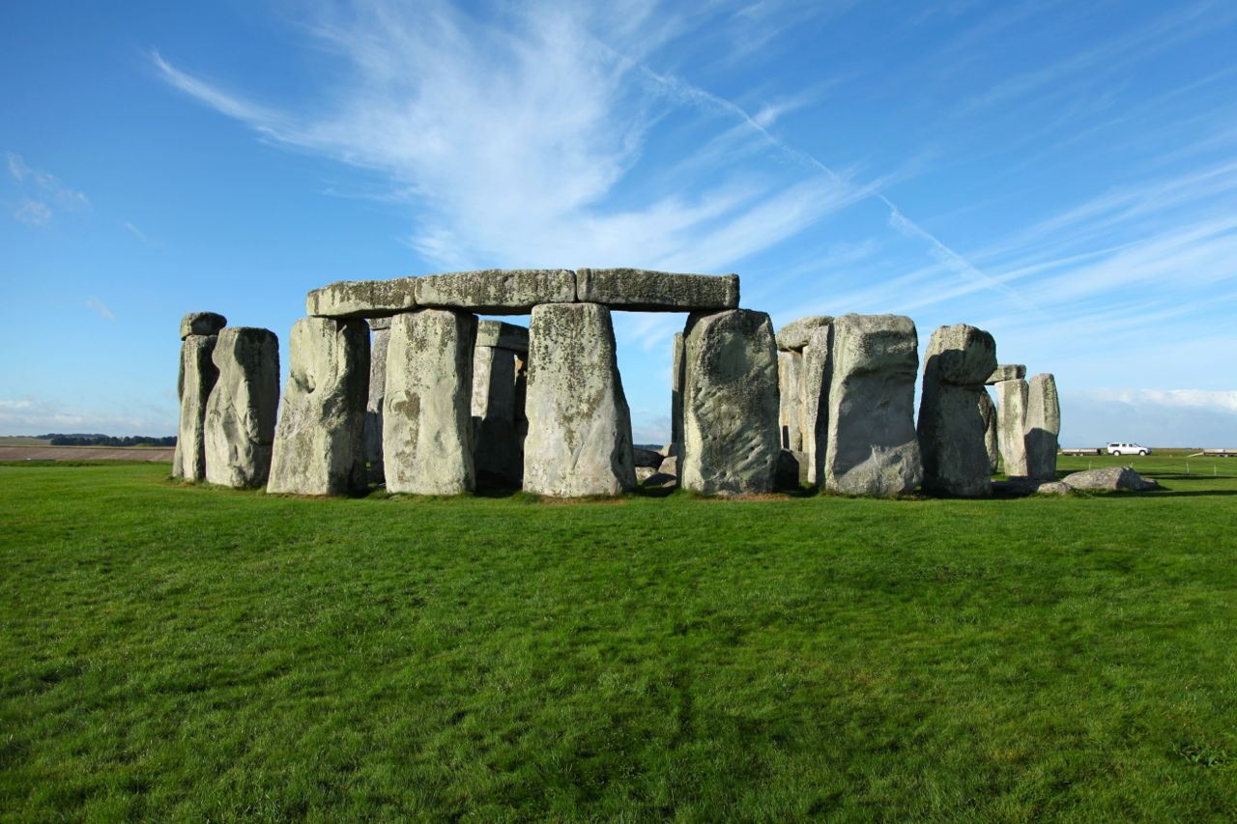
Example of LEE: Stonehenge

Slide 46
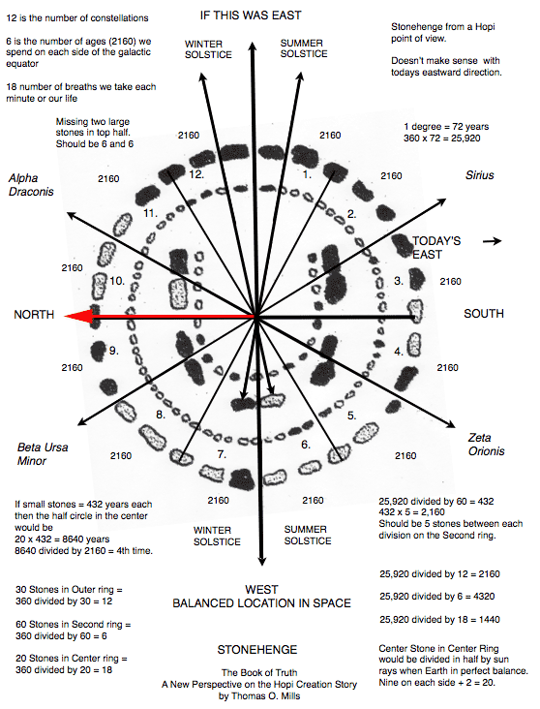

Slide 47
Are alignments significant?
Atkinson replied with his article "Moonshine on Stonehenge" in Antiquity in 1966, pointing out that some of the pits which ….. had used for his sight lines were more likely to have been natural depressions, and that he had allowed a margin of error of up to 2 degrees in his alignments. Atkinson found that the probability of so many alignments being visible from 165 points to be close to 0.5 rather that the "one in a million" possibility which ….. had claimed.
….. had been examining stone circles since the 1950s in search of astronomical alignments and the megalithic yard. It was not until 1973 that he turned his attention to Stonehenge. He chose to ignore alignments between features within the monument, considering them to be too close together to be reliable. He looked for landscape features that could have marked lunar and solar events. However, one of …..'s key sites, Peter's Mound, turned out to be a twentieth-century rubbish dump.

Slide 48
Why 5σ for Discovery?
Statisticians ridicule our belief in extreme tails (esp. for systematics)
Our reasons:
1) Past history (Many 3σ and 4σ effects have gone away)
2) LEE
3) Worries about underestimated systematics
4) Subconscious Bayes calculation
p(H₁|x) = p(x|H₁) * π(H₁)
p(H₀|x) p(x|H₀) π(H₀)
Posterior Likelihood Priors
prob ratio
“Extraordinary claims require extraordinary evidence”
N.B. Points 2), 3) and 4) are experiment-dependent
Alternative suggestion:
L.L. “Discovering the significance of 5σ” http://arxiv.org/abs/1310.1284

Slide 49
How many σ’s for discovery?
SEARCH | SURPRISE | IMPACT | LEE | SYSTEMATICS | No. σ
Higgs search | Medium | Very high | M | Medium | 5
Single top | No | Low | No | No | 3
SUSY | Yes | Very high | Very large | Yes | 7
B_{s} oscillations | Medium/Low | Medium | Δm | No | 4
Neutrino osc | Medium | High | sin²2ϑ, Δm² | No | 4
B_{s}→ μ μ | No | Low/Medium | No | Medium | 3
Pentaquark | Yes | High/V. high | M, decay mode | Medium | 7
(g-2)_{μ} anom | Yes | High | No | Yes | 4
H spin ≠ 0 | Yes | High | No | Medium | 5
4th gen q, l, ν | Yes | High | M, mode | No | 6
Dark energy | Yes | Very high | Strength | Yes | 5
Grav Waves | No | High | Enormous | Yes | 8
Suggestions to provoke discussion, rather than `delivered on Mt. Sinai’
Bob Cousins: “2 independent expts each with 3.5σ better than one expt with 5σ”

Slide 50
Wilks’ Theorem
Data = some distribution e.g. mass histogram
For H0 and H1, calculate best fit weighted sum of squares S₀ and S₁
Examples: 1) H0 = polynomial of degree 3
H1 = polynomial of degree 5
2) H0 = background only
H1 = bgd+peak with free M₀ and cross-section
3) H0 = normal neutrino hierarchy
H1 = inverted hierarchy
If H0 true, S₀ distributed as χ² with ndf = ν₀
If H1 true, S₁ distributed as χ² with ndf = ν₁
If H0 true, what is distribution of ΔS = S₀ – S₁? Expect not large. Is it χ²?
Wilks’ Theorem: ΔS distributed as χ² with ndf = ν₀ – ν₁ provided:
H0 is true
H0 and H1 are nested
Params for H1→ H0 are well defined, and not on boundary
Data is asymptotic
.

Slide 51
Wilks’ Theorem, contd
Examples: Does Wilks’ Th apply?
1) H0 = polynomial of degree 3
H1 = polynomial of degree 5
YES: ΔS distributed as χ² with ndf = (d-4) – (d-6) = 2
2) H0 = background only
H1 = bgd + peak with free M₀ and cross-section
NO: H0 and H1 nested, but M₀ undefined when H1→ H0. ΔS≠χ²
(but not too serious for fixed M)
3) H0 = normal neutrino hierarchy *********
H1 = inverted hierarchy *********
NO: Not nested. ΔS≠χ² (e.g. can have Δχ² negative)
N.B. 1: Even when W. Th. does not apply, it does not mean that ΔS
is irrelevant, but you cannot use W. Th. for its expected distribution.
N.B. 2: For large ndf, better to use ΔS, rather than S₁ and S₀ separately

Slide 52
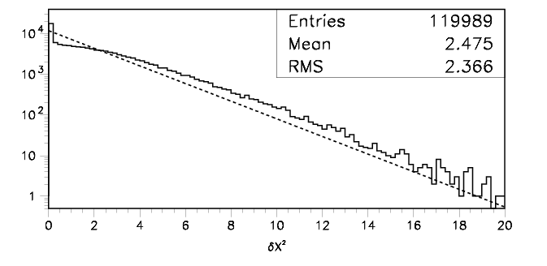
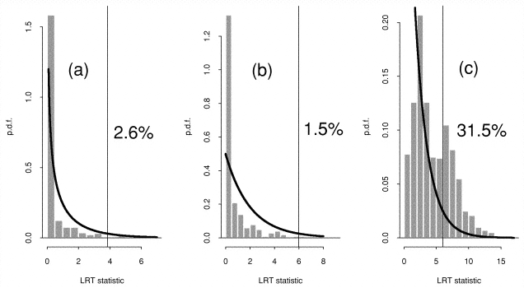
Is difference in S distributed as χ² ?
Demortier:
H0 = quadratic bgd
H1 = ……………… +
Gaussian of fixed width,
variable location & ampl
What is peak at zero?
Why not half the entries?
Protassov, van Dyk, Connors, ….
H0 = continuum
H1 = narrow emission line
H1 = wider emission line
H1 = absorption line
Nominal significance level = 5%

Slide 53
Is difference in S distributed as χ² ?, contd.
So need to determine the ΔS distribution by Monte Carlo
N.B.
For mass spectrum, determining ΔS for hypothesis H1 when data is generated according to H0 is not trivial, because there will be lots of local minima
If we are interested in 5σ significance level, needs lots of MC simulations (or intelligent MC generation)
Asymptotic formulae may be useful (see K. Cranmer, G. Cowan, E. Gross and O. Vitells, 'Asymptotic formulae for likelihood-based tests of new physics', http://link.springer.com/article/10.1140%2Fepjc%2Fs10052-011-1554-0 )

Slide 54
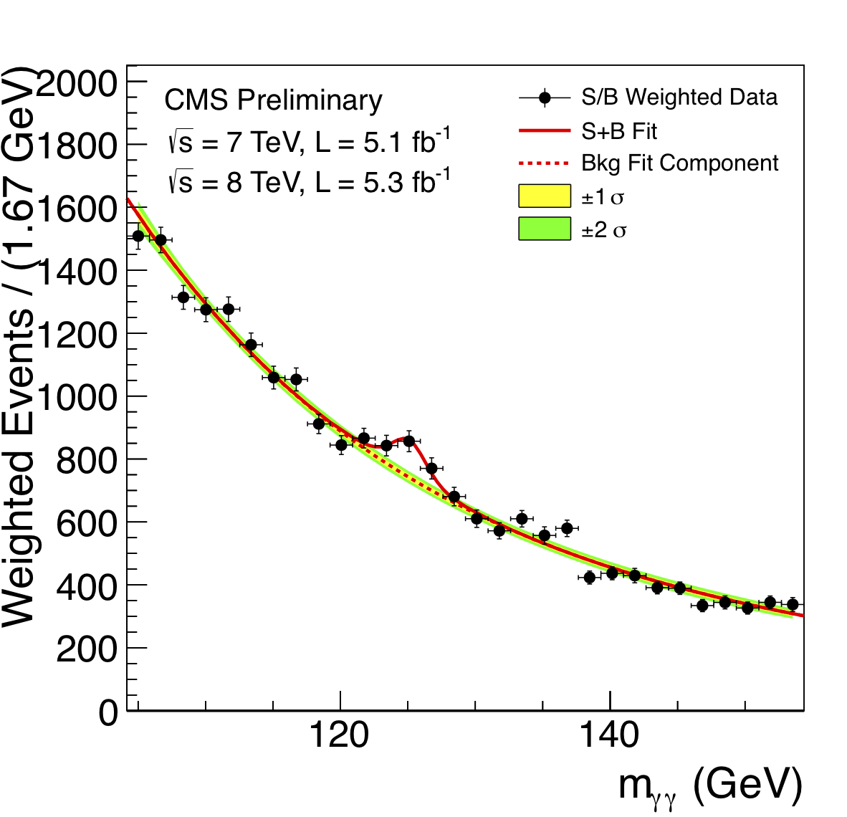
Background systematics

Slide 55
Background systematics, contd
Signif from comparing χ²’s for H0 (bgd only) and for H1 (bgd + signal)
Typically, bgd = functional form f_{a} with free params
e.g. 4th order polynomial
Uncertainties in params included in signif calculation
But what if functional form is different ? e.g. f_{b}
Typical approach:
If f_{b} best fit is bad, not relevant for systematics
If f_{b} best fit is ~comparable to f_{a} fit, include contribution to systematics
But what is ‘~comparable’?
Other approaches:
Profile likelihood over different bgd parametric forms
http://arxiv.org/pdf/1408.6865v1.pdf?
Background subtraction
sPlots
Non-parametric background
Bayes
etc
No common consensus yet among experiments on best approach
{Spectra with multiple peaks are more difficult}

Slide 56
“Handling uncertainties in background shapes: the discrete profiling method”
Dauncey, Kenzie, Wardle and Davies (Imperial College, CMS)
arXiv:1408.6865v1 [physics.data-an]
Has been used in CMS analysis of H→γγ
Problem with ‘Typical approach’: Alternative functional forms do or don’t contribute to systematics by hard cut, so systematics can change discontinuously wrt ∆χ²
Method is like profile L for continuous nuisance params
Here ‘profile’ over discrete functional forms

Slide 57

Reminder of Profile L
υ
Stat uncertainty on s from width of L fixed at υ_{best}
Total uncertainty on s from width of L(s,υ_{prof(s)}) = L_{prof}
υ_{prof(s)} is best value of υ at that s
υ_{prof(s)} as fn of s lies on green line
Total uncert ≥ stat uncertainty
s
Contours of lnL(s,υ)
s = physics param
υ = nuisance param

Slide 58
-2lnL
∆
s

Slide 59
Red curve: Best value of nuisance param υ
Blue curves: Other values of υ
Horizontal line: Intersection with red curve→
statistical uncertainty
‘Typical approach’: Decide which blue curves have small enough ∆
Systematic is largest change in minima wrt red curves’.
Profile L: Envelope of lots of blue curves
Wider than red curve, because of systematics (υ)
For L = multi-D Gaussian, agrees with ‘Typical approach’
Dauncey et al use envelope of finite number of functional forms

Slide 60
Point of controversy!
Two types of ‘other functions’:
Different function types e.g.
Σa_{i} x_{i} versus Σa_{i}/x_{i}
b) Given fn form but different number of terms
DDKW deal with b) by -2lnL → -2lnL + kn
n = number of extra free params wrt best
k = 1, as in AIC (= Akaike Information Criterion)
Opposition claim choice k=1 is arbitrary.
DDKW agree but have studied different values, and say k =1 is optimal for them.
Also, any parametric method needs to make such a choice

Slide 61
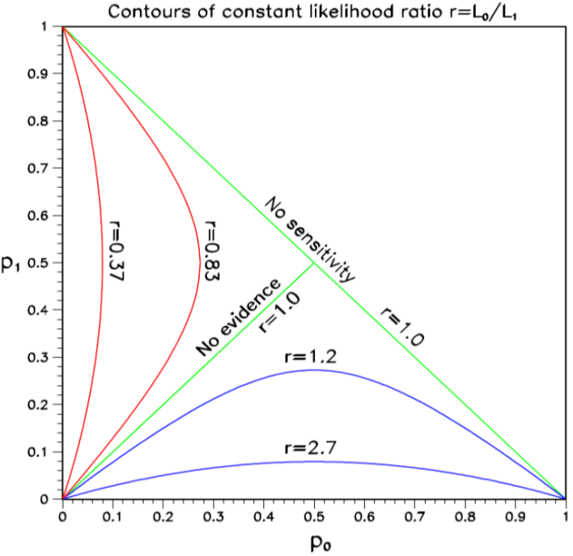
p₀ v p₁ plots
Preprint by Luc Demortier and LL,
“Testing Hypotheses in Particle Physics: Plots of p₀ versus p₁”
http://arxiv.org/abs/1408.6123
For hypotheses H0 and H1, p₀ and p₁ are the tail probabilities for data statistic t
Provide insights on:
CLs for exclusion
Punzi definition of sensitivity
Relation of p-values and Likelihoods
Probability of misleading evidence
Sampling to foregone conclusion
Jeffreys-Lindley paradox

Slide 62
CLs = p₁/(1-p₀) → diagonal line
Provides protection against excluding H₁ when little or no sensitivity
Punzi definition of sensitivity:
Enough separation of pdf’s for no chance of ambiguity
Δµ
H₀ H₁
t
Can read off power of test
e.g. If H₀ is true, what is prob of rejecting H₁?
N.B. p₀ = tail towards H₁
p₁ = tail towards H₀

Slide 63
Why p ≠ Likelihood ratio
Measure different things:
p₀ refers just to H0; L₀₁ compares H0 and H1
Depends on amount of data:
e.g. Poisson counting expt little data:
For H0, μ₀ = 1.0. For H1, μ₁ =10.0
Observe n = 10 p₀ ~ 10⁻⁷ L₀₁ ~10⁻⁵
Now with 100 times as much data, μ₀ = 100.0 μ₁ =1000.0
Observe n = 160 p₀ ~ 10⁻⁷ L₀₁ ~10⁺¹⁴

Slide 64
Jeffreys-Lindley Paradox
H0 = simple, H1 has μ free
p₀ can favour H₁, while B₀₁ can favour H₀
B₀₁ = L₀ / ∫L₁(s) π(s) ds
Likelihood ratio depends on signal :
e.g. Poisson counting expt small signal s:
For H₀, μ₀ = 1.0. For H₁, μ₁ =10.0
Observe n = 10 p₀ ~ 10⁻⁷ L₀₁ ~10⁻⁵ and favours H₁
Now with 100 times as much signal s, μ₀ = 100.0 μ₁ =1000.0
Observe n = 160 p₀ ~ 10⁻⁷ L₀₁ ~10⁺¹⁴ and favours H₀
B₀₁ involves intergration over s in denominator, so a wide enough range
will result in favouring H₀
However, for B₀₁ to favour H₀ when p₀ is equivalent to 5σ, integration
range for s has to be O(10⁶) times Gaussian widths

Slide 65
WHY LIMITS?
Michelson-Morley experiment → death of aether
HEP experiments: If UL on expected rate for new particle < expected, exclude particle
CERN CLW (Jan 2000)
FNAL CLW (March 2000)
Heinrich, PHYSTAT-LHC, “Review of Banff Challenge”

Slide 66
Methods (no systematics)
Bayes (needs priors e.g. const, 1/μ, 1/√μ, μ, …..)
Frequentist (needs ordering rule,
possible empty intervals, F-C)
Likelihood (DON’T integrate your L)
χ² (σ² =μ)
χ²(σ² = n)
Recommendation 7 from CERN CLW (2000): “Show your L”
1) Not always practical
2) Not sufficient for frequentist methods

Slide 67
Ilya Narsky, FNAL CLW 2000

Slide 68
DESIRABLE PROPERTIES
Coverage
Interval length
Behaviour when n < b
Limit increases as σ_{b} increases
Unified with discovery and interval estimation

Slide 69
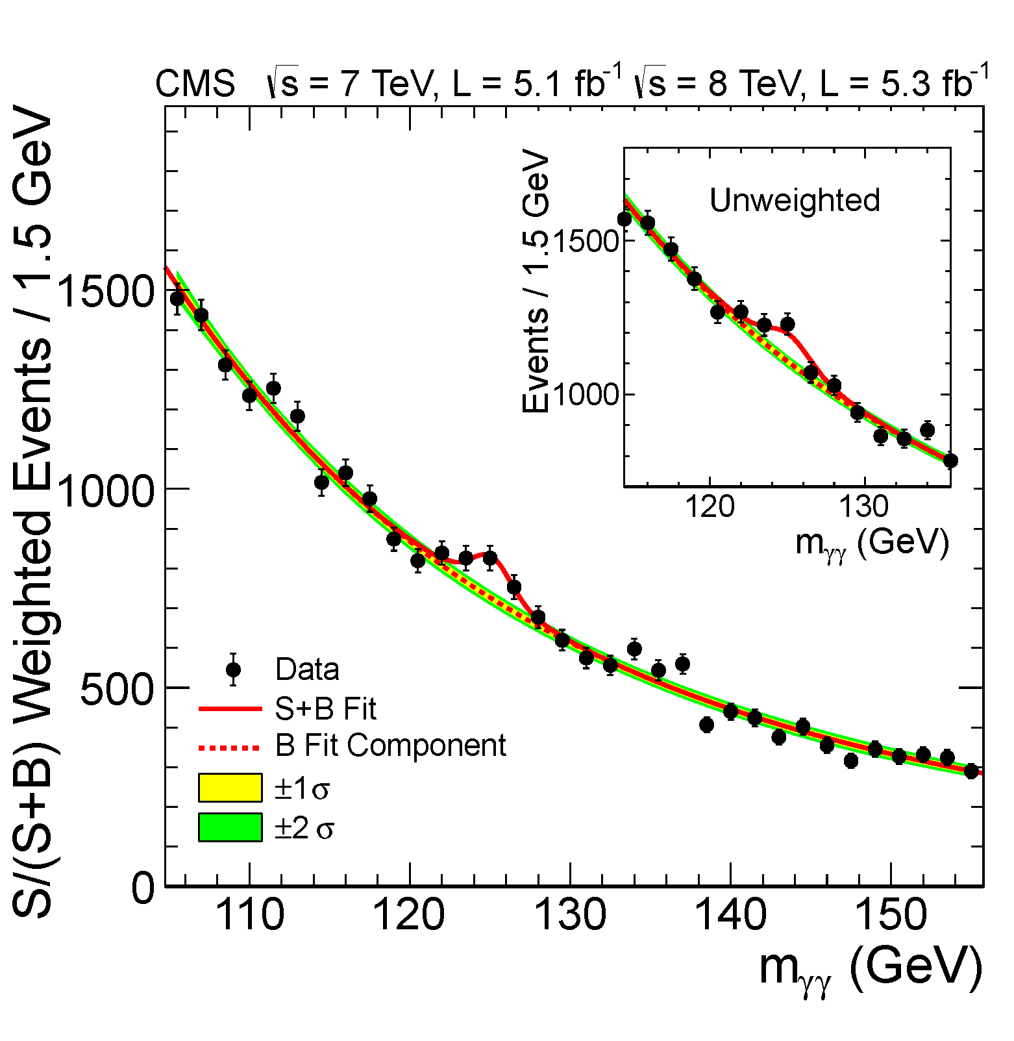
Search for Higgs:
H→ γ γ: low S/B, high statistics

Slide 70
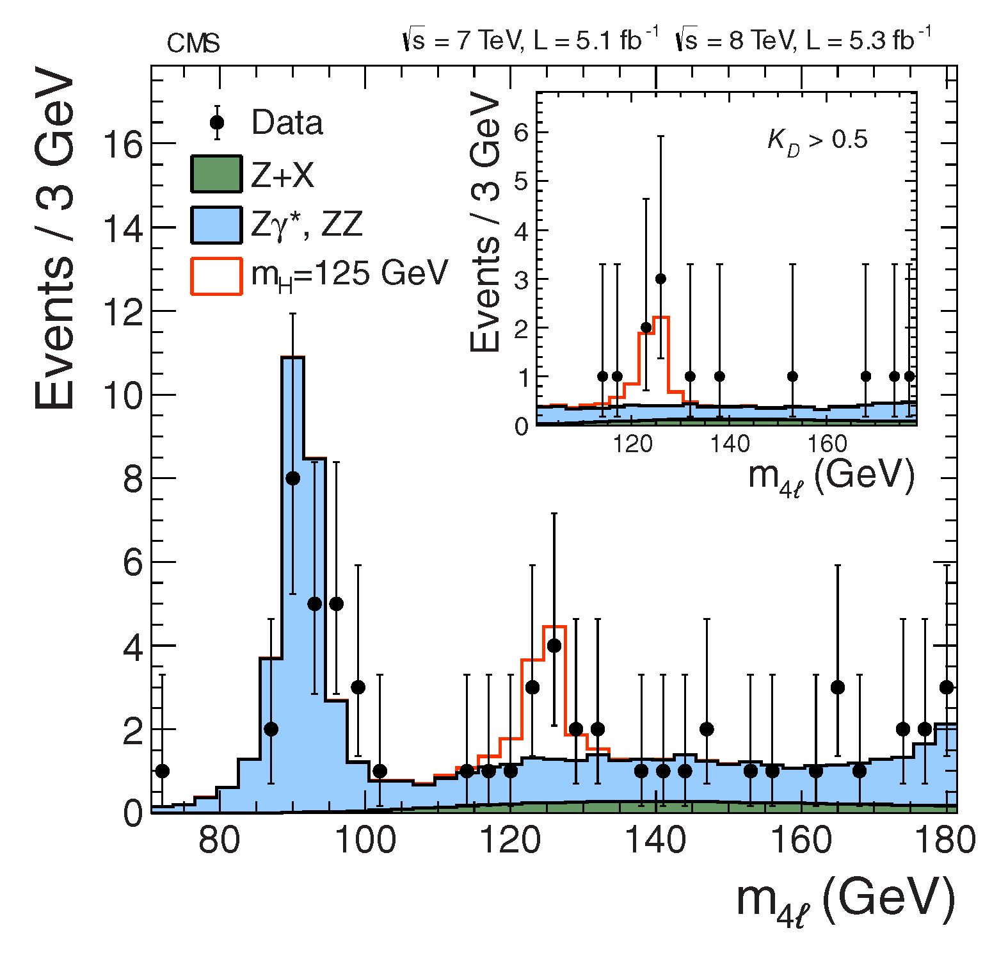
H→Z Z → 4 l: high S/B, low statistics

Slide 71
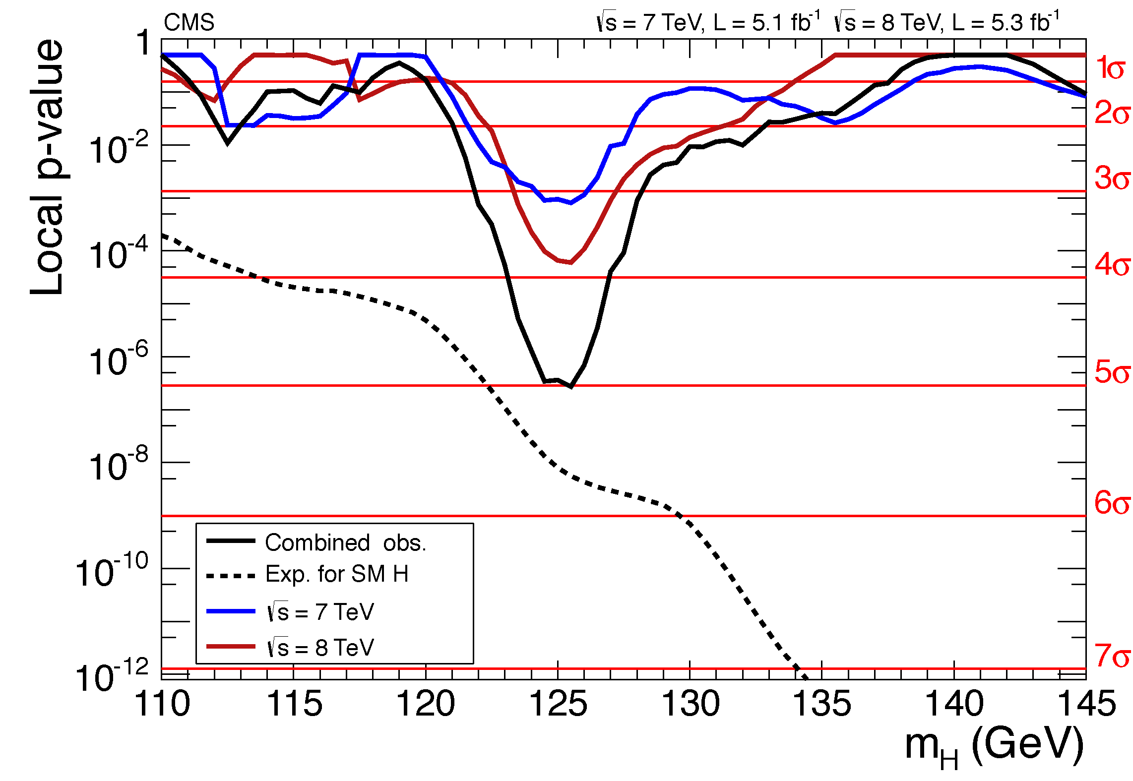
p-value for ‘No Higgs’ versus m_{H}

Slide 72
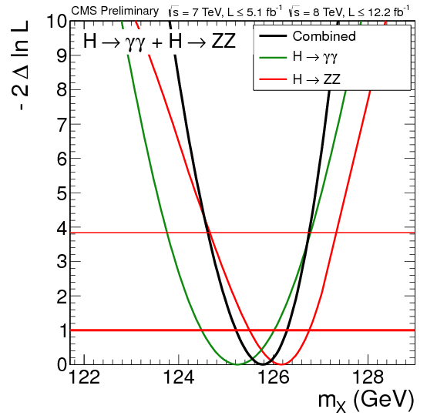
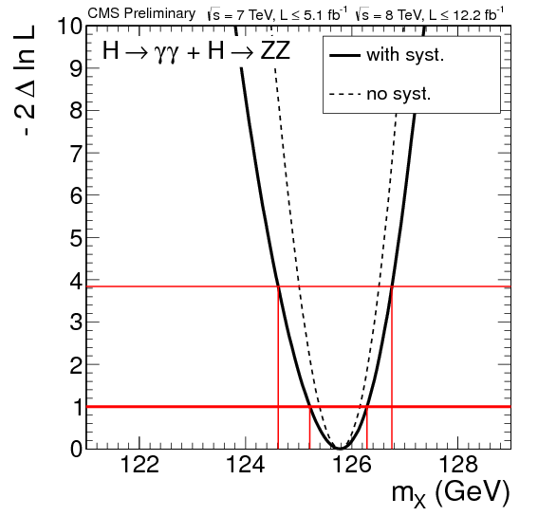
Mass of Higgs:
Likelihood versus mass

Slide 73
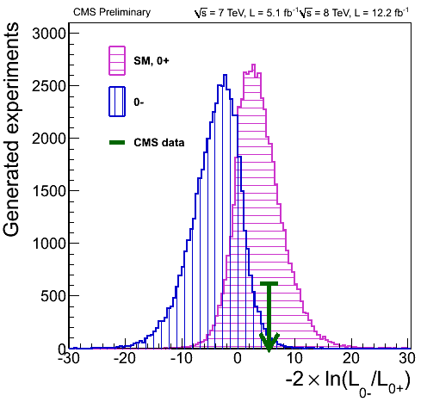
Comparing 0⁺ versus 0⁻ for Higgs
(like Neutrino Mass Hierarchy)
http://cms.web.cern.ch/news/highlights-cms-results-presented-hcp

Slide 74
Conclusions
Resources:
Software exists: e.g. RooStats
Books exist: Barlow, Cowan, James, Lista, Lyons, Roe,…..
`Data Analysis in HEP: A Practical Guide to
Statistical Methods’ , Behnke et al.
PDG sections on Prob, Statistics, Monte Carlo
CMS and ATLAS have Statistics Committees (and BaBar and CDF earlier) – see their websites
Before re-inventing the wheel, try to see if Statisticians have already found a solution to your statistics analysis problem.
Don’t use a square wheel if a circular one already exists.
“Good luck”, and enjoy PHYSTAT-ν

