Slide 1


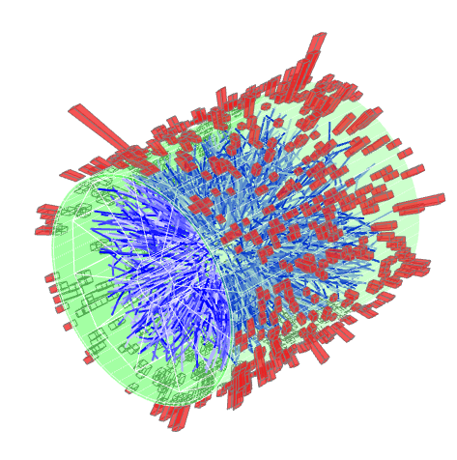
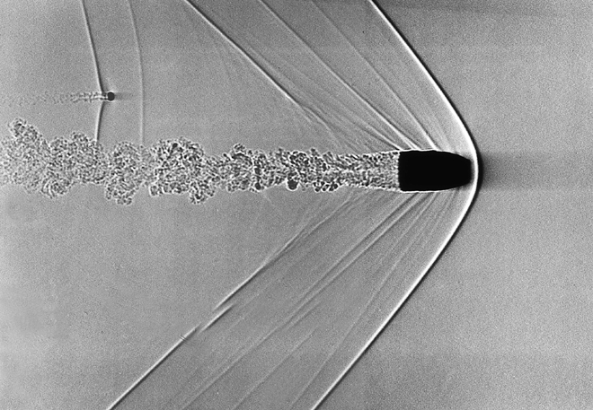
Heavy ion jets at RHIC and LHC: a common approach
Peter Jacobs
Lawrence Berkeley National Laboratory

Slide 2
Jets in vacuum
CMS, Eur. Phys. J C76 (2016) 451
Magnificent achievement of QCD
needed 30 years of development in theory, experiment, and algorithms to connect the two
Infrared and colinear-safe (IRC) jet reconstruction algorithms:
Integrate out all hadron degrees of freedom
Same procedures applied pQCD theory and experiment
Enables direct, precise and improvable comparison of theory/experiment
  ➔ jets measure partons

Slide 3
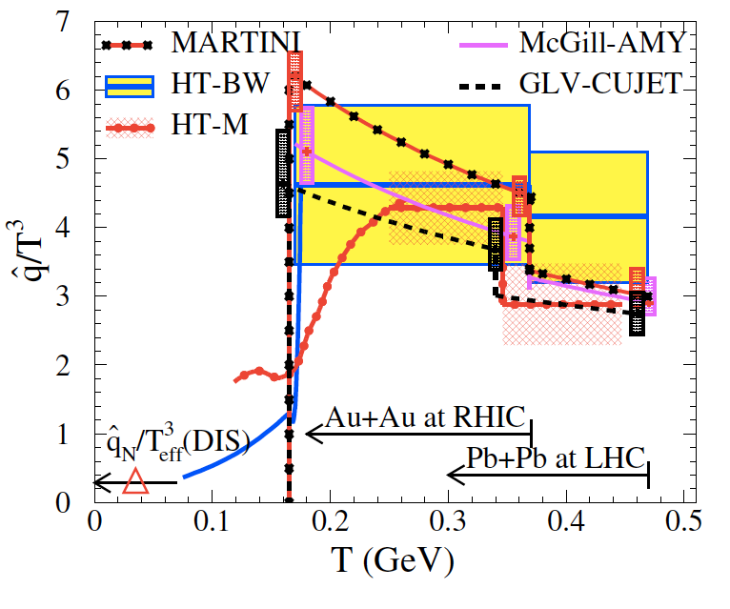
Jet quenching theory vs experiment: current example
Extraction of q^ via data + modeling
Fit pQCD-based models to inclusive hadron suppression data at RHIC and LHC
  No consideration of correlations or jets
JET Collaboration
Phys.Rev. C90 (2014) 1, 014909
For a 10 GeV light quark at time 0.6 fm/c:
Certainly interesting, but can we learn more?

Slide 4
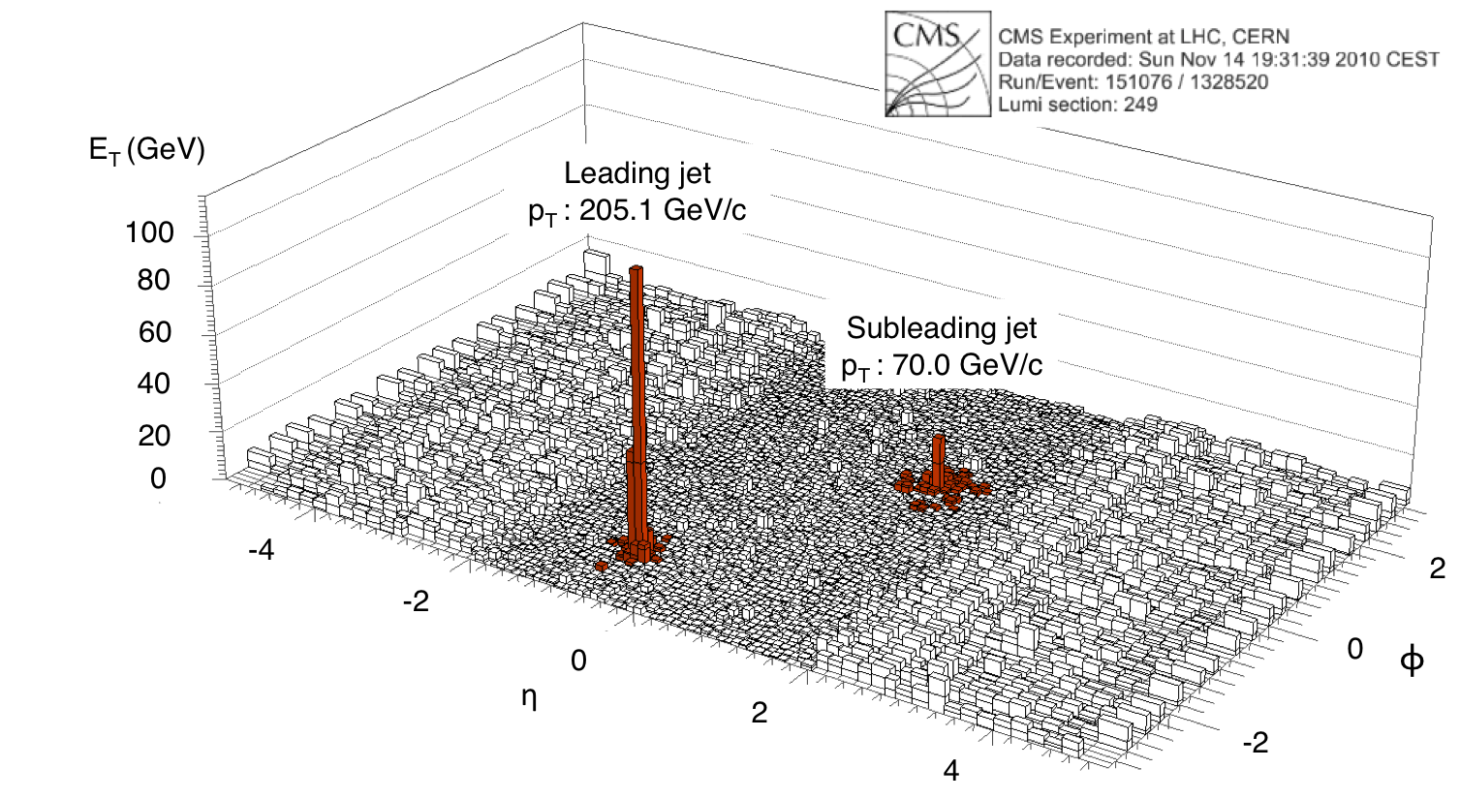
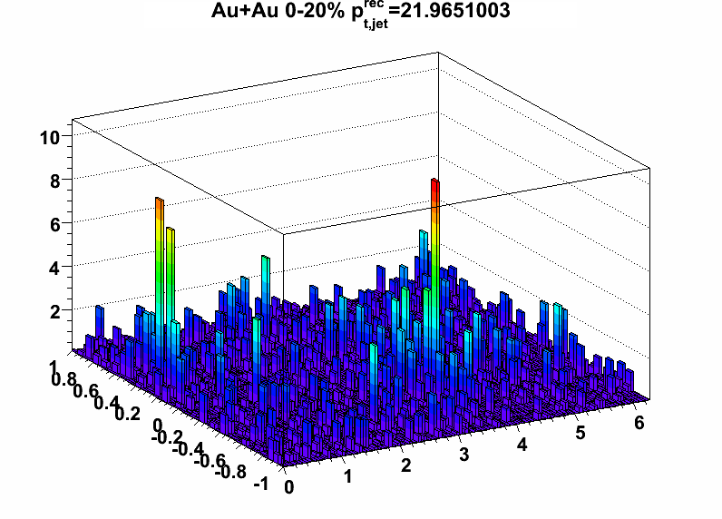
Jets in real heavy ion collisions
LHC/CMS
RHIC/Star
Visual identification of energetic jets above background is fairly easy
Much harder: accurate measurement of jet energy and structure within finite cone
  Pb+Pb at LHC: ~100 GeV of uncorrelated background energy in cone R=0.4
  Uncorrelated background has complex structure, including multiple overlapping jets at multiple energy scales
  Very challenging…

Slide 5
Partonic jet quenching: observables
Observables should be calculable in field theory
at least in vacuum: start from rigorous basis, then extend to in-medium
Minimize the need for Monte Carlo modeling
“Infrared-safe” and collinear-safe observables: very low cuts on hadron p_{T} (preferably at limit of tracking)
Minimize fragmentation bias of jet population
Trigger bias should be calculable without modeling of backgrounds
  Prefered triggers: hadron (selected “inclusively”), photon, Z

Slide 6
Partonic jet quenching: observables (cont’d)
Partial list of observables:
Inclusive high p_{T} hadrons (parameterized by collinear FFs)
Inclusive jet cross sections and semi-inclusive jet yields
  R_{AA}, I_{AA},…
  Variation with R
Moliere scattering in-medium
Jet mass
N-subjettiness
Groomed subjets
…?
Coincidence observables: choice of trigger varies geometric and flavor biases
Not on the list: soft hadron distributions

Slide 7
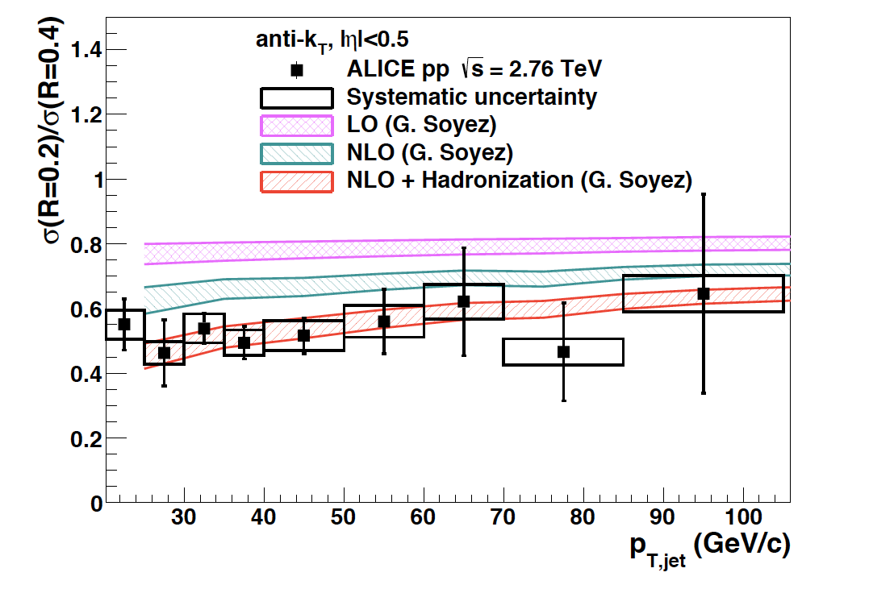
Warm-up example: “jet shape” via R-dependence of inclusive cross section in p+p collisions
Ratio of inclusive cross sections in 2.76 TeV p+p collisions
Phys.Lett. B722 (2013) 262-272

Slide 8
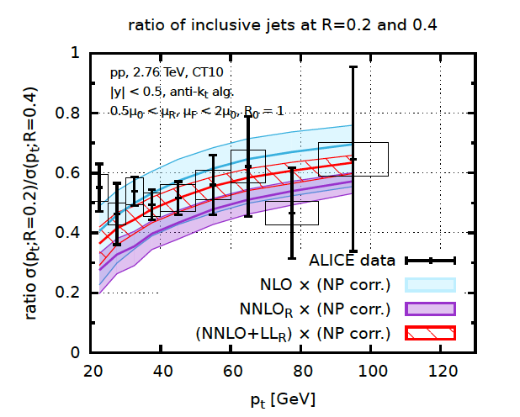
R-dependence of incl. jet xsection (cont’d)
arXiv:1602.01110
Dasgupta et al., JHEP 1606 (2016) 057
CMS, Phys Rev D90 (2014) 7, 072006
σ(R=0.5)/σ(R=0.7)
R
Jets with different R sensitive to different components of shower
Incl cross section vs. R is sensitive probe of intra-jet structure
Calculable in vacuum at NNLO + LL resummation

Slide 9
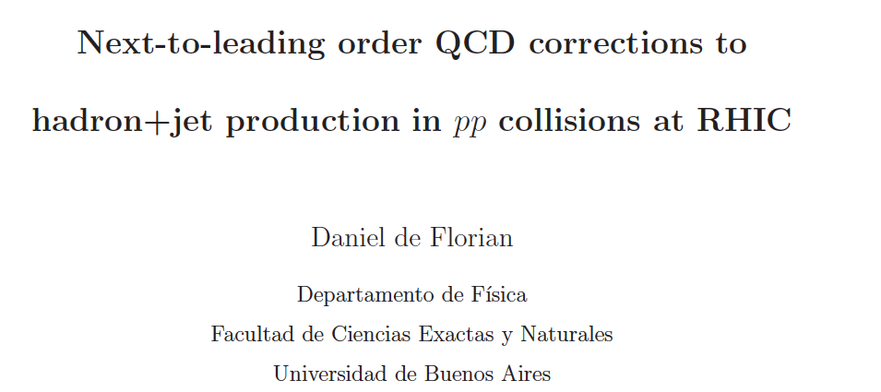
Coincidence observable: hadron+jet correlations
trigger
hadron
Phys.Rev. D79 (2009) 114014
arXiv:0904.4402
Recoil jet
R
Initial motivation: spin dependence of h+jet inclusive cross section in polarized pp collisions

Slide 10
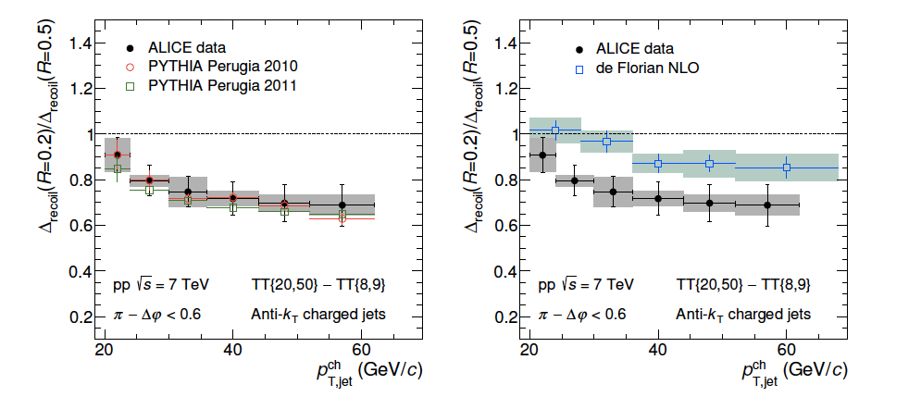
Shape of recoil jets in vacuum
trigger
hadron
Semi-inclusive h+jet, pp √s=7 TeV (unpolarized, of course)
per-trigger recoil yield vs R
ALICE: JHEP 09 (2015) 170
R
Picture similar to inclusive jet cross section ratio:
well-described by PYTHIA
less well-described by pQCD@NLO, needs NNLO

Slide 11
ALICE Collaboration
JHEP 09 (2015) 170
STAR Collaboration, arXiv:1702.01108

Slide 12
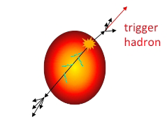
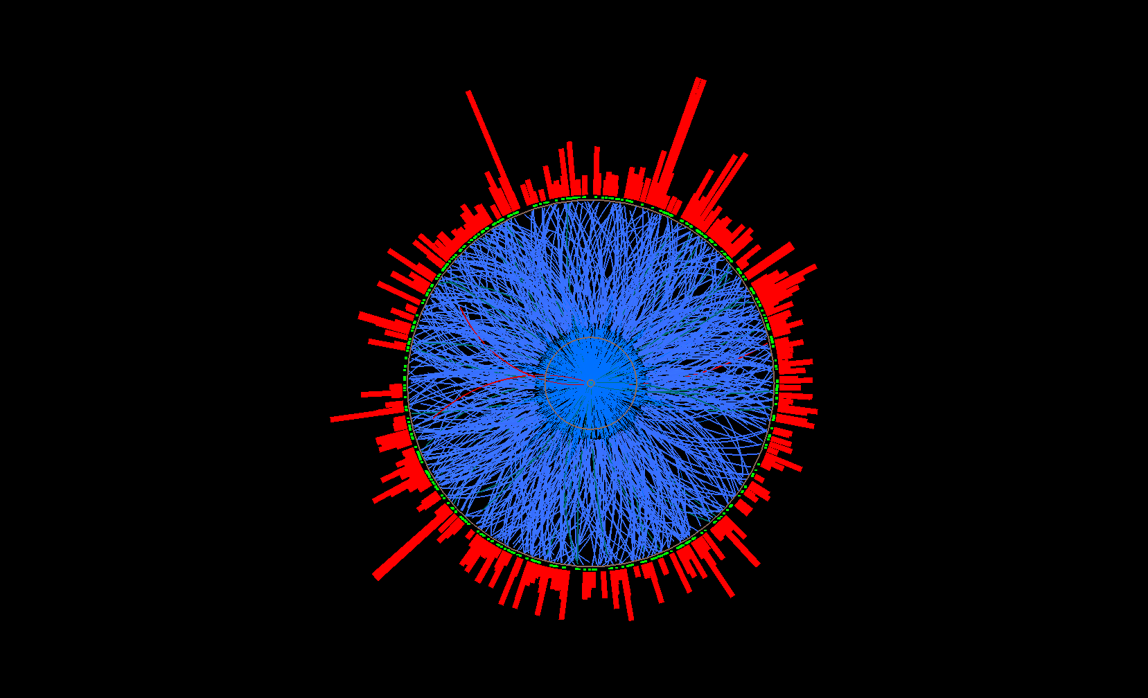
Measuring jet quenching with h+jet: semi-inclusive recoil jet yield
Trigger-normalized yield of jets recoiling from a high p_{T} hadron trigger
Measurable
Calculable in pQCD (in vacuum)
Semi-inclusive: event selection only requires trigger hadron
Trigger hadron selected “inclusively”
experimentally clean in heavy ion collisions: trigger bias theoretically calculable
Count all recoil jet candidates:
uncorrelated background corrected at level of ensemble-averaged distributions
jet selection does not impose fragmentation bias
Recoil jet
acceptance
Trigger
hadron
Expected geometric bias: surface, not tangential
Large path length for recoil
Model studies: T. Renk, PRC74, 024903; H. Zhang et al., PRL98 212301;…

Slide 13
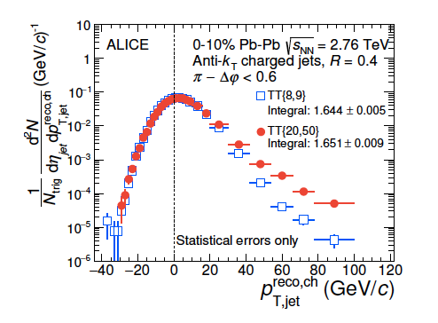

h+jet in heavy ions: raw recoil spectrum @ RHIC/LHC
arXiv:1702.01108
JHEP 09 (2015) 170
Signal+
bkgd
uncorrelated
background

Slide 14
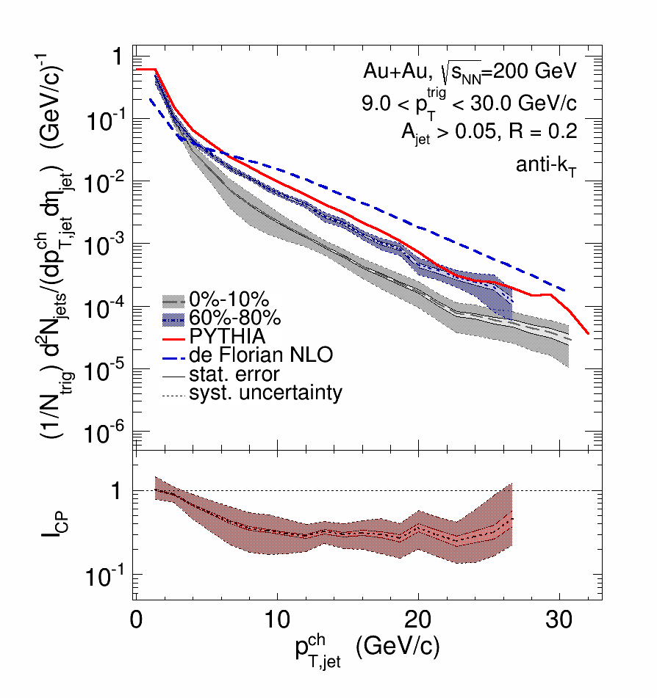
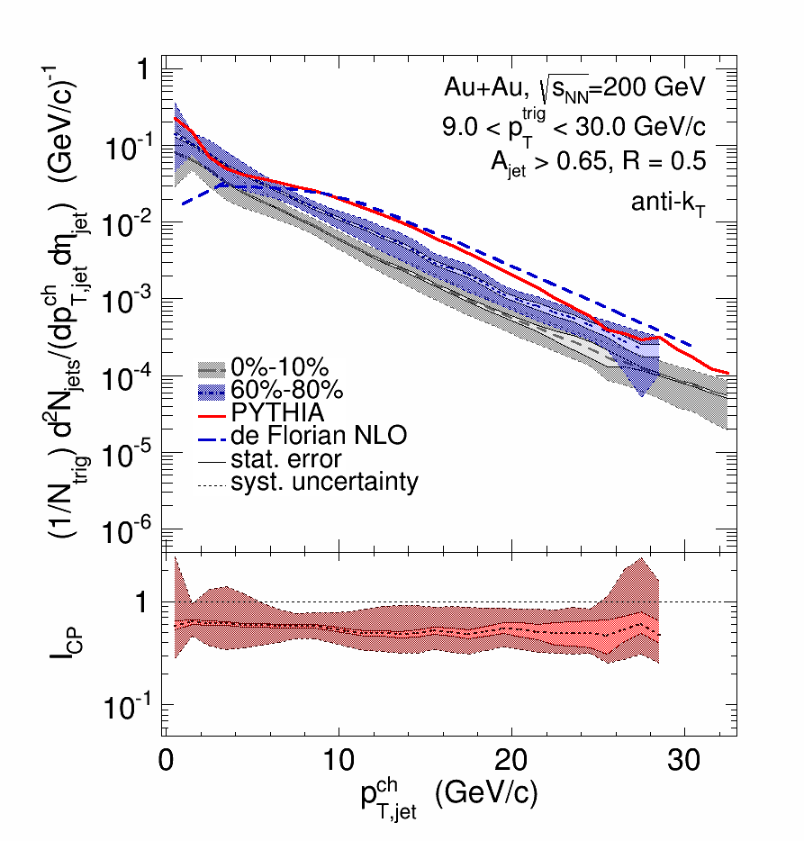
Corrected recoil jet spectra
Measurements of full recoil jet spectra:
all centralities, p_{T}, R
No bias imposed by bkdg suppression
Improvable systematic uncertainties
R=0.2
R=0.5
R
Effectively: IRC-safe jet measurements in heavy ion collisions

Slide 15
Recoil jet yield suppression
R=0.3
R=0.5
Spectrum shift → energy transport out-of-cone
RHIC: no significant dependence of shift on R for R<0.5
R=0.5: smaller shift at RHIC than LHC → lower energy loss at RHIC

Slide 16
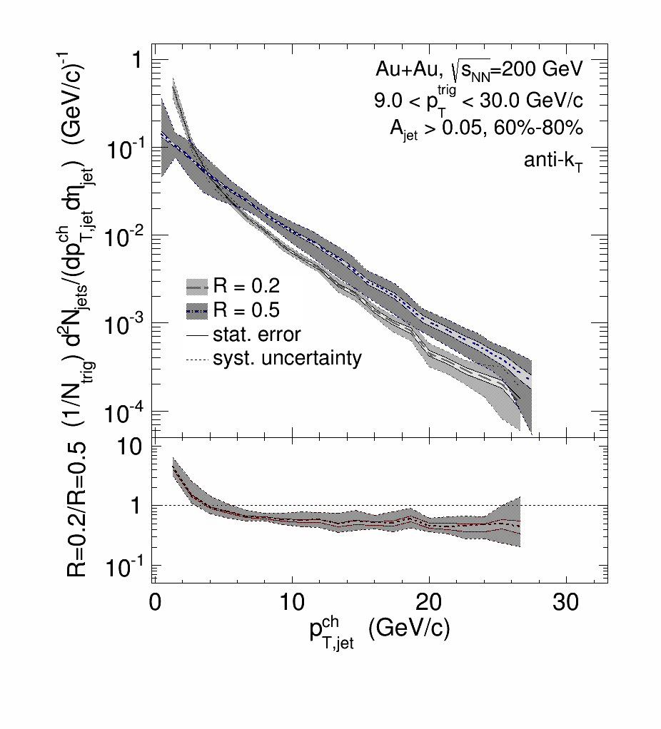
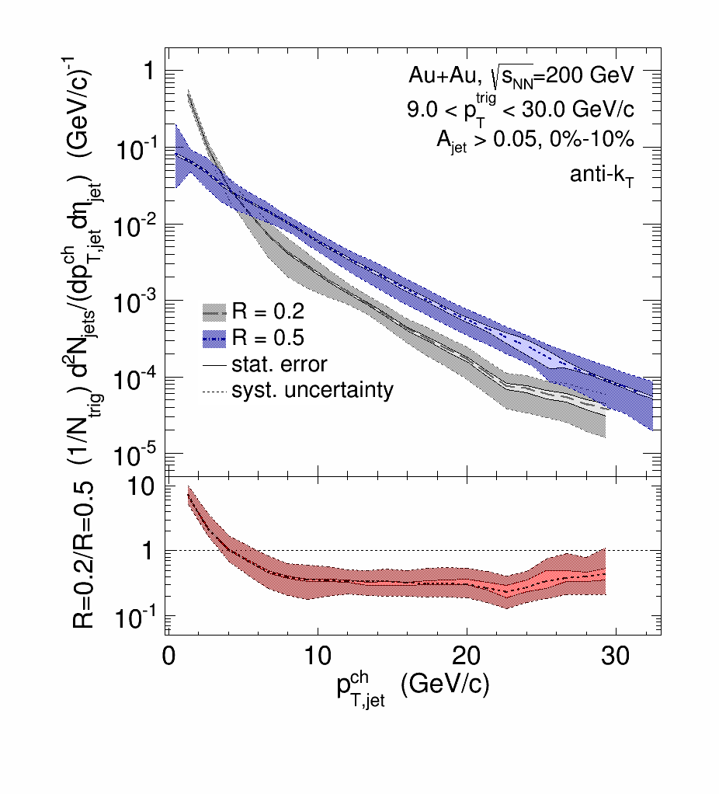
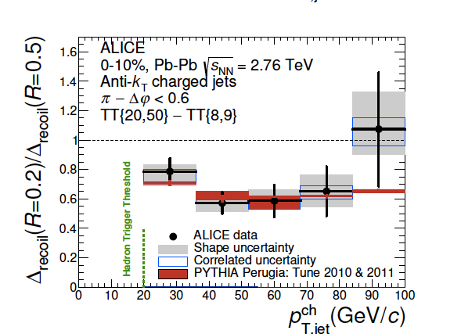
Jet quenching: intra-jet broadening
Au+Au peripheral
Au+Au central
Au+Au central
R
ALICE: JHEP 09 (2015) 170
Ratio 0.2/0.5 for peripheral and central consistent within uncertainties
compatible with some broadening within R<0.5
future measurements will reduce uncert.
ALICE: similar picture in overlapping p_{T} range

Slide 17
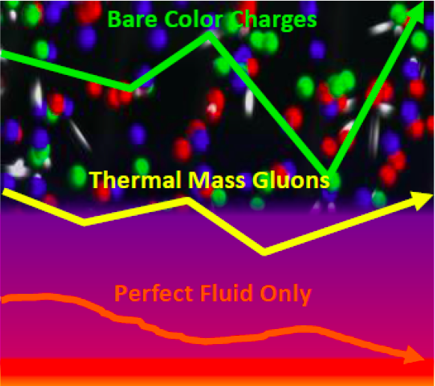
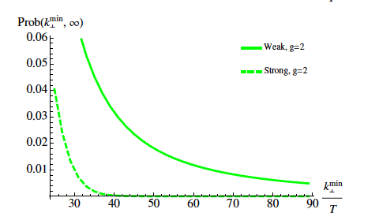
Inter-jet broadening: secondary scattering off the QGP
Discrete scattering centers or effectively continuous medium?
d’Eramo et al., JHEP 1305 (2013) 031
Distribution of momentum transfer k_{T}
Strong coupling:
Gaussian distribution
Conjecture for weak coupling: Δφ distribution dominated by single hard Molière scattering at “sufficiently large” Δφ
vacuum QCD effects fall off more rapidly
“sufficiently large” not yet known
?
Δφ

Slide 18
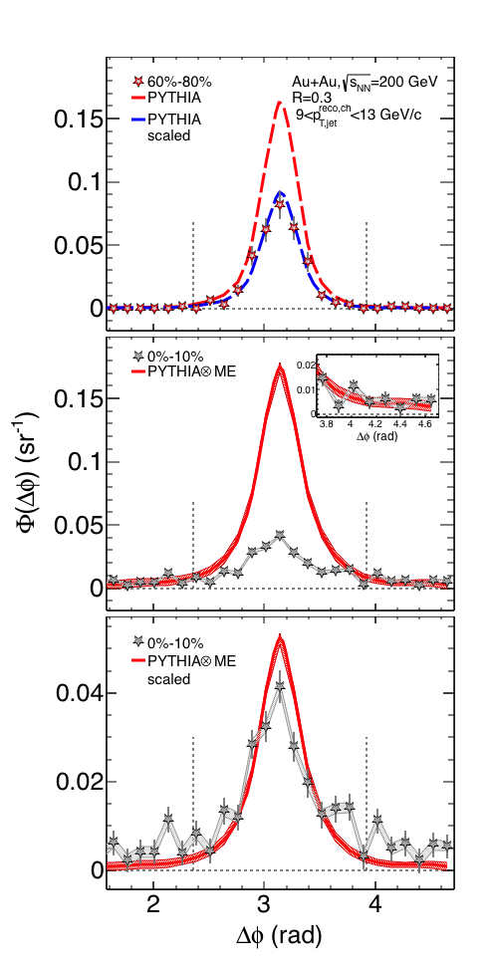
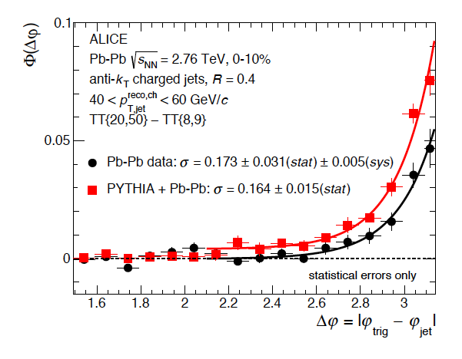
Interjet broadening: RHIC and LHC
PbPb √s_{NN}=2.76 TeV
AuAu √s_{NN}=200 GeV
JHEP 09 (2015) 170
arXiv:1702.01108
Low jet p_{T} of special interest: largest effects expected
current measurements consistent with zero yield
QCD calculation of scattering in q/g gas needed to estimate integrated luminosity needed for significant measurement
Δφ

Slide 19
Acoplanarity in Z+jet
Ran Bi, CMS
QM17

Slide 20
arXiv:1607.01932
Vacuum parton shower: Sudakov resummation
➞broadening of main recoil peak at |Δφ-π|~small
Medium-induced broadening: <qhat*L>
Optimal kinematics: low jet p_{T} ~ 10 GeV
Δφ
R=0.3
R=0.3
R=0.4
Predicts small but observable effect
→ direct measurement of <qhat*L>…?

Slide 21
Sudakov broadening: RHIC vs LHC
Chen et al., arXiv:1607.01932
Sudakov broadening for the same kinematic objects in p+p collisions at RHIC and LHC
h+jet:
9<p_{T}^{trig}<30 GeV/c
18< p_{T} ^{recoil jet} <48 GeV/c
RHIC
LHC
Significantly larger broadening at LHC than RHIC
  →harder to pull out broadening due to <qhat*L>
Challenging measurement at both colliders
Needs high statistical and systematic precision for low p_{T} jets
  At minimum can set limit on <qhat*L>
    → positive measurement possible?

Slide 22
Summary and Outlook
Jet measurements in vacuum: precise comparison to QCD requires IRC-safe observables ➞integrate out hadronic degrees of freedom
Rigorous jet quenching measurements in heavy ion collisions:
observables that are theoretically well-founded in vacuum
what changes in-vacuum ➞in-medium?
requires similar approaches in theory
Current focus: semi-inclusive h+jet measurements (γ+jet in progress)
Statistical approach to background:
  “IRC-safe”: no fragmentation bias imposed by bkgd suppression
  good and improvable systematic precision for all R + all p_{T} + all systems
Applied at STAR/RHIC and ALICE/LHC
Observables: yield suppression, medium-induced jet broadening, jet substructure,…
Next steps:
Extend techniques to fully calormetric jets, higher int lumi RHIC+LHC
Quantitative comparison to theory calculations

Slide 23
Backup slides

Slide 24
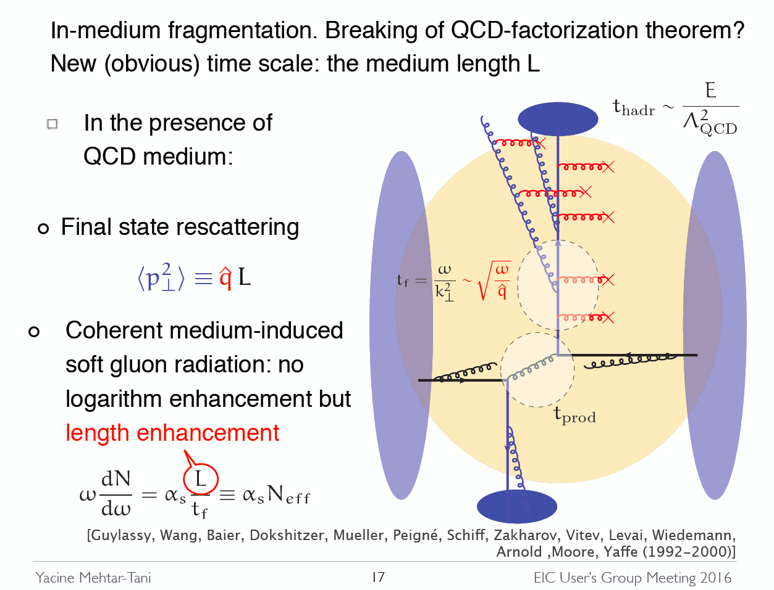
A common picture of jets in-medium
Yacine Mehtar-Tani
EIC Workshop Jan ‘16
There are no pions in this picture
Jet quenching is a partonic phenomenon
  ➔measure it at the partonic level

Slide 25
From sPHENIX Science Review, summer 2014
Current theoretical efforts have an overemphasis on medium modeling and phenomenological parameter tuning, specifically mock-up applications of energy loss or medium-induced parton showers not based on rigorous theory in Monte Carlo codes.
For jet and heavy flavor applications there is a need to put the emphasis back on field theory and QCD factorization. These should be priority areas for the next generation heavy ion theorists who should seek input and expertise from particle physics. The incorporation of recent advances in pQCD, SCET results in the largely phenomenological Monte Carlos should be encouraged.

Slide 26
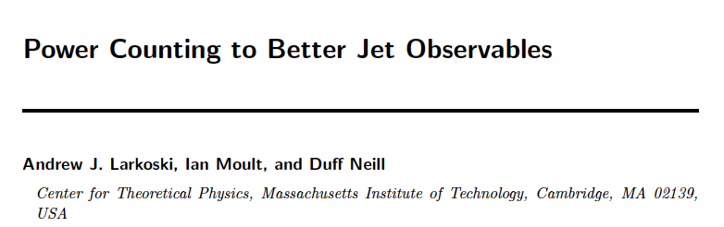
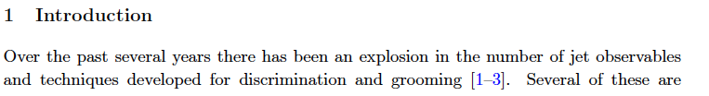
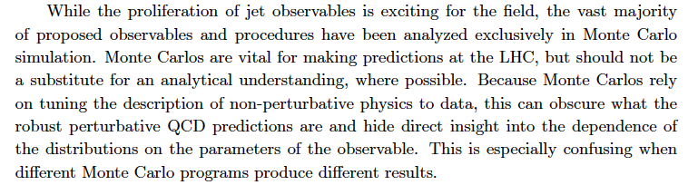
From a neighboring field…
JHEP 1412 (2014) 009

Slide 27
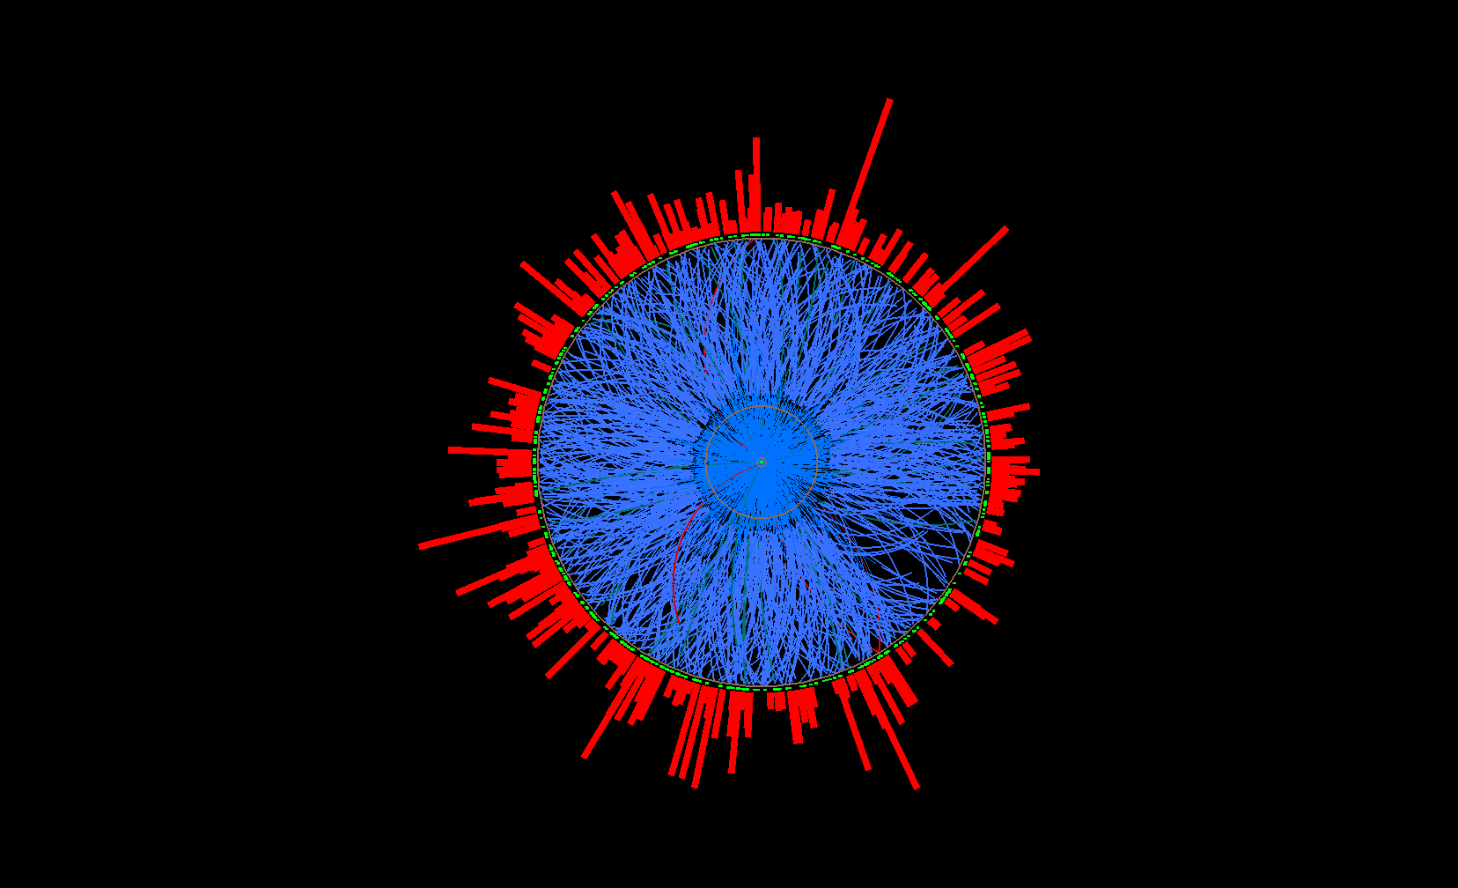
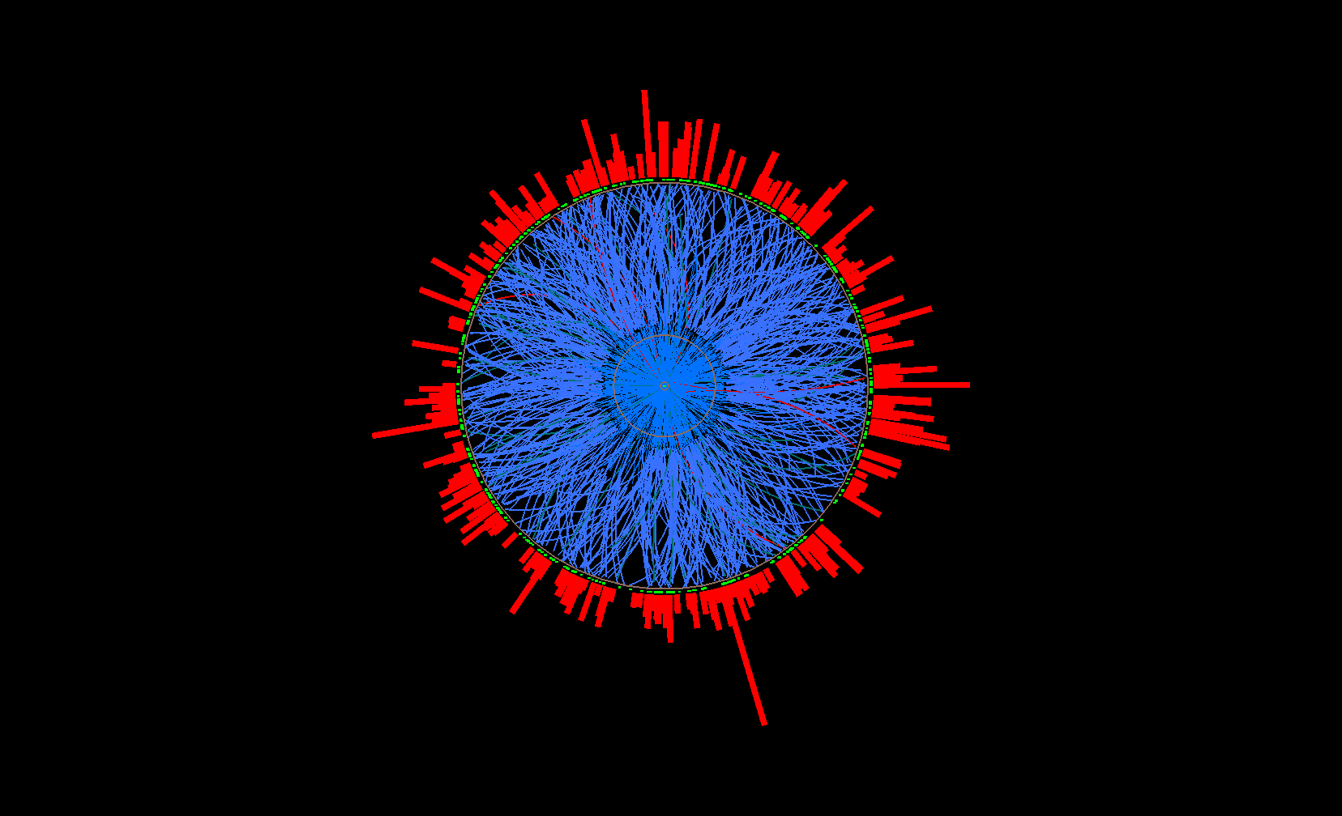
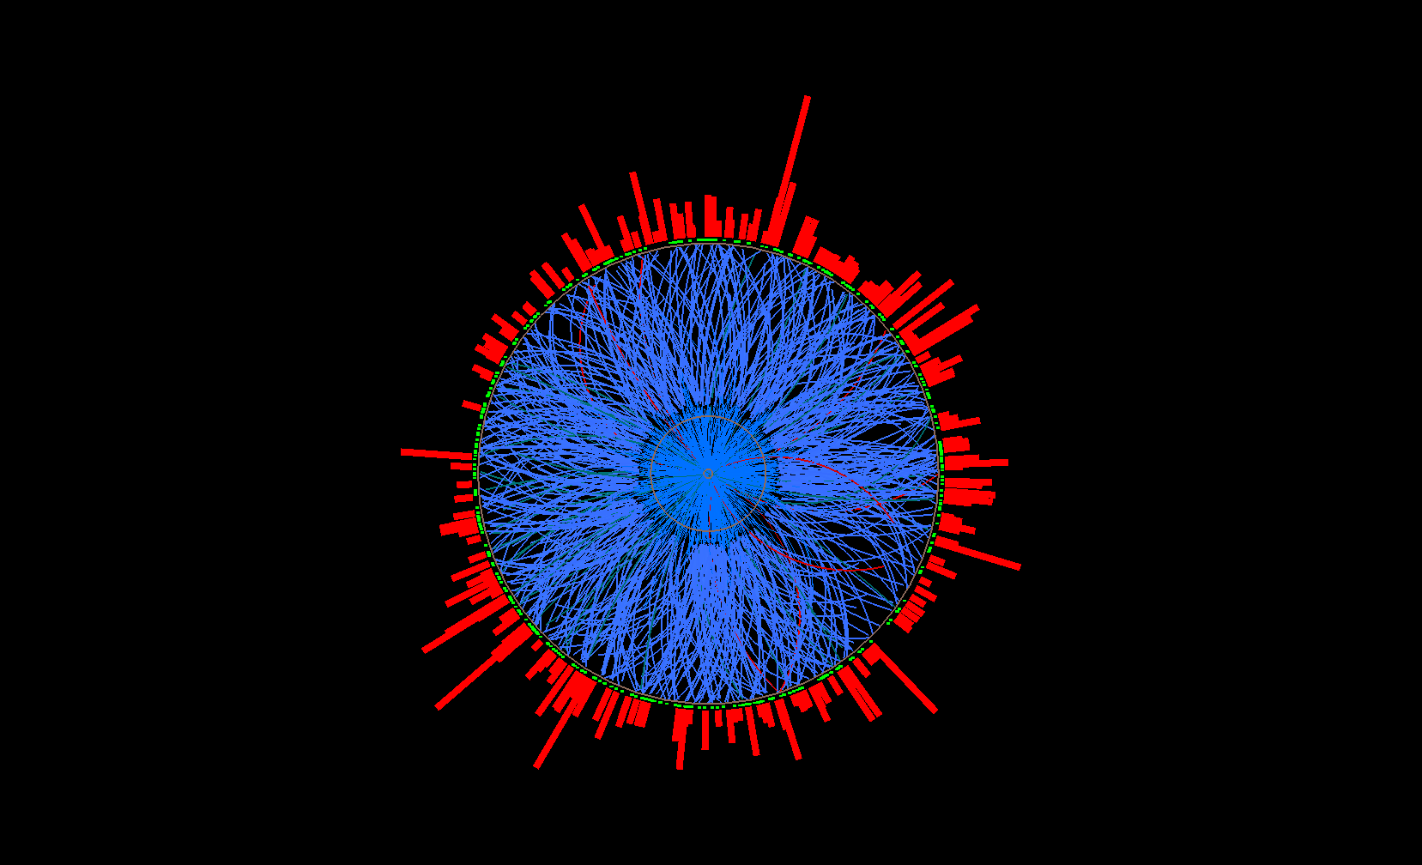
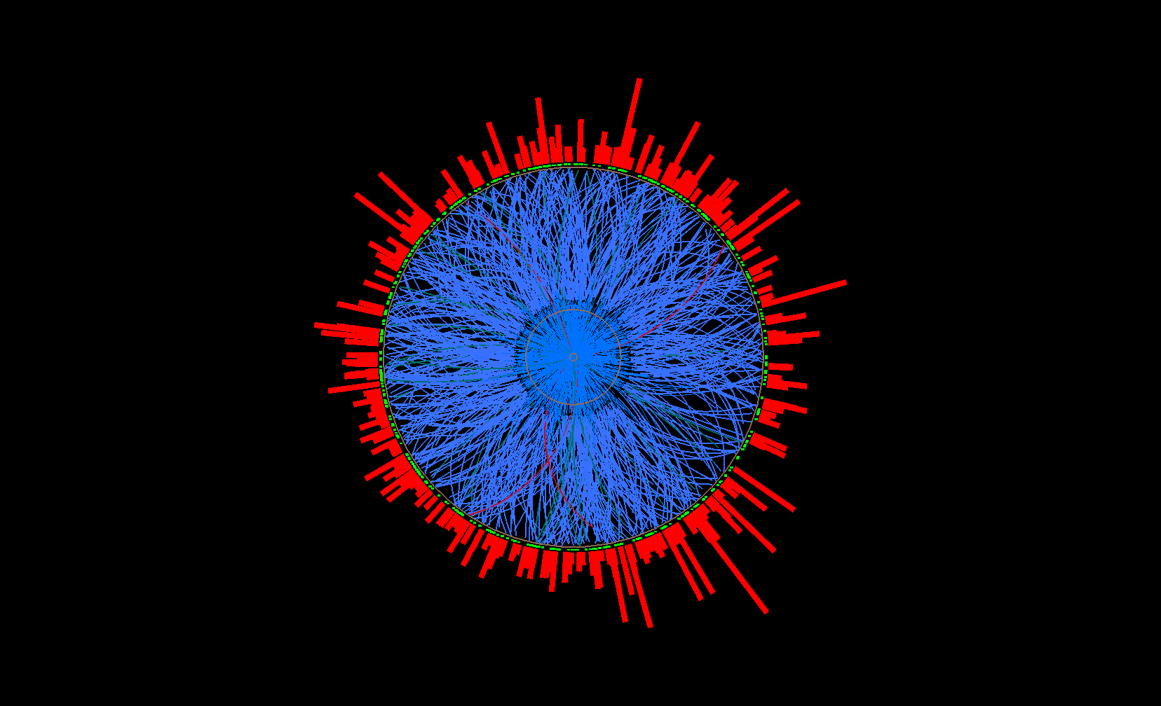
STAR approach to Uncorrelated Background:
Mixed Events
Mixed event
Mix only similar centrality, Ψ_{EP} ,
z-vertex position
Pick one random
track per real event
→ add to mixed
event
…
Ev. 1
Ev. 2
Real events
Ev. 3
Ev. 765

