Slide 1
Technical Design Review of the Dual Phase ProtoDUNE
April 24-25, 2017
Signal FT chimneys (SFTC)
C. Cantini, P. Chiu, A. Gendotti, L. Molina Bueno, S. Murphy, A. Rubbia,
C. Regenfus, F. Sergiampietri, S. Wu
CERN - ETHZ
1

Slide 2
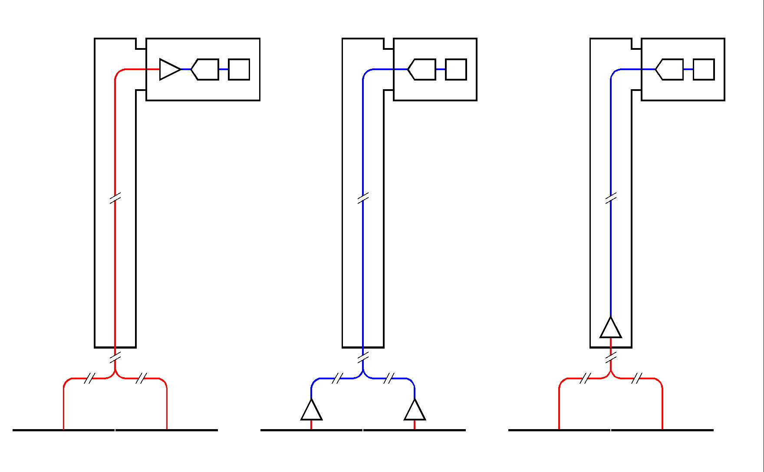
SFT CHIMNEYS CONFIGURATION
Depending on the charge readout configuration:
1. Cable connection of the CRPs to the outer/warm FE (front-end) and A2D (analog-to-digital) electronics, via 2.75m (≡118.25pF) long cables . (CRP capacitance: ~110pF/m). | 2. Connection of the CRPs to cold/in-vessel (not accessible) FE electronics, plus connection via chimney + warm SFT to the outer A2D electronics. | 3. Connection of the CRPs to ~cold/in-chimney (accessible/replaceable) FE electronics (cable length = 0.5-0.75m ≡ 21.5-32.5pF), plus transmission of the amplified signal to the outer A2D electronics via in-chimney cables.
A2D
A2D
FE+A2D
FE
CRP
FE
CRP
CRP
All the 3 configurations imply heat input through signal cables (~43W for 12 chimneys) and through the top cap crossing tubes and chimney tubes (~35W for 12 chimneys).
Configuration 1 implies an increase of detector channel capacitance and works at room temperature (lower S/N ratio).
Configuration 2 and 3 imply heat dissipation from the FE electronics (~60W (?) for 12 chimneys). In configuration 3 the conduction heat input and FE electronics dissipation can be compensated by local heat exchangers.
Configuration 3, with cold, accessible/replaceable electronics, and short signal cables (good S/N ratio), has been chosen.
2

Slide 3
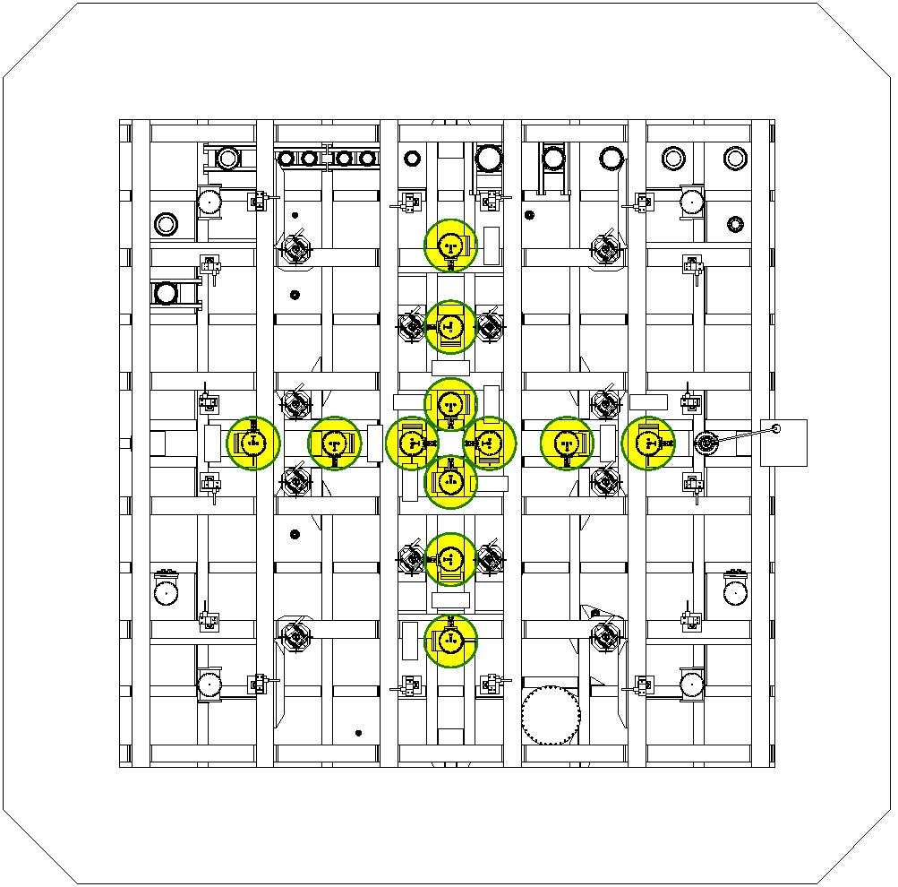
12 SFTC on the top of the cryostat.
6 Chimneys for the X-coordinate readout (1/meter) and 6 for the Y­-coordinate readout (1/meter)

Slide 4
12 SFTC on the top of the cryostat.
6 Chimneys for the X-coordinate readout (1/meter) and 6 for the Y­-coordinate readout (1/meter)
1 m
1 m

Slide 5
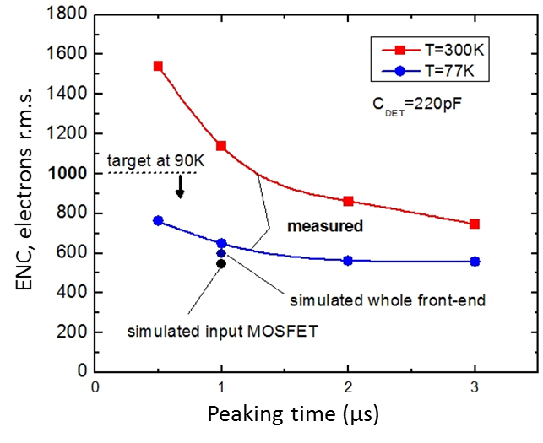
Signal FT chimney configuration
Low-noise front-end electronics: advantage to operate at temperatures 90K-110K
Gianluigi De Geronimo, Alessio D’Anadragora*, Shaorui Li, Neena Nambiar, Sergio Rescia, Emerson Vernon Hucheng Chen, Francesco Lanni, Don Makowiecki, Veljko Radeka, Craig Thorn, and Bo Yu,
Brookhaven National Laboratory, NY, USA and * University of L’Aquila, Italy
5

Slide 6
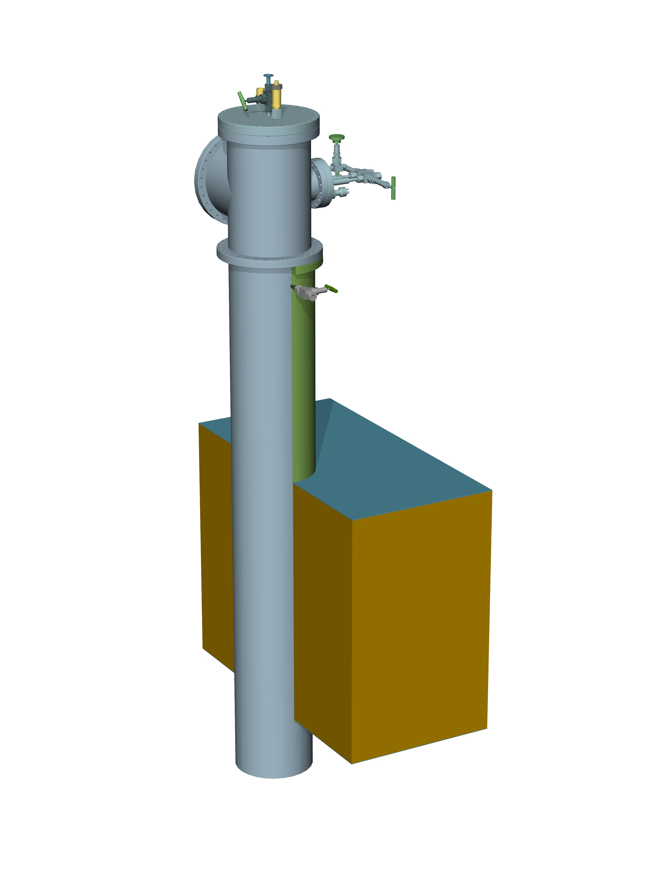
SFT chimney across the cryostat top cap
640 channels SFTC
Outer tube diameter = 254mm
Penetration pipe
Inner diameter = 273mm
TOP (outer) SS layer
GRPE thermal insulation
BOTTOM (inner) SS layer
6

Slide 7
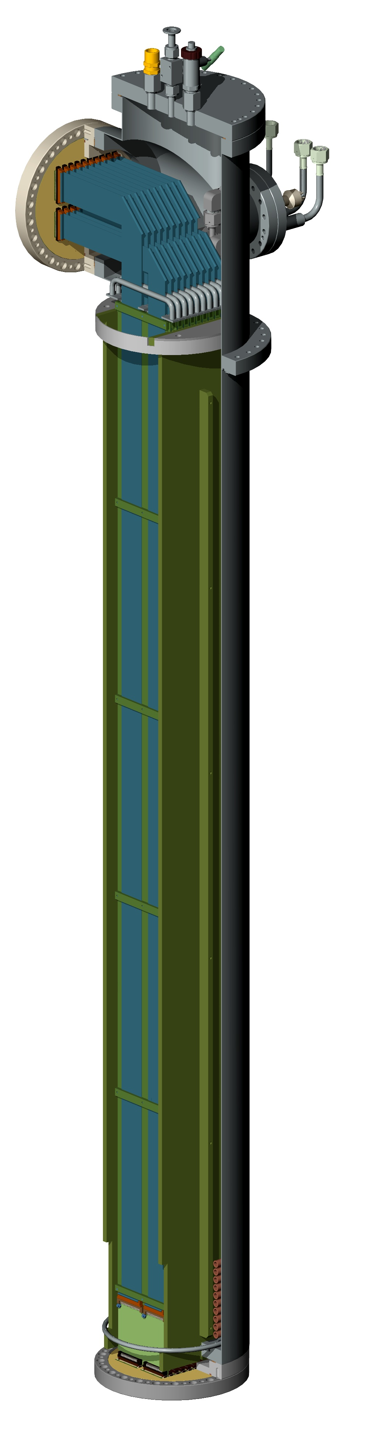
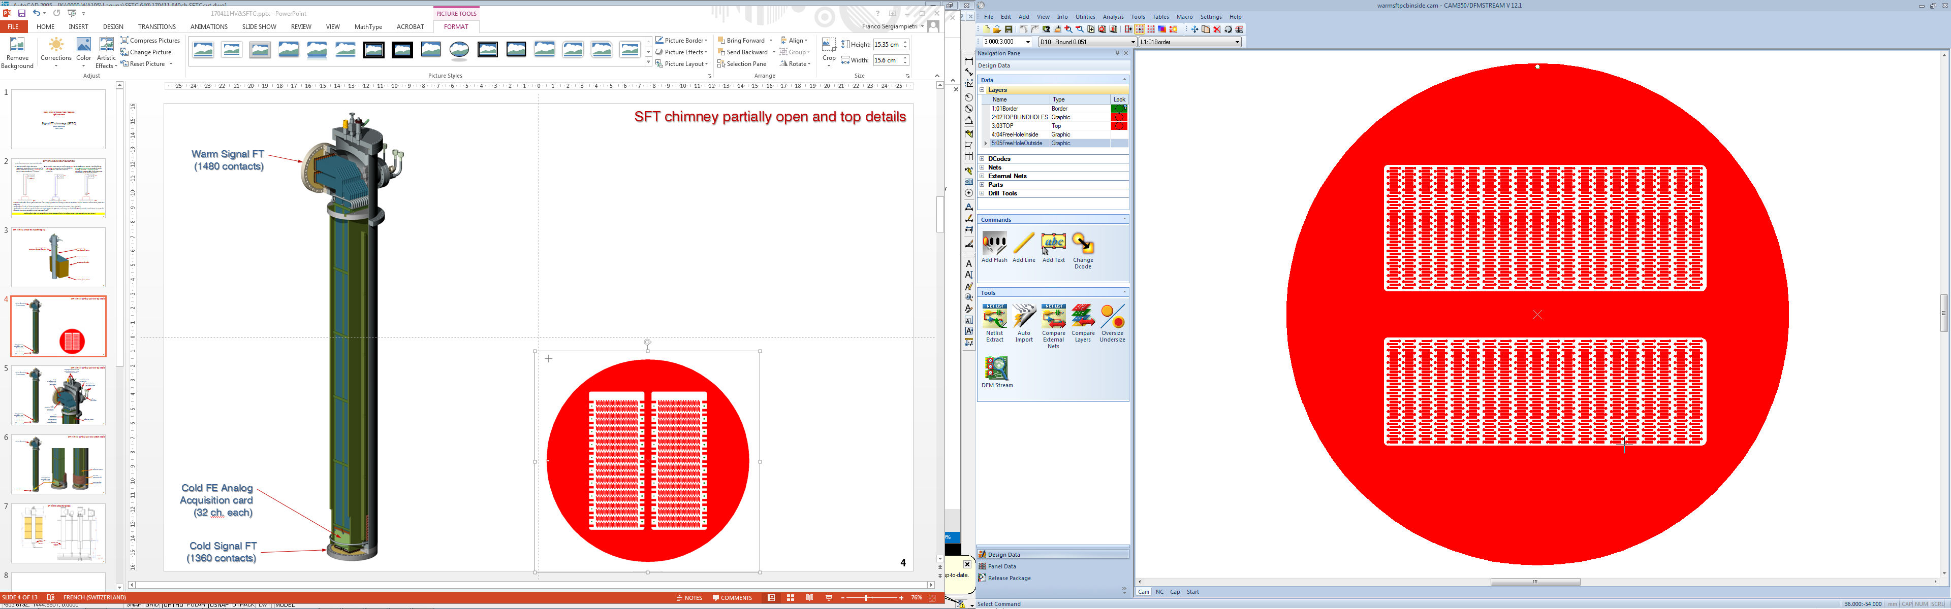
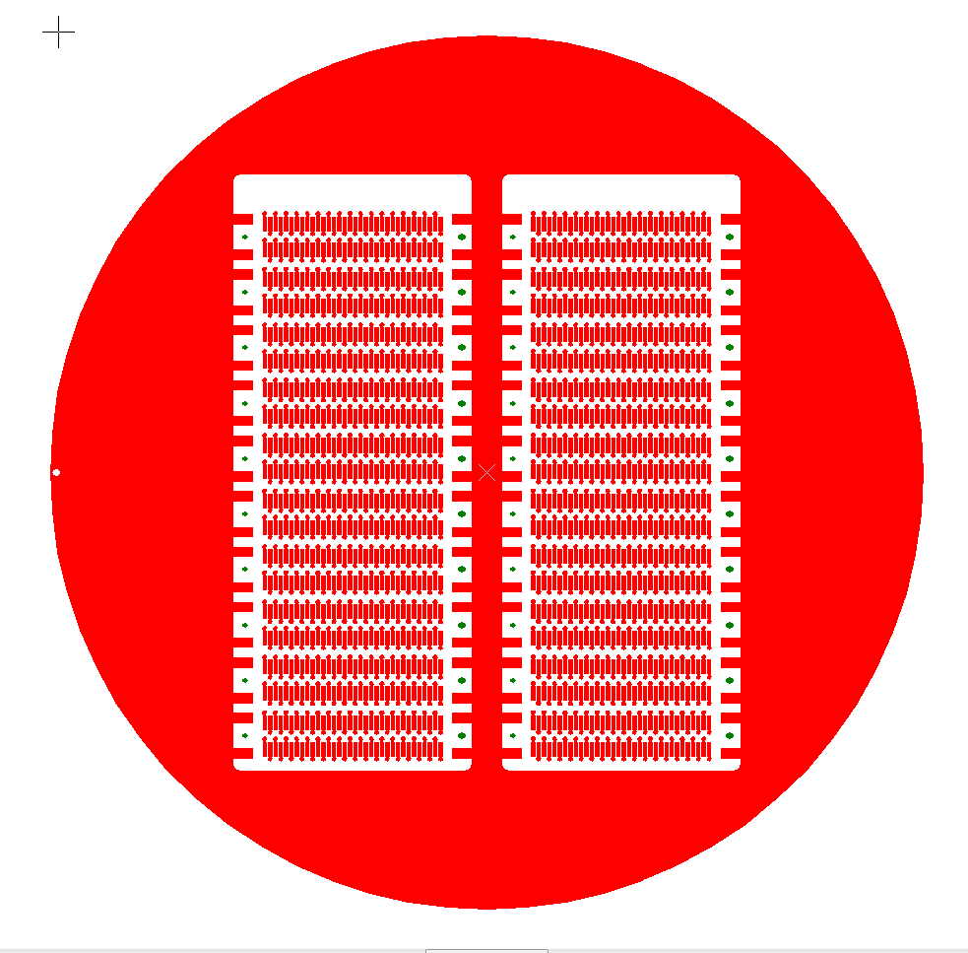
SFT chimney partially open and SFT pcb
Warm Signal FT
(1480 contacts)
Cold FE Analog Acquisition card (32 ch. each)
Cold Signal FT
(1360 contacts)
7

Slide 8
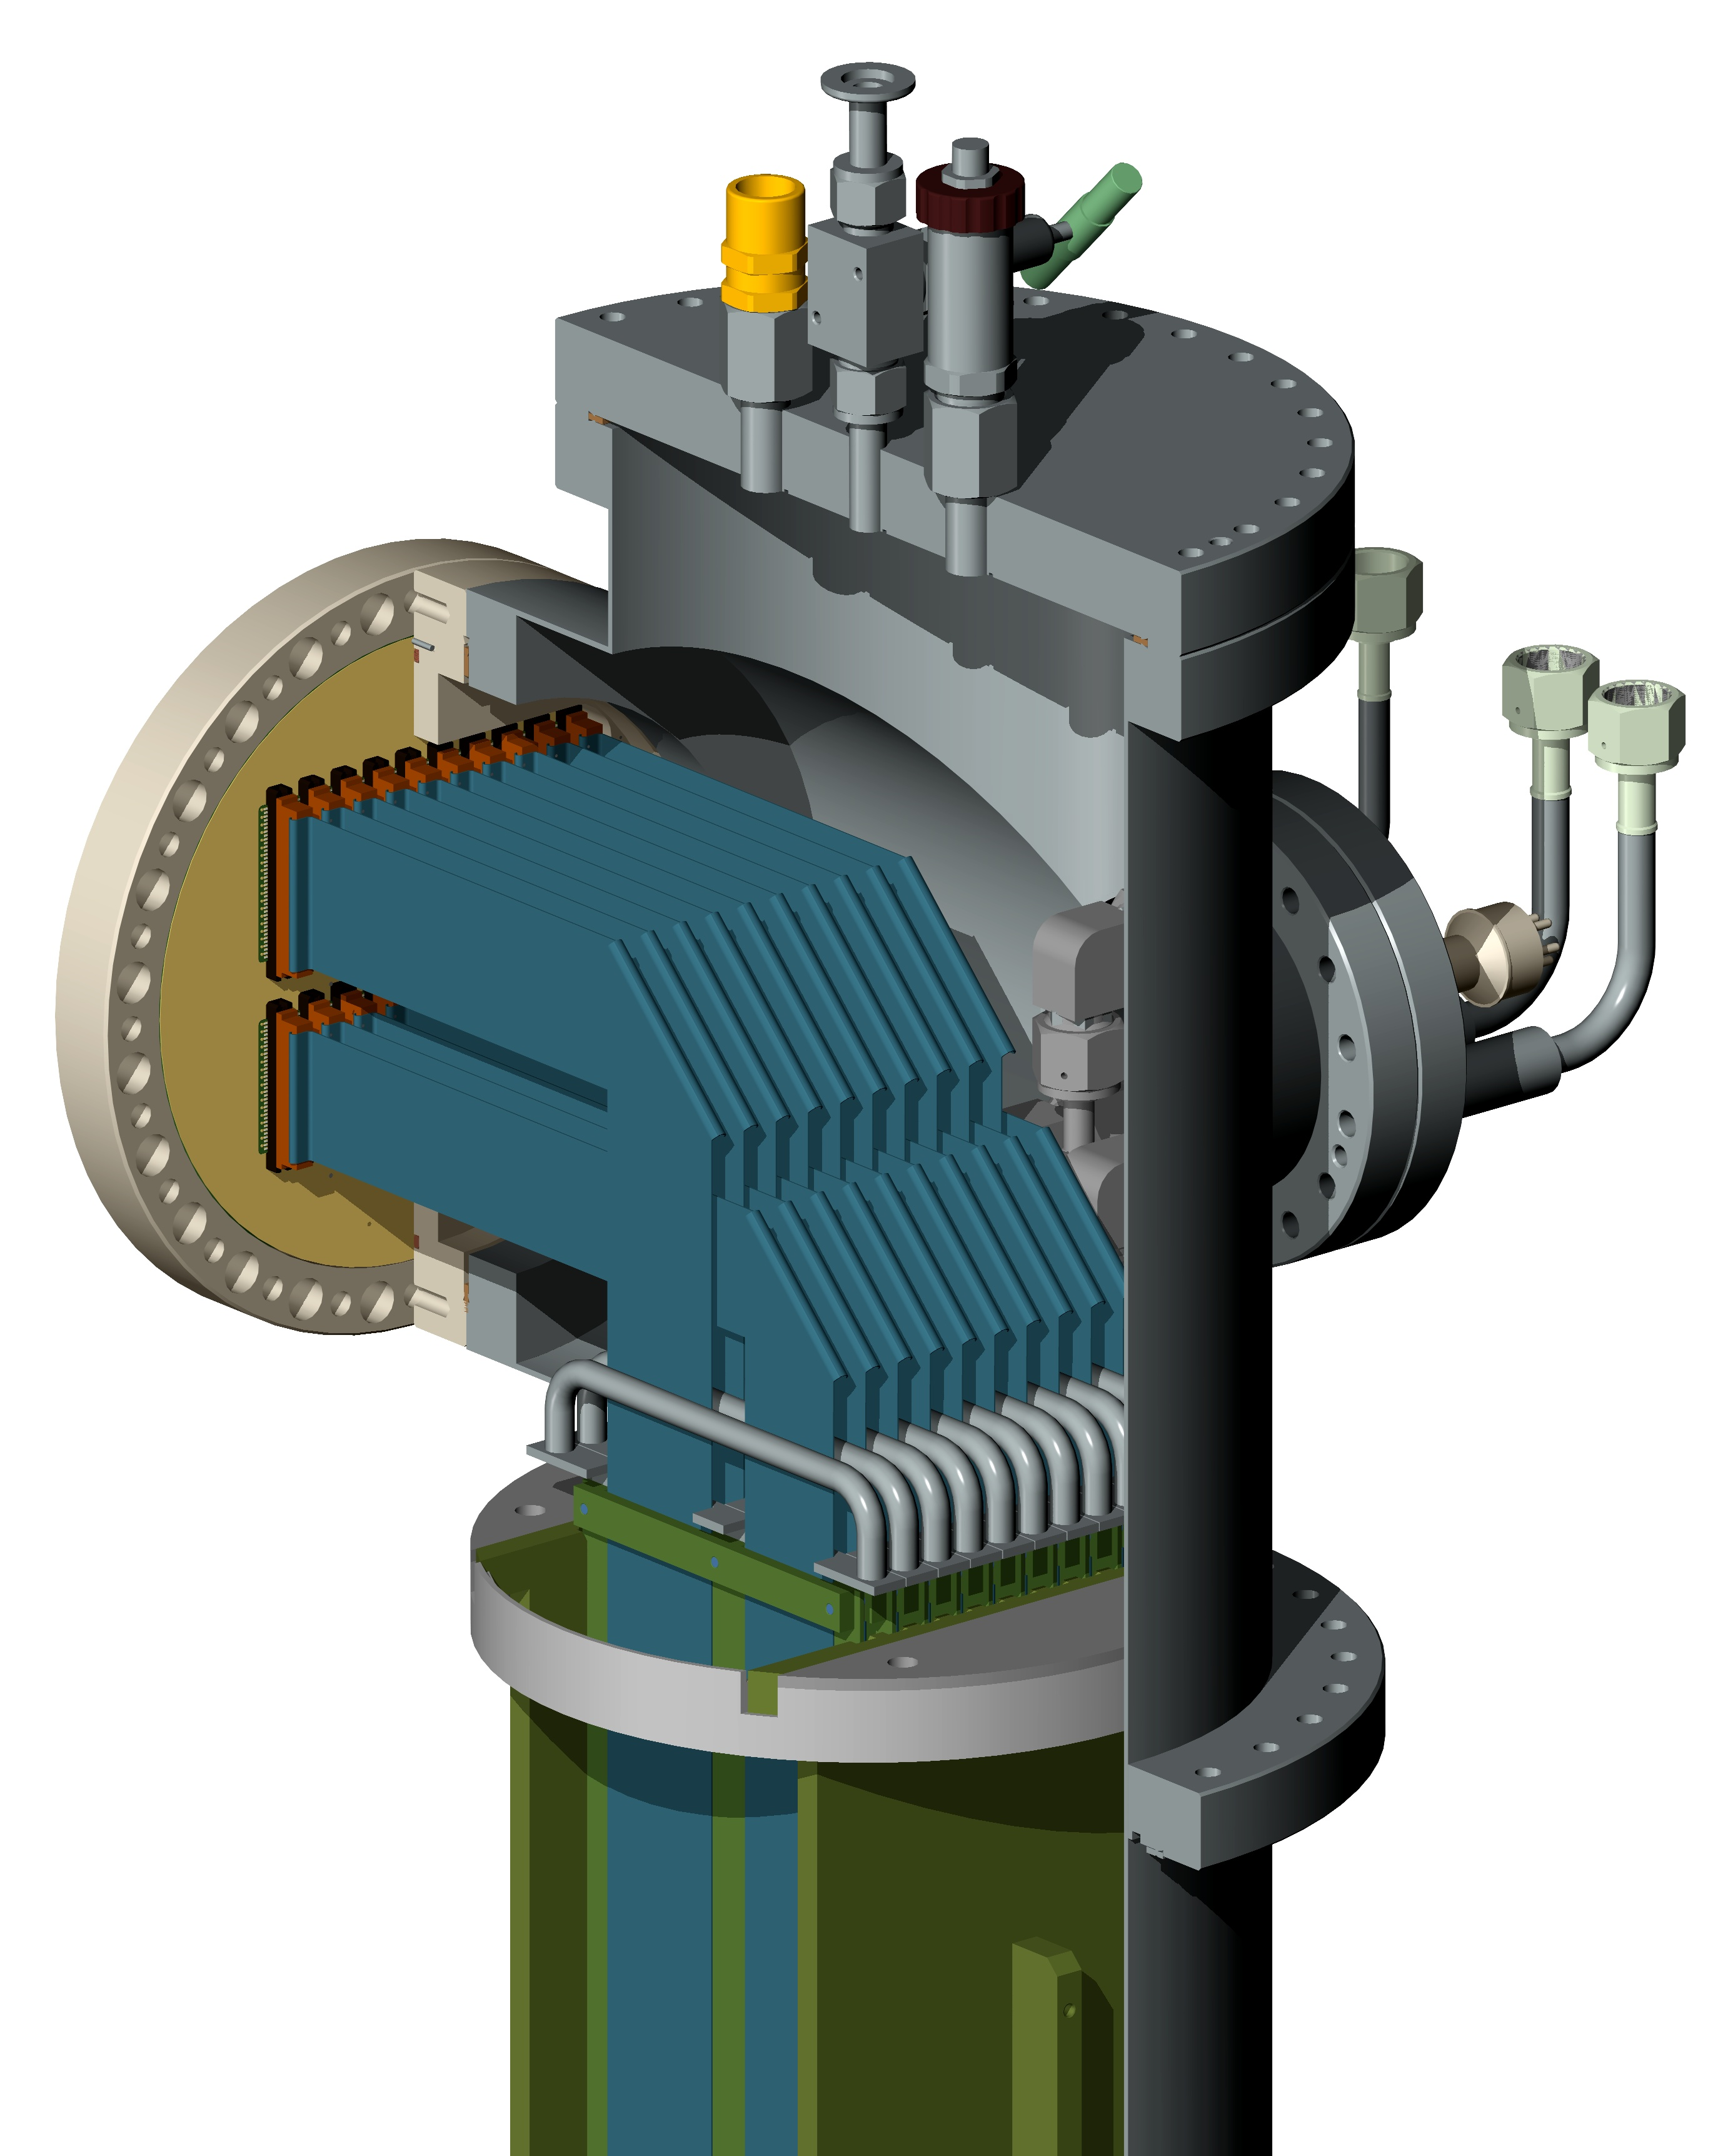
SFT chimney partially open and top details
Emergency removable flange with increased N₂ gas flushing
Overpressure check valve
Preliminary vacuum valve
Pressure transducer
Warm Signal FT
(1480 contacts)
N. 10
40-twisted pairs
Cables and Connectors
Input pipe for N₂ gas flushing
In-Out pipes for LAr bottom heat exchanger
Pt-1000 connector
N. 10
34-twisted pairs
Cables and Connectors
Cold FE Analog Acquisition card (32 ch. each)
N. 10
Extractable blades with handles for TP cables and FE electronics cards
Guides for blades
Cold Signal FT
(1360 contacts)
8

Slide 9
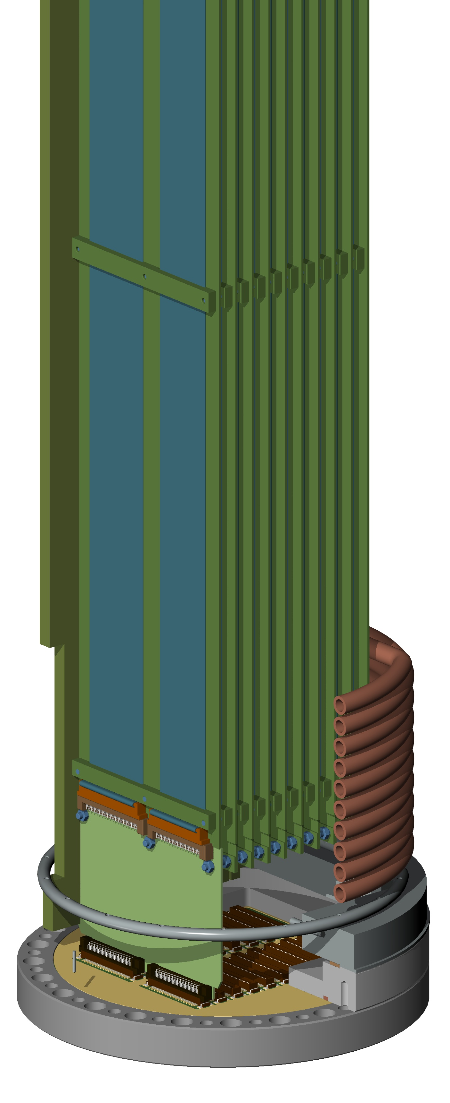
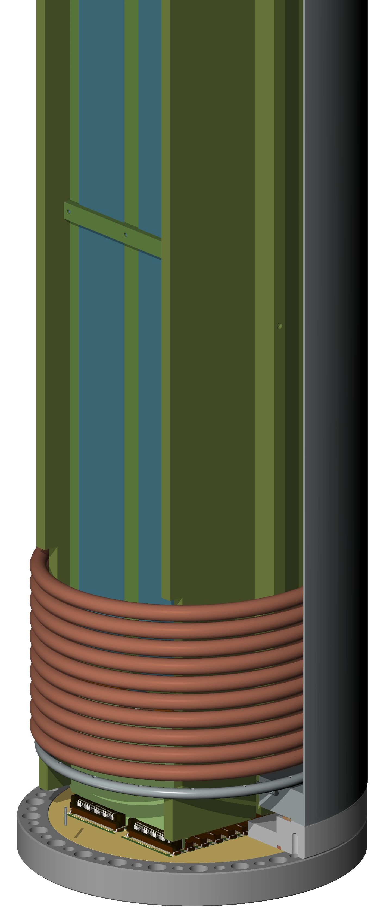
SFT chimney partially open and bottom details
Warm Signal FT
Guides for blades
LAr heat exchanger coil
Cold FE Analog Acquisition card (32 ch. each)
N₂ gas flushing perforated ring
Cold Signal FT
9

Slide 10
SPARE SLIDES
ETH
Eidgenössische Technische Hochschule Zürich
Swiss Federal Institute of Technology
10

Slide 11
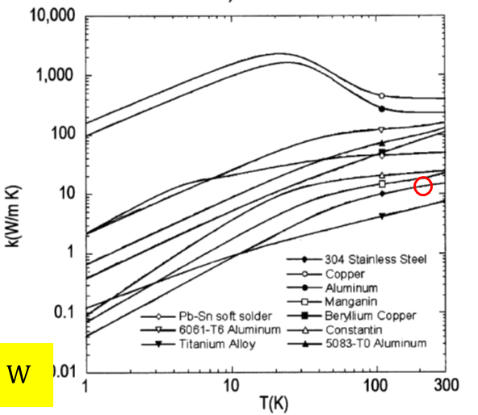
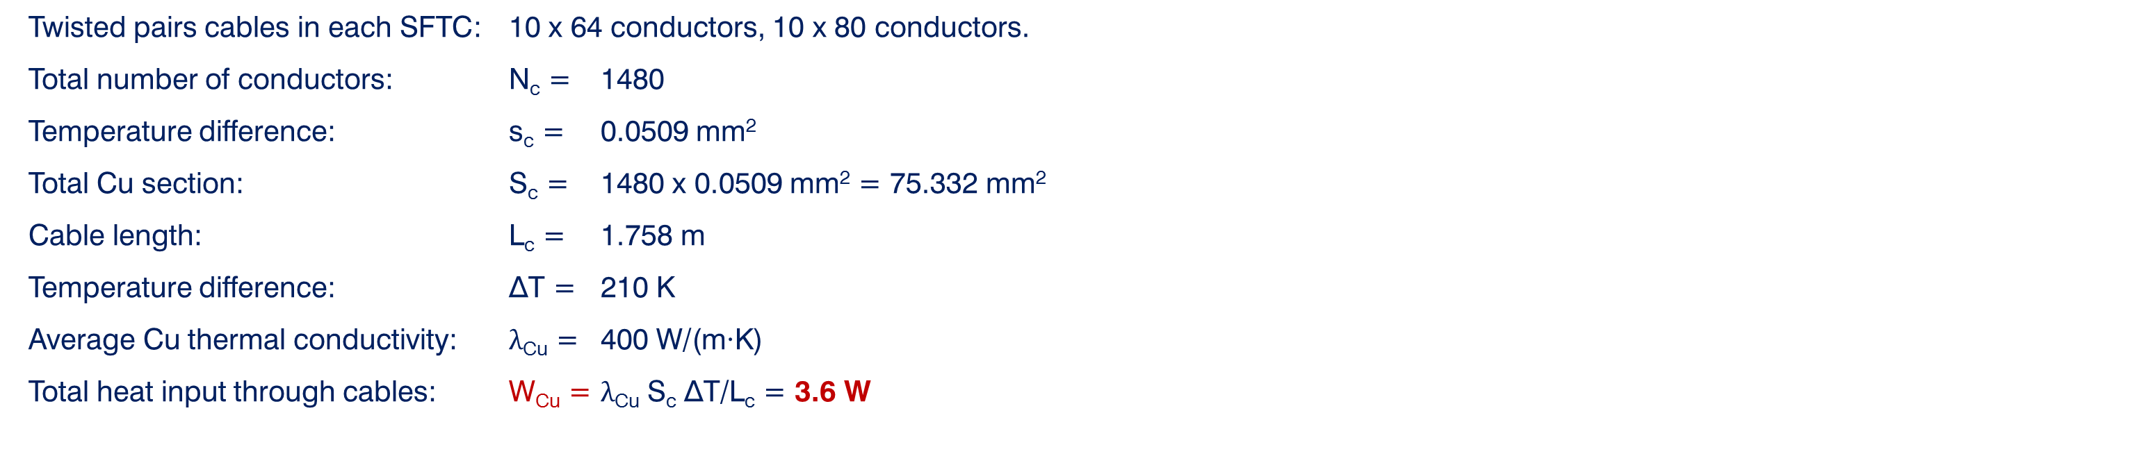
Heat input through cables in each SFT chimney
Twisted pairs cables in each SFTC: 10 x 64 conductors, 10 x 80 conductors.
Total number of conductors: N_{c} = 1480
Temperature difference: s_{c} = 0.0509 mm²
Total Cu section: S_{c} = 1480 x 0.0509 mm² = 75.332 mm²
Cable length: L_{c} = 1.758 m
Temperature difference: ∆T = 210 K
Average Cu thermal conductivity: λ_{Cu} = 400 W/(m∙K)
Total heat input through cables: W_{Cu} = $\text{λ}\text{Cu}$ S_{c} ∆T/L_{c} = 3.6 W
Copper
Heat input through SS chimney tube (D: 250x254 mm)
Length L_{ss} = 1720 mm
X-section Sss = 1583.36 mm²
Average SS thermal conductivity λ_{SS} = 15 W/(m∙K)
Total heat input through SS W_{SS} = 2.9 W
304 Stainless Steel
11

Slide 12
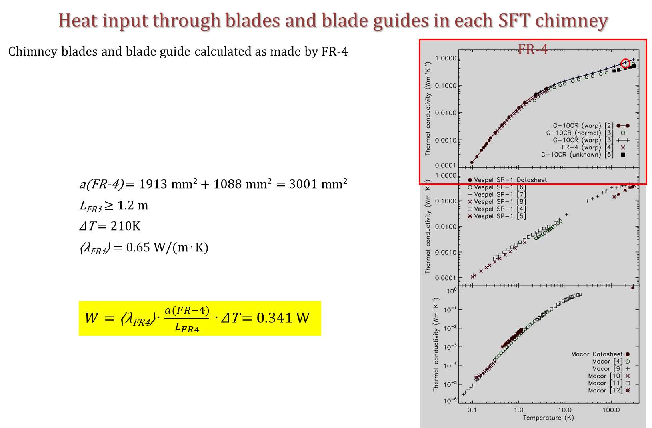
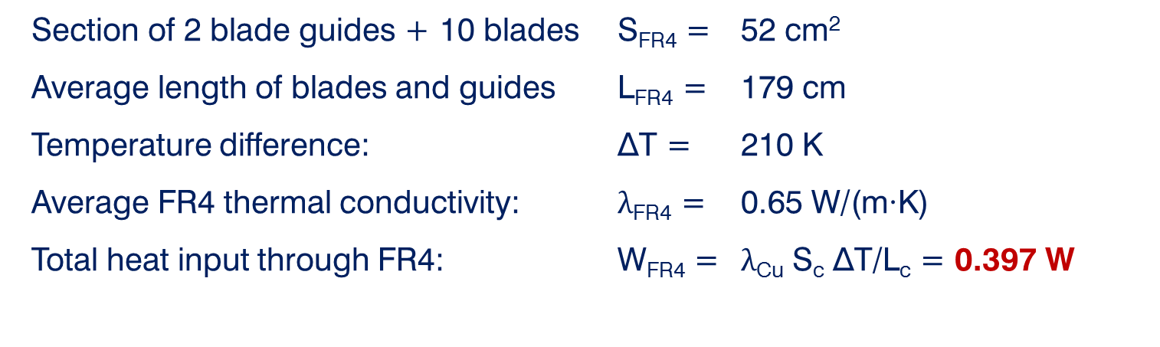
Heat input through FR4 blades and blade guides in each SFT chimney
Section of 2 blade guides + 10 blades S_{FR4} = 52 cm²
Average length of blades and guides L_{FR4} = 179 cm
Temperature difference: ∆T = 210 K
Average FR4 thermal conductivity: λ_{FR4} = 0.65 W/(m∙K)
Total heat input through FR4: W_{FR4} = $\text{λ}\text{Cu}$ S_{c} ∆T/L_{c} = 0.397 W
Heat input through 12 SFT chimney
Total heat input through 12 SFTC: W_{SFTC} = 12 (0.397+3.6+2.9) W = 12x6.9 W = 82.8 W
Total heat input from cold FE electronics: W_{FE} = 120 x 0.3W/card (estimated) = 36 W
Total heat input: W_{T} = 119 W
Induced LAr evaporation rate: Ø_{LAr}=~0.5 cm³/s = ~45.3 L/day
(in the internal heat exchanger in each chimney)
12

Slide 13
Situation at present for SFT chimneys
Offers requested for Chimney Mechanical Construction/Assembly and Tests. One (from CINEL) arrived (8 working weeks delivery). Preliminary order submitted on EDH. Waiting for other 3-4 offers.
Offers requested and received for Commercial Components (Swagelok VCR valves and connectors, MDC 6-pin feedthrough) and CERN details to be sent to the selected construction company for integration. Delivery in 8-10 weeks from the order. Order submitted on EDH.
Offers for Cold SFT PCBs requested and received. 20 working days delivery. Order submitted on EDH.
Offers for metallic seals for Cold and Warm SFT (Spring energized C seal). ~7 weeks delivery. Order submitted on EDH.
13

Slide 14
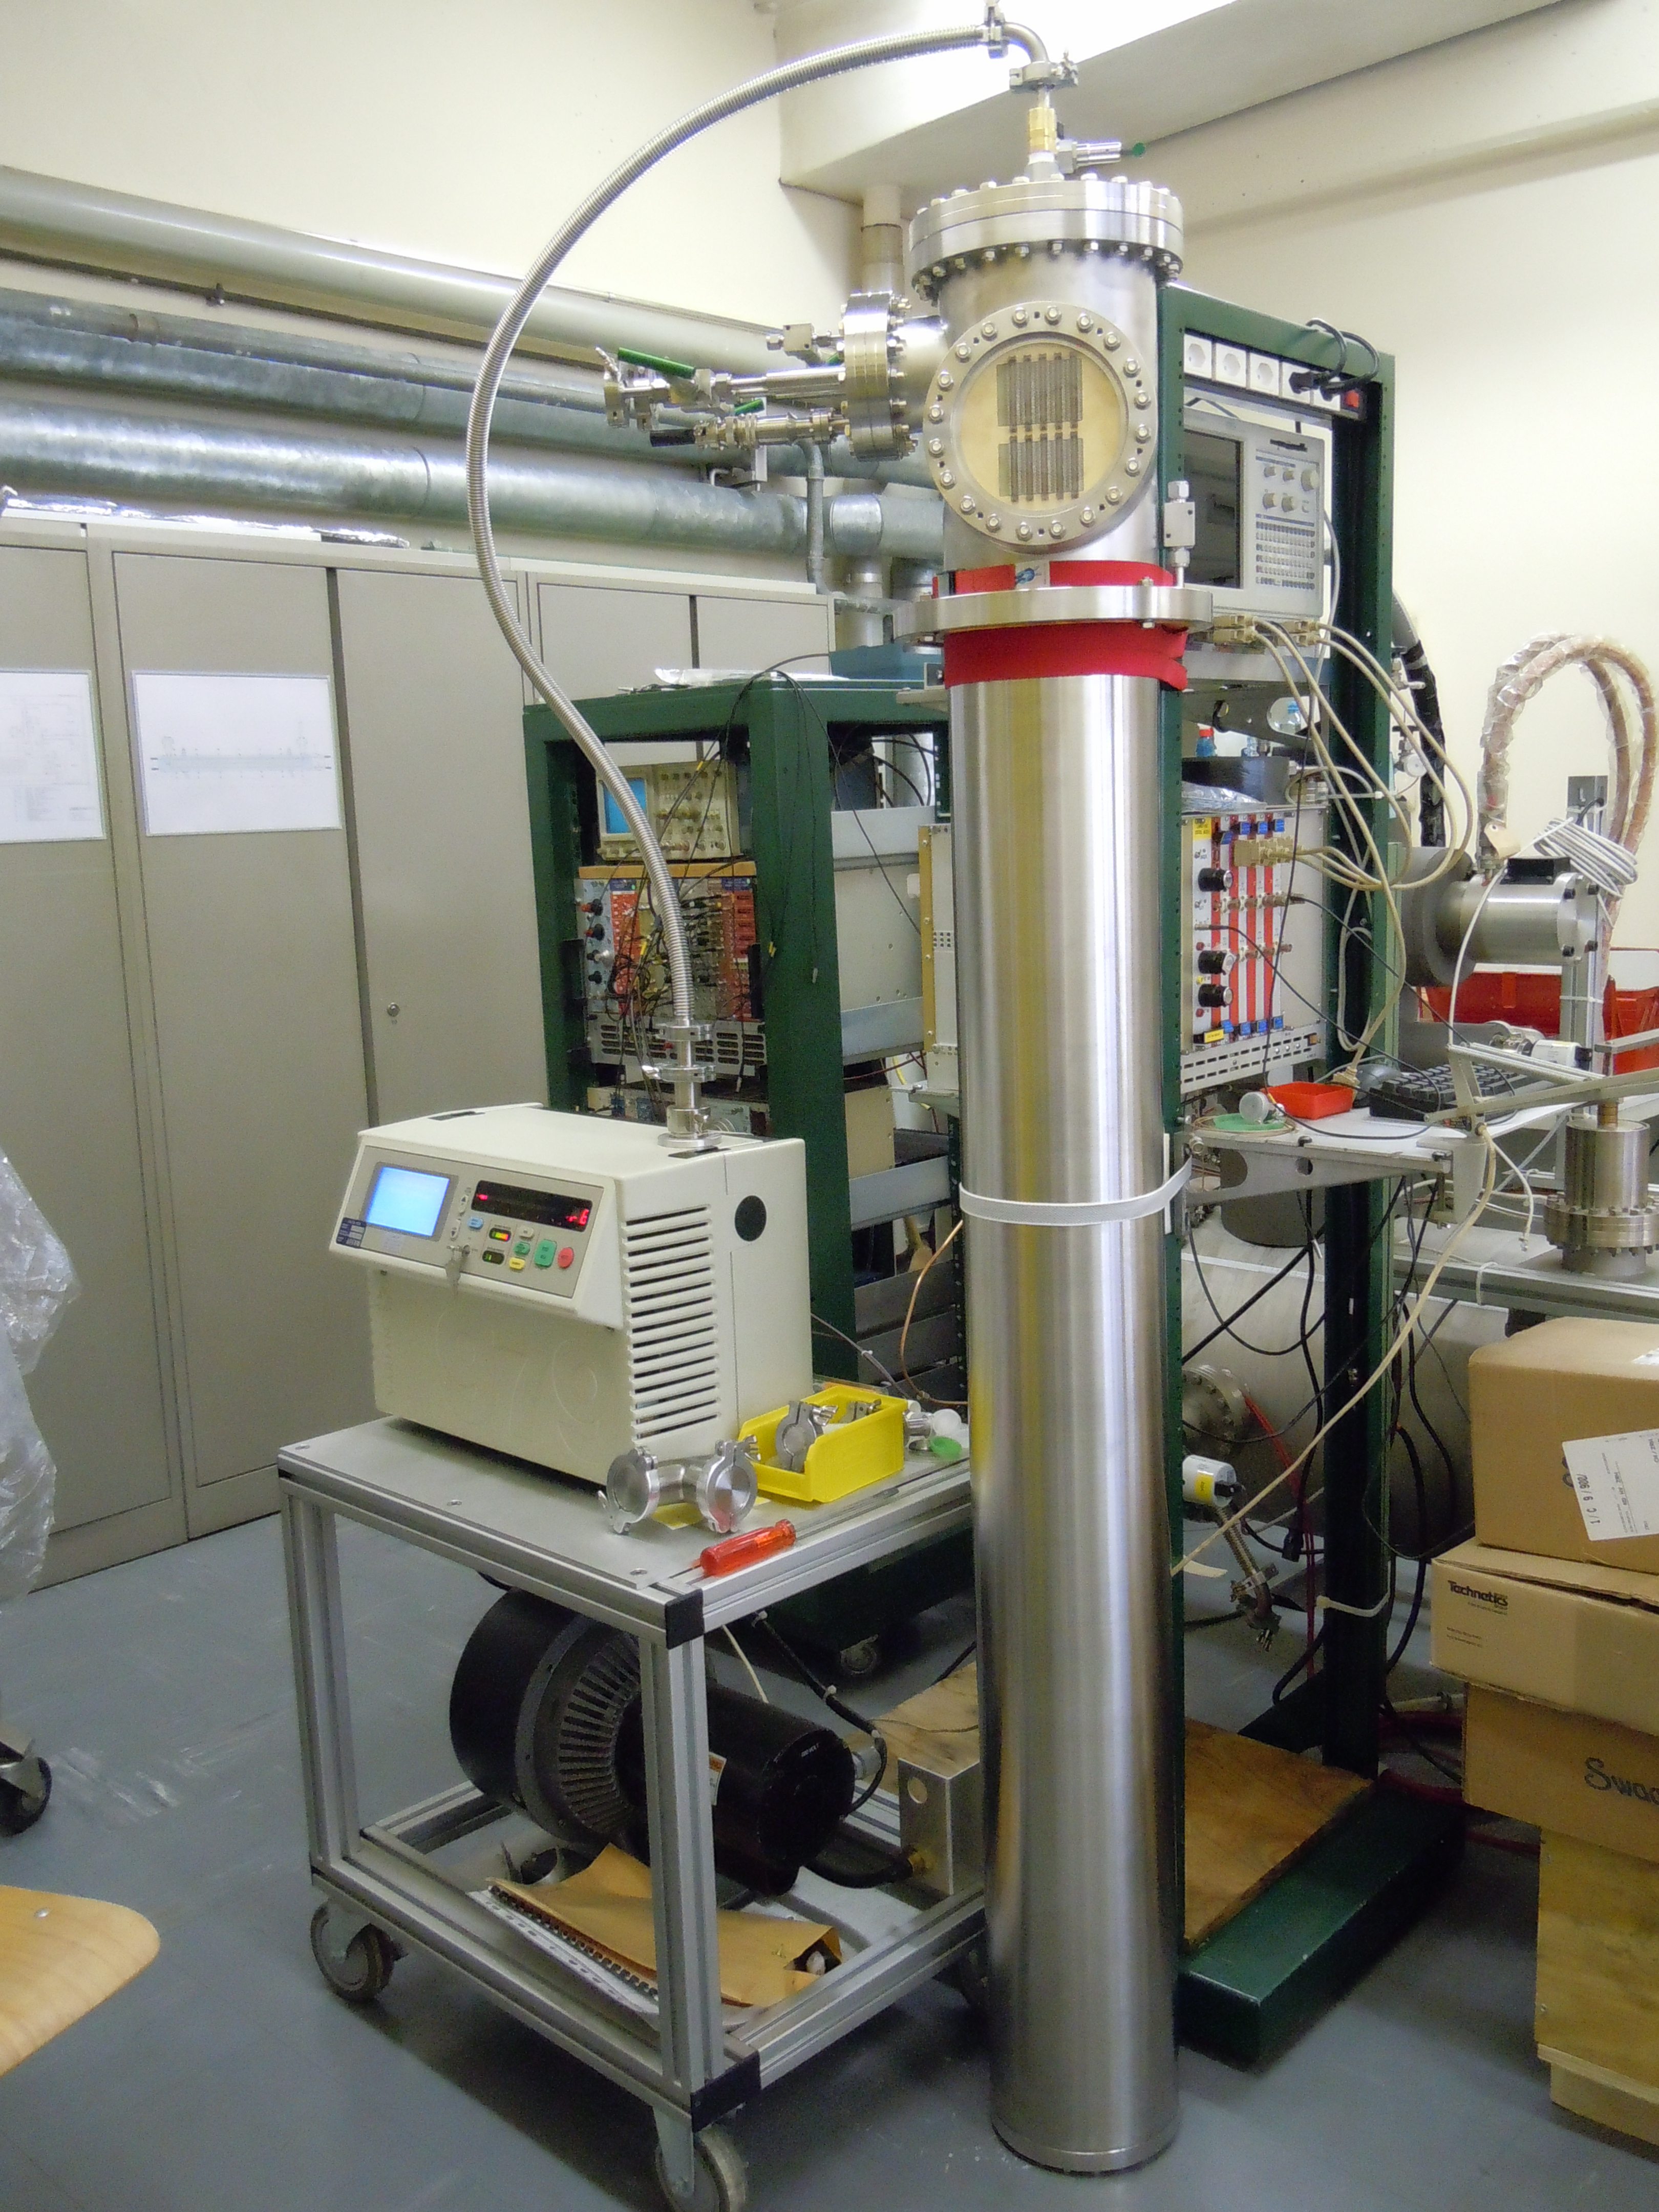
Past experience on Signal Feedthrough Chimneys
Test on a SFTC for the 311 Dual-Phase Demonstrator
N. 4 SFT chimneys with the same configuration of the one proposed, but with half electronic channels (320 in place of 640) are at present installed in the 311 DP Demonstrator.
The chimneys have been tested for correct insertion of the front-end electronic cards and connected to the outer digital conversion/acquisition electronics crates. The 20 front-end electronics cards, at present in the 311-DP, can be inserted in the 6x6x6 ProtoDUNE-DP detector (N. 120 in total required with same dimensions and connectors).
SFTC for 311
⌀_{PIPE} = 204mm
H (under the CF250/306 flange) = 1565.9mm
In the SFTC for ProtoDUNE DP
⌀_{PIPE} = 254mm
H (under the CF273/325 flange) = 1771.2mm

Slide 15
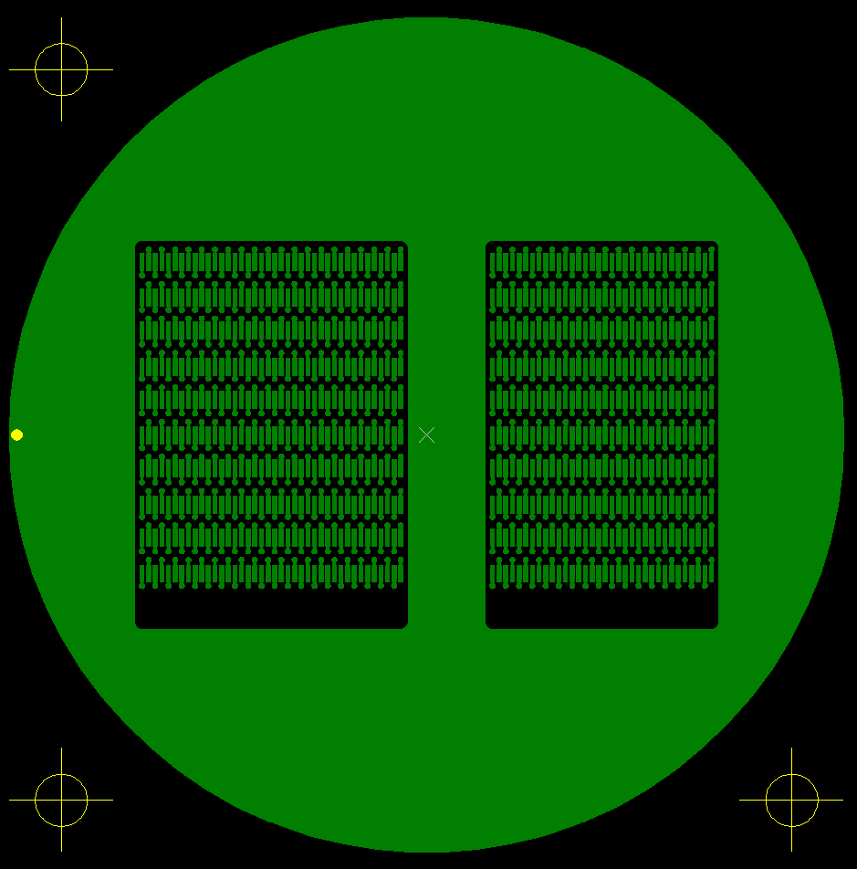
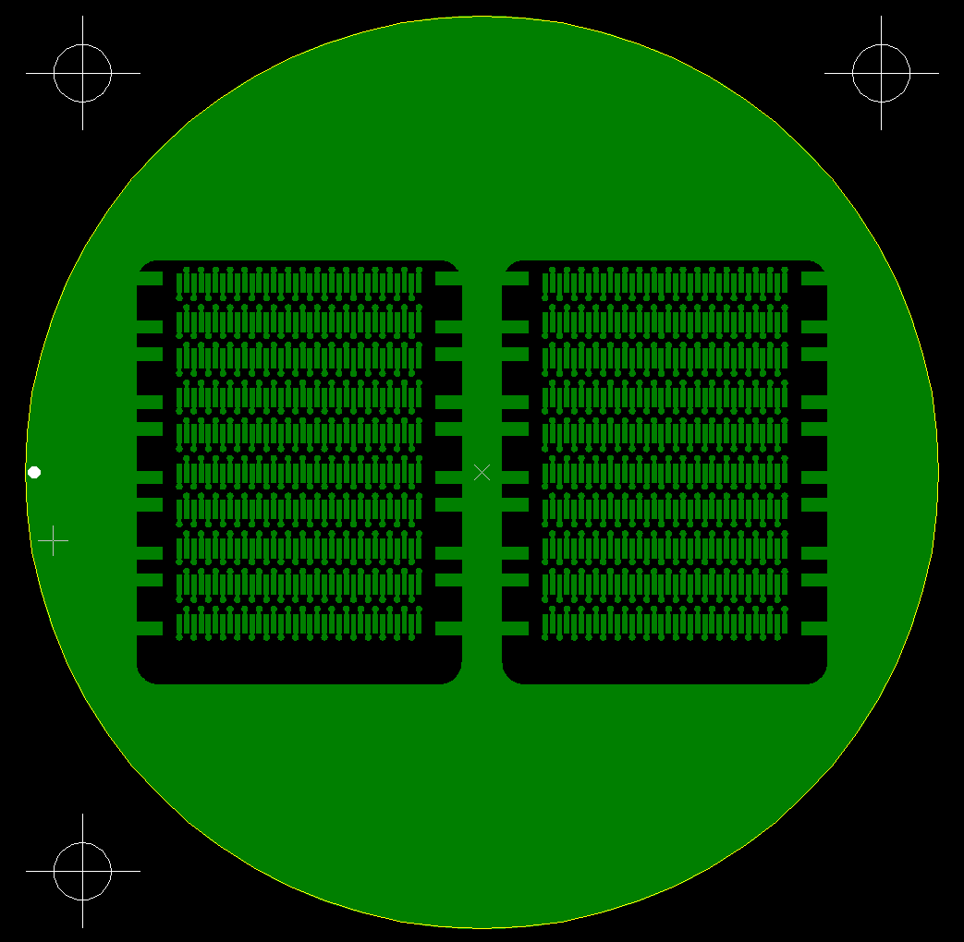
SFT PCBs for ProtoDUNE-DP chimneys vs SFT PCBs for 311 DP
Warm Signal FT
(1480 contacts)
⌀ = 208mm
Warm Signal FT
(740 contacts)
⌀ = 159.8mm
Cold Signal FT
(1360 contacts)
⌀ = 208mm
Cold Signal FT
(680 contacts)
⌀ = 159.8mm
15

Slide 16
Extension of the 311 SFT chimney to the 6x6x6 ProtoDUNE DP
6 Chimneys for the X-coordinate readout (1/meter) and 6 for the Y­-coordinate readout (1/meter)
1 Chimney for the X-coordinate readout (1/meter) and 3 for the Y­-coordinate readout (1/meter).
X-channels same as for the 6x6x6
3 m
1 m
1 m
1 m

