Slide 1
Dual Phase Drift Cage Production QA/QC & Installation
protoDUNE Design and Production Review April 25, 2017
Jaehoon Yu for
A. Chatterjee, S. Shshsavarani, G. Brown & UTA Team
A. Gendotti, S. Murphy, C. Cantini & ETH Team
F. Pietropaolo & CERN Team

Slide 2
Contents
Drift Cage Design Concept
Drift Cage Pre-Production Procedure and QA/QC
Drift Cage Production Status
Drift Cage Bent Profile Production
Drift Cage Assembly Facilities at CERN
Drift Cage Installation in the cryostat (A. Gendotti’s talk)
Conclusions

Slide 3
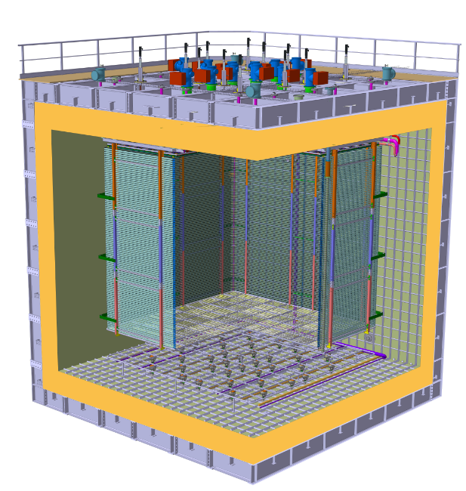
Drift Cage in protoDUNE DP
Drift Cage and cathode hangs off of the ceiling
Essential to have light yet sturdy structure
Based on modular concept as SP
Charge Readout Planes
6 m
Drift Cage (common structural elements with SP)
Cathode
6 m

Slide 4
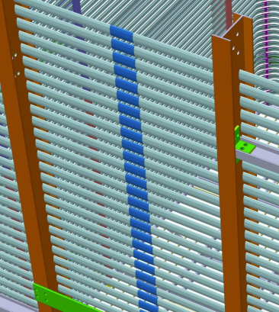
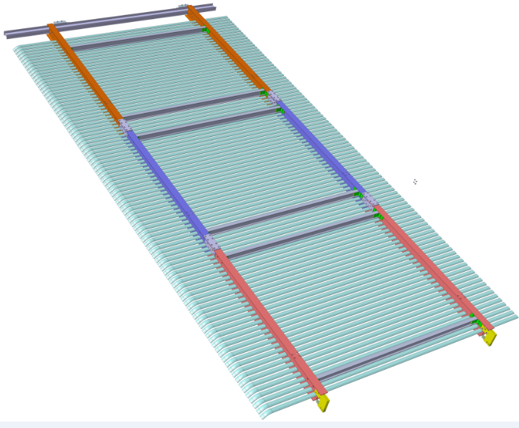
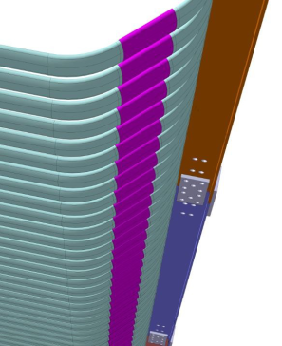
Drift Cage Design
Shares common basic structural elements w/ ProtoDUNE-SP
Consists of 8 vertical modules of 6310 x 3010 mm² (2 modules per detector face)
Each module is assembled out of 3 distinct sub-modules
11 profiles with one end bent at 45 degrees are electrically connected by 1 HV divider board
98 electrically continuous rings in 60mm pitch using straight aluminum clips
Three distinct types of sub-modules with 33, 33, and 32 profiles each held by a frame with two 6” and two 3” horizontal FRP I-beams
Inter-module connections made with FRP plates connected with FRP threaded rods
Each profile is made of extruded aluminum with a supporting rib running in the middle
Sub-module 1
33 profiles
Sub-module 2
33 profiles
Sub-module 3
32 profiles + cathode
Continuity at center and borders w/ Al clips

Slide 5
DC Production Procedure Overview
This procedure is based on the SP DC End plate group’s (LSU group) and is included in the QC Doc
Production & QC procedure is as follows:
Receipt inspection of the parts for QA
Cleaning of the parts
Pre-assembly of the DP-DC sub-modules
Disassembly
Packaging and Shipping

Slide 6
DC Production – Receipt Inspection/QA
Inspect profiles, I-beams and other FRP parts for their dimensional and functional qualification
Visual Inspection for dimensions and structural damages and categorize them by the severity of defects
Al profiles: deformation or surface damages and bend angle
FRP I-beams and connecting plates
Visual inspection
Cracks & Fractures
Delamination
Dry fiber
Burn or thermal decomposition
Blisters
Dimensional inspection
Cross sectional dimensions and lengths
straightness, flatness and camber

Slide 7
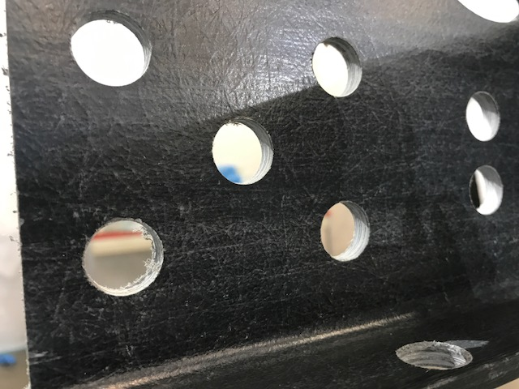
DC Production – Parts Cleaning
This step will be done in a clean and lockable secure area
All members will wear disposable lab coats, masks, hairnets and powerfree gloves
Deburr and defiber the machined holes of the FRP parts with fine sandpaper, vacuuming the fiber as sanding
Clean FRP I-beams and connecting plates with simple green without color and de-ionized water, using Kimwipes
Dry and remove moisture from I-beams w/ hot air heat gun
Clean small parts – threaded rods, nuts, screws, slip-nuts and inserts –in an ultrasonic cleaner w/ ethanol
Inspect cleanliness of each part after the above processes
Store cleaned parts on the shelf in the cleanroom

Slide 8
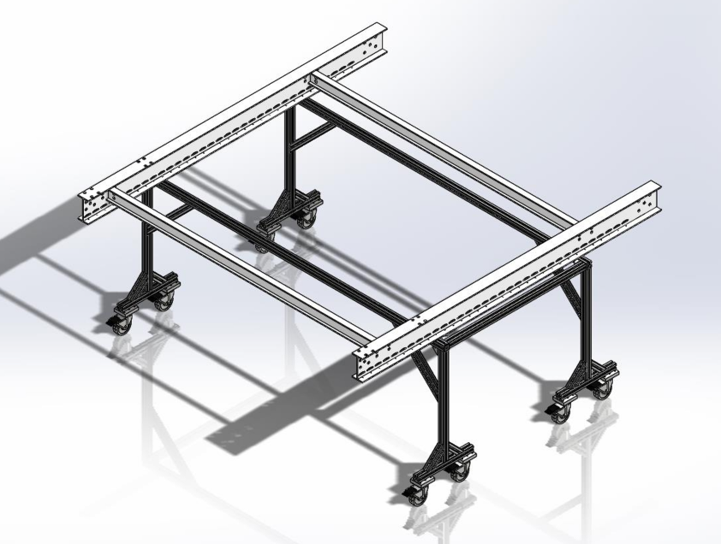
DC Production – Assembly
This process will be done in a class 100,000 clean room. All members of the assembly team will wear disposable lab coat, mask, hairnet and power-free gloves
Connect two 6” primary I-beams w/ two 3” horizontal ones using the L-brackets and FRP threaded rods and nuts on the A-frame based assembly stand
Slides the aluminum field shaping profiles through the corresponding cutouts one at a time and secure each using slip-nut to one side of the frame near the bent part
Check the alignment, straightness and part fitness of the submodule

Slide 9
Production – Disassembly
This process will be done in a class 100,000 clean room. All members of the assembly team will wear disposable lab coat, mask, hairnet and powerless gloves
For shipping, we will disassemble the DC in the following order:
Unscrew the profiles one at a time, collecting all screws and slip nuts in a bag, and store the removed profiles on the shelf
Unscrew FRP nuts from the threaded rods to disassemble the horizontal I-beams from the primary ones, collecting all threaded rods and nut in a bag
Clean all small parts in ethanol in an ultrasonic cleaner to ensure cleanliness and dry off the ethanol and put them in ziplock bags
Inspect the I-beams for cleanliness and any damages

Slide 10
Production – Packaging & Shipping
This process will be done in a class 100,000 clean room. All members of the assembly team will wear disposable lab coat, mask, hairnet and powerless gloves
Packaging process will be done as follows:
Collect zip-lock bags for screws and slip-nuts for profile mounting
Collect zip-lock bags for FRP threaded rods and nuts
10% spare parts will be included in the package to ensure the assembly of the sub-module in case they are lost
Stack 6” I-beams and 3” I-beams as small a packing factor as possible and mount zip-lock bags for small parts and shrink wrapped multiple layers to ensure isolation from moisture during storage ➔ as small as 165mmx160mmx2000mm
Each package will contain the list of included parts and be clearly tagged w/ the type of the sub-module (top, middle and bottom) and to ensure proper identification of the locations of the specific sub-module
The package is then moved into a separate semi-clean room with a lock for storage until shipping

Slide 11
Sub-module Construction Sequence
In order to prepare strategically for installation into the cryostat, we will build the three sub-modules for one module at a time
Each sub-module package in shrink wrap will be stored in a clean and secured area
Ship out to CERN four module worth of sub-modules – 12 sub-modules - at a time, ideally one in early September and in mid to late October 2017
The actual shipping dates could be adjusted based on the situation at CERN but the shipping must complete prior to the Thanksgiving to avoid holiday rush and to ensure the safe arrival at CERN prior to the holiday shutdown

Slide 12
DP DC Production Status
Production readiness documents in review
QC Procedure
QC Checklist
Hazard analysis
Vendor documents
Production readiness review scheduled on May 15 but requested an earlier visit to begin production of I-beams earlier to avoid delays of production I-beams delivery
Assembly facility preparation complete
All parts for module-zero delivered
Two I-beam vendors identified
40 Aluminum profiles with 45 degree bend at hand
All members of production team in place
Module-zero in production in progress with initial QC measurements
Initial flatness inspection looks good, and the hole dimensional measurements are within the 1mm tolerance
All I-beams cleaned but requires a deburring and defibering process
Profiles are being cleaned
Four profiles put into the slots and screwed in for a trial fit

Slide 13
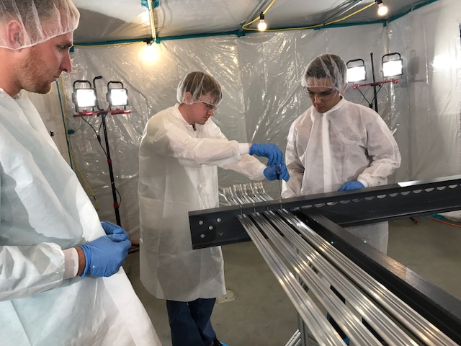
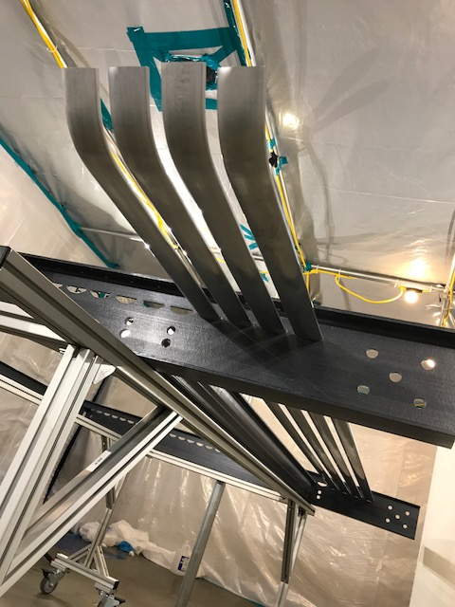
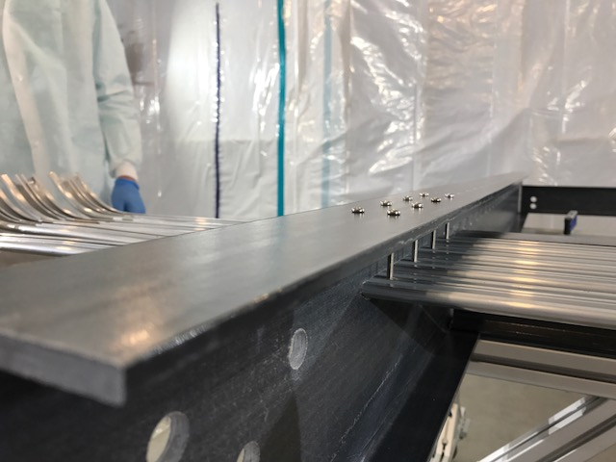
DC Module Zero Production

Slide 14
Production of Bent Profiles (FP)
Two production chains identified:
Full production by manufacturer, MIFA (NL)
Extrusion, bending, conductive coating
Slightly more expensive than Alexia: ~25-30 Euros/profile
Less risky: defects and mistake absorbed by manufacturer, included in cost.
Different manufacturers for each production stage
Extrusion: Alexia (Italy); bending: CERN; coating (Finland)
Less expensive: 5 Euros/profile (extrusion), ~10 Euros/profile (bending: manpower), 3 Euros/profile (conductive coating); + some transport costs
Additional risks due to transport requires more spare parts (to be evaluated)
Choice to be evaluated on quality of prototypes:
Extrusions (MIFA, Alexia):
Very similar profile shape accuracy and surface finish
Bending procedure tested at CERN on 50 profiles (4 man-days):
No loss, ~mm accuracy on straight section ~1 degree bending accuracy,
waiting for MIFA prototypes (mid May) for comparison
Conductive coating (SURTEC) is a well established process:
Company selected based on best offer

Slide 15
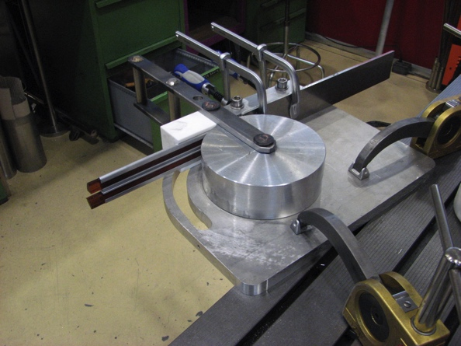
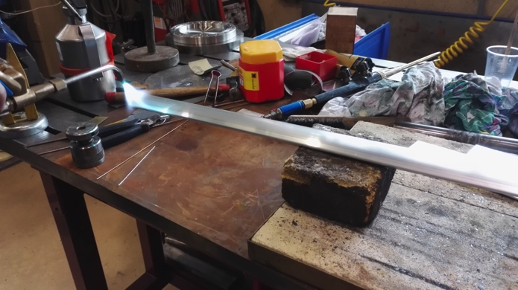
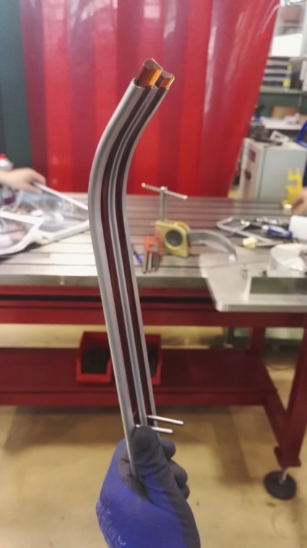
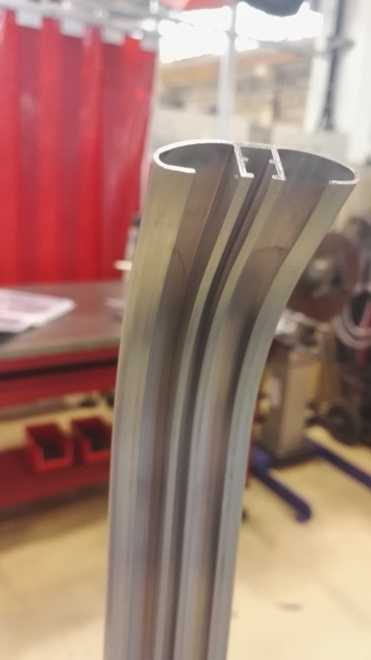
Al Profile Bending
Dedicated bending tool designed constructed and tested at CERN main workshop guaranteeing ~1 mm accuracy in straight segment length and ~1 degree accuracy in bent angle
Al profile end heated for few minutes to make it locally (10 cm) malleable
Polymer strips (density and elasticity accurately tuned) matching the profile shape are inserted to ensure that profile keep the shape during bending.
~50 profiles per day can be bent by two people

Slide 16
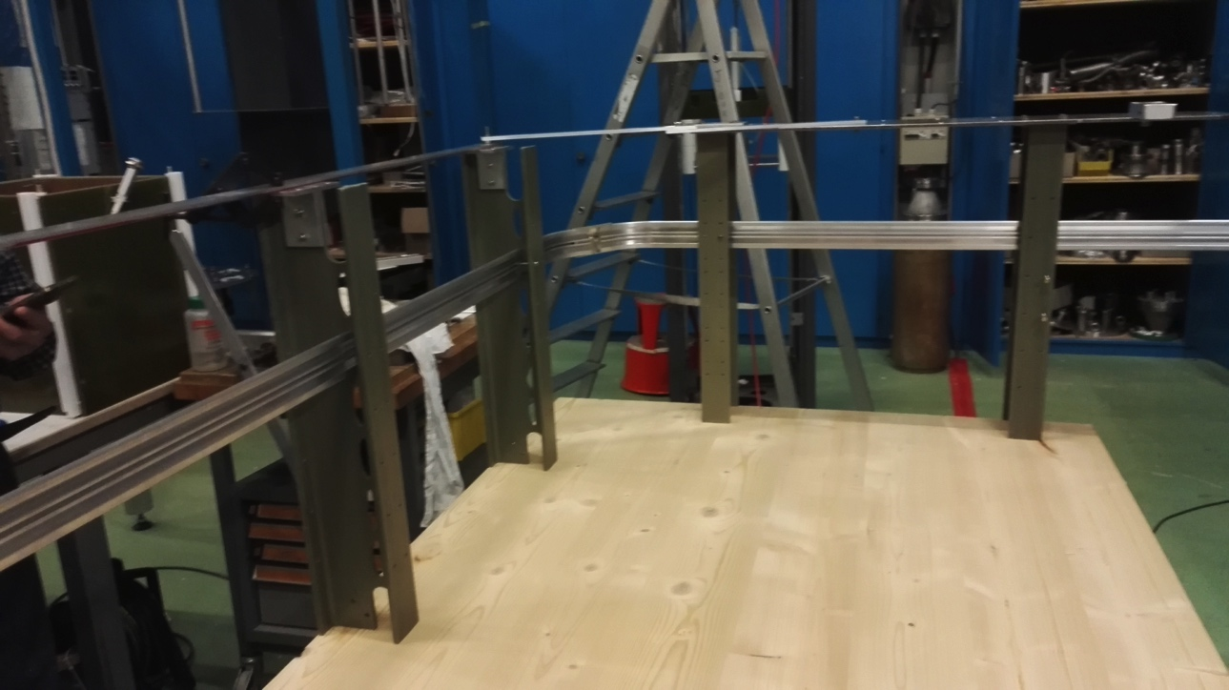
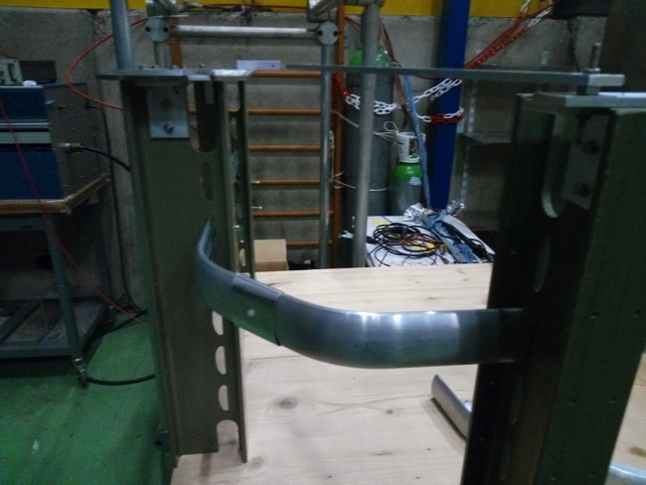
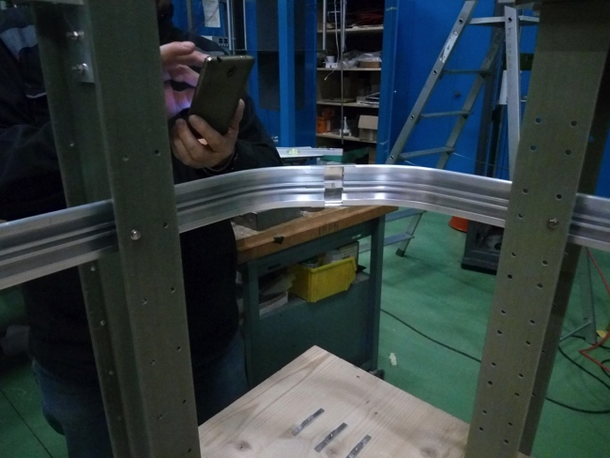
Test stand at CERN
50 3m long profiles bent at CERN
One corner assembly tested at CERN few few elements using home roll formed clips and home made joining bars
profile alignment and bending angles successfully checked
Full set of profiles sent to Texas to be used for Module 0 and pre-constructions of I-beam structures

Slide 17
Clips/Profiles production schedule
Clips production by MIFA:
Prototypes ready and being sent to CERN for evaluation (present week)
Final production in ~ 1 month from our green light
800 pieces + 400 spares (large spare number driven by the requirement on shape accuracy that can be degraded during assembly: to be verified bin prototype assembly)
Bent profiles:
Preferred choice is full production by MIFA:
if prototypes quality is similar or better than those bent at CERN
Full production available at CERN by early September (tbc):
800 pieces + 5% of spares
Alternative production chain has similar schedule, but requires CERN manpower (~2 people fully dedicated to bending for one month) during summer:
Possible clash with single phase drift cage assembly
Extrusion and coating time: < 1+1 months including transport

Slide 18
DP FC Assembly Facilities @ CERN
DP field cage modules assembly can be performed in EHN1:
In the clean room buffer (CRB) in front of the TCO
Vertically in a dedicated clean area (class 100000) at the ground level
Alternatively the clean room in Bdg. 182 is being refurbished for the assembly of the 28 SP Field cage modules 3.6m long and 2.3/1.5m wide :
Assembled horizontally on optical table for best planarity and QA/QC tests
Stored and transported vertically in appropriate clean bags.
SP module assembly scheduled during July/August
All these facilities could be re-used for the assembly/storage/transport of the DP field cage modules starting from September.
Man-power:
CERN will provide adequate man-power as for the SP case:
At least 3 people fully dedicated to field cage assembly for 1 month (1 module/day).

Slide 19
Material Reception and Assembly QA/QC
Procedures described for pre-production will be strictly replicated at CERN
See slides 6-to-8.
In particular Al profiles will be inspected for deformations, surface damage, bend angle, straight segments length.
Conductive coating (few microns) is invisible: handling care to avoid outer surface scratches
Clips will be inspected for uniformity of surface shape and matching with AL profile shape
No cleaning required (but it will be done as described on small components in case of need).
QC after assembly:
Module planarity
Bent segment alignment
Bent angle uniformity
Mechanical locking of profiles on supporting beams
Transport (in case of assembly in bdg 182):
Dedicated supporting structures and protective bags.

Slide 20
Conclusions
The protoDUNE DP DC uses the same modular concept using the same extruded aluminum profiles
Slightly different design from SP due to the fact that field cage and the cathode hang from the ceiling
Production/QC/QA facility at UTA is in operation
Production readiness review documents ready
Module-zero production in progress
Bent profiles are being prepared at CERN for the final assembly before the installation in the cryostat
Two final assembly facilities identified

