Slide 1
The Light Detection System of protoDune DP
Thorsten Lux
On behalf of CIEMAT and IFAE

Slide 2
Outline
Motivation
Baseline design
Components of the light readout system:
PMTs
Bases
Support structure
Wavelength shifter
High voltage system
Cabling
PMT monitor and calibration system
Objectives
Conceptual design

Slide 3
Light in protoDUNE DP
Anode (strips) 0V
Light sources:
S1 during ionization process in the LAr
S2 from the high electric field regions in the gas phase, especially the LEM
36 PMTs below the cathode to measure the light
2 mm
Collection field 5kV/cm
1 cm
S2: 128 nm
Extraction field 2-3kV/cm
Grid
Drift field
0.5 – 1 kV/cm
S1: 128 nm
e-
6 m
Cathode (~600 kV)
PMTs (provide t₀)

Slide 4
Motivation
Study of the light distribution in view of the DUNE far detector
S1 and S2 light distribution (spatial and temporal)
Light attenuation
Light produced by the different beam particles
Testing the triggering based on light
Tagging of cosmic muons which enter the TPC within readout window

Slide 5
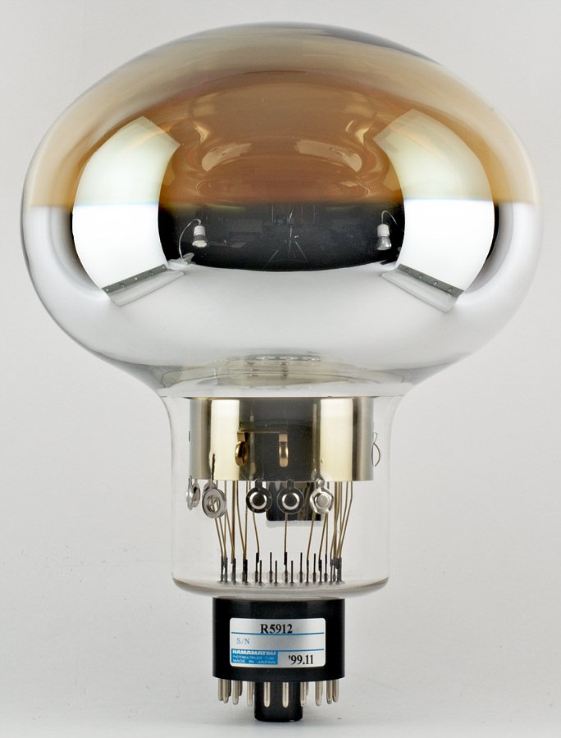
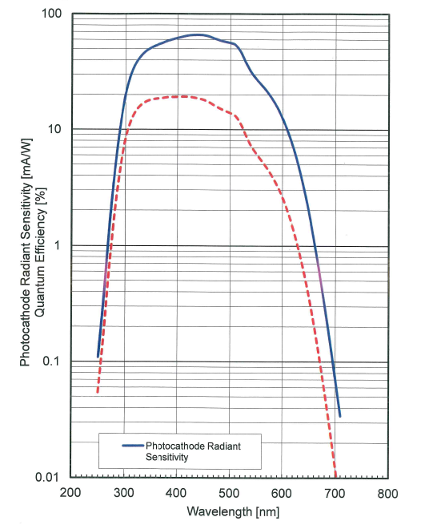
PMTs
R5912-20 MOD LRI from Hamamatsu
Same dimensions as ICARUS
Diameter: 202 mm / 8”
14 dynodes => gain up to 10⁹
Q_{eff}@420 nm: at least 15%
Qeff of IFAE reference PMT

Slide 6
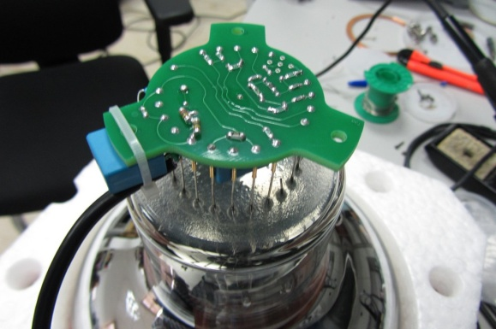
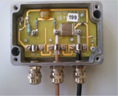
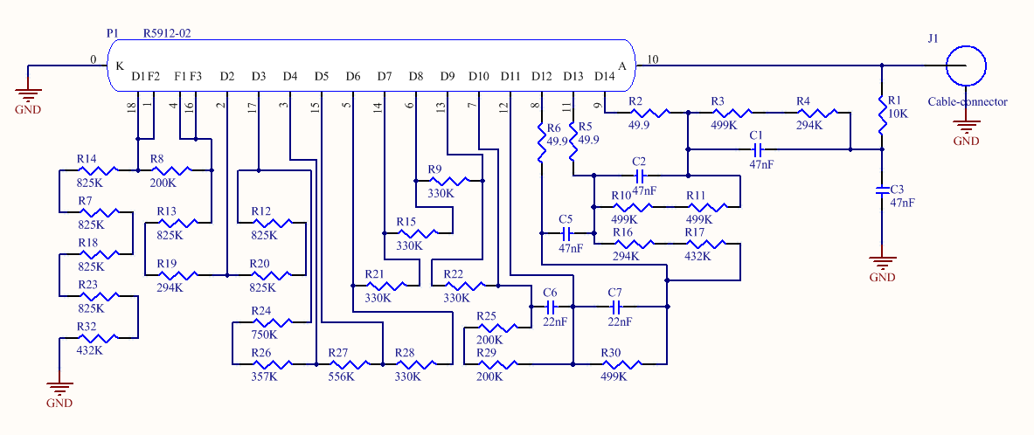
PMT Base
Different PMT bases were studied:
Positive base was selected: 1 cable base (positive HV) + ext. splitter
GND
Bases currently produced for starting PMT characterization (see Antonio Verdugo’s talk in next session)
Positive power
supply
+HV
+HV
,+HV
Splitter
Front-end
Decoupling capacitor
& power supply filter

Slide 7
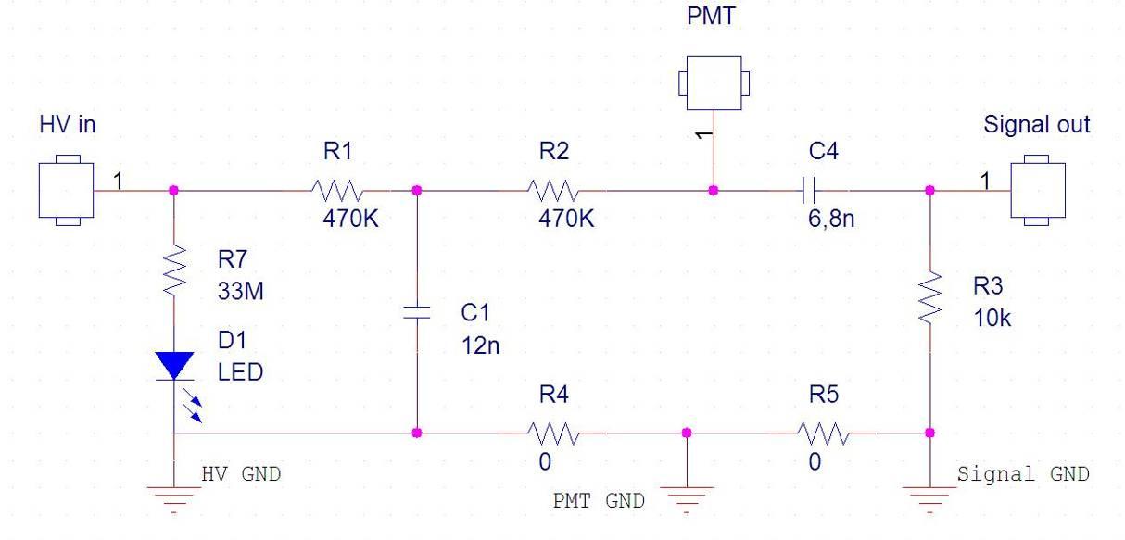
PMT Splitter
Based on experience from Double Chooz
Tested intensively in LN2
2 PMTs of 311 also operated with this splitter
HV power
supply
Splitter
Front-end
Power supply filter
Signal decoupling

Slide 8
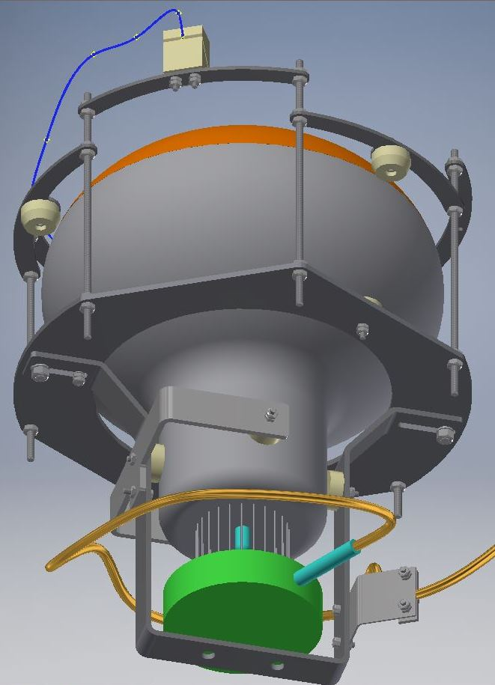
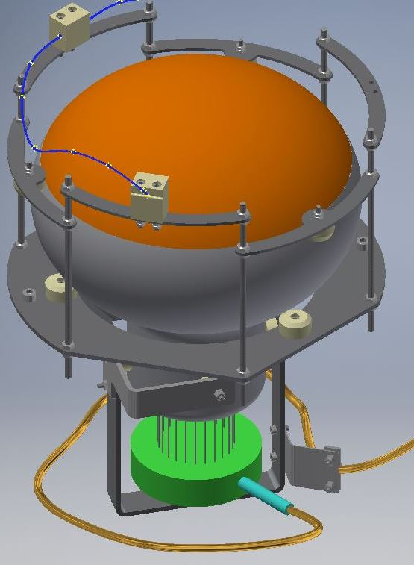
PMT Support Structure
Assembly Composed by:
Hamamatsu PMT
Positive base
Support frame structure of 304 L Stainless steel and Nylon 6.6 pieces assemblies by A4 stainless steel screws
Design was driven to allow both, direct coating or placing PMMA plate coated with TPB in front of PMT
Fixation support

Slide 9
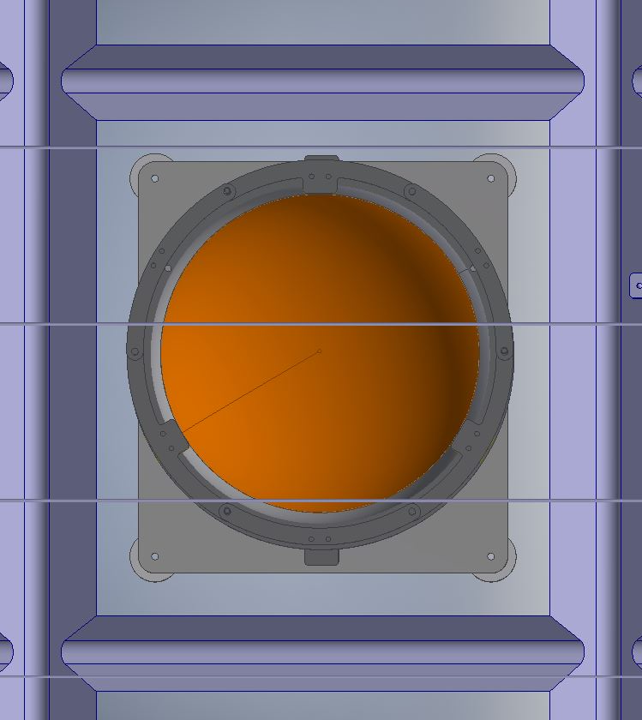
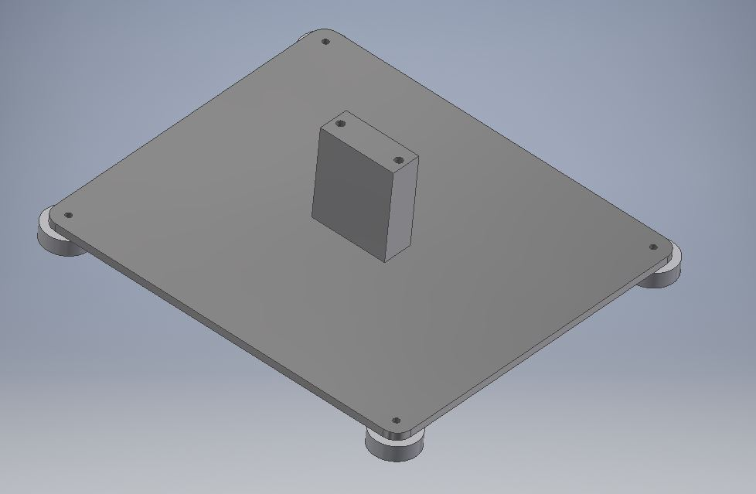
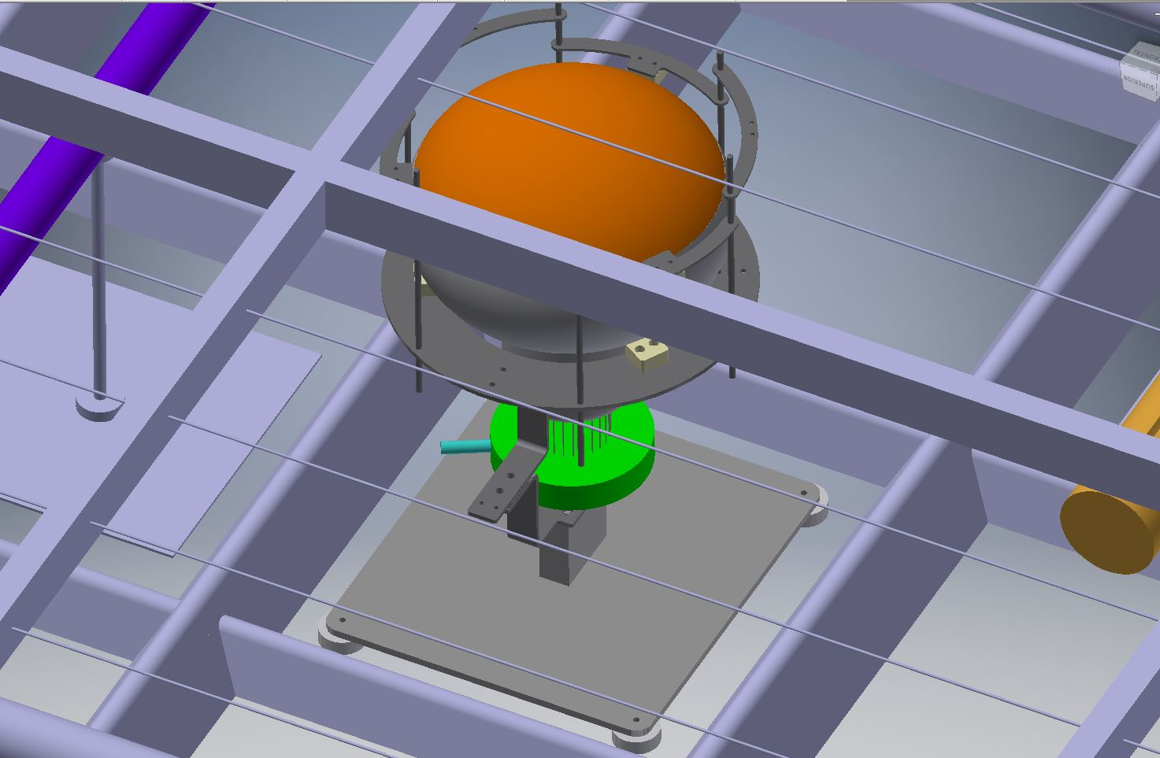
230
Weight of the PMT +support & base ~6,5 kg.
Buoyancy force of the system ~5,5 kg.
=> Apparent weight when immersed ~1 kg
Tests in 1 bar overpressure (corresponding to 7 m of LAr) and cryogenic temperatures performed.
255
Stainless Steel support base of the PMTs:
4 PTFE Ø30 mm contact pieces on the membrane floor.
800 mm

Slide 10
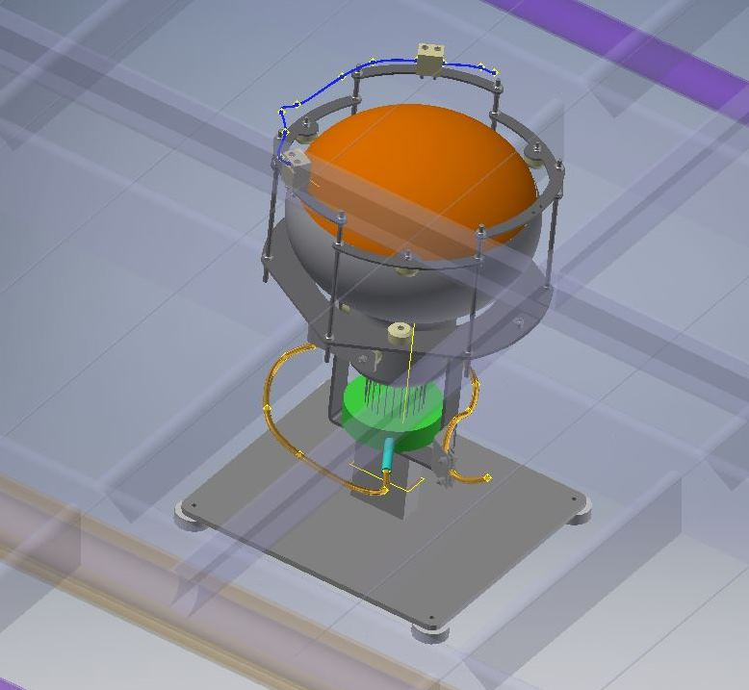
PMTs inside protoDUNE DP
The PMT will be placed on the ‘square’ position between the membrane corrugations.
36 CIEMAT-IFAE PMTs will be installed

Slide 11
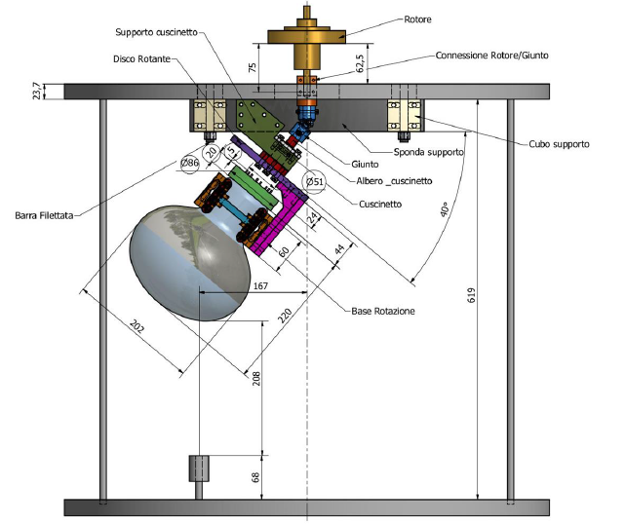
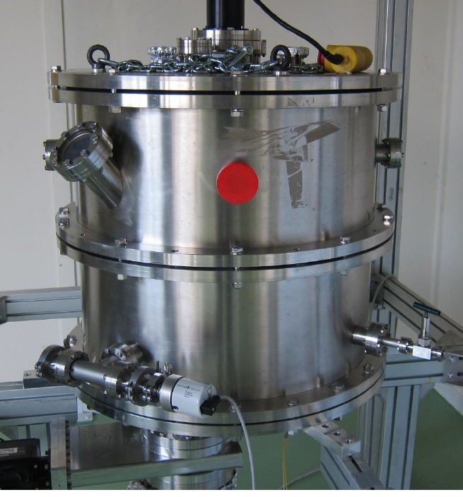
TPB Coating
PMTs will be directly coated with TPB
Coating with WA104/ICARUS facility at CERN
Thickness of 500 nm as for ICARUS
Available between September and December 2017
PMTs will be shipped from CIEMAT to CERN 09/2017

Slide 12
HV System
Based on CAEN A1536D modules:
12 channels per module
0 ÷ 3 kV output voltage
1 mA current full scale, with 50 nA resolution
100 mV Voltage Set/Monitor resolution
Module with 6 positive and 6 negative channels used in 311 detector

Slide 13
PMT related Cables
To connect the PMT with the HV power supply and the electronics the following cables are needed:
RG303 coaxial cable inside the cryostat and between cryostat and splitter box
RG58 coaxial cable between splitter box and electronics
HTC-50-3-2 SHV coaxial cable between HV power supply and splitter box

Slide 14
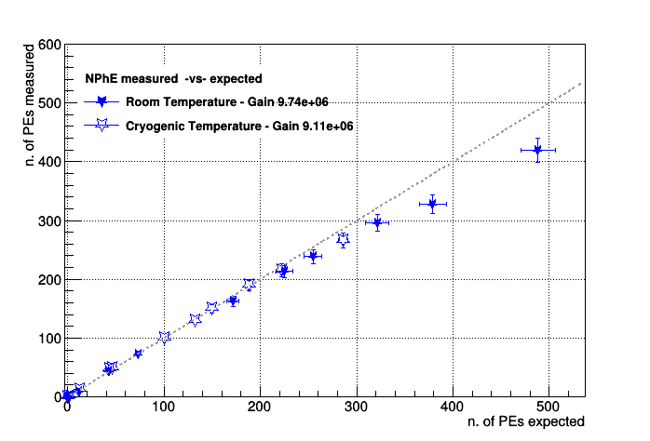
PMT Monitor and Calibration System
Objectives of the system:
Functionality test of the PMTs independent of TPB
Linearity response of the PMT
Gain measurement with single photo electrons

Slide 15
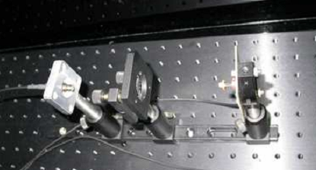
PMT Monitor and Calibration System
Air
X2
X2
Cryostat
black box with light source outside of cryostat
2 fibers going to cryostat
each splitting into 20 micro fibers (~200 μm thick)
either directly on top of cryostat or at bottom of cryostat

Slide 16
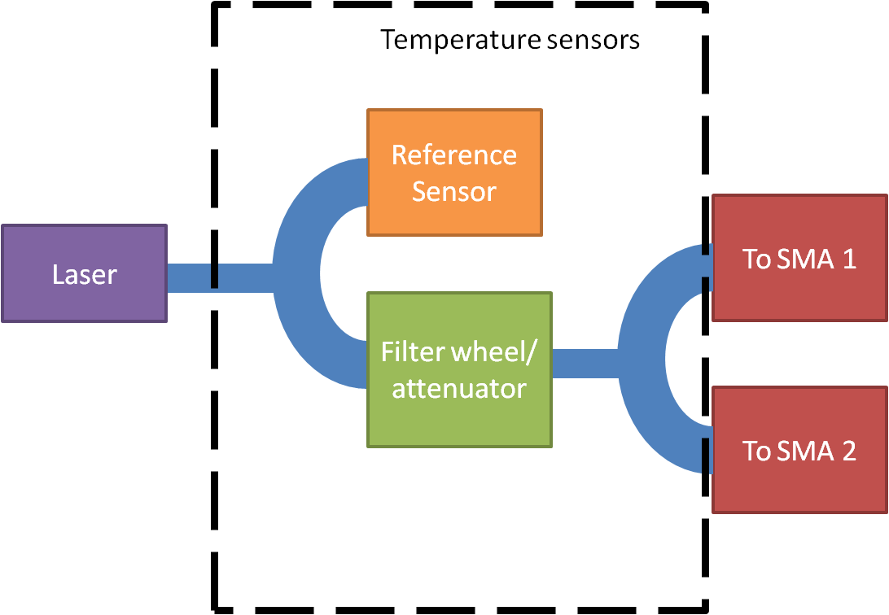
Light Monitor and Calibration System
Laser (Class 3b):
405 nm wavelength
installed in DAQ barrack
laser output split between reference sensor and PMTs
2 opticial fibers (~30 m) between black box and cryostat
LED with Kaputschinsky driver:
465 or 525 nm wavelength
installed directly on optical feedthroughs
possibly reference sensor next to it
similar to Microboone approach but one LED for 18 PMTs

Slide 17
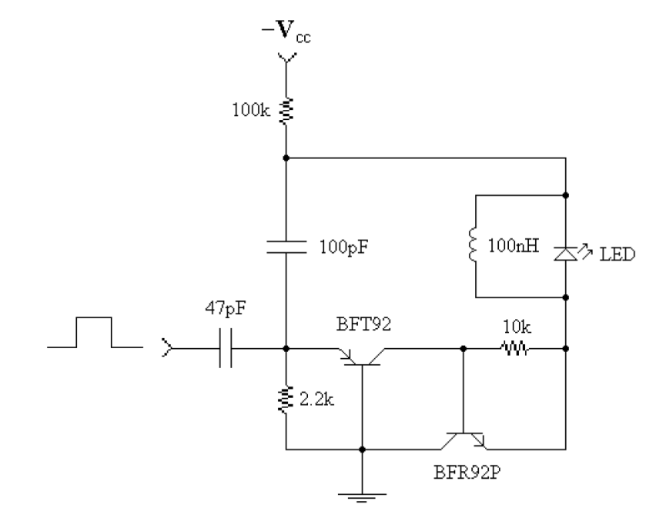
Light Monitor and Calibration System
Light sources:
Laser: P405-SF10
Kaputschinsky LED driver
Optical fibers/bundles under consideration
Black box – cryostat: SM300 (Thorlabs)
Cryostat top – bottom: FP1000ERT (Thorlabs)
Multi-bundle:
Fan-Out Fiber Optic Bundles (Thorlabs)
Bare multi-fiber (i-fiberoptics)
Reference sensors (still optional):
Powermeter: PD300-UV de Ophir
PMT/SiPM

Slide 18
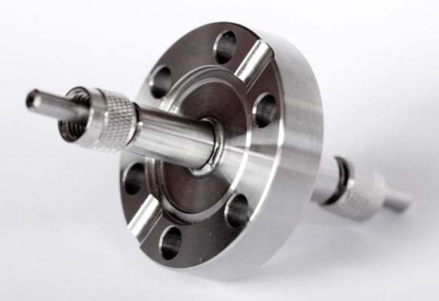
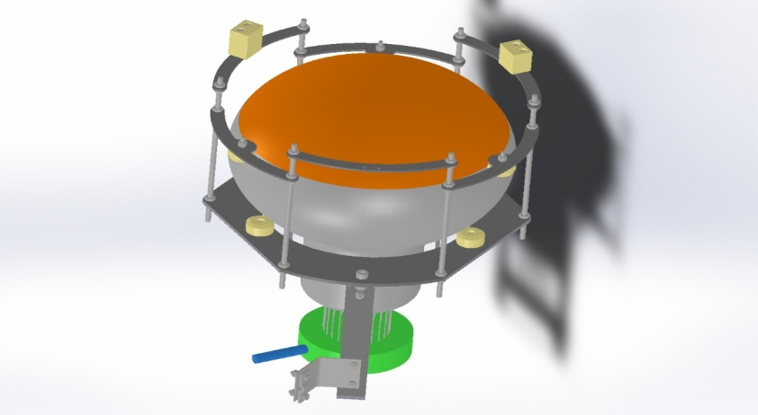
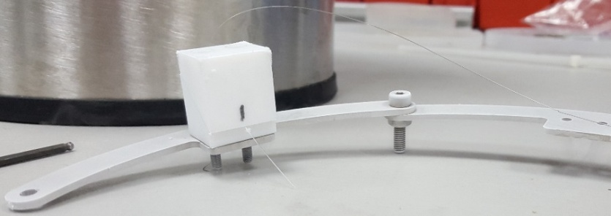
Light Monitor and Calibration System
Optical feedthrough:
V2H6S (Thorlabs)
SMA-SMA
Fiber fixation to PMT:
design adapted to hold 200 μm fiber
first prototype built
already tested in LN2 and fiber holds position

Slide 19
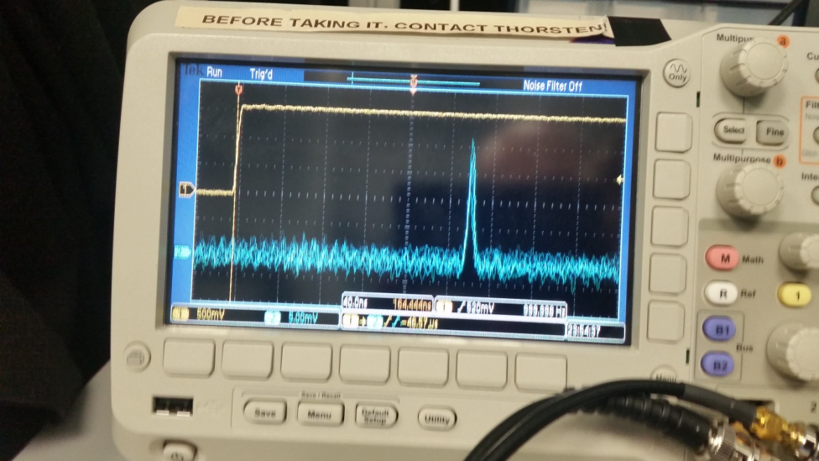
Light Monitor and Calibration System
Decision taking process (until 10/2017):
Testing performance the different options under consideration at room and cryogenic temperatures
Other factors beside performance:
Safety regulations in the case of the usage of a laser
Accessibility during operation for maintenance
Costs
Measured power [nW] at end of each fiber vs LED voltage
Light pulse at end of bundle fiber (width: ~12 ns)

Slide 20
Summary
protoDUNE DP light system will be based on 36 PMTs
Overall design of the system well advanced
Production of bases already completed for characterization of PMTs at CIEMAT
Support structure was designed to place PMTs inside the cryostat and to hold them in place
TPB coating will be done at well established ICARUS setup
Light monitor system design still ongoing
Currently various tests ongoing at IFAE and CIEMAT to decide some last details of the calibration system by July 2017. No impact on the installation time-schedule

Slide 21
Backup

Slide 22
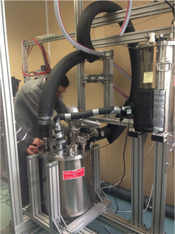
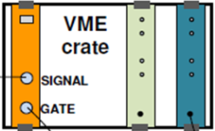
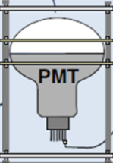
Experimental Setup@CIEMAT
Designed to test one PMT immersed in LN2 with a configurable amount of light
Laser pulsed with =< 1 ns pulses
Filters box
Fiber splitter
Laser (405 nm)
Optical fiber
Fixed Filter
LED & Laser controller
Diffuser
(to provide homogeneous illumination)
Signal from PMTs
QDC
LabView
PMT under test
R5912-02
PMT monitor
R6041-506 @ room temp
(to keep track of possible
variations in the lighting system)
Dewar for LN₂

Slide 23
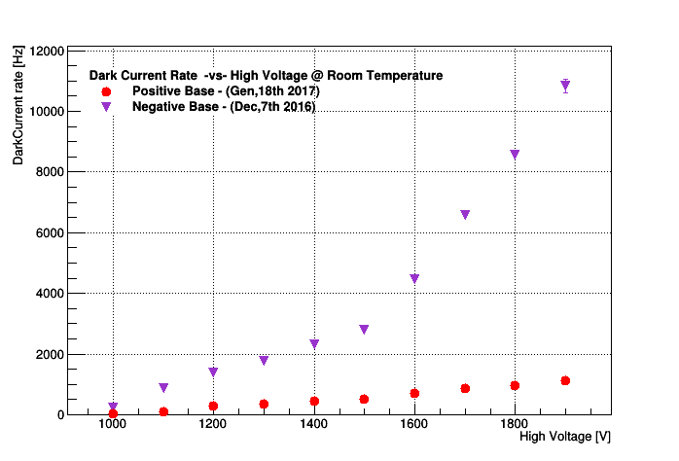
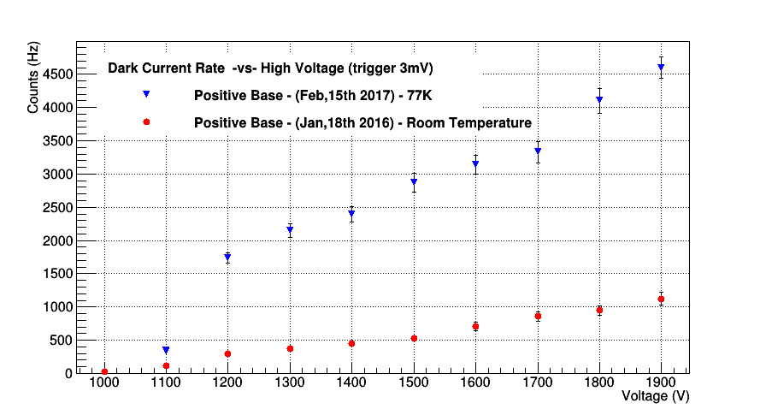
PMT Characterization@CIEMAT
Dark current (DC)
Threshold = 3 mV
Threshold = 3 mV
Positive base lower DC than negative base at RT
DC at CT higher than at RT
⇒ Positive base will be used for protoDUNE DP

Slide 24
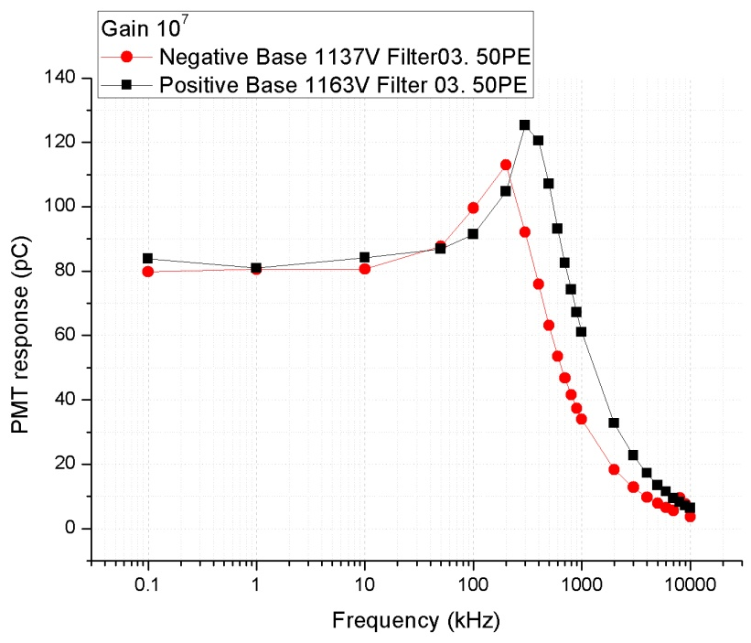
PMT Characterization@CIEMAT
PMT response vs pulsed light frequency
Over-linearity
RT
saturation curve
There is a characteristic saturation curve.
Over-linearity effect is observed previous to the PMT saturation.
Negative base saturates at lower frequency than the positive base.
High frequency decreases the PMT gain at cryogenic temperature.
Notes:
24

Slide 25
Fibers Attenuation Curves
Aim is to choice fiber and connector combinations which minimize light losses:
SMA300 => 70 dB/km
Losses in fiber at 405 nm larger than at 465 or 525 nm
i-fiberoptics
FP1000ERT

Slide 26
Light Monitor System
Beam splitler based on fiber coupler from Thorlabs (ordered)
Reference light source (already at IFAE):
Powermeter (default if sensitive enough for pulsed mode)
PMT or SiPM (alternative)
Multi-bundle fiber ordered and delivered this week to IFAE, further tests at CIEMAT:
Mechanical / robustness with the final mounting
Attenuation / Maximum light transmission
Light distribution over the different fibers
Long terms stability
Direct coupling to feedthrough or at bottom of cryostat?

Slide 27
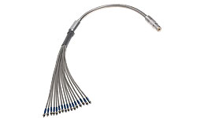
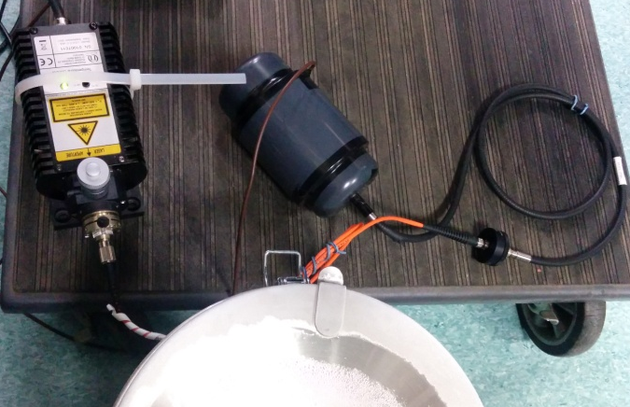
Light Monitor System
Connector performance Goal: Decide if the bundle at the bottom of the detector or directly attached to the flange at the top.
Next: Characterize the bundle and new connectors to determine the light output difference among fibers (bundle ordered).
z
vs.
Measurement: Study the relative light loss due do adding an extra connector (on-going).
Preliminary results:
Big light loss observed, studying systematics.
Will measure it also with a power sensor
Laser
Filters box
LN2 dewar
PMT @ RT
Fiber w or w/o connector(s)
Laser
PMT
Fiber
LN2 dewar

Slide 28
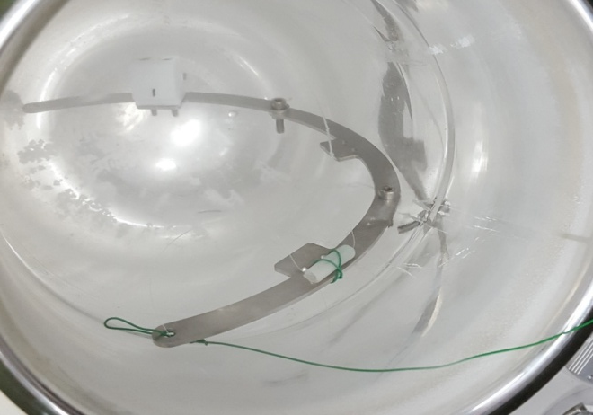
Light Monitor System
Single fiber testing at LN2 on-going at CIEMAT
Fiber Holder Cryogenic Tests Goal: check that the fibers stay in place at cryogenic temperature. Two configuration tested: one as it is, and the other, with a groove and a strip of Teflon → Both worked fine.
The fiber remains in the same position as before being submerged in LN2 and the light transmission looks fine.
We plan to measure if there is any light loss due to mechanical stress

Slide 29
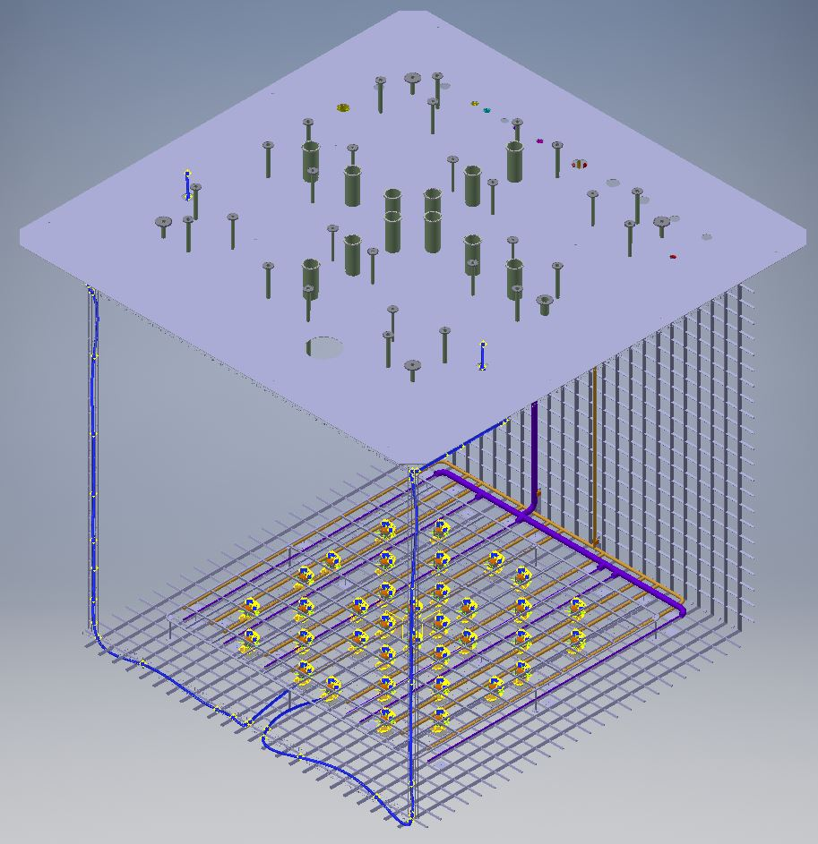
Light calibration system
2 optical feedthroughs: 2 main fibers from top to bottom of the detector
Each main fiber is split in 18 fibers distributed to half of PMTs

Slide 30
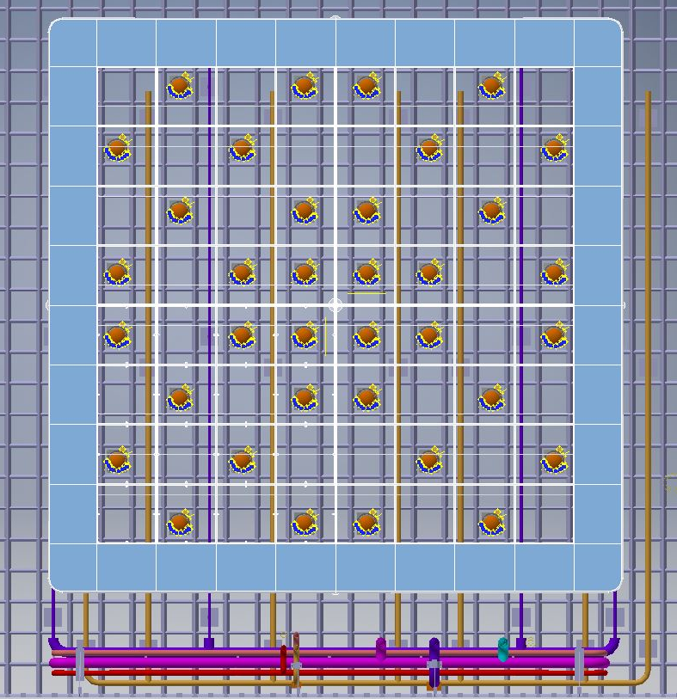
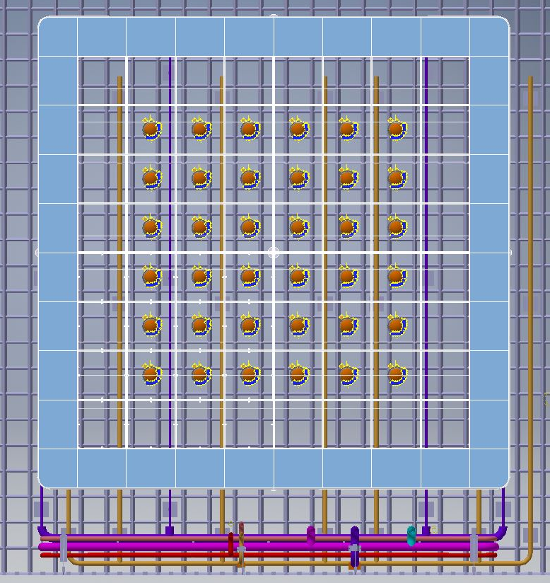
Baseline
PMTs layout in the detector:
2 options have been studied to avoid interferences with filling tubes and to center the PMTs in the cathode frame structure.

Slide 31
New base for WA105 PMTs
Use of low temperature coefficient resistors (25ppm/ºC) and capacitors (C0G dielectric) to minimize variations with temperature.
Use SMD components: less volume, less inductance (no legs), easier to find the best place on the PCB.
The capacitors are placed as close as possible to the PMT pins to reduce the inductances between them to get faster pulses and less oscillations (ringing).

Slide 32
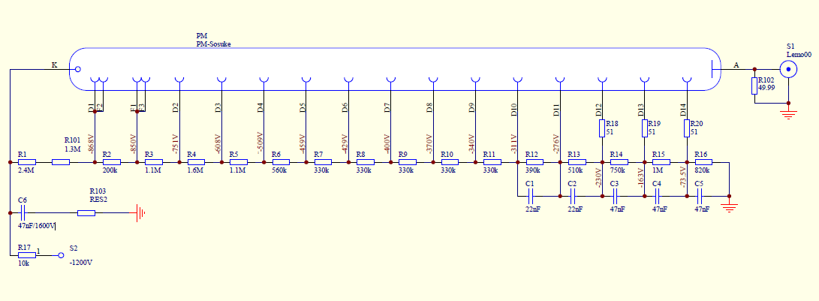
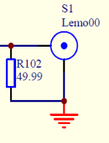
WA105 PMTs base
Real
+ HV & signal
2
4.7nF/3KV
4.7nF/3KV
Simplified

Slide 33
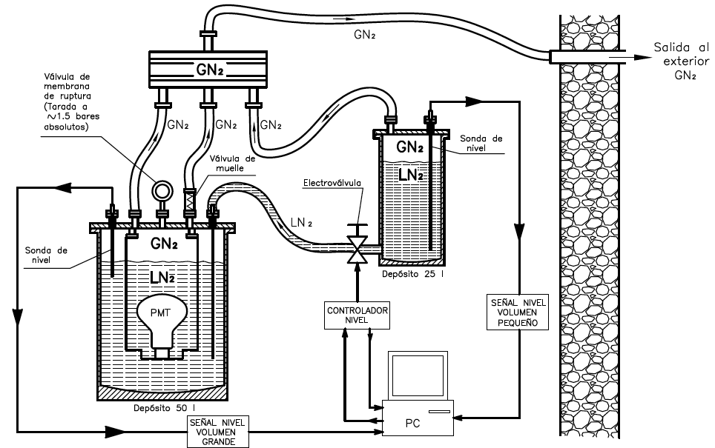
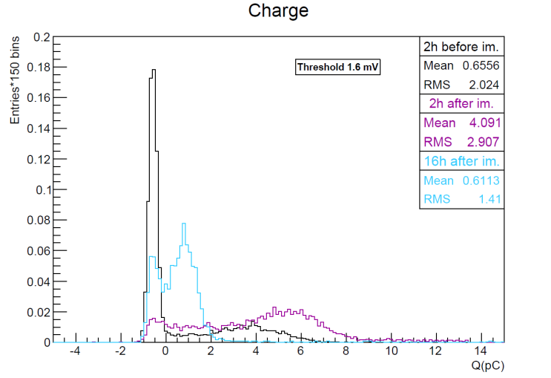
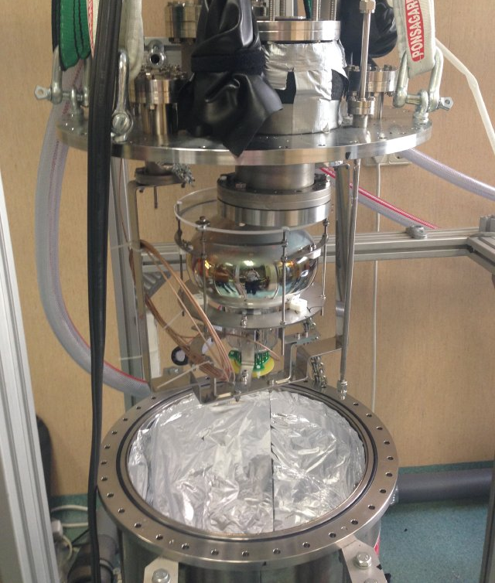
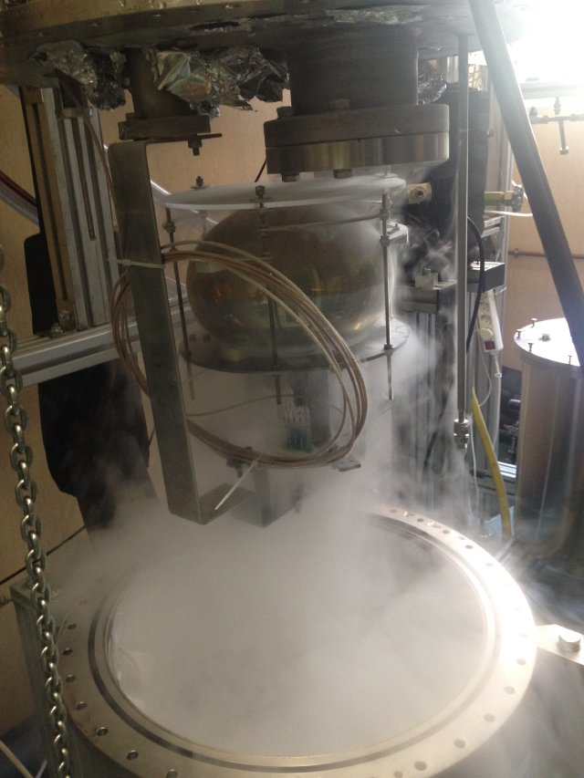
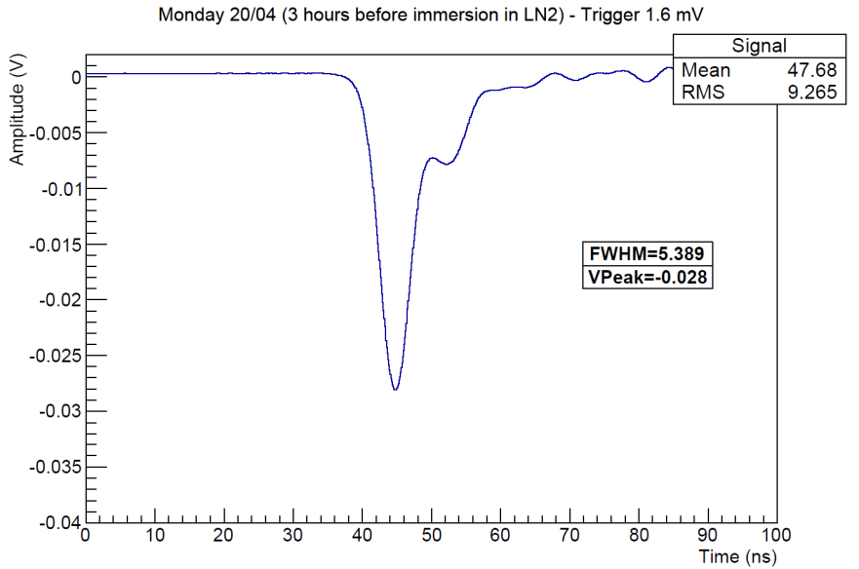
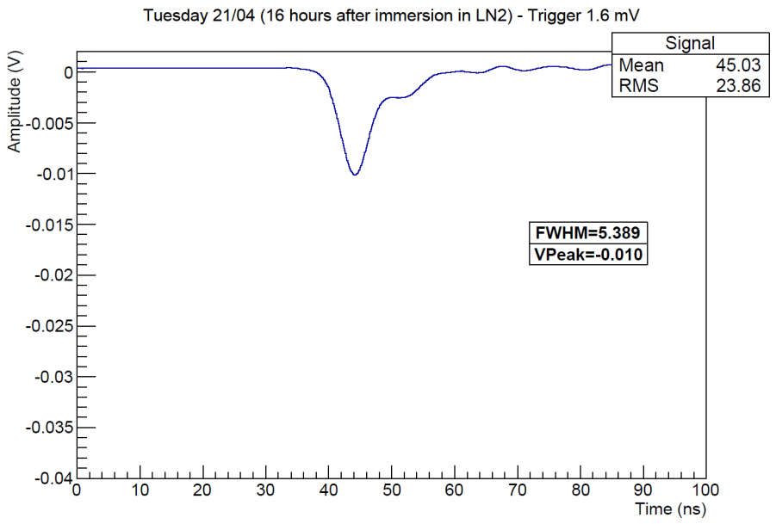
Cryogenic tests at CIEMAT
PMT system tests in LN₂:
Test of the PD system up to 1 bars (overpressure) (equivalent to ~7m LAr)
Test of PMT response in cold with single wire base: dark current, pulse shape, gain
Mechanical and pressure tests @CIEMAT
Gain evolution with time
Before immersion
16 h after immersion

Slide 34
TPB Coating
ICARUS observed excellent coating quality
Quality test of 4 to 8 PMTs in CERN setup which was already used for 311 PMTs
Available October/November 2017

Slide 35
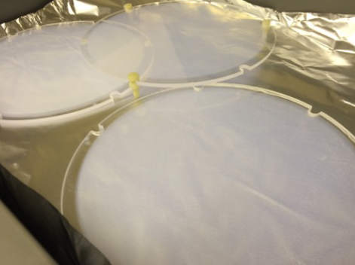
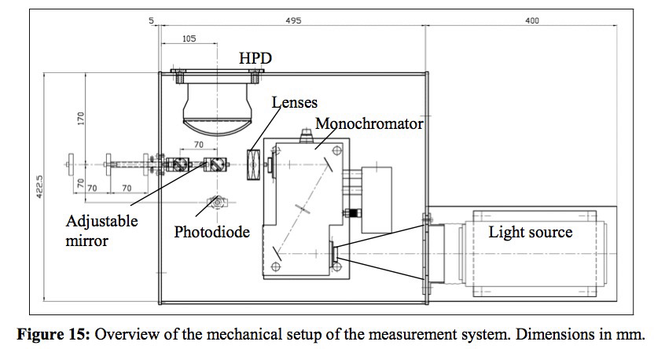
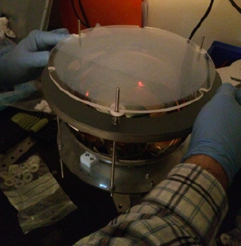
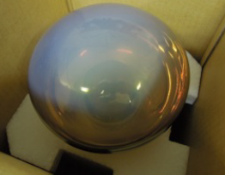
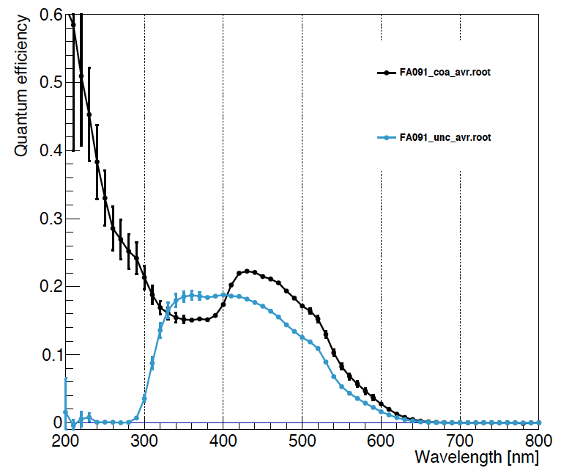
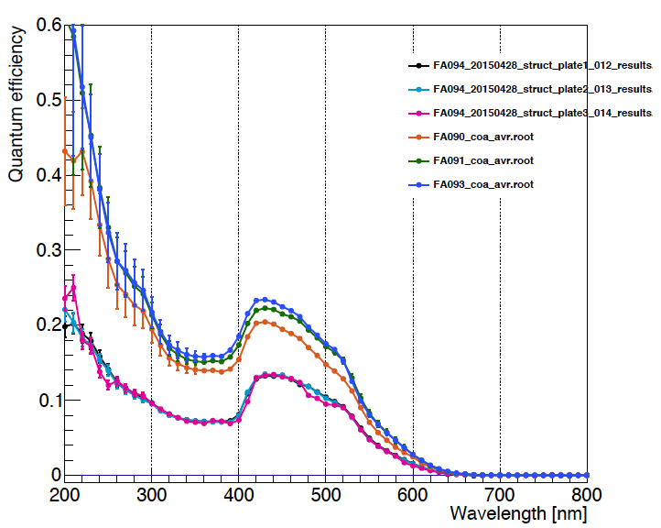
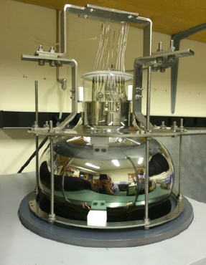
TPB coating and QE measurements @CERN
Coated PMT
uncoated
Notes:
TPB is coated in PMT glass and PMT plates by vacuum evaporation (0.05-0.2 mg/cm2)
TPB uniformity was checked

Slide 36
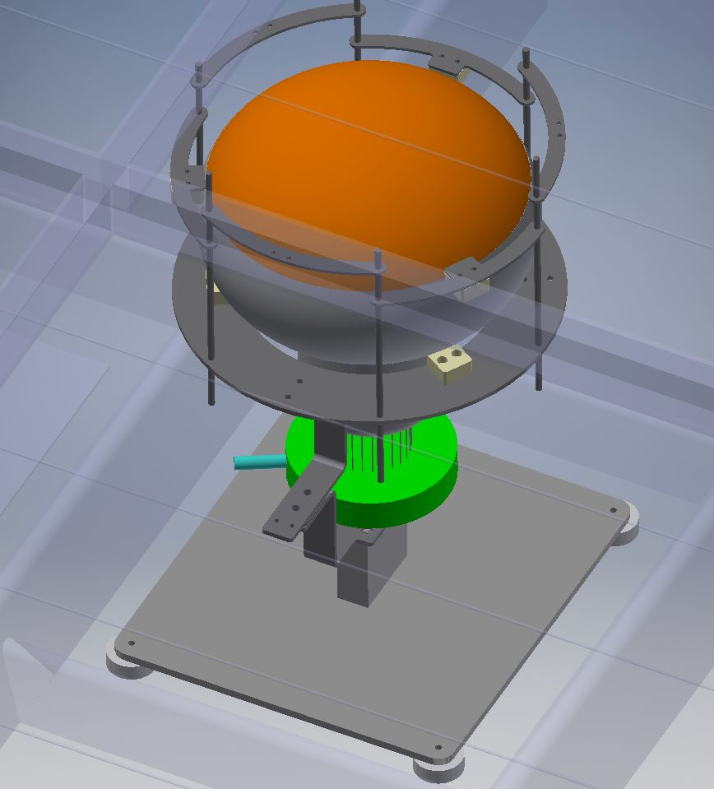
The PMT can be placed on the centre of the ‘square’ position between the stiffener of the shell .

Slide 37
Weight of the PMT +support & base ~6,5 kg.
Buoyancy force of the system ~5,5 kg.
230
From Adamo
255
800 mm
Stainless Steel support base of the PMTs:
4 PTFE Ø30 mm contact pieces on the shell.

