Slide 1
APA and Field Cage HV Connections
Bo Yu
Sept. 26, 2017

Slide 2
Outline
Features and Overall Circuit Diagrams
Design of Components
Warm Filter
SHV panel
FC Termination Board
FC Termination Cables
Failsafe Termination
Connection Validation Details
Summary

Slide 3
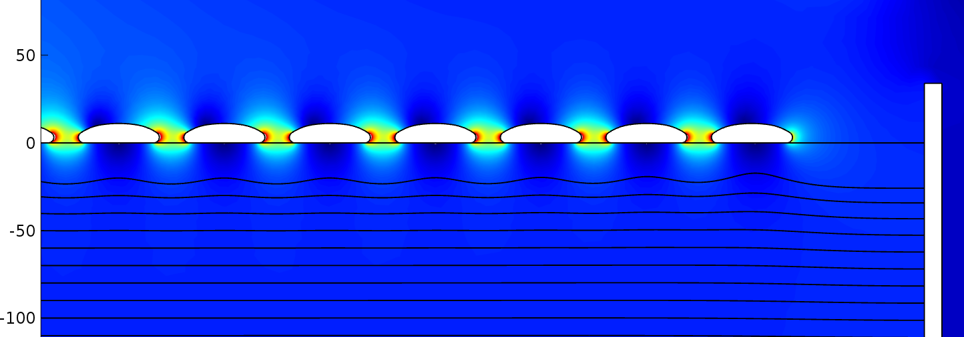
Adjusting the FC Termination Voltage
We need to maintain independent control of the drift field and the APA wire bias voltages (electron transparency)
Need to bring a bias voltage line to the last field cage profile
We want to monitor the current flowing through each divider
The center of the last FC profile is 98mm away from the grid plane. This set the voltage of the last FC profile at -5kV relative to the grid plane
The minimum bias voltage on the grid plane is -665V
So the minimum voltage on the last FC profile is -5665V.
This value is too high for SHV connectors in the ullage.
Add a series resistance between the bias line and profile #58

Slide 4
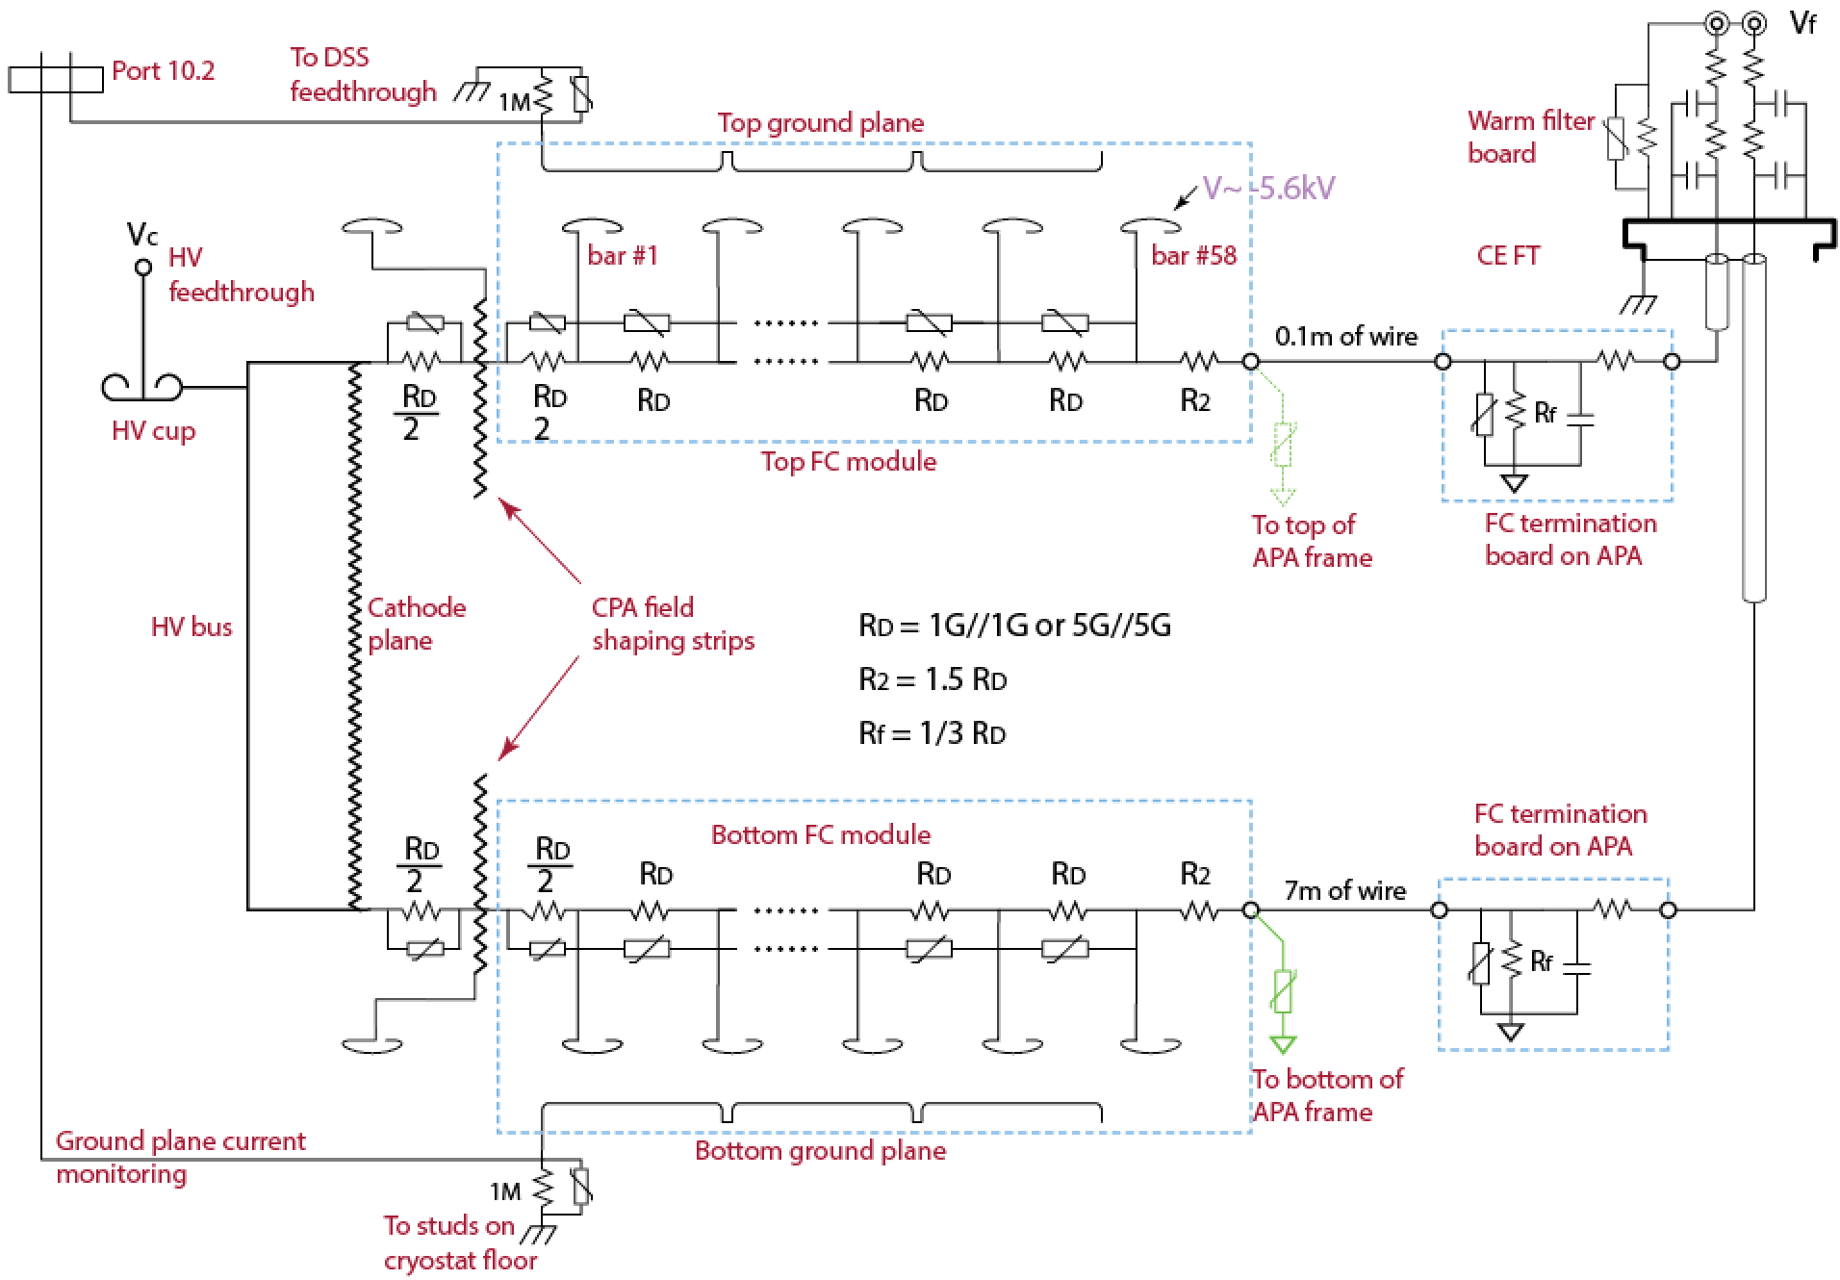
Terminating the T/B Divider Chain

Slide 5
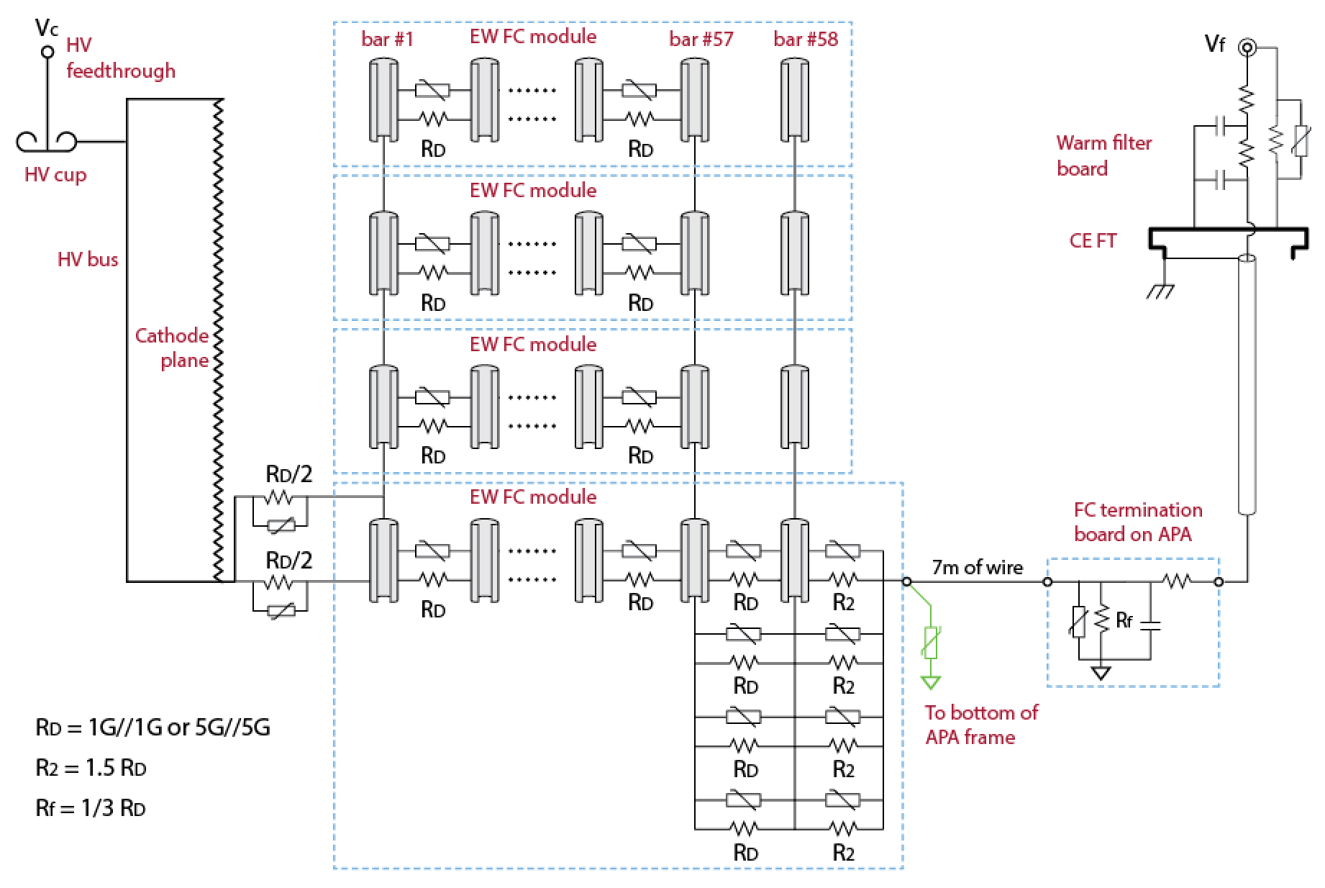
Terminating the EW Divider Chain

Slide 6
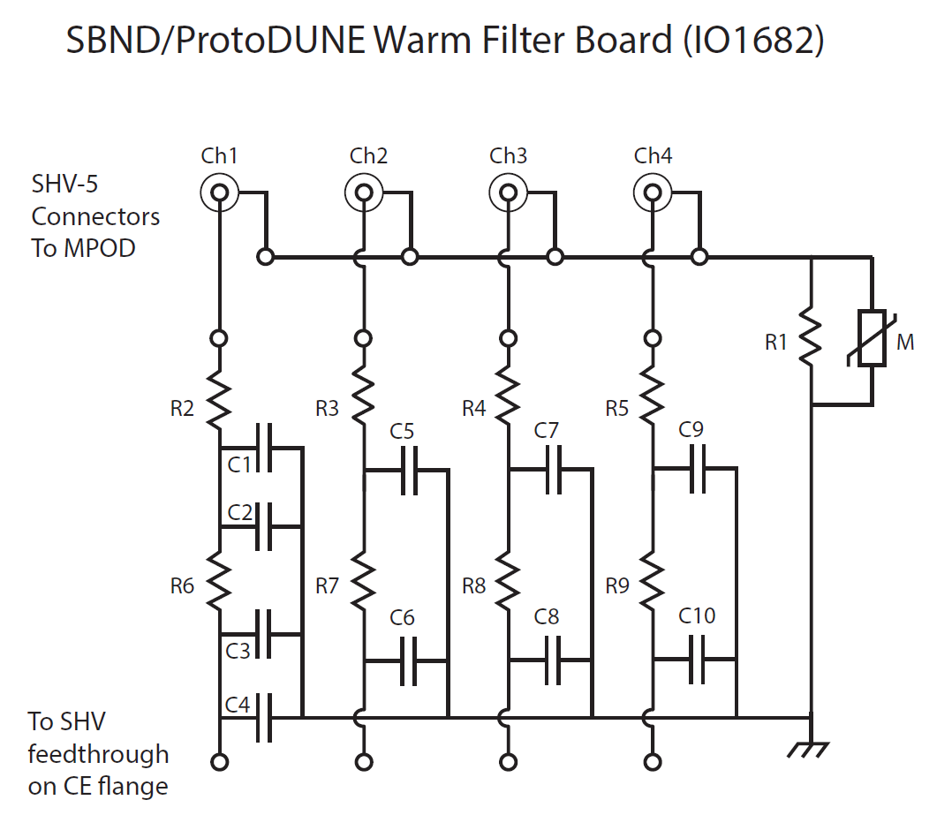
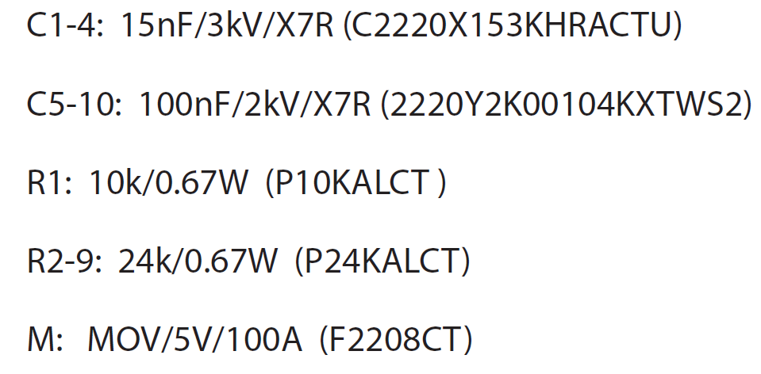
Bias Warm Filter Board

Slide 7
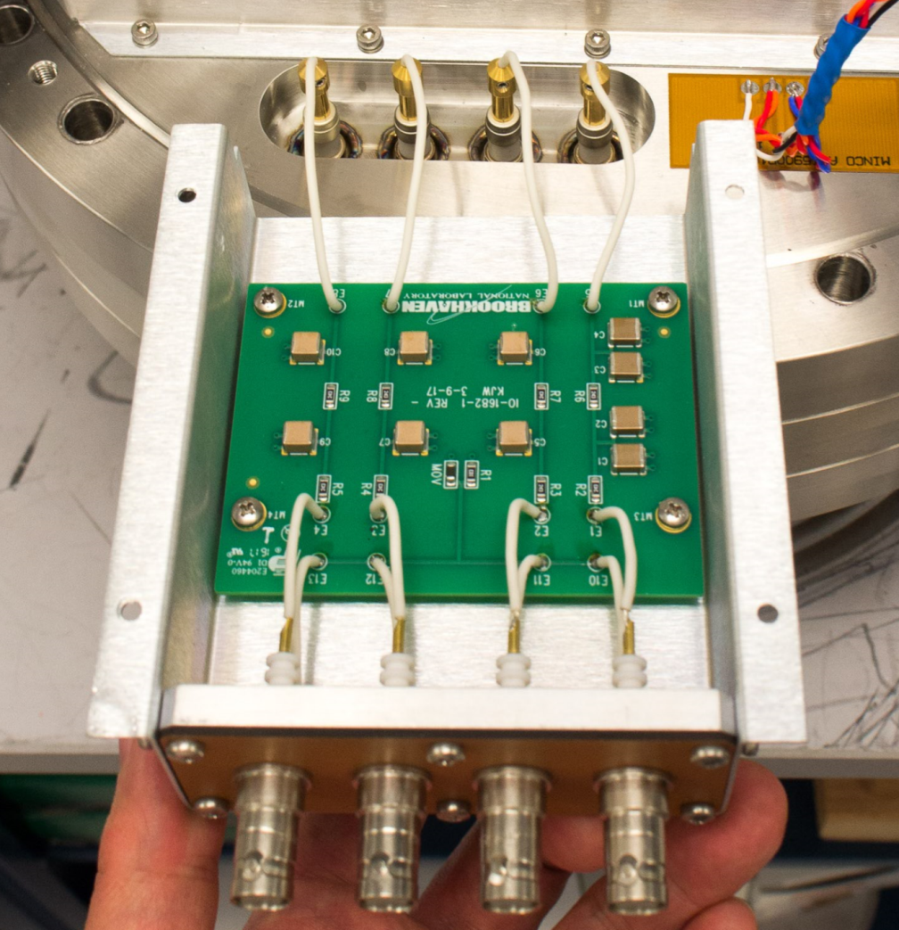
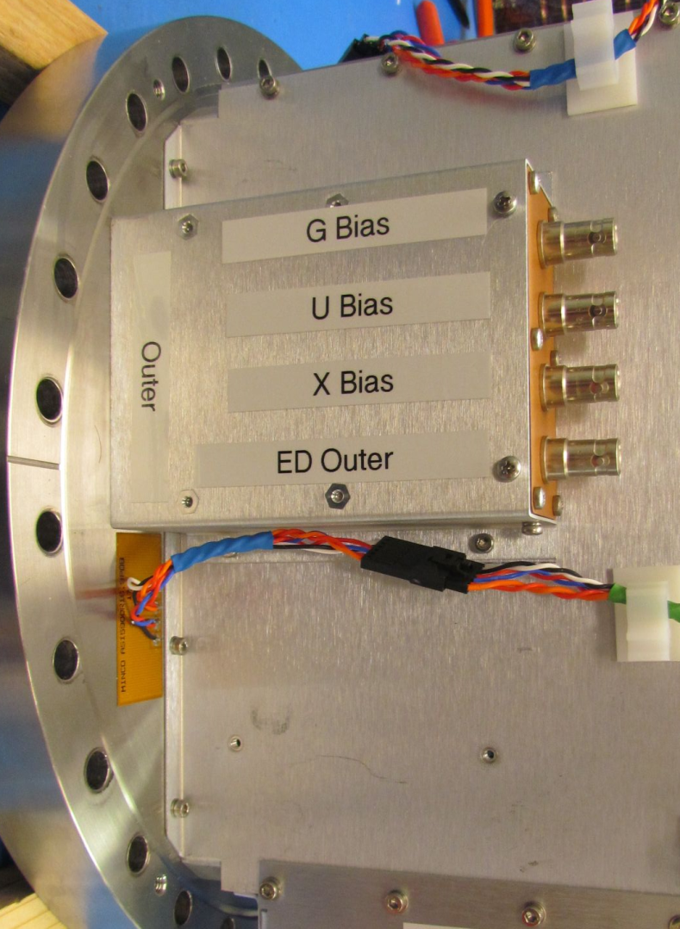
Bias Warm Filter Board
2 filter boards (8 ch. total) are mounted on the CE flange.

Slide 8
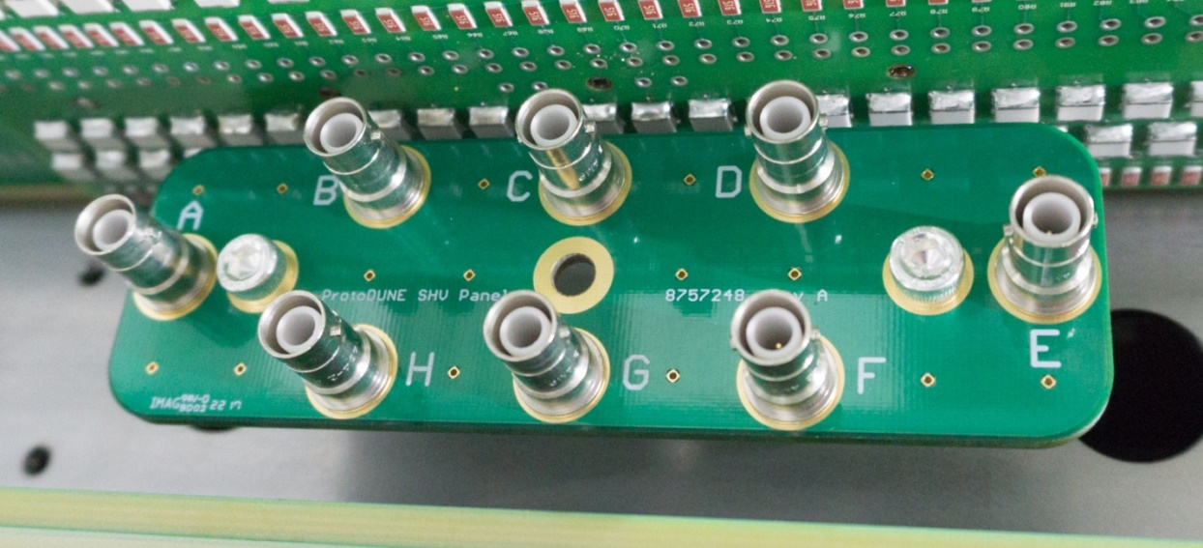
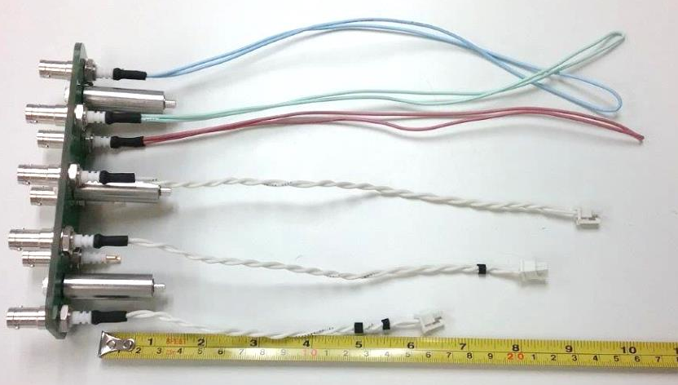
APA Bias SHV Panel
X wire bias | H, red wire
U wire bias | B, green wire
G wire bias | A, light blue wire
Top FC termination | C, no marking on output wire
Bottom FC termination | D, one marker on output wire
Endwall FC termination | E, two markers on output wire
Outer electron diverter | F, wire marking TBD
Inner electron diverter | G, wire marking TBD

Slide 9
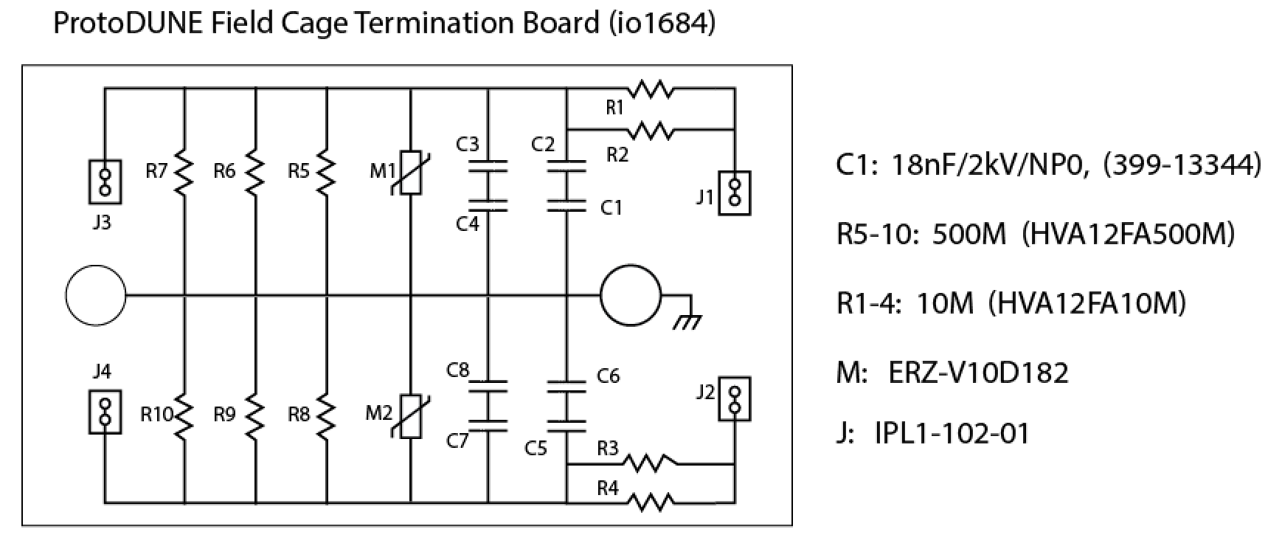
FC Termination/Filter Board
Capacitors in series to prevent a single cap fail-short
Termination resistance: 500M/3=167M
The value of R5-10 in this case is only valid for the Top/Bottom field cage of the 1Gohm divider chains

Slide 10
All Board Configurations
Flavor | Termination R | 3R configuration
1G Top/Bottom | 167M (1) | 500M//500M/500M
1G End Wall | 42M (x1/4) | 250M/100M/100M
5G Top/Bottom | 833M (x5) | 5G//2G//2G
5G End Wall | 208M (x5/4) | 2G//3G//250M Or 1G/.5G/.5G
Post installation verification
From the SHV connectors on the CE flange (input):
Resistance to ground: R value in the table above + 5M.
Capacitance to ground: 18nF + warm filter capacitance
From the FC termination wire (output):
Resistance to ground: R value
Capacitance to ground: 18nF + warm filter capacitance

Slide 11
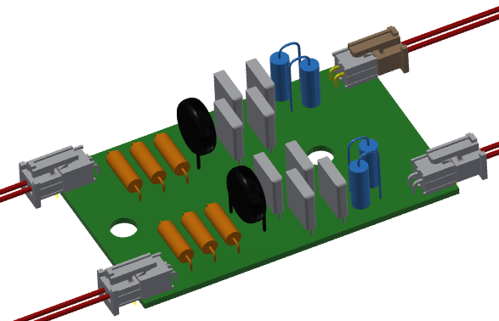
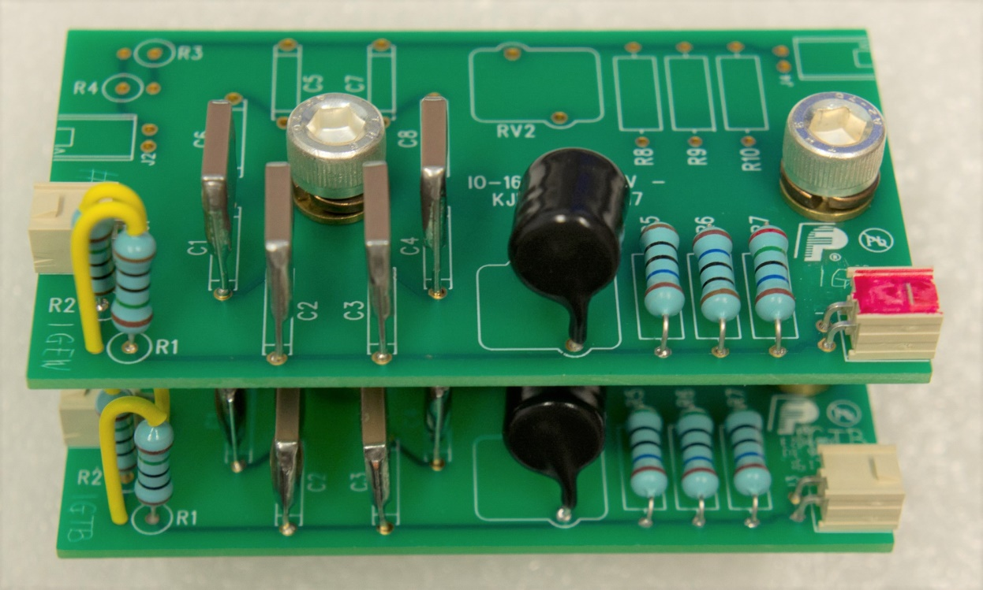
Board Design Model and Photo of Assembly
Samtec IPL1 and IPD1 series connectors are used for MicroBooNE and NP04 CE power.
Silver plated SS screws (or brass screws) are used for ground connection, with lock washers to ensure good contact and rework.

Slide 12
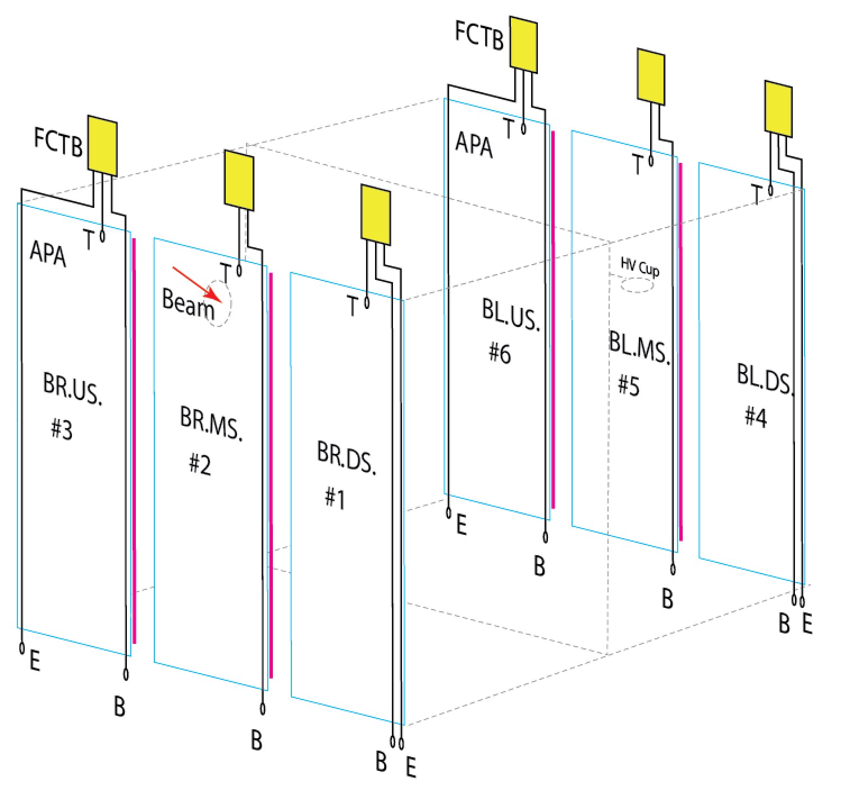
FC Termination Location on APAs

Slide 13
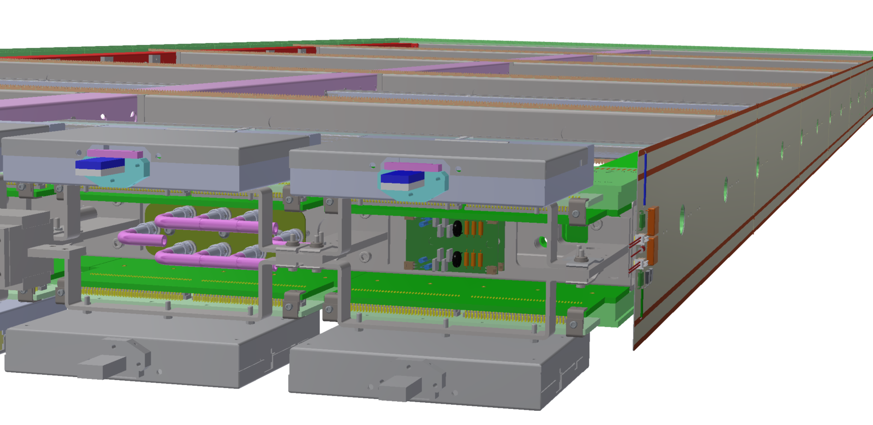
Locations of FC Termination Board
Bias SHV Connector Panel
FC Termination Board (x2)
Bottom & Endwall
(through the tube
down to APA foot)
CE box
Top FC
Bias connector panel made from G10: SHV shield are not connected to the APA frame.
Redundant 5kV rated hookup wires connect the SHV connector center pins to FC termination boards or e-diverter board. (Solder on one end, connector (IPD1) on the other)
Local strain relieves near each board.

Slide 14
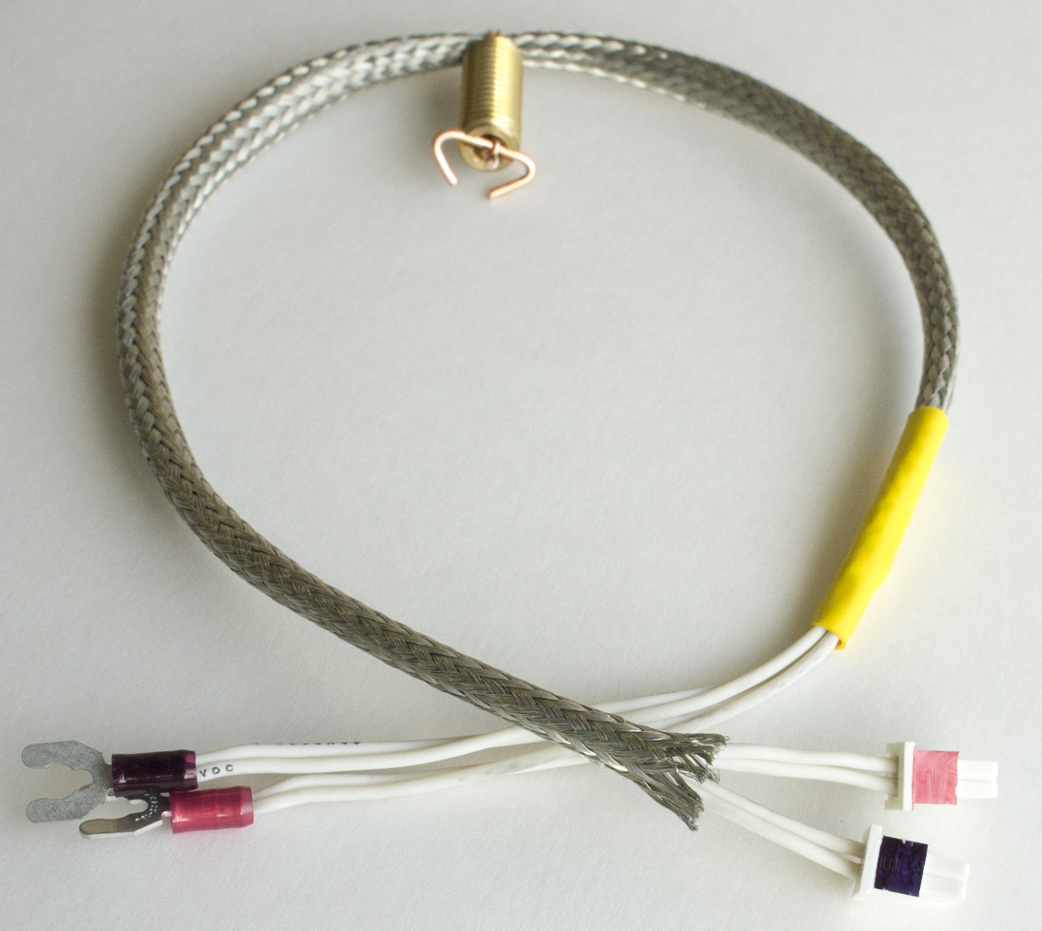
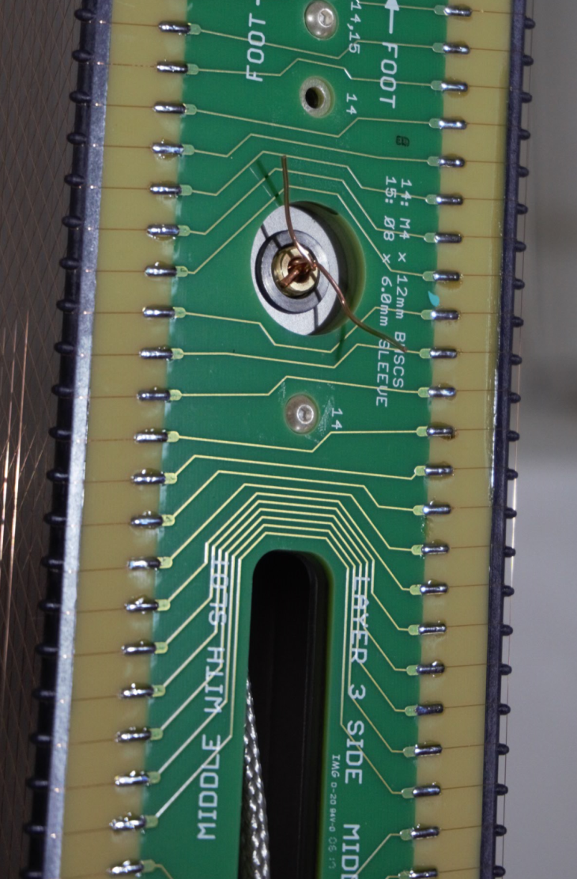
Field Cage Termination Cable, Bottom/Endwall
Strain relief on APA frame
To field cage divider
bottom/end wall
To termination/filter boards

Slide 15
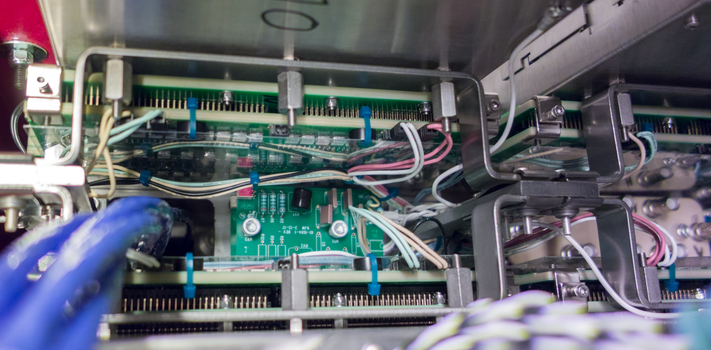
Cable Routing on Top of APA
Strain Relief
To top FC
To bottom/endwall FC

Slide 16
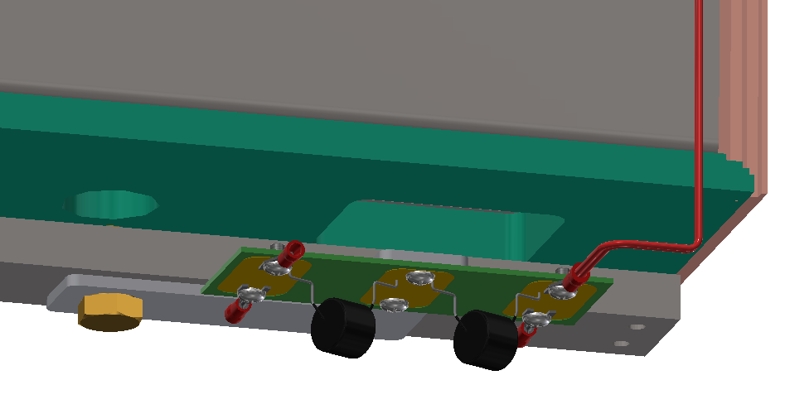
Failsafe termination at the bottom of APA
To FC divider board
To termination/filter board

Slide 17
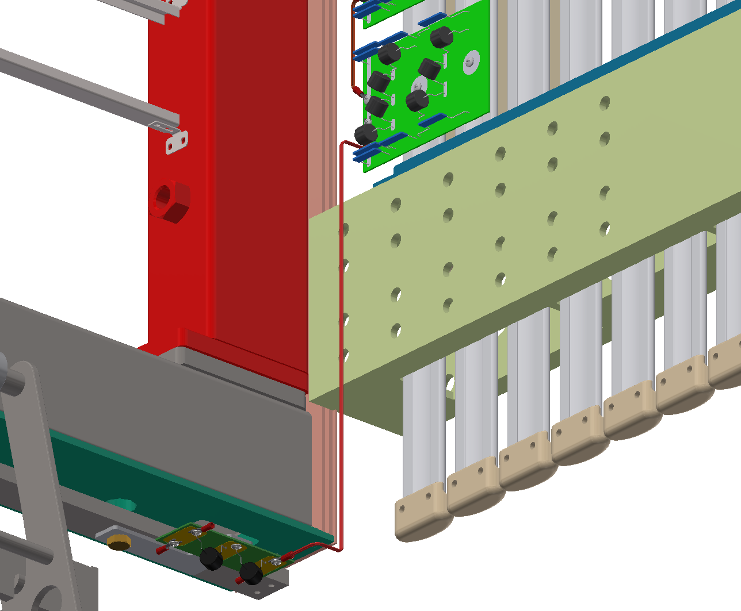
Connection to the termination wire

Slide 18
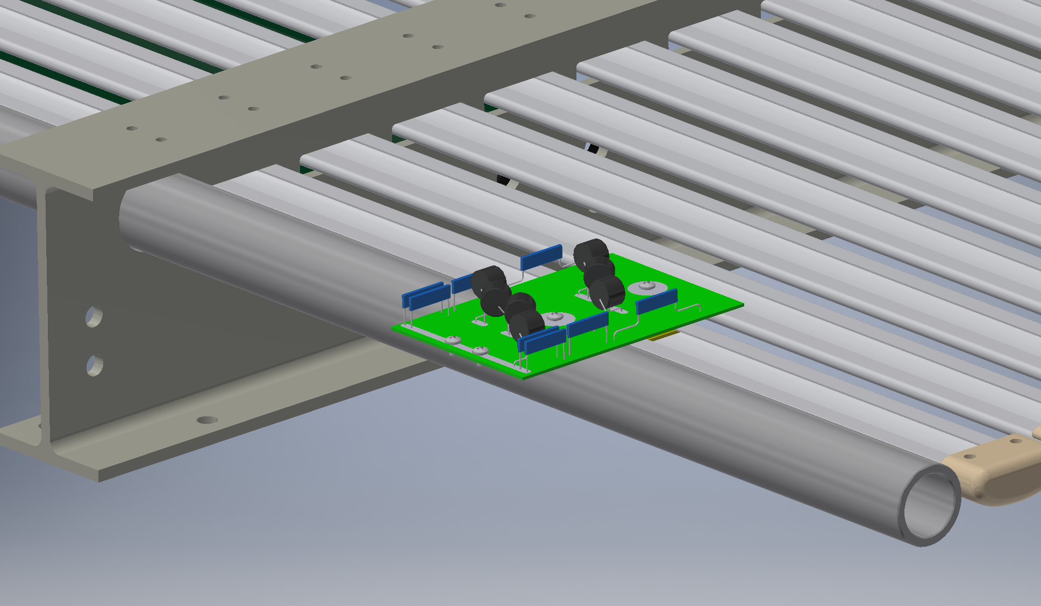
Top/Bottom FC Last Divider Board
To termination/filter board

Slide 19
Validation of Connections
After all cables for the FC terminations have been connected on the APA, use a DVM to verify that the resistance between the center conductor of a given channel on the SHV panel has about 5M resistance to the spade terminals of each termination cable.
After the cold SHV cables have been connected to the CE flange, verify the resistance from the center conductor of each SHV connector on the warm filter box shows the correct terminating resistance (+5M) to ground.
After a field cage module have been deployed and connected to the corresponding termination cables, verify that screw terminals on both ends of a termination cable have a resistance to the APA frame equal to the termination resistance of the corresponding channel.
If possible, apply a moderate voltage to the CPA relative to the cryostat ground and measure the voltage on the warm filter SHV connector. For reference, 180V on the CPA should give ~ 1V on the warm SHV connector, if measured by a meter with high input impedance.

Slide 20
Summary
All connections between the field cage modules and the APA (ground) have been defined and documented.
All connections are using existing know techniques and practices that are compatible with LAr operation.
Redundant wires/pins/connections, and failsafe features are designed into the critical components.
A few details on cable strain relieves and connection locations are to be finalized.

