Slide 1
Field Cage Ground Plane Connections
Bo Yu
Sept. 26, 2017

Slide 2
Purpose of the Ground Plane
Perforated ground plane panels are installed on the outside of the top/bottom field cage modules at a distance of 20cm.
These panels form two continuous ground planes above and below the TPC, covering about 80% of the highest voltage field cage surface.
These two ground planes shield the high electric field from entering the gas ullage space above and the cryogenic pipes below. With the shielding, the DSS above and the cryogenic pipes below do not have to worry about HV discharge risks.
The original plan was to connect the ground planes directly to the cryostat ground.

Slide 3
The Need for Monitoring Ground Plane Current
In the previous 35ton HV tests, we noticed current flow through unexpected paths
Current from the HV power supply does not equal the currents flow out of the “anodes”
Excess unstable current recorded from power supplies, but not “visible” from PMTs, or cold cameras
To help us identify the source of these “streamer” currents, we implemented a set of current monitoring channels by segmenting the ground plane panels in the 35ton HV setup, and adding resistance between the ground plane panels and the cryostat ground, and bring the ground plane voltages out of the cryostat.
We are planning to duplicate this scheme in NP04. Since this is a late decision, we are still working on the design details.

Slide 4
General Description
See Glenn’s presentation:
https://indico.fnal.gov/getFile.py/access?contribId=1&resId=0&materialId=slides&confId=15059

Slide 5
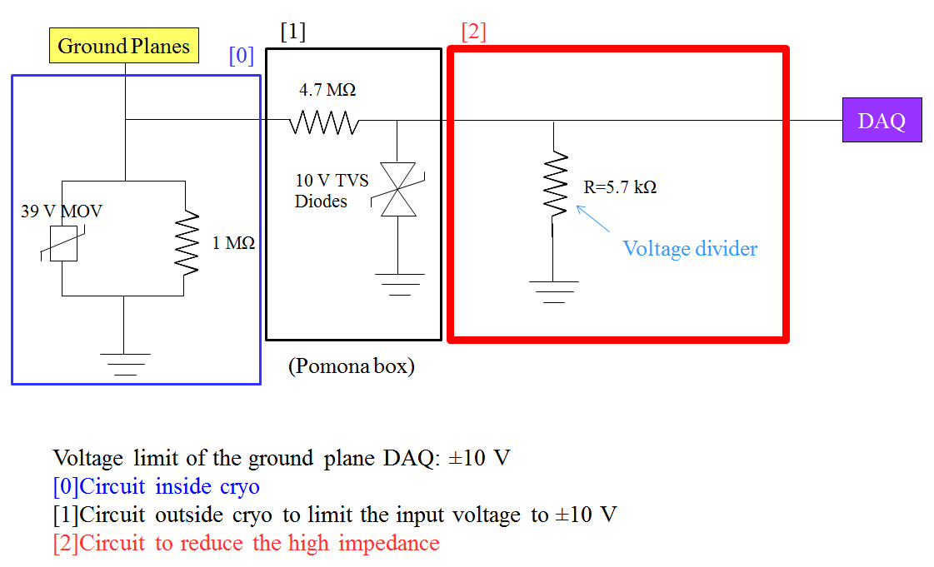
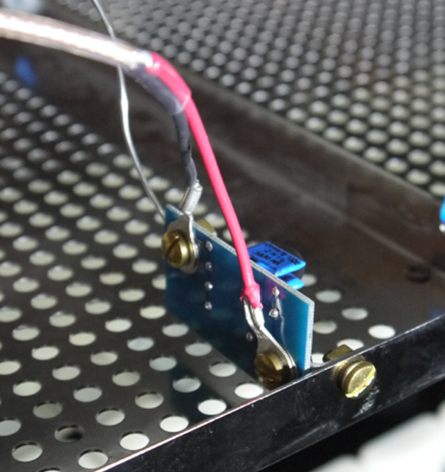
Implementation in 35ton
From Heng-Ye Liao

Slide 6
Readout Channels
Number of Channels
12, one for each top/bottom ground plane assembly: 6 on top, 6 on bottom
Cable type
RG316
Cold cable lengths
Connections to the ground planes are near the CPAs
Cable length depends on routing
Top: 5 - 10m
Bottom: 16 - 22m

Slide 7
Readout Channels
Feedthrough Port
10.2, near the beam left manhole
Feedthrough type
Low voltage D-sub type (15 or 25pin)
Readout Type
Voltage, 0 to -10V, equivalent to 0-10µA
High input impedance
FNAL uses NI USB-6211 in 35ton HV setup.
We will implement additional input protection outside cryostat

Slide 8
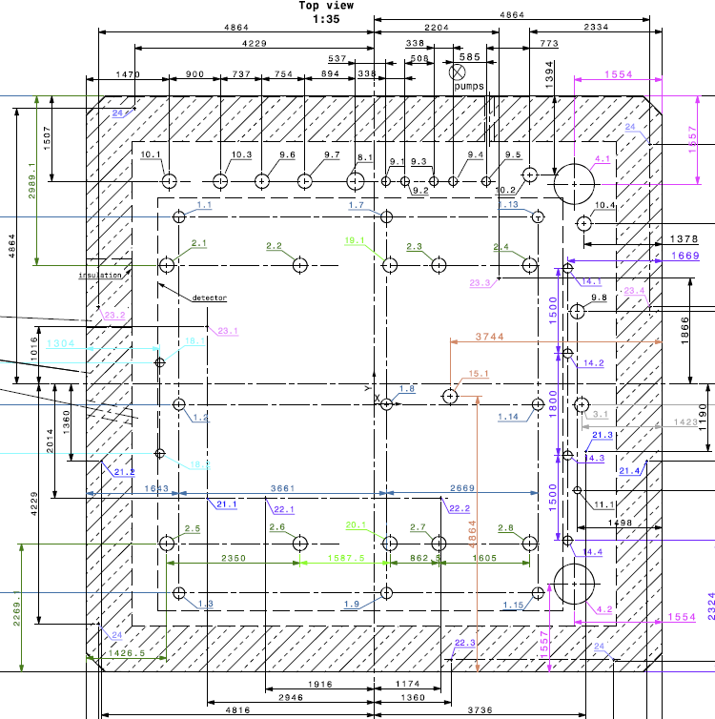
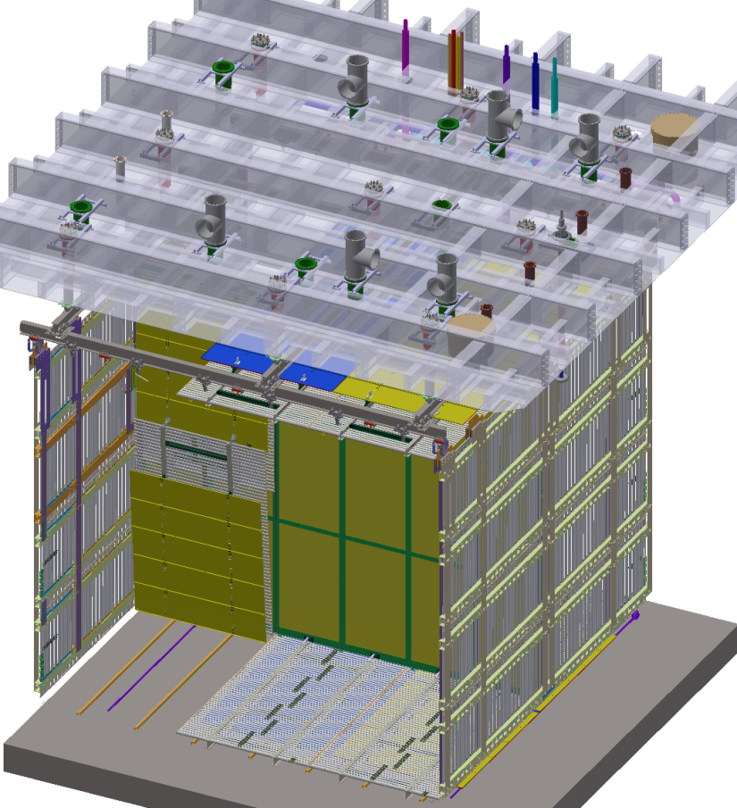
Port for the Signals
Use port 10.2, originally reserved for the cryogenic system

Slide 9
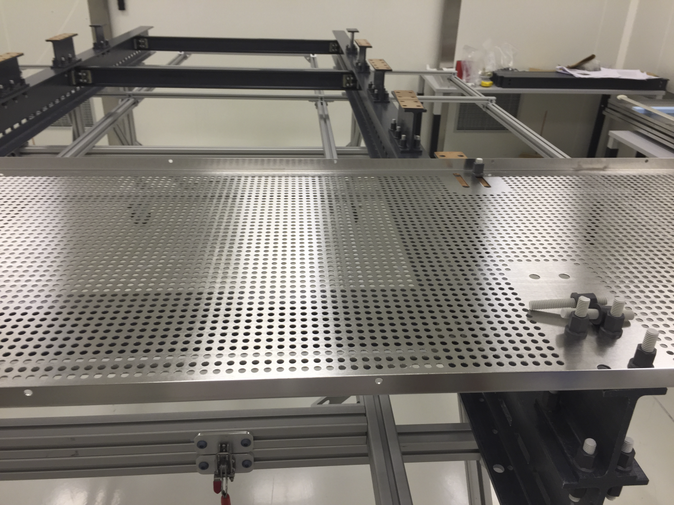
Connections to the Ground Plane
All ground plane panels on each FC module have already been shorted together through copper sheets under the standoffs.
Will use a robust wire (1/4” copper braid) with spade terminals to connect the grounding PCB to the first (CPA side) ground plane panel using one of the mounting bolts.

Slide 10
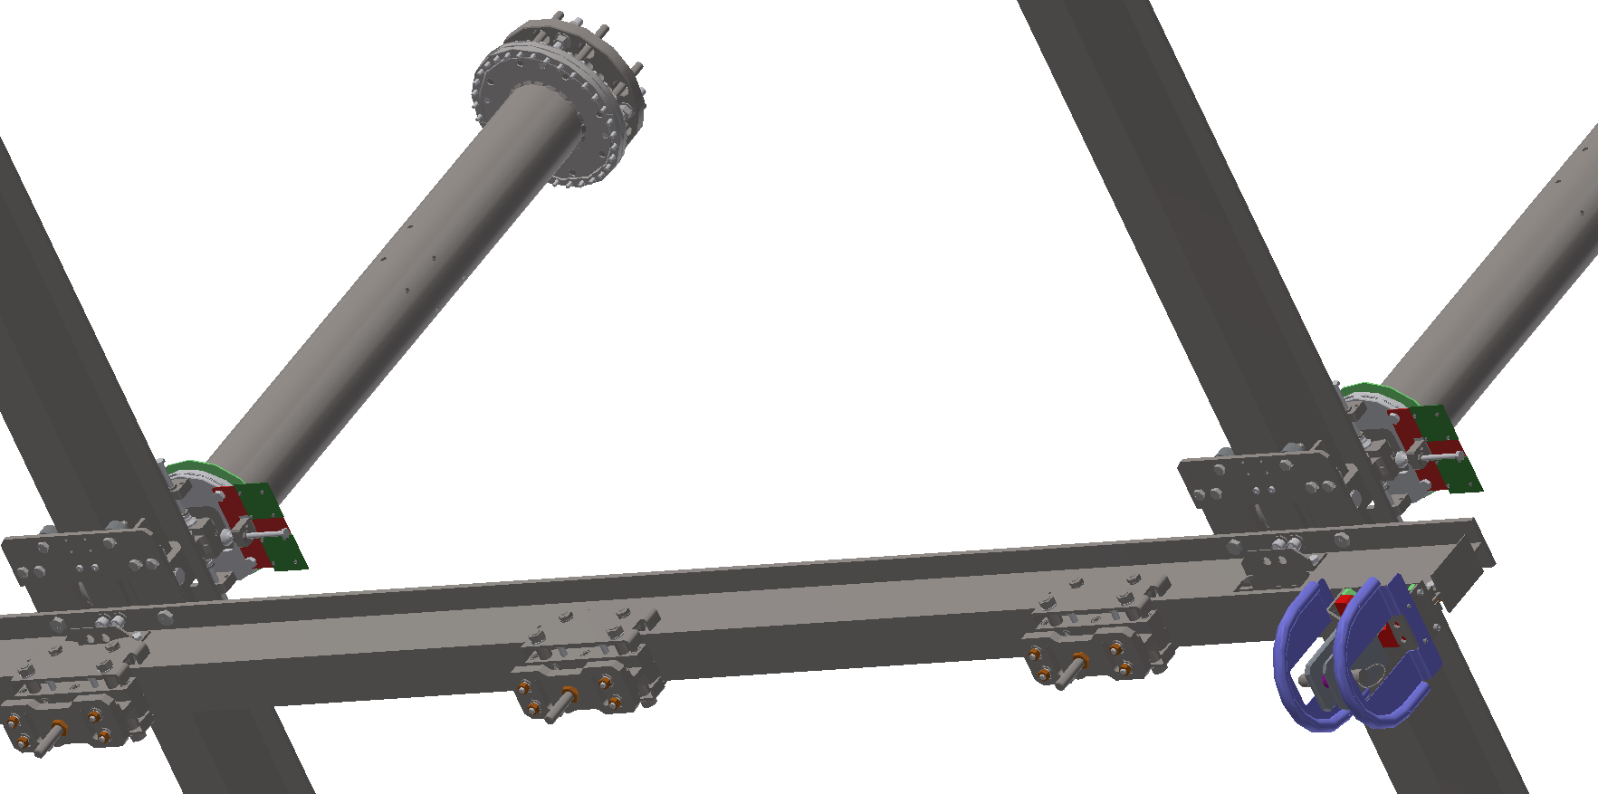
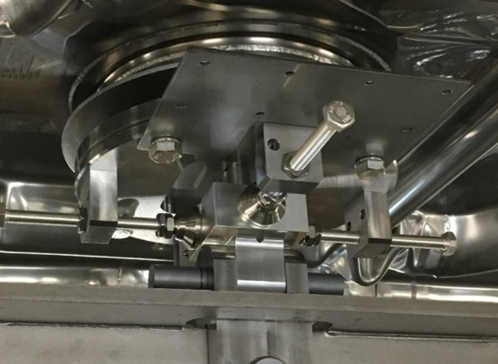
Top Ground Connections
Three grounding plates have been installed by Dan onto the DSS feedthroughs inside the cryostat above the CPA rail. Grounding PCBs will be mounted on the plates and output wires routed under the ceiling to port 10.2

Slide 11
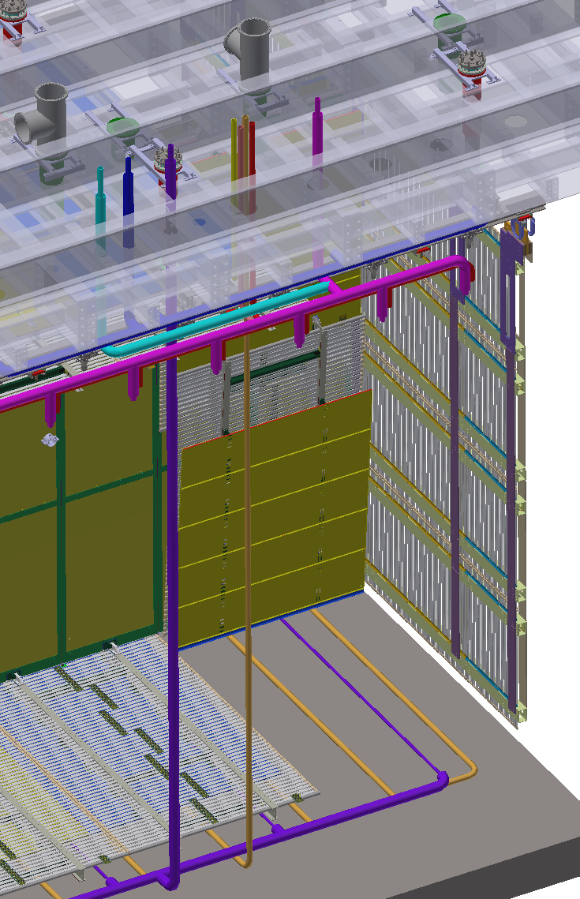
Bottom Ground Connections
One possible configuration is 3 groups of 4 studs on the membrane floor directly under the CPA rail. This way, we can make our connections while the FCs are still folded with the wires going straight down. This will have minimal interference with the TPC installation. If there is a line of corrugation directly under the CPA, we might have to split the studs into two pairs (BL and BR).
Waiting for GTT approval on the welding of studs.
Cable routing:
running from the CPA along the cryo pipes to the beam left wall,
then to the beam right, downstream corner,
climb up the corner along the cable tray,
reaching port 10.2

Slide 12
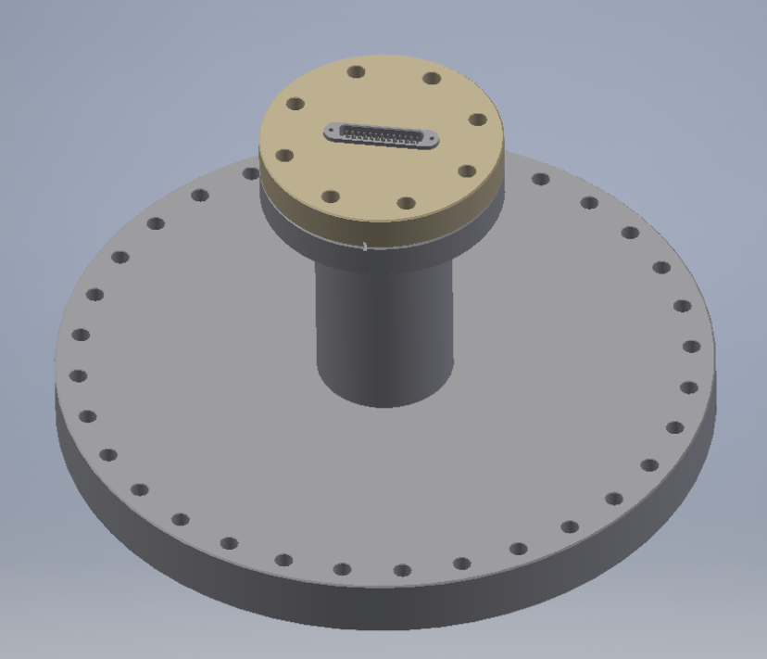
Connections at the Feedthrough
Port 10.2 uses a 12” CF (DN250) flange. David M. already has a blank flange for it.
We will purchase a 4.5” CF with a Db25 feedthrough on it (MDC P.N. 9132018), a “half nipple” (MDC P.N. 401004) and weld it on the CF12.
The center conductors of the 12 RG316 cables are connected to one side of the DB25 connector.
The shields of the 12 cables are floating.
Need to get local details near port 10.2 to determine mechanical support for the cables.

Slide 13
Summary
A new feature is being introduced recently to monitor the current flog to the ground plane modules.
The 12 ground planes on the top and bottom field cage will be connected to the cryostat ground through 1M resistors, in parallel with low voltage surge suppressors to ensure safety during a HV discharge to a ground plane.
The voltages on the 12 ground planes will be brought out through RG316 cables to port 10.2 to a db25 feedthrough, and monitored by the slow control group using yet to be determined DAQ hardware
A similar configuration is in use at the 35ton HV test.
We are still working on the final design of this feature. Procedure documents will follow as soon as the design is finalized.

