Slide 1
46: Encapsulated Sulfur Targets
Ntombizonke Kheswa
(iThemba LABS)

Slide 2
46:Enriched Sulphur targets for light ion beam experiments
Low abundance of ³⁶S (0.01%).
Enriched ³⁶S material is very expensive ($190/mg) while having an enrichment of less than 90%.
Elemental sulphur targets sublime rapidly in vacuum when subjected to beam bombardment.

Slide 3
Enriched Sulphur targets for light ion beam experiments
Ag₂S, thickness 20 μg/cm², A. S. Kachan et al., Izv. Akad. Nauk RAS, Ser.Fiz. 72, 430 (2008)
CdS S. Piskor et al., Nucl. Phys. A414 (1984) 219
GeS L.M. Solinet al., Sov. J. Nucl. Phys. 29 (1979) 143
C implanted foils 26μg/cm² carbon, 2-3 μg/cm² ³⁶S W.von Oertzen, et al., Z.Phys. A353, 373 (1996) 30μg/cm² carbon, 10 μg/cm² ³⁶S(96%) L.K. Fifield and N.A. Orr, Nucl. Instr. Meth. A288 (1990) 360
H₂S gas target (100 μg/cm² Ti foils), G. Eckle et al., Nuclear Physics A491 (1989) 205-226
S (264 μg/cm² ) sandwiched between C + Formvar (30 + 5 μg/cm), A. Hogenbirk et al., Nuclear Physics A516 (1990) 205-254

Slide 4
Target for energetic light ion beam experiments
Light ions with low energy loss p, d, t, α at 100 Mev/u
Minimal use of enriched material: “what I buy is what I use”
Reduced loss of sulphur material using Mylar sandwich (C₁₀H₈O₄)
Spread of heat deposition using a swivelling mechanism

Slide 5
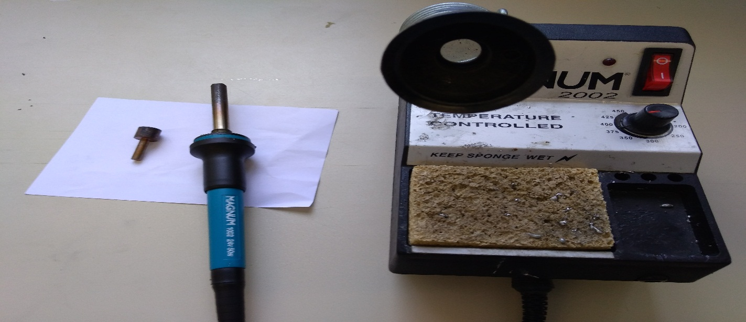
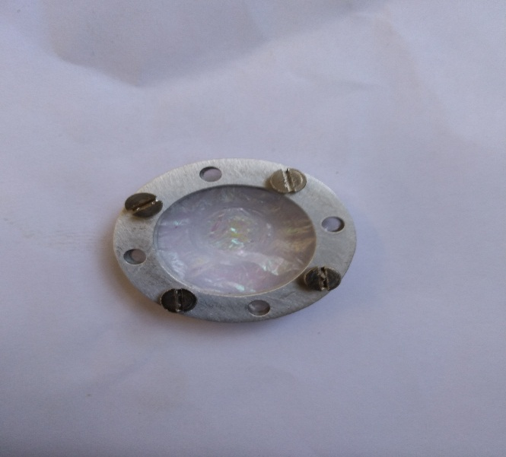
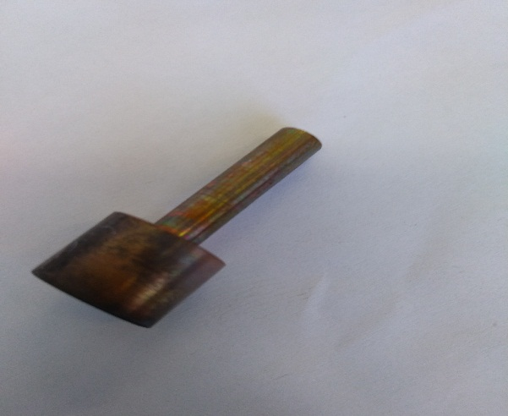
Target Production
Two Mylar (0.5 µm thickness) foils are “adhered” together by applying heat using a temperature controlled soldering iron and conducting rod (copper)
Mylar foils are stuck together and encapsulating 1 mg of sulfur material with a surface area of approximately 1 cm²
The target frame is made of two identical rings allowing 4 M2.5 screws to clamp the mylar foil in between.
Heat supply
Target
Welding tool
Mylar
Sulfur

Slide 6
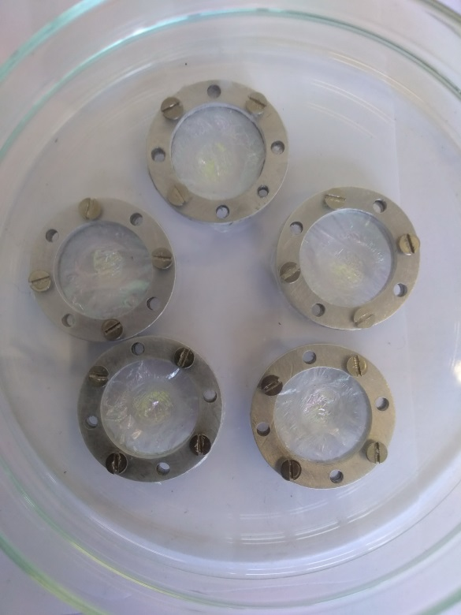
Targets

Slide 7
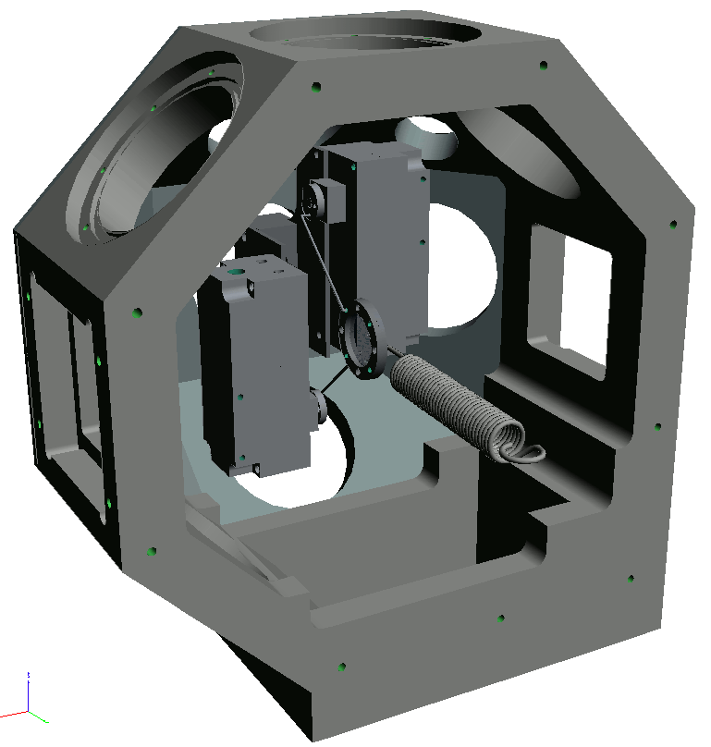
Ion Beam Analysis
Two motors displace the target to expose the sulphur material evenly
A surface barrier detector placed at 135 degrees with respect to the beam axis.
3MeV proton beam between 1-10nA.

Slide 8
Target in action

Slide 9
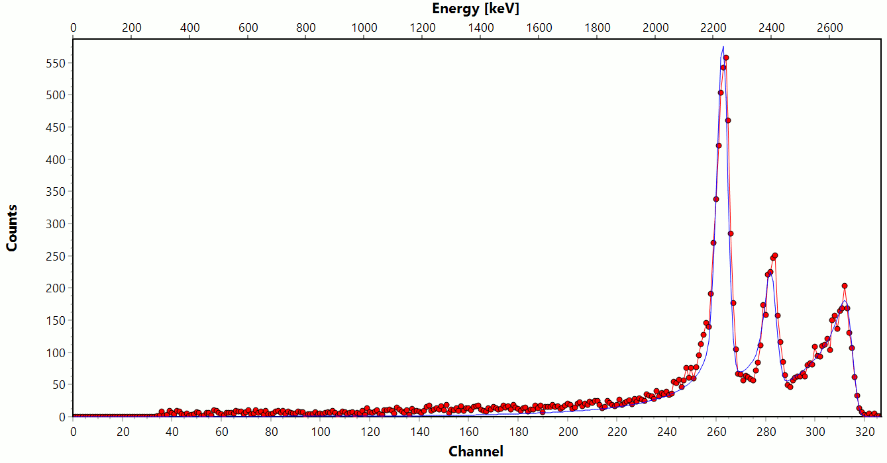
RBS spectrum
C
O
S
C, O from Mylar. Highest energy contributor is Sulphur

Slide 10
Typical thickness
C | H | O | S | Total μg/cm²
85 | 5 | 120 | 450 | 660
Starting with 1mg/cm² of Sulphur material, RBS indicates about
0.5mg/cm² in between the foils (consistently observed on 3 different targets)
Material may be lost at the welding stage
High roughness ~2mg/cm² FWHM (powder directly deposited on foils)

Slide 11
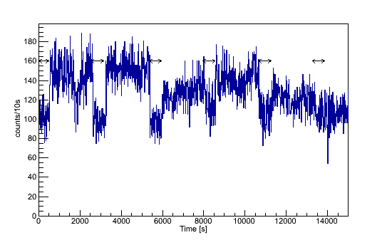
Scaler on E_{p} > 2.5 MeV
Arrows indicate when the target is swivelling, measurements taken when high sulphur spots are found (4 hours @ 6nA, 3MeV protons)

Slide 12
Conclusions
Roughness was expected to reduce with beam exposure, but it keeps pretty high
Heat treatment after welding could be applied to melt sulphur in between the foils
Effective method to produce targets with extremely small amount of material (1mg → 0.5mg/cm²) and good tenure to radiation

Slide 13
THANK YOU FOR THE ATTENTION

