Slide 1


Manufacturing and characterization of targets in IFIN-HH: developing an interdisciplinary body of knowledge
Andreea MITU
Horia Hulubei National Institute for Physics and Nuclear Engineering
(IFIN-HH)
INTDS, 2018

Slide 2
Outlines:
Target laboratory in IFIN-HH
Laboratory development
Target preparation and characterization
Specific examples and particularities
Nuclear forensics laboratory: developing an interdisciplinary collaboration
Conclusions and perspectives
INTDS, 2018
1/81

Slide 3
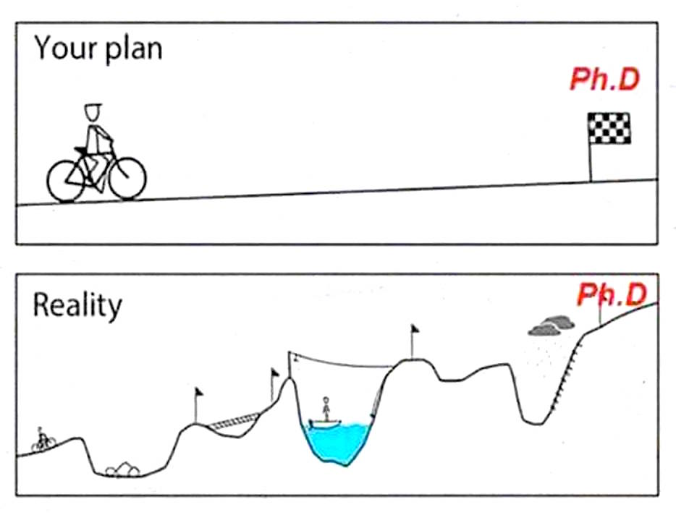
My current status
INTDS, 2018
2/81

Slide 4
Outlines:
Target laboratory in IFIN-HH
Laboratory development
Target preparation and characterization
Specific examples and particularities
Nuclear forensics laboratory: developing an interdisciplinary collaboration
Conclusions and perspectives
INTDS, 2018
3/81

Slide 5
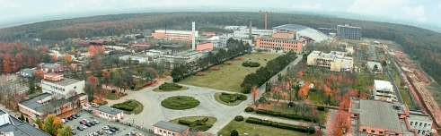
Where?
Horia Hulubei National Institute for Physics
and Nuclear Engineering
IFIN-HH
Bucharest-Magurele, Romania
INTDS, 2018
4/81

Slide 6
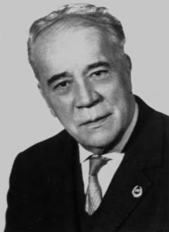
General information
Brief History
1949: Institute of Physics of the Romanian Academy
1956: Institute of Atomic Physics (IFA)
1977: Central Institute of Physics (ICEFIZ)
IFIN (nuclear),
IFTAR (radiation equipment),  IFTM (materials),
CFPS (earth),
IGSS (space),
1990: ICEFIZ became IFA
1996: IFIN-HH
￼
Horia Hulubei (1896-1972)
Founder and First Director
of the Institute
Contribution to the study of quantum diffusion of X-rays
(Ph.D. Thesis, Paris, 1933)
Supervisor: Jean Perrin (Nobel Prize)
Chairman: Marie Curie (Nobel Prize)
INTDS, 2018
5/81

Slide 7


Research Areas
Basic Physics Research
Nuclear Physics and astrophysics
Particle physics and field theory
Atomic physics and condensed matter physics
Mathematical physics and information physics
Life and environmental protection
￼
Applied Physics Research
Advanced detection systems
Nuclear safety, radiation protection and radioactive products
Radioecology and nuclear biomedicine
Nuclear techniques and applications
Advanced communication systems
INTDS, 2018
6/81

Slide 8
Research Departments
Theoretical physics
Nuclear physics
Tandem Accelerators
Hadronic Physics
Elementary Particles Physics
Computational Physics and Informational Technologies
Life and Environmental Sciences
Radioisotopes and Radiation Metrology
Applied Nuclear Physics
Multipurpose Irradiation Facility Centre
Nuclear Training Centre
Reactor Decommissioning
Radioactive Waste Management
Protection and Prevention Compartment
The Centre for Technology Transfer and Marketing
￼
Details on: http://www.nipne.ro
INTDS, 2018
7/81

Slide 9
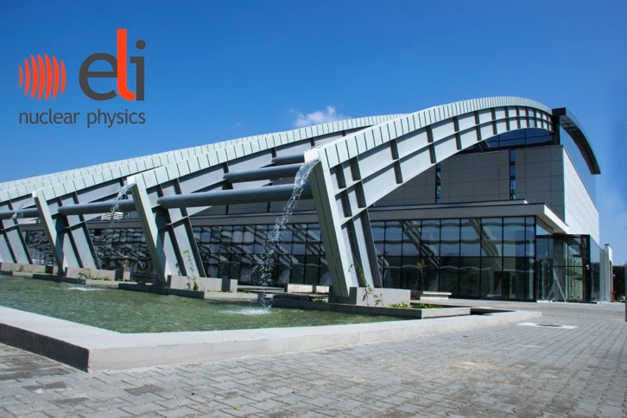
Extreme Light Infrastructure (ELI-NP)
ELI-NP facility will consist of two components:
A very high intensity laser system, with two 10 PW laser arms;
A very intense brilliant γ beam (10¹³ γ/s), which is obtained by incoherent Compton back scattering of a laser light of a very brilliant, intense, classical electron beam (E_{e} up to 720 MeV) produced by a warm LINAC.
￼
Under construction!
Details on: http://www.eli-np.ro
INTDS, 2018
8/81

Slide 10
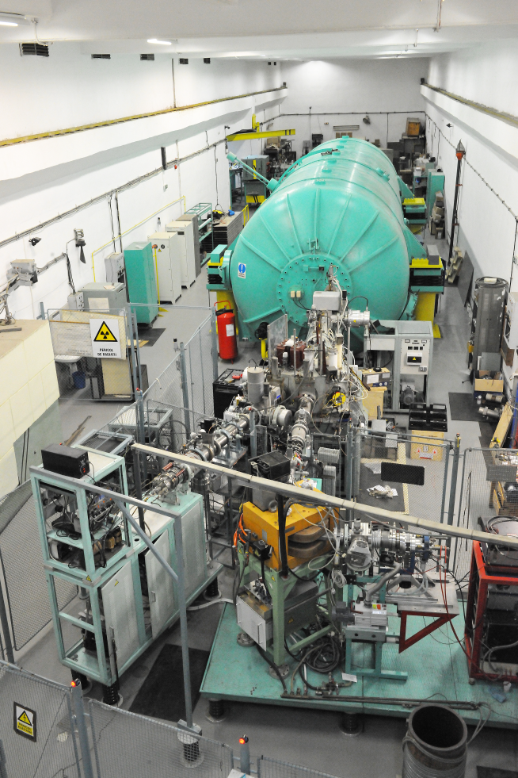
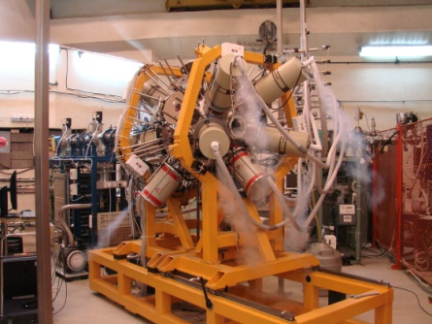
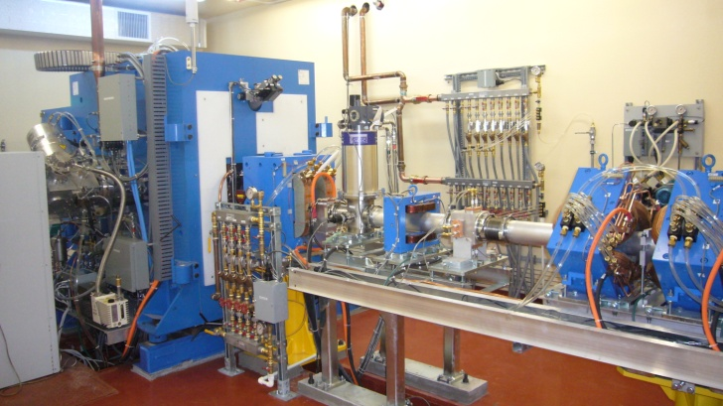
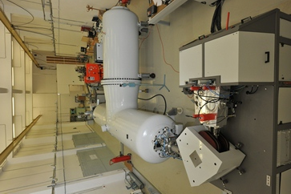

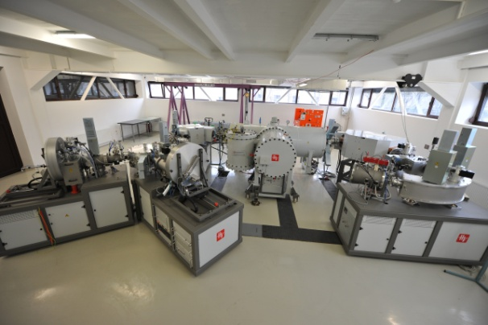
Experimental Infrastructure in IFIN-HH
9 MV Tandem
ROSPHERE gamma detectors array
19 MeV Proton Cyclotron for production of radioisotopes
3MV Tandetron
1MV Accelerator Mass Spectrometry
Gamma-ray Irradiator
INTDS, 2018
9/81

Slide 11
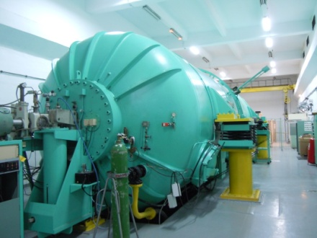
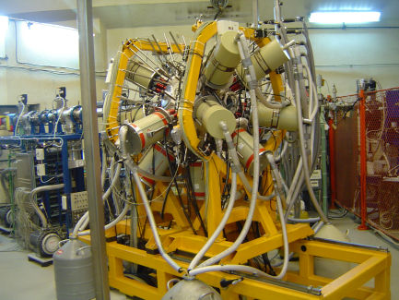

9MV TANDEM ACCELERATOR
- ROmanian array for γ-SPectroscopy in HEavy ion Reactions
25 positions on 5 rings (37◦ ,70◦, 90◦, 110◦, 143◦ )
2 configurations envisaged: - 15 50% HPGe detectors with BGO shields and 10 to 20 LaBr₃(Ce)
scintilators
- 25 50% HPGe detectors
INTDS, 2018
10/81

Slide 12
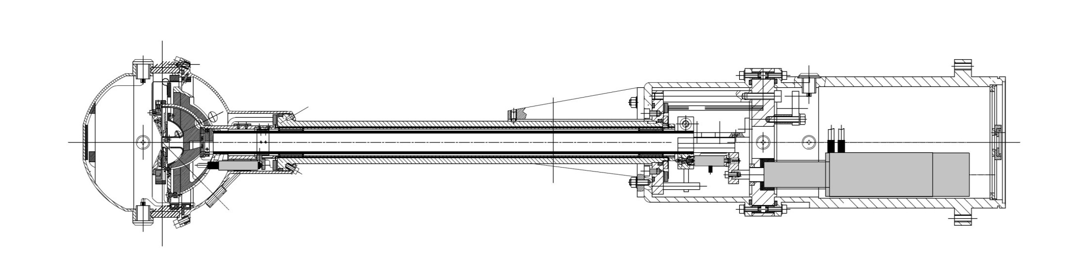
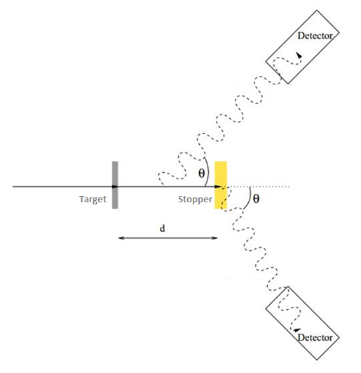
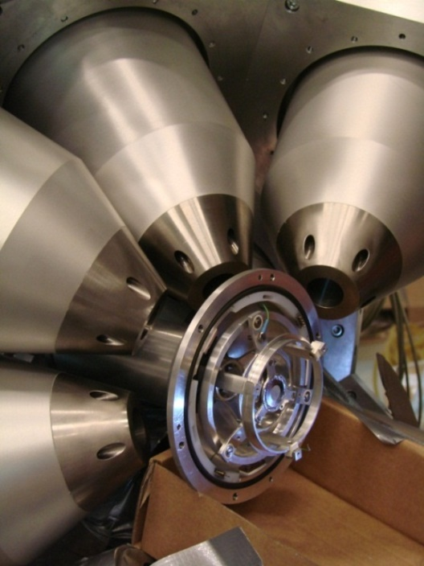




Types of experiments performed at 9MV tandem accelerator
PLUNGER reaction chamber (Cologne design)
Recoil Distance Doppler Shift method (RDDS)
Stopper support
Target support
Sliding Bearings
inchworm
Micrometer
Piezocrystal
L=814 mm
INTDS, 2018
11/81

Slide 13
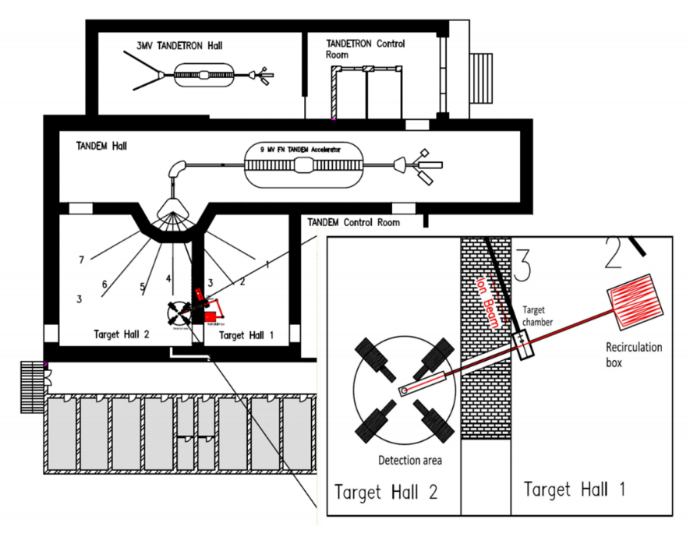
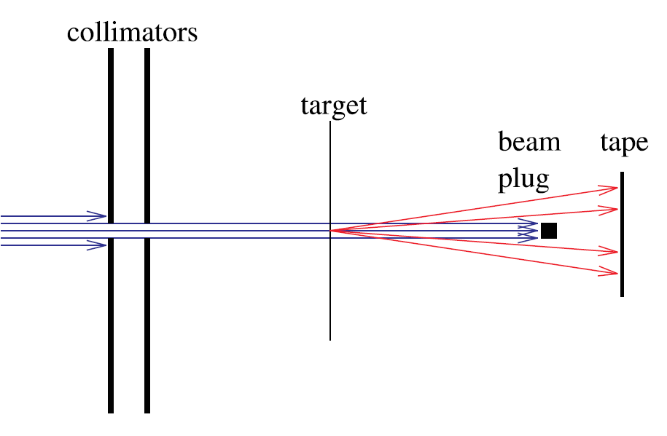
Types of experiments performed at 9MV tandem accelerator
Tape Station used for gamma-ray spectroscopy:
• Kapton tape transport station in closed loop
• Flexible time cycle control using in-house electronics
• 3x HPGe clovers (Eff ~ 1%) w/ BGO suppression
• Angular correlation table
• Digital data acquisition system
Target requirements
thin (<2 mg/cm²)
self-supported targets that allow the recoil products to scatter onto the kapton tape
INTDS, 2018
12/81

Slide 14
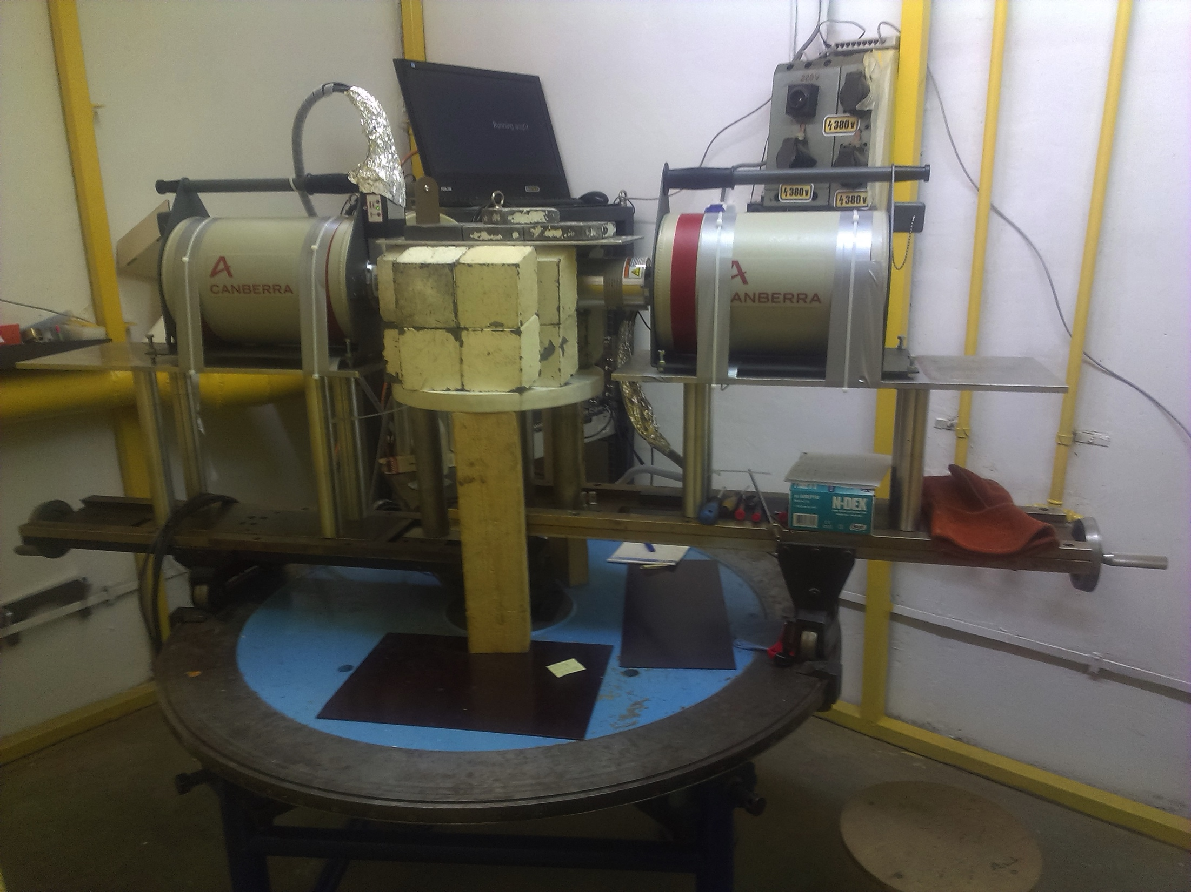
Types of experiments performed at 9MV tandem accelerator
I. Activation
ejectile
The activation technique consists in bombarding the target with α-particles to produce radioactive nuclei followed by the measurement of their specific activities once the irradiation has stopped.
α
γ,n,p
projectile
target
II. Counting
Counting setup in Bucharest, IFIN-HH, Romania
              2 HPGe detectors (relative
              efficiency of 55 % and 100%)
              Passive lead shielding
              Close detection geometry
              -> the summing corrections were performed using the Monte Carlo simulation code GESPECOR
HPGe
detector
γ
γ
target
Pb walls and Cu and Al plates on the inside
INTDS, 2018
13/81

Slide 15

No matter the type of experiment one wishes to perform, a good target is needed!
INTDS, 2018
13/81

Slide 16
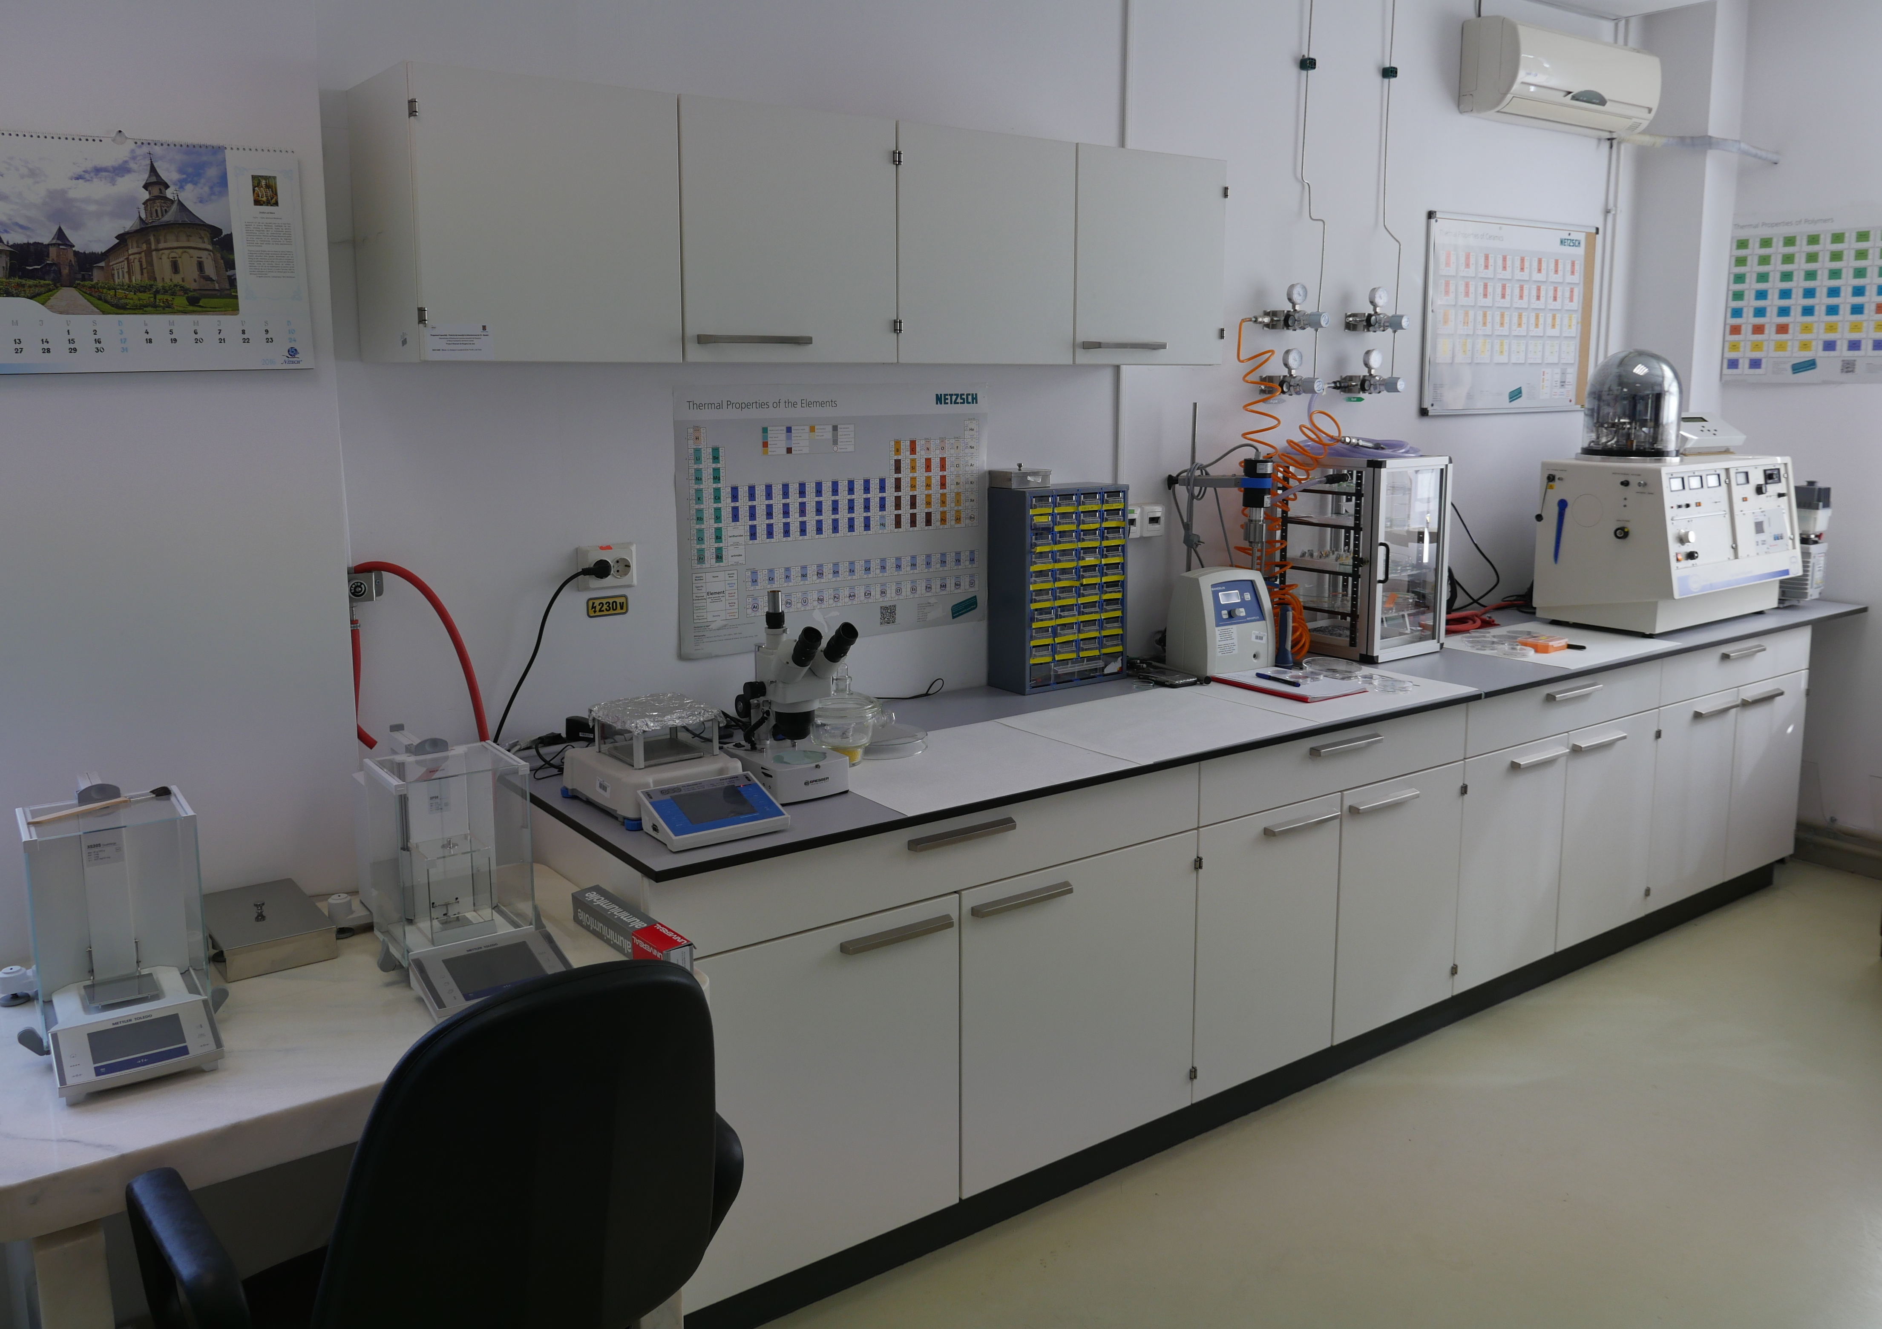
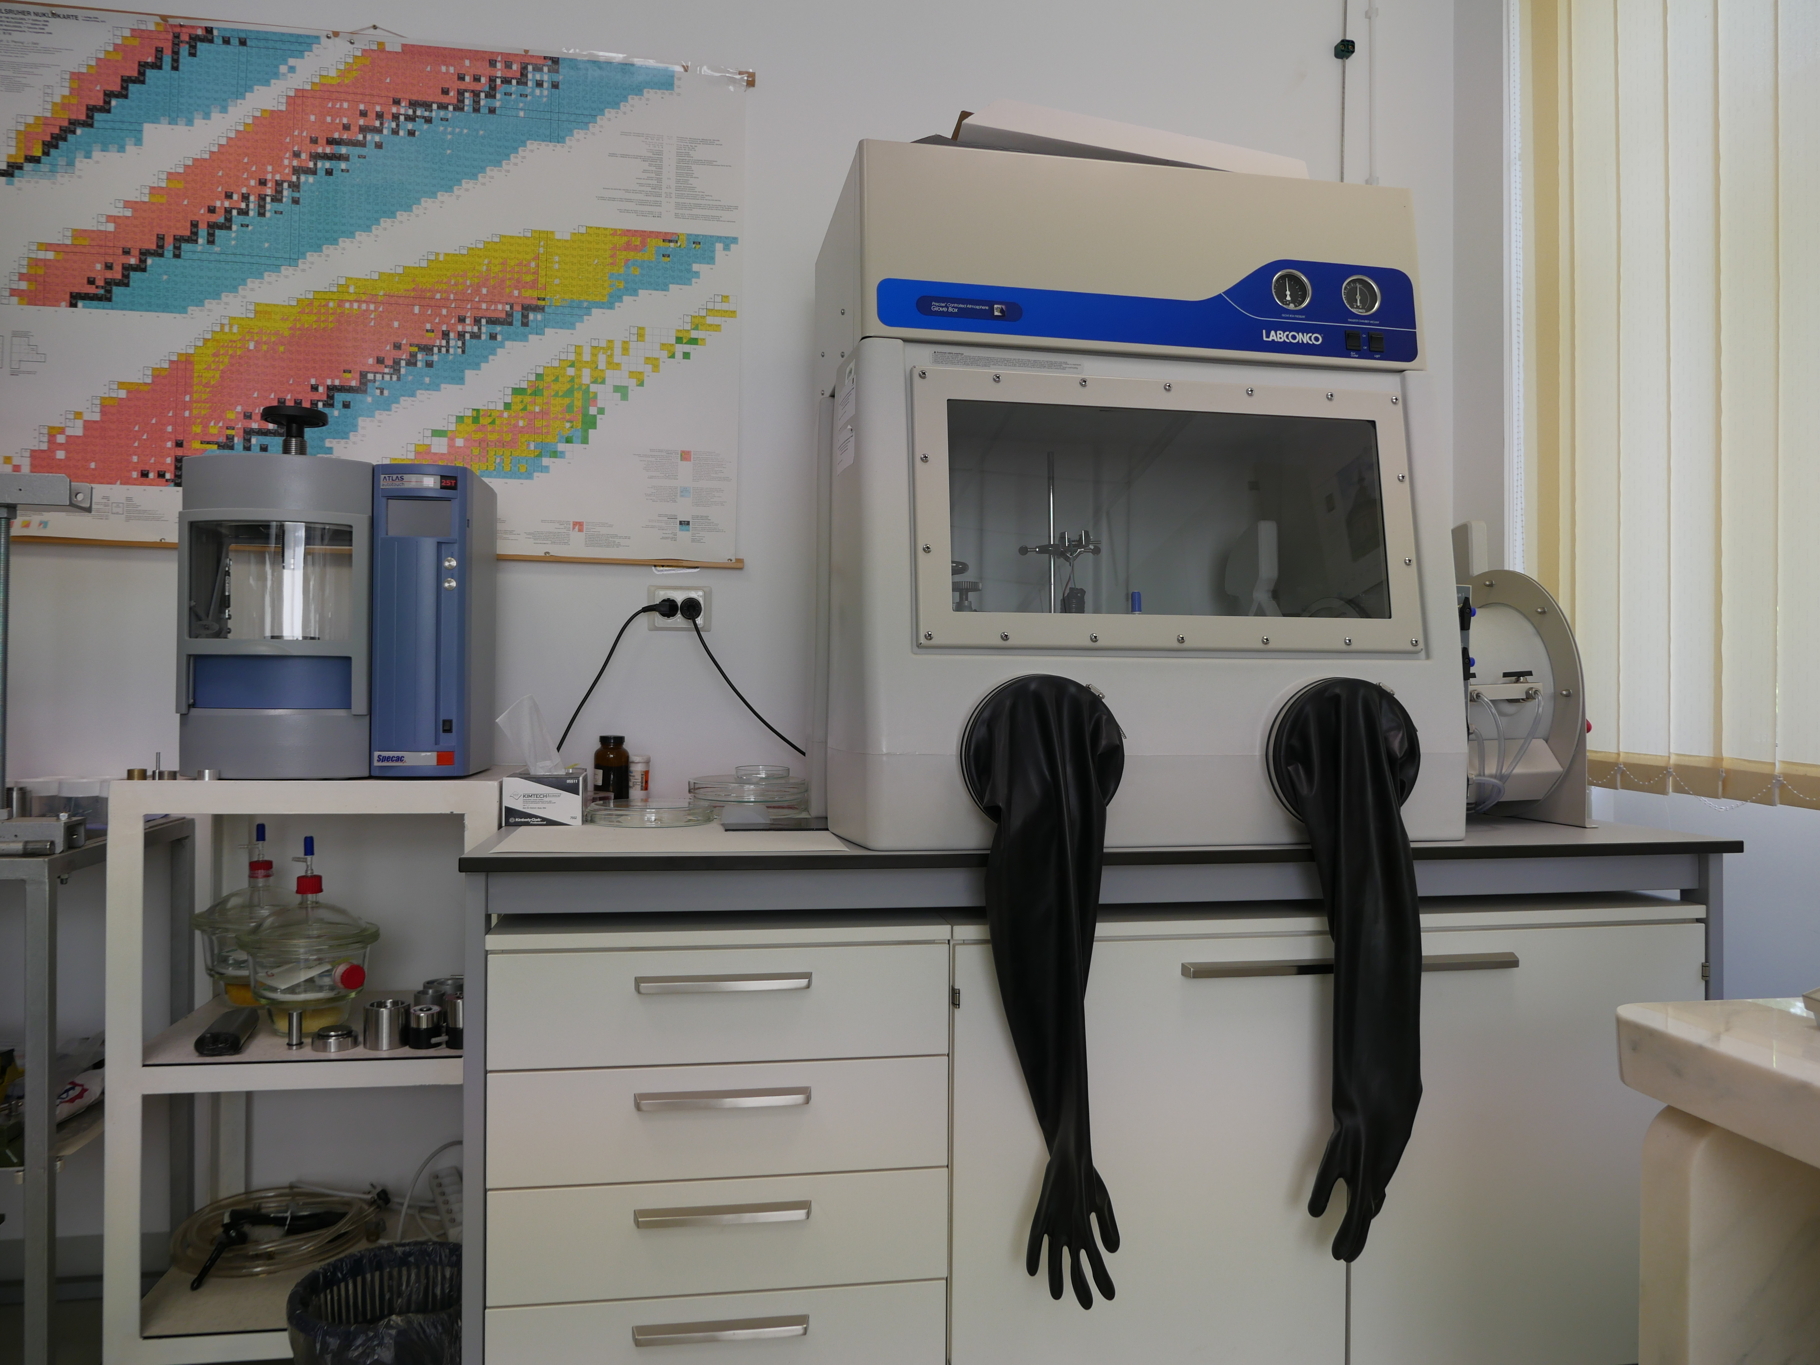
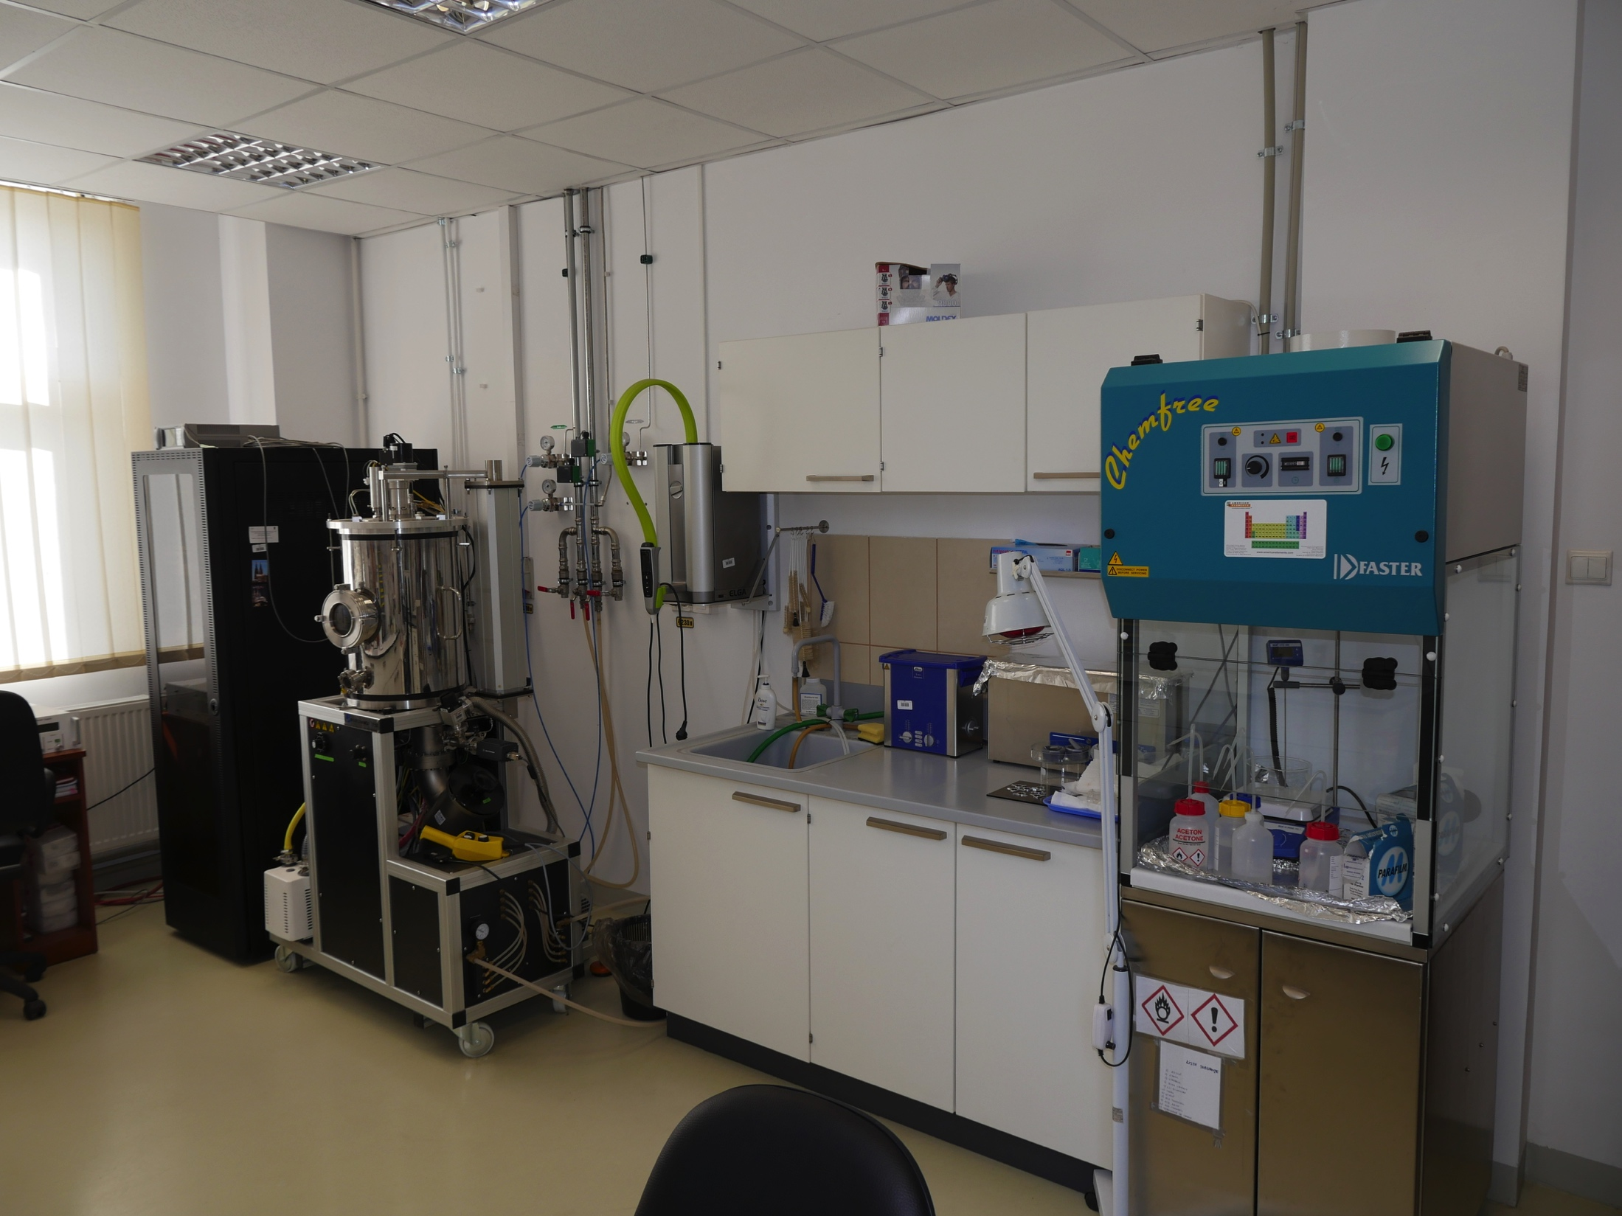

The target preparation laboratory in IFIN-HH
TARGETS FOR NUCLEAR STRUCTURE EXPERIMENTS:
thin films, self-supported or deposited on various backings, the material to be deposited is isotopically enriched
INTDS, 2018
14/81

Slide 17
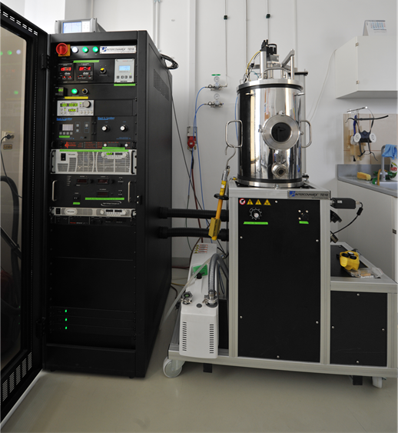
Equipment for target preparation
HIGH VACUUM DEPOSITION SYSTEM produced by
Intercovamex Company
Vacuum chamber
- stainless steel
- cylindrical
- 45 cm diameter
- 53 cm high
used for creating self-supported,
backed or sandwiched targets by:
  - thermal evaporation
  electron-gun evaporation
  sputtering deposition methods
INTDS, 2018
15/81

Slide 18
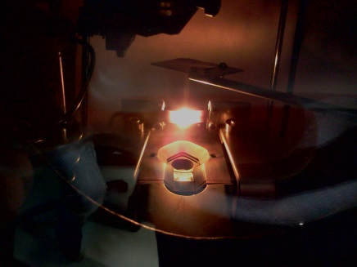
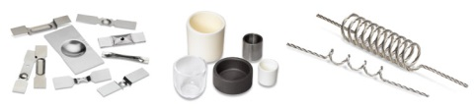
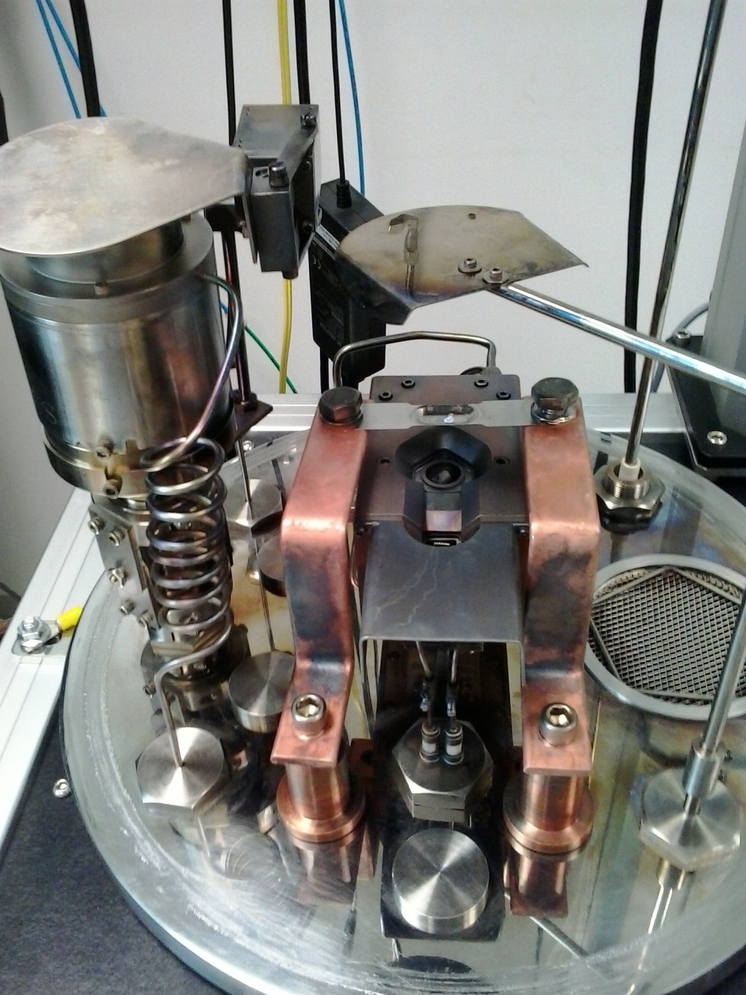
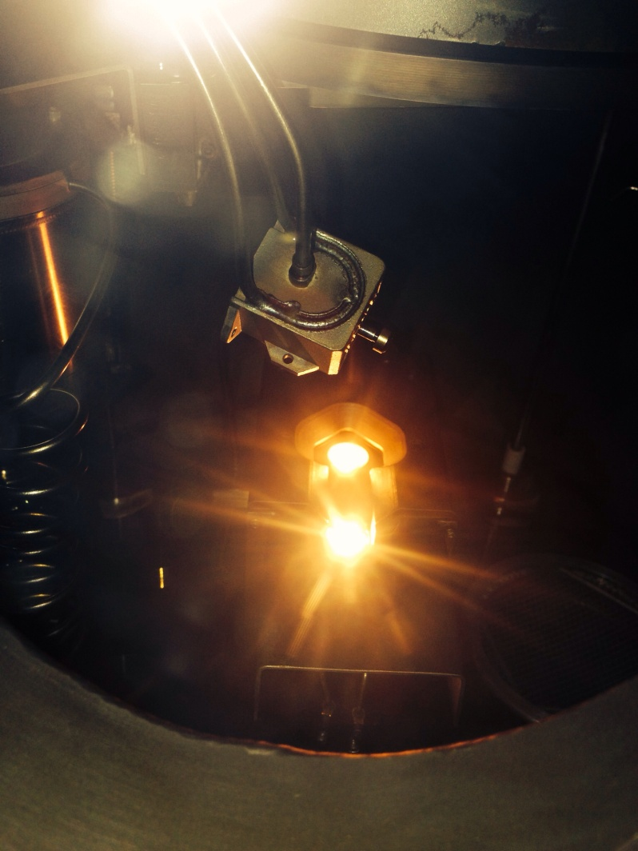
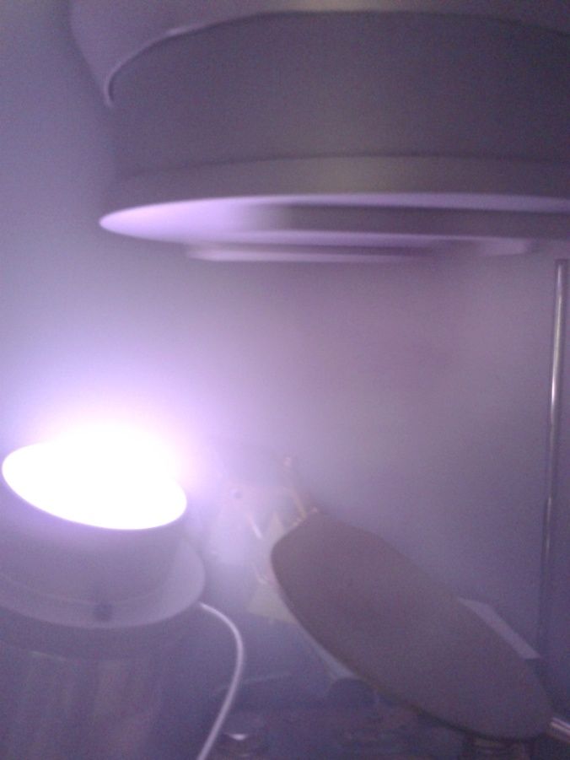
Evaporation methods
Thermal evaporation process
Electron gun process
Sputtering process
INTDS, 2018
16/81

Slide 19
Outlines:
Target laboratory in IFIN-HH
Laboratory development
Target preparation and characterization
Specific examples and particularities
Nuclear forensics laboratory: developing an interdisciplinary collaboration
Conclusions and perspectives
INTDS, 2018
17/81

Slide 20
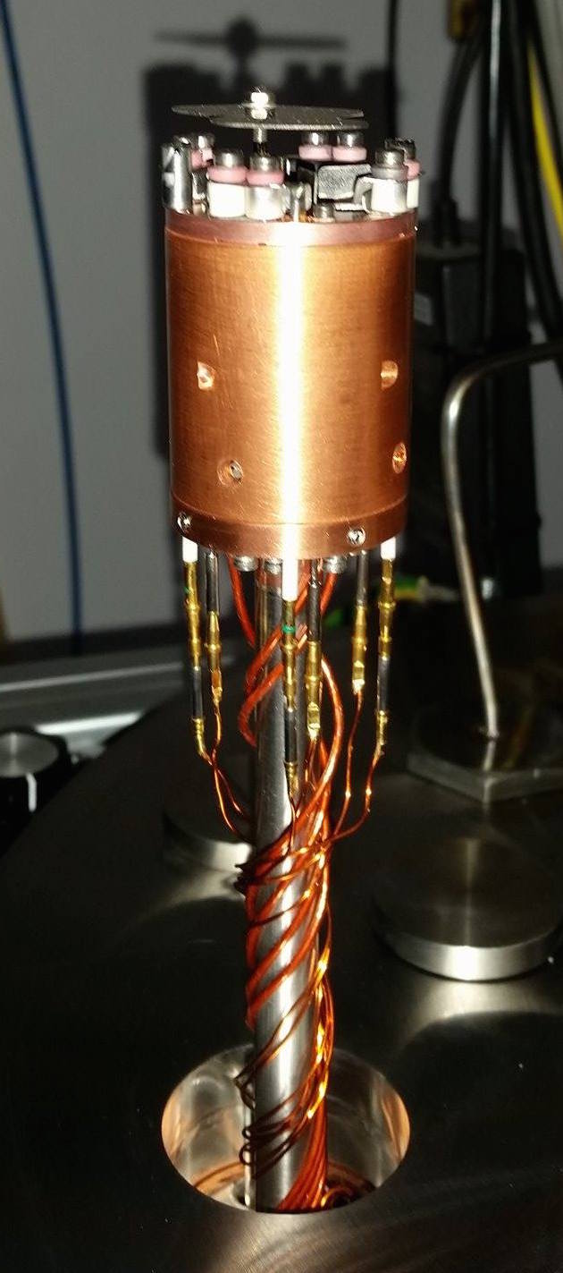
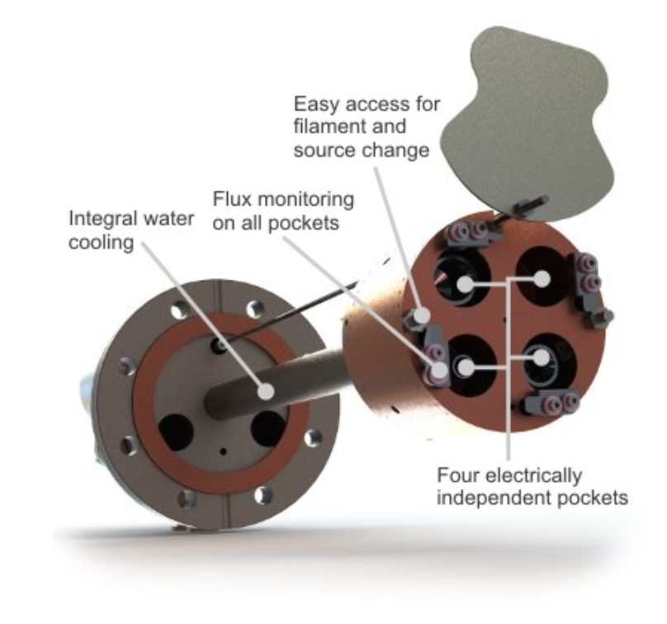
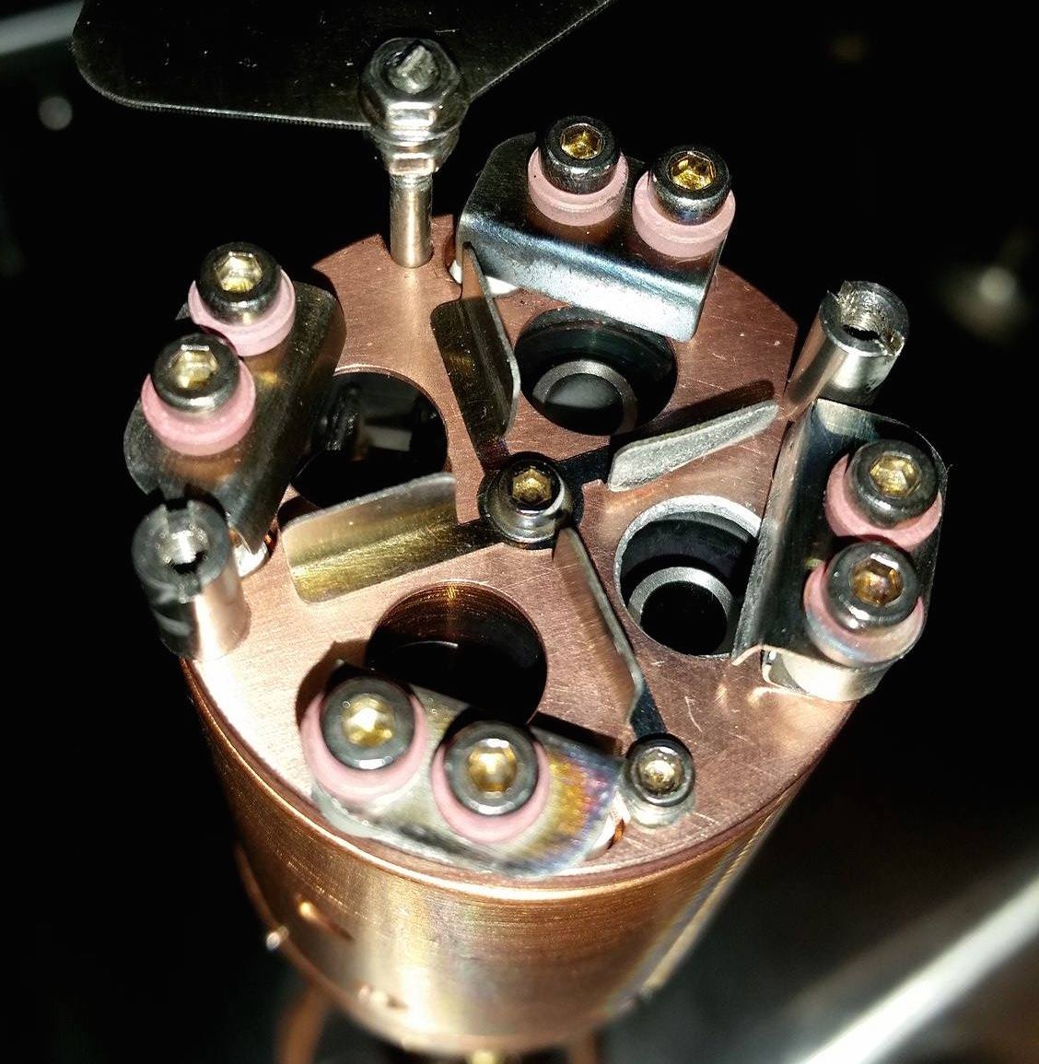
e-beam evaporation - Mantis Deposition System
Description…..
https://www.mantisdeposition.com/uhv-components
INTDS, 2018
18/81

Slide 21
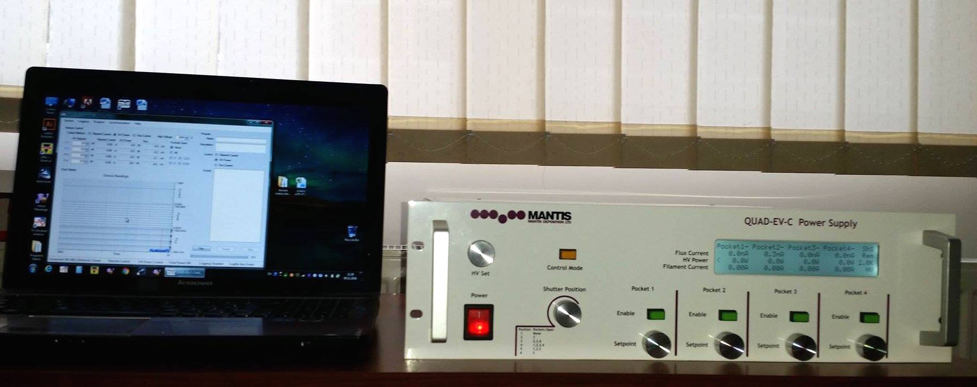
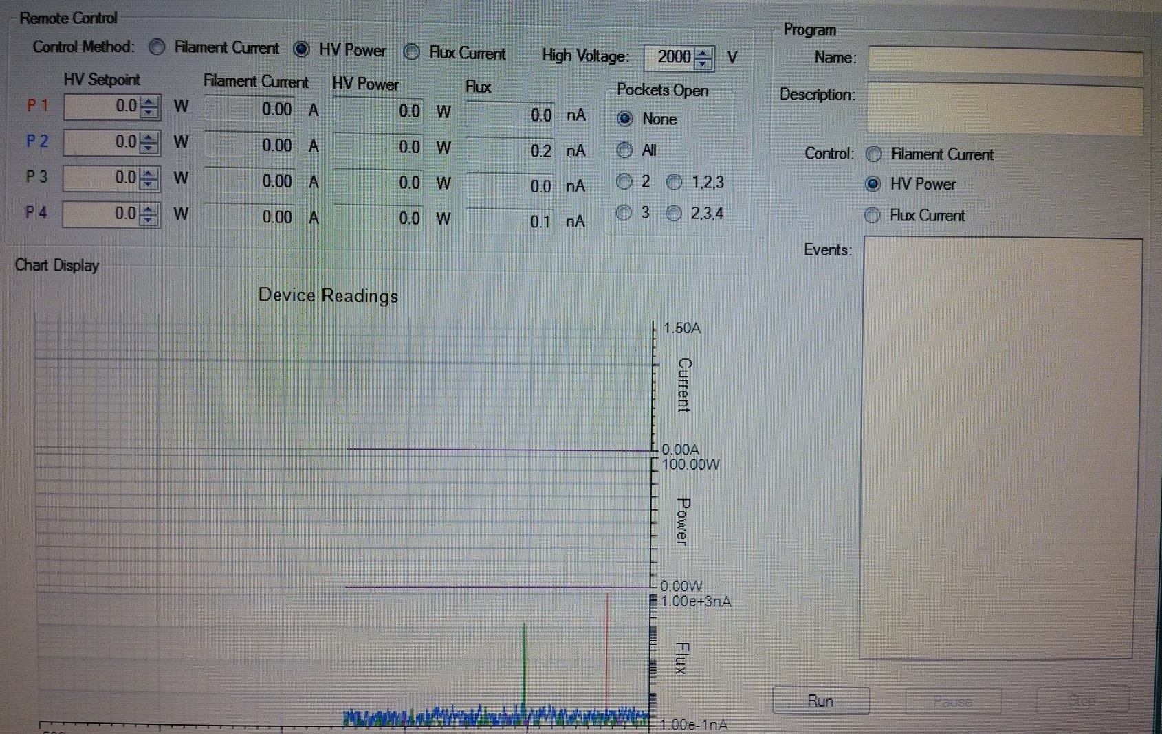
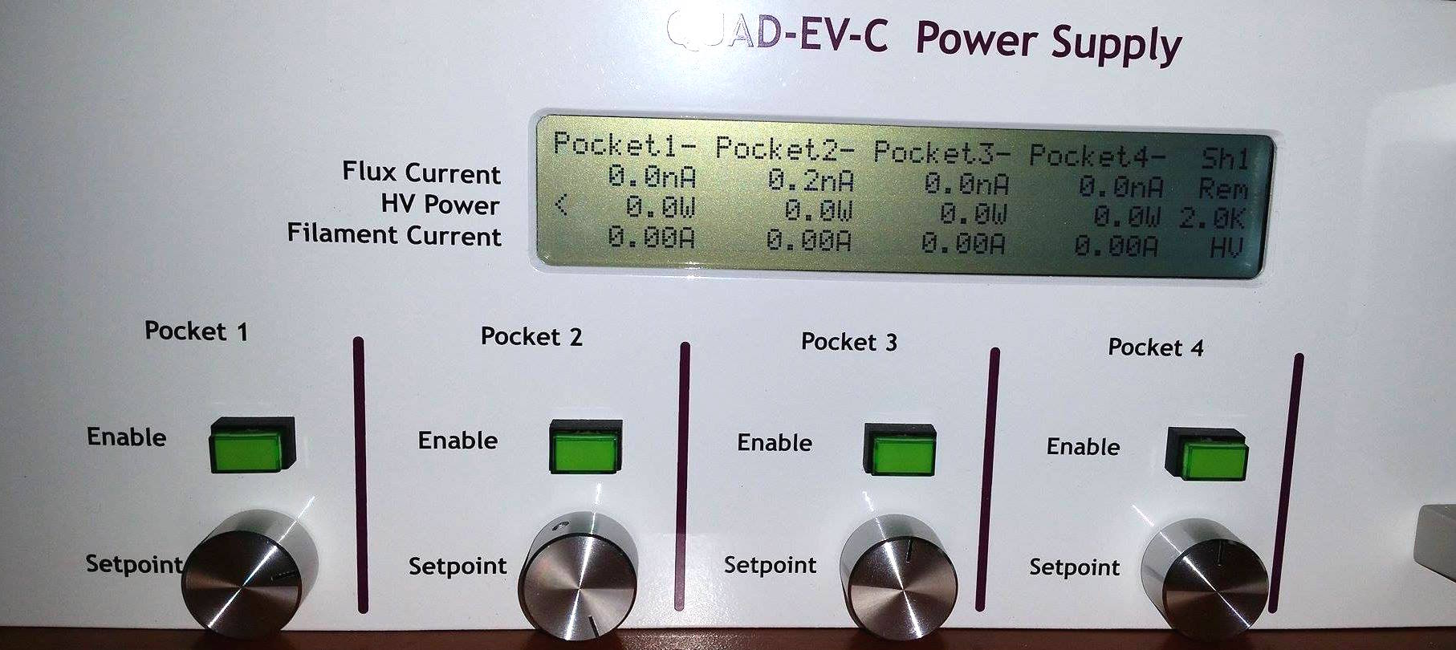
The control system for e-beam
Monitoring all parameters
Control of each pocket
INTDS, 2018
19/81

Slide 22
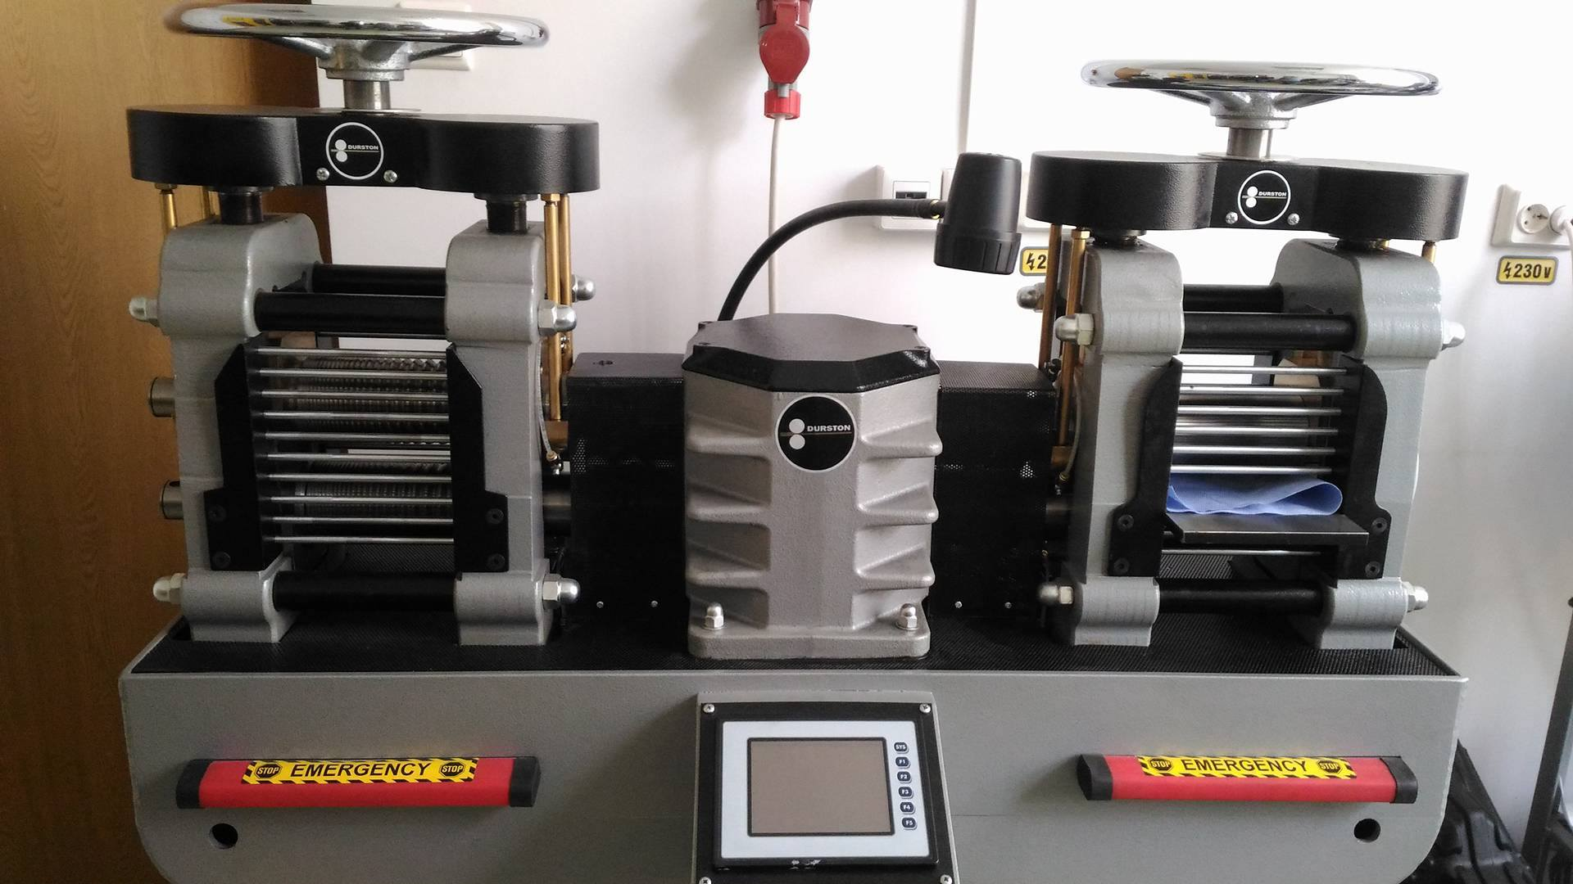
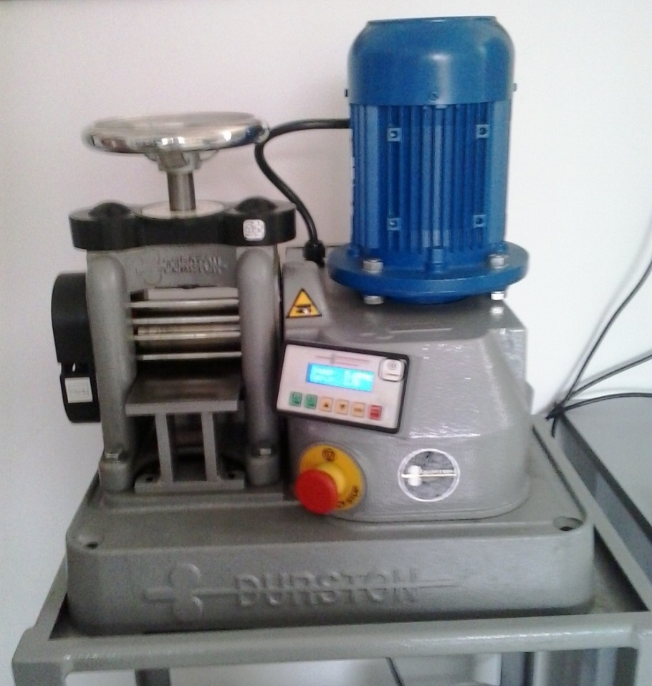
Rolling equipment
This is an extremely efficient method for self-supported metallic foil production using small amounts of starting material. The rolling method allows preparation of metallic foil with thicknesses ranging from several hundreds of µg/cm² to hundreds of mg/cm².
INTDS, 2018
20/81

Slide 23
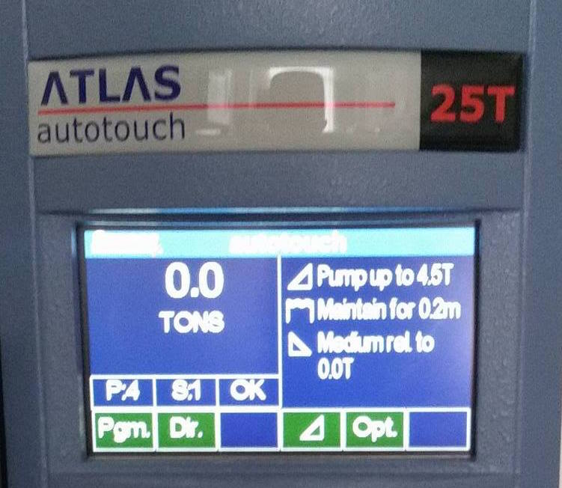
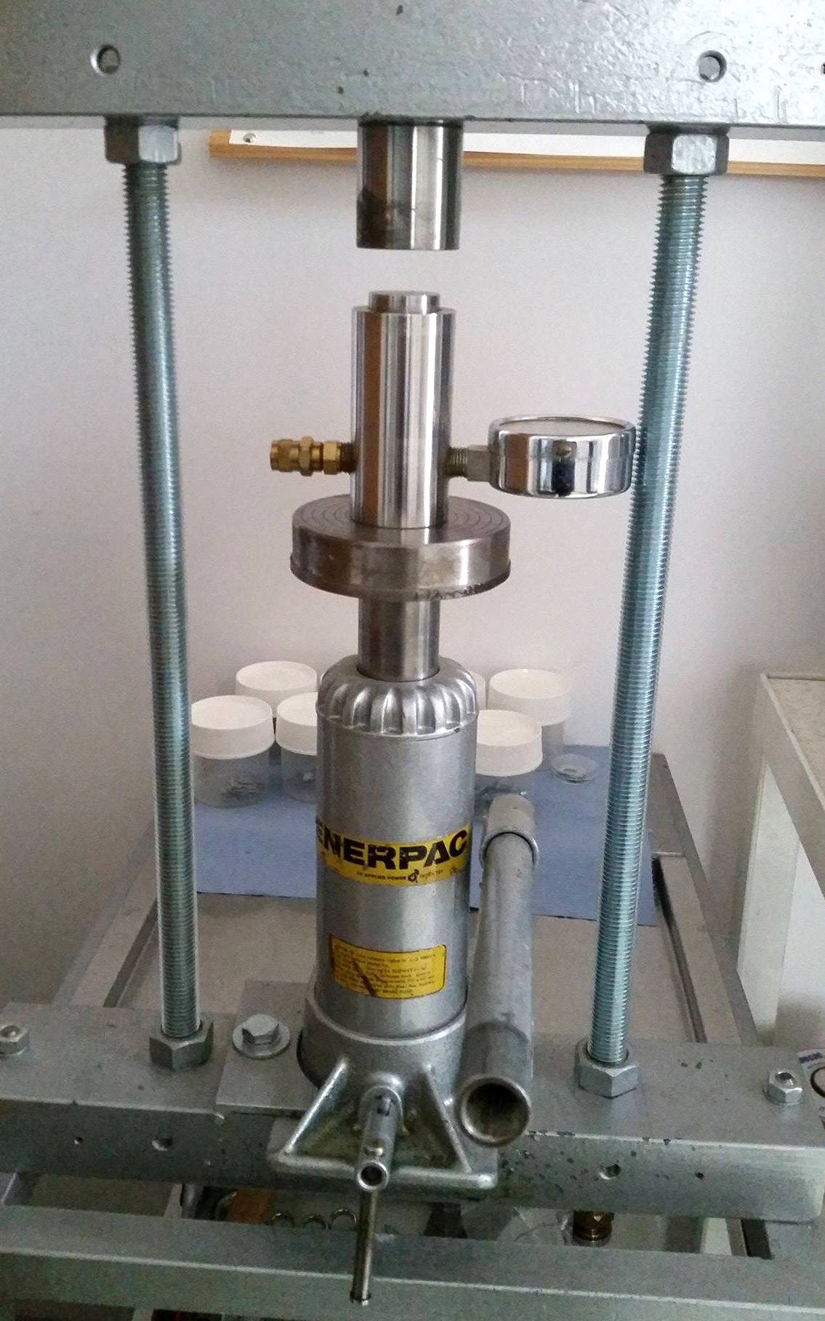
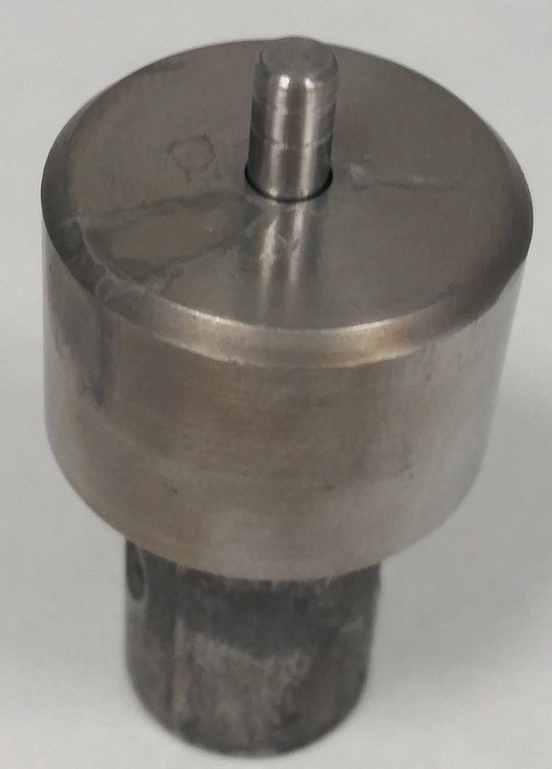
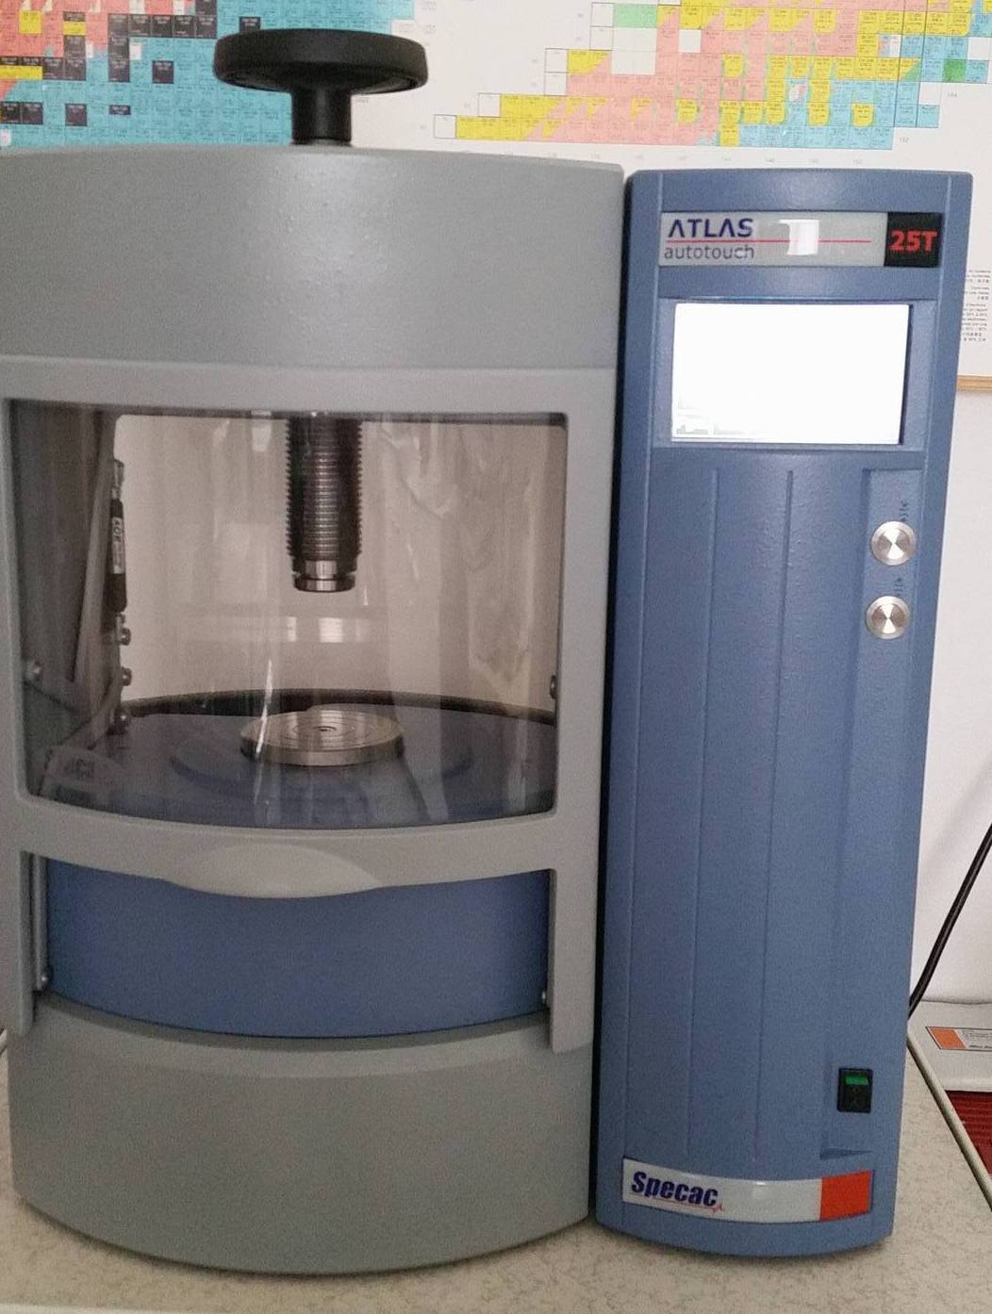
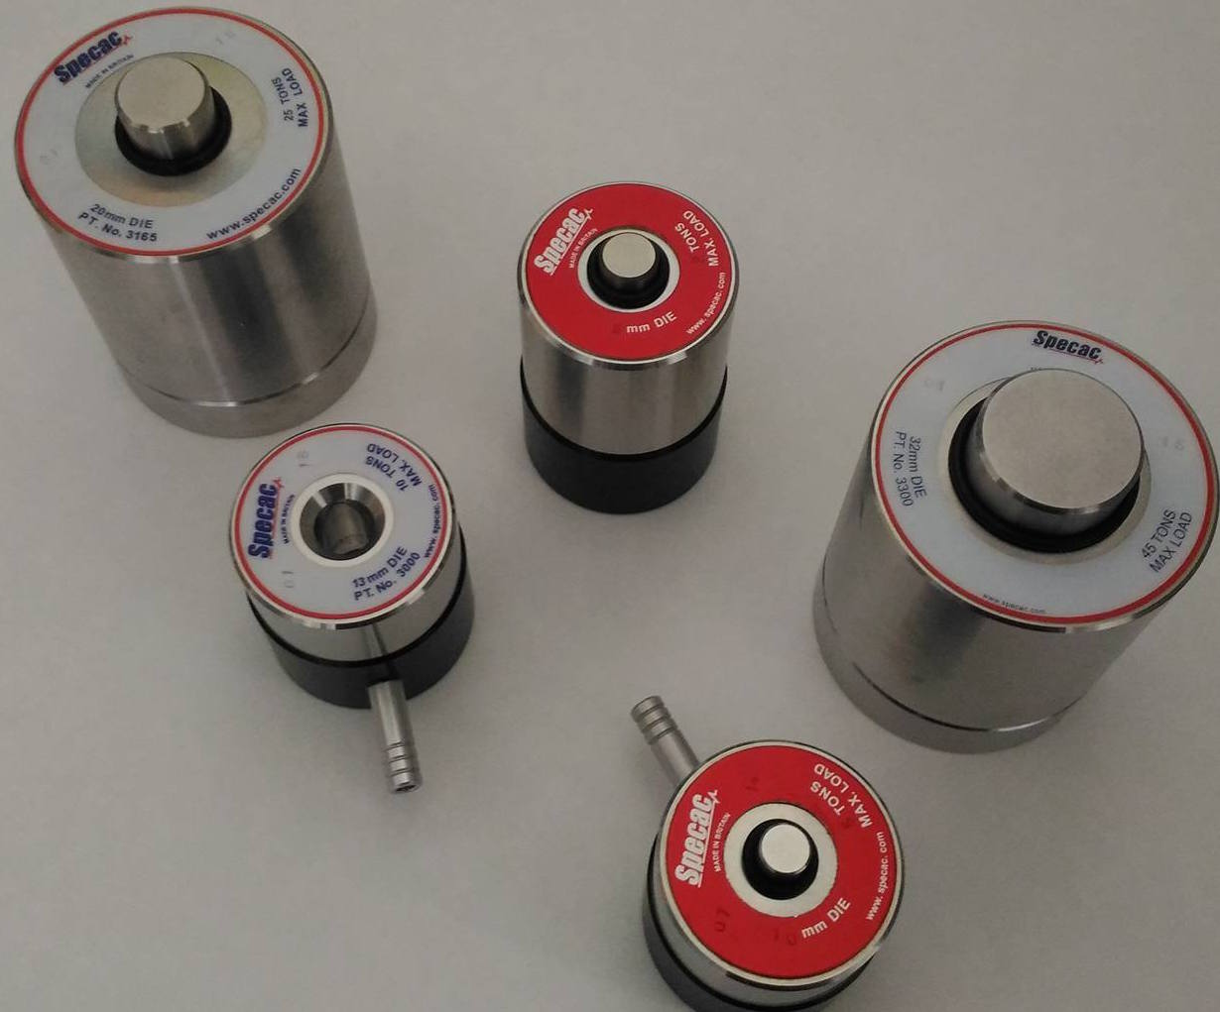
Manual press vs. Hydraulic press
INTDS, 2018
21/81

Slide 24
Outlines:
Target laboratory in IFIN-HH
Laboratory development
Target preparation and characterization
Specific examples and particularities
Nuclear forensics laboratory: developing an interdisciplinary collaboration
Conclusions and perspectives
INTDS, 2018
22/81

Slide 25
How to choose the preparation method?
target characteristics (thickness, surface, shape)
material cost and availability (metallic form, compound)
availability of the method in the target preparation laboratory
method effectiveness
avoiding contamination of the target
INTDS, 2018
23/81

Slide 26
Target characteristics
TARGET
thickness
thickness uniformity
identification of impurities
surface roughness
surface morphology
INTDS, 2018
24/81

Slide 27
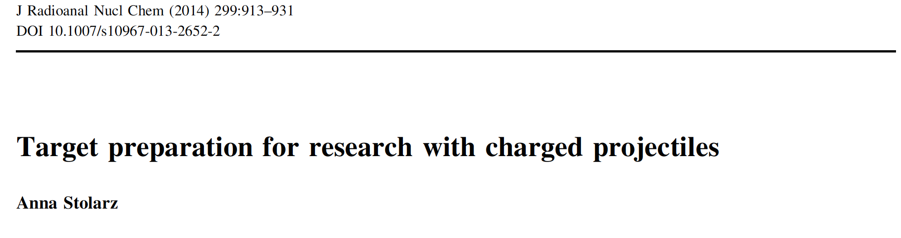
Classification
Target preparation methods
Mechanical reshaping and powder processing
Physical
Chemical
Rolling
Material preparation (melting, conversion into metallic form)
Powder processing (tablet pressing, sedimentation)
Vacuum deposition (resistive heating, electron gun, sputtering)
Electrodeposition
Molecular plating
INTDS, 2018
25/81

Slide 28
Target characterization
Alpha particle energy loss
PIXE (Particle Induced X-Ray Emission)
PIGE (Particle Induced Gamma-Ray Emission)
RBS (Rutherford Back Scattering)
AFM (Atomic Force Microscopy)
SEM/EDX (Scanning Electron Microscopy/ Energy dispersive X-Ray)
XRD (X-ray Diffraction)
INTDS, 2018
26/81

Slide 29

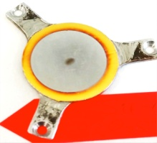
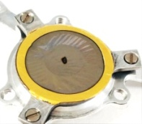
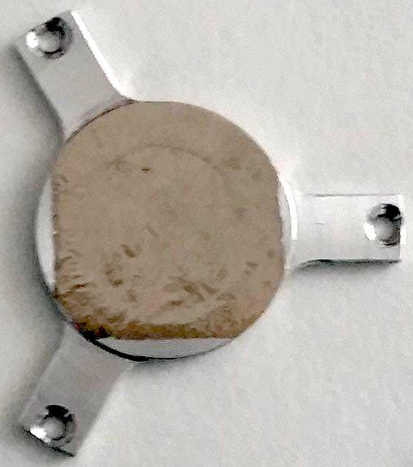
Targets
SrF₂
SrCO₃
⁵⁷Fe
²⁴Mg
⁶⁴Ni
Rh
⁵⁸Ni
⁷⁰Zn
⁶⁸Zn
LiF₂
¹⁹⁶Pt
¹⁹⁴Pt
Os
W
¹⁰⁶Cd
INTDS WEBSITE
INTDS, 2018
27/81

Slide 30




Database
Strong
Community
Network
Database
Argonne National Laboratory, 2018
28/81

Slide 31
Outlines:
Target laboratory in IFIN-HH
Laboratory development
Target preparation and characterization
Specific examples and particularities
Nuclear forensics laboratory: developing an interdisciplinary collaboration
Conclusions and perspectives
INTDS, 2018
29/81

Slide 32
Specific examples and particularities
Preparation and characterization of thick osmium targets
Strontium targets for nuclear astrophysics experiments
Decontamination of ⁶⁴Ni targets
INTDS, 2018
30/81

Slide 33
Preparation and characterization of thick osmium targets
preparation and characterization of Os targets for nuclear astrophysics experiments with alpha particles
Os layer
Al backing
γ
α beam
n
p
Os target
INTDS, 2018
31/81

Slide 34
Required characteristics:
Os
target
very smooth
without specks or wrinkles
constant thickness
INTDS, 2018
32/81

Slide 35

Physical properties
high density
(22.5g/cm³)
toxic
brittle
hard
refractory
high vaporization temperature
(5012 °C)
₇₆Os
Because of its hardness, brittleness, low vapor and very high melting point (3033 °C, the fourth highest of all elements, after only C, W, and Re), solid osmium is difficult to machine, form or work.
INTDS, 2018
33/81

Slide 36

Target preparation method
PULSED LASER DEPOSITION
( PLD )
Developed in collaboration with INFLPR
National Institute for Laser, Plasma and Radiation Physics
(Bucharest-Magurele, Romania)
INTDS, 2018
34/81

Slide 37
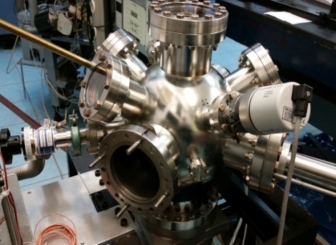
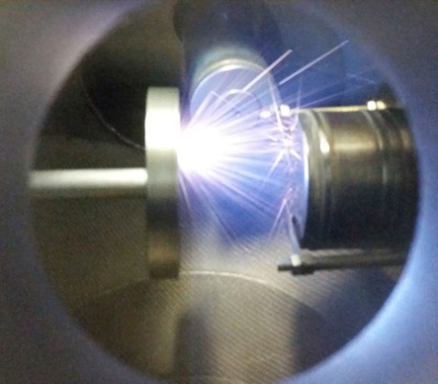
PULSED LASER DEPOSITION (PLD)
vacuum chamber
INTDS, 2018
35/81

Slide 38
The advantages of PLD method
- It allows deposition of chemical elements, compounds and some polymers;
- It allows obtaining thin layers of better quality compared to other methods:
high density
thickness uniformity on the defined surface
controllable thickness
high purity
durability
INTDS, 2018
36/81

Slide 39
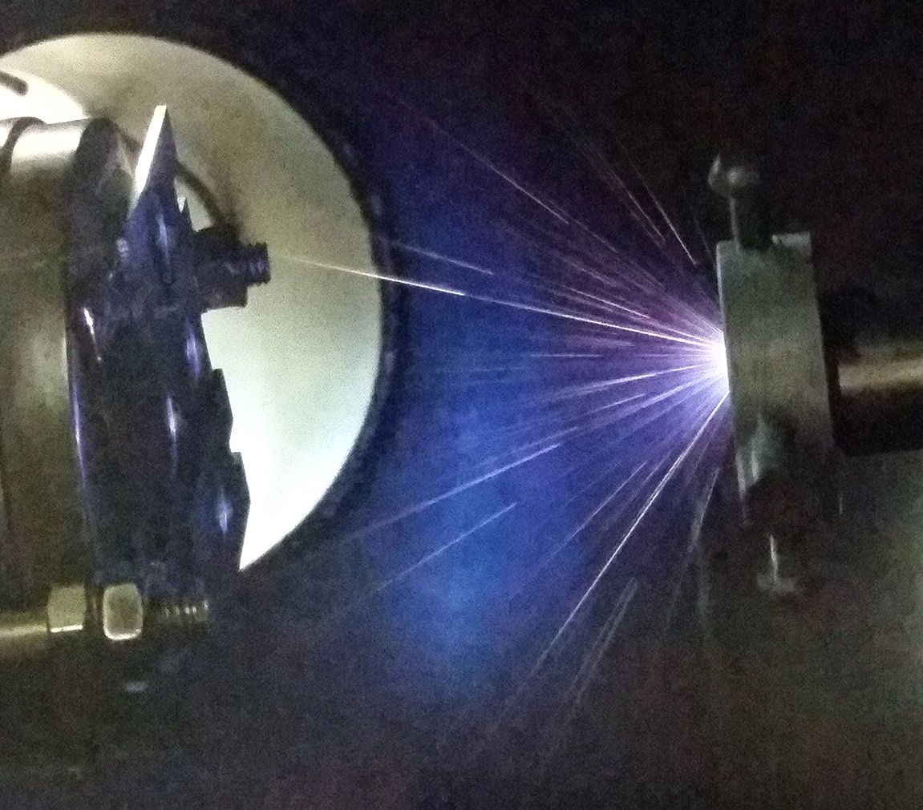
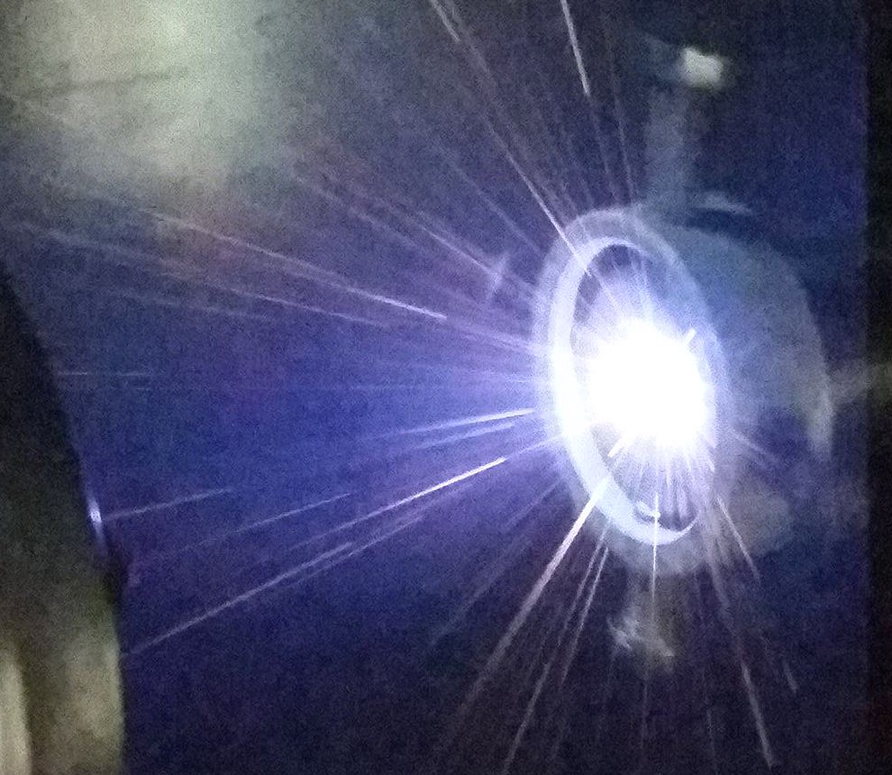
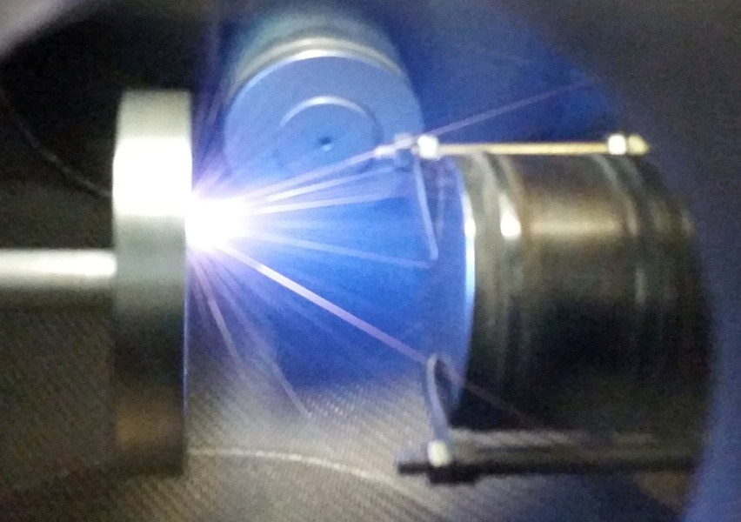
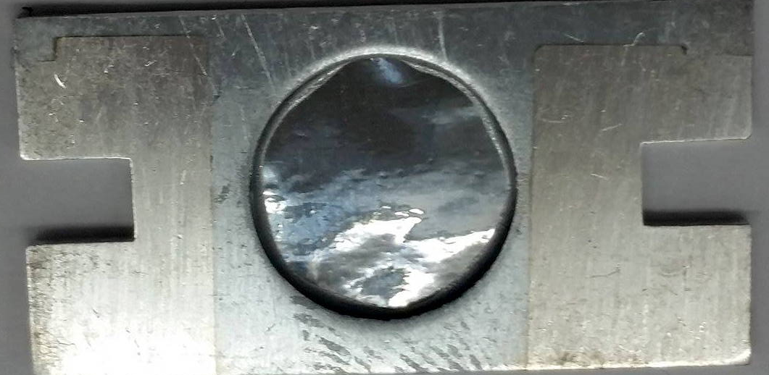

Os targets
Nd:YAG Laser: 1064 nm (IR range)
Os [2000nm] / Al [20um]
Os [100nm] / glass (test)
INTDS, 2018
37/81

Slide 40
Target characterization
-morphology, composition, structure and thickness determination-
XRD (X-Ray Diffraction)
RBS (Rutherford Back Scattering)
AFM (Atomic Force Microscopy)
SEM/EDX (Scanning Electron Microscopy/ Energy Dispersive X-ray Spectroscopy)
INTDS, 2018
38/81

Slide 41
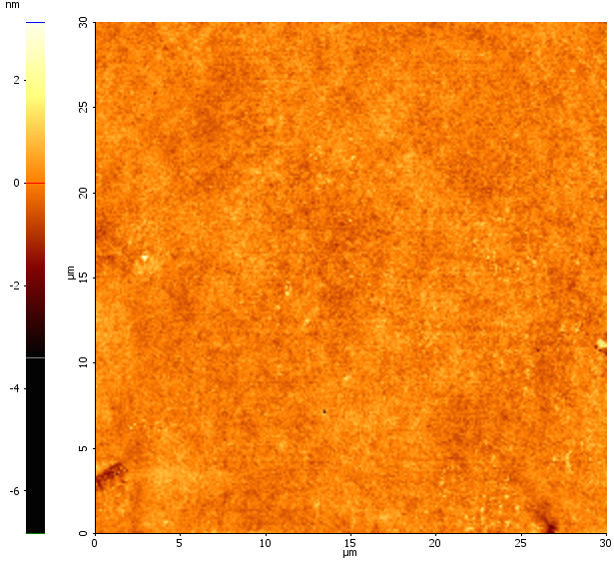




Morphological features
Backing
Short deposition (5 h)
Long deposition (30 h)
glass
Os/glass
AFM
topography images
R_{q}=0.31 nm
Rq=1.38 nm
Al
Os/Al
Os/Al
R_{q}=35.6 nm
R_{q}=44.06 nm
R_{q}=36.33 nm
INTDS, 2018
39/81

Slide 42




SEM and EDX Os/Al mapping micrographs
Os/Al
Mag=25.00KX
Al
Al
INTDS, 2018
40/81

Slide 43
XRD spectra
INTDS, 2018
41/81

Slide 44

RBS spectra of Os deposited on Al,
measured by the RBS fixed detector at 165°
It implies - the use of a rather simple scattering geometry
- the use of a beam composed of light nuclei
- a particle detector placed at backwards angles
The thickness is: 98.6 nm, corresponding to 0.222 mg/cm²
The thickness is: 2240 nm, corresponding to 5.05 mg/cm²
INTDS, 2018
42/81

Slide 45

Experimental results
Example of one of the reaction of interest:
Os stable isotopes:
¹⁸⁴Os 0.02 %
¹⁸⁶Os 1.59 %
¹⁸⁷Os 1.96 %
¹⁸⁸Os 13.24 %
¹⁸⁹Os 16.15 %
¹⁹⁰Os 26.26 %
¹⁹²Os 40.78 %
INTDS, 2018
43/81

Slide 46

Strontium targets for nuclear astrophysics experiments
Proposed experiment
0.56 % ⁸⁴Sr
9.86 % ⁸⁶Sr
7.00 % ⁸⁷Sr
82.58 % ⁸⁸Sr
⁸⁸Zr
⁸⁹Zr
⁹⁰Zr
⁹¹Zr
⁹²Zr
(α,γ)
(α,n)
(α,p)
(α,p)
(α,p)
⁸⁷Y
⁹⁰Y
⁹¹Y
⁸⁴Sr
⁸⁶Sr
⁸⁷Sr
⁸⁸Sr
The isotopes produced on natural strontium targets by α irradiation
INTDS, 2018
44/81

Slide 47

Ideal target
INTDS, 2018
45/81

Slide 48


Slide 49

Can we use it?
NO!

Slide 50

Trouble…
Metallic Sr targets exhibit a significant chemical activity and oxidize very fast in regular environment (air)!
INTDS, 2018
48/81

Slide 51

Solutions?
This is a major constraint for measuring absolute cross-sections for the alpha particle activation of Sr isotopes.
INTDS, 2018
49/81

Slide 52

Strontium compounds
Goal of the present study:
overcome this constraint by using targets consisting of strontium compounds which are not reactive in air!
SrF₂
SrCO₃
INTDS, 2018
50/81

Slide 53






Targets
⁸⁴Sr
⁸⁶Sr
⁸⁷Sr
⁸⁸Sr
SrF₂
SrCO₃
INTDS, 2018
51/81

Slide 54


Preparation of Sr targets
1. Pressing powder
2. Heating pellet
3. Evaporation of the Sr compound on Al backing
INTDS, 2018
52/81

Slide 55
Vaporization temperature
~1500°C
~3000°C
SrF₂
SrCO₃
INTDS, 2018
53/81

Slide 56
Target characterization
XRD (X-Ray Diffraction)
SEM (Scanning Electron Microscopy)
EDX (Energy Dispersive X-ray)
Nuclear activation measurements
INTDS, 2018
54/81

Slide 57


X-ray diffraction
SrF₂
SrCO₃
XRD patterns of Al substrate, SrF₂ powder and SrF₂/ Al target
XRD patterns of Al substrate, SrCO₃ powder and SrCO₃/ Al target
INTDS, 2018
55/81

Slide 58


SEM micrographs
SrF₂
B
SrCO₃
4μm
Al backing
SEM micrographs of:
SrF₂/ Al
SrCO₃/ Al
Al backing
INTDS, 2018
56/81

Slide 59


EDX analyses
Copper contamination!
INTDS, 2018
57/81

Slide 60
Nuclear activation spectra
SrF₂
⁸⁷Sr(α,p)⁹⁰Y
⁸⁴Sr(α,p)⁸⁷Y
⁸⁶Sr(α,n)⁸⁹Zr
SrCO₃
⁸⁶Sr(α,n)⁸⁹Zr
⁸⁴Sr(α,p)⁸⁷Y
INTDS, 2018
58/81

Slide 61


Slide 62




Decontamination of ⁶⁴Ni targets
AIM and IMPORTANCE of the experiment
- shape coexistence in ⁶⁶Ni
T. Otsuka , private communication
⁶⁴Ni(¹⁸O,¹⁶O)⁶⁶Ni 39 MeV ROSPHERE array
INTDS, 2018
60/81

Slide 63




Target used in the experiment
68%
26%
1%
4%
~1%
INTDS, 2018
61/81

Slide 64
Targets required for the proposed experiment
2 thick
targets
3-4 thin
targets
5 mg/cm²
1 mg/cm²
To achieve all these targets I started
from 100 mg of ⁶⁴Ni powder
INTDS, 2018
62/81

Slide 65


Preparation of ⁶⁴Ni foils
1. Pressing powder
2. Heating pellet
3. Rolling process
INTDS, 2018
63/81

Slide 66

Reaction Kinematics below Coulomb barrier
Before
After
¹⁶O
¹⁸O
⁶⁴Ni
⁶⁶Ni
γ
+2n
HPGe detectors
ROSPHERE
INTDS, 2018
64/81

Slide 67

¹⁸O + ⁶⁴Ni @ 39 MeV
Fusion-evaporation
cross-section calculation
Contaminants from ¹⁸O on ¹⁶O
1760
⁶⁶Ni
1425
INTDS, 2018
65/81

Slide 68
How to improve the experimental
results?
Removing oxygen
INTDS, 2018
66/81

Slide 69
How to remove the oxygen?
Which is the first formula that we learn in chemistry?
O
2H
H₂O
INTDS, 2018
67/81

Slide 70


Hydrogen oven
INTDS, 2018
68/81

Slide 71

The thermal treatment for the ⁶⁴Ni target
a- heating to 600⁰C (60min)
b- stationary at 600⁰C (30min)
c- heating to 645⁰C (60min)
d- stationary at 645⁰C (15min)
e- heating to 650⁰C (60min)
f- stationary at 650⁰C(120min)
g- cooling process to 25⁰C (625min)
INTDS, 2018
69/81

Slide 72

Comparison between before (top) and after (bottom)
the “target treatment”
The peak at 1425 keV has been used as normalization the two spectra
INTDS, 2018
70/81

Slide 73

¹⁸O + ⁶⁴Ni @ 39 MeV
(γγ – total projection)
INTDS, 2018
71/81

Slide 74



Slide 75
Concluding remarks
2
3
improvements
process efectiveness
1
Argonne National Laboratory, 2018
73/81

Slide 76
Outlines:
Target laboratory in IFIN-HH
Laboratory development
Target preparation and characterization
Specific examples and particularities
Nuclear forensics laboratory: developing an interdisciplinary collaboration
Conclusions and perspectives
INTDS, 2018
74/81

Slide 77

The first nuclear forensics laboratory of Romania
The aim of this project:
Age, Isotopic Composition, Physical Form, Chemical Composition, Microstructure, Impurities, Dimensions, Surface roughness, etc.
Materials that contain uranium, plutonium and their descents
National Nuclear Forensic Library
Loss-of-Control Point
INTDS, 2018
75/81

Slide 78


Why?
Over 630 nuclear trafficking incidents were recorded in the Black Sea states between 1991 and 2012
“In a strange turn of history, the threat of global nuclear war has gone down, but the risk of a nuclear attack has gone up.”
© B. Obama
INTDS, 2018
76/81

Slide 79
Unknown nuclear material
CHEMICAL CHARACTERISTICS
PHYSICAL CHARACTERISTICS
-the exact chemical composition of the material -1 week
-weight, sizes and geometry -24h
-microstructure, morphology (aprox. 0.5μm) -24h
-microstructure, morphology (≤ 1nm) -1 week
NULCEAR MATERIAL IDENTIFICATION
(U, Pu, MOX and their daughter products)
-metallic impurities, other elements -1 week
-type of material and isotopic composition -24h
-age determination -2months
ELEMENTAL
COMPOSITION
ISOTOPIC
COMPOSITION
INTDS, 2018
77/81

Slide 80
Tuning the first Romanian nuclear forensics lab
to Euroatlantic standards
Physical characteristics and macroscopic parameters:
Precise analytical balance
3D scanner
Optical microscope
High-resolution scanning electron microscope (SEM), equipped with energy dispersive X-ray detector (EDX)
X-ray diffractometer (XRD)
Chemical and isotopic composition:
Particle induced X-ray emission (PIXE)
Particle induced γ-ray emission (PIGE)
AMS (Accelerator Mass Spectrometry)
Gamma-ray Spectrometry
INTDS, 2018
78/81

Slide 81
Outlines:
Target laboratory in IFIN-HH
Laboratory development
Target preparation and characterization
Specific examples and particularities
Nuclear forensics laboratory: developing an interdisciplinary collaboration
Conclusions and perspectives
INTDS, 2018
79/81

Slide 82
Conclusions and perspectives
ACHIEVEMENTS:
Thin films preparation for various types of nuclear physics experiments with accelerators
Production of targets by pulsed laser deposition
Target quality - characterization in terms of thickness, uniformity, purity in collaboration with several departments of our Institute
LOOKING FORWARD:
Developing a database
INTDS, 2018
80/81

Slide 83

THANK YOU FOR YOUR ATTENTION!
INTDS, 2018
81/81

