Slide 2
First Experience with Carbon Stripping Foils for the 160 MeV H⁻ Injection into the CERN PSB
Chiara Bracco
Louise Jorat
Remy Noulibos
Pieter van Trappen
Wim Weterings

Slide 3
Abstract
In 2020, after the CERN accelerators complex Long Shutdown 2 (LS2), a novel Linac4 (L4)-to-PS Booster (PSB) charge-exchange injection system will allow to transform the L4 160 MeV H⁻ beam into H⁺, which will be injected into the four PSB superposed rings. For this, a 200 µg/cm² carbon stripping foil will convert negative hydrogen ions (H⁻) into protons by stripping off the electrons. L4 is now performing operational reliability runs, which include a stripping foil test stand installed in the L4 transfer line. These tests will permit to gain experience on the fragile foils, test different foil materials and thicknesses, measure the efficiency and lifetime of the foils, and evaluate the foil changing mechanism as well as the interlocking functions. This paper briefly describes the stripping foil test stand setup, before reporting on the obtained important test results.

Slide 4


Outline
Introduction to the LIU project
  Foil Exchange Mechanism
  Stripping Foil Test Stand
  Test Conditions
  Test results
  Conclusion
Measurements with the Stripping Foil Test Stand in the Linac4 Transfer Line
29th World Conference of the International Target Development Society
INTDS2018, Michigan (USA), 10/10/2018
Wim WETERINGS, Slide 4

Slide 5

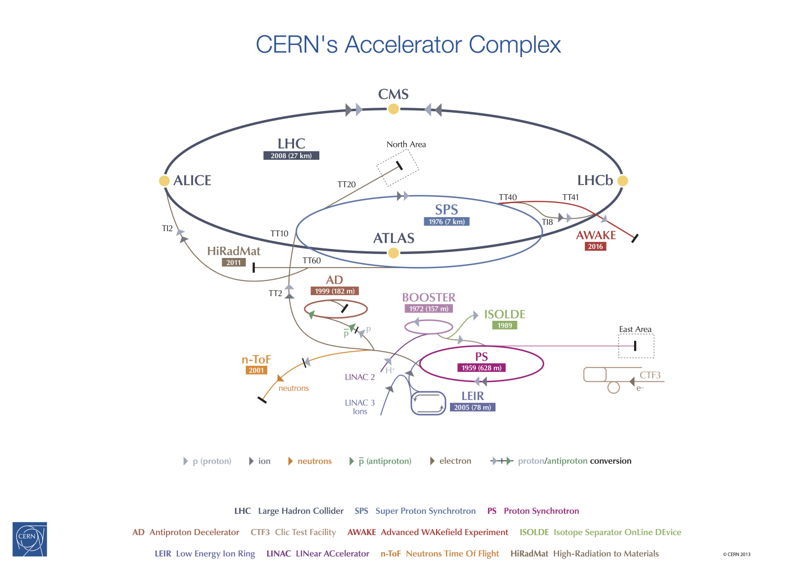
Introduction to LIU Project
Present
LIU Project
Proton flux / Beam power
50 MeV
Linac2
Linac4
160 MeV
P⁺
H⁻
1.4 GeV
PSB
2.0 GeV
PSB
P⁺
26 GeV
Output energy
PS
PS
H⁻ Charge exchange
New Linac4
160Mev H⁻
450 GeV
SPS
LINAC 4
H−
(Presently 6.5TeV)
LHC /
HL-LHC
The CERN Accelerator Complex
7 TeV
The LHC injector chain needs to produce beams with the challenging High Luminosity LHC (HL-LHC) parameters. The LHC Injectors Upgrade (LIU) project comprises a new Linac4 and major upgrades of the Proton Synchrotron Booster (PSB), the Proton Synchrotron (PS) and the Super Proton Synchrotron (SPS).

Slide 6
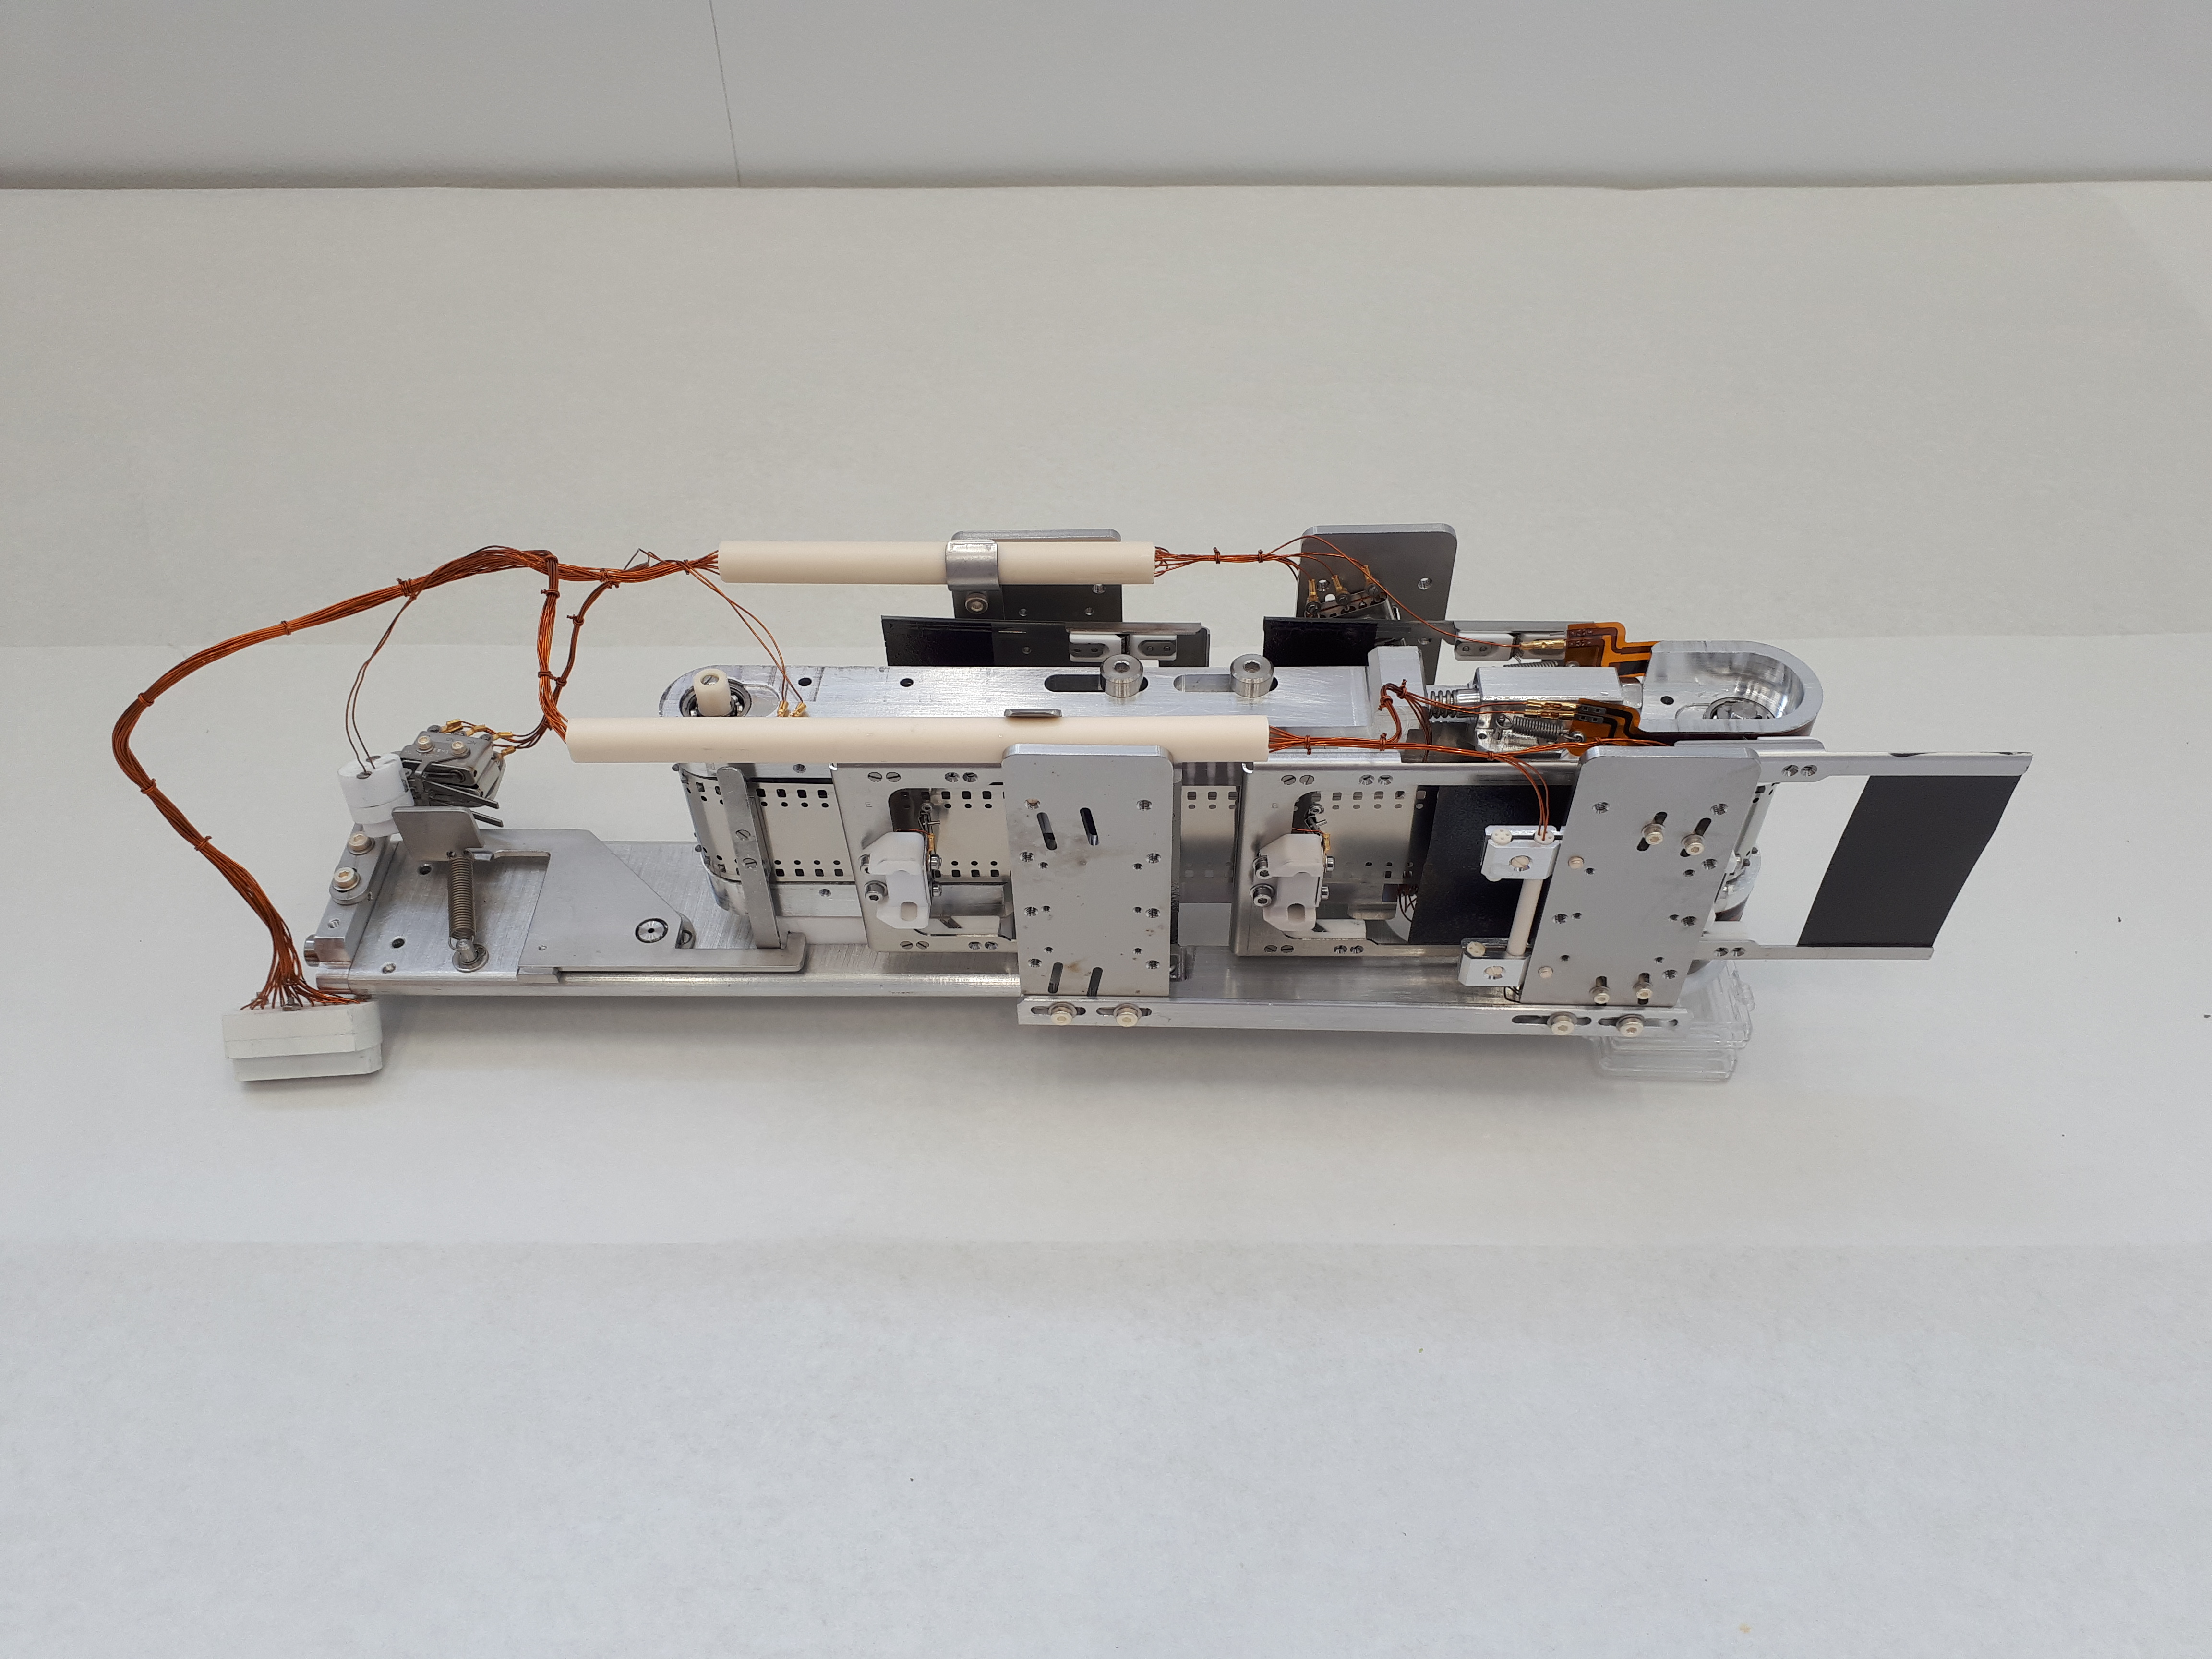
Stripping Foil Exchange Mechanism (TKSTR)
UHV compatible Kapton® cabling
UHV compatible micro switches
membrane potentiometers
Beam
rotating stainless steel belt for 6 holders
Ceramic cable guides
holder with 200µg/cm² stripping foils attached
Schematic top view of the loader with foil in beam
Rotation
Schematic top view of the loader with foil out beam

Slide 7
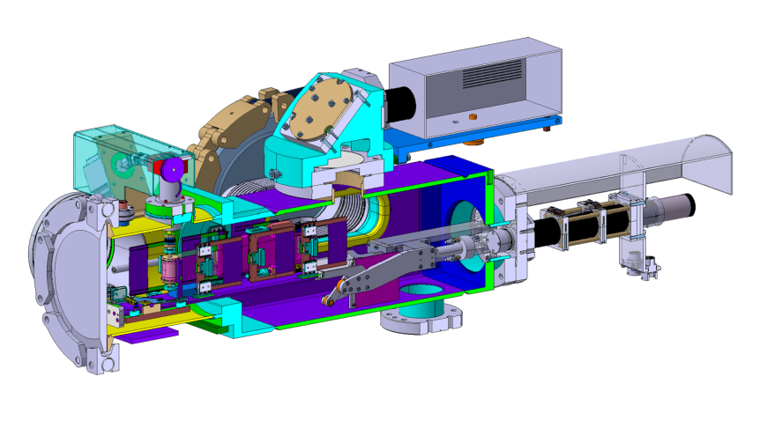
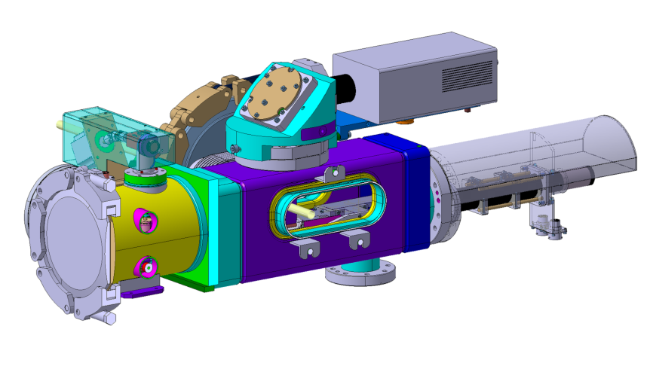
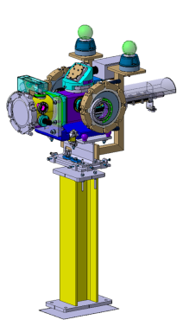
Stripping Foil Test Stand – from INTDS2014
Conceptual Design
J. Radioanal. Nucl. Chem. (2015) 305: 831. doi:10.1007/s10967-014-3917-0
Radiation Hard
Camera
Mirrors and
Optical Filters
Stepping motor with resolver
Beam
Foil Exchange
Mechanism
(TKSTR)
Beam Observation
System (BTV) with
Screen retracted
Rotational Feedthrough

Slide 8
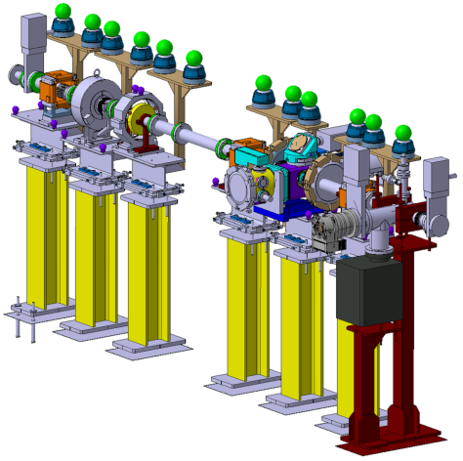
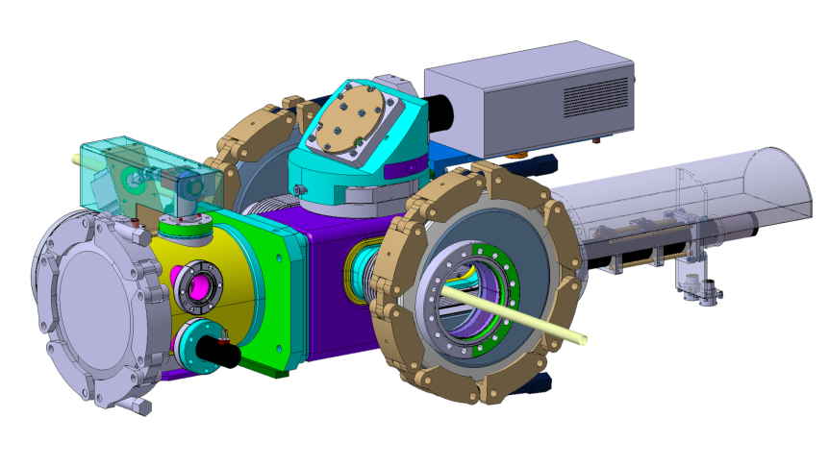
Stripping Foil Test Stand – from INTDS2014
Conceptual Design
J. Radioanal. Nucl. Chem. (2015) 305: 831. doi:10.1007/s10967-014-3917-0
Beam Current
Transformer (BCT)
Beam
Vacuum
Valve
VacuumValve
In order to gain experience with the foil changing mechanism and the very fragile foils a stripping foil test stand was installed in the Linac4 transfer line.
Integrated in a Vacuum tank
Stripping Foil
Test Stand
Vacuum
Chamber

Slide 9
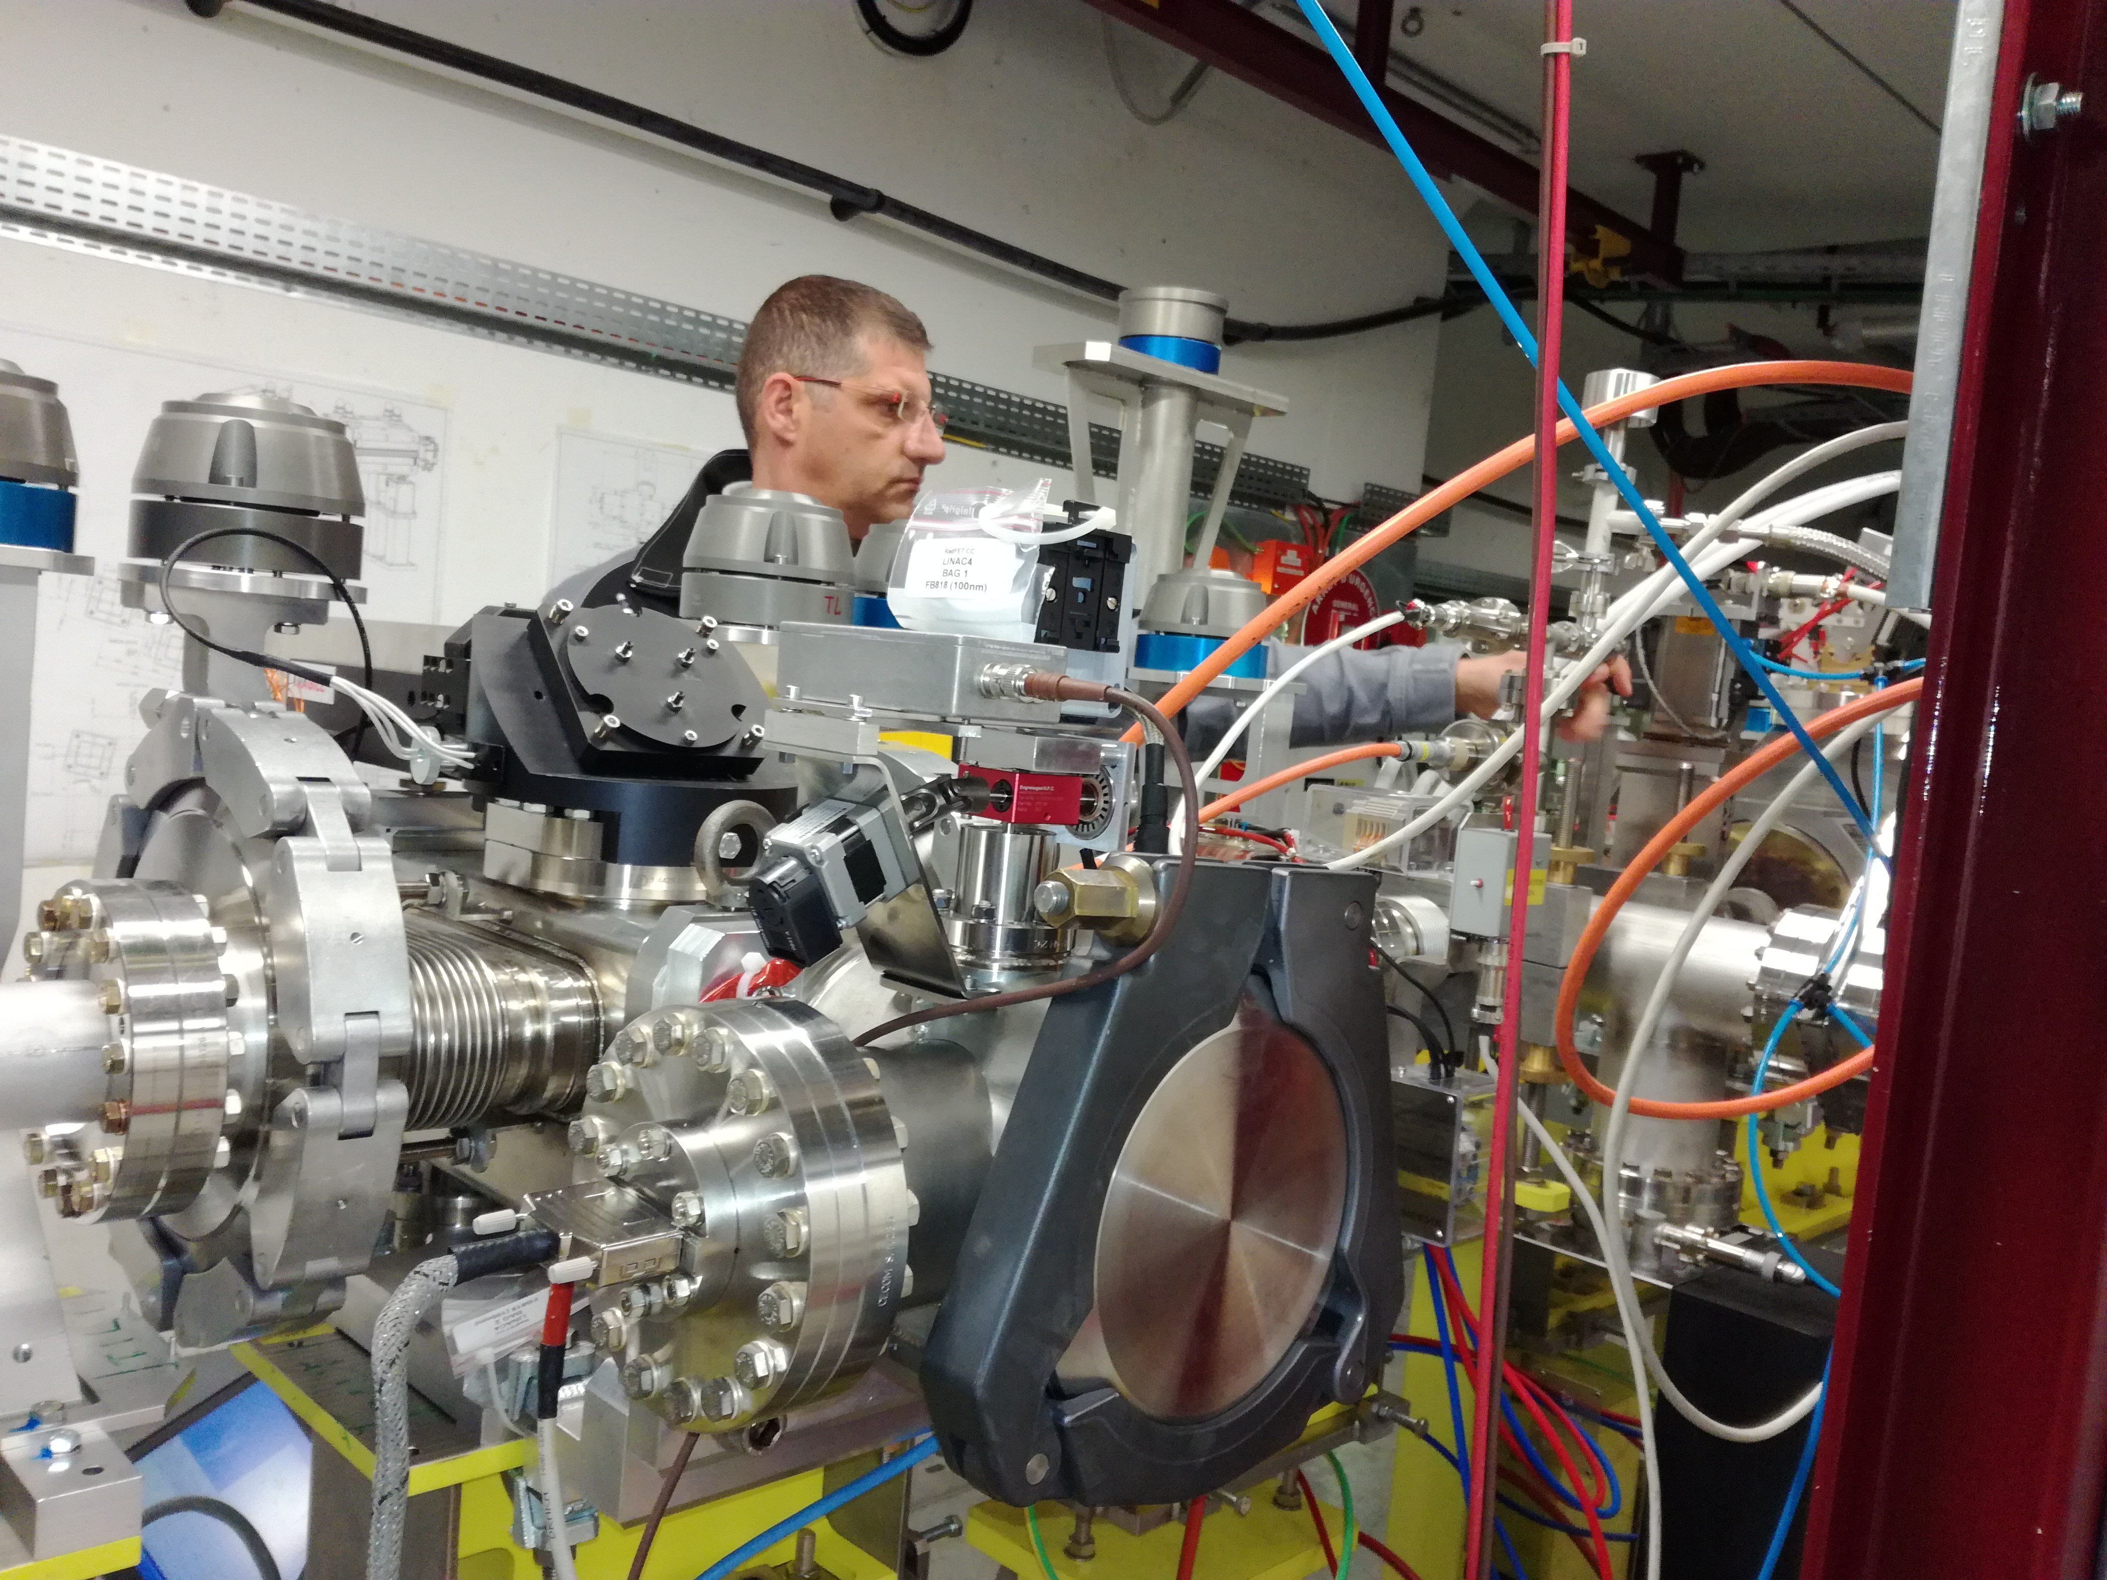
Stripping foil Test stand (TKSTR side)
TKSTR Motorisation
Camera optic module
Flange for loading foil mechanism
Measurements with the Stripping Foil Test Stand in the Linac4 Transfer Line
29th World Conference of the International Target Development Society
INTDS2018, Michigan (USA), 10/10/2018
Wim WETERINGS, Slide 9

Slide 10
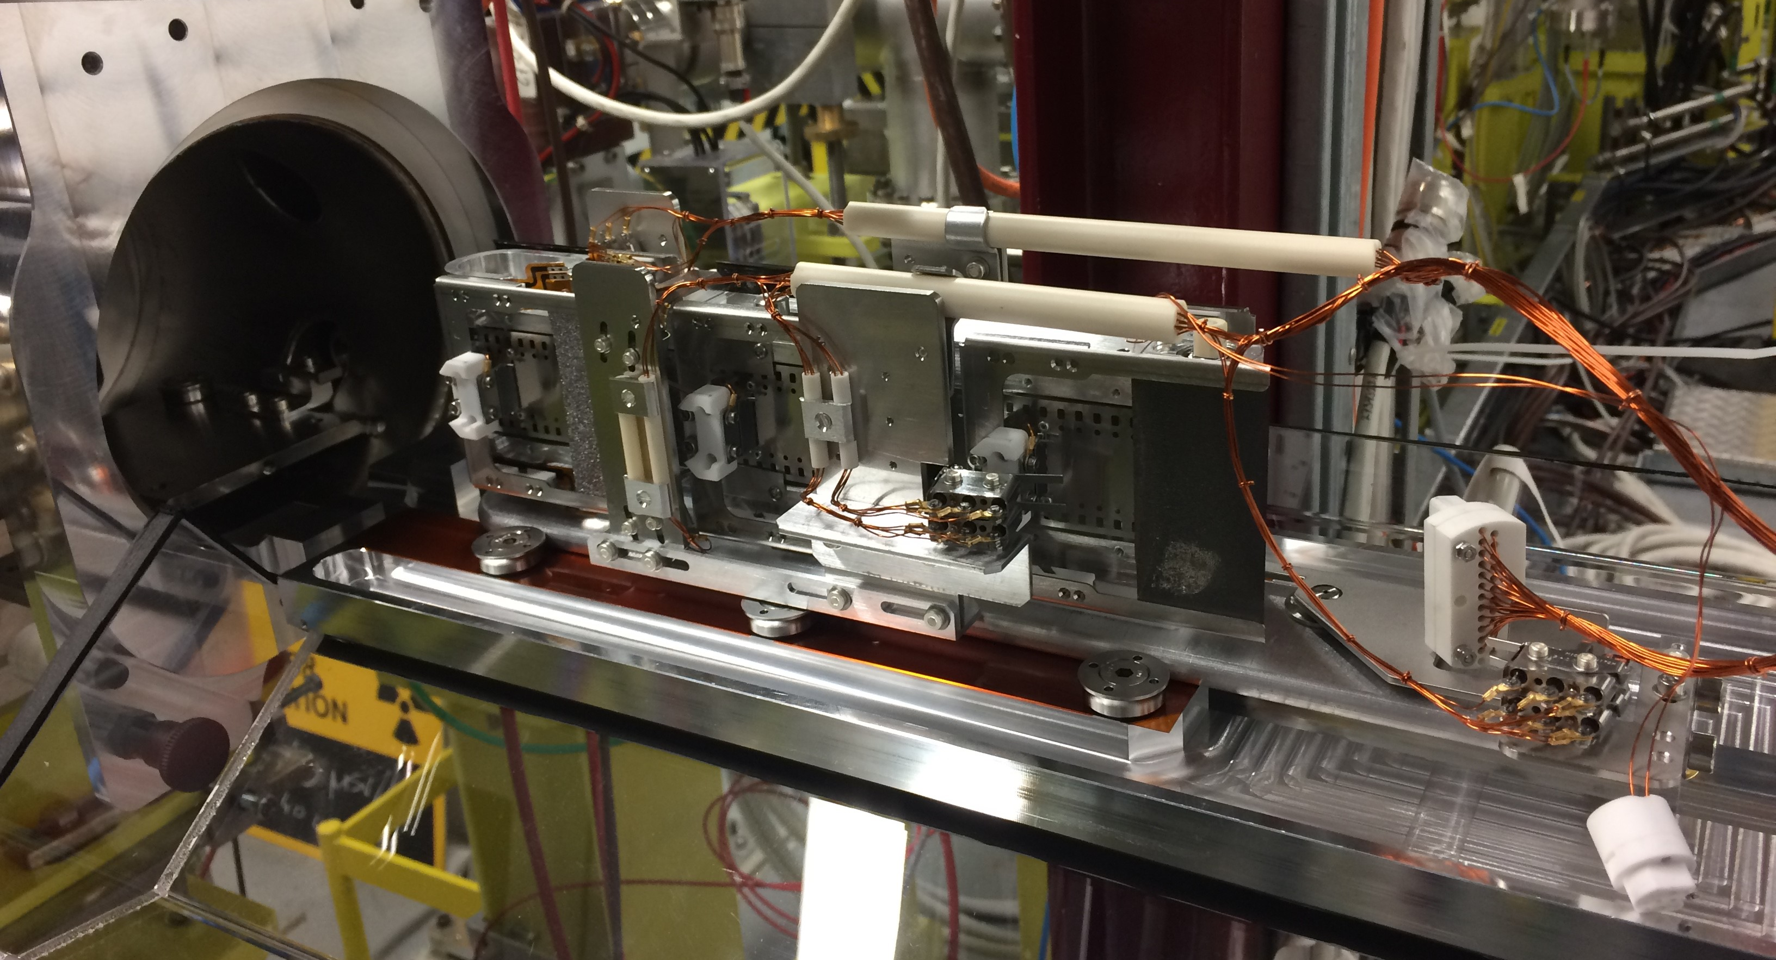
Stripping foil Test stand (TKSTR being loaded)
Measurements with the Stripping Foil Test Stand in the Linac4 Transfer Line
29th World Conference of the International Target Development Society
INTDS2018, Michigan (USA), 10/10/2018
Wim WETERINGS, Slide 10

Slide 11
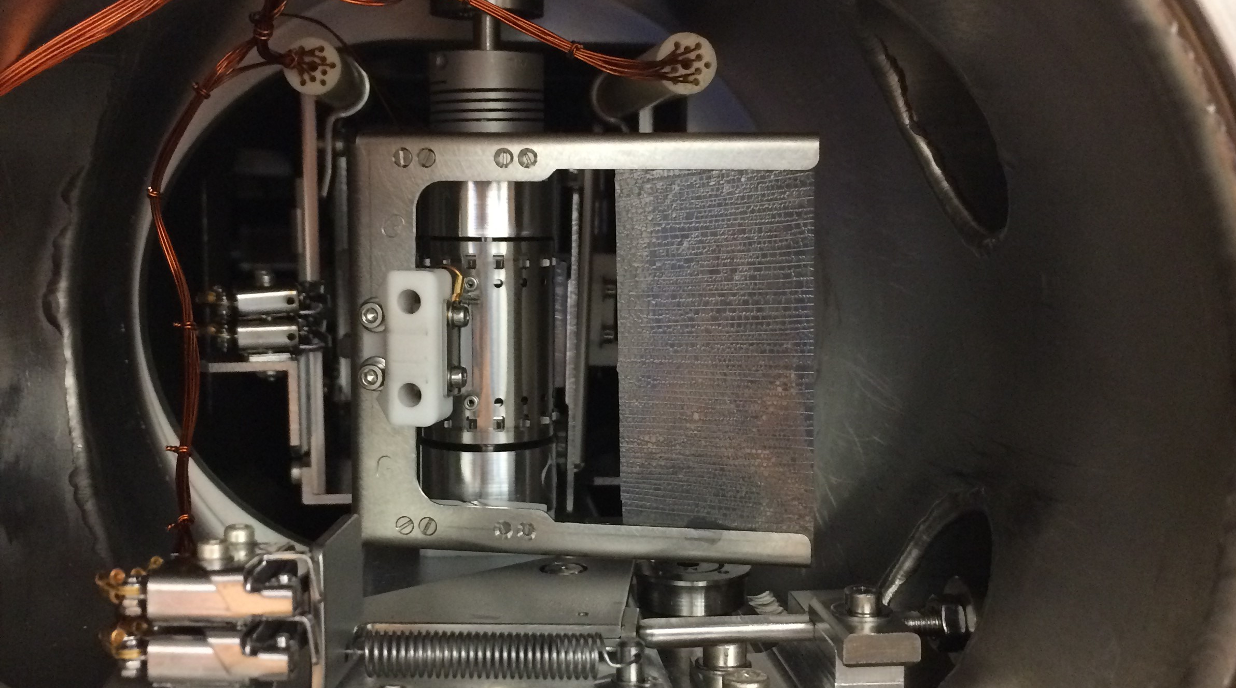
Stripping foil Test stand (TKSTR Inside tank)
58 mm
32 mm
Measurements with the Stripping Foil Test Stand in the Linac4 Transfer Line
29th World Conference of the International Target Development Society
INTDS2018, Michigan (USA), 10/10/2018
Wim WETERINGS, Slide 11

Slide 12
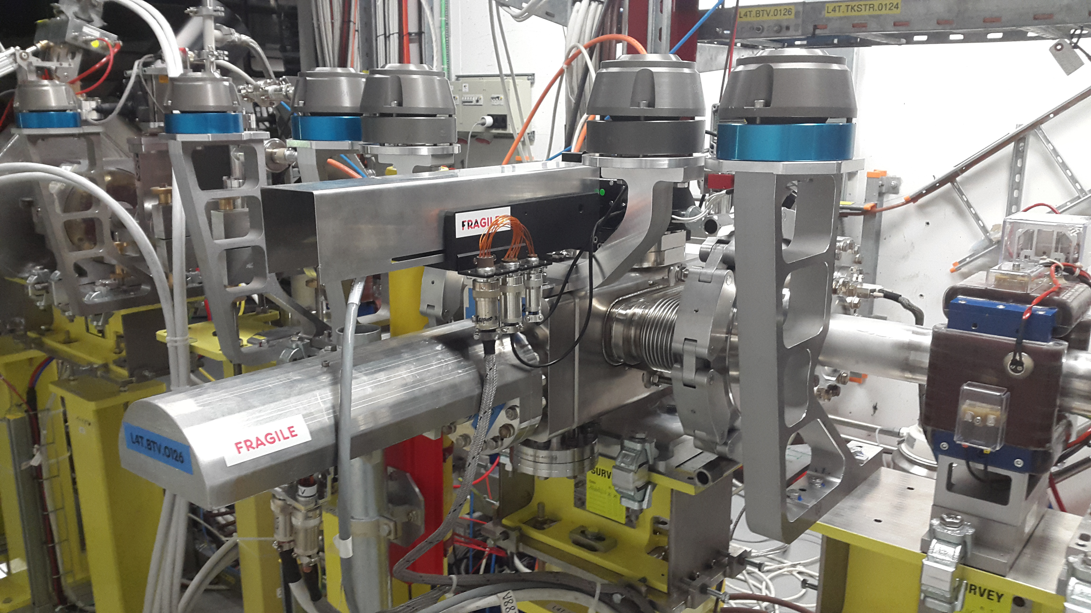
Stripping foil Test stand (BTV side)
Radiation Hard Camera
TKSTR Vacuum Chamber
BTV System

Slide 13
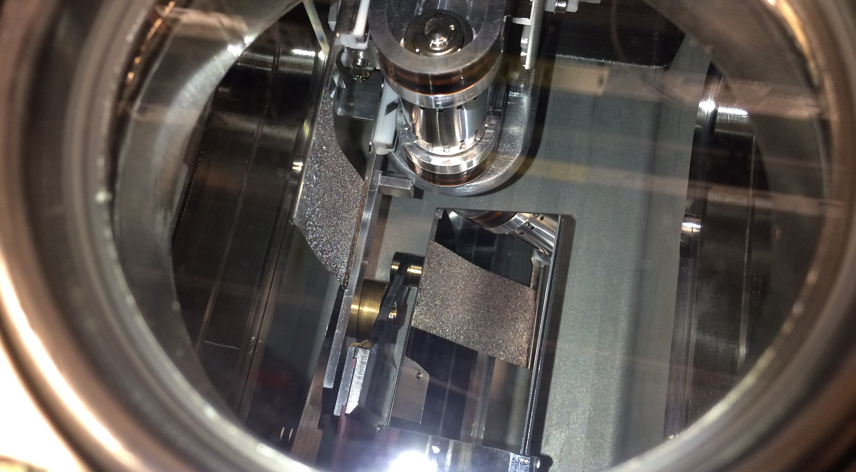
A look through the BTV camera Viewport
Frame with foil
Membrane potentiometer
Mirror giving foil reflection to camera.

Slide 14
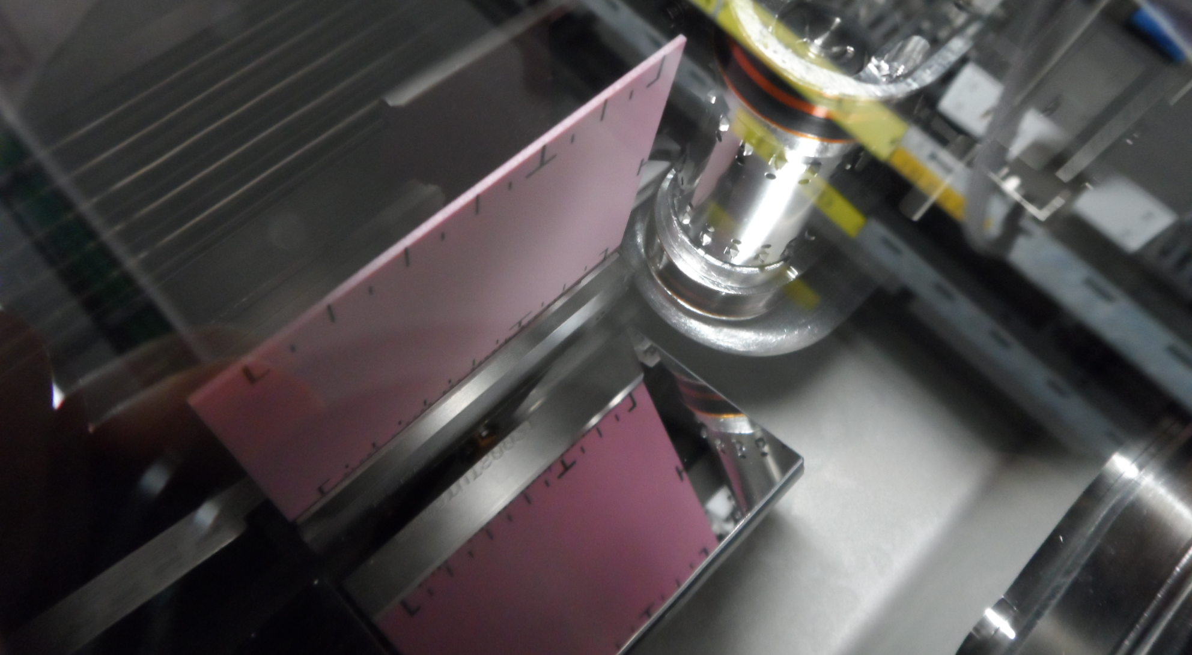
A look through the BTV camera Viewport
BTV Chromox scintillating screen in beam position
Mirror giving BTV reflection to camera.

Slide 15
Test Conditions - BCT
Downstream
Beam Current Transformer (BCT)
DUMP
Stripping Foil Test-stand (TKSTR)
Transfer Line to Proton Synchrotron Booster (PSB)
Two cross-calibrated beam current transformers (BCT), located upstream and downstream of the foil, are used to measure the stripping efficiency by looking at their relative current decrease.
Upstream
Beam Current Transformer (BCT)

Slide 16
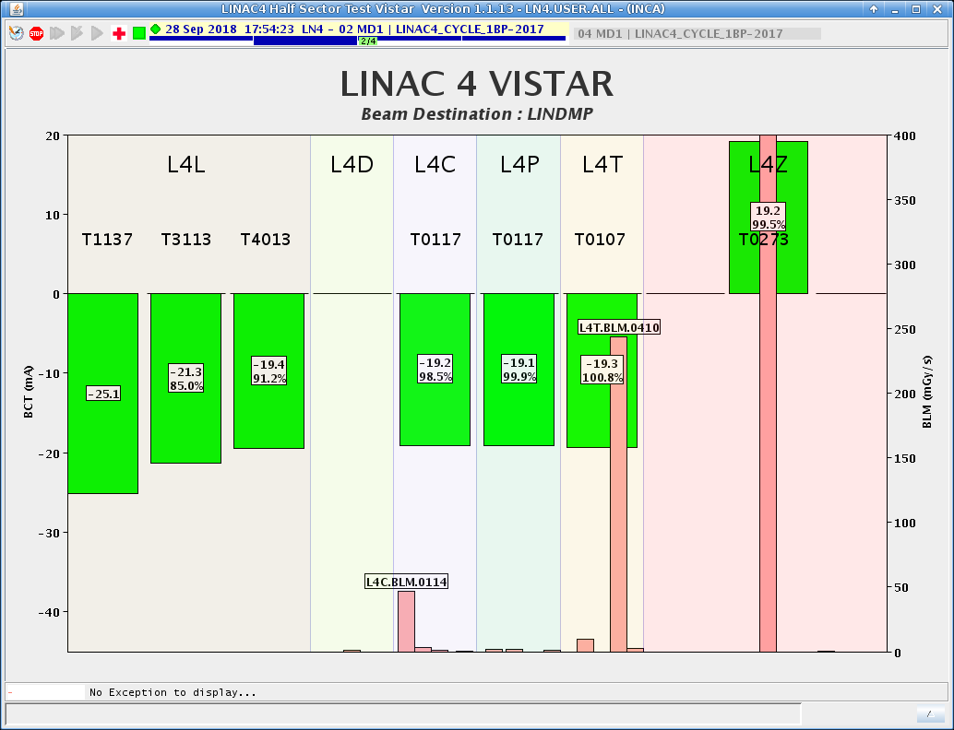
Test Conditions - BCT
Downstream
Beam Current Transformer (BCT)
Two cross-calibrated beam current transformers (BCT), located upstream and downstream of the foil, are used to measure the stripping efficiency by looking at their relative current decrease.
Upstream
Beam Current Transformer (BCT)

Slide 17
Test Conditions – Stripping foils
Description | Thickness | Remark | Reference
Amorphous Carbon | 200 μg/cm² | Collodion coated | XCF-200 | [1]
Amorphous Carbon | 199 μg/cm² |  | GSI-199 | [2]
Diamond-like Carbon | 200 μg/cm² | Boron doped 10% | DLC-23-1000-S | [3]
Multilayer Graphene | 200 μg/cm² |  | MLG-200 | [4]
Multilayer Graphene | 233 μg/cm² |  | MLG-233 | [4]
Multilayer Graphene | 251 μg/cm² |  | MLG-251 | [4]
[1] ACF-Metals, 2239 E. Kleindale Road, Tucson, Arizona, U.S.A.
[2] GSI, Helmholtzzentrum für Schwerionenforschung GmbH, Planckstraße 1, 64291, Darmstadt, Germany.
[3] MICROMATTER, Unit #1, 8333 - 130th Street, Surrey, BC V3W 7X4, Canada.
[4] Curtesy Tatami A, KANEKA Corporation, 5-1-1, Torikai-Nishi, Settsu Osaka 566-0072, Japan.

Slide 18
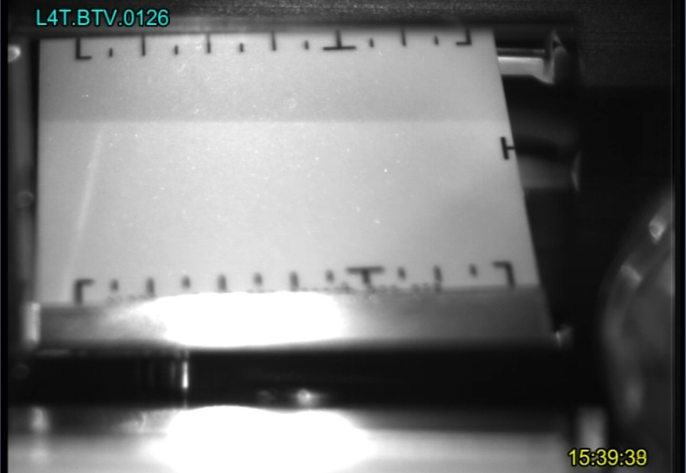
Test Conditions – Setting up with BTV
BTV screen in beam position, camera image

Slide 19
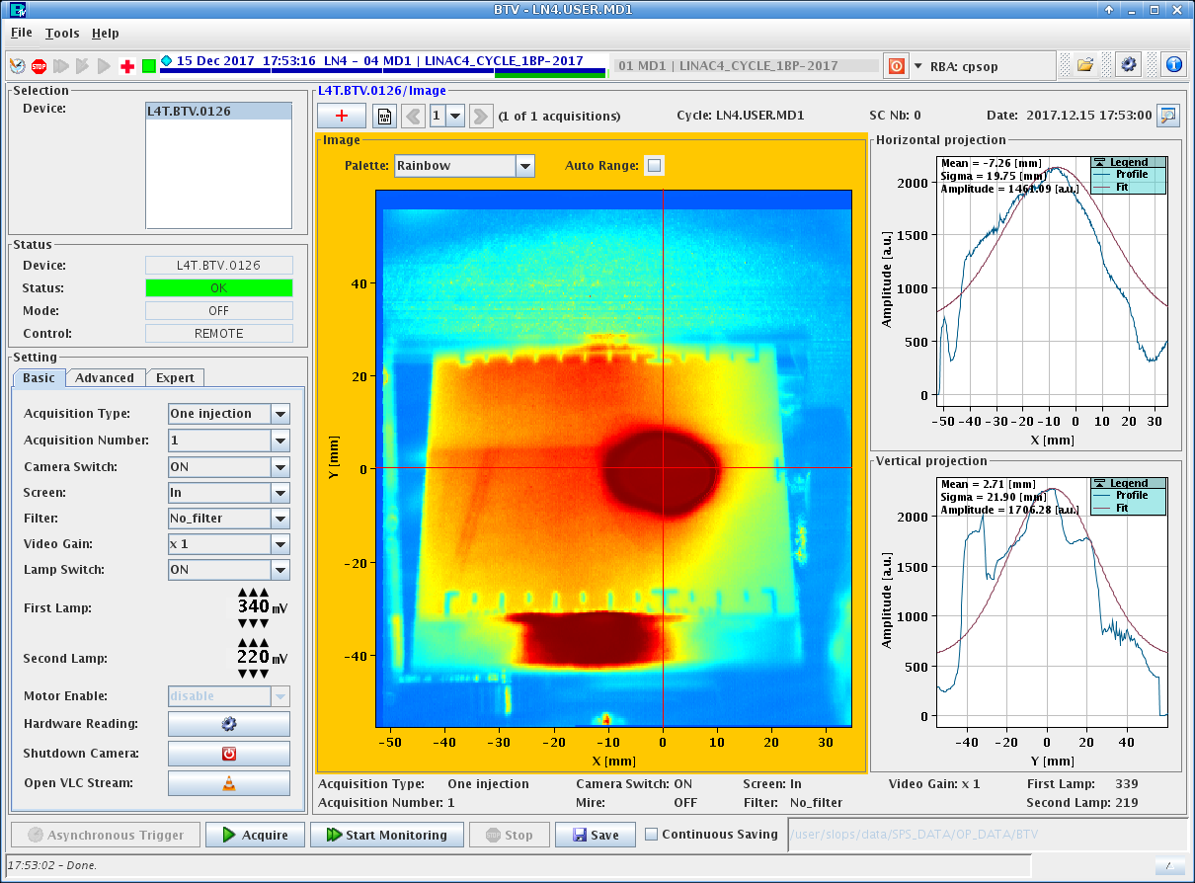
Test Conditions – Setting up with BTV
Beam spot on BTV screen, acquisition interface image

Slide 20
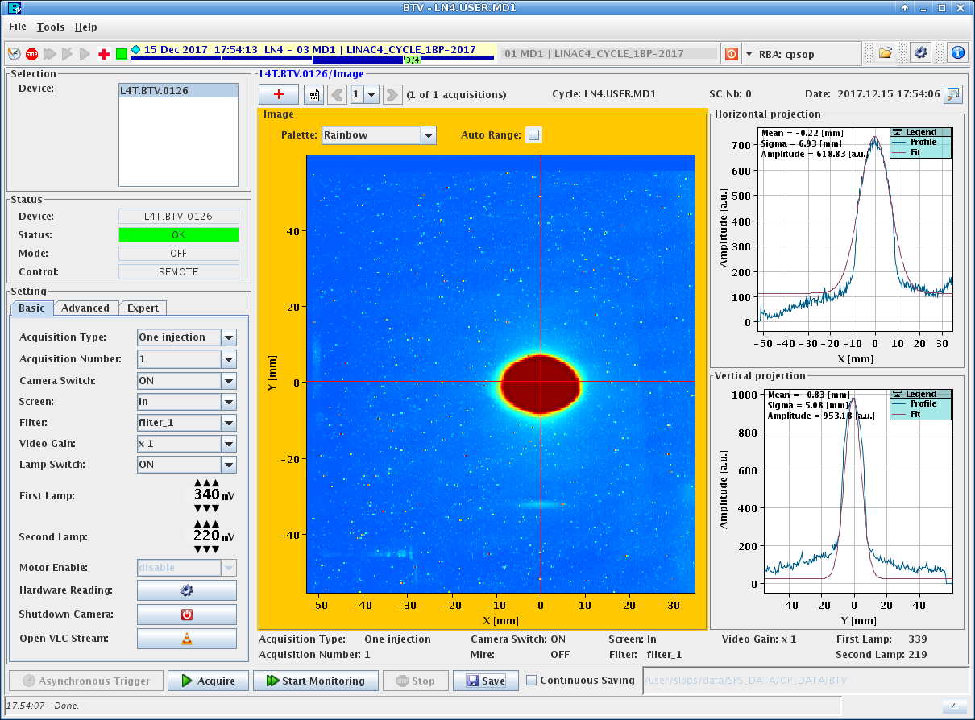
Test Conditions – Setting up with BTV
Beam spot on BTV screen, acquisition interface image

Slide 21
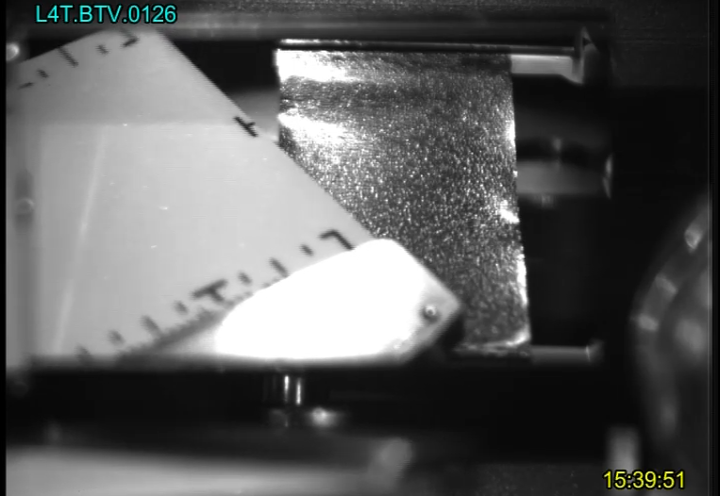
Test Conditions – Setting up with BTV
BTV screen moving away from the foil

Slide 22
Test Conditions – Beam Characteristics
Parameter | Value | Unit
Ion Species | H⁻
Output energy | 160 | MeV
Repetition rate | 1.2 | s
Beam pulse length | 200-600* | μs
Mean pulse current | 5-20 | mA
Transverse emittance | 0.4 | π μm (rms)
* Beam pulses can vary from 200 μs to 600 μs with 50 μs to 150 μs batches

Slide 23
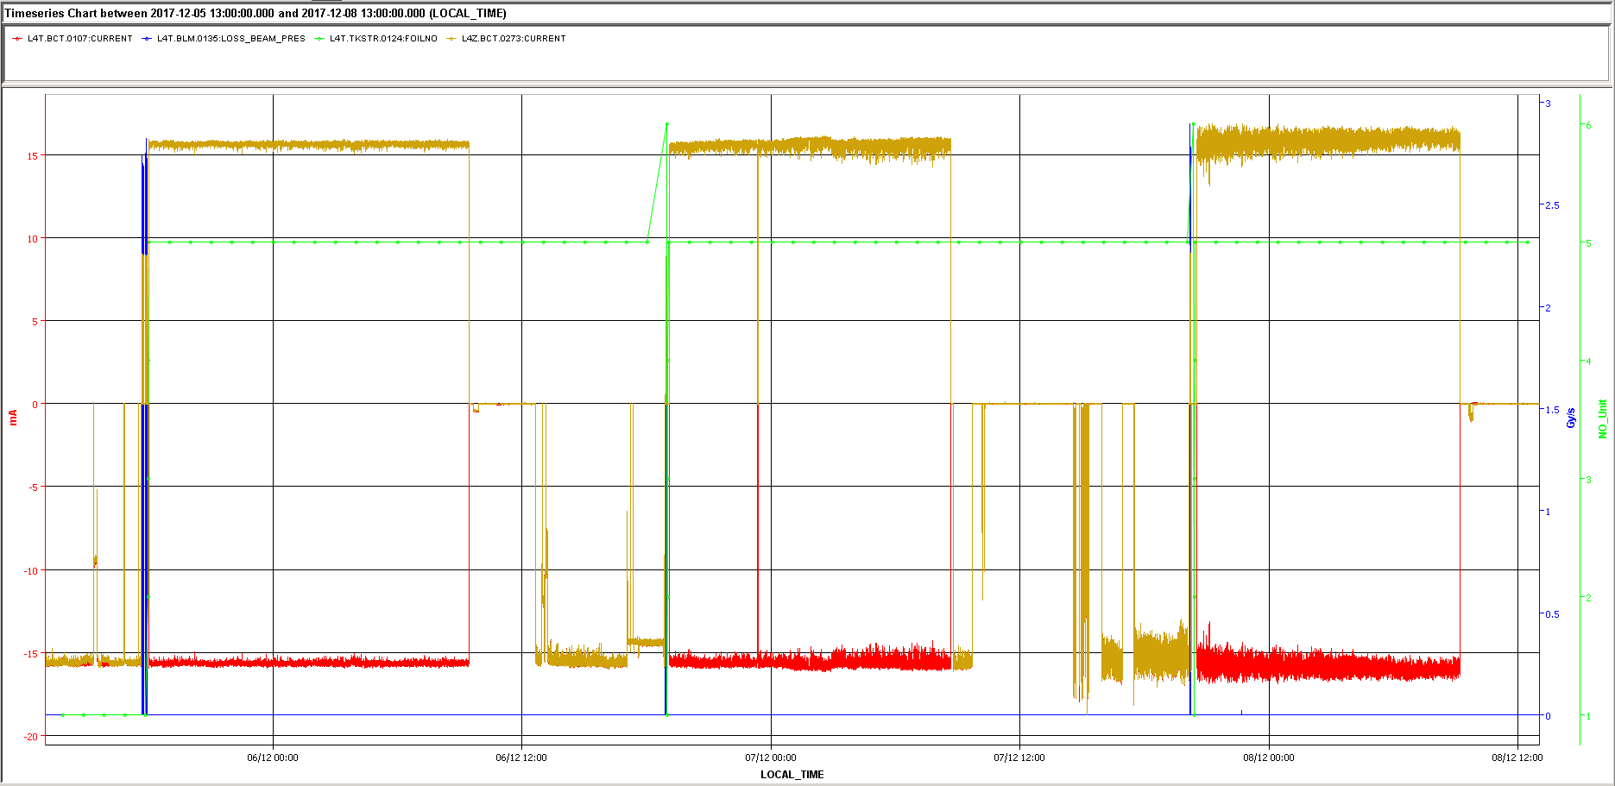
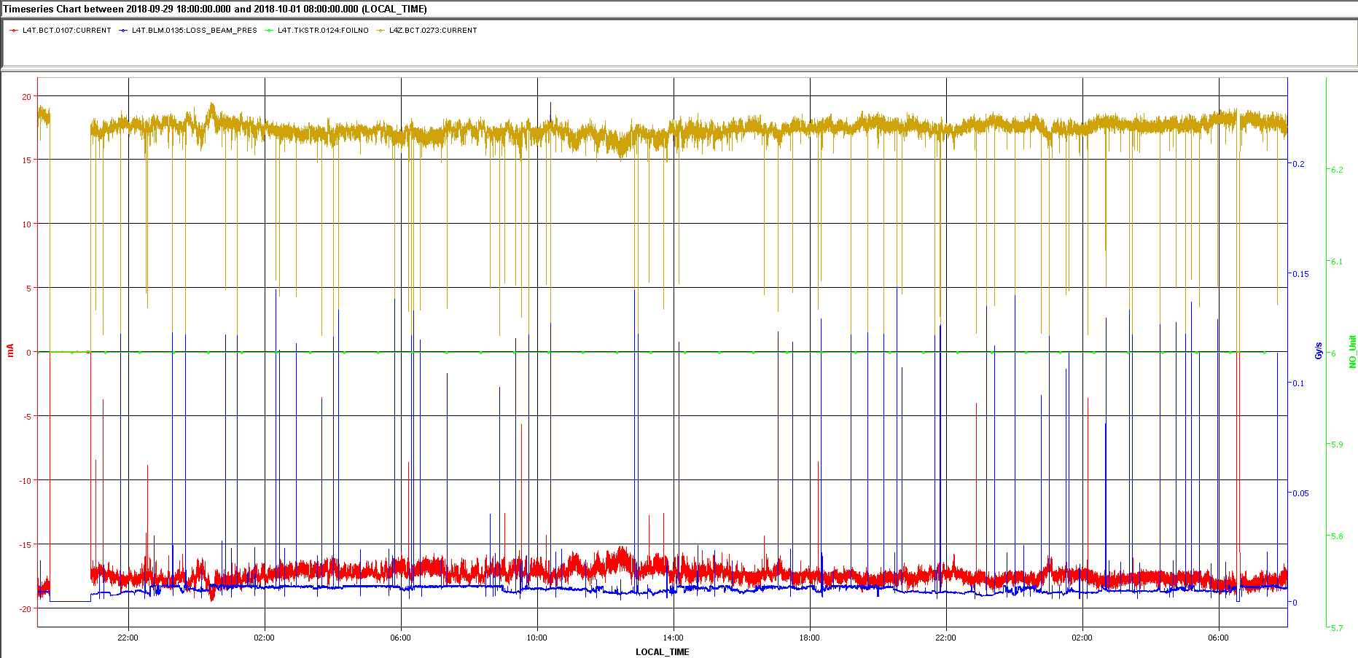
Test Results – Logged Data
Downstream BCT (P⁺)
Foil Number
Beam Losses
Upstream BCT (H⁻)

Slide 24
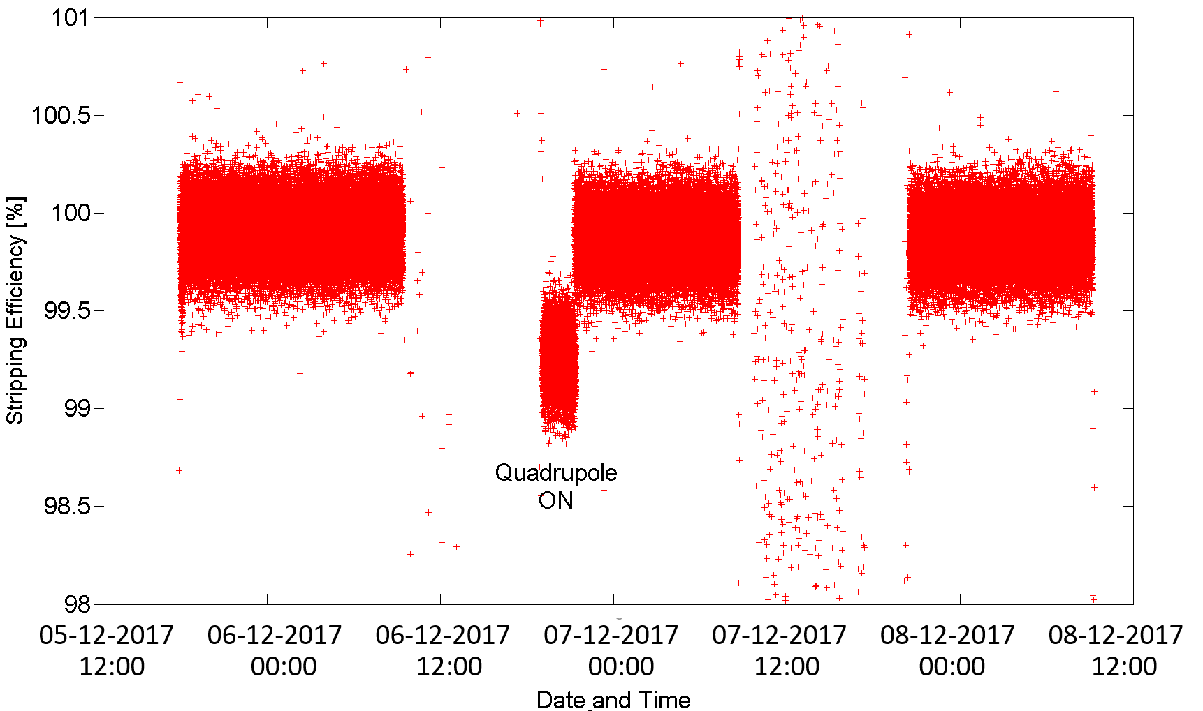
Test Results – Post Processing
Data from 3 night-shift runs with 400μs pulses of ∼15.7 mA beam current

Slide 25
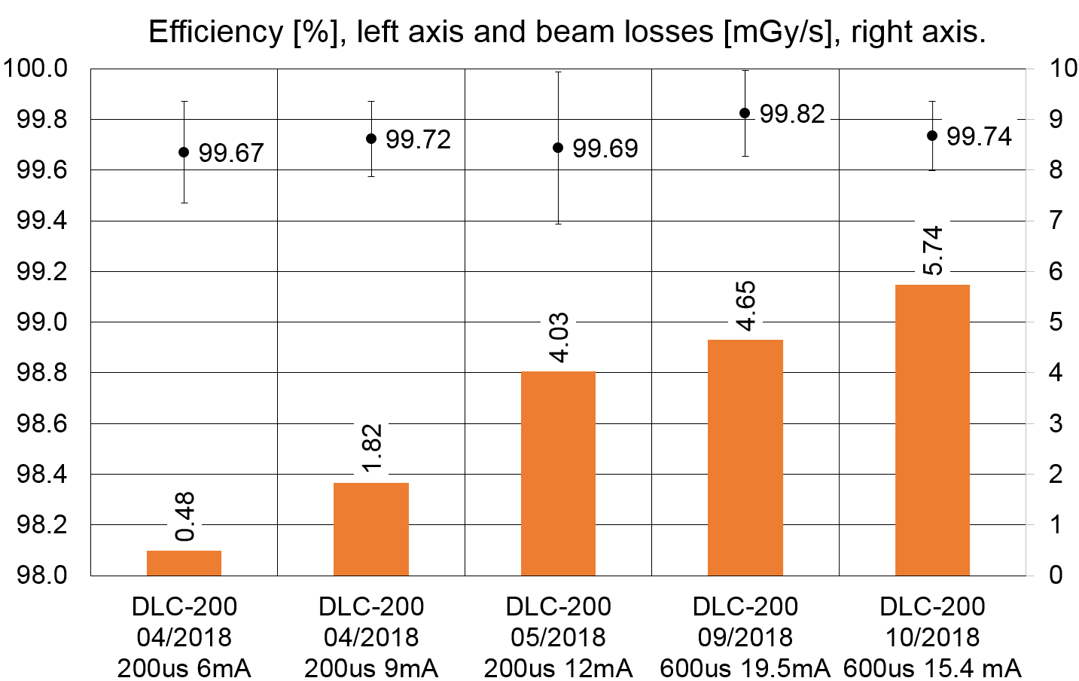
Test Results – Stripping Efficiency
Efficiency [%]
Results of DLC-23-1000-S measurements.
Increase in beam losses is related to the beam intensity.

Slide 26
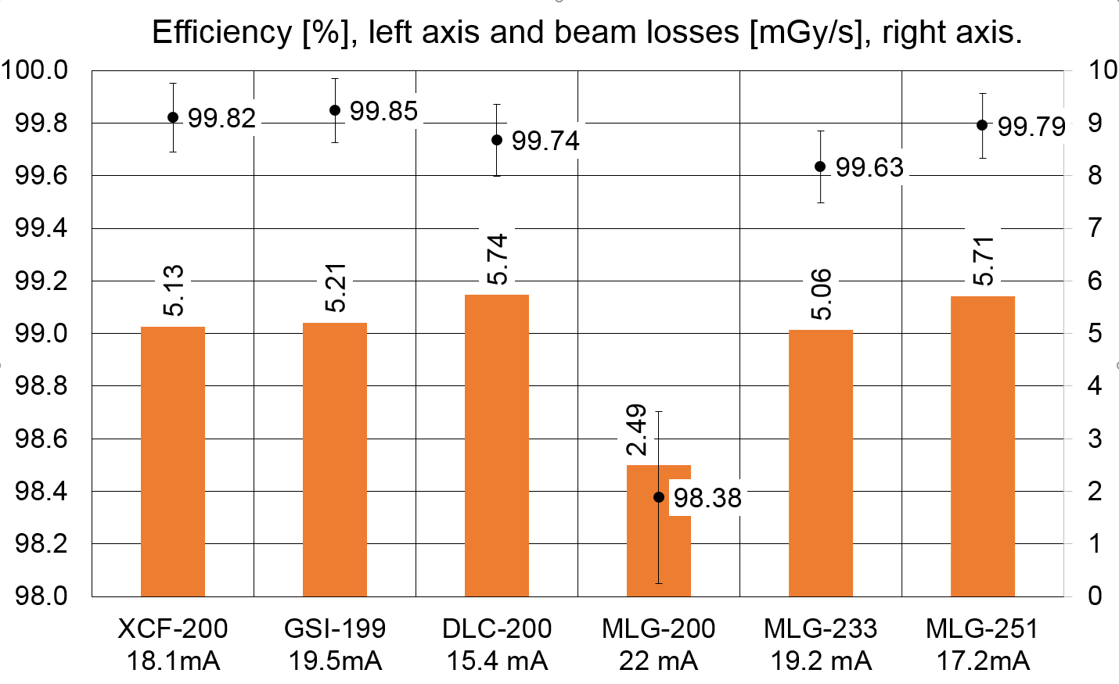
Test Results – Stripping Efficiency
Efficiency [%]
Results of foil measurements with 600 µs beam pulses and comparable beam current. Each foil was ~12 hrs in beam. MLG-200 (200 µs pulses) was found to be too thin.

Slide 27

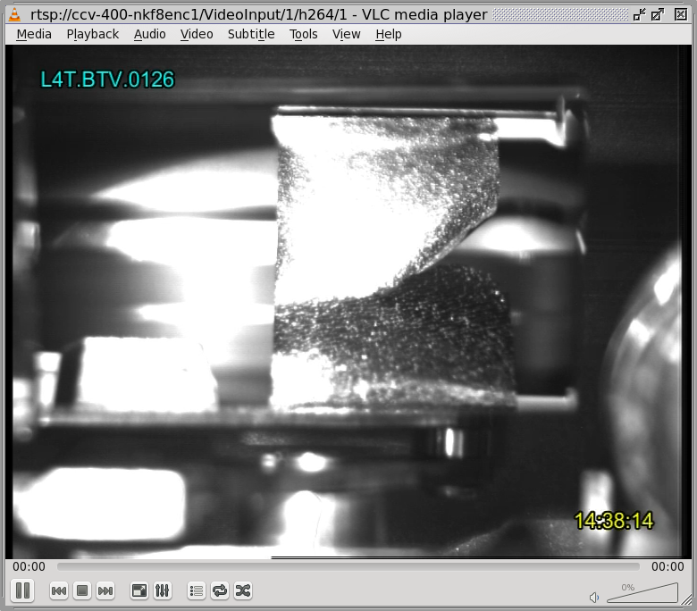
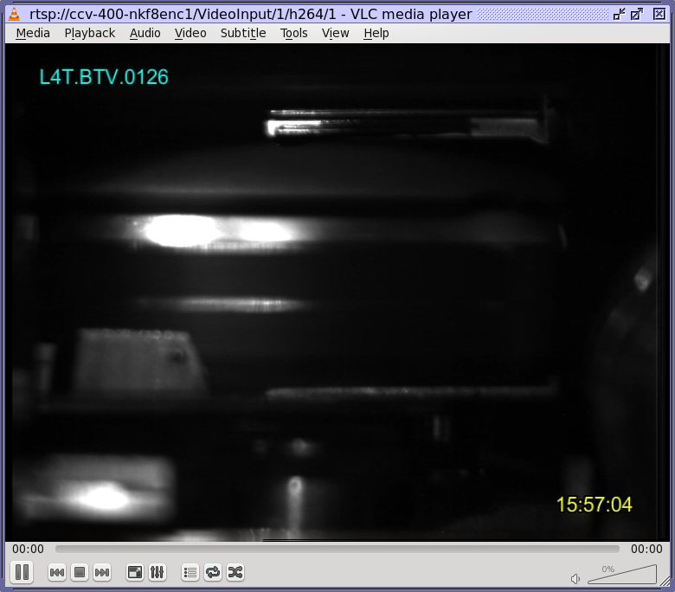
Test Results – Observation #1
01/11/2016 14:36h
Seems foil got broken - due to radiant heat from BTV screen? - right after putting the BTV screen in for ~2min with beam. Efficiency not affected since rupture is rather at the right-hand side.
INTDS2016; AIP Conference Proceedings 1962, 030003 (2018)
03/11/2016 15:56h
Foil #5 broken! It has disappeared completely. Also some vacuum activity visible.
It happened while we moved OUT the BTV screen (beam was kept ON).
Since improvement of the electrical contacts of the foil holders and application of a silver conducting layer on the backside of the BTV screen this phenomena has not anymore been observed.

Slide 28
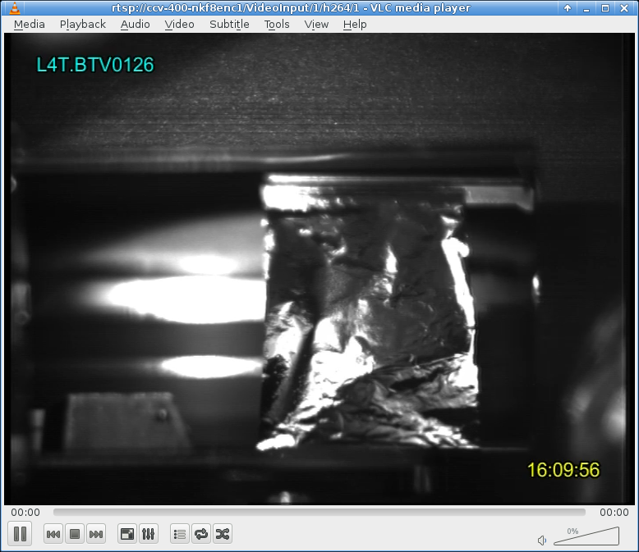
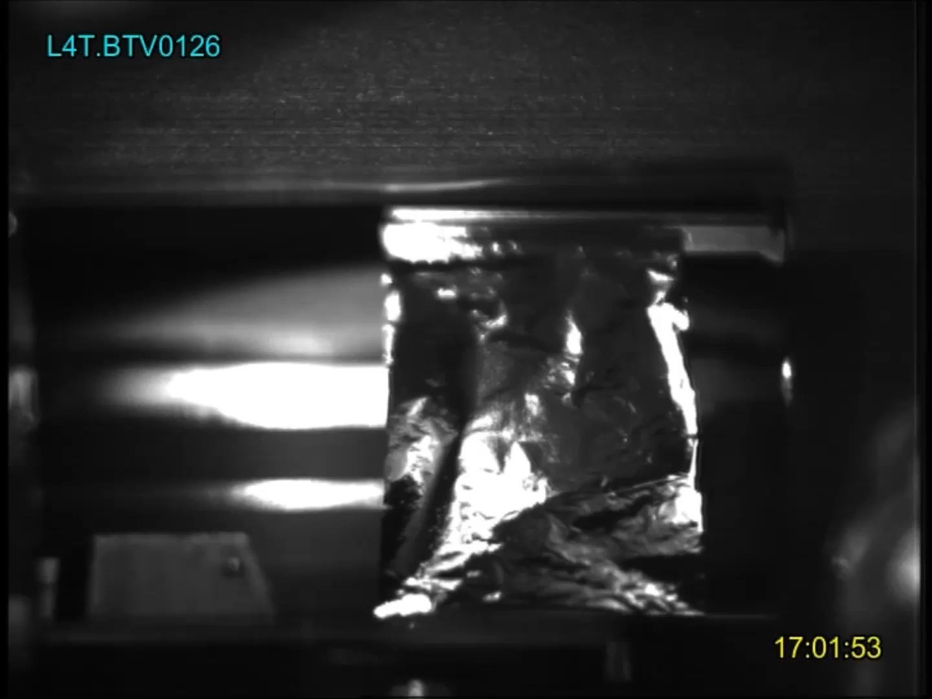
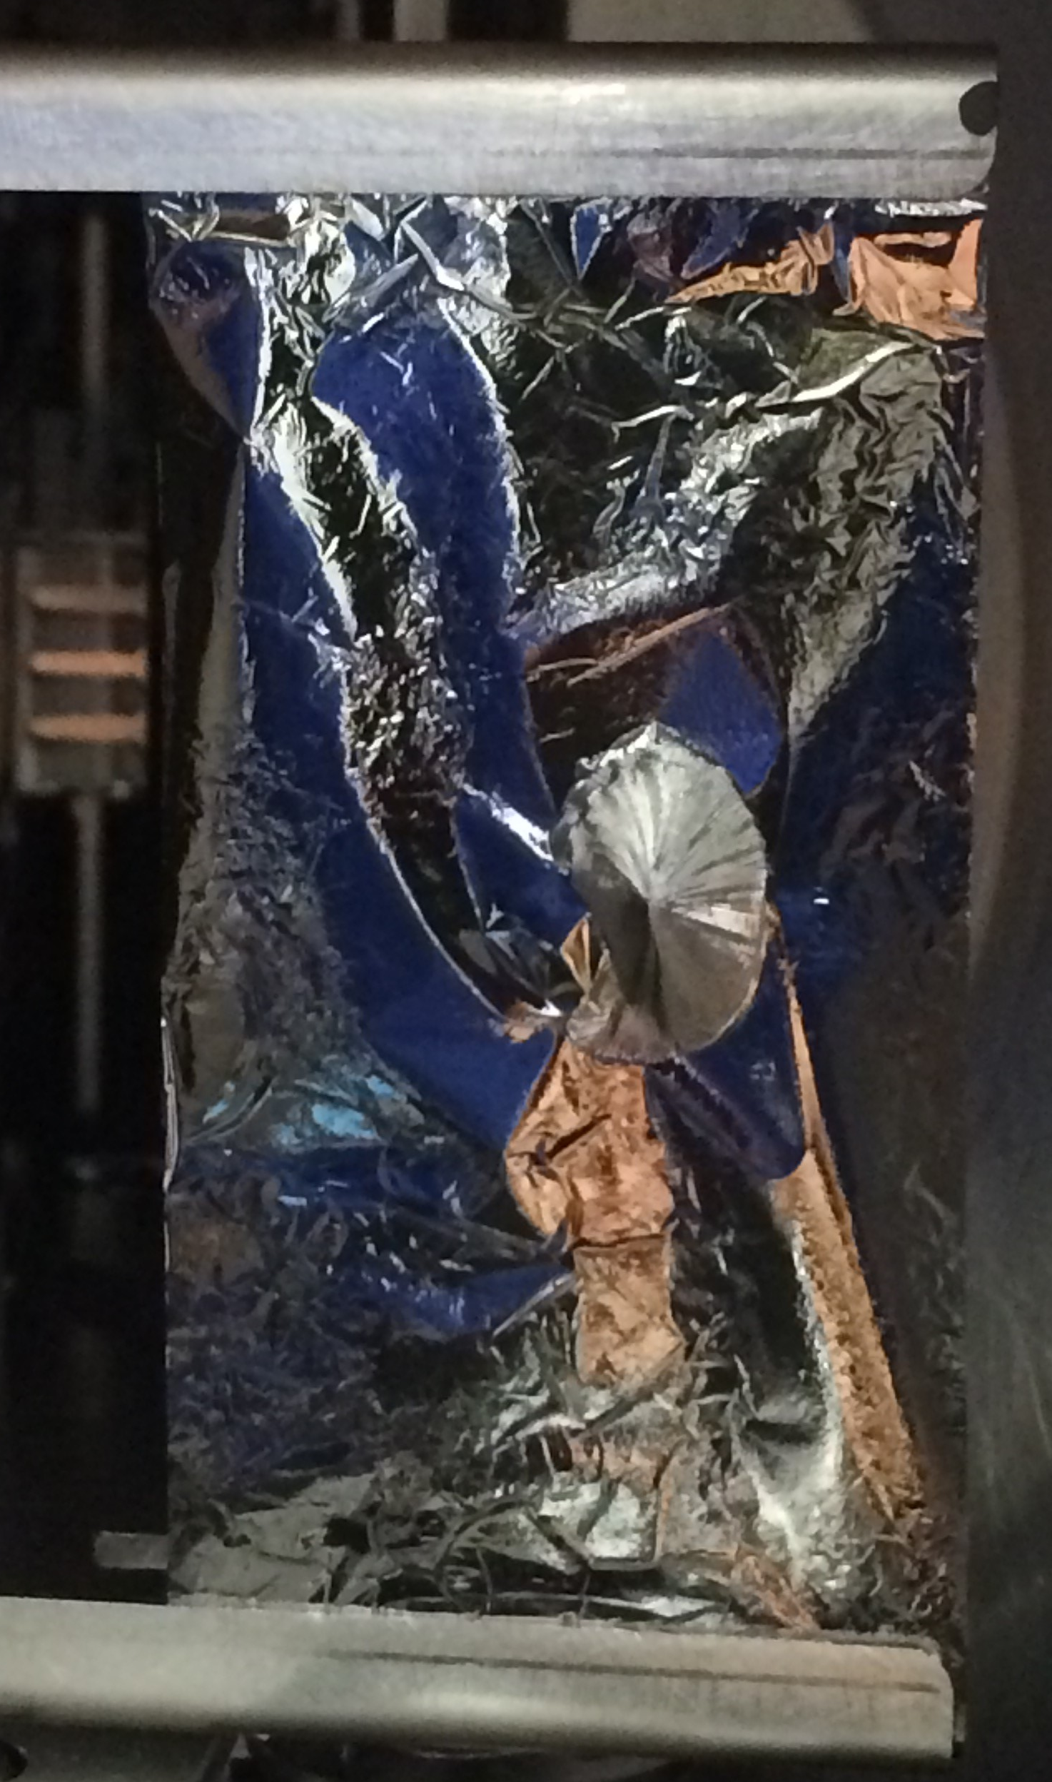
Test Results – Observation #2
10/11/2017 15:58h
Foil #5, DLC-23-1000-S , movement of the foil is observed at every beam shot (like a heartbeat). Foil in for ~ 5 minutes. BCT.L4z Value 100%

Slide 29
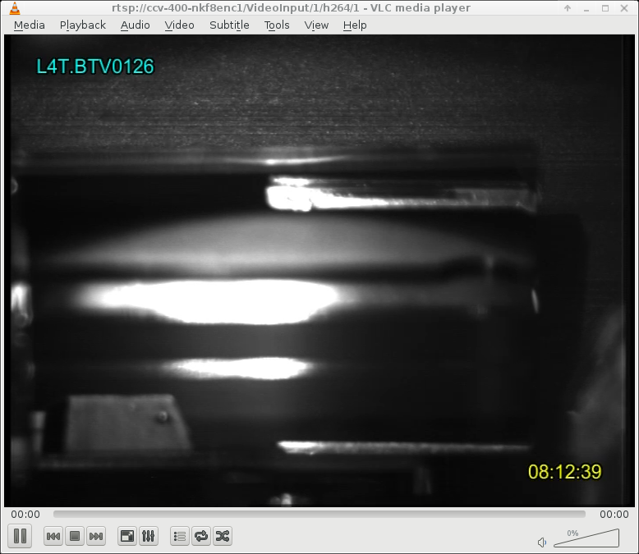
Test Results – Observation #3
24/04/2018 08:05h Removed foil #5 from beam, foil visually in same condition as last night. [WW], Inspection of other foils, foil #2, DLC-23-1000-S, has disappeared from frame....
This foil has not been in the beam position, nevertheless it was completely removed from the foil holder.

Slide 30
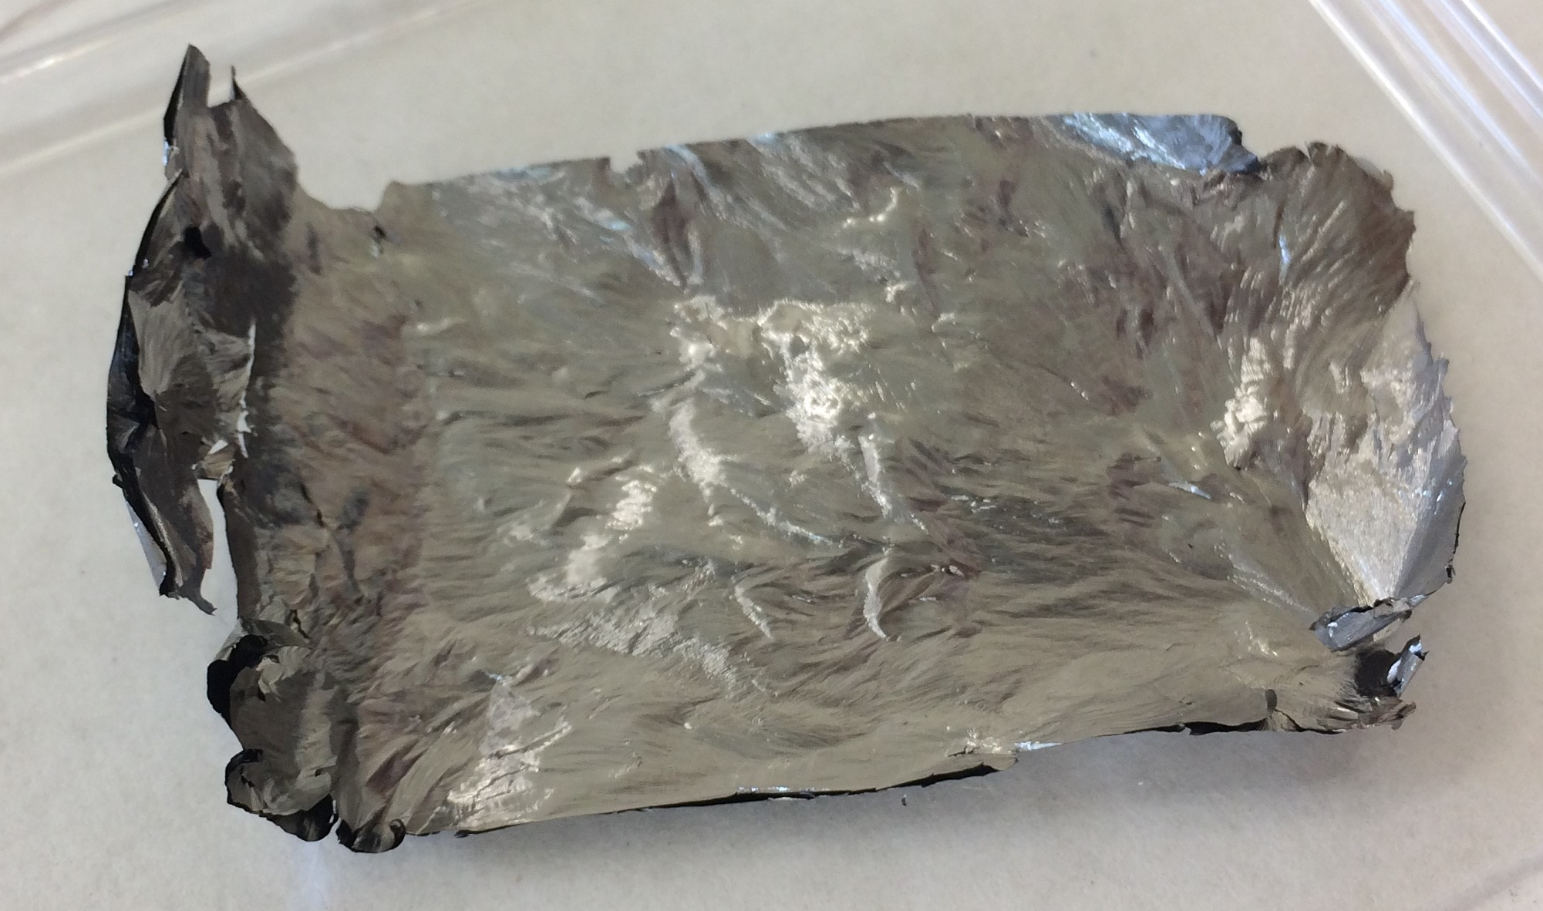
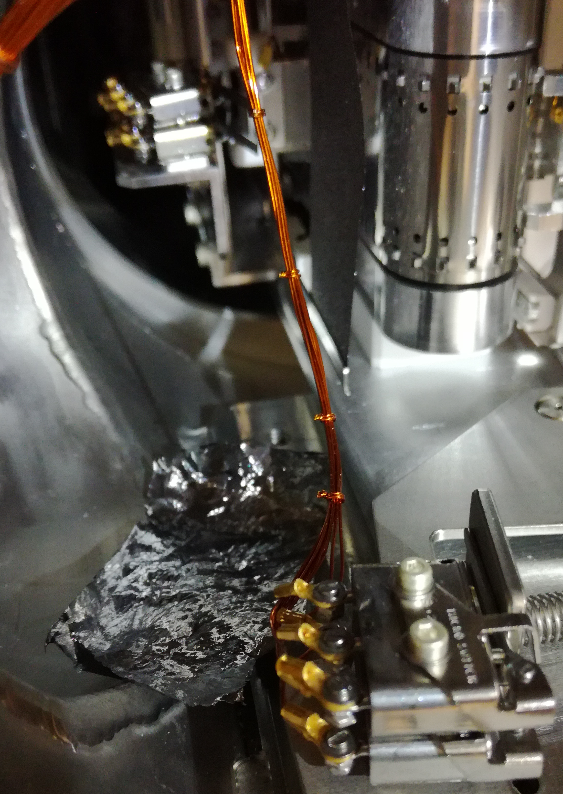
Test Results – Observation #3
24/04/2018 08:05h Removed foil #5 from beam, foil visually in same condition as last night. [WW], Inspection of other foils, foil #2, DLC-23-1000-S, has disappeared from frame....
It was found lying inside the vacuum tank and looked completely burnt. We notice delamination of the foil layers at the edge of the foil. The foil holder of this particular foil was very activated, > 38 µSv at contact, compared to 0.1 µSv of all other frames.

Slide 31
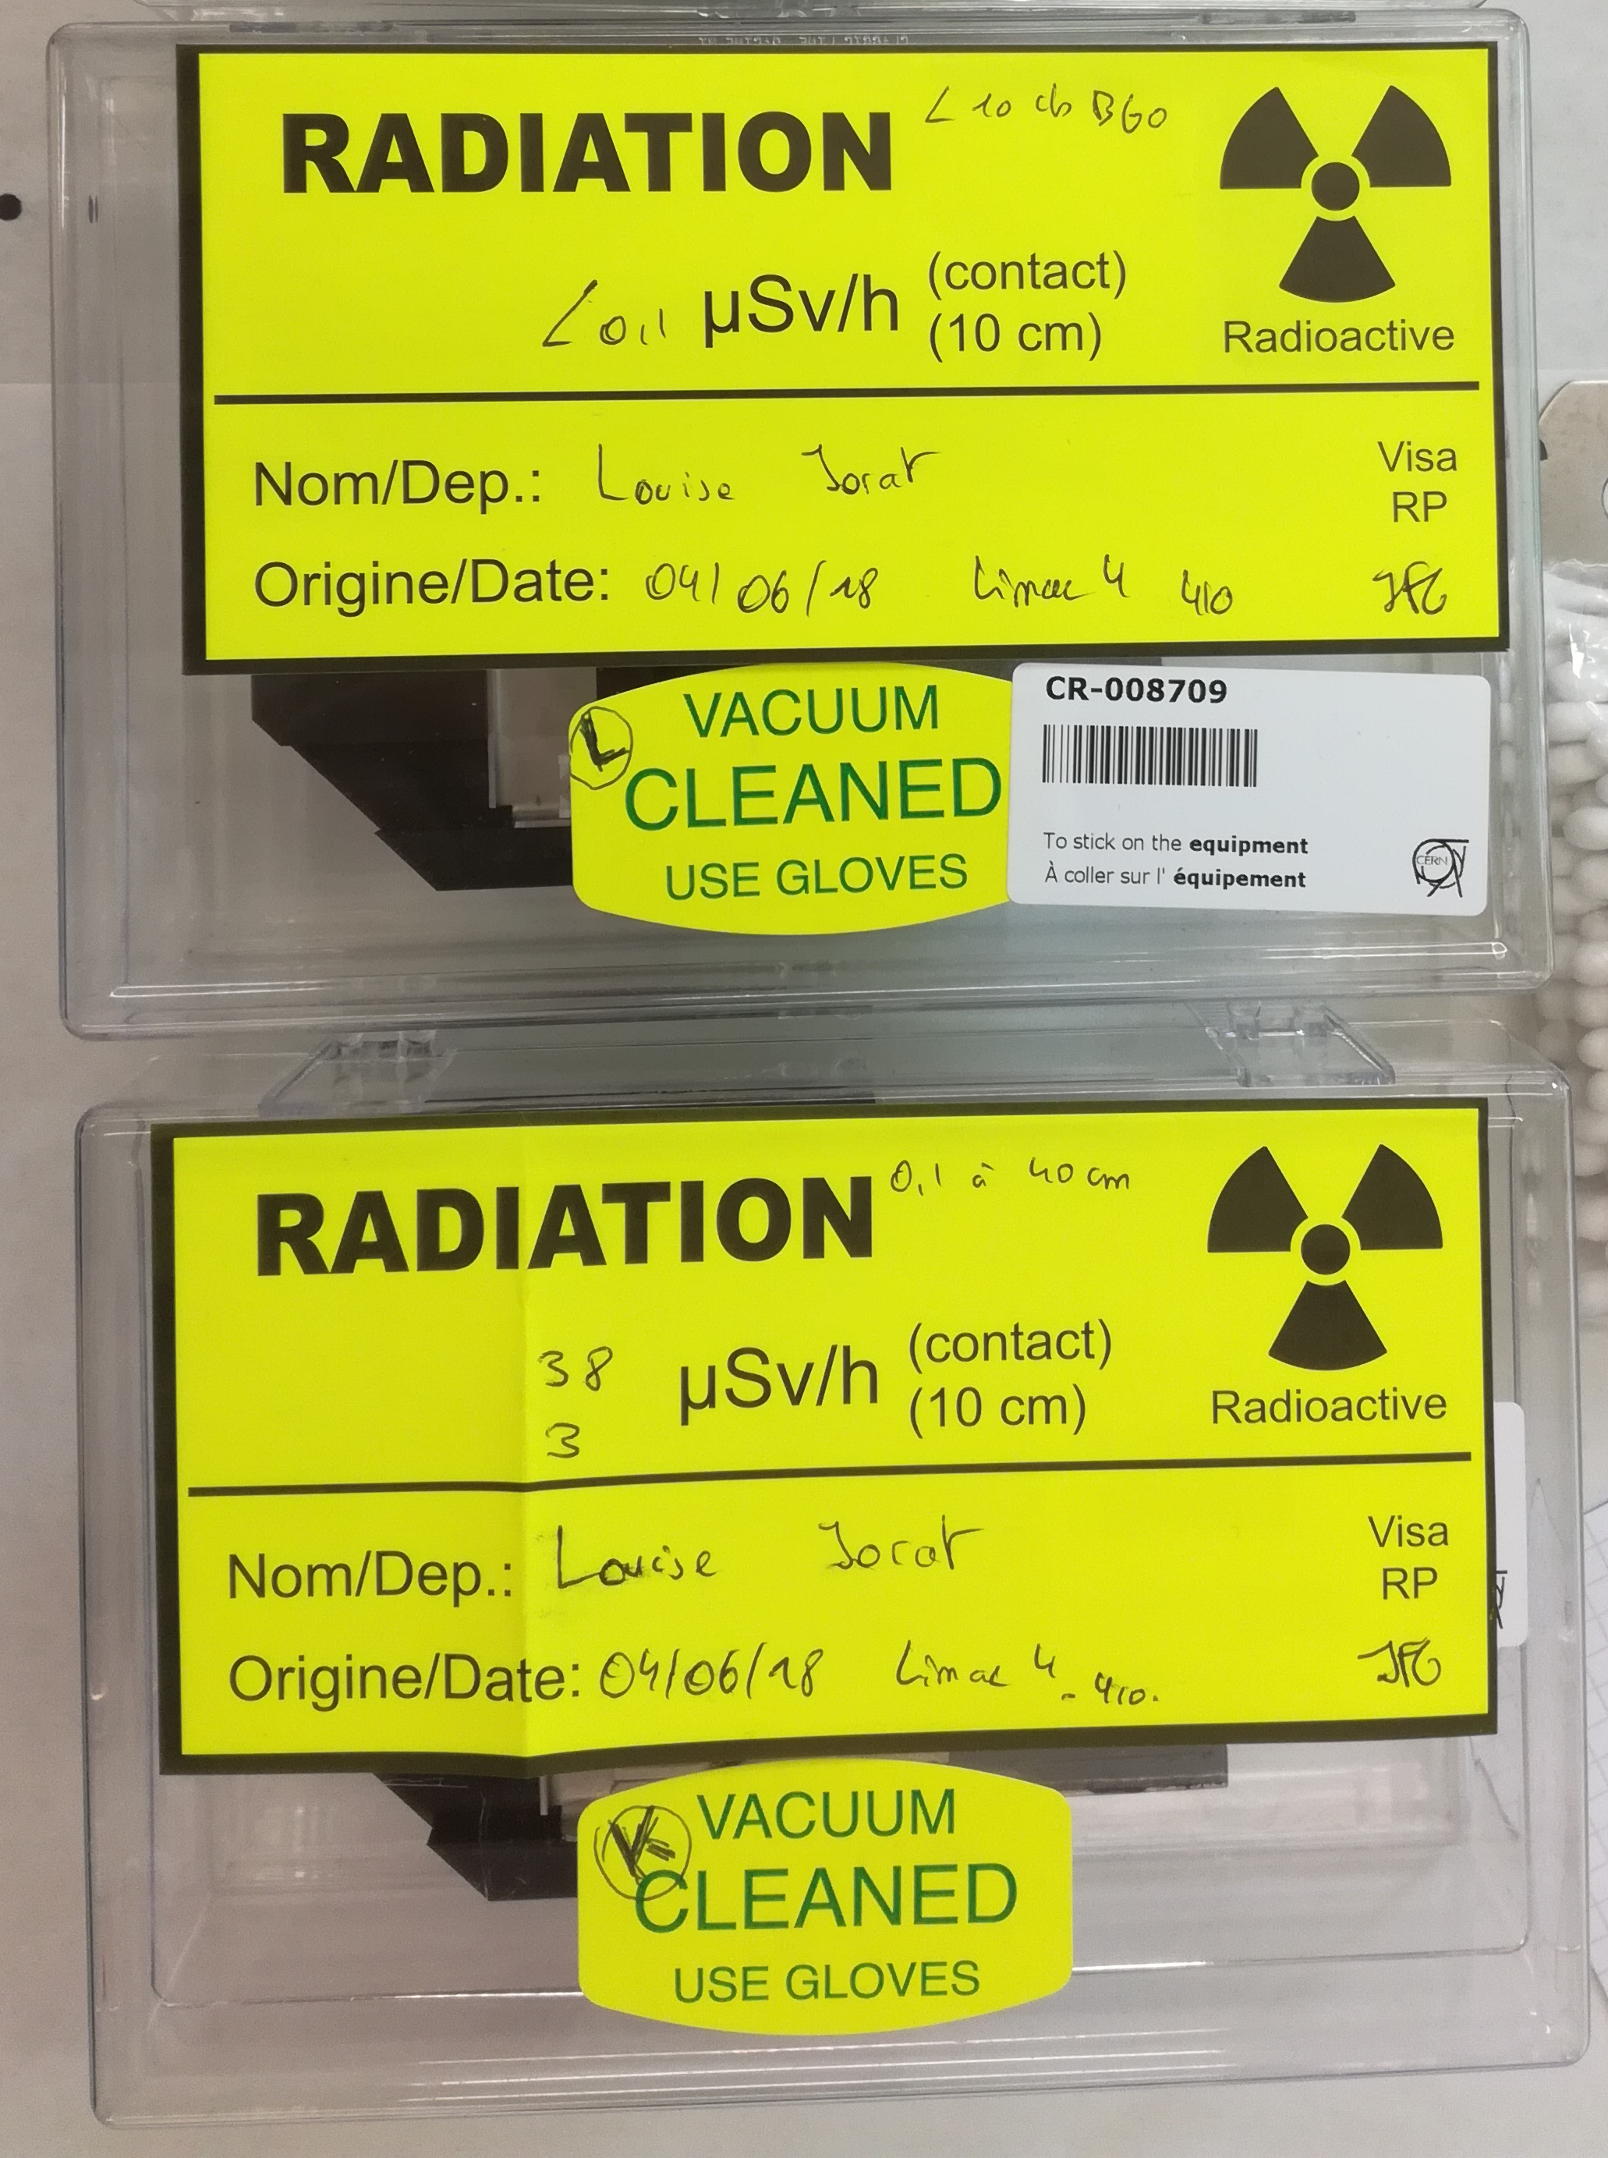
Test Results – Observation #3
24/04/2018 08:05h Removed foil #5 from beam, foil visually in same condition as last night. [WW], Inspection of other foils, foil #2, DLC-23-1000-S, has disappeared from frame....
Hypotheses
Schematic top view of the loader with foil in beam
Schematic top view of the loader with foil out beam
Beam
Showers on frame.
Standard frame
0.1 µSv contact
0.1 µSv @ 10cm
Impacted frame
38 µSv contact
3 µSv @ 10cm
Logbook entries show that during the low energy tuning @ 3MeV, the beam was not properly steered and was lost just upstream of the TKSTR, causing showers on the foil holder. This was confirmed by damage to downstream electronics.

Slide 32
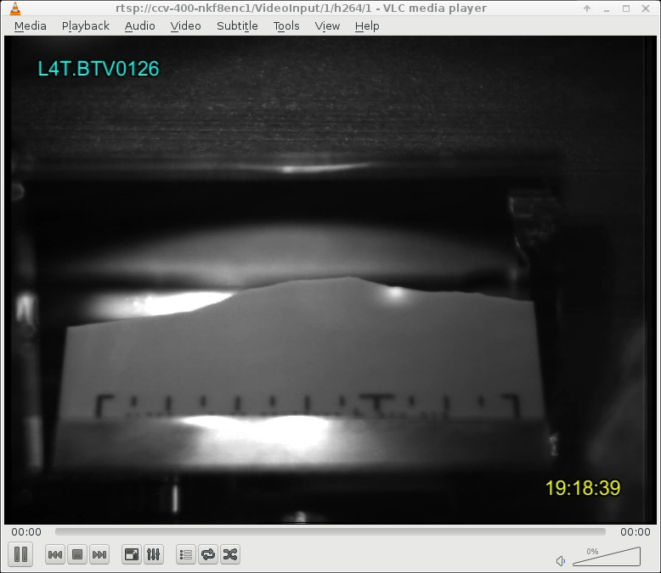
Test Results – Observation #4
26/09//2018 19:03h
Preparing stripping foil tests. L4T.RQF.021 disabled. Image of beam on screen.
Unfortunately the screen is BROKEN!
Re-enable L4T.RQF.021
Reason for this is still unclear and will be investigated during the next technical stop.

Slide 33
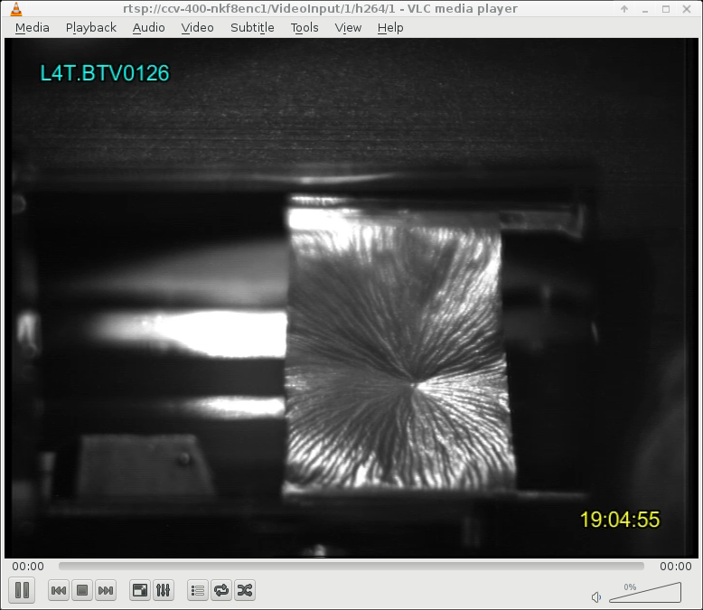
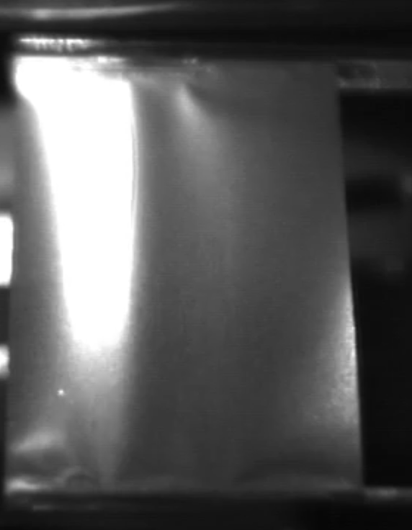
Test Results – Observation #5
27/09//2018 19:05h
Foil_2, GSI_199. After 1 beam pulse the foil completely changed aspect. It looks like the foil shrunk, or stressed towards the centre. Nevertheless, no changes in efficiency.
After only one 600µs pulse, 4x150µs @19.7mA, the foil completely deformed.
No influence on performance, the foil remained in beam for 12 hours with stripping efficiency of ~99.8%.

Slide 34
Conclusion
A new H⁻ charge exchange injection system will be installed in 2020 when the 160MeV Linac4 is connected to the PS Booster.
We installed a stripping foil test stand in the Linac4 transfer line.
Several types of foils are evaluated using calibrated BCTs, all having the expected theoretical efficiency >99%.
Movement of foils is observed creating deformation at the beam impact location without influence on the stripping efficiency.
Damage and activation of a foil, not been in the beam, was observed and is thought to be caused by uncontrolled beam losses during the L4 low energy tuning @ 3MeV impacting on the stripping foil mechanism.

Slide 35
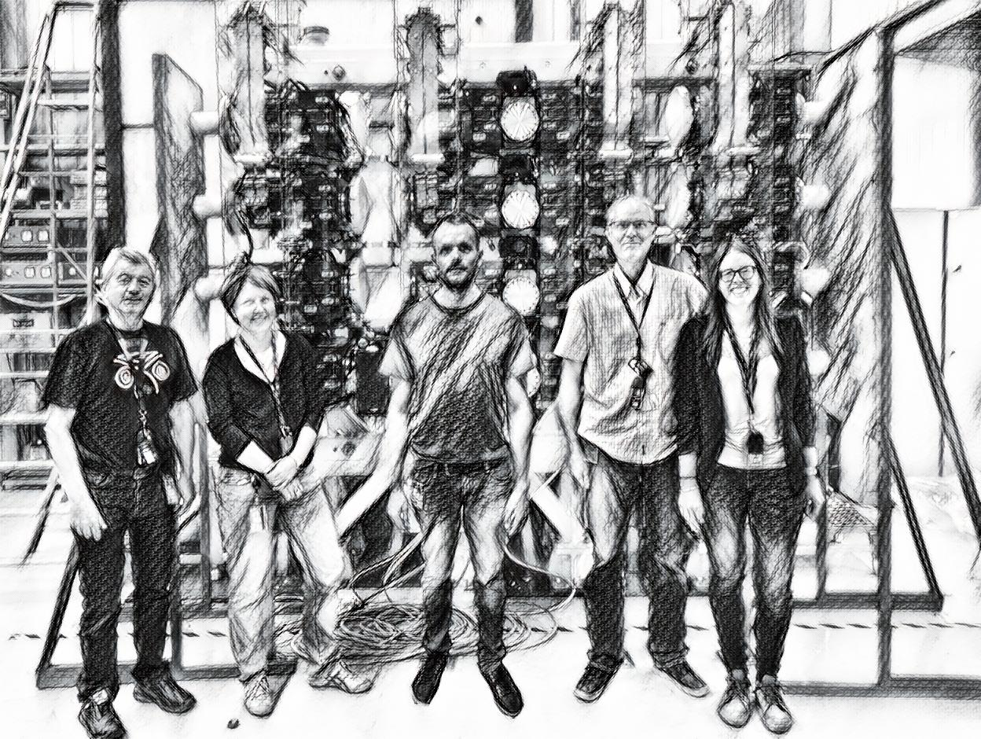
The Authors Thank you for your Attention

Slide 36
SPARE SLIDES

Slide 37
Introduction to LIU Project
The 160 MeV H⁻ beam from the Linac4 will be injected horizontally into the PSB by means of a H⁻ charge exchange injection system, one for each ring.
Future Situation (2020)
H⁻ Injection
Current Situation
P⁺ Injection
LINAC 4
H−
The Linac4 project is a new 160 MeV H⁻ linear accelerator replacing Linac2 as injector to the PS Booster (PSB).

Slide 38
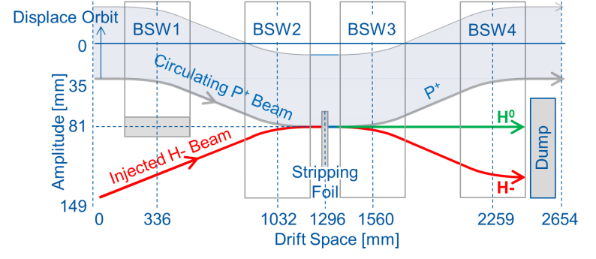
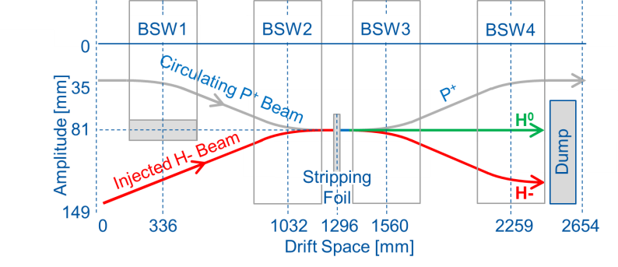
Charge Exchange Injection
Configuration of the PSB injection region with 380mm long BSW magnets
The local orbit of the PSB beam is displaced by ~81 mm using two independent closed orbit bump systems:
The Painting Bump, made by 4 horizontal kickers (KSW) outside the injection region, giving a 35 mm closed orbit bump, with falling amplitude.
The Injection Chicane, made by a set of 4 pulsed dipole magnets (BSW).
A stripping foil will convert ~98% of the H− into protons by stripping off the electrons.

Slide 39
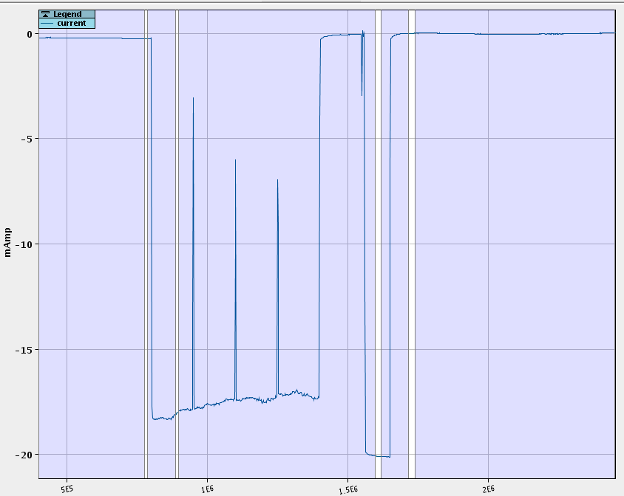
Test Conditions – Beam Characteristics
600µs pulse of 4x 150µs batches @~16.5mA

Slide 40
Test Results – Logged Data
Downstream BCT (P⁺)
Foil Number
Beam Losses
Upstream BCT (H⁻)

