Slide 1
Continuum extrapolation of the critical endpoint in 4-flavor QCD with Wilson-Clover fermions
Hiroshi Ohno¹
in collaboration with
Y. Kuramashi^{1,2}, Y. Nakamura² and S. Takeda³
¹CCS, University of Tsukuba, ²RIKEN, ³Kanazawa University
Lattice 2018
Kellogg Hotel and Conference Center, MSU, MI, USA
July 26, 2018

Slide 2
Critical endpoint in 3-flavor QCD
R. D. Pisarski and F. Wilczek, PRD 29 (1984) 338
Phase transition of 3-flavor QCD
- expected to be 1st order at m = 0
- 2nd order critical endpoint at m = m_{E}
- crossover m > m_{E}
The location of m_{E} is still not conclusive!
Columbia plot
N_{f}=2
Quenched
∞
2ndorder
1storder
O(4)
m_{s}
Z(2)
Physical point
N_{f}=3
N_{f}=1
m_{E}
Crossover
Z(2)
1storder
0
0
m_{ud}
∞

Slide 3
Lattice studies so far
Action | N_{t} | m^{E}_{π} | Ref.
Staggered, standard | 4 | 290 MeV | Karsch et al ’01, Liao ‘01
Staggered, p4 | 4 | 67 MeV | Karsch et al ‘04
Staggered, standard | 6 | 150 MeV | de Forcrand et al ‘07
Staggered, HISQ | 6 | < 50 MeV | Ding et al ‘17
Staggered, stout | 4-6 | ~ 0 | Varnhorst ‘14
Wilson, standard | 4 | < 670 MeV | Iwasaki et al, ‘96
Wilson, clover | 6-8 | 300 MeV | Nakamura et al, ‘14
Wilson, clover | 4-10 | < 170 MeV | Jin et al, ‘17
m_{E} gets smaller for finer lattices and more improved actions.
There is clear difference between staggered and Wilson results.

Slide 4
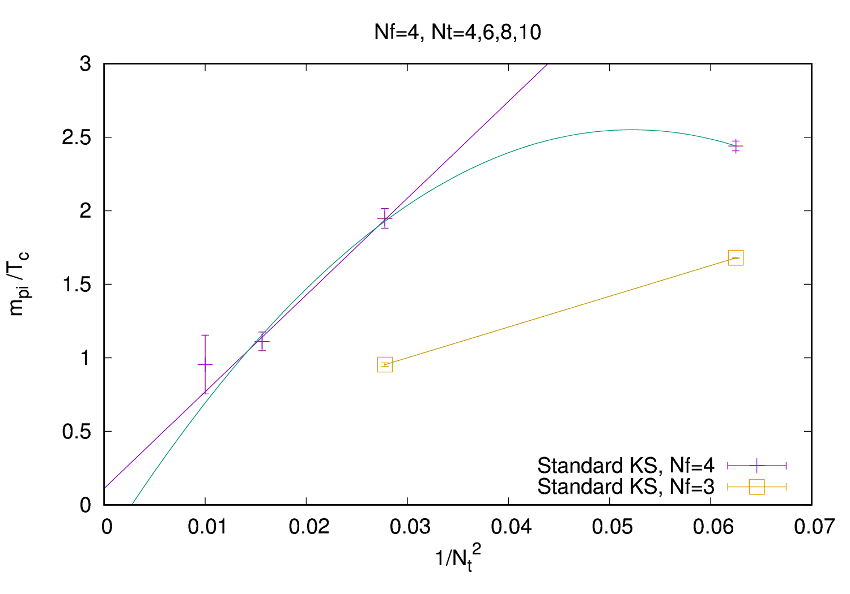
A staggered result in 4-flavor QCD
4-flavor QCD
- 1st order phase transition
is expected at m = 0
- Stronger phase transition
compared to N_{f} = 3
→ larger m_{E}
→ less expensive computation
- No rooting issue
- A good analogue to understand
3-flavor results
Similar behavior as N_{f} = 3
- quite small m^{E}_{π} in the continuum limit
→ important to crosscheck also with Wilson-type quarks
P. de Forcrand and M. D’Elia, PoS LATTICE2016 (2017) 081

Slide 5
Simulation setup
Iwasaki gauge + O(a)-improved Wilson quarks with 4 degenerate flavors
C_{sw} has been non-perturbatively determined in N_{f} = 4
3 different cutoffs towards the continuum limit
N_{t} = 4, 6 and 8
2-3 different β values at each N_{t}
β = 1.60, 1.61 and 1.62 at N_{t} = 4
β = 1.67, 1.68 and 1.69 at N_{t} = 6
β = 1.66 and 1.67 at N_{t} = 8
Chiral condensate and its cumulants
Up to 4th order, i.e. susceptibility, skewness and kurtosis
Traces, e.g. TrD^{-n} for n = 1, 2, 3 and 4, measured with 10 noises
Multi-ensemble reweighting for κ
to improve signals
Zero temperature simulations also have been done on a 16³×32 lattice for scale setting (t₀ and m_{PS})

Slide 6
Kurtosis intersection method
V < V < V
0
K
κ
1st order
2nd order
Endpoint
κ
K
-2
Crossover
β
Critical endpoint : No volume dependence
↓
Searching for an intersection

Slide 7
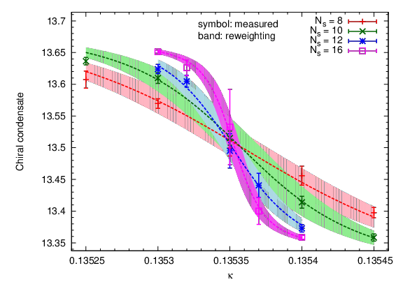
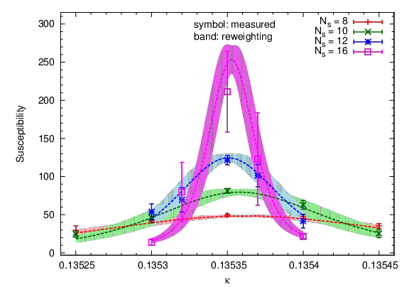
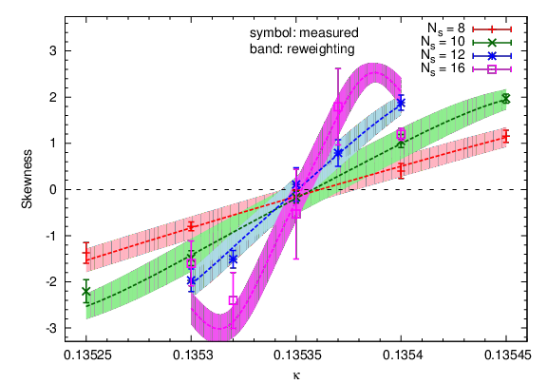
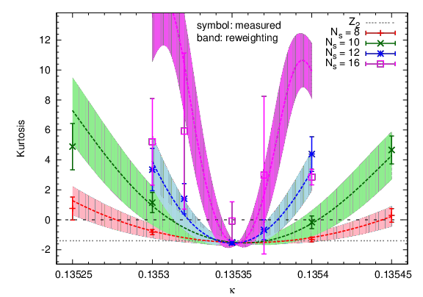
An example of cumulants at N_{t} = 4
β = 1.61
Susceptibility
N_{s} = 8
N_{s} = 10
N_{s} = 12
N_{s} = 16
Chiral condensate
dotted curves:
reweighting
Skewness
Kurtosis

Slide 8
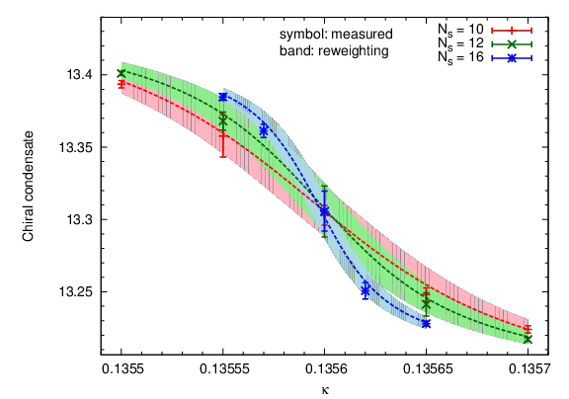
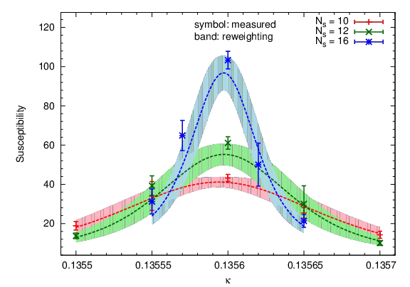
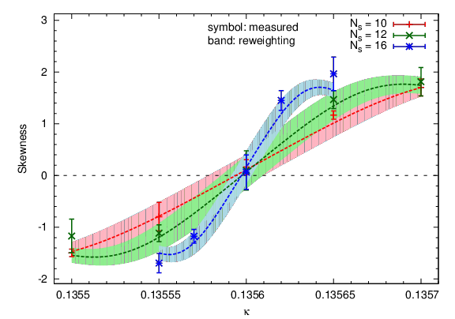
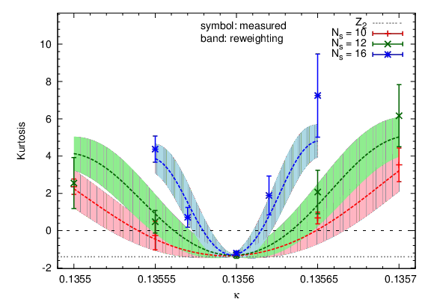
An example of cumulants at N_{t} = 6
β = 1.68
Susceptibility
N_{s} = 10
N_{s} = 12
N_{s} = 16
Chiral condensate
dotted curves:
reweighting
Skewness
Kurtosis

Slide 9
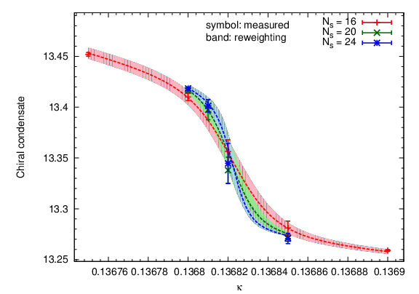
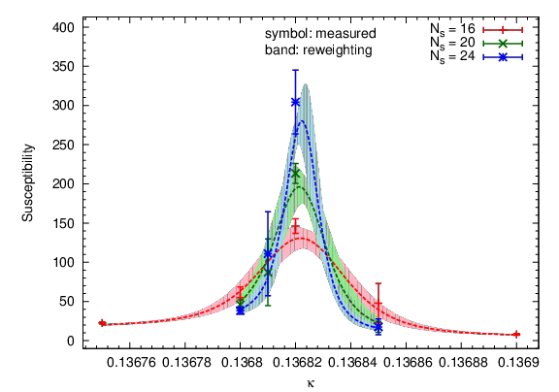
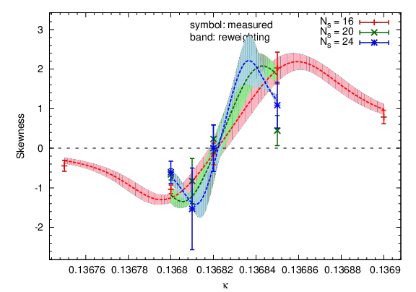
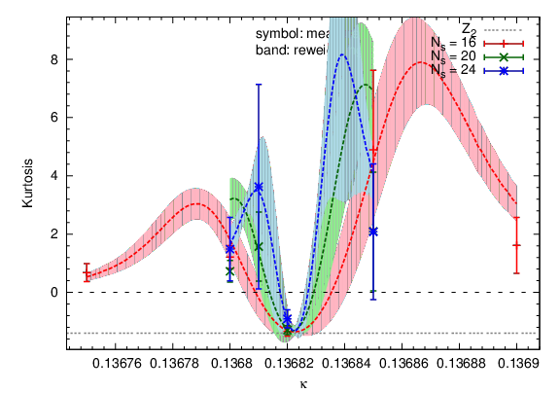
An example of cumulants at N_{t} = 8
β = 1.66
Susceptibility
N_{s} = 16
N_{s} = 20
N_{s} = 24
Chiral condensate
dotted curves:
reweighting
Skewness
Kurtosis

Slide 10
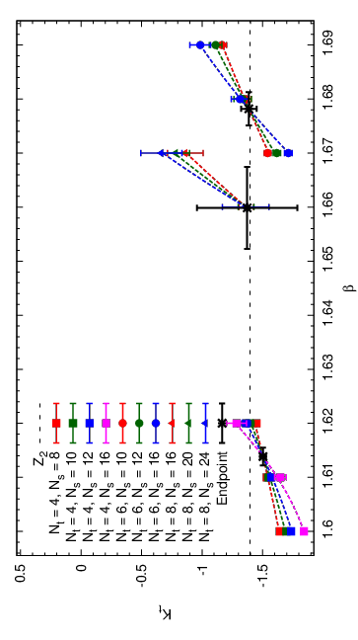
Results of kurtosis intersections
Fit ansatz:
N_{t} = 8
χ²/d.o.f. = 0.018
N_{t} = 6
χ²/d.o.f. = 0.12
N_{t} = 4
χ²/d.o.f. = 0.22
K_{E} slightly deviates from that of Z₂ at N_{t} = 4
while it is consistent with Z₂ at N_{t} = 6 and 8.

Slide 11
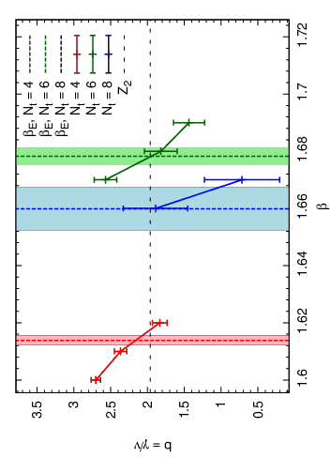
Further universality check with susceptibilities
Fit ansatz:
N_{t} = 4
N_{t} = 8
N_{t} = 6
χ²/d.o.f. = 0.80
χ²/d.o.f. = 0.11
χ²/d.o.f. = 0.23
χ²/d.o.f. = 0.007
χ²/d.o.f. = 0.12
χ²/d.o.f. = 0.4
χ²/d.o.f. = 0.058
χ²/d.o.f. = 0.079
b at the endpoint is larger than that of Z₂ at N_{t} = 4
while it is consistent with Z₂ at N_{t} = 6 and 8.

Slide 12
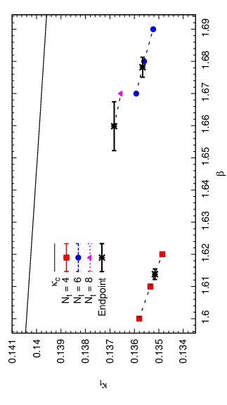
Critical endpoints in N_{f} = 4 QCD

Slide 13
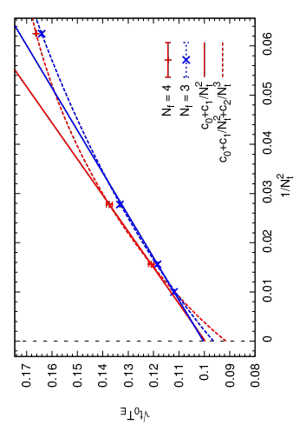
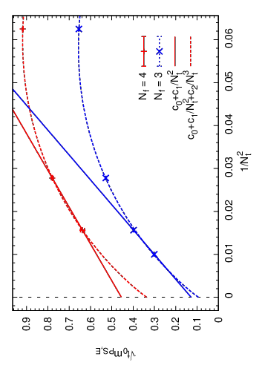
Cutoff dependence of critical endpoints
N_{f} = 3 results: X.-Y. Jin et al., Phys.Rev. D96 (2017) no.3, 034523
N_{f} = 4 results have similar cutoff dependence as those of N_{f} = 3.
m_{PS,E} in N_{f} = 4 is larger than that in N_{f} = 3.

Slide 14
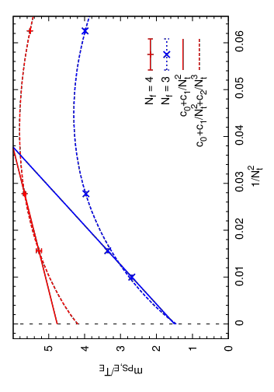
Comparison with staggered results
Staggerd results:
P. de Forcrand and M. D’Elia, PoS LATTICE2016 (2017) 081
m_{PS,E}/T_{E} for N_{f} = 4 Wilson might remain finite even in a → 0,
which is different from m_{PS,E}/T_{E} ≃ 0 for N_{f} = 4 staggered.
Difference between Wilson and staggered is not due to the rooting.

Slide 15
Summary and outlook
Critical endpoints in N_{f} = 4 QCD has been studied.
N_{f} = 3 and N_{f} = 4 have a similar scaling behavior in a → 0.
Larger m_{PS,E} has been observed in N_{f} = 4 than in N_{f} = 3.
Wilson and staggered results are different from each other even in N_{f} = 4, which indicates that the difference does not come from the rooting.
Future plans:
Further studies for more reliable continuum extrapolations, e.g. simulations with N_{t} = 10.

Slide 16
End

Slide 17
Backup slides

Slide 18
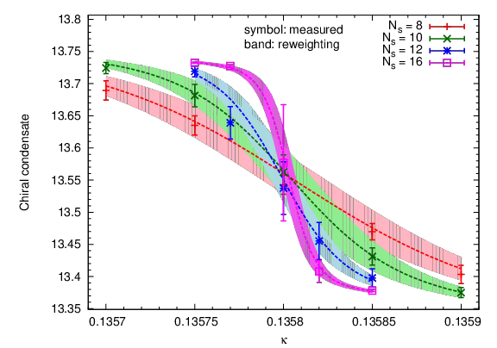
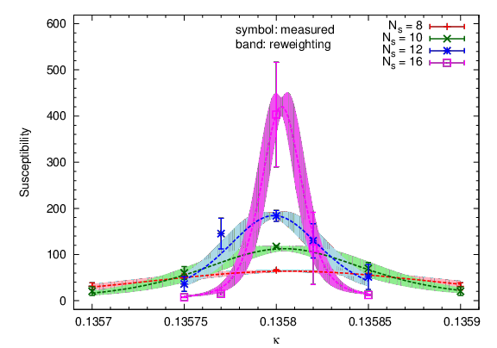
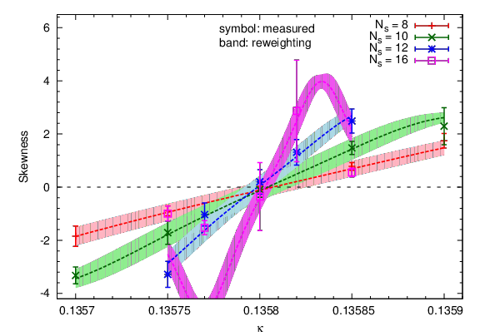
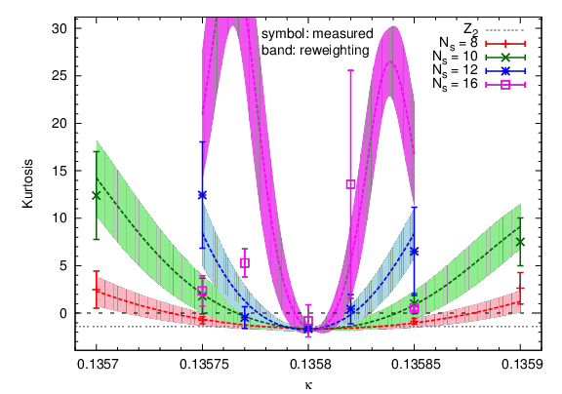
Cumulants at N_{t} = 4, β = 1.60
Susceptibility
N_{s} = 8
N_{s} = 10
N_{s} = 12
N_{s} = 16
Chiral condensate
dotted curves:
reweighting
Skewness
Kurtosis

Slide 19
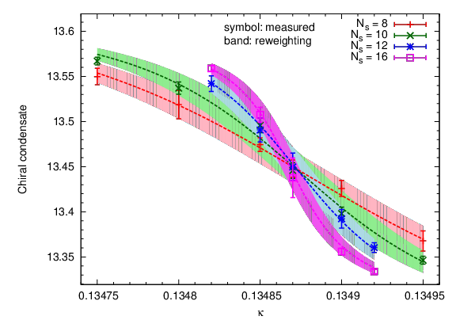
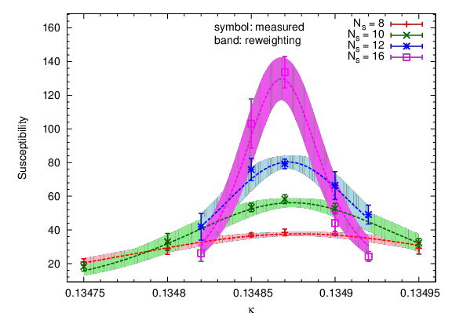
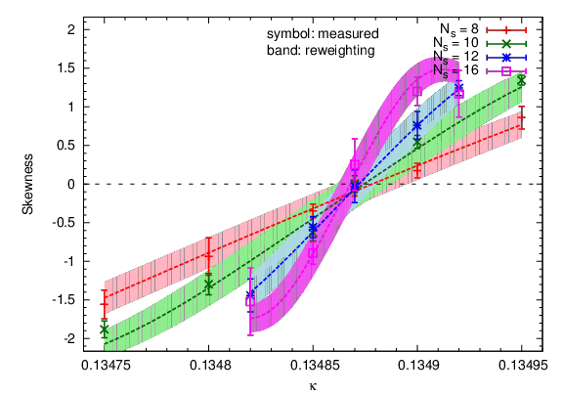
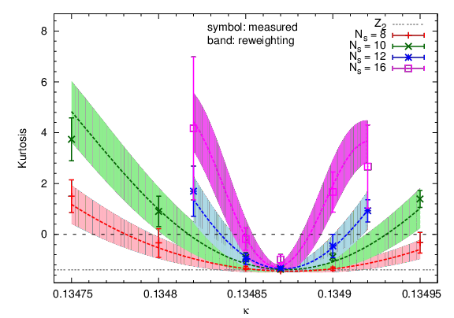
Cumulants at N_{t} = 4, β = 1.62
Susceptibility
N_{s} = 8
N_{s} = 10
N_{s} = 12
N_{s} = 16
Chiral condensate
dotted curves:
reweighting
Skewness
Kurtosis

Slide 20
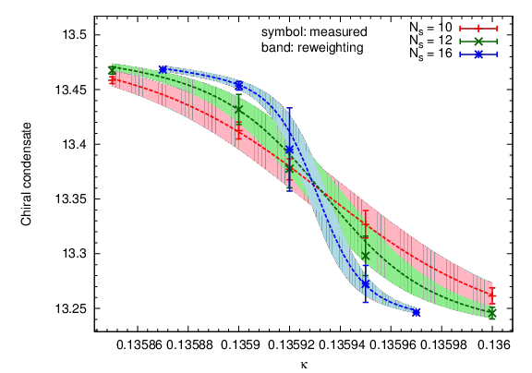
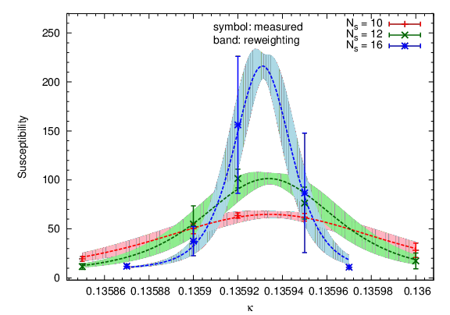
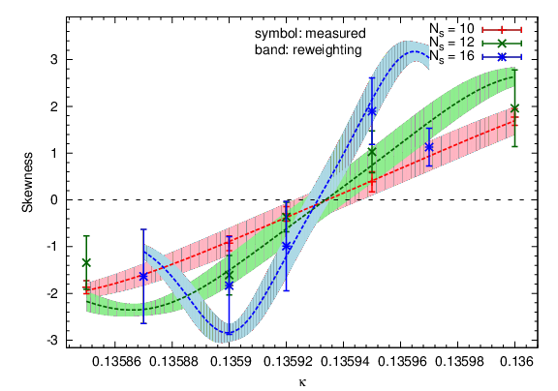
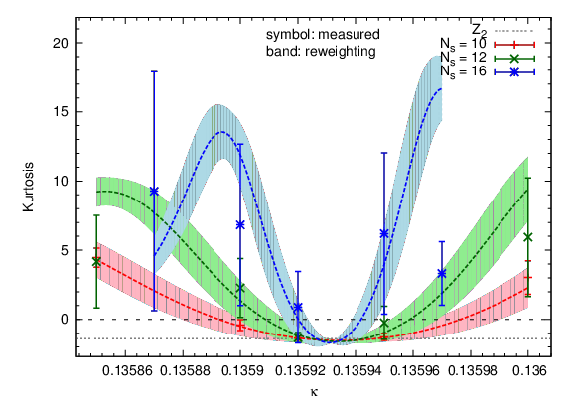
Cumulants at N_{t} = 6, β = 1.67
Susceptibility
N_{s} = 10
N_{s} = 12
N_{s} = 16
Chiral condensate
dotted curves:
reweighting
Skewness
Kurtosis

Slide 21
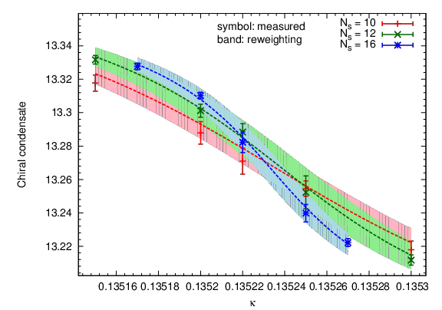
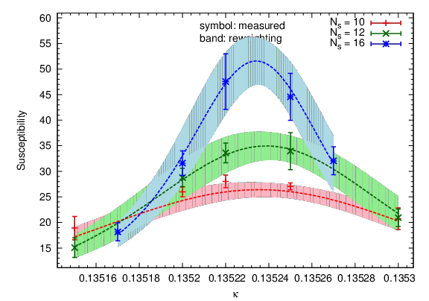
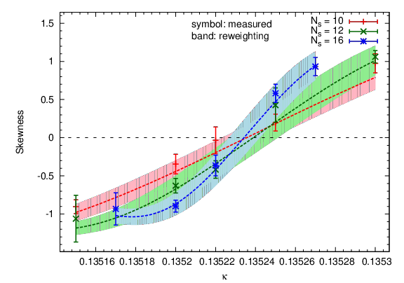
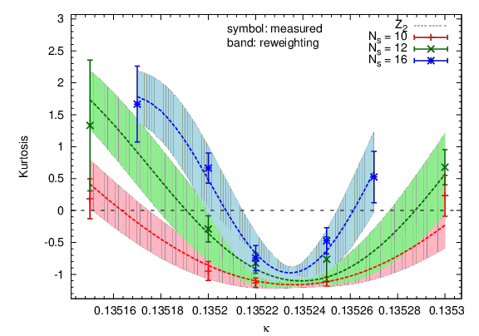
Cumulants at N_{t} = 6, β = 1.69
Susceptibility
N_{s} = 10
N_{s} = 12
N_{s} = 16
Chiral condensate
dotted curves:
reweighting
Skewness
Kurtosis

Slide 22
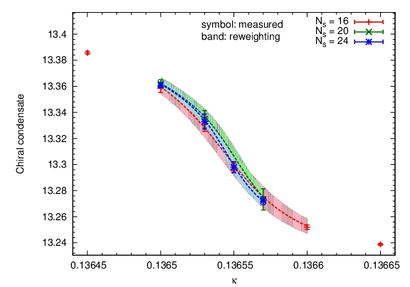
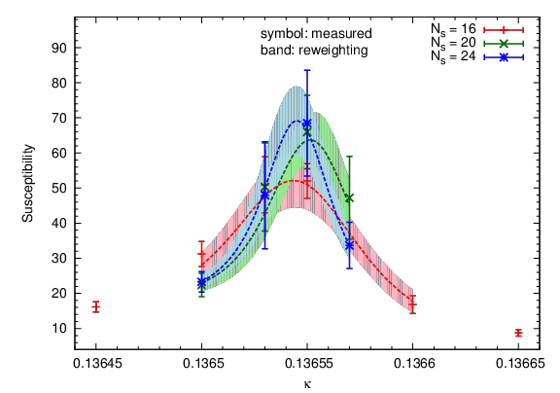
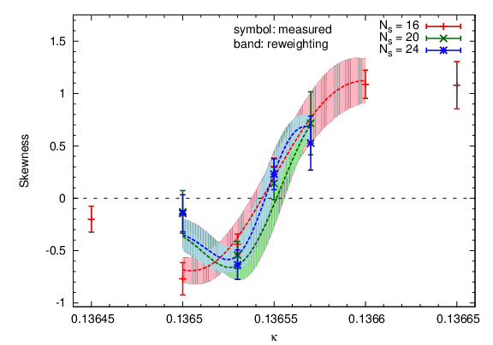
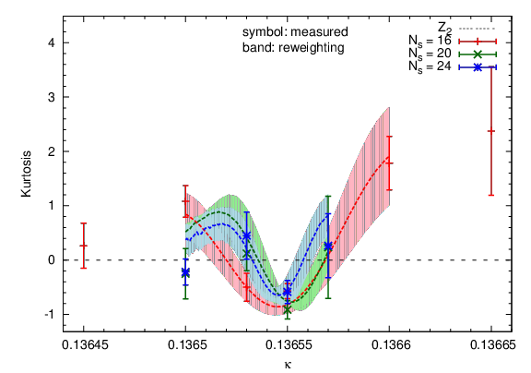
Cumulants at N_{t} = 8, β = 1.67
Susceptibility
N_{s} = 16
N_{s} = 20
N_{s} = 24
Chiral condensate
dotted curves:
reweighting
Skewness
Kurtosis

