Slide 1
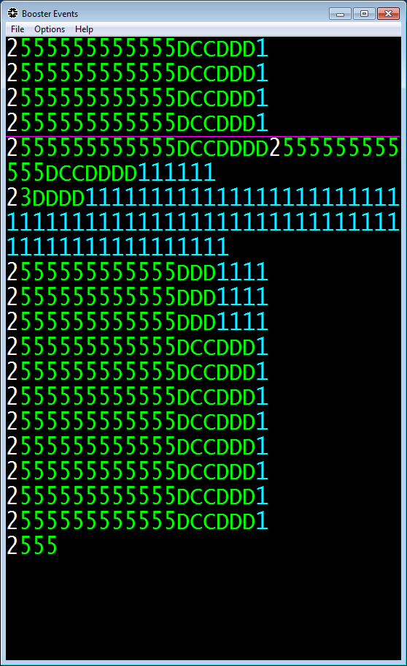
Beam to MTA
66.67msec (15Hz)
Pulse rate: 15 Hz
Pulse width: 2 – 60 μsec
Peak Current: 23.5 mA
RF frequency: 805MHz
Transverse emittance:
~6 pi mm mrad
Operation
pulse length: 32 μsec
intensity: 4.7 ppp
rep. rate: ~ 13Hz
2 − 60μsec
5nsec
1.24nsec
12.92Hz operation

