Slide 1
Operational Data and Testing: OIM, RSV and MyOSG
Elizabeth Chism, Soichi Hayashi, Rob Quick
Grid Operations Center
March 3, 2009

Slide 2
What we will talk about
OIM – OSG Information Management -Registration of Administrative Data
RSV – Resource & Service Validation – Status testing and Reporting
MyOSG – Consolidation of OSG Information Sources

Slide 4
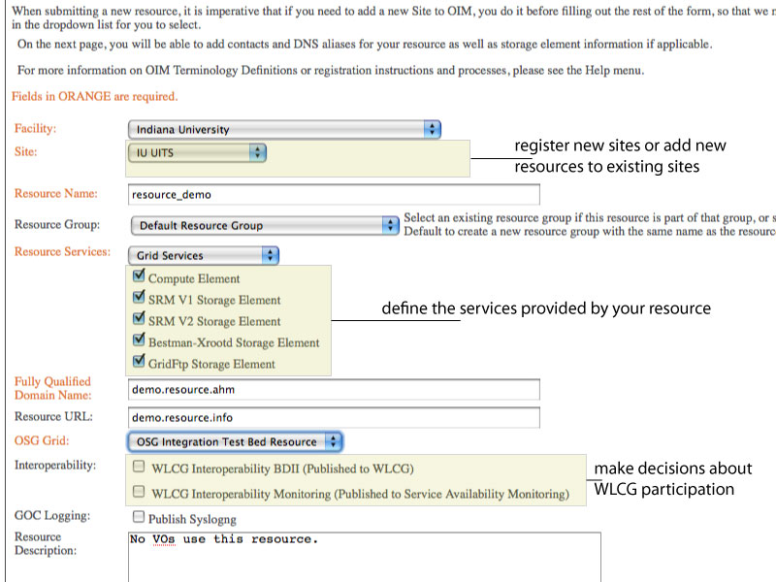

Slide 7
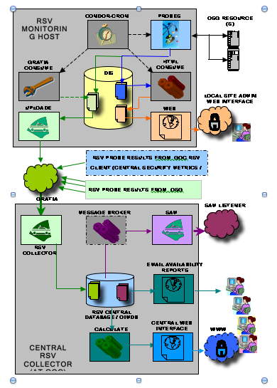
RSV

Slide 8
RSV
Small local (or remote) tests for basic grid functionality.
Authentication
Hello World
CA/CRL Expiry
OSG Version
Job Manager Available
Scheduling mechanism (Condor-Cron, Nagios)
Reporting mechanism (Gratia)
Display mechanism (Local html, Nagios, MyOSG, SAM)

Slide 9
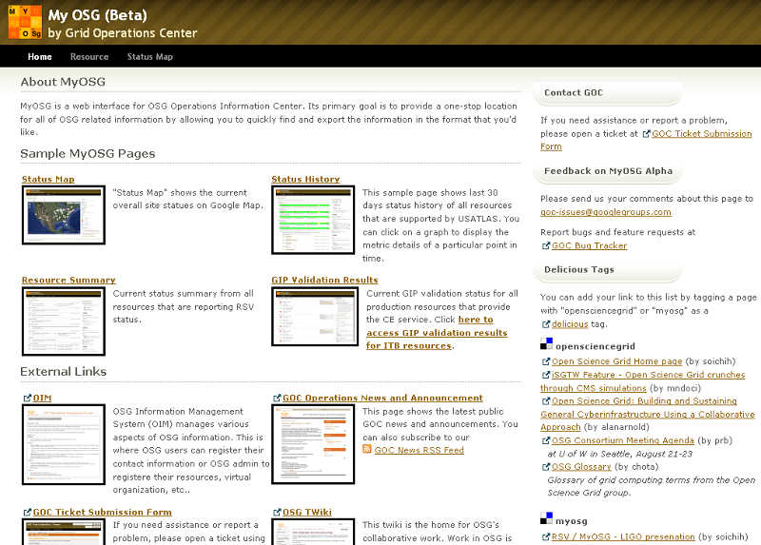
MyOSG

Slide 10
MyOSG

Slide 11
MyOSG

Slide 12
MyOSG

Slide 13
MyOSG

Slide 17
Questions

