Slide 1
RSV Phase 3 MyOSG Demo
Soichi Hayashi, Rob Quick
OSG All-Hands Meeting
Monday, March 2

Slide 2
Goal of RSV
“The goal of the OSG Resource and Service Validation (RSV) project is to provide OSG site administrators, users and internal interests with dependable information about the state and capabilities of the resources accessible and Grid services provided on the OSG.”

Slide 3
RSV Phase 3
New Probes
Management Interface
Start/Stop/Rerun Tests
Probe Updates
Configuration
Enhanced Interface
Replace VORS (With MyOSG)
Central Bookkeeping Monitoring
Improve Stability
New Certificate Process (Robot Certs?)

Slide 4
Goal of MyOSG
“The primary idea is to use an authoritative source of information about OSG entities, and collate all possible tools to be accessible in a single web portal called MyOSG, where a user can visit, and access various pieces of information. MyOSG also provides the ability for users to export / subscribe to a variety of information in formats such as XML, CSV, and in industry standard widget formats (UWA). This will enable users of MyOSG to to construct Individual Infomation Centers (IICs) for on tools such as iGoogle, Netvibes, Opera Widgets, iPhone, etc.. The MyOSG will allow users to access only the information that matters to them in on a format that is once again most convenient to them.”

Slide 5
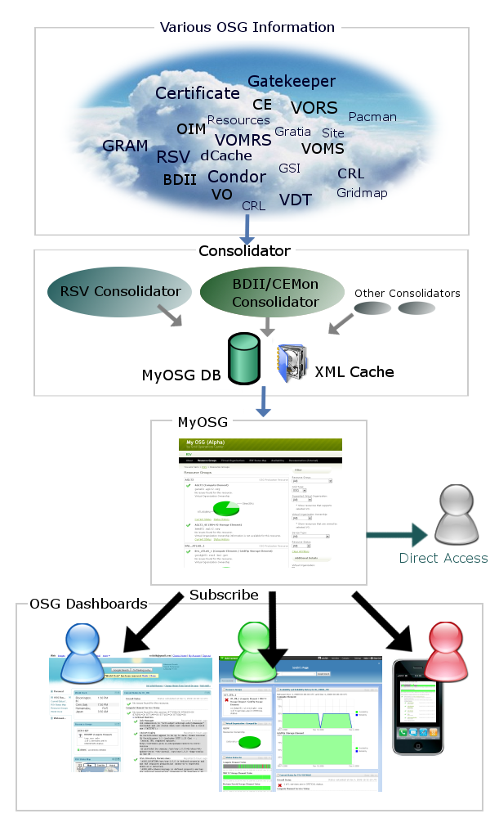
MyOSG

Slide 6
Demo
myosg.grid.iu.edu

Slide 7
Some Questions for the Attendees
Is this a useful tool for a site admin?
What other audiences would find this useful?
What is missing?
What needs to be enhanced?
What would the perfect status display be to you?
Any other comments, suggestions?
Continued suggestion can be sent to Please send us your comments about this page to goc-issues@googlegroups.com
Bugs and feature requests can be submitted at http://code.google.com/p/osggoc/issues/entry

