Slide 1
BDII and Site Information
Rob Quick
OSG Operations Coordinator
March 3, 2007

Slide 2
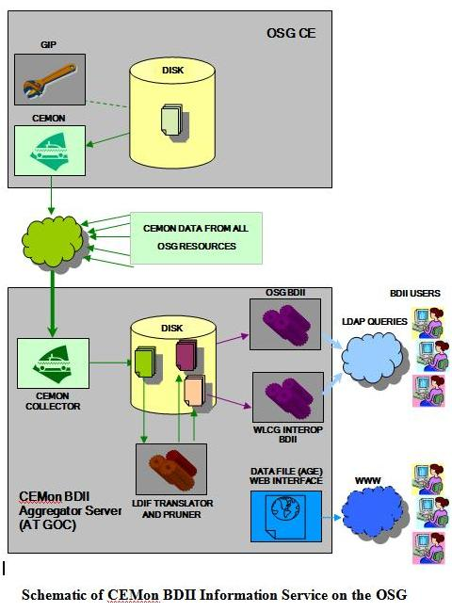
BDII Structure

Slide 3
BDII Structure
Site level GIP gathers information
CEMon Client
CEMon Collector
LDIF Translator
OSG BDII
WLCG BDII
Web Interface (www.grid.iu.edu)

Slide 4
BDII Structure
DNS Round Robin from is.grid.iu.edu
IU BDII (is1.grid.iu.edu)
IUPUI BDII (is2.grid.iu.edu)

Slide 5
What kind of information?
GlueCEUniqueID: osg.rcac.purdue.edu:2119/jobmanager-condor-sbgrid
GlueCEInfoGatekeeperPort: 2119
GlueCEInfoHostName: osg.rcac.purdue.edu
GlueCEInfoLRMSType: condor
GlueCEInfoLRMSVersion: 7.0.5
GlueCEInfoTotalCPUs: 1569
GlueCEInfoJobManager: condor
GlueCEInfoContactString: osg.rcac.purdue.edu:2119/jobmanager-condor-sbgrid
GlueCEInfoApplicationDir: /apps/osg
GlueCEInfoDataDir: /scratch/osg
GlueCEInfoDefaultSE: dcache.rcac.purdue.edu
GlueCEStateEstimatedResponseTime: 60
GlueCEStateFreeCPUs: 27
GlueCEStateRunningJobs: 0
GlueCEStateStatus: Production
GlueCEStateTotalJobs: 0
GlueCEStateWaitingJobs: 0
GlueCEStateWorstResponseTime: 86400
GlueCEStateFreeJobSlots: 27
GlueCEPolicyMaxCPUTime: 6000
GlueCEPolicyMaxObtainableCPUTime: 0
GlueCEPolicyMaxRunningJobs: 0
GlueCEPolicyMaxWaitingJobs: 0
GlueCEPolicyMaxTotalJobs: 0
GlueCEPolicyMaxWallClockTime: 6000
GlueCEPolicyMaxObtainableWallClockTime: 0
GlueCEPolicyPriority: 0
GlueCEPolicyAssignedJobSlots: 1569

Slide 6
Constructing a BDII Query
All GLUE information for all resources
ldapsearch -h is.grid.iu.edu -p 2170 -x -b mds-vo-name=local,o=grid
All GLUE information for a single source
ldapsearch -h is.grid.iu.edu -p 2170 -x -b mds-vo-name=NYSGRID-CCR-U2,mds-vo-name=local,o=grid
All GLUE information for sources that support a VO (Example SBGrid)
ldapsearch -h is.grid.iu.edu -p 2170 -x -b mds-vo-name=local,o=grid "(&(objectClass=GlueCE)(GlueCEAccessControlBaseRule=*sbgrid))”

Slide 7
Constructing a BDII Query
Filtered information for sources that support a VO (Example SBGrid)
ldapsearch -h is.grid.iu.edu -p 2170 -x -b mds-vo-name=local,o=grid "(&(objectClass=GlueCE)(GlueCEAccessControlBaseRule=*sbgrid))" GlueCEUniqueID GlueForeignKey GlueCEHostingCluster
Filtered information for a single CE
ldapsearch -h is.grid.iu.edu -p 2170 -x -b mds-vo-name=NYSGRID-CCR-U2,mds-vo-name=local,o=grid "(&(objectClass=GlueCE)(GlueCEAccessControlBaseRule=*sbgrid))" GlueCEUniqueID GlueForeignKey GlueCEHostingCluster GlueCEStateFreeCPUs

Slide 8
Questions?

