Slide 1
M. Murphy
Applied Physics and Superconducting Technology Division
Karie Badgley
53rd Annual Users Meeting
August 12, 2020
http://td.fnal.gov

Slide 2
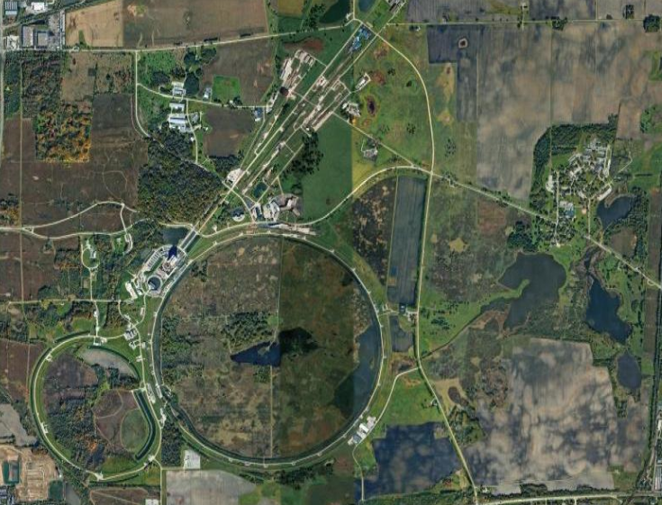
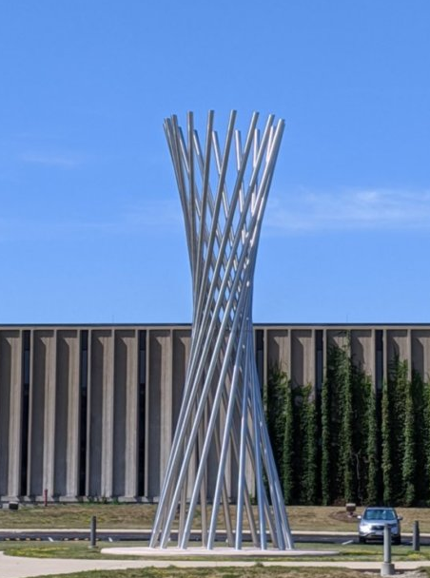
APS-TD Mission
Pursue highly innovative R&D program in superconducting magnets and SRF for accelerators and quantum technology to advance the lab’s scientific mission and to help in defining the lab’s future direction
Operate accelerator test facilities to maximize the lab’s scientific productivity and impact
Develop and build next generation accelerators and detectors using cutting-edge technologies
Educate and train the next generation of physicists and engineers
Machine Shop
Wilson
APS-TD

Slide 3
Departments and Projects
R&D
Superconducting RF R&D
Superconducting Magnet R&D
Quantum Technologies
Departments
SRF Department
Magnet Systems
Cryogenics
Machine shop
Test & Instrumentation
Quality & Materials
Talk by Sarah Demers
Talk by Farah Fahim
Programs and Projects
PIP II
LCLS-II
High Luminosity LHC Accelerator Upgrade Project (HiLumi AUP)
Mu2e
SRF Program
Magnet Development Program
Accelerator Support
Talk by Lidija Kokoska
Talk by Manolis Kargiantoulakis
Talk by Sarah Demers

Slide 4
Departments and Projects
R&D
Superconducting RF R&D
Superconducting Magnet R&D
Quantum Technologies
Departments
SRF Department
Magnet Systems
Cryogenics
Machine shop
Test & Instrumentation
Quality & Materials
Programs and Projects
PIP II
LCLS-II
High Luminosity LHC Accelerator Upgrade Project (HiLumi AUP)
Mu2e
SRF Program
Magnet Development Program
Accelerator Support

Slide 5
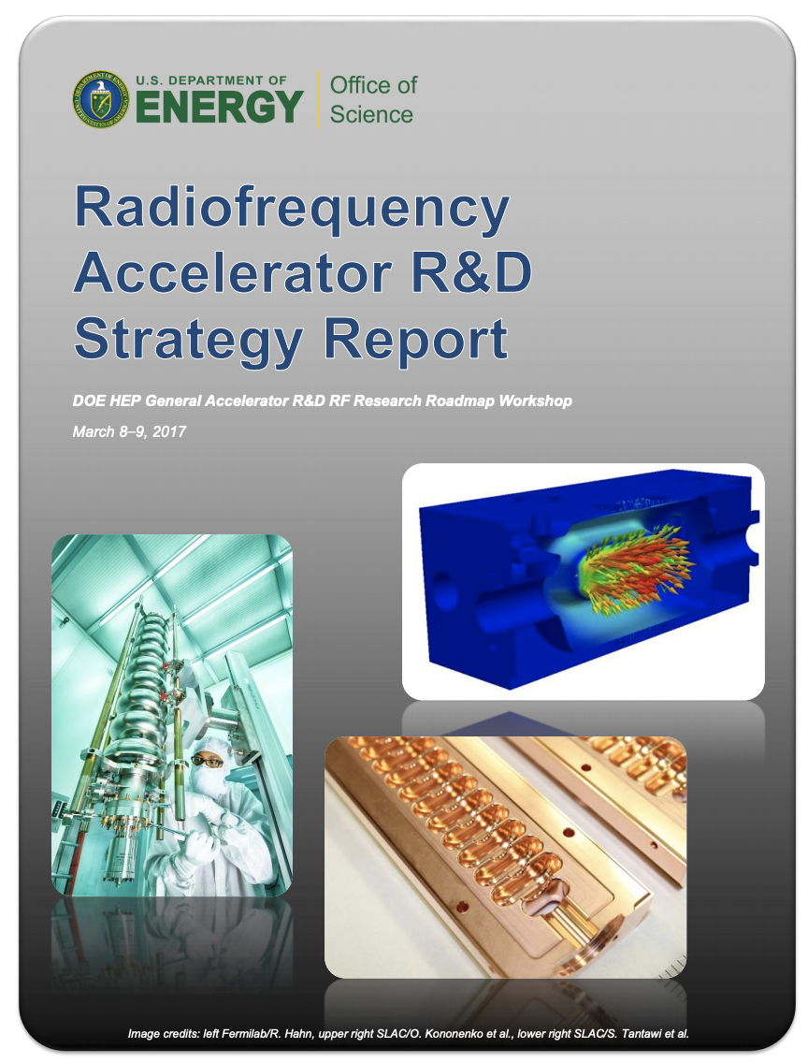
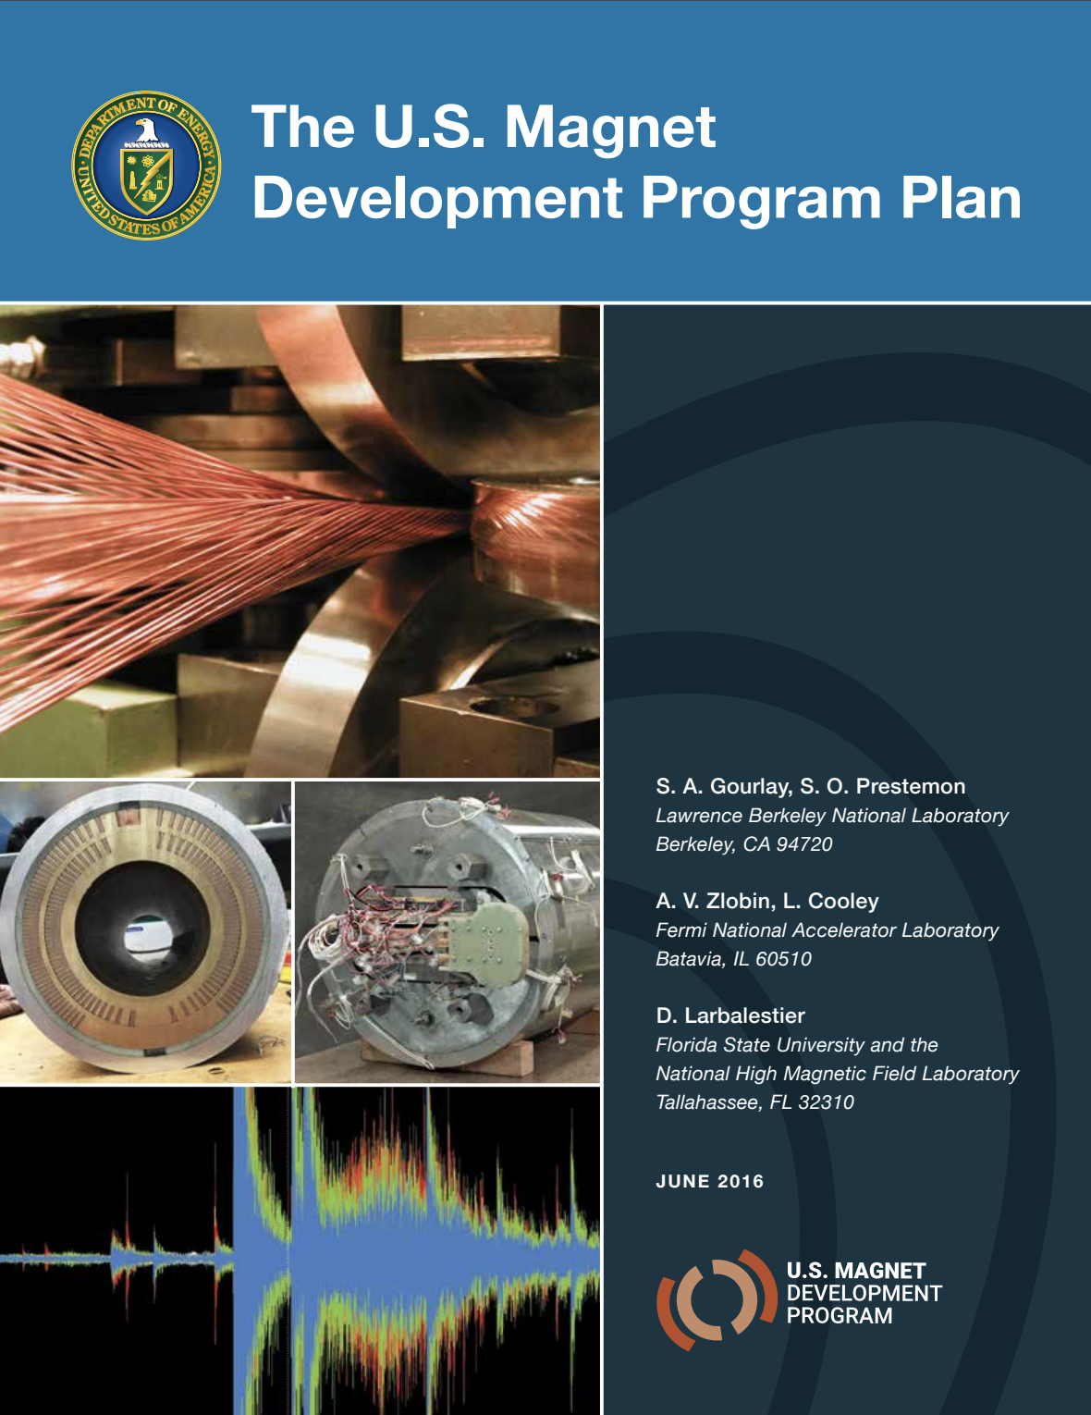
Decadal SRF and Magnet R&D Roadmaps
In last few years, US magnet and RF communities have developed “roadmaps” to carefully evaluate R&D directions for the next decade
Goal is to continue to provide frontier accelerator-based physics for years to come

Slide 6
Superconducting RF Cavities R&D
HEP + BES
FNAL R&D – benefits range of initiatives from Energy Frontier to Intensity Frontier to Basic Energy Science and to Quantum Information Science
Frontier projects which build upon our SRF facilities + experience include the following:
PIP-II, LCLS-II, LCLS-II HE, HL-LHC AUP
Highlights from FY20 R&D:
  First ever Nb₃Sn-coated 9-cell cavity – key technical demonstration for accelerators for industry, universities, and beyond
  Breakthrough in understanding oxygen diffusion mechanism in Nb for reaching very high gradients – impact to all high gradient cavity applications
Nb₃Sn 9-cell cavity: world record
accelerating gradient for a
non-niobium multicell cavity!

Slide 7
LCLS-II and LCLS-II-HE
https://lcls-ii.fnal.gov/
HEP + BES
Upgrade of the Linear Coherent Light Source at SLAC
LCLS-II work at Fermilab is nearing completion
  Finishing testing with a schedule to ship remaining
  3.9 and 1.3 GHz cryomodules to SLAC by Feb 2021
  A 3.9 GHz CM is going through extended testing to
  gain experience with its low level RF control system
LCLS-II-HE Fermilab scope has building 10+ 1.3 GHz CMs including designing and building an SRF gun for the second injector line
  Successful transfer of protocols to industry with four
  vendor cavities completed and others under testing
  The corresponding verification cryomodule on schedule
  for fabrication and testing in FY21.

Slide 8
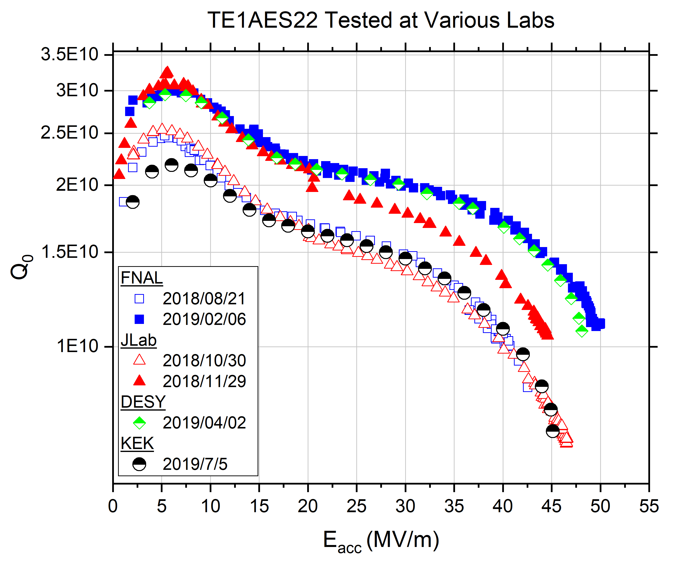
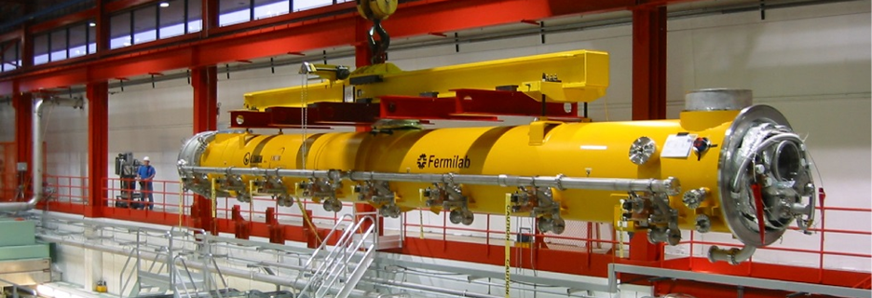
Research towards an ILC
SRF R&D for ILC focused on achieving high gradient (40-50 MV/m) and quality factor (Q > 10¹⁰)
A FNAL cavity was sent around the world (KEK, JLab, DESY, Cornell) for cross-verification of its performance
Work is ongoing for preparation of a > 40 MV/m cryomodule demonstration at FNAL
JLab, Cornell, KEK, Saclay, DESY, TRIUMF will join this effort with in-kind contributions
f=1.3GHz
T=2K
ILC Spec

Slide 9
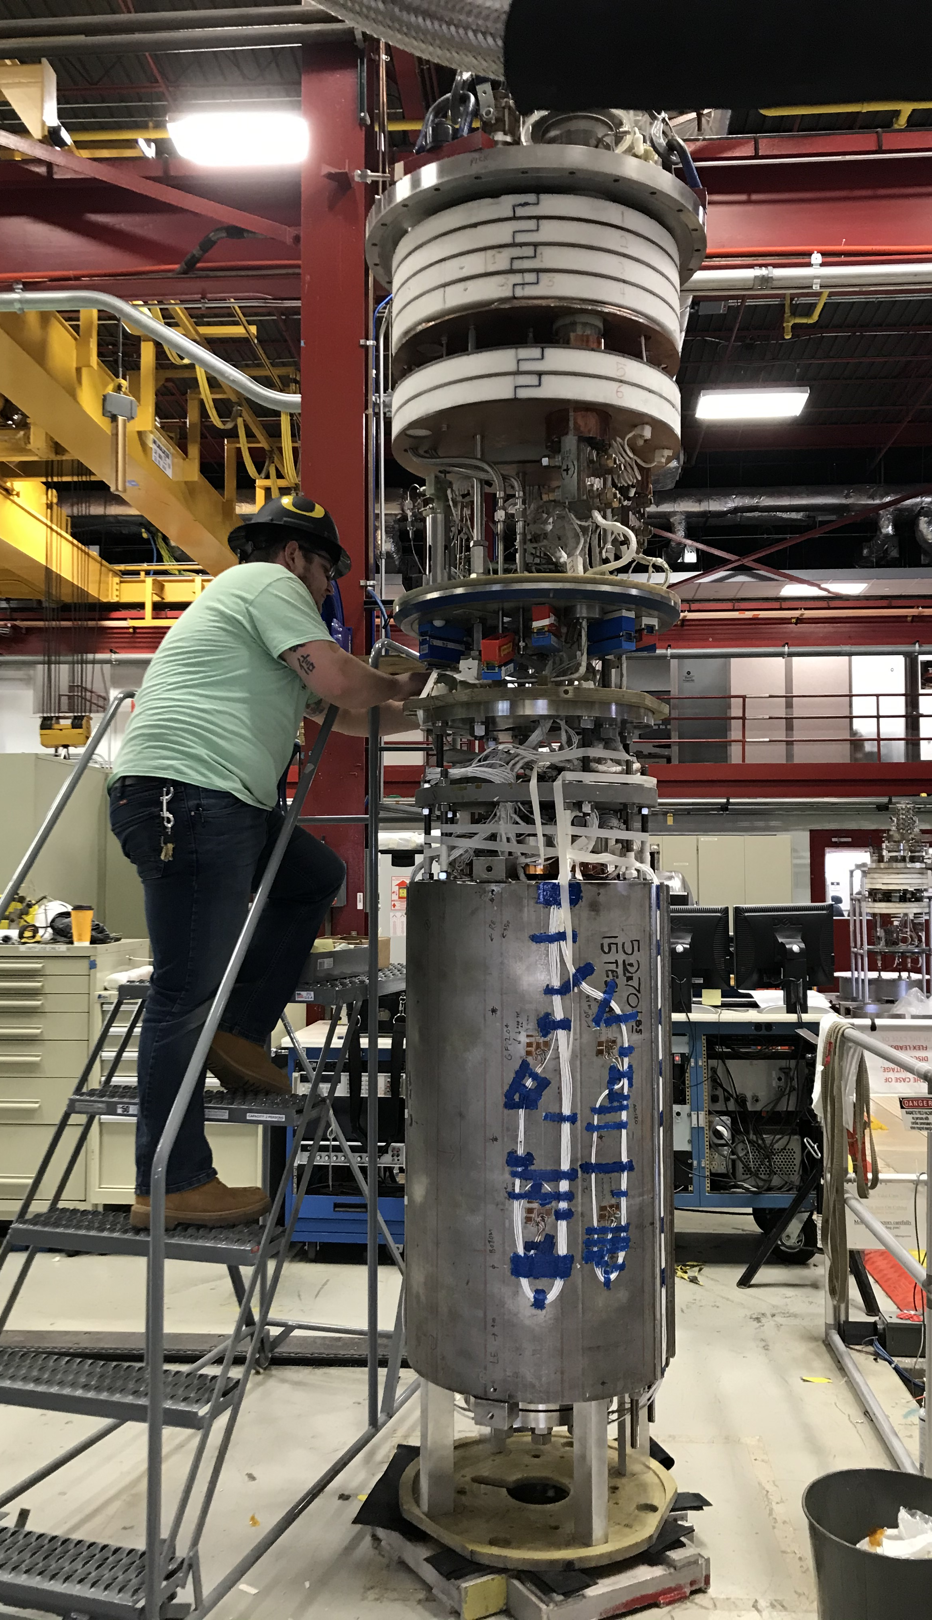
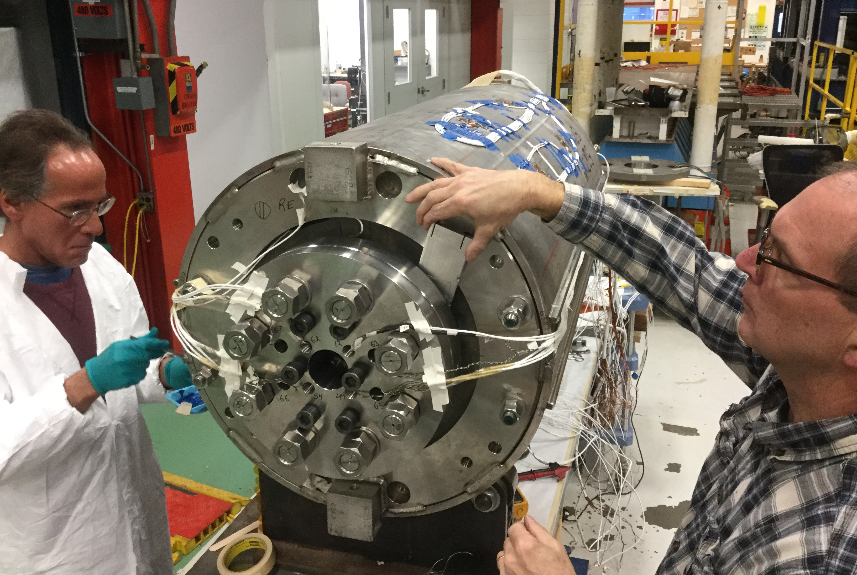
Magnet R&D: 15 T Dipole (MDPCT1) (A. Zlobin, I. Novitski et al.)
Magnet Dipole Prototype Cos-Theta type 1
Towards the limit of the Nb₃Sn accelerator magnet technology
MDPCT1 design features:
60 mm aperture, 1 m long graded 4-layer Nb₃Sn dipole coil
600 mm diameter innovative support structure

Slide 10
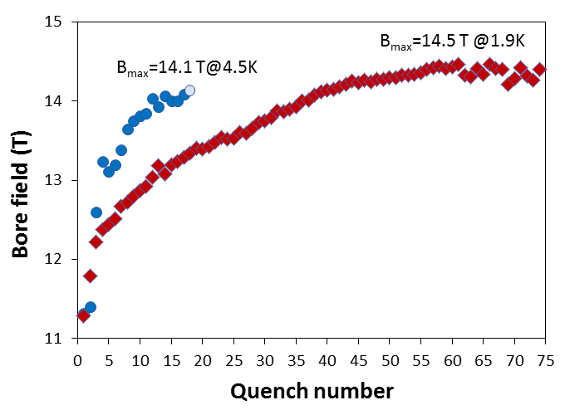
Magnet R&D: 15 T Dipole Test (A. Zlobin, I. Novitski et al.)
1. 1st test – May-July 2019
Test target: B_{max}=14 T
B_{max} =14.1 T @4.5K – the world record field for accelerator magnets!
2. August 2019-February 2020
magnet re-assembly with improved coil axial support and higher pre-stress
3. 2nd test – May-July 2020
Reached the conductor limit
B_{max}=14.5 T @1.9K – the new world record field for accelerator magnets!
The world record field for accelerator magnets is now at Fermilab!

Slide 11
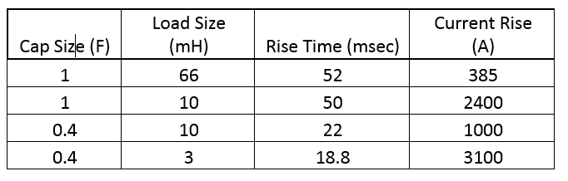
R&D: Quench Current-boosting Device (QCD)
Stoyan Stoynev
CIs: Maria Baldini, Sandor Feher
Has the potential to accelerate training by “skipping” intermediate current quenches
Capacitor based device with 0.4 F banks (upgradable)
Boost the quench current through SC magnet to higher levels at quench detection
To be tested on a single coil (“mirror magnet”) first
Expert support: Matt Kufer, Howie Pfeffer,Chris Jensen
(simulations)
Status
Started in April 2019
Component optimization work on the device completed, components ordered but long lead times
Preparations for mirror magnet assembly started
Main components purchased and work on individual parts done, assembly toward the end of the year

Slide 12
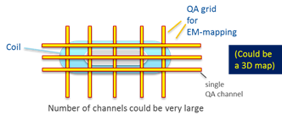

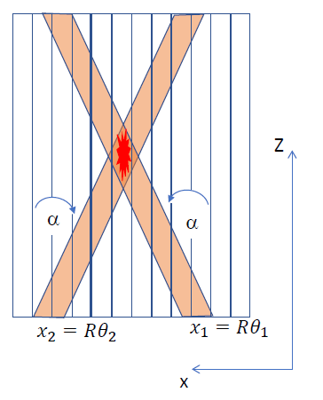
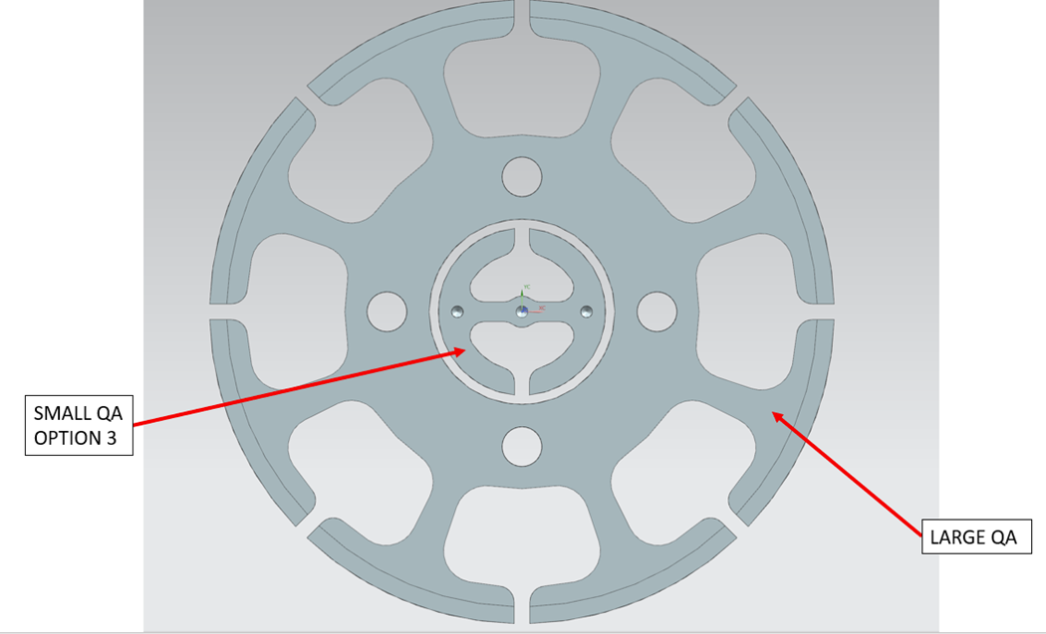
R&D: Quench Antenna (QA)
Stoyan Stoynev, Joe DiMarco
Induction loop quench antennas
Design and fabricate sheet-like flexible multi-channel devices - senseSkins
Grid-like and “pixelized” (point-like QA sensors) versions
Fit for “warm” and “cold” bore operations specifically for VMTF
  becoming part of this FNAL testing facility
Coil-specific versions in addition
Use intersection of determined quench angle/x-position from each of the two panels to locate quench

Slide 13
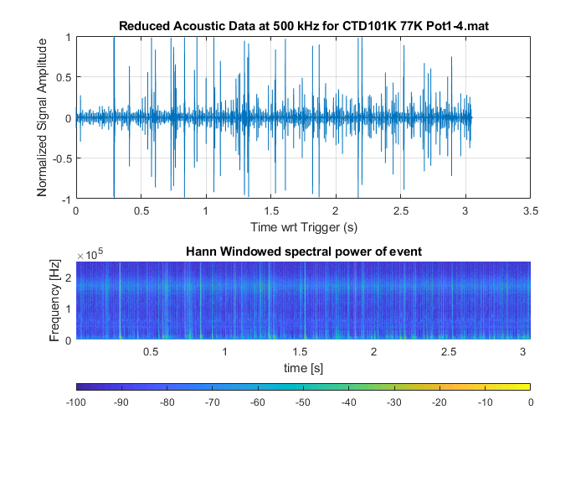
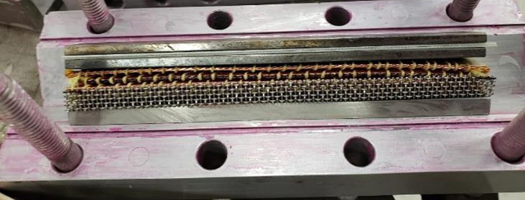
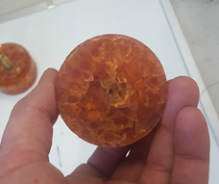
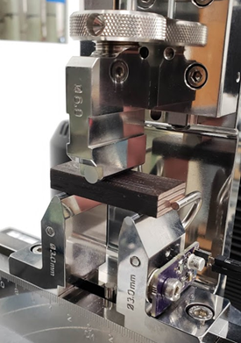
Nb₃Sn Composite R&D Goals and Progress
Correlate Conductor Properties with Magnet Performance
Identify signatures for quench Initial
Quantify Energy Release events in real loading conditions
Develop Techniques for enabling different classes of magnet impregnation systems
Use the above to develop insulation systems that reduce or eliminate magnet training
  Build quiet magnets, eliminate training
Sample demonstrating techniques for enabling highly viscous resins
Load and acoustic data: Enabling quantification and measurement of behavior in magnet like configuration
Thermal Shock sample demonstrating poor thermal shock resistance
Energy Spectrum during sample testing: Use this to target quench mitigation actions
New Resins have been demonstrated to have twice the shear strength with respect to baseline and substantially better thermal shock performance
K. Badgley | 53rd Annual Users Meeting | APS-TD

Slide 14
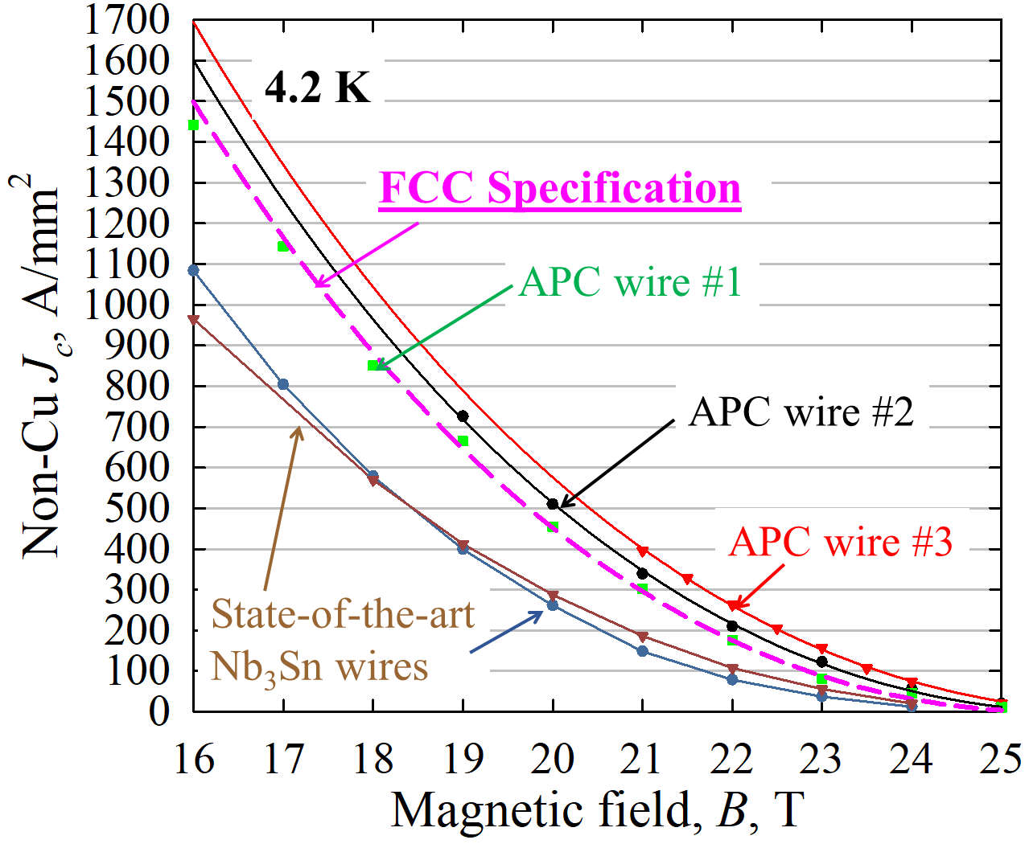
Nb₃Sn - Superconductor R&D: X. Xu et al.
Accelerator magnets for Future Circular Collider (FCC)-hh: will be based on Nb₃Sn conductors
A grand technical challenge for FCC-hh: critical current density (J_{c}) of state-of-the-art Nb₃Sn has plateaued for ~2 decades, but 50% below FCC specification
R&D in Fermilab: developing new-generation Nb₃Sn using artificial pinning center (APC) technology
X. Xu et al., Patent # 9916919, 2018
Supported by X. Xu Early Career Award
Current Status: achieved new record J_{c}, surpassed the FCC specification!
Other R&D on Nb₃Sn conductors: enhance specific heat for stability

Slide 15
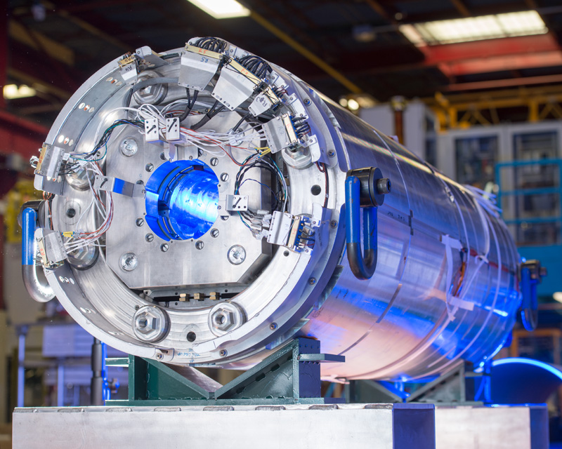
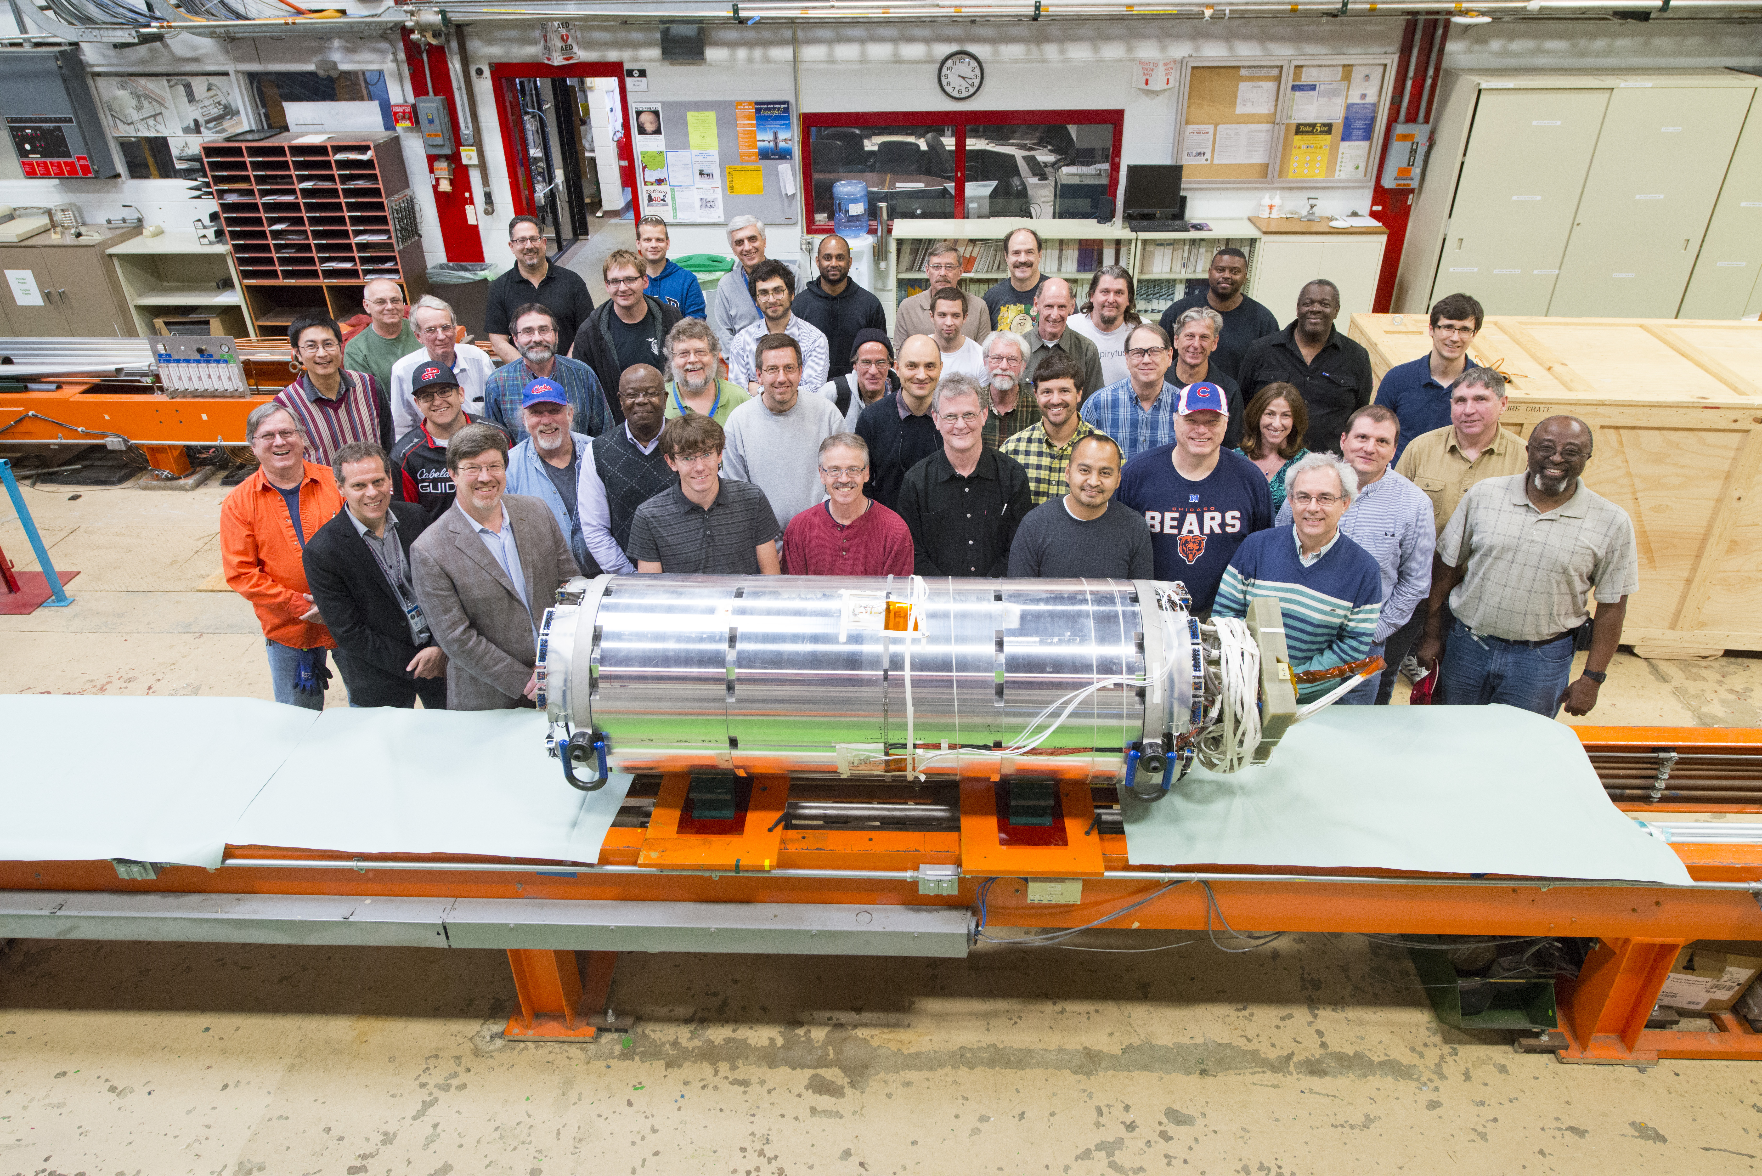
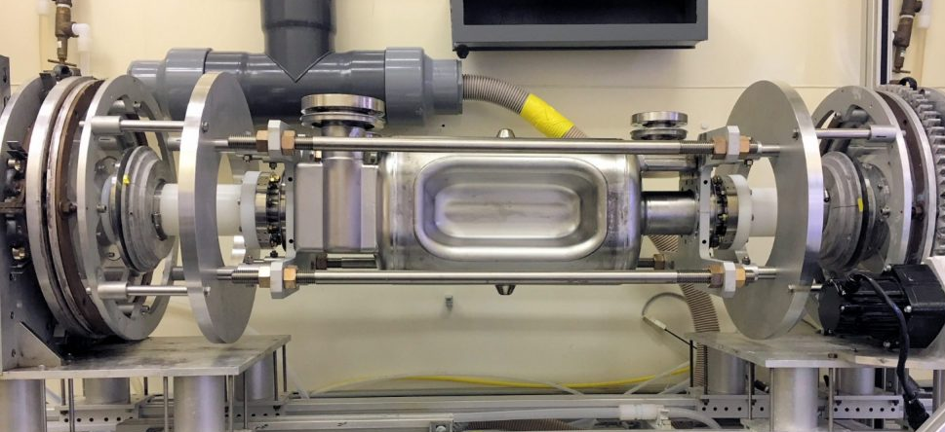
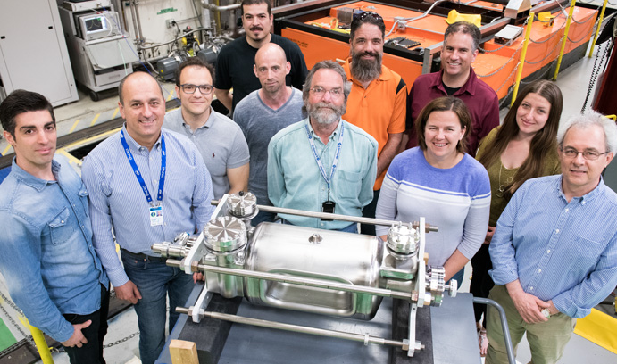
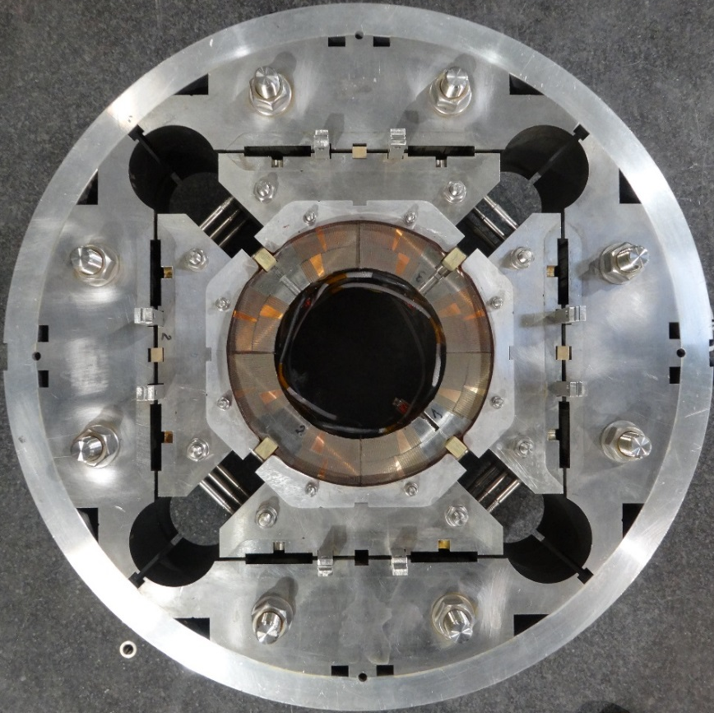
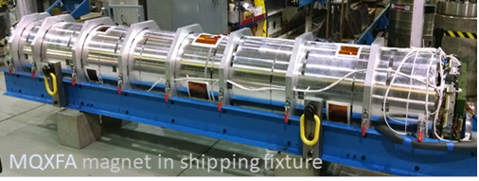
U.S. HL-LHC AUP
U.S. High-Luminosity LHC (HL-LHC) Accelerator Upgrade Project (AUP)
APS-TD plays a key role in the fabrication and test of:
MQXF Nb₃Sn low β quadrupoles
RFD Crab Cavity

Slide 16
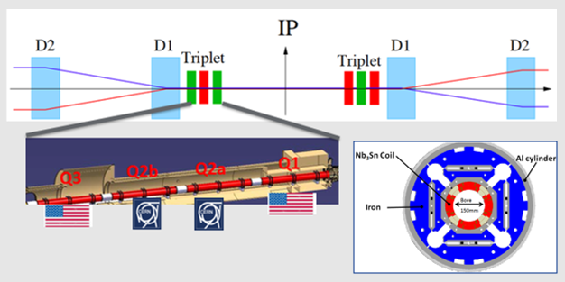
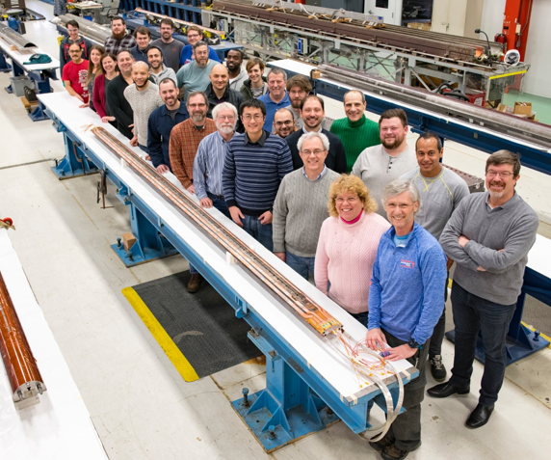
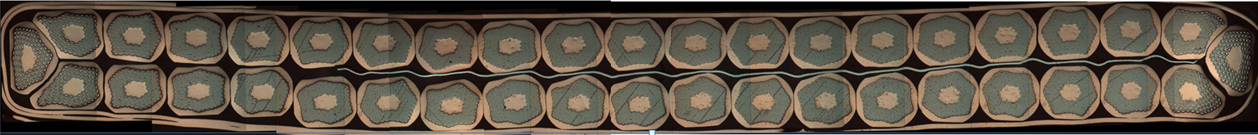
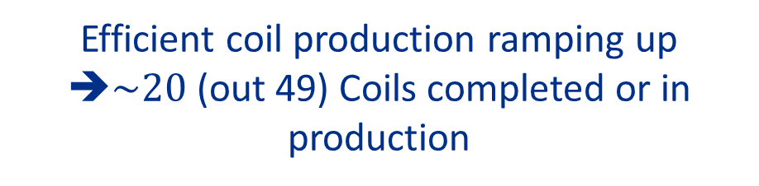
Nb₃Sn low β quadrupoles (MQXFA): status
HL-LHC AUP Coil Fabrication at FNAL
Target: 132.6 T/m
- 150mm aperture, 11.4T B_{peak}
Rutherford cable
Q1/Q3 (by AUP)
2 magnets MQXFA with 4.2m
  Series:20 magnets
Efficient coil production ramping up
➔$\sim 20$ (out 49) Coils completed or in production
Q2a/Q2b (by CERN)
1 magnet MQXFB with 7.15m
  Series:10 magnets

Slide 17
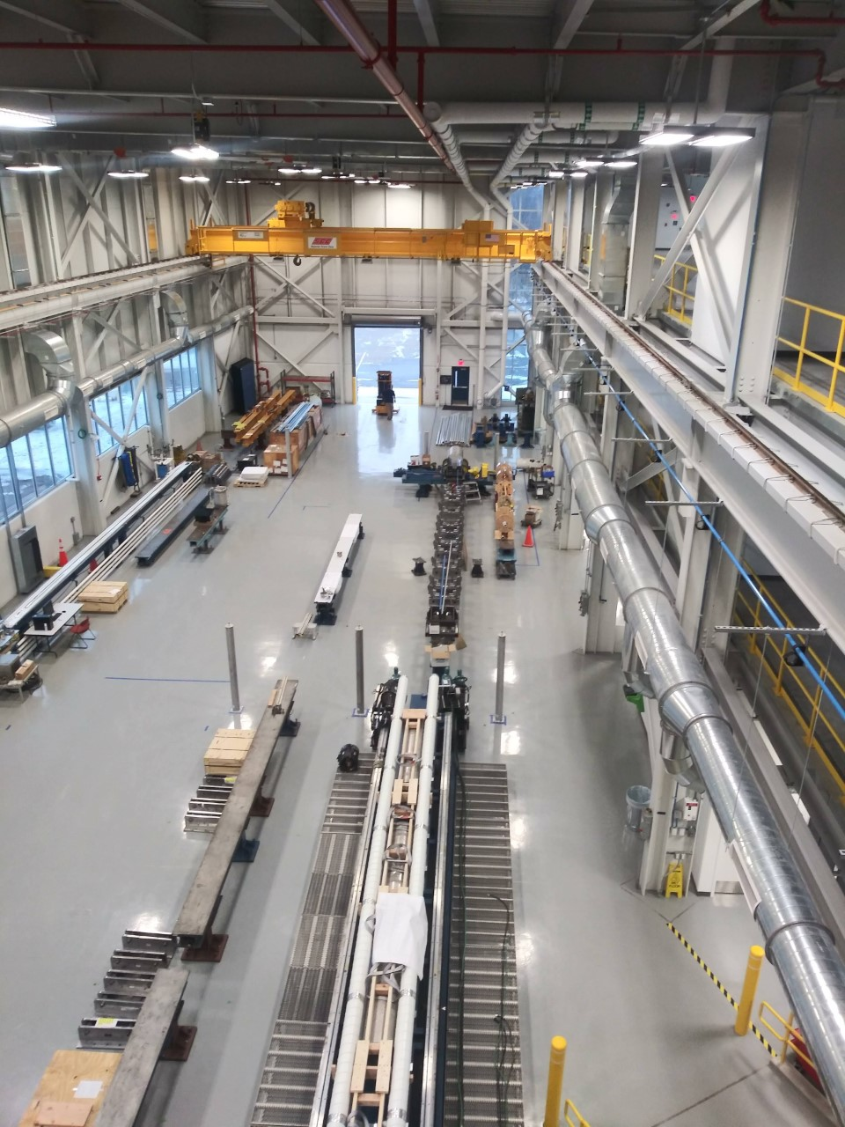
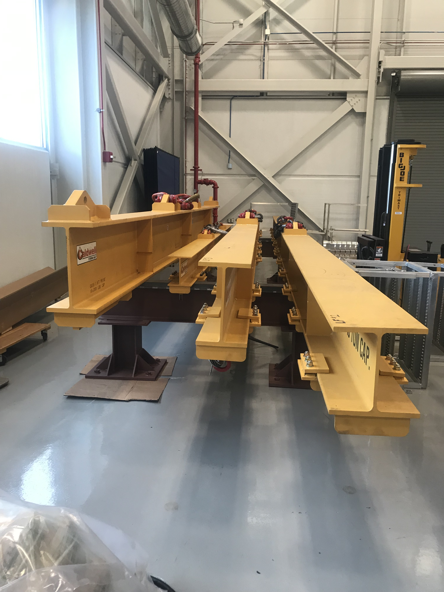
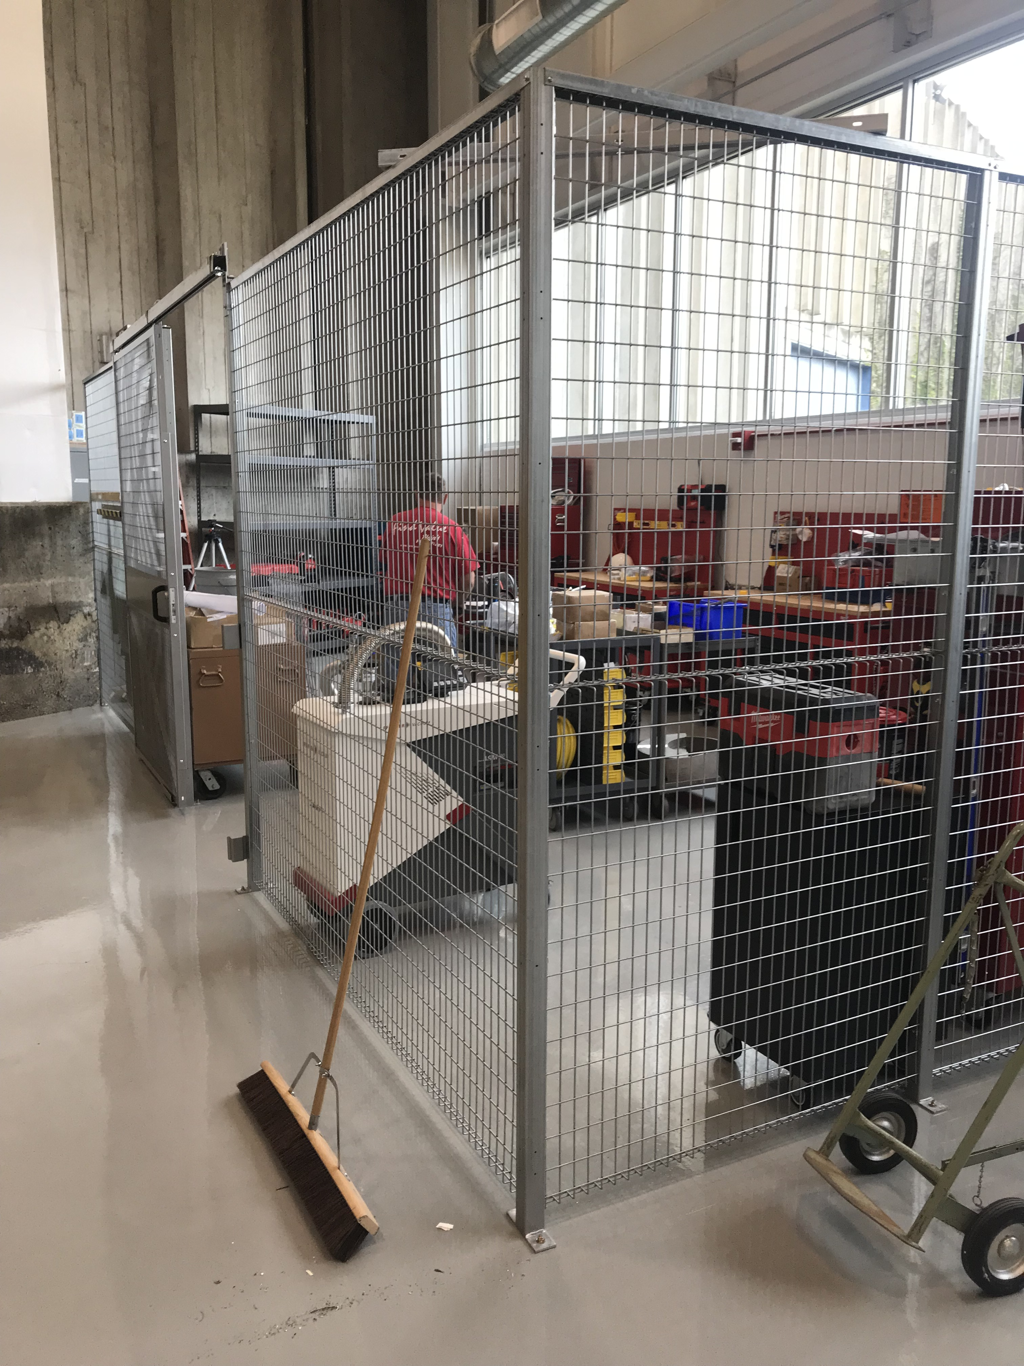
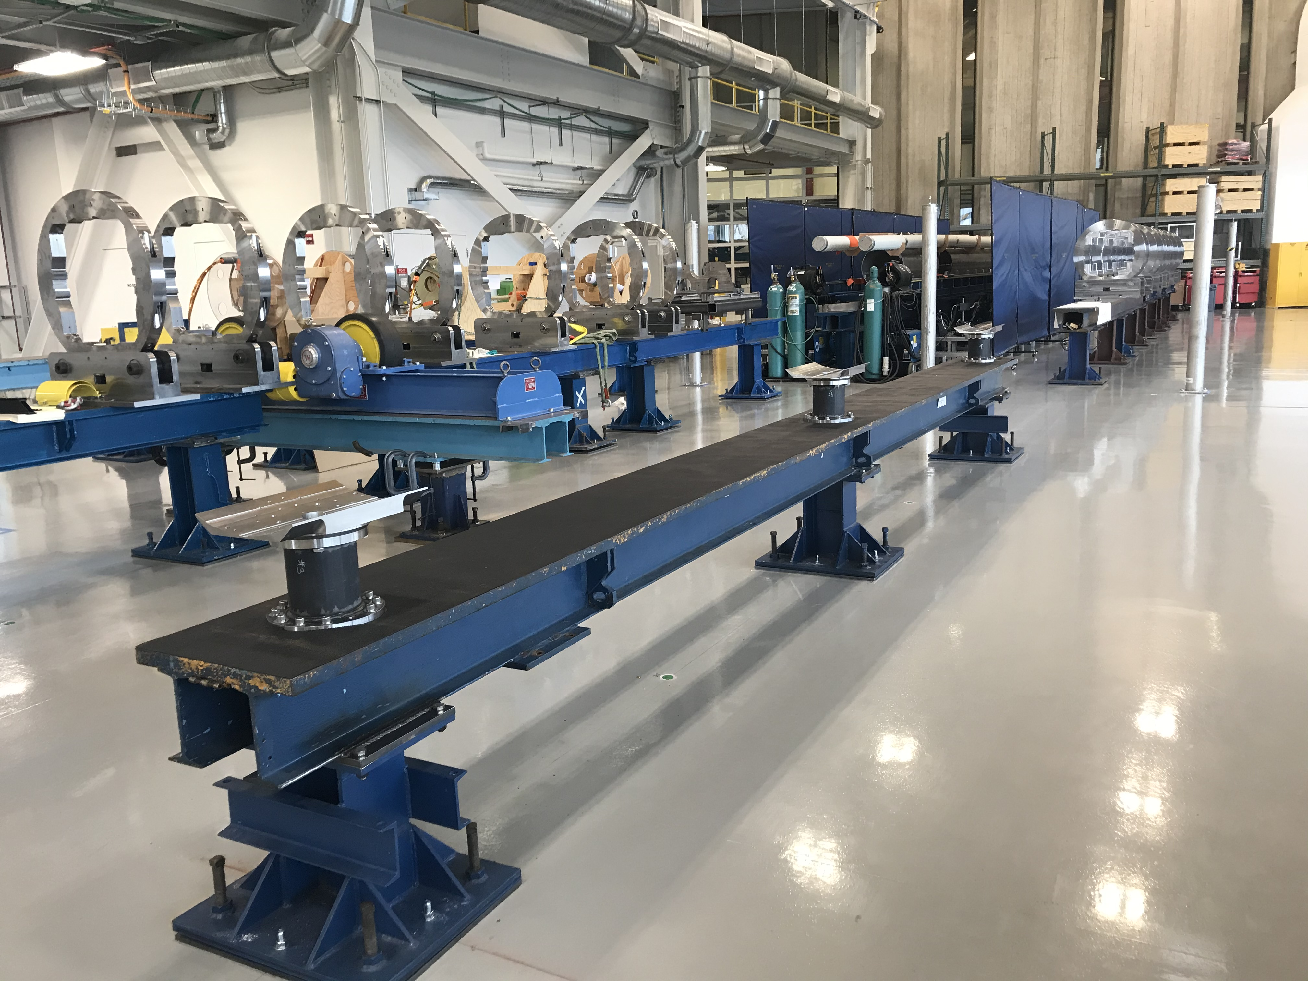
AUP Cold Mass Production
New expansion, ICBA, to host cold mass and cryostating for AUP
Production will last ~ 4 years
Lift Fixture
Tool Crib
Production Floor

Slide 18
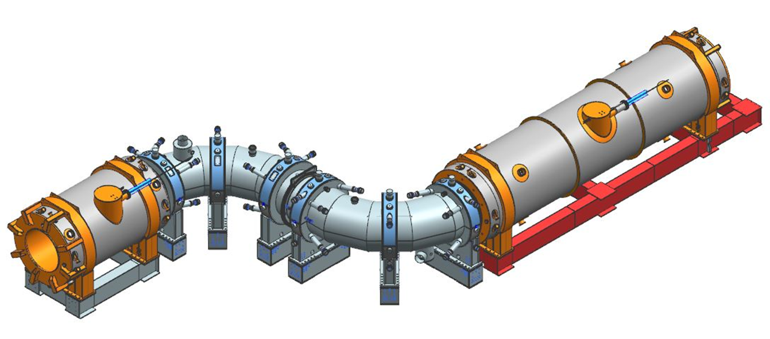
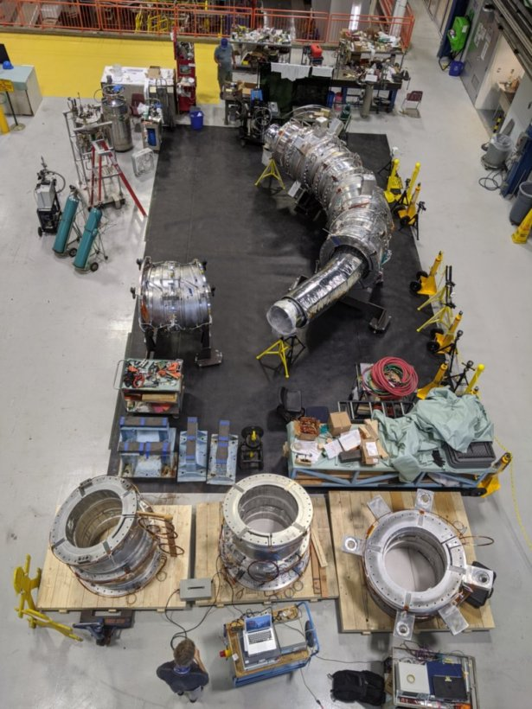
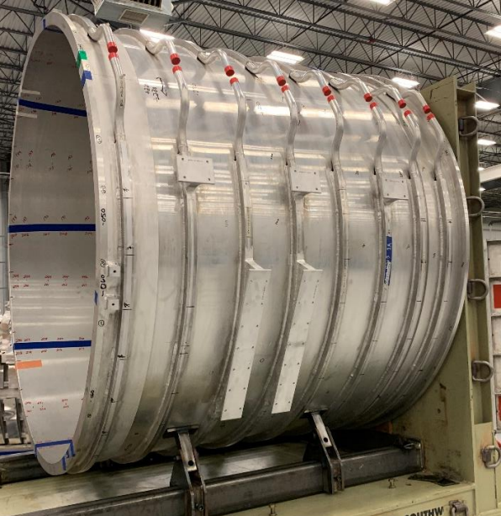
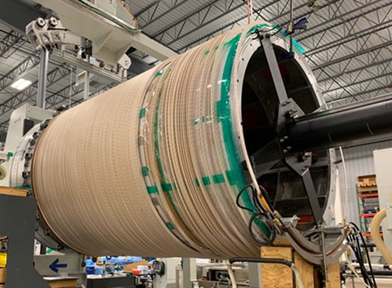
Mu2e Solenoids
https://mu2e.fnal.gov/
DS
TSU
PS
Testing and assembly of Transport solenoids in HAB
  12 of 14 units at FNAL!
  Cold testing complete on TSU
Production and Detector Solenoid being fabricated at General Atomics
  2 of 3 PS solenoids wound, starting the last winding
  3 of 11 DS solenoids wound
TSD
Winding PS2
DS 10 Shell
TS Assembly in HAB

Slide 19
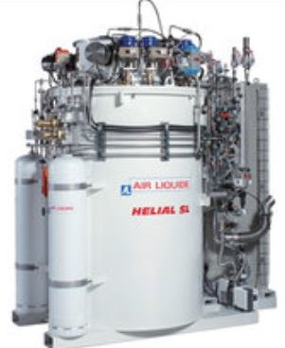
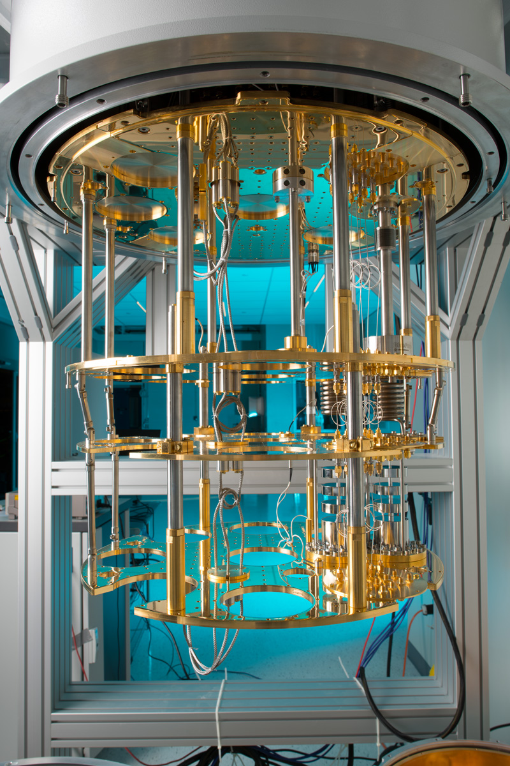
Cryogenic Capabilities
APS-TD supports the laboratory helium cryogenic engineering and operational requirements
4.5 K Facilities
  Physics experiments
  Test facilities for project support
2 K Facilities
  Accelerator test beams
  Test facilities for project support
  Future PIP-II superconducting linac
mK Facilities
  Quantum computing
  Astrophysics
  Detector development

Slide 20
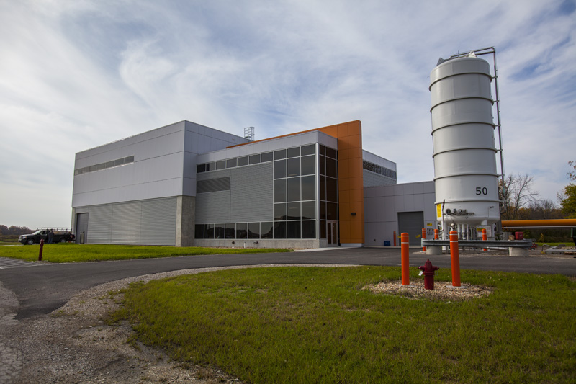
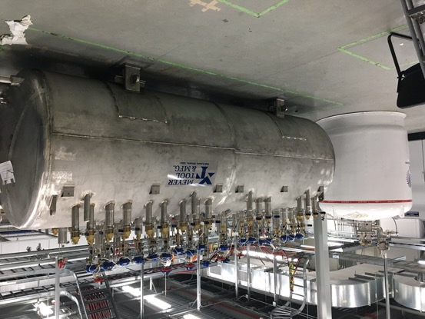
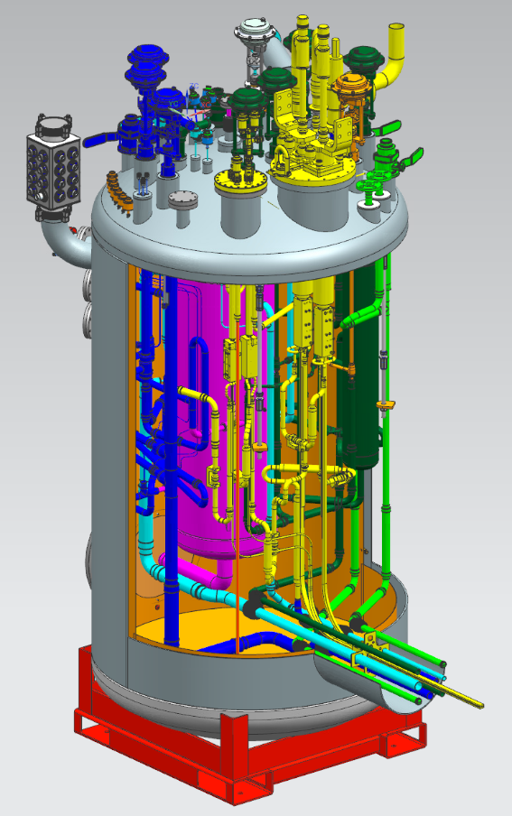
Cryogenic Capabilities
APS-TD supports the laboratory helium cryogenic engineering and operational requirements
4.5 K Facilities
Current systems have capabilities up to 2,500 W refrigeration and 350 liter/hour liquefaction
Muon Campus
  Muon g-2
  Mu2e
Distribution box Mu2e
Feedbox Mu2e
Engineering and operational experience developed with the groundbreaking 20 kW Tevatron cryogenic system which operated for over 25 years
  Earned the ASME International Historic Mechanical Engineering Landmark

Slide 21
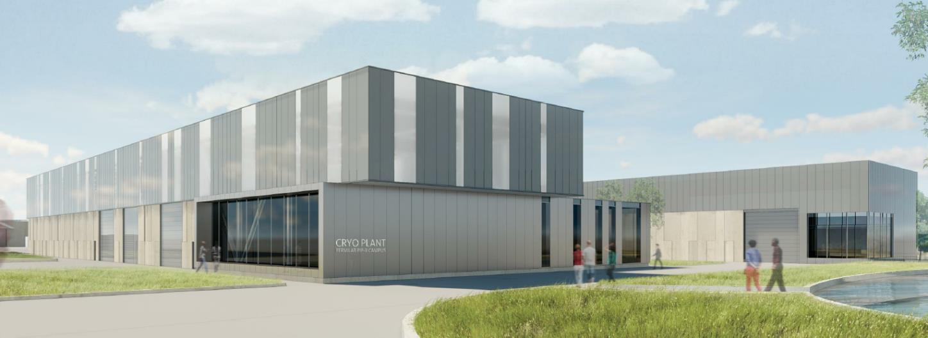
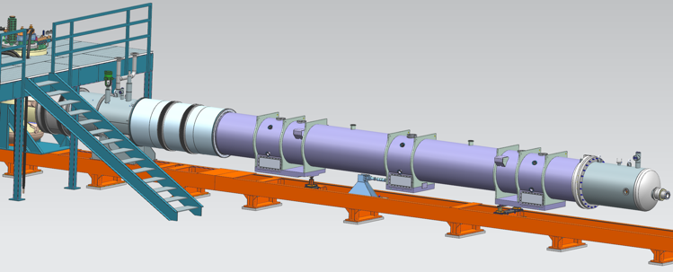
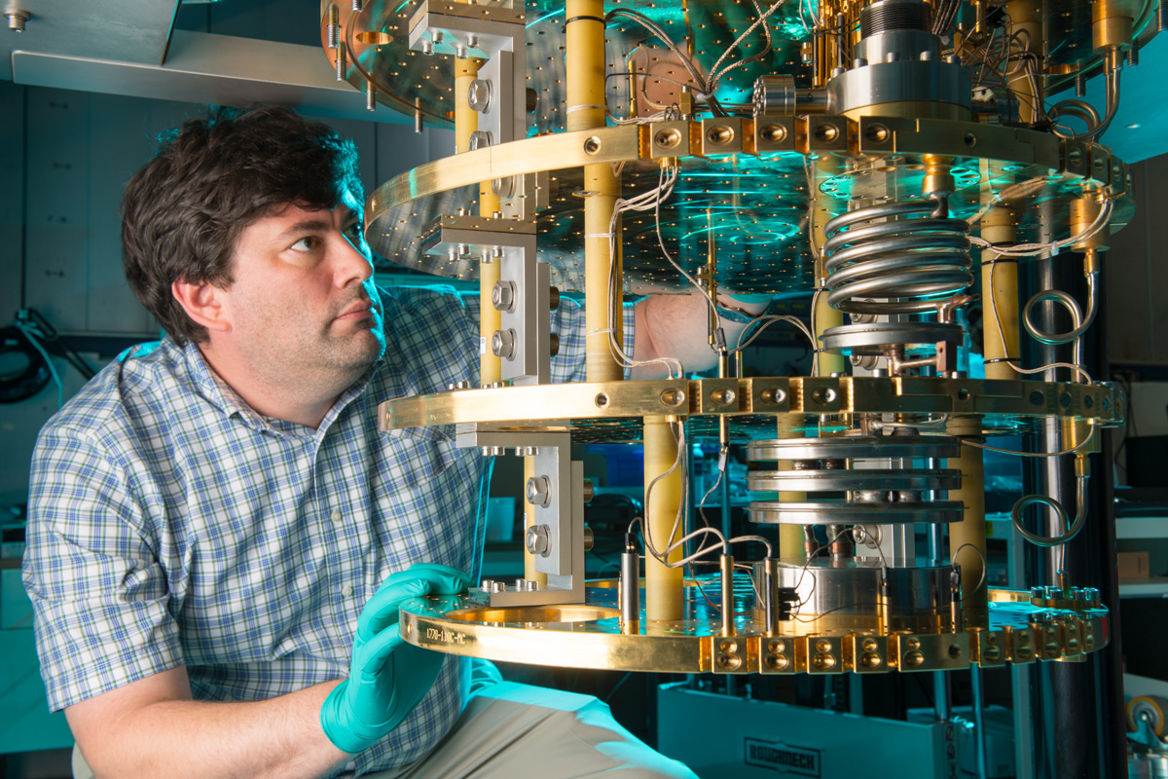
Cryogenic Capabilities
APS-TD supports the laboratory helium cryogenic engineering and operational requirements
2 K Facilities
  Supports superconducting
  magnet and RF cavity
  development and application
mK Facilities
  Supports astrophysics experiments,
  quantum computing and quantum
  detector development
Future PIP-II Cryoplant
  2,500 W at 2 K
LHC high luminosity magnet test stand
Quantum Computing Lab
SuperCDMS

Slide 22
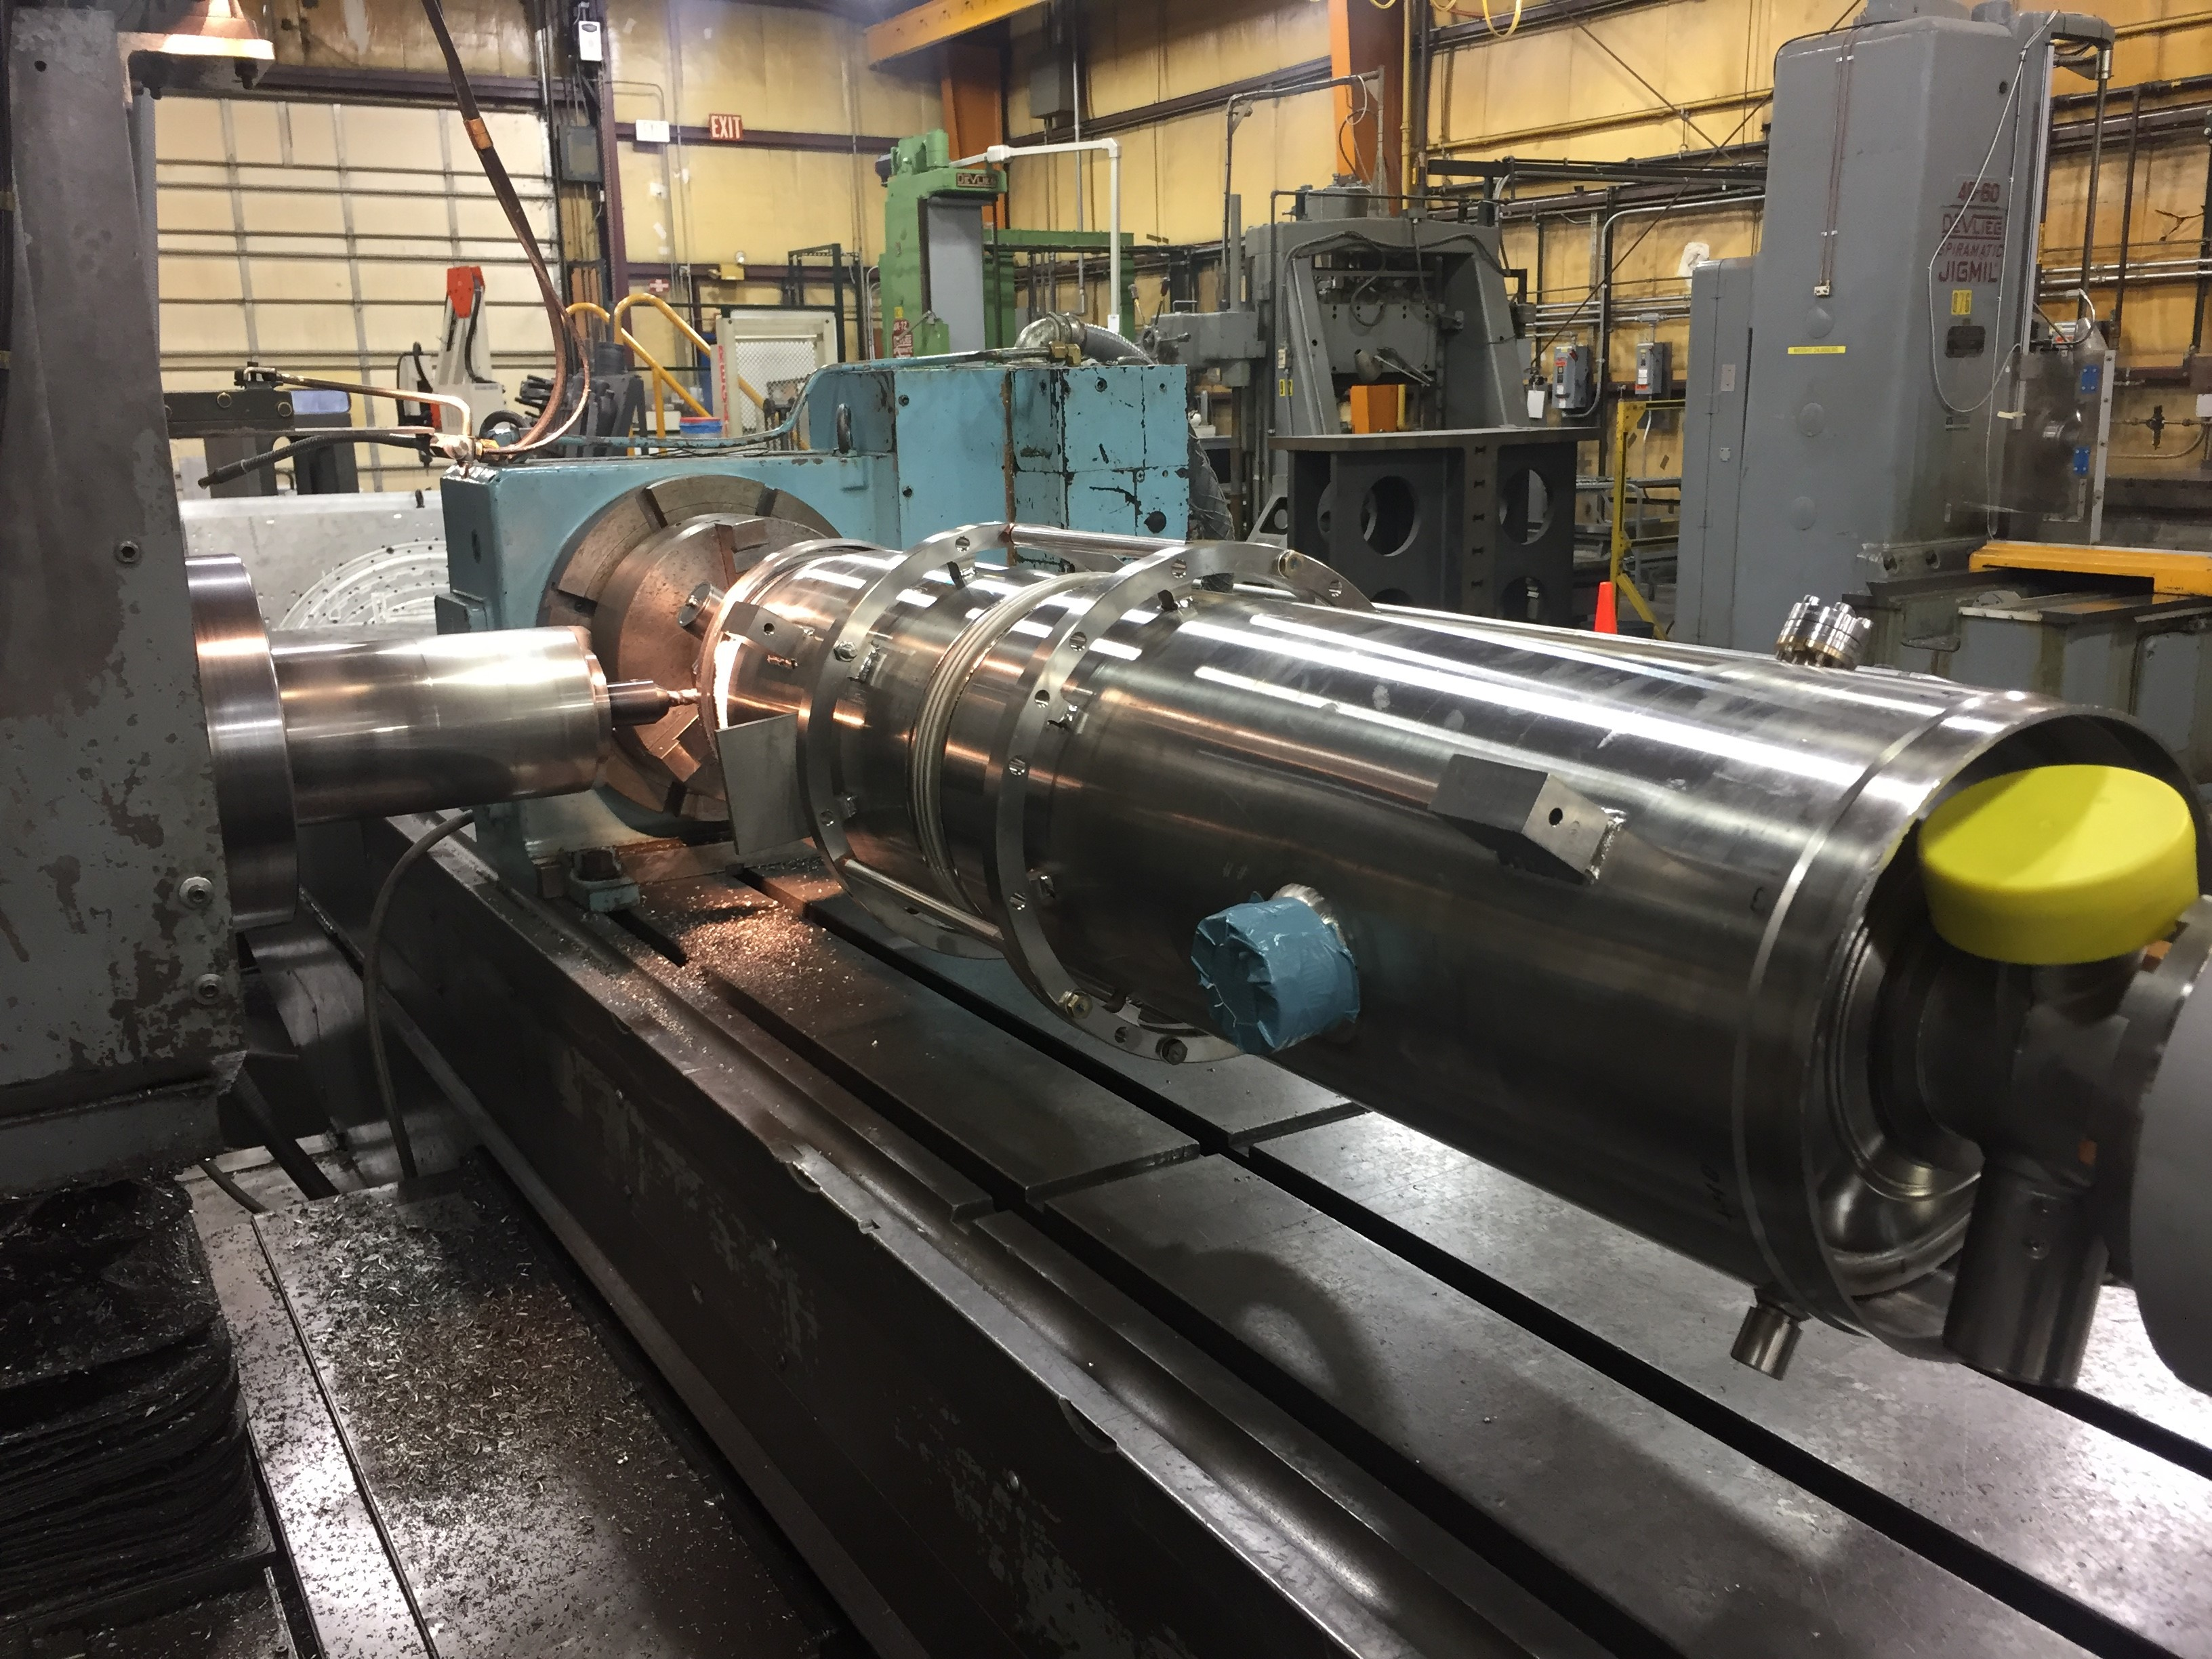
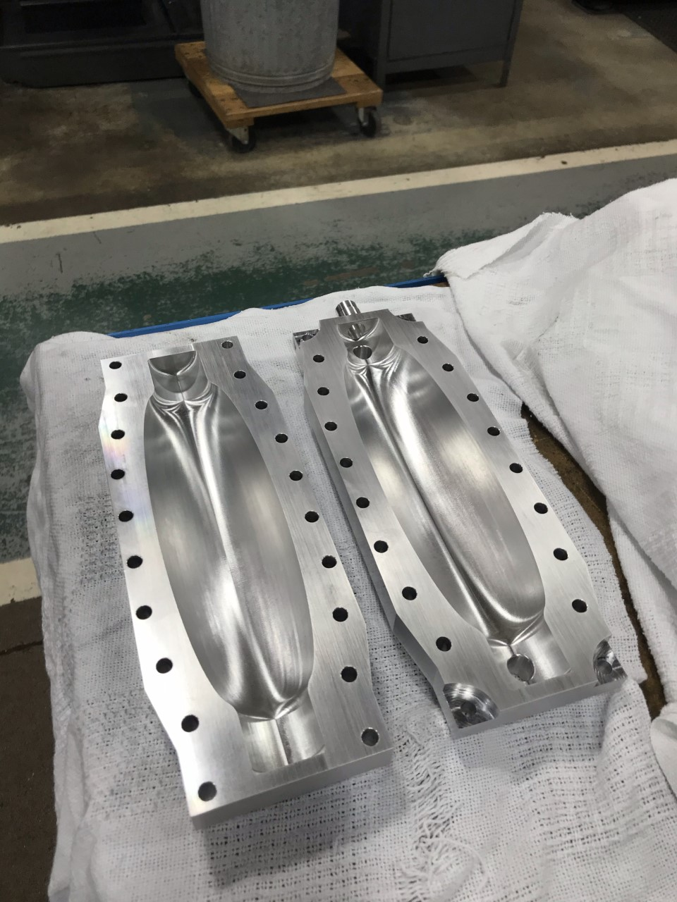
Machine Shop
Serving FNAL experiments
and operations along with other Labs
Provides high tolerance rapid prototype
and small run machined parts along with
radioactive (Class 1) work
Certified welding processes
  SMAC – (Arc)
  GMAW – (Mig)
  FCAW – (Flux-Core)
  GTAW – (Tig)
  PAW – (Plasma Arc)
  And others
Cavity Undressing
Niobium Cavity Machining

Slide 23
Concluding Remarks
SRF and Magnet R&D
  World record accelerating gradient for a non-niobium multicell cavity
  World record field for accelerator magnets
  World record J_{c} for Nb₃Sn superconductor
LCLSII work nearing completion
HL-LHC AUP quadrupoles in production ~20 of 49 complete
Mu2e Solenoids making progress, DS/PS in production, 12 of 14 TS Units at FNAL
Apologies to the numerous activities in APS-TD not covered
Thank you to all who provided material for this talk!

Slide 25
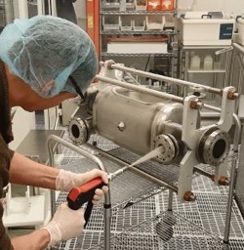
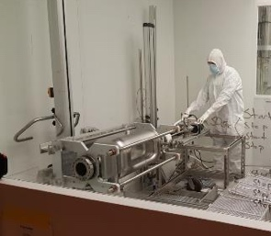
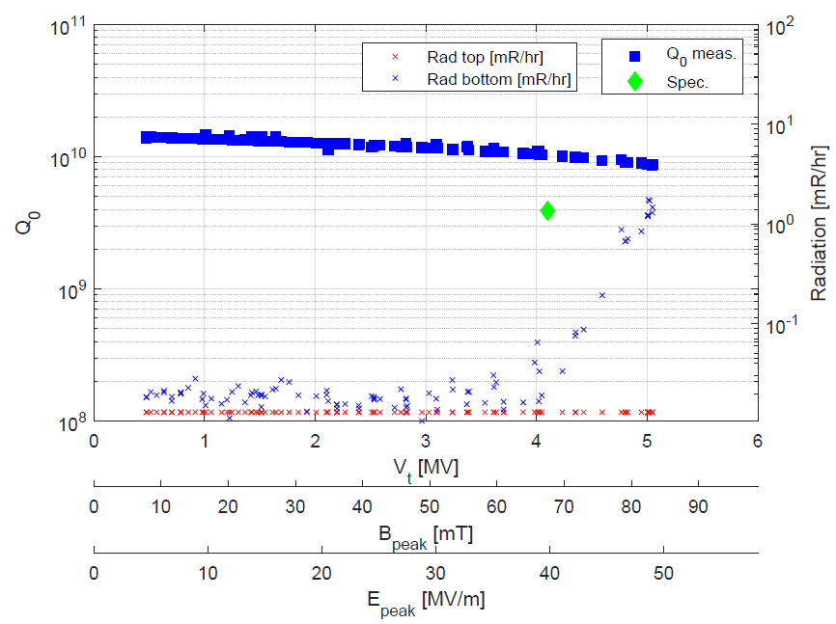
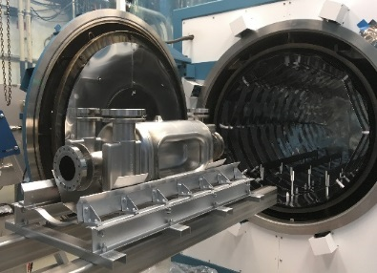


RFD crab cavities: status
RFD-LARP-001 has been successfully tested at FNAL, after undergoing full processing at APS-TD and ANL facilities
Processing and Facilities validation is complete
  New rotational Bulk & Light BCP
  600 C degassing and 120 C bake
  HPR and clean assembly
  VTS test
RFD HPR and Cleanroom Assembly
RFD cavity 600 C and 120 C heat treatments
RFD-LARP-001 Q vs V_{t}, exceeding requirement for HL-LHC
(Nominal: 3.4 MV, Acceptance: 4.1 MV)
Rotational BCP tool for RFD cavity

