Slide 1
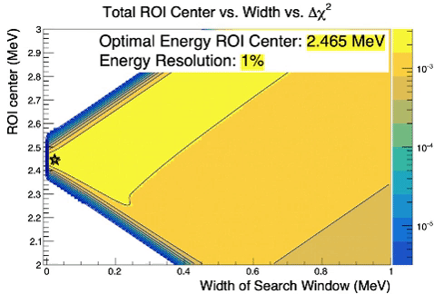
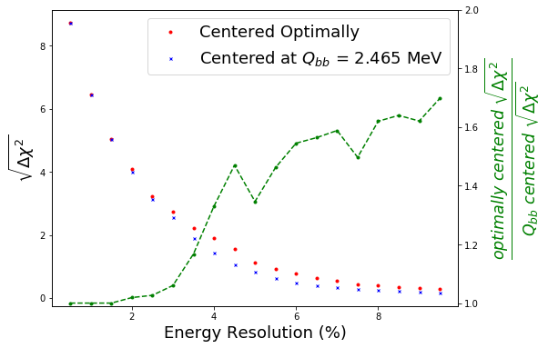
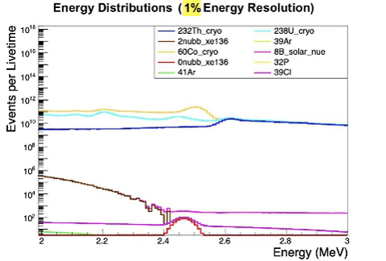
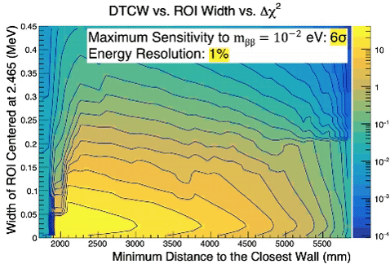
$0υββ$ searches at a theoretical DUNE 4th module
G. Reesman – University of Missouri at Kansas City (SULI Intern), J. Zennamo – Fermilab, F. Psihas - Fermilab
Introduction & Background
Figure 2 (left): The The width of the search window is plotted against the center of the energy ROI. The color axis is the sensitivity.
Background | Origin
Thorium 232 (²³²Th) | Cryostat Steel
Uranium 238 (²³⁸U) | Cryostat Steel
Cobalt 60 (⁶⁰Co) | Cryostat Steel
Boron 8 (⁸B) Solar Neutrinos | Sun
Argon 39 (³⁹Ar) | LAr Background
Argon 41 (⁴¹Ar) | Spallation
Phosphorus 32 (³²P) | Spallation
Chlorine 39 (³⁹Cl) | Spallation
$$2υββ$$ | Xenon 136 (¹³⁶Xe) Double Beta Decay
$0υββ$ (signal) | Xenon 136 (¹³⁶Xe) Double Beta Decay
The goal of this project was to examine DUNE’s potential for observing $0υββ$ with the doping of the detector medium (LAr) with 2% ¹³⁶Xe. The backgrounds around the $0υββ$ signal that were examined are given in the table.
Signal Selection
An energy region of interest (ROI) and optimal minimum distance to the closest wall were used to optimize a signal event selection and fiducial volume. Because the ROI center and radius that produce the highest sensitivities are dependent on smeared energy resolution, these metrics were optimized for signal selection at multiple energy resolutions.
-- $Qββ$
Energy Resolution
Detector energy resolution contributes to difficulties in differentiating the signal from the background. In order to account for imperfect energy resolution, energy is smeared at a range of resolutions assuming Gaussian fluctuations.
Figure 4: Energy resolution is plotted against the ratio between sensitivity when optimally centered and when centered at Q$ββ$.
Conclusions
Assuming a test mass of $mββ=10^{−2}$ eV, the maximum discovery significance attained was 6$σ$ at 1% energy resolution. This study shows centering the ROI using the methods found in this project resulted in up to 1.7 times greater discovery significance than when centered at Q$ββ$.
Figure 1: The gif shows energy spectra including all simulated sources different smeared energy resolution (no background mitigation).
Figure 3: The width of the search window is plotted against the minimum distance to the closest wall. The color axis is the sensitivity to $mββ=10^{−2}$ eV.

