Slide 1
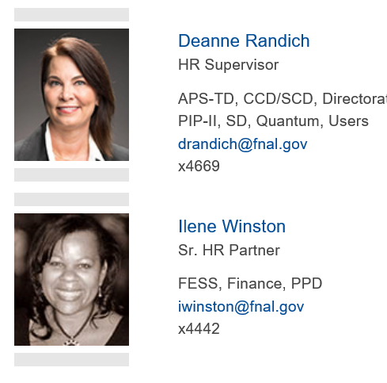
User/Visitor HRP Resources:

Slide 2
Employee/Users Assistance Program
Fermilab’s Employee/Users Assistance Program provides comprehensive and effective on-line, telephone and face-to-face (virtual) services for employees, household members, users at the Lab and anyone covered under employees’ health insurance benefits.

Slide 3
ERS provides you and your family members with free and confidential help for any kind of problem that affects your life or your work
Counseling Up to 3 sessions per problem per year (In-Person, Virtual and Phone)
Emotional or Stress Related Problems
Marital or Family Problems
Drug or Alcohol Abuse Problems Related to Work
Legal & Financial Consultations
Work/Life Referrals (Child & Elder Care, etc.) New Services offered:
Life Coaching
Medical Advocacy
Personal Assistant Services

Slide 4
Getting started is easy: Visit www.mylifeexpert.com on your desktop or mobile device 1. Click “Create a new account with your company code” 2. Enter your company access code: Fermilab 3. Follow the instructions in the activation email (a code will be emailed once you are registered).
Log on to the new website: www.mylifeexpert.com or download the app to check out all that is offered. Call 1-800-292-2780 to ask questions or request services from Employee Assistance Program (EAP) Employee Resources Systems (ERS).

Slide 5
Statement of Community Standards https://directorate-docdb.fnal.gov/cgi-bin/RetrieveFile?docid=174
We are committed to a work environment in which all individuals are treated with respect and dignity.
Discrimination is not tolerated on the basis of race, color, religion, gender, age, national origin, sexual orientation, gender identity, pregnancy, national origin, veteran status, marital status, disability or any other characteristic protected by federal or state law or executive order.
Fermilab is committed to providing a workplace free from all forms of harassment, including those based on gender or sexual preference. We expect all interactions and exchanges among persons in the workplace to be respectful and free of bias, prejudice, and harassment.
Harassment, discrimination, and retaliation interfering with work performance or creating an intimidating, hostile or offensive workplace environment, are unacceptable and strictly prohibited.

