Slide 1
Monitoring, Logging, and Accounting on the TeraGrid
David Hart, SDSC
MLA09
June 10, 2009
Notes:
I’m the TeraGrid’s area director for User-Facing Projects and Core Services, which includes our Accounting and Allocations functions.

Slide 2
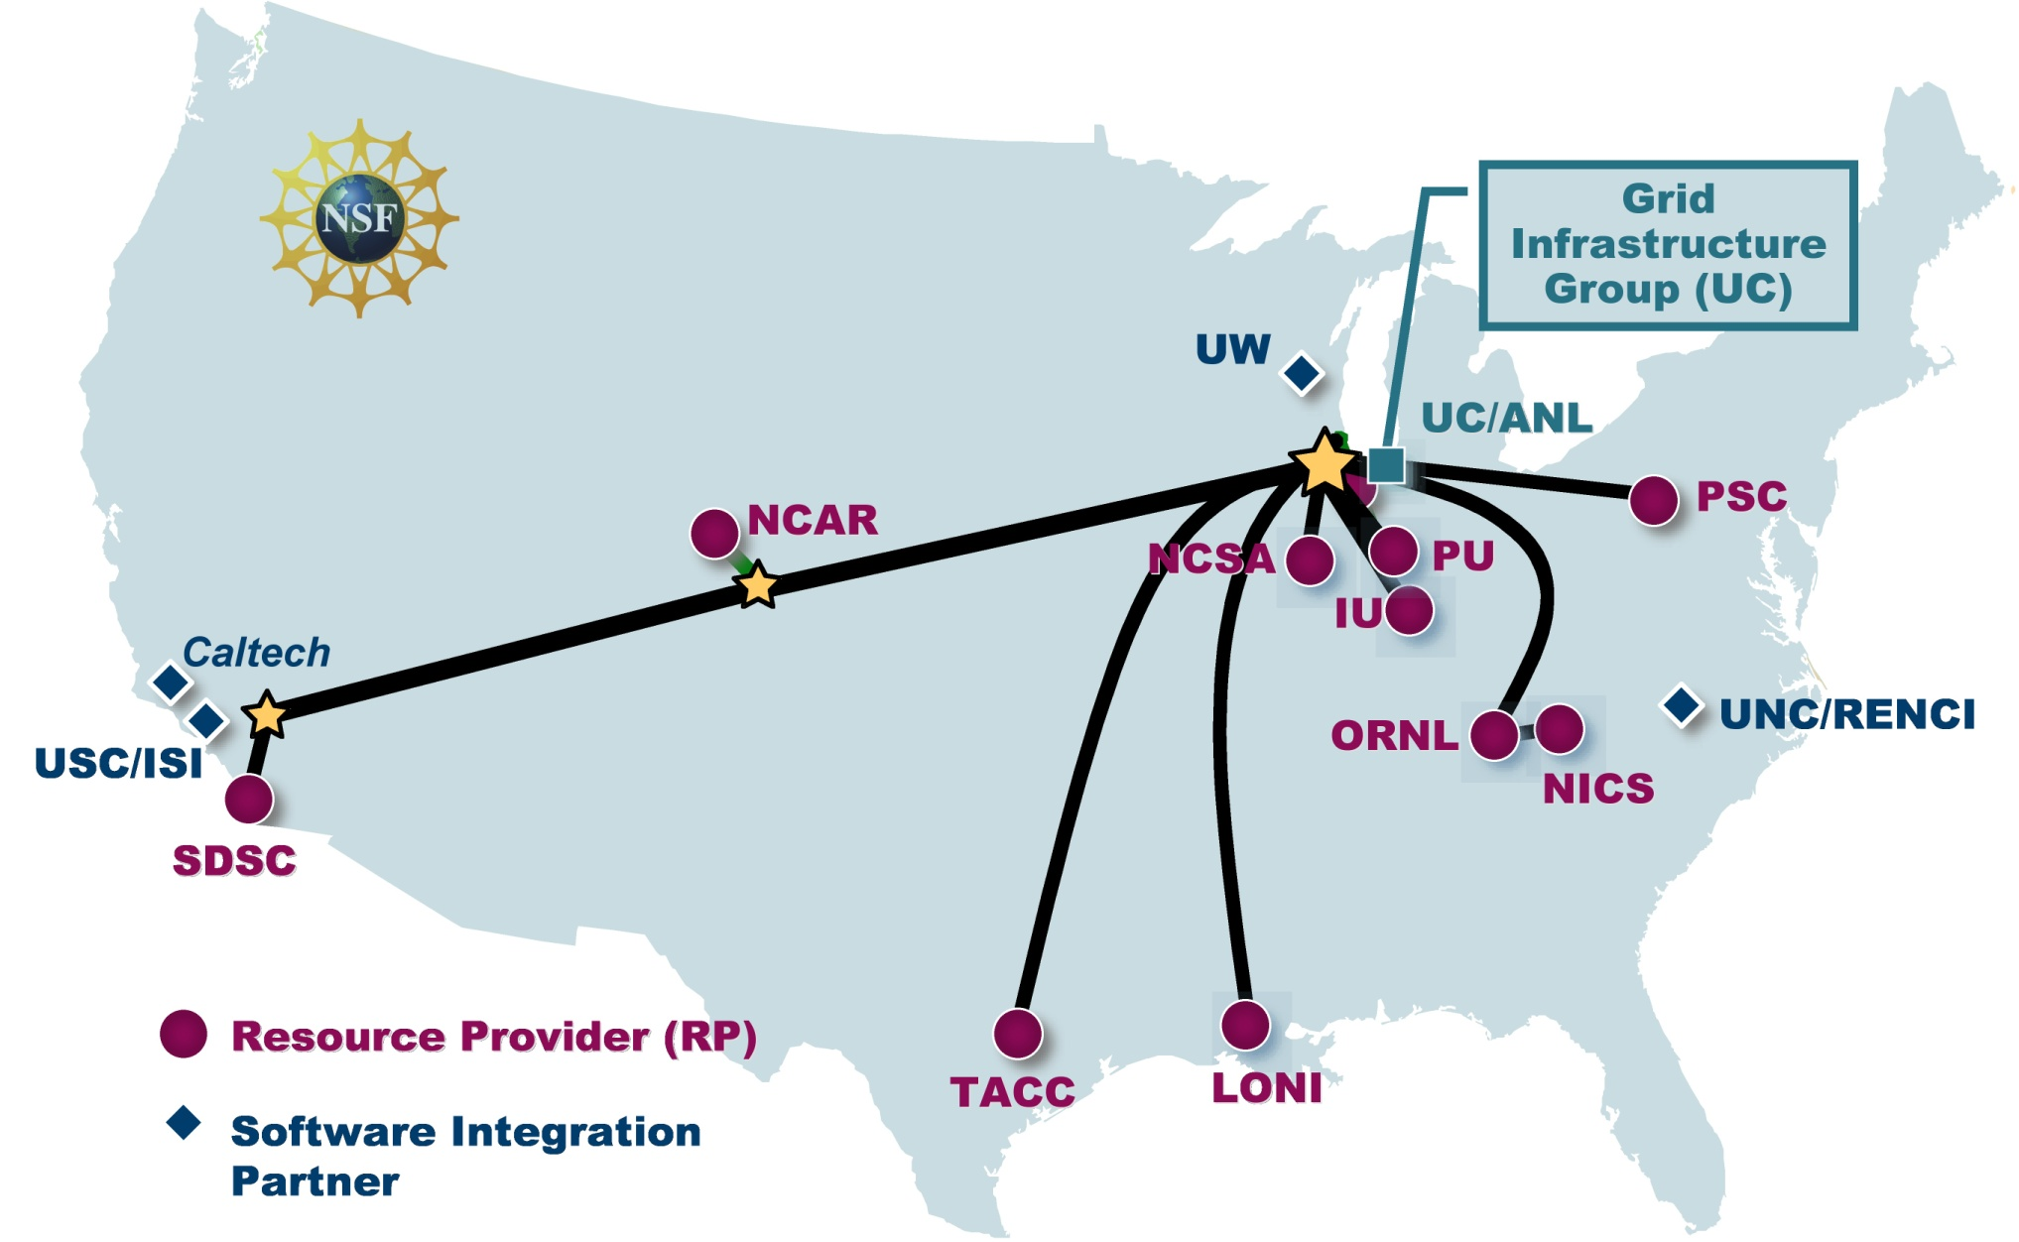
TeraGrid: A Supercomputing Grid
Notes:
11 Resource Providers, approx. 2 dozen HPC systems
Several software integration partners
Centrally managed by the GIG, with strategic oversight by the TeraGrid Forum
An important feature of TG HPC systems is that none are managed centrally, and most share only a portion of their cycles with TeraGrid.

Slide 3
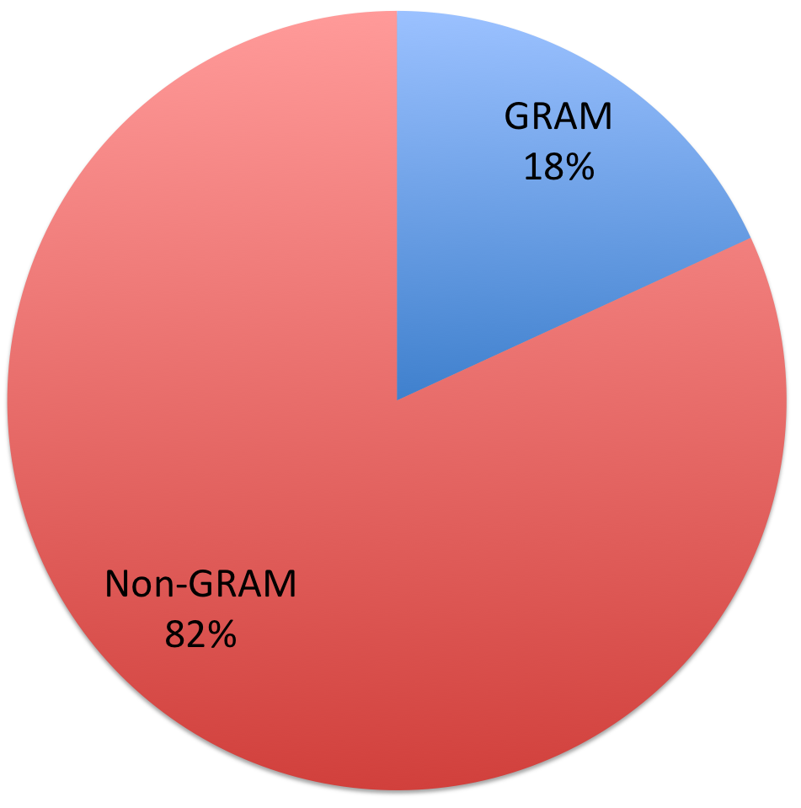
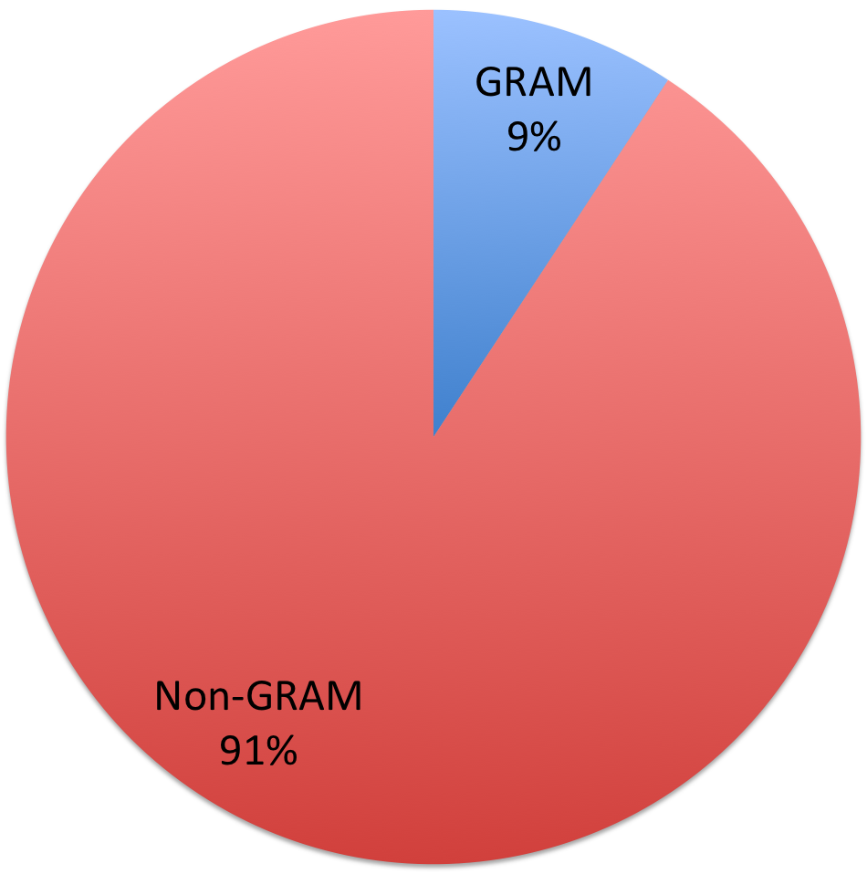
TeraGrid “grid-style” usage, 2008
JOBS
CPU-HRS
3 million non-GRAM jobs (1.1 million batch, 1.9 million Condor) 667,000 GRAM jobs
Upper bound on GRAM-related CPU-hrs (actual probably much lower)
Notes:
CPU-hour bound calculated by assuming all jobs on a given resource of same cost, and calculating GRAM costs proportionately by resource.
We expect to be able to calculate GRAM-initiated usage more accurately starting in Q4 2009.

Slide 4
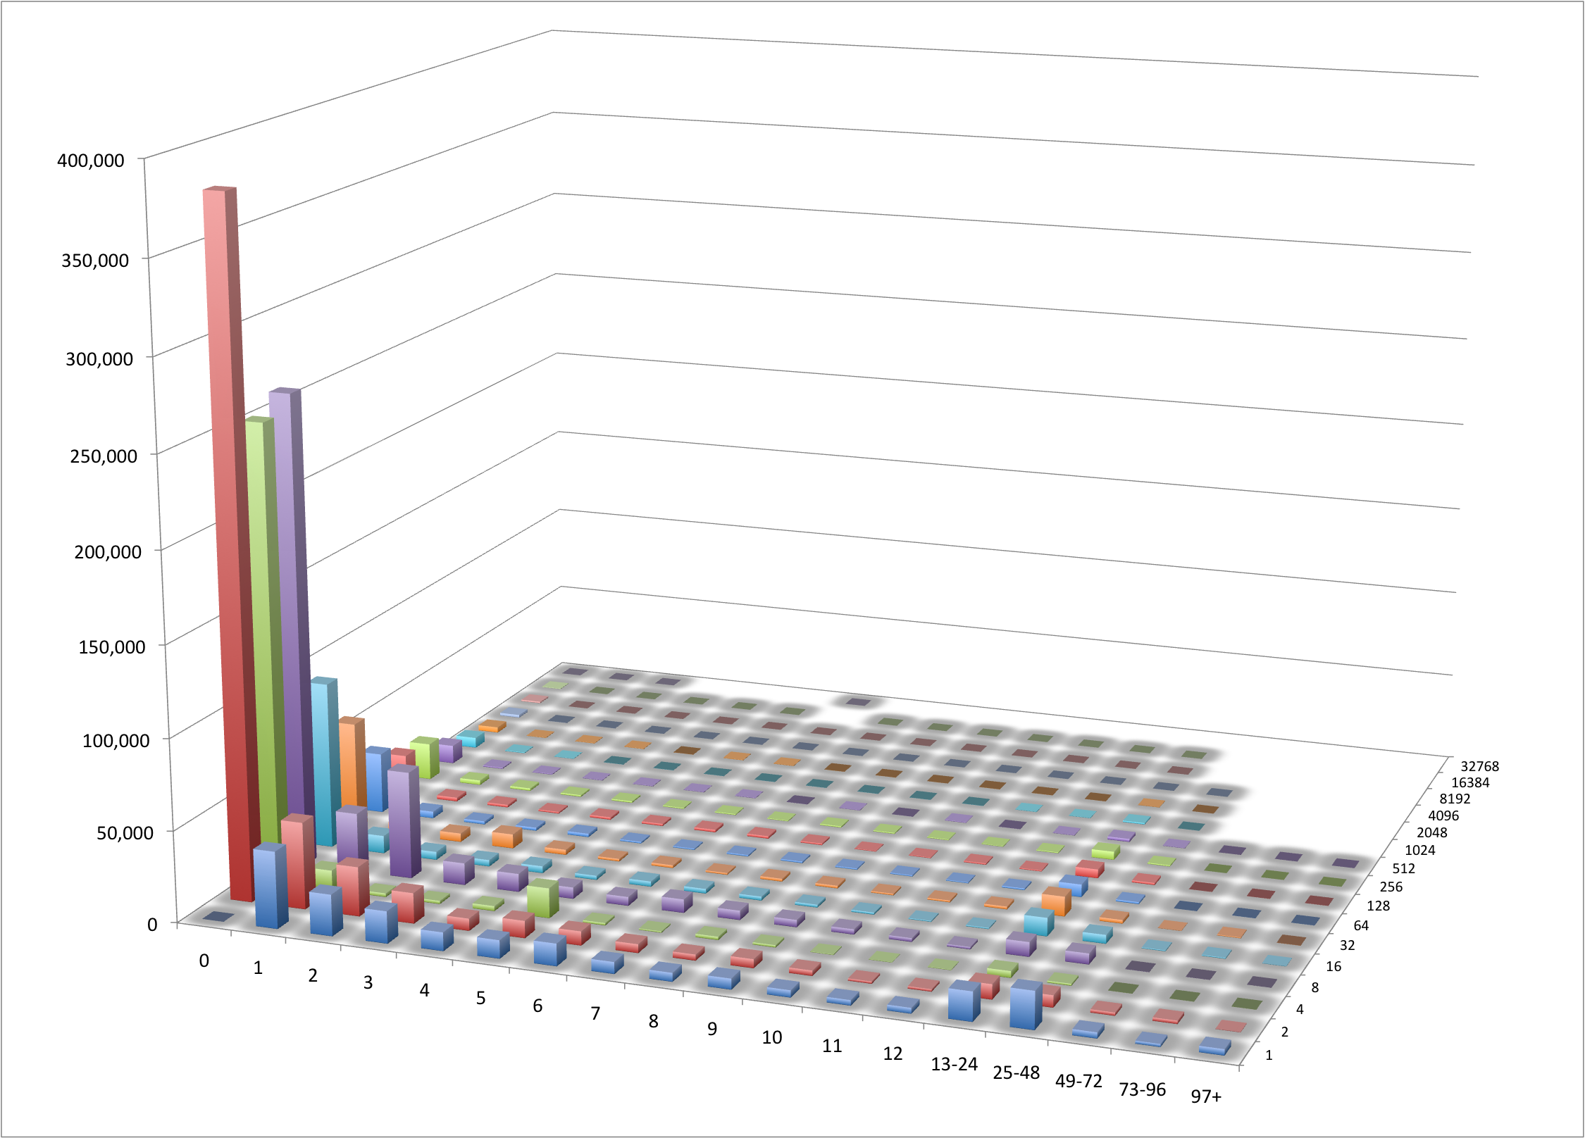
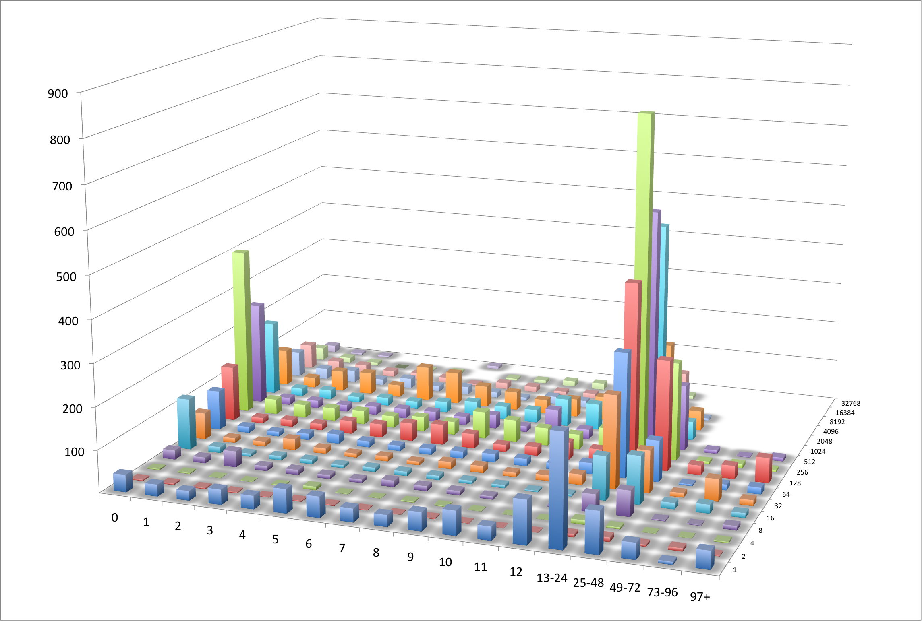
TeraGrid’s Overall Usage Profile, 2008
Job Counts
Job Charges
While the number of jobs is stacked toward shorter, smaller jobs, the computation on TeraGrid is dominated by larger and/or longer jobs.
# Jobs
NUs (millions)
Cores - Bigger
Cores - Bigger
Hrs - Longer
Hrs - Longer
1.9 million 0-hr, 1-core jobs
Notes:
Note: 1.9 million 0-hour, 1-core jobs (mostly Purdue Condor) omitted from left graph so it would be remotely interesting.

Slide 5
TeraGrid’s Evolution
Many TeraGrid functions have evolved independently—including monitoring, logging and accounting
Allocations and Accounting were in place from the start
Leveraged capabilities from and continued policies of PACI partnerships and Supercomputer Centers program
At the same time, always supported “roaming” and multi-resource allocations, in anticipation of grid future
Monitoring has changed more significantly over the years, adapting to the growth, evolution of TeraGrid resources, governance, and technology.
From initial set of four homogeneous clusters to a federation of ~20 heterogeneous HPC systems
Notes:
NSF Supercomputer Centers program: 1985-1998
PACI program: 1998-2004

Slide 6
Monitoring/Logging

Slide 7
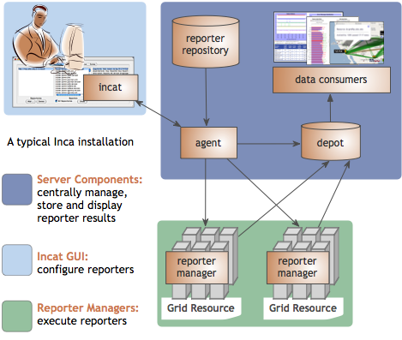
Inca: User-Level Grid Monitoring
Enables consistent user-level testing across resources
Easy to configure and maintain
Easy to collect data from resources
Archived results support troubleshooting
Large variety of tests (~150)
Comprehensive views of data
Notes:
Benefits Grid administrators/operators who want to verify that requirements are being met by their resource providers and want to understand failure trends; helps system administrators by notifying when failures are detected on their system and provides detailed information to help troubleshoot failures; helps end users by (hopefully) detecting failures before they do
Key differences between Inca and other monitoring systems is that it
Tests from a regular user account on all resources so can reflect user experience better than testing done from sys admin account which has privileges and custom shell initialization
In order to ensure test results collected across all sites are consistent, we centrally manage the test configuration and push it out to all resources automatically – this allows us to catch a lot of misconfiguration errors that are a result of sites misunderstanding the requirements -- other monitoring tools like OSG’s RSV aggregate each site’s self-managed test results which can lead to inconsistencies in the results – Inca can be used in coordination with these other tools
The centralized management approach also allows us to push out changes quickly (i.,e. to fix a test) and not have to log into each machine individually
New tests can easily be inserted to Inca by writing “reporters”, executables that output results in XML. Inca’s XML schema allows more than just pass/fail information – we also report versions, usage data, and performance information (i.e., any piece of XML limited to 4000 chars) – example of performance information is running IPM instrumented applications and reporting the results
Inca provides full archiving of results which allows longer term trend analysis – what’s failing the most over time and is it the same errors or different errors – aids in troubleshooting complex issues - other views show are we doing better or worse than last week
Inca has a repository of over 150 different reporters (primarily tests of Grid tools like Globus, SRB, MPICH-G, etc.) and some performance measurements)
Inca’s web pages provides a lot of different views that show high-level summary information to specific details on how a test result was collected
Inca has users in the U.S., Europe, and Australia -- TeraGrid, NGS, ARCS (Australia), DEISA, GEON, TEAM, and ZIH (Dresden)

Slide 8
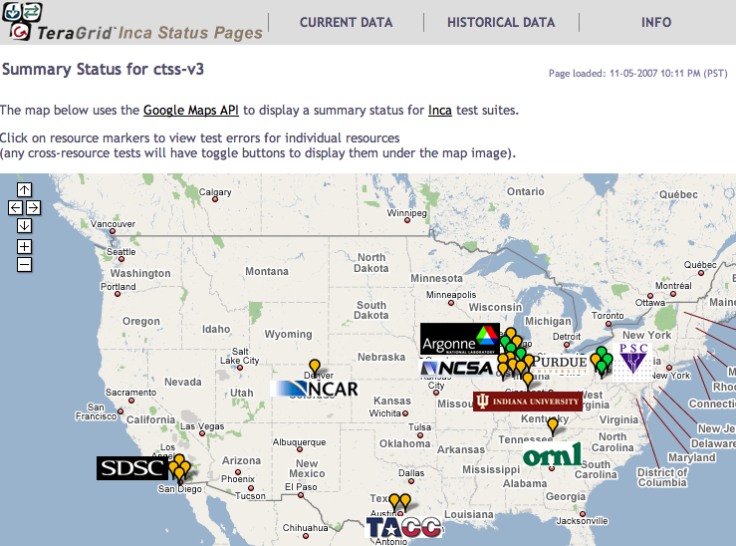
Inca Deployment on TeraGrid
Running since 2003
Total of ~2,400 tests running on 20 login nodes, 3 grid nodes, and 3 servers
Coordinated software and services
Resource registration in information services
Cross-site tests
CA certificate and CRL checking
TeraGrid GIG services
Screenshot of Inca status pages for TeraGrid
http://inca.teragrid.org/
Notes:
Inca was developed originally for TeraGrid and we’ve been running on there since 2003
Inca mainly tests the various CTSS4 kits but also has a number of tests that run across sites to pick up site-to-site specific configuration errors (i.e., host.deny) – Inca configures testing based on what sites register into IIS (i.e., is what they register into IIS available on their systems)
Also does some tests for the security group
Tests GIG services such as IIS, the User Portal, CVS

Slide 9
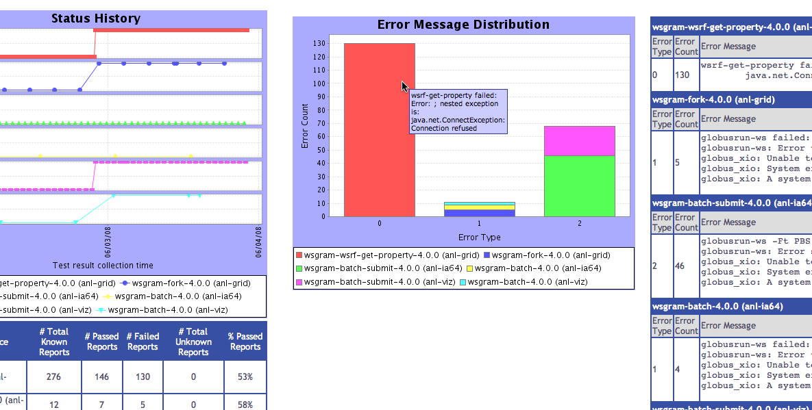
Inca Monitoring Benefits End Users
“Inca-reported errors mirror failures we’ve observed, and as they are addressed, we’ve noticed an improvement in TeraGrid’s stability.”
—Suresh Marru (LEAD developer)
Tests resources and services used by LEAD.
Pings service every 3 minutes
Verifies batch job submission every hour
Automatically notifies admins of failures
Show week of history in custom status pages
Notes:
All of the monitoring we do on TeraGrid is to improve the overall user experience. LEAD is a good example. They were encountering many problems with Globus on TeraGrid resources. They were using Globus at a larger scale than others and were also using cutting edge version of services deployed by sites (not even registered into IIS). Inca worked with the science gateway team and globus developers to develop a custom Inca web page view that showed tests that mirrored LEAD’s usage of TG services and produced reports for weekly telecons where problems were debugged until stability improved for LEAD.

Slide 10
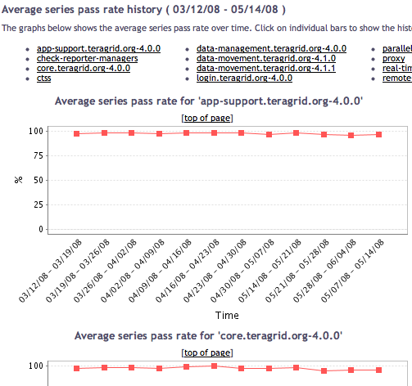
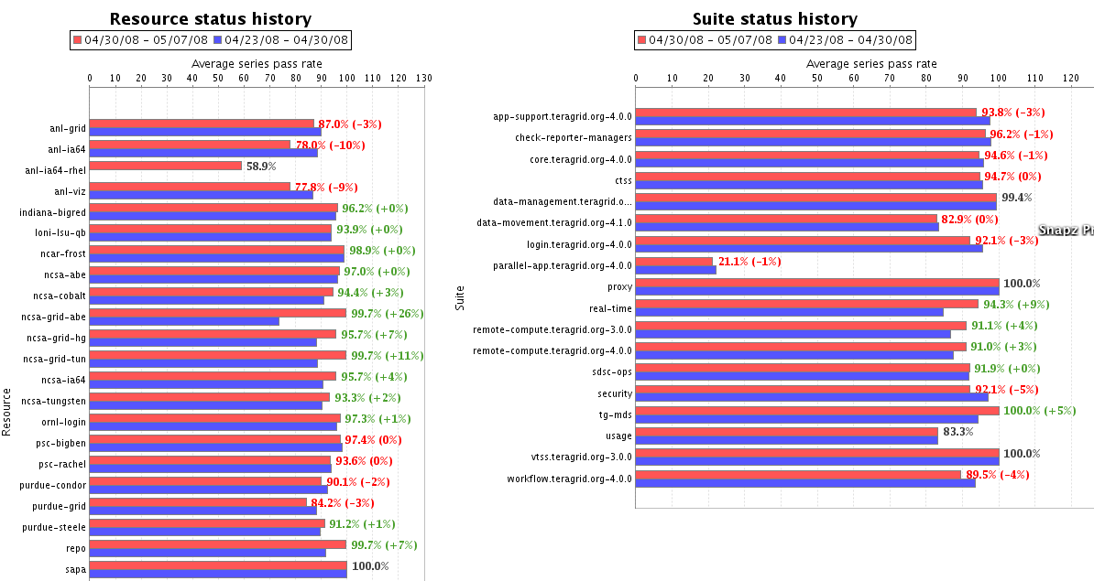
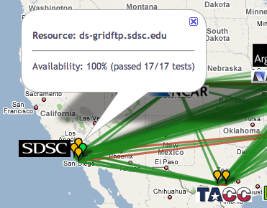
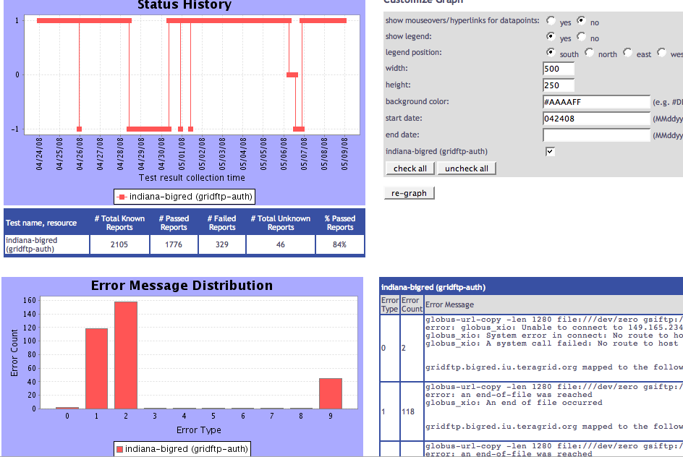
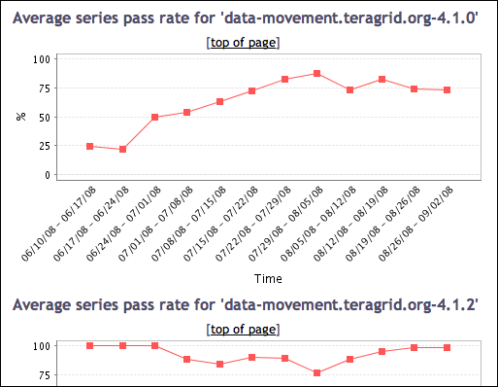
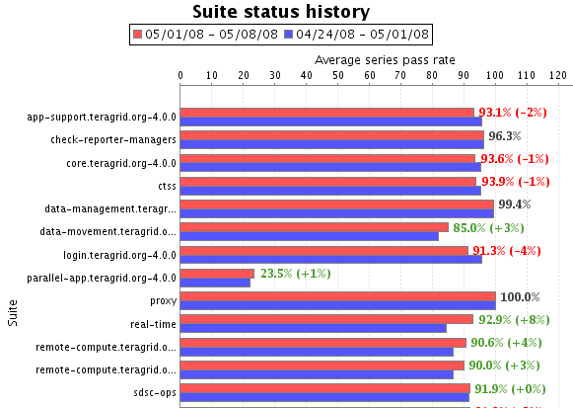
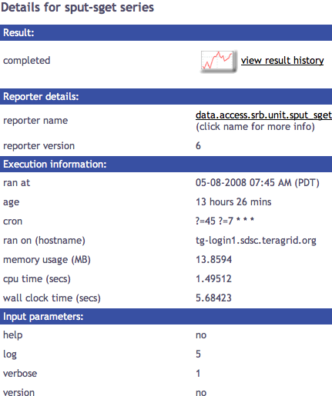
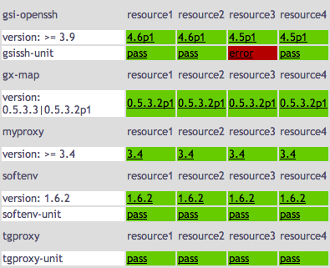
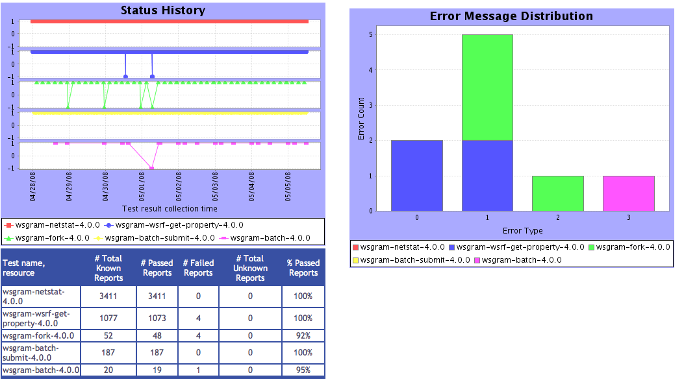
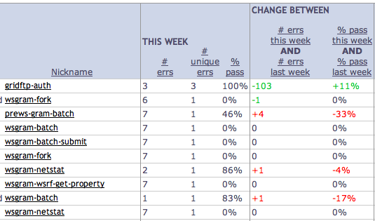
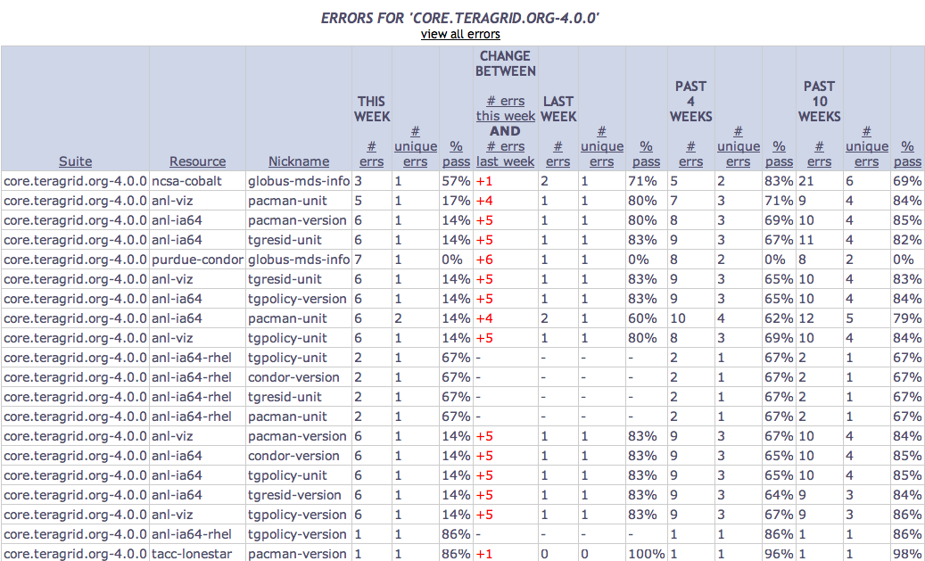
Tests
Summary
Weekly status report
Cumulative test status by resource
Resource status history
Inca’s status pages provide multiple levels of details
Error history summary
Test status by package and resource
Related test histories
Individual test result details
Test
Details
Individual test history
Historical
Current status
Notes:
* If have room, here are our different web status page views

Slide 11
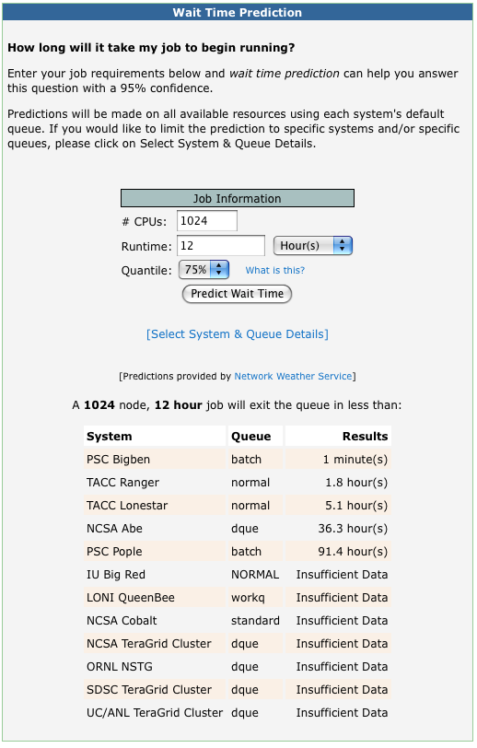
QBETS: Batch queue prediction
Wait-time Prediction
How long will it take my job to begin running?
Deadline Prediction
What is the chance my job will complete within a certain time?
Available via User Portal
Portlet uses QBETS Web service
Wolski, et al., UC Santa Barbara
http://nws.cs.ucsb.edu/

Slide 12
System load, queue monitoring
TeraGrid Integrated Information Services
Load: percent of nodes running jobs (public)
Jobs: lists jobs in the batch queue (requires auth)
Uses Apache 2, Tomcat, and Globus MDS4
http://info.teragrid.org
Accessed via HTTP GET or wsrf-query
Used by User Portal, Scheduling Services, etc.

Slide 13
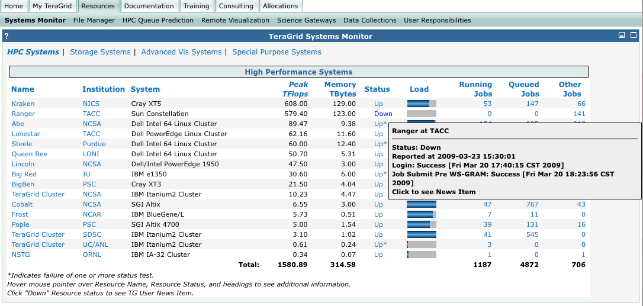
User-Oriented System Monitor
TGUP System Monitor brings many pieces together…
Integration with TeraGrid IIS, Inca, User News
https://portal.teragrid.org
System Load, Queues from IIS
Up/Down Status from Inca
Inca test results re: access
User News about Outage

Slide 14
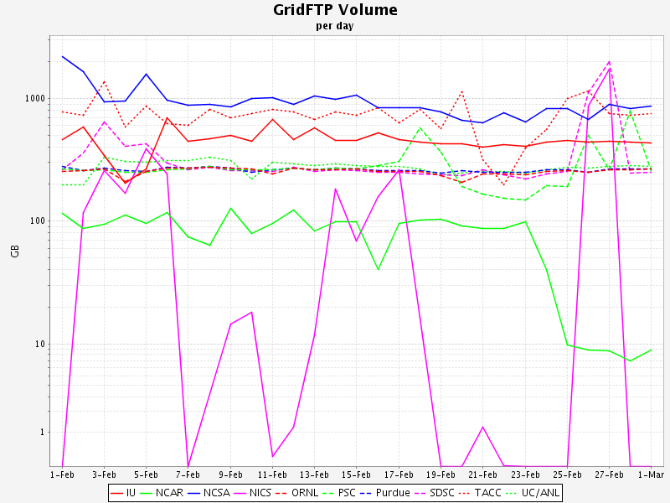
Inter-site Data Movement
GridFTP transfers
Counts and data volume
203 TB moved in Apr 09
Data collected via Globus Listener
http://incubator.globus.org/metrics/
Centralized Listener deployed for TeraGrid, used for GridFTP and WS-GRAM data
Would like to expand to other services

Slide 15
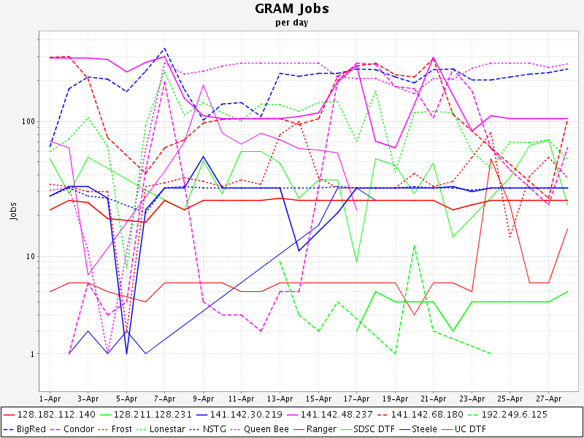
Monitoring Grid Computing Use
GRAM job submission monitoring
Part of monthly Globus reporting
GRAM and PreWS GRAM job monitoring
PreWS GRAM jobs counted by monthly parsing of log files at RP sites
GRAM jobs counted by Globus Listener
No current link between GRAM job records and accounting job records
Likely to happen Q4 2009

Slide 16
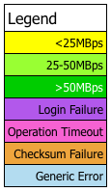
Inter-site Data Movement Performance
SpeedPage—speedpage.psc.teragrid.org
Monitors GridFTP performance between TG endpoints
Backend primarily Python, UI in PHP
Pulls GridFTP endpoints from TG IIS
Spawns globus-url-copies (one per endpoint at a time), with striping, and records results in DB
2x per day
Working toward full automation
$SCRATCH locations now manually updated for each resource
Related Lustre WANpage
Monitors Lustre-WAN systems at Indiana U and PSC
http://wanpage.psc.edu

Slide 17
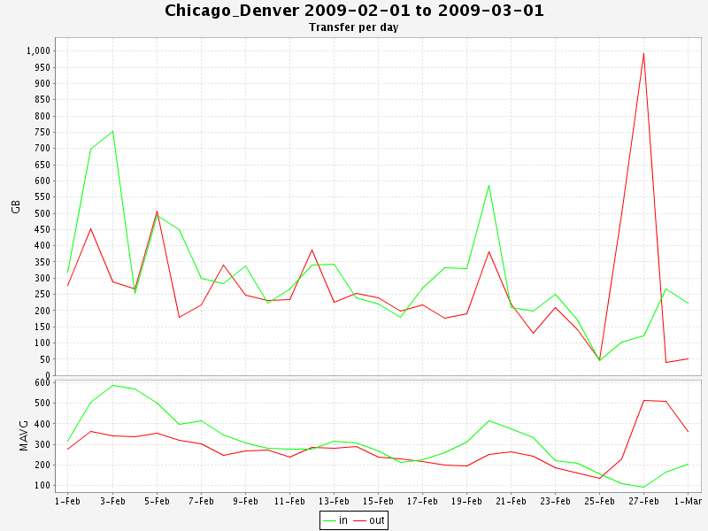
Network Monitoring
Monitoring TeraGrid’s dedicated network
network peak rates
daily transfer volume
In the past, had active bandwidth testing, but not currently
Collected via SNMP
20-s polling
Use RTG
http://rtg.sourceforge.net/

Slide 18
Quality Assurance Working Group
How to handle tough/repeating problems in federated environment?
Many cracks for things to fall into
Arose from issues encountered by LEAD Gateway
QA-WG established to improve reliability and availability of services
Problems not solvable by site admin, or problems that keep coming back, are kicked to QA-WG.
QA-WG prioritizes problems, works to resolve them, if need be engages with software packagers, developers or other experts.
Notes:
QA is somewhat of a misnomer IMHO

Slide 19
Monitoring Needs
Don’t have centralized log collection for all services yet.
Site-by-site collection painful and error prone.
Look to expand central logging via syslog, Globus Metrics
Have a handle now on what is being used, want to understand better by whom and why
Knowing who is impacted by a failure and how helps to prioritize resources and reliability efforts.
Defining usage modalities to characterize user behavior.
Integrating science gateways/Globus use and users into accounting infrastructure

Slide 20
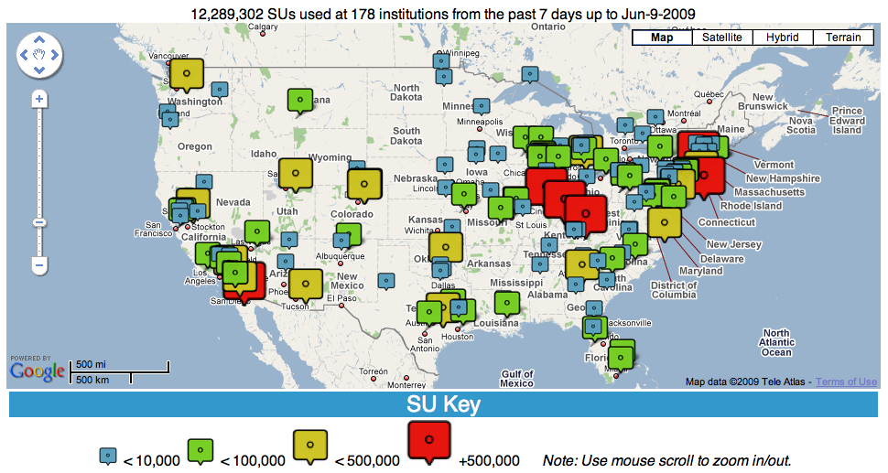
Allocations/Accounting

Slide 21
Centralized Allocations Process
Allocations process has origins back to start of supercomputer centers program (circa 1985)
Users submit requests, Startup or Research
Startups reviewed continually
Research requests reviewed quarterly by external committee
Allocations set usage limits for projects
Projects have one “PI”, any number of authorized users
Managed by POPS system (https://pops-submit.teragrid.org)
pops-submit for user submissions
pops-review for review process
pops-admin for managing, handling, awarding requests
Originated out of NCSA’s local request management system, dating back to 2001 for use across NSF-supported sites.
Notes:
If you’ve ever used a system like EasyChair, POPS is comparable, but tailored to TeraGrid policies.

Slide 22
AMIE: Account Management Info Exchange
TG User Portal
POPS
AMIE protocol
Federates Allocations and Accounting information
Establishes projects and allocations
Establishes user accounts—all TeraGrid users must be on at least one allocation
Manages usage reporting from RPs
Asynchronous exchange of XML packets
System tolerant of RP delays and independence
Originated pre-TeraGrid by NCSA Alliance
AMIE/Gold interface developed by LONI
TeraGrid Central Database (TGCDB)
Definitive TeraGrid data source
Implements TeraGrid policies
Creates AMIE “request” packets
AMIE
AMIE
TGCDB
AMIE
AMIE
RP₁
RP_{n}
http://software.teragrid.org/amie/ http://scv.bu.edu/AMIE/
Notes:
PIs manage their project’s users via TeraGrid User Portal
User creation handled through POPS

Slide 23
TeraGrid Accounting Features
AMIE system independent of specific HPC resource
One AMIE instance can support all resources at a site
RPs retain control of HPC resource admin, can have both TG/non-TG activities
Usage based on job-level records sent from RPs
Averaging ~35,000 records per week
Supports “grid” (multi-resource) allocations
Allocations that are usable on sets of resources, at user's discretion.
TGCDB amasses usage, notifies RPs when allocation exceeded
Usage can be normalized to a common “service unit”
Supports TeraGrid Single Sign-On (SSO)
Distinguished Name synchronization across sites
gx-map suite of utilities for managing grid-mapfiles
Supports non-HPC allocations
Requests/allocations supported for storage resources
Requests in POPS possible for Advanced User Support
But accounting definitions/support are lagging
Notes:
Note that we have implemented a ‘workaround’ to reduce the volume of Purdue Condor jobs, which are all single-core and generally very short jobs. A single AMIE job record can report “aggregate” job record for sets of Condor jobs associated with the same user and project and close together in time. Purdue aggregates up to 100 Condor jobs in a single AMIE job record.

Slide 24
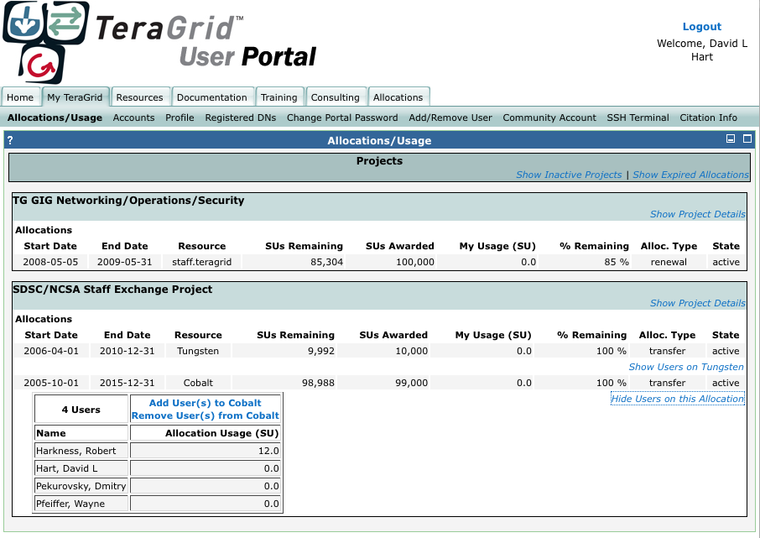
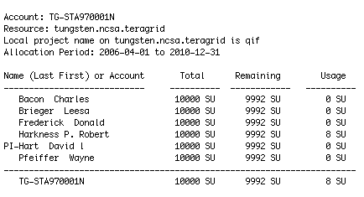
User Views for Allocations/Accounting
TeraGrid User Portal
IIS-based profile service
under development
tgusage
command-line utility

Slide 25
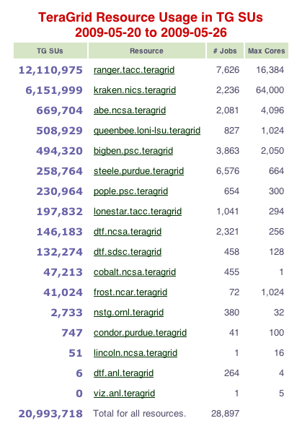
Staff Views for Allocations/Accounting
Web interface for staff to monitor TGCDB “ground truth”
Help desk uses to troubleshoot user issues
Used to monitor accounting system functioning
Custom metrics/reports for management needs
Mostly Perl

Slide 26
Conclusions and Acknowledgments
Within TeraGrid, these efforts are coordinated across several programmatic areas
Monitoring/logging activities fall under the GIG’s Network, Operations, and Security activities
Allocations/accounting managed under User-Facing Projects & Core Services activities
Information Services managed under Software Integration activities
Thanks to Shava Smallen, SDSC; Von Welch (NCSA); JP Navarro (UC/ANL); Robert Budden (PSC) for their contributions to this presentation.
Questions?

