Slide 1
OSG Information Management
Keeping Your Information Current
Elizabeth Chism
Grid Operations Center

Slide 2
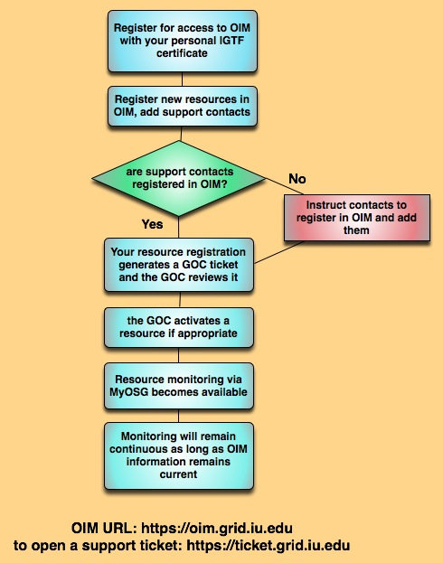
Registration and Maintenance of Information
The GOC feeds resource information directly from OIM into our monitoring tools.

Slide 3
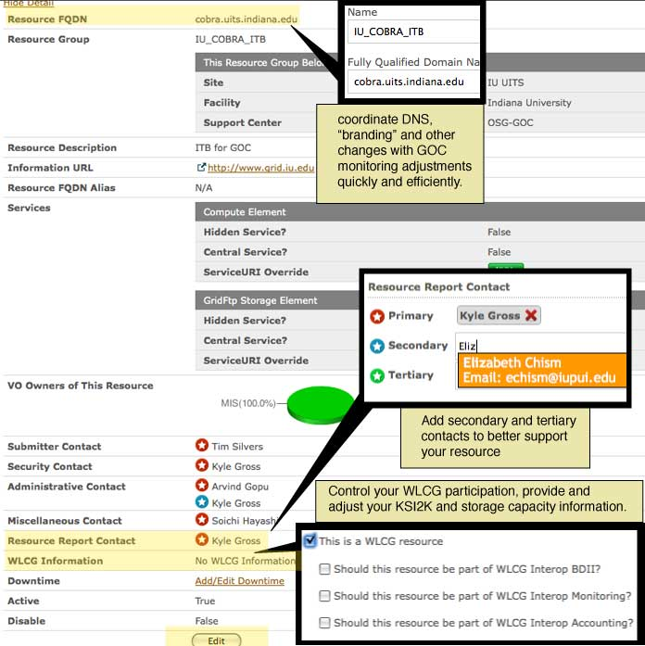
OIM ensures that the information used for GOC monitoring stays current

Slide 4
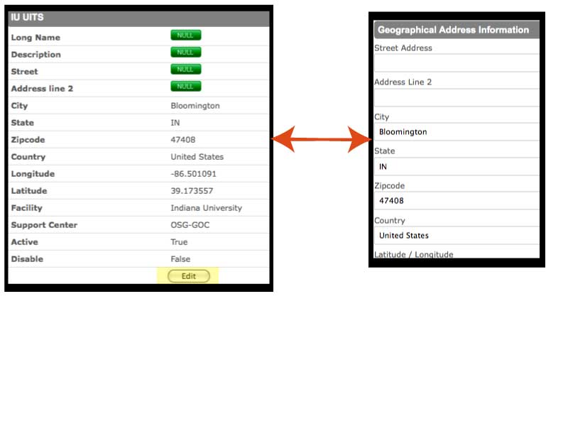
Edit your site information

Slide 5
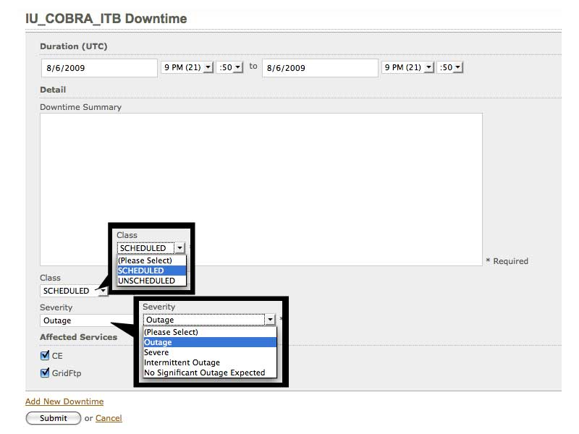
Scheduling a maintenance

Slide 6
So remember…
Get your collaborators personal certs
Have them register in OIM
Schedule your maintenances
OR ELSE…

Slide 7
Your email starts to look like this

