Slide 1
Workshop on Future Directions for Accelerator R&D at Fermilab
S.Y. Lee
Indiana University
IU Accelerator Physics group Research Topics may be helpful to future high energy physics projects.
ICA
Experiments on Space charge; non-scaling FFAG
What is ALPHA (Advanced eLectron and PHoton fAcility) project?
Inverse Compton X-ray source
Ideas on Coherent THz source
Coherent X-ray with electron laser interaction (Inverse Compton scattering)
Conclusion
X. Huang et al., PRSTAB 8, 064001 (05)
F. Wang et al., PRSTAB 11, 024001 (08)
X. Pang et al., JAP (2009)
X. Huang et al., PRSTAB 9, 014202 (06)
SY Lee, PRL 97, 104801 (06)
SY Lee et al., NJP 8, 291 (06)
X. Pang et al, HB2008 (2008)
SY Lee et al., RSI 78, 075107 (2007)
SY Lee et al., RSI (2009)

Slide 2
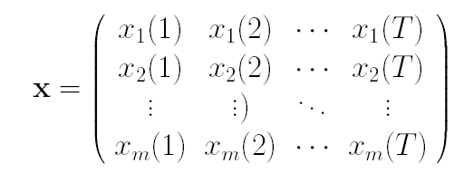
ICA: Data mining for BPM turn-by-turn data
The turn-by-turn beam position signal is a combination of various source signals.
For the i’th BPM
or
is the mixing matrix
The source signals include betatron motion, synchrotron motion and others (e.g., ground motion, power supply ripples, etc.)
m BPMs and T turns
Form a matrix of the BPM data
The source signals are assumed to be narrow-band with non-overlapping spectra, so their un-equal time covariance matrices are diagonal.
Or
The mixing matrix A diagonalizes the un-equal time sample covariance matrices simultaneously.

Slide 3
Diagonalize the equal-time covariance matrix (data whitening)
D1,D2 are diagonal
Set to remove noise
with
Construct an intermediate “whitened” data matrix
which satisfies
This is the PCA-based MIA. Matrix z is just the temporal patterns of MIA modes.
Jointly diagonalize the un-equal time covariance matrices of matrix z of selected time-lag constants.
for
Then
and
The columns of A (spatial vectors) and corresponding rows (temporal vectors) of s are the resulting modes.
* The second order blind identification (SOBI) algorithm of A. Belouchrani, et al.

Slide 4
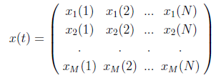
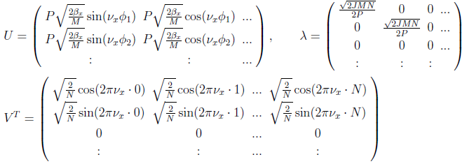
The betatron component
Beta function and phase advance
The synchrotron component
Dispersion function and momentum deviation

Slide 5
Measurements of turn-by-turn data have traditionally being used to measure and model accelerators. Employing the independent component analysis (ICA), we were able to measure the betatron and synchrotron tunes, betatron amplitude functions, dispersion functions for the entire ramping cycle (submitted for publication).
The amplitude of oscillation is about 0.4 mm; Notice the bursts due to the pinger, which is fired about every 225 turns.
An impression of raw data; 2500 turns from turn 1; at location L01

Slide 7
Using the tracking results as “ experimental data”, and carrying out ICA analysis, we can obtain D_{z} at all BPM locations.

Slide 9
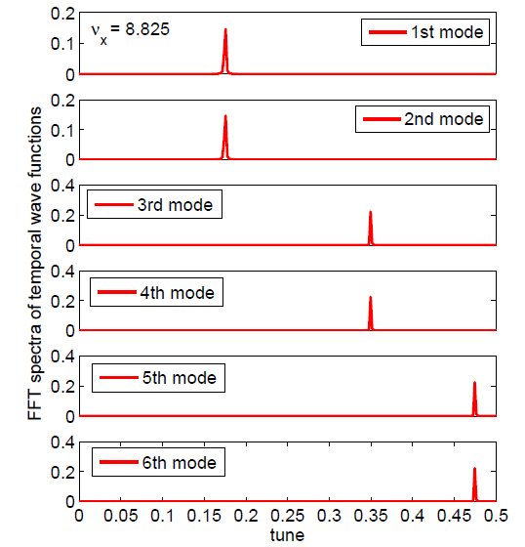
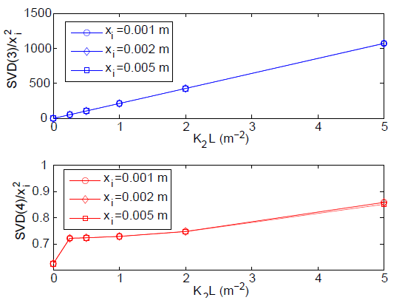
ICA and Nonlinear dynamics
One sextupole in the AGS lattice:

Slide 10
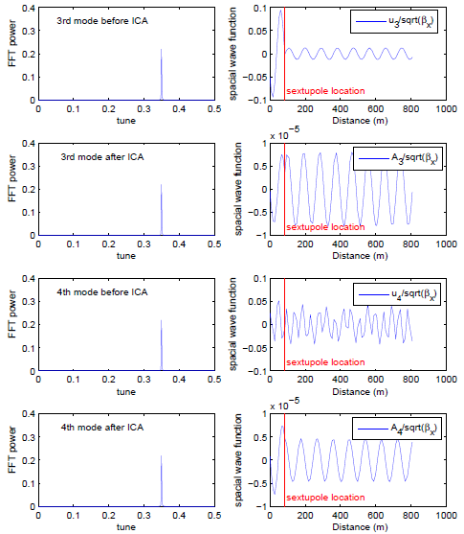
What will the wave function of 2ν_{x} mode teach us?

Slide 11
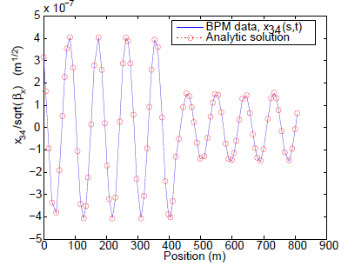
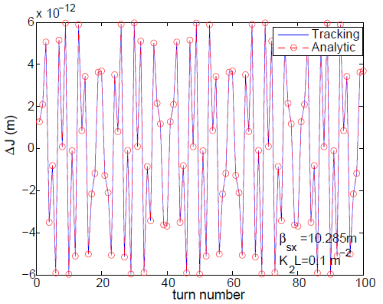

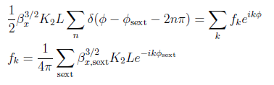


Slide 12
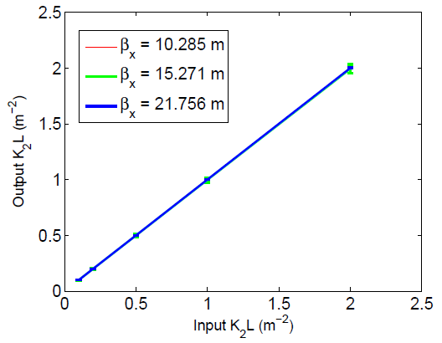
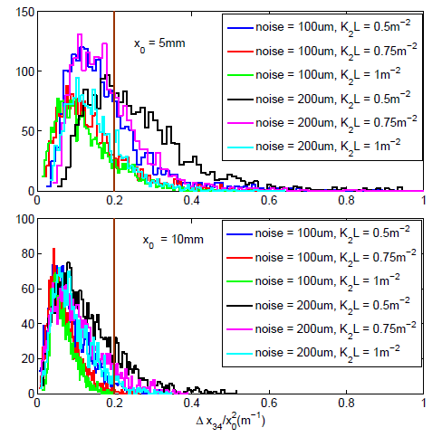

Slide 13
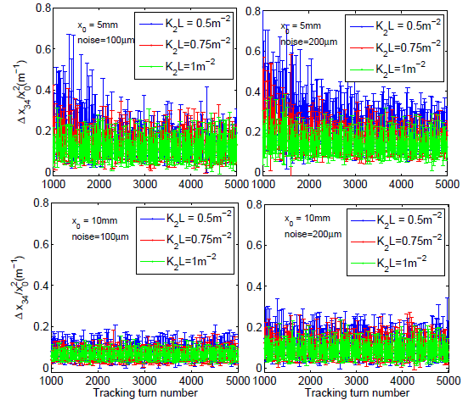

Slide 14
Summary on ICA development
ICA is a multivariate statistical technique, developed and applied for data mining in many branches of science. In beam physics, ICA can be applied to analyze turn-by-turn beam position monitor (BPM) data of beam motion. The narrow-band filtering of ICA provides us an accurate method to identify and extract information on the linear betatron and synchrotron motion, effects of wake fields, nonlinear elements in accelerators, and other sources of perturbation. We have found applications in
Linear betatron motion, tunes, betatron functions, linear coupling, etc
Dispersion function measurement and emittance correction
Nonlinear magnet field identification in storage rings. We are developing a new idea of turn-by-turn ICA-beam based measurement.
Data in science are classified either in ensembles or in time sequences, or in combination of these two modes. Further development is of great interest in beam physics. ICA analysis to Experimental data would be highly valuable!

Slide 15
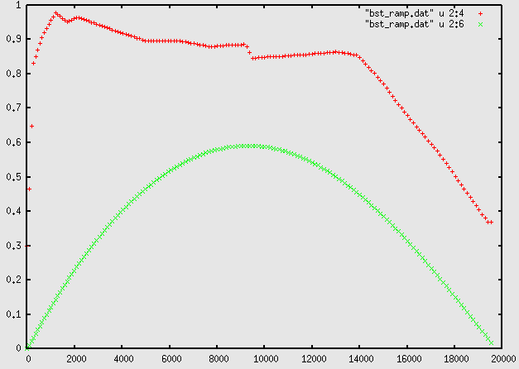
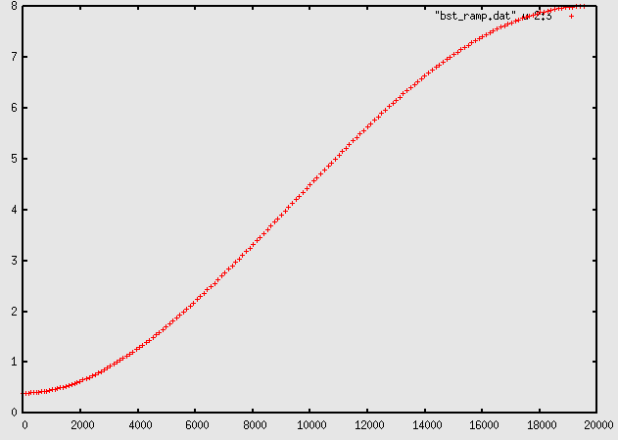
Space charge experiments at Fermilab Booster, and
space charge effects of non-scaling FFAG accelerators
V_{rf}
V_{rf}sinφ_{s}
KE

Slide 16
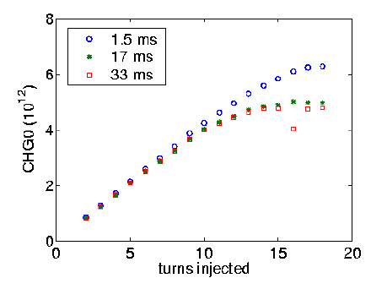
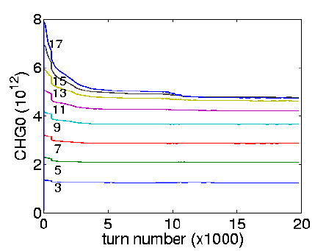
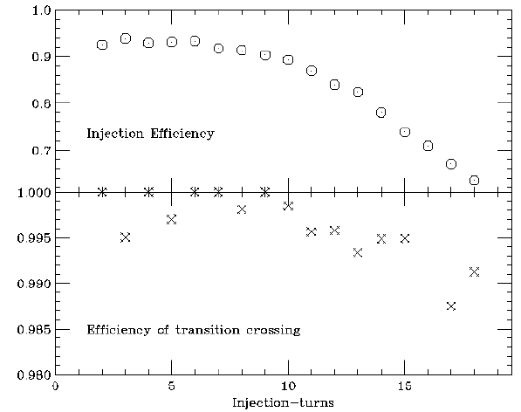
Typical Injection scheme at the Fermilab Booster: H- at 400 MeV from Linac is about 30 mA. Strip injection into the Booster gives about 4.2×10¹¹ protons per injection turn. At 400 MeV, the revolution frequency is 4.51×10⁵ Hz. The Normal operation has 12 injection turns, and the total intensity is about 5×10¹² ppp at 15 Hz rep-rate. In fact, when the injection turn is larger than 12, the Booster loss problem becomes severe.

Slide 17
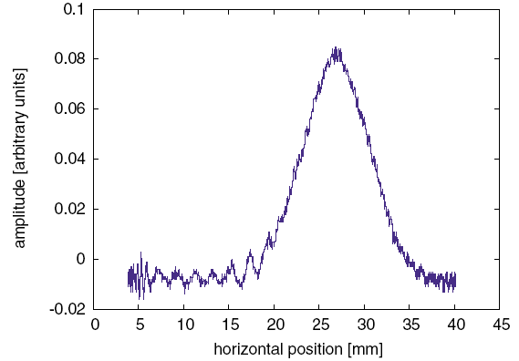
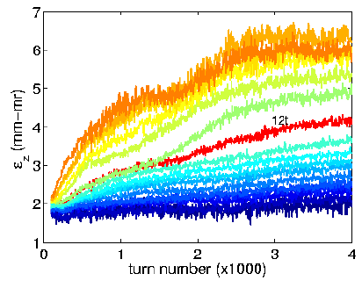
Ionization beam profile monitors (IPM's) measure the beam profile by collecting electrons from background gas ionization. Measurement accuracy will depend on the number of electrons collected. The number of electrons collected depends on pressure, bunch intensity, and data collection mode. The center-to-center distance between microchannels is of the order of 1.5mm. Thus one can measure the beam width to within 3.0mm. For the IPM at Fermilab Booster, the space charge correction has been shown to be important [J. Amundsen et al PRSTAB 6 102801 (2003)]

Slide 18
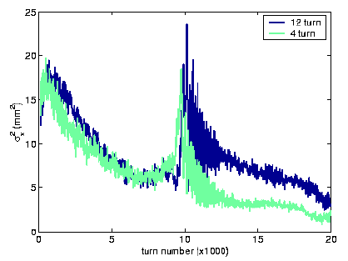
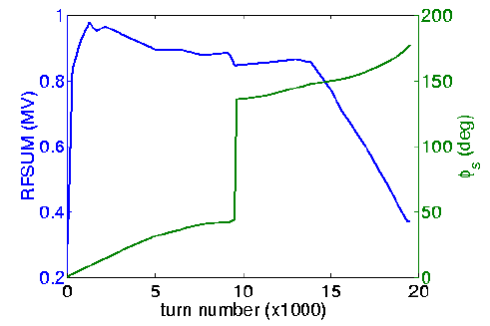
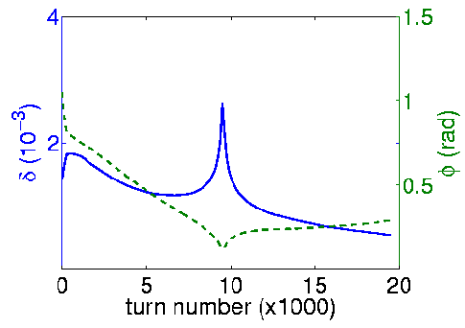
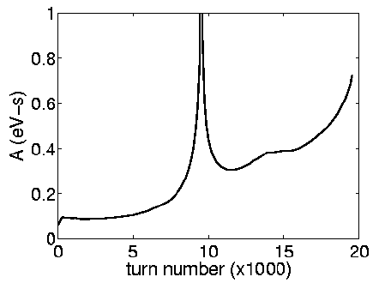
Horizontal IPM measurements

Slide 19
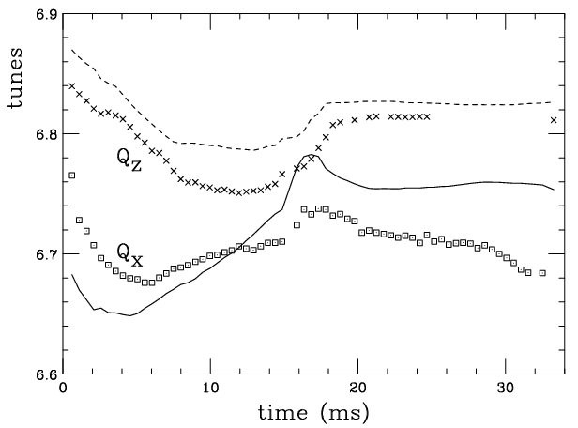
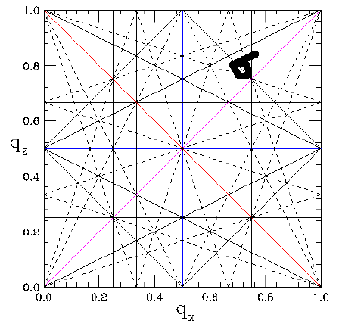
γ_{T}
Betatron tunes obtained by ICA has been used.
All possible emittance growth mechanisms have been included: mis-injection, random quadrupole field errors, skew quadrupole field error, rapid acceleration, transition crossing, sextupoles

Slide 20
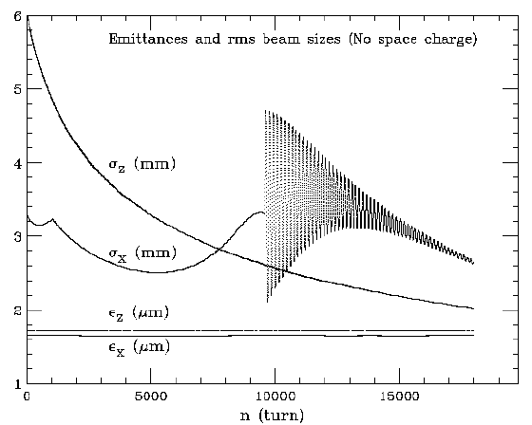
No sextupole

Slide 21
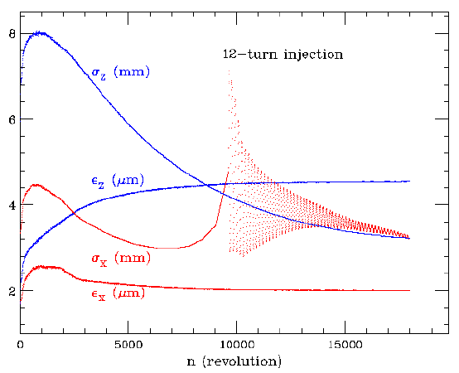
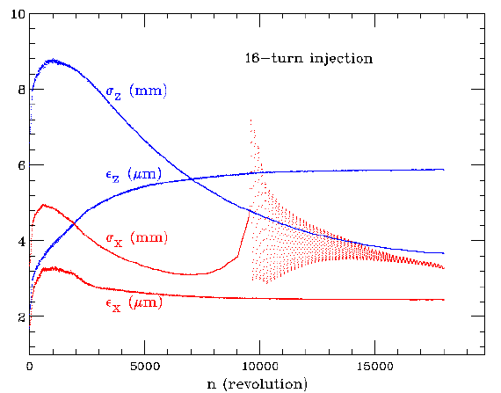

Slide 22
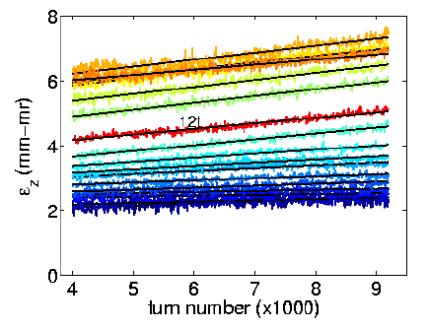
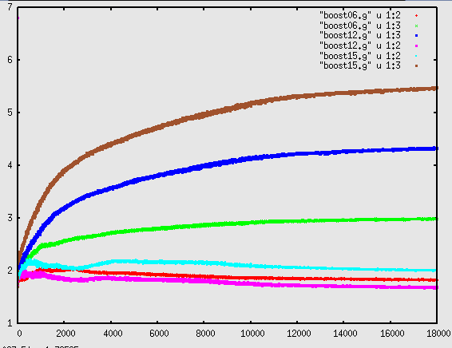

Slide 23
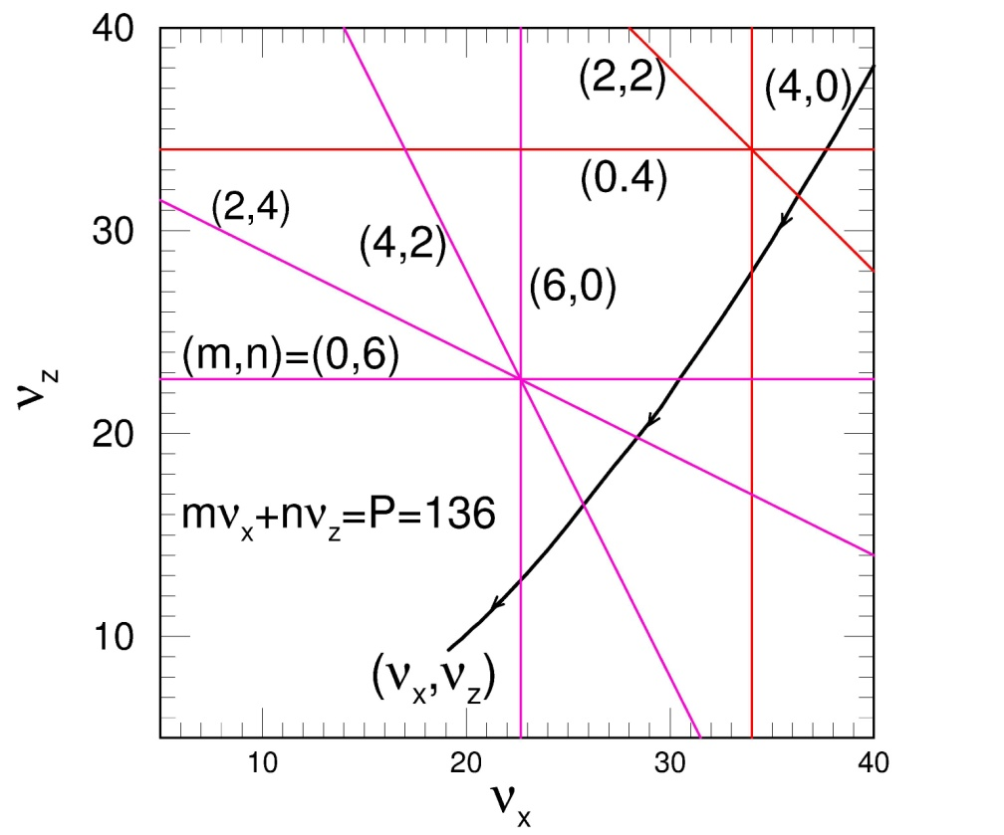
Space charge effect of non-scaling FFAG
For example: Ruggiero suggested 3 concentric FFAGs as a proton driver to replace BNL AGS to reach 10 MW beam power.
Tunes change from
(n_{x}, n_{z}) = (40,38.1) to (19.1,9.3)
Cross systematic 4th and 6th resonances: (P=136)
4ν_{x}=P, 4ν_{z}=P, 2ν_{x}+2ν_{z}=P
6ν_{x}=P, 6ν_{z}=P, 2ν_{x}+4ν_{z}=P, 4ν_{x}+2ν_{z}=P
Emittance growth obeys scaling laws
Thus phase advance per cell cannot be near 90⁰ and 60⁰.
Lattice design can become very restricted.

Slide 24
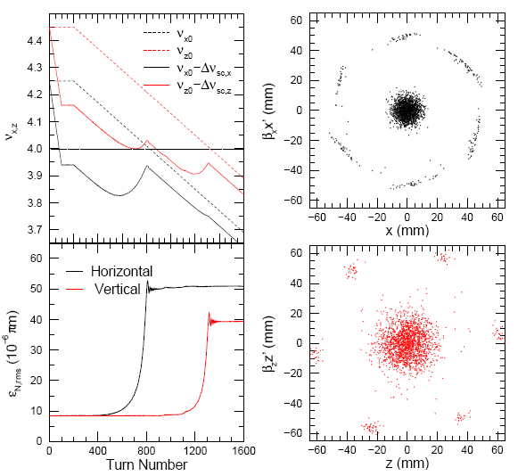
100 turns injection
Crossing systematic resonances:
6ν_{x}=P, 6ν_{z}=P, P=24
dν_{x,z}/dn = -0.0004
Aperture=
Emittance growth factor
EGF: Final emit./initial emit.
Turn 820
Turn 1270

Slide 25
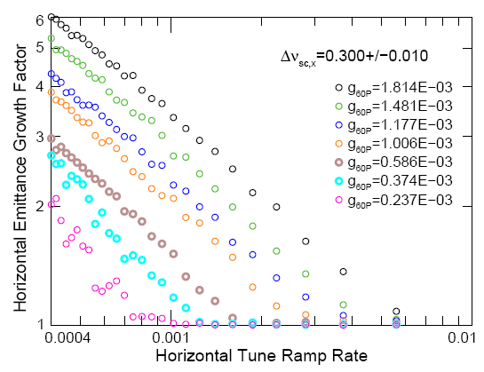
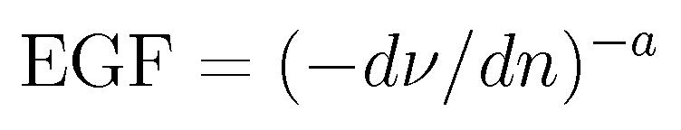
Scaling Power Laws
Tune ramp rate:
0.0004 → 0.0112
Log-log plots
Scaling Law
Critical tune ramp rate

Slide 26
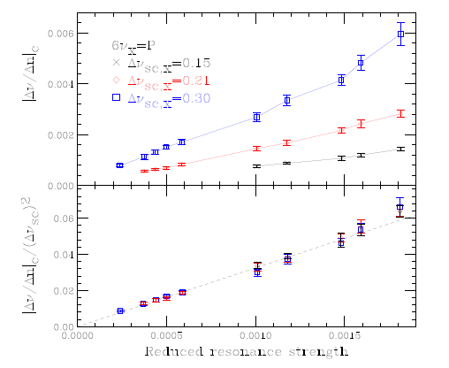

Critical Tune Ramp Rate
Can serve as a guideline for FFAG
design!

Slide 27
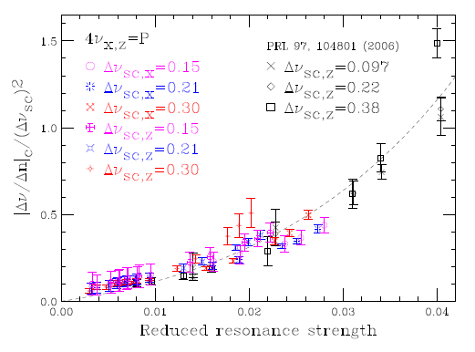

4th order Systematic Resonances

Slide 28


Besides these systematic space-charge resonances, random errors play an important role in particle beam dynamics. Since the dipole field errors affect the closed orbit, which is relevant to the beam emittance at injection, we assume that the closed orbit is properly corrected. The random quadrupoles break the superperiodicity, and produce half-integer stop bands. The random skew quadrupoles introduce both the sum and difference coupling resonances, found to be important in beam-emittance growth in fast ramping accelerators.
The scaling law of the emittance factor in passing through these resonances is
Summary on space charge studies:
Need experimental verification of these EGF scaling laws
Fermilab Booster is the most suitable accelerator for these experiments

Slide 29
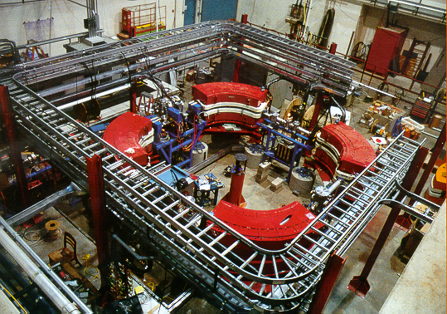
ALPHA project at IU/IUCF funded by the CRANE: We are building an electron storage ring with circumference 20 m. The accelerator can provide de-bunched beam for CRANE research center radiation effect experiments; and provide IU with X-ray photon source through Inverse Compton Scattering.
Injection kickers
Lambertson
septum
Chicane for laser-electron interaction
Damping wiggler
cavity
Quadrupole does not work
How about Robinson wiggler? – not effective in changing J_{x}
Gradient Damping wiggler
Long straight section
Make it easy to operate
C=20 m, B₁/B₀=1.9 m^{–1}.

Slide 30
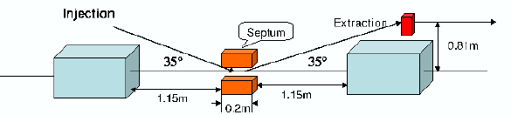
Pulse from linac
Extracted beam
Debunch in 1 revolution
Lambertson septum
Kicker 1
Kicker2
Beam in and out in one revolution satisfies the CRANE requirement of steady state experiment.
The accelerator can accumulate 250 nC of charge in 10 or more turns and extracted in one turn for transient mode experiment (15J).

Slide 31
Location of Bumpers

Slide 32
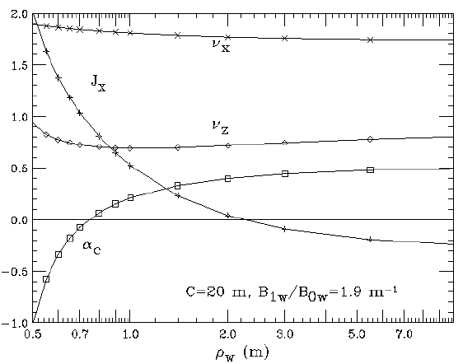
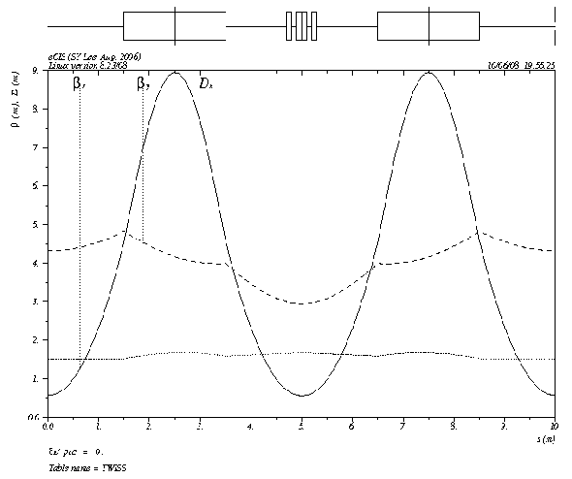
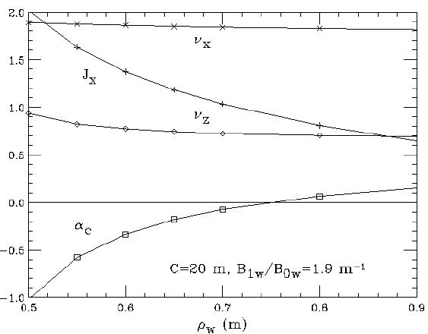
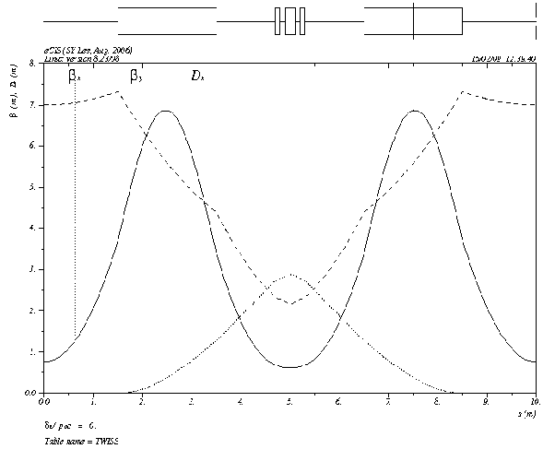
Note that a large compaction factor is necessary for achieving de-bunching for the electron beams in a single path!
DBA
ε=7.8nm
α_{c}=0.15

Slide 33
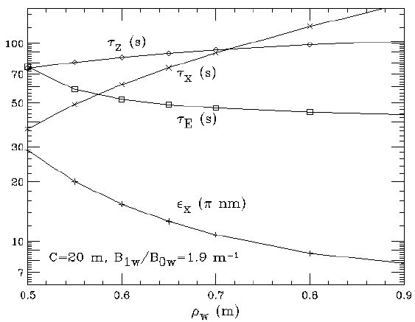
Emittance and damping time!

Slide 34
The chicane angle can vary from 0 to 110 mr. The photon beam and the electron beam can easily be separated within a distance of 40 cm from the interaction point!

Slide 35
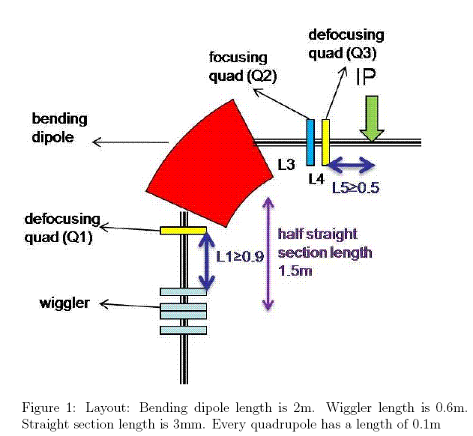
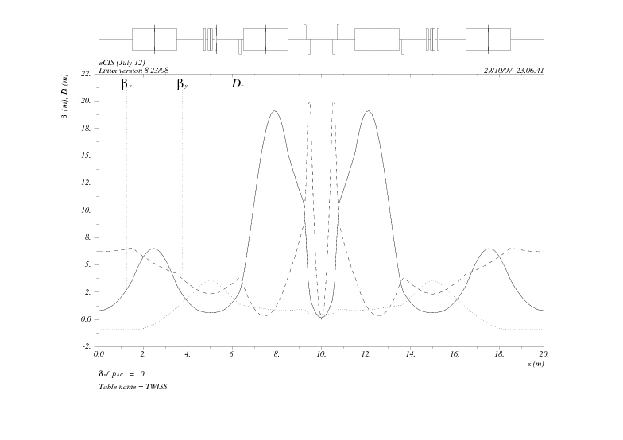
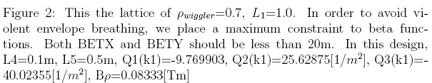
Quadrupole Triplet
X-ray flux can be enhanced by 30, and Brilliance enhanced by a factor of 1000.

Slide 36
Research Topics in Accelerator Physics:
Laser-beam interaction; ICX experiments and optimization
CSR in THz using the optical grating
CSR in X-ray? Quasi-isochronous accelerator + laser-beam interaction ~ (infinite long linac + infinite long weak undulator)
Touschek Lifetime measurement and modeling; A known difficulty for all 1-3 GeV SR storage rings.
Beam dynamics of quasi-isochronous storage ring; nonlinear beam dynamics.

Slide 37
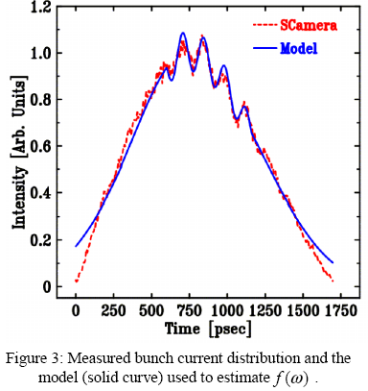
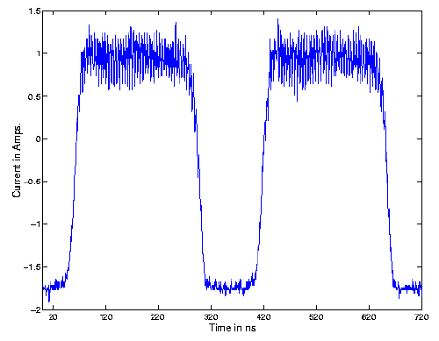
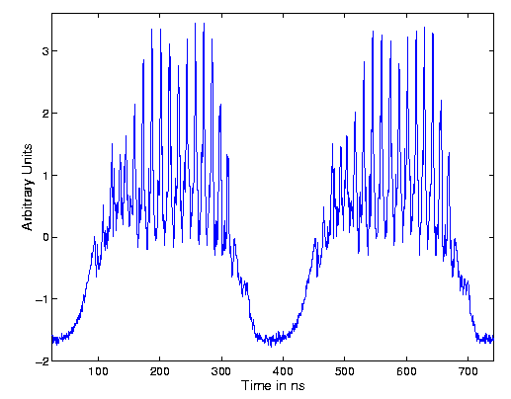
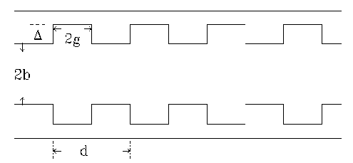
Coherent radiation arises from microbunching in beams.
PSR data, R. Macek; C. Beltran, Ph.D. thesis, IU 2003

Slide 38









Slide 39
Summary on ALPHA project for Accelerator Physics Research:
Laser-beam interaction; ICX experiments and optimization
CSR in THz using the optical grating
CSR in X-ray? Quasi-isochronous accelerator + laser-beam interaction ~ (infinite long linac + infinite long weak undulator)
Touschek Lifetime measurement and modeling; A known difficulty for all 1-3 GeV SR storage rings.
Beam dynamics of quasi-isochronous storage ring; nonlinear beam dynamics.
Many thanks for your attention

