Slide 1
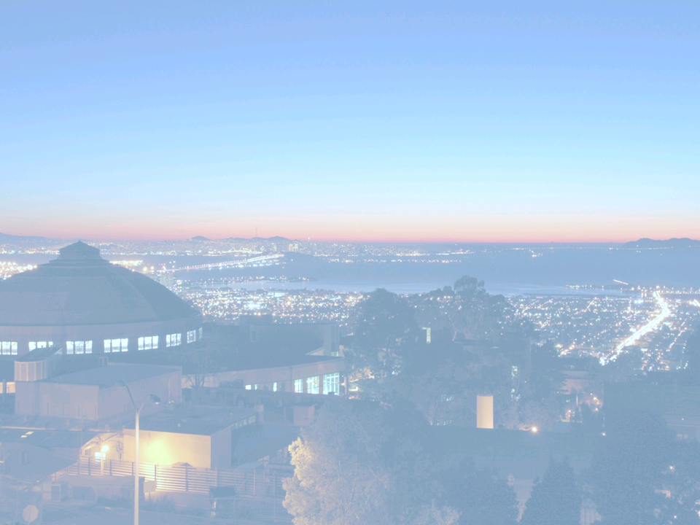
Laser-Plasma Accelerators: Opportunities and Challenges
Carl B. Schroeder
Lawrence Berkeley National Laboratory
Future Directions for Accelerator R&D at Fermilab
May 11-13, 2009 – Lake Geneva, WI
Office of Science

Slide 2
Outline
Progress:
Physics of laser-driven plasma accelerators
Ultra-high field gradients – compact accelerators
Ultra-short bunch durations – fraction of plasma wavelength
GeV electron beams generated in cm-scale plasmas
Opportunities:
Light sources
Driver for free-electron laser
Compact gamma ray source
Laser-plasma-accelerator-based linear collider
Challenges:
Improved beam quality and stability: triggered injection
Higher energy beams: staging laser-plasma accelerators

Slide 3
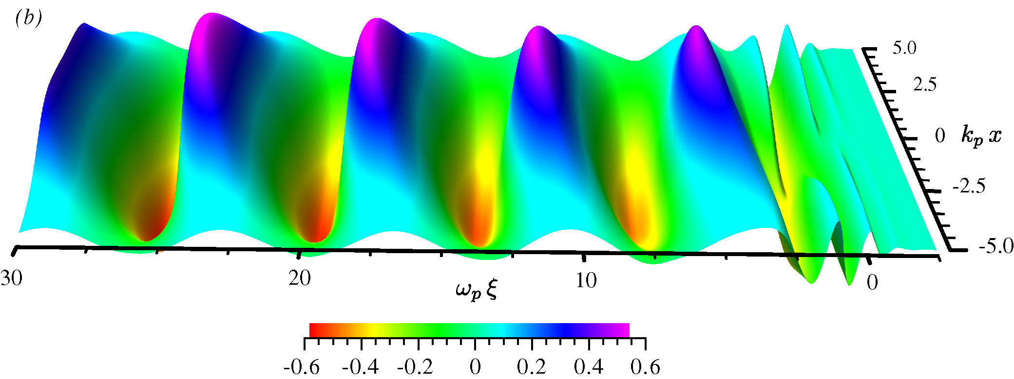
Short-pulse laser-excited plasma waves
Tajima & Dawson, Phys. Rev. Lett. (1979); Esarey, Schroeder, Leemans, Rev. Mod. Phys. (2009)
Plasma wave: electron density perturbation
Laser ponderomotive force (radiation pressure)
Ti:Sapphire laser: I~10¹⁸ W/cm²
Laser pulse duration ~ λ_{p}/c ~ tens fs

Slide 4
Laser-plasma accelerators: >10 GV/m accelerating gradient
plasma wave (wakefield) E ~100 GV/m (for n~10¹⁸ cm⁻³)
(>10³ larger than conventional RF accelerators)
λ_{p} =2πc/ω_{p}= (πr_{e}^{-1/2} ) n_{p}^{-1/2} ~10 μm
laser
For high energy gain, the fields must act on the charged particles over extended distances.

Slide 5
Limits to single-stage energy gain: Laser Diffraction
Laser Diffraction:
limits interaction ~ Rayleigh range
most severe limitation (Z_{R} << L_{int})
solutions:
Use relativistic self-guiding of ponderomotive self-channeling to guide laser pulse (requires increased laser energy and power)
Tailoring plasma density to form plasma channel (optical guiding – analogous to optical fiber)
Z_{R}
n(r)
Guiding:
r

Slide 6
Limits to single-stage energy gain: Dephasing and Depletion
• Laser-electron beam dephasing:
• slippage between beam and plasma wave
• overcome be tailoring plasma density (longitudinal increase)
c
V_{gr}
• Laser depletion: length scale for deposition of laser energy into plasma wave
• For non-relativistic laser intensities (a<<1):
• For relativistic intensities (a>1):

Slide 7
Prior to 2004: Self-modulated laser-plasma accelerator experiments
charge ~ nC
Laser beam
Mirror
~ mm
ultra-short ~ 50 fs (measured CTR THz)
few TW
Gas jet
e⁻ beam
Parabolic
mirror
n >10¹⁹ cm⁻³
• Plasma wave generated via Raman scattering instability (modulation of a long laser pulse)
e-beam spectrum
Energy spectrum
0.75
0.50
Leemans et al., PRL (2002)
laser pulse
Schroeder et al., Phys. Plasmas (2003)
0.25
0.00
-0.25
-0.50
Plasma density wave
-0.75
-40
-20
0
20
40
Exponential distribution:
(1) Raman instability results in continued electron trapping
(2) High density ⇒ L_{dephase} << L_{gas-jet} ⇒ electrons accelerated and deccelerated

Slide 8
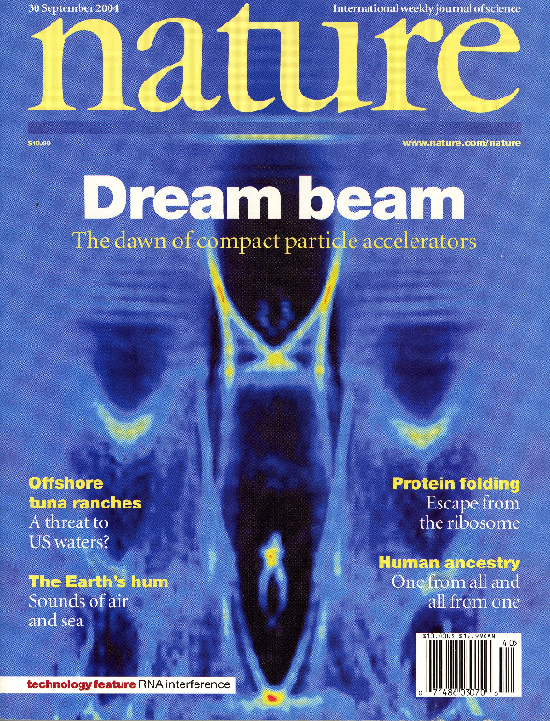
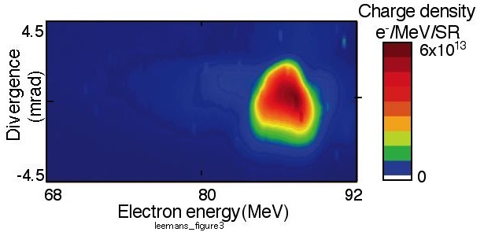
2004 Experimental Results: High-quality 100 MeV beams
Extend interaction length and lower plasma density to match interaction length to dephasing length:
Approach 1: bigger laser spot (more laser energy)
RAL (UK): Mangles et al, Nature (2004)
LOA (France): Faure et al, Nature (2004)
Approach 2: preformed channel guided: LBNL expt.
PIC Simulation of LBNL Expt.
Geddes et al, Nature 431 (2004)

Slide 9
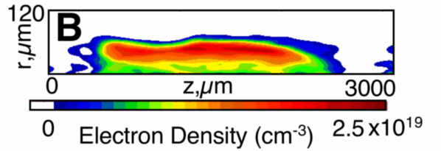
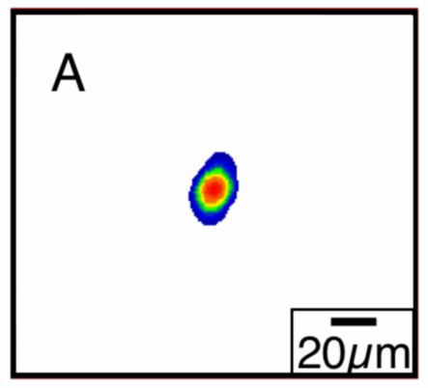
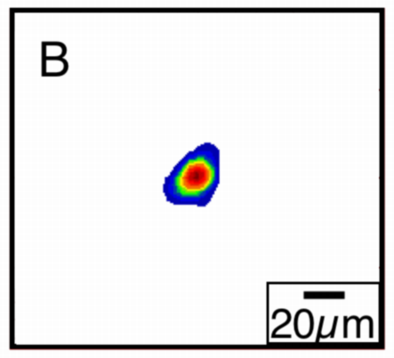
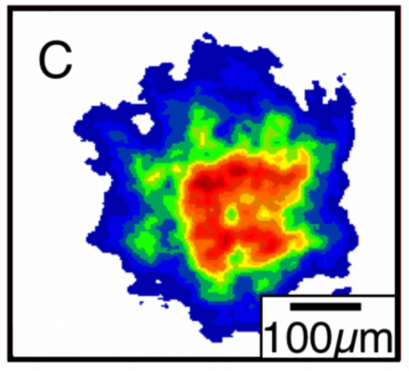
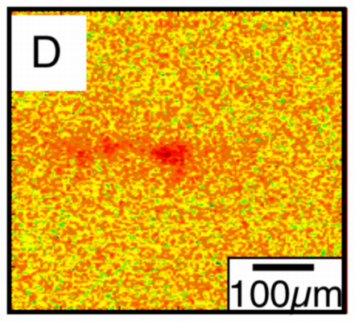
2004 LBNL Expts: Plasma channels produce high quality e-beams by guiding relativistic intensities
Main beam ~10TW
Ionizing beam
H gas jet
9TW: high-quality e-bunches
hundreds of pC, 2% ΔE/E, 3 mrad
e⁻
magnetic
spectrometer
Heater beam
Interferometer
CCD
Channel creation via inverse bremsstrahlung heating
Channel density
4TW: Guiding at P > Pcrit
Geddes et al., Nature 2004
Input
Guided Output
11/19/03gv 1
11/19/03
Gi 2
high vφ
low vφ
Vacuum Output
Unguided Output
variation of n_{e} guides laser
Density profile tuned to
compensate for self guiding
Notes:
Laser =4TW:
Guiding over > 10 ZR at intensity from ~0 to > 1e18 W/cm² or a_{out} >1 (a_{in}>2).
Controlled guiding -> mode quality, long scale wake with/out trapping for staging
PIC Simulations reproduce depletion, indicate E_{dephase} ~ 100MeV.
Laser = 9TW, 55 fs, Z_{R}=200µm Plasma = 1.8e19cm⁻³, 1.7mm
High quality, intense beams
2e9 electrons Divergence 3mrad Energy Spread<4MeV
Beams up to 3e9 @ 78MeV, and electrons up to 170 MeV
Channeling enhanced stability
Main beam
<500mJ >50fs
Pre-ionizing
(ignitor)
Beam 20mJ
Heater beam
150mJ 250ps

Slide 10
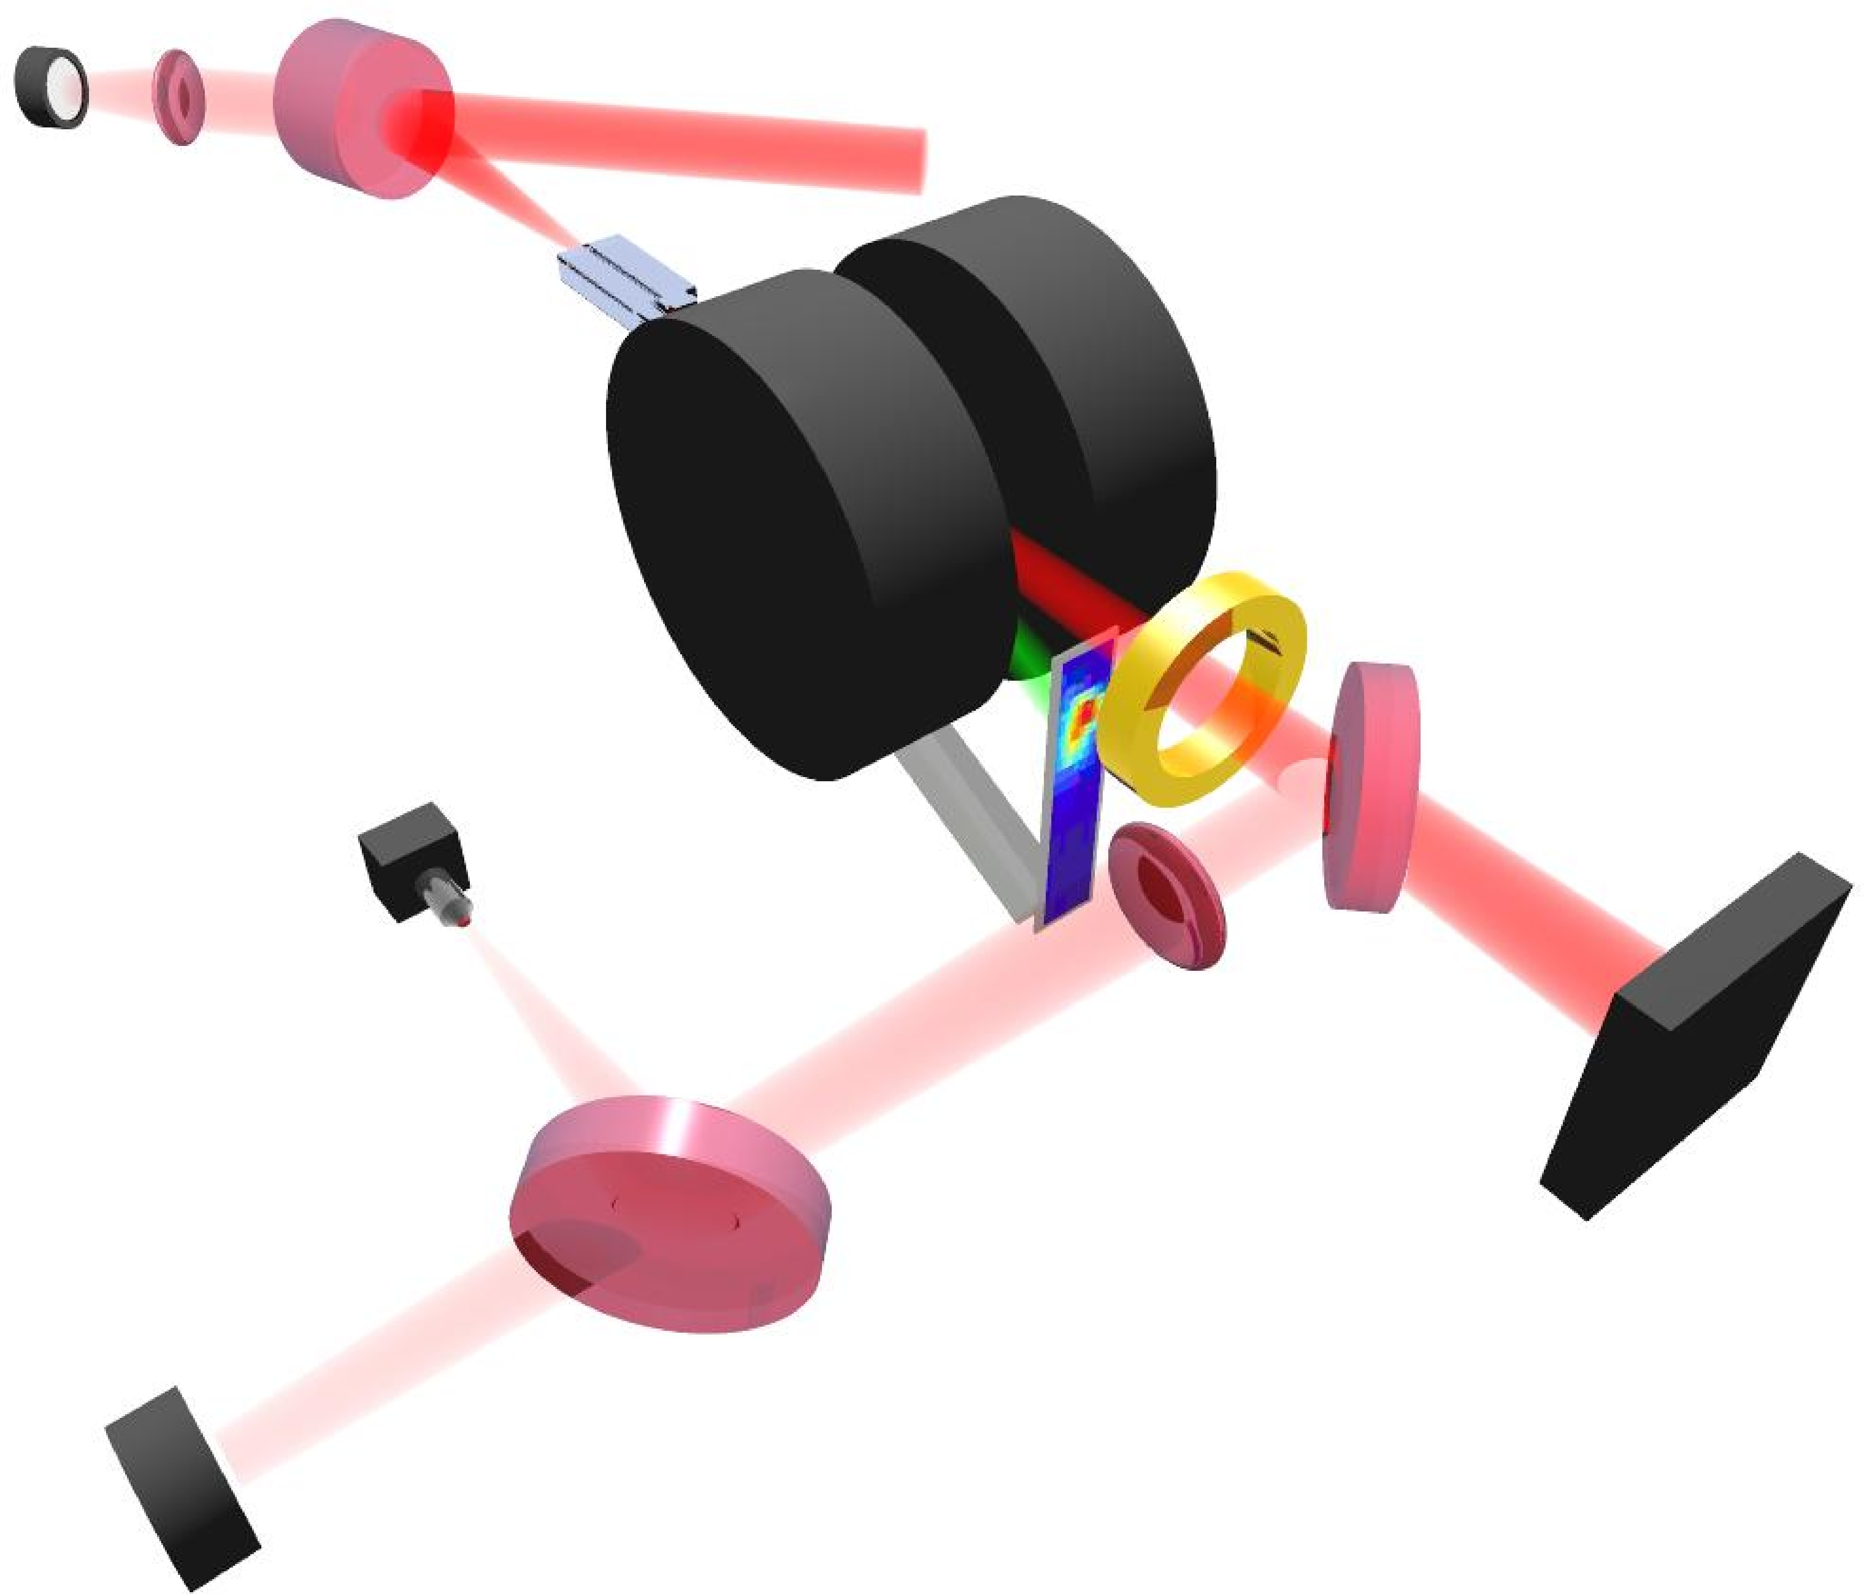
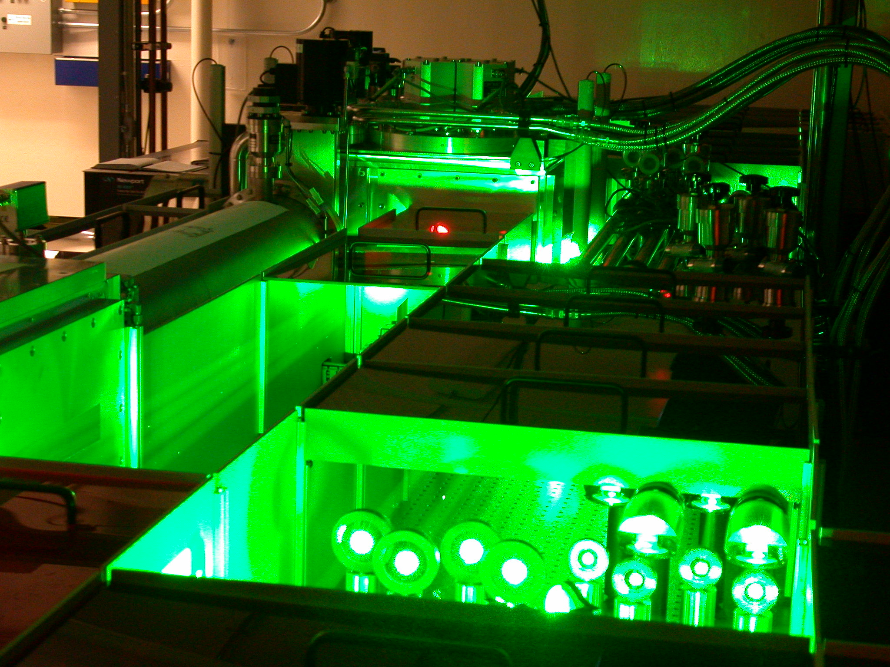
Laser-plasma accelerator for GeV beams
Energy gain:
low density plasmas (~10¹⁸ cm⁻³)
Accelerator length:
long plasma channels (~cm)
Laser energy/power:
more laser energy (power)
LBNL Ti:Al₂O₃ laser system:
3J, 40 fs, 10 Hz
OAP
Capillary
Dipole magnet
ICT
Lanex
Notes:
So we’ve seen the waveguide and the high-power laser. In this section we’ll see how these were used in our electron acceleration experiments.
This is our experimental setup. The laser beam is focused onto the entrance of capillary discharge plasma by OAP, focal length of which is 2 m. Leakage light is used for monitoring input power and pointing. After the interaction, laser beam is sampled by an optical spectrometer, a photodiode, and mode-imaging CCD camera. The electrons are deflected by the magnetic field of a electromagnet that allows the electron beam energy to be measured.

Slide 11
Capillary discharge plasma waveguides
Gas slots
channel
~cm
Ionized by pulse discharge (200-500A, ~100ns)
Plasma fully ionized for t > 50 ns
After t ~ 80 ns plasma is in quasi-equilibrium: Ohmic heating is balanced by conduction of heat to wall
Ablation rate small: cap. lasts for >10⁶ shots
n_{e} ~ 10¹⁷ - 10¹⁹ cm⁻³
4
3
Φλ (rad)
2
1
Simulation
0
-200
-100
0
100
200
Spence & Hooker, Phys. Rev. E (2001); Gonsalves et al. PRL (2007)
y (μm)
Notes:
So we’ve seen the waveguide and the high-power laser. In this section we’ll see how these were used in our electron acceleration experiments.
This is our experimental setup. The laser beam is focused onto the entrance of capillary discharge plasma by OAP, focal length of which is 2 m. Leakage light is used for monitoring input power and pointing. After the interaction, laser beam is sampled by an optical spectrometer, a photodiode, and mode-imaging CCD camera. The electrons are deflected by the magnetic field of a electromagnet that allows the electron beam energy to be measured.

Slide 12
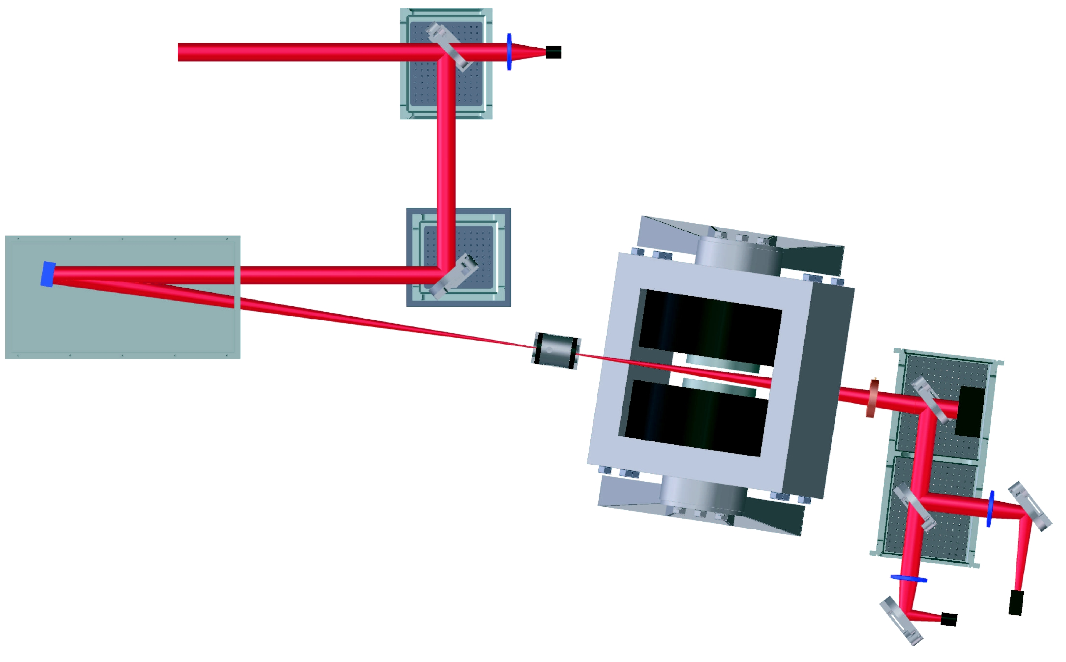
GeV electron beam from laser-plasma accelerator demonstrated
laser
spectrometer
a₀ ~ 1.46 (40 TW, 37 fs)
n_{e} ~ 4x10¹⁸ cm⁻³
capillary: 33 mm length
capillary
Peak energy: 1000(+70/-62) MeV
Divergence (rms): 1.6 mrad
Energy spread (rms): +/-2.8%
Resolution: 2.6%
Leemans et al., Nature Physics (2006)
Notes:
With 312 micron diameter, 33 mm length capillary, 1 GeV electron beam was generated. This is a spectrum. Input laser was 40 TW - 37 fs. Peak energy was 1 GeV, divergence was 2.0 mrad, energy spread was 2.5 %. Here, the resolution of the magnetic spectrometer was 2.4 %. This spread was clearly resolution limited, means might have been smaller. Charge was 30 pC.

Slide 13
GeV beam stability: sensitive to laser-plasma parameters
Discharge delay against laser arrival
H₂ gas pressure (density)
Capillary diameter
Laser energy, pulse duration, pointing
Fluctuations in bunch charge, energy, energy spread, divergence
peak energy: 976 MeV
beam divergence: 0.7 mrad
energy spread (rms): 1.0 %
resolution: 0.8 %
peak energy: 1012 MeV
beam divergence: 1.7 mrad
energy spread (rms): 2.9 %
resolution: 2.6 %
peak energy: 900 MeV
beam divergence: 1.7 mrad
energy spread (rms): 2.2 %
resolution: 2.2 %
peak energy: 922 MeV
beam divergence: 1.0 mrad
energy spread (rms): 4.5 %
resolution: 1.3 %
operates near self-trapping threshold ⇒ shot-to-shot fluctuations
GeV beams independently demonstrated:
MPQ (Germany): Karsch et al., New J. Physics (2007)
APRI (Korea): Hafz et al., Nature Photonics (2008)

Slide 14
Stable regime for 0.5 GeV beams
Laser: a₀ > 0.6 (12 TW, 1 J, 80 fs)
Capillary: 225 μm diameter and 33 mm length
Nakamura et al. Phys. Plasmas (2007)
Divergence (rms): 1.6 mrad
Energy spread (rms): 5.6%
Resolution: 1.1%
Charge: 50 pC
Representative shots:
Charge = 32 ± 14 pC, Energy = 456 ± 45 MeV, dE/E = 6 ± 3%
Stable (~200 MeV) electron beams independently demonstrated:
MPQ (Germany): Osterhoff et al., PRL (2008)
Notes:
With 225 micron diameter capillary, stable generation of half GeV mono-energetic beams was found. This a processed image from the spectrometer. Horizontal axis is Energy in MeV, and vertical axis is divergence. Input laser parameter was about 11 TW 80 fs. For this particular shot, peak energy was 490 MeV, divergence was 1.6 mrad, energy spread was 5.6 %, and charge was around 50 pC.
Below is a selection of beams obtained in this regime. These, and another 7 shots correspond to a charge of ….energy…. And energy spread …

Slide 15
Free-electron laser driven by laser-plasma accelerated beam
Nakajima Nature Phys. (2008)

Slide 16
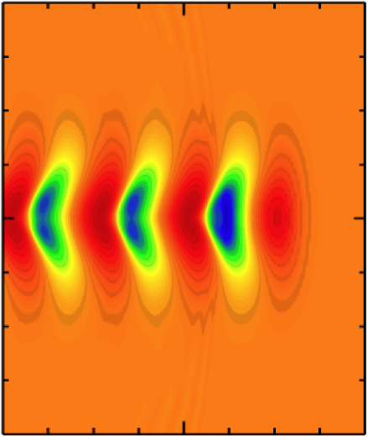
Ultra-high beam current allows compact FEL
plasma-based accelerators are intrinsically sources of femtosecond beams:
• Bunch duration << λ_{p}/2
• Simulations indicate ~ 5 fs
λp
I_{peak} >10 kA
laser
Conventional accleerator: ~1 kA,
accelerator length ~ 100 m
Ultra-high peak current ⇒ reduced undulator length for saturation
Saturation Length (m)
LBNL laser-plasma-accelerator FEL:
10 kA, λ_{u} =2.18 cm, K=1.85,
plasma accelerator length ~ 3 cm
Peak current (kA)
Notes:
With 225 micron diameter and 33 mm length capillary,
stable generation of half GeV mono-energetic beams was found.
This is a typical image from the spectrometer.
Horizontal axis is Energy in MeV, and vertical axis is space.
Input laser parameter was about 11 TW 75 fs.
For this particular shot, peak energy was 490 MeV, divergence was 1.6 mrad,
energy spread was 5.6 %, and charge was around 50 pC.

Slide 17
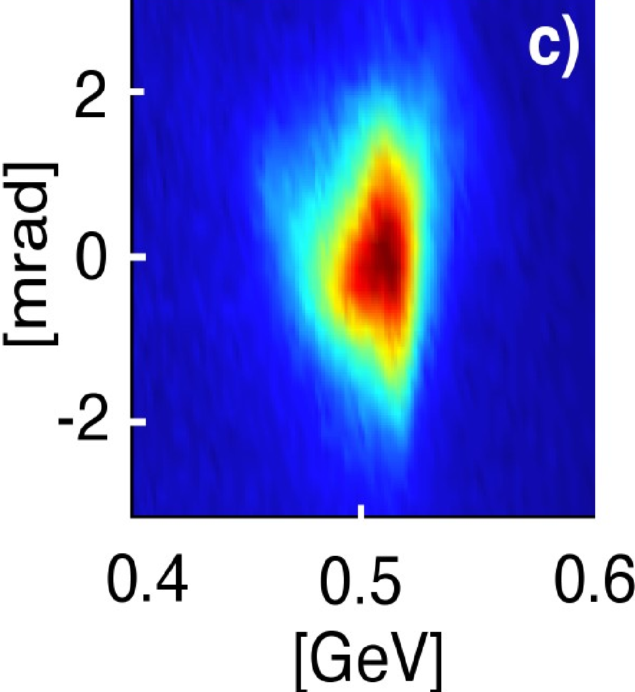
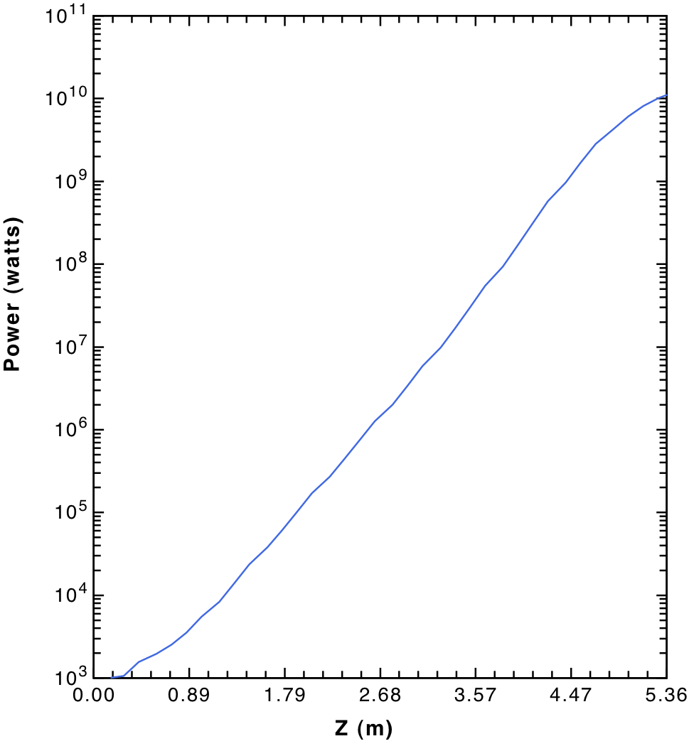
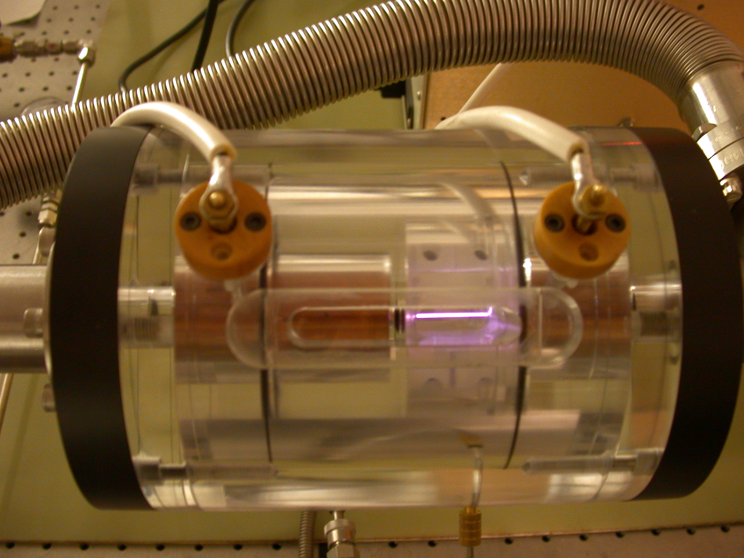
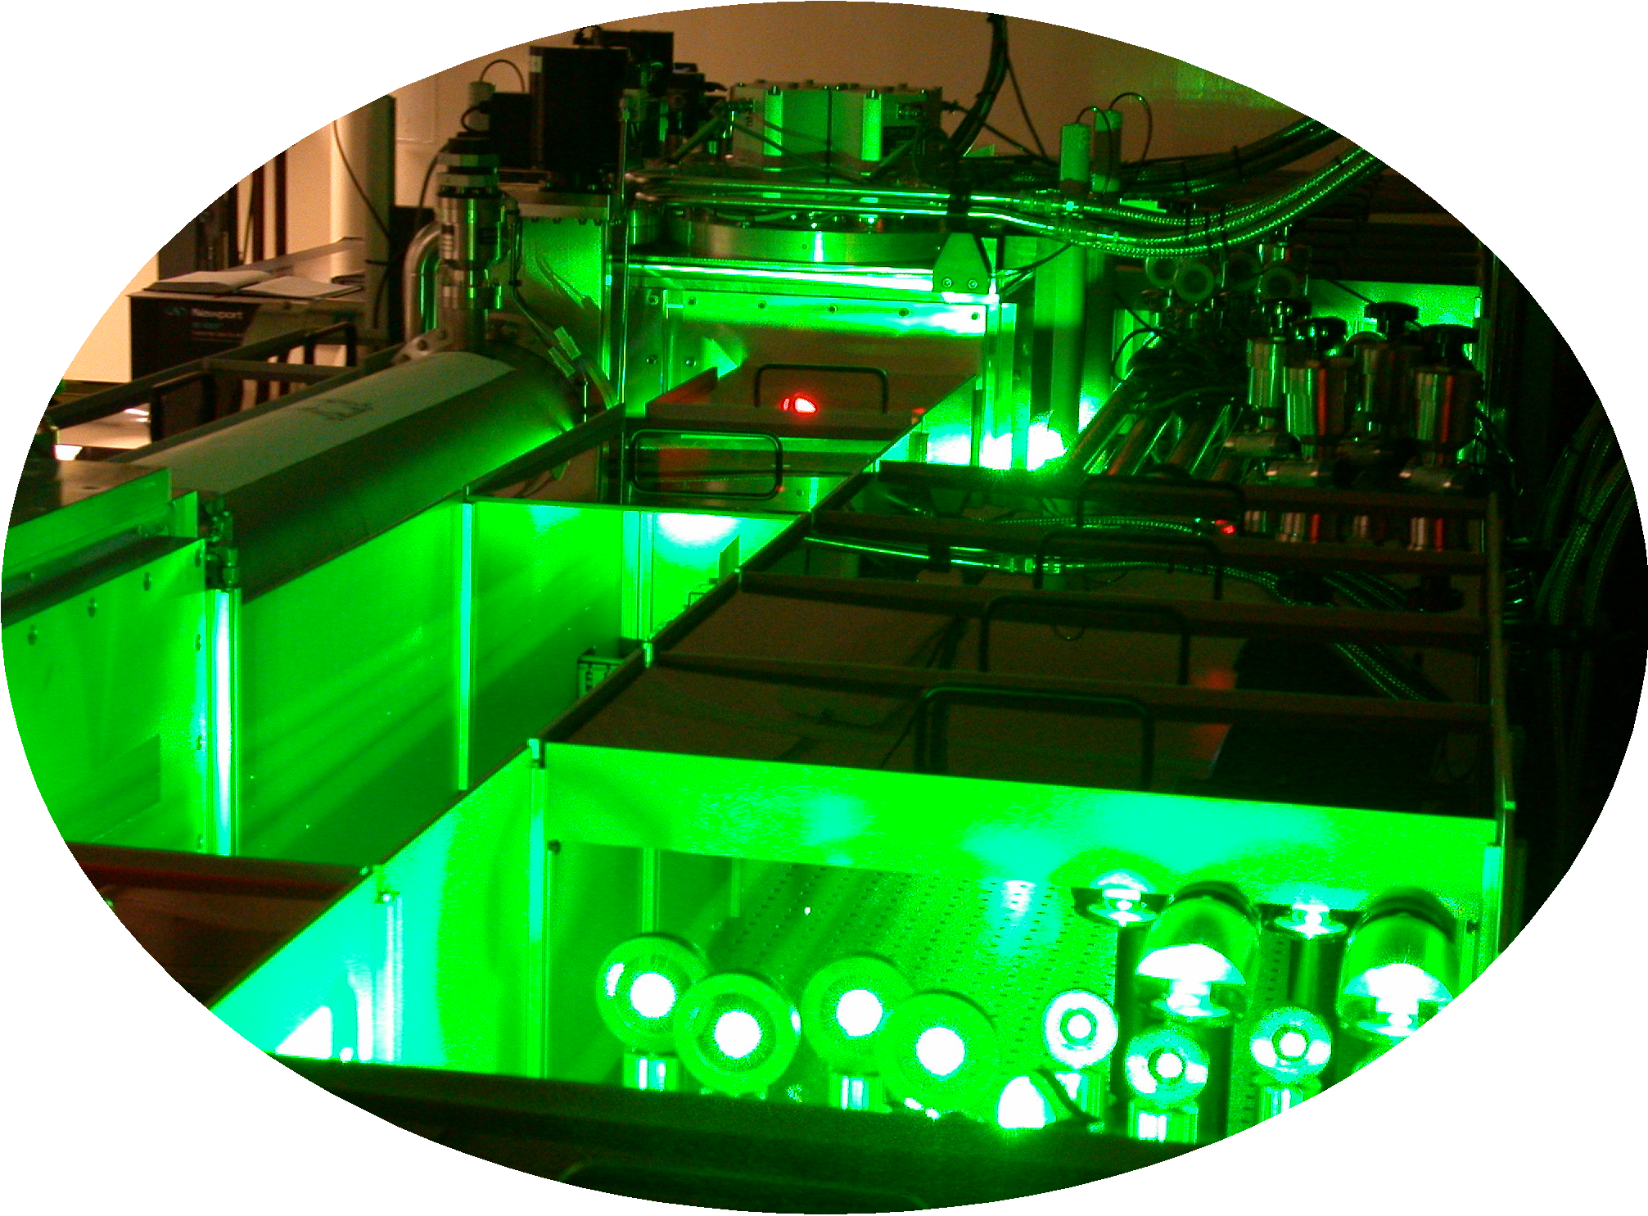
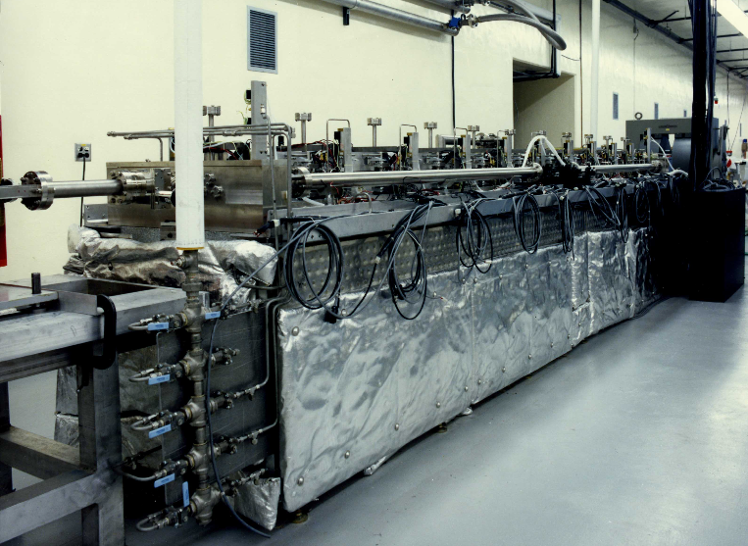
Laser-plasma accelerator driven XUV FEL
Schematic of LBNL laser-plasma-accelerator-driven FEL:
C. B. Schroeder et al., in Proc. of FEL06 (2006).
single-pass, high-gain FEL
FEL output:
λ=31 nm
10¹³ photons/pulse
30TW, 40fs,
10¹⁸ W/cm²
10 Hz
~3 cm
focusing optics
Undulator
~ 5 m
Laser beam
plasma channel
10¹⁸ cm⁻³
0.5 GeV,
electron beam
XUV radiation
2.18 cm period, K=1.8
GeV-class beams demonstrated
Leemans et al., Nature Phys. (2006)
Radiation:
Resonant wavelength 31 nm
Photon energy 40 eV
FEL parameter 7x10⁻³
1D gain length 0.15 m
3D gain length 0.21 m
Spont. rad. power 8 kW
Slippage length 5 μm
Energy/pulse 0.2 mJ
Ti:Al₂O₃ laser system
Plasma capillary technology
conventional undulator (THUNDER)
K. Robinson et al., IEEE QE (1987)
GINGER simulation
5 m

Slide 18
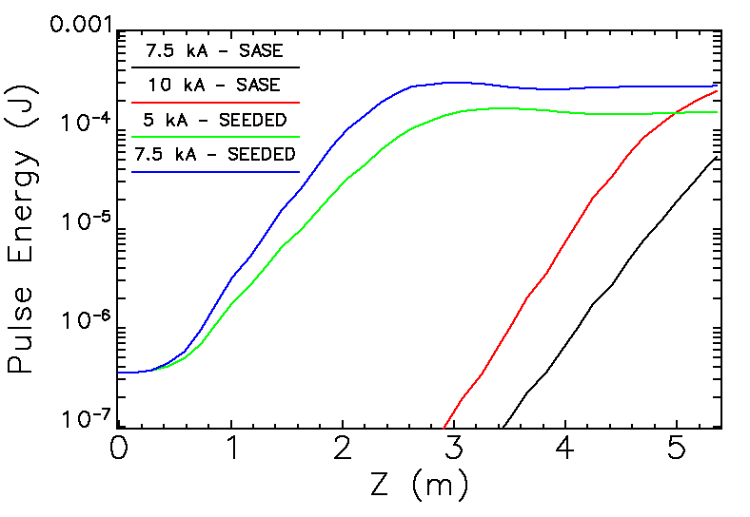
High harmonic generation (HHG) FEL seeding
HHG seeding demonstrated with conventional accelerator technology: Lambert et al., Nature Phys. (2008)
HHG seed:
hollow gas-filled waveguide
λ=31 nm
P~15 MW
~20 fs
Laser beam
single-pass, high-gain FEL
VUV radiation
λ=31 nm
10¹³ photons/pulse
~3 cm
Undulator
plasma channel
0.5 GeV electron beam
Laser beam
~3 m
Laser-plasma accelerator
Reduced undulator length
Reduced power fluctuations
Improved coherence
Intrinsic synchronization (laser, harmonics, electron beam)

Slide 19
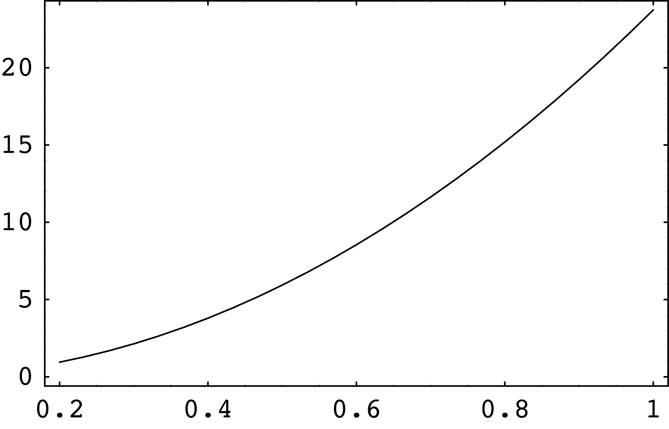
Compact gamma-ray source
Thomson scattering
LWFA
Beam focusing optics
laser:
1-2 J, ~40 fs
laser:
40 J, 0.8 micron
~ cm
plasma channel
~10¹⁸ cm⁻³
0.2-1 GeV electron beam
MeV gamma rays
ph/pulse
compact gamma-ray source
Photon energy [MeV]
photofission
²³⁵U NRF
Electron beam energy [GeV]
⇒ Compact source of tunable, narrow energy spread, small divergence, MeV photons: active stand-off interrogation of special nuclear material (SNM)

Slide 20
Laser-plasma-accelerator-based linear collider
Leemans & Esarey, Physics Today (March 2009)

Slide 21
Single-Stage Density Scalings
Accelerating gradient
Single-stage length
E₀ (GV/m)
L (m)
n (cm⁻³)
n (cm⁻³)
Single-stage energy gain
W (GeV)
n (cm⁻³)

Slide 22
Proper choice of plasma density and staging minimizes main linac length
Accelerator length will be determined by staging technology
Laser
LWFA
L_{c}
L_{acc}
L_{stage}

Slide 23
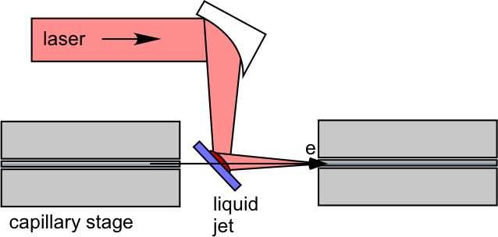
Novel approaches to staging technology
Conventional approach: stage length determined by damage on conventional final focus laser optic
~10 m
Laser
Laser
Plasma mirror in-coupling:
“Renewable” mirror for high laser intensity
Relies on critical density plasma production
Thin liquid jet or foil (tape)
Laser contrast crucial (>10¹⁰)
~10 cm
Advantage of laser-driven plasma waves: short in-coupling distance for plasma wave driver (high average gradient)
Development of staging technology critical to collider application

Slide 24
Quasi-linear plasma wake: symmetric properties for e+ & e- acceleration
Quasi-linear regime:
Nearly symmetric for positron and electron focusing and accelerating phase regions
Expected to be more stable
Allows for controlled injection of bunch (dark-current-free structures): production of high-quality beams
Control of focusing forces (laser pulse tailoring)
Quasi-linear
laser
Nonlinear regime:
Focusing force determined by density
Linear regime:
Focusing force determined by density and transverse laser intensity gradient
Flexibility via laser tailoring:
Allows for choice of focusing strength
Allows for asymmetric focusing
Small matched beam radius:
Stringent alignment tolerances
σ_{r} = 0.1 micron
for ε_{x}= 10⁻⁷ m,
10 GeV,
n=10¹⁷ cm⁻³

Slide 25
Challenge: Controlled injection for improved beam quality and stability
In regime of beam self-trapped from background plasma, beam quality determined by self-trapping physics.
Controlled injection (charge and location) of electrons into plasma wave to improve beam stability and quality
External injection (from conventional RF gun)
problematic: coupling to plasma-wavelength-scale and synchronization
Triggered trapping (injection) of plasma electrons:
Laser-triggered injection (colliding pulse injection)
Plasma density gradient injection
In principle, triggered injection in a plasma wave could achieve beam quality (low emittance) beyond state-of-the-art photocathodes (space-charge shielding provided by ions, rapid acceleration)

Slide 26
Controlled injection via colliding laser pulses improves beam quality
Theoretical development:
Colliding pulse injection:
γ
trapped orbits
untrapped orbits
Esarey et al. PRL (1997); Schroeder et al. PRE (1999); Fubiani et al. PRE (2004)
Δγ
e⁻
laser
laser
k_{p} (z-ct)
Experimental demonstration:
Rechatin et al. Phys. Rev. Lett. (2009)
LOA (France): Faure et al., Nature (2006)
Pump laser (drives wake)
Colliding laser pulse
a=1.2
a=0.35
laser
laser
1% FWHM energy spread
3 mm
Gas jet: 7x10¹⁸ cm⁻³

Slide 27
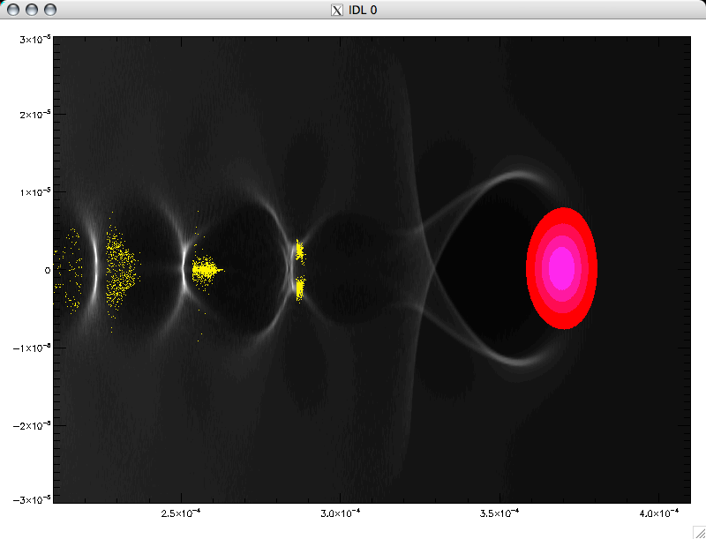
Triggered trapping via plasma density gradient
Triggered trapping via plasma density gradient [Bulanov et al. PRE (1998)]: Plasma wave phase velocity is reduced to allow trapping of background plasma electrons.
n(z)
Plasma wave phase:
z
Plasma wave phase velocity:
Trapping of background plasma electrons controlled by ramp:
gradient
length

Slide 28
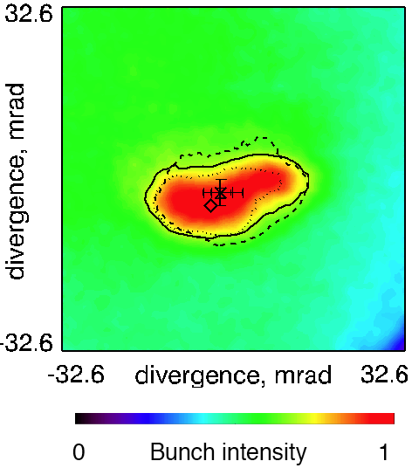
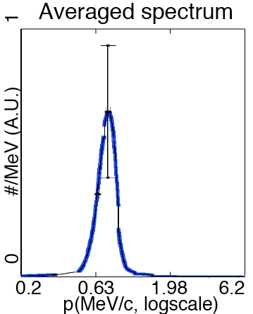
Stable beam generation using negative density gradient demonstrated
Focusing on negative plasma gradient yields stable high-quality beams
Laser focused on downramp of gas jet density profile
Electron Beam Image
Laser
10TW, 47 fs
2x10¹⁹ cm⁻³
Laser
10TW
e⁻
n
Z_{R}~200 μm
z
Jet
Stable MeV beam produced:
Charge ~ 300 pC
Low absolute momentum spread (170 keV/c)
Low divergence (20 mrad; p_{y} ~ 20 keV/c)
Good stability
Geddes et al., Phys. Rev. Lett. (2008)

Slide 29
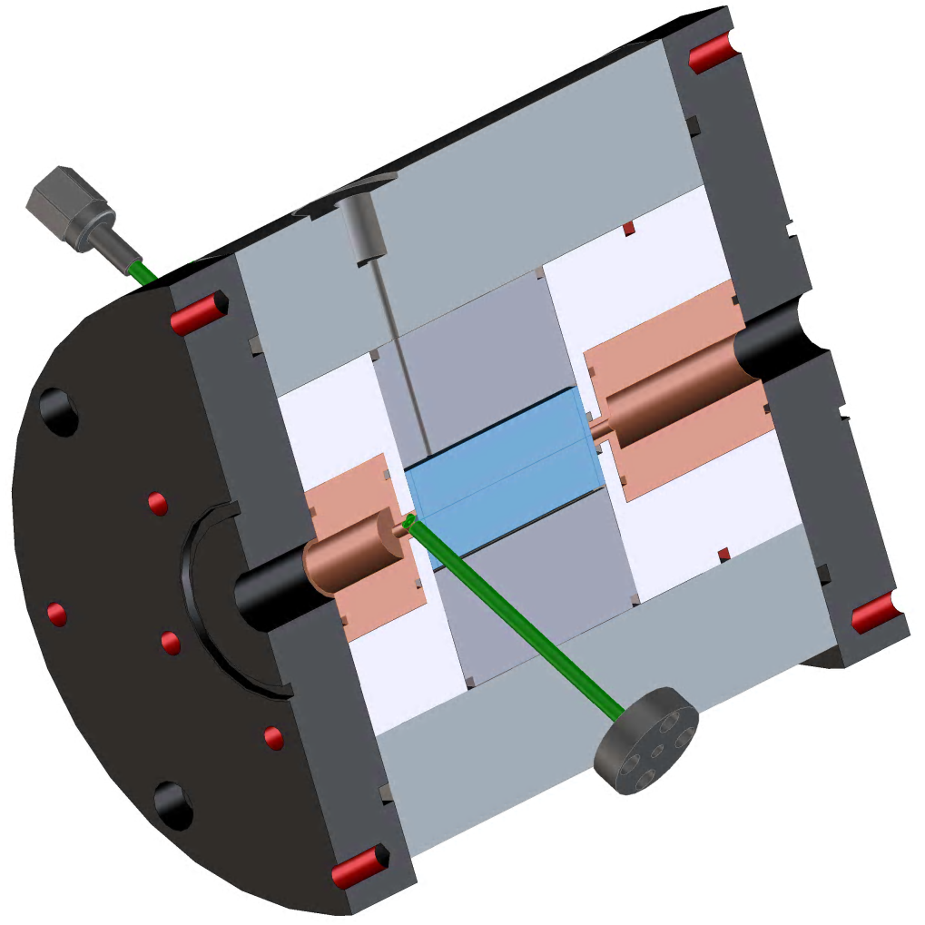
Integrated injector and capillary for stability, improved beam quality
Couple (plasma density gradient) injector to (long, low density) plasma channel:
n
Injector, n~10¹⁹ cm⁻³
laser
GeV
electron beam
x
accelerator: ~cm, n~10¹⁸ cm⁻³
Experimental implementation of plasma density profile:
laser
Plasma channel: discharge capillary
High density plasma gradient: gas jet
Jet
Capillary

Slide 30
Integrated injector and capillary for improved beam stability
Grey = rms shot-to-shot fluctuations
Laser:
44 TW, 40 fs, 25 micron spot
Gonsalves et al. (2009)

Slide 31
Summary
Rapid experimental progress:
Demonstration of guiding intense laser pulses (~100 MeV beams in ~mm)
Demonstration of 1 GeV electron beam in ~cm
Demonstration of triggered injection methods
World-wide interest in laser-plasma accelerators – many new groups emerging to contribute to the field
The possibility of compact multi-GeV linear accelerators producing, ultra-short (fs) bunches, located at universities and national laboratories for a wide variety of applications in basic science
Quality and stability are improving with controlled injection methods:
Laser-triggered injection
Plasma density gradient injection

Slide 32
Conclusions
Challenges:
Continued improvement in stability and quality
Demonstrate staging of laser-plasma accelerators
Near future (1-5 years)
Free-electron lasers (VUV, soft-x-ray) driven by laser-plasma accelerators
New laser systems will yield plasma accelerator developments
At LBNL: BELLA (Berkeley Lab Laser Accelerator: 40 J, 40 fs, 1 Hz) laser system planned:
10 GeV electron beam in 1 m plasma (n=10¹⁷ cm⁻³, single collider stage).
Additional advances in laser technology (high average power, high efficiency) will enable future frontier physics applications

