Slide 1

A Plan for Discovery
“Fermilab’s twenty-year plan”
(2011 – 2030)
Young-Kee Kim
FRA Board Meeting
October 14, 2011

Slide 2
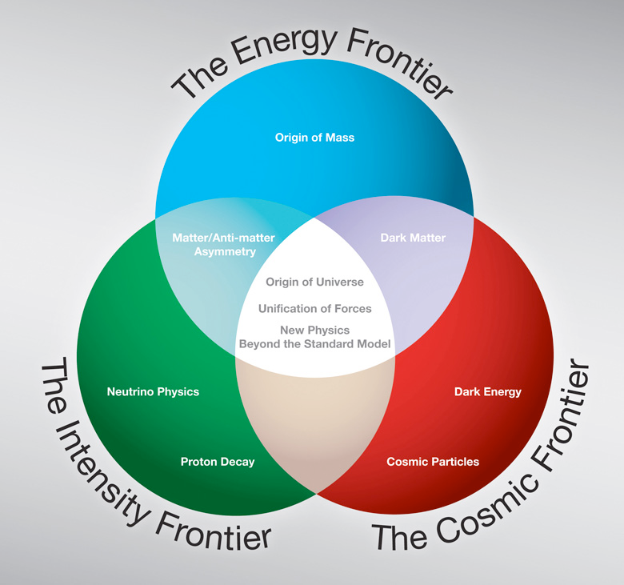
Fermilab program expressed in three frontiers

Slide 3
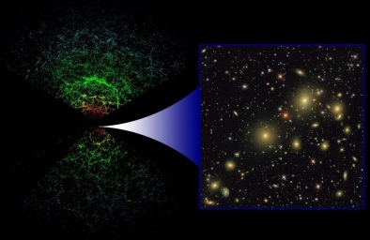
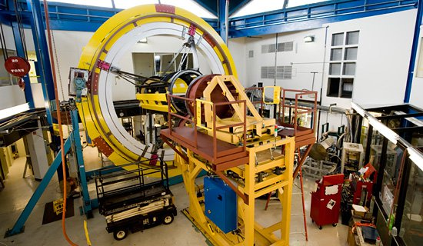
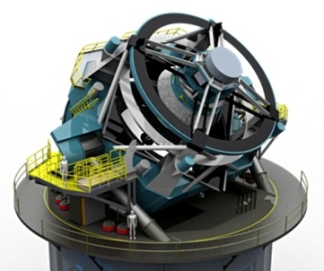
The Cosmic Frontier: Dark Energy
SDSS
DES
1LSST
Last decade (2000s): SDSS 2.5m telescope, New Mexico, US
This decade (2010s): DES being installed in the Blanco 4m telescope, Cerro Tololo, Chile
Next decade (2020s): LSST 8m telescope, El Peñón, Chile. In process of approval.

Slide 4
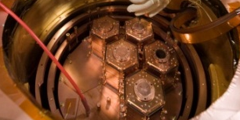
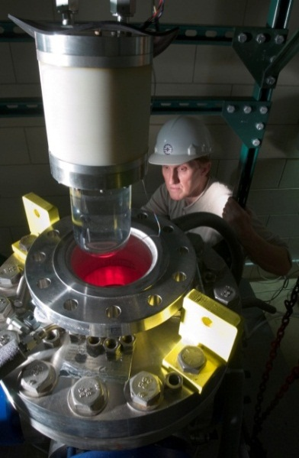
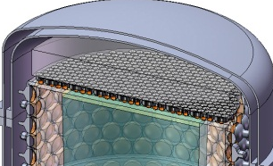
The Cosmic Frontier: Dark Matter
Efforts towards “zero background”
CDMS
  Ge bolometers
  Soudan/SNOLab
COUPP
  bubble chamber
  SNOLab
DarkSide
  depleted LAr
  Gran Sasso
Dark Matter Search Sensitivities
Current gen. (~10kg)
2010s
Generation II (~100kg)
2020s
Generation III (~1 ton)

Slide 5
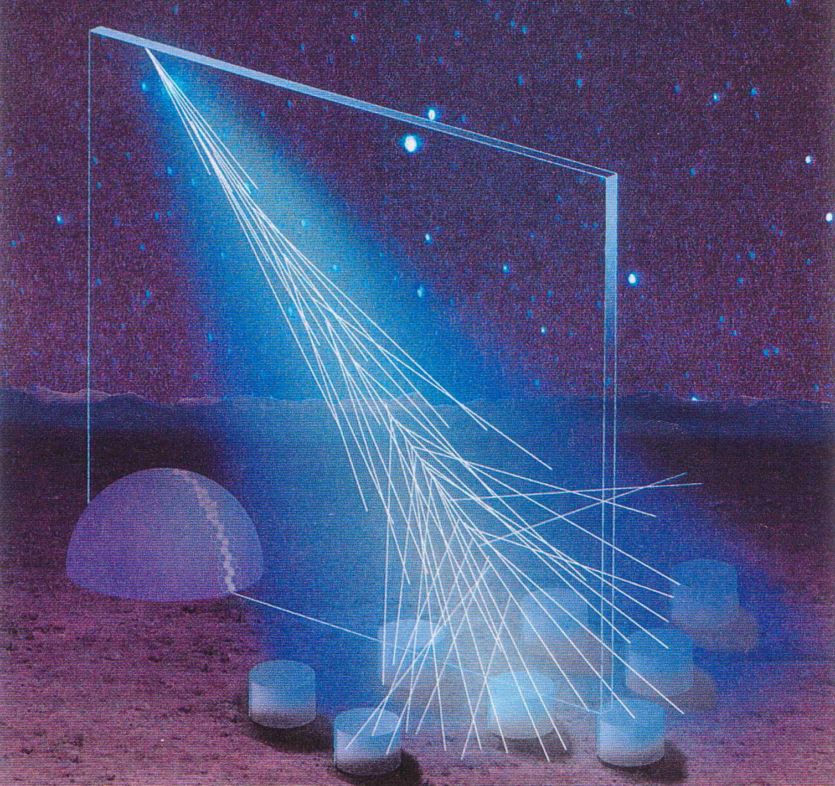
The Cosmic Frontier: Other Programs
High Energy
Cosmic Particles
  Pierre Auger Observatory
  in Argentina (2010s)
Quantum Spacetime
  Holometer to study Planck-scale physics (2010s)

Slide 6
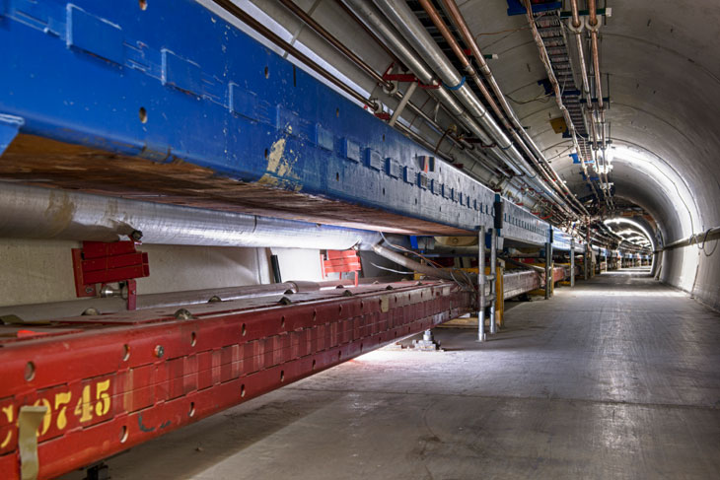
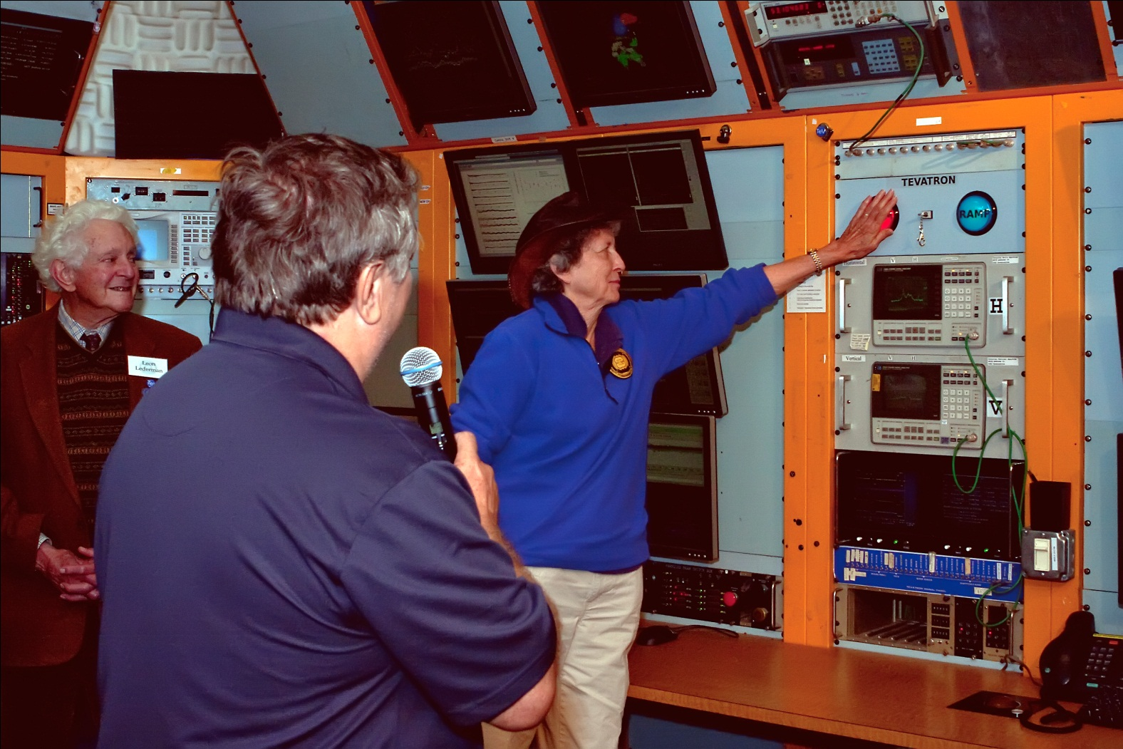
The Energy Frontier: The Tevatron
We just shut down the Tevatron down at ~2:30 pm, Friday, September 30, 2011; the analysis will continue for several years
shut down at ~2:30 pm, Sept. 30th after 28 years of operations.

Slide 7
Higgs at low mass
Direct searches: LEP, Tevatron, LHC
  114 GeV/c² – ~140 GeV/c² not excluded
This is the mass range favored by the top quark and W boson mass measurements
Search strategy (now)
  Tevatron: dominated by H → bb
  LHC: dominated by H → γγ
  Data analysis by this winter will be able to exclude this region if Higgs is not there!
_

Slide 8

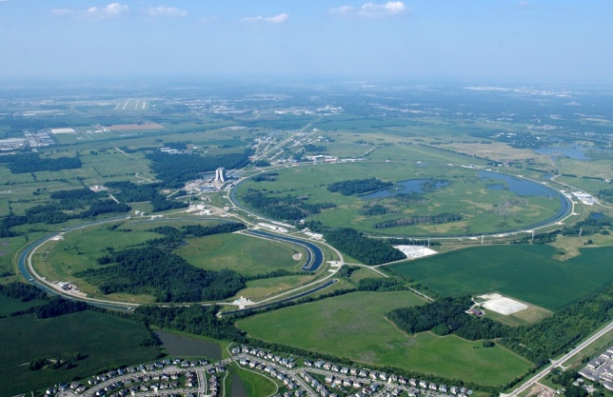
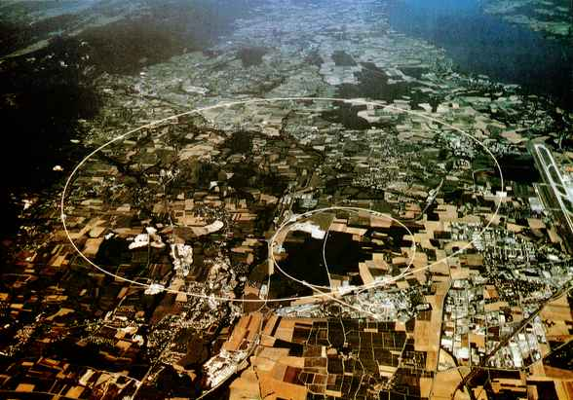
Fermilab and LHC: Accelerators and Experiments
CMS Tier-1 Computing Center, LHC Physics Center, Remote Operation Center
Supporting the US Community
Fermilab
CERN
Tevatron
LHC
Lepton Collider
(energy to be determined)
(technology, site to be determined)
Notes:
0166734314

Slide 9
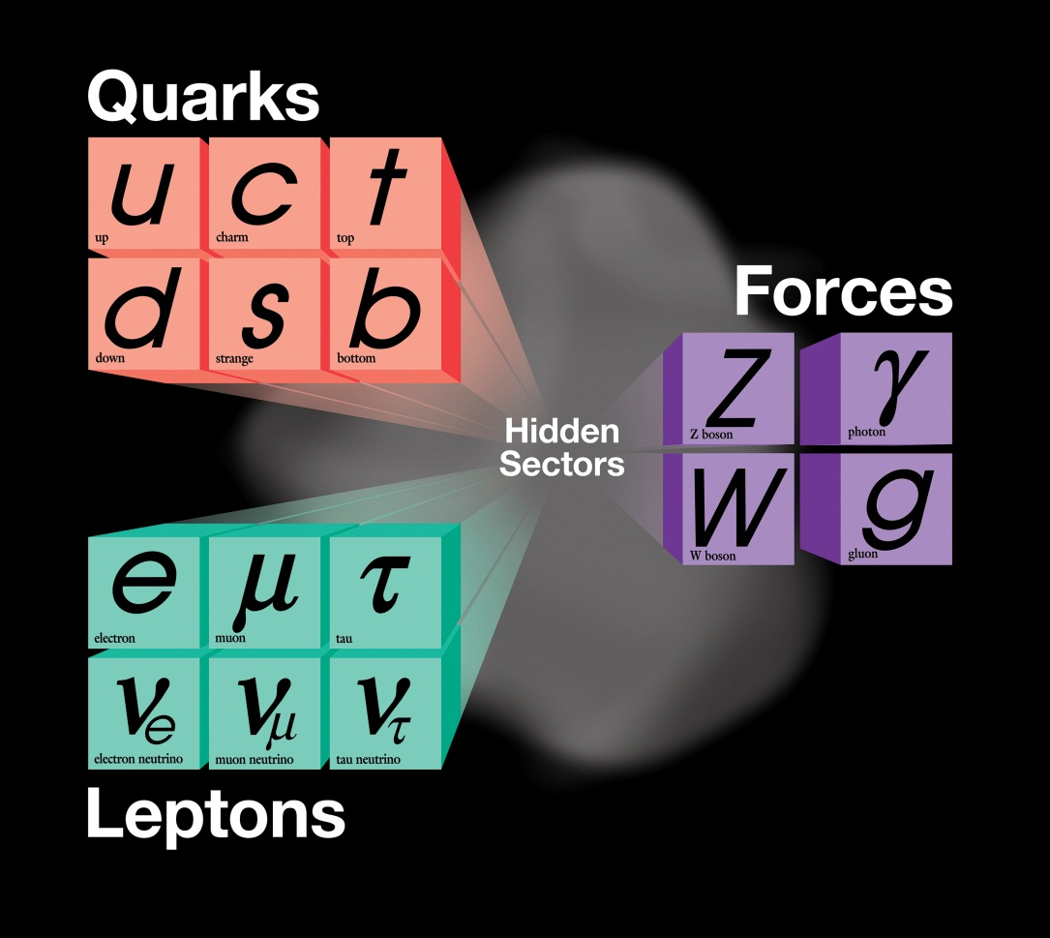
The Intensity Frontier
The present theory is a remarkable intellectual construction
But is not complete; can not answer many deep questions
2020s
2010s
now

Slide 10
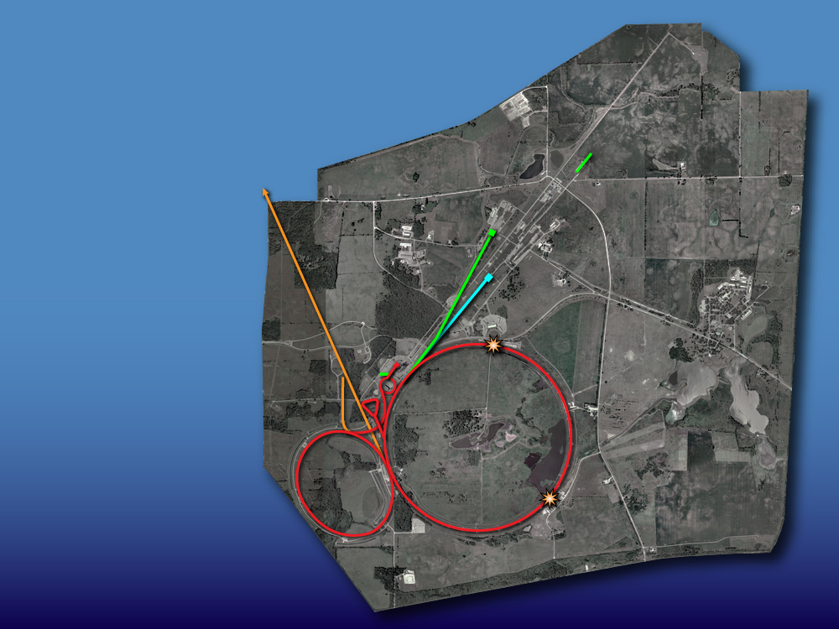
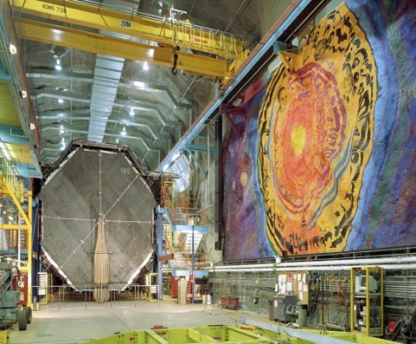
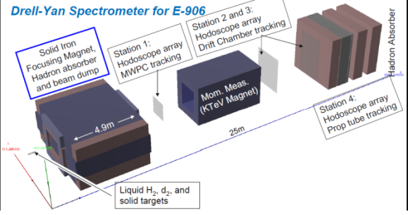
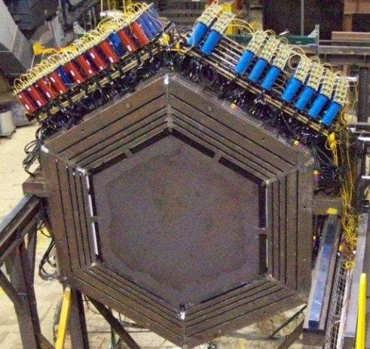

The Intensity Frontier: Now
SCRF Test Facility
(Integrated program for Project X and ILC)
Neutrino beams
MINOS
Testbeam
Proton beam
SeaQuest
Muon Test Facility
MINERvA
Accumulator,
Debuncher
Neutron cancer center
Tevatron
Main Injector,
Recycler
Mini
BooNE

Slide 11
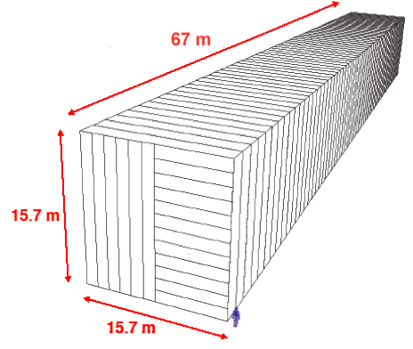
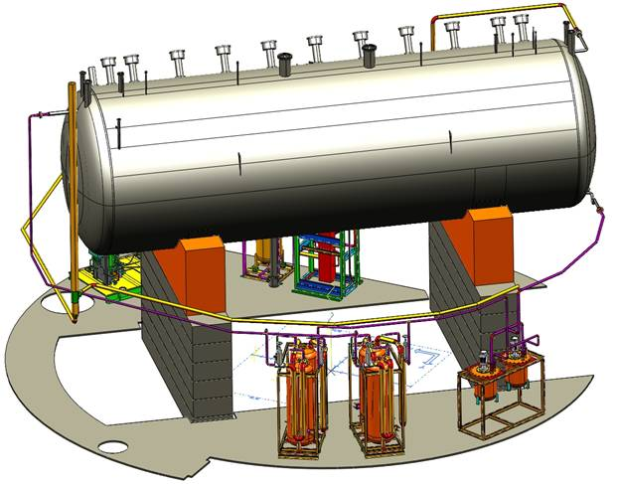
The Intensity Frontier: NOvA era (2013 ~ )
SCRF Test Facility
(Integrated program for Project X and ILC)
NOvA
Neutrino beams
MINOS+
Testbeam
Proton beam
SeaQuest
Muon Test Facility
MINERvA
Accumulator,
Debuncher
Neutron cancer center
Tevatron
Main Injector,
Recycler
MicroBooNE
Mini
BooNE
(TBD)

Slide 12
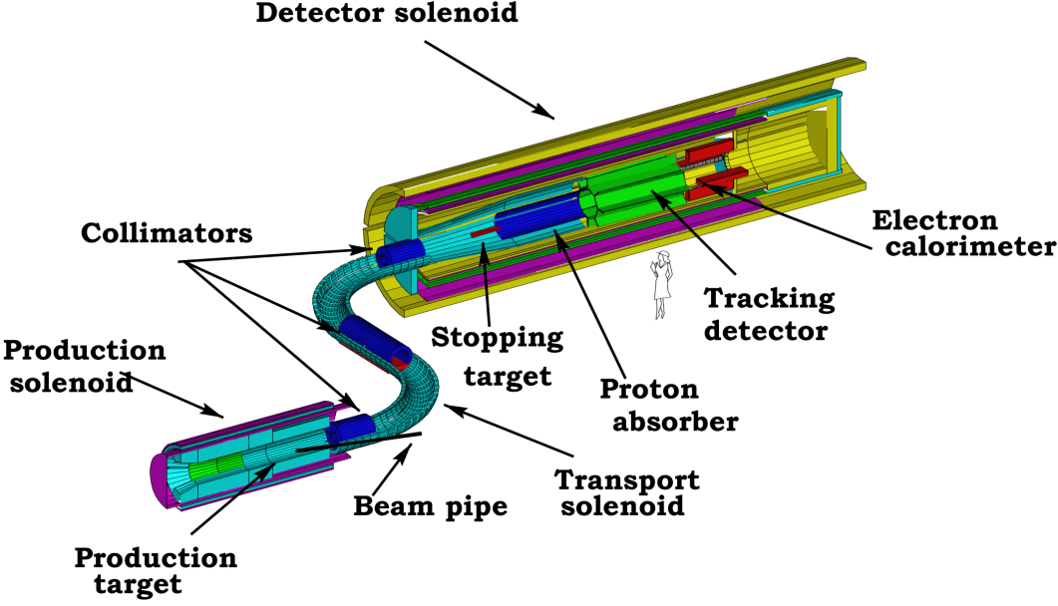
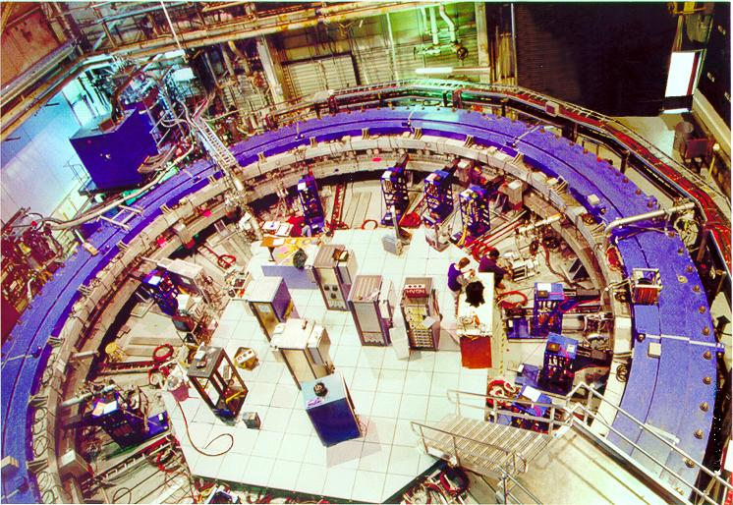
The Intensity Frontier: adding muon programs (2010s +)
SCRF Test Facility
(Integrated program for Project X and ILC)
nothing
Only handle on the
next energy scale
Neutrino beams
Rare Processes
LHC
Testbeam
Determine/verify
structure
Proton beam
Lots
Muon Test Facility
Muon g-2
Accumulator,
Debuncher
Neutron cancer center
Tevatron
Main Injector,
Recycler
Mu2e

Slide 13
2020s +
proton-accelerator program:
LBNE
Project X: accelerators and experiments
R&D
construction
in this decade

Slide 14
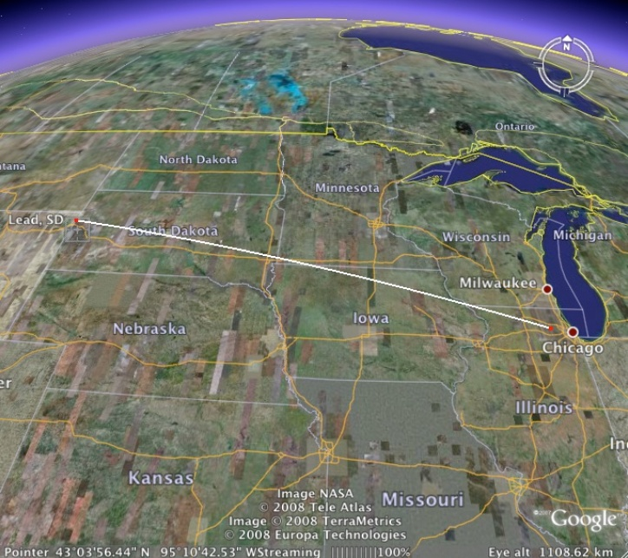
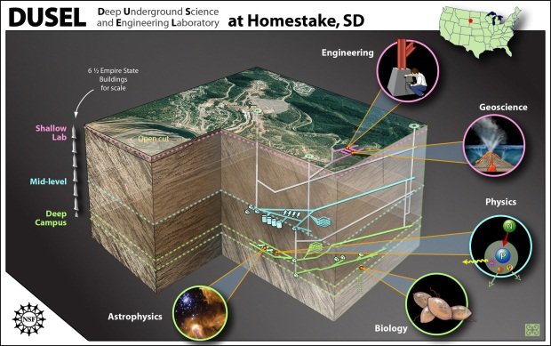
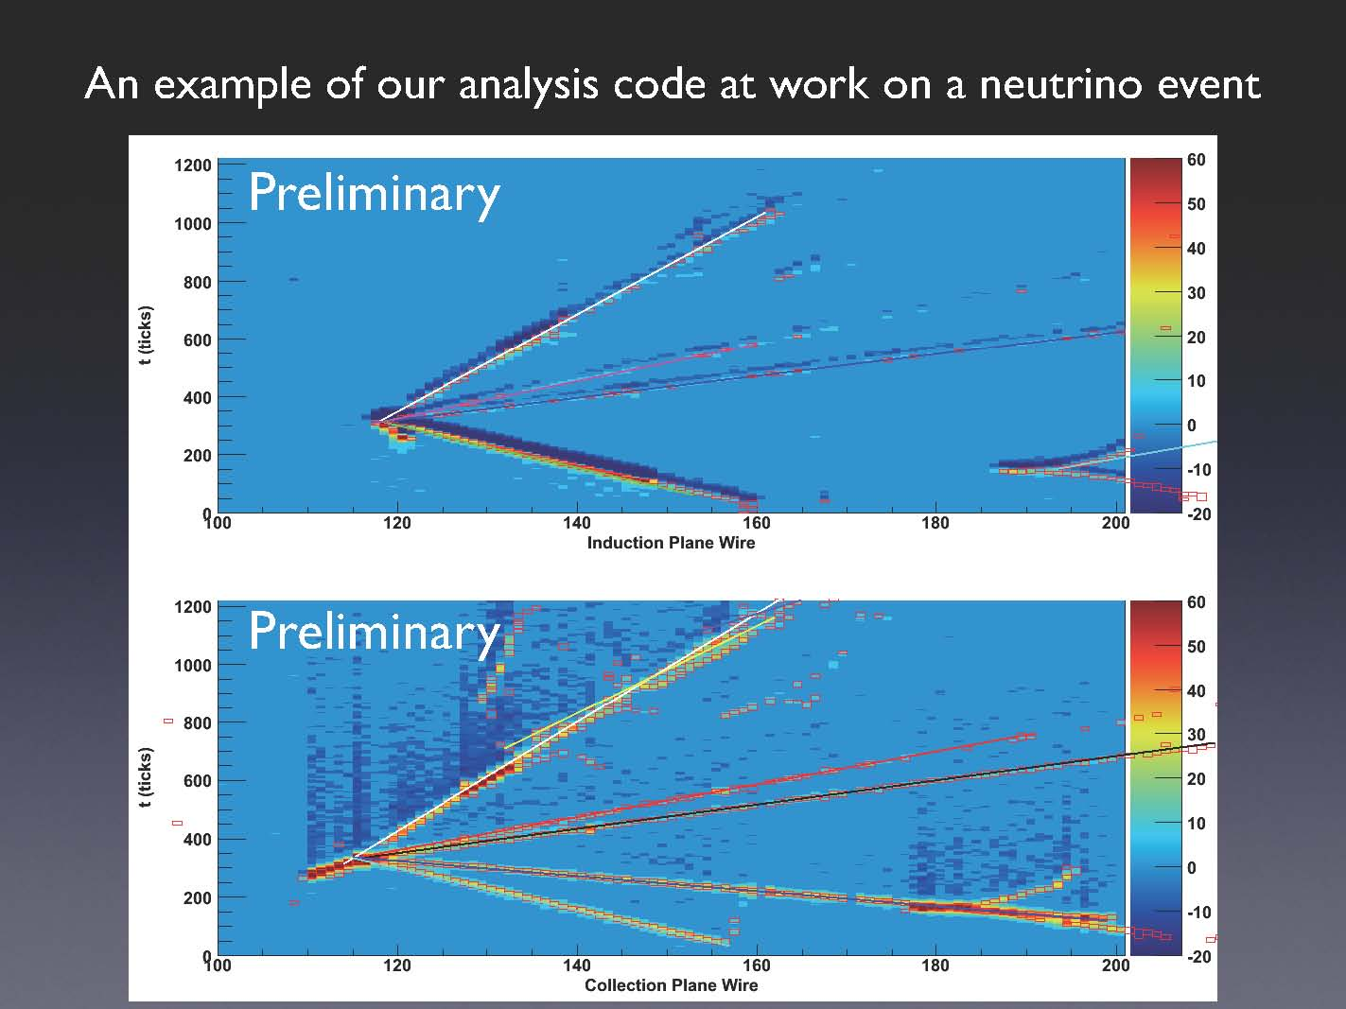
LBNE (Long Baseline Neutrino Experiment):
318 members from 58 institutions from India, Italy, Japan, UK, US
Continue to grow!
1300 km
~200 kton
Water Cerenkov
(Super K)
~34 kton Liquid Ar TPC
ICARUS
ArgoNeuT
MicroBooNE
Matter – Antimatter Asymmetry with Neutrinos
Proton Decay
Supernovae Neutrinos
Notes:
14

Slide 15
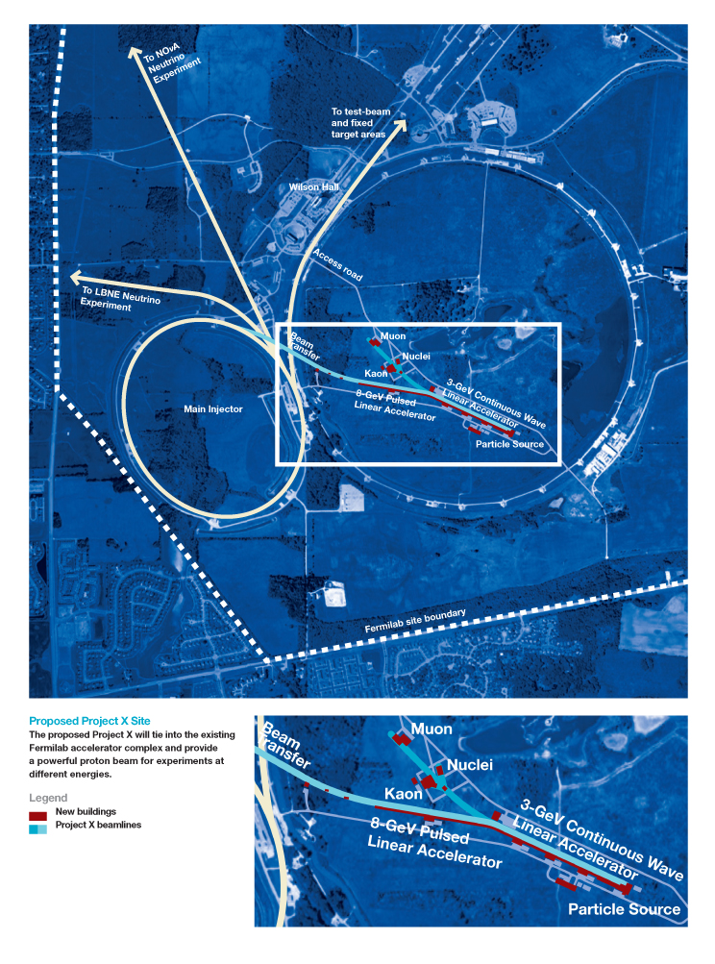
Project X: 5 MW Proton Accelerator
LBNE
Neutrino program
Muon program
Kaon program
New physics with nuclei
Energy applications

Slide 16
Fermilab’s Scientific Plan
NuMI (120 GeV):
350 kW
Booster (8GeV): 35 kW
NuMI (120GeV):
700 kW
Booster (8GeV): 80 kW
Project-X:
>2MW @ 120 GeV
3MW @ 3 GeV
150 kW @ 8 GeV
Neutrino Factory
2010s +
DM (~100kg)
DE (DES)
Cosmic Particles Holometer, …
2020s +
DM (~ton scale)
DE (LSST)
New initiatives
Beyond
To be determined
LHC
Tevatron
LHC Upgrades in
luminosity and energy
Lepton Colliders
Data Analysis + Technology Research and Development

Slide 17
Fermilab’s Scientific Plan
MINOS
MiniBooNE
SciBooNE
LBNE + other ν’s
Muon program
Kaon program
New physics with nuclei
Energy Applications
Neutrino Factory
2010s +
DM (~100kg)
DE (DES)
Cosmic Particles Holometer, …
2020s +
DM (~ton scale)
DE (LSST)
New initiatives
Beyond
To be determined
MINOS+
NOvA
MINERvA
MicroBooNE
Mu2e
Muon g-2
SeaQuest
LHC
Tevatron
LHC Upgrades in
luminosity and energy
Lepton Colliders
Data Analysis + Technology Research and Development

Slide 18
Communicating our vision with staff
September
  03:30 – 05:00 pm, Friday, September 2 for Scientists
October
  10:30 – 12:00 pm, Wednesday, October 12 for IT Professionals
  10:00 – 11:30 am, Thursday, October 13 for Engineers
November
  01:00 – 02:30 pm, Thurs., November 17 for Technical staff
  02:30 – 04:00 pm, Thurs., November 17 for Administrative staff
  09:00 – 10:30 am, Friday, November 18 for Technical staff
  10:30 – 12:00 pm, Friday, November 18 for Administrative staff
https://indico.fnal.gov/categoryDisplay.py?categId=4

Slide 19
A Plan for Discovery (DRAFT)
Distributed the draft to the community for their input
Inside the lab
  All scientists including postdocs
  All engineers
  All IT professionals
  Employee advisory group
  Senior management team
  Division/section/center heads
Outside the lab
  FRA board
  FSO
  PAC
  AAC
  HEPAP Chair / deputy Chair
  DPF Chairs
  DOE OHEP
  NSF EPP
  OSTP (Jerry Blazey)
  Carole McGuire, April Burke, Matthew Greenwald
  UEC
  APS news (Mike Lucibella)
  Lab representatives (ANL, BNL, LANL, LBNL, SLAC)
  ….

