Slide 1
Fermilab Briefing
Young-Kee Kim
URA Board of Trustees
November 1, 2011

Slide 2
Outline
Fermilab’s plan
  2011 – 2030
Other news items
  Safety Statistics in FY12
  DUSEL / LBNE
  Other new projects: MicroBooNE, Mu2e, Project X
  Budget

Slide 3
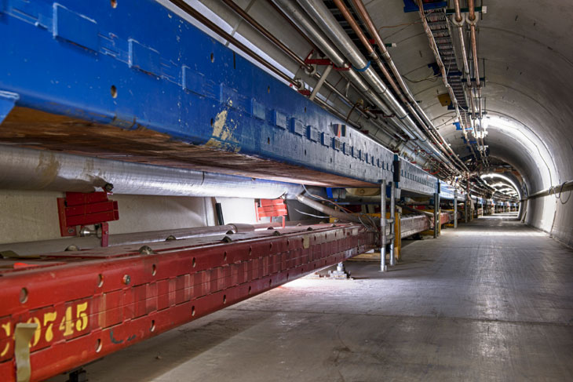
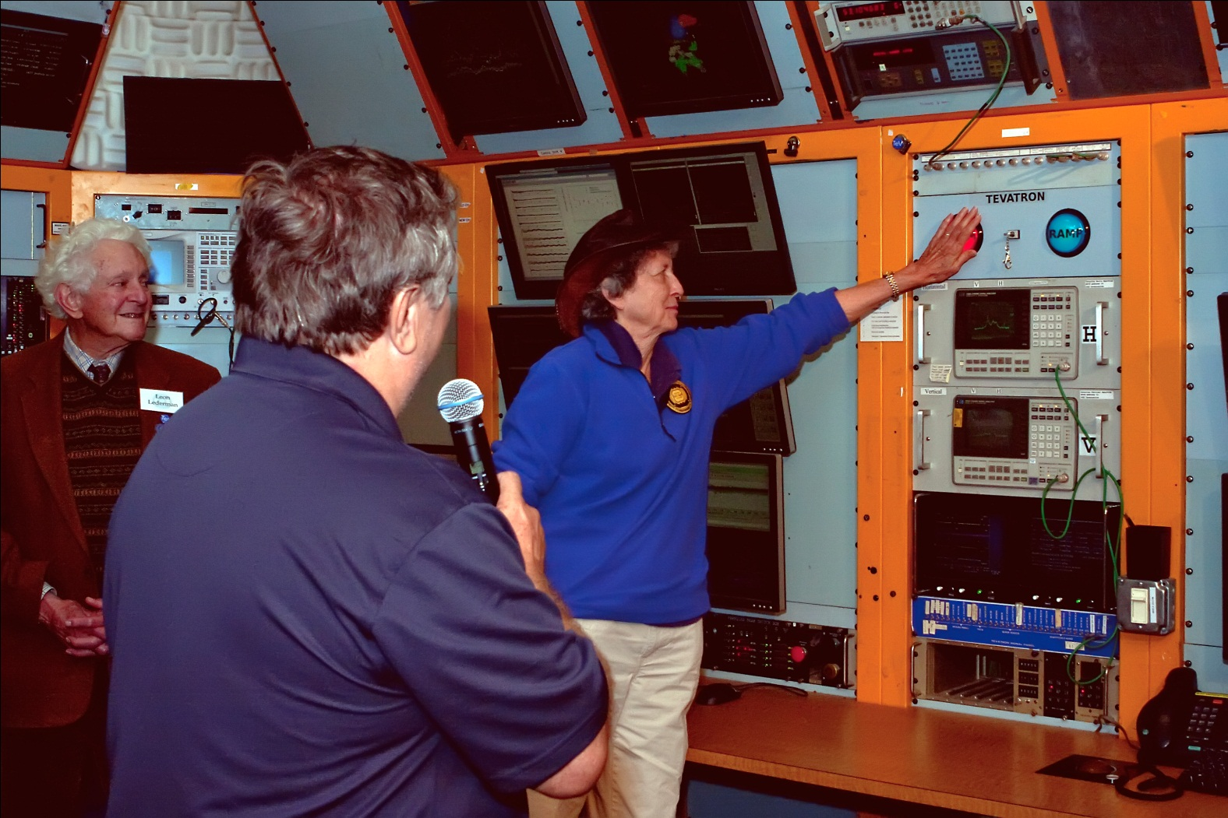
The Tevatron
We just shut down the Tevatron down at ~2:30 pm, Friday, September 30, 2011; the analysis will continue for several years
shut down at ~2:30 pm, Sept. 30th after 28 years of operations
Tevatron Symposium
Monday, June 11, 2012

Slide 4
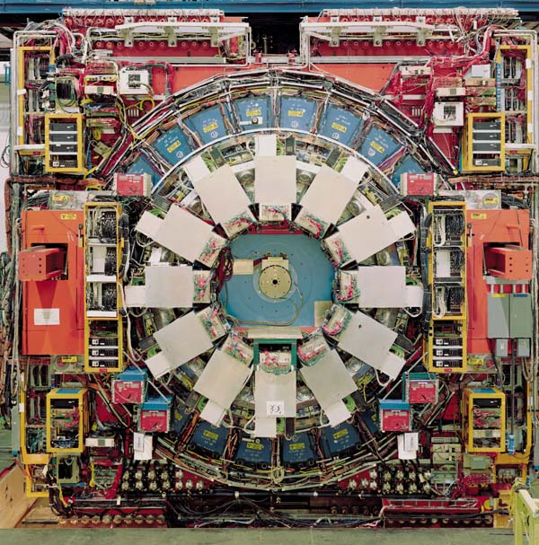
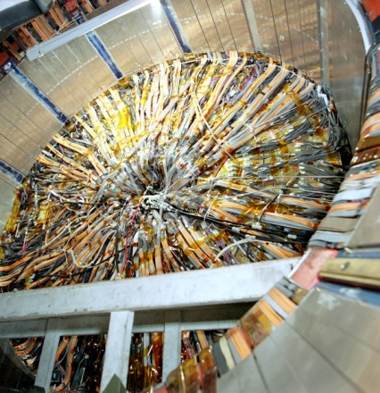
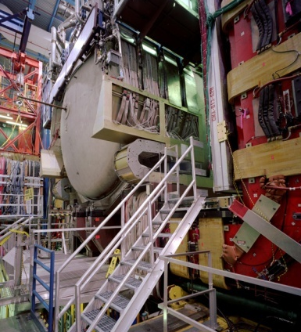
CDF and DØ Detectors
Stabilize and secure systems
Clean out areas & remove components that have immediate reuse
Prepare CDF and DØ detector for public display

Slide 5
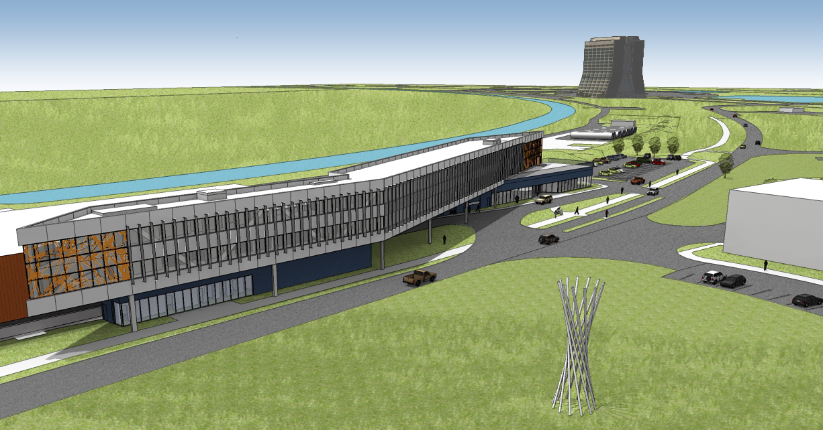
Illinois Accelerator Research Center (IARC)
Ground Breaking on December 16, 2011
Construction ends by the end of 2012
CDF Assembly / Collision Hall
New building
Accelerator science, technology, education, partnerships with industry

Slide 6
The Tevatron (1983 – 2011)
First high-energy superconducting synchrotron
Model for HERA (ep) proton ring
Key milestone toward Large Hadron Collider
> 5 Wilson Prizes
4 National Medals of Technology
July 2, 1983: 512 GeV protons

Slide 7
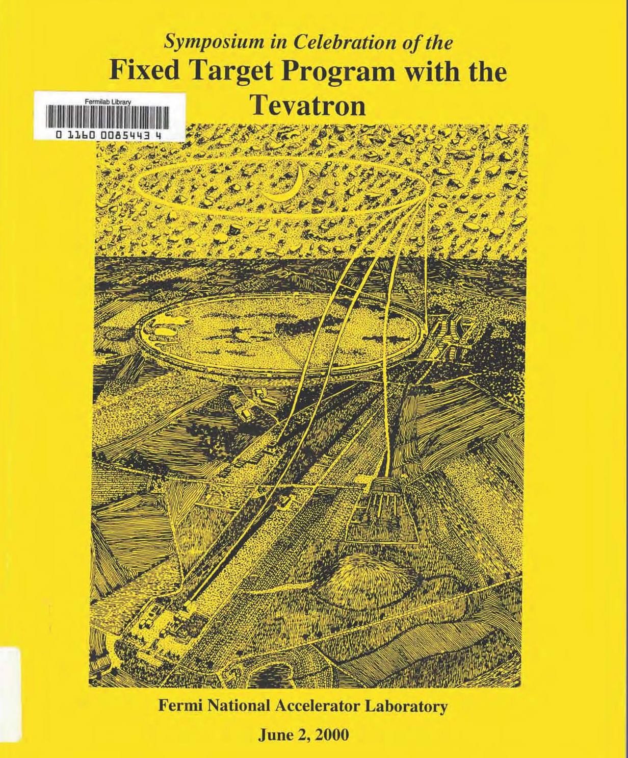
800 GeV
Fixed-Target
Experiments:
1984 – 2000

Slide 8
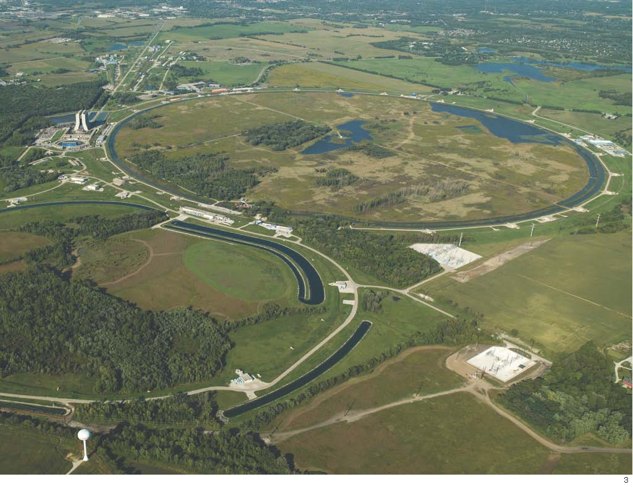
Tevatron Collider: 1985 – 2011
Antiproton source
Tevatron
Main Injector
Recycler

Slide 9
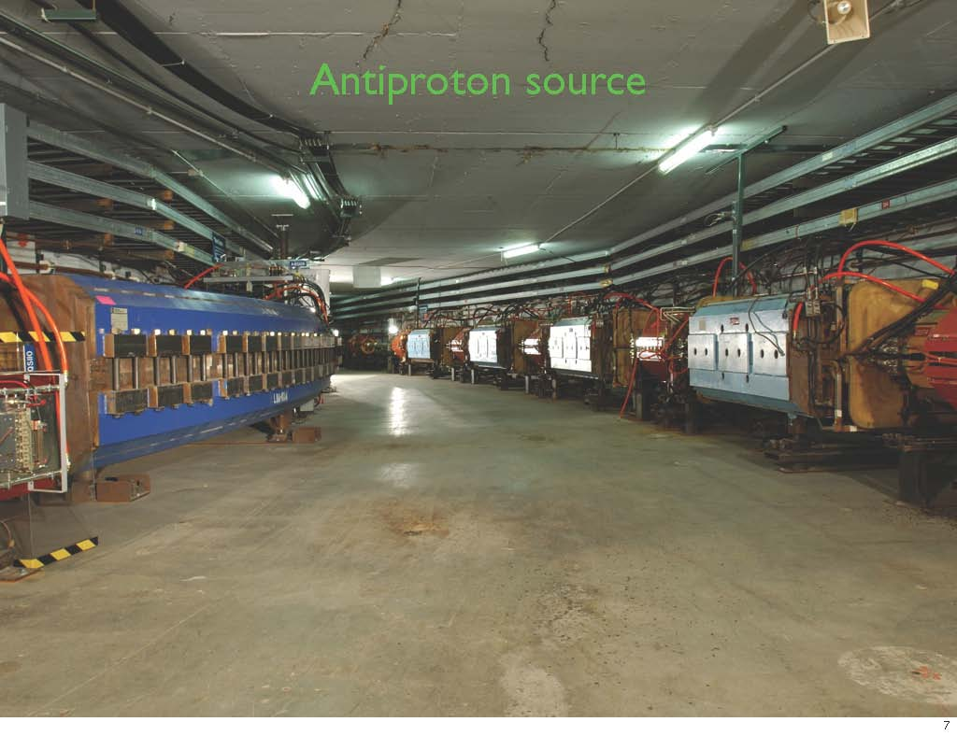

Slide 10
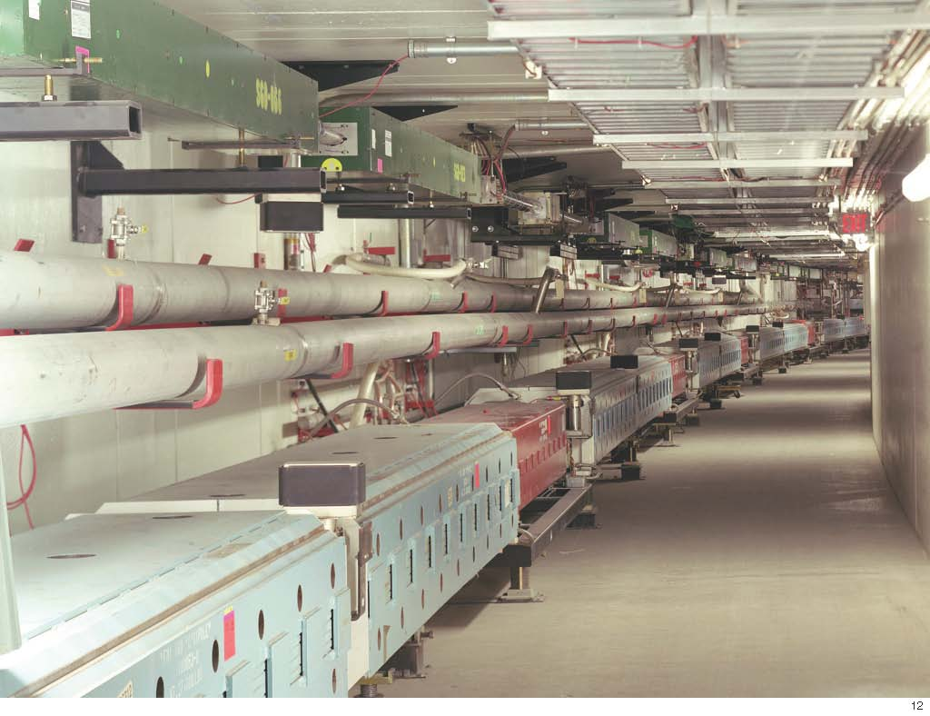

Slide 11
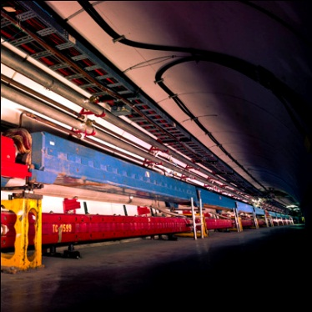
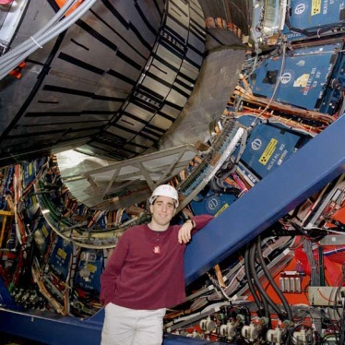
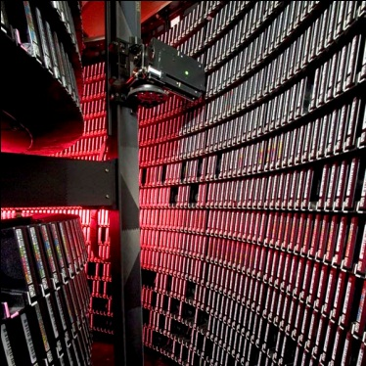
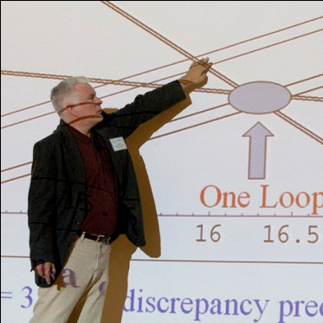
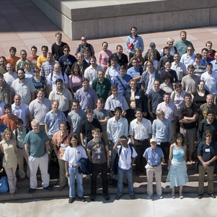
Completion of an era: Tevatron Collider
Accelerator Innovations
  First major SC synchrotron
  Industrial production of SC cable (MRI)
  Electron cooling
  New RF manipulation techniques
Detector innovations
  Silicon vertex detectors in hadron environment
  LAr-U238 hadron calorimetry
  Advanced triggering
Analysis Innovations
  Data mining from Petabytes of data
  Use of neural networks, boosted decision trees
  Major impact on LHC planning and developing
  GRID pioneers
Major discoveries
  Top quark
  B_{s} mixing
  Precision W and Top mass → Higgs mass prediction
  Direct Higgs searches
  Ruled out many exotica
The next generation
  Fantastic training ground for next generation
  More than 500 Ph.D.s
  Produced critical personnel for the next steps, especially LHC

Slide 12
Data Analysis at the Tevatron
Low mass Higgs
  Direct searches: LEP, Tevatron, LHC
    114 GeV/c² – ~140 GeV/c² not excluded (95% CL)
  This is the mass range favored by the top quark and W boson mass measurements
  Search strategy (now)
    Tevatron: dominated by H → bb
    LHC: dominated by H → γγ
    Data analysis by this winter will be able to exclude this region if Higgs is not there!
_

Slide 13
Fermilab’s Plan
(2011 – 2030)

Slide 14
Communicating our future with staff
September
  03:30 – 05:00 pm, Friday, September 2 for Scientists
October
  10:30 – 12:00 pm, Wednesday, October 12 for IT Professionals
  10:00 – 11:30 am, Thursday, October 13 for Engineers
November
  01:00 – 02:30 pm, Thurs., November 17 for Technical staff
  02:30 – 04:00 pm, Thurs., November 17 for Administrative staff
  09:00 – 10:30 am, Friday, November 18 for Technical staff
  10:30 – 12:00 pm, Friday, November 18 for Administrative staff
https://indico.fnal.gov/categoryDisplay.py?categId=4

Slide 15

“Fermilab Plan” Documents
Finalize two documents by the end of 2011
  For the particle physics community
  “Short” document for the Fermilab staff
  (including non-scientific staff)
Two other documents
  For the general public and policy makers
  For the broad scientific community
    Alternative: giving department colloquia at universities

Slide 16

16

Slide 17
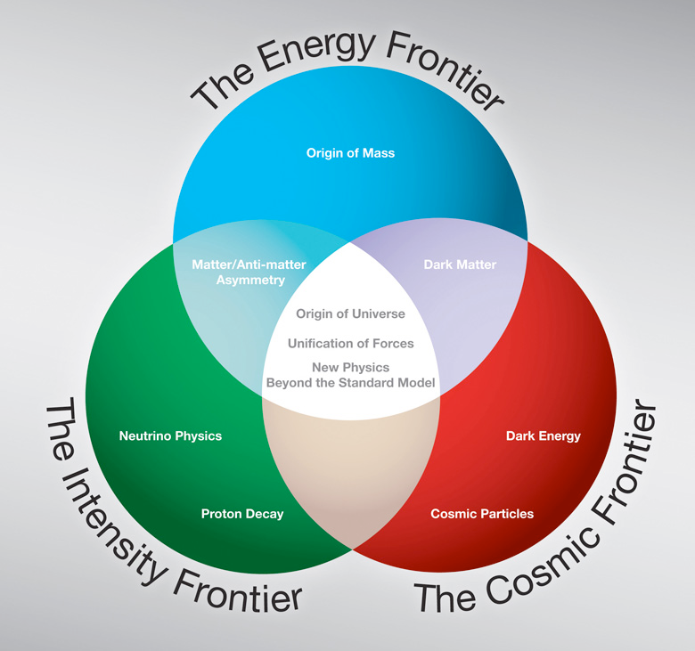
Fermilab program expressed in three frontiers

Slide 18
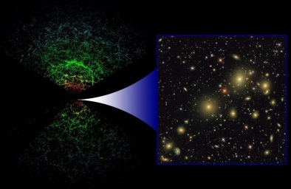
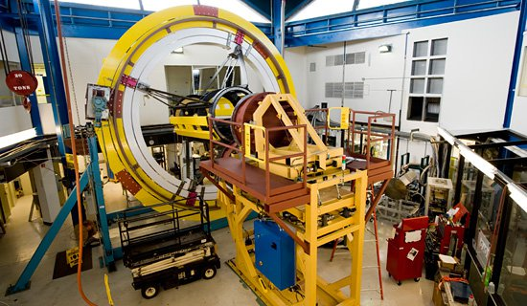
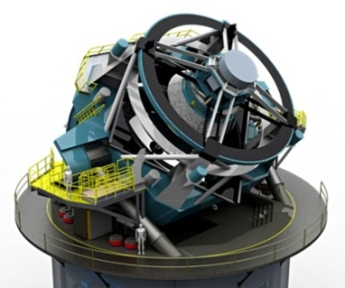
The Cosmic Frontier: Dark Energy
SDSS
DES
1LSST
Last decade (2000s): SDSS 2.5m telescope, New Mexico, US
This decade (2010s): DES being installed in the Blanco 4m telescope, Cerro Tololo, Chile
Next decade (2020s): LSST 8m telescope, El Peñón, Chile. In process of approval.

Slide 19
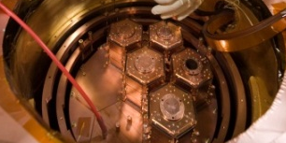
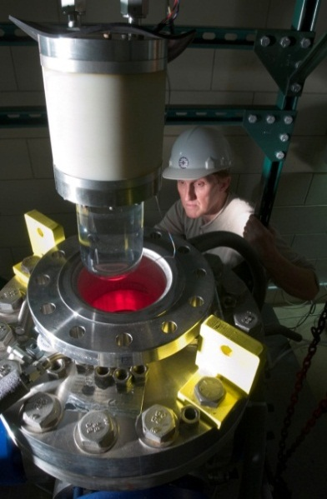
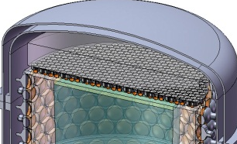
The Cosmic Frontier: Dark Matter
Efforts towards “zero background”
CDMS
  Ge bolometers
  Soudan/SNOLab
COUPP
  bubble chamber
  SNOLab
DarkSide
  depleted LAr
  Gran Sasso
Dark Matter Search Sensitivities
Current gen. (~10kg)
2010s
Generation II (~100kg)
2020s
Generation III (~1 ton)

Slide 20
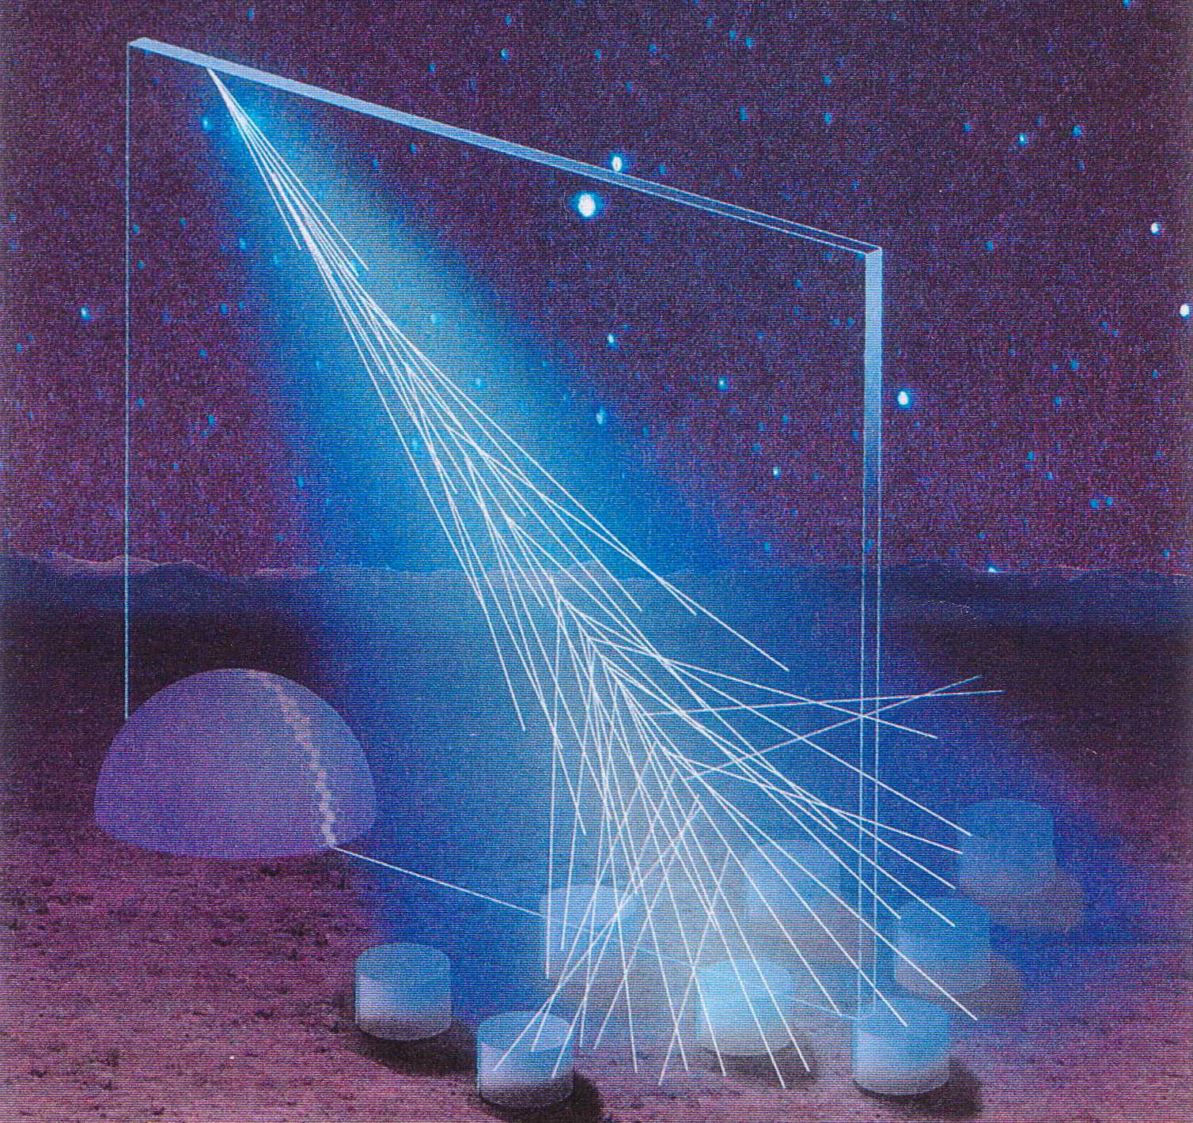
The Cosmic Frontier: Other Programs
High Energy
Cosmic Particles
  Pierre Auger Observatory
  in Argentina (2010s)
Quantum Spacetime
  Holometer to study Planck-scale physics (2010s)

Slide 21

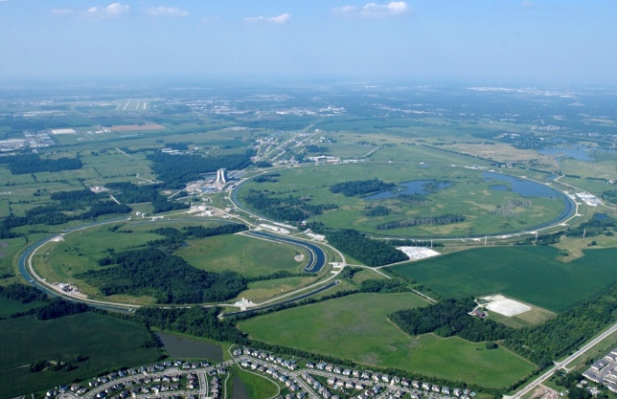
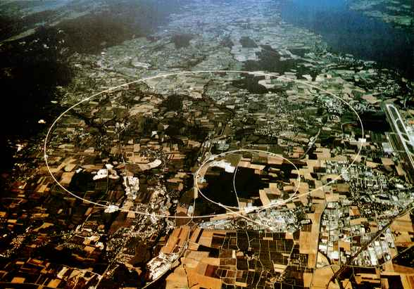
The Energy Frontier
Fermilab
CERN
Tevatron
LHC
Lepton Collider
(energy to be determined)
(technology, site to be determined)
Notes:
0166734314

Slide 22
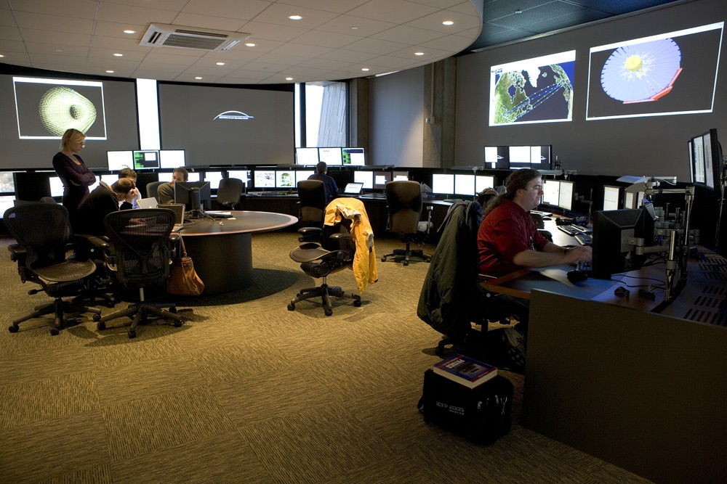
The Energy Frontier: Fermilab and LHC
Strong participation in accelerators and CMS experiment
Supporting the US Community
CMS Tier-1 Computing Center
LHC Physics Center
Remote Operation Center

Slide 23
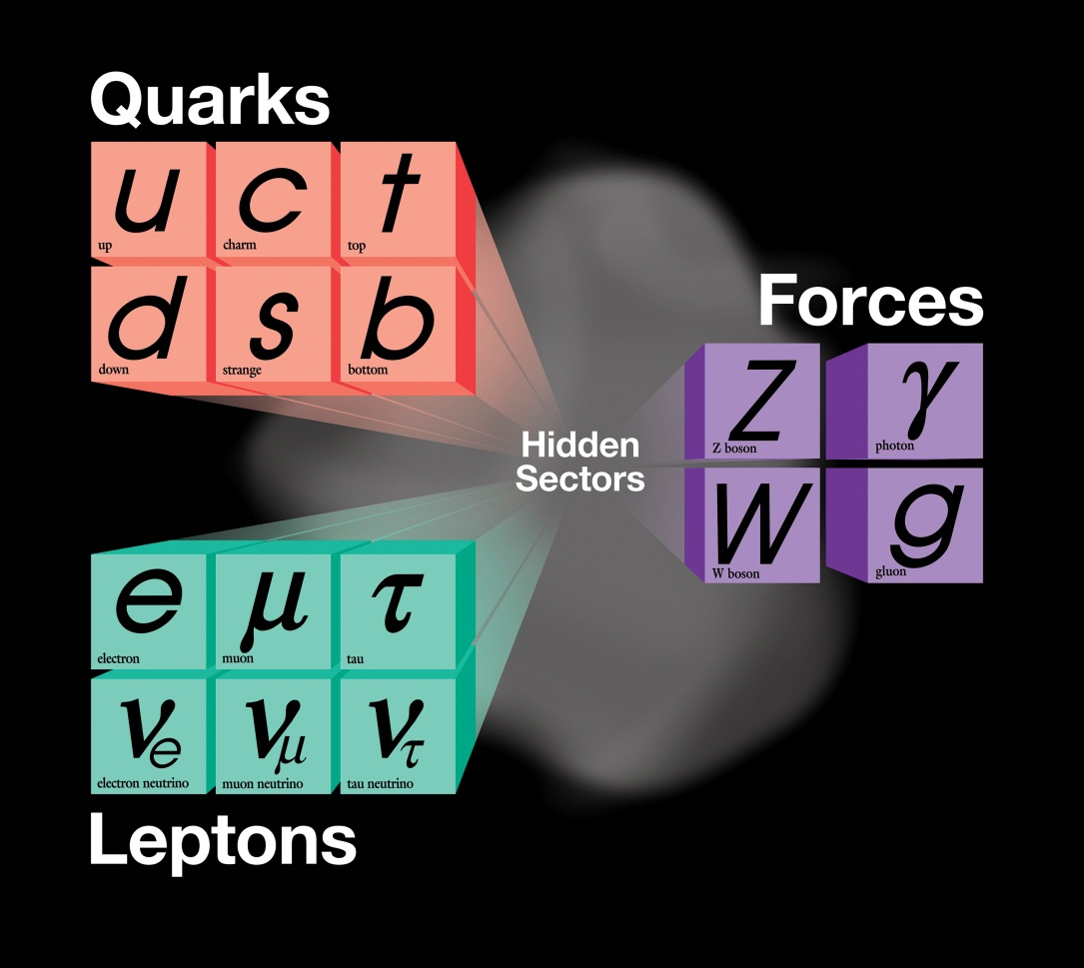
The Intensity Frontier
The present theory is a remarkable intellectual construction
But is not complete; can not answer many deep questions
2020s
2010s
now

Slide 24
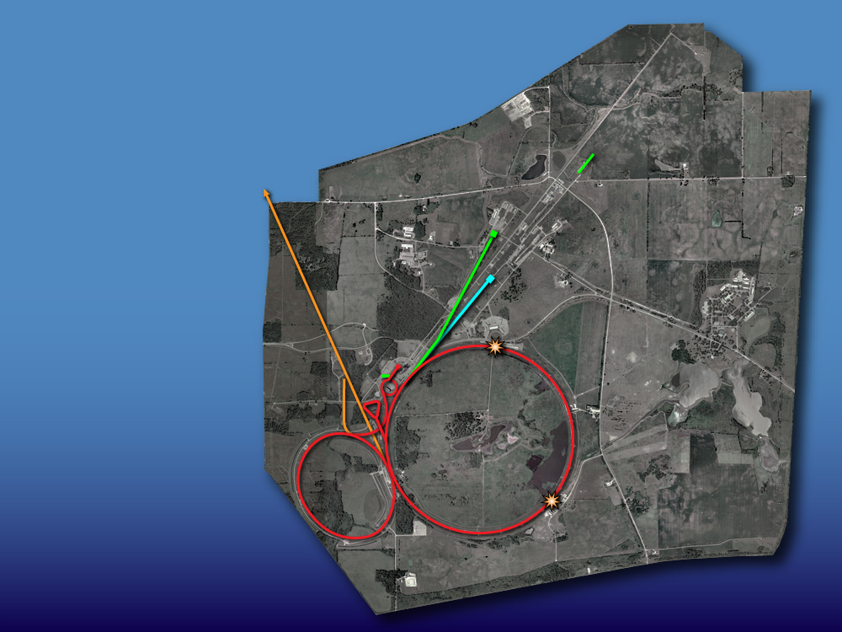
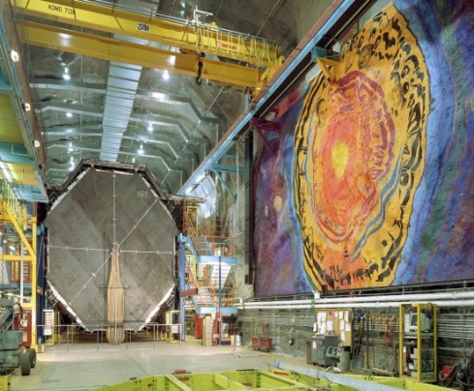
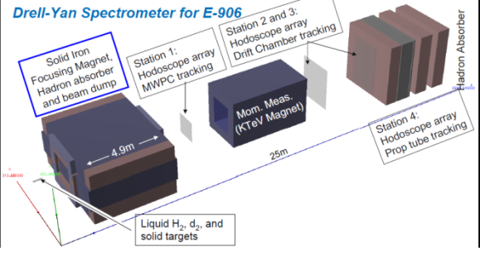
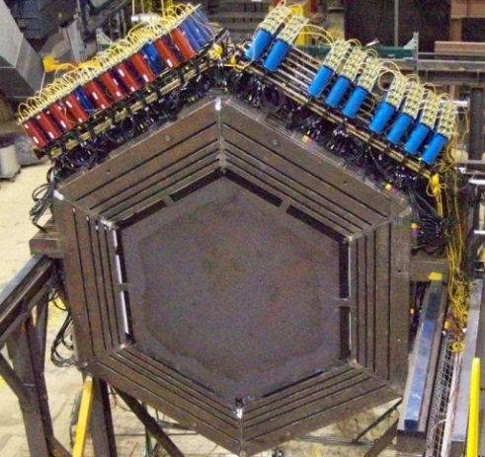

The Intensity Frontier: Now
SCRF Test Facility
(Integrated program for Project X and ILC)
Neutrino beams
MINOS
Testbeam
Proton beam
SeaQuest
Muon Test Facility
MINERvA
Accumulator,
Debuncher
Neutron cancer center
Tevatron
Main Injector,
Recycler
Mini
BooNE

Slide 25
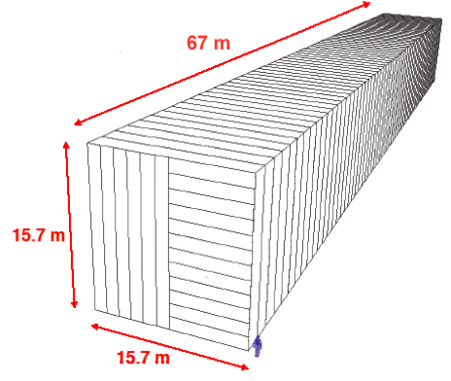
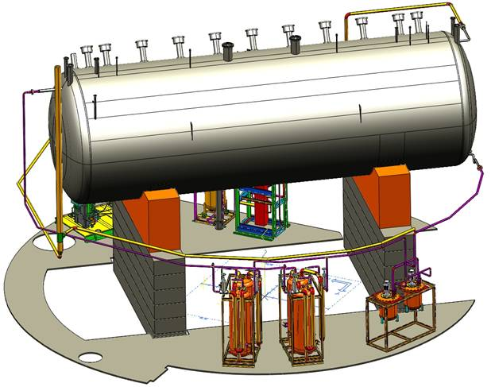
The Intensity Frontier: NOvA era (2013 ~ )
Double neutrino beam power
SCRF Test Facility
(Integrated program for Project X and ILC)
NOvA
Neutrino beams
MINOS+
Testbeam
Proton beam
SeaQuest
Muon Test Facility
MINERvA
Accumulator,
Debuncher
Neutron cancer center
Tevatron
Main Injector,
Recycler
MicroBooNE
Mini
BooNE
(TBD)

Slide 26
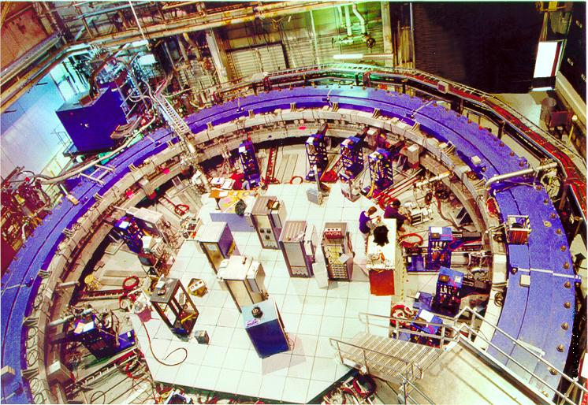
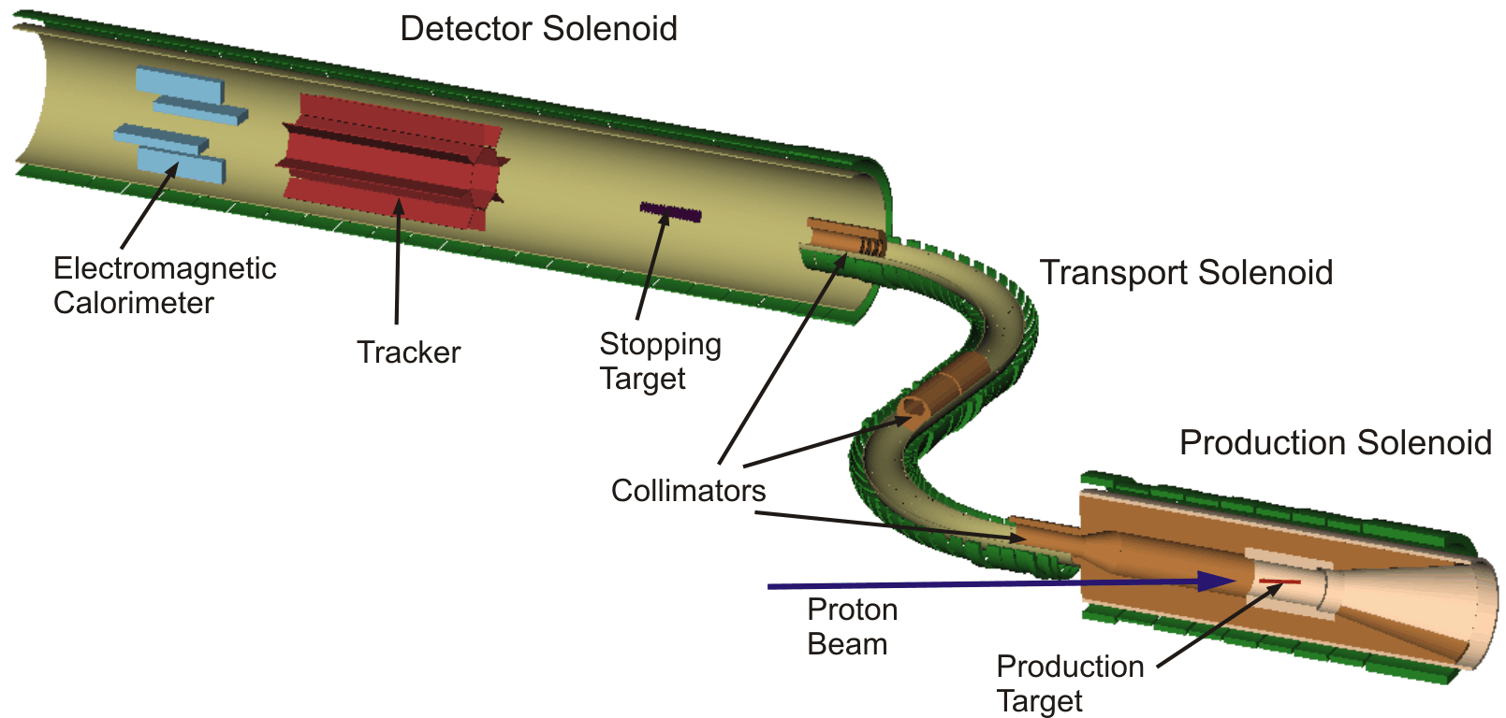
The Intensity Frontier: adding muon programs (2010s +)
Double neutrino beam power
New muon beams
SCRF Test Facility
(Integrated program for Project X and ILC)
nothing
Only handle on the
next energy scale
Neutrino beams
Rare Processes
LHC
Testbeam
Determine/verify
structure
Proton beam
Lots
Muon Test Facility
Muon g-2
muon beams
Mu2e
Neutron cancer center
Tevatron
Main Injector,
Recycler

Slide 27
2020s +
proton-accelerator program:
LBNE
Project X: accelerators and experiments
R&D
construction
in this decade

Slide 28
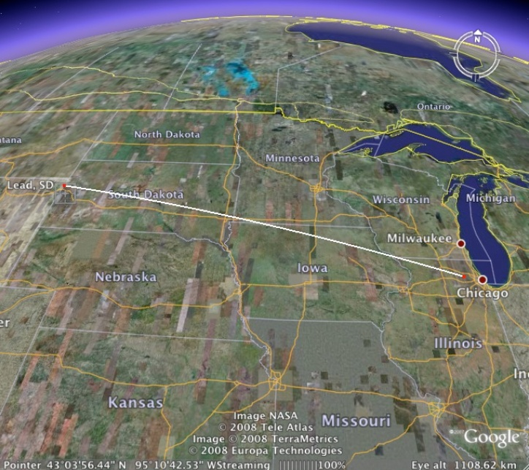
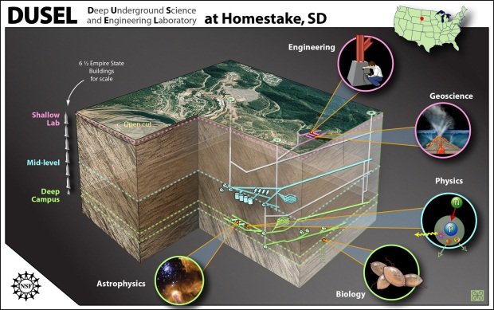
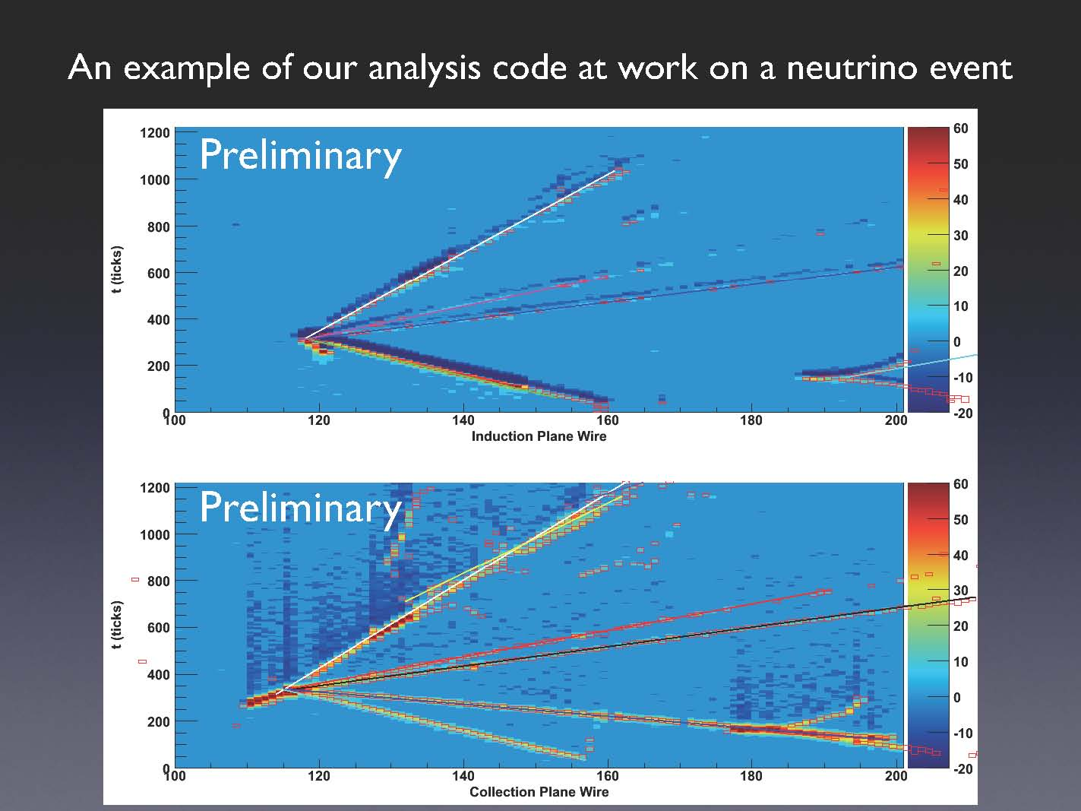
LBNE (Long Baseline Neutrino Experiment):
318 members from 58 institutions from India, Italy, Japan, UK, US
Continue to grow!
1300 km
~200 kton
Water Cerenkov
(Super K)
~34 kton Liquid Ar TPC
ICARUS
ArgoNeuT
MicroBooNE
Matter – Antimatter Asymmetry with Neutrinos
Proton Decay
Supernovae Neutrinos
Notes:
28

Slide 29
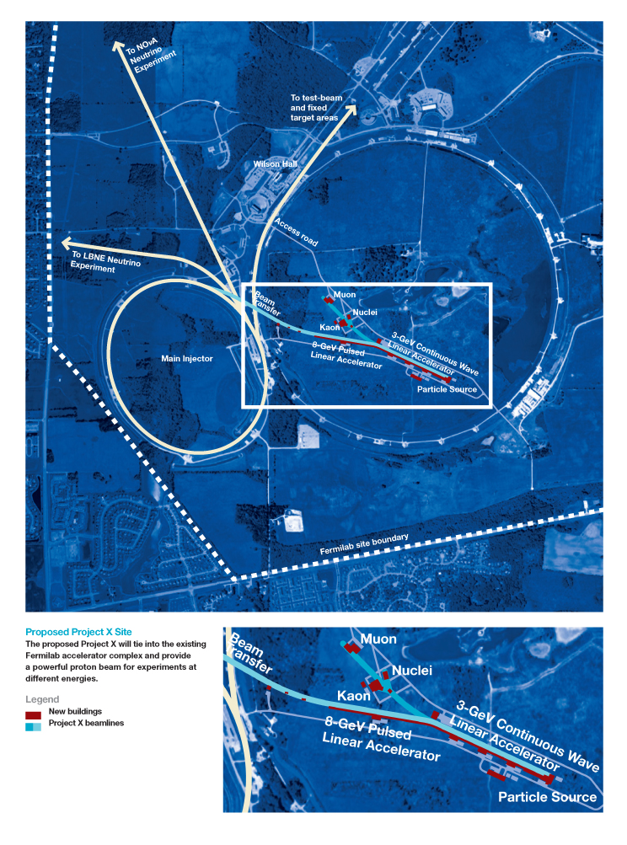
Project X: 5 MW Proton Accelerator
LBNE
Neutrino program
Muon program
Kaon program
New physics with nuclei
Energy applications

Slide 30
Fermilab’s Scientific Plan
NuMI (120 GeV):
350 kW
Booster (8GeV): 35 kW
NuMI (120GeV):
700 kW
Booster (8GeV): 80 kW
Project-X:
>2MW @ 120 GeV
3MW @ 3 GeV
150 kW @ 8 GeV
Neutrino Factory
2010s +
DM (~100kg)
DE (DES)
Cosmic Particles Holometer, …
2020s +
DM (~ton scale)
DE (LSST)
New initiatives
Beyond
To be determined
LHC
Tevatron
LHC Upgrades in
luminosity and energy
Lepton Colliders
Data Analysis + Technology Research and Development

Slide 31
Fermilab’s Scientific Plan
MINOS
MiniBooNE
SciBooNE
LBNE + other ν’s
Muon program
Kaon program
New physics with nuclei
Energy Applications
Neutrino Factory
2010s +
DM (~100kg)
DE (DES)
Cosmic Particles Holometer, …
2020s +
DM (~ton scale)
DE (LSST)
New initiatives
Beyond
To be determined
MINOS+
NOvA
MINERvA
MicroBooNE
Mu2e
Muon g-2
SeaQuest
LHC
Tevatron
LHC Upgrades in
luminosity and energy
Lepton Colliders
Data Analysis + Technology Research and Development

Slide 32
Other news items

Slide 33
Safety: Injury Cases
DART: days away, restricted or transferred
TRC: total recordable case
goal
goal
Many due to “normal” actions – walking, reaching, etc.
Comparison to other DOE SC labs (DART):
  the best in FY10 and 2nd best in FY11(as of August 2011)

Slide 34
DOE Underground Science Committee
Charge by Bill Brinkman
Help define cost-effective options for planned underground experiments, and strategies for implementing a world-class program of underground science, consistent with SC’s mission in High Energy and Nuclear Physics
  Experiments – long baseline neutrino experiment (LBNE), 3rd generation dark matter (DM), 1-ton scale neutrinoless double-beta decay (DBD)
  Assess cost and schedule estimates for deploying these experiments
  Review will provide the “baseline” needed for budget planning and discussion of strategies going forward.

Slide 35
Summary of the DOE Committee
The committee believes there are compelling scientific motivations for all three experiments and an important opportunity for the U.S. to take a leadership position for the foreseeable future.
There are important advantages and opportunities in developing a common site for these experiments if the needed infrastructure can be shared in a cost effective manner.

Slide 36
Summary of the DOE Committee (cont.)
A common site only works in the scenario where LBNE has one or more detectors at 4850ft at Homestake.
  Either an early technology choice for water Cerenkov or the 1+1 option would support this scenario but it may be several years before known if DBD is feasible at 4850ft
  If LBNE pays for the infrastructure that LBNE needs, there would be additional infrastructure costs for DM or DBD experiment that would exceed those at SNOLAB by something like $100M; worthwhile considering given the advantages of a common site and the multi-decade timescale
If no LBNE at Homestake 4850ft level, DBD and DM are not cost effective at Homestake
The lowest cost option for DM or DBD is SNOLAB.

Slide 37
NRC Committee on DUSEL: Summary
The proposed DUSEL offers:
  Excellent science program
  Strong programmatic impact
The value of the whole is greater than the sum of the parts.
  Merits of: stewardship, addressing need in the international context, education/outreach
The cost of the whole is less than the sum of the parts.
  Merits of co-location.
If the proposed DUSEL cannot be achieved, strive to:
  Develop the 3 major physics experiments
  Benefit from co-location and stewardship
Prepublication version of report: http://www.nap.edu/catalog.php?record_id=13204

Slide 38
LBNE Milestones
Determine the tar detector technology choice
  By December 2011
Establish a governance model
  By early 2012
CD-1
  late 2012

Slide 39
Other New Projects
MicroBooNE: received CD2/3a in Sept. 2011
Mu2e
  CD-1 Lehman review was scheduled mid December, but it is postponed by ~6 months (cost issue): good progress made with alternative solutions

Slide 40
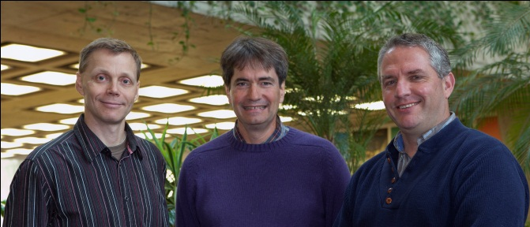
Project X
Making steady progress (R&D), stronger national and international (e.g. India) collaboration
Project Scientist for experimental program appointed
Project Manager
Project Scientist for Accelerators
Project Scientist for Experiments
Project Engineer
http://www.fnal.gov/pub/today/archive_2011/today11-10-31.html

Slide 41
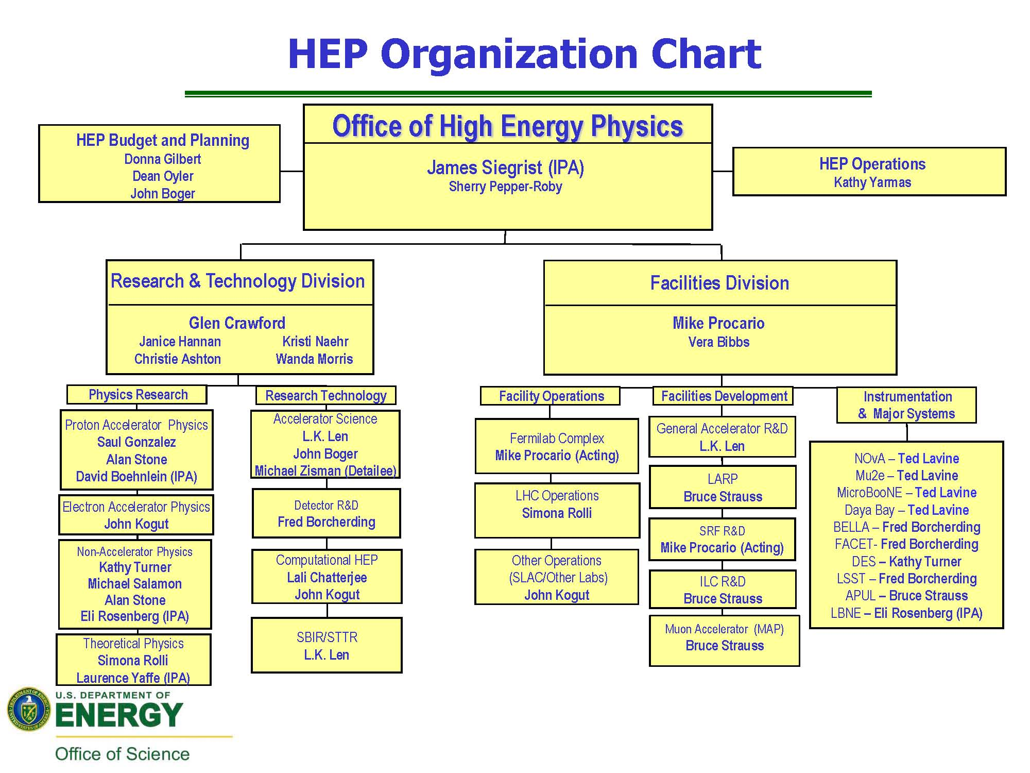
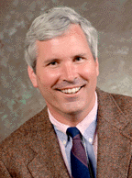
DOE Office of High Energy Physics
Associate Director
James Siegrist

Slide 42
Budget
 | FY10 Actual | FY11 Actual | FY12 Request
HEP | 810 M | 795 M | 797 M
SC | 4,789 M | 4,843 M | 5,416 M
The FY 2012 DOE Request has been passed by both House and Senate
  Overall SC funding approx. $4.8B
  House provides HEP funding at Request level, -7% for projects (reductions restored in Research budgets to match Request)
  Senate provides HEP funding at Request level but no funds for LBNE construction (-$17M) : “project is not mature enough”
However, currently under FY12 CR until Nov 18.
  No new starts for LBNE, Mu2e, and MicroBooNE.
  Small amounts of funding were supplied to keep making progress towards CD-1 for LBNE and Mu2e and CD-2/3 for MicroBooNE.

Slide 43
FY12 Budget Impact
Lack of conceptual design funding for LBNE is the most serious issue
  Will not impact technology downselect scheduled for December
  However schedule for CD-1 is at risk if
    FY 2012 CR is not lifted before calendar 2012, and/or
    FY 2012 Senate language prevails in final Appropriation
Both House and Senate bills support DOE request for $15M to maintain de-watering / safe operations at Homestake Mine previously supported by NSF
  However under the FY12 CR this is also considered a “new start”
  DOE and NSF are working together to keep minimal Homestake operations going during FY12 CR.
  If supported in final FY12 Appropriation, DOE will take over support for minimal Homestake operations for the rest of FY2012, pending DOE decisions on cost-effective options for underground science.
FY12 CR has contributed to delay in processing of DOE grant actions, waiting for budget approval. Grants up for renewal are receiving priority.

Slide 44
Congressional Language: Accelerator R&D
The Committee understands that powerful new accelerator technologies created for basic science and developed by industry will produce particle accelerators with the potential to address key economic and societal issues confronting our Nation. However, the Committee is concerned with the divide that exists in translating breakthroughs in accelerator science and technology into applications that benefit the marketplace and American competitiveness. The Committee directs the Department to submit a 10-year strategic plan by June 1, 2012 for accelerator technology research and development to advance accelerator applications in energy and the environment, medicine, industry, national security, and discovery science. The strategic plan should be based on the results of the Department’s 2010 workshop study, Accelerators for America’s Future , that identified the opportunities and research challenges for next-generation accelerators and how to improve coordination between basic and applied accelerator research. The strategic plan should also identify the potential need for demonstration and development facilities to help bridge the gap between development and deployment.

Slide 45
Congressional Language: Intensity Frontier
…the Committee understands that the United States has an opportunity to lead in the intensity frontier. Specifically, the United States has unique capabilities that should be exploited to develop a world-leading program of neutrino science to understand the role neutrinos play in the evolution of the universe and design new particle beams and highly sensitive detectors to advance this area of science. The Committee directs the Office of Science to submit a report not later than 180 days of enactment that lays out
  the expected benefits of intensity frontier science,
  a strategy for maintaining the U.S. lead, and
  the funding needs over the next 10 years, including construction activities, of implementing the proposed strategy.

Slide 46
DOE OHEP Response
Task forces, workshops to help formulate OHEP response
Intensity Frontier workshop
  Nov 30 – Dec 2, Rockville Hilton, www.intensityfrontier.org.
Accelerator taskforce being formed

