Slide 1
Report:
LBNE Reconfiguration Steering Committee
The Steering Committee Report and Supporting Documents are available at
http://www.fnal.gov/directorate/lbne_reconfiguration/
Young-Kee Kim
Chair, the Steering Committee
HEPAP meeting
August 27, 2012

Slide 2
Outline
LBNE
Reconfiguring LBNE
  Charge / membership
  Process
  Options considered
  Viable options
  Preferred option
  Enhancing the physics scope of the preferred phase-1 option
Conclusions

Slide 3
LBNE Physics Case
The 2008 P5 report has as a central pillar of the future US HEP program a long-baseline neutrino program driven by a high-intensity beam from Fermilab because it would address a number of important physics questions.
  Is there CP violation in the neutrino sector?
  What is the ordering of the neutrino states?
  Is the proton stable?
  What physics & astrophysics can we learn from the neutrinos emitted in supernova explosions?
P5 reaffirmed the 2008 plan in October 2010 (in conjunction with Tevatron extension consideration)
Large value of θ₁₃ (March 2012) → Physics risk was mitigated.
Executing the P5 plan
  Critical Decision-0 approval in Jan. 2010 (full LBNE); DOE CD-1 review is scheduled on Oct.30-Nov.1, 2012 (LBNE Phase 1)
  Project / Collaboration accomplishments will be presented by Milind Diwan.

Slide 4
Vision of U.S. Intensity Frontier Programs
Experimental Reach
Model dependent
Proton Decays
Neutrinos
Intensity
Frontier
Charged Leptons
Indirectly
Directly
Quarks
Connection
Energy
Frontier
LHC
Tevatron
1 3 5 Log (Energy [GeV]) 13 15 17

Slide 5
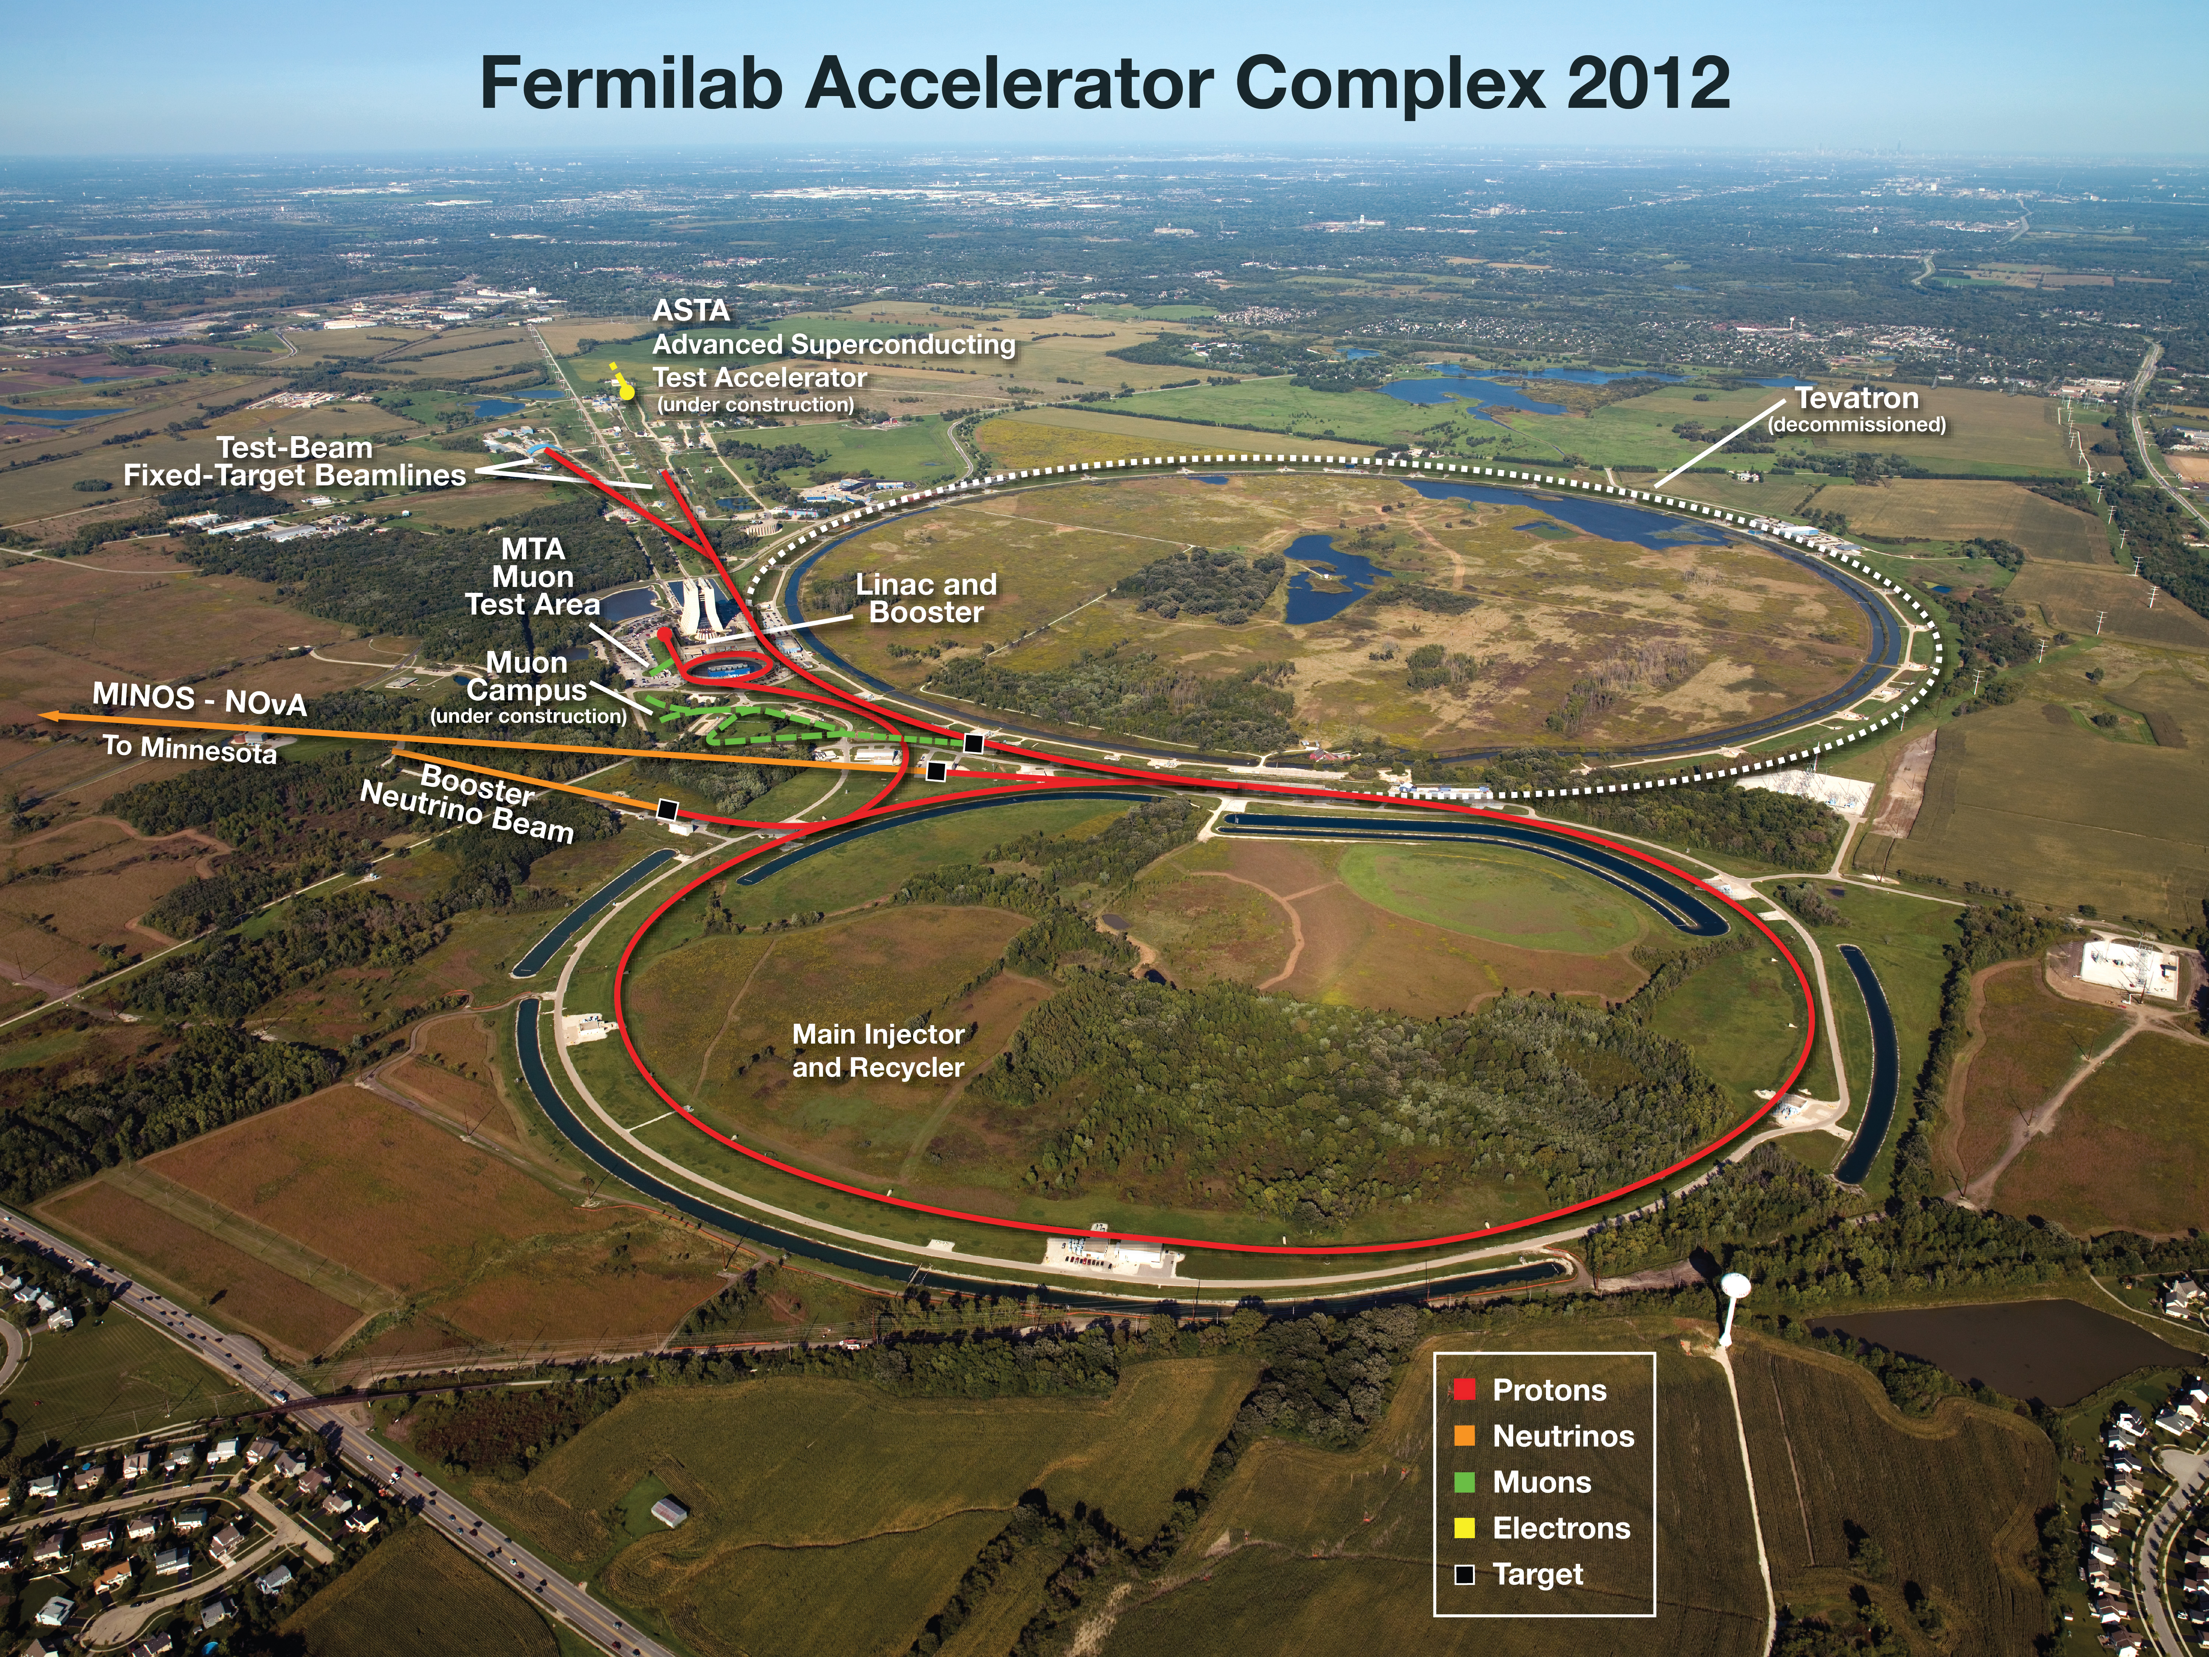
Fermilab Accelerator Complex: 2012

Slide 6
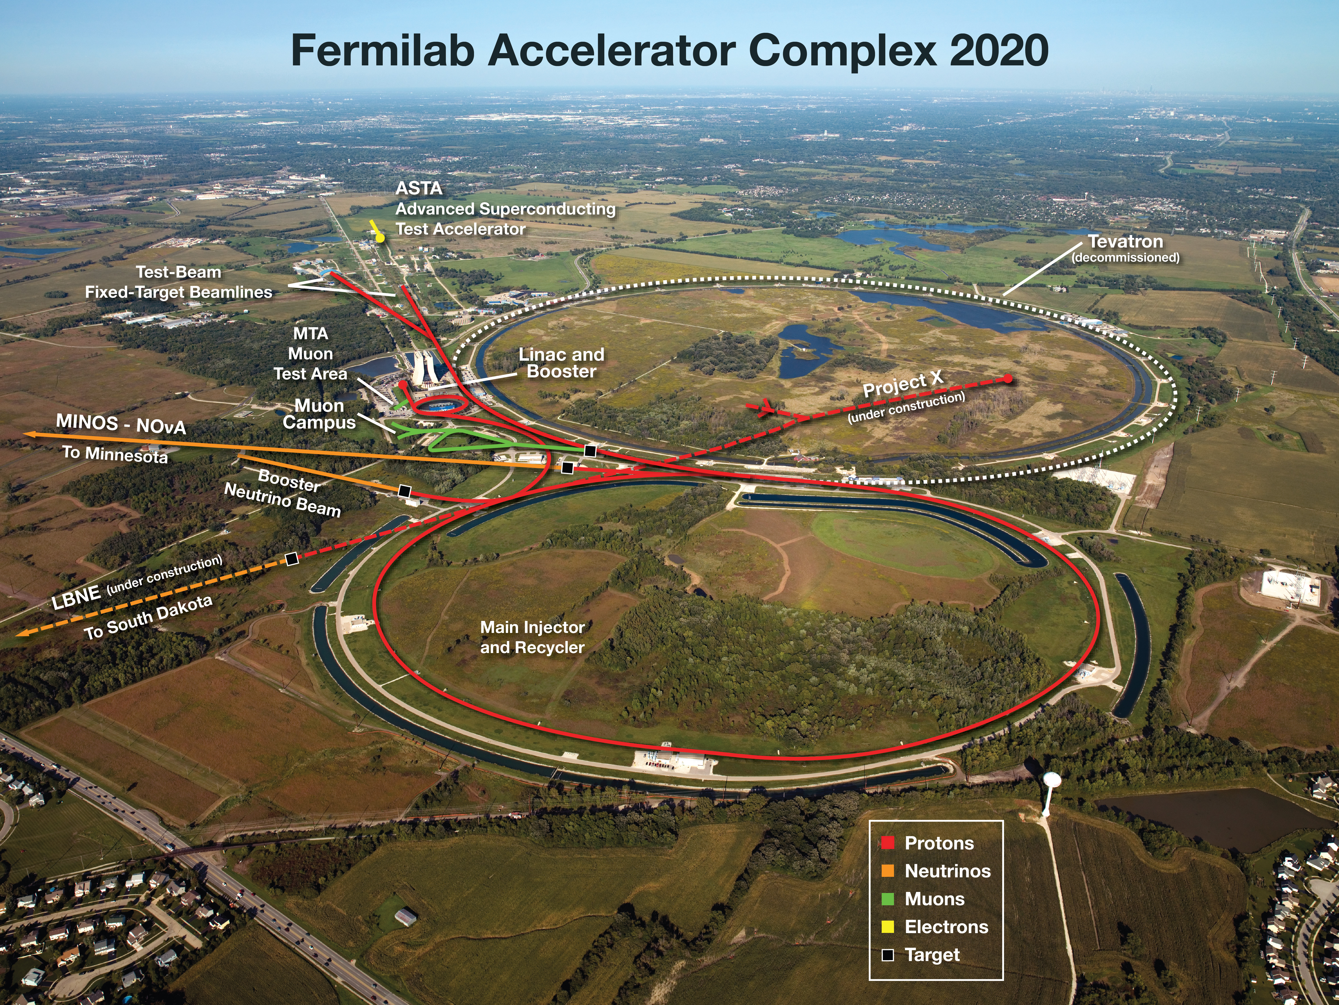
Fermilab Accelerator Complex: Vision
40 years old now
Project X: phased approach
(> 5 MW)
LBNE: phased approach
Opportunities for Collaboration at Fermilab
Input to the European Strategy for Particle Physics, 2012
Pier Oddone, July 30, 2012
https://indico.cern.ch/contributionDisplay.py?contribId=84&confId=175067
Notes:
add the reference to the European Strategy paper somewhere....... saying that it summarizes the opportunities at Fermilab.

Slide 7

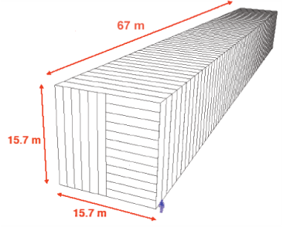
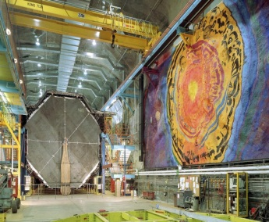
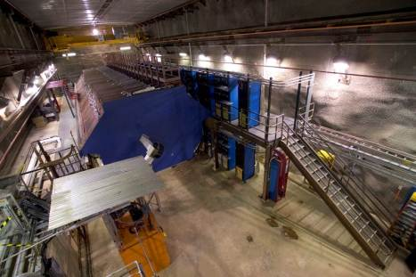
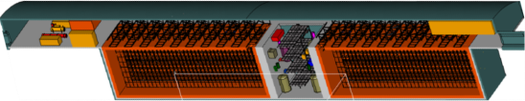
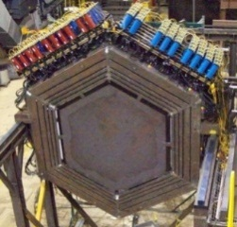
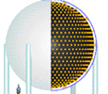
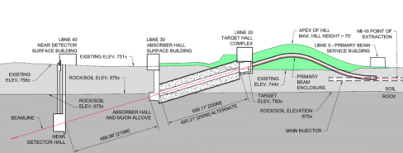
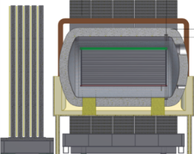
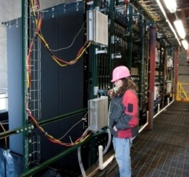
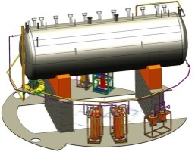
Evolution of U.S. Long Baseline Neutrino Experiments
MINOS(2005-~2015) → NOvA(2013-~2022) → LBNE(~2022-~2040?)
Electron efficiencies 4% → 30% → > 80%
under construction
online 2013
(700 kW)
NOvA (far)
Surface
14 kton
MINOS (far)
at 2340 ft level
5 kton
operating
since 2005
(350 kW)
MINOS (near)
735 km
810 km
MINERvA
1300 km
LBNE Far detector
at 4850 ft level
34 kton LAr TPC
700 kW → 2.3 MW(Project X)
MiniBooNE
New beamline
Near detector
NOvA
(near)
MicroBooNE
under construction
(LAr TPC)

Slide 8
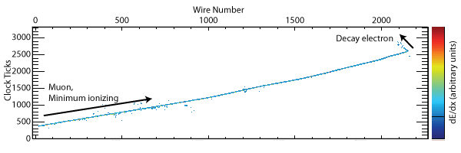
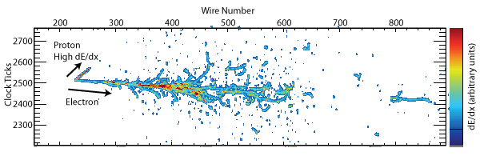
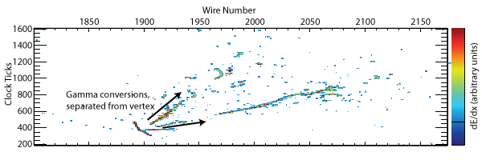
Detector Technology Choice Made (Jan. 2012)
Liquid Argon TPC based on its extremely high performance in particle identification and uniqueness of the technology
ν_{μ} CC event w/ μ decay
ν_{e} QE event
NC event w/ π⁰→γγ
Exquisite 3D event information!

Slide 9
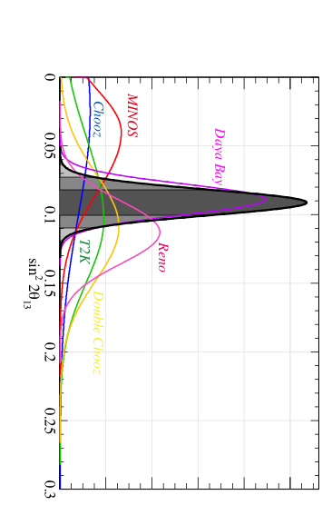
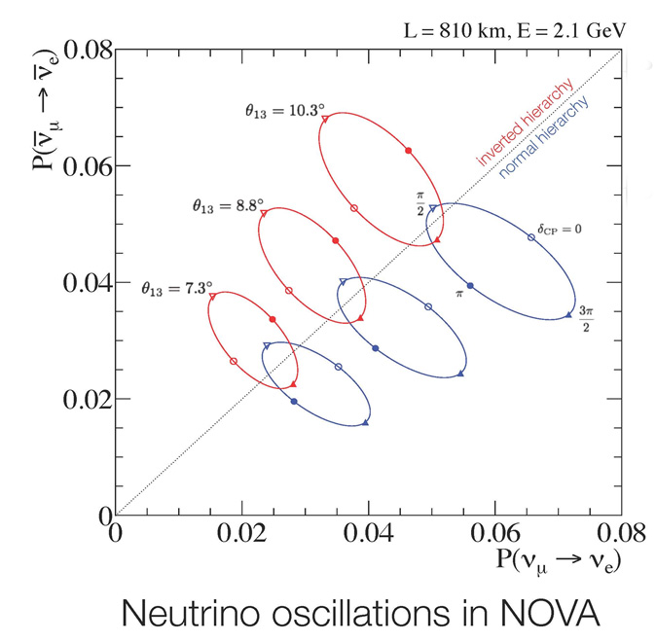
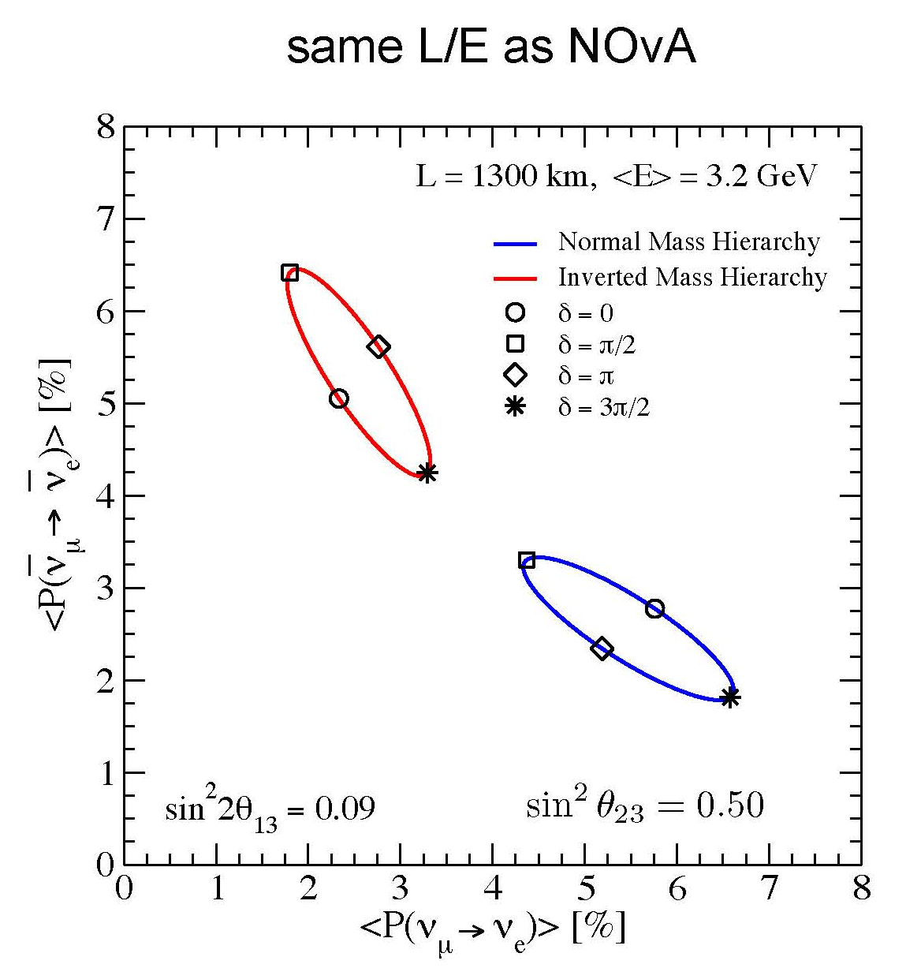
Large θ₁₃ (March 8, 2012)
θ₁₃ ~ 9º
June 2012
δ_{CP} = π
Courtesy Mark Messier
δ_{CP} = 0
δ_{CP} = 0
δ_{CP} = π
Richer long-baseline neutrino physics
Near term experiments have some sensitivity on the mass hierarchy.
What is the optimal baseline for the known value of θ₁₃ ~ 9º ?

Slide 10
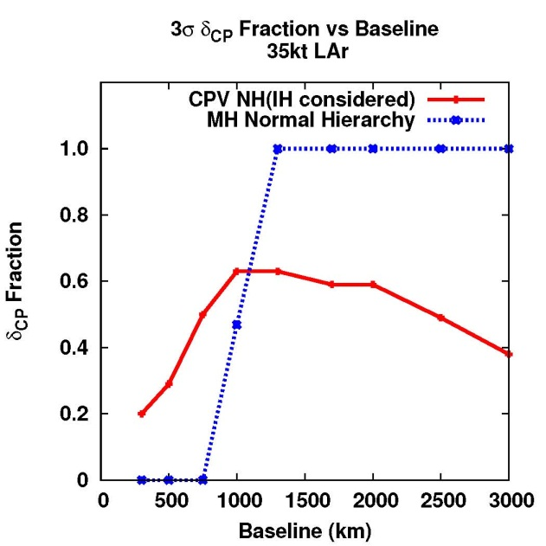
Large θ₁₃ (March 8, 2012)
Mass hierarchy and CP sensitivity vs. Baseline
35 kt LAr TPC
~1,300 km is nearly optimal for a combined sensitivity of CP and mass hierarchy measurements.

Slide 11
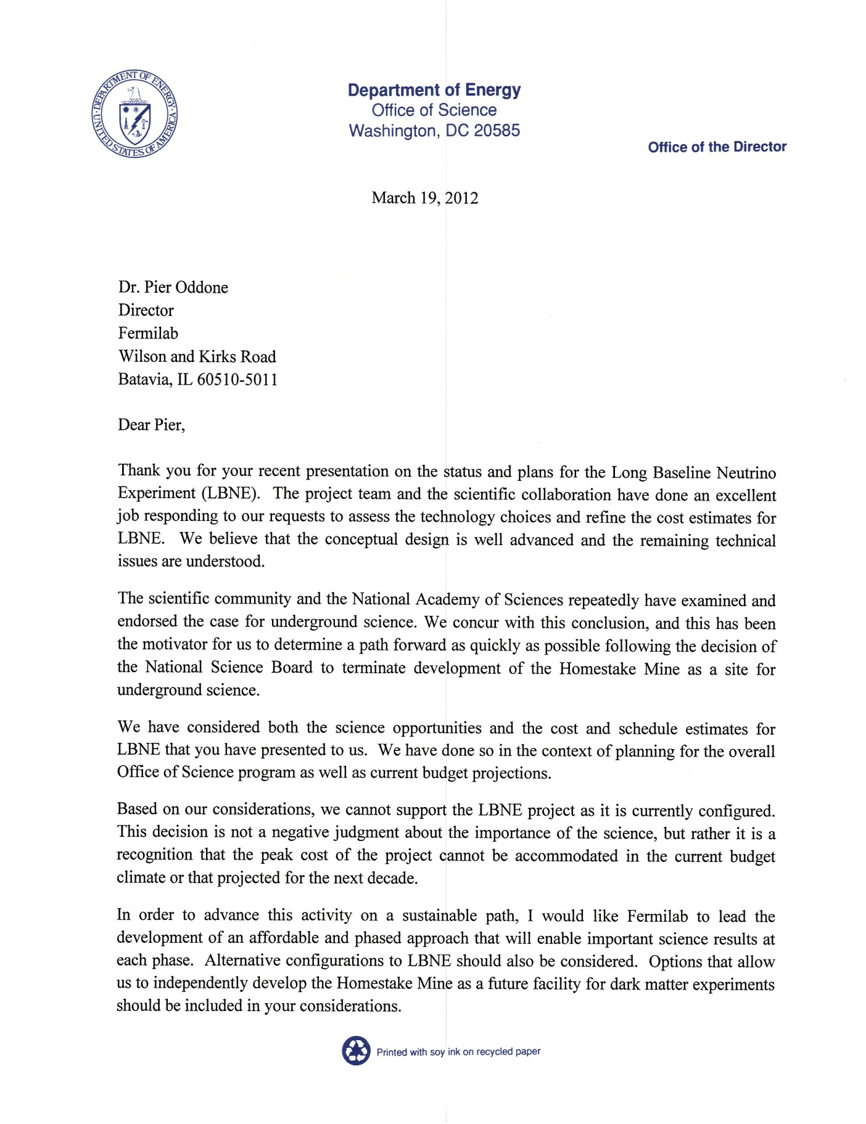
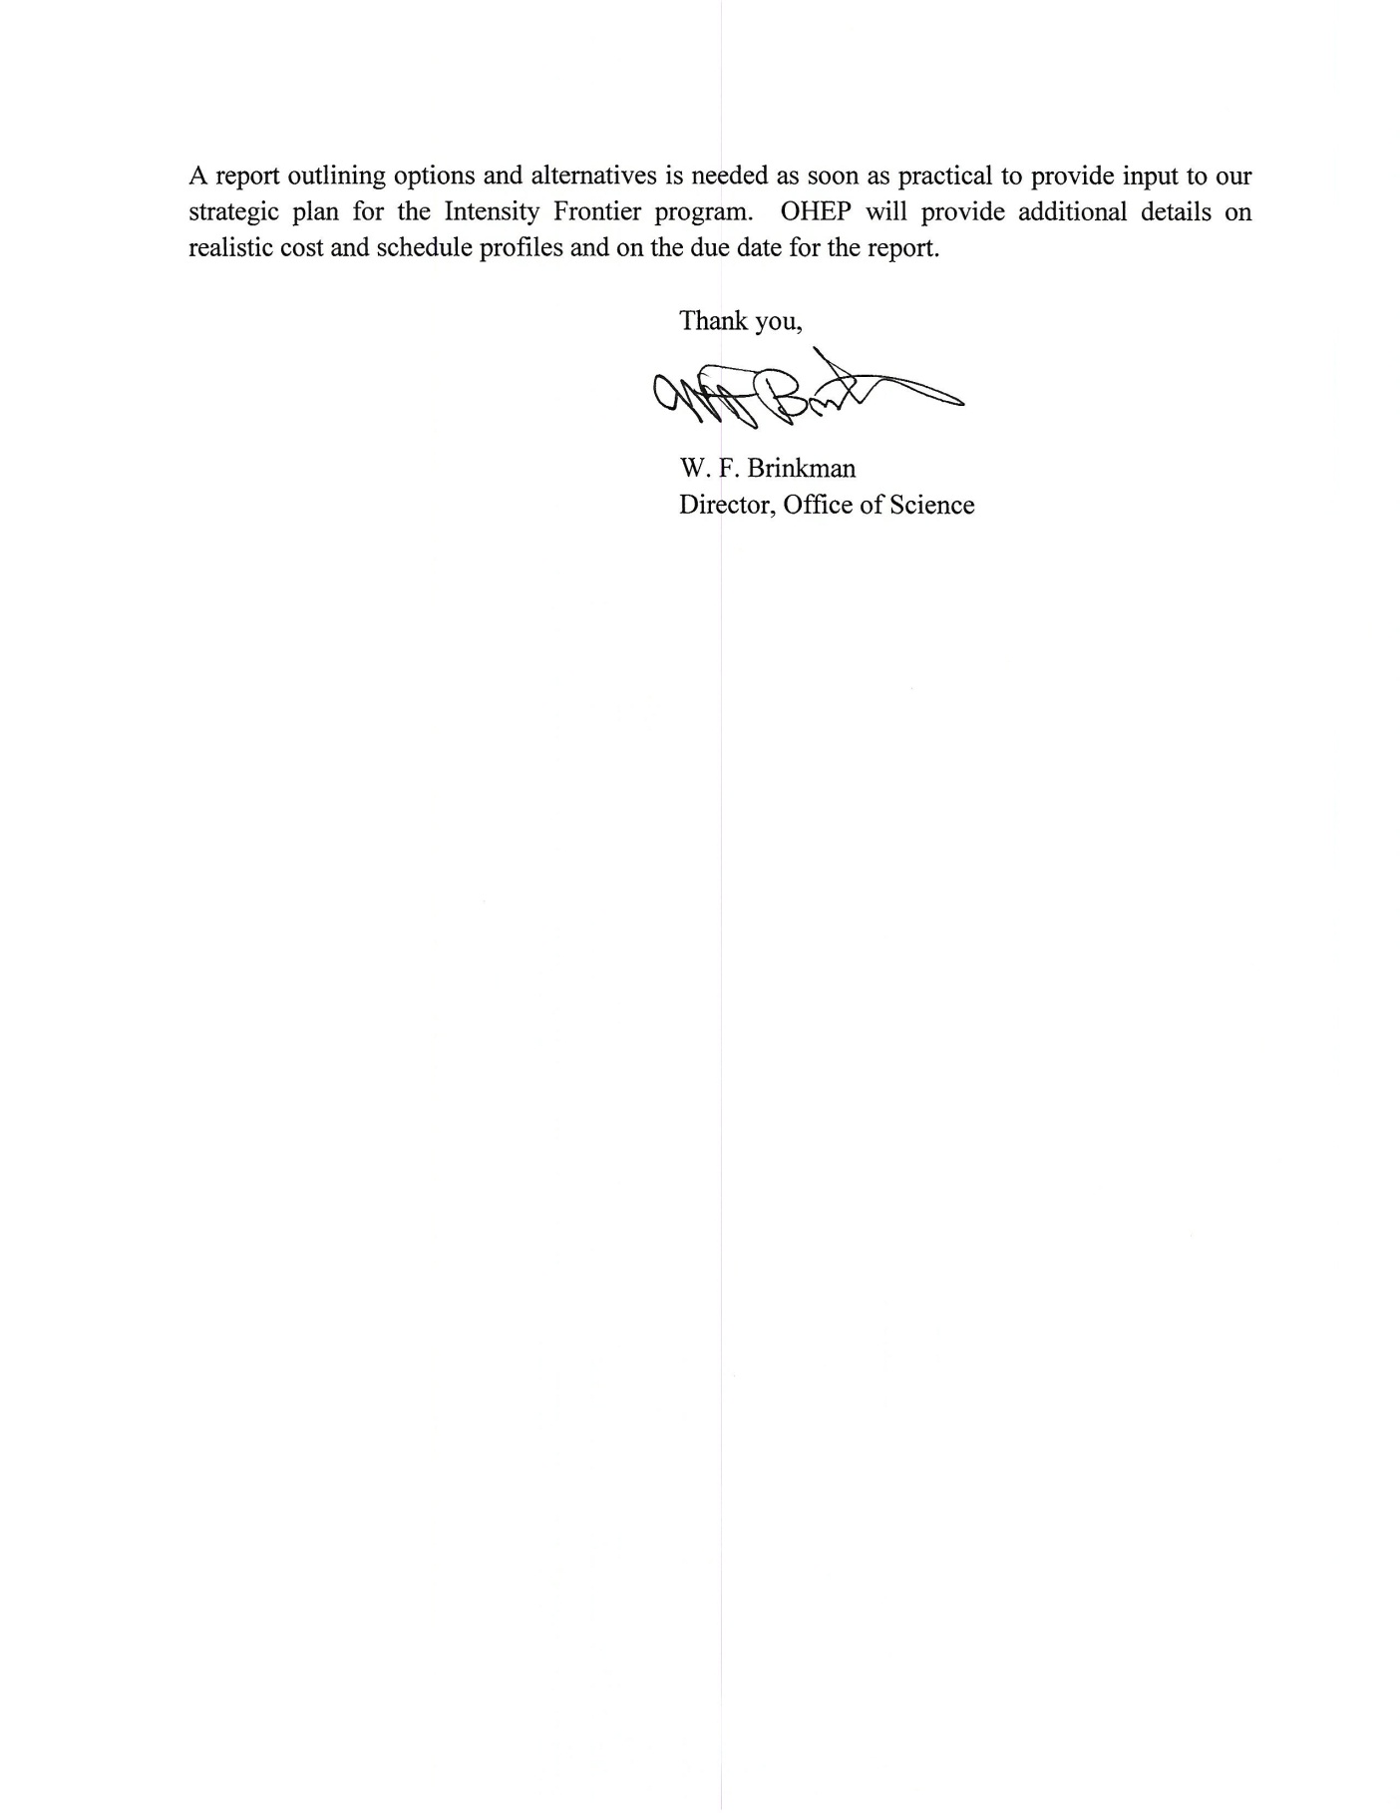
Dr. Brinkman’s Charge (March 19, 2012)
DOE SC is planning investments in the next generation neutrino experiment, the LBNE.
In light of the current budget climate, Dr. Brinkman asked Fermilab to find a path forward to reach the goals of the LBNE in a phased approach or with alternative options. His letter notes that this decision is not a negative judgment about the importance of the science, but rather it is a recognition that the peak cost of the project cannot be accommodated in the current budget climate, or that projected for the next decade.

Slide 12
Steering Committee and WGs formed (April 3, 2012)
Pier Oddone, Director of Fermilab, formed a Steering Committee and two working groups (Physics and Engineering/Cost Working Groups), to address this request.
The Steering Committee to provide guidance to the working groups, to identify viable options and to write the report to the DOE.
The Physics WG to analyze the physics reach of various options on a common basis, and the Engineering/Cost WG to provide cost estimates and to analyze the feasibility of the proposed approaches with the same methodology.
Steering Committee
Physics
Working Group
Engineering/Cost
Working Group

Slide 13
The Steering Committee
Steering Committee
Ex-officio group
Membership | Institution
Jon Bagger | JHU
Charlie Baltay | Yale
Gary Feldman | Harvard
Young-Kee Kim , Chair | Fermilab
Kevin Lesko | LBNL
Ann Nelson | UW Seattle
Mark Reichanadter | SLAC
Mel Shochet | Chicago
Bob Svoboda | UC Davis
James Symons | LBNL
Steve Vigdor | BNL
Membership | Institution (comments)
Andy Lankford | UC Irvine (HEPAP chair, DUSEL NRC study chair)
Steve Ritz | UC Santa Cruz (PASAG chair)
Jay Marx | Caltech (DUSEL review committee co-chair)
Pierre Ramond | U. Florida (DPF chair)
Harry Weerts | ANL (Intensity Frontier Workshop co-chair)
JoAnne Hewett | SLAC (Intensity Frontier Workshop co-chair)
Jim Strait | FNAL (LBNE Project Director, Engineering/Cost WG deputy chair)
Pier Oddone | FNAL (Director, Fermilab)
Susan Seestrom | LANL (LBNE Lab Oversight Group member)

Slide 14
Working Groups
Physics Working Group | Engineering / Cost Working Group
Jeff Appel, FNAL (Scientific secretary) Matthew Bass, Colorado State Univ. Mary Bishai, BNL Steve Brice, FNAL Ed Blucher, U. Chicago Daniel Cherdack, Colorado State Univ. Milind Diwan, BNL Bonnie Fleming, Yale Gil Gilchriese, LBNL Zeynep Isvan, BNL Byron Lundberg, FNAL Bill Marciano, BNL Mark Messier, Indiana U. Stephen Parke, FNAL Mark Reichanadter, SLAC Gina Rameika, FNAL Kate Scholberg, Duke U. Mel Shochet, U. Chicago (Chair) Jenny Thomas, UCL Bob Wilson, Colorado State Univ. Elizabeth Worcester, BNL Charlie Young, SLAC Sam Zeller, FNAL | Jeff Appel, FNAL (Scientific secretary) Bruce Baller, FNAL Jeff Dolph, BNL Mike Headley, SURF Tracy Lundin, FNAL Marvin Marshak, U. Minnesota Christopher Mauger, LANL Elaine McCluskey, FNAL Bob O’Sullivan, FNAL Vaia Papadimitriou, FNAL Mark Reichanadter, SLAC (Chair) Joel Sefcovic, FNAL Jeff Sims, ANL Jim Stewart, BNL Jim Strait, FNAL (Deputy Chair)
Strong young scientists’ involvement

Slide 15
Process
community input (individuals)
DPF announcement for workshop and community input to SC
(April 15, 2012)
DPF news letter to solicit community feedback on the interim report
(July 3, 2012)
Community input
Steering Committee
Input to the European Strategy Group
(July 30, 2012)
HEPAP meeting
(August 27-28, 2012)
Workshop
(April 25-26, 2012)
Steering Committee + working groups formed
(April 3, 2012)
Interim Report
(June 5, 2012)
Final Report
(August 6, 2012)
Steering Committee face-to-face meeting
(April 26, 2012)
Steering Committee face-to-face meeting
(May 22-23, 2012)
Briefing to Brinkman
(June 6, 2012)
Briefing to NSF
(June 18, 2012)
Brinkman’s charge
(March 19, 2012)
Steering Committee Kickoff meeting
(April 9, 2012)
Brinkman’s letter in response to the interim report
(June 29, 2012)
Briefing to Siegrist / Lehman
(June 26, 2012)
12 steering committee teleconference meetings
numerous working group meetings

Slide 16
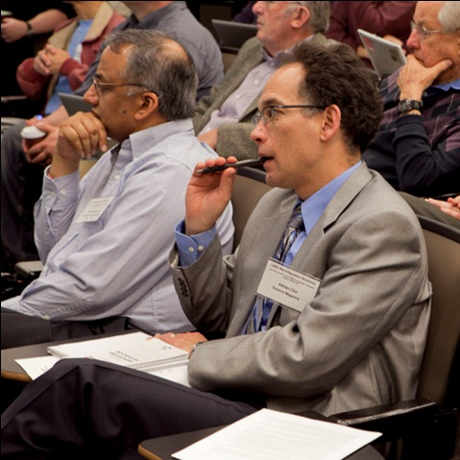
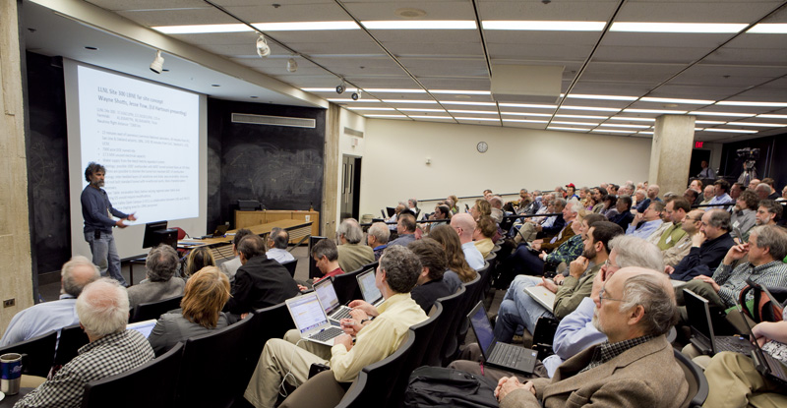
Workshop (April 25-26, 2012)
More than 200 participants
~5 hours devoted to community voice

Slide 17
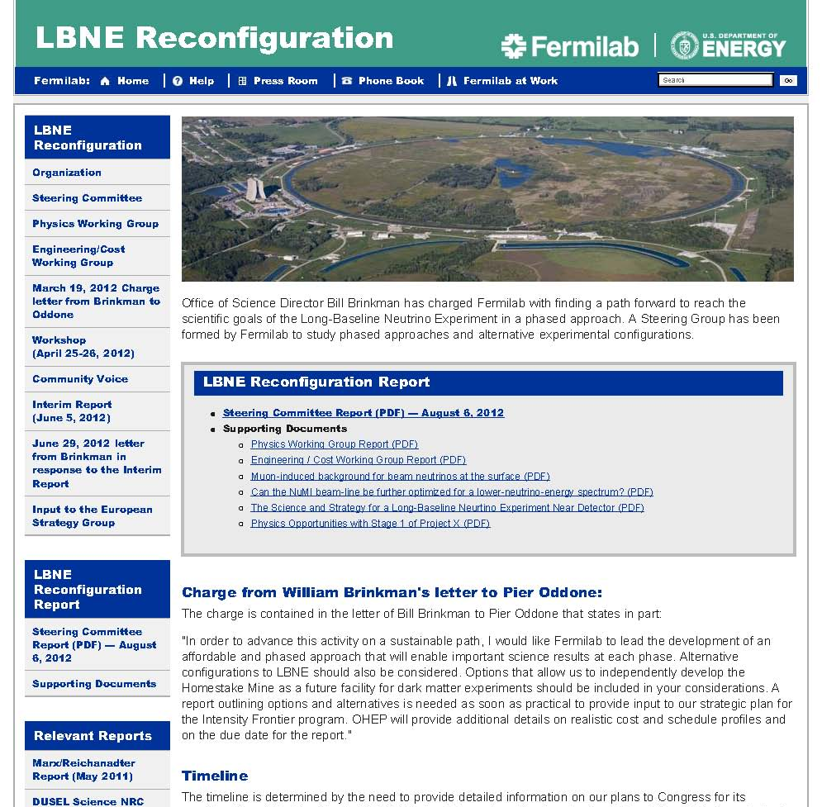
Open Process
http://www.fnal.gov/
directorate/lbne_reconfiguration
All documentation on this web site

Slide 18
Issues for LBNE Phase 1
A guideline of LBNE Phase 1 budget:
  about $700M ~ $800M (including escalation and contingency)
  about half of the full LBNE cost (more about cost later)
Main issues for Phase 1:
  What physics to be compromised in order to make it affordable
  What long-term physics limitations are imposed by the different Phase-1 options
The fundamental practical choice:
  Do we use the existing NuMI beamline to Soudan / Ash River or do we develop a new beamline to Homestake?

Slide 19

A beamline is a significant investment.
Target hall with remote handling in high-radiation environment
Beam extraction and transport from the Main Injector to target
Focusing horns for secondary particles
Beamline to Homestake
(not to scale)
Large underground decay pipe (4m x 200m for Homestake ; 2m x 675m for NuMI)
Homestake beamline: much better aquifer protection than the NuMI beamline

Slide 20
Issues for LBNE Phase 1
Using the existing NuMI beamline
  saves the cost of a new beamline and allows funding a more ambitious detector in Phase 1
  but may limit the future physics reach for neutrino physics.
  also beamline maitanability issues and safety concerns
Developing a new beamline to Homestake
  requires the investment of substantial resources that reduces the mass of the Phase 1 detector
  but preserves the ability to develop the full physics potential in the long term.

Slide 21
Options considered
Homestake options (1,300 km baseline)
  New beamline + a smaller detector → long baseline neutrino physics
  No beamline + a large detector → non-accelerator based physics
  Conclusion: accelerator-based neutrino physics has higher priority, and we chose (a) over (b).
Long baseline (1,000 km – 2,300 km) accelerator-based neutrino physics options that require a new beamline
  Homestake
  Other sites (less developed than Homestake)
  Conclusion: (b) is not cheaper than the Homestake option, thus no gain, but loss (there has been significant investments by South Dakota, funding agencies, LBNE project). We chose (a) over (b).

Slide 22
Options considered (cont.)
1,000 km baseline using the existing NuMI beamline
  At 1,000 km, the beam is 21 mrad off axis and the neutrino flux is too low for CP. This option became not viable.
735 km Soudan
810 km Ash River
1,000 km Canada
NuMI beam

Slide 23
Options selected for further studies
Beam |  |  | Far Detector (LAr TPC)
Energy | Baseline | Off-axis angle | Location | Depth (ft) | Mass (kt) (physics) | Mass (kt) (cost)
NuMI LE (wide band) NuMI LE (wide band) | 735 km 735 km | 0 0 | Soudan Soudan | 0 2340 | 5, 10, 15, 34 5, 10, 15, 34 | 5, 17, 34 5, 17. 34
NuMI ME (narrowest band) NuMI LE (narrow band) | 810 km 810 km | 14 mrad 14 mrad | Ash River Ash River | 0 0 | 5, 10, 15, 34 5, 10, 15, 34 | 5, 17. 34 5, 17. 34
LBNE LE (wide band) LBNE LE (wide band) | 1300 km 1300 km | 0 0 | Homestake Homestake | 0 4850 | 5, 10, 15, 34 5, 10, 15, 34 | 5, 17. 34 5, 17. 34
NuMI LE (ME) = the low-energy (medium-energy) tunes of the existing NuMI beamline
LBNE LE = the low-energy tune of a new proposed beamline aimed at Homestake
The costs of other detector masses estimated by interpolation.
-
  LBNE Phase 1 running (ν and ν): 120 GeV proton beam,
  700 kW (or 6 x 10²⁰ protons on target / year) for 10 years
  NOvA running (ν and ν): 6 years for the Homestake site and 16 years for the Minnesota sites
  T2K running (neutrinos only): 5 x 10²¹ protons on target in total
-

Slide 24
Physics Sensitivity Studies

Slide 25
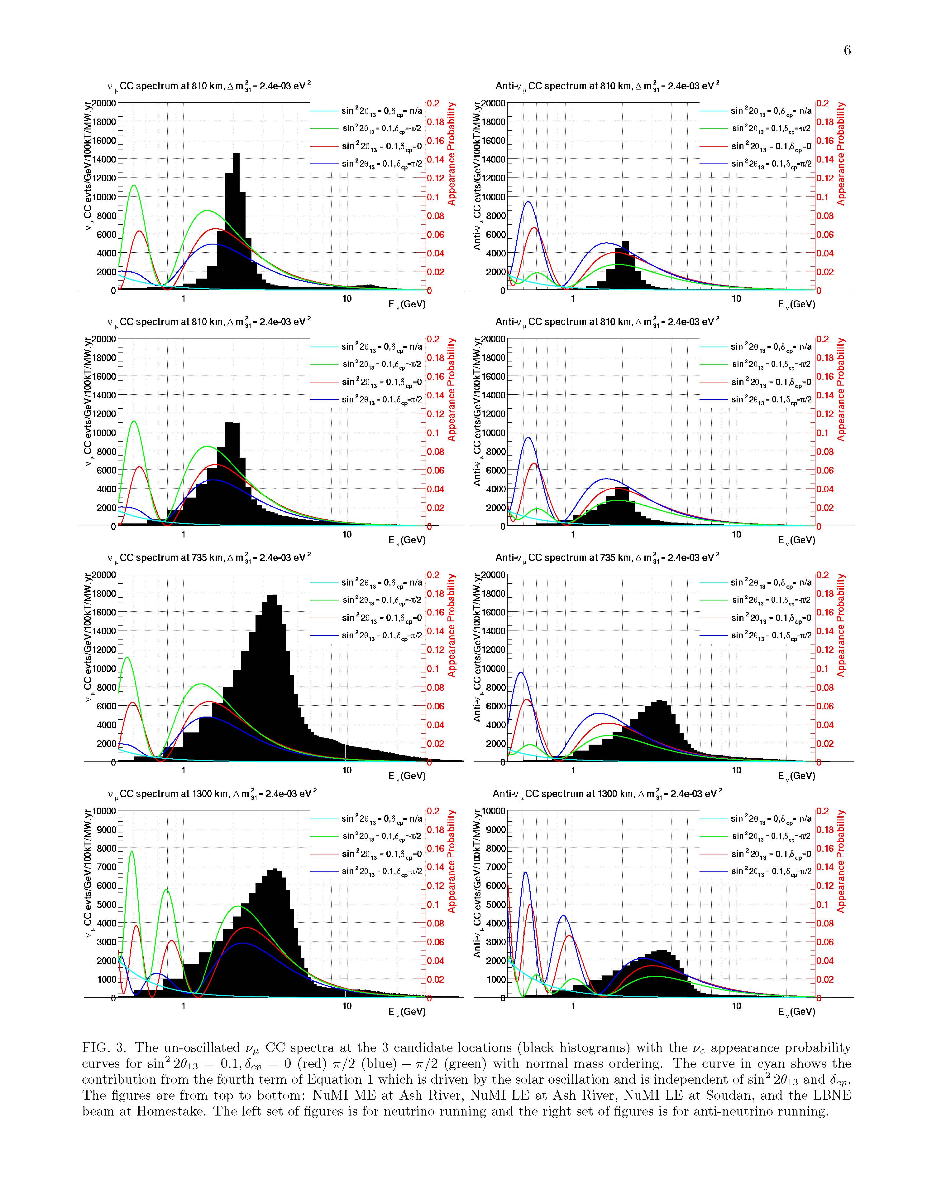
Unoscillated ν_{μ} charged-current spectra with ν_{e} appearance probability curves.
2nd
1st
δ_{CP} = -90º, 0, +90º
normal mass ordering
Ash River Medium Energy
(810 km)
Ash River Low Energy
(810 km)
Soudan Low Energy
(735 km)
underground=surface
Homestake Low Energy
(1,300 km)
underground=surface
2nd
1st
2nd
1st
2nd
1st

Slide 26
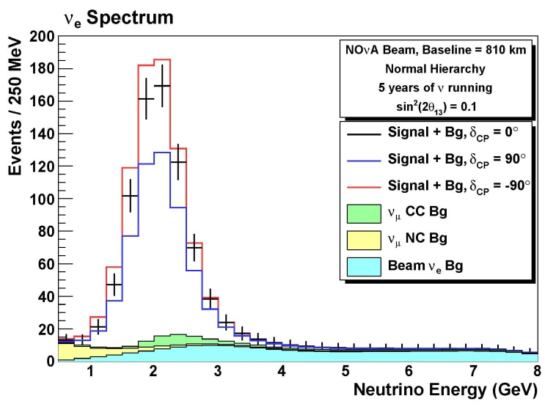
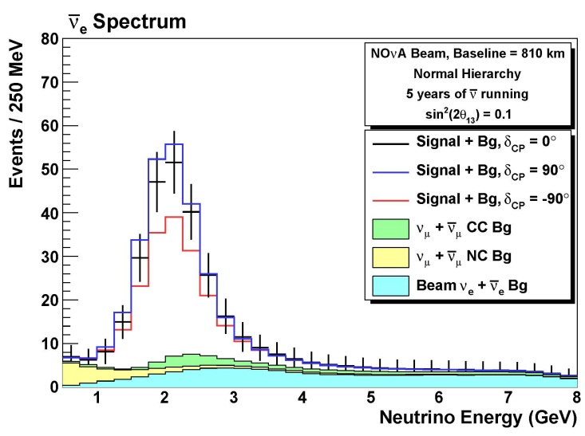
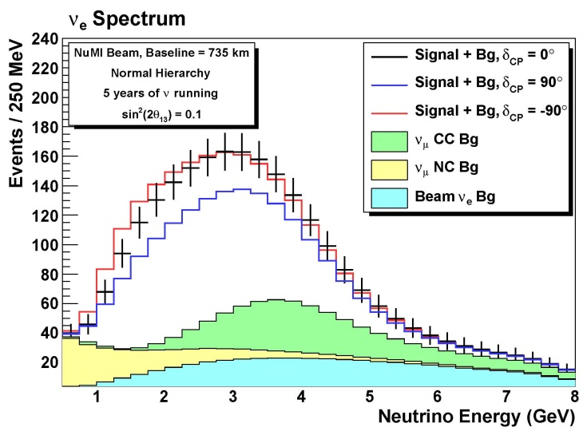
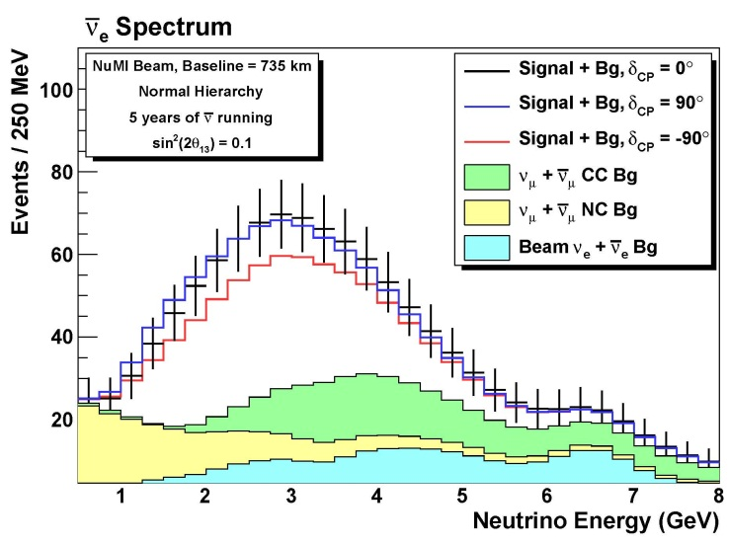
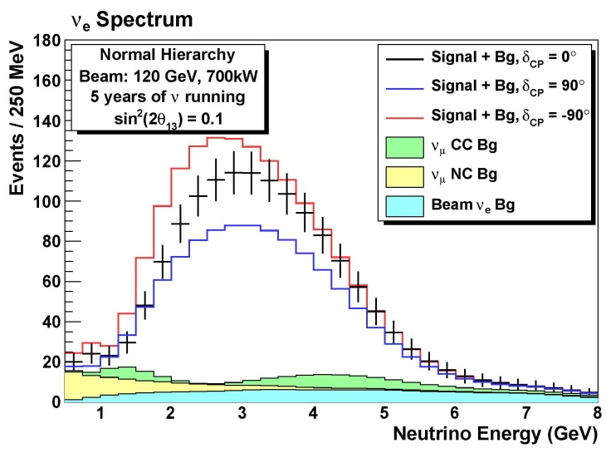
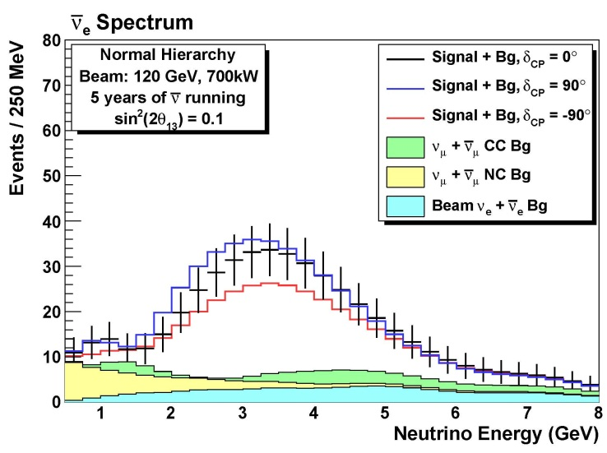
Expected ν_{e} appearance spectra (34 kt LAr detector)
5 years of ν running 5 years of ν running
ν_{e} spectra ν_{e} spectra
_
_
Ash River
(Medium Energy)
Soudan
(Low Energy)
Homestake
(Low Energy)

Slide 27
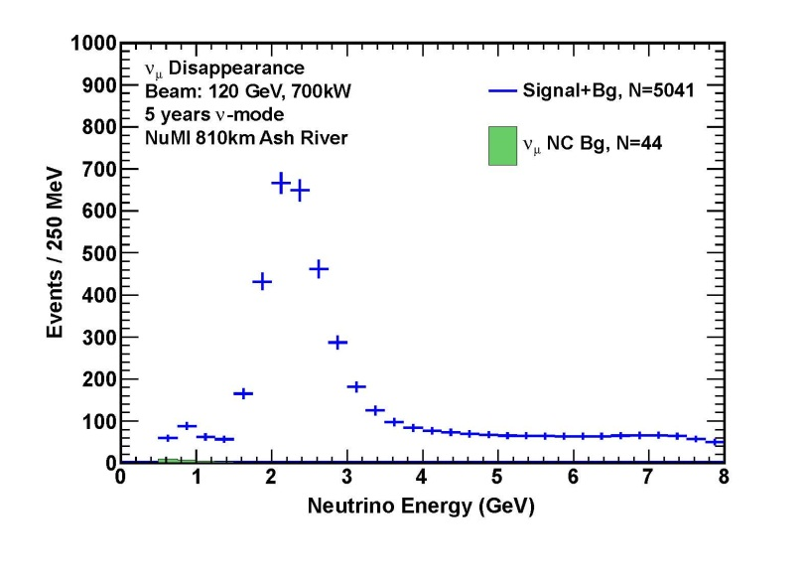
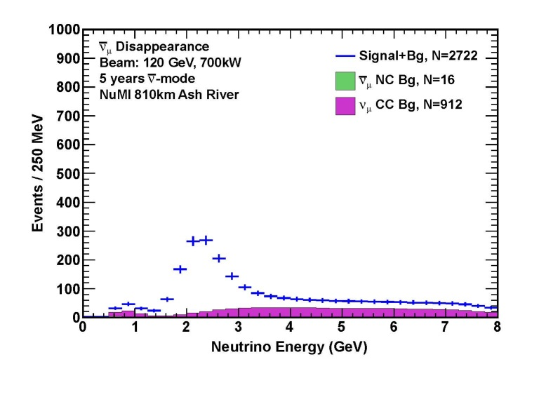
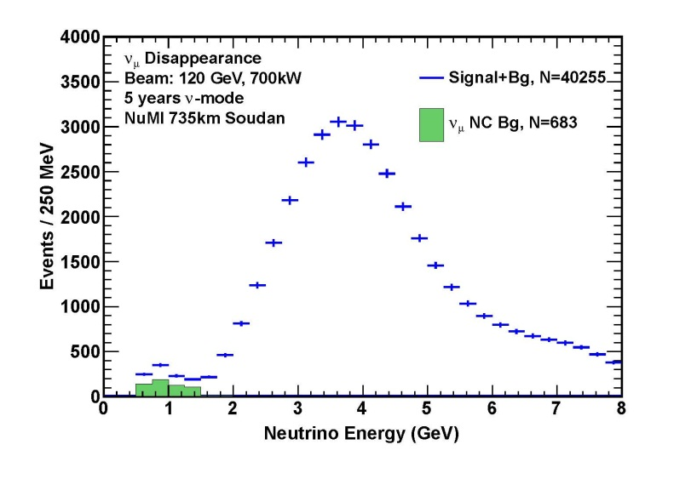
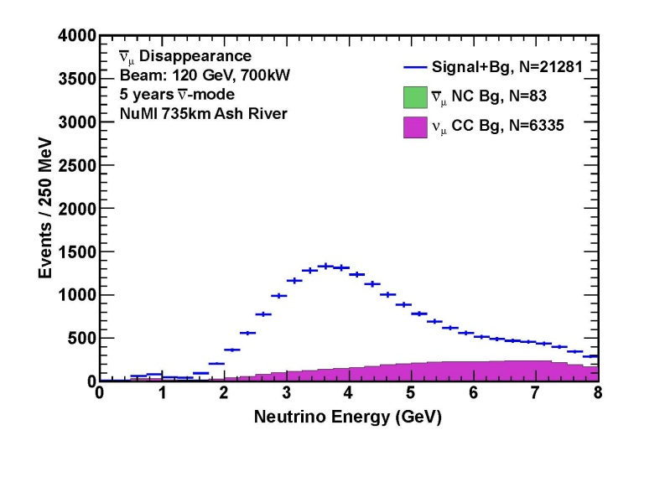
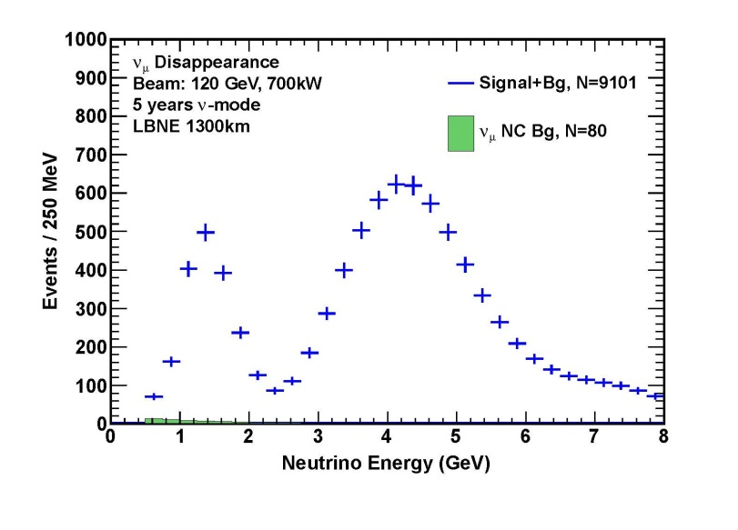
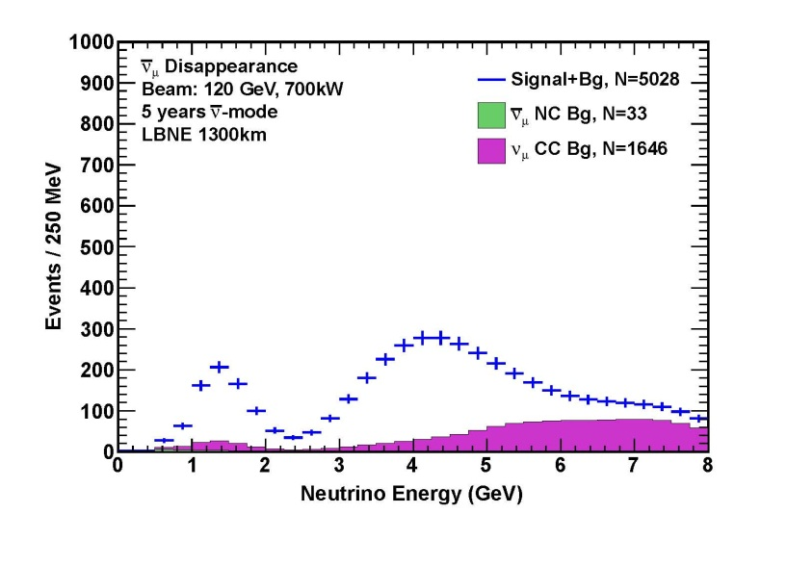
Expected ν_{μ} disappearance spectra (34 kt LAr detector)
5 years of ν running 5 years of ν running
ν_{μ} disappearance ν_{μ} disappearance
_
_
Ash River
(Medium Energy)
Soudan
(Low Energy)
Homestake
(Low Energy)

Slide 28
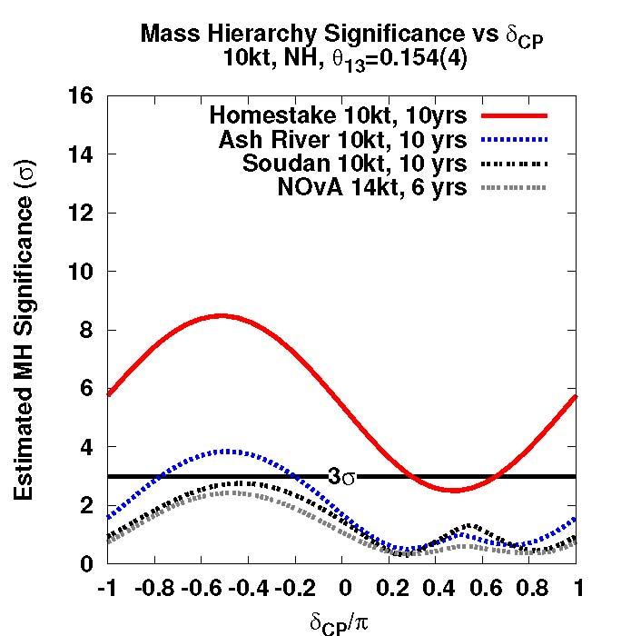
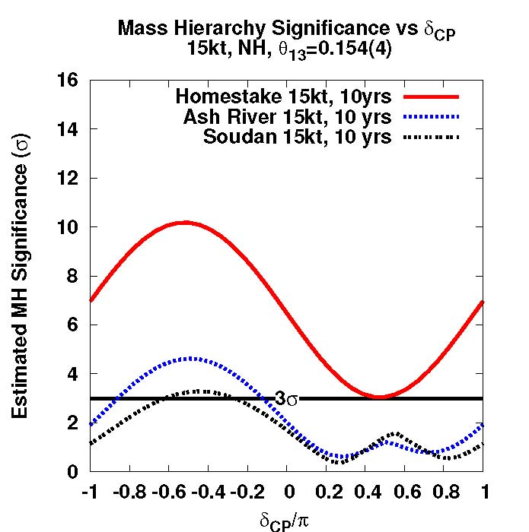
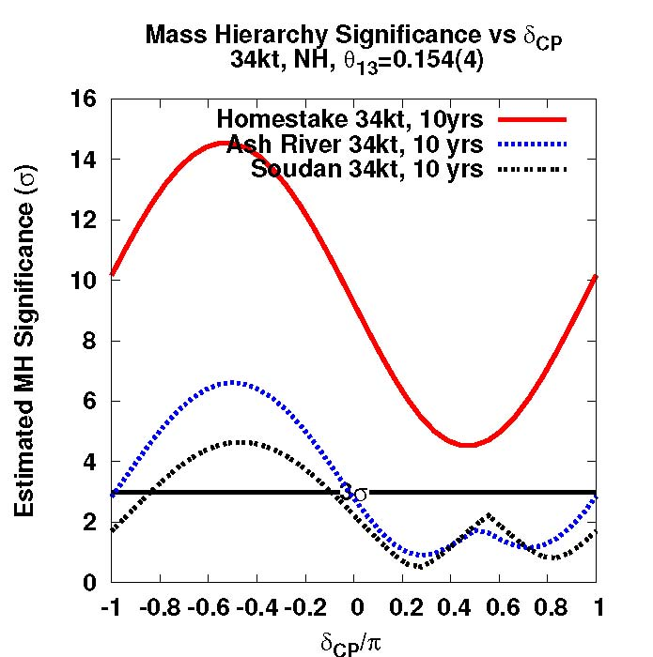
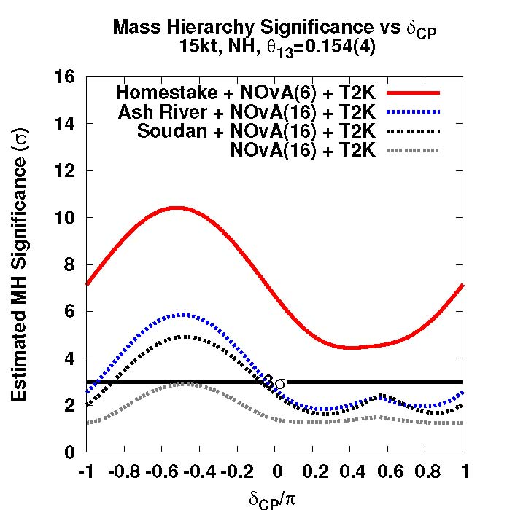
Mass Hierarchy Reach
Adding NOvA & T2K

Slide 29
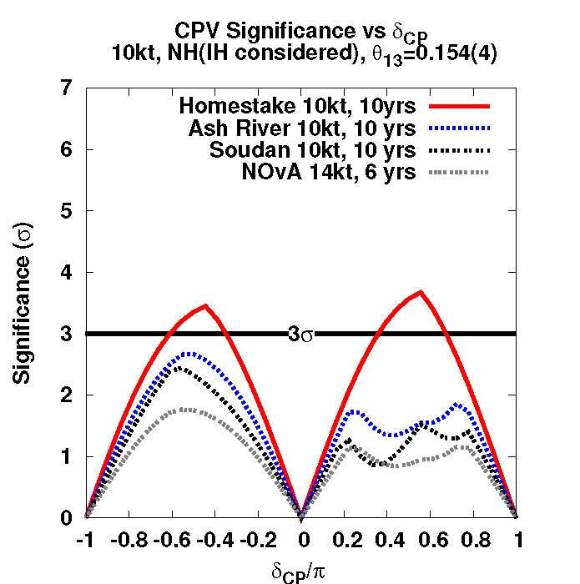
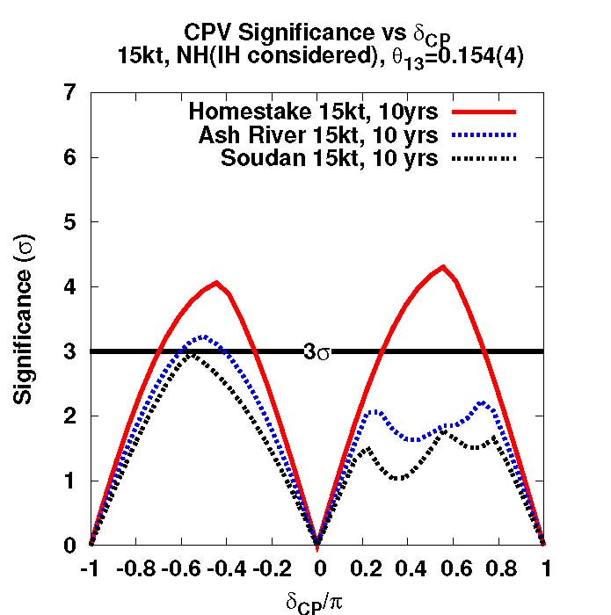
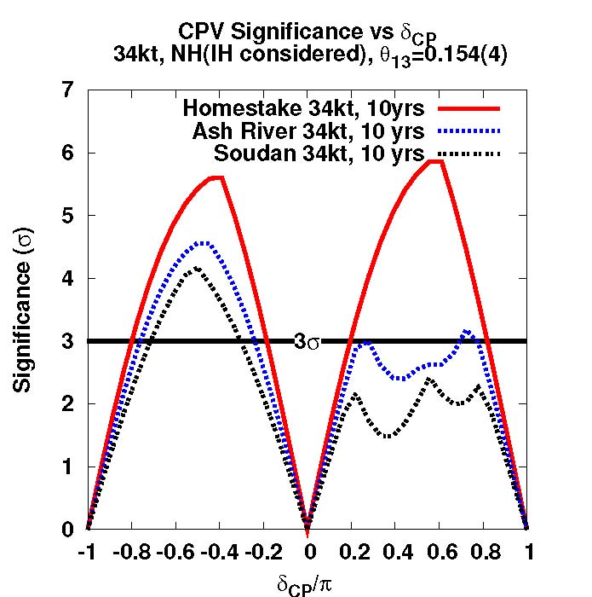
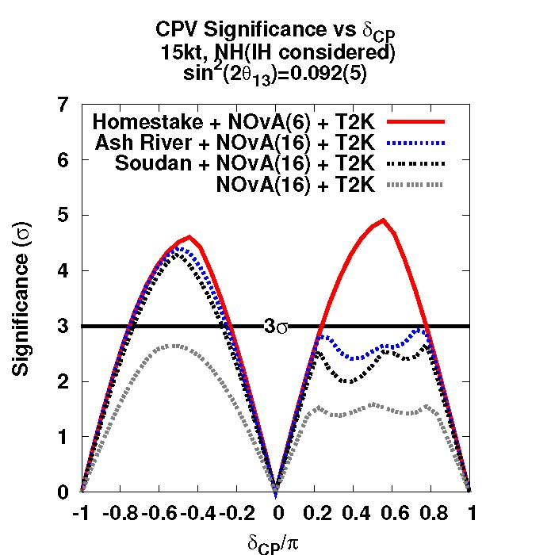
CP Violation Reach
δ_{CP}/π
Hierarchy problem → δ_{CP}>0 problem (at short baselines)
δ_{CP}/π
Adding NOvA & T2K

Slide 30
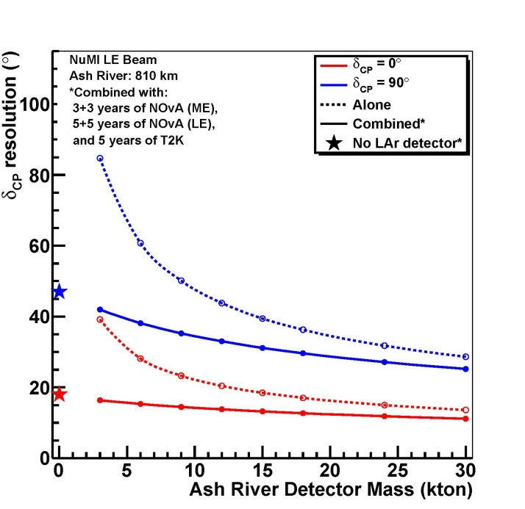
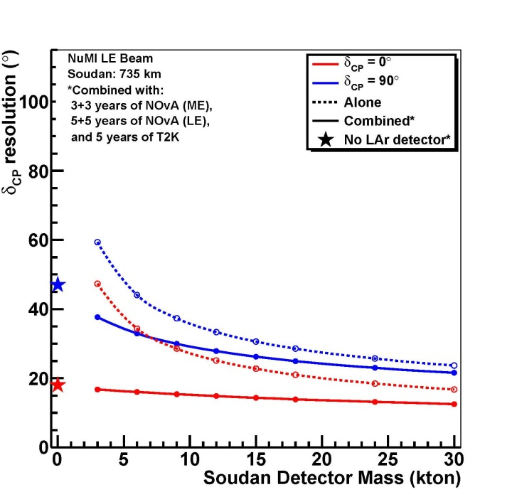
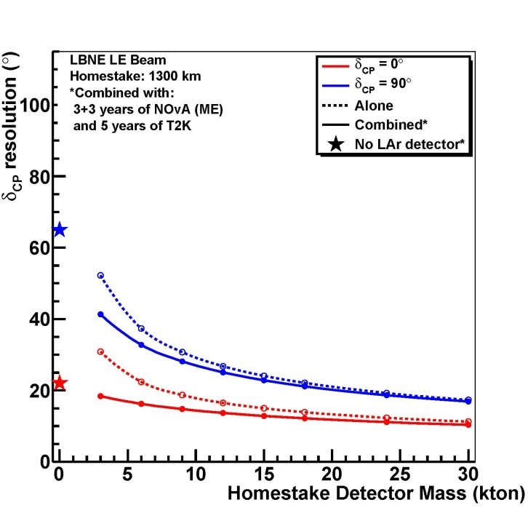
δ_{CP} Measurements (resolution)
Ash River Soudan Mine Homestake
δ_{CP} = 0, +90º

Slide 31
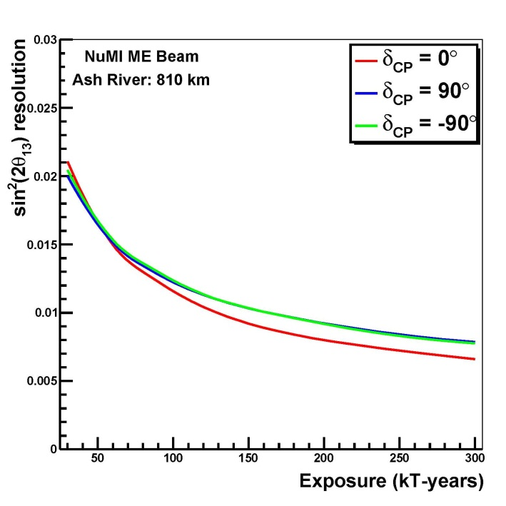
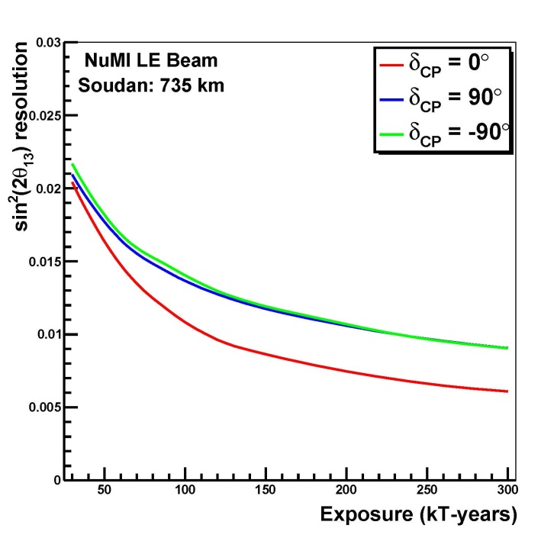




Other mixing parameters
Ash River Soudan Mine Homestake
sin²(2θ₁₃) resolution
θ₂₃ resolution (radians)

Slide 32
Searching for new physics
Using a wideband beam and long baseline to look for a breakdown of the 3 generation mixing model.
  neutral current non-standard matter effects
  long-range interactions between neutrinos and background sources
  active-sterile neutrino mixing from the neutral current event rate

Slide 33


Non-accelerator physics
Proton Decay (p → Kν)
  distinctive in LAr (K→μ→e)
  Favored mode for SUSY-inspired GUTs
  Must be underground and at least 10 kt to be competitive.
  Studies of proton decay are complementary to those being performed with existing water Cerenkov detectors.

Slide 34



Non-accelerator physics (cont.)
Atmospheric neutrinos
  Similar to accelerator-ν events
  underground necessary (background)
  mass hierarchy sensitivity
ν_{e} CC event
ν_{μ} CC event

Slide 35

Non-accelerator physics (cont.)
Supernova Core Collapse Neutrinos
  Needs to be underground
  A time-correlated burst over a well measured background rate.
  LAr TPCs are sensitive to neutrinos
  whereas WC detectors are sensitive to antineutrinos
  Core collapses are expected
  to occur a few times per
  century at a most-likely
  distance of about 10-15 kpc.

Slide 36
Physics Sensitivities: Summary
The neutrino hierarchy and the CP phase angle are accessible with the options being considered.
A longer baseline allows complete separation between matter and CP effects.
A longer baseline and a wide-band beam allow observation of multiple oscillation peaks and the valleys between them in the long term. This provides broader sensitivity to neutrino oscillation physics beyond that described by the standard 3×3 matrix.
The search for proton decay and the study of atmospheric and supernova-burst neutrinos require the detector to be underground.
  Homestake at 4850 ft depth: excellent opportunities
  Soudan lab at 2340 ft depth: modest compromise in physics reach

Slide 37
Engineering/cost studies
LBNE has developed a CD-1-level conceptual design and cost estimate for the full project, which has been reviewed and found to be sound.
The reconfiguration cost estimates are based to the greatest extent possible on that cost estimate.
Value Engineering during the reconfiguration process lowered the cost estimate for the full LBNE to <~$1.5B.
  This was done by simplifying designs to a minimal configuration while maintaining the same scientific capability
Comparison between the Homestake cost estimates and operational methods and actual experience at Soudan and Ash River was very helpful in this process.

Slide 38


Engineering/cost studies
$M $M
(no near detector)
Phase 1 cost range: $700M ~ $800M
Fixed costs
All options: Project management (~10% of the project)
Homestake with beam: new beamline
Soudan underground detector: two new shafts + beamline upgrade
Ash River or Soudan surface detector: surface infrastructure + beamline upgrade

Slide 39
The Steering Committee Conclusions for LBNE Phase 1
Viable Options
Preferred Option
Strategy to enhance the physics scope of the preferred option

Slide 40
Three options
Three options are (not priority ordered):
  Using the existing NuMI beamline in the low energy configuration with a 30 kt LAr-TPC surface detector 14 mrad off-axis at Ash River, 810 km from Fermilab. ($684M)
  Using the existing NuMI beamline in the low energy configuration with a 15 kt LAr-TPC underground (at the 2,340 ft level) detector on-axis at the Soudan Lab, 735 km from Fermilab. ($675M)
  Constructing a new low energy LBNE beamline with a 10 kt LAr-TPC surface detector on-axis at Homestake, 1,300 km from Fermilab. ($789M)
The committee looked at possibilities of projects with significantly lower costs and concluded that the science reach for such projects becomes marginal.

Slide 41


Mass hierarchy reach for the three options
experiment alone combined with NOvA and T2K
Homestake
Ash River
Soudan
widths – impact of sin²(2θ₁₃) range (0.07 ~ 0.12) on Mass Hierarchy

Slide 42


CP reach for the three options
experiment alone combined with NOvA and T2K
Homestake
Ash River
Soudan
widths – impact of sin²(2θ₁₃) range (0.07 ~ 0.12) on CP reach

Slide 43
δ_{CP} measurements for the three options
Ash River Soudan Mine Homestake
δ_{CP} = 0, +90º

Slide 44
Summary: 30 kt at Ash River (810 km, surface)
Pros | Best Phase 1 CP-violation sensitivity in combination with NOvA and T2K results for the current value of θ₁₃. The sensitivity would be enhanced if the mass ordering were known from other experiments. Excellent (3σ) mass ordering reach in nearly half of the δ_{CP} range.
Cons | Narrow-band beam does not allow measurement of oscillatory signature. Shorter baseline risks fundamental ambiguities in interpreting results. Sensitivity decreases if θ₁₃ is smaller than the current experimental value. Cosmic ray backgrounds: impact and mitigation need to be determined. Only accelerator-based physics. Limited Phase 2 path: Beam limited to 1.1 MW (Project X Stage 1). Phase 2 could be a 15-20 kt underground (2,340 ft) detector at Soudan.

Slide 45
Summary: 15 kt at Soudan (735 km, 2340 ft)
Pros | Broadest Phase 1 physics program: Accelerator-based physics including good (2σ) mass ordering and good CP-violation reach in half of the δ_{CP} range. CP-violation reach would be enhanced if the mass ordering were known from other experiments. Non-accelerator physics including proton decay, atmospheric neutrinos, and supernovae neutrinos. Cosmic ray background risks mitigated by underground location.
Cons | Mismatch between beam spectrum and shorter baseline does not allow full measurement of oscillatory signature. Shorter baseline risks fundamental ambiguities in interpreting results. This risk is greater than for the Ash River option. Sensitivity decreases if θ₁₃ is smaller than the current experimental value. Limited Phase 2 path: Beam limited to 1.1 MW (Project X Stage 1). Phase 2 could be a 30 kt surface detector at Ash River or an additional 25-30 kt underground (2,340 ft) detector at Soudan.

Slide 46
Summary: 10 kt at Homestake (1300km, surface)
Pros | Excellent (3σ) mass ordering reach in the full δ_{CP} range. Good CP violation reach: not dependent on a priori knowledge of the mass ordering. Longer baseline and broad-band beam allow explicit reconstruction of oscillations in the energy spectrum: self-consistent standard neutrino measurements; best sensitivity to Standard Model tests and non-standard neutrino physics. Clear Phase 2 path: a 20 – 25 kt underground (4850 ft) detector at the Homestake mine. This covers the full capability of the original LBNE physics program. Takes full advantage of Project X beam power increases.
Cons | Cosmic ray backgrounds: impact and mitigation need to be determined. Only accelerator-based physics. Proton decay, supernova neutrino and atmospheric neutrino research are delayed to Phase 2. ~15% more expensive than the other two options: cost evaluations and value engineering exercises in progress.

Slide 47
Can a LAr detector successfully operate on the surface?
Issues:
  long drift time of electrons in the TPC ~ 1.4 ms
  beam spill duration ~ 10 μs (1.33 second beam spill repetition)
The LBNE collaboration has conducted initial studies.
  A combination of simple cuts together with the low (~2%) expected probability of e-γ misidentification can reduce background to a level below the expected ν_{e} appearance signal. Positioning the detector behind a hill (a location exists) together with optional photon detection system and veto would largely improve background rejection.
Studies are ongoing to increase statistics and to identify and remove rarer processes.
The shorter drift distance for surface options is chosen to mitigate the effects of space charge build-up due to cosmic rays.

Slide 48
The need for a near detector during Phase 1
Phase 1
  Soudan / Ash River: the existing near detectors + MINERvA.
  Homestake: muon detectors to monitor the beam – adequate for Phase 1
    The statistical uncertainties dominate, at least for the mass hierarchy and CP phase measurements.
    Background determination will be better due to the LAr detector.
    The LBNE beam will be very similar to NuMI, so the measurements there will be transferable.
    Measurement of the neutrino and antineutrino cross sections on Argon will have been measured with MicroBooNE.
A complete LBNE near detector system will be required in a later stage to achieve the full precision of the experiment.

Slide 49
Preferred option: Homestake
While each phase-1 option is more sensitive than the others in some particular physics domain, the Steering Committee strongly favored the Homestake option (a new beamline and a 10 kt LAr-TPC detector on the surface).
The physics reach of this first phase is very strong; it would determine the mass hierarchy with no ambiguities and measure the CP-violating phase δ_{CP} with 20º ~ 30º resolution and measure other oscillation parameters: θ₁₃, θ₂₃, and |Δm²₃₂|.
Moreover this option is seen by the Steering Committee as a start of a long-term world-leading program that would achieve the full goals of LBNE in time and allow probing the Standard Model most incisively beyond its current state.

Slide 50
Preferred option: Enhancing the physics scope
Placing a 10 kt detector underground in the first phase would
  allow for a rich physics program including proton decay, and supernova and atmospheric neutrinos
  Support a broader community
  increase the cost by ~$135M
Additional national or international collaborators have the opportunity to increase the scope of the first phase (place the detector 4850 ft underground and provide a full near detector) and accelerate the implementation of subsequent phases.

Slide 51
Conclusions
On Mar. 19, 2012, we received a letter from Brinkman that stated that LBNE as currently conceived could not be funded within the expected budget envelope for Office of Science and charged us to present a phased approach or alternatives, with physics productivity at every stage.
We have answered the charge through the work of the Steering Committee, the Physics and the Engineering/Cost Working Groups, and with input from the physics community.
The committee identified 3 viable options for the first phase of LBNE:
  Using the existing NuMI beamline in the low-energy configuration with a 30 kt LAr-TPC surface detector 14 mrad off-axis at Ash River, 810 km from Fermilab.
  Using the existing NuMI beamline in the low-energy configuration with a 15 kt LAr-TPC detector underground (at the 2,340-ft level) on-axis at the Soudan Lab, 735 km from Fermilab.
  Constructing a new low-energy LBNE beamline with a 10 kt LAr-TPC surface detector on-axis at Homestake in South Dakota, 1,300 km from Fermilab.
Preferred option

Slide 52
Conclusions
Preferred Homestake option: a new beamline and an initial 10-kt LAr-TPC detector on the surface.
  The physics reach is very strong; moreover this option is seen by the Steering Committee as a start of a long-term world-leading program that would achieve the full goals of LBNE over time and allow for the most incisive studies of neutrinos.
  Clear Phase 2 path: a 20 – 25 kt underground (4850 ft) detector at the Homestake mine. This covers the full capability of the original LBNE physics program.
  Takes full advantage of Project X beam power increases.
The Committee produced an interim report and presented it to Dr. Brinkman on June 6. On June 29, Dr. Brinkman wrote a letter to Pier Oddone, asking the laboratory to proceed with planning a Critical Decision 1 review later this year based on the reconfigured LBNE options. The CD-1 review is scheduled on October 30 – November 1, 2012 (baseline: Homestake option).

Slide 53


Slide 54
Conclusions
Additional national or international collaborators have the opportunity to increase the scope of the first phase of LBNE (e.g. place the detector underground) and accelerate the implementation of subsequent phases
Ongoing discussions with NSF
LBNE and Project X collaboration between Indian institutions and Fermilab
  On July 17, 2011; the U.S. DOE and India’s Department of Atomic Energy (DAE) signed an Implementing Agreement on Discovery Science that provides the framework for India’s participation in the next generation particle accelerator facility at Fermilab.
    http://www.state.gov/r/pa/prs/ps/2011/07/168740.htm
  U.S. has “In Principle” agreed to share technology with Indian DAE for the Indian program: Project Annex I and II (DOE→DAE)
  DAE has “In Principle” recommended to make significant “In-Kind” contributions to Project X and LBNE construction.
  Awaiting Indian Government Approval and Signing of the DOE-DAE Project Annex (I & II ) before CY 2012.

Slide 55

This is a start of a long-term world-leading program
and much more
other neutrino oscillation parameters
new physics in the neutrino sector
proton decay (various modes)
atmospheric neutrinos
neutrinos from supernova explosions
…….

Slide 56
Backup slides

Slide 57



Fraction of δ_{CP} values for 2, 3σ mass hierarchy sensitivity
Ash River Soudan Mine Homestake
2σ
3σ
2σ
3σ
2σ
3σ
2σ
3σ
2σ
3σ
Red: combined with NOvA + T2K
Black: experiment alone without NOvA + T2K

Slide 58



CP Violation Reach
Fraction of δ_{CP} values for 3, 5σ δ_{CP} sensitivity
Ash River Soudan Mine Homestake
Red: with NOvA + T2K
Black: experiment alone
2σ
2σ
2σ
2σ
2σ
3σ
3σ
2σ
3σ
3σ

