Slide 1
Consequences of the LHC results in the interpretation of γ ray families and giant EAS data
Jean-Noël CAPDEVIELLE
APC, CNRS, Univ. Paris-Diderot

Slide 2
Remarkable cosmic ray events in the LHC energy range
From X-emulsion Chambers
Centauros ?
Coplanar emission
Spikes in pseudo rapidity distribution
Needs from EAS
Large multiplicities and large Pt’s
Rising energy cross sections
Exotics, fluctuation artefacts or tracks to new physics ?
Phase transition to QGP
Diquark breaking mechanism
Fragmentation of strings with very high tension

Slide 3
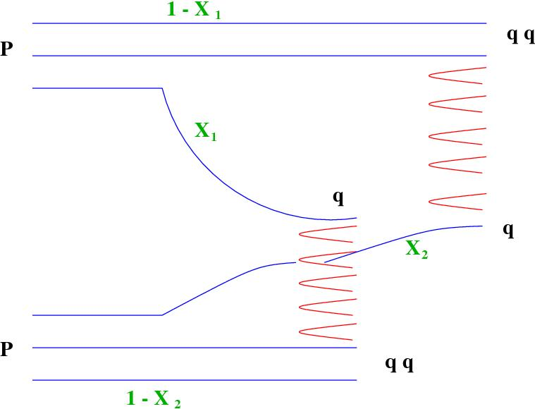

Slide 4
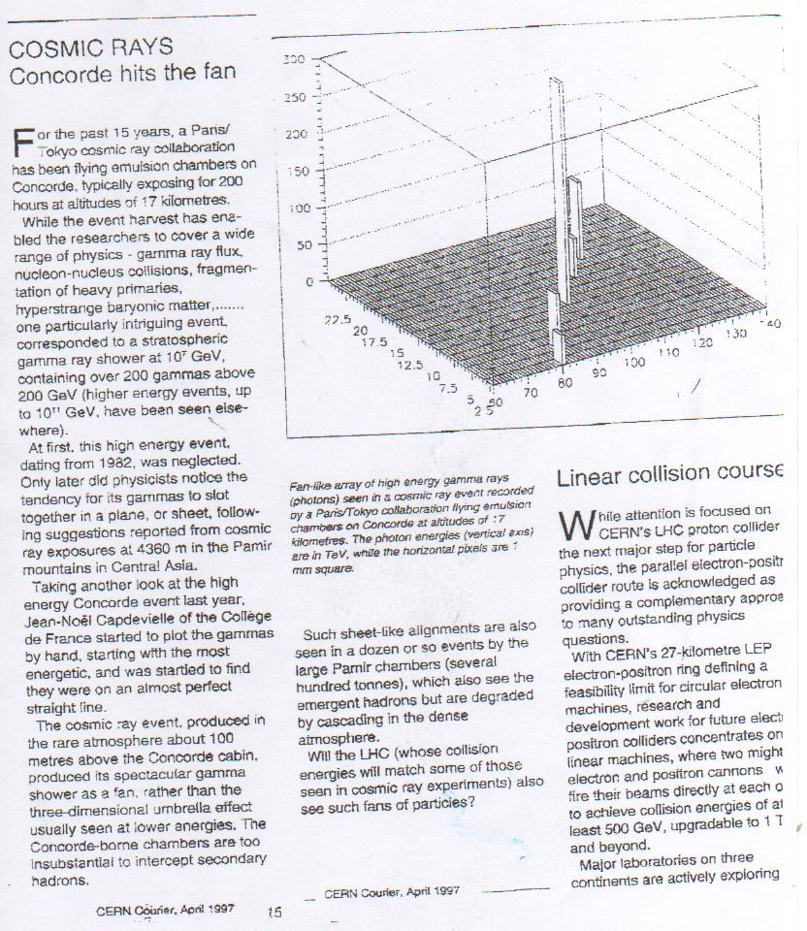
CERN Courier april 97
Near 10⁷GeV, 211 γ’s

Slide 5
JF2af2 and Strana
2 events with alignments in the stratosphere
Strana from a russian balloon flight at 10g/cm2
JF2af2 at 100g/cm2
30 Hadrons in Strana (2500 TeV)

Slide 6
Schwinger theory, tension 10 times larger for partners of valence diquark?

Slide 7
Very large tension for the diquark partners ?
Most energetic gamma’s aligned in realtion with valence quarks?
Energy threshold for valence diquark fragmentation √s = 4-5 TeV ?
Minimal energy consumed at threshold and maximal probability of observation in cosmic rays

Slide 8
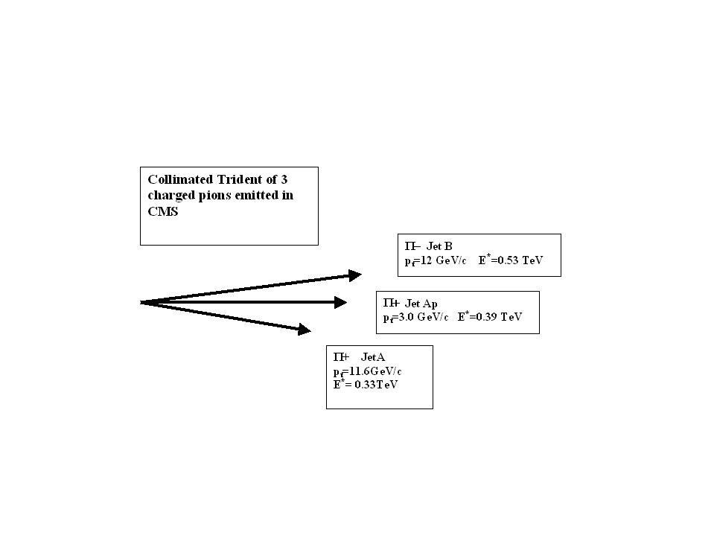
When E(cms) exceeds the threshold, the coplanar emission disappears, but non aligned clusters remain

Slide 9
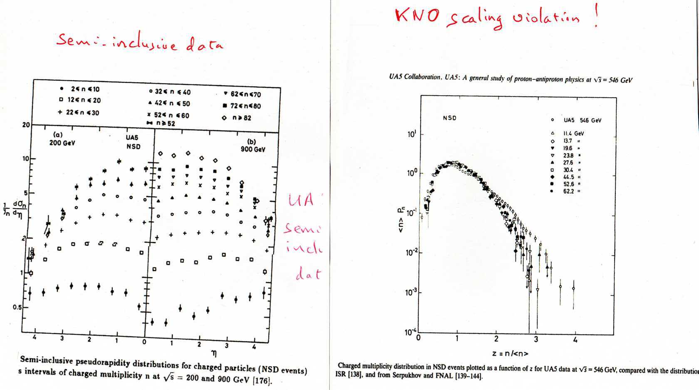

Slide 10
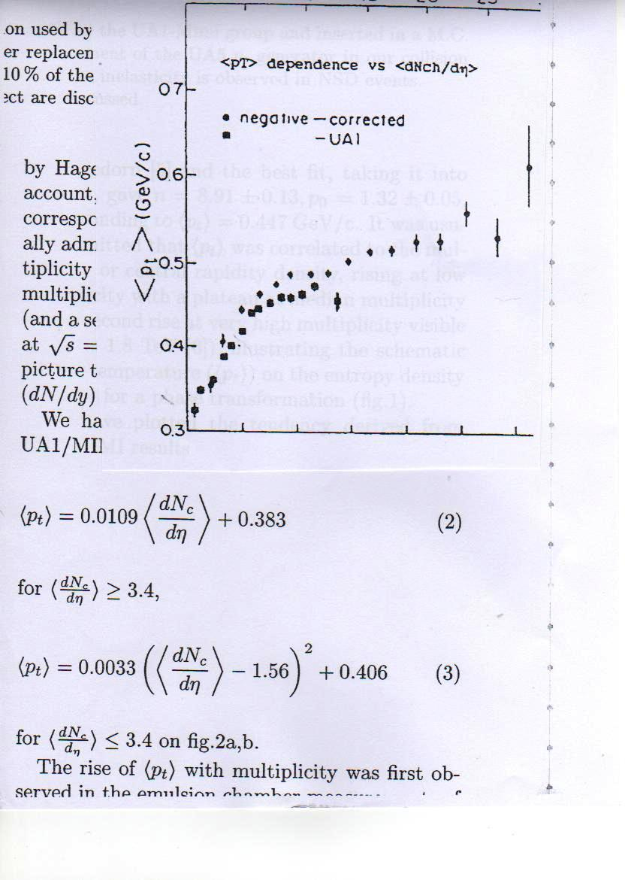

Slide 11
CERN Courier
October 1981
Experiences ECHOS started in October 1978
0ne collision of 10⁶ GeV (high multiplicity, spikes in the distribution of pseudo-rapidité) at first exposure

Slide 12
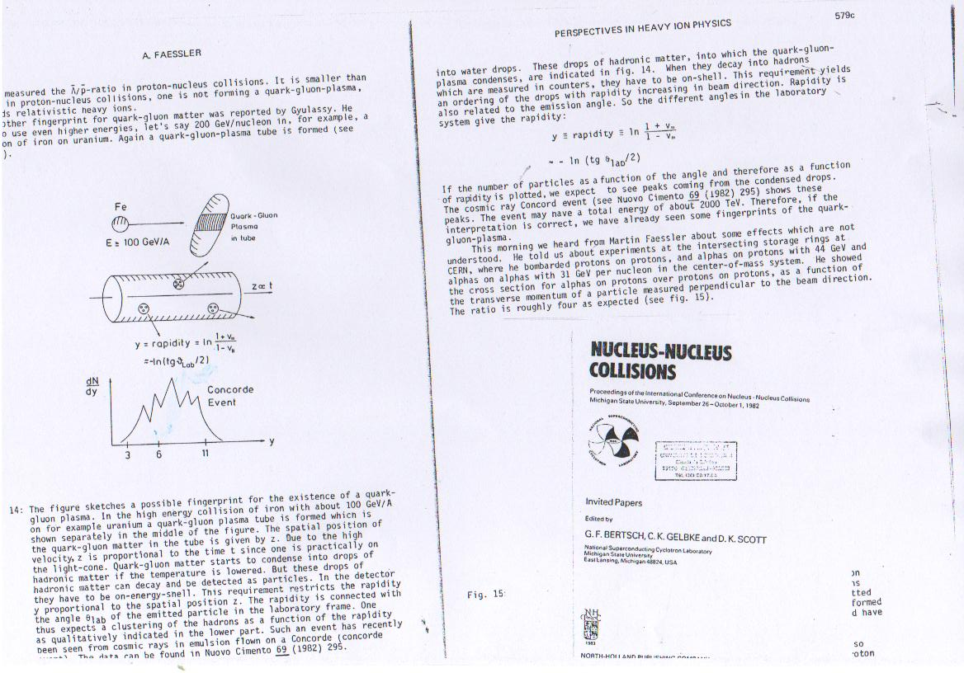
Hints of hot spots for QGP ? Nucleus-Nucleus Collisions, 82

Slide 13
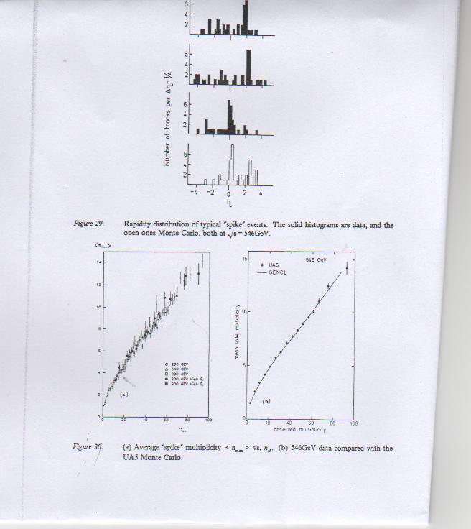

Slide 14
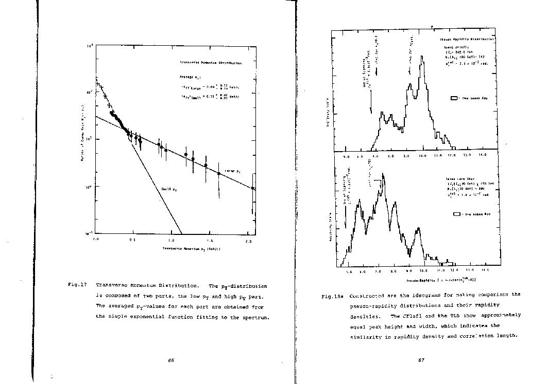

Slide 15
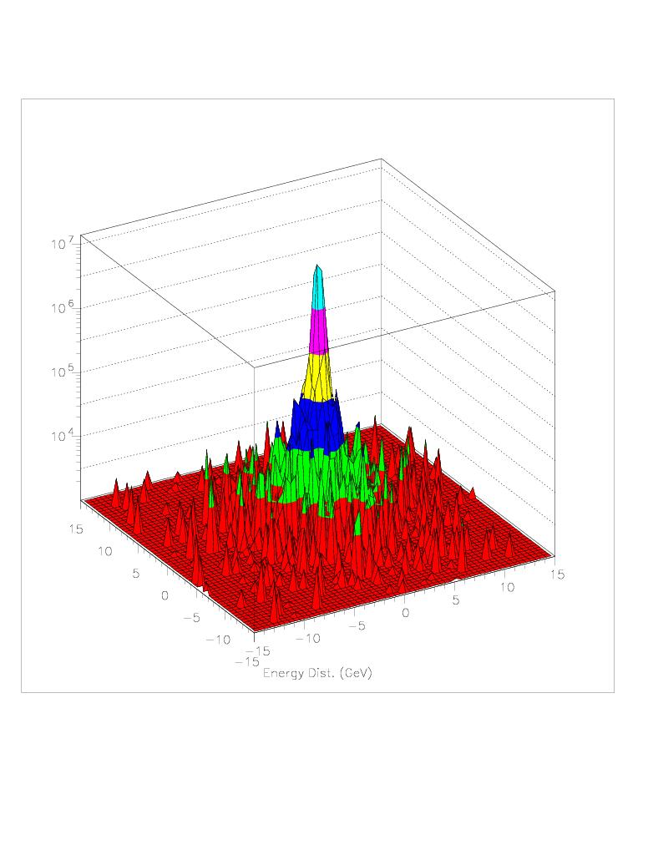
TADJIKISTAN
No alignements in super families above 7 TeV in CMS

Slide 16
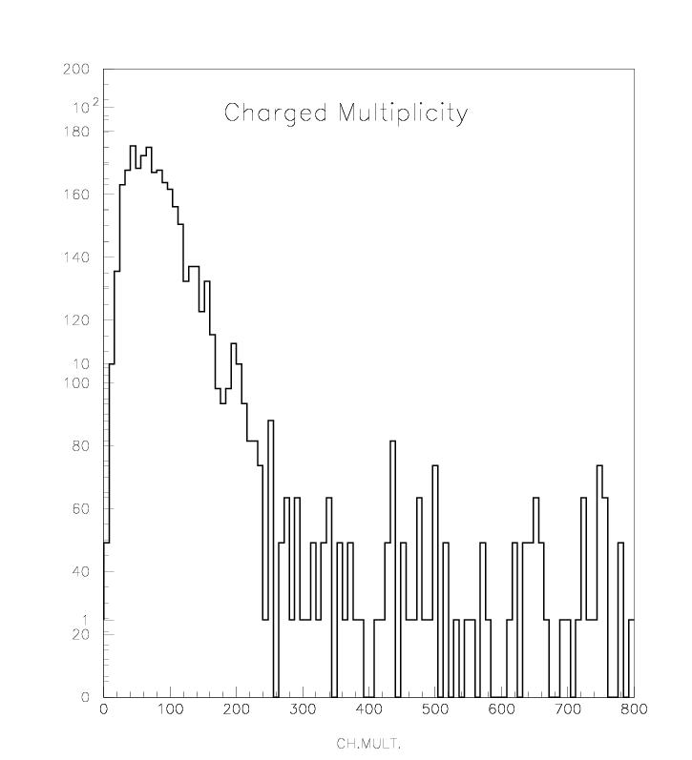
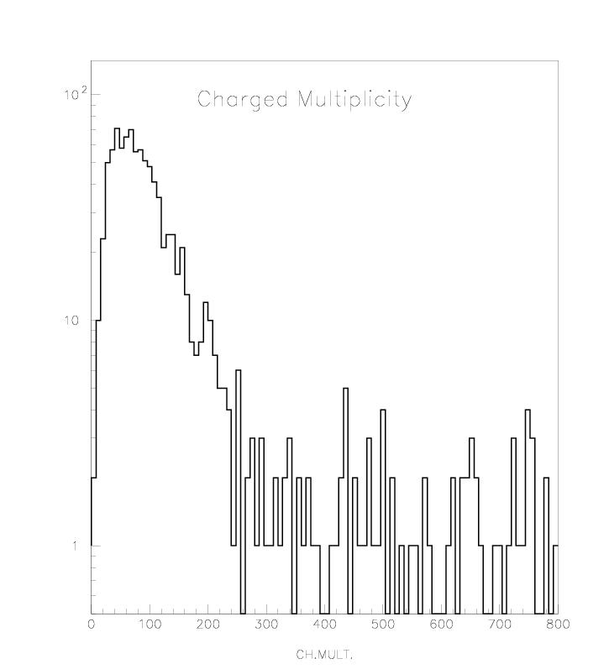
Violation du scaling de KNO (1000 collisions) 10²⁰ eV

Slide 17
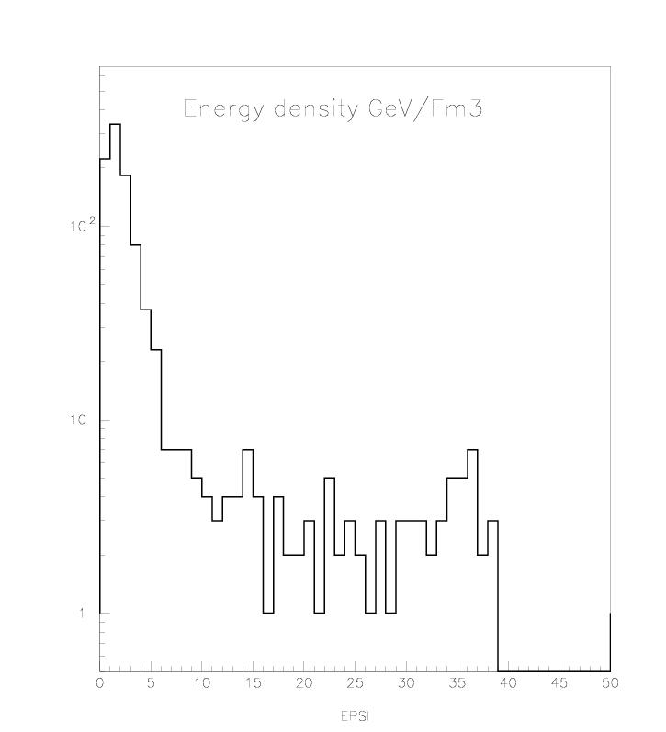
Energy densities above 30 GeV/Fm3

Slide 18
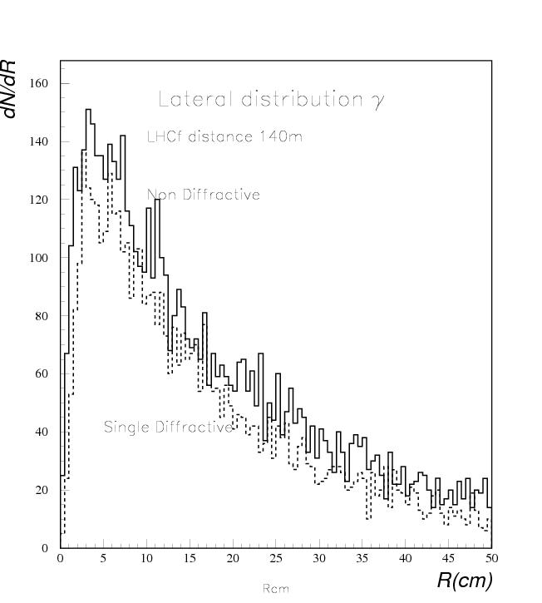
Lateral distribution of γ’s simulated for LHCf

Slide 19
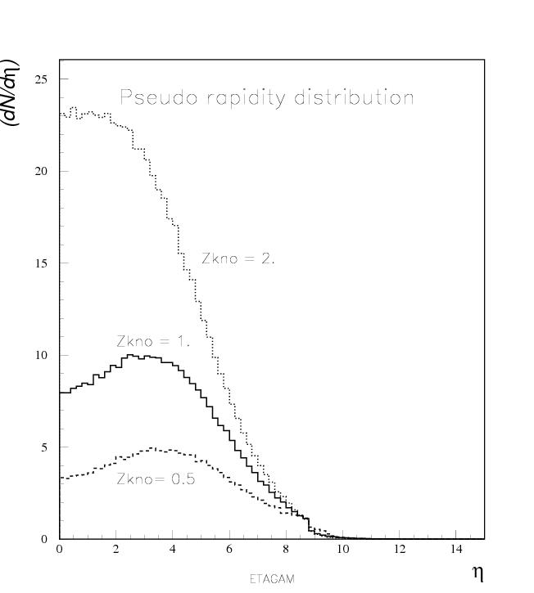

Slide 20
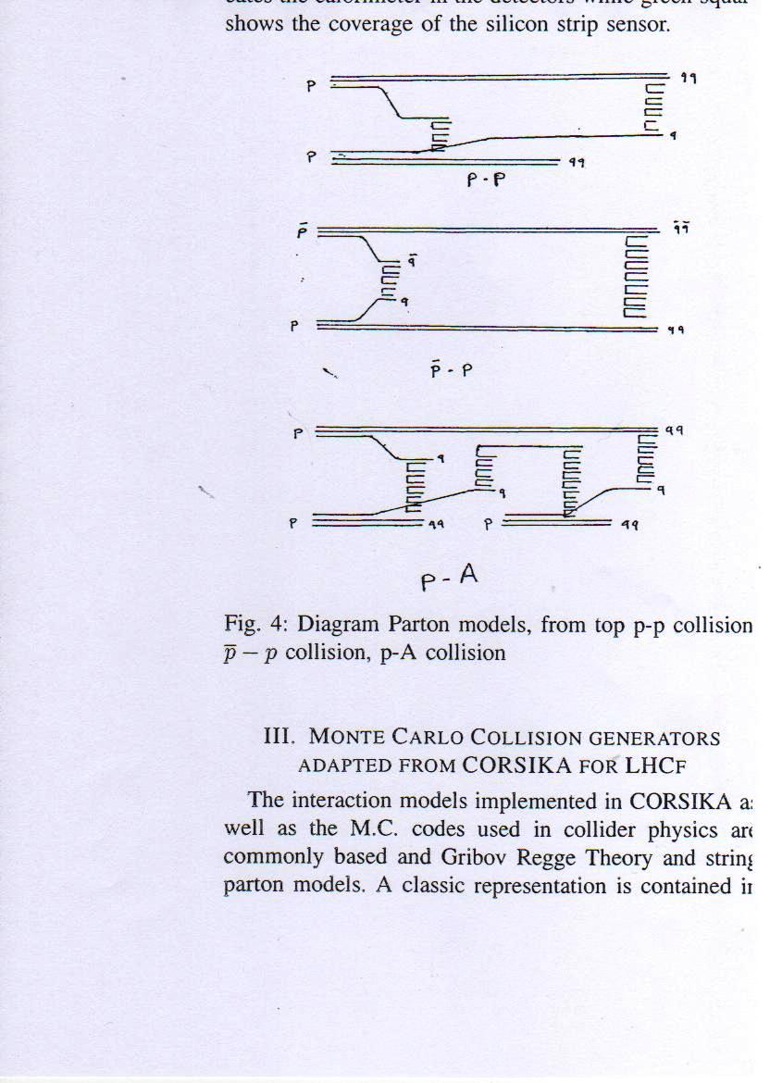

Slide 21
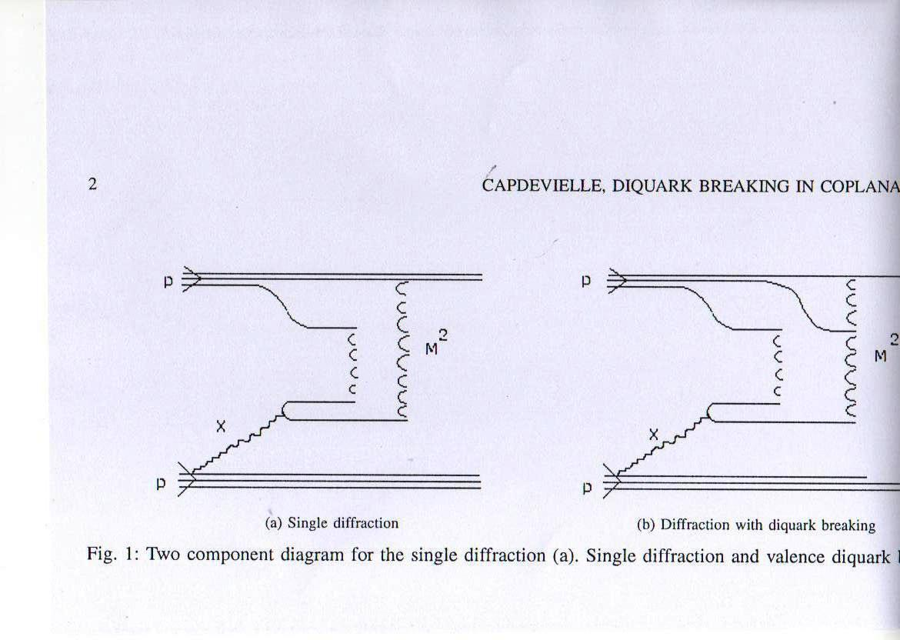

Slide 22
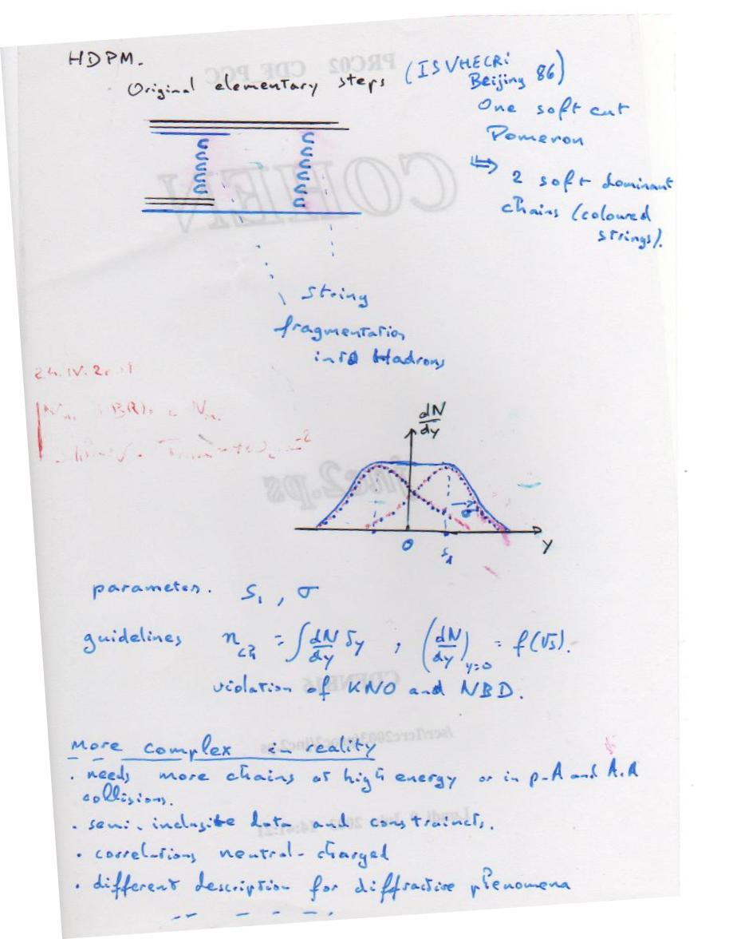

Slide 23
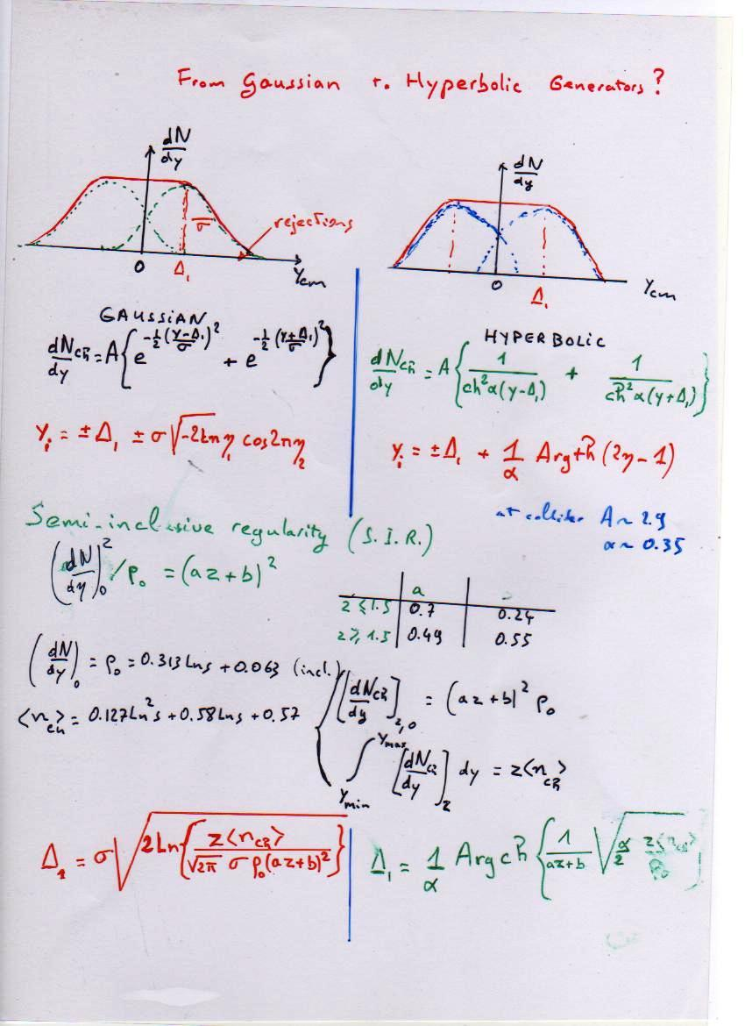

Slide 24
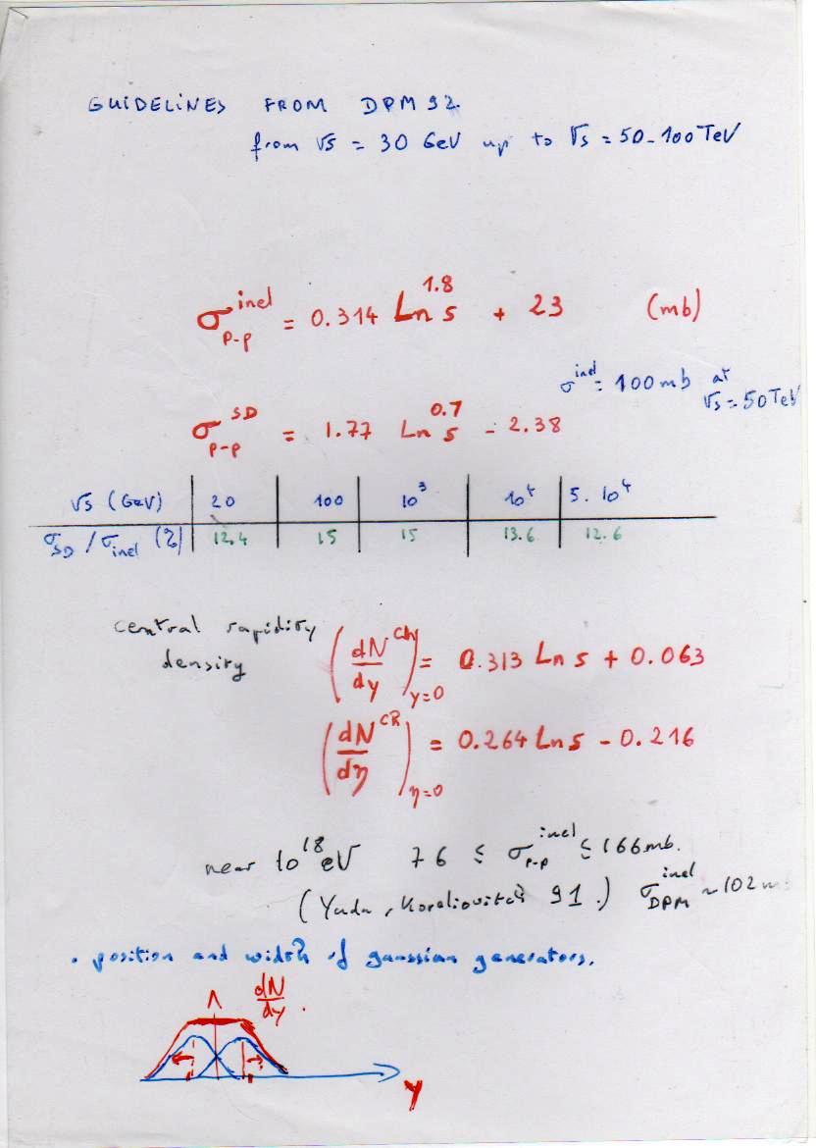

Slide 25
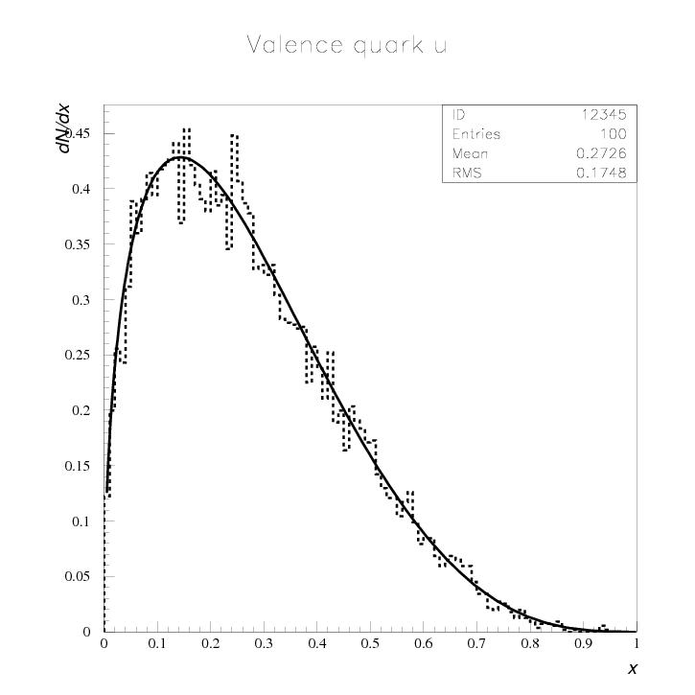

Slide 26
New guidelines from LHC
CMS, ATLAS and ALICE
Central pseudo rapidity densities larger than expected in usual models !
dN_{ch}/dη = 4.47 ± 0.04(stat.) ±0.13(syst) for √s= 2.36 TeV (2.97 PeV in Lab.)
dN_{ch}/dη = 6.01 ± 0.01(stat.) _{-0.62}^{+0.2}(syst)
for √s= 7 TeV (26.1 PeV in Lab.) NSD

Slide 27
Guidelines inserted in Hybrid dual parton model
dN_{ch}/dη = 0.595 s^{0.13} for √s > 0.9 TeV
dN_{ch}/dη = 0.74 s^{0.105} from UA5 data
N_{ch} = 2.257 s^{0.195} for √s > 0.9 TeV
N_{ch} = -7 + 7.2 s^{0.127} from UA5 data
Landau Hydrodynamical model predicted a behaviour (assuming a major part of CMS available energy converted in s^{0.25} whereas Feyman’s scaling and colliders were in favour of s^{0.13}

Slide 28
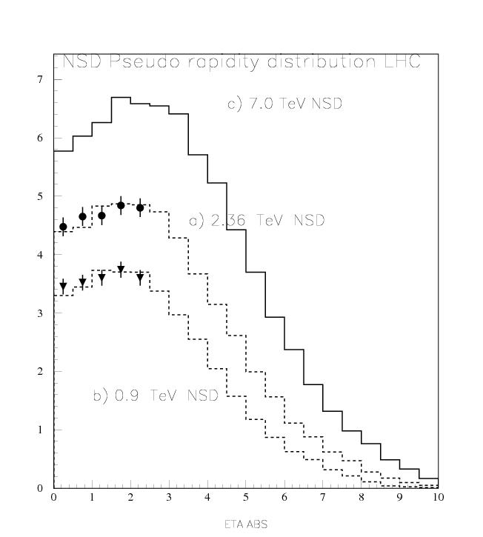
Alice 6.01→
CMS 4.47 →
CMS 3.48 →

Slide 29
Fe or fat proton ?
Change of p interaction near 2-3 EeV or progressive evolution of the collision with higher multiplicities and cross sections?

Slide 30
CONCLUSION
A situation similar to the period preceeding the discovery of the Charm.
Several simulations shows that coplanar events as well as spikes could result from random groupings
However spikes close to fragmentation region, as well as alignements concentrated near 3-5 TeV CMS energy could be investigated in LHC

Slide 31
CONCLUSION
The faster increase of central rapidity density (multiplication of chains in central region) suggests more muons in EAS, a maximum at higher altitude and lower primary mass in the knee region.
If those tendancies persists, the maximum depth at UHE observed in AUGER would be explain by a pure proton composition.

Slide 32
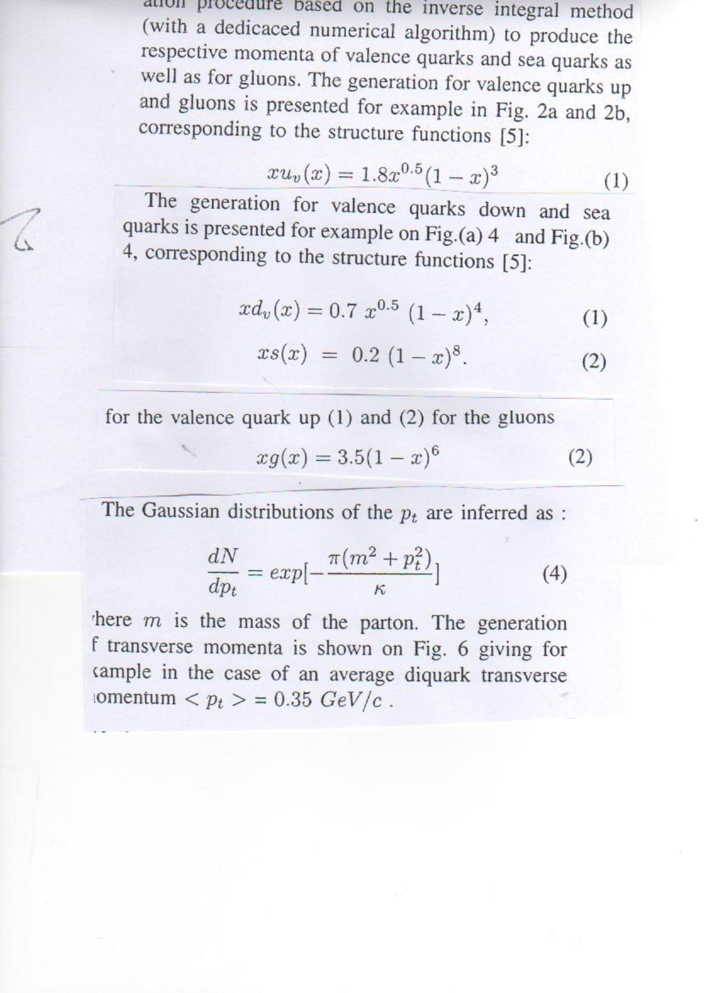

Slide 33
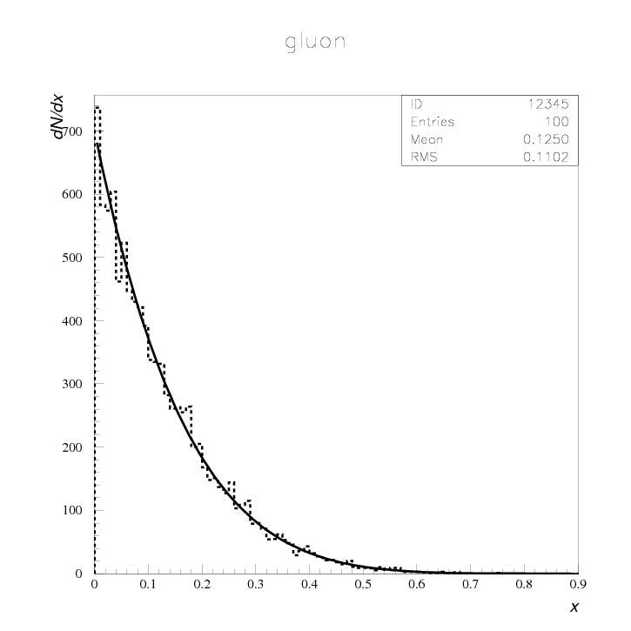

Slide 34
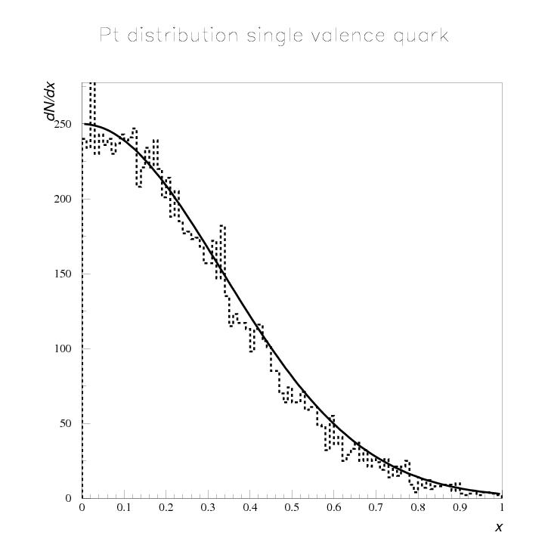

Slide 35
