Slide 1
CASTOR LHC and Cosmic Rays
Edwin Norbeck and Yasar Onel University of Iowa
Apostolos Panaqiotou University of Athens
For ISVHECRI at FNAL
5:00 PM June 28,2010
1
1
1
1

Slide 2
Contents of Talk
The “CASTOR”Calorimeter
Physics to be addresses with CASTOR
Cosmic – Ray “exotic” phenomena
Searching for “Long penetrating particles” → Strangelets?
Outlook – Summary

Slide 3
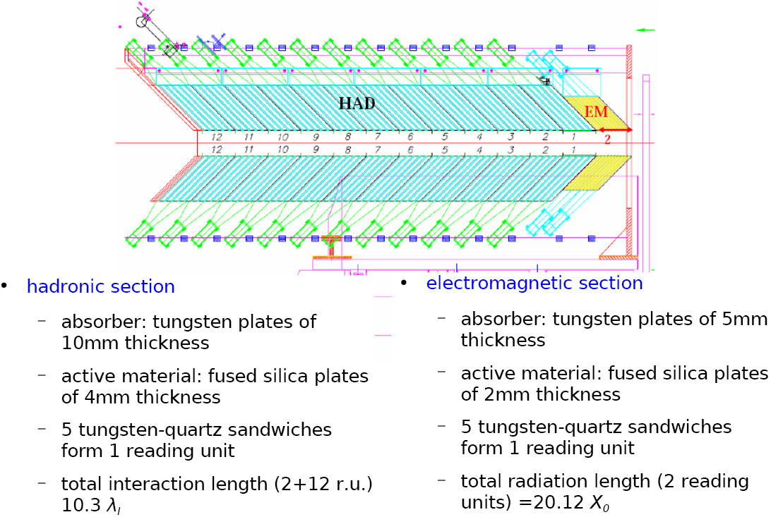
CMS/CASTOR Calorimeter
3
3

Slide 4
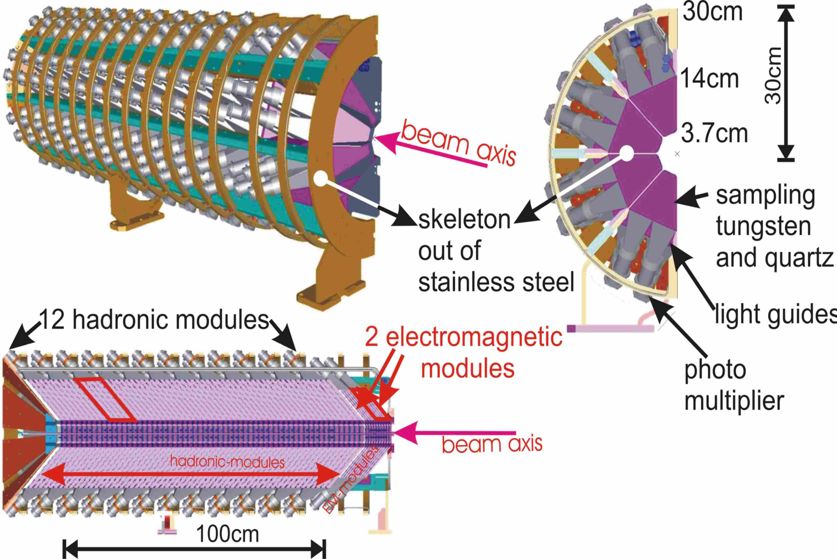
CMS/CASTOR Calorimeter
4
4

Slide 5

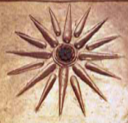
CMS/CASTOR Calorimeter
Sampling calorimeter with quartz plates as active medium and tungsten as absorber → compact, radiation hard
and fast
16 segments around the beam line
Each segment has 2 EM sections and 12 HAD sections
No radial segmentation
Small angles, 1º to 7º in the center of mass
Extends CMS in forward direction to -6.6 < η < -5.2
CASTOR is 1.5 m long and 36 cm in diameter.
Čerenkov calorimeter at 14.39 m (-z) from CMS IP

Slide 6
CMS/CASTOR Calorimeter
6
6

Slide 7
CMS/CASTOR p=p physics
CASTOR has taken p-p data at 0.9, 2.4 and 7 TeV
Extends reach of CMS from η = 5 to η = 6.6
Measure forward angle jets
Extra coverage helps search for Higgs, supersymmetry etc.
Useful in identifying diffractive reactions.
Disadvantage—All interactions in a single beam crossing are combined. (Over a dozen at full design luminosity.)
For |η| < 2.6, reactions are separated by silicon tracker.
CASTOR will be removed for highest luminosity p-p runs.
No such problems with heavy ion runs.

Slide 8
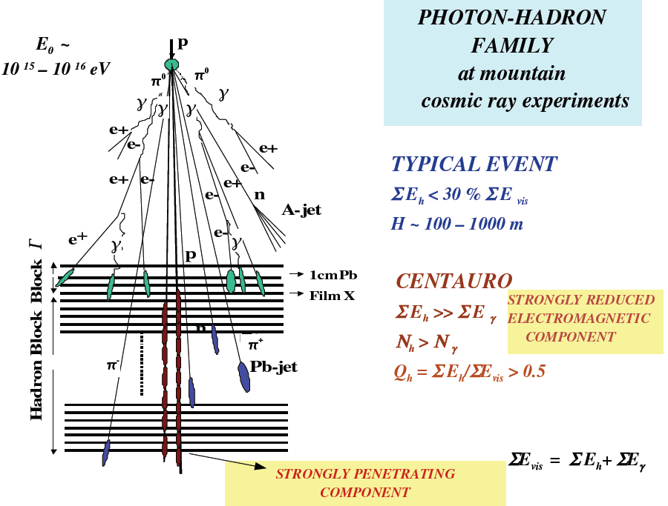
Exotic Cosmic – Ray Events

Slide 9
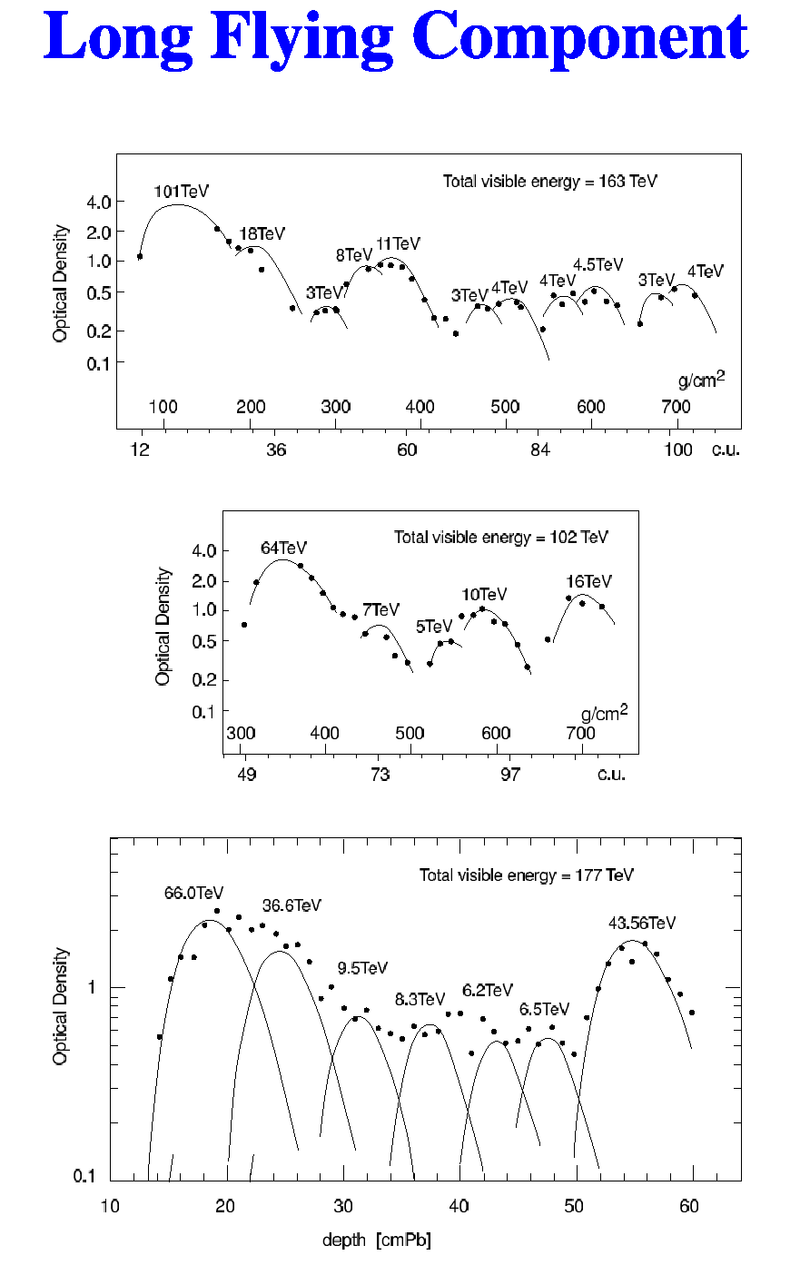
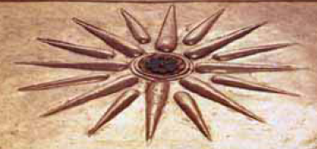
(Strangelet ?)
1.5 λ_{I} Hadron limit
3.6 λ_{I}
Measurement settings:
100 μm shower core diameter → threshold ~ 3 TeV
3.6 λ_{I}
Hadron limit
3.2 λ_{I}

Slide 10

CASTOR designed to recognize unusual objects
Recognizing the long flying object requires a detector at small angles with adequate longitudinal segmentation.
At the LHC only CASTOR with its 14-fold longitudinal has such a capability.
CASTOR is designed for heavy ions, but is also valuable for p-p at low luminsities.
With heavy ions there are no problems with pileup, overload or radiation damage.
CASTOR will provide the only window for observing the many strange objects, with one exception—Strangelets.

Slide 11
Strangelets
Defined here as light nuclei with enough strange quarks to substantially reduce Z/A.
Thought to be a common object seen in the core of cosmic ray showers (in mountain top detectors).
Typical reaction: cosmic iron on nitrogen.
How could such a reaction produce a strangelet?

Slide 12
Cosmic ray stranglets
Cannot be formed from hot quark-gluon plasma.
Nucleons (P, N, Λ_{o}) from hot QGP do not stick together to form nuclei.
[J. Ellis et al J. Phys. G 35 (2008) 115004]
Suggest formed by Ks, Λs, etc. from QGP getting into the spectators.
For Fe on N there is always much spectator matter.

Slide 13
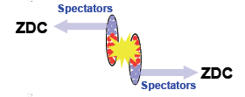
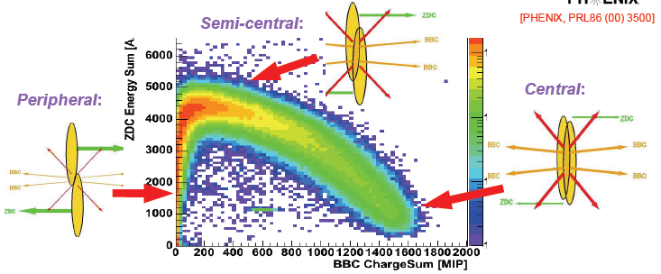
ZDC measures reaction centrality but could also see stranglets
ZDC measures spectator neutrons
Notes:
-help measure geom of collision, dist btw ->centrality

Slide 14
Stranglets at CMS
Would like to make the stragelets with Pb-Pb and see them in CASTOR.
Unfortunately spectators go in the same direction as the beam and pass through the middle of CASTOR .
A spectator with Z/A less than the beam would be seen by the Zero Degree Calorimeter.
The ZDCs are between the ingoing and outgoing beam lines at 140 m.
How can particles with strange quarks get from the hot interaction region into a spectator?

Slide 15
Look at a peripheral reaction
Cross sections for K⁻ and Λ are so large that they interact in the spectator.

Slide 16
Summary – Outlook
CASTOR is an excellent detector for recognizing unusual cosmic-ray type objects.
Spectator nuclei with reduced Z/A likely produced in suitably non-central heavy-ion collisions at the LHC. These would be seen in Zero Degree Calorimeters.
Short lived stranglets that could reach mountain-top cosmic ray detectors may not live long enough to reach a ZDC (at 140 m).

Slide 17
Back Up Slides

Slide 18
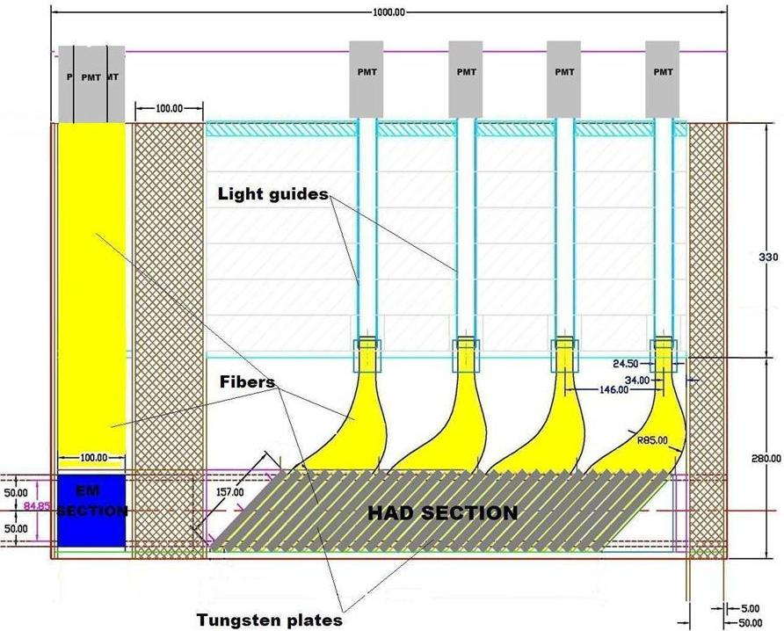

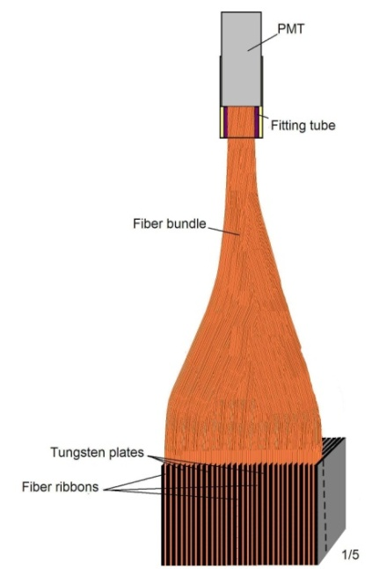
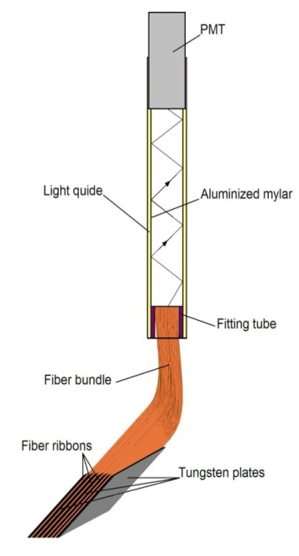
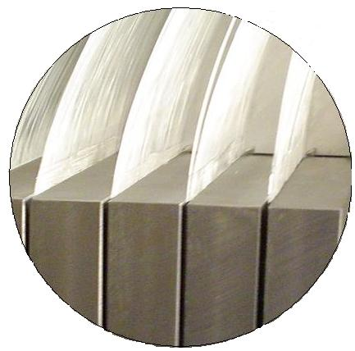
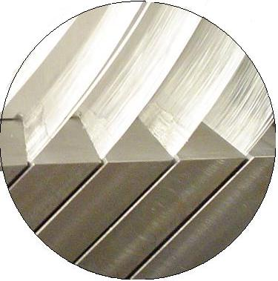
ZDC Design
Tungsten stops beam. Kinetic energy of n, γ produces showers of charged particles, which make Čerenkov light in fibers.
N,γ
EM has 5 horizontal towers
HAD section has 4 longitudinal towers

Slide 19
CASTOR Calorimeter Response

Slide 20
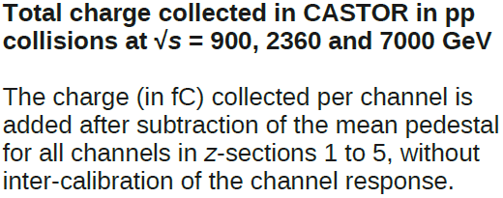
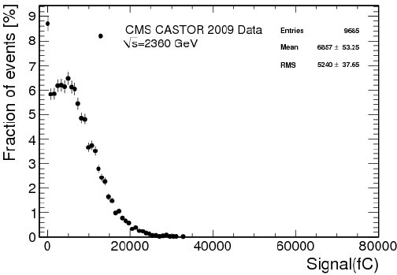
First pp Data 2009 & 2010

Slide 21
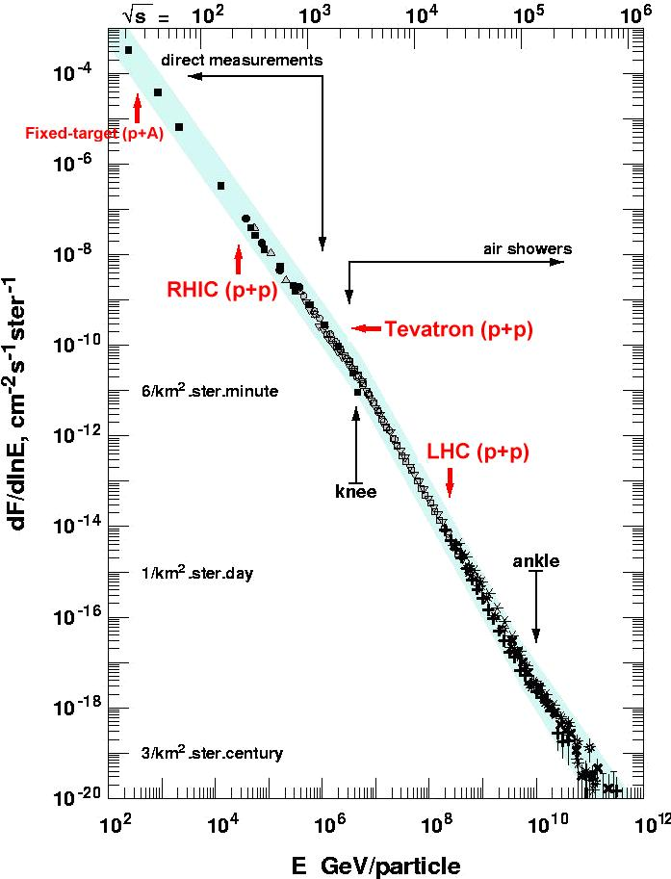
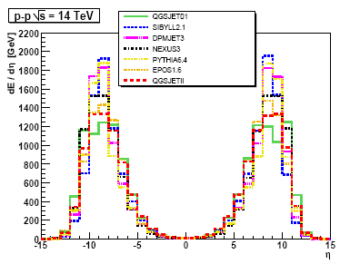
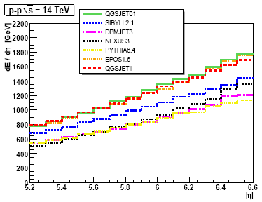
UΗΕ Cosmic-Rays (I)
MC simulation of hadronic cascades
Forward region not known
Models differ by a factor of >3

Slide 22

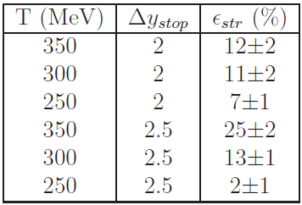
Probability of Centauro & Strangelet Detection
~ 60% of Centauro decay products and ~1-20% of Strangelets are within CASTOR acceptance

Slide 23
MC simulation of Strangelets in CASTOR

Slide 25

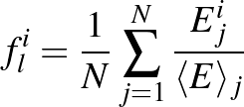

Analysis (Ι)
“Strangelet signature”
Azimouthal Energy distribution
Cascade Energy distribution
- Event-by-event
- Sector-by-sector
(Central Pb+Pbcollisions, b=0)

Slide 26
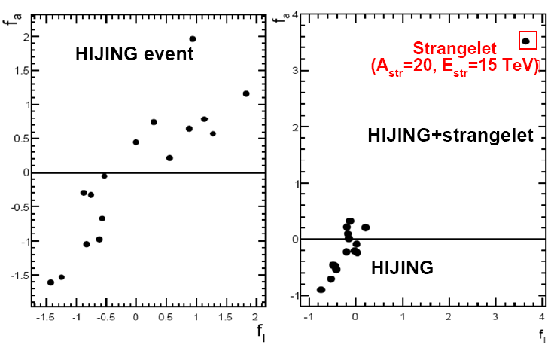
Analysis (Ι)
“Strangelet signature”
Azimouthal Energy distribution
Cascade Energy distribution
- Event-by-event
- Sector-by-sector
(central Pb+Pb collisions, b=0)
Select φ-sector containing Strangelet

Slide 27
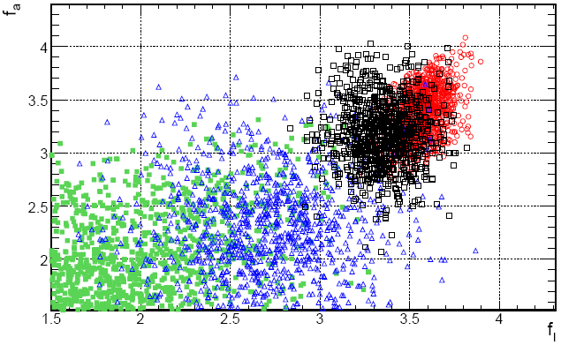
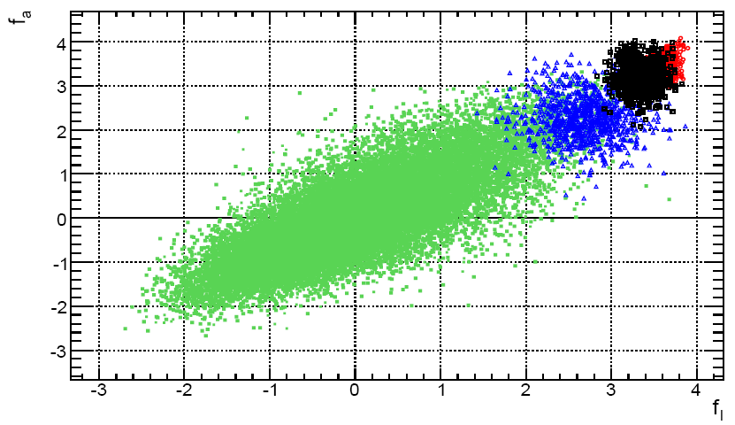
Analysis (ΙI)
Fluctuations on the (f_{a}, f_{l}) plane
Strangelets
E=6-15 TeV
HIJING
(2k events)‏
Statistical fluctuations of HIJING events with similar characteristics
Strangelets with higher energies are separated from conventional HIJING events
Distinction of conventional events with similar fluctuations E_{em}/E_{had}

Slide 28
Analysis (ΙII)

Slide 29
Analysis (ΙII)

Slide 30
Characteristics of a “Strangelet” Event
Sector with much higher energy than the average:
Strong azimuthal asymmetry in energy deposition
2. Strong penetration of the longitudinal cascade in a sector:
Strong fluctuations in longitudinal transition curves
Much smaller E_{EM} / E_{HAD} compared to HIJING
4. Appearing in a very low multiplicity event compared to HIJING

Slide 31
Cross Section Estimation for Strangelets
Probability for a hadron-rich ‘Centauro-type’ event is about 3%, estimated from statistics of Chacaltaya and Pamir experiments for cosmic ray families with visible energy greater than 100 TeV.
In about 10% of hadron-rich events, strongly penetrating cascades, clusters, or “halo” were observed. Assume total probability for “Long penetrating component” (Strangelet?) production in central nucleus-nucleus collisions to be approximately: 0.03 x 0.1 ~ O(10⁻³).
At LHC kinematics, the percent of Strangelets in CASTOR phase space is at least ~ 1% of total number of Strangelets produced in central Pb-Pb collisions, depending on the mass and energy of the Strangelet (CENGEN).
An order of magnitude estimation of the total probability for Strangelet detection in CASTOR is:
P^{CASTOR}_{strangelet} ≈ 10⁻³ × 0.01 ≈ O(10⁻⁵)
→ Ν_{strangelet} ~ 1-10 in 4 wks Pb+Pb (5M central events in 2010)

Slide 32
Conditions for DQM-bag Stability P_{qg} = B
Pressure of (u,d) quark-gluon plasma
Minimization of Bag energy (dE/dR = 0) in spherical DQM distribution with radius R and N_{q} massless quarks.
P_{qg} = (8/45)π²Τ⁴ +μ_{q}²Τ² + μ_{q}⁴/2π² = (2.034Ν_{q}/4π)(1/R⁴) = B
For CR Centauro (μ_{q}~ 600 MeV, T ~ 130 MeV, N_{q} ~ 225) R = r_{o}N_{b}^{1/3} ~ 1.43 fm → r_{o} = 0.34 fm (~ r_{o} ‘collapsed’ nucleus)
Astroparticle Phys.13(2000)173

Slide 33

Stable Strangelet interaction in CASTOR
MC-algorithm
Strangelet is considered with radius:
Mean interaction path:
Strangelets passing through the detector collide with W nuclei:
Spectator part is continuing its passage.
Wounded part produces particles in a standard way.
Particles produced in successive interactions initiate electromagnetic-nuclear cascades.
Process ends when strangelet is destroyed.
E. Farhi, R. Jaffe, Phys.Rev.D30(1984)2379; M. Berger, R. Jaffe, Phys.Rev.C 35(1987)213, G.Wilky, Z.Wlodarczyk, J.Phys.G22(1996)L105; E. Gładysz, Z. Włodarczyk, J.Phys.G23(1997)2057
The rescaled r₀ is determined by the number density of the
strange matter: n = A/V = (1/3)(n_{u}+n_{d}+n_{s})
where n_{i}=- ∂Ω_{i}/∂μ_{i}; Ω(m_{i},μ_{i},α_{s}), taking into account the QCD O(α_{s}) corrections to the properties of SQM.
s
s
s

Slide 34
Properties of Strangelets

