Slide 1
The ARRA ANI Network Testbed Project
September 29, 2009
Brian L. Tierney
bltierney@es.net

Slide 2
Overview
Project Start Date: September, 2009
Funded by ARRA for 3 years
  Hopefully will continue beyond ARRA
Designed, built, and operated by ESnet staff
1 of 3 ARRA “Advanced Network Initiative” (ANI) projects in the DOE
  ANI 100G Prototype
  ANI Testbed
  4 ANI research projects

Slide 3
ARRA/ANI Testbed Goals
Enable network, middleware and application end-to-end R&D at 100G
Configurable
Breakable
  Isolated from the production network
Reservable
Easy to reset to known state
A community network R&D resource
  open to researchers and industry to conduct experiments

Slide 4
Multi-Layer Architecture Capability Planes

Slide 5
Testbed Requirement:
Support Network Research
Support research on:
  Data Plane
  Control Plane
  Management Plane
  AA Plane
  Service Plane
Ability to do multi-domain hybrid networking
  Support R&D on multi-layer and multi-domain control and signaling at layers 1-3
Ability to reserve and manage each components
Support protection and recovery research
Support interoperability testing of multi-vendor 100G network components
Provide access to all available monitoring data

Slide 6
Testbed Requirement:
Support Middleware/Application Research
Ability to support end-to end experiments at 100 Gbps
  Connect to Magellan systems at NERSC and ALCF
Ability to reserve and manage components
  End hosts / storage as well as network
Use virtual machine technology to support protocol and middleware research

Slide 7
ANI 100G Prototype Network
The “100G Prototype” network will connect NERSC, ALCF, OLCF, and MANLAN at 100Gbps
  Not for production ESnet traffic
Testbed will use 100G waves from the prototype network
Testbed will use 100G routers from the prototype network

Slide 8
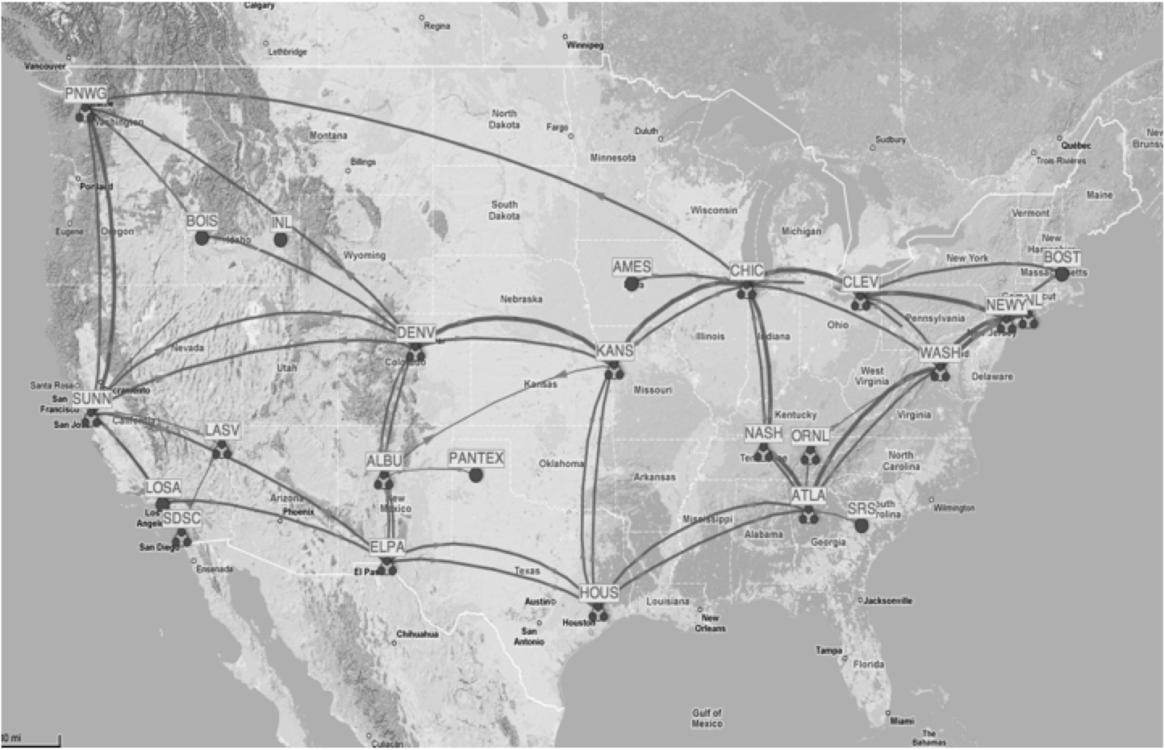
Nationwide 100G Prototype Network
Chicago
NYC
Magellan
ALCF / ANL
Magellan
NERSC
Sunnyvale
OLCF / ORNL
Nashville
100 G

Slide 9
ANI Testbed “Nodes”
Each testbed node will consist of:
  DWDM device (Layer 0-1)
    e.g.: Infinera, Ciena, Adva, etc.
    GMPLS-enabled
  Ethernet Services Router (layer 2-3)
    e.g.: OSCARS compatible Juniper, Cisco, etc.
    MPLS-enabled
  Test and measurement hosts
    Virtual Machine based test environment
    10G test hosts initially
      Eventually 100G from Acadia 100G NIC project

Slide 10
Phased Approach
Phase 1:
  4 nodes in a lab at LBL
  Multiple10G waves between each node (> 40)
    Combination of Ethernet and SONET
  Full mesh connectivity
  Ability to simulate multiple domains
  MPLS enabled routers
  Secure access via a gateway node from anywhere
  Scheduled via simple calendar

Slide 11
Phase 1: Tabletop Testbed in Lab
N2
N1
N4
N3
Notes:
Can configured in multiple ways, including example above with 3 possible paths from N1 to N4
Can be used to simulate multiple domains

Slide 12
Phased Approach
Phase 2:
  Nodes are deployed on the WAN
  1 or more 10/100G Ethernet circuits between each node
    Will upgrade segments to 100G as hardware becomes available
  Partial physical mesh connectivity
    Logical full mesh possible via VLANs
  Ability to simulate multiple domains
  MPLS enabled routers
  Scheduled using OSCARS-like system

Slide 13
Phase 2 Deployment Assumptions
The following architecture assumes the following comes out of the ESnet ANI RFPs:
  “Dim fiber” between Sunnyvale and NERSC
  “Dim fiber” between Chicago and ANL
  A single 100G service between Sunnyvale, Chicago, Nashville, and New York
Dark fiber ring in Long Island connecting AofA to BNL
Note that the ANI architecture presented here will change if these assumptions are not true

Slide 14
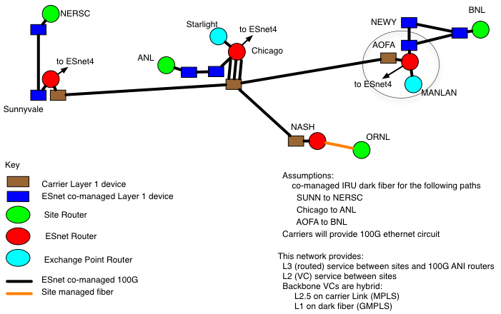
ANI Prototype Network – current plan

Slide 15
Testbed Access
Testbed will be accessible to anyone:
  DOE researchers
  Other government agencies
  Industry
Must submit a short proposal to the testbed review committee
  Committee will be made up of members from the R&E community and industry

Slide 16
Timeline: Phase 1
Milestone
Oct 2009
Project Start
Hardware selection
Jan 2010
Initial Hardware Ordered
Testbed installed and configured
Apr 2010
Simple management software developed
Initial ‘table top’ node hardware setup at LBL
Jul 2010
Review committee established
Testbed available to DOE-funded researchers
Oct 2010
Hold Testbed Workshop
Start accepting Testbed proposals
Jan 2011

Slide 17
Timeline: Phase 2
Milestone
Oct 2010
WAN deployment planning based on ANI Prototype awards
Jan 2011
OSCARS-like interface to schedule resources deployed
Apr 2011
Connect Testbed to Magellan
100G WAN Testbed Available to researchers
Jul 2011
Testbed available to 1st group of non-DOE researchers
Accept 2nd round of Testbed Proposals
Oct 2011
Refine Testbed Management Software
Jan 2012
2nd round Testbed users get access

Slide 18
Testbed to support DOE ARRA-funded Research Projects
Climate 100 (LLNL, LBL, ANL)
  Project Goal: Scaling the ESG to 100G
  Testbed role: provide interconnect between “Magellan project” resources at ANL and NERSC
Advanced Network and Distributed Storage Laboratory (OSG: U Wisc, FNAL, etc)
  Project Goal: enhance Virtual Data Toolkit (VDT) data management tools to effectively utilize 100G networks
  Testbed role: provide interconnect between “Magellan project” resources at ANL and NERSC
100G NIC (Acadia and Univ New Mexico)
  Project Goal: produce a host NIC capable of 100 Gbps
  Testbed role: Provide test environment for this device
100G FTP (BNL/Stony Brook University)
  Project Goal: design 100G transport protocols and tools to enable 100G FTP server to client data transfer
  Testbed role: Provide a 100G test environment

Slide 19
Testbed to support DOE Network Research Projects
“Resource optimization in hybrid core networks with 100G links” (Univ Virginia)
  Project Goal: Develop methods for automatic identification and tagging of flows that should be moved from the IP network to a dynamic virtual circuit
  Testbed role: Provide a test environment for validating these these methods
“Integrating Storage Resource Management with Dynamic Network Provisioning for Automated Data Transfer” (BNL, LBL)
  Project Goal: Integration of dynamic virtual circuits into BestMAN (Berkeley Storage Manager / SRM v2.2)
  Testbed role: Provide a 100G test environment for verifying this work
“Provisioning Terascale Science Apps using 100G Systems” (UC Davis)
  Project Goal: Advanced path computation algorithms for efficiency and resiliency
  Testbed role: Provide a control plane test environment for these algorithms using OSCARS

Slide 20
Testbed to support DOE Network Research Projects (cont.)
Virtualized Network Control (ISI, ESnet, Univ New Mexico)
  Project Goal: multi-layer, multi-technology dynamic network virtualization
  Testbed role: provide a control plane test environment for experiments using hybrid networking
“Sampling Approaches for Multi-domain Internet Performance Measurement Infrastructures to Better Serve Network Control and Management” (Ohio State Univ)
  Project Goal: Develop new network measurement sampling techniques and policies
  Testbed role: Provide a network environment for initial deployment

Slide 21
For More Information
Contact: bltierney@es.net

Slide 22
EXTRA SLIDES

Slide 23
Objectives
Provide a easily re-configurable high-performance network research environment to enable researchers to accelerate the development and deployment of 100G networking through prototyping, testing, and validation of advanced networking concepts.
Provide experimental network environments for vendors, IPSs, and carriers to perform inter-operability tests necessary to implement end-to-end heterogeneous 100G networks.
Provide support for prototyping middleware and software stacks to enable the development and testing of 100G science applications.
Notes:
This text from Thomas Ndousse

Slide 24
Relation to the Magellan Project
High-speed storage resources for the ANI Testbed will be provided by the ARRA-funded Magellan Project
  DOE computing project funded at $33M
  Goal is 100G end-to-end
Magellan is:
  a research and development effort to establish a nationwide scientific mid-range distributed computing and data analysis testbed.
  Consists of two sites
    NERSC / LBNL
    ALCF / ANL
  Will provide multiple 10’s of teraflops and multiple petabytes of storage, as well as appropriate cloud software tuned for moderate concurrency.

