Slide 1
SNS Target Systems Operational Experience and Upgrade Plans
T. J. McManamy
October 2009
Workshop on Applications of High Intensity Proton Accelerators
October 19-21, 2009
Fermi National Accelerator Laboratory, Batavia, IL, USA

Slide 2
Overview
Overall Power and Availability History
Target Systems Availability and Operational Issues
Proton Beam Window Replacement
Target Imaging System
Mercury System Development
Power Upgrade Planning
Second Target Station Planning

Slide 3
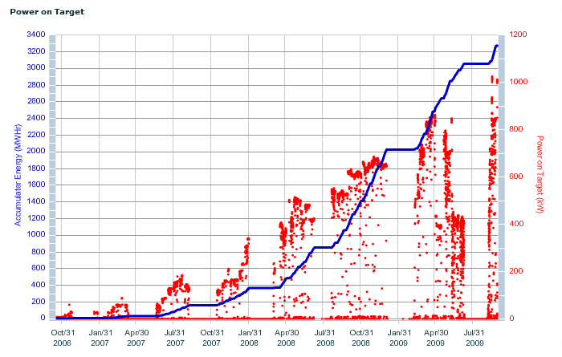
Energy and power on target from October 2006
First Target & PBW Replacement

Slide 4
SNS Performance Relative to Design
 | Design | Best Ever | Routine Operation
Kinetic Energy [GeV] | 1.0 | 1.01 | 0.87
Beam Power [MW] | 1.4 | 0.69 | 0.69
Linac Beam Duty Factor [%] | 6 | 3.6 | 3.6
Peak Linac Current [mA] | 38 | 56 | 38
Linac pulse length [msec] | 1.0 | 1.0 | 0.6
Repetition Rate [Hz] | 60 | 60 | 60
SRF Cavities | 81 | 76 | 76
Ring Accumulation Turns | 1060 | 1020 | 620
Ring Bunch Intensity | 1.5x10¹⁴ | 1.3x10¹⁴ | 8.1x10¹³
0.93
1.02
0.85
4.8
4.8
0.8
80
80
800
1.5x10¹⁴
1.1x10¹⁴
The “Best” values were not necessarily achieved simultaneously
Notes:
Updated 25Sep09 courtesy John Galambos

Slide 5
Overall Unscheduled Downtime - FY09
Good availability has been achieved for the Target Systems

Slide 6
Operational Issues
The mercury pump required repairs in 2007 to fix a failed gas seal on the shaft and leaking oil seals but has operated well since then
The moderator 7.5 kW helium refrigerator was repaired in December 2007 by installing the heat exchanger core in a vertical cold box
  This stopped the trend of a loss of capacity with time and allowed 4-5 month run cycles
  Recently the problem has reappeared at higher flow rates and is under investigation
A cryogenic hydrogen flow problem with the bottom downstream moderator was fixed by installing a flow guide (spring) through the transfer line using a 10 m fiber optic probe from outside the monolith

Slide 7
Target & PBW Replacement
The first target accumulated 3055 MW hours with an estimated peak damage of 7.5 dpa in the 316L material
While up to ~ 10 dpa was considered acceptable, it was replaced early during the July shutdown to avoid unscheduled loss of neutron production during the next run cycle
The Inconel 718 Proton Beam Window (PBW) was also replaced during this shutdown with an estimated peak damage of 6. 5 dpa.
The PBW replacement was done early to avoid scheduling conflict with other remote handling work planned for the next shutdown.
The target and PBW replacement also allowed deployment of a new Target Imaging System (TIS) which could improve estimates of the peak beam intensity on the target

Slide 8
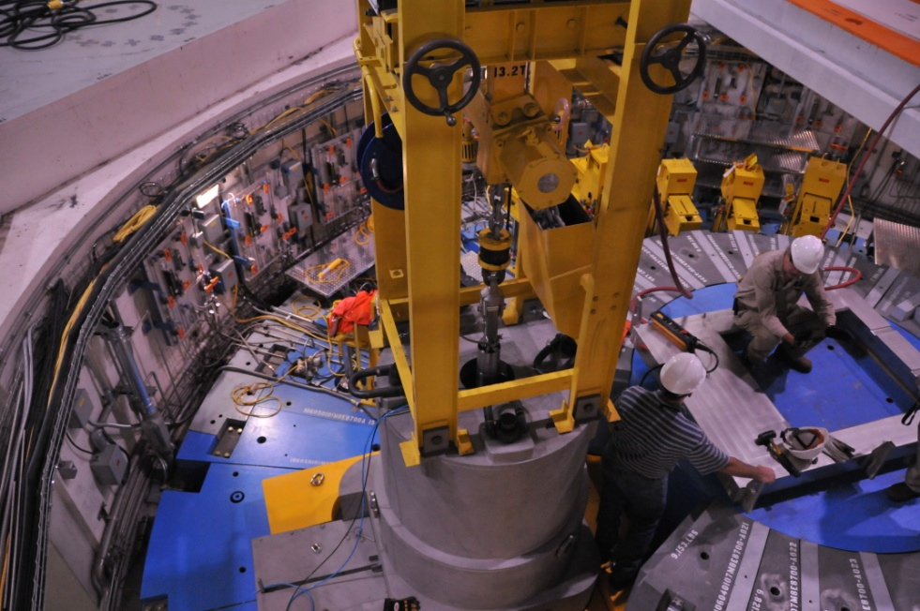
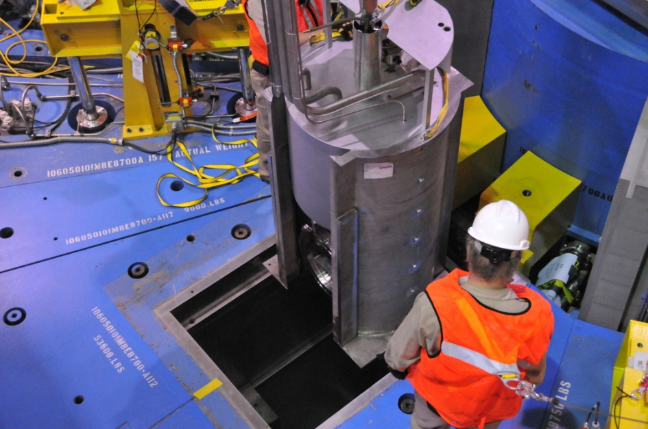
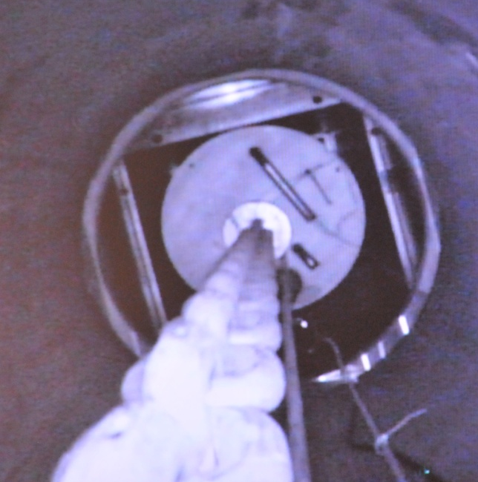
Proton Beam Window Replacement
Shielded Cask and Hoist
New PBW with guide can and counterweight being installed
Cooling lines cut prior to removal with long handle tools
Old PBW during retraction into cask

Slide 9
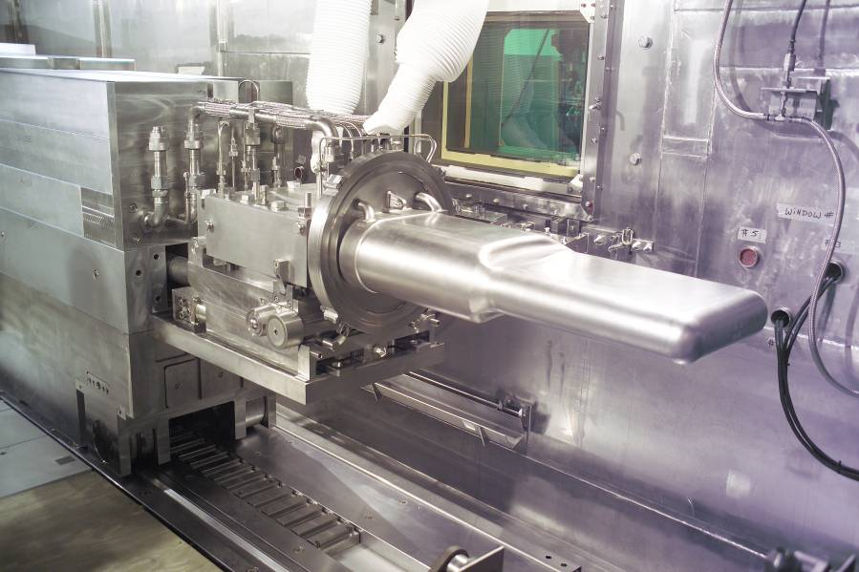
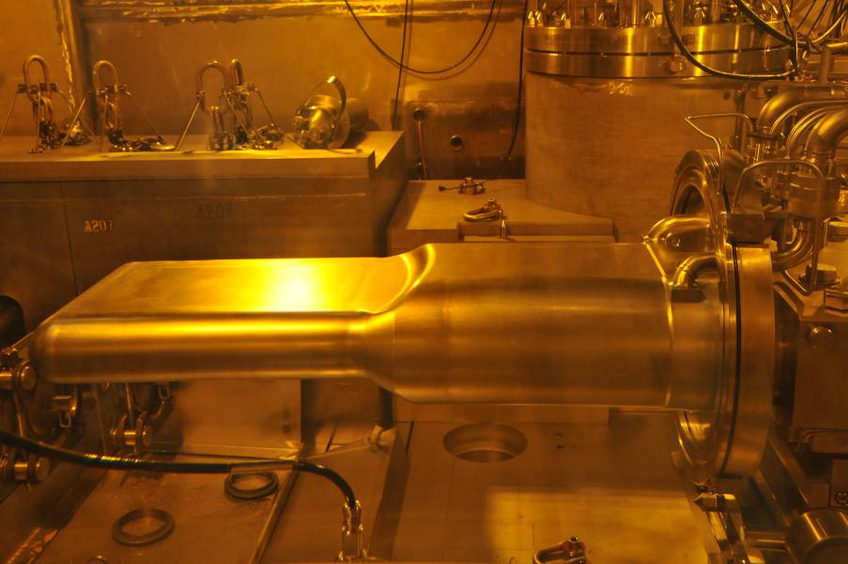
First target replacement
Hours above power level
Operating hours
First Target in 2006
Beam power on target [kW]
No observed corrosion
Internal Boroscope examination in progress
~ 50 mm diameter samples to be cut from target nose around the end of October
First Target after removal
Notes:
7.5 dpa peak damage estimated

Slide 10
Target Operational Experience
The first target performed very well
  No mercury leak indications in the target or other connections
  No water leaks
  Inflatable seal to the core vessel worked well and the helium concentration in the vessel was typically maintained at >99.97%
  No evidence of any corrosion on the target after removal
  Neutronic performance appears consistent with predictions based on moderator performance
The second target has accumulated > 400 MW-hrs as of 10/12/09
  The inflatable seal does not appear to be expanding fully, but core vessel helium is being maintained >99.97% using a small helium flow instead of vacuum for the interstitial region

Slide 11
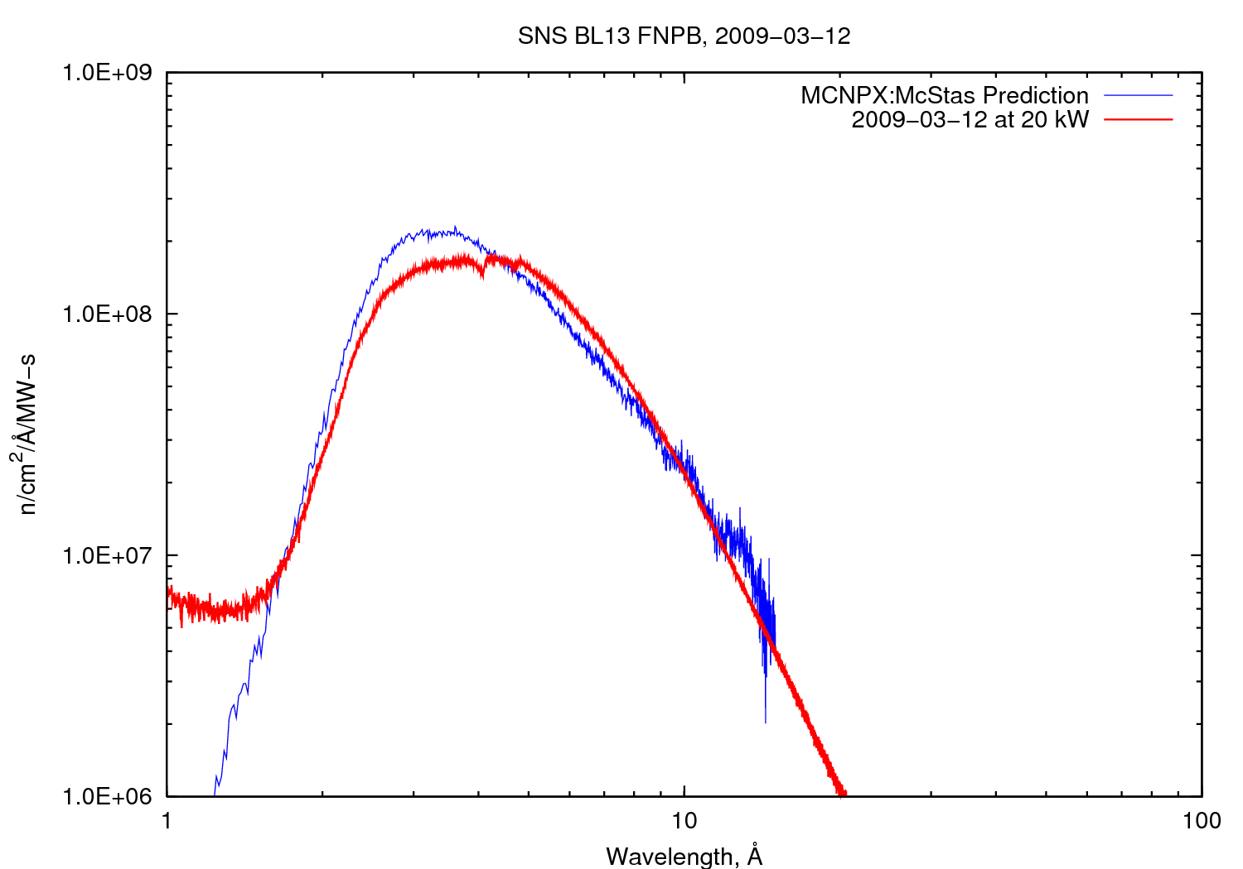
Source seems to be performing as predicted
Neutron flux at sample location
Bottom downstream coupled hydrogen moderator (post Jan09 repair)
Includes guide modeling in McStas and MCNPX
Notes:
Normalized to 1 MW operation

Slide 12
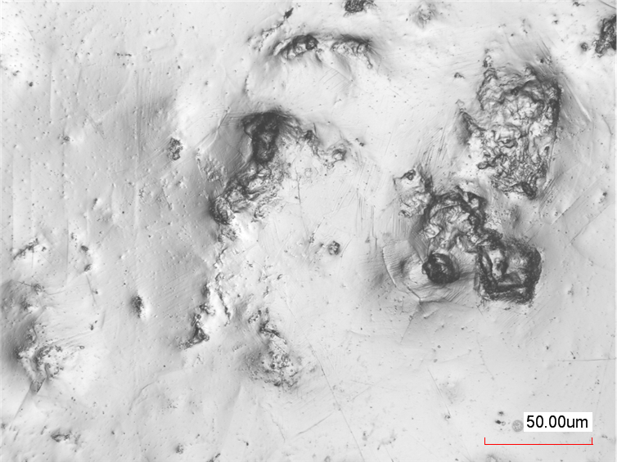
Target Lifetime Considerations
The first target operated for >1700 hours at or above 600 kW and up to 800 kW without a failure
R&D by the SNS and J-PARC teams has shown that the target wall is likely to experience pitting damage by the collapse of cavitation bubbles
  This has been shown for short pulse
  (< 1μsecond ) operation
  The rate of damage is sensitive to beam power
  ( P⁴?)
A target imaging system (TIS) is being developed to give improved measurement of the beam profile which could improved beam control and target lifetime
Mitigation methods using small distributed bubbles or bubble walls near the surface are being developed by the R&D programs
Test plate from 2008 WNR experiment
100 pulses with proton flux equivalent to 2.7 MW SNS

Slide 13
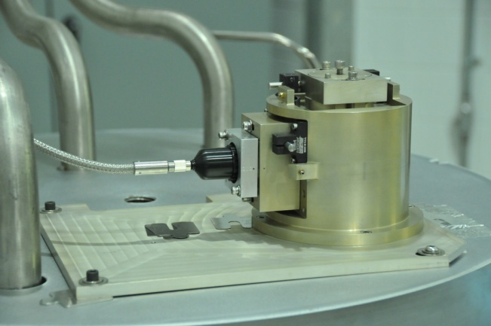
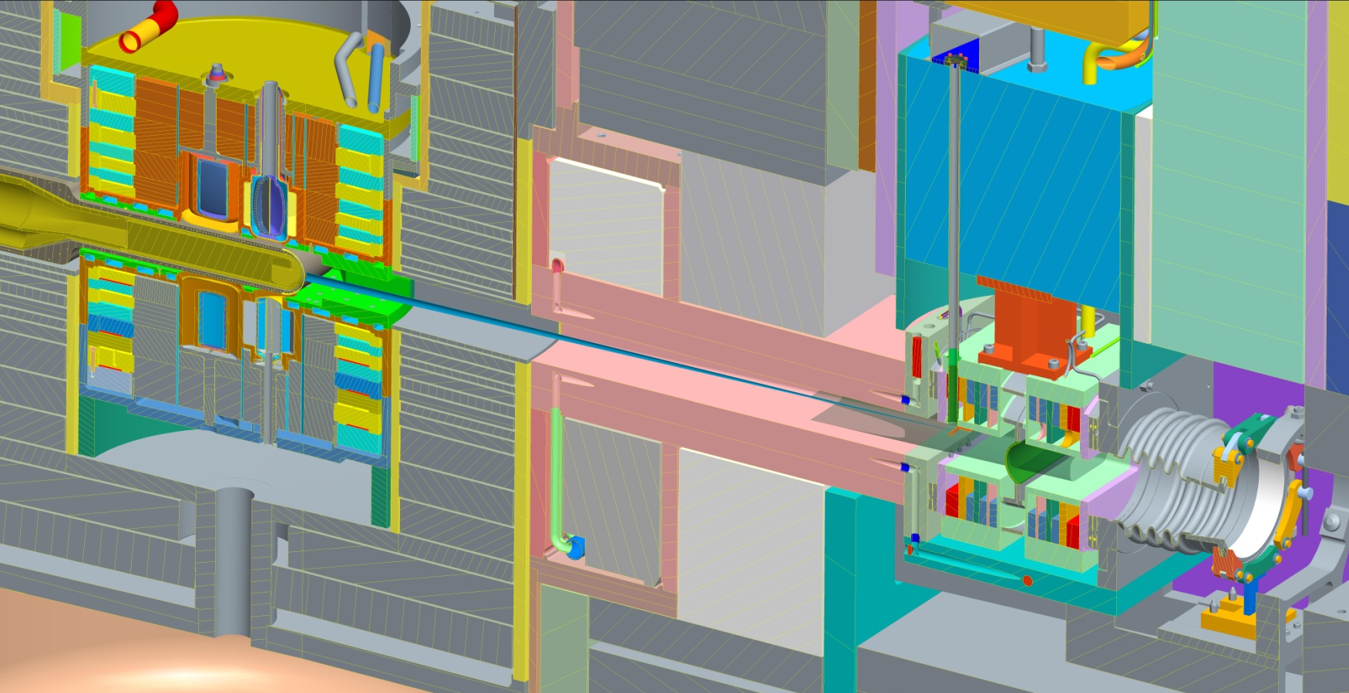
Target Imaging System
turning mirror and focusing elements
25 mm ID viewport
Proton Beam Window
Parabolic mirror
System Deployed during July 2009 Shutdown
Notes:
13

Slide 14
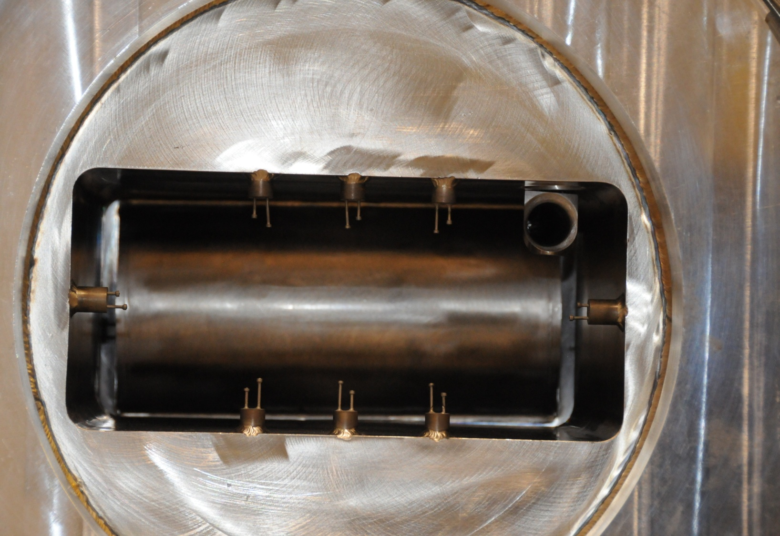
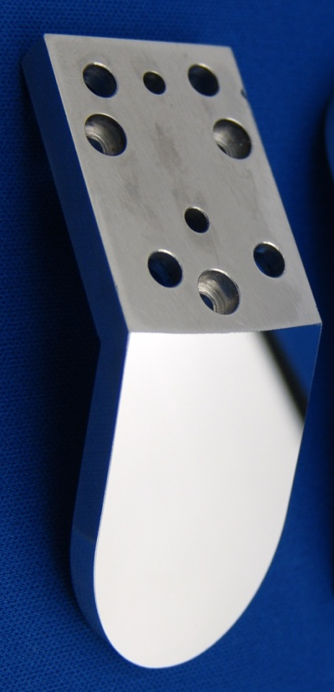
Second PBW view from downstream side
Thermocouples for Halo monitoring & Beam Centering
Parabolic diamond turned aluminum mirror
115 mm
Cylindrical double wall Inconel 718 window

Slide 15
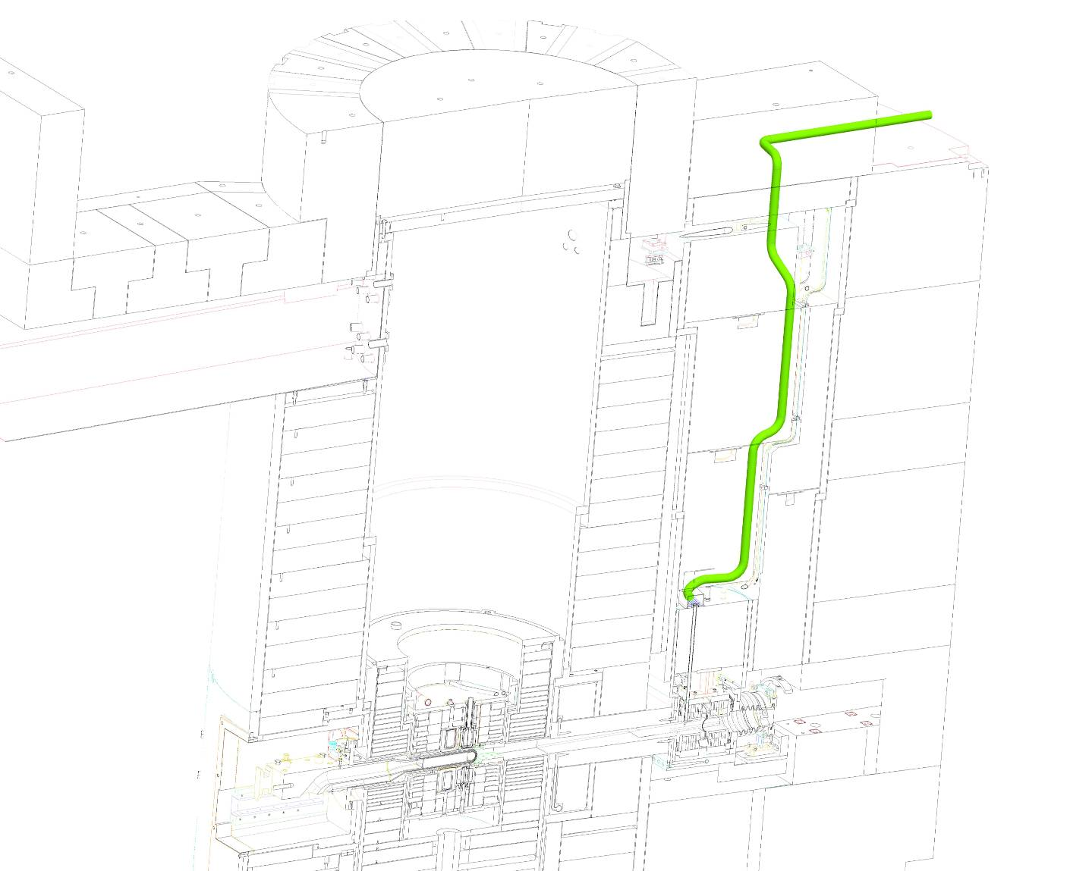
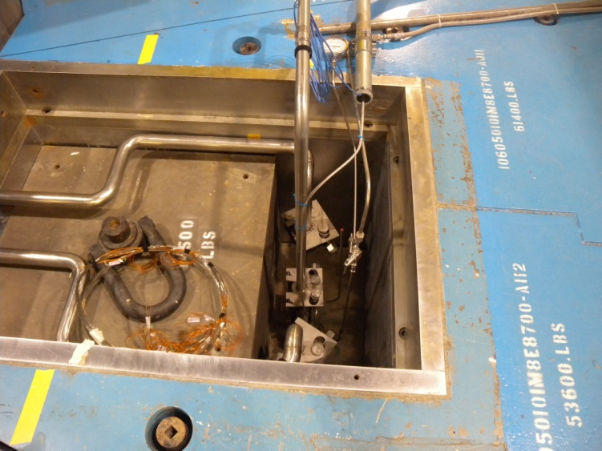
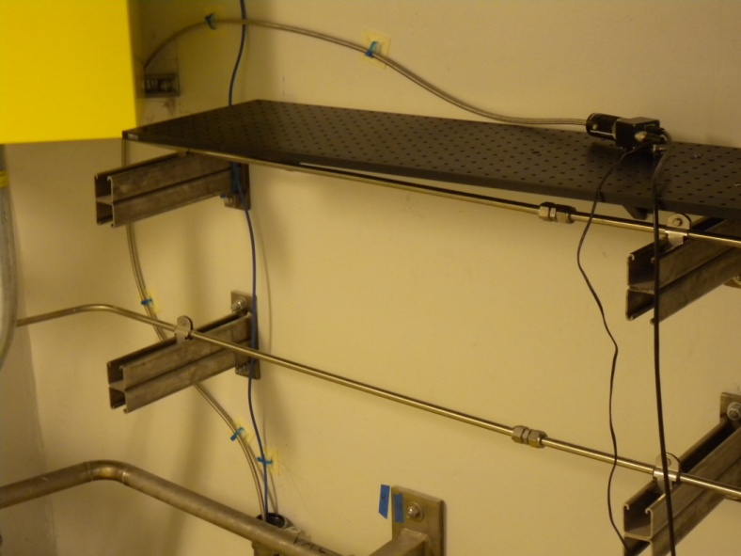
Imaging Fiber routing
Radiation Hard Fiber 38 ft overall length
10,000 fibers, ~1 mm diameter
Camera located outside of shutter drive equipment room
Standard camera with GigE interface used
Camera mounted outside shielding
Notes:
15
15

Slide 16
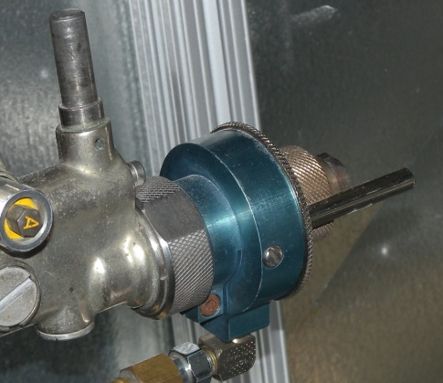
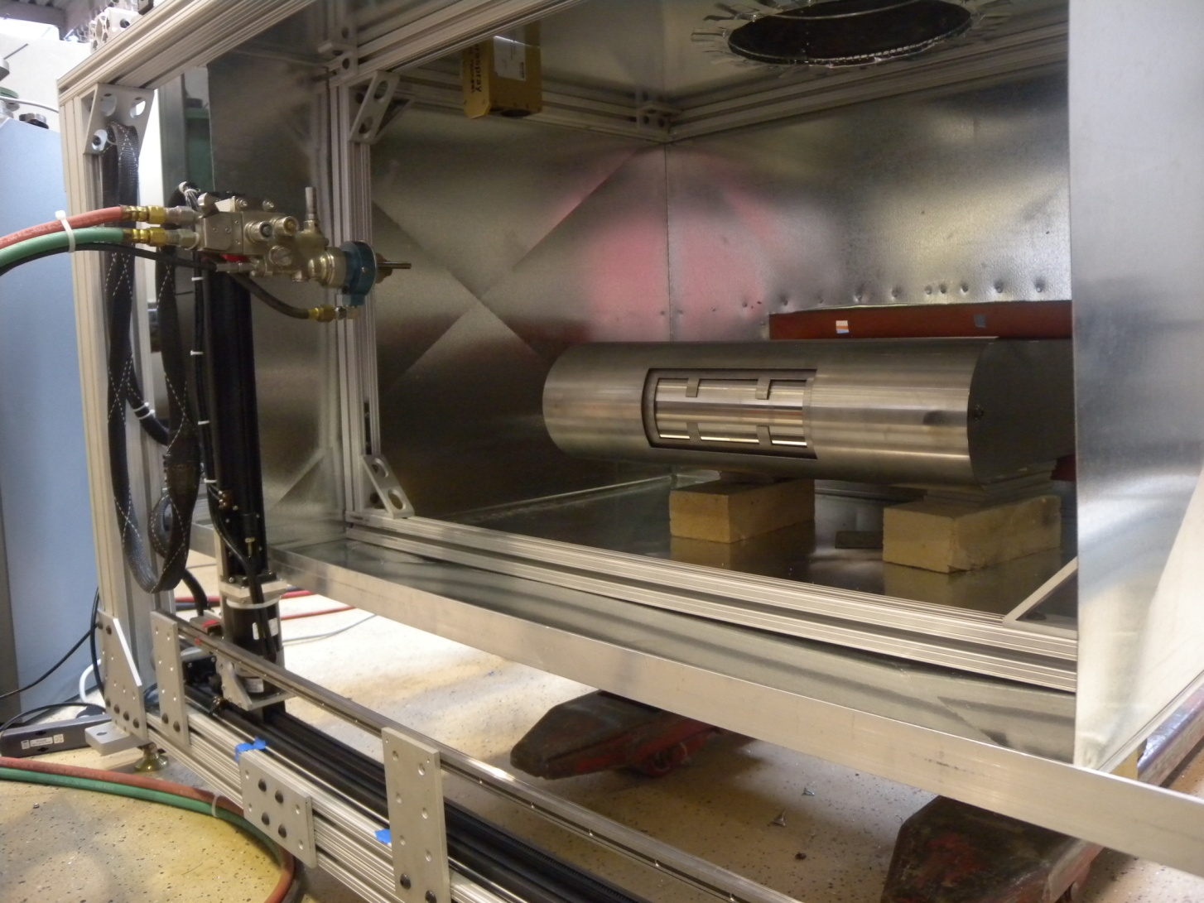
Flame Spray (Al₂O₃+ 1.5% CrO) development
Torch
Sensor
Exhaust
Air jet on each side
Drives
Heat shield and mask over target
Portable Flame Spray Coating and Ventilation System Developed by the Center for Thermal Spray Research ( SUNY at Stony Brook)

Slide 17
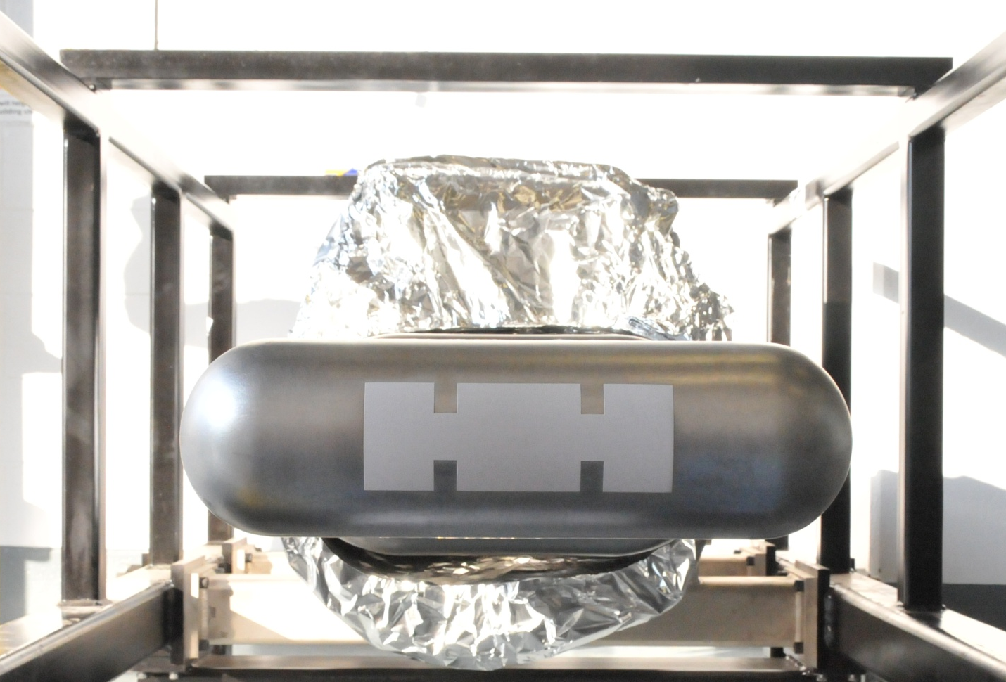
Completed Target Coating
Pattern to scale image with beam
Nominal Thickness 0.25 mm, 200mm x 70 mm pattern
Mockup testing established parameters and showed substrate temperatures were < 120 C with air cooling

Slide 18
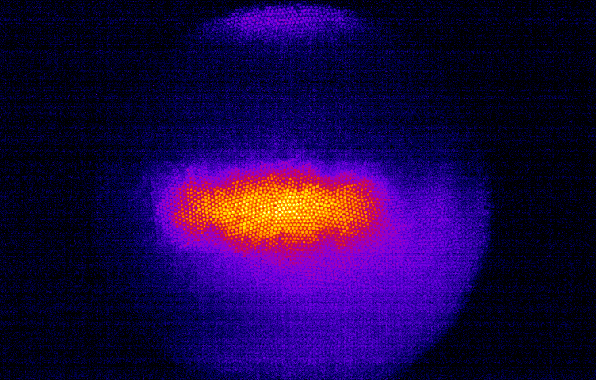
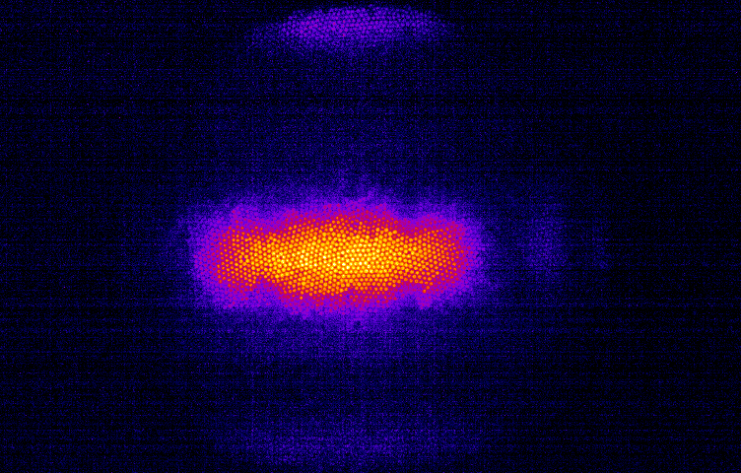
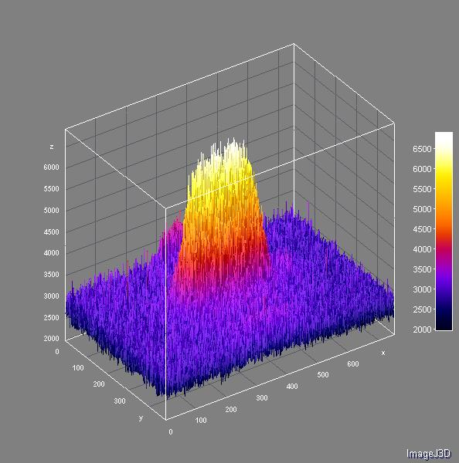
False color target images at 800 kW
Case 2: image with shutter delayed by 4 microseconds to gate out suspected gas
Case 1: image with potential gas scintillation
Data analysis of profiles in progress
  Initial results similar to previous projections
  No beam tilt
  ~10% higher peaking than previous estimates

Slide 19
SNS R&D on cavitation damage mitigation began in 2001
The program includes experimental, simulation and theoretical activities
  Five full time staff members at ORNL and ~12 part time contributors
    (Bernie Riemer is the team leader)
  Contributions from universities and industries
  Collaborations with JPARC and RAL
Goal is to develop technologies to mitigate damage such that it is not the life limiting mechanism for the target
Key points:
  The damage erosion rate is strongly sensitive to beam power … perhaps as much as P⁴
  Target vessel materials and surface protecting treatments have limited potential to significantly extend the life and power capacity of the vessel
  Power threshold for damage to begin is uncertain for SNS

Slide 20
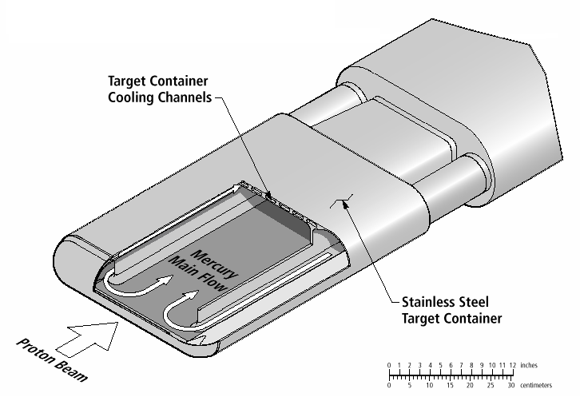
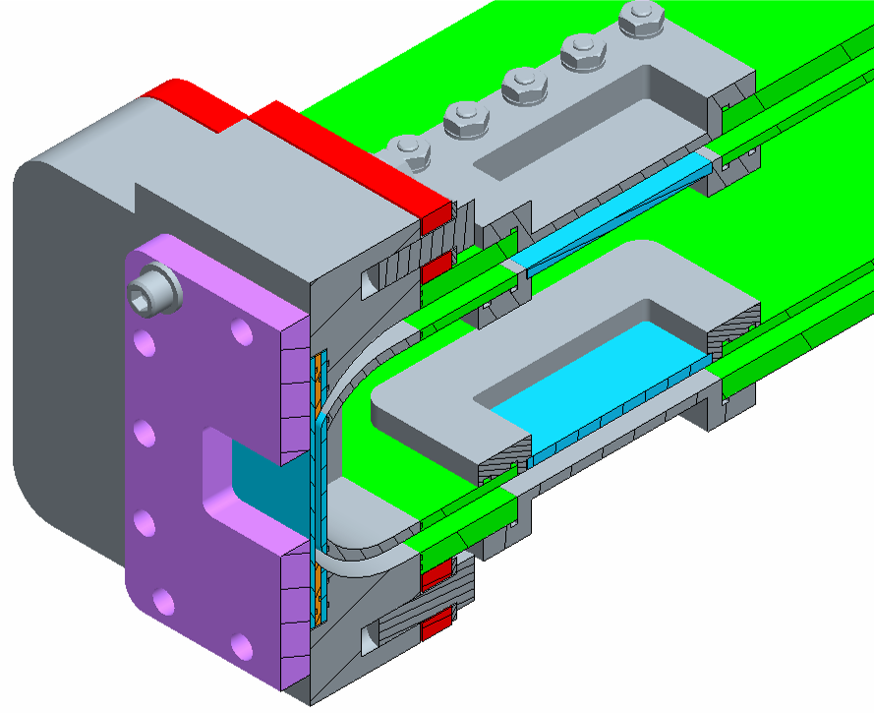
Window Flow Vulnerability Test Loop (WFVTL) experiments (WNR 2008)
In-beam experiment examined narrow mercury channel damage under conditions more prototypic to SNS
  Previous in-beam test results for channel damage indicated this region is especially vulnerable
Investigated damage reduction vs. flow velocity
  Previous in-beam test indicated damage reduced by flow
Sought confirmation that water in channel is benign
Channel flow
Channel flow
Bulk mercury region (stagnant)
Test surfaces
(3 each location)
SNS mercury vessel
WFVTL module section

Slide 21
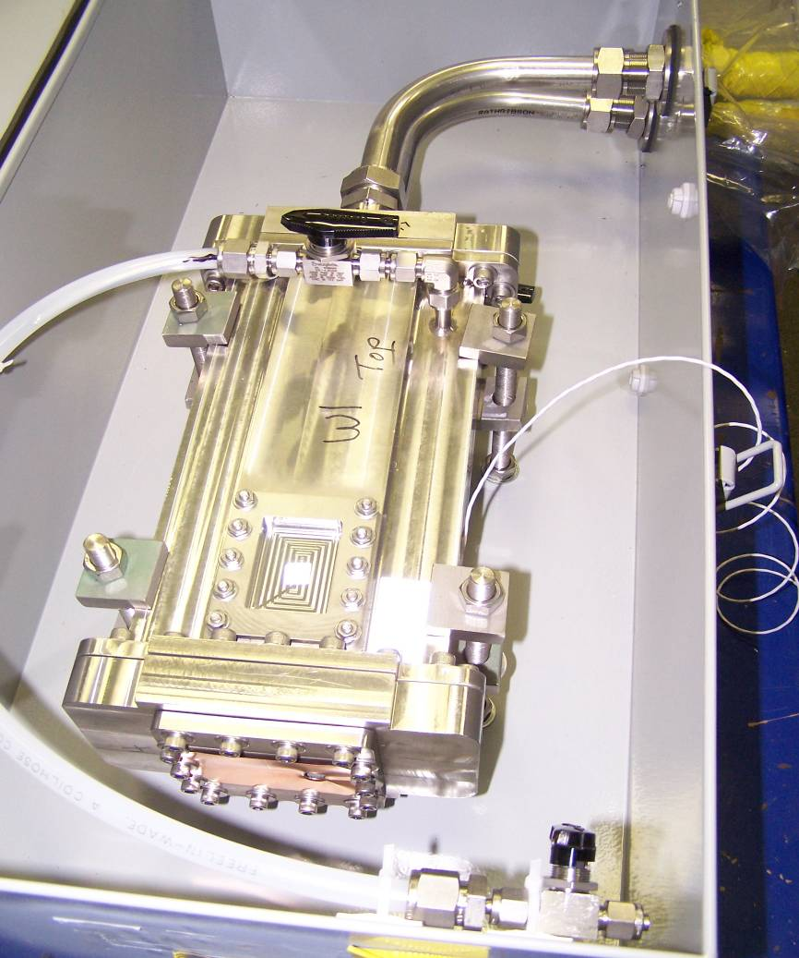
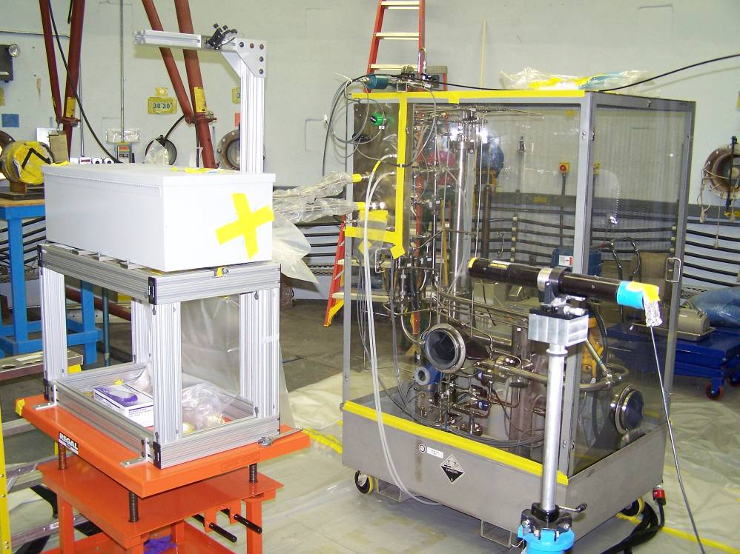
WFVTL target module and mercury loop
Variable speed centrifugal pump employed for channel flow speeds for up to 7 m/s
  Only ca. 4.3 m/s achieved
Test targets connected to loop via flexible hoses
Hg length: 325 mm

Slide 22
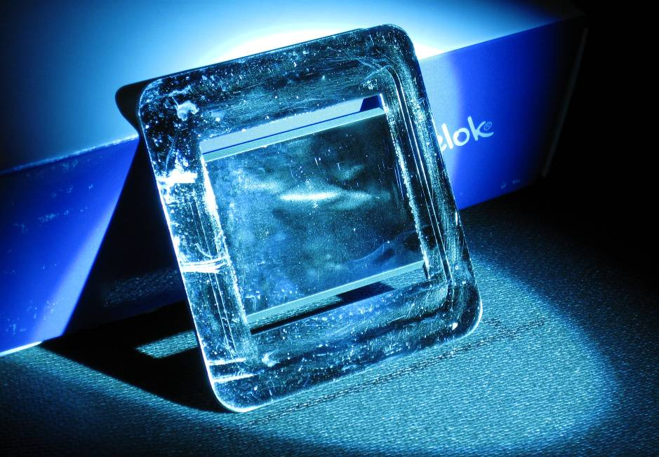
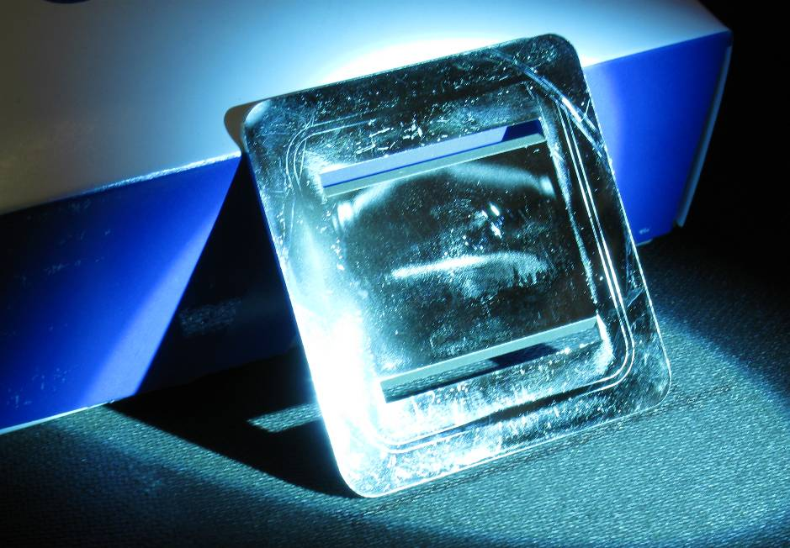
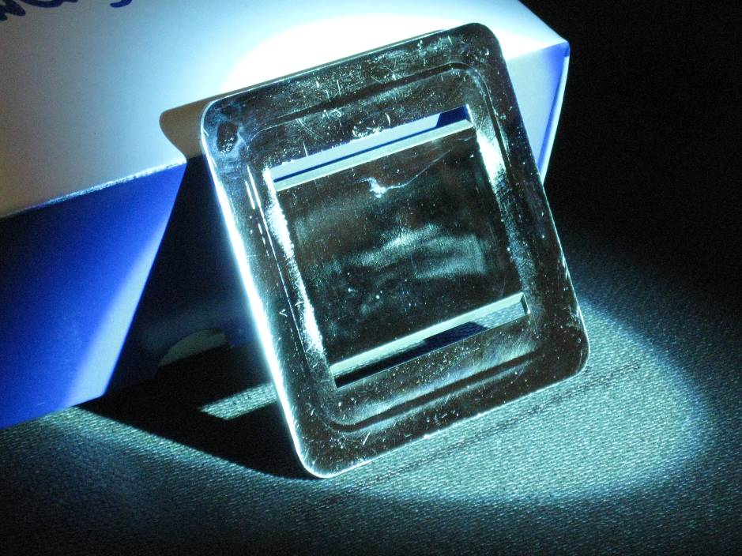
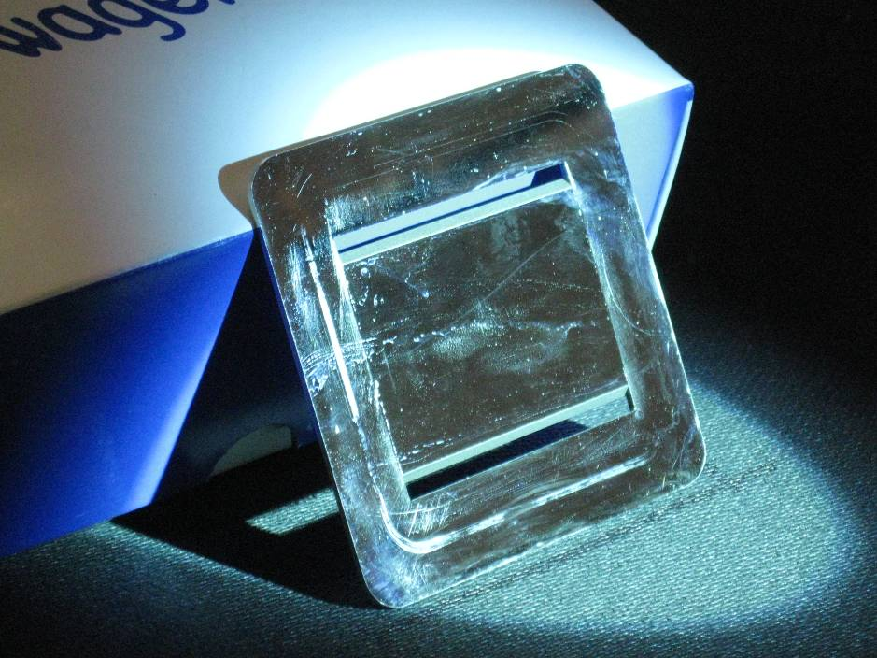
Damage patterns - Front inside plate – Channel side
0
1.5
3
4.3

Slide 23
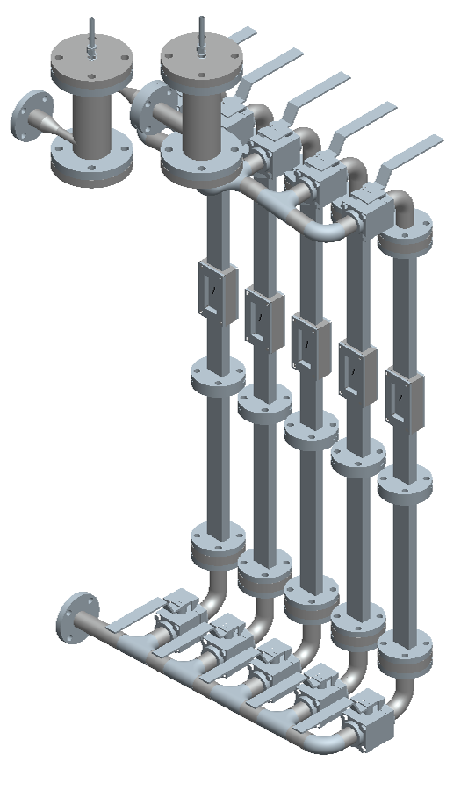
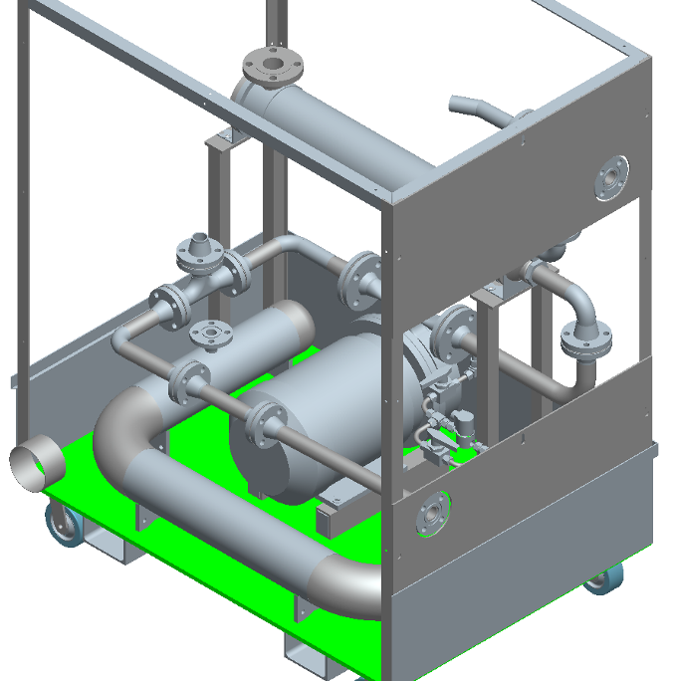
Next WNR Hg target experiment is planned for late 2010
This will investigate small gas bubble mitigation with improved bubblers
Flowing mercury system required
Will be done in close collaboration with JPARC team
Pump system
Bubblers & damage
test plates

Slide 24
Target Upgrade
Experience with targets at or above 1 MW is needed to determine if gas mitigation methods are needed
  Post Irradiation Examination (PIE) will be done on samples from the nose region of the first target (which did not fail)
  Subsequent Targets will be run until mercury is detected in the interstitial region (or to 10 dpa) and PIE performed to locate the leaking region and remove samples
  At 1 MW with the nominal beam profile, 10 dpa would be reached after 5000 hours of operation
If cavitation damage does not limit lifetimes unacceptably, structural analysis of the current target design indicates it can operate at 1.4 MW

Slide 25
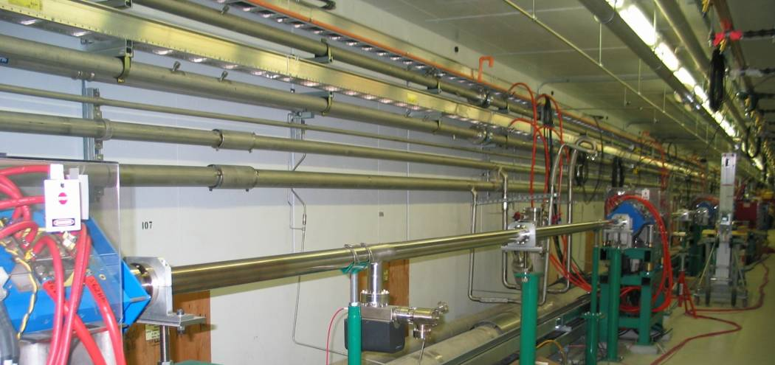
SNS Power Upgrade Plan
Power upgrade plan has been revised
  Formerly, Power Upgrade Project (PUP) doubled SNS power
  DOE directed us to restructure the elements of the PUP
    Proton energy increase to 1.3 GeV (30%) forms the new PUP
    Beam current increase (60%) and target improvements will be accomplished through R&D and Accelerator Improvement Projects (AIPs)
Conceptual design for PUP completed, and R&D underway
  BES review held in August 2008 and Critical Decision-1 (start preliminary design) approved in Jan 2009
Net result of PUP + R&D + AIPs will be a doubling of the SNS beam power by 2016

Slide 26
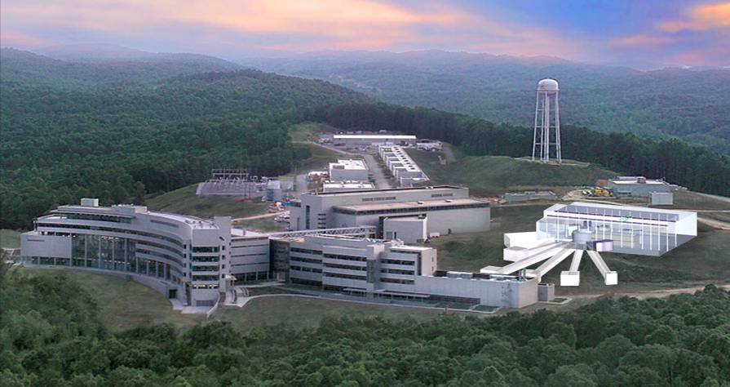
SNS Second Target Station (STS)
Scope of STS includes design, build, install, test, and commission a second target station at SNS consisting of:
  New spallation target and supporting systems
  Extended SNS accelerator systems
  Conventional support buildings
  Initial neutron beam instruments
Mission Need Critical Decision-0 approved in January 2009!
  Current plan: Start construction project in 2012; complete in 2019

Slide 27
Two STS Target Options
Mercury Target
  Similar configuration as the first SNS target station.
    Mercury process installed in a shielded service bay downstream of the monolith.
    Moderators and reflector mounted in a vertically accessed plug.
    Target /Moderator/Reflector optimized to improve cold neutron production
    Process equipment optimized based on FTS experience.
    Cavitation damage is not likely to be an issue with long pulse operation
Rotating Target
    Target, moderators and reflectors mounted in a single large vertical plug
    Target driven with assembly mounted 3.5 meters above the disk.

Slide 28
Solid Rotating Target Option for STS
A preconceptual design study for a 3 MW tantalum clad tungsten target with water cooling which gave promising results¹
  Target lifetime of ~ 5 years for 10 dpa on the shell window
  Equal or better neutronic performance compared to a mercury target
  Greatly reduced remote handling requirements compared to a mercury target
A mockup of the drive unit including seals and bearings was fabricated and tested for > 1000 hrs
A 4 meter shaft and 1.2 m diameter mockup target has been fabricated by the ESS-Bilbao team as part of a collaboration and will be tested within 6 months with the ORNL drive unit
1. http://dx.doi.org/10.1016/j.jnucmat.2009.10.007

Slide 29
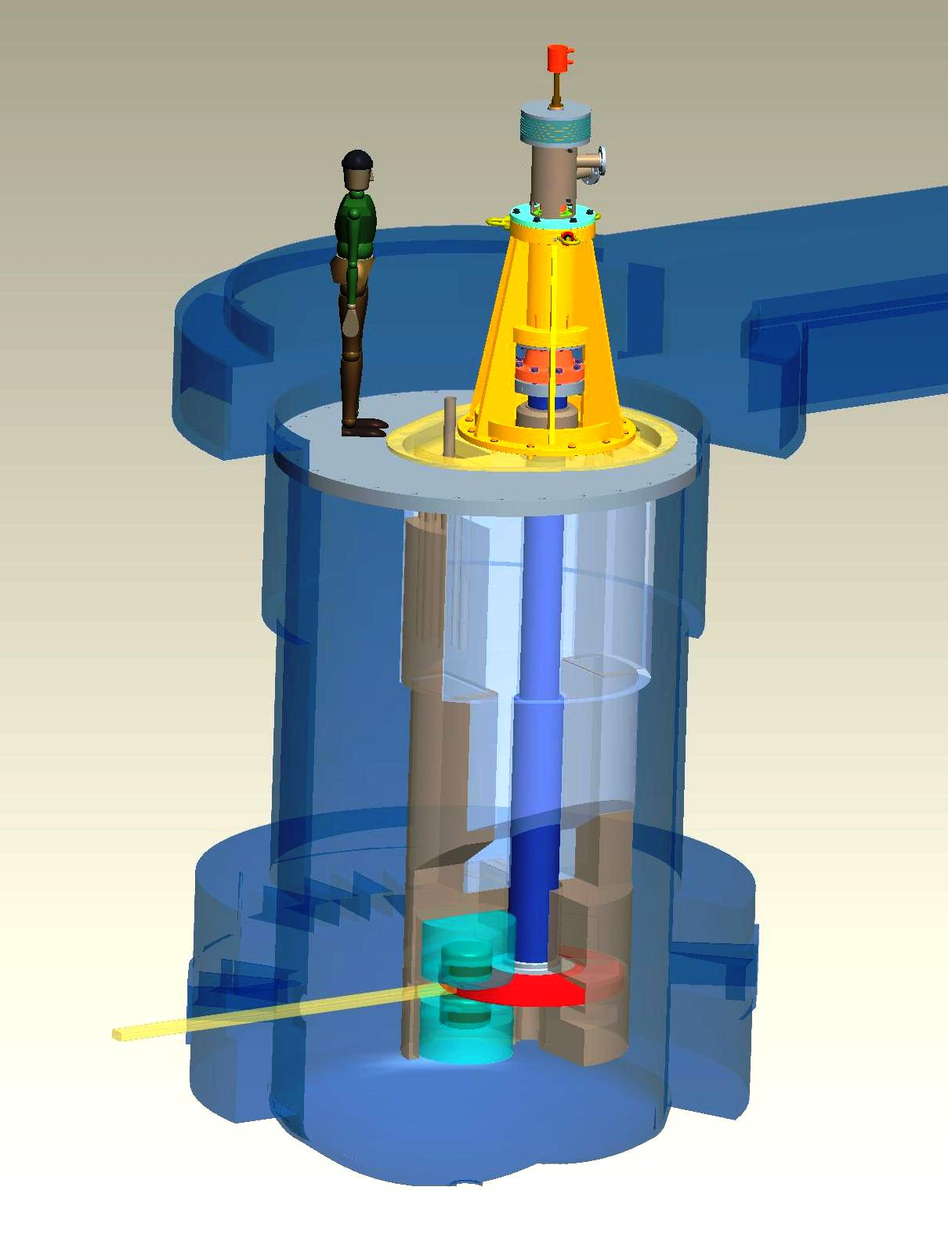
Target Plug Configuration
Rotating
Couplings
Drive/Target
Joint
Cooling Water
Pipe Chase
Core Vessel
Moderator/Reflector
Fixed Shielding
Shield Plug
Assemblies
Neutron Beam Ports
Proton Beam
Target Disk

Slide 30
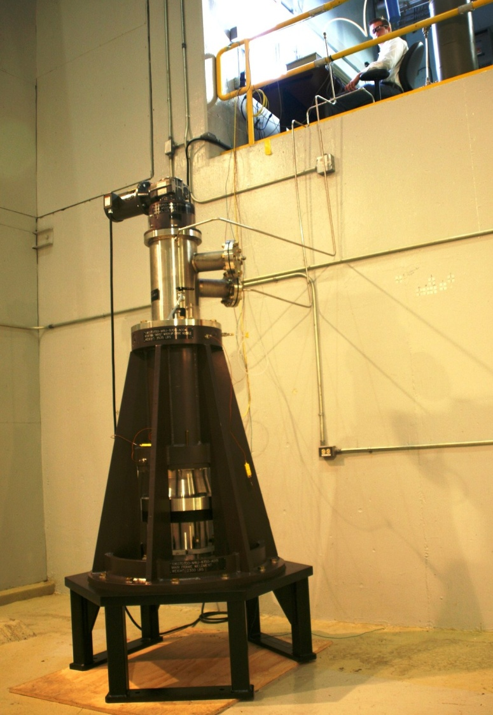
Rotating Target Drive Configuration
A Prototype drive module has been built and successfully tested for > 1000 h.
Drive designed to be removed independently of the target module
Testing with shaft and target disk planned for FY10

Slide 31
STS –Rotating Target Development
Recent power upgrade accelerator studies have indicated that 1.5 MW is a likely upper bound for power on the second target station for reasonable costs with ~2 MW on the first target station
Rotating Target design studies have started based on this power level with long pulse operation at 20 Hz and 1.3 GeV, consistent with the Power Upgrade Planning and Accelerator Improvement Projects
Design Studies
  Optimize target neutronic & thermal hydraulic design for 1.5 MW
  Develop safety basis for passive decay heat removal
  Develop integrated monolith and hot cell structures

Slide 32
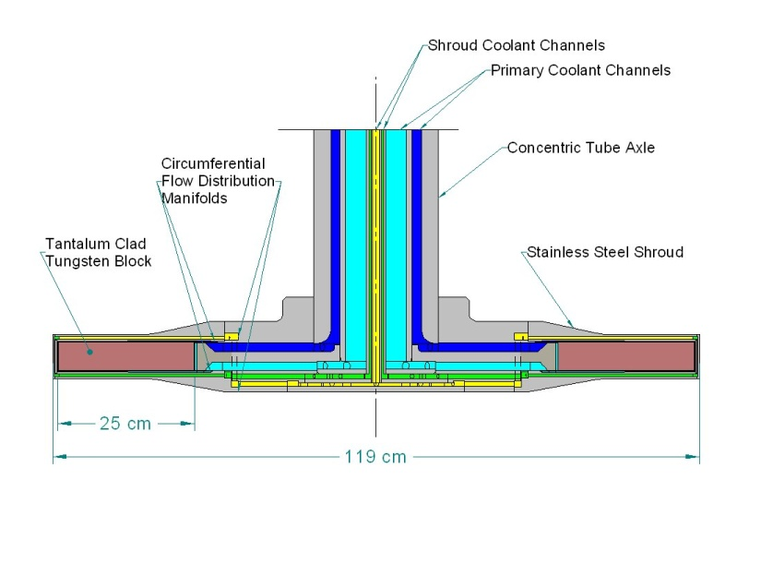
Configuration Studies
Target Parameters
1.2 m diameter
~60 mm W height
~ 12 mm steel shell
~ 1.5 mm flow channel
1mm Ta clad Tungsten
~30 RPM
Gaussian or flat beam profile

Slide 33
Rotating target vacuum operation
The proton beam window (PBW) is a credited engineering boundary for containing mercury in case of target failure
For a rotating target with water cooling an option under evaluation is eliminating the PBW and operating the target in vacuum
Ferrofluidic seals on the shaft are under consideration
  10⁴ Gray/year estimated dose should be acceptable based on testing at Riken to 1.8 x 10⁵ Gy
Improved neutronic performance and reduced remote handling maintenance are expected from this change

Slide 34
Summary
SNS Target Systems are achieving good availability (>99%)
The mercury loop and first target performed well
R&D is proceeding on cavitation damage mitigation methods which could be needed at higher power
The first target and proton beam window replacements have been successfully accomplished with a lot of “lessons learned.”
The Power Upgrade Project and Accelerator Improvement Projects are projected to double the SNS power by 2016
Conceptual design work has started for the Second Target Station with mercury and rotating target options under consideration

