Slide 1
Fermilab SRF Linac Development
Steve Holmes
Workshop on High Intensity Proton Accelerators
October 19, 2009

Slide 2
Outline
Strategic Context/Evolution of the Fermilab Complex
Project X Goals and Initial Configurations
Research, Design, and Development Plan
Relationships to other Programs
Project X website: http://projectx.fnal.gov/
Notes:
Test
2

Slide 3
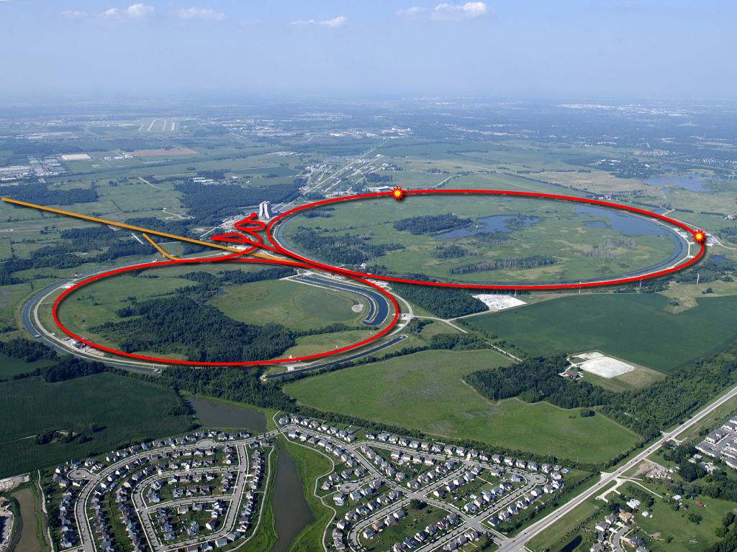
Strategic Context: Fermilab and the World Program
Fermilab currently operates the highest energy collider, and the highest power long baseline neutrino beam, in the world.
In 2009:
  LHC will capture the energy frontier
  J-PARC will initiate a competitive neutrino program
To Soudan

Slide 4
Evolution of the Fermilab Accelerator Complex
A multi-MW Proton Source, Project X, is the linchpin of Fermilab’s strategy for future development of the accelerator complex.
Provides long term flexibility/opportunities
  Energy Frontier:
  Tevatron → ILC or Muon Collider
    Technology alignment
    Fermilab as host site for ILC or MC
  Intensity Frontier:
  NuMI→ NOνA→ LBNE/mu2e→ PX → NuFact
    World leading program in neutrino physics and other beyond the standard model phenomena

Slide 5

Mission Need
Mission need for a multi-MW proton source (P5):
  Long baseline neutrino oscillation experiments
    2 MW proton source at 60 - 120 GeV
  High intensity, low energy
  precision experiments with
  kaons and muons
    Few × 100 kW simultaneous
    with neutrino operations
  Platform for a future muon
  Facility – Neutrino Factory or
  Muon Collider
    Upgrade potential to 2-4 MW
    at ~5 - 15 GeV.

Slide 6
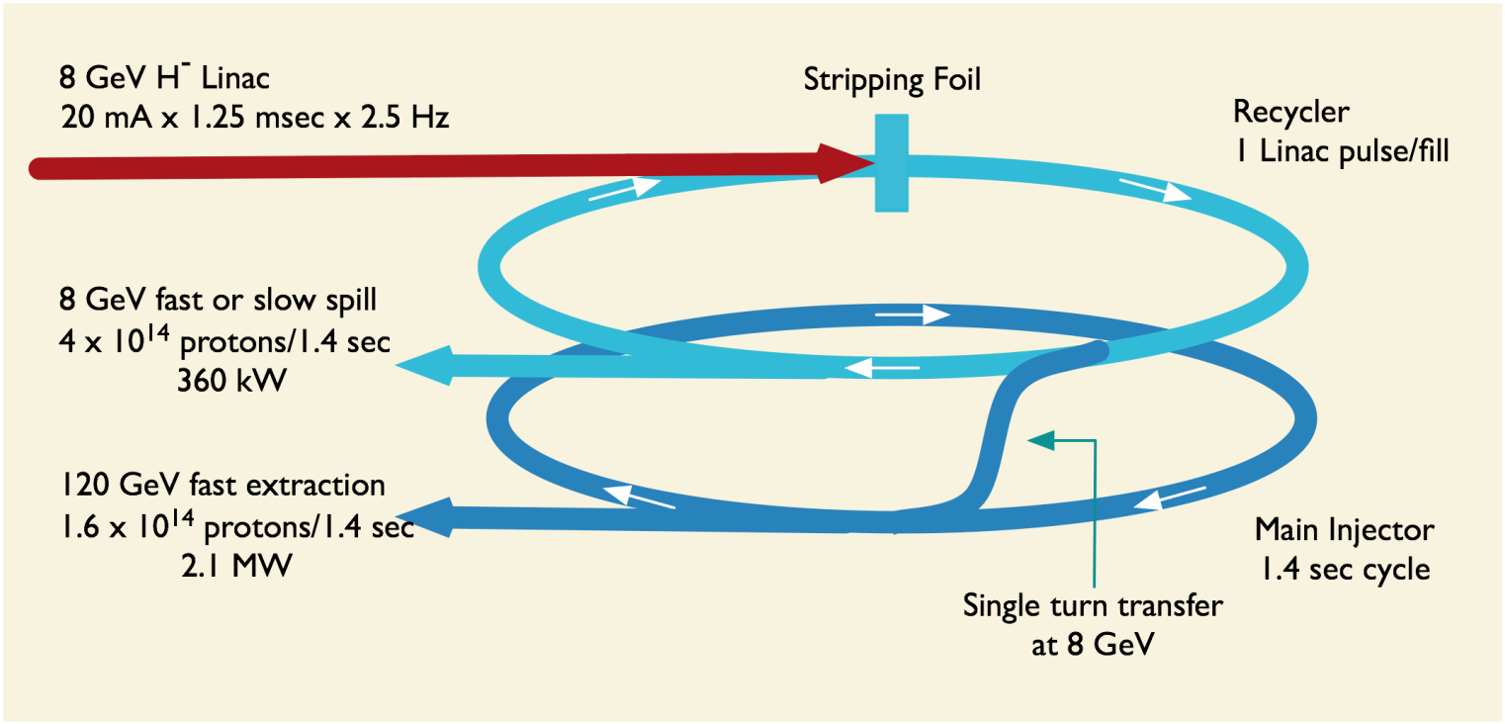
Initial Configuration-1
Project X Design Criteria
  >2 MW of beam power over the range 60 – 120 GeV;
  Simultaneous with >150 kW of beam power at 8 GeV;
  Compatible with future upgrade to 2-4 MW at 8 GeV

Slide 7
Initial Configuration-1 Performance Goals
Linac
Particle Type H⁻
Beam Kinetic Energy 8.0 GeV
Particles per pulse 1.6×10¹⁴
Linac pulse rate 2.5 Hz
Beam Power 500 kW
Recycler
Particle Type protons
Beam Kinetic Energy 8.0 GeV
Cycle time 1.4 sec
Particles per cycle to MI 1.6×10¹⁴
Particles per cycle to 8 GeV program 1.6×10¹⁴
Beam Power to 8 GeV program 360 kW
Main Injector
Beam Kinetic Energy (maximum) 120 GeV
Cycle time 1.4 sec
Particles per cycle 1.6×10¹⁴
Beam Power at 120 GeV 2100 kW

Slide 8
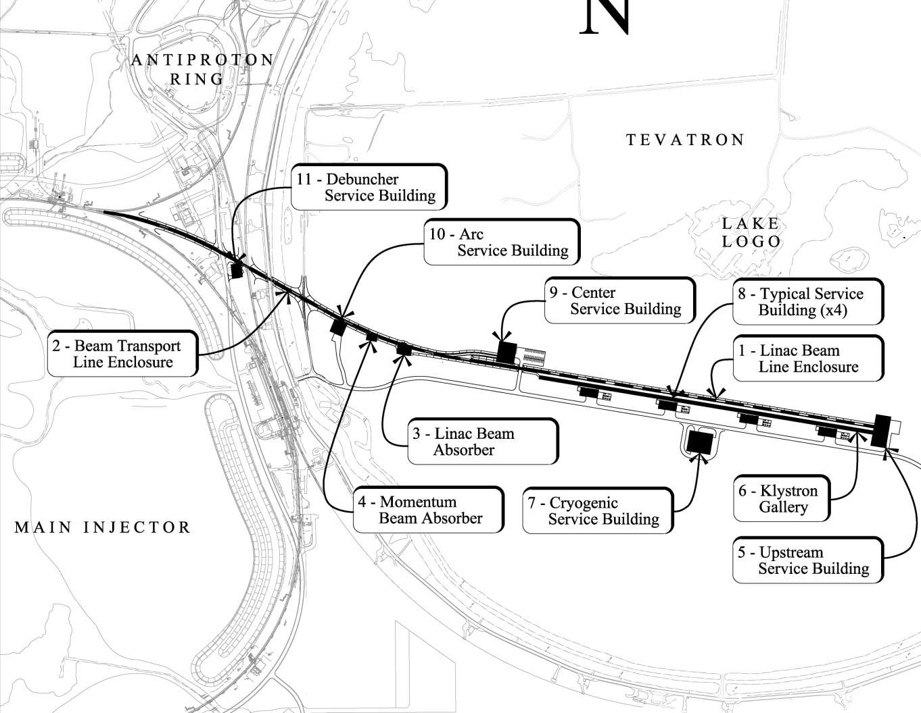
Initial Configuration-1
Provisional Siting

Slide 9
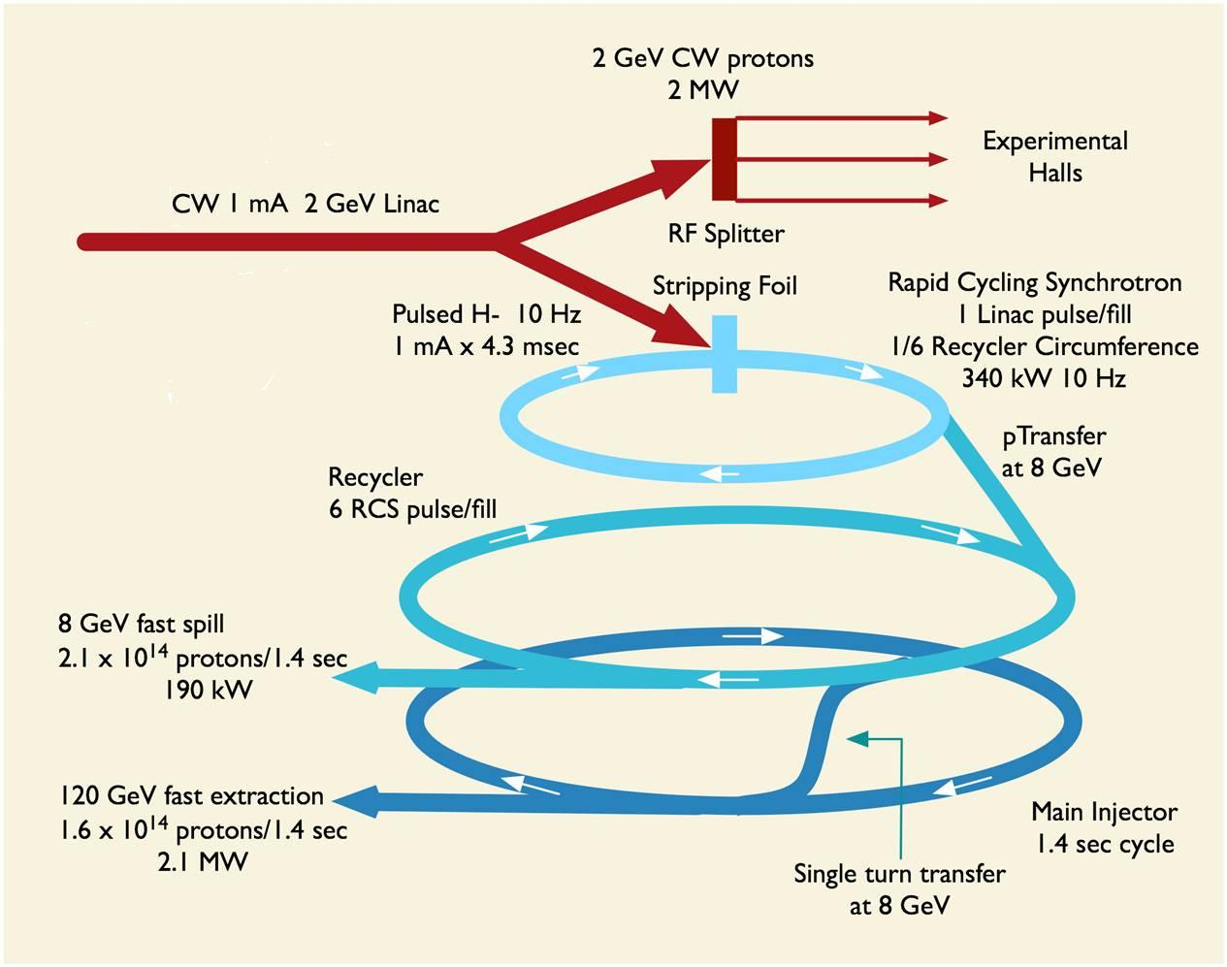
Initial Configuration - 2
Project X Design Criteria
  2 MW of beam power over the range 60 – 120 GeV;
  Simultaneous with 2 MW beam power at 2 GeV;
  Compatibility with future upgrades to 2-4 MW at 8 GeV
Page 9

Slide 10
Initial Configuration-2 Performance Goals
Linac
Particle Type H⁻
Beam Kinetic Energy 2.0 GeV
Average Beam Current 1.0 mA
Linac pulse rate CW
Beam Power 2000 kW
Beam Power to 2 GeV program 1920 kW
RCS
Particle Type protons
Beam Kinetic Energy 8.0 GeV
Cycle time 0.1 sec
Particles per cycle to MI 2.6×10¹³
Beam Power to 8 GeV program 200 kW
Main Injector/Recycler
Beam Kinetic Energy (maximum) 120 GeV
Cycle time 1.4 sec
Particles per cycle 1.6×10¹⁴
Beam Power at 120 GeV 2100 kW

Slide 11
Initial Configuration-2
To neutrino,
8-GeV programs
RCS
500m circm
H-
RFQ
2-GeV SC Linac
RF splitter
Kaons
µ2e
Other
2-GeV programs

Slide 12
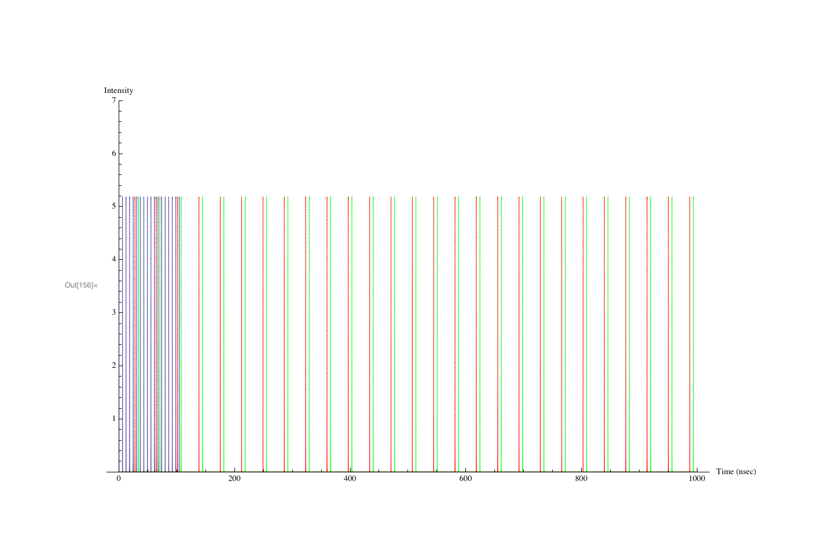
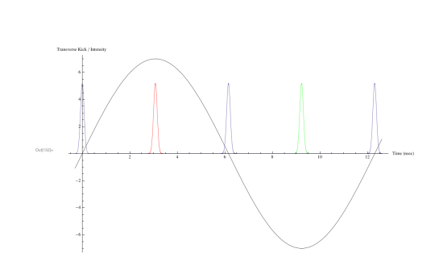
Initial Configuration-2
Operating Scenario
1 μsec period at 2 GeV
mu2e pulse (9e7) 162.5 MHz, 100 nsec 518 kW
Kaon pulse (9e7) 27 MHz 777 kW
Other pulse (9e7) 27 MHz 777 kW

Slide 13
Initial Configuration-2
Provisional Siting
Page 13
Page 13

Slide 14
Near-term Strategy
Develop an Initial Configuration Document
  Meeting the high level design criteria
  Released V1.1, March 2009: available at http://projectx.fnal.gov/
Revise/update the current RD&D Plan
  Based on the ICD-1
  Released V2.2, March 2009 following mid-February AAC evaluation
Create a preliminary cost range estimate
  Based on the ICD-1
  Complete and subject of Director’s Review March 16-17, 2009

Slide 15
Near-term Strategy
Establish design criteria and operating scenarios for alternative configurations
  Alternative configuration (ICD-2) under development
Establish a multi-institutional collaboration for the RD&D phase
  Collaboration established
CD-0 in 2010
  Based on: ICDs, preliminary cost estimates, P5 mission definition
  Coordinated with very long baseline (LBNE) and mu2e

Slide 16
Research Design and Development (RD&D) Plan
Primary goal is to complete a fully developed baseline scope, cost estimate, and schedule in 2012-13 (CD-2).
  Design and technical component development;
  Undertaken by a multi-institutional collaboration capable of executing both the RD&D plan and the follow-on construction project
Secondary goals:
  Coordinate Project X and ILC SCRF development programs;
  Retain alignment with Neutrino Factory and Muon Collider programs

Slide 17
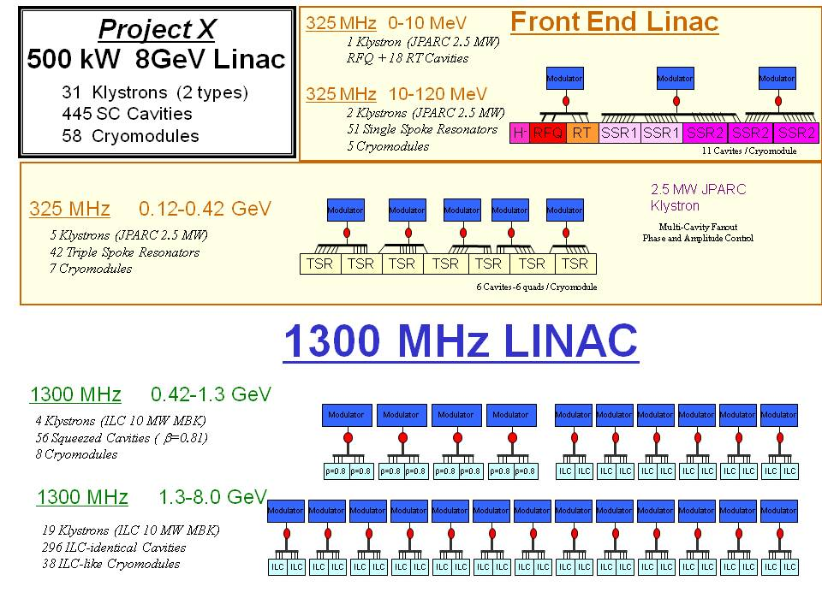
Technology Map (ICD-1)

Slide 18
Joint PX/HINS Strategy
The High Intensity Neutrino Source (HINS) program was established to pursue a new approach to high intensity, low energy ion acceleration.
HINS is a candidate for the Project X front end.
  Designed for 27 mA x 1 msec x 10 Hz
Primary goals:
  Accelerate axially symmetric beam (solenoidal focusing) to 30 MeV, utilizing superconducting rf technology beyond 10 MeV
  Demonstrate vector modulators for phase/amplitude control of individual cavities fed by a common rf source
  Demonstrate high-speed (nsec) beam chopping at 2.5 MeV
Goal is to complete facility (@30 MeV) in ~2012

Slide 19
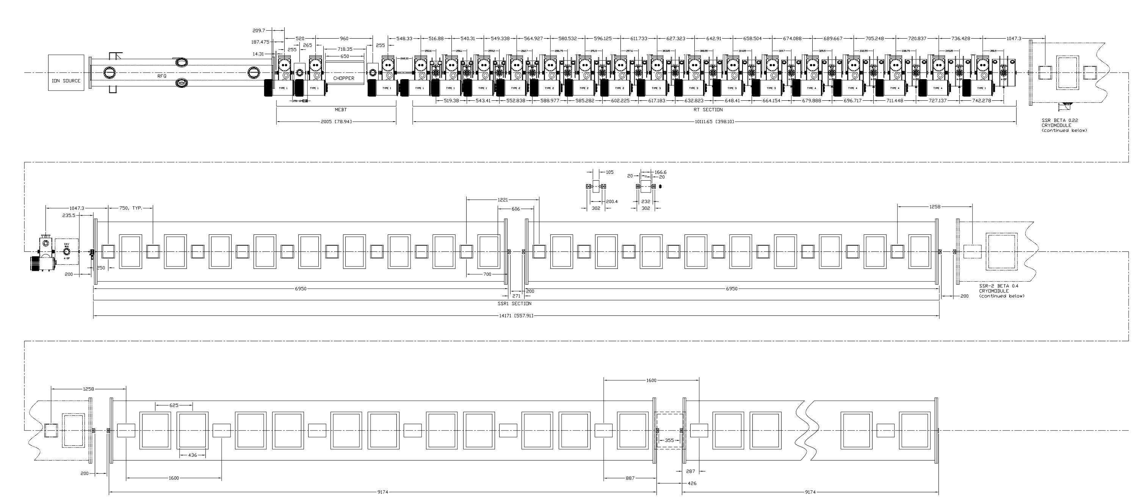
Joint PX/HINS Strategy
Ion Source
RFQ
MEBT
Room Temperature 16-Cavity, 16 SC Solenoid Section
50 KeV
2.5 MeV
10 MeV
Two β=0.2 SSR 9-Cavity, 9-Solenoid Cryostats
20 MeV
30 MeV
One β=0.4 SSR 11-Cavity, 6-Solenoid Cryostat
60 MeV
~14 meters

Slide 20
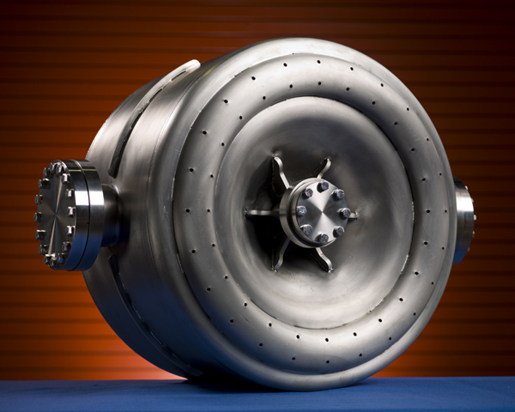
HINS Status
Ion source (H+) installed and operating
RFQ received and under rf testing
Room temperature spoke resonators tested
Prototype VMs tested
Two β = 0.22, 325 MHz, SSRs successfully tested
    Goal: >10 MV/m @ Q0>5E8 @ 4 K
Achieved at 2°K !!!
Design Goal
↔
↔

Slide 21
Joint PX/ILC/SRF Strategy
Project X shares 1.3 GHz technology with ILC
  ICD-1/ICD-2 requires 46/20 ILC-like cryomodules. In detail they will not be identical to ILC:
    Beam current: (3×ILC charge/pulse, ICD-1)
    Focusing required in all CMs
    Gradient: 25/16 MV/m
4 year construction period
⇒ 1 CM/month
Close coordination with GDE
  Common development effort
  Shared facilities for assembly and testing
  Yield vs gradient is key metric

Slide 22
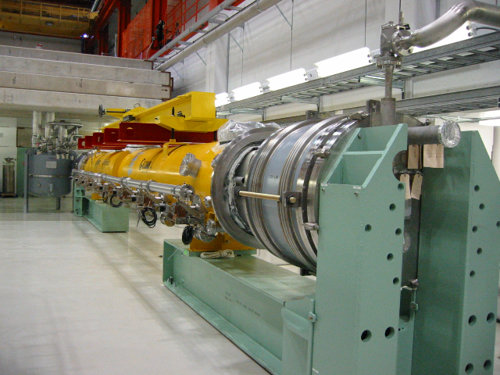
Joint PX/ILC/SRF Strategy
Industrialization
  Production of 1 CM/month represents a significant step beyond current capabilities; however, the production rate remains well below that required by ILC.
  Could represent initial phase of (U.S.) industrialization buildup for ILC
Cryomodule Assembly Plan
  CM1: TESLA Type III (2009)
    DESY supplied cavities
  CM2: TESLA Type III (2009)
    U.S. supplied cavities
  CM3: Type IV.1 (2011)
    Project X preliminary
  CM4: Type IV.2 (2012)
    Project X prototype

Slide 23
Collaboration Plan
Multi-institutional collaboration established to execute the Project X RD&D Program.
  Organized as a “national project with international participation”.
    Fermilab as lead laboratory
    International participation via in-kind contributions, established via bi-lateral MOUs. (First MOU with India in place)

Slide 24
Collaboration Plan
  (National) Collaboration MOU for the RD&D phase outlines basic goals, and the means of organizing and executing the work. Signatories:
  ANL ORNL/SNS
  BNL MSU
  Cornell TJNAF
  Fermilab SLAC
  LBNL ILC/ART
  Collaborators to assume responsibility for components and sub-system design, development, cost estimating, and potentially construction .

Slide 25
Working Timeline (technically limited)
FY2010
  CD-0: Mission Need
  Initiate work on Conceptual Design Report
FY2012
  CD-1: Initial Baseline Range
FY2013
  CD-2: Baseline Project
FY2014
  CD-3: Initiate Construction
~FY2014~2018
  Construct

Slide 26
Other Synergies
We are well aware that the technology we are developing is broadly applicable beyond Elementary Particle Physics:
  Accelerator Driven Energy Systems
  Rare isotope production for nuclear physics
  Neutron Sources (e.g. SNS)
  X-ray FELs
  Energy recovery linacs
  Muon facilities for materials research…
Hence, this workshop

Slide 27
Summary
Project X is central to Fermilab’s strategy for future development of the accelerator complex:
  Energy Frontier: Aligned with ILC technology development; Fermilab as potential site for ILC or a Muon Collider
  Intensity Frontier: World leading program in neutrinos and rare processes; Fermilab as potential Neutrino Factory site
Initial configurations established
  >2 MW at 60-120 GeV, simultaneous with up to 2 MW at 2 GeV
Strong technology synergies with many other applications
Work done in this workshop will be carried forward into the DOE Accelerators for America Workshop next week

