Slide 1
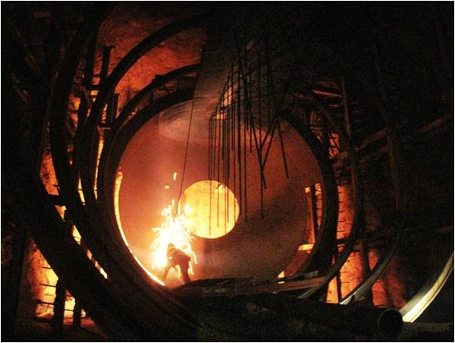
Neutrino Physics and
Project X
R.Svoboda, FNAL, November 2009

Slide 2
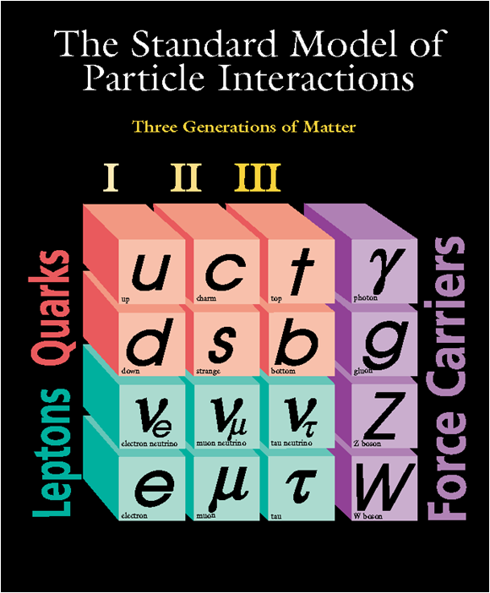
Why Neutrinos?
Only six known stable particles: ν₁, ν₂, ν₃, p, e, and γ.
Estimates give ~300 ν’s cm⁻³, roughly the same density as CMB photons. Nucleons and electrons are ~10⁻⁷ per cm³. Neutrinos are a major component of the universe.
Neutrinos allow for the study of particle physics without the complications of the strong and electromagnetic interaction.

Slide 3

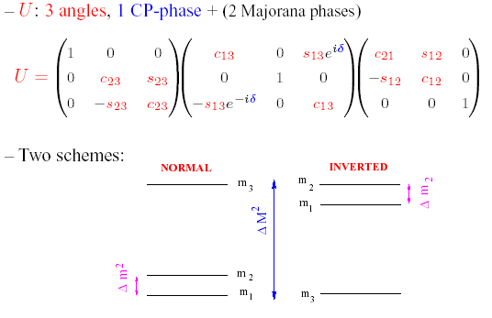
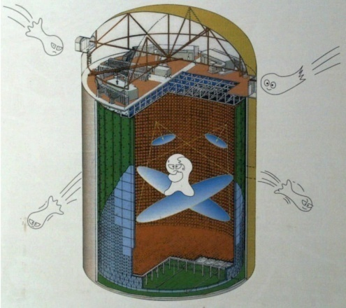
Neutrino Mixing
atmospheric
solar
s_{ij} = sinθ_{ij} c_{ij} = cosθ_{ij}

Slide 4
Neutrinos and the Standard Model
Massive neutrinos have several implications beyond just lepton flavor oscillations:
- Neutrinos may have a non-zero magnetic moment.
- Heavier neutrinos could decay into lighter ones
- They will have an effect on the CMB spectrum
- CP violation in early universe?
- Hint of unification scale below GUTs

Slide 5
We don’t know the mass ordering or absolute mass scale
New information will be coming soon
from several sources

Slide 6
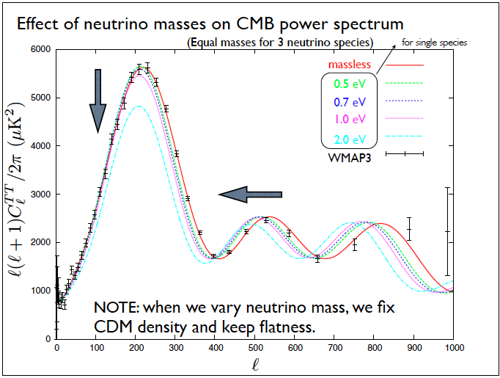
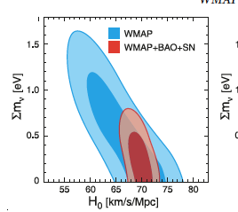
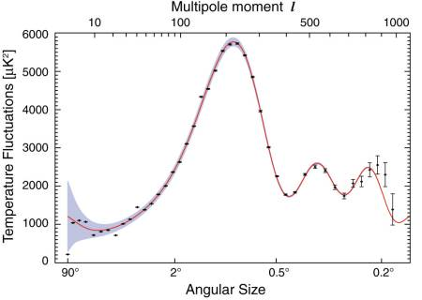
The Absolute Neutrino Mass
Limits on total neutrino mass from cosmology are getting better (<0.67 eV)
Direct measurement from KATRIN is possible at <0.2 eV
Neutrinoless double beta decay for Majorana neutrinos also possible
WMAP-5

Slide 7
Dirac or Majorana?
Do neutrinos have a mass term of the same form as the charged leptons? E.g. a Dirac fermion.
If so, why is the mass so small?
Neutrinos could have a Majorana mass, generated by linking objects with the same chirality. In this case, neutrinos are their own antiparticle.

Slide 8
The “seesaw” mechanism
(there are many variations!)
Light neutrinos may have heavy RH partners that may mix via couplings that link LH and RH
The mass of the light neutrino go roughly as:
m_{ν} ∼ m²/M
Where m is the mass associated with our low energy EW scale (~246 GeV) and M is the mass of the heavy RH partner.
Oscillation measurements imply M~10¹⁵ GeV

Slide 9
Leptogenesis
Simply put, if there does exist a RH heavy partner for the LH neutrinos, and if such a partner violates CP in its decay, it could influence the baryon/anti-baryon symmetry of the universe
CP violation in the light neutrinos does not prove that neutrinos have a heavy CP-violating partner, but it is strong circumstantial evidence
Knowing the absolute neutrino mass and structure would also help!

Slide 10
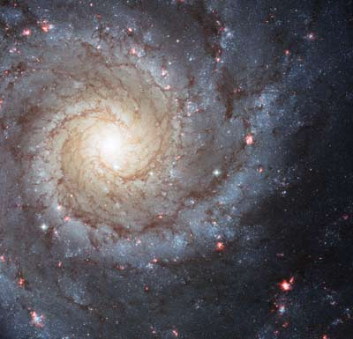
A New Physics
Explain the symmetry of the mixing matrices
Explain the smallness of the neutrino mass scale relative to u,d quarks and electrons. Note: plausibility of seesaw mechanism does not make it true. If it is true, why is RH neutrino mass scale not the GUT scale?
Understand the role of neutrinos in the Big Bang. Neutrino mass and interactions are closely linked to the origins of our universe.

Slide 11
We need to:
Measure θ₁₃ as soon as possible.
Push ahead with 0ν2β decay experiments.
Improve CMB measurements on absolute neutrino mass.
Investigate neutrinos on cosmological scale
Design a next generation long baseline experiment with a high-intensity neutrino beam

Slide 12
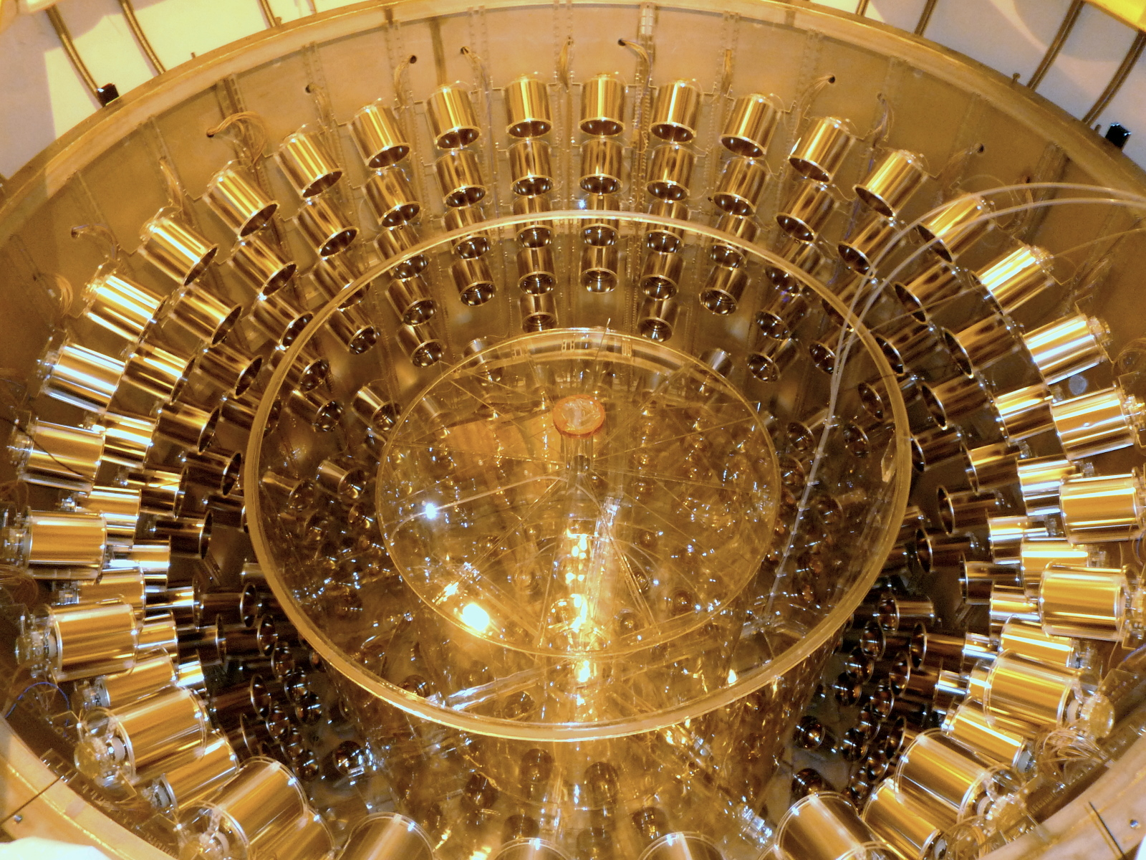


Slide 13
ν_{e} appearance in a ν_{μ} beam
P(ν_{μ}gν_{e}) = (2c₁₃s₁₃s₂₃)² sin²Φ₃₁
+8c₁₃s₁₂s₁₃s₂₃(c₁₂c₂₃cosδ−s₁₂s₁₃s₂₃)cosΦ₃₂sinΦ₃₁sinΦ₂₁
−8c₁₃c₁₂c₂₃s₁₂ s₁₃s₂₃sinδ sinΦ₃₂sinΦ₃₁ sinΦ₂₁
+4s₁₂c₁₃(c₁₂c₂₃+s₁₂s₂₃s₁₃−2c₁₂c₂₃s₁₂s₂₃s₁₃cosδ)sin²Φ₂₁
−8c₁₃s₁₃s₂₃(1−2s₁₃ )(aL/4E)cosΦ₃₂sinΦ₃₁
²
²
²
²
²
²
²
²
²
²
²
²
²
a = constant X n_{e}E
CP: ag-a, δg−δ

Slide 14
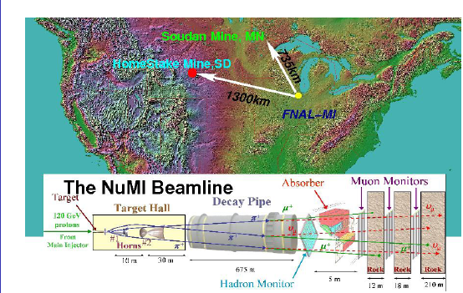
M.Bishai

Slide 15
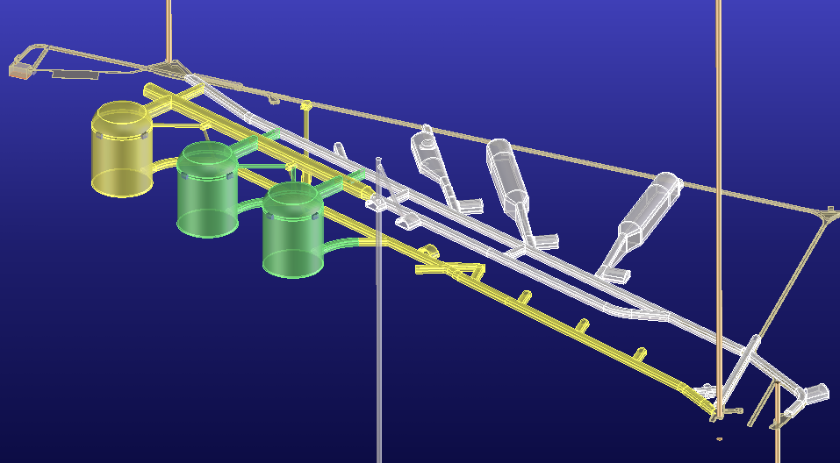
Excavation Plans
October 09
Davis Cavern
Yates Shaft
Ross Shaft
Existing Drifts
Lab Modules
Large Cavities
Excavation Drifts
at 5040L
Access Drifts
at 4850L
New Winze
to 7400L
#6 Winze

Slide 16
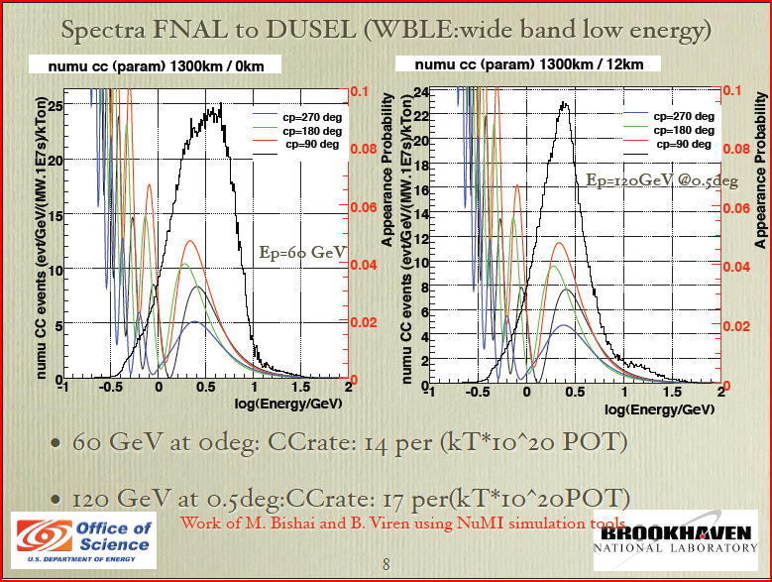

Slide 17
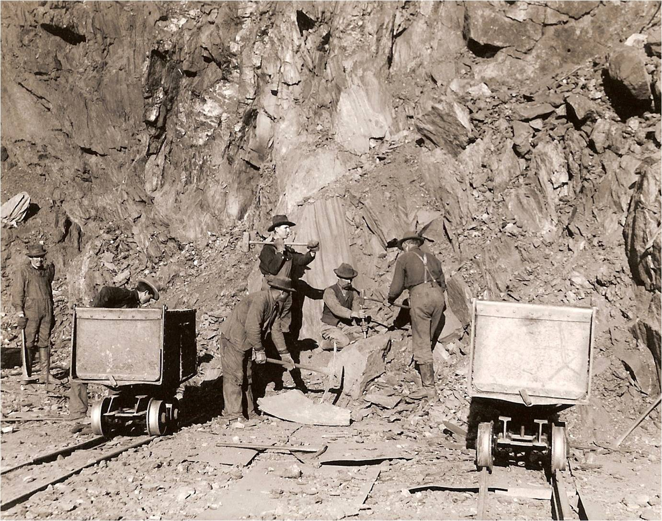
The age old question…
Y’all find any CP violation yet?
more signal!
less background!
Not yet
…more signal
or less background?

Slide 18
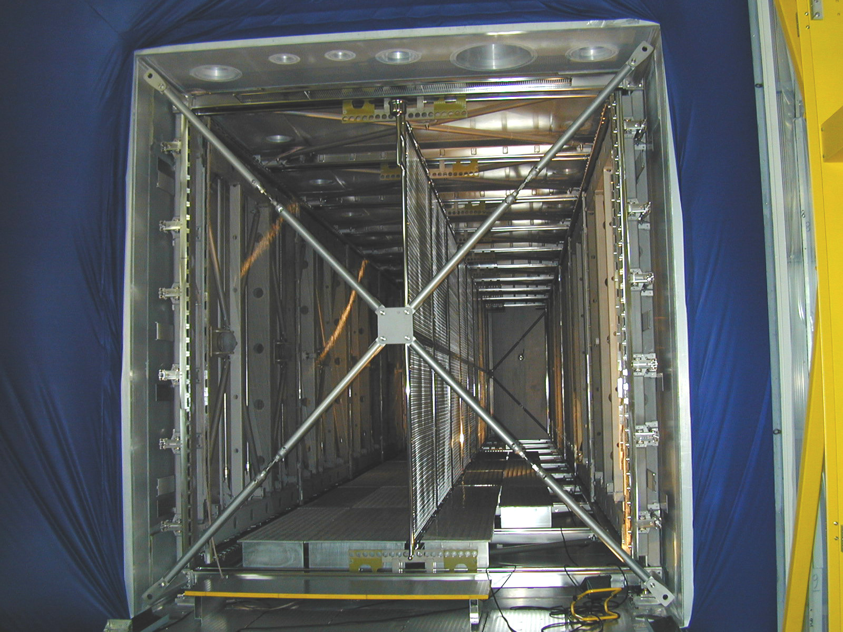
Liquid Argon TPC Detectors
Bubble chamber-like imaging, detailed event topology, with few mm resolution.
Developed over 30 years, and now being applied in 600 ton Icarus in Gran Sasso.
No free protons for nucleon decay or inverse beta studies.
Only detector for potential discrimination of e⁺ from e⁻ at neutrino factory.
Assume 100% efficiency for
background rejection and
80% efficiency

Slide 19

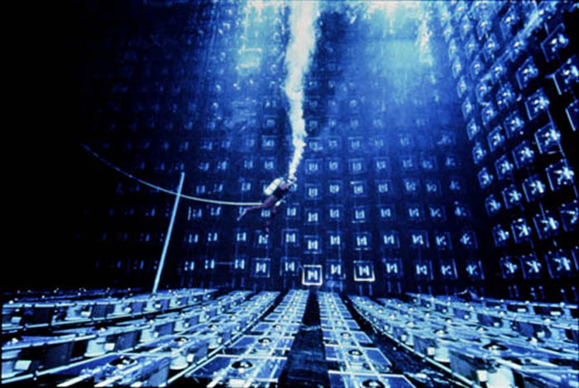
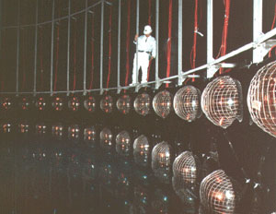
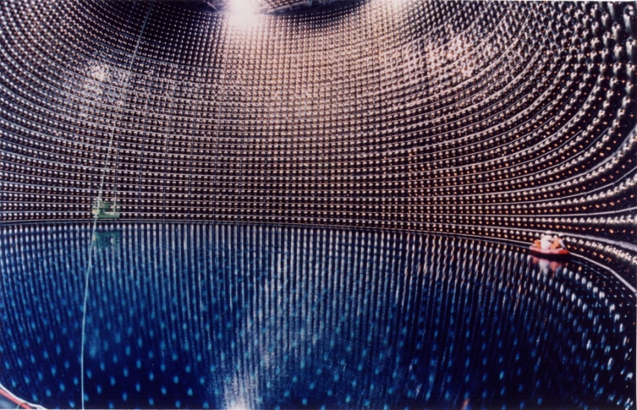
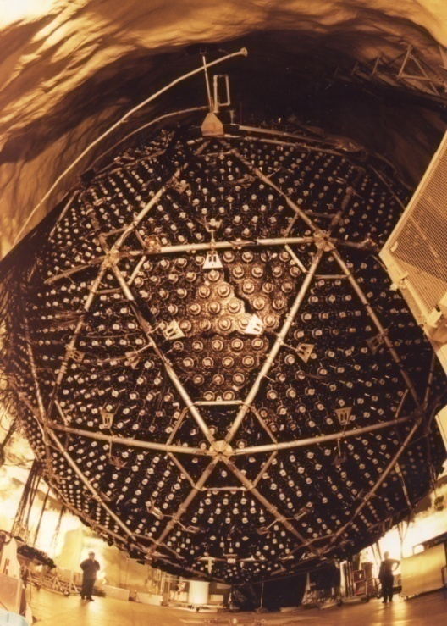
Water Cerenkov Detectors
IMB
3 ktons
Kamiokande
1 kton
SNO
1 kton
Super-Kamiokande
22 ktons

Slide 20
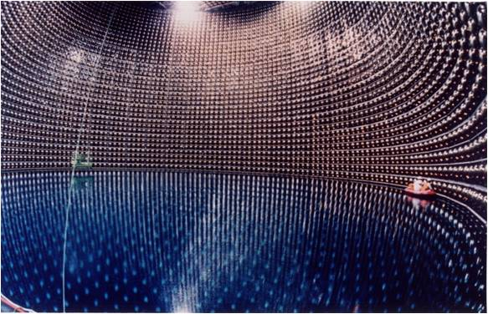
A Large Water Cherenkov Neutrino Detector for DUSEL
Note: the DUSEL detector will
likely be realized in 2-3 modules
The muon rate in the DUSEL detector
will be 1/30th that of Super-Kamiokande
300 ktons
22 ktons
3 ktons
IMB
Super-
Kamiokande
DUSEL

Slide 21
Improved π⁰/e separation in SK
2-R e-like tag (old ring-finder)
π⁰ fitter (improved ring-finder)
work to adapt
this to LBNE
in progress
Reconstruction efficiency of π^{0(%)}
used in
current studies

Slide 22
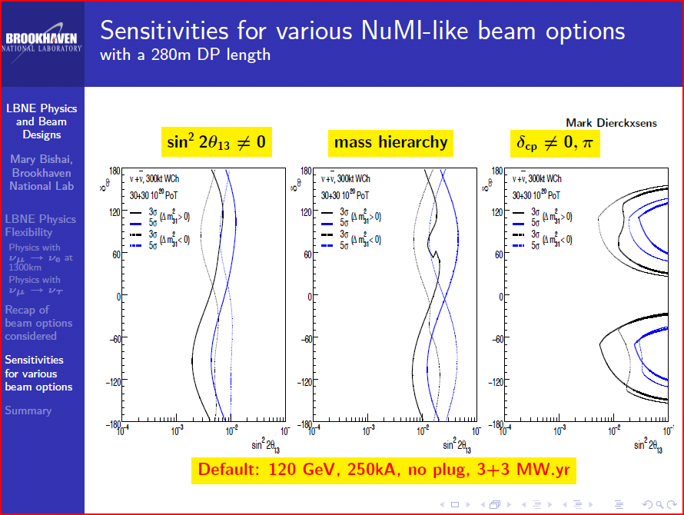

Slide 23
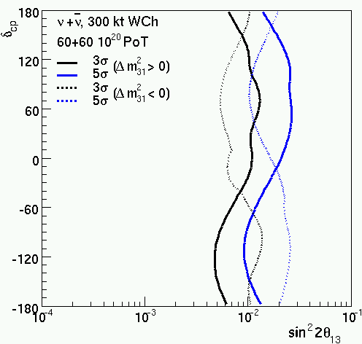
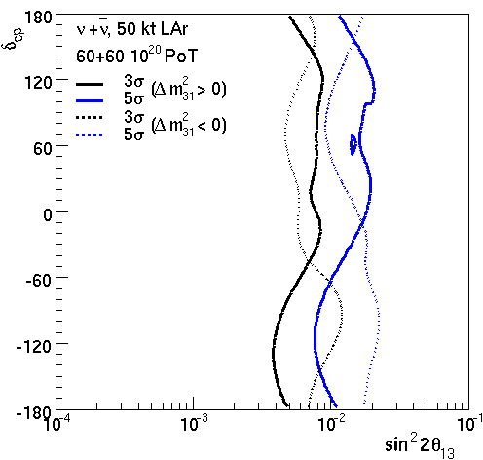
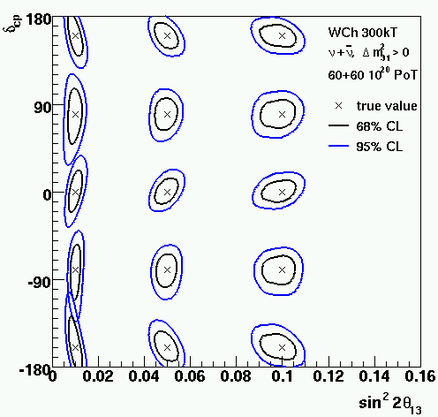
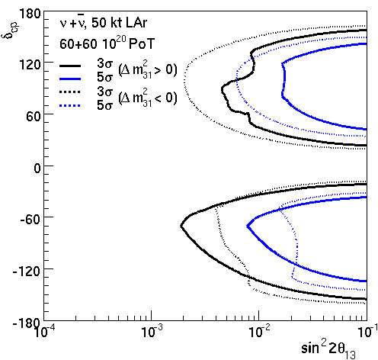

Slide 24
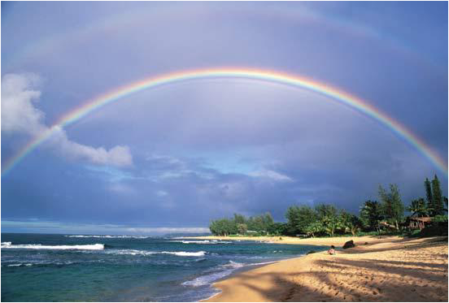
Long Baseline Neutrino Experiment (Science Collaboration)
~180 people
Science Goals: We want a broad program!
Neutrino Mass Hierarchy & CP violation
Supernovae
Relic Supernovae
Proton Decay
neutrino physics

Slide 25
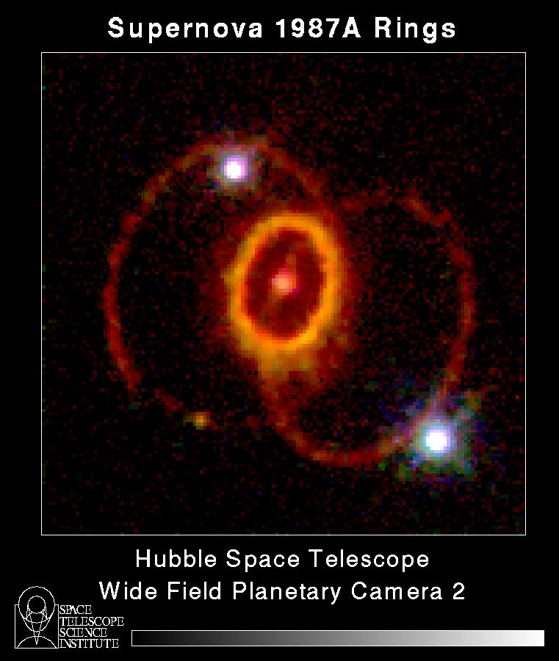
Supernova Burst
Huge signal for a galactic supernova
More importantly: very precise knowledge of the cross-section (~0.2%) for ν_{e} + p -> e⁺ + n makes the statistics meaningful!
Double coincidence: zero background (need Gd)
Positron spectrum mirrors neutrino spectrum
10 kpc with 300 ktons
CC ν_{e} 70,000 events
NC ν_{x} 3,000 events
ES ν_{e} 3,000 events

Slide 26
Gadolinium Doping
Sensitivity to neutron capture via 8 MeV gamma cascade (e.g. M.Vagins, NNN08)
Inexpensive, low risk. Could be implemented after construction completed, no schedule risk.
Technical challenges:
- material compatibility. Chose materials that do not contaminate the water.
- water treatment . Remove impurities but leave gadolinium in solution.

Slide 27
Diffuse SN FLux
C.L., Astropart.Phys.26:190-201,2006
Differences due to different inputs/methods
For a Gd-loaded 300 kton WC detector, estimates range from 6-60 events/year.
SK background of ~20/year significantly reduced by neutron tagging. (Beacom and Vagins)
C.L., Astropart.Phys.26:190-201,2006, Fogli et al. JCAP 0504:002,2005,
Volpe & Welzel, 2007, C.L. & O.L.G. Peres, to appear soon.
Notes:
Put table from my paper instead…

Slide 28
Nucleon Decay
Neutrinos, electrons, photons, and protons are the only known stable particles
Stable over what time scale?
Lifetime of universe 10¹⁰ years
Many theories that try and unite the known forces of nature into a “Grand Unified Theory” (GUT) predict that free protons will decay with lifetimes of 10³⁰ years or longer

Slide 29
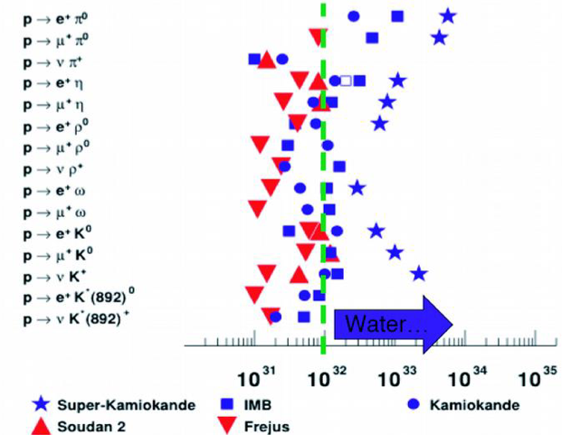
Proton Decay Limits
GOAL: push this
Sensitivity forward
By factor of 10 or more
E.Kearns

Slide 30
Summary
Neutrinos are a fundamental part of our particle universe – one we know little about
An intense neutrino beam from FNAL to DUSEL would provide an unequaled opportunity to measure the mass hierarchy and look for CP violation
The sensitivity of this setup is well-matched to expectations of theta13 sensitivity

Slide 31
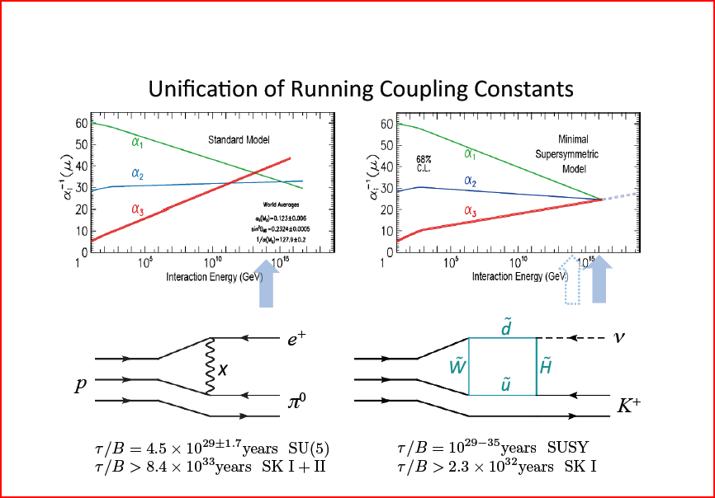

Slide 32
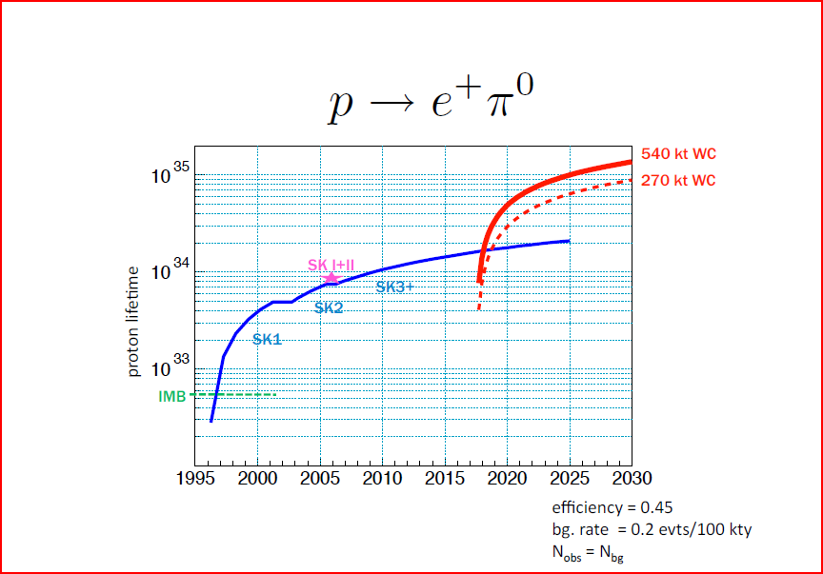

Slide 33
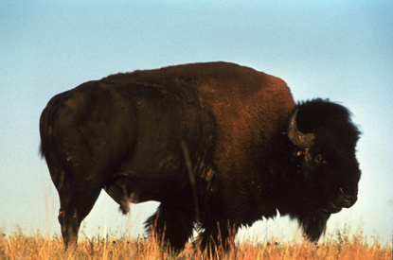
Schedule
Initial design and costing complete by Fall, 2010
DOE CD-1, December 2010
National Science Board, Spring 2011
Preliminary Design (~CD-2), end of 2012
DUSEL construction start, 2013
Large Cavity construction, 2016-2017 (this could be earlier)

Slide 34
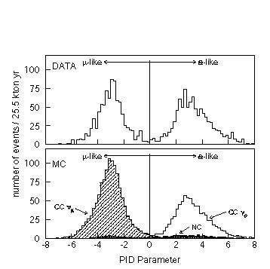
Excellent particle identification

Slide 35
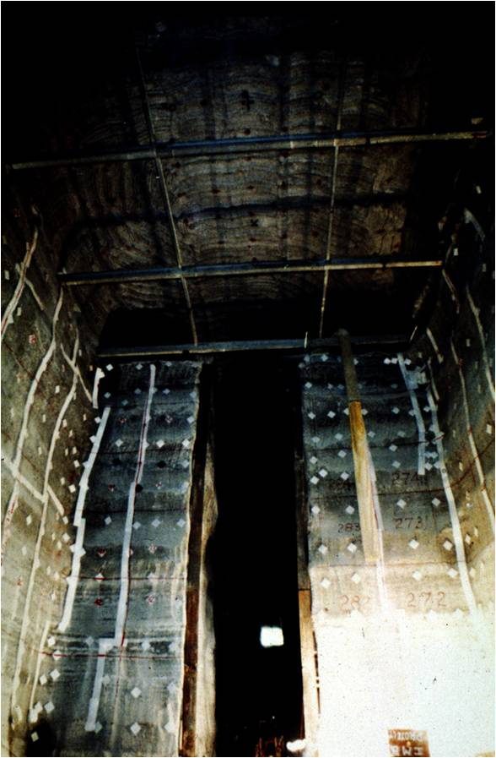
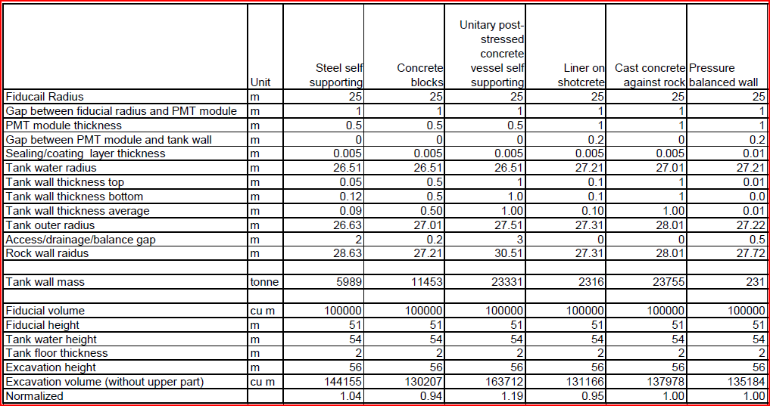
Possible Solutions
SK IMB, SNO
miniBooNE KamLAND

Slide 36
Photon Economics
About 50% of the detector cost is expected to be in photosensors
Even small improvements can make a big impact
Development of light enhancement techniques underway
New high QE PMTs are now available – will be tested in a statistically large sample this year
Prevention of implosion chain reaction (BNL+U.S. Navy). This is a possible point for international cooperation.
Developments outside Project: waveshifting dyes, MCP development

Slide 37
Other Experiment Components
Electronics: conceptual designs in progress. Would like further international cooperation.
Water transparency: facilities at UCI, LLNL
Gadolinium loading: UC Irvine, LLNL, BNL
Calibrations: specifications being developed
PMT’s: FNAL
Project Integration: BNL/DUSEL/S4
Safety: BNL
Environmental Impact: ANL

Slide 38
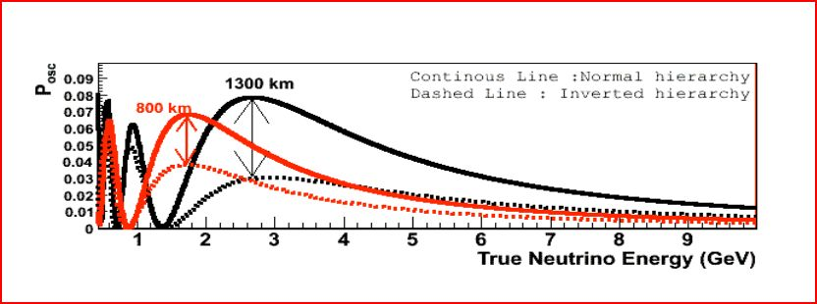
Why DUSEL?
1300 km distance is significant for determination of neutrino mass hierarchy
Deep underground site allows rich physics program in addition to LB neutrinos

Slide 39
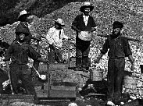
Experiments and Projects
An Experiment
A Project

Slide 40
Long Baseline Neutrino Experiment (LBNE)
NSF
DOE
DUSEL
LBNE Office
(FNAL)
NEAR DET
(LANL?)
WCh Detector Office (BNL)
LAr Detector Development
S4 Office
(universities)
BEAM

Slide 41
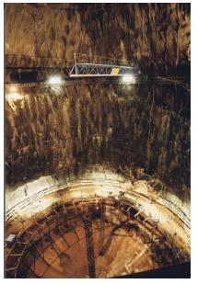
The Big Hole
One large cavity is included in the scope of DUSEL. DOE will also cost one cavity.
Large Cavity Board report: a large 100 kton detector could be built safely and economically. 150 kton cavities may also be possible.
Three independent cost estimates
We want 300 ktons total

Slide 42
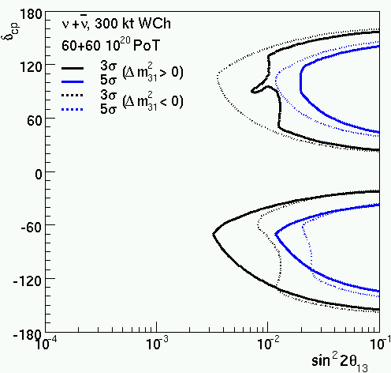

Slide 44
