Slide 1
Project X Cavity and Cryomodule Status
Jim Kerby
AAC Meeting
November 16-17, 2009

Slide 2
Outline
IC-2 Cavity and Cryomodules
  LE Linac Design and Status
  HE Linac Design and Status
Changes required from IC-1 to IC-2
Summary
SSR0
SSR1
SSR2
TSR
SILC
ILC
325 MHz, 2.5
–
466
MeV
1.3 GHz, 0.466
–
2
GeV
~150 m long
~300 m long

Slide 3
IC-2 Low Energy Linac Design
Section | Energy range MeV | β | Number of cavities/ lenses/CM | Type of cavities and focusing element | Maximal power/cavity, kW (I_{av}=1 mA)
Bunching SSR0 (β_{G}=0.11) | 2.5 | 0.073 | 2/3/2 | Single spoke cavity, Solenoid | >0.1
SSR0 (β_{G}=0.11) | 2.5-10 | 0.073-0.146 | 16/16/2 | Single spoke cavity, Solenoid | 0.8
SSR1 (β_{G}=0.22) | 10-32 | 0.146-0.261 | 18/18/2 | Single spoke cavity, Solenoid | 1.5
SSR2 (β_{G}=0.4) | 32-117 | 0.261-0.5 | 33/17/3 | Single spoke cavity, Solenoid | 3.2
TSR (β_{G}=0.6) | 117-466 | 0.5-0.744 | 48/48/8 | Triple spoke cavity, quads | 8.5
Buncher cavities and RT section of IC-1 are replaced in IC-2 with SSR0 single spoke SC cavities.
Quality factor / cryogenic requirements result in operating temperature reduced to 2K (from 4.5K)

Slide 4
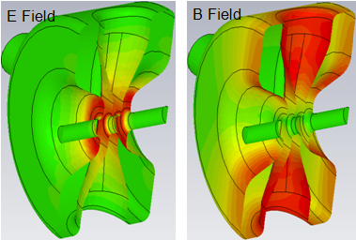
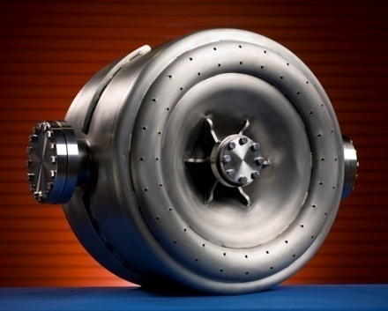
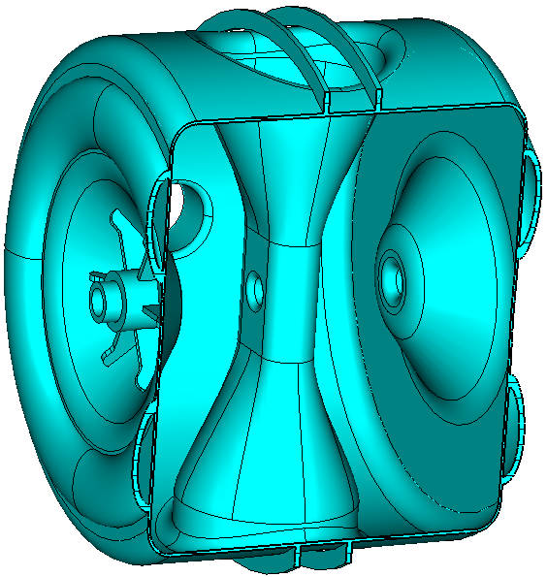
Single Spoke Resonator Sections
Currently SSR1 effort is largely captured in the HINS program (B. Webber talk later)
EM designs exist for each cavity through SSR2
2 SSR1 prototype cavities have been successfully tested
  Project X relies on the extrapolation of these results in the designs of SSR0 and SSR2 cavities

Slide 5
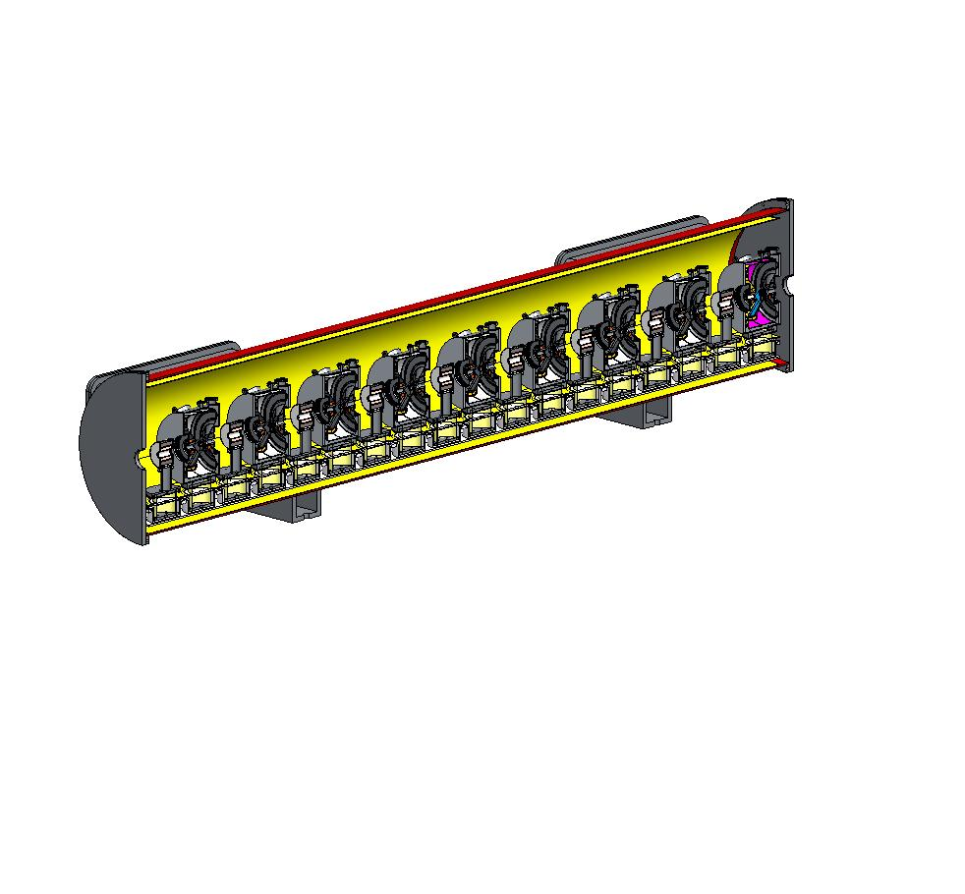
Single Spoke Resonator Sections
HINS will also include SSR1 Cryomodules
  Contains 9 SSR1 cavities and 9 solenoids
  Project X expects that these designs could be extended to SSR0 and SSR2 requirements

Slide 6
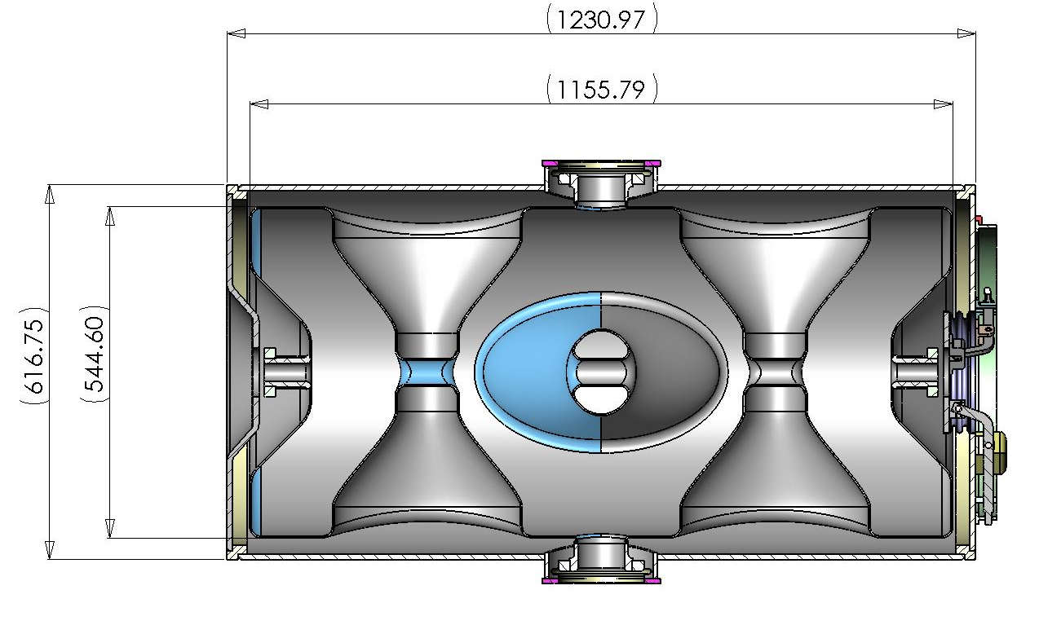
Triple Spoke Resonator Section
Triple Spoke Resonator near 325MHz design has existed for several years, with several proposed applications
  RIA, Proton Driver, FRIB, …
Strong ANL desire to pursue design further
  Potential Jlab interest as well
Design is highly compact and efficient, but not proven
Cavity design funded in FY10 PrX RD&D
No PrX specific cryomodule design development to date

Slide 7
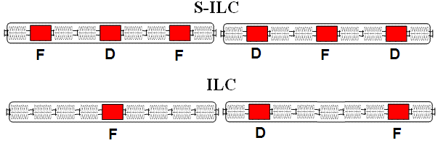
IC-2 High Energy Linac Design
Section | Energy range MeV | β | Number of cavities/ quads/CMs | Type | Max Power/cavity (on crest), kW (I_{av}=1 mA)
S-ILC(β_{G}=0.81) | 466-1200 | 0.744-0.9 | 66 / 42 / 11 | Squeezed elliptical | 13
ILC (β_{G}=1) | 1200-2000 | 0.9-0.95 | 68 / 13 / 9 | 9-cell ILC | 15
Modified ILC Type IV 2/5/8 Cryomodule assumed throughout
Std ILC 9-cell cavity used in β = 1 section
Std ILC 9-cell cavity unit length used for magnet and β = 0.81 design
Two cryogenic segments

Slide 8
ILC / SRF Program
The Americas Region ILC/SRF cavity program funding is recovering from crisis of a couple of years ago
ARRA funds provided a further positive increment to the industrialization program this year (B. Kephart talk)
  Jlab and FNAL/ANL processing facilities up to speed
  FNAL VTS stand completed 35 vertical tests in FY09; civil construction for VTS 2 & 3 just completed
  1 cell qualification of Americas Region Vendors and soon Indian collaborators
  Recent 9 cell success of AES cavities 8-9-10
  Installation of CM1 at NML
  Completion of Type IV Cryomodule design
  ….
In short, after a very difficult time and much extra effort, a good return on investment we are trying to utilize in the Project X design

Slide 9
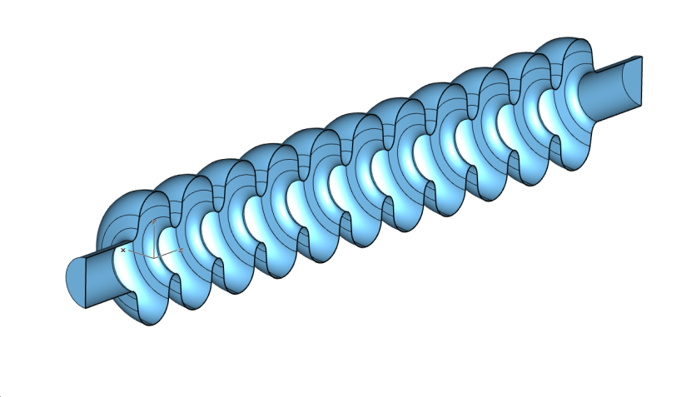
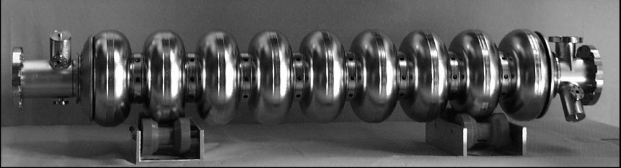
β = 0.81 and β = 1 Cavities
β = 0.81 cavities are squeezed elliptical designs
  Several variants in design; optimization of #cells, rigidity, length
  MSU to complete older design effort (made dormant by budget) and transfer information to Indian collaborators
  Looking for strong Indian participation in this regime
β = 1 cavities are standard ILC 9 cell design

Slide 10
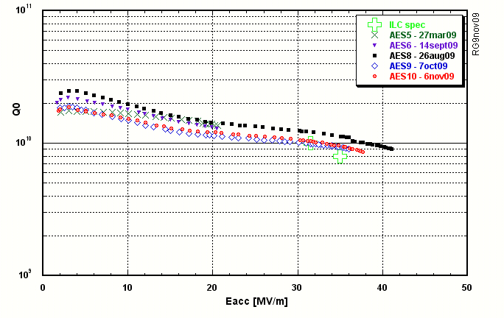
AES ILC 9 cell Cavities at JLab
PrX
Courtesy R. Geng, Jlab

Slide 11
IC-2 Cryomodules
Using the ILC investment to date the ILC modified Type IV cryomodule design from the S-ILC section of IC-1 has been utilized throughout IC-2
  Of the 9 units in the cryomodule, in addition to the center section (#5) being able to accommodate a magnet sections #2 and #8 are also designed to potentially receive a magnet
  All cryomodules in S-ILC and ILC section are of the same design

Slide 12
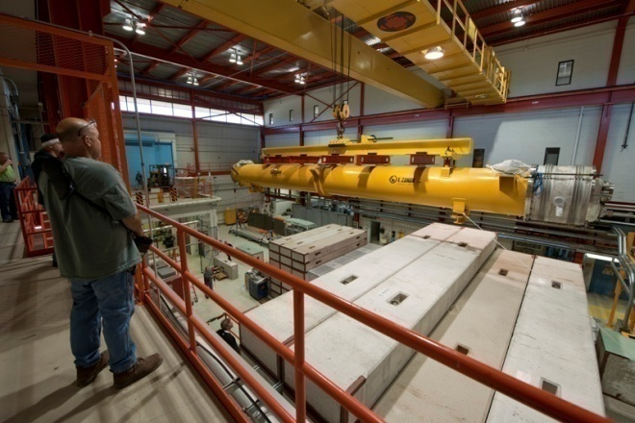
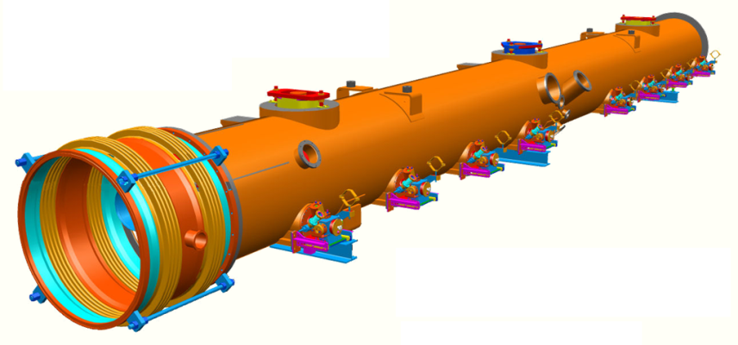
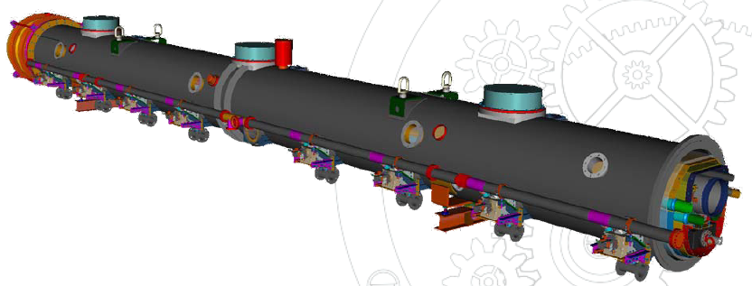
ILC Cryomodule Status
CM1 Installation in NML
Oct 2009
CM2 Construction
Spring 2010
CM3-6 Procurement
2010

Slide 13
Changes Required
The fundamental change is the power required to drive the linac in cw mode
In the low energy linac
  SSR1 cavity OK but not optimized for 2K
    Helium vessel and tuner need redesign
  RF power supply, distribution must be changed
    SSR1 input couplers OK at cw average power levels
    Initial review suggests individual powering is most cost effective
  Cryogenic operation at 2K most cost effective
    Cryostat will require evaluation for inclusion of appropriately sized piping
    Shields should be reevaluated in light of dynamic load
    Potential further segmentation

Slide 14
Changes Required
In the high energy linac
  Baseline elliptical cavity designs OK, potentially not optimized β
    Re-evaluate HOM coupler, Piezo tuner
  Cryogenic operation lower than 2K appears most cost effective
    Potential further segmentation
Courtesy DESY

Slide 15
Changes Required
In the high energy linac
  RF power supply, distribution must be changed
    Initial review suggests individual powering of cavities is most cost effective
    Couplers must be redesigned
      Use Type IV cryomodule cavity cold port and vacuum vessel port size→initial review suggests OK
        Conductor cooling needs re-evaluation
        Cornell ERL, KEK ERL Main Linac Coupler designs equal or greater cw power
          Larger cold ports; but not fundamental limitation
        KEK ERL ML Test Bench uses 30kW IOT as proposed for cw Linac cryomodules

Slide 16
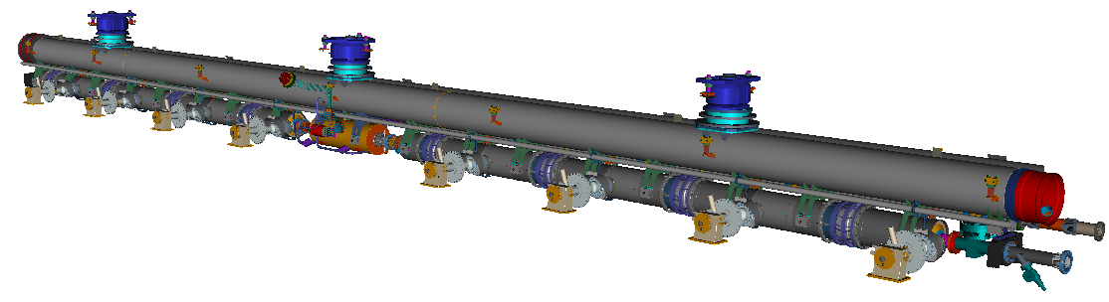
Changes Required
In the high energy linac (con’t)
  Overall cryostat design OK, however
    Use of modified Type IV 2/5/8 required
    Design constraints imposed on
      Pitch of coupler spacing in cryomodule
      Magnet package length / volume
    Helium 2 phase pipe diameter too small
    Shields should be re-evaulated in light of dynamic load
      Recent KEK studies suggest 2K static change ~<1W

Slide 17
Summary
IC-2 cavities and cryomodules are derivates of designs already developed by HINS and ILC/SRF programs
  Continuation of these efforts is crucial to Project X
The high energy linac cryomodules will remain an important industrialization exercise leading toward the ILC
Operation in cw mode requires design changes, both in the machine and test facilities
  RF power requirements and distribution
  Cryogenic sizing, integration, segmentation
Evaluation of the design changes will require more effort
  Implementation will require careful review and control

