Slide 1
IC-2 Linac Design
Nikolay Solyak
AAC Meeting
November 16-17, 2009

Slide 2
Outline
Linac concept and breaking points
325 MHz and 1.3 GHz SC cavities
RF couplers
Magnets and Focusing
Crymodules
Lattice design, options
R&D program
Conclusion

Slide 3
Layout of IC-2 complex
LEBT
MEBT

Slide 4
Ion source and RFQ
H⁻ ion source :
  10mA DC current, 50-60 kV
  Normalized transverse emittance ~0.25 mm-mrad (rms)
  Sources with similar parameters are available (TRIUMF, BINP)
  Maintenance >~3 weeks
CW RFQ: 325 MHz, 2.5 MeV, 10 mA
  No SC RFQ in operation for protons/H- (80 MHz, 350 keV SRFQ for heavy ions operates for PIAVE linac).
  Number of CW RFQs operating at room temperature for beam currents of up to 100 mA and energies of up to ~7 MeV.
    LEDA CW RFQ (LANL) 350 MHz, 6.7 MeV, 100 mA, and wall losses of 1.2 MW.
    KOMAC/KTF: 3.3m, 3 MeV , 20 mA. The wall losses are 350 kW.
  Design is feasible. RF power ~350-450 kW. RF source for a CW RFQ is available at 350 MHz; it is possible to redesign it for 325 MHz
  New proposal -162.5 MHz RFQ (J.Staples/ LBNL: L=3.85m, P=155kW)

Slide 5
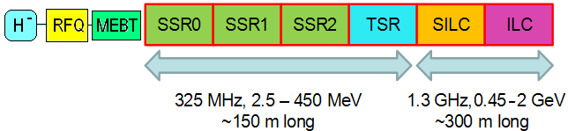
Concept of the 2 GeV CW Linac (IC-2)
Major features of the linac:
SC Linac is divided by two parts:
    325 MHz: Four families of spoke cavities: SSR0, SSR1, SSR2, TSR
    1.3 GHz: Two families of elliptical cavities: SILC (β=0.81), ILC ((β=1)
Constrains: cryogenic and RF CW power
Individual RF sources for each cavity (IOT, 25-30 kW)
Focusing by SC solenoids (up-to ~100 MeV) and FODO (0.1-2GeV)
Cryomodules are assembled in strings ~(8-10) CM’s per string
Warm sections between cryo-strings (diagnostics, etc.)

Slide 6
Breaking points between sections
Section | Energy MeV | β range | #cavities/ lenses/CM | Type of cavities and focusing | End Z m | Power/cav, kW
MEBT | 2.5 | 0.073 | 2 / 3 / 2 | SSR, Solenoid | 2.75 | 0.5
SSR0 (β_{G}=0.11) | 2.5-10 | 0.073-0.146 | 16 / 16 / 2 | Single spoke cavity, Solenoid | 11.9 | 0.5
SSR1 (β_{G}=0.22) | 10-32 | 0.146-0.261 | 18 / 18 / 2 | Single spoke cavity, Solenoid | 26.4 | 1.3
SSR2 (β_{G}=0.4) | 32-117 | 0.261-0.5 | 33 / 17 / 3 | Single spoke cavity, Solenoid | 55 | 4.1
TSR (β_{G}=0.62) | 117-466 | 0.5-0.744 | 48 / 48 / 8 | Triple spoke cavity, quads | 148 | 8.5
S-ILC(β_{G}=0.81) | 466-1200 | 0.744-0.9 | 66 / 42/ 11 | 11-cell Squeezed ILC | 280 | 13
ILC (β_{G}=1) | 1200-2000 | 0.9-0.95 | 68 / 13 / 9 | 9-cell ILC | ~400 | 15
Drifts: (SSR0-SSR1) ~ 40 cm. (SSR2–TSR) ~70 cm, (TSR-SILC) ~5 m, (SILC-ILC) ~10m.

Slide 7
Parameters of the SC cavities
325 MHz spoke cavities
Cavity type | E_{acc} [MV/m] | L_{eff} mm | E_{p}/E_{acc} | B_{p}/E_{acc} mT/(MV/m) | R/Q Ω | G Ω | Q_{0,2K} ×10⁹ | Q_{0,4K}×10⁹ | P_{2K} [W] | P_{4K} [W]
SSR0 | 8.7 | 72 | 4.1 | 4.6 | 120 | 57 | 9.5 | 0.7 | 0.34 | 4.67
SSR1 | 10.8 | 135 | 2.62 | 3.87 | 242 | 84 | 14.0 | 1.0 | 0.63 | 8.78
SSR2 | 13.6 | 246 | 2.42 | 3.95 | 322 | 112 | 18.0 | 1.3 | 1.93 | 26.74
TSR | 9.75 | 943 | 3.22 | 6.85 | 554 | 117 | 19.0 | 1.4 | 8.03 | 109
1300 MHz elliptical cavities
Cavity type | E_{acc} [MV/m] | L_{eff}, mm | Ep/E_{acc} | B_{p}/E_{acc} mT/(MV/m) | R/Q Ω | G Ω | Q_{0,2K} ×10⁹ | P_{2K} [W] cryo
11-cell, β=0.81 | 14.4 | 1028 | 2.41 | 5 | 750 | 228 | 12.7 | 22.4
9-cell, ILC | 16.9 | 1038 | 2 | 4.26 | 1036 | 270 | 15.0 | 19.7
Gradient is moderate, limited mostly by cryogenic & available RF power sources, power couplers

Slide 8
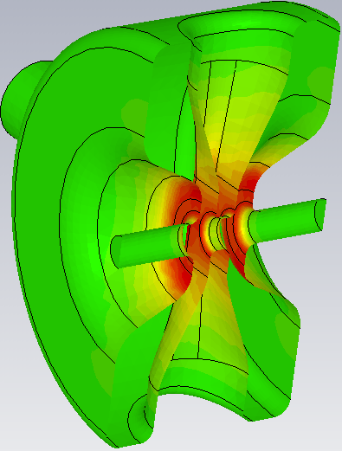
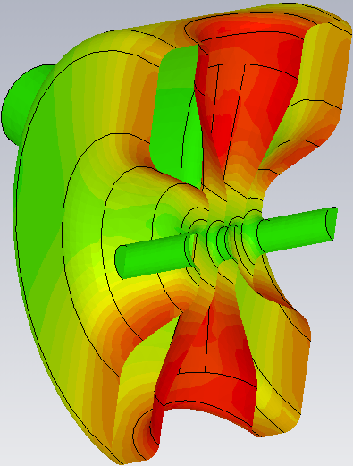
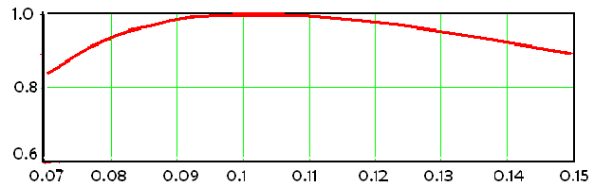
SSR0 β=0.117 (design)
Energy gain per cavity vs. β
E Field
B Field
Hs = 60 mT
HINS RT cavities
E_{acc*}=E_{acc}(β_{optimal})* TTF, Average
F(MHz) | 325
β_{optimal} | 0.117
Diameter, mm | 200
D_{eff} = (2*βλ/2),mm | 108
R/Q, Ω | 120
(E_{max}/E_{acc}) | 5.5
(H_{max}/E_{acc}) (mT/MV/m) | 6.5
Transit time factor vs. beta

Slide 9
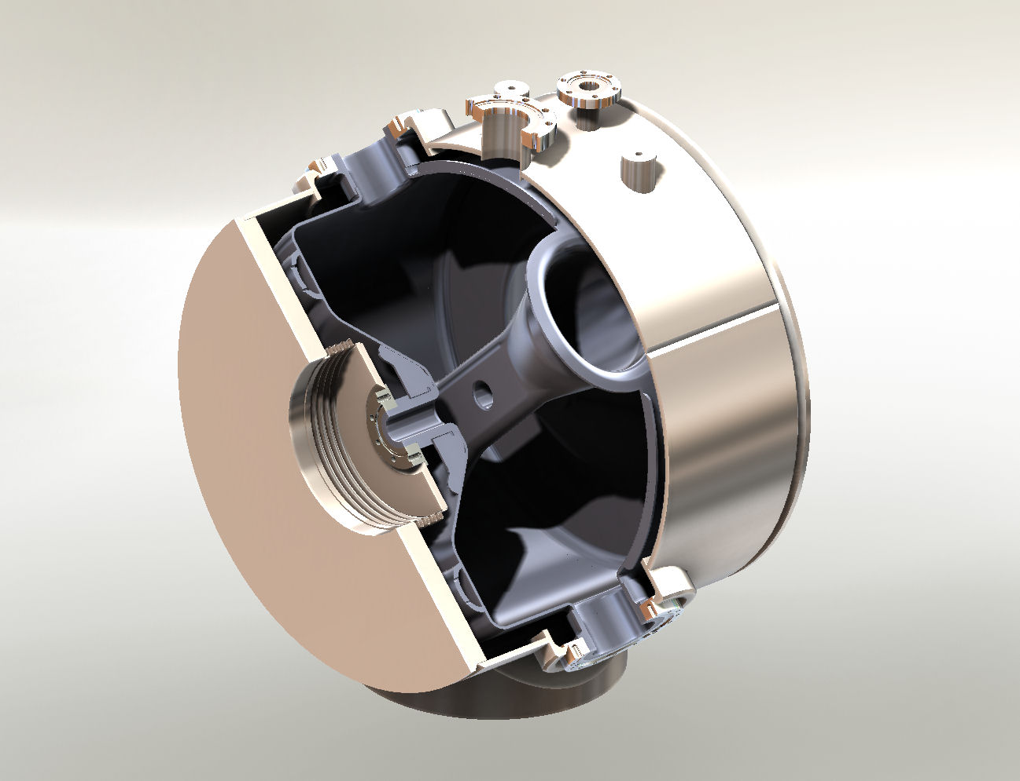
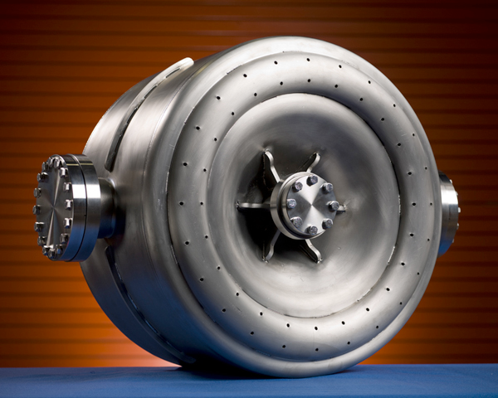
SSR1, β=0.22
Status: 2 prototypes were built and tested. Results: #1: 19 MV/m @ 4K, 20 MV/m@2K #2: 25 MV/m @4K, 33 MV/m@2K

Slide 10
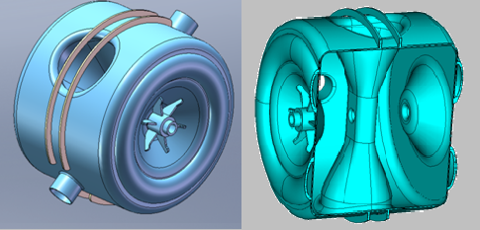
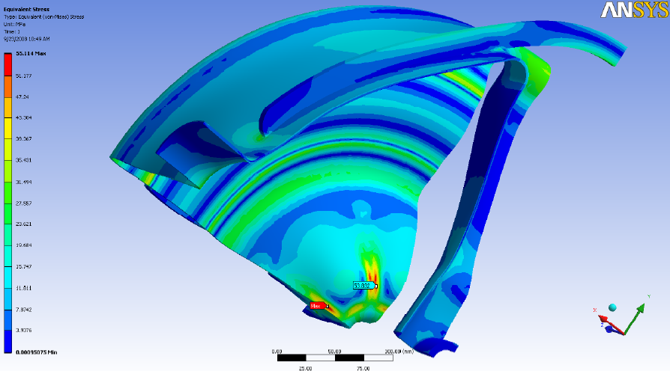
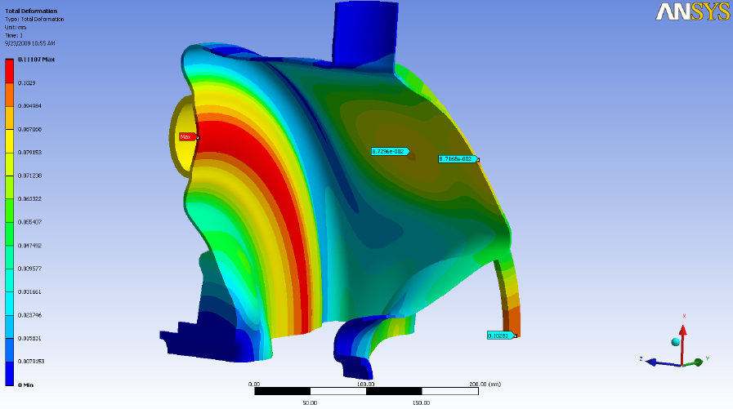
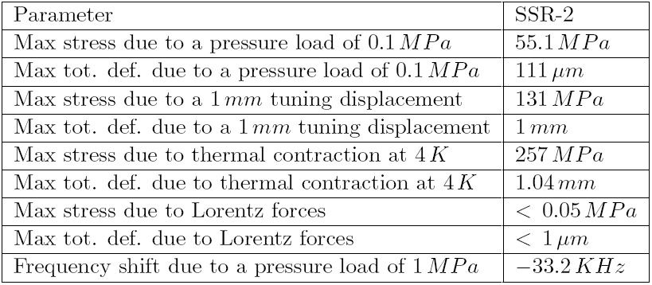
SSR2, β=0.4
(RF and mechanical design)
Stresses (up) and displacement due to 1Atm pressure

Slide 11
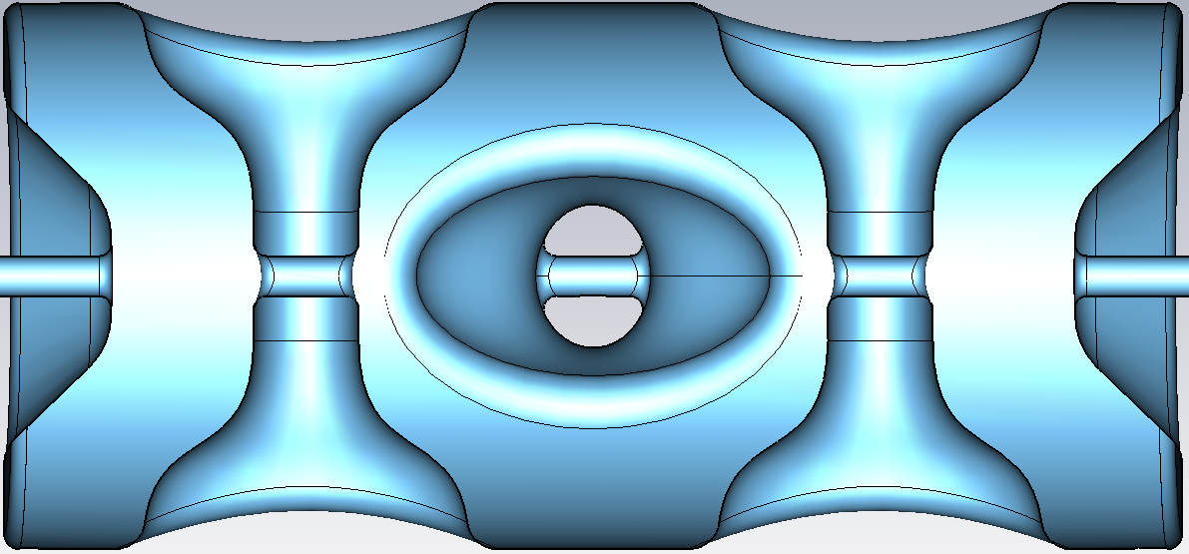
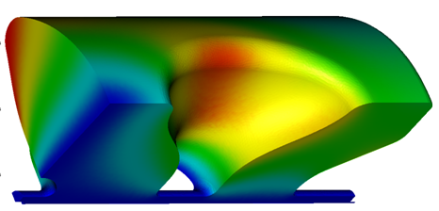
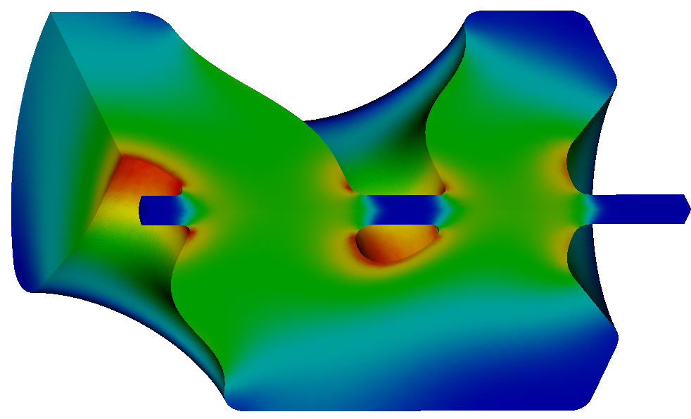
Design of the Triple-Spoke Resonator (TSR) β=0.62
2009
1173mm
Version | R/Q, Ω | E_{p}/E_{acc}* | B_{p}/E_{acc}* _{mT/(MV/m)}
2006 | 580 | 3.11 | 6.84
2009 | 665 +14.6% | 2.88 -8% | 6.08 -12.5%
544mm
360mm
183mm
* Length for normalization iris-to-iris
Magnetic fields
Electric fields
I.Gonin, FNAL)
RF design, ANL is ready to built prototype

Slide 12
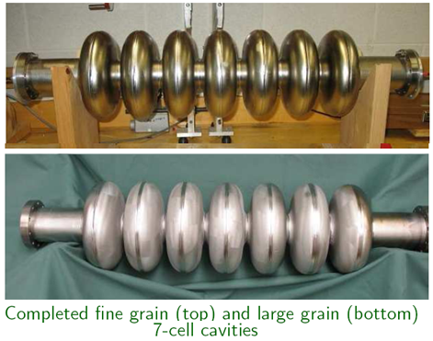
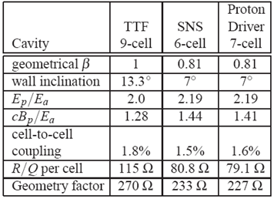
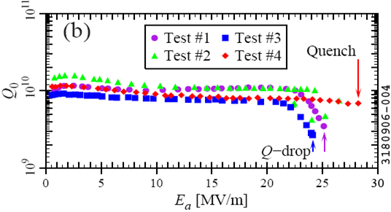
Elliptical 1.3 GHz 7-cell β=0.81 cavity (MSU-FNAL collaboration)
(W. Hartung et al, SRF2007,TUP55)
Single-cell tests
Plan to test both cavities at Fermilab

Slide 13
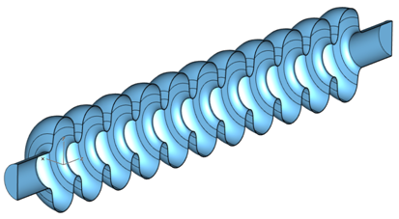
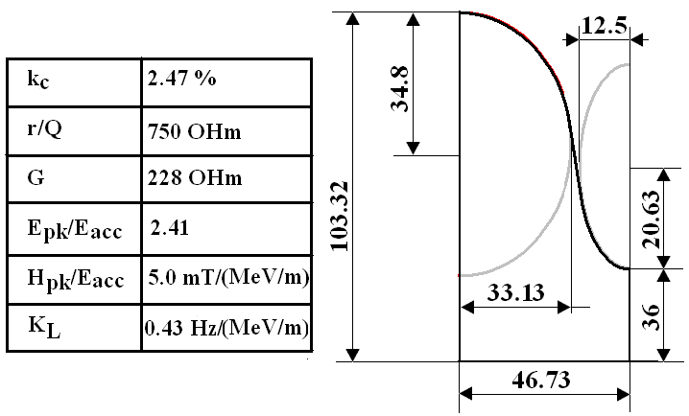
1.3 GHz Squeezed β=0.81 11-cell cavity (design)
mid-cell geometry
Design constrains and advantages:
Large cell-to-cell coupling to provide the same field flatness requirements, as ILC cavity
Cavity length is close to ILC cavity (~2mm difference): it allows to use
  Same components: helium vessel and frequency tuners, coupler, HOMs
  Fit space in Type-4 cryomodule, same assembly tooling
  High energy gain per cavity ➔ less number of cavities and CM are required
Now considering new design: 9-cell cavity. Need redesign of ILC cryomodule (more cavities, short quads)
Collaboration with India to design and built cavity and cryostat

Slide 14
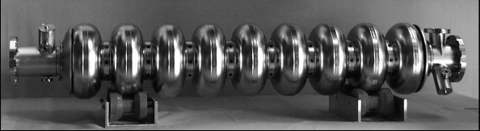
ILC cavity
CW regime
E _{acc} = 16.9 MV/m
Q = 1.5 *10¹⁰
P cryo = 20 W
PrX goal

Slide 15
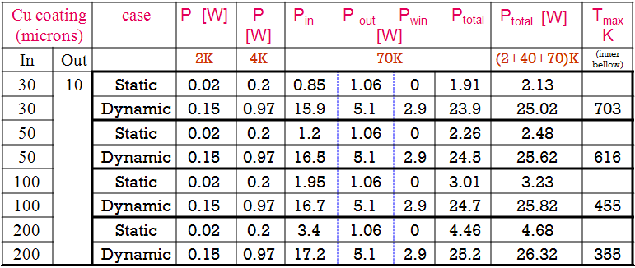
Re-design of the TTF-3 coupler for 15kW CW
Table: Cryogenic Power Losses (static & dynamic) for different thickness of copper coating @15 kW average power
Inner bellows overheated
Acceptable overheating
SLAC is planning to order and test TTF-3 coupler with ~200 um copper plating
T distribution on inner conductor for different thickness of copper coating

Slide 16

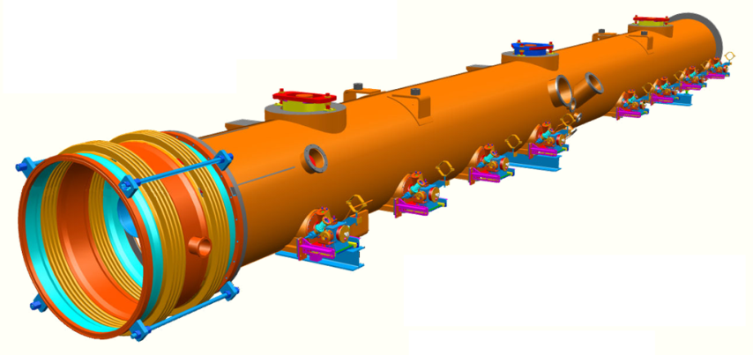
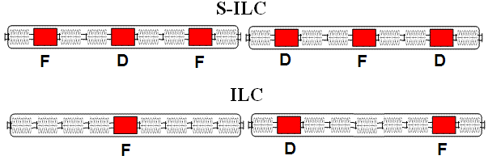
Magnetic Focusing
Standard ILC Type 4 cryomodule with additional ports for magnet leads in slots 2,5,8.
Slots can be used for installation of cavity or quadrupole.

Slide 17
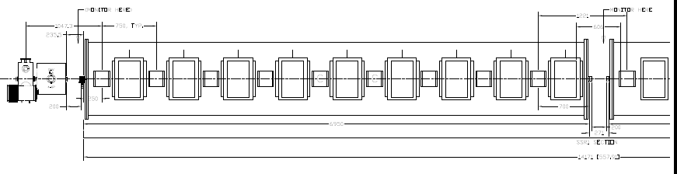
Cryomodules
1. SSR1 cryostat design (HINS)
750 mm
750 mm
6950 mm
271 mm
2. No designs for SSR0, SSR2, TSR cryostats
3. ILC Type-4 cryomodule with small modifications (3 ports for magnets) for S-ILC and ILC sections

Slide 18
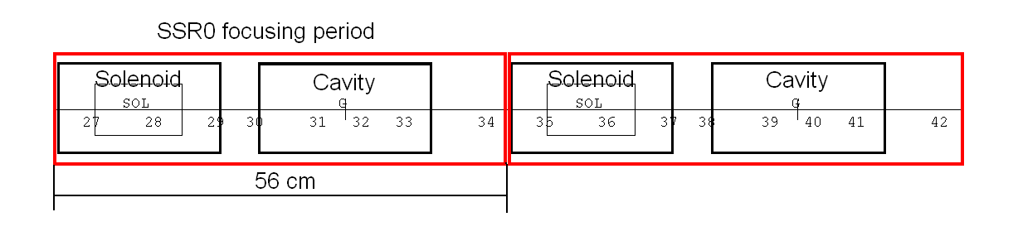
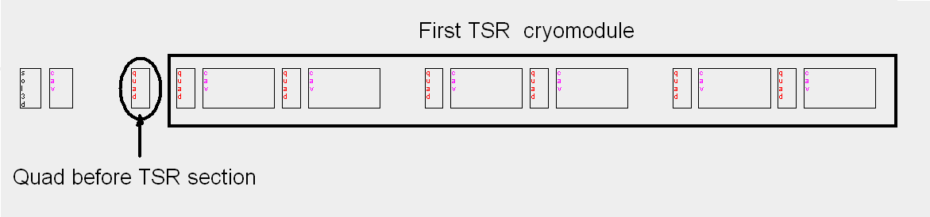
SSR0 section (1 CM)
325 MHz Sections (concept)
SSR1 section (2 Cryomodules):
SSR2 section (3 Cryomodules):
TSR section (8 Cryomodules with):
Extra quad between SSR2 and TSR sections (warm section with diagnostics) ?

Slide 19
Lattice Design
Assumptions:
  MEBT (10-15m):
    Space in MEBT for beam diagnostics (BPMs, profile & current monitors)
    Longer space for choppers and beam dumps
    RT (or SC) buncher cavities
  325 MHz sections:
    14 SSR0, β=0.117
    Solenoids in SRR0,SSR1 and SSR2. FODO in TSR
    Cryostats are separate, not in string (like in HINS and ICD-1)
  1.3 GHz section:
    Use Type-4 cryostat for S-ILC and ILC cavities. FODO focusibg11-cell beta=0.81 cavity instead of 8-cell cavity
    Gradient reduced to 14.4 MV/m in S-ILC and 16.9 MV/m in ILC cavity
    Warm sections in between TSR, S-ILC, ILC-1 sections
Other possible options under investigation:
  Doublet and triplet focusing to replace solenoids and TSR
  Low frequency (650 MHz) cavities in HE part (instead of 1.3 GHz)

Slide 20
Energy gain, RF power and phase profile in cavities
Energy gain and power per cavity
Cavity Phases along the Linac
RF Power/cavity, kW
325 MHz: cavities #1-#117: 1.3 GHz: cavities #118-251
Few cavities at the end of 325 MHz section have large (60-70°) RF phase in order to match the beam longitudinal dynamics to the 1.3 GHz section.

Slide 21
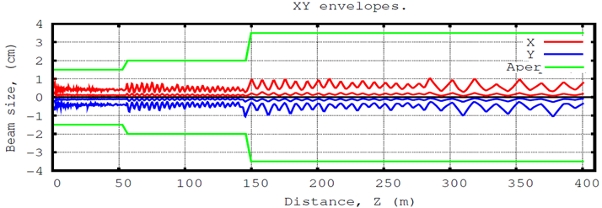
Beam size and emittances (TRACK, 10 mA)
XY envelopes (RMS and max)

Slide 22
Longitudinal Beam size and Emittance
Z envelopes (RMS and max)
Z RMS emittance

Slide 23
R&D program
Linac components design and prototyping:
  Spoke cavities: SSR0, SSR2, and TSR (ANL)
  S-ILC beta=0.81
  Magnets: solenoids, doublets/triplets
  Cryostats
  RF components: Couplers, IOT’s, RR distribution
  diagnostics
Lattice design and beam dynamics studies
  Ion source, LEBT, RFQ – optics, performances
  MEBT lattice (choppers, diagnostics, focusing, bunching)
  Study different focusing options: solenoids, doublets, triplets
  Errors and misalignment studies. Tolerances and Alignment algorithms
  Collimation, Diagnostics, warm sections
  Study alternative options:
    High energy linac with 650 MHz cavities (???)
  HINS – test bench for R&D program. Other facilities: SNS, Linac4, …

Slide 24
Conclusion
Design of the CW linac for 2 GeV, 1mA looks feasible.
Many critical components (cavities, couplers, RF sources, magnets) are exist or designed. Some were tested at FNAL or elsewhere.
HINS provide experimental proof of principle for SC solenoids and spoke cavities.
First look on Lattice not shows problem. Work is ongoing.
Strong R&D program (experimental and design) is essential to optimize design, reduce risk and the cost of the project.
Collaboration and expertise is key of success

