Slide 1
HINS Chopper and Application to Project X
Robyn Madrak
AAC Meeting
November 16-17, 2009

Slide 2
Outline
HINS Chopper as originally designed
Relevance to Project X
HINS as a test facility for Project X Choppers

Slide 3
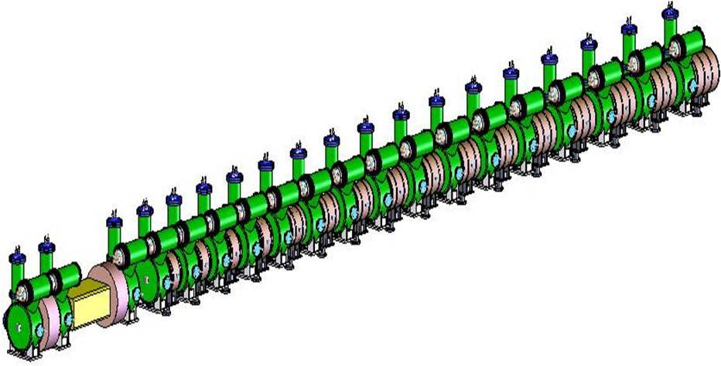
HINS Chopper
Original purpose: to chop single bunches which would not fall into a Main Injector RF bucket (325 MHz ≠ 53 MHz * n)
  Given the amount of space, repetition rate, voltage and rise time requirements, this is extremely challenging
    Only ~5.5ns for full pulse width
    Voltage 2.4 kV → 100 Ω per plate
    Repeat every ~20 ns (50MHz)
    Burst 3(1) ms @ 2.5(10) Hz
Chopper is in MEBT after RFQ and 1 buncher:
chopper
solenoids
RFQ
2.5 MeV
buncher cavities

Slide 4
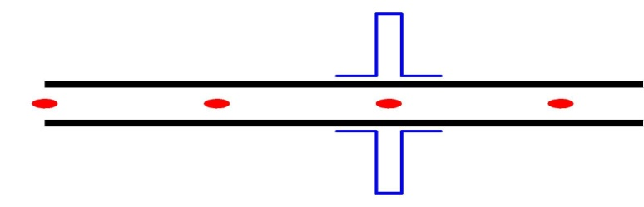

Traveling Wave Structure
For needed kick, beam sees field for ~ 50 cm
Beam is deflected by traveling pulse
β(beam) = 0.073 ⇒ must slow down pulse
  Use travelling wave “meander” structure
    50 cm long
    16 mm between plates
    2.4 kV per plate
    ~30 cm of drift downstream
chopper plates
(meanders)
V = +2.4 kV
β=0.073
⅛″ thick substrate (ε = 9.6)
100Ω
β=0.073
β=0.073
d = 16mm
~6ns
.015 ″
6 mm
V = -2.4 kV
Pwid < 6 ns
deflection θ = 24mRad
20 mm

Slide 5
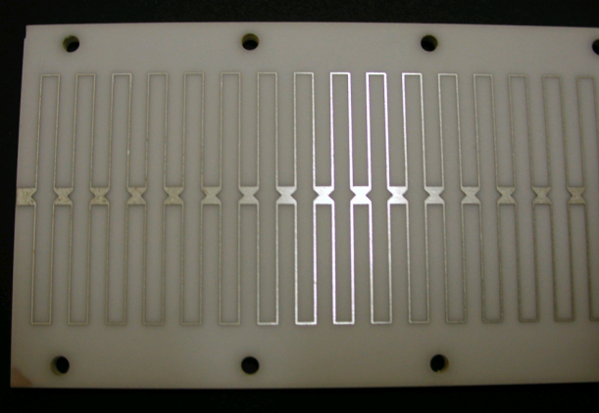
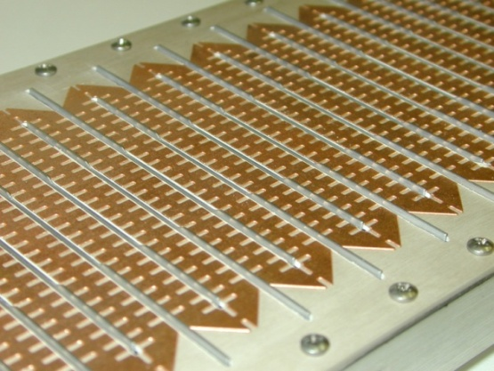
Similar Choppers
 | CERN-SPL | LANL-SNS | RAL/ESS | FNAL HINS
Beam Energy | 3 MeV | 2.5 MeV | 2.5 MeV | 2.5 MeV
Electrode Length | 2 X 40 cm | 35 cm | 34 cm | 50 cm
Electrode Gap | 20 mm | 18 mm | 14 mm | 16 mm
Deflection Angle | 5.3 mRad | 18 mRad | 16 mRad | 24 mRad
Electrode Voltage | ±0.5 kV | ±2.35 kV | ±2.2kV | ±2.4kV
Pulse Rise Time | < 2ns | 10 ns | 2 ns | < 2ns
Pulse Duration | min 8ns | 300 ns | 12 ns | < 5.5 ns
Pulse Rep Rate | 44MHz | 1 MHz | 2.4 MHz | 53 MHz
Bunch Frequency | 352 MHz | 402.5 MHz | 280 MHz | 325 MHz
Burst Duration | 0.6 ms | 945 ns | 1.5 ms | 3ms, 1ms
Burst Rep Rate | 50 Hz | 60 Hz | 25 Hz | 2.5, 10 Hz
Chop Description | 3/8 bunches | On 300,off 645 ns |  | 1 or 2/6 bunches
CERN-SPL
LANL-SNS

Slide 6
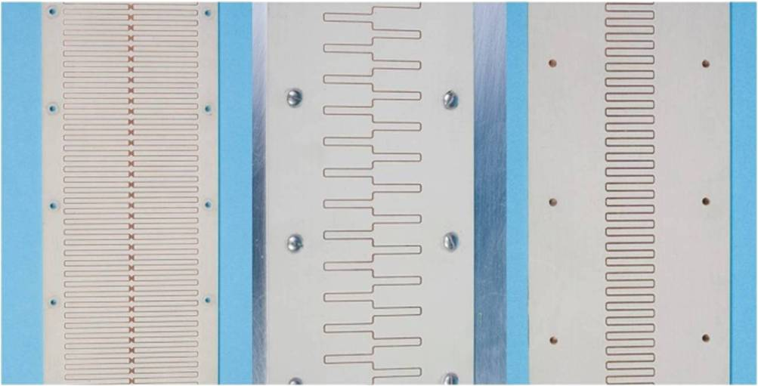
Traveling Wave Structure
Structure must have correct pulse velocity, impedance, acceptable dispersion and risetime, and coverage factor
We have prototyped several structure layouts on Rogers TMM10i (ceramic composite with ε = 9.8)
78mm
40mm
20mm
50 Ω
100 Ω
100 Ω

Slide 7
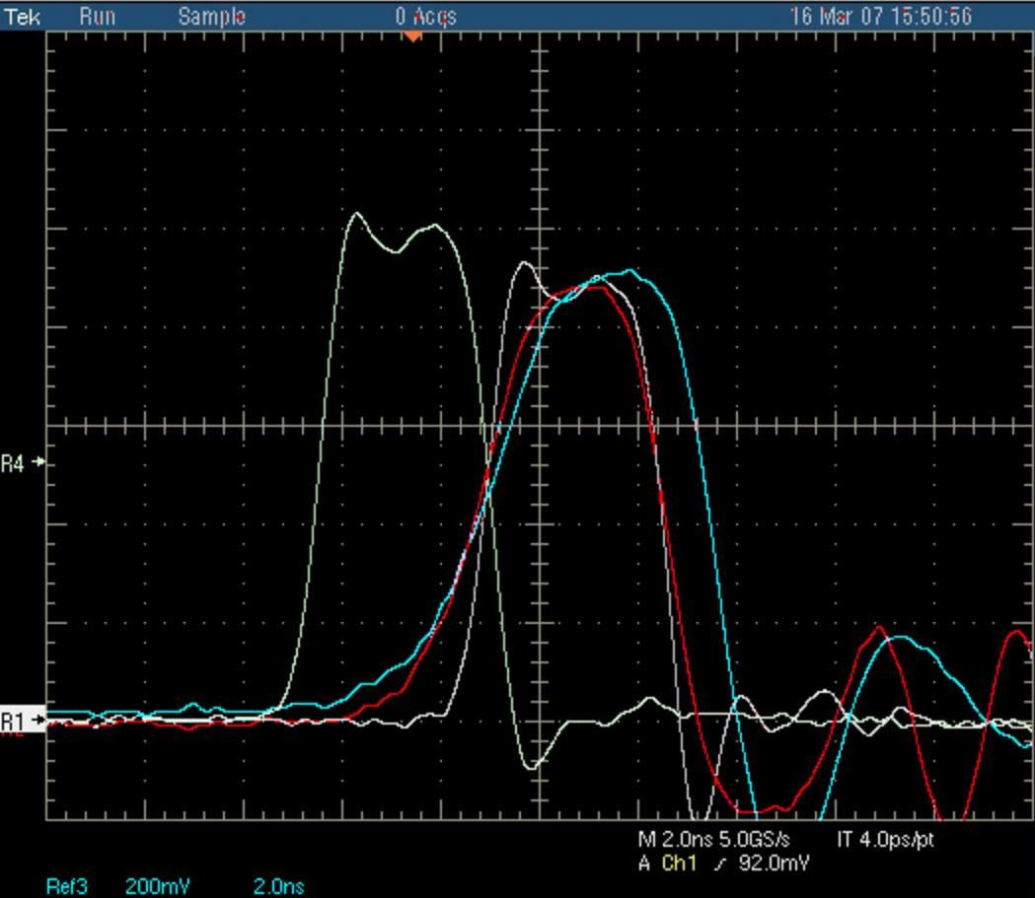
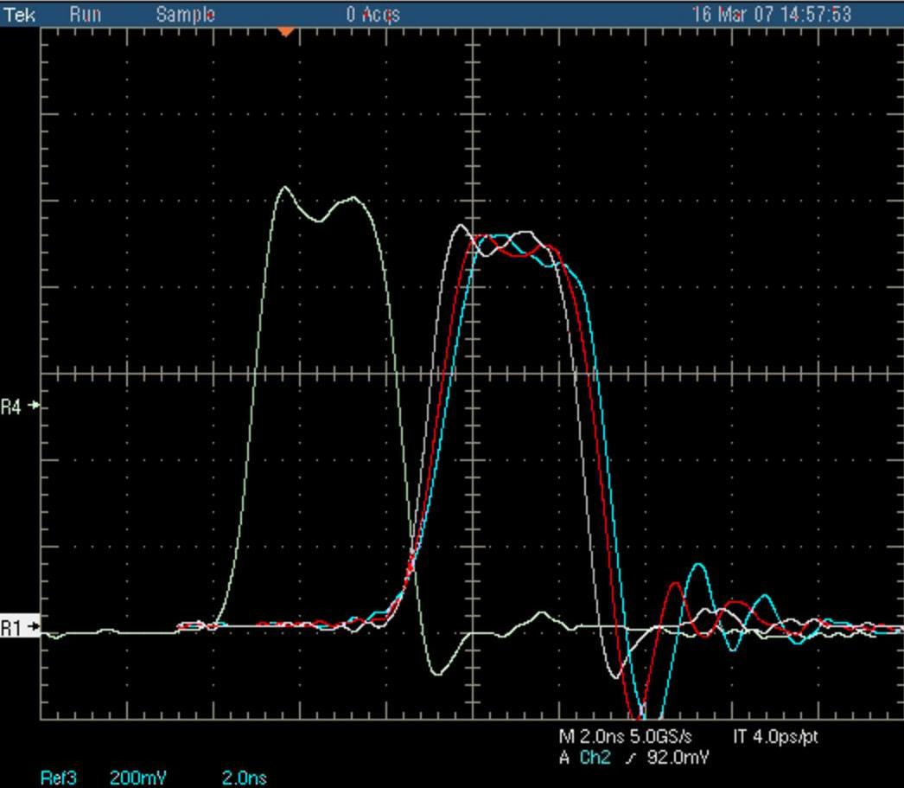
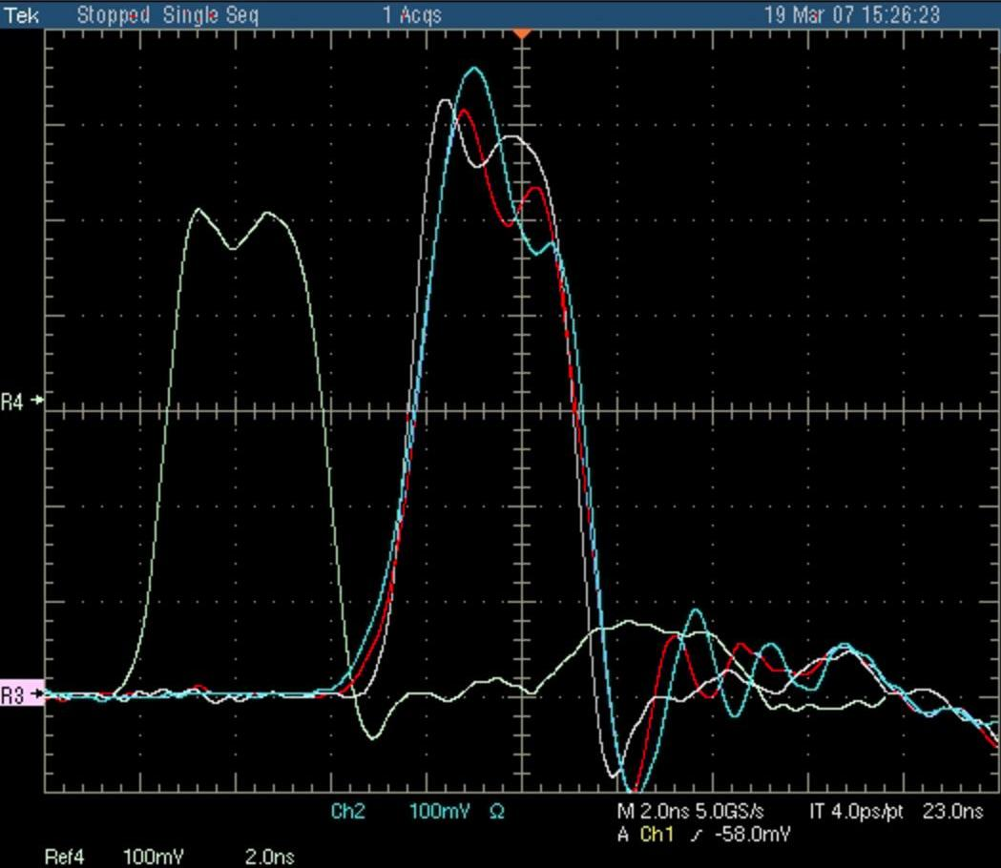
Dispersion
78mm
40mm
20mm
input pulse
beginning
half way
end
worst
best
good
50 Ω
100 Ω
100 Ω
double
Low dispersion
High coverage factor

Slide 8
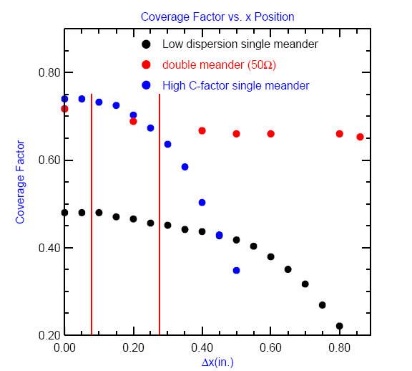
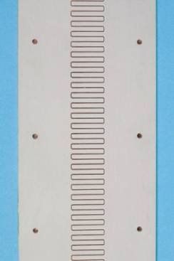
Coverage factor
CF = actual electric field seen by beam / (Δ V/d)
20mm = 0.79″
beam RMS size
100%
x

Slide 9
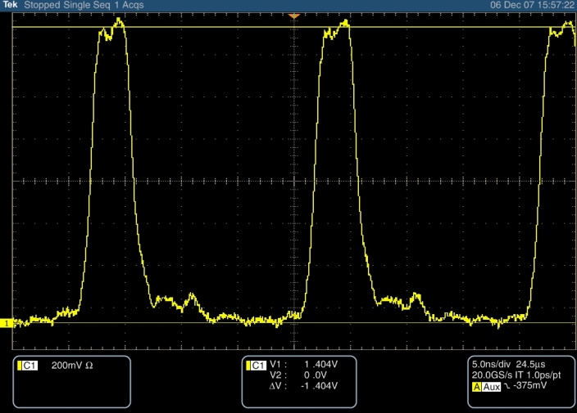
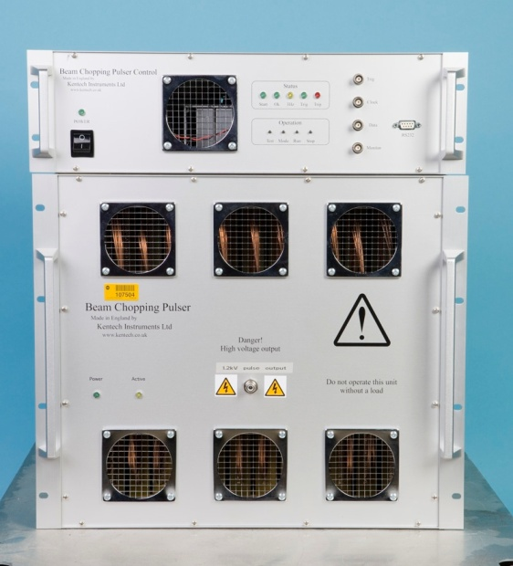
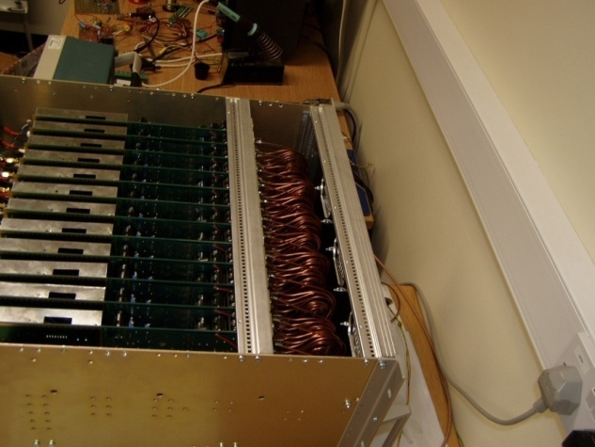
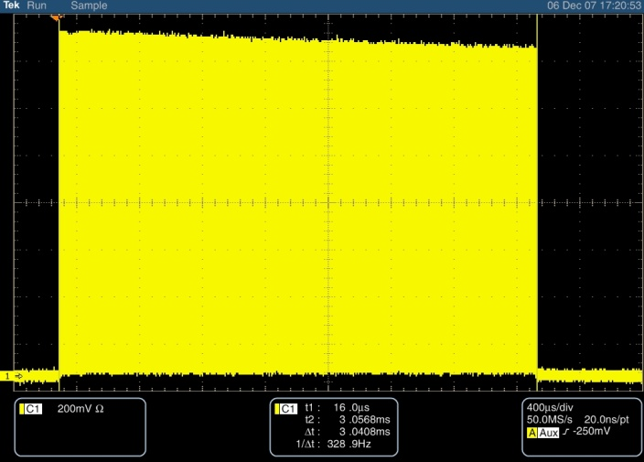
Pulser Development
From Kentech Instruments, Ltd: a 500 V prototype pulser in June ‘06
A 1.2 kV pulser in Nov ’07
HINS Chopper would require four of these
Pulser output
200V/div
5ns/div
3ms burst
200V/div
400μs/div

Slide 10
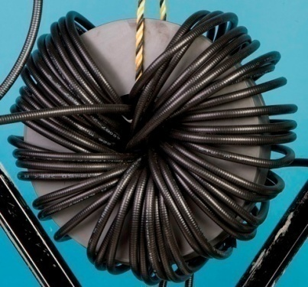
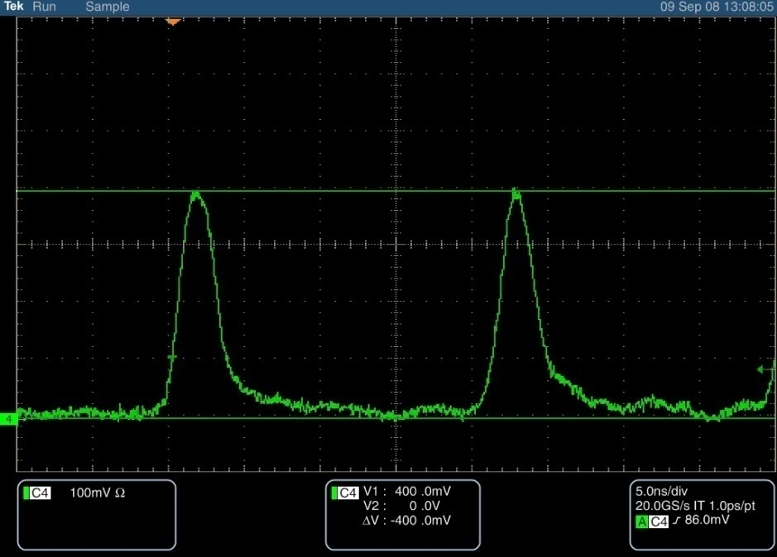
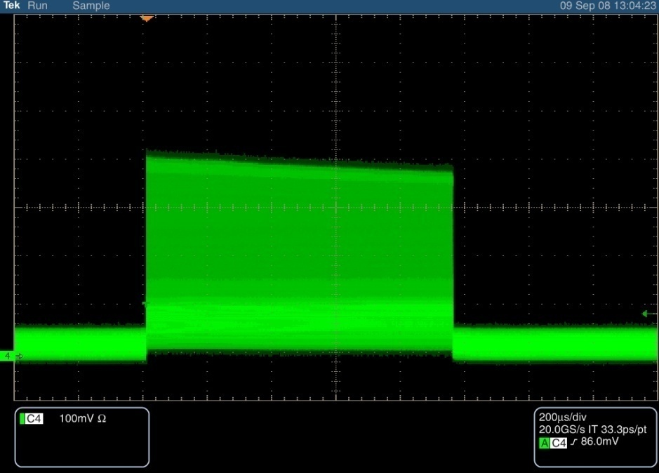
Final Scheme
2400 V →100 Ω
One chopper plate:
To test: one 1200 V pulser with one 500 V prototype:
1200 V pulse → 50 Ω
combiner
100 Ω
meander
structure
1200 V pulse → 50 Ω
two Kentech pulsers
46 turns of ⅜″ superflex around five 1″ MN60 cores
5ns/div, 1600 V
200 μs/div
1ms pulse

Slide 11
HINS Chopper Status Now
Meander design complete; We have fabricated one meander with the final design.
Combiners are fabricated and ready to go.
Final version of pulser performs to specs. We have purchased one of four needed. (Expensive!)
Mechanical design for chopped beam absorber not yet done
For more details, see proceedings of Linac’08 : R. Madrak et al., “A Fast Chopper for the Fermilab High Intensity Neutrino Source (HINS)”

Slide 12
Chopper Requirements and Power
Project X: Must be able to chop bunch-by-bunch, for 162.5 MHz bunches
  Compared to HINS: bunch-by-bunch for 325 MHz bunches
Dumped beam power for Project X much larger
  For HINS: ~33% of beam, DF = 1%, 25 mA, 2.5 MeV
    ⇒ average dumped beam power ~210 W
  For Project X
    Ion source at 3.24mA → 1mA ave beam current
    ⇒ chop 2.24 mA @ 2.5 MeV(if in MEBT) ⇒ 5.6 kW
    Dump requirements may be eased by doing bulk chopping (slower rise time) at lower energy in LEBT

Slide 13
Pulser and Chopper Structure
HINS Chopper pulser is inherently pulsed (max on time 0.75 ms); Not sufficient duty factor for Project X
HINS chopper structure (meander) design: thermal conductivity of substrate too low, however a similar design using alumina may work
  For HINS used TMM10i (ceramic thermoset polymer composite coated with copper): was “good enough”, cheaper, and traces could be routed in house
  Alumina has much higher thermal conductivity (x 30) but more time consuming/expensive: electrochemical deposition of traces

Slide 14
HINS as Chopper Test Facility - MEBT
To test any chopper performance does not require CW beam
  A pulsed MEBT would be sufficient for testing
    Pulser/chopper plates performance: rise and fall time
    Behavior of unchopped beam; influence of ‘tails’ in pulse.
    Chopped beam absorber
  Within the pulse, similar beam parameters: 2.5 MeV (as for Project X) and pulse freqency and 2 X 162.5 MHz
  (chopping out two HINS bunches would be equivalent to chopping out one Project X bunch)
could completely test even a final version CW chopper even if beam is not continuously present
No other facilities exist with such similar parameters
Chopper is a large part of Project X; early and in-depth testing will be indispensible

Slide 15
HINS as a Chopper Test Facility - LEBT
Project X demands for chopper are challenging
One sensible scheme is to do the bulk of the chop (slow rise time, larger width) in the LEBT; clean up the edges with the fast rise time in the MEBT
  Eases constraints on a chopper which is already difficult
  Spreads out dumped beam
HINS LEBT could likely be modified to incorporate and test an LEBT chopper for Project X

Slide 16
Conclusions
HINS Chopper as it currently is designed will not fit the needs of Project X; though it has given us valuable insight
  Some aspects may be incorporated
Chopper development and testing with beam is essential for
Project X
  HINS infrastructure/beam is uniquely suited to this
  HINS beam and facility flexibility can accommodate a full range of chopper concepts.

