Slide 1
E-Center Project
Winter ESCC Meeting
February 4, 2010

Slide 2
E-Center Overview
Problem space:
No coherent view of monitoring data from an end-to-end perspective
Proposed Solution:
Central network monitoring data collection system that crosses network domain boundaries
A “weather” center to find out about network path conditions
E-Center = a facility
Design will be with portability in mind
A central location for network monitoring & measurement information

Slide 3
Targeted basic services
Hop-by-hop link data across a network path
L3 at this point
Historical perspective(s)
Active performance measurements
Initially, ongoing performance measurements
Eventually on-demand measurements
Anomaly-centric statistical analysis
Supporting collaborative services

Slide 4
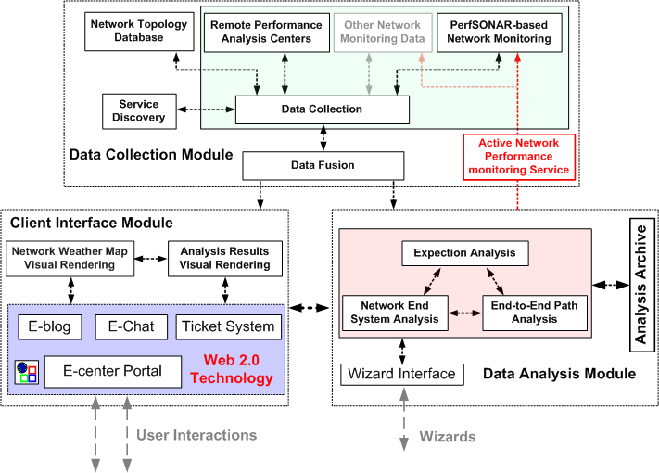
E-Center Architecture

Slide 5
Explicit non-goals:
NOC-type functions
Network problem troubleshooting center
Performance analysis center

Slide 6
Monitoring & Measurement Data Collection
Foundation of collection is perfSONAR data:
But not limited only to perfSONAR-accessible data
SNMP-collected data on router/switch interfaces
PerfSONAR active measurement tools
Monitoring data lives where its collected
Retrieval from measurement archive (MA)
But caching of “useful” data

Slide 7
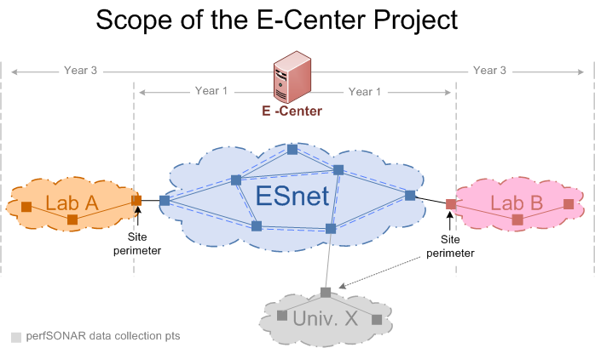
Scope
Deployment focus on ESnet & sites directly attached
Design objective = federated model

Slide 8
Project Partners, Roles, & Principals
Fermilab:
Primary role: Overall system development & integration
Phil DeMar (PI)
Maxim Grigoriev
Lawrence Berkeley Laboratory (Esnet):
Primary role: Data collection support & integration
Brian Tierney (Co-PI)
Joe Metzger
Andy Lake
Bucknell University:
Primary role: Data mining, statistical analysis, & forecasting
Michael Frey (Co-PI)

