Slide 1
ChiMAN Upgrade
Winter ESCC Meeting
February 4, 2010

Slide 2
ChiMAN
Collaborative project between ANL, FNAL, & ESnet established in 2006
Jointly Operated by ANL & FNAL
Based on inter-Lab MOU
FANG = working group that coordinates operations & planning
A layered approach to network services
ANL/FNAL provide ESnet L2 channel (10GE) services
ESnet provides ANL & FNAL with L3 & enhanced L2 services
Not limited to DOE services
ANL operating several links funded by other projects

Slide 3
ChiMAN Fiber Ring - Before 1/11/2010

Slide 4
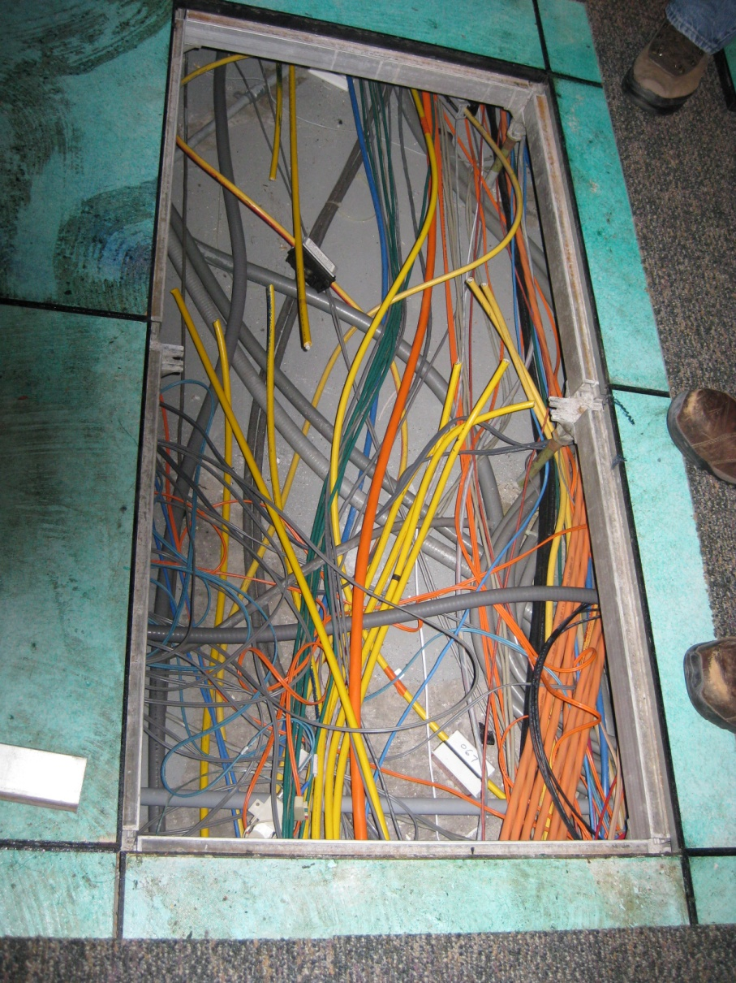
Question:
Which yellow cable wasn’t legacy ethernet?

Slide 5
ChiMAN Fiber Ring - After 1/15/2010
Objective was DWDM equipment and fiber path diversity

Slide 6
2010 ChiMAN - Channel View

Slide 7
Misc Comments on Upgrade
A multi-day project
Contracted with vendor; three Ciena engineers for a week
Most engineering activities conducted in prime-time
No significant disruption in off-site services during upgrade
A little nervousness about having only one off-site fiber path
Contingency planning turned out to be difficult
Cost (relatively speaking) was modest; risk assessment indicated value proposition
100% fiber path diversity not quite achieved
FNAL has some fiber rerouting left to do

Slide 8
Channel Dashboard – Room to Grow…

